Slide 1
FTM simulations
Yasser Maghrbi
American University of the Middle East, Kuwait
5/2/2018
<number>

Slide 2
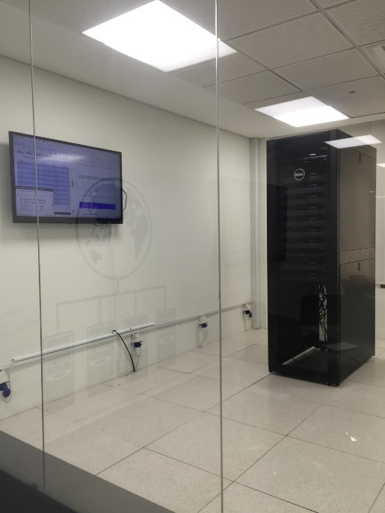
SORMA conference June 11-14, paper in NIM A.
Results to be presented: gain, time resolution and collection efficiency, with scan on drift field and test of different gas mixtures.
Analysis for 1, 2, 4, 8, 12, 16 layers. We can go higher but issues with ANSYS: for 12 layers and more, the code should be manually written (Area numbering issue).
Initial parameters: 3 kV/cm drift field, 100 kV/cm amp field
Calculations are done using AUM HPC, 1 track (150 GeV/c muon) per CPU.
AUM HPC: Dell PowerEdge R730 Intel Xeon E5-2698 v3 2.3GHz, 640 CPU, Aggregate memory 1.28 TB, Total storage: 20 TB, GPU accelerator: NVidia Tesla K40C 12GB, Mellanox 40 Gbps InfiniBand Interconnection.
For Ar:CO2 (70:30), 1000 tracks are simulated in ~ 6 hours (penning at 0.57) for 16 layers.
The calculation takes much longer time in Ar:iC4H10 (90:10).
8 layers FTM
with ANSYS
<number>
Notes:
<number>

Slide 3
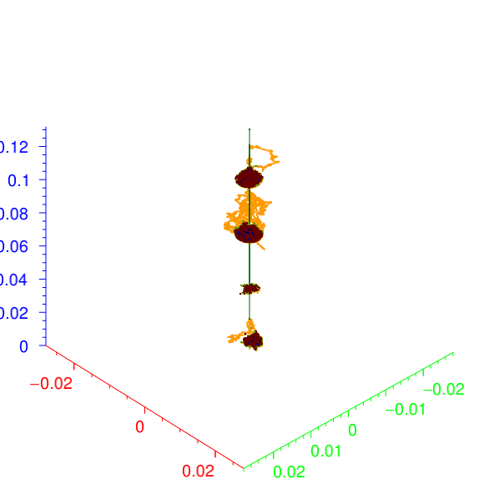
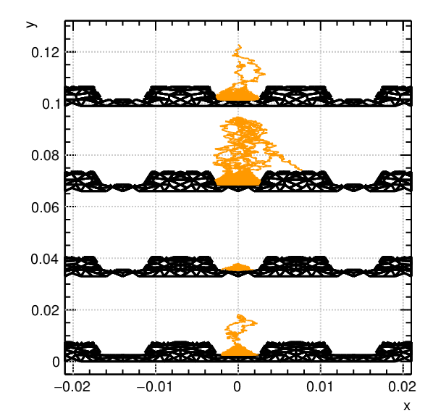
150 GeV/c muon track in 4-layer FTM using HEED in Garfield++
<number>
Notes:
<number>

Slide 4
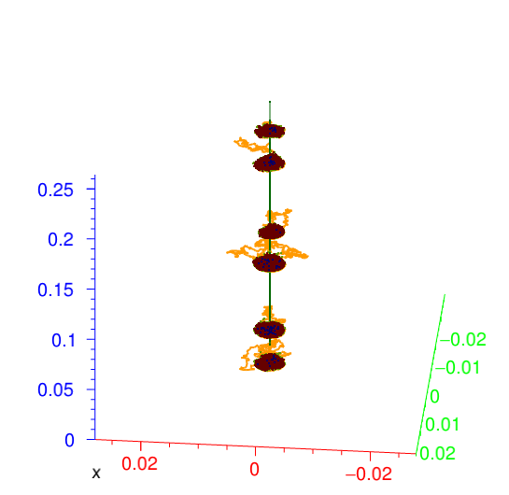
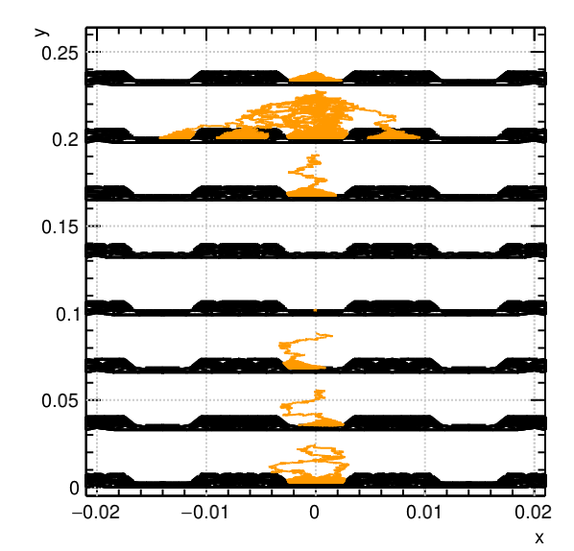
150 GeV/c muon in 8-layer FTM
<number>

Slide 5
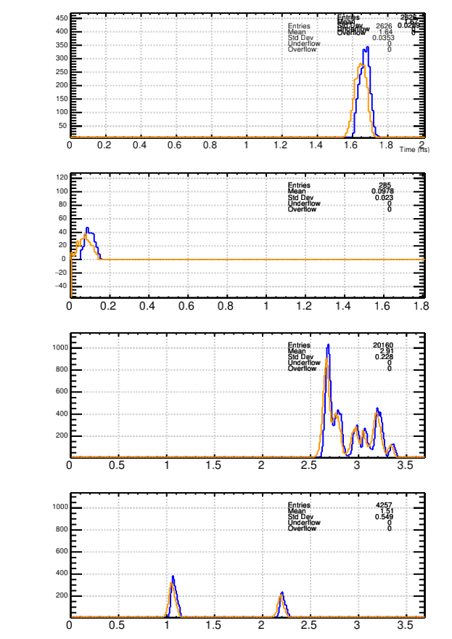
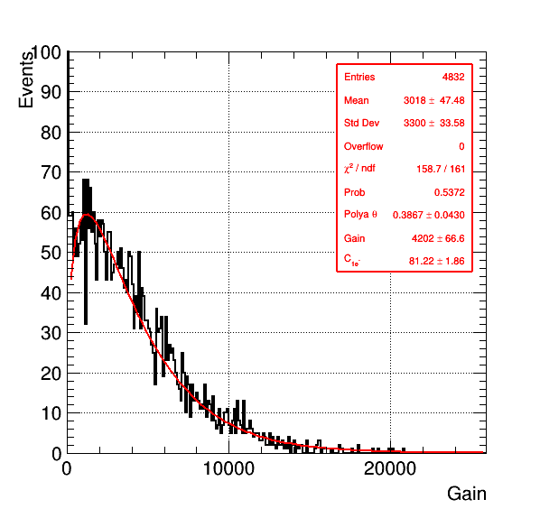
Procedure
Layer 1
The gain is given by the total number of electrons created in the avalanche.
Record the endpoints of the electrons.
If the Z position of an electron endpoint falls in the PCB of one of the layers, the timing is recorded in a 1D histogram.
For each track, for each layer, the value of the fastest electron is recorded if above a certain threshold (1000, 2000 or 3000 e).
If the threshold is not reached, the charge integration is reset and the next peak is considered.
For each track, the smallest value of all layers is recorded
The time resolution of the detector is given by the standard deviation of the obtained distribution
Layer 2
Layer 3
Layer 4
Orange: Amplification time, Blue: endpoint time
<number>

Slide 6
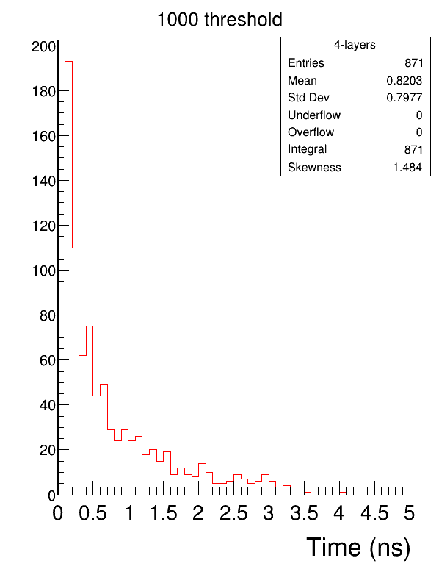
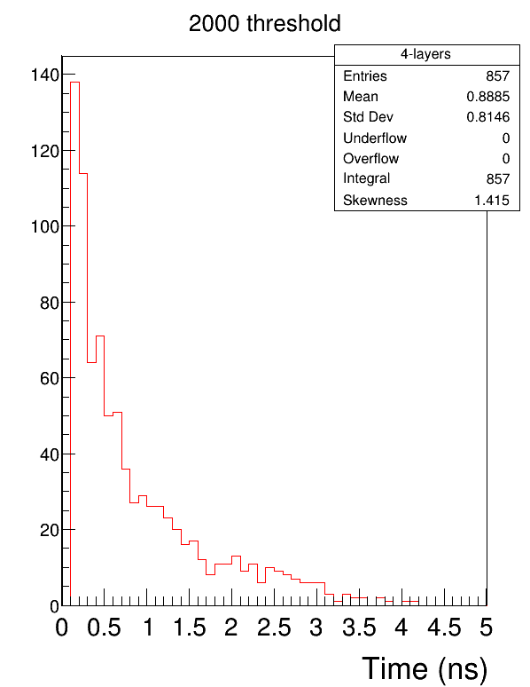
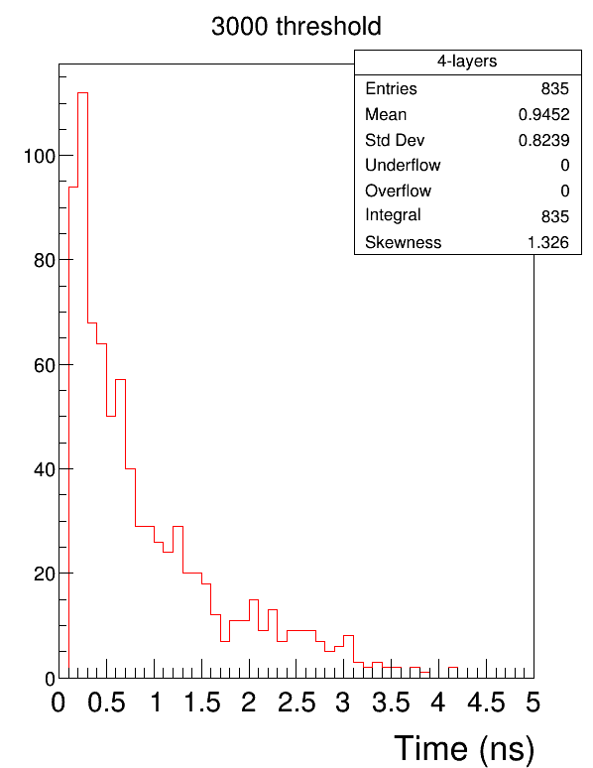
150 GeV/c muon in 4-layer FTM – 1000 simulated downstream tracks – ArCO2 70:30
<number>

Slide 7
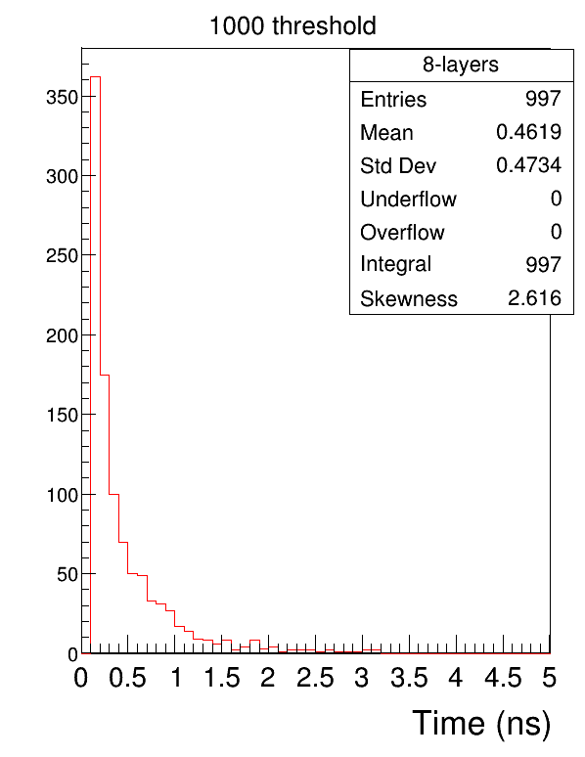
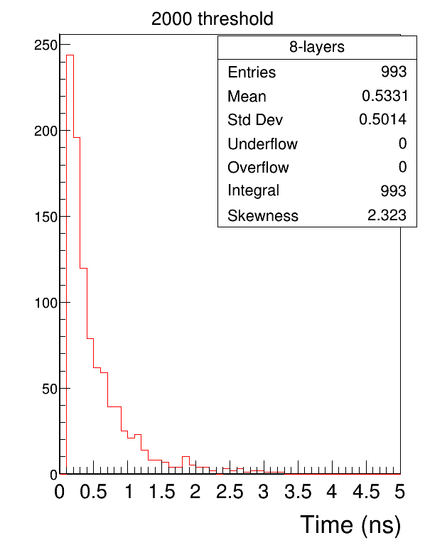
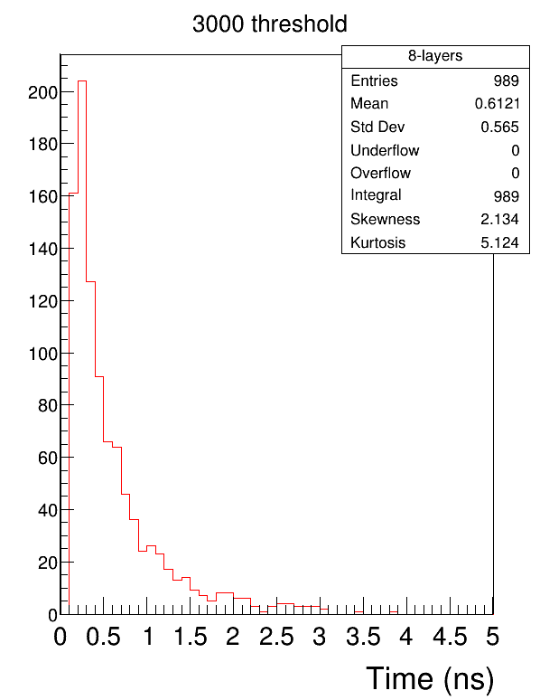
150 GeV/c muon in 8-layer FTM – 1000 simulated downstream tracks – Ar:CO2 70:30
<number>

Slide 8
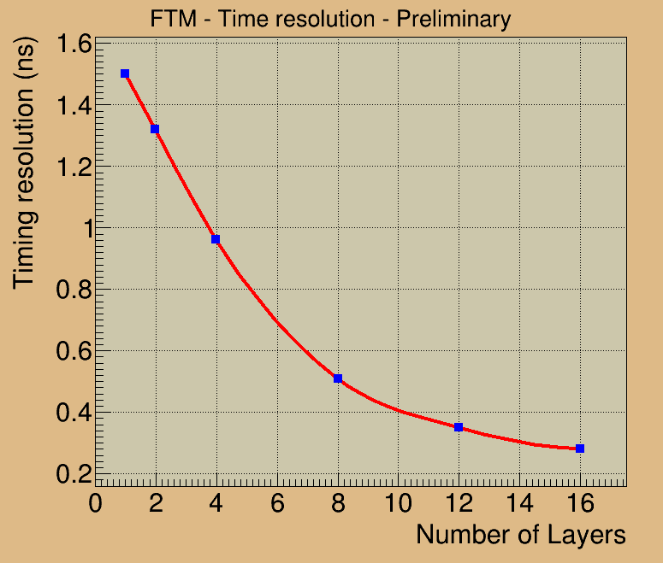
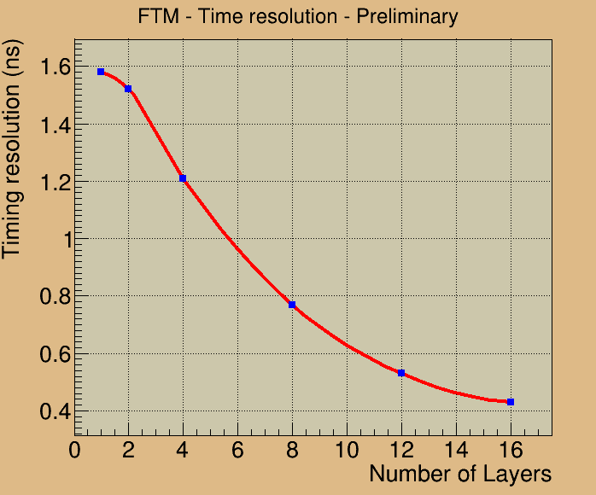
Preliminary
1000 e threshold 3000 e threshold
<number>

Slide 9
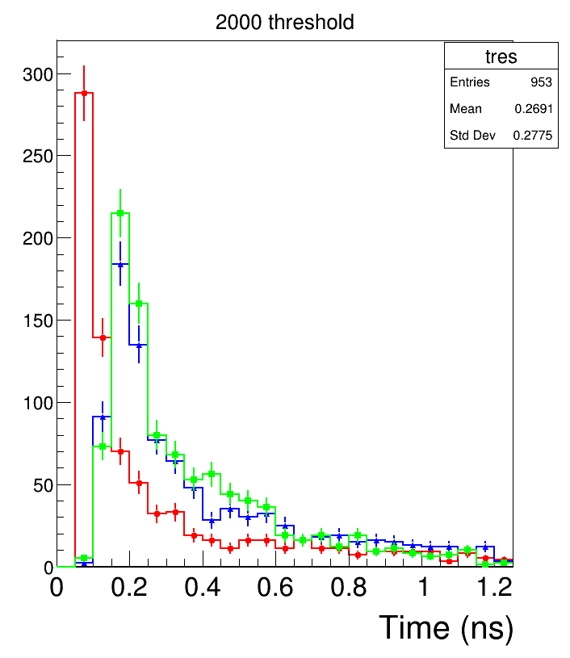
Summary and outlook
Preliminary results for the conference seem reasonable
First draft of the paper to be ready in ~ 2 weeks
Number of layers?
Should we do a collection efficiency study first to fix the value of the drift field?
Simulations will continue after the paper (guidance needed)
Later on, we would be very interested to participate in experimental efforts, also involving students if possible
In addition, electrical engineering faculty at AUM with good experience in rad-hard electronics
Ar:iC4H10 (90:10)
Ar:CO2:CF4 (45:15:40)
Ar:CO2 (45:15:40)
Amp. field to be adjusted to have similar gains
<number>

