Slide 1
Emulsion Cloud Chamber Status
A. Alexandrov, G. De Lellis, A. Di Crescenzo, A. Lauria,
M.C. Montesi, V. Tioukov
8 may 2018

Slide 2
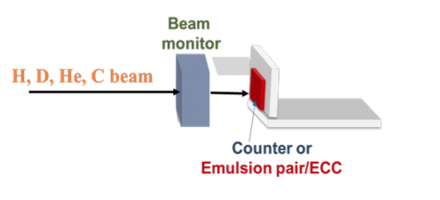
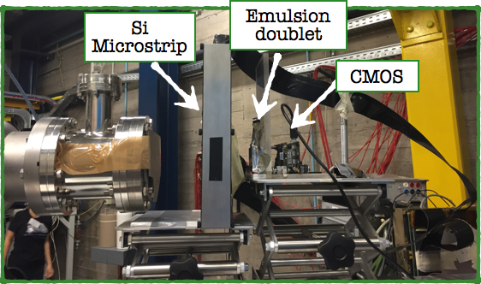
Emulsion Test Beam
Motivation: new nuclear emulsions, produced by Nagoya, never used for particle identification and test the refreshing procedures to define the working point
LNS test beam with 80 MeV proton, deuterium, helium and carbon
Exposure of nuclear emulsion to calibrate the responce at different ionizing beam (charge idetntification)
Exposure of two Emulsion Cloud Chambers for the isotopic identification
Test beam at Centro di Proton Terapia (TN) with 50, 80 and 200 MeV proton
Exposure of nuclear emulsions at 50 MeV to simulate the ionization of a 250 MeV He beam
Scintillator Counter
Emulsion Doublet

Slide 3
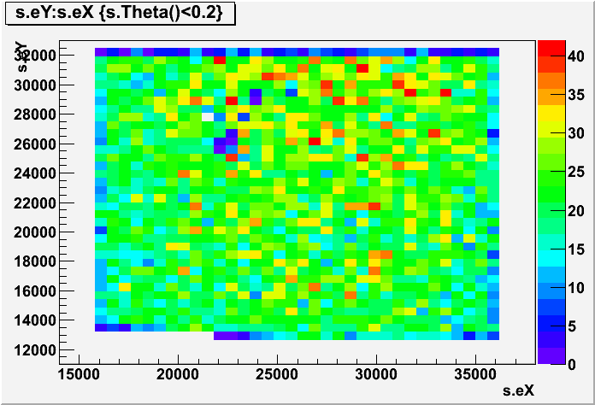
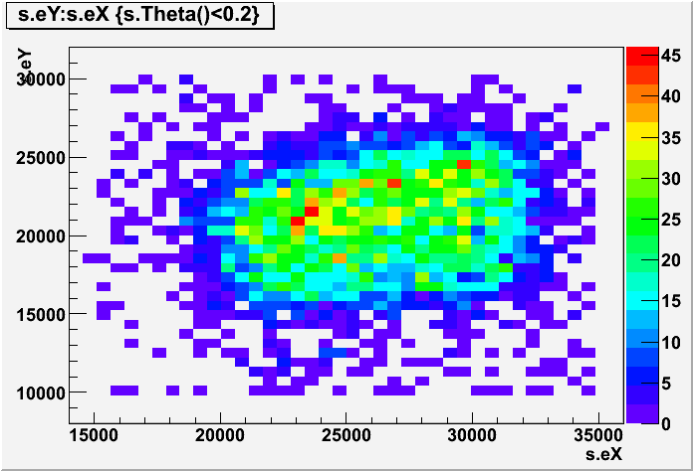
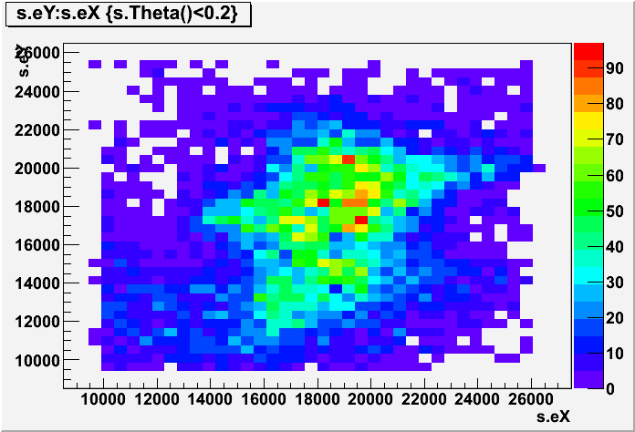
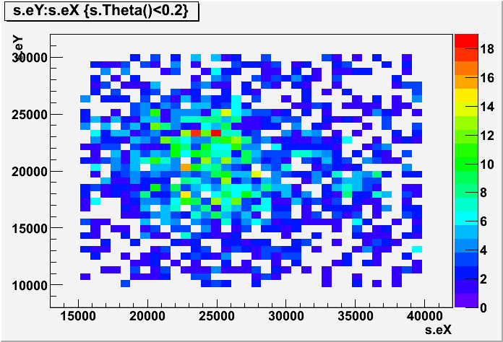
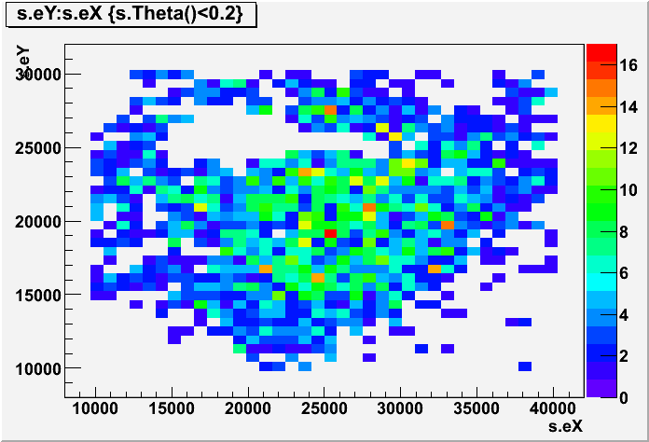
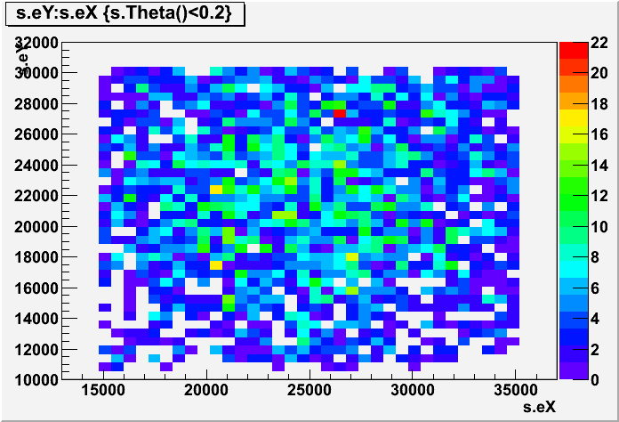
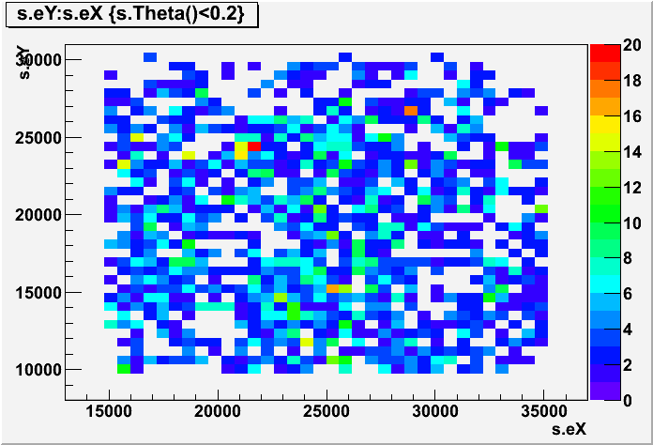
beam spatial distribution (no refresh_LNS)
beam spatial distribution (no refresh _TN)

Slide 4
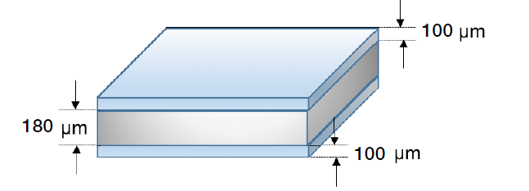
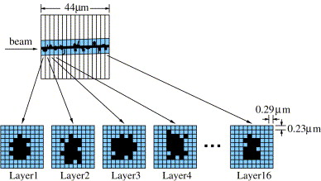
Emulsion films: structure and track volume
Top emulsion layer
70 μm
70 μm
Bottom emulsion layer

Slide 5
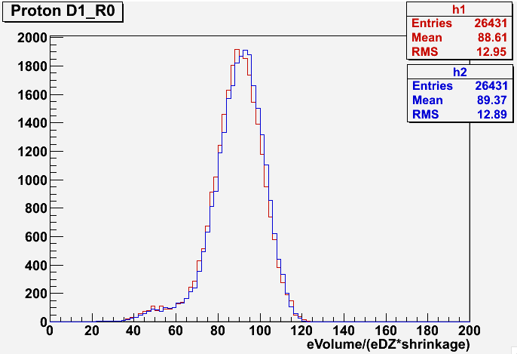
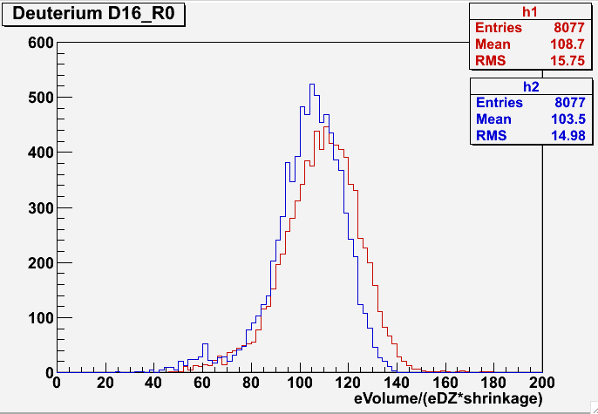
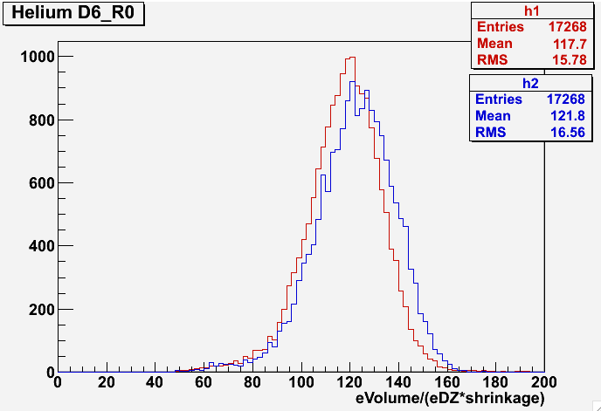
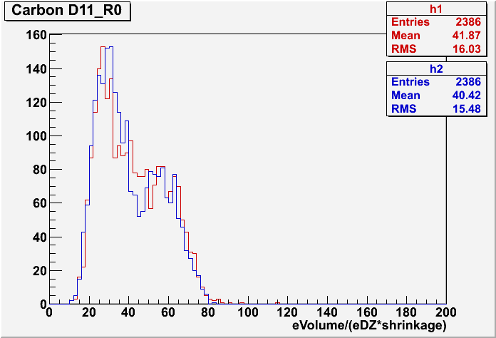
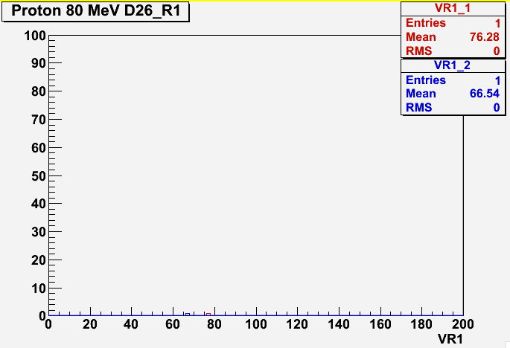
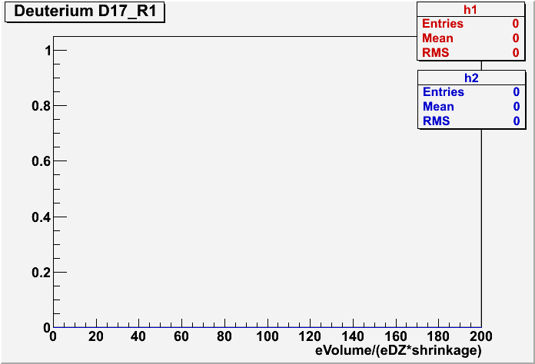
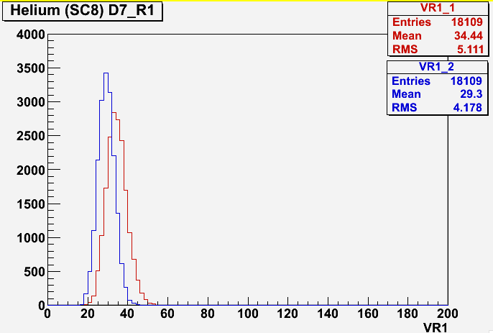
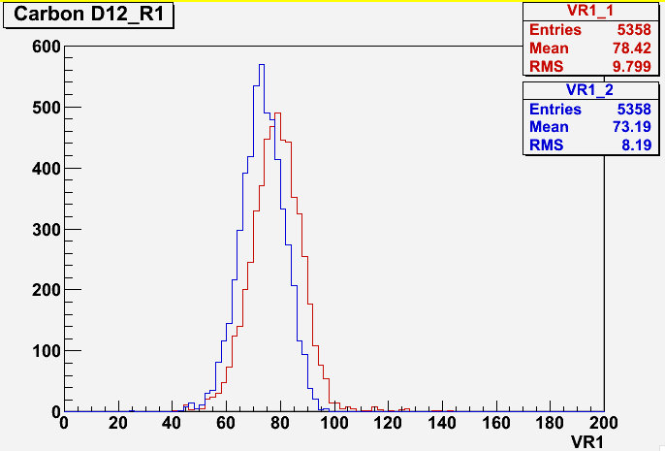
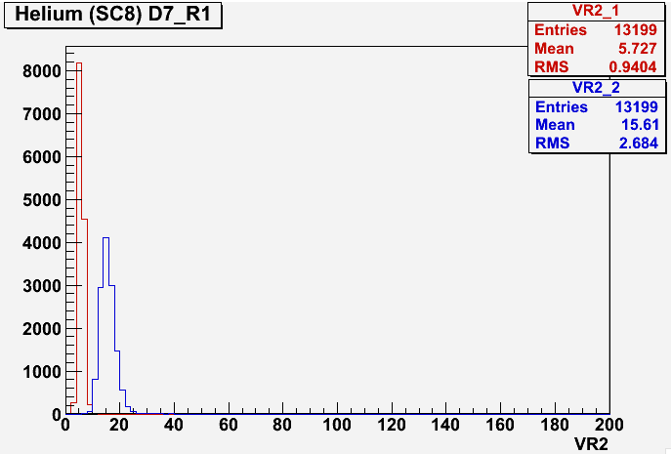
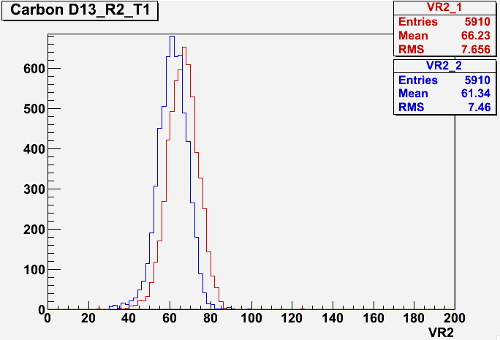
refreshing@lns: microtracks top e bottom
No
Refresh
cosmic
signal
T = 28°C
T = 34°C

Slide 6
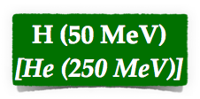
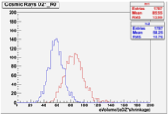
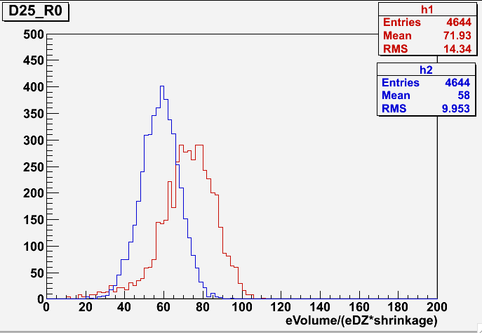
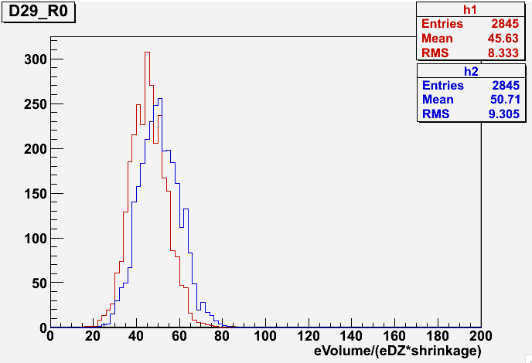
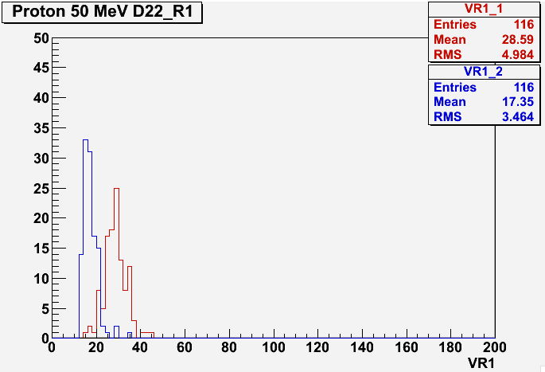
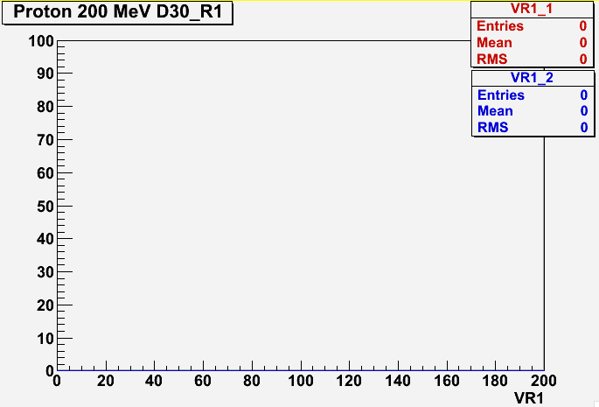
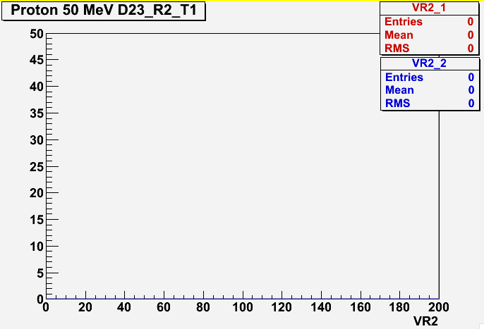
refreshing@tn: microtracks top e bottom
No
Refresh
T = 28°C
T = 34°C

Slide 7
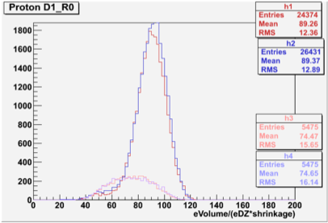
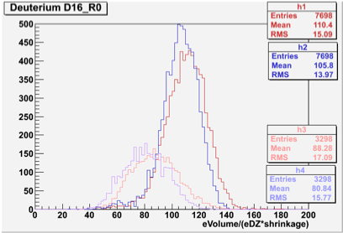
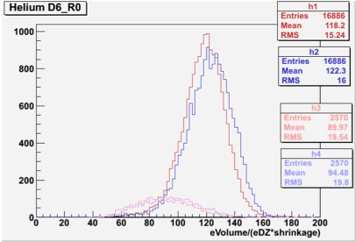
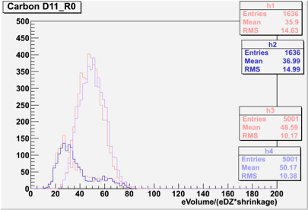
signal and cosmic rays
theta <0.2
theta >0.2

Slide 8
Tracks in emulsion

Slide 9
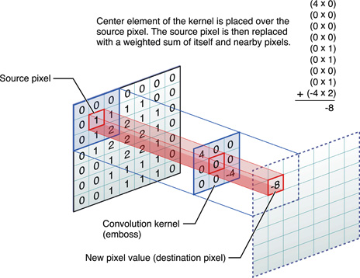
Convolution filter
Image Processing based on a 5x5 Convolution Filter
- needed to change the convolution filter for carbon ions producing a lot of ionization

Slide 10
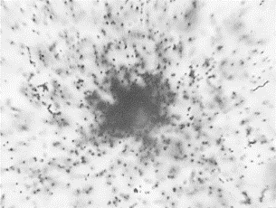
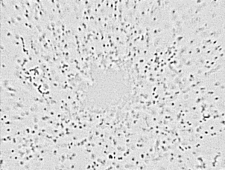
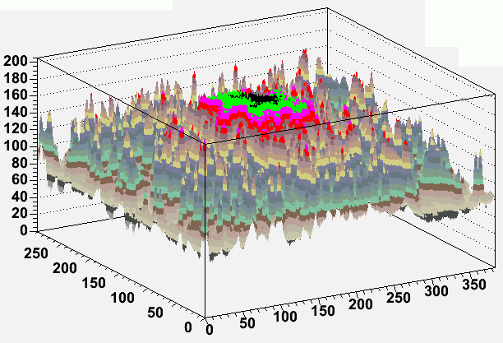
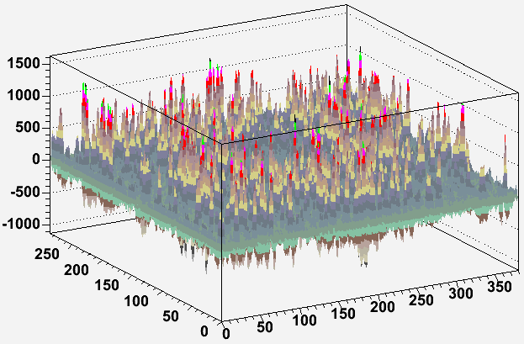
Effect of the convolution filter

