Slide 1
ATLAS@CNAF report
Recovery after flooding
New resources (CINECA and HNSC)

Slide 2
Recovery after flooding
Many thanks to all involved people for the very hard work
In general recovery operations went quite smoothly
Problems with storm tables (cleanup needed) https://ggus.eu/?mode=ticket_info&ticket_id=133320
Ipv6 conf (causing problem in FTS) https://ggus.eu/?mode=ticket_info&ticket_id=133830
Checksum error due to full tape buffer full (missing alarm) https://ggus.eu/index.php?mode=ticket_info&ticket_id=134459
Still some missing data on wet tapes
ATLAS cern ←(ATLAS Italy) → CNAF communication had some very small mis-understandings (promptly cleared)

Slide 6
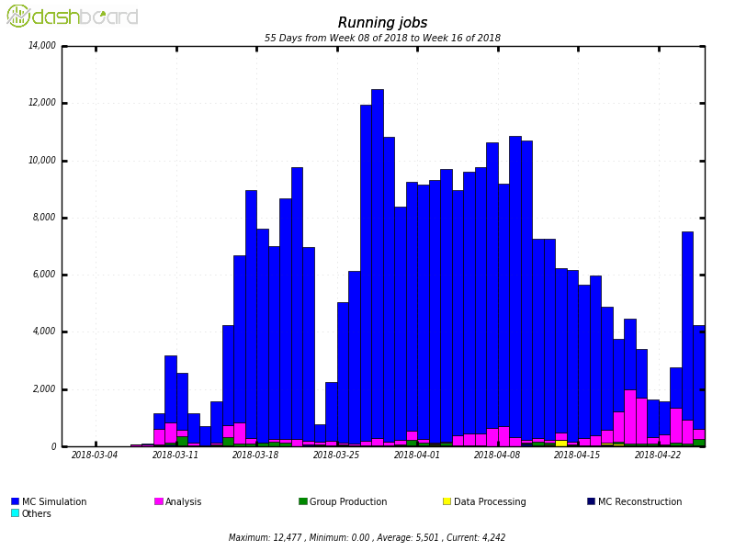
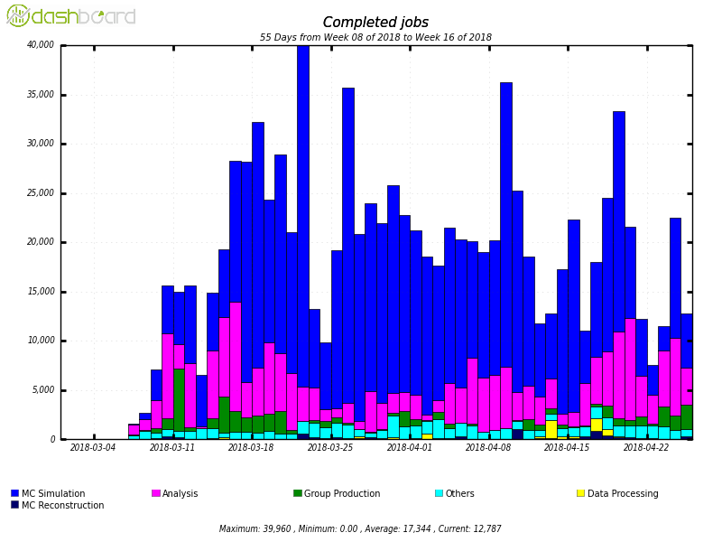
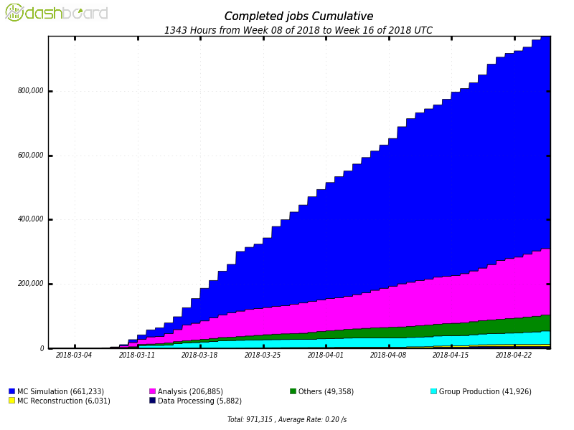
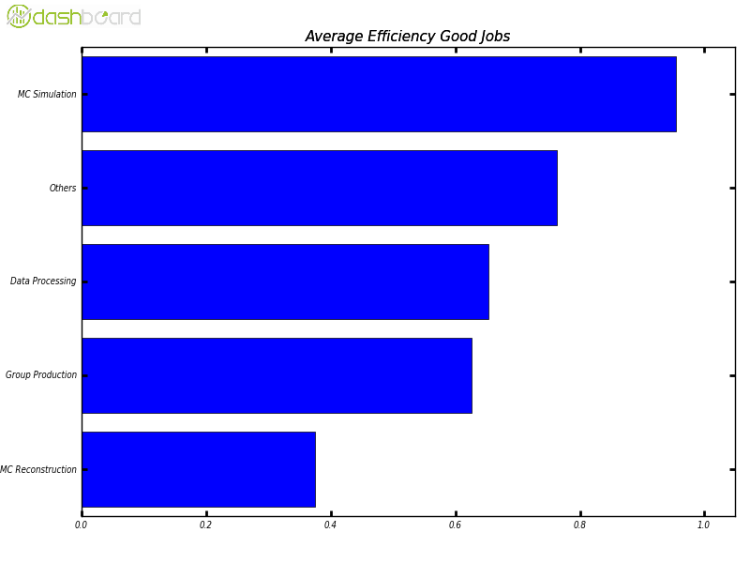
T1 data processing stats (all inclusive)
Running jobs
Completed jobs (daily)
Cineca ON
Average
5500
Completed jobs
CPU/WALL
>900,000 jobs

Slide 7
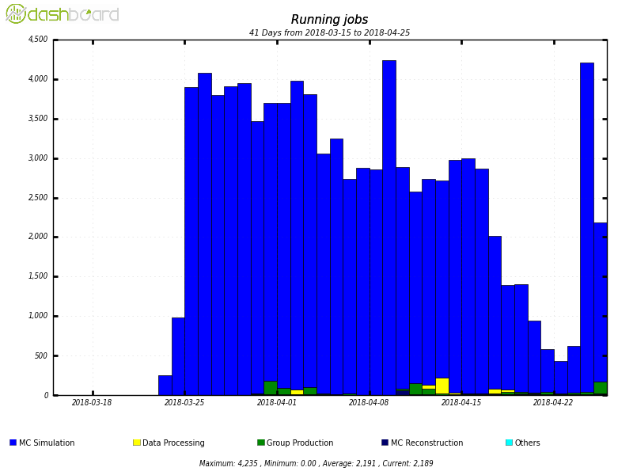
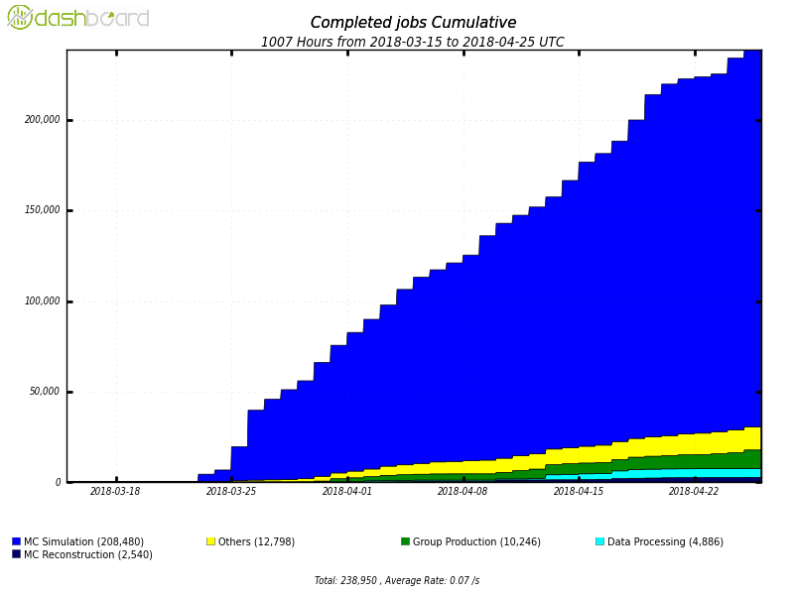
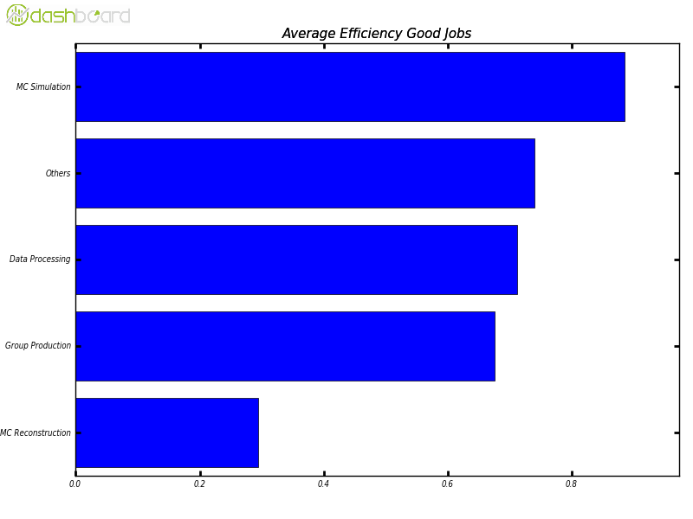
CINECA
Running jobs
Completed jobs
>200,000 jobs
Cpu/wall
Cpu/wall by Activity (last month) | CNAF – SL6 – storm-mover | Cineca – SL7 – rucio- mover
Data processing | 0,65 | 0,71
Group production | 0,62 | 0,67
MC reco | 0,37 | 0,29
MC sim | 0,95 | 0,88
Others (mainly HC) | 0,67 | 0,74

Slide 8
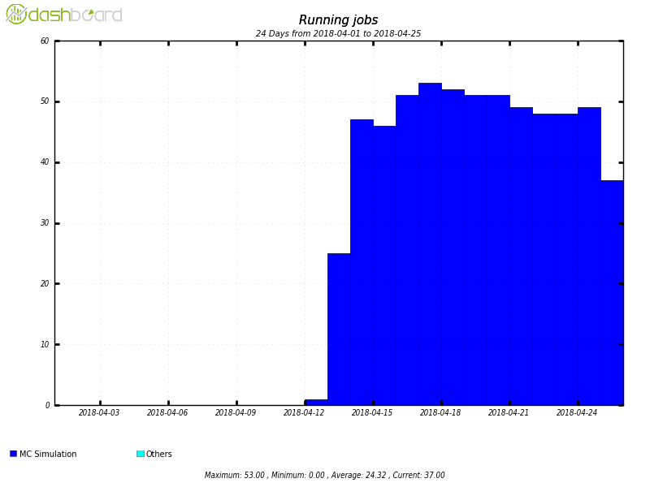
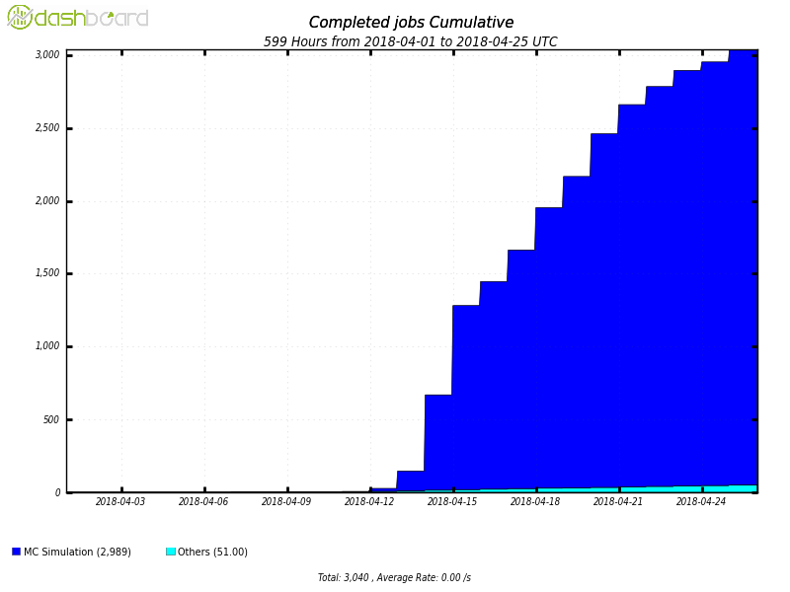
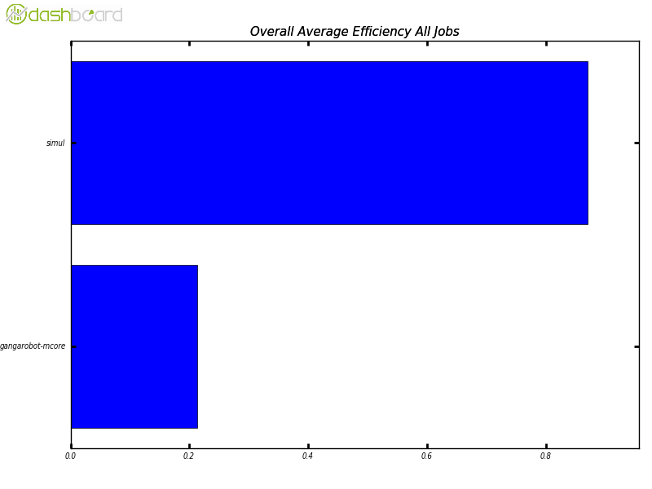
Helix Nebula Science Cloud
Running jobs
Completed jobs
Average: ~50
3000 jobs
CPU/WALL
Extension of local batch queue on external heterogeneous cloud resources
Rucio-mover
MC sim only
>80%average efficiency for SIM

