Slide 1
Mu2e Calorimeter mechanics status of the design and parts realization
F. Happacher, A. Saputi
for the Calorimeter group

Slide 2
status
We are going to undergo a Construction Readiness Review next July
The calorimeter mechanics design is almost final
Need to check final tolerancies of crystals and Sipms
Harmonize matching of all components
We built prototypes for all the parts
The most delicate task has been the realization of the cooling system for the SiPM and FEE.
We optimized it and tested with the module-0 and with dedicatet tests in vacuum (see Matteo and Fabrizio’s talks)
The assembly and integration of the calorimeter has been discussed and agreed upon with the Muon Beam line

Slide 3
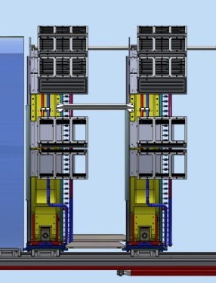
The Mu2e calorimeter view

Slide 5
Calorimeter parts
non chi comincia ma quel che persevera
The calorimeter consists of two annuli each one composed of:
Source_Plate
n. 10 Readout elect . crates
Crystals
FEE_Plate
Inner ring
SiPM holder
Outer ring
Manifolds
Hydraulic connections
Inner steps
Outer steps
Alignment targets
Foot

Slide 6
Prototypes
We have prototyped most of the mechanical parts of the calorimeter:
The feet
The outer cylinder
The inner CF cylinder
The crates and theyr cooling
The CF source plate
The FEE plate (module 0)
The FEE cooling circuit
The FEE holder

Slide 7
Mock up activities
The prototyped outer cylinder didn’t have the stepped profile to arrange the crystals:
We manufactured a monolithic stepped ring to insert in the outer cylinder
The CF inner ring also did not come with the stepped margin
We 3D printed it @LNF
we now have this parts; we start piling up the iron fake crystals wrapped with Tyvek as soon as we assemble the two rings together.
Measure the alignment of crystals at every row
Build a front plate portion with the appropriate FEE apertures to check stacking tolerances

Slide 9
Feet mock up

Slide 10
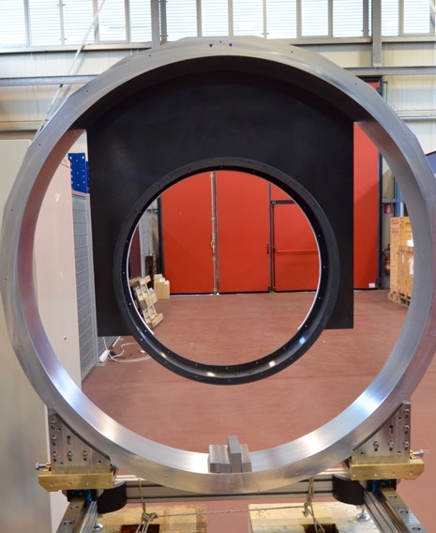
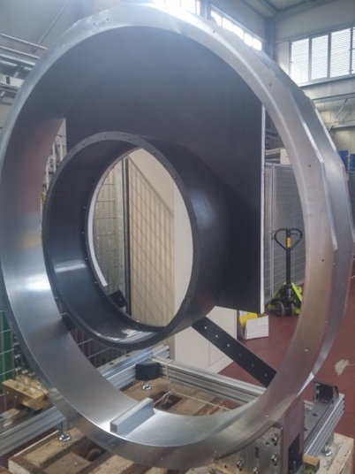
Support rings
stepped margin

Slide 13
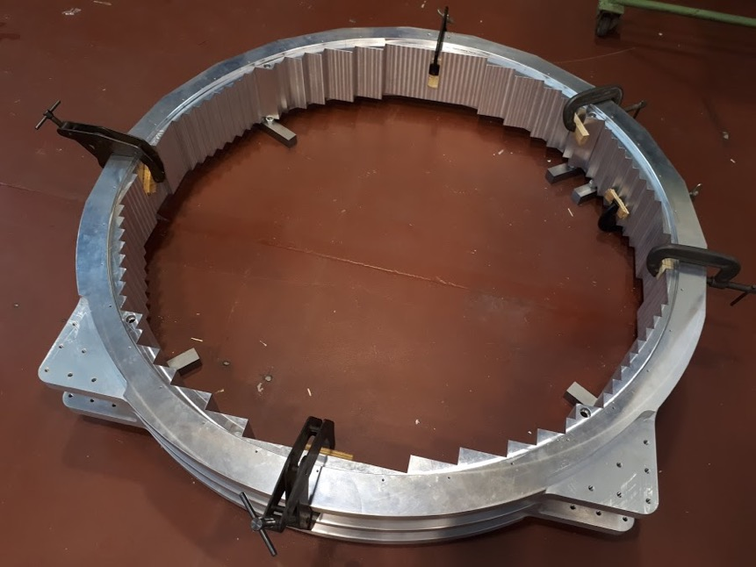

Slide 14
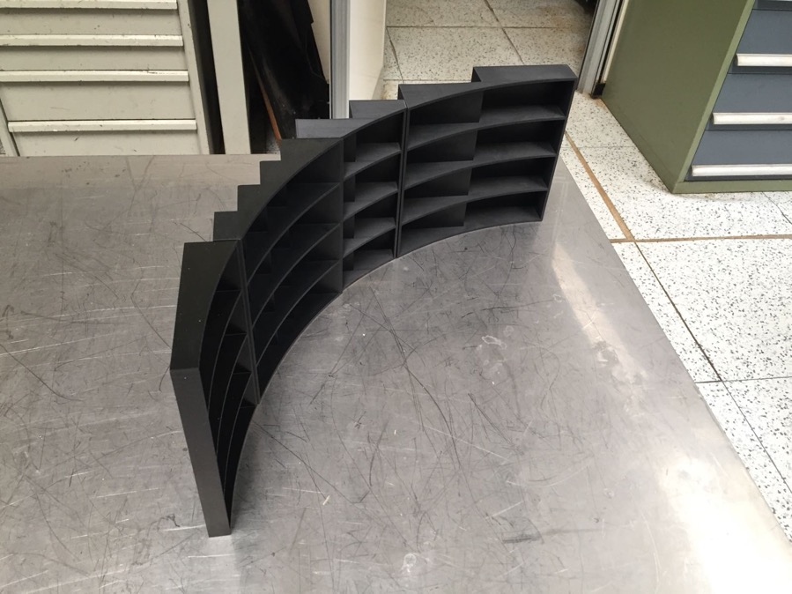

Slide 15
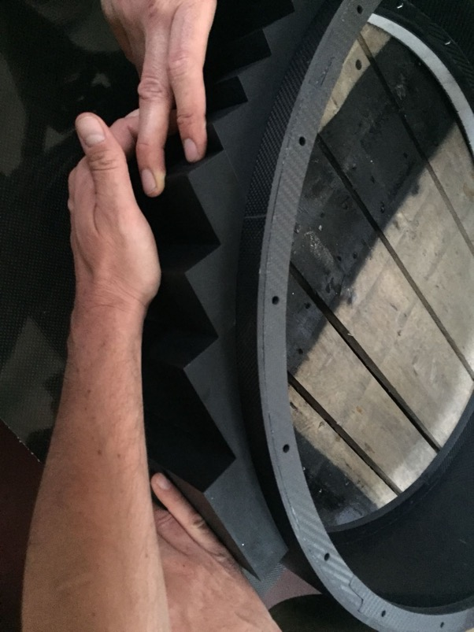
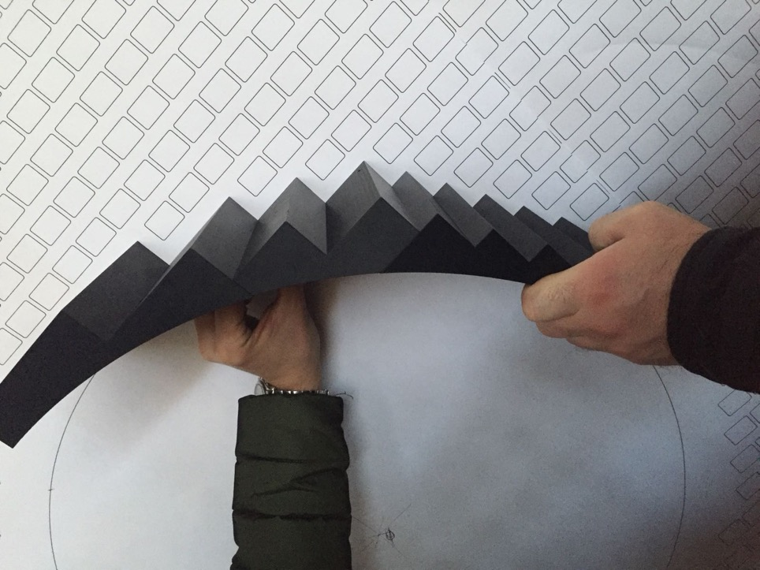

Slide 16
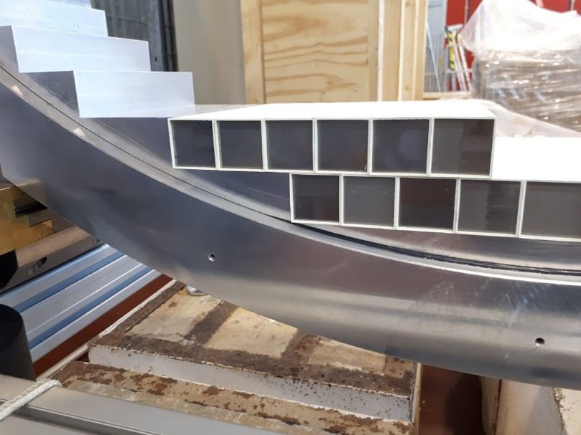
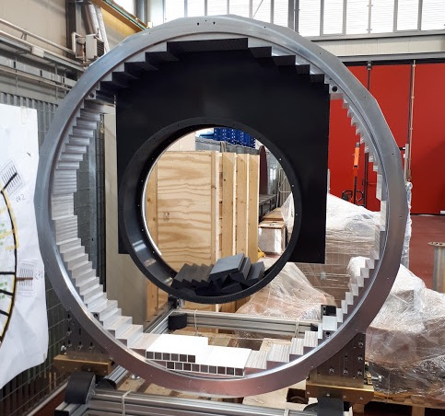

Slide 17
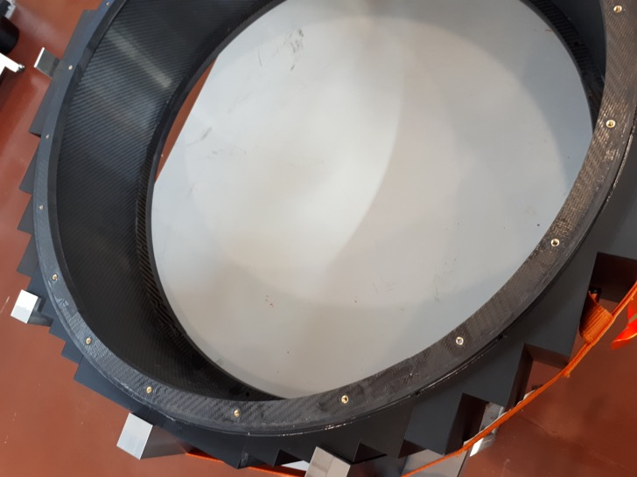
Inner steps

Slide 18
Survey of the geometry

Slide 19
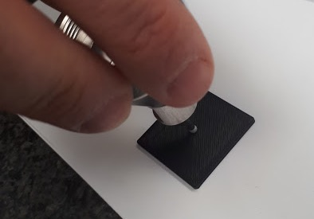
Crystal positioning survey

Slide 20
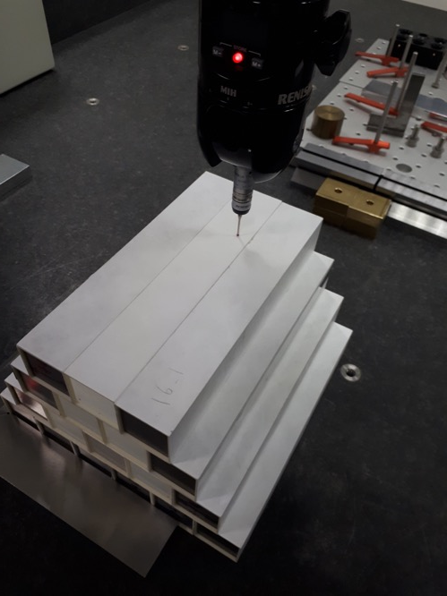
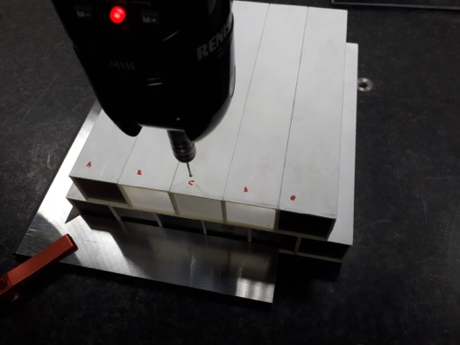
Staggered stack

Slide 21
Detector assembly sequence
non chi comincia ma quel che persevera
Step_3
Step_7&8
Step_4&6
Main assembly steps:
Outer ring
FEE plate (pre-assembled)
Crates (empty)
Crystals
Inner ring
Crystals
Alu sponge
Calibration source plate
EL boards
SiPM holders
Fibers (spheres, etc.)
Cables (LV connection)
Step_2
Step_5
Step_1
Step_10
The calorimeter components will be assembled using a workbench that allows also to move the calorimeter if needed.
The outer ring will be bolted on the workbench and all others components will be mounted on it.

Slide 22
Services cables routing tray
1. red is the envelope of LV AWG 8 cables. ⦰ 40 mm.
2. yellow is the envelope of LV and HV AWG 12 cables. ⦰ 25 mm.
3. Green is the envelope of all HV AWG 22 cables. ⦰ 16 mm.

Slide 23
Loop for recovering cables slack in/out when calo moves
No cable induced strain

Slide 24
Detector handling (Transport and installation tools)
non chi comincia ma quel che persevera
Each disk will be transported and installed using the TI-frame.
The feet will be installed on the rails before the installation of the disk.

Slide 25
Prototyping: Module-0
All the designed technology has been tested building a module 0 that implements all the choices of the actual calorimeter:
Arrangement of crystals
Cooling system
Crate prototype
FEE+Sipm housing
Crystal wrapping

Slide 26
Module - 0
non chi comincia ma quel che persevera
n. of crystals: 51
Fill Factor: ~81%
Total weight: ~70 kg
Overall sizes:
Dout= 356 mm
Depth = 226 mm

Slide 27
Module - 0
non chi comincia ma quel che persevera
Back_Plate
Al Cylinder
Matrix
FEE_plate
O-ring
SiPM
+
FEE
Cylinder: INFN Lecce + INFN Padova
Back plate + base: INFN Lecce
FEE_plate: INFN Pisa
SiPM holders: INFN/LNF
Crystals wrapping: INFN/LNF
Assembly: all

Slide 28
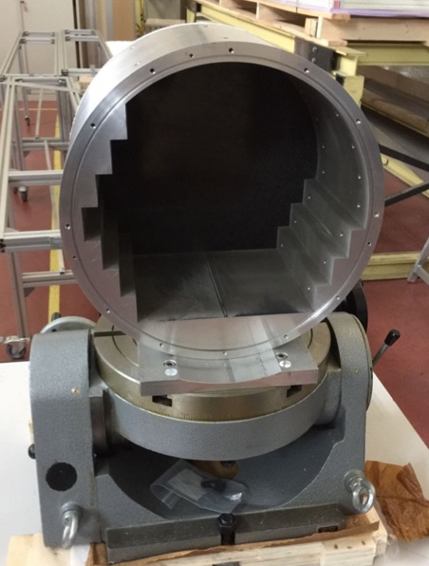
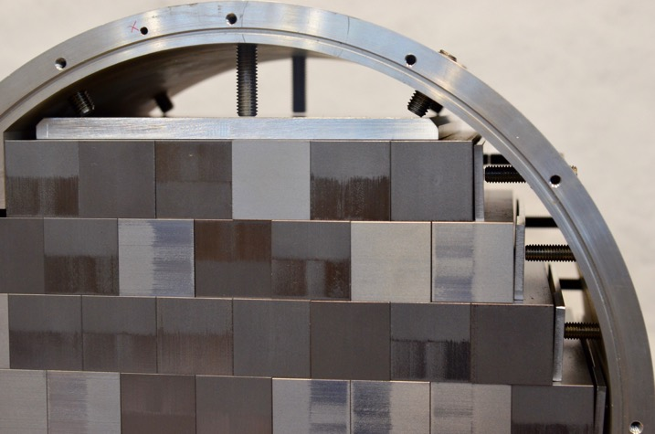
Al shell

Slide 29
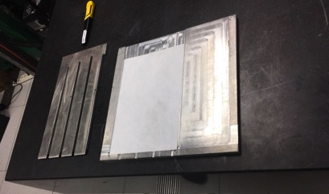
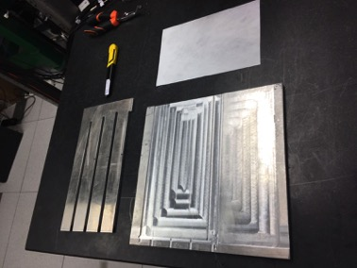
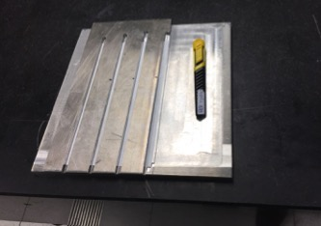
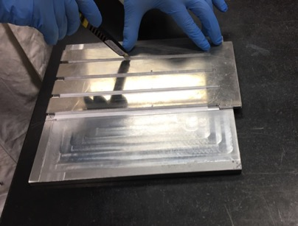
Preparation of wrapping: Tyvek folding (1)

Slide 30
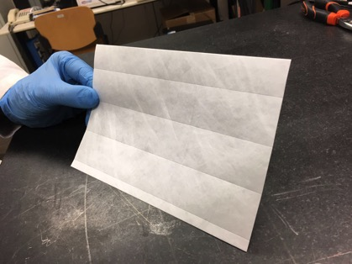
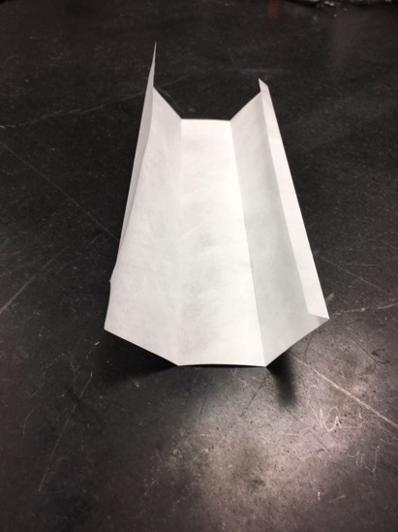
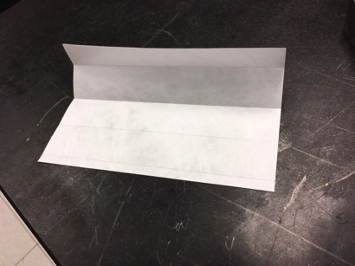
Preparation of wrapping: Tyvek folding (2)

Slide 31
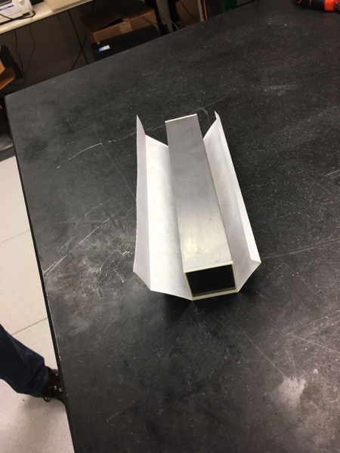
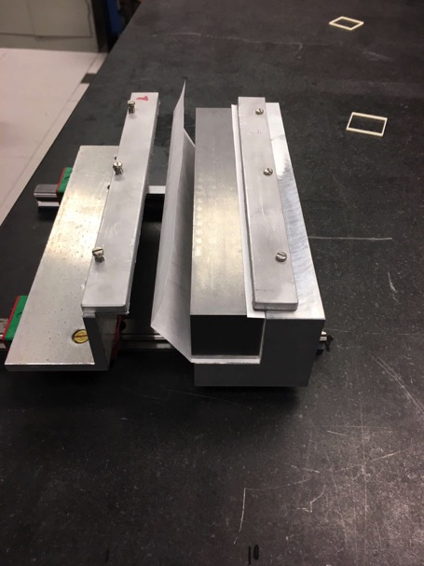
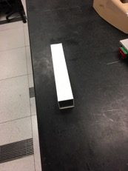
Crystal wrap: step-1, folding crystal in machine

Slide 32
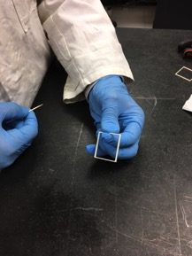
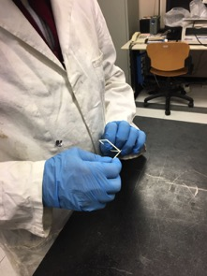
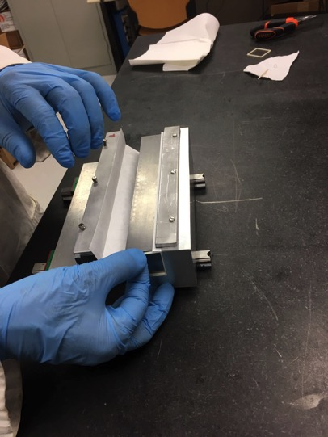
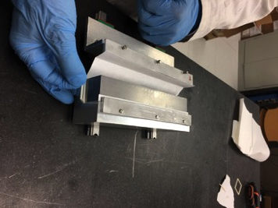
Crystal wrap: Step-2 .. Gluing of frames

Slide 33
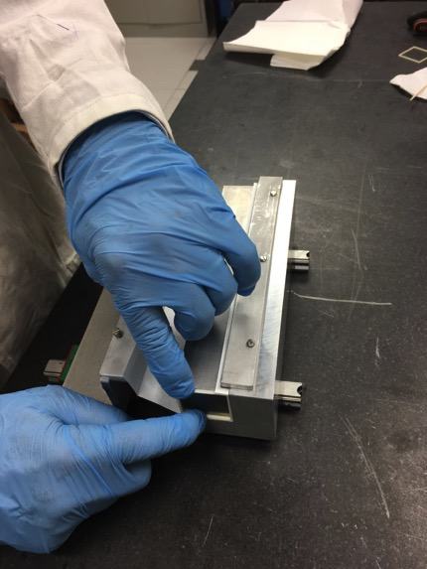
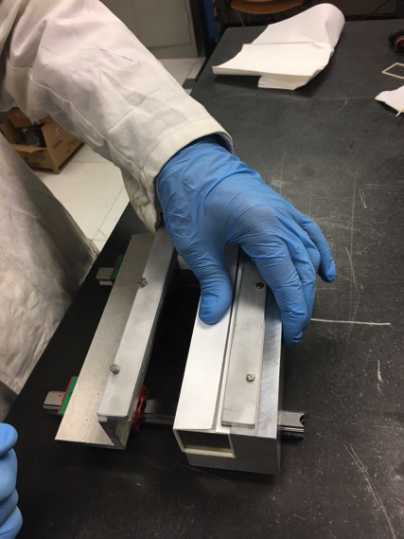
Crystal wrap: Step-2, gluing frames

Slide 34
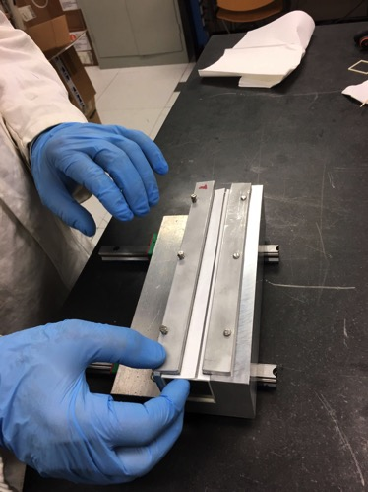
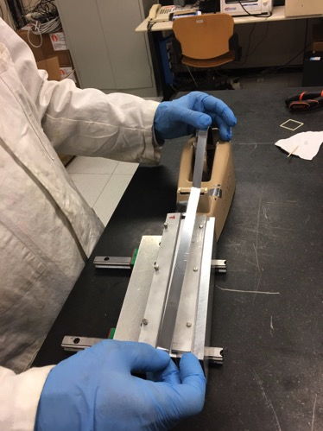
Crystal wrap: Step-3 Aluminum tape
After curing of frames on the Tyvek

Slide 35
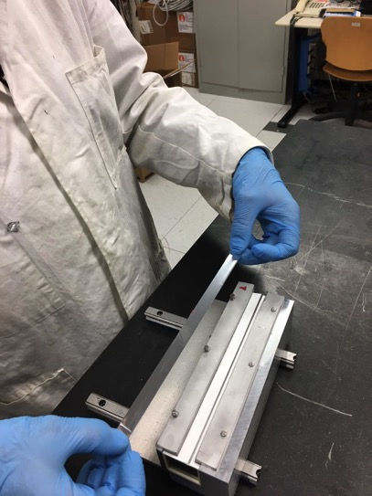
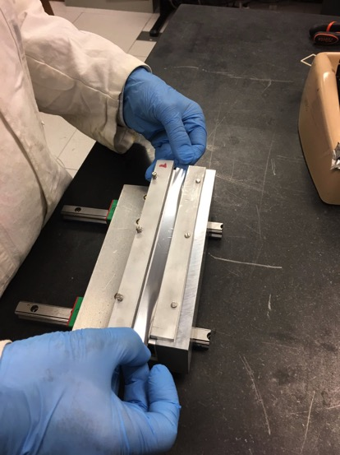
Preparation of wrapping: Crystal wrap

Slide 36
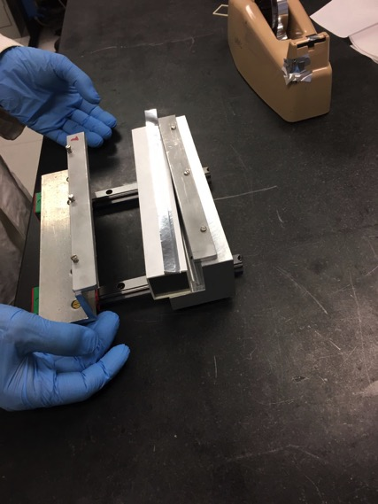
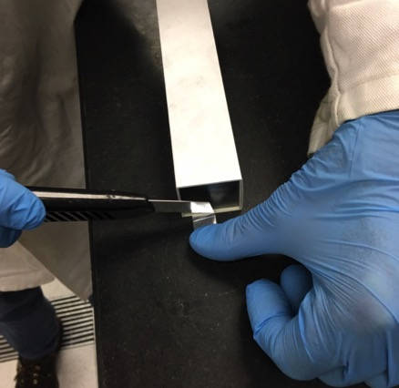

Slide 37
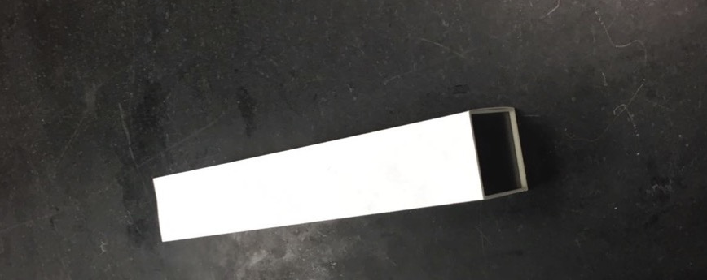
Crystal wrap: final resut

Slide 38
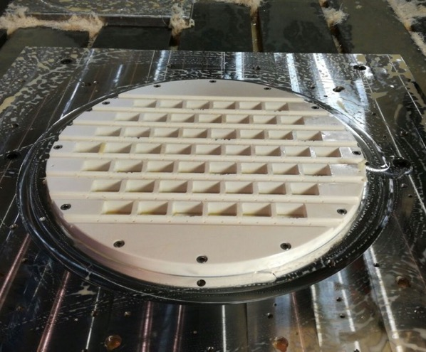
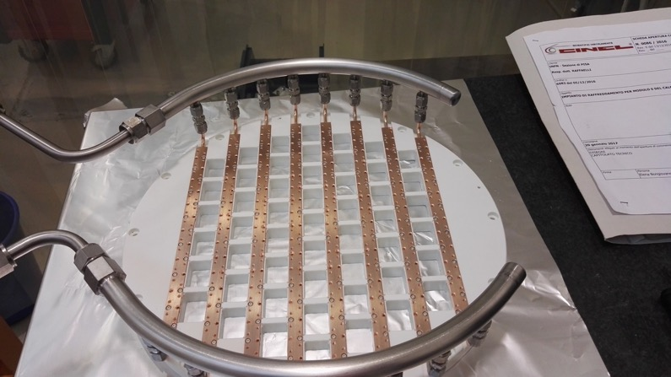
Module 0 FEE plate

Slide 39
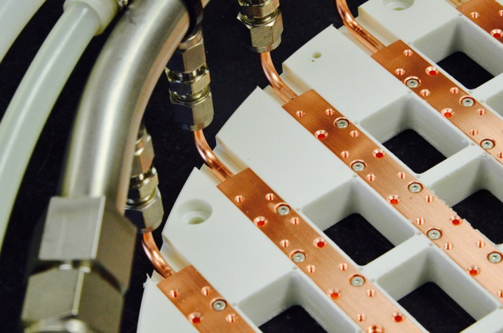
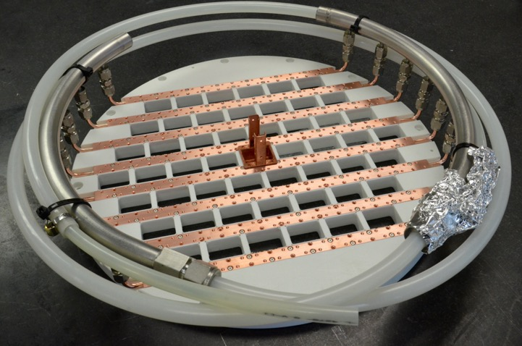
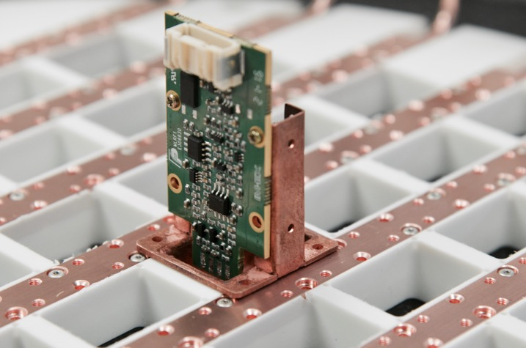

Slide 41
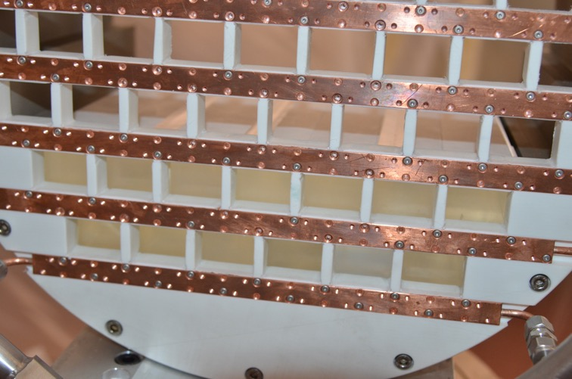

Slide 42
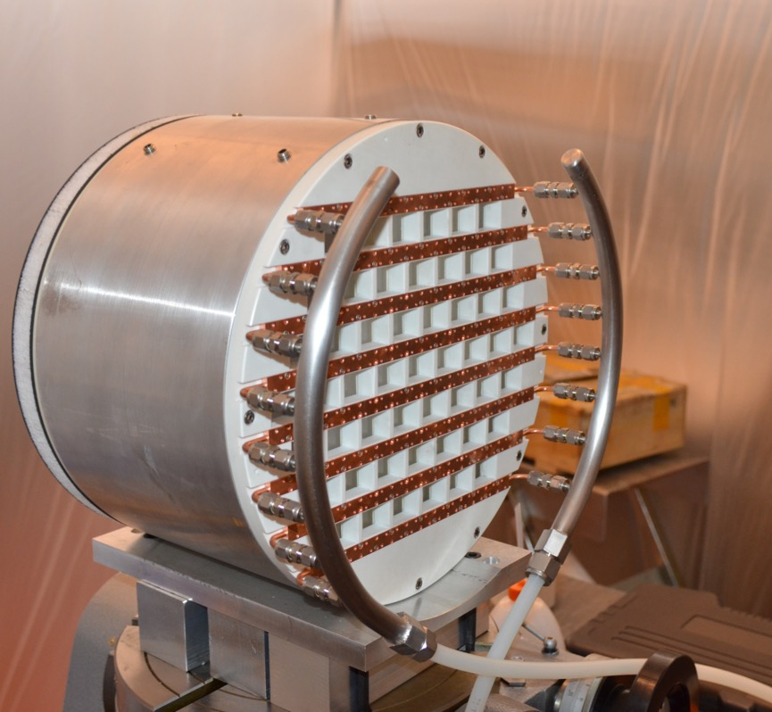

Slide 43
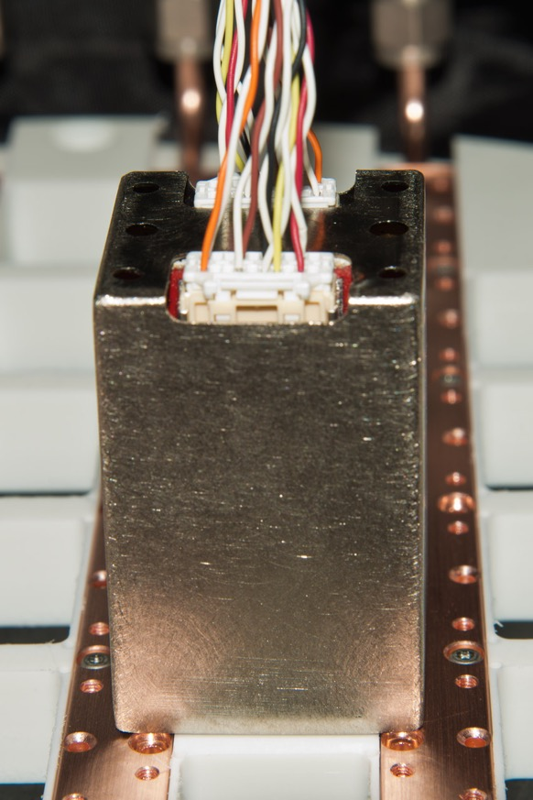
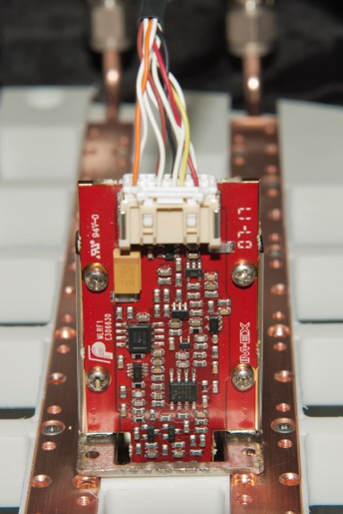
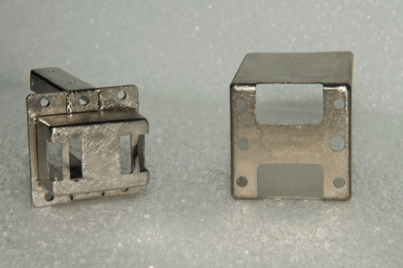
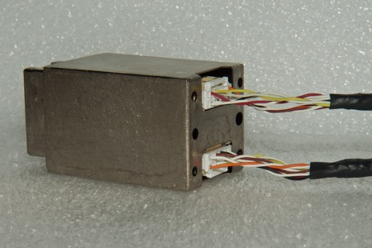

Slide 44
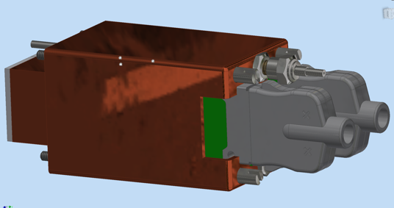
SiPM +FEE holder
New design for the Sipm+FEE holders
New prototype with more precise
production technique machining
The holder dimensions are customized
for the Hamamatsu SiPM.

Slide 45
holder

Slide 46
SiPM & FEE holders
non chi comincia ma quel che persevera
The holder houses the SiPMs, the FEE boards and fiber connectors.
The body of the holder is made of golden copper to achieve a good thermal conductivity and facilitate the gluing of the SiPMs.
It provides:
mechanical support for SiPM &FEE board;
heat exchange between SiPM and cooling circuit;
light-tightness;
faraday cage.

Slide 47
SiPM & FEE holders: components
The SiPM are glued on the case (body)
REG_Board
The FEE is screwed
through a bridge resitor
SiPMs
Holder
(copper+Au)
Closing Screw
Faraday cage
Screws
Spacer
Fiber Guide
Fiber optic connector

Slide 48
Sipm holder: total cost
non chi comincia ma quel che persevera
Parte | Q.ty | Prezzo unitario | Prezzo lotto
Body | 1650 | 15,50 € | 25.575 €
Fiber Guideline | 1650 | 0,45 € | 742,5 €
Closing screw | 1650 | 0,41 € | 676,5 €
Screws | 6600 | 0,37 € | 2442 €
Spacers | 3300 | 0,38 € | 627 €
 |  | TOTALE | 30.063 €
Gabbia di Faraday
ABS* | 1650 | 4,56 € | 7524 €
ASA* | 1650 | 4,59 € | 7573,5 €
Victrex@ Peek* | 1650 | 8,6 € | 14190 €
Alluminio imbutito | 1650 | 11,95 € | 19.717,5 €
Rame imbutito | 1650 | 12,32 € | 20.328 €
Alluminio pressofusione | 1650 | 18,6 € | 30.690 €
Stampa 3D – ASA** | 1650 | 18 € | 29.700 €

Slide 49
additional costs to be sustained
SiPM holder
From the quotes in our hands, the overall cost of this component is estimated to be 60 kE
We hope that during the bids the costs will go down at least 10-15 %
Y adj
The Y adjustment mechanism has to be purchased, the cost is estimated to be 2250x4 =9 kE

Slide 50
plans 2018
Plan CRR in July 2018
The mock-up of a real size annulus is growing.
final designs for all the parts
Bids
A tender is out for the purchase of the 2 Outer Al Cylinder
We needed 14 kEuro extra to add stepped margin in the machining
Tender in preparation for FEE plate – 10 kE extra cost
FEE Cooling pipes machining 22 kE extra cost
Divided in two: material and machining
Tender in preparation for CF source plate, also in two parts.
Feet and adjustment mechanism – LNF workshop
2 annuli connection mechanisms – LNF workshop
Assembly and lifting tools will be built @FNAL
Changed manufacturing technique for SiPM + FEE holders
we have now a first good prototype - assessing extra cost

