Slide 1
Gravity Gradient Noise: estimates & reduction strategies
G. Cella
I.N.F.N. Sezione di Pisa

Slide 2
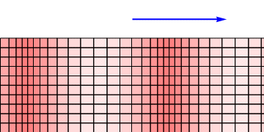
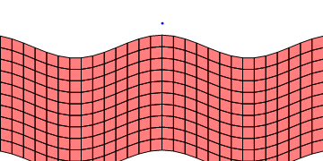
What is Gravity Gradient Noise
Direct gravitational coupling between density fluctuation in the environment and test masses
The mass density fluctuates .....
..... and the gravitational field will do the same

Slide 3
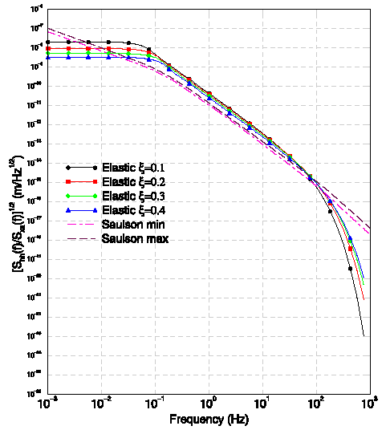
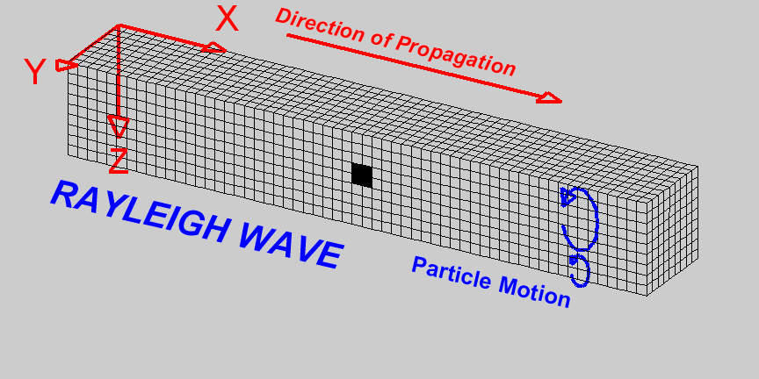
Analytical estimates: the modelization strategy
Find the relevant normal modes (elastic waves)
Evaluate the contribution of each mode to GGN
Determine statistics of modes’ amplitudes (using measurements and ad-hoc assumptions)
Sum all contributions in an appropriate way (quadrature?)
Transfer function between seismic noise and GG noise on the surface
Beccaria et al., Class. Quant. Grav. 15:3339-3362 (1998)
S.A.Hughes, K.S.Thorne, Phys. Rev. D58:122002 (1998)

Slide 4
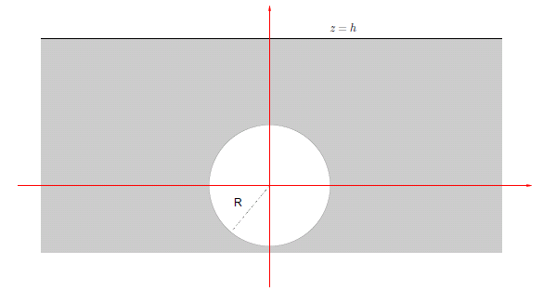
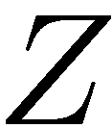
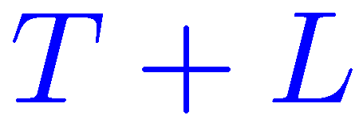
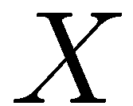
GGN Estimation: the homogeneous model (above and below the ground)
Big simplification: an half space filled homogeneously with a material of given ½, c_{T}, c_{L}
Bulk contribution
+ Surface contribution
- Cavity contribution
+ Cav. surface contr.
= GGN
Several kind of modes:
Surface waves (GGN: volume and surface)
Transverse volume waves (GGN: no)
Mixed (GGN: volume and surface)

Slide 5
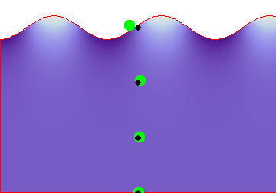
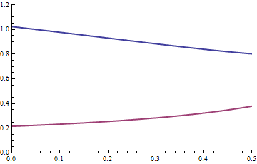
Model 1: surface waves only
The couplings to GGN noise:
All contributions are exponentially suppressed with the depth
Cavity contributions are suppressed by a factor (kR)²
Two length scales:
¸₁=c_{S} /2¼! : seismic suppression with the depth:
¸₂=¸₁/¯_{L} : the “averaging effect”
¯_{L}
¯_{T}

Slide 6
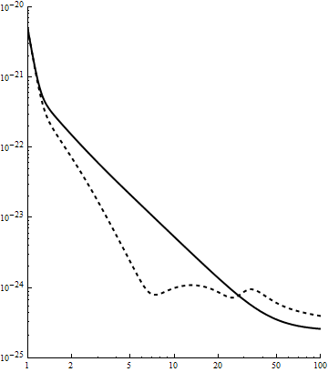
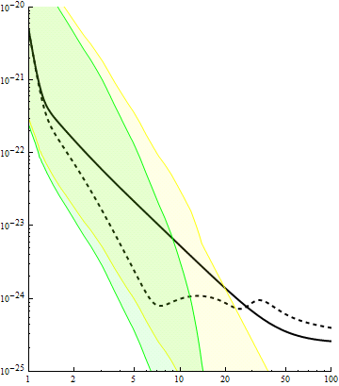
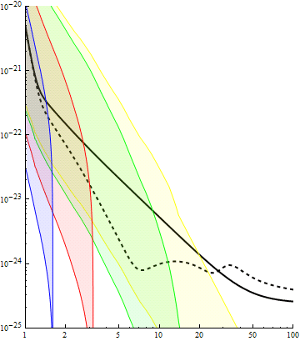
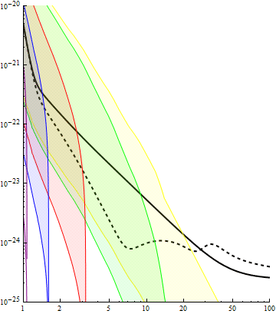
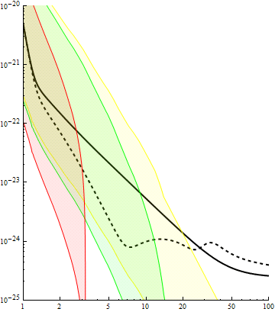
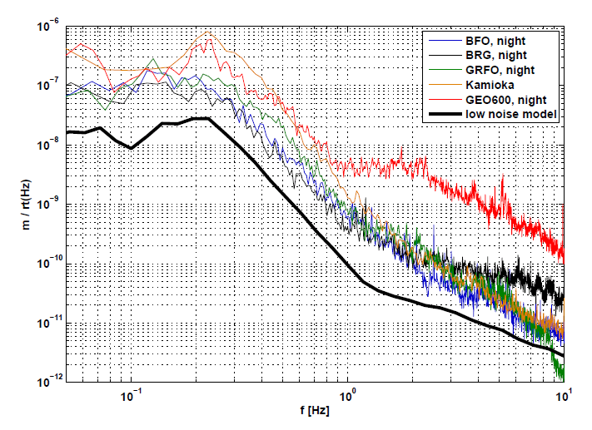
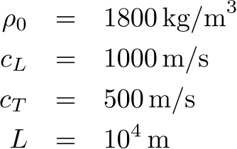
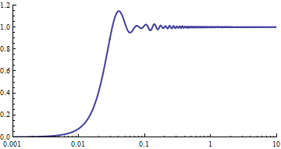
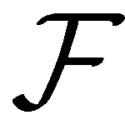
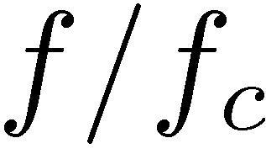
Model 1: comparison with the planned ET sensitivity curve
S. Hild, S. Chelkowski, A. Freise: "Pushing towards the ET sensitivity using 'conventional' technology" http://arxiv.org/abs/0810.0604
S.Hild, S.Chelkowski, A.Freise, J.Franc, N.Morgado, R.Flaminio and R.DeSalvo: "A Xylophone Configuration for a third Generation Gravitational Wave Detector" http://arxiv.org/abs/0906.2655
Related to the seismic noise spectral amplitude:
Surface
-10 m
-50 m
-100 m
-150 m
M.G. Beker, G.C., R. DeSalvo, M. Doets, H. Grote, J.Harms, E. Hennes, V. Mandic, D.S. Rabeling, J.F.G. Van den Brand, C.M. Van Leeuwen, “Mitigating noise in future GW observatories in the 1-10 Hz band”, submitted to GRG
ET-C
ET-B

Slide 7
Effect of sound speed
From c_{L}=200 m/s to c_{L}=2000 m/s
Low speed gives larger reduction
Surface
-10 m
-50 m
-100 m
-150 m

Slide 8
Effect of sound speed
From c_{L}=200 m/s to c_{L}=2000 m/s
Low speed gives larger reduction
Surface
-10 m
-50 m
-100 m
-150 m

Slide 9
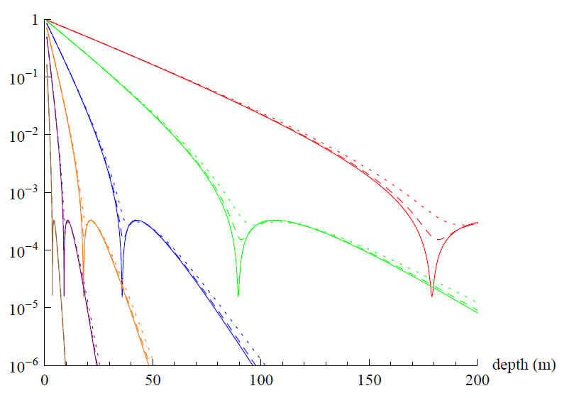
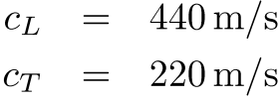
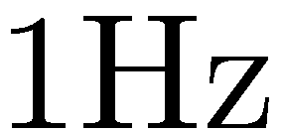
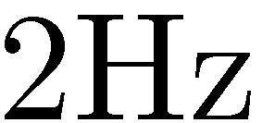
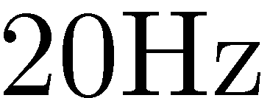
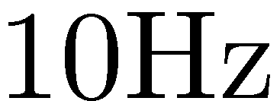
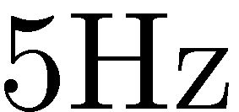
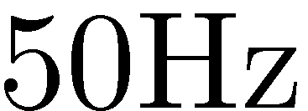
Effect of losses
Modelization:
Assign a line width to each mode
Coherence is reduced
Not a big effect on the attenuation
Probably important for the subtraction efficiency
If dissipative effects are present, an external periodic force excite modes with a different natural frequency.

Slide 10
Surface wave only: HV anisotropy
How to validate the model?
It gives predictions about seismic motion
Example: Vertical/Horizontal anisotropy
Measured in the VIRGO central building, for sure perturbed by local effects
But measured anisotropy ratios (in quiet times) are tipically below 1
We can improve the model taking into account the other modes
Measured V/H anisotropy
Frequency (Hz)

Slide 11
Model 2: Surface waves and purely transverse waves
The new estimate:
Purely transverse waves does not contribute to GGN
They contribute to V/N anisotropy (reducing it)
Typical suppression factor around 0.5-0.7
Surface
-10 m
-50 m
-100 m
-150 m
ET-C
ET-B

Slide 12
A systematic improvement program
M.G. Beker, G.C., R. DeSalvo, M. Doets, H. Grote, J.Harms, E. Hennes, V. Mandic, D.S. Rabeling, J.F.G. Van den Brand, C.M. Van Leeuwen, “Mitigating noise in future GW observatories in the 1-10 Hz band”, submitted to GRG
Several tunable parameters can be introduced in the homogeneous model considered.
Coherence effect: inversion formulas
Anisotropy effects
Measure of X,Y,Z seismic spectral amplitude
Volume modes
Seismic correlations needed
Validation strategy more complicated, but available
Important point: volume modes with a longitudinal component contribute to GGN and does not decrease with the depth

Slide 13
Monitoring and subtraction
The idea:
measure some auxiliary quantities (correlated with the noise to subtract)
construct the “optimally subtracted” signal as
Spectral correlation between sensors
Signal power spectrum
Efficiency of the subtraction procedure:
Correlation between sensors and signal
High N_{i}: GOOD
“Small” C_{ij}: GOOD
For a given model of seismic motion we can study the best strategy for auxiliary measurements

Slide 14
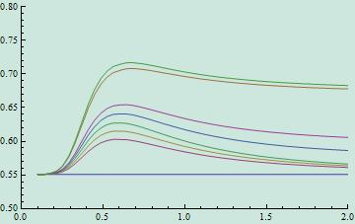
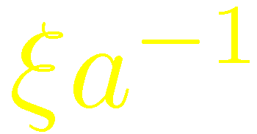
Subtraction: dependency on the number of sensors
Subtraction efficiency (amplitude)
It seems difficult to get more than an order of magnitude
Sensors distribution should be tuned with the requested frequency range for the subtraction
This is not the optimal placement

Slide 15
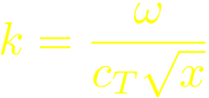
Conclusions
Recipe for the estimation of GGN
1. Find the solution x of
Ingredients:
C_{L} longitudinal sound speed
C_{T} transverse sound speed
½₀ density
A V/H anisotropy ratio
S_{seism} power spectrum of horizontal seismic motion on the surface
Z depth of the interferometer
2. Define
3. Evaluate the correlation factor (j_{n}(x) are the spherical Bessel functions):
4. Evaluate the factor ¡
5. Evaluate the anisotropy correction:
6. Evaluate the GGN spectral amplitude:

