Slide 1
Einstein Telescope
Status of WG1: site selection and infrastructure
2nd Annual ET meeting
October 16, 2009
Jo van den Brand
Nikhef / VU Amsterdam
jo@nikhef.nl

Slide 2
Contents
Contents
  Progress overview of year 1
  Infrastructure issues
    Site selection, geophysical issues
    Seismic data
    NN noise, modeling (e.g. FEA)
    Infrastructure and safety
    Suspensions, vacuum and cryogenic systems
  Goals for year 2
    Progress on vacuum and infrastructure
    Costing

Slide 3
Progress overview of year 1
WG1 meetings
  Stuva (May. 2008)
  COM (Oct. 2008)
  Nikhef (Oct. 2008)
  Gran Sasso (Feb. 2009)
  Ft. Lauderdale (May 2009)
  EGO (Sep. 2009)
Seismic data
  Data collection
  Joined Homestake activity
  RealMonte mine (Oct. 2009)
  Kamioka (2010)
  Ilias Next proposal
GGN
  Analytical calculation (Cella)
  Stochastic simulations (Harms)
  Impulse excitations (Beker)
  Adaptive filtering (Harms, Rabeling)
ET design progresses
  Optical design
  Suspensions
After 2nd ET meeting
  WG leader discussion
Reporting
  General site issues
  Seismic issues
  GGN conclusions

Slide 4
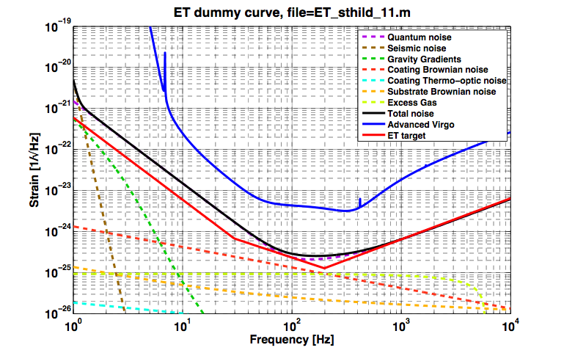
Seismic noise and GGN Status
Seismic noise
  Assumptions by Stefan Hild
    Ambient seismic noise around 5 nm/rtHz at 1 Hz
    For frequencies > 1 Hz noise depends on 1/f²
    Need a factor 50 for GGN!
  Several existing sites feature
    Ambient seismic noise below 1 nm/rtHz at 1 Hz
    Cultural noise sources dominate
  Get suppression from going underground
    Tough at 1 Hz
    Suppression factors 10 – 100 possible for continuous noise (Cella, Harms, Beker)
    More difficult for impulse type excitations (Beker)
    Employ filtering / subtraction schemes (Cella, Harms, Rabeling)

Slide 5
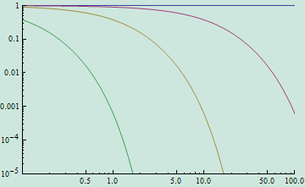
a [ m/s² ]
a_{x}
-16
a_{z}
H=400 m
a_{y}
c_{P}
c_{S}
-16
H=500 m
Surface
-16
H=600 m
Reduction factor
Z=-10 m
P-wave passing 600m depth
Time [ s ]
Z=-100 m
FEA model and impulse response Beker
  All wave types included
  GGN drops less than order of magnitude
  Little geometric suppression
Z=-1000 m
Analytical results by G. Cella
The 58th Fujihara Seminar (May 2009)
Frequency (Hz)

Slide 6
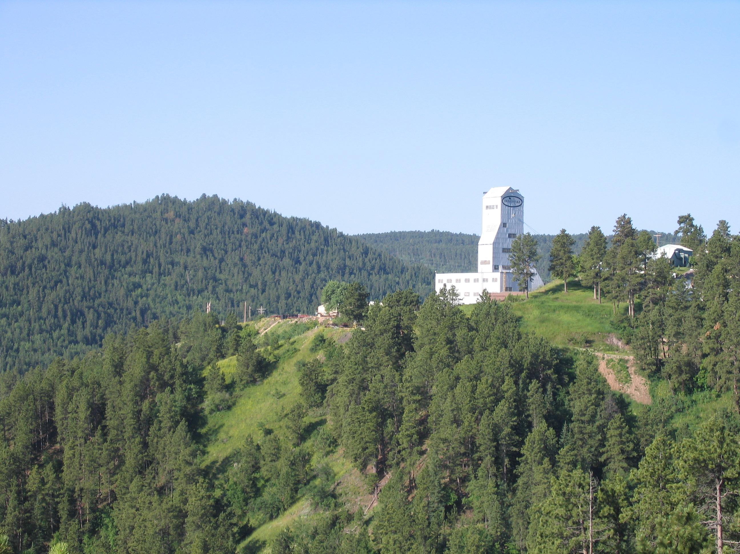
Homestake - Dusel

Slide 7
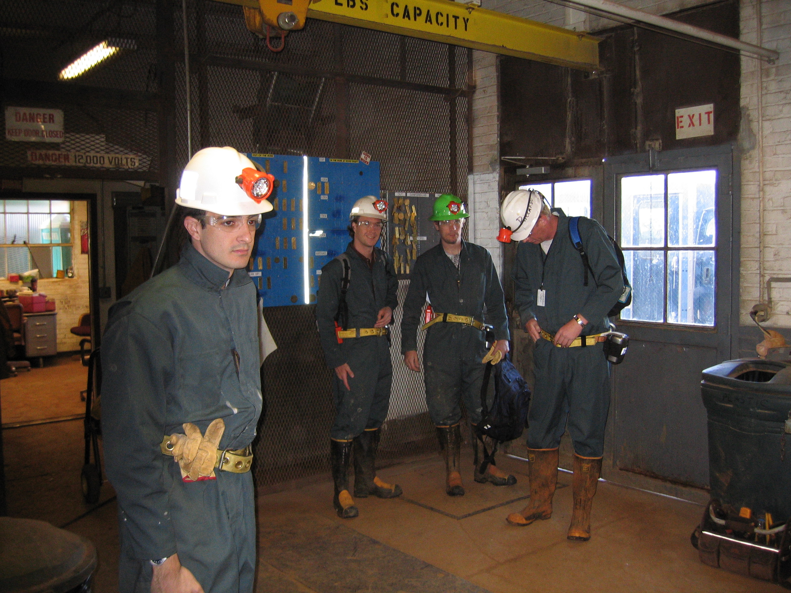
Safety issues: training, guides (by appointment)
Elevator: access (operators)

Slide 8
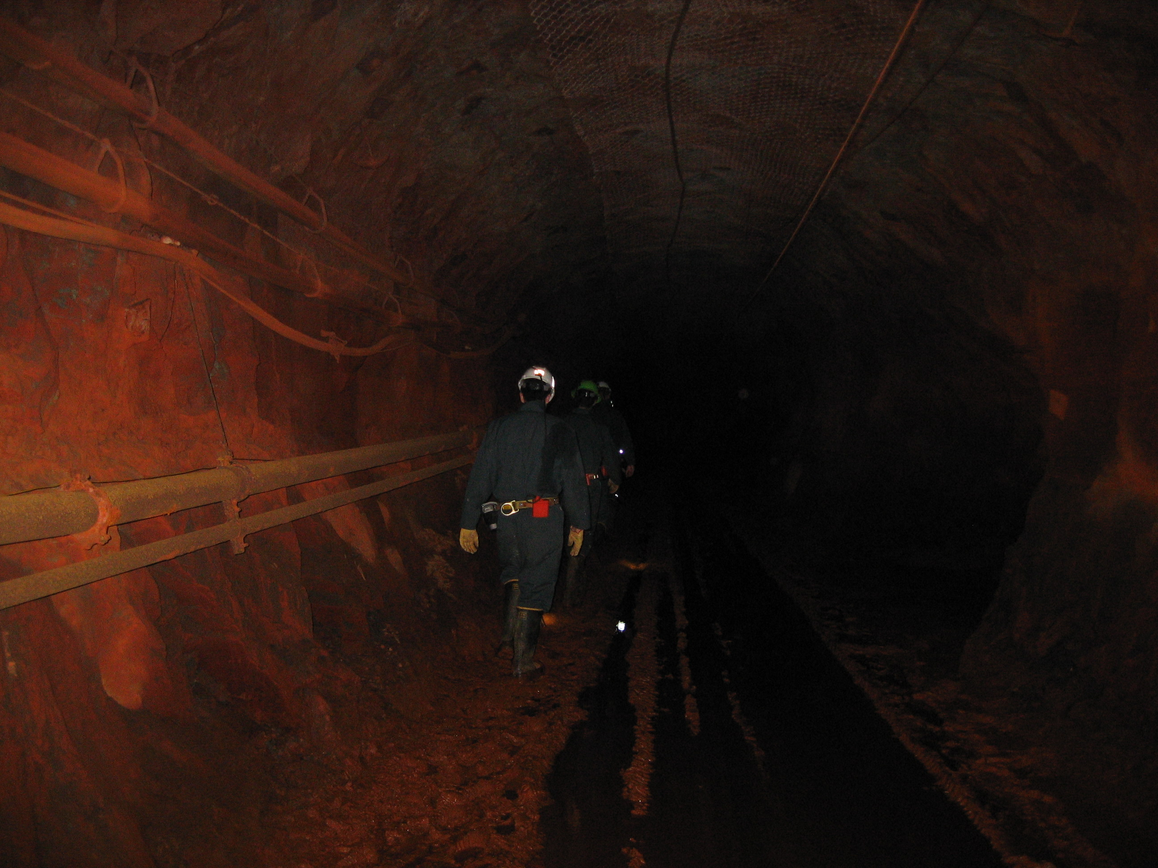
Level 4880 ft (1600 m)
Water at 5100 ft
Infrastructure replaced
Significant local expertise
Dust
Water
Air circulation

Slide 9
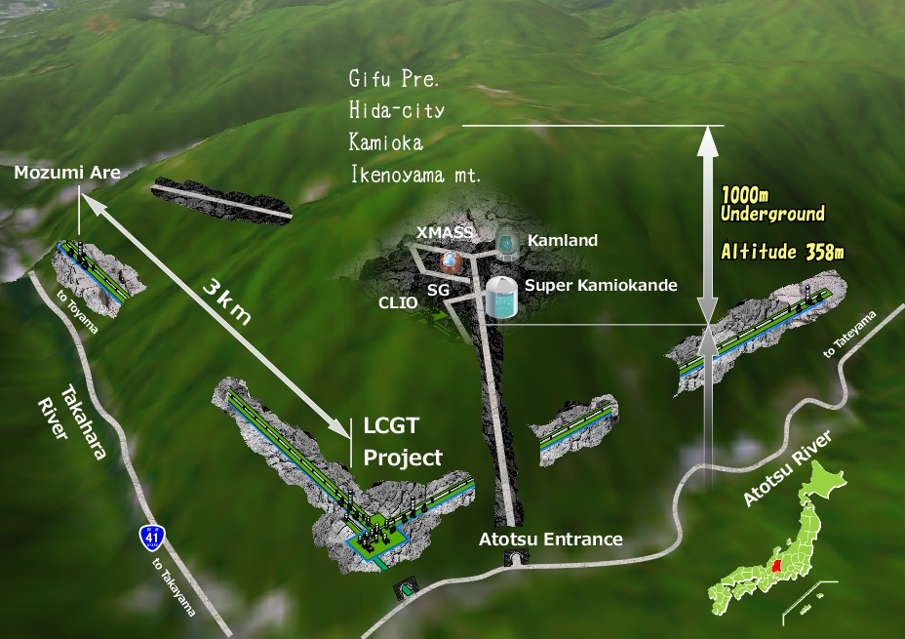
Schematic view of Kamioka Research Facility (Kuroda, Ft. Lauderdale, May 09)

Slide 10
The goodness of underground must be tested using interferometers
Kuroda et al.
Long term stability
  Checked by a practical interferometer
Harmful environment of high humidity
  Vacuum pump and optics
Dust contamination due to mining history
  Optics
Other harmful factors

Slide 11
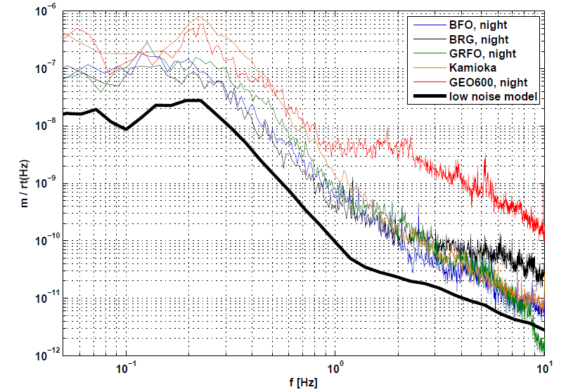
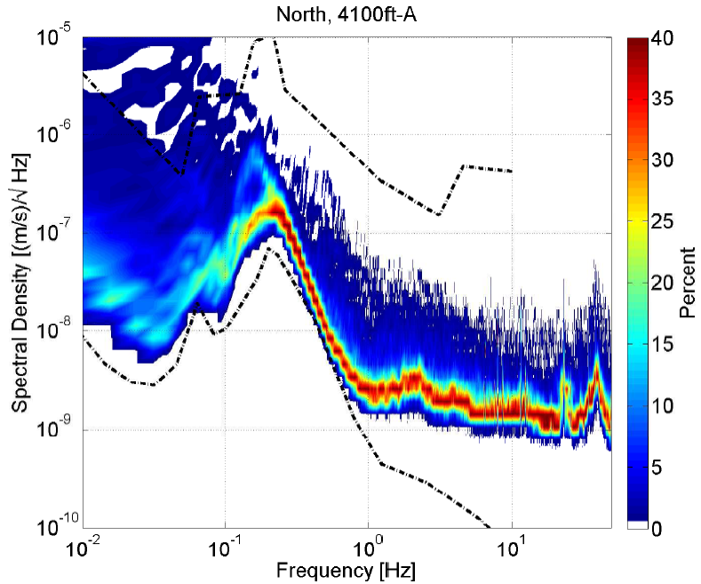
Seismic data
Harms et al.
Grote
ILC database:
http://vibration.desy.de
Asse, Moxa, LHC

Slide 12
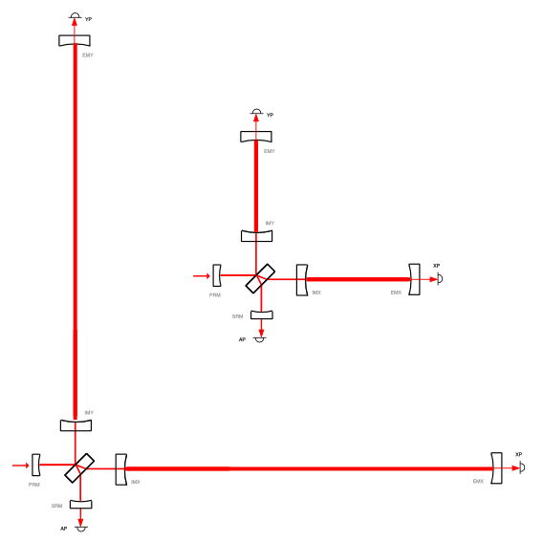
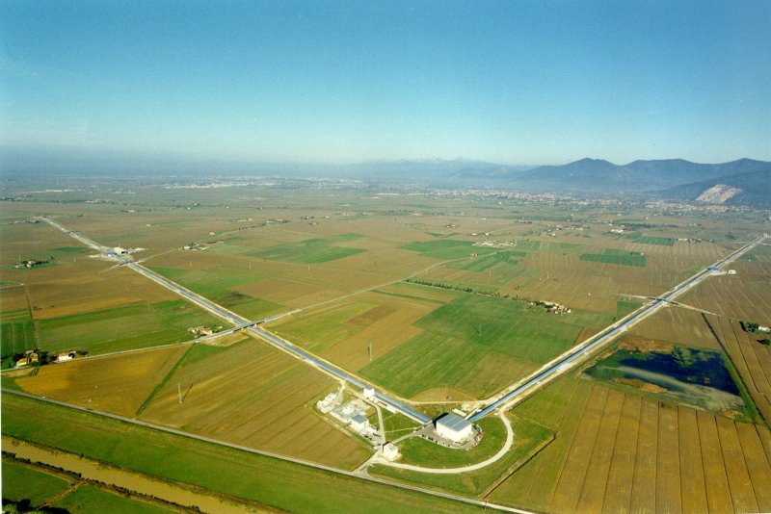
Einstein Telescope
Main characteristics
  Arms 10 km length
  3 ITFs
  Separate LP and HP ITF?
  Underground
  Cryogenic
ADV (3km)
ET (10km)

Slide 13
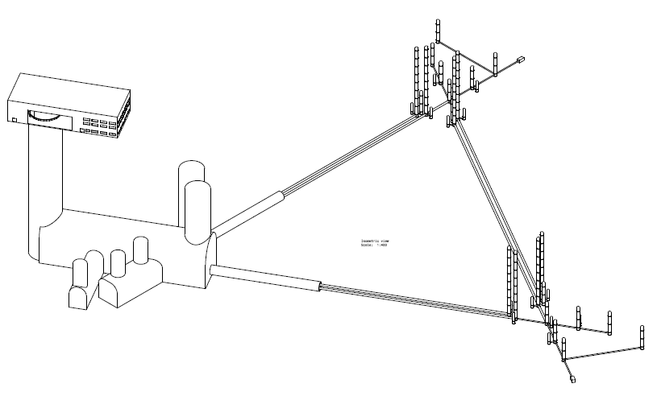
Infrastructure design
Martin Doets
Surface building
End mirror 1
Access shaft
End mirror 2
IMC
Detection system

Slide 14
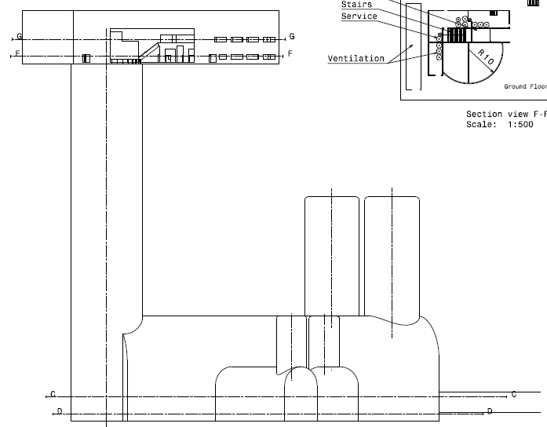
General layout
Surface building
- Workshops, cleanrooms, offices
- Power, ventilation, etc.
- Control room
Access shaft
- Elevator, stairs
- Services
Underground facility
- ITFs
- Services
o Vacuum
o Cryogenics
- Cleanrooms
How to create low noise environment

Slide 15
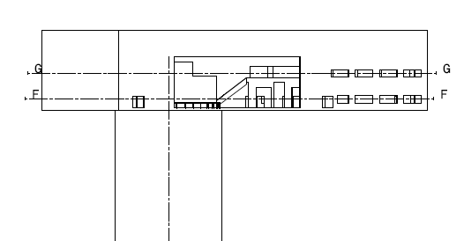
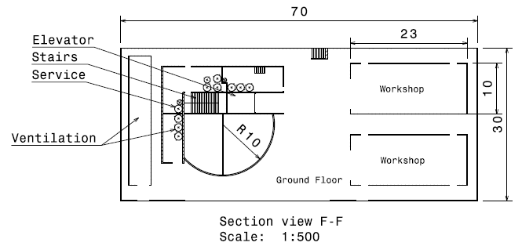
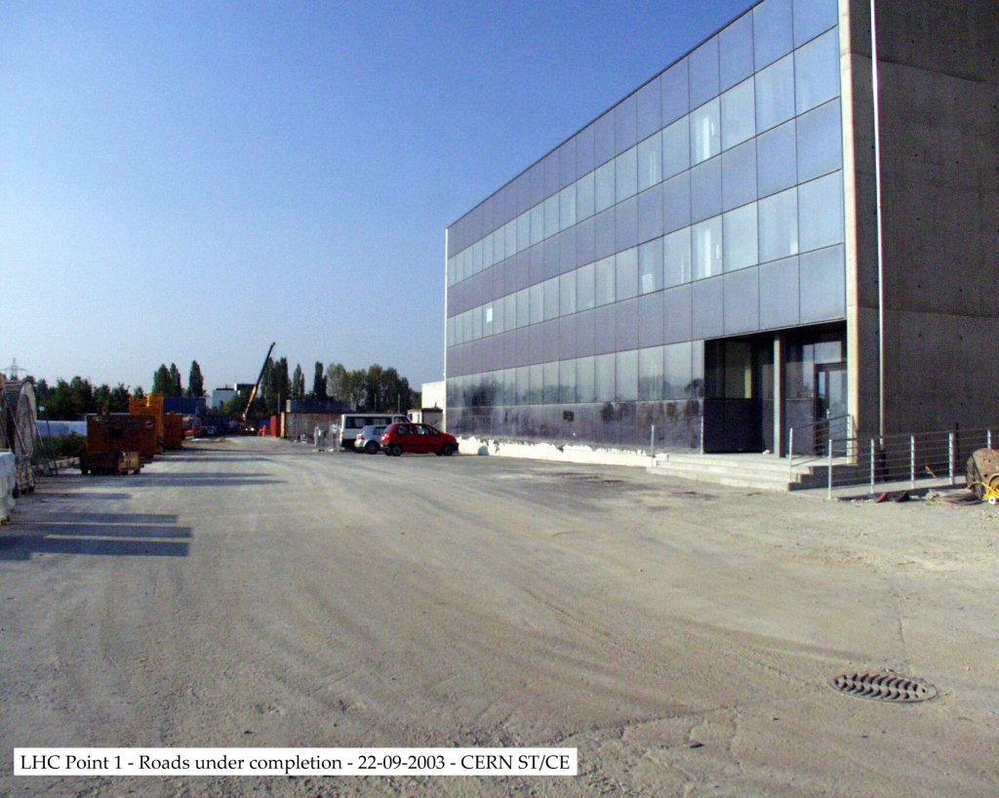
Surface buildings
Ground floor
- L = 70 m, W = 30 m
- 2 workshops (23 m x 10 m)
o vacuum tubes
o cleanrooms later?
- Large entrance doors
- Ventilation system (outside?)
- Cryocoolers?
- Services
Lifting facility
- D = 20 m
- Excavation entrance (TBMs?)
- Stairs, Elevator

Slide 16
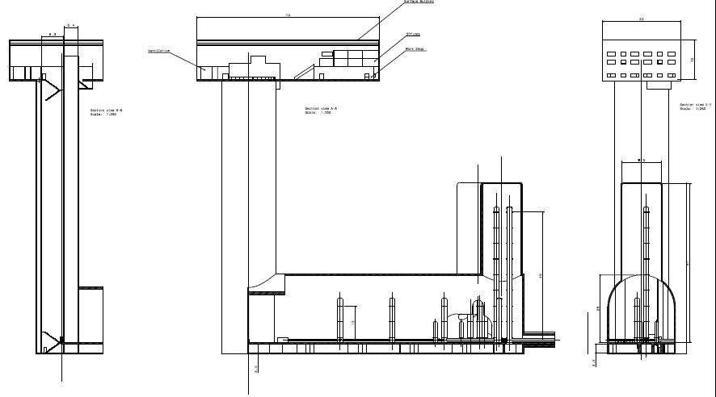
Access shafts

Slide 17
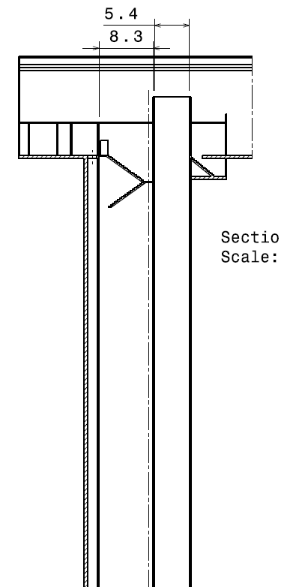
Access shafts
Elevator
- 5.4 m x 4.0 m
- Pressurized (fire containment)
Stairs
- W = 2 m
- Fire doors
Concrete construction
- Fire proof

Slide 18
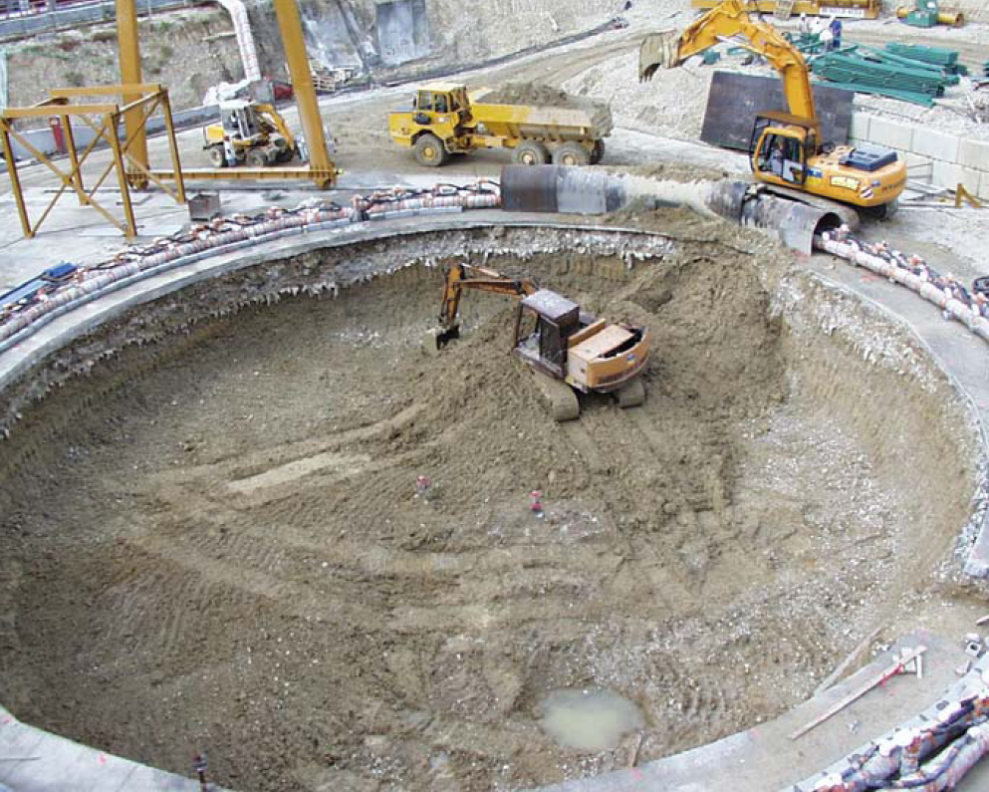
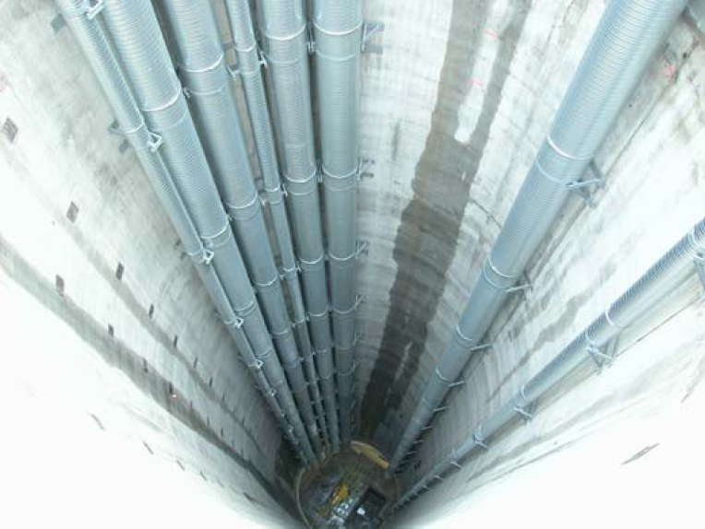
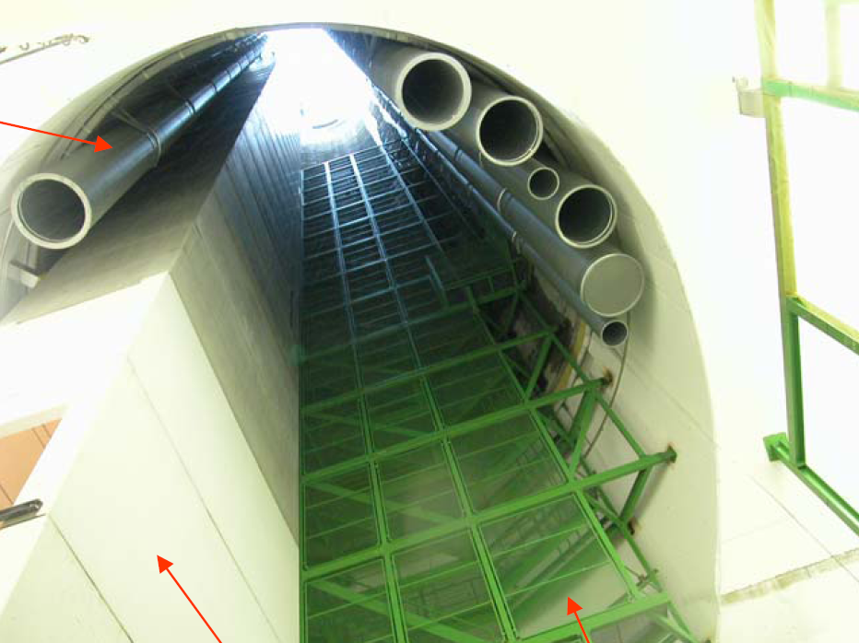
LHC project: CMS shaft
Ventilation ducts
Concrete lift modules
Staircase

Slide 19
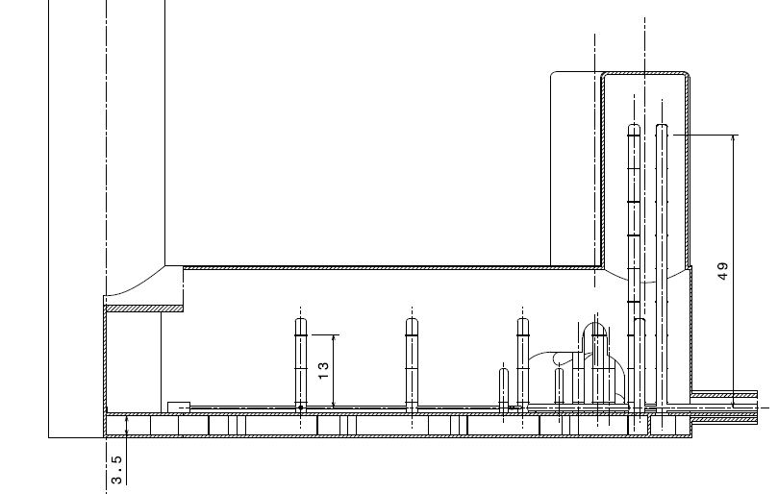
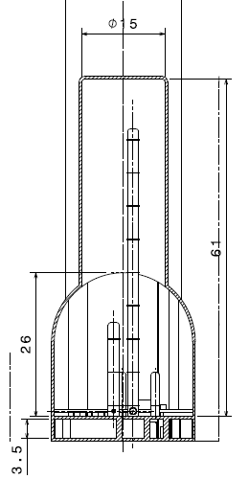
Infrastructure design
Dimensions:
L = 105 m
W = 25 m
H = 26 + 3.5 m

Slide 20
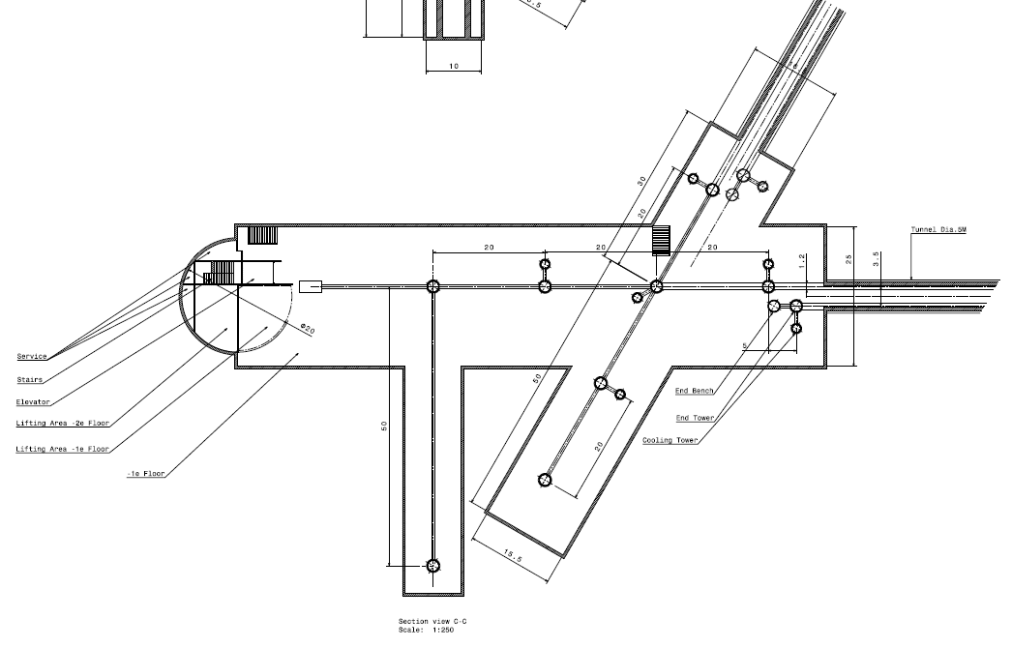
Underground facility
IM1
Level -1
Laser
PRM
IM2
BS
IMC

Slide 21
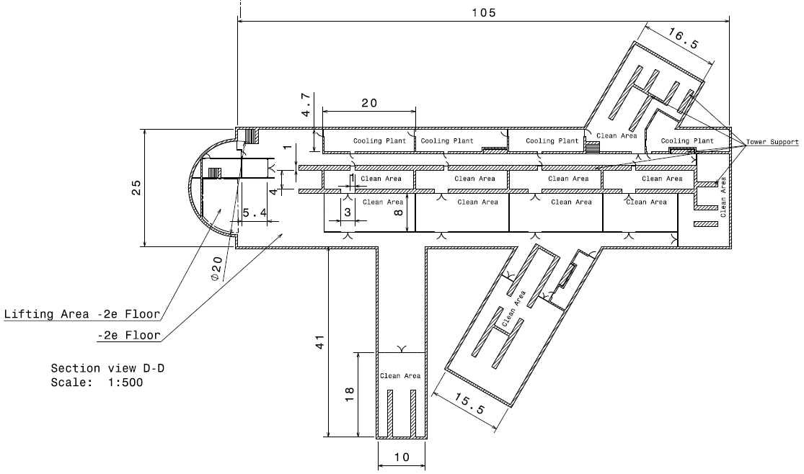
Underground facility
Level - 2

Slide 22
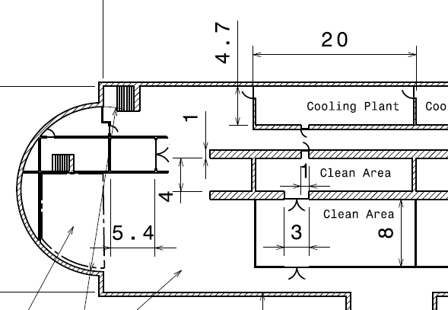
Underground facility
Level - 2
Cryo-coolers?
Emergency escapes
Suspension supports
Below suspension
Cleanroom

Slide 23
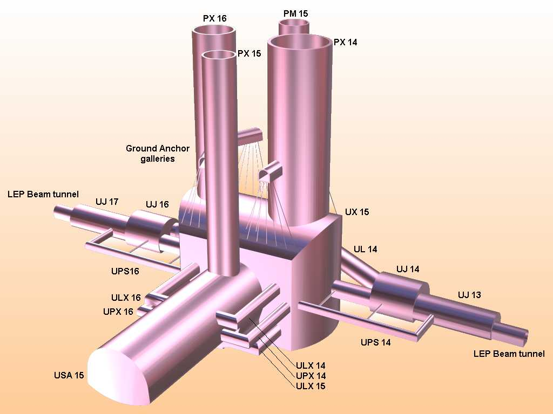
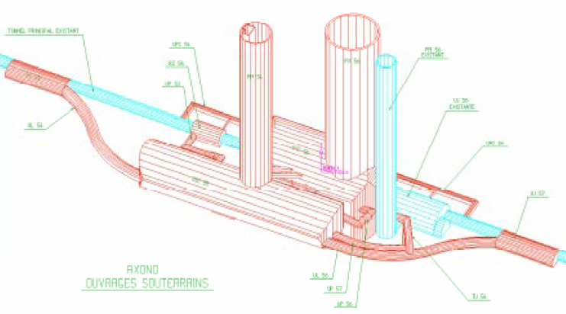
LHC project: Cern Atlas and CMS
Point 1 (depth ~ 92 m)
  Shaft PX14 (D = 18, l = 60 m)
  Shaft PX16 (D = 12.6, l = 60 m)
  Cavern UX15 (h, w, l = 35, 32, 55 m)
  Service cavern USA15 (l = 62 m)
  Construction 4.5 yr
Point 5 (50 m moraine on top)
  Shaft : 20.4 m
  Shaft : 12 m
  Cavern UX55 (h, w, l = 25, 27, 53 m)
  Service cavern US5 5 (w = 18 m)
  Construction 6.5 yr

Slide 24

 | CIVIL ENGINEERING (ST/CE)
Packages | Location | Works | Engineering Consultant | Main Works Contractors
1 | Point 1 | Caverns, tunnels, shafts, building for ATLAS U + S Structures for LHC | EDF (F) KNIGHT & PIESOLD (GB) | TEERAG-ASDAG (A) BARESEL (D) LOCHER (CH)
2 | Point 5 | Caverns, tunnels, shafts, building for CMS U + S Structures for LHC | GIBB (UK) GEOCONSULT (A) SGI (CH) | DRAGADOS (E) SELI (I)
3a | Other areas (except TI 8) | U + S Structures for ALICE (P2) and B-Physics (P8) Transfer tunnels, TI 2, Beam Dump and other U + S Structures for LHC | BROWN & ROOT (UK) INTECSA (E) HYDROTECHNICA (P) | TAYLOR-WOODROW (GB) AMEC (GB) SPIE-BATIGNOLLES (F)
3b | TI 8 | Transfer tunnel TI 8 | Dito | SCRASA (CH) LOSINGER (CH) REYMOND (CH) PRADER (CH)

Slide 25
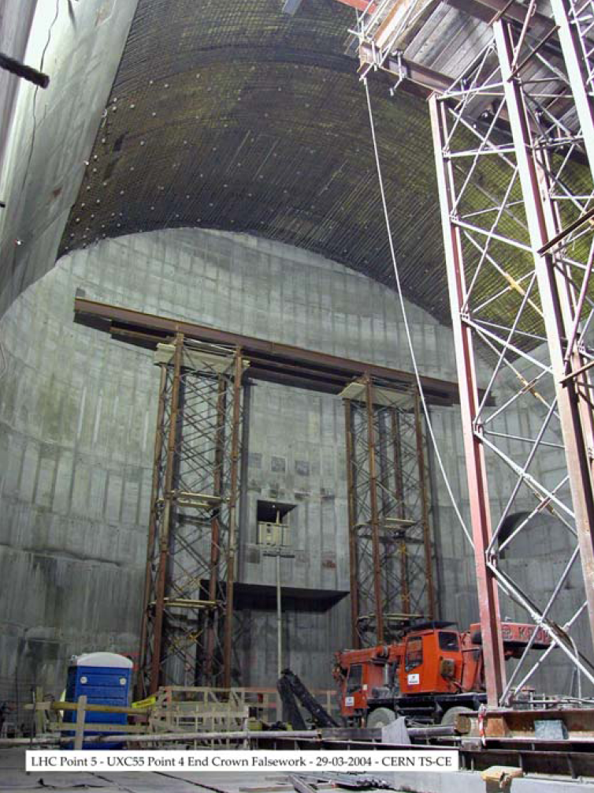
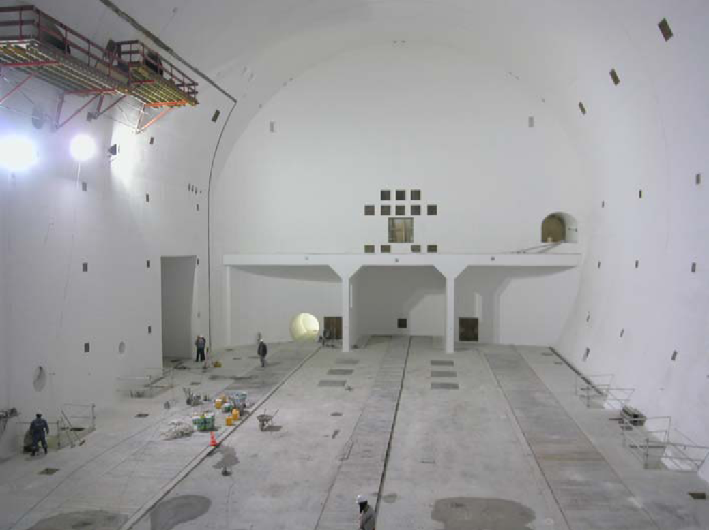
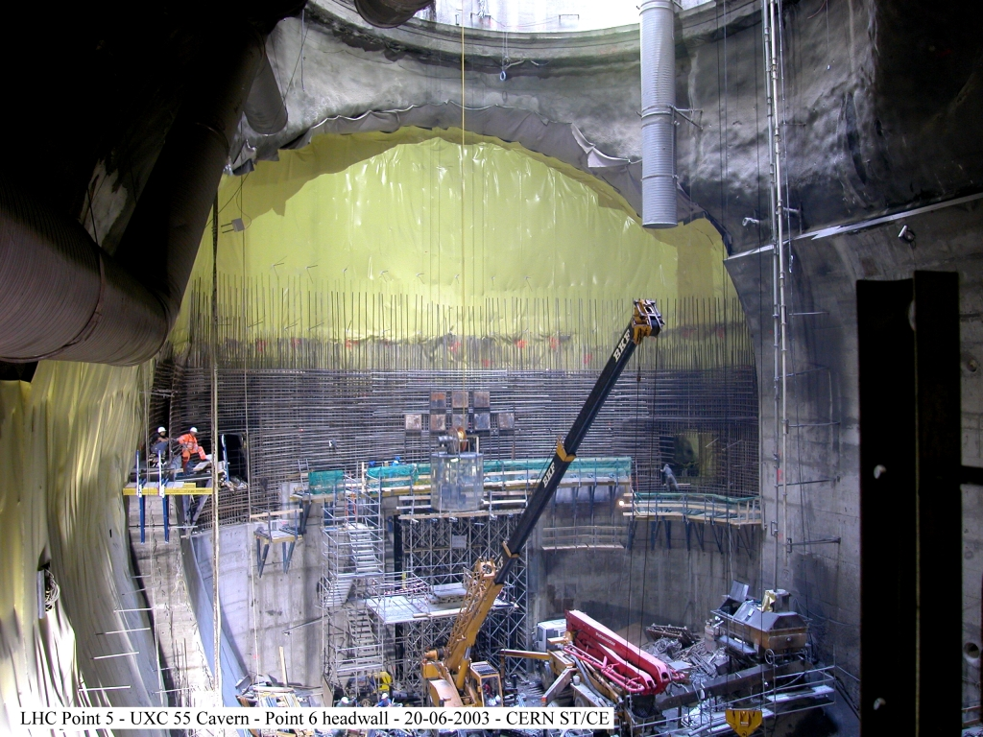
LHC project: CMS cavern
Show movie

Slide 26
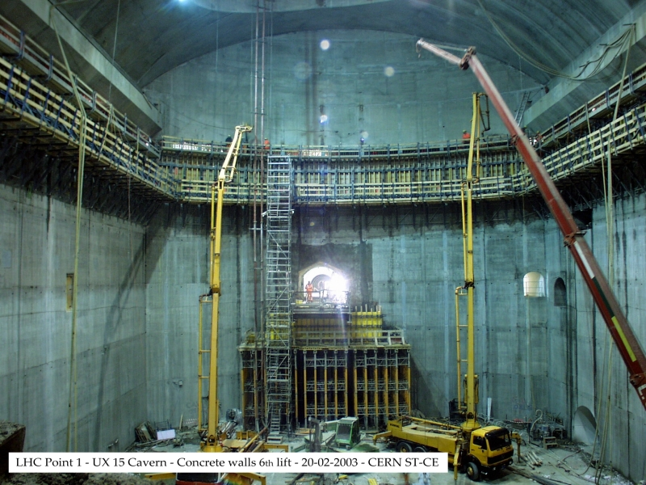
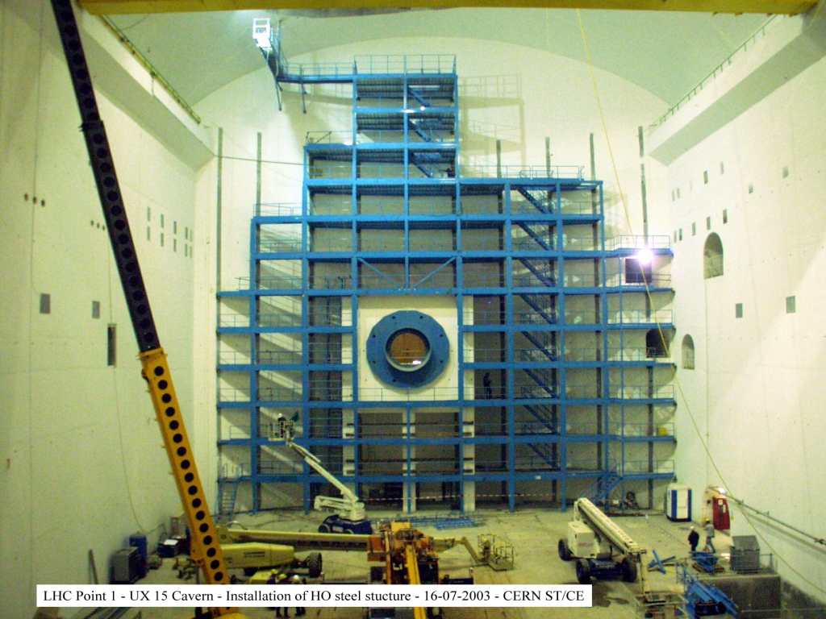
LHC project: Atlas cavern

Slide 27
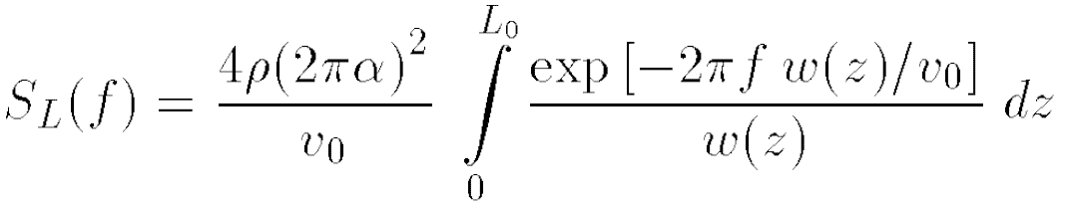
Vacuum issues: partial pressures
PSD depends on
  Length of beam path
  Gaussian beam radius
  Most probable velocity
  Spectral frequency
  Molecular number density
  Polarizability
  Apparent length difference amplitude SD
Consequences for ET
  Length helps
  Larger beam size (12 cm radius) helps
  Sensitivity ET about 10⁻²⁵ /rtHz
  AdV for 1.5 × 10⁻²⁵ /rtHz we need P_{H2O} ≈ 10⁻¹⁰ mbar, P_{H2} ≈ 10⁻⁹ mbar
  For ET we need order of magnitude and thus lower partial pressures (factor 5 or so)
Under study at EGO

Slide 28

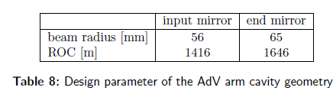
Vacuum issues: coating Brownian noise
Assume beam size radius 12 cm
  Mirrors of 60 – 65 cm diameter
  Diffused light
Criteria applied in Virgo to moderate diffused light
  Minimum free aperture radius is 5 times larger than the average beam radius.
  Any discontinuity (potential reflecting spot) of the vacuum enclosure is hidden by suitable absorbing glass baffles, with respect to the beam spot on any mirror.
  No point of the smooth surface of the vacuum enclosure can be seen contemporarily by the beam spots on two facing mirrors.
  Moreover, in the main part of the arm tubes, between two large valves, all the inner surface is hidden by conical stainless steel baffles, with respect to the beam spots on the mirrors
Simple scaling from Virgo+:
  Dmirror = 35 cm
  Dbaffles up to 85 cm
  Dvessel = 1.2 m
Consequences for ET vessel diameter!?
ET Tunnel: at least 2 beams, maybe 4 beams

Slide 29
Summary
Year 2 goal: formulate a first-order design for ET
  Suspensions
  Optics
Draw first conclusions from GGN simulations
  Depth
  Cavern size
  Preferred geology
Prepare infrastructure design
  Homestake type facility
  Cern / Gran Sasso type facility
Prepare cost estimate
Other issues
  Safety issues

