Slide 1

Einstein telescope:
Status and perspectives
Michele Punturo
EGO & INFN Perugia

Slide 2
Project Description
ET is a conceptual Design Study of a 3rd generation GW observatory, supported by the European Commission within the FP7-Capacities
Why a 3rd generation GW Observatory?

Slide 3
GW detectors evolution path
Same Infrastructures, improvements of the current technologies, some prototyping of the 2nd generation technologies
Same Infrastructures, engineering of new technologies developed by currently advanced R&D
2nd Gen
1.5
Commis-sioning/ Upgrade
Upgrades & Runs
Com-mis-sioning
Either the detection is reached or there is something fundamentally wrong
Commis-sioning
Scientific run(s)
Scientific Run /
LIGO - Virgo
eLIGO, Virgo+
Scientific run(s)
advLIGO, advVirgo
2007
2008
2009
2011-12
2015
2017
2022
1st Gen
BNS
Notes:
The pulsar signal has been computed in a strange way: C.Palomba computed the spin down limit for each known pulsar >1Hz. Then he computed the minimal detectable amplitude curve for adV assuming 1 year of observation, false alarm probability 1% and false dismissal probability 10%. Instead to plot that curve superimposed to the spin down limit scatter plot, I multiplied the pulsar amplitudes by the factor (536,1) needed to superimpose the previous curve with the adV sensitivity curve.

Slide 4
GW detectors evolution path
Same Infrastructures, improvements of the current technologies, some prototyping of the 2nd generation technologies
Same Infrastructures, engineering of new technologies developed by currently advanced R&D
2nd Gen
1.5
3rd Gen
Upgrades & Runs
Upgrades (High frequency oriented?) and runs
Commis-sioning/ Upgrade
Com-mis-sioning
Commis-sioning
Scientific run(s)
Scientific Run /
LIGO - Virgo
eLIGO, Virgo+
Scientific run(s)
advLIGO, advVirgo
2007
2008
2009
2011-12
2015
2017
2022
1st Gen

Slide 5
3rd gen. GW observatory science goals
GW detection is expected to occur in the advanced detectors. The 3rd generation should focus on observational aspects:
Astrophysics:
  Measure in great detail the physical parameters of the stellar bodies composing the binary systems
    NS-NS, NS-BH, BH-BH
    Constrain the Equation of State of NS through the measurement
      of the merging phase of BNS
      of the NS stellar modes
      of the gravitational continuous wave emitted by a pulsar NS
  Contribute to solve the GRB enigma
Relativity
  Compare the numerical relativity model describing the coalescence of intermediate mass black holes
Cosmology
  Measure few cosmological parameters using the GW signal from BNS emitting also an e.m. signal (like GRB)
  Probe the first instant of the universe and its evolution through the measurement of the GW stochastic background
Astro-particle:
  Contribute to the measure the neutrino mass
WP4 session:
GW astronomy

Slide 6
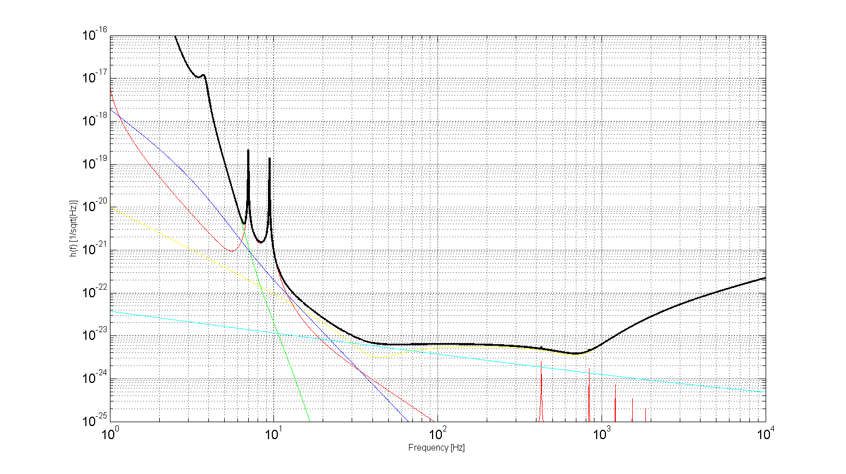
Target Sensitivity
10⁻¹⁶
Seismic
Newtonian
Seismic
Susp. Thermal
h(f) [1/sqrt(Hz)]
Quantum
Thermal
Quantum
Mirror thermal
3rd generation ideal target
10⁻²⁵
1 Hz
Frequency [Hz]
10 kHz

Slide 7
ET Design Study targets
The main targets of the DS are:
  understand if/how the target sensitivity is feasible in about one decade from now
  Define the main technologies needed to approach that sensitivity
  Define and design the infrastructures needed to realize a 3rd generation GW observatory
    Geometries, topologies
    Site(s) requirements

Slide 8
ET Organization
Site and infrastructure
Thermal noise of mirrors and suspensions / cryogenics
Optical configuration
Astrophysics issues
Management
WP1
WP2
WP3
WP4
WP5
J. v.d. Brand
F. Ricci
A. Freise
B. S. Sathyaprakash
J. Colas
M. Punturo
H. Lück

Slide 9
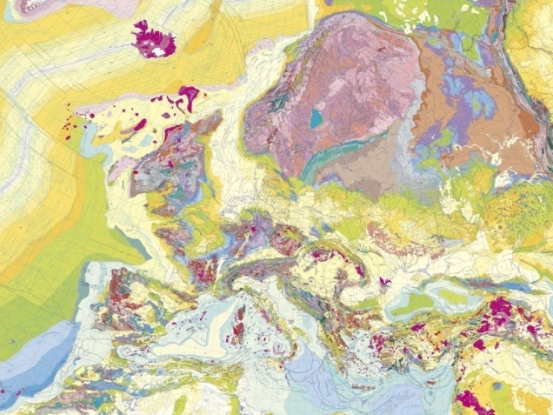
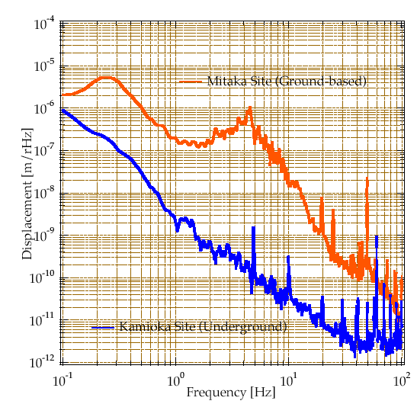
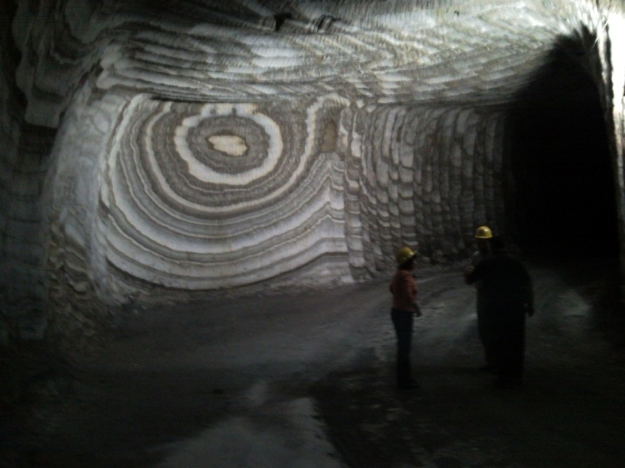
WP1: Site and infrastructures
Credit: K.Kuroda
To approach the target sensitivity we need a giant interferometer (~10km)
Located underground in some “quiet” region
Capable to accommodate cryogenic apparatuses
Capable to accommodate long seismic filtering suspensions

Slide 10

WP2: Suspensions & Thermal noise
An improvement of the sensitivity in the low & intermediate frequency range requires to
  Reduce the thermal noise of the suspension system and of the optics
    Cryogenics
    New materials for substrates and coatings
    New coating-less approach?
  Further filter the residual seismic noise approaching the 1 Hz “wall”

Slide 11
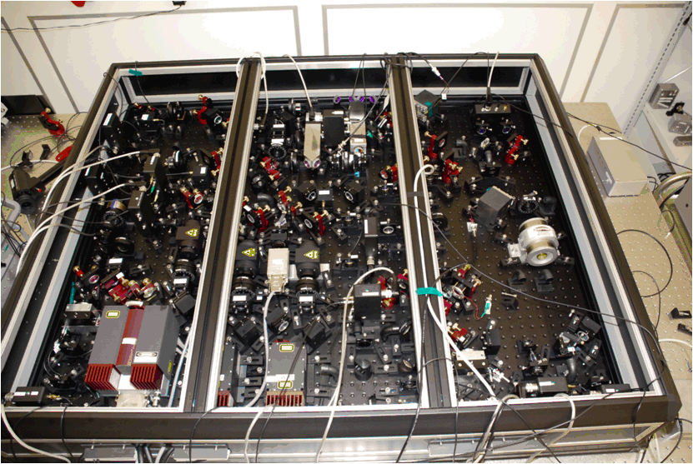
WP3: Optics, Geometries, Topologies
Reduction of the high frequency noises will require new high power lasers, probably new wavelength
Squeezing
New interferometer topologies (Michelson, Sagnac?)
Is still the L shaped geometry the right solution?
Do we need new beam geometries?

Slide 12
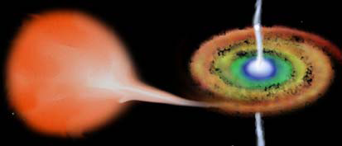

WP4: Astrophysics issues
Build and update the ET science case
Investigate the synergies with space based GW detectors (LISA, …)
Manage the multi-messenger aspects of a 3rd generation GW observatory

Slide 13
WP5: Management
ET management is well beyond the “simple” administration, but it is a coordination tool to arrive to the realization of the 3rd generation of GW observatories in Europe
ET design study is a milestone in a long path started with the first proposal to Europe:
  EGO (FP6), 2004 (unsuccessful)
  ILIAS (FP6), 2004-2009 (successful)

Slide 14
ET: current status
ET design study (FP7) started in May 2008 and will finish in June 2011
  The first intermediate report is due to the EC in December
  The final conceptual design in July 2011
ET is successfully involving scientists well beyond the 8 “beneficiaries”
Participant no. | Participant organization name | Country
1 | European Gravitational Observatory | Italy-France
2 | Istituto Nazionale di Fisica Nucleare | Italy
3 | Max-Planck-Gesellschaft | Germany
4 | Centre National de la Recherche Scientifique | France
5 | University of Birmingham | United Kingdom
6 | University of Glasgow | United Kingdom
7 | NIKHEF | The Netherlands
8 | Cardiff University | United Kingdom

Slide 15
ET science Team
The richness of ET is the open structure (Science Team) we adopted in the proposing phase
    any scientist interested to the ET science & technology can participate to the ET activities and receive a (limited) support
    Currently there are 219 subscribers

Slide 16
ET Status: fellowships
ET-DS is also supporting directly the beneficiaries with fellowships and contracts

Slide 17
ET future perspectives
It is by far obvious that the largest and priority effort is the realization of the advanced detectors
The requirement for the realization of a 3rd generation GW observatory is the first detection in the advanced detectors
  > 2016-2017 ?
It is clear that it will be very difficult to have a serious support from national funding institutions before that event
We must preserve the current investment and “play the game” with different tools
  “European Strategy”

Slide 18
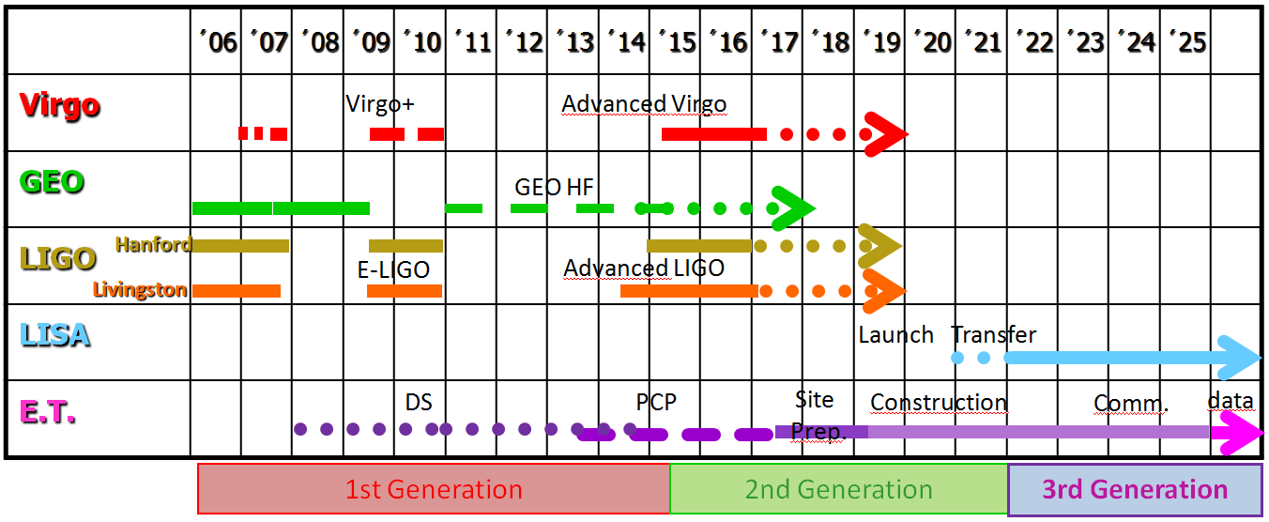

“European Strategy”
ET
Design
What next?

Slide 19
Typical evolution of a RI
To realize an European “Research Infrastructure” the typical path is reported in the following scheme
  The inclusion in the ESFRI roadmap is mandatory
    The next step after the DS is the “preparatory phase”
European Strategy Forum
on Research Infrastructures

Slide 20
Roadmaps
The target is to enter in the ESFRI roadmap
  Quite “stable” now, saturated by the selected projects
  Update call just now for Energy and Food, Agriculture and Fisheries, Biotechnology
Intermediate steps are the presence in the
  National Roadmaps
    Status to be discussed at the Round Table
  ASPERA roadmap
    We are one of the “Magnificent 7”, but it is not enough
  GWIC roadmap
    Role in the EU strategy to be understood
  OECD Global Science Forum roadmap?

Slide 21
“European Strategy”
ET
Design
How to fill the gap?
No PCP phase for ET before the end of FP7
End FP7
FP8 still in the fog

Slide 22


“EU Strategy: fill the gap”
ET
Design
ILIAS-next
GOST ?

Slide 23
ILIAS next
EU call (Top-Down):
  INFRA-2010-1.1.34: Research Infrastructures for dark matter search, neutrinos, gravitational waves.
    A project under this topic should aim at integrating the key deep underground laboratories in Europe, for dark matter search, double beta decay, low energy neutrino physics, long-baseline neutrino beam experiments, and gravitational wave physics, including theory.
GW weights (now) about the 20% of the proposed budget
  Networking activities to maintain the coordination focused on ET
  Small R&D activities to co-support the development of technologies ET-related

Slide 24
“EU Strategy: fill the gap”
ET
Design
ET
Prep. phase
?
ILIAS-next
GOST ?
FP7
FP8 ?

Slide 25
Next steps
Complete the design study duties
  Report in December
  Need to form NOW a team of people working full time on the design study document production, analyzing all the solutions proposed in the WP activities and realizing an homogeneous design
    Voluntary and involuntary candidate will be selected and contacted during this meeting
  Decisions about fundamental geometries and requirements are needed “now”

Slide 26
… Next steps
Priority items:
  Define basic infrastructures and their rough cost
  Define site characteristics and produce a list of candidates
    Completely new optimal site with respect to partially existing infrastructures?
  Define main technologies and needed R&D
    ILIAS next
    ASPERA-2 R&D call?
    National funds
  Realize the design study document
Increase the outreaching activity of ET to prepare the approach to the national ESFRI delegates and to the national funding agencies

Slide 27
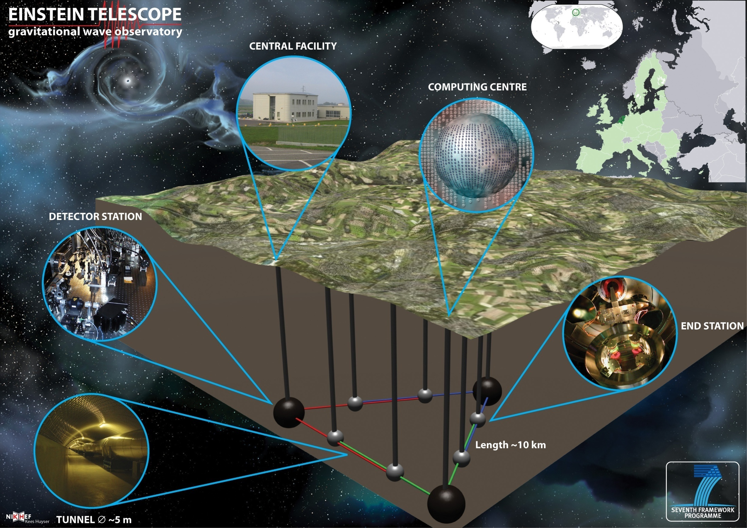
Have a nice meeting

