Slide 1
Present Superattenuator performance vs. ET Requirements S.Braccini – VIRGO for WG2 group

Slide 2
1) Seismic Noise Attenuation
2) Control Noise Reduction

Slide 3
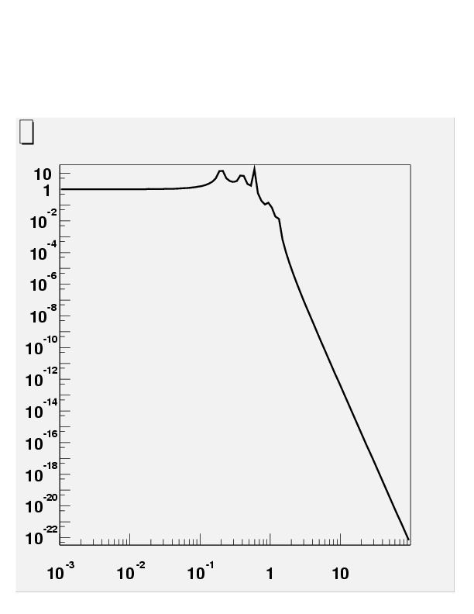
Ground
2 Hz
Resonances
Transmission
f^{-2N}
Frequency (Hz)
Long Pendula
Soft Springs
Mirror
3

Slide 4
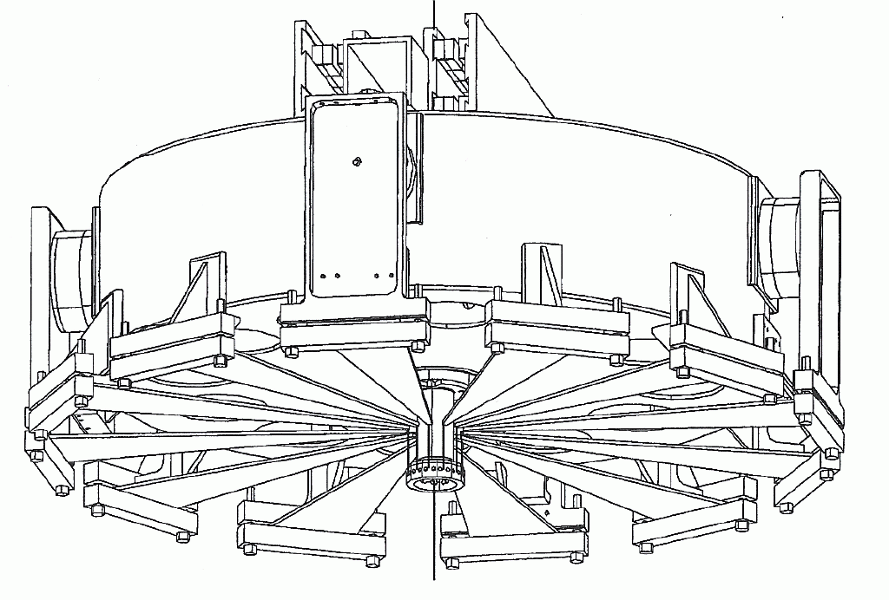
Superattenuator
Magnetic
Antisprings
8 m
Blade Springs
4

Slide 5
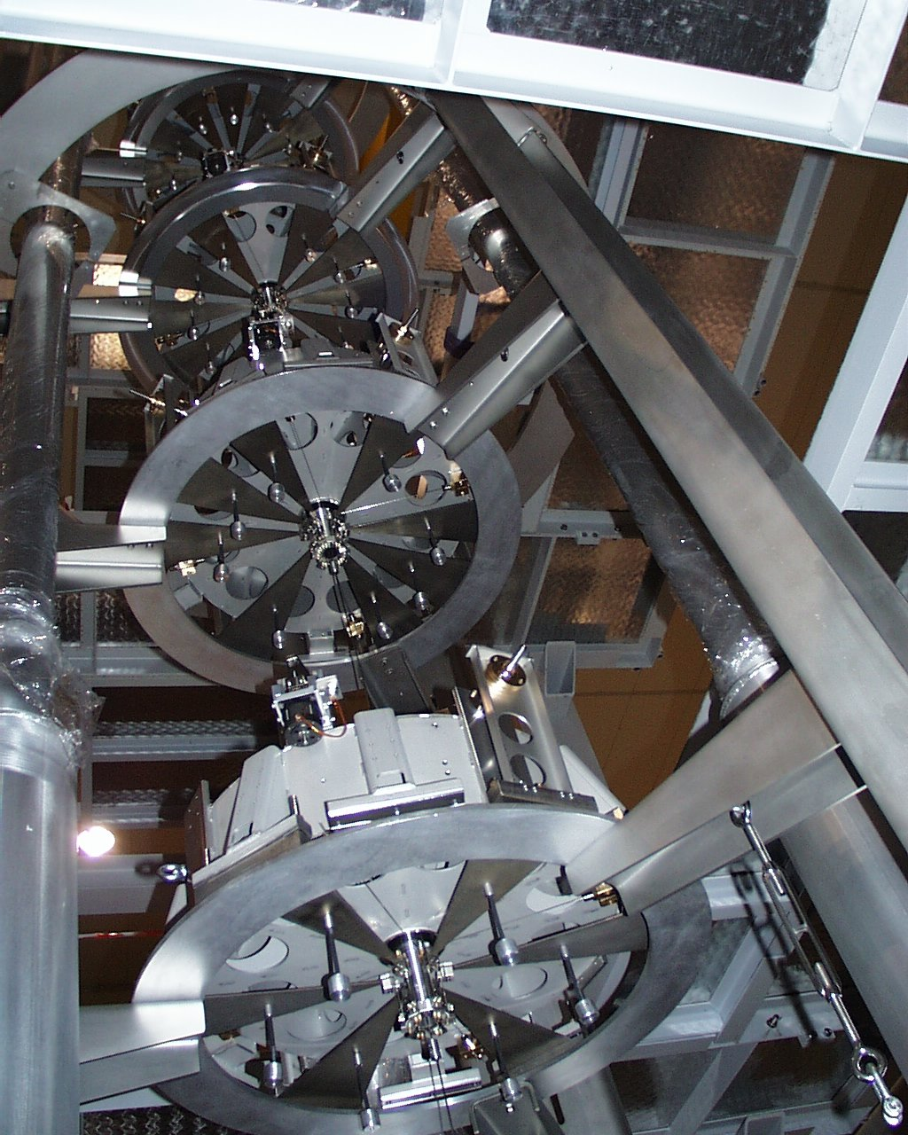
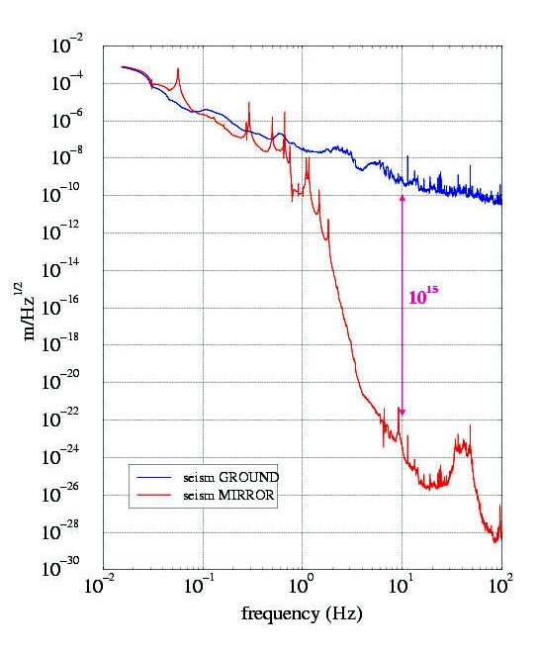
Transfer Function Indirect Measurement
Thermal Noise
Ground Seismic Noise
Mirror Residual Seismic Noise
5

Slide 6
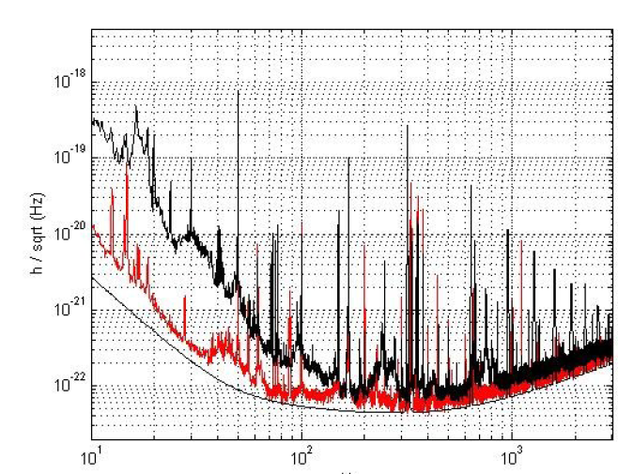
Scientific Run 1 → Scientific Run 2

Slide 7
What are seismic isolation requirements in ET?

Slide 8
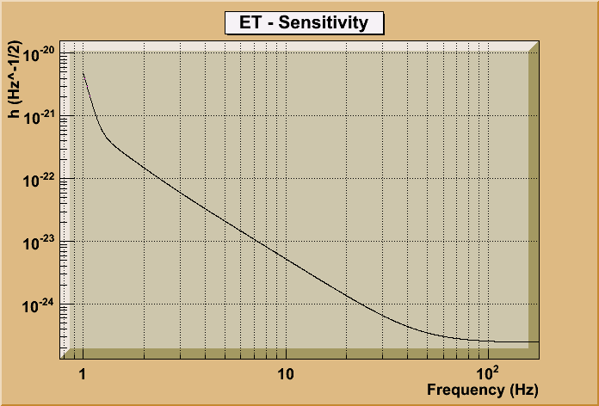
Notes:
Spiegare in dettagli in modo didattico e aggiungere slide vecchie

Slide 9
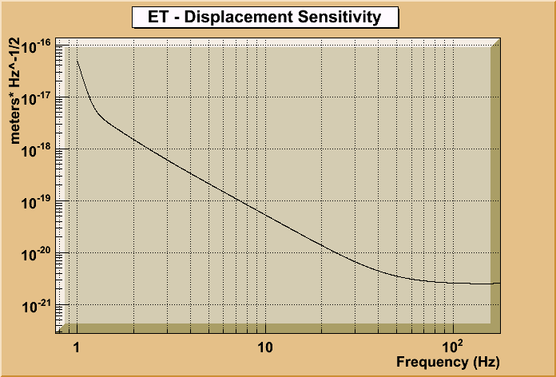
ΔL(f) = h(f) x 10000
Notes:
Spiegare in dettagli in modo didattico e aggiungere slide vecchie

Slide 10
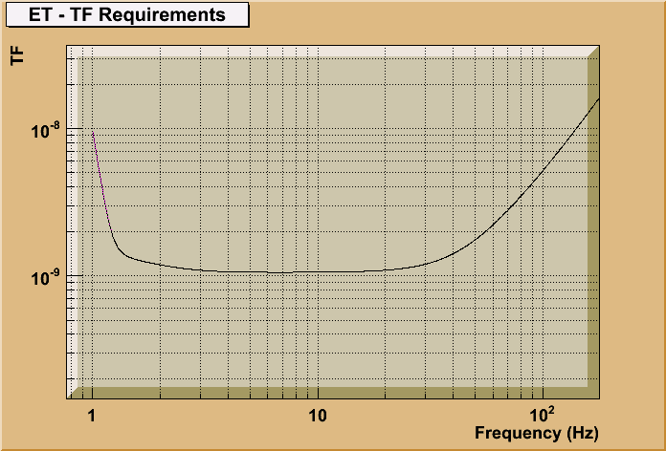
TF_{max} = ΔL(f) / (LSD Underground Seismic Noise)
LSD Ground Seismic Noise (Kamioka) - 5 x 10 ⁻⁹/ f ²
(Dusel Mine better)
Notes:
Spiegare in dettagli in modo didattico e aggiungere slide vecchie

Slide 11
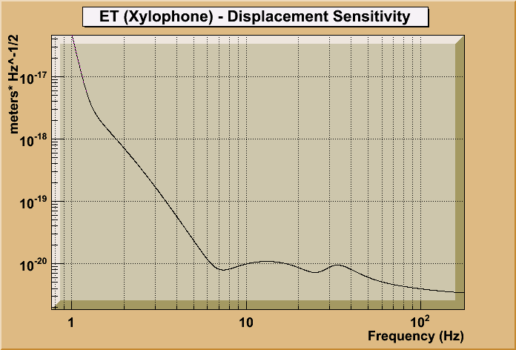
Same Exercise for ET-Xylophone sensitivity
Notes:
Spiegare in dettagli in modo didattico e aggiungere slide vecchie

Slide 12
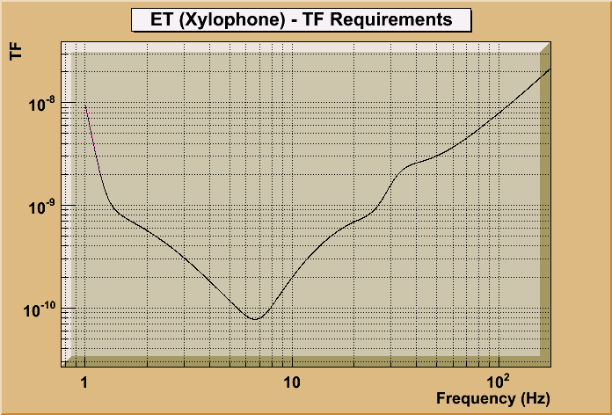
TF_{max} = ΔL(f) /(LSD Ground Seismic Noise)
LSD Ground Seismic Noise (Kamioka) - 5 x 10 ⁻⁹/ f ²
Notes:
Spiegare in dettagli in modo didattico e aggiungere slide vecchie

Slide 13
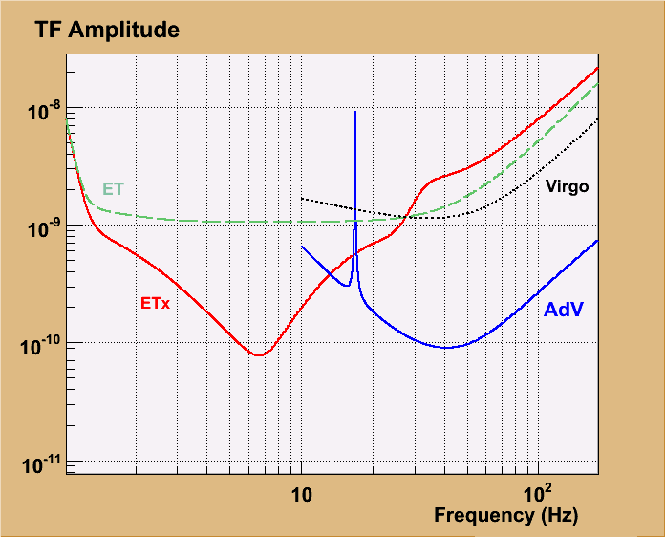
TRANSFER FUNCTION REQUIREMENTS

Slide 14
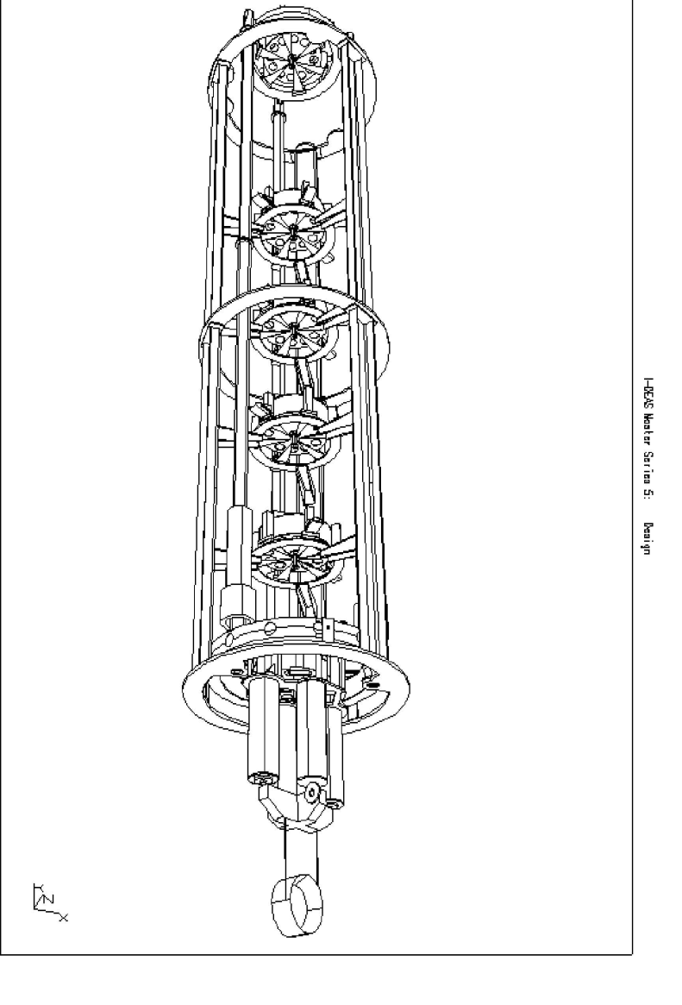
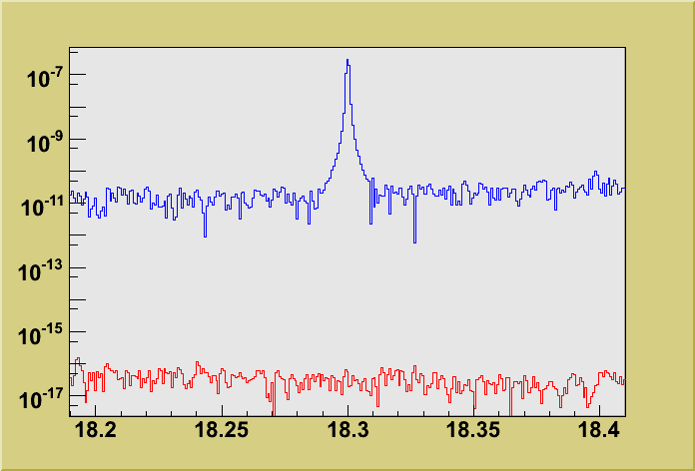
Transfer Function < 10⁻¹⁰
SA design
e freccette
Displacement (m .Hz^{-1/2})
Top
Mirror
frequency (Hz)
14

Slide 15
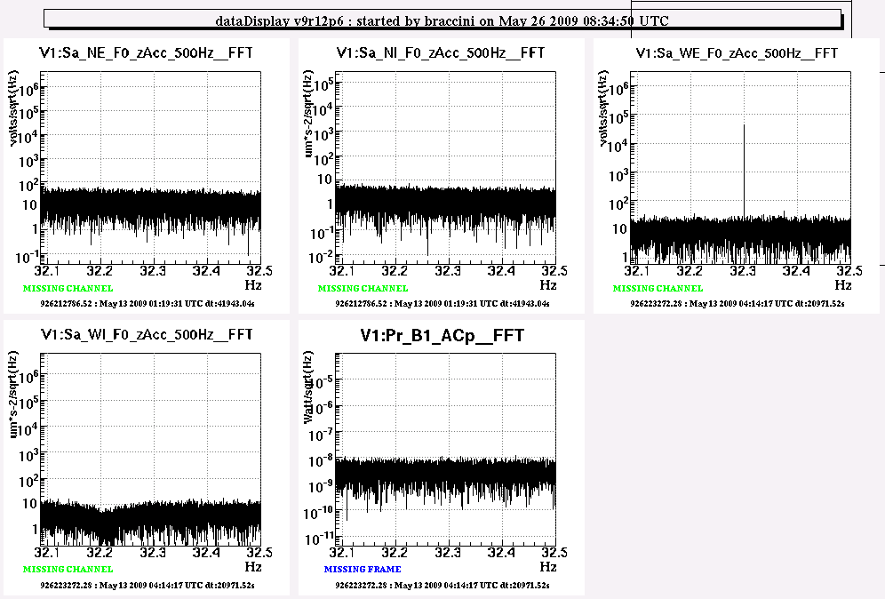
TOP
1.2 x 10⁻⁶ m Hz^{-1/2}
TF < 1.7 x 10⁻¹²
MIRROR
Stressed
Measurement
T = 41943 s
High Sens Range
2 x 10⁻¹⁸ m Hz^{-1/2}
15

Slide 16
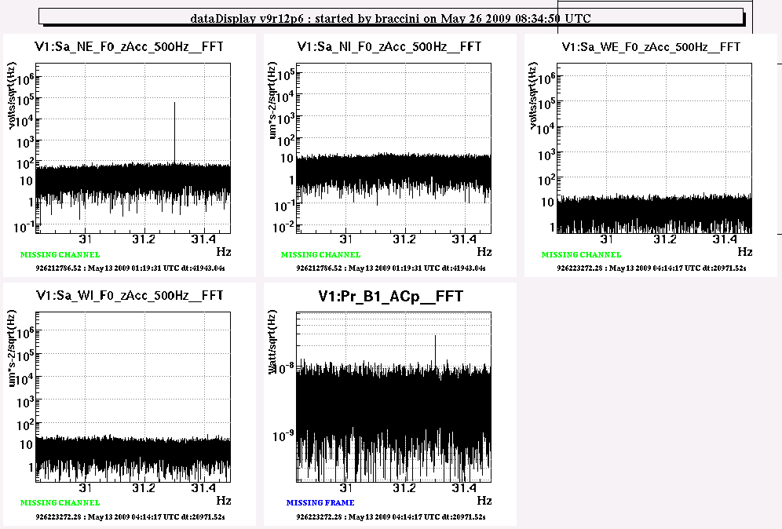
TF = 1.26 x 10⁻¹¹
!
!
16

Slide 17
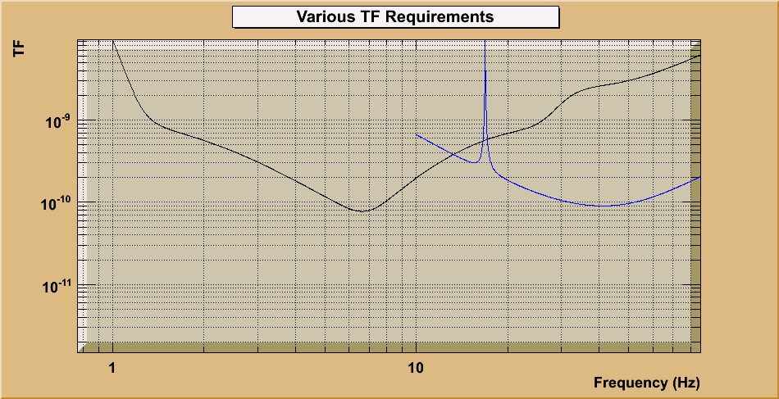
AdV
ET-Xylophone
1.26 x 10⁻¹¹
+ Pre-Isolator
17

Slide 18
SA design
e freccette
SA design
e freccette
Possible Bypass
X-Excitation
Experiment
18

Slide 19
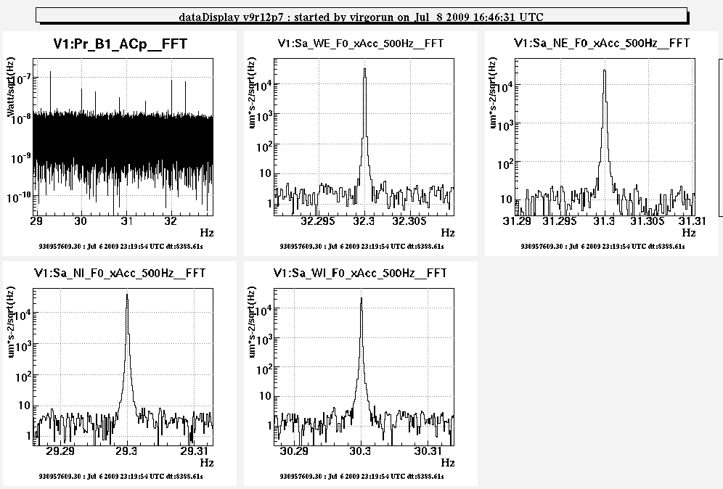
X - Excitation Results
Bypass
Indication ?
19

Slide 20
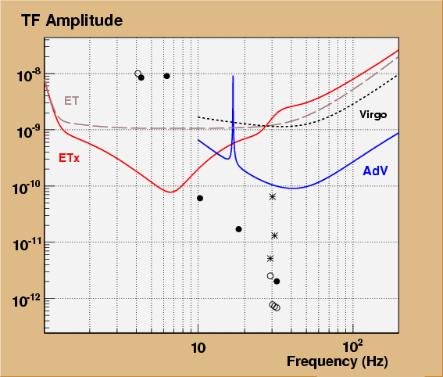
Preisolator provides
a safety margin

Slide 21
… and guarantees to cover
the upper limit gap in ET

Slide 22
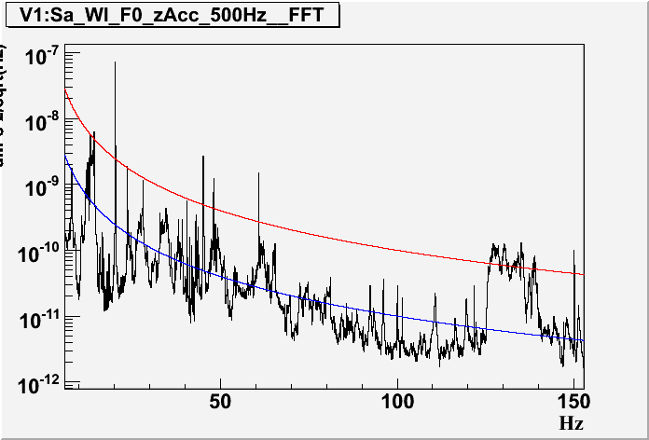
Pay attention to top stage resonances
F.Frasconi talk
3 x 10⁻⁶ m/Hz^{1/2}

Slide 23
Where is the cross-over ?
23

Slide 24
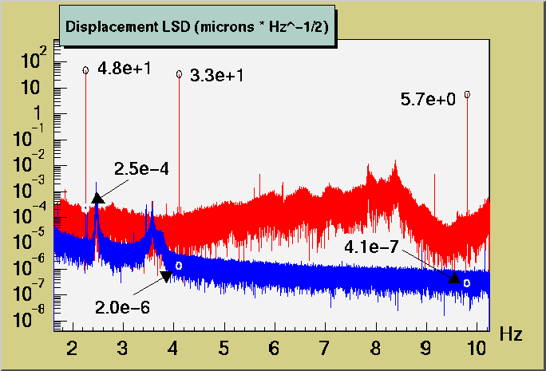
HORIZONTAL
@ 2.25 Hz
5 ⋅10e-6
Remarkable Attenuation also at 2.25 Hz
(but likely not enough)
24

Slide 25
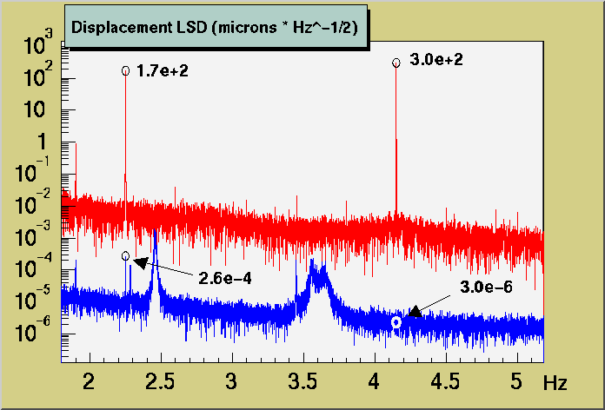
VERTICAL
@ 2.25 Hz
1.5 ⋅10e-6
Remarkable Attenuation also at 2.25 Hz
(but likely not enough)
25

Slide 26
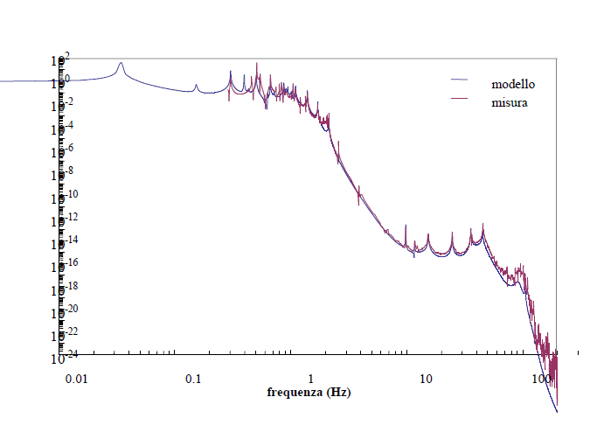
Stage by Stage Measurement (and Model)
TF
Model
No
Meas.
10⁻⁶
10⁻⁸
Maybe
10⁻¹⁰
Yes
2
3
4
f
26

Slide 27
PART 1 - Conclusions
SA attenuation compliant with Adv
…..enough also for ET but only above 3 Hz
(ET Note 25-09)
F.Frasconi
UPGRADES
Top Stage Resonances
DESIGN STUDY
Cross-Over Reduction

Slide 28
1) Seismic Noise Attenuation
2) Control Noise Reduction

Slide 29
several microns
swing
29

Slide 30
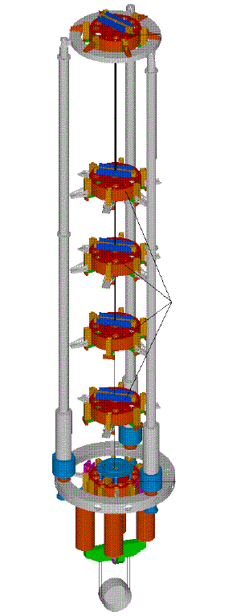
M
30 mHz
g
Flex Joint
30

Slide 31
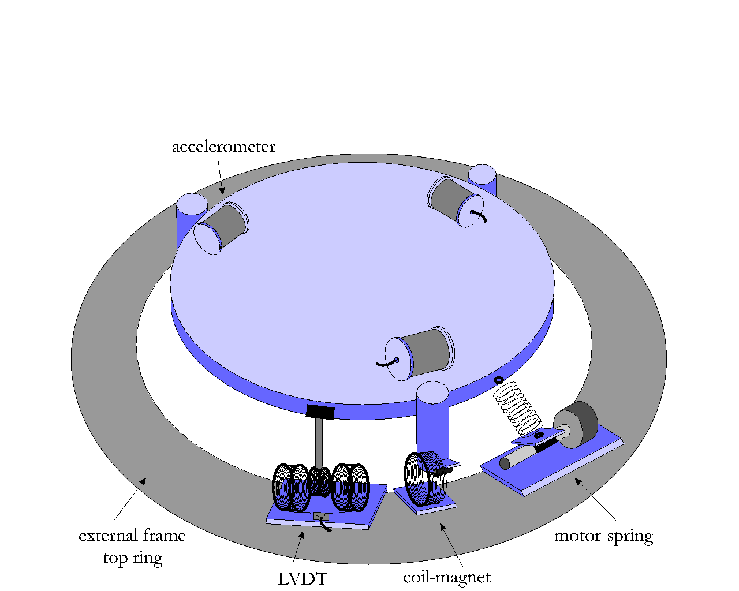
Accelerometers
Actuators
ADC
DSP
DAC
31

Slide 32
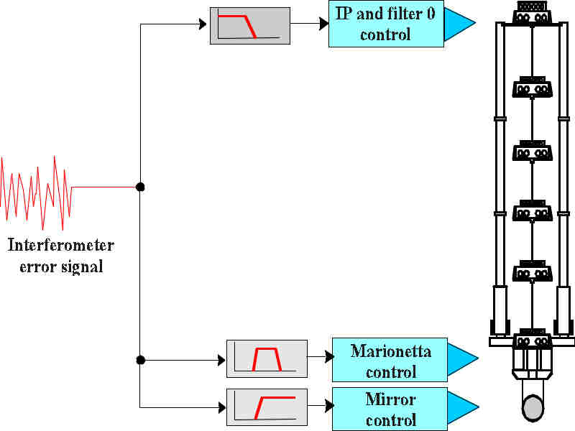
Hierarchical Control
RESIDUAL SWING < 0.1 μm !
32

Slide 33
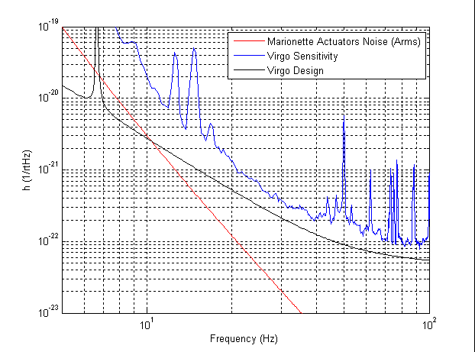
Direct Measurement on the ITF !
Present
Control
Noise
VIRGO
A.Gennai (VIR 029-A09)
33

Slide 34
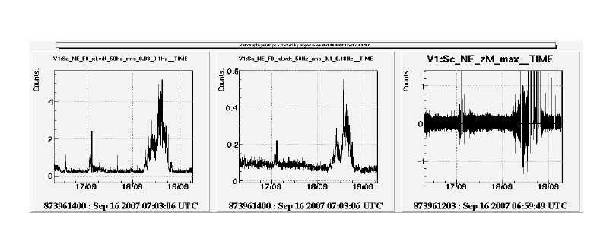
The tilt problem
MIRROR ACTUATION
WIND
SEA
34

Slide 35
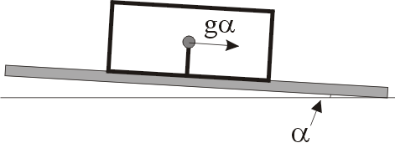
The tilt problem
F.Frasconi
Tilt
Control
35

Slide 36
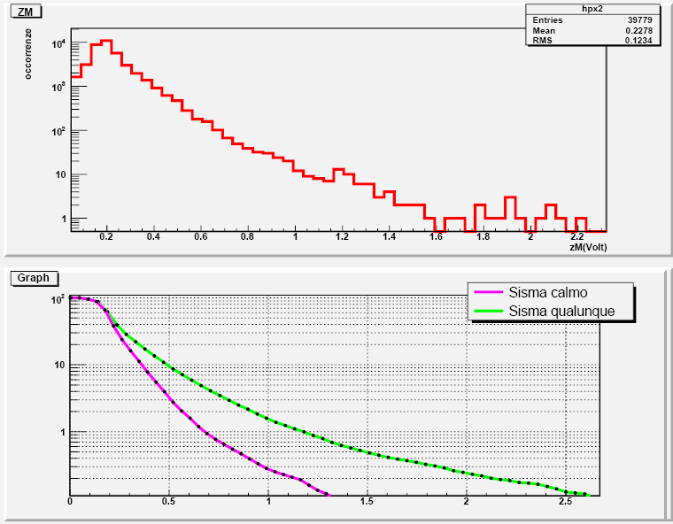
Noise Reduction
by a factor
4-5 (Wind)
7-8 (Calm)
Available
Distribution (VSR1)
Integral (VSR1)
Any
Calm
WE ARE USING ONLY
A PART OF THE DAC RANGE !
36

Slide 37
Reduction factor
4-5 Wind (5%)
7-8 Calm (95%)
Wind
Calm
AdV
Direct Meas. Now
Compliant for AdV but noisy for ET !
37

Slide 38
Present performance
on 10 km
Notes:
Spiegare in dettagli in modo didattico e aggiungere slide vecchie

Slide 39
What can we do ?
1) New DAC board (factor 5-10)
2) Additional Hierarchical control
3) More mirror actions
4) Filter Enhancements
………………………………
Notes:
Spiegare in dettagli in modo didattico e aggiungere slide vecchie

Slide 40
PART 2 - Conclusions
Payload swing chilled to “minimal values”
The frontier is to operate a silent payload control

Slide 41
General Remarks
1) Attenuation OK above 3 Hz → Cross-over reduction
2) Payload swing close to minimum (Damping + Hierarchical)
3) Actuation noise OK for AdV but dominant in ET
Short-Term upgrade (SAFE): New Pre-Isolators + Tilt control
Control Noise Reduction Strategy: DAC, …hierarchy, …
41

