Slide 1
SuspensionThermal noise limit
on the ET sensitivity curve
Outline
The last stage suspension of the ET interferometer;
The model for the thermal noise;
Parameters for the LSS in ET;
Numerical evaluations and comparison with the ET goal curve
Conclusions.
P. Puppo INFN Roma, Italy paola.puppo@roma1.infn.it
WG2-ET General –Erice –October 15th 2009

Slide 2
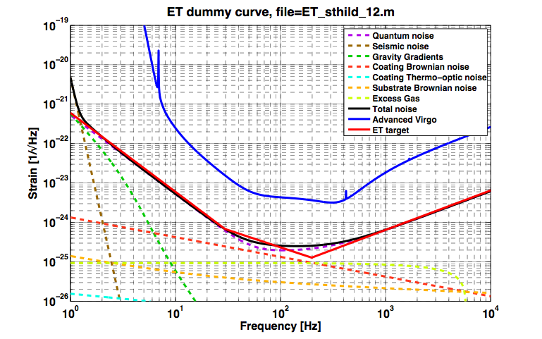
Cryogenic 3° Generation GW detector
Suspension Thermal Noise
---MirrorsThermal(Low T)
Suspensions Thermal (Low T, monolithic)
---Readout (High P, Bigmasses)
---Newtonian (go underground)
big massmirrors,
monolithicsuspensions
low T
High P_{cavity}(>1MW)
From S. Hild et al. http://arxiv.org/abs/0810.0604
WG2-ET General –Erice –October 15th 2009

Slide 3
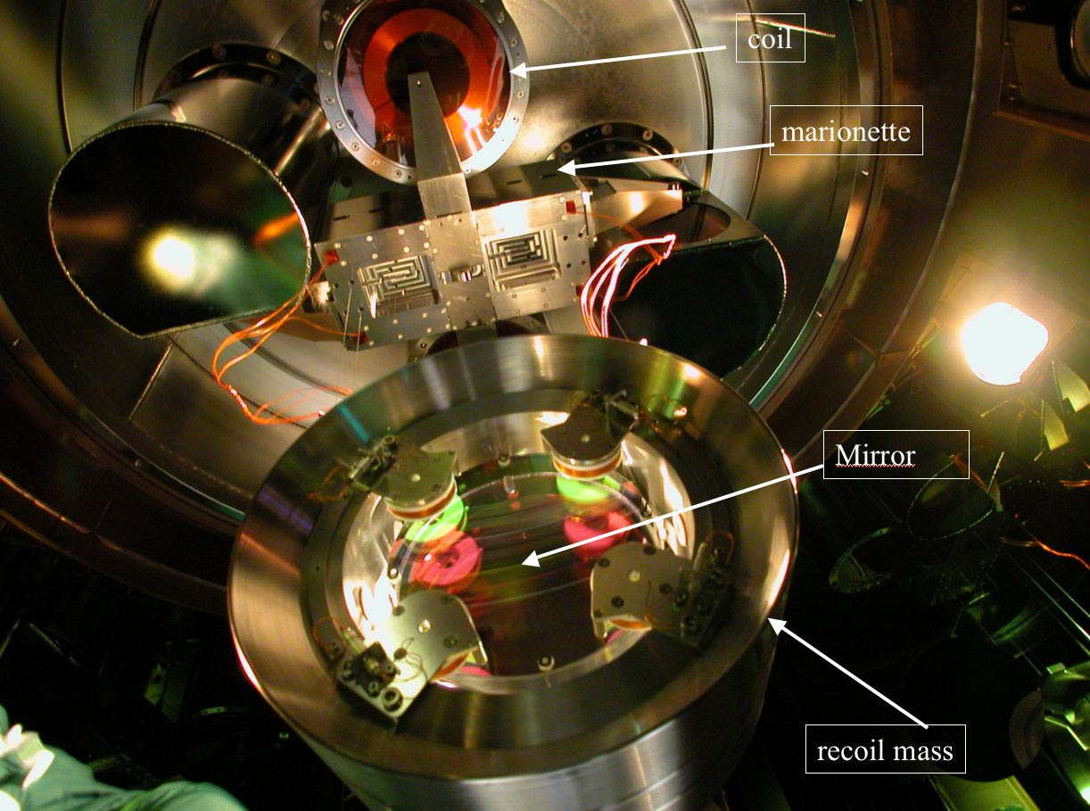
The mirror last stage suspension
The role of the Last Stage Suspension is to compensate the residual seismic noise and to steer the optical components maintaining the relative position of the interferometer mirrors.
Components and roles:
Marionette: Mirror control with actuators (coil-magnets, electrostatic) between the upper suspension stage and marionette;
Reaction Mass (RM): Mirror steering with (coil-magnets, electrostatic) actuator between RM and mirror; Mirror protection;
Mirror: monolithic silicon suspension.
Requirements:
Materials:
UHV compatible;
Amagnetic;
No electrostatic charges;
Internal Frequencies above the antenna bandwidth;
Low frequencies of the system below control bandwidth;
Compatibility with SuperAttenuator and lower part of the tower:
Weights
Shape
WG2-ET General –Erice –October 15th 2009

Slide 4
The ET mirror last stage suspension (Cryogenic)
Mirror and its suspension wires:
wires and mirror materials compatible with good mechanical and thermal properties;
High thermal conductivities materials;
Low mechanical and optical losses;
a promising material both as mirror substrate and wire is silicon having
high thermal conductivity
very low thermal expansion (zero below 17K)
WG2-ET General –Erice –October 15th 2009

Slide 5
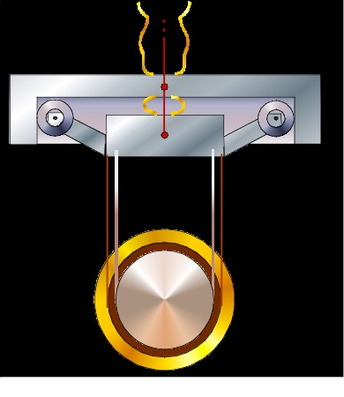
Conceptual scheme
Q from refrigerator
Vacuum Chamber and Cryostat Thermal Shields
Marionetta Reaction Mass:
Thermal Shield
High Efficiency Soft Thermal Links
(e.g. pure Al, copper)
Silicon Monolithic Suspension
Mirror Reaction Mass:
Thermal Shield
Q from laser beam
WG2-ET General –Erice –October 15th 2009

Slide 6
Big Masses: M_{mirror}= 150 kg,
M_{rm} = 150 kg(to have a proper recoil mass action)
M_{mario}= 400 kg (to reduce the marionette recoil)
High Power on the mirror: P_{laser}= 500 W
Arm Power: P_{FP} = 3 MW
Power on coating and substrate P_{abs} = 3 W
Going at cryogenic temperature: thermal noises reduced
Thermal lensing negligible
T? 20K is OK for silicon
can we do better? do we need that?
Refrigeration system: noiseless, reliable
a. PT coolers
b. cryogenic fluids
WG2-ET General –Erice –October 15th 2009

Slide 7
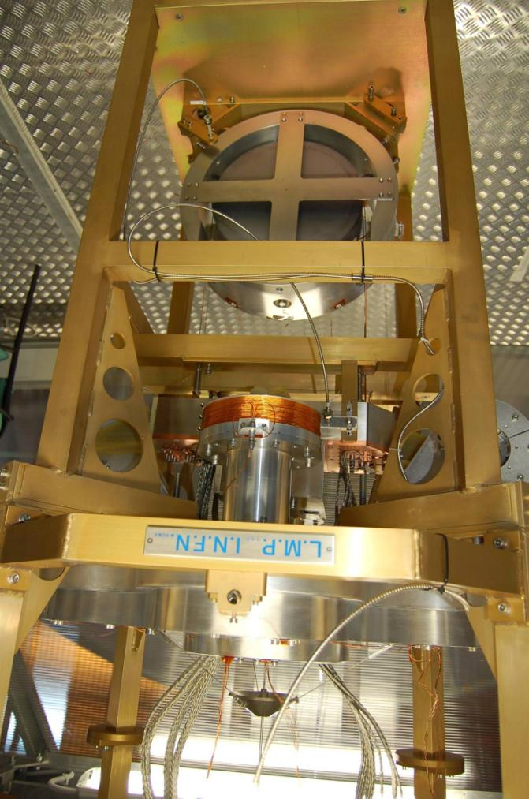
We can look some experimental facts The “cryo last stage”
Set-up:
Silicon mirror suspended by using two Be-Cu wires loops (1.25mmX2.5mm section);
Marionette with copper clamps,connected to the cooler by copper heat links, suspended with a titanium alloy cable;
Reaction mass of the mirror and marionette position monitored with fiber bundle sensors to measure the system modes (suspended with copper wires);
Reaction mass of the marionette holding the Virgo-like electromagnetic actuators (macor support, copper wire kapton insulated);
MRM suspended with three titanium wires;
WG2-ET General –Erice –October 15th 2009

Slide 8
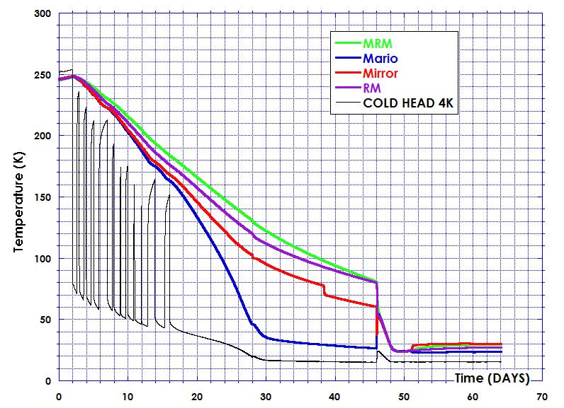
First Payload Cooling run (January 5th 2009)
During the cooling several times the PT cryo-coolers were stoppes, because of failure in the water refrigeration system of the compressors.
Helium gas filling
Helium gas pumped out
The final mirror temperature results to be 30 K while the cold head is at 15 K.

Slide 9
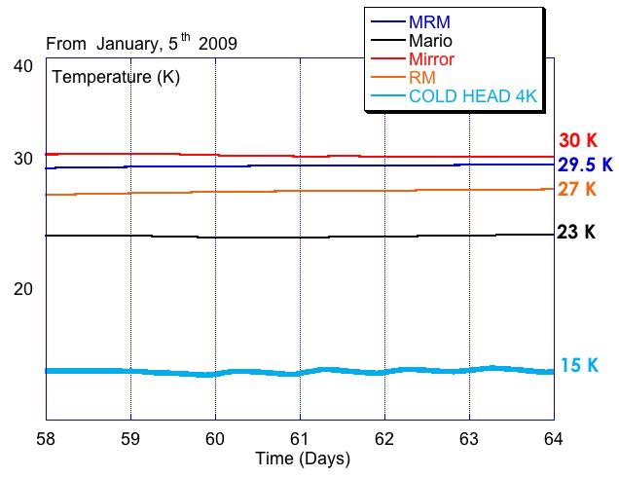
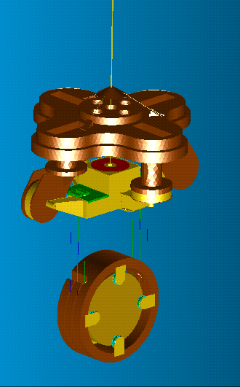
Thermal inputs Estimations
15 K
29.5 K
23 K
Mirror: 1.9 mW (CoBe3 wires)
Recoil Mass: 1 mW (Steel c70 wires)
Marionette: 6 mW (Ti6Al4 wires)
If there is a thermal input, in the steady state, the temperature is not homogenous
27 K
30 K
WG2-ET General –Erice –October 15th 2009

Slide 10
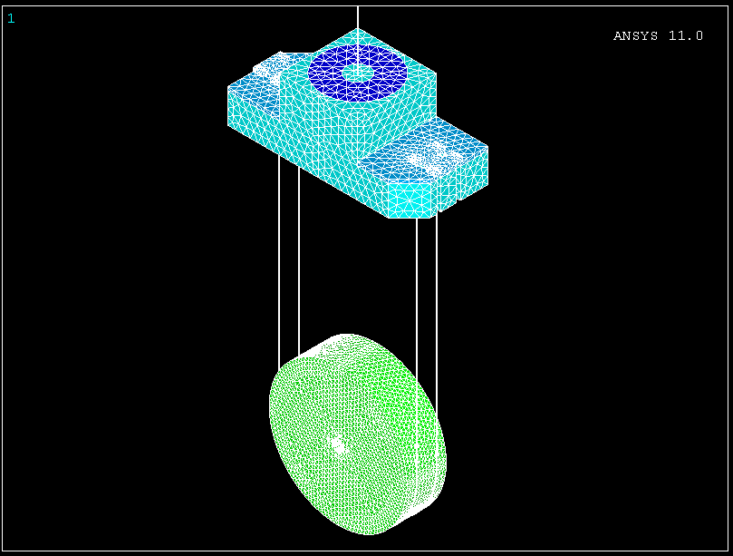
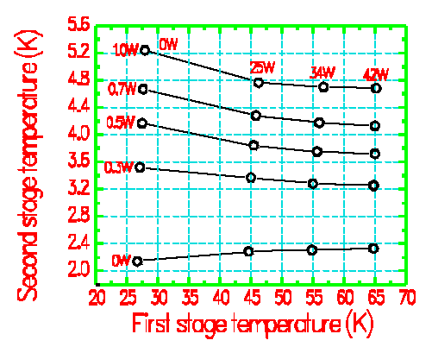
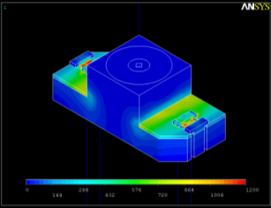
FEM thermal simulation
draw the expected equilibrium temperature when there is a laser light on the mirror
The model
Boundary Conditions
Cryocooler Second stage link to the marionetta
P_{cooler} depends on the temperature (Cryomec PT curve used)
with 2 coolers the extracted power at 5 K is 1 W
Laser power on the mirror
Gaussian beam
P_{abs}= 1W
P_{abs} = 100 mW by the mirror bulk
The power absorbed by the coating is dominant
The reaction masses are not present in the simulation;
Their screen effect is simulated by the surround system at 10K;
The marionetta arms are not present.
Copper and silicon thermal properties vs temperature are included in the simulation.
The mirror and marionette reaction mass will lengten the overall cooling time;
Starting point:
termalised system at 10 K
laser power on
surrounding system at 10K

Slide 11
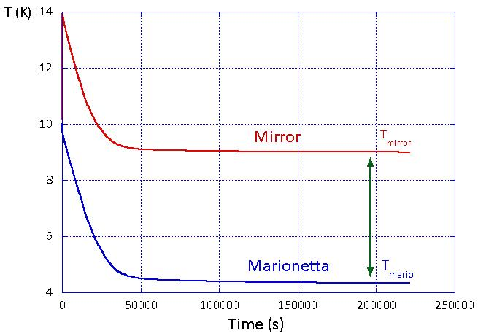
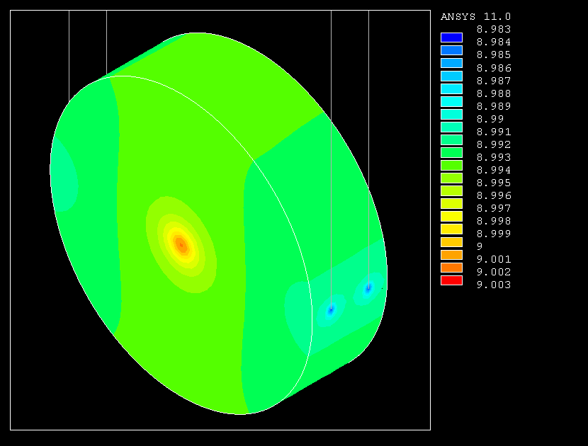
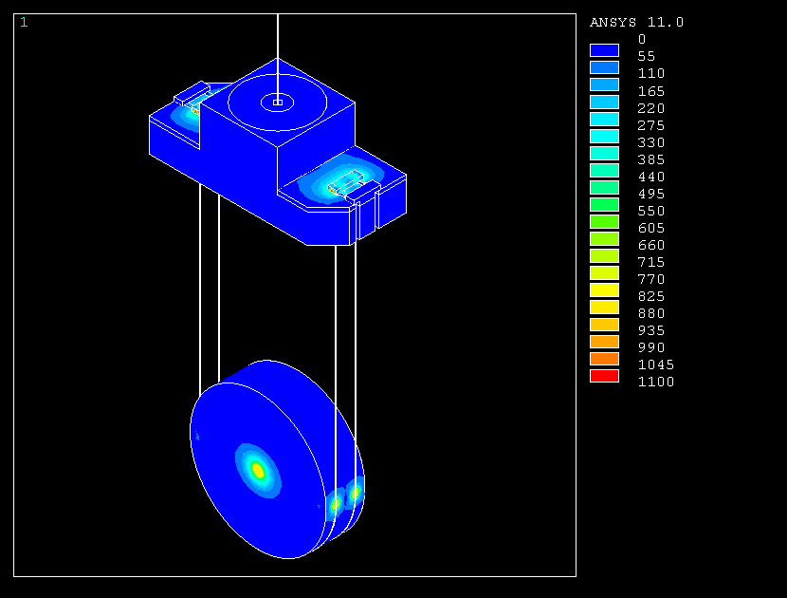
FEM thermalsimulation
Steady state Mirror temperature
The transient depend on the masses
involved
9 K
5K
For a wire diameter of 1.0 mm.
Thermal flux in the steady state

Slide 12
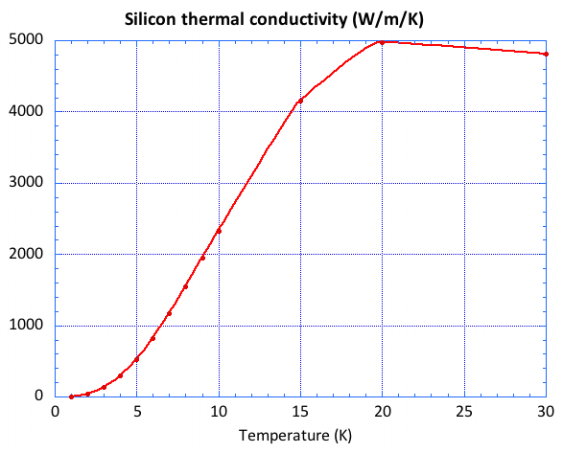
Thermal steady state
With liquid Helium
With PT cooler
To reach a temperature of 20K with a power of 3W on the mirror we need a silicon suspension wire with a diameter of 4.5 mm;
The temperature of the marionette stage can be 5 K or 2K depending on which kind of refrigeration system is used

Slide 13
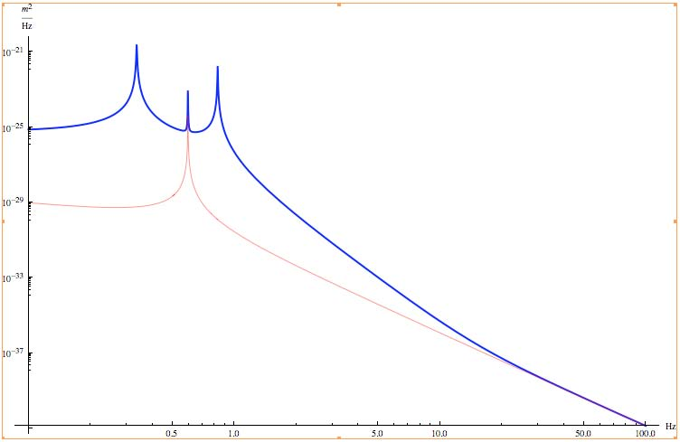
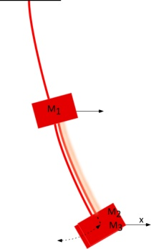
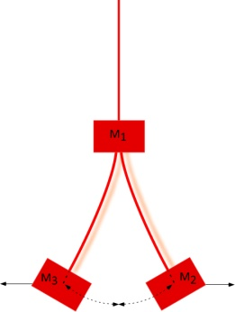
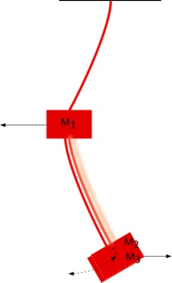
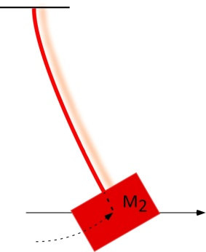
The suspension Thermal noise
In presence of low dissipative mirror suspensions, the contributions of the other last stage suspension elements to thermal noise of the mirror cannot be neglected.
A new thermal noise estimation must be done by including the viscous and internal dissipations of the marionette and recoil mass pendulum.
It turns out that the marionetta’s mechanical pendulum losses give a non negligible effect via its recoil, in the off-resonance high-freq. range.
Example: branched pendulum Virgo-like:
Upper pendulum 110 kg (Q=50) Recoil mass 50 kg (Q=10⁵) Mirror 21 kg (very low losses→ monolithic suspensions)
LLS pendulum model
Simple pendulum
[*] VIR-015C-09, F. Piergiovanni, M. Punturo and P. Puppo, The thermal noise of the Virgo+ and Virgo Advanced Last Stage Suspension (The PPP effect).

Slide 14
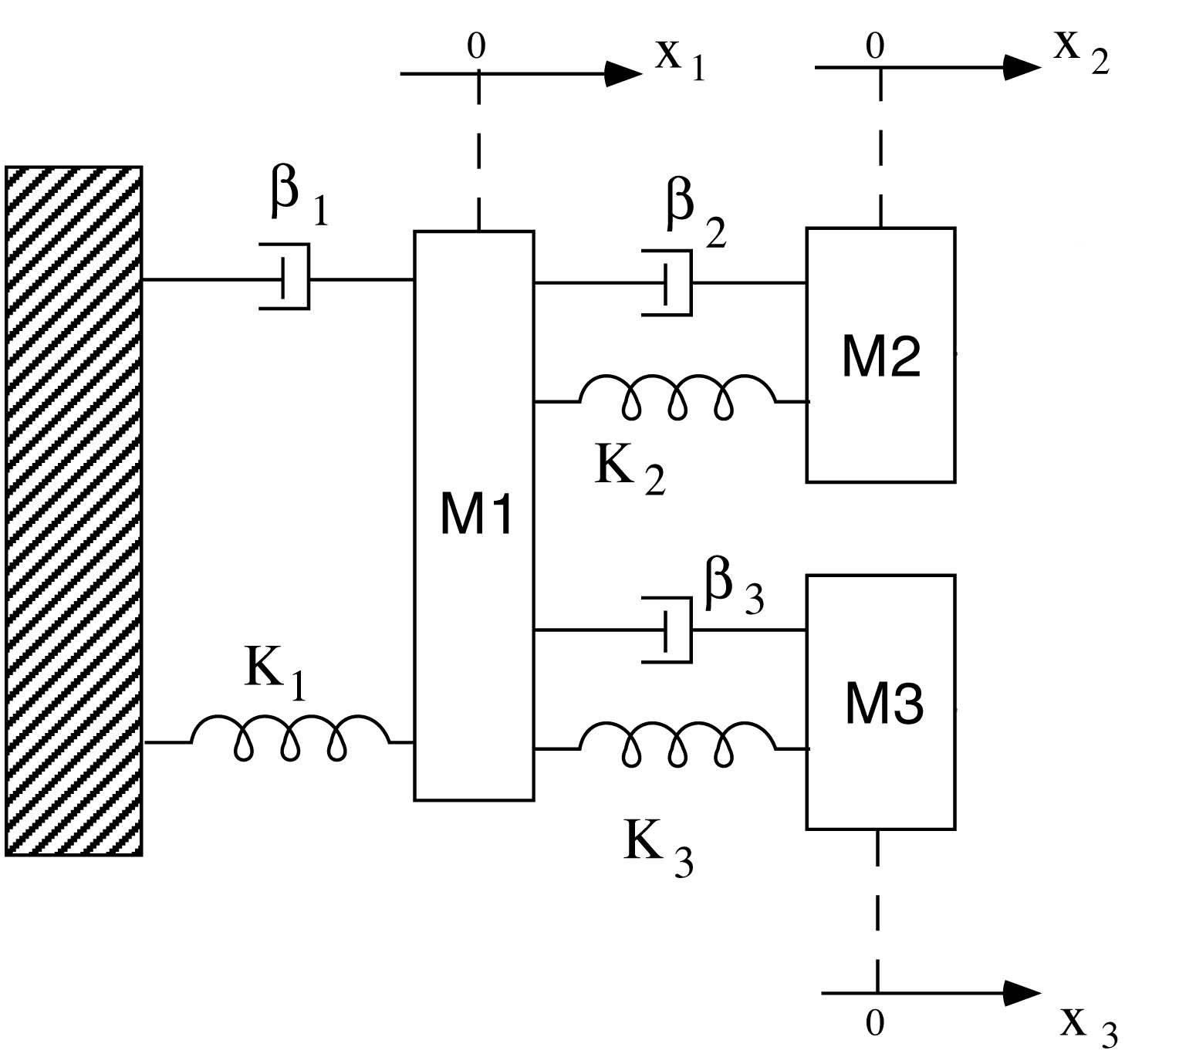
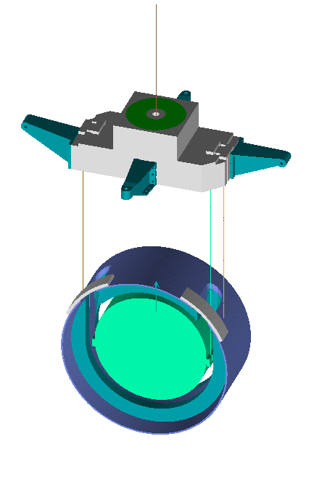
The mirror last stage suspension as a branched system
A Virgo-like last stage suspension is a cascade of three pendula. To the first pendulum (the marionette) the mirror and the recoil mass are hung as branches.
Equivalent to a branched combination of three harmonic oscillators [*]. This is true for
horizontal and vertical degrees of freedom.
M₁
θ₁
M₁
θ₂
θ₃
M₂
M₂
M₃
M₃
M₁marionette
M₂mirror
M₃recoil mass
[*] Bernardini A., Majorana E. ,Puppo P. ,Rapagnani P. , Ricci F., Testi G. "Suspension last stages for the mirrors of the Virgo interferometric gravitational wave antenna." Rev. Sci. Instr. 70, no. 8 (1999): 3463.

Slide 15
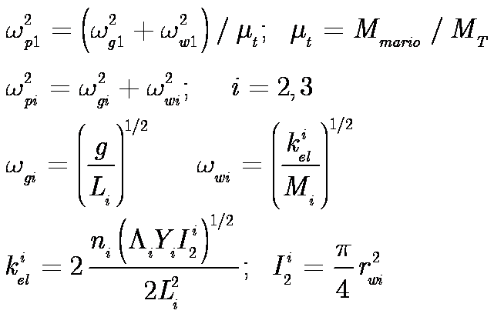
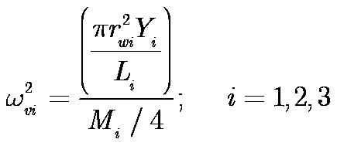
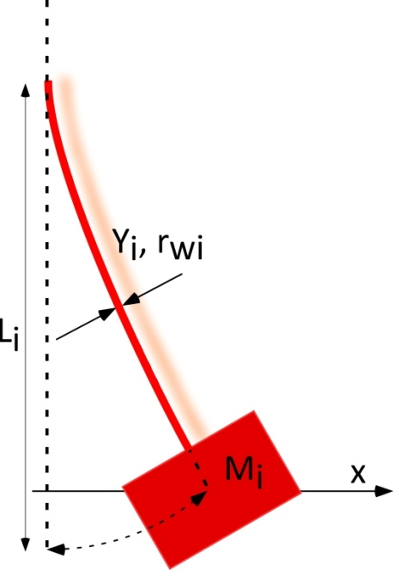
Lagrangian of the branched system
Pendulum frequencies
Vertical frequencies
Wire radius
Wire length
Young’s modulus
Wire load
Number of
suspension wires

Slide 16
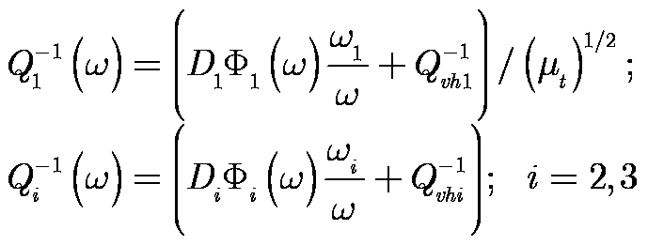
How dissipation is introduced
Dissipation function
Wires loss angle:
Intrinsic, thermoelastic and eccess losses
Q_{vhi}, Q_{vvi} viscous quality factors D_{i} pendulum dilution factors
Φ_{i}(w), Φ_{iv}(w) loss angles describing the structural losses of the suspension wires.

Slide 17
Thermal Noise models (PPP):
1. FDT model
Lagrange Equations
Generalized forces related to the uncoupled stochastic thermal forces
Equations of motion with thermal stochastic forces
Thermal noise of an element of the branched system via the FDT theorem
The impendance matrix Z(ω) contains the whole system mechanical behavior
The system is at temperature T
The thermal noise of each mass is influenced by the presence of the other masses

Slide 18
Thermal Noise models (PPP):
2. The normal modes treatment
Lagrange Equations
Normal Modes,Normal Frequencies
and normal masses
Independent thermal noise generators

Slide 19
ET suspensions parameters
Marionette: (Ti6Al4V wire)
d = 3 mm, Mass: 400 kg, L=2 m T=2 K
Mirror (silicon wire)
d = 5 mm, Mass: 150 kg, L=2 m T=20 K
Recoil Mass (silicon wire)
d = 3 mm, Mass: 150 kg L=2 m T=20 K
Modes: pendulum 0.28 Hz, 0.36 Hz, 0.60Hz
vertical 0.4 Hz (blades), 19 Hz, 36 Hz
violins 25 Hz, 52 Hz, 82 Hz, 120 Hz, 160 Hz, 207 Hz
Some Issues on:
Big Masses:
reduces the recoils (good for suspension thermal noise )
increases the violin modes (good for control)
BUT
reduces the vertical modes (not good for control)
look at the overall weight!!
Wires Length Increment
reduces the pendulum frequencies (good for suspension thermal noise )
BUT
reduces the violin modes (not good for control)
reduces the vertical modes (not good for control)
Wires Diameter Increment:
increment of the wire sections (good for cooling)
BUT
reduces the violin modes (not good for control)
reduces the dilution factor (not good for suspension thermal noise )

Slide 20
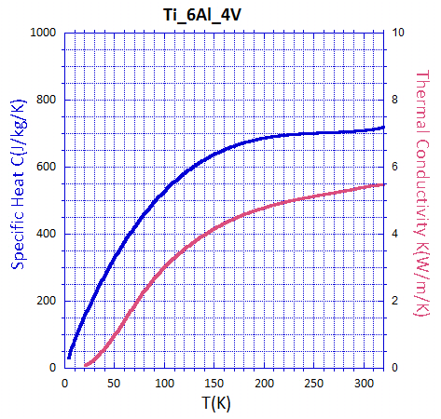
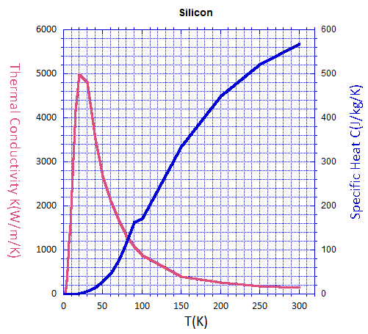
ET suspensions Materials
Ti6Al4V
Si

Slide 21
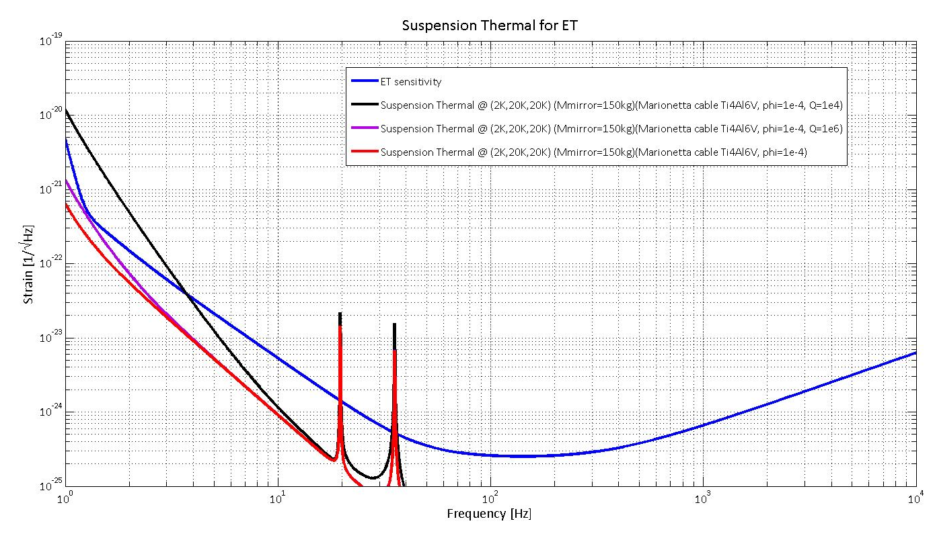
SuspensionThermal Noise
P. Puppo. Suspension Thermal Noise for ET. (ET – 023 – 09)

Slide 22
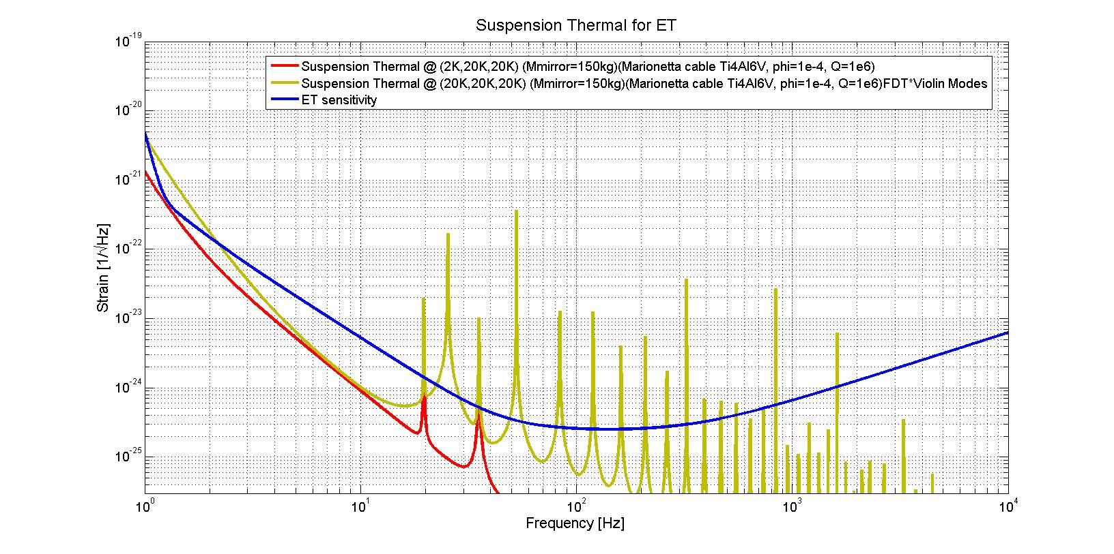
Suspension Thermal: comparison with FDT @ 20K + violin modes

Slide 23
Conclusions
The suspension thermal noise affects the sensitivity in the frequency range below 10 Hz;
Importance of the different temperatures of the pendulum stages in the computation of the thermal noise
The marionette stage thermal effect is very important
The thermal noise of violin modes is negligible (but look at the frequencies)
The presence of the Marionette RM is crucial
It acts as intermediate mass
The marionette suspension cable must be at 2 K, Marionette RM cooled
The modal expansion model is ready and can be included in the matlab gwinc program.

Slide 24
Materials Database
Definition of a standard data format
data format has been defined over the “Parameters and Constants used in the Advanced and Third Generations Interferometers noise calculations” document
DB is a common container that permits:
Simple query, looking for a specific material, e.g. on the base on the name
More complex query, aggregating materials following user search criteria and particular parameters requirements or constrains
It uses a standard query language: SQL (Simple Query Language)
Flexibility on output data organization and presentation
The system can be attached to a web frontend and interrogated remotely
The system is based on MySQL DBMS, Apache server and php

Slide 25
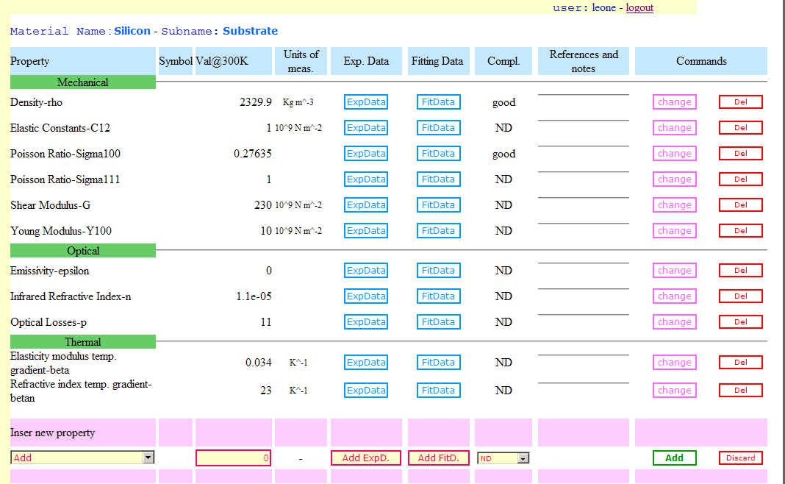
Materials Database http://virgo.pg.infn.it/MaterialDB/v1
Type of property
Operations
Properties
Table data type
Insertion

Slide 26
Materials Database
Some characteristics:
Materials properties can be expanded without limitations
During the insertion of material a sub set of properties can be used
Properties are automatically classified and visualized by typology
The data type can be also extended (In the current versionwe have implemented:value@300K, 2 table data, completeness, References and note)
For more information, the document about materials and DB is under develop and will be released soon.

