Slide 1
Recent progress at the Sanford and Realmonte Laboratories
Luca Naticchioni (Sapienza University of Rome - Italy),
Thomas O’Keefe (Saint Louis University),
Steven Dorsher, Jan Harms and Vuk Mandic (University of Minnesota),
David Rabeling, Mark Beker (Nikhef),
Riccardo DeSalvo (Caltech)
LIGO Document G0900xxx

Slide 2
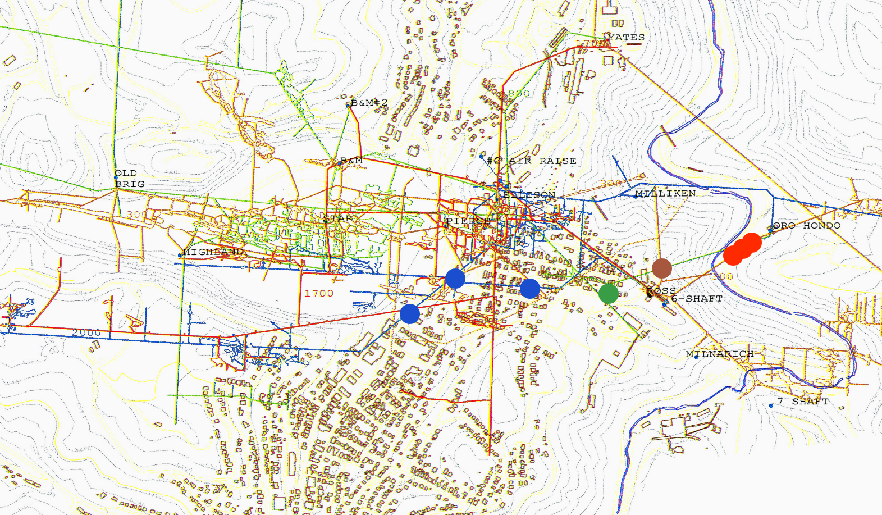
the Homestake seismic array
Homestake seismic array, September2009
90m
300 ft (91m)
4100 ft (1250m)
2000 ft (610m)
800 ft (244m)
350m

Slide 3
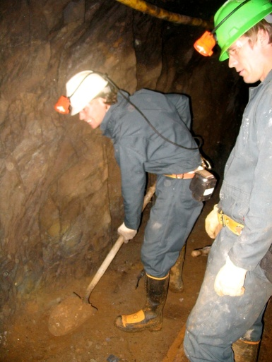
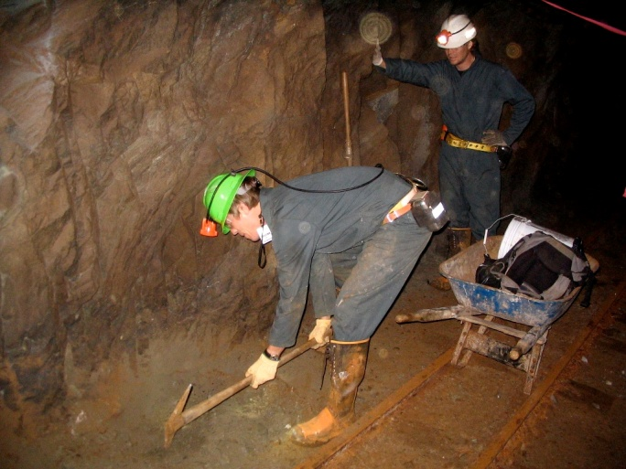
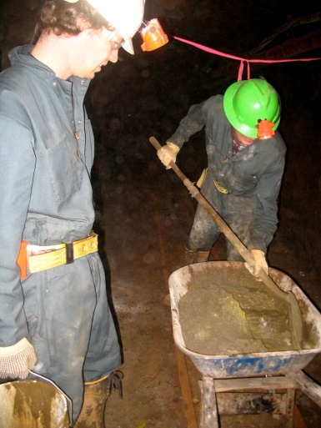
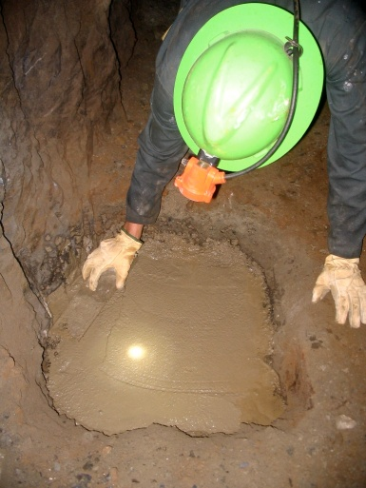
Preparing the sites… digging and concrete laying
- Dig and shovel loose rock and debris
- Sound the rocks to identify and remove rock fractures
- Build a concrete base well connected to the bedrock

Slide 4
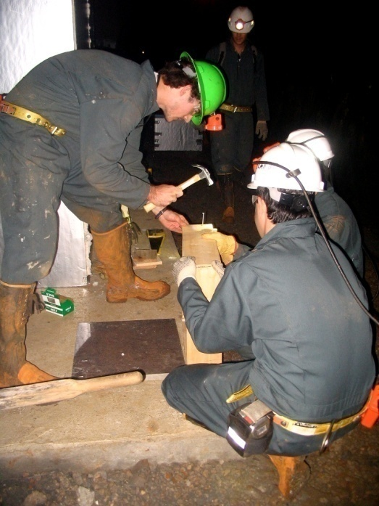
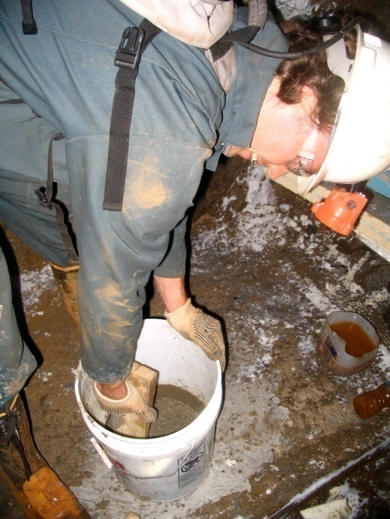
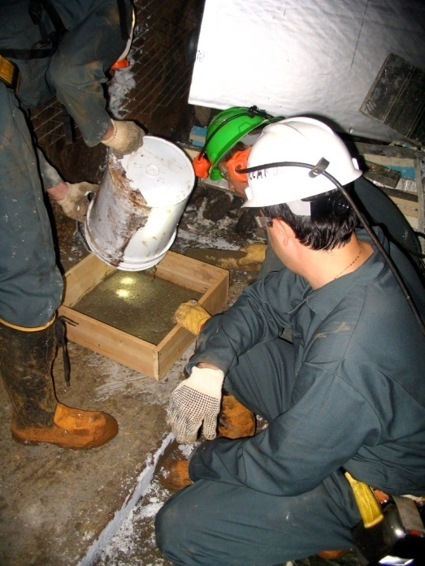
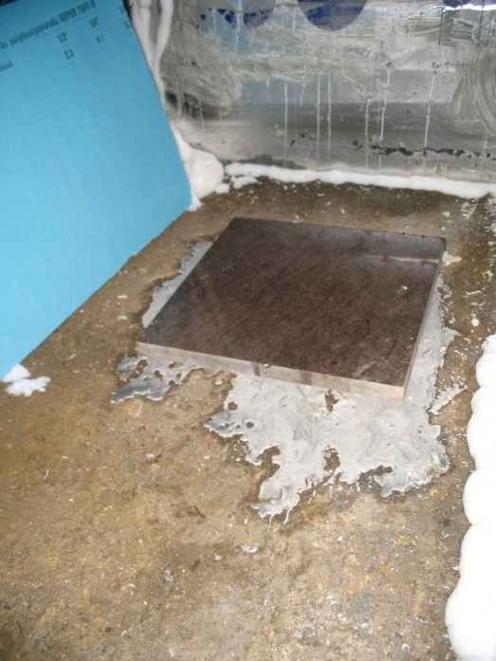
Preparing the sites… the seismometer base
Leveled tile with smooth surface is grouted to concrete base for each seismic instrument
A larger tile is grouted at the 4100ft station for side-by-side measurements

Slide 5
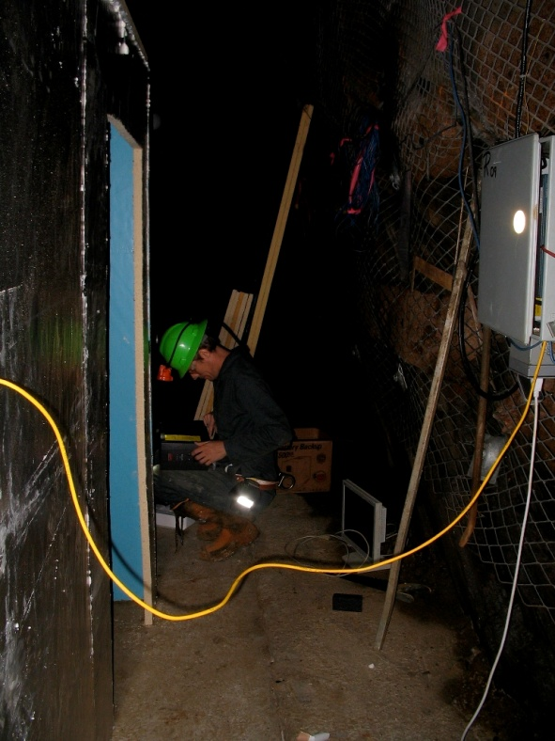
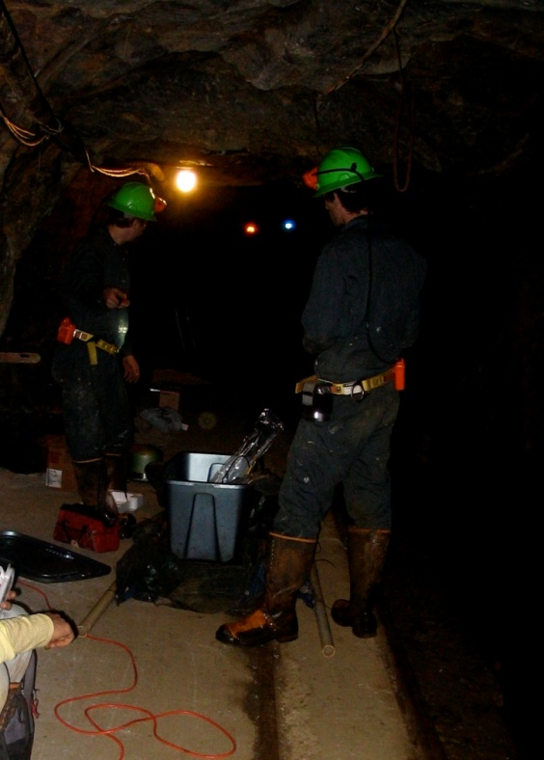
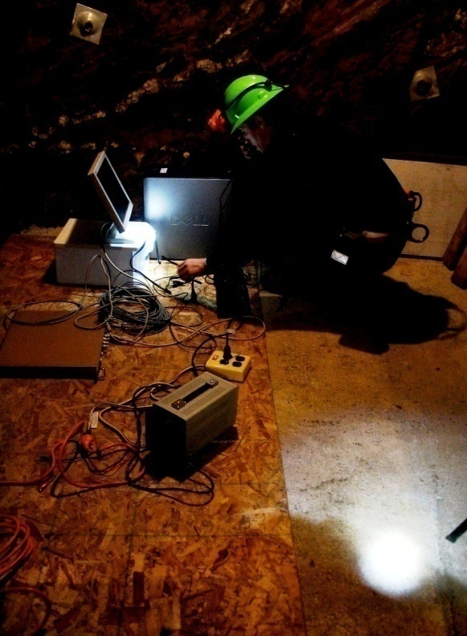
Preparing the sites… power and network
Power and fiber optics are provided by the Sanford Laboratory for most stations
UPS units ensure a continuous power supply, preventing black-outs and protecting from power surges
Notes:
station ensures a continuous power supply, preventing black-outs and voltage surges.

Slide 6
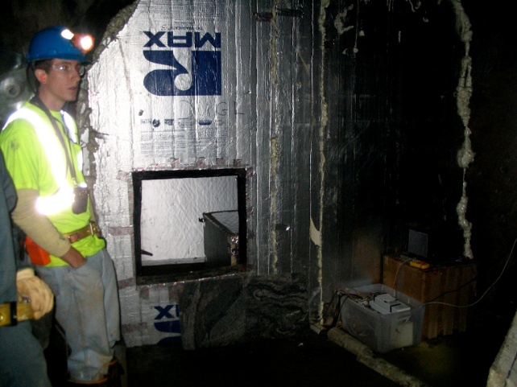
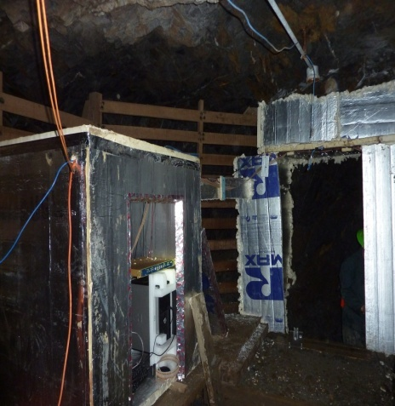
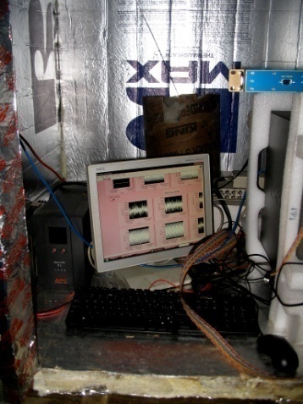
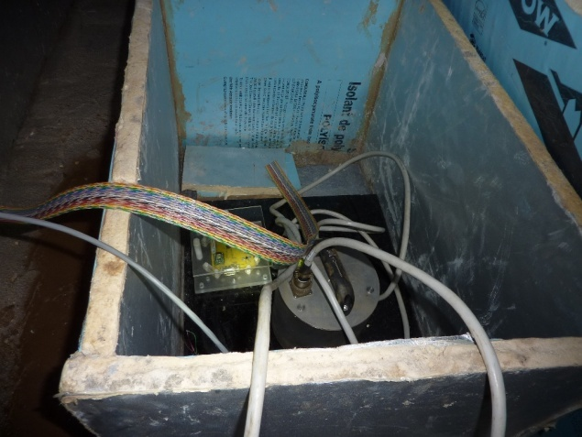
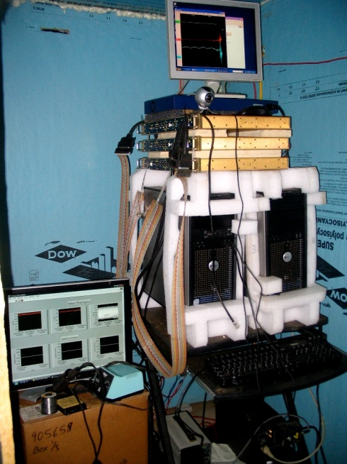
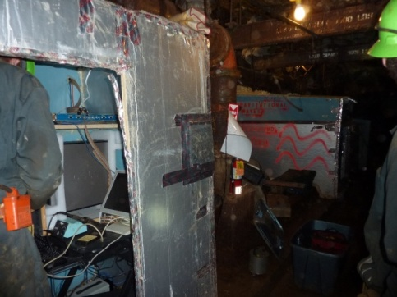
Air current and acoustic shields
800 ft
300 ft
2000 ft
300 ft
2000 ft
800 ft

Slide 7
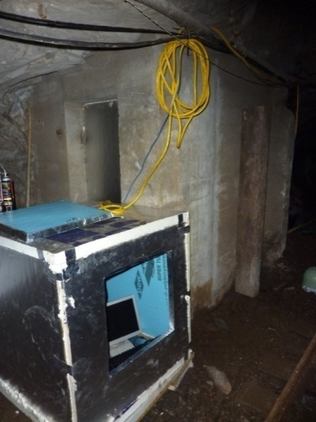
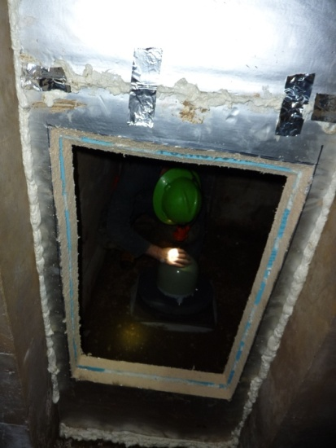
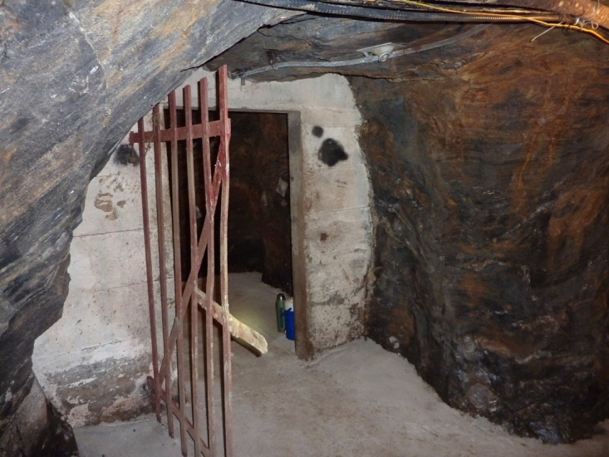
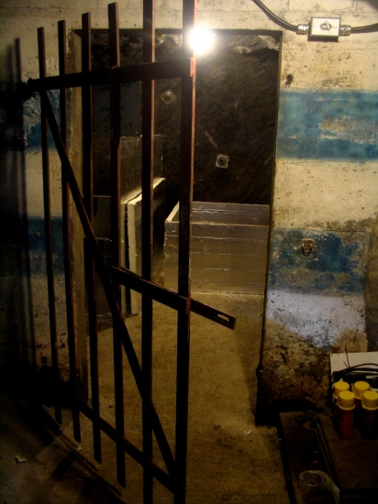
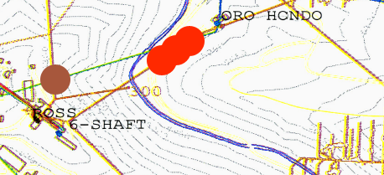
Three new stations at 4100 ft
90m
4100 ft sub-array

Slide 8
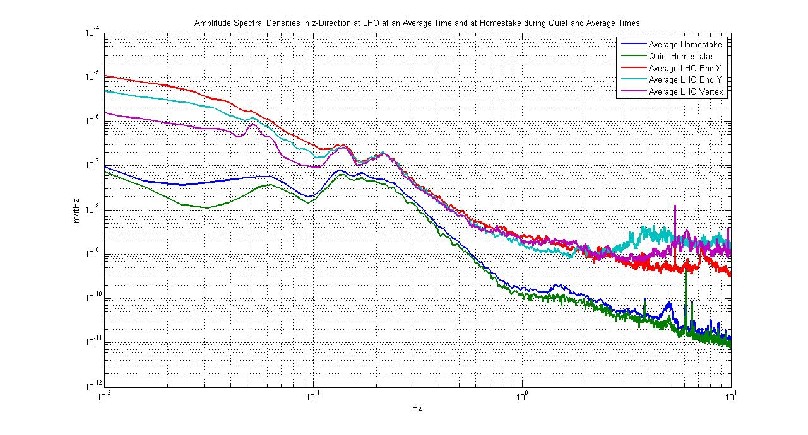
Comparison ground motion: Homestake, 4100ft LHO

Slide 9
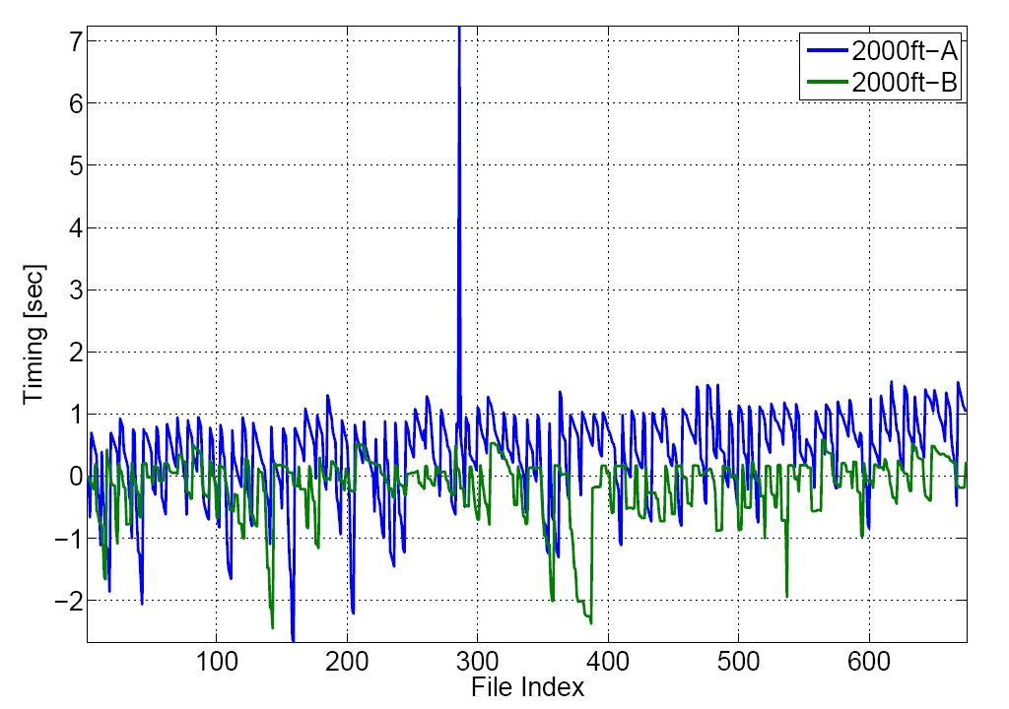
Timing Issues
Difference between PCI-card oscillator and time stamp produced by LabVIEW.
Time-stamp accuracy can be improved (used to be better in earlier implementations).
Current LabVIEW DAQ produces unreliable time stamps
Oscillator in PCI DAQ card shows drift relative to NTP synchronized clock over a day

Slide 10
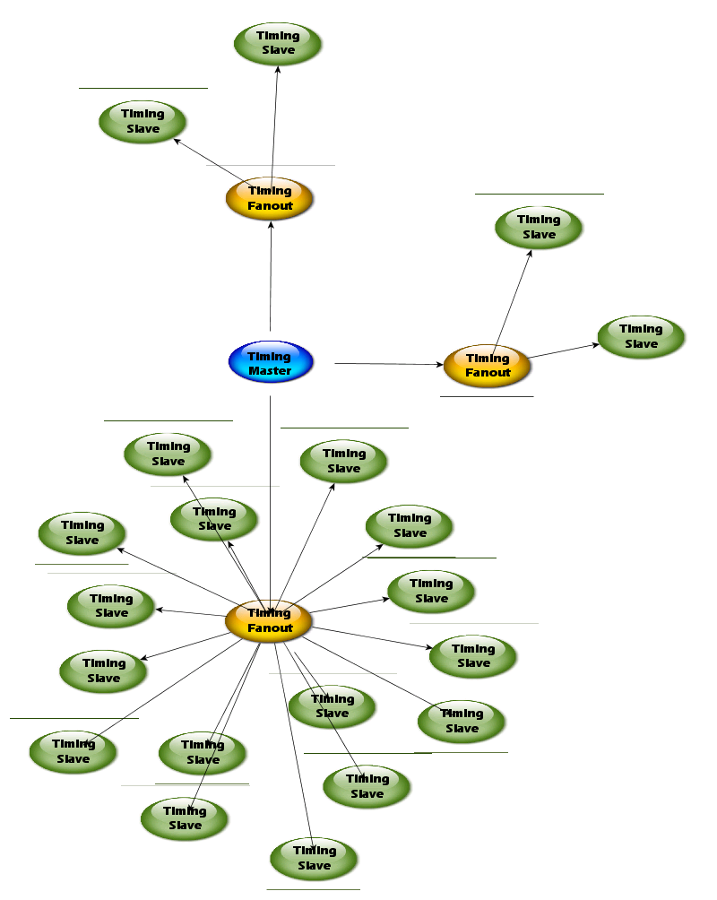
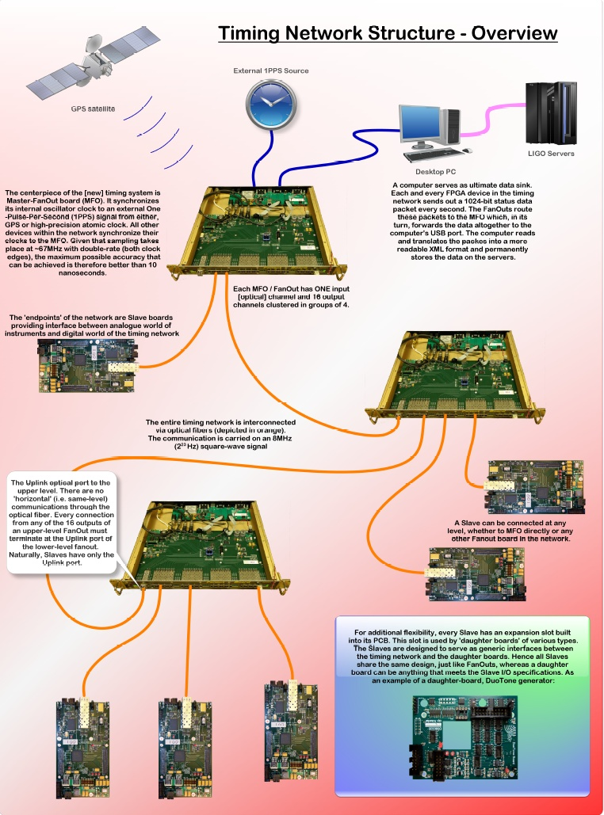
Optical Timing Distribution System
15 ns precision
GPS reference
Columbia U.

Slide 11
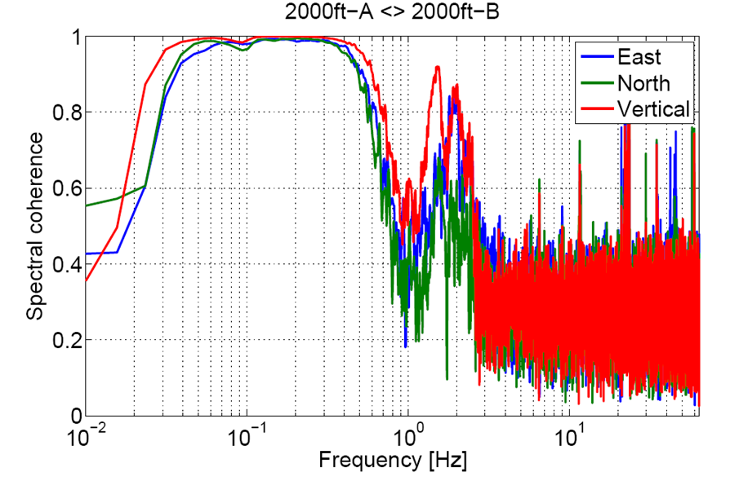
Spectral coherence of 2000 ft stations A and B

Slide 12
Tsunami data

Slide 13
How quiet it is 4100 feet below ground? two quiet days two weeks

Slide 14
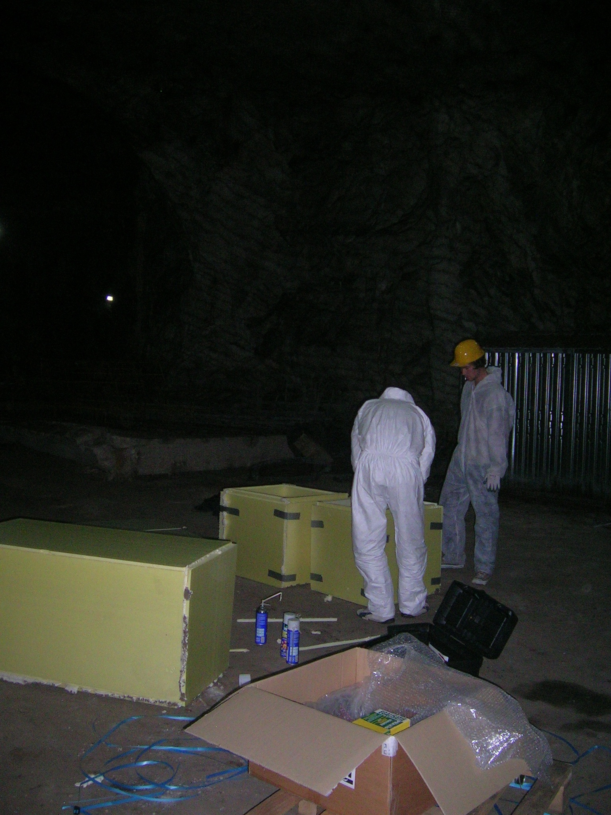
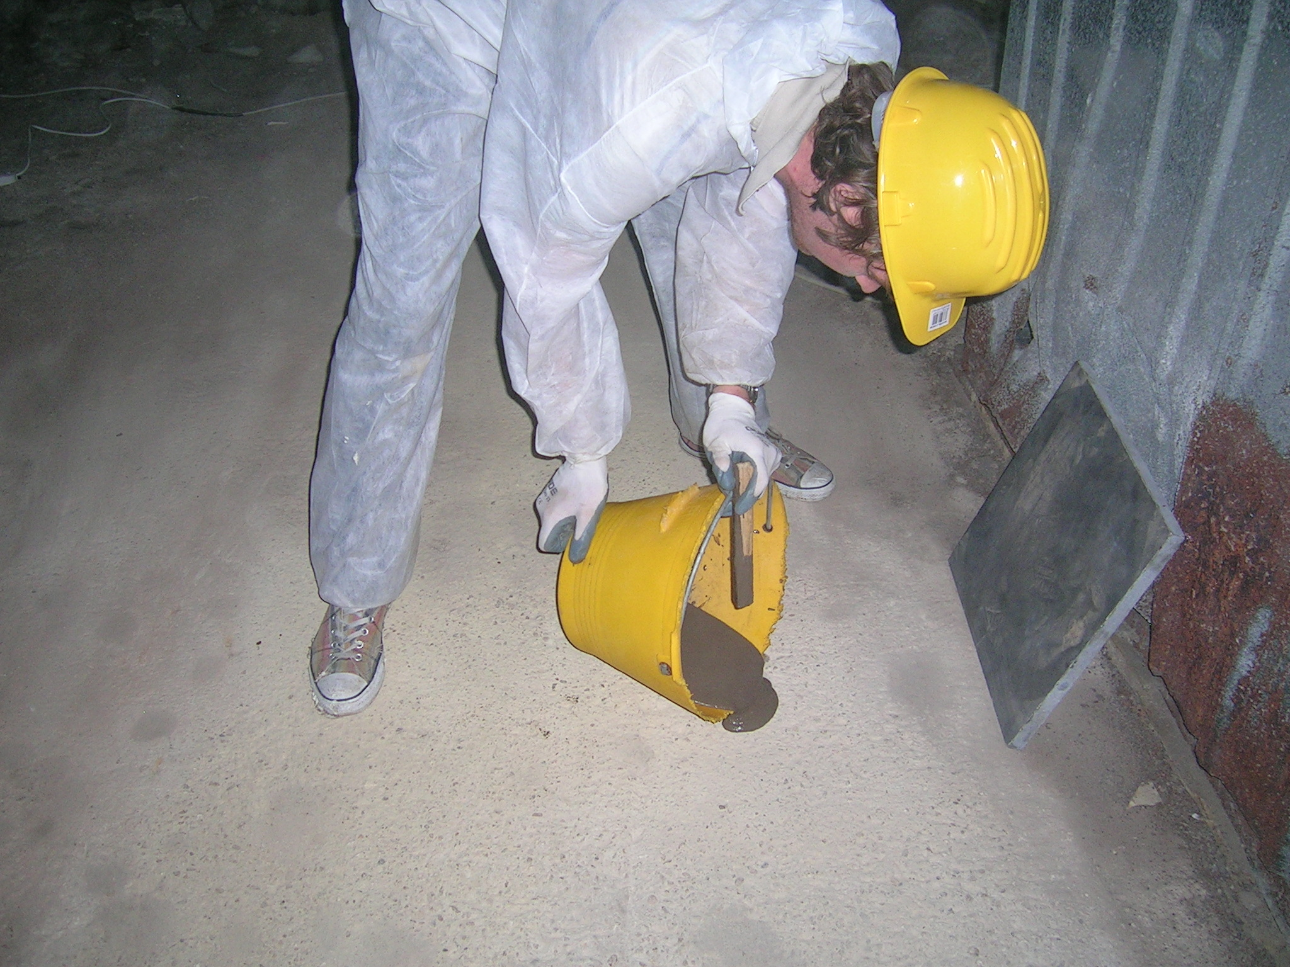
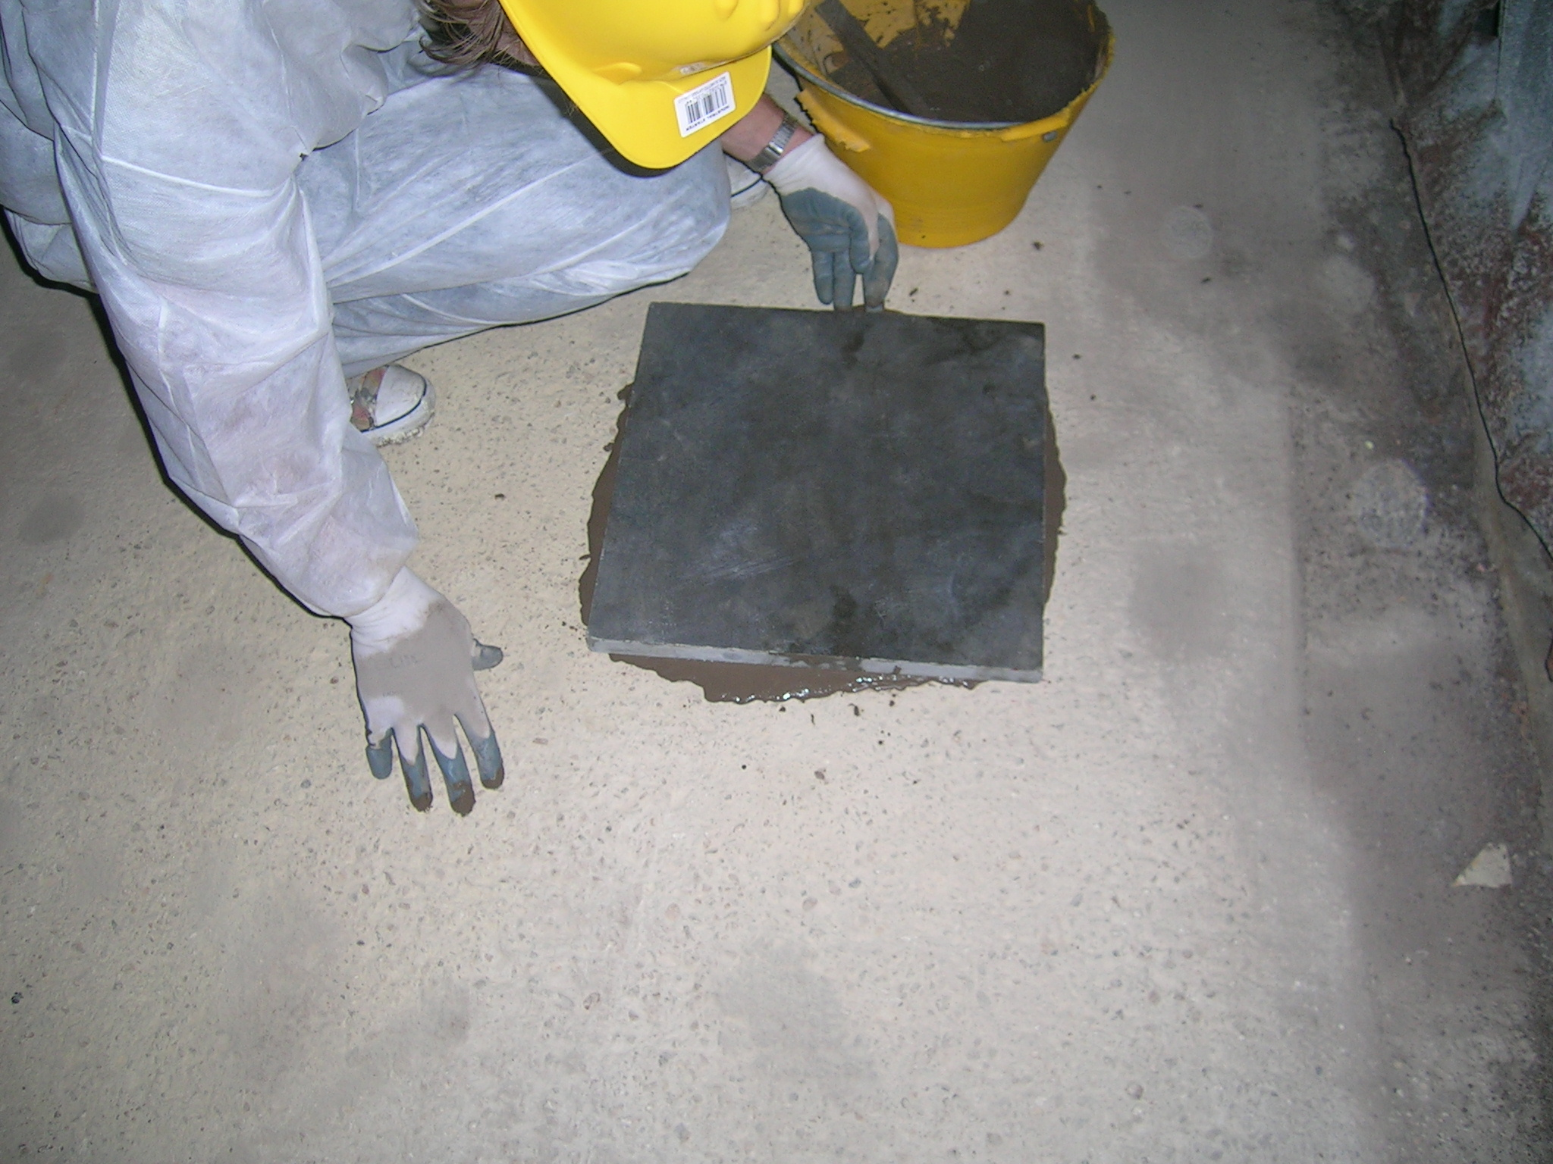
New Realmonte stations !
~100 m depth
~-30m below sea level
Near powerful conveyor belt

Slide 15
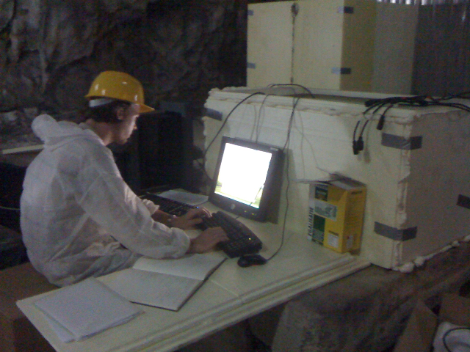
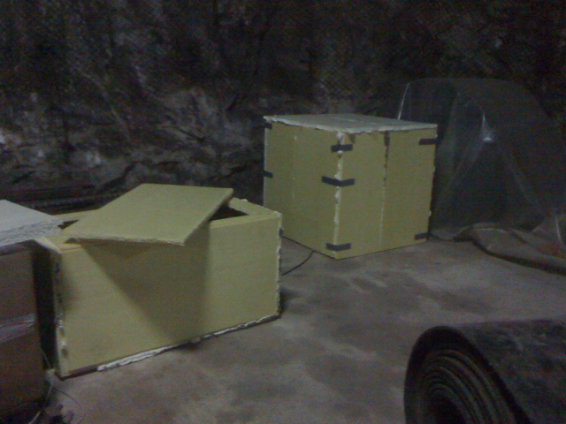
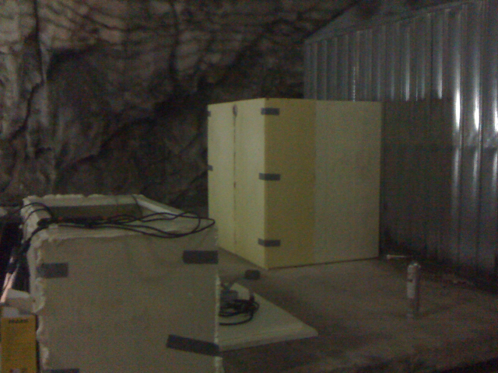

Slide 16
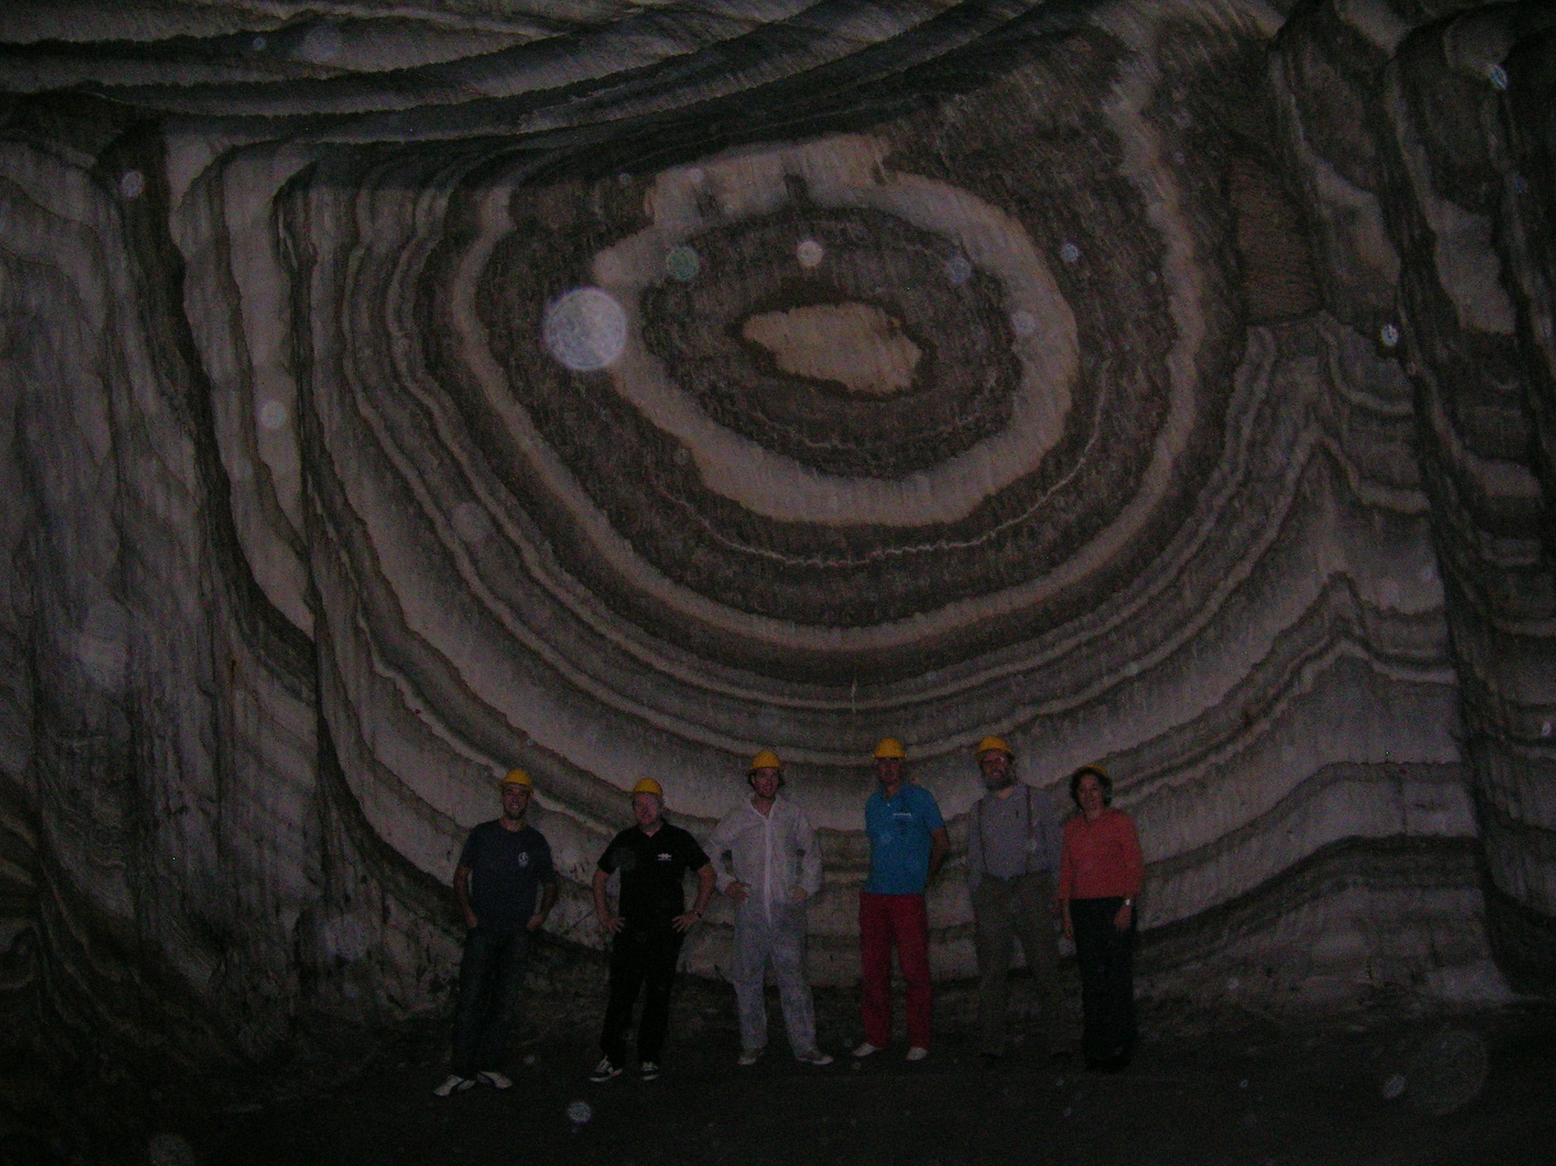
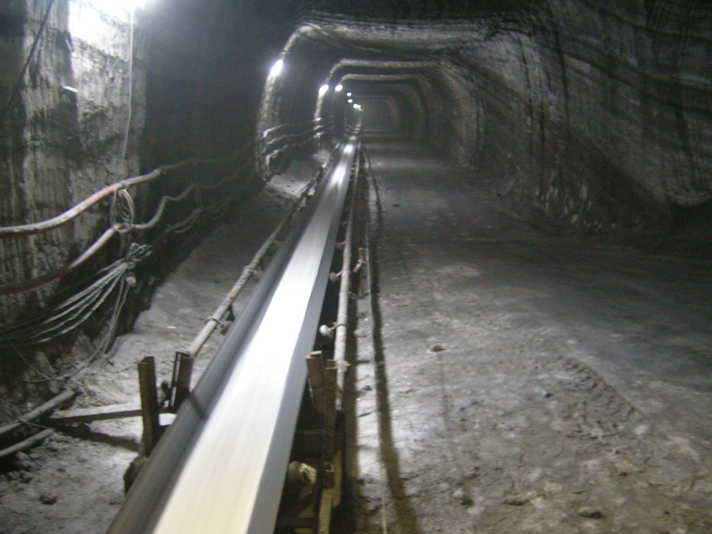
Tunnel size
Typical access Tunnel
Two km straight
Tunnel

Slide 17
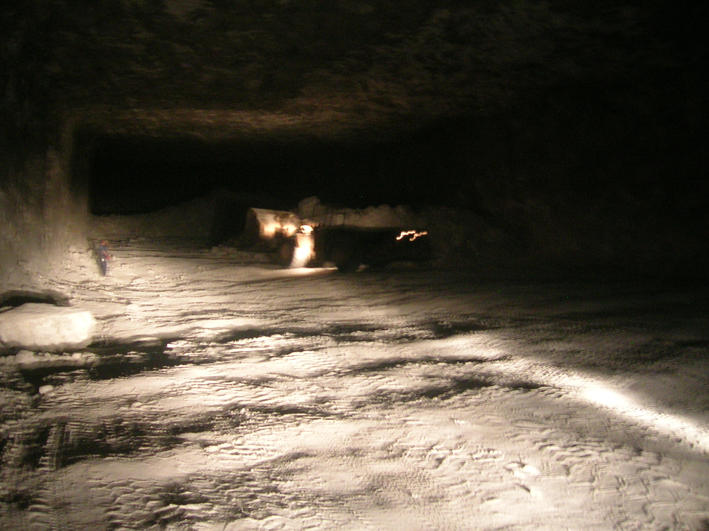
Cavern size 200 m long ~30 m wide ~60 m tall (only 1/3 height visible)

Slide 25
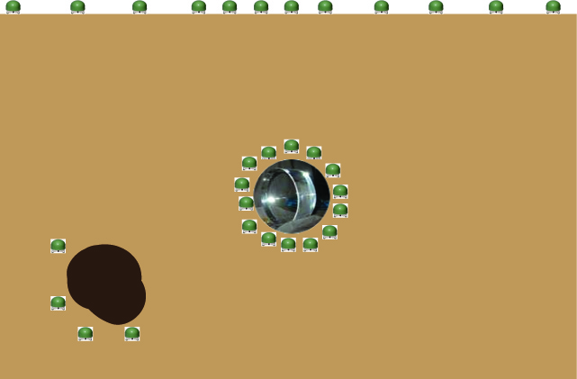
Seismic array distribution for Newtonian Noise Subtraction
Dense Surface array
Wave reflection effects
Local array
second order effects
diffraction effects
must
disentangle shear
from pressure modes
Small caves needed
Large caves not useful
Secondary array
Monitor movement of inhomogeneities close to the test mass
Simulation of underground gravity gradients from stochastic seismic fields J Harms, et al. LIGO Document P0900102-v1
Gravity-Gradient Subtraction in 3rd Generation Underground Gravitational-Wave Detectors in Homogeneous Media Jan Harms, et al., https://dcc.ligo.org/cgi-bin/private/DocDB/ShowDocument?docid=p0900113

Slide 26
Local array The key point
Movement of the cave
with respect to the test mass
Rock to Test Mass “LISA” phase meter
Pm precision

Slide 27
Cavity deformation
Surface array of rock to rock strainmeters
(LISA strainmeters)

Slide 28
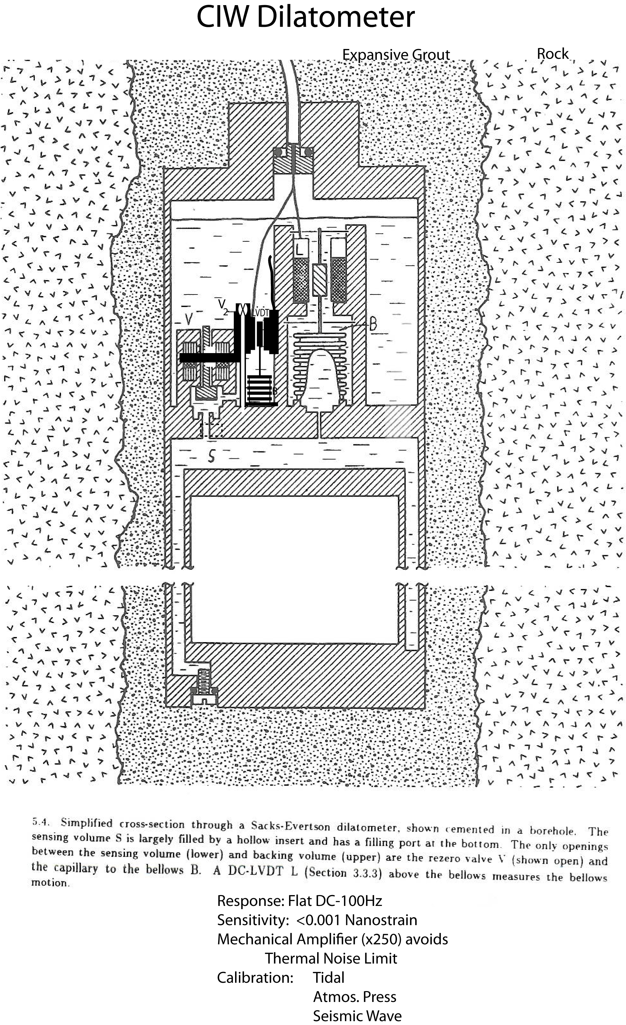
Disentangle pressure from shear waves
Malcolm Johnston - USGS
Dilatometers measure more directly the rock density variations (P-waves)
insensitive to S-waves
Bore hole instruments
simpler and cheaper
boreholes filled with incompressible liquids

Slide 29
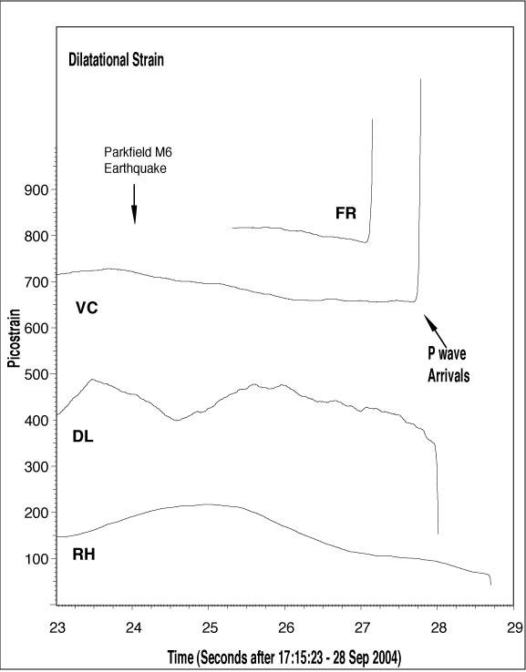
Immediate Pre-seismic Strain before the 2004 M6 Parkfield earthquake
Malcolm Johnston
USGS
<Pm sensitivity

Slide 30
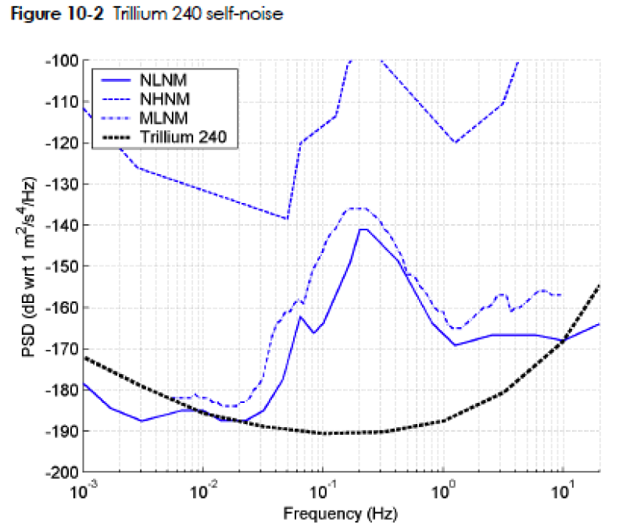
Are commercial sensors useful?
seismometer’s sensitivity designed to measure Petersen’s model
Need 10 x 100 x suppression of NN
Marginally sufficient,
Need improvement
Probably sufficient for surface array
BUT !

Slide 31
Sensor or seismic attenuator flexure noise
Fractal noise at low frequency
Generates extra noise directly interpreted as GW signal,
not filterable in Wiener filters
Solution
eliminate fractal noise
or
triple instruments in each location
Use Majority logic instead of average signal

Slide 32
Conclusions
Homestake is a particularly quiet place, occasionally beats the Petersen’s model
Well timed array to characterize scattering reflection, et c. well under way, need funding to complete
Started comparative study of salt mine
New understanding of NN subtraction will allow Low Frequency GW detection without need of instrumenting several cubic km of rock
New sensors of formidable sensitivity needed, but also possible

