Slide 2
Many thanks to all the speakers for the excellent quality talks

Slide 4
WG4
Science case for ET really well developed
Need for strong collaborations and synchrony with other messengers
Need to carry the news on what can be done with ET into the astronomers community
Point out what only ET can do
Point out what should be done together
Computing
although data rates will not dramatically increase, the number of searches and the parameter space will
Keep efforts up in making algorithms more efficient
increase computing power using available clusters, grid structures and investigate GPU usage

Slide 5
WG2
Design full Suspension and look at all aspects
isolation
thermal noise
Control
cryo aspects (including heat input from scattered, absorbed light)
Substrate material: Si promising, but can not yet be adopted as baseline until we know more about optical properties (absorption, scattering)
Coatings
check for low T behaviour
Keep an eye on mechanical losses
Keep fancy (e.g. wave-guides) as an option?

Slide 6
WG3 Technology review documented in internal notes and papers
Quantum noise reduction
Detector geometry and topology
High power lasers
Optical properties of Si
Parametric instabilities
Diffractive interferometers
Squeezed light
Displacement noise free interferometry

Slide 7
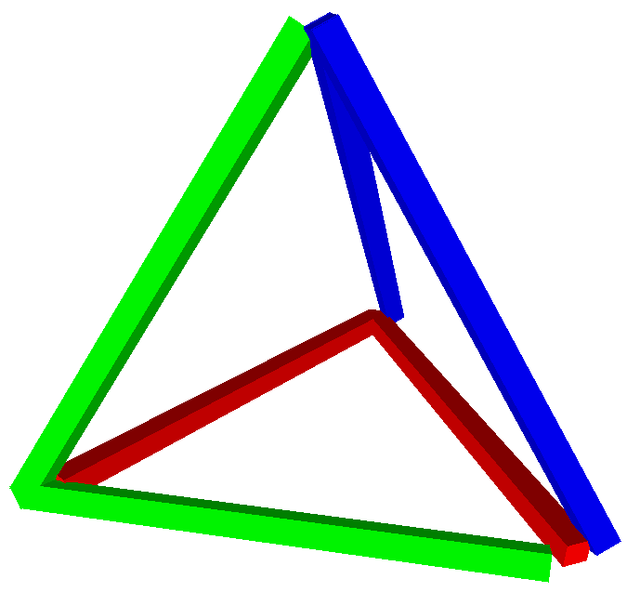
WG3: Next steps: from technology reviews to detector design
Problem:
New technology ideas are cheap, we have to stop evaluating those at some point
Everything depends on everything (e.g. thermal noise on beam size, on free aperture, on tunnel size on available money): it is difficult to do trade-off studies with too many options
Proposal:
Identify parameters/problems which can be separated, such as the triangular shape from the QND topology
For the rest, agree on one (maybe two) complete design as reference and compute sensitivity, noise models, costs
Trade-off studies need tight collaboration between WGs

Slide 8
WG1
Benefits / need of going underground
Infrastructure for ET. Lifetime ~50 years
Large surface buildings needed, access shafts vs sloped roads access
Vacuum issues require interaction with other WGs
Prepare infrastructure design
Prepare cost estimate
Need to foster exchange between WGs wrt. Infrastructure requirements
What is the road to site selection?
Istvan proposed Gyöngyösoroszi as a first candidate

Slide 9
WG1
Gravity Gradient Noise
Most severe obstacle at low frequencies
Models available FE and analytical; Need for validation
Subtraction simulations: in general hard to come close to what is needed but a lot of good work is going on
Starting to grasp what sensor arrays are needed but still a lot of work neededb

Slide 10
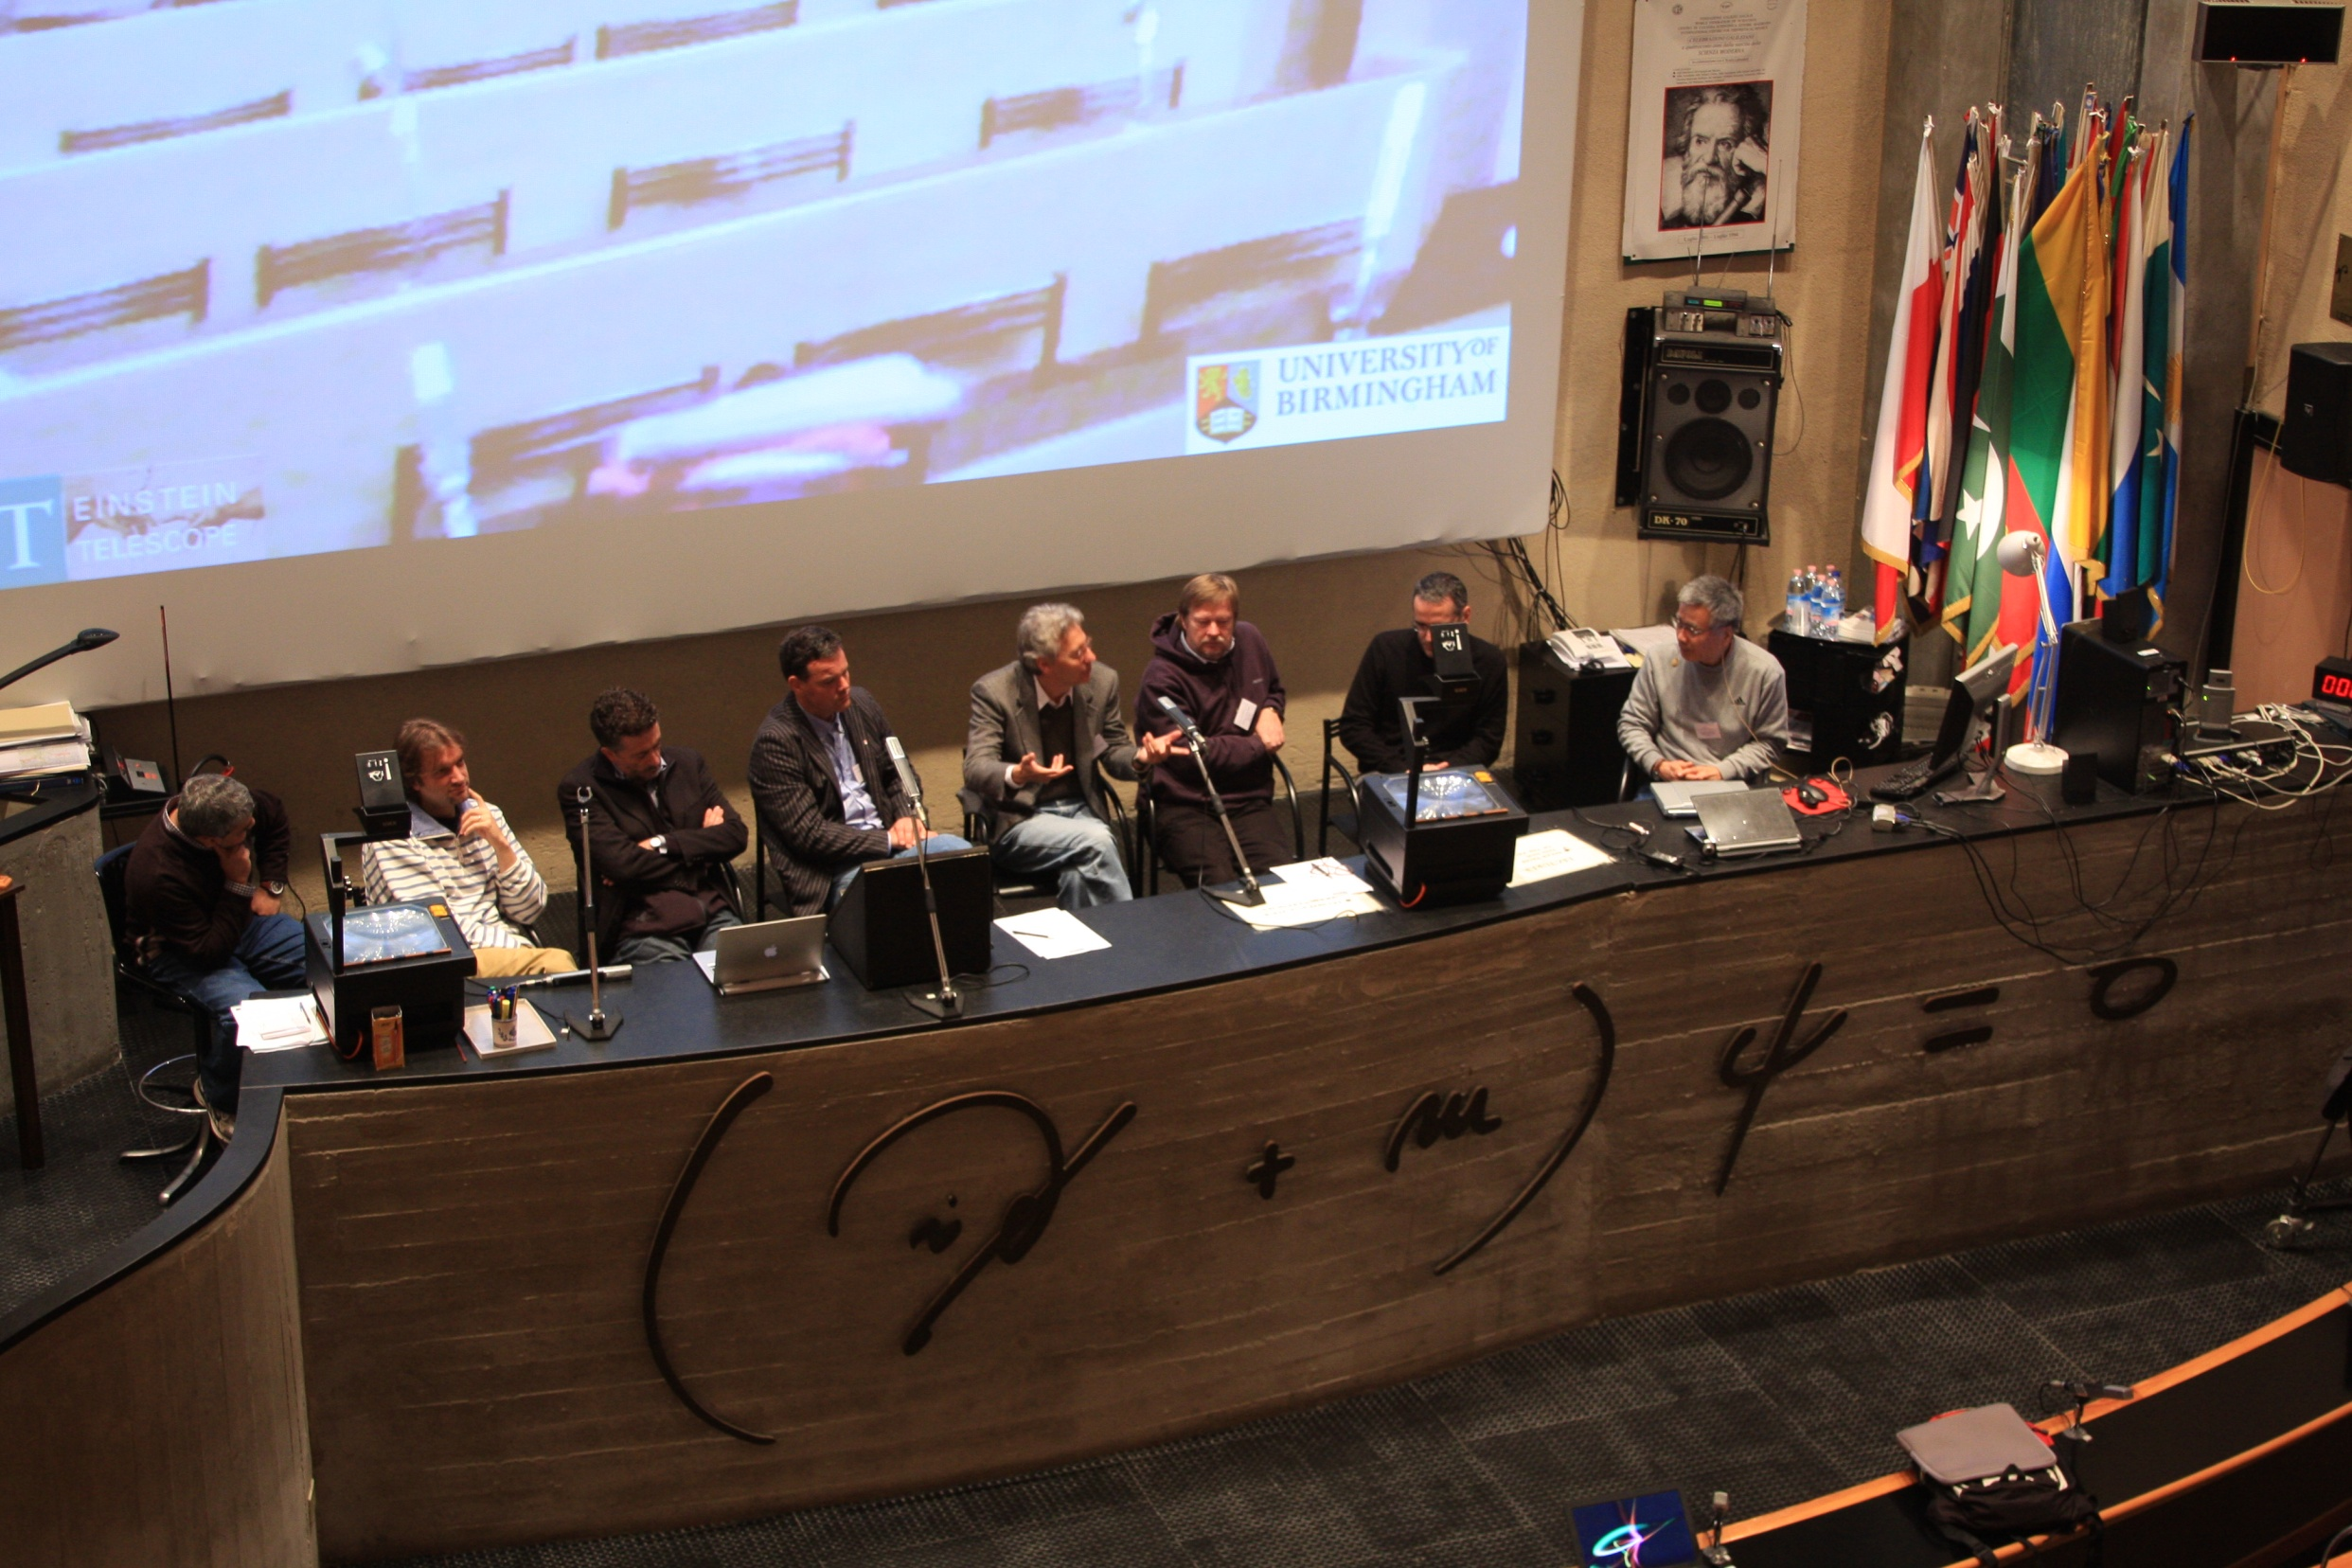
Round table discussion
International aspects of cooperation with other future observatories
Roadmap business: long road before us
WG of WGs will be started soon
Voluntary and involuntary candidates:
Ronny Nawrodt, Stefano Braccini, Stefan Hild, David Rabeling, Leone Bossi, Paola Puppo, ….
WP coordinators will complete the list in the next future

Slide 11
Mid Term Report
In the short time of the DS we have made very good progress
We have got a big, good, enthusiastic team working in a cooperative, friendly spirit
In the next month we have to do our homework finishing the mid term report
From the amount of the results achieved there is no problem for funding of the next period.

Slide 12
Second half of the DS
We have to enter the time of trade-off studies
An inter-WG WG will be formed soon.
Keep on going with the same determination

Slide 13
Next general meeting place ?

Slide 14
Many thanks to Virginie for the excellent organization of the meeting

Slide 16
CNRS and NIKHEF participants
Because of the different reimbursement rules for these institutions, please, pay NOW directly the workshop fee by cache to the Ettore Maiorana Center
(contact Mr. Alessandro Noto)

