Slide 1
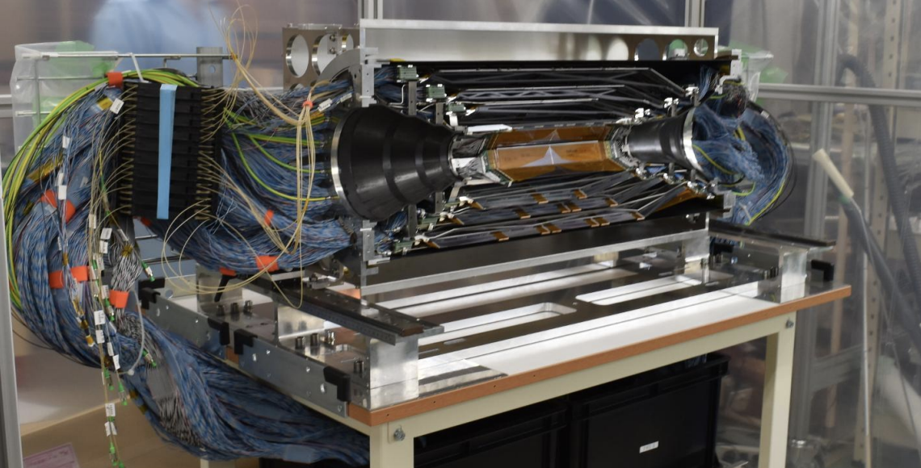
The SVD +X half in its temporal storage tent in B1
SVD activities:
Phase3
Phase2
SVD Introduction:
S. Bettarini
Belle2 Italia – 23-24 Maggio - Torino

Slide 2
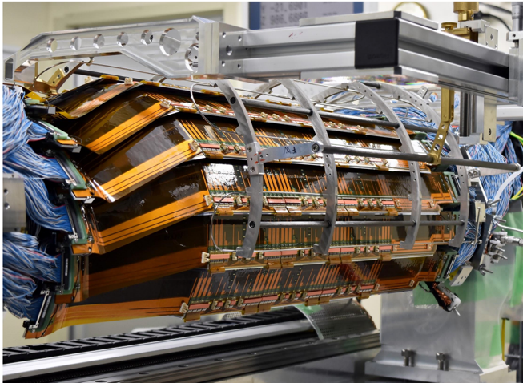
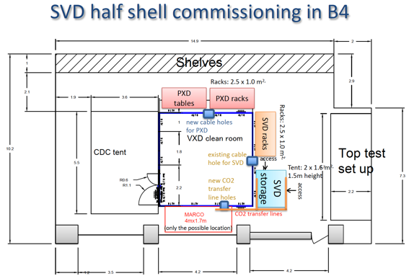
SVD Phase 3 Activities
Ladder Assembly:
completed all the L6 ladders: 8 + 1 spare (more 2⁻) to be installed
Ladder Mount (INFN milestone 30/6):
completed the first +X half (Sept.→Jan.)
completed up to the L5* (to be completed by beg. July)
Next SVD step: July
full SVD only commissioning
The schedule of the SVD/PXD
integration is driven by PXD:
PXD-L1@KEK beg. July
PXD+SVD coupling by end August.
VXD (= PXD+SVD) commissioning: Sept.→Oct.
VXD installation in Belle2 in two steps:
Cables: mid. Sept.→end Oct.
VXD insertion: Nov.→mid Dec.
WE GOT AN EXTRA SET OF CABLES

Slide 3
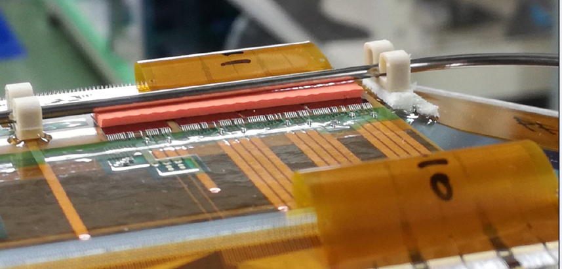
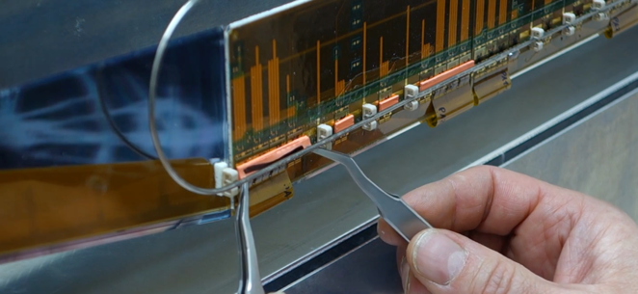
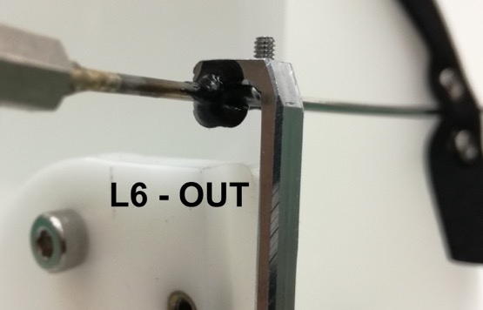
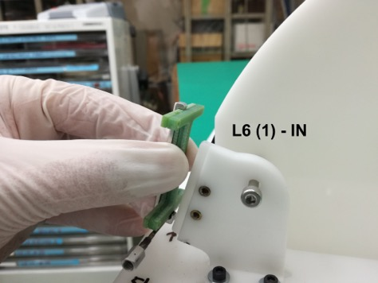
… latest issues during ladder mount
Not optimal cooling efficiency on a chip of a L5 ladder → +11 ºC wrt normal
Visual inspection spotted and improper gluing of the clamp on the L6 Cooling pipe(S)
A local intervention is needed to place an additiponal keratherm layer under the pipe:
causing mechanical interference during
the mounting with the H-shape →
Needed intervention
(scheduled after June 11°)

Slide 4
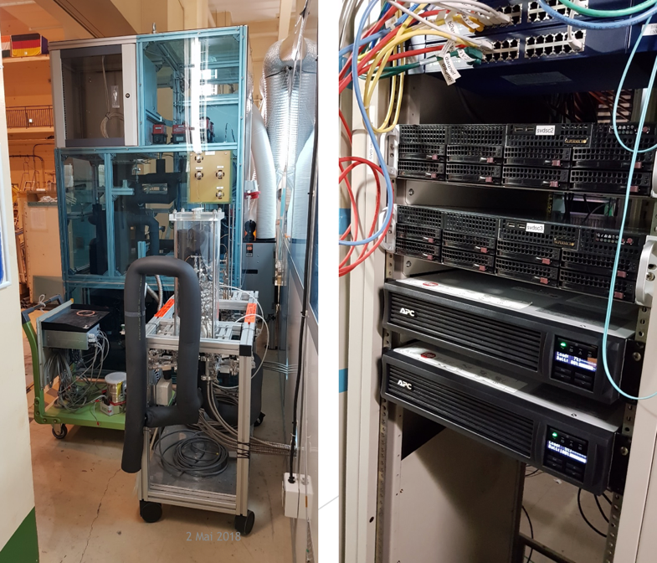
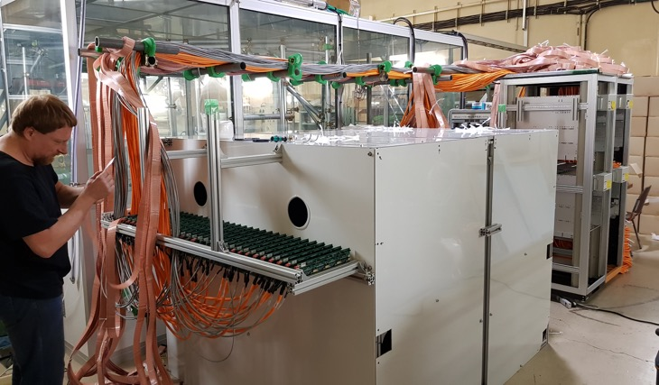
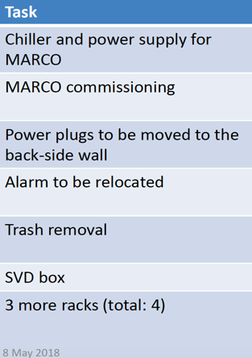
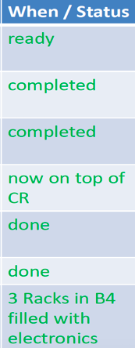
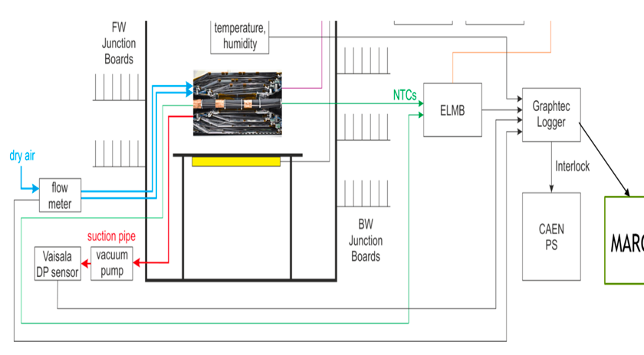
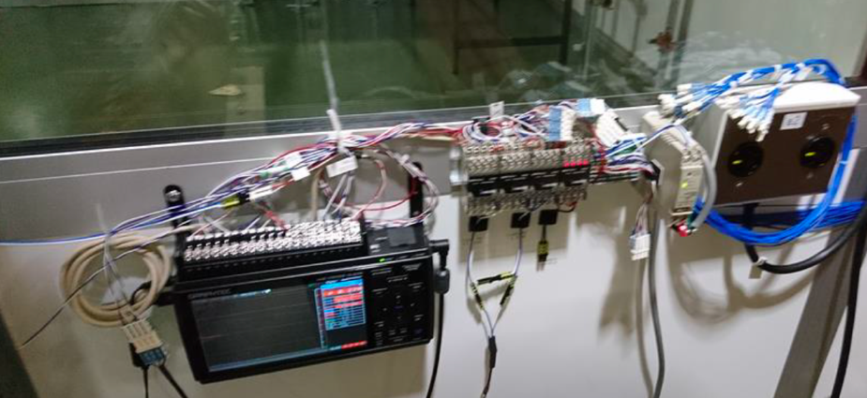
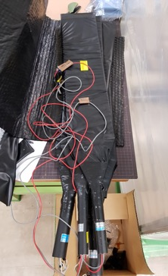
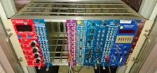
Advanced preparation for SVD commissioning in B4 (internal Review on 1/6)
The SVD box
MARCO
commissioned
SVD
Servers
ILK MARCO & Power Supply + data loggers
NIM crate
Interlock Set-up

Slide 5
Current
PXD
Installation
&
Integration
SVD/PXD
schedule
Yesterday
@TB
PXD declared
that they are
updating this
schedule …

Slide 6
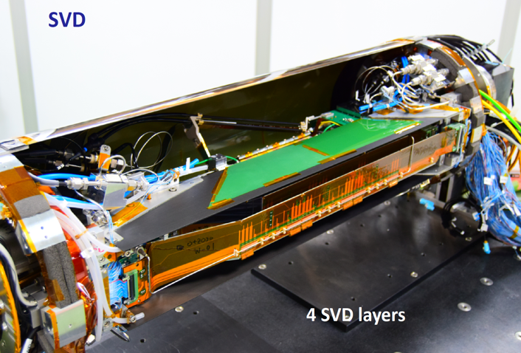
SVD Phase 2 Activities
Daily noise calibration show that all the detectors in the SVD cartridge work as expected
SVD read-out integrated in the global DAQ
A lot of operational experience gained for the phase III:
As we knew even a sector of SVD must be carefully managed:
Organized an operational model (2 shifters+experts)
SVD participates in global runs with HV OFF and in the nightly luminosity runs
SVD HV can now be operated remotely by the CR shifter
Running in global with HV OFF/ON requires different configuration files (implementing an automatic switching mechanism).
See Giuliana’s talk for studies on the impact of machine BKG on the SVD:
BKG puzzle (w.r.t. extrapolation based on simulation):
in SVD is x 15
in Diamonds is x 2
ON these
Phase2 → phase3 Transition :
by the end of June: decision on whether or not stop phase2 on July 17°and move on to the VXD installation and to phase 3.
cartridge: 1 ladder for each L3,4,5,6

Slide 7
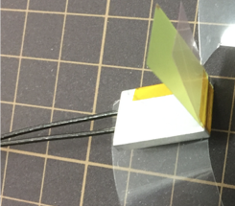
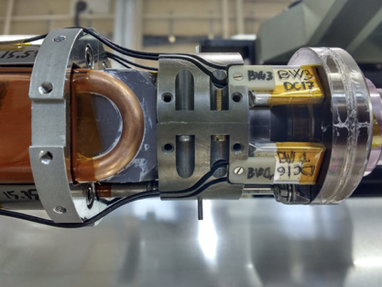
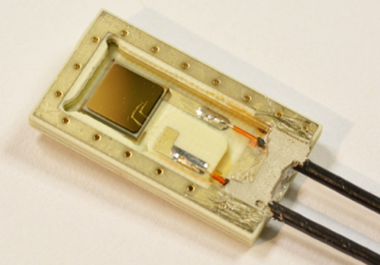
Radiation Monitoring Roadmap
Phase 2
Sep 2017: 8 diamond detectors with 2 radio-chromic films on Beam Pipe
Nov 2017: Cabling
Dec17-Jan18: 2 Diamond Control Units (DCU) installed in E-Hut
Dec17-Feb18: Several tests (Interlock, SuperKEKB)
Jan-Feb18: Slow Control EPICS integration for phase2
Phase 3
Jun+Nov 2017: All 12 detectors installed on SVD
Now: preparation and calibration of last detectors
More Irradiation tests together with RCF
Next installations:
Mid-June 2018: 8 detectors on the beam pipe for Phase 3
Oct-Nov 2018: Cabling, DOCK interconnection, tests
Readout: 3+1 DCU
See Livio’s Talk for the update on Radiation Monitoring/Protection and Abort System at WORK in Phase 2

