Slide 1
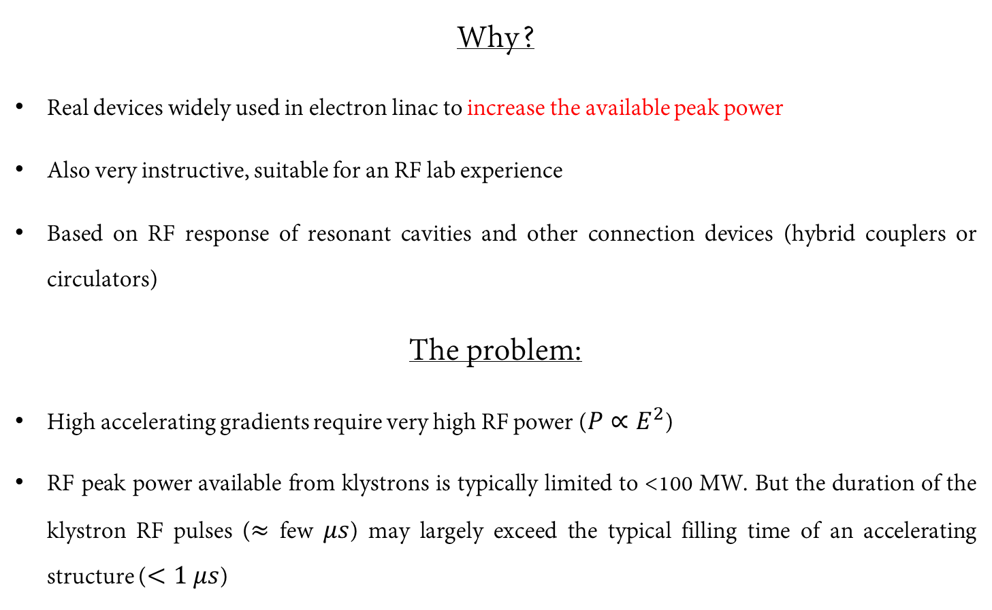
Experimental activity #2: RF pulse compressors
Why?
Real devices widely used in electron linac to increase the available peak power
Also very instructive, suitable for an RF lab experience
Based on RF response of resonant cavities and other connection devices (hybrid couplers or circulators)
The problem:
High accelerating gradients require very high RF power ($P∝E^{2}$)
RF peak power available from klystrons is typically limited to <100 MW. But the duration of the klystron RF pulses ($≈$ few $μs$) may largely exceed the typical filling time of an accelerating structure ($<1 μs$)

Slide 2
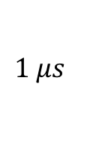

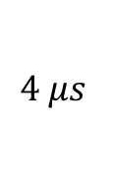
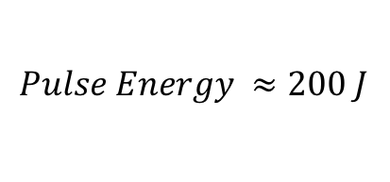
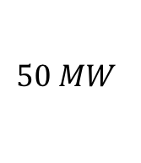
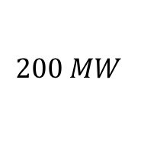
The Idea: SLED (Stanford Linac Energy Doubler)
Let’s compress the energy of the RF pulse in about 1 filling time to increase the peak power to the maximum!
$$50 MW$$
$$200 MW$$
Pulse Compression
$$4 μs$$
$$klystron RF pulse$$
$$Pulse Energy ≈200 J$$
$$1 μs$$
A factor of 4 in power corresponds to a factor of 2 in accelerating gradient, i.e. in beam energy. Smart!!! But how a large RF power flowing in a waveguide can be manipulated in order to be compressed?
This idea has been firstly implemented at SLAC in the 70’s [1]. The compression is obtained by capturing the RF power reflected by high-Q resonant cavities.
[1] Farkas et al. - SLED A method of doubling SLAC energy

Slide 3
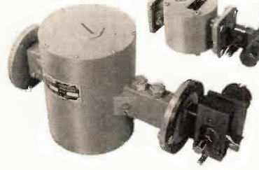
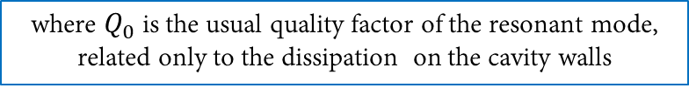
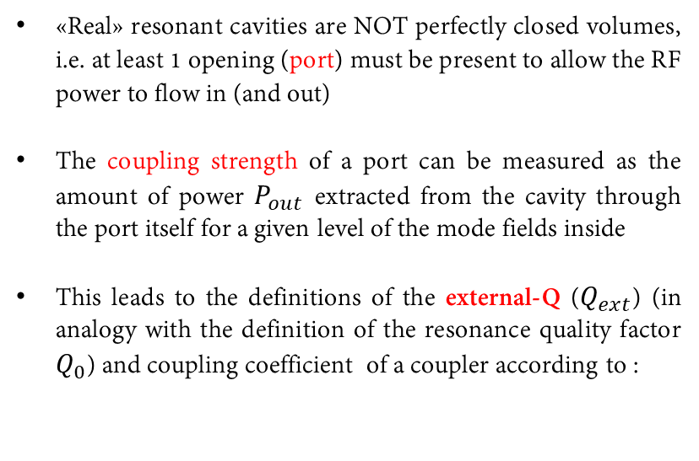
Recap: coupling coefficients of a resonant cavity
«Real» resonant cavities are NOT perfectly closed volumes, i.e. at least 1 opening (port) must be present to allow the RF power to flow in (and out)
The coupling strength of a port can be measured as the amount of power $P_{out}$ extracted from the cavity through the port itself for a given level of the mode fields inside
This leads to the definitions of the external-Q ($Q_{ext}$) (in analogy with the definition of the resonance quality factor $Q_{0}$) and coupling coefficient of a coupler according to :
where $Q_{0}$ is the usual quality factor of the resonant mode, related only to the dissipation on the cavity walls
The extra-power that flows through the cavity couplers may significantly change the characteristics of the resonance. This effect is known as “cavity loading”. The loaded cavity Q-factor is lowered by the power coupled out through the cavity ports and results to be:

Slide 4
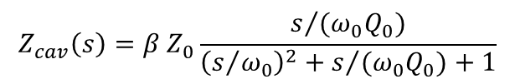
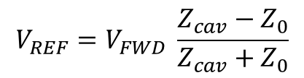
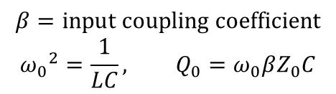
Wave reflection in a guide terminated on a resonant load
A resonant cavity is a non-matched load for a waveguide or a transmission line, and can be modeled as an RLC parallel circuit.
$$Z_{cav}\left(s\right)=β Z_{0}\frac{s/{(ω_{0}Q_{0})}}{{\left(s/{ω_{0}}\right)}^{2}+s/{{(ω}_{0}Q_{0})}+1}$$
$$β=input coupling coefficient$$
$${ω_{0}}^{2}=\frac{1}{LC}, Q_{0}=ω_{0}βZ_{0}C$$
An RF wave travelling from the generator toward the cavity is always partially reflected at the cavity input. The reflected wave can be calculated according to:
$$V_{REF}=V_{FWD} \frac{Z_{cav}−Z_{0}}{Z_{cav}+Z_{0}}$$

Slide 5
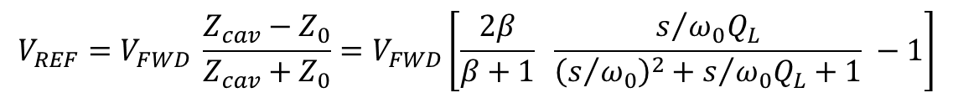
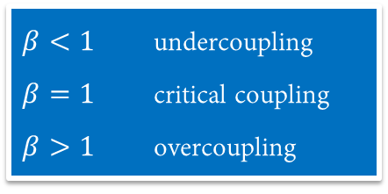

Cavity reflected waves and input coupling coefficient
In the previous equation, if we substitute the expression for $Z_{cav}$, the reflected wave becomes function of the coupling coefficient:
Coupling
coeff.
Lorentzian network
transfer function
$$V_{REF}=V_{FWD} \frac{Z_{cav}−Z_{0}}{Z_{cav}+Z_{0}}=V_{FWD}\left[\frac{2β}{β+1} \frac{s/{ω_{0}Q_{L}}}{{\left(s/{ω_{0}}\right)}^{2}+s/{ω_{0}Q_{L}}+1} −1\right]$$
$β<1$ undercoupling
$β=1$ critical coupling
$β>1$ overcoupling
Depending on the value of $β$, 3 practical situations can occur:
What are we going to do:
Step pulse
Calculate and plot the Lorentzian network response when V_{IN} :
Calculate and plot the cavity reflected wave when V_{FWD} :
Rectangular pulse
Step pulse
Rectangular pulse

Slide 6
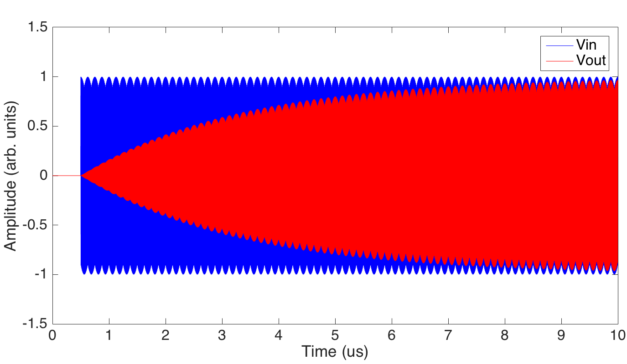

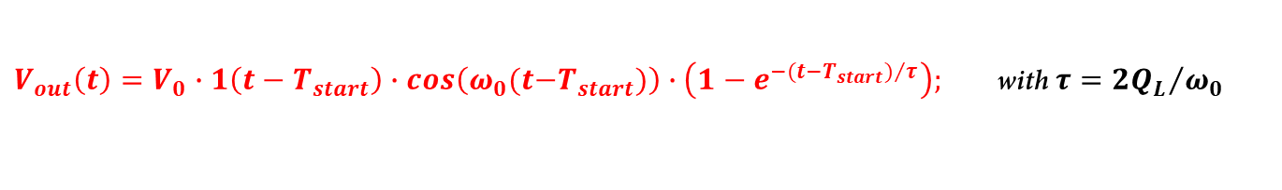
Lorentzian network response: RF step pulse
The response of a Lorentzian network to an RF step pulse is:
1
$$V_{in}(t)=V_{0}∙1(t−T_{start})∙cos\left(ω_{0}(t−T_{start}\right))$$
T_{start}
$V_{out}\left(t\right)=V_{0}∙1\left(t−T_{start}\right)∙cos\left(ω_{0}(t{−T}_{start})\right)∙\left(1−e^{−{(t−T_{start})}/τ}\right);$ with $τ={2Q_{L}}/{ω_{0}}$
$$T_{start}$$
$$Q_{L}=25000;ω_{0}=2856 MHz;T_{start}=0.5 μs; τ≈2. 8μs$$

Slide 7
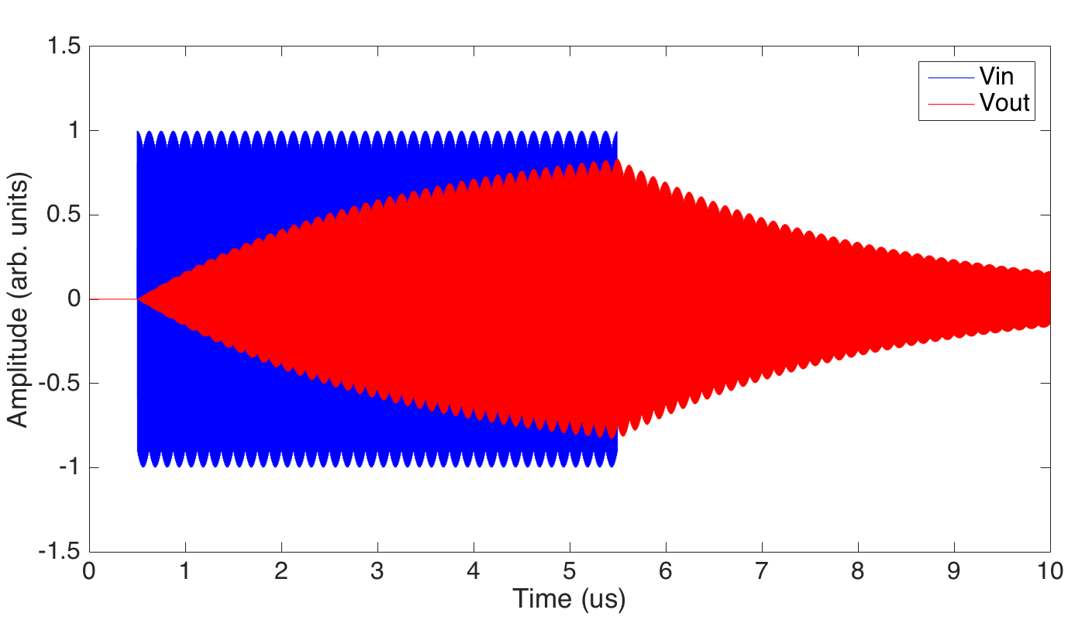
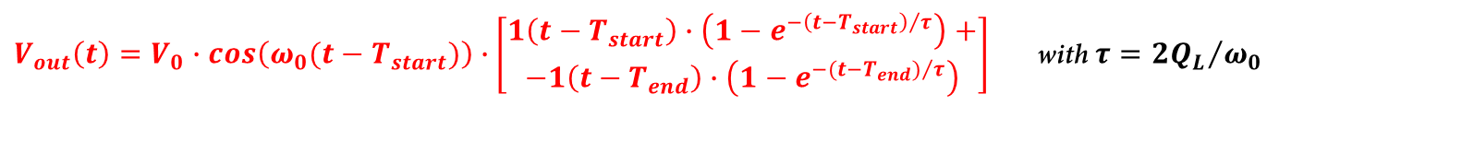


Lorentzian network response: RF rectangular pulse
The response of a Lorentzian network to an RF rectangular pulse is:
1
$V_{in}(t)=V_{0}∙cos\left(ω_{0}(t−T_{start})\right)$ $∙\left[1\left(t−T_{start}\right)−1(t−T_{end})\right]$
T_{start}
T_{end}
$V_{out}\left(t\right)=V_{0}∙cos\left(ω_{0}(t−T_{start})\right)∙\left[\begin{aligned}1\left(t−T_{start}\right)∙\left(1−e^{−{\left(t−T_{start}\right)}/τ}\right)+ \\ −1\left(t−T_{end}\right)∙\left(1−e^{−({t−T_{end})}/τ}\right)\end{aligned}\right]$with $τ={2Q_{L}}/{ω_{0}}$
$$T_{start}$$
$$T_{end}$$
$$Q_{L}=25000;ω_{0}=2856 MHz;T_{start}=0.5 μs;T_{end}=5.5 μs; τ≈2. 8μs$$

Slide 8
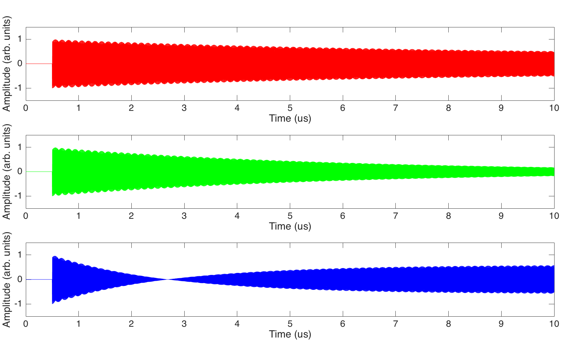




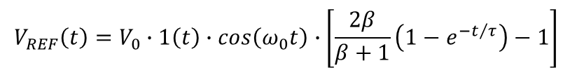
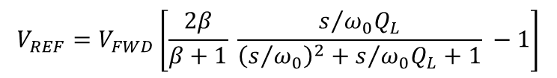
RF step pulse reflected by a resonant cavity
The reflected wave of a resonant cavity to an RF step pulse has the following transfer function:
$$V_{REF}=V_{FWD}\left[\frac{2β}{β+1} \frac{s/{ω_{0}Q_{L}}}{{\left(s/{ω_{0}}\right)}^{2}+s/{ω_{0}Q_{L}}+1} −1\right]$$
In time domain:
$V_{FWD}(t)=V_{0}∙1(t)∙cos\left(ω_{0}t\right)$;
$$V_{REF}\left(t\right)=V_{0}∙1\left(t\right)∙cos\left(ω_{0}t\right)∙\left[\frac{2β}{β+1}\left(1−e^{−t/τ}\right)−1\right]$$
Undercoupled, $β<1$
Critically coupled, $β=1$
Overcoupled, $β>1$

Slide 9



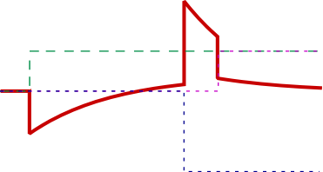

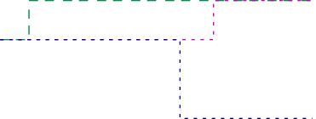


RF rectangular pulse reflected by an over-coupled resonant cavity
The wave reflected by an over-coupled cavity excited by a rectangular RF pulse is:
$$V_{FWD}(t)=V_{0}∙cos\left(ω_{0}t\right)∙\left[1\left(t\right) −1(t−T_{p}) \right]$$
$$V_{RFL}\left(t\right)=V_{0}∙cos\left(ω_{0}t\right)∙\left\{1\left(t\right)\left[\frac{2β}{β+1}\left(1−e^{−t/τ}\right)−1\right]−1\left(t−T_{p}\right)\left[\frac{2β}{β+1}\left(1−e^{−{\left(t−T_{p}\right)}/τ}\right)−1\right]\right\}$$
$$T_{p}$$
The RFL peak field is maximum at the end of the FWD pulse, and its value exceeds the peak of the FWD itself.
This effect can be enhanced by forcing a 180° phase jump in the driving pulse at a certain time before the end of the pulse. By doing that we induce an equivalent step in the driving signal of double amplitude which adds in phase with the signal originated by the first rising front of the driving RF pulse.
$$V_{FWD}(t)=V_{0}∙cos\left(ω_{0}t\right)∙\left[1\left(t\right) −2∙1\left(t−T_{s}\right)+1(t−T_{p}) \right]$$
$$T_{s}$$
$$V_{RFL}\left(t\right)=V_{0}∙cos\left(ω_{0}t\right)∙\left\{1\left(t\right)\left[\frac{2β}{β+1}\left(1−e^{−t/τ}\right)−1\right]−2∙1\left(t−T_{s}\right)\left[\frac{2β}{β+1}\left(1−e^{−{\left(t−T_{s}\right)}/τ}\right)−1\right]+1\left(t−T_{p}\right)\left[\frac{2β}{β+1}\left(1−e^{−{\left(t−T_{p}\right)}/τ}\right)−1\right]\right\}$$

Slide 10
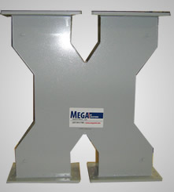
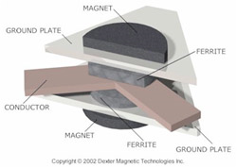
How to route the power flow towards the accelerator (and not towards the power units)
Circulators are non-reciprocal (typically) 3-ports devices whose scattering matrix is ideally given by:
90° hybrids are non-reciprocal (typically) 4-ports devices whose scattering matrix is ideally given by:
1
2
3
4

Slide 11
How to route the power flow towards the accelerator (and not towards the power units)
90° hybrids are non-reciprocal (typically) 4-ports devices whose scattering matrix is ideally given by:
If we assume to feed from port 1 (klystron):
There is no power emerging from port 2 S₂₁=0
Half power emerges from port 3 (90° phase shift) S₃₁= j/√2
Half power emerges from port 4 (in phase) S₄₁= 1/√2
The reflected power from cavity 1:
No power emerging from port 4 S₄₃=0
Half emerges from port 1 with another 90° phase shift S₁₃= j/√2
Half emerges from port 2 in phase S₂₃= 1/√2
RF source
(klystron)
Accelerating section
The reflected power from cavity 2:
No power emerging from port 3 S₃₄=0
Half emerges from port 1 in phase S₁₄= 1/√2
Half emerges from port 2 with 90° phase shift S₂₄= j/√2
1
2
-1/ √2
+ 1/ √2 = 0
3
4
Total power at port 1:
Total power at port 2:
j/ √2
+ j/ √2
RF cavity 1
RF cavity 2

Slide 12
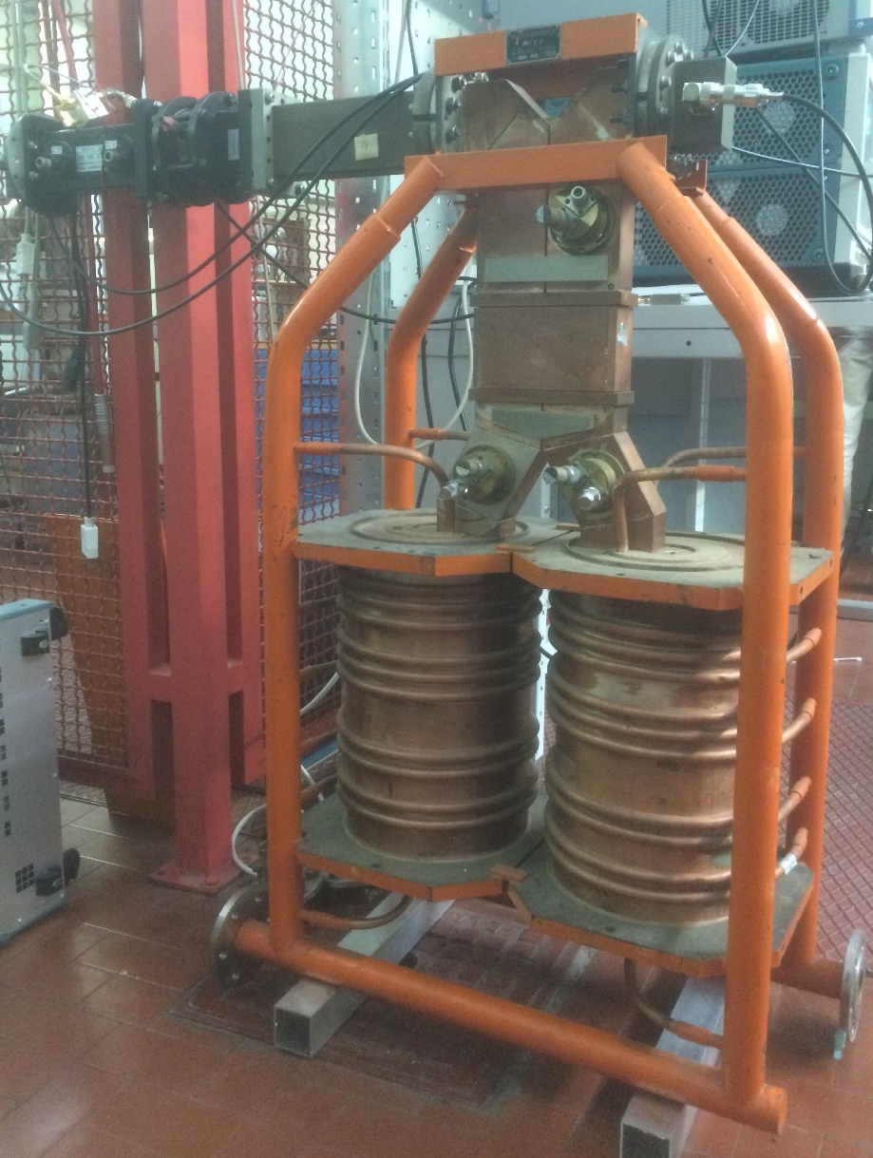
Experimental activity #2
Introduction:
Measure environmental conditions and calculate SLED tuning frequency (working temperature T_{r} = 40 °C, and nominal frequency f_{RF} = 2856 MHz)
Time domain: set-up of the RF pulse
CW signal at f_{LP} from signal generator
Stanford setup (5 us, 100 Hz, TTL HighZ)
RF Switch setup
Oscilloscope cross-check
Frequency domain: realization of the 180° phase jump
Design of a 180° phase shifting circuit
Functionality cross-check of the 180° phase shifter provided
Actual phase shift measurement
Generation and timing regulation of the trigger signals
Oscilloscope cross check (30 dB att. 500 mV/div)
Time domain: SLED tuning with rectangular input pulse (no 180° phase jump)
Cavity n.1 optimization
Cavity n.2 optimization
Tuning optimizing SLED output
Time domain: visualization of SLED output pulse with 180° phase jump
Fine frequency tuning of the SLED pulse
Qualitative measurement of energy/power gain
Scan T_{jump} vs energy gain
90° hybrid
Output port
Input port
High Q cavities

Slide 13
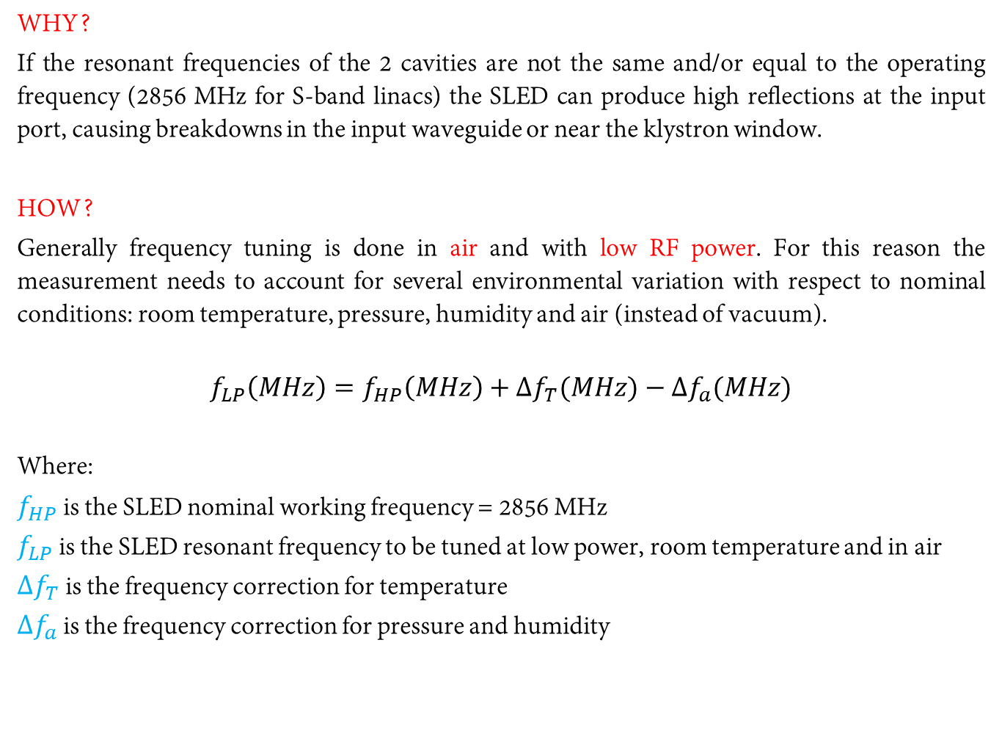
Hint: SLED tuning
WHY?
If the resonant frequencies of the 2 cavities are not the same and/or equal to the operating frequency (2856 MHz for S-band linacs) the SLED can produce high reflections at the input port, causing breakdowns in the input waveguide or near the klystron window.
HOW?
Generally frequency tuning is done in air and with low RF power. For this reason the measurement needs to account for several environmental variation with respect to nominal conditions: room temperature, pressure, humidity and air (instead of vacuum).
$$f_{LP}\left(MHz\right)=f_{HP}\left(MHz\right)+∆f_{T}(MHz)−∆f_{a}(MHz)$$
Where:
$f_{HP}$ is the SLED nominal working frequency = 2856 MHz
$f_{LP}$ is the SLED resonant frequency to be tuned at low power, room temperature and in air
${∆f}_{T}$ is the frequency correction for temperature
${∆f}_{a}$ is the frequency correction for pressure and humidity

Slide 14
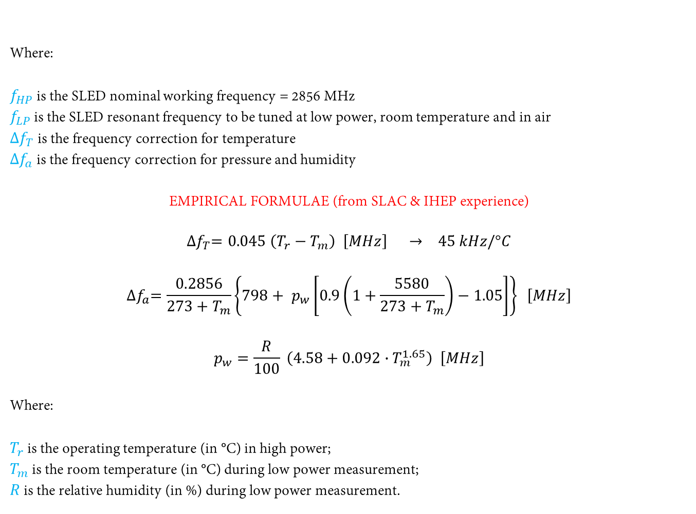
Hint: SLED tuning (finding f_{LP})
Where:
$f_{HP}$ is the SLED nominal working frequency = 2856 MHz
$f_{LP}$ is the SLED resonant frequency to be tuned at low power, room temperature and in air
${∆f}_{T}$ is the frequency correction for temperature
${∆f}_{a}$ is the frequency correction for pressure and humidity
EMPIRICAL FORMULAE (from SLAC & IHEP experience)
$${∆f}_{T}=0.045 \left(T_{r}−T_{m}\right) \left[MHz\right] → 45 kHz/°C$$
$${∆f}_{a}=\frac{0.2856}{273+T_{m}}\left\{798+ p_{w}\left[0.9\left(1+\frac{5580}{{273+T}_{m}}\right)−1.05\right]\right\} \left[MHz\right]$$
$$p_{w}=\frac{R}{100} \left(4.58+0.092∙T_{m}^{1.65}\right) \left[MHz\right]$$
Where:
$T_{r}$ is the operating temperature (in °C) in high power;
$T_{m}$ is the room temperature (in °C) during low power measurement;
$R$ is the relative humidity (in %) during low power measurement.
$$f_{LP}\left(MHz\right)=f_{HP}\left(MHz\right)+∆f_{T}(MHz)−∆f_{a}(MHz)$$

Slide 15
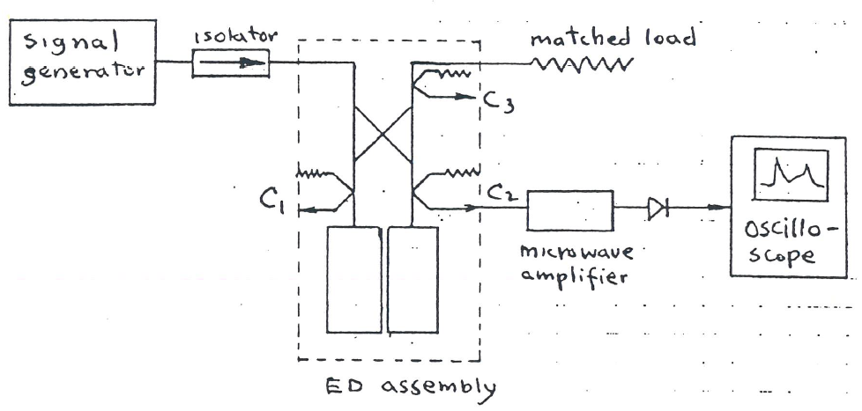
Hint: SLED tuning (single cavities)
Connect the output waveguide to a matched load;
Set-up the RF pulse:
CW signal at f_{LP}
Pulsed signal at f_{LP} (5 us length, 100 Hz rep. rate)
Display the reflection signal from each cavity on an oscilloscope (use a flat pulse without phase reversal). The connections should look like the scheme below:
Rotate the tuning screw to tune the resonant frequency of the cavity to have a minimum (dashed line). Repeat the procedure a couple of times for fine tuning.
Check the input VSWR: it should not be higher than 1.2
OSCILLOSCOPE

Slide 16
Hint: SLED tuning (sum of 2 cavities)
Once the cavities are individually tuned, the output signal of the SLED (without phase jump) should look like the one below:
Rotate the tuning screw to fine-tune the SLED output
If the cavities do not have the same response (different Q₀ or different β), the optimum might not be where one expects…
OSCILLOSCOPE

