Slide 1
Executive Summary
Hybrid Stave status
Stave/0 Status
Stave/1 Status
Planning

Slide 2
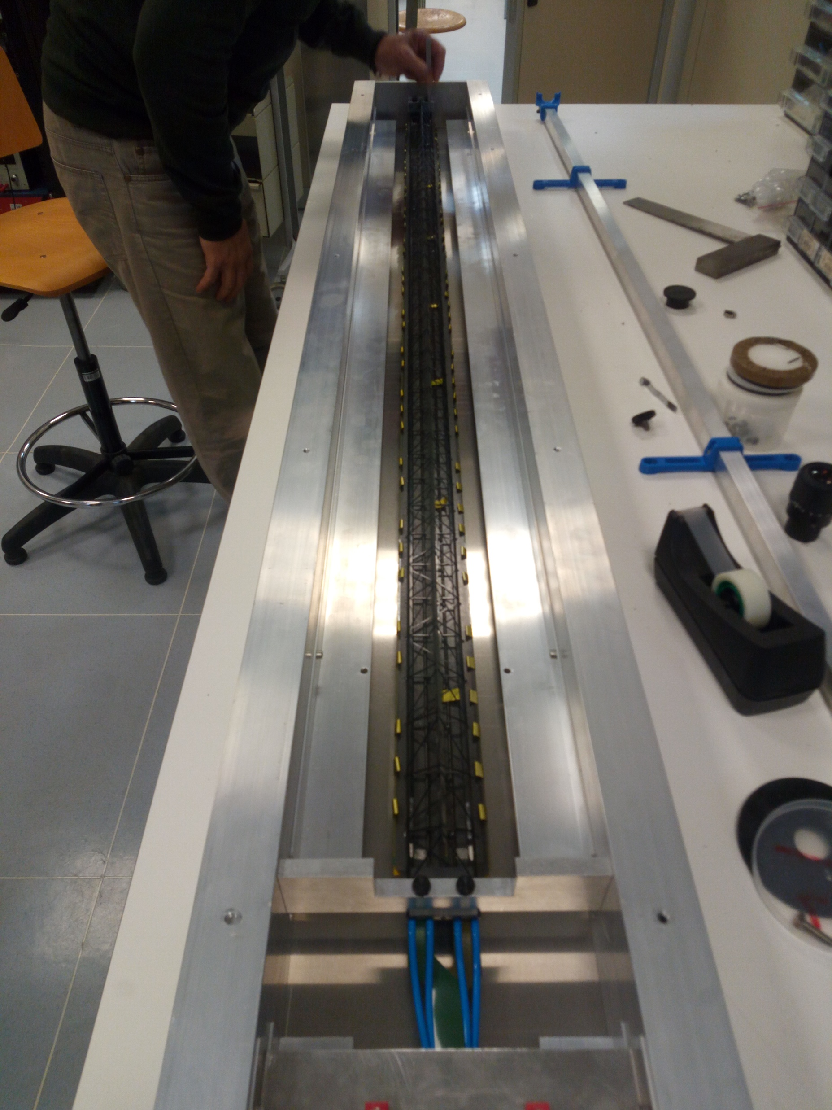
Hybrid Stave
U-Arms glued with 2-min standard araldite
Stave moved (with PB folded) into transport box
To be shipped to CERN for insertion test (date TBD)

Slide 3
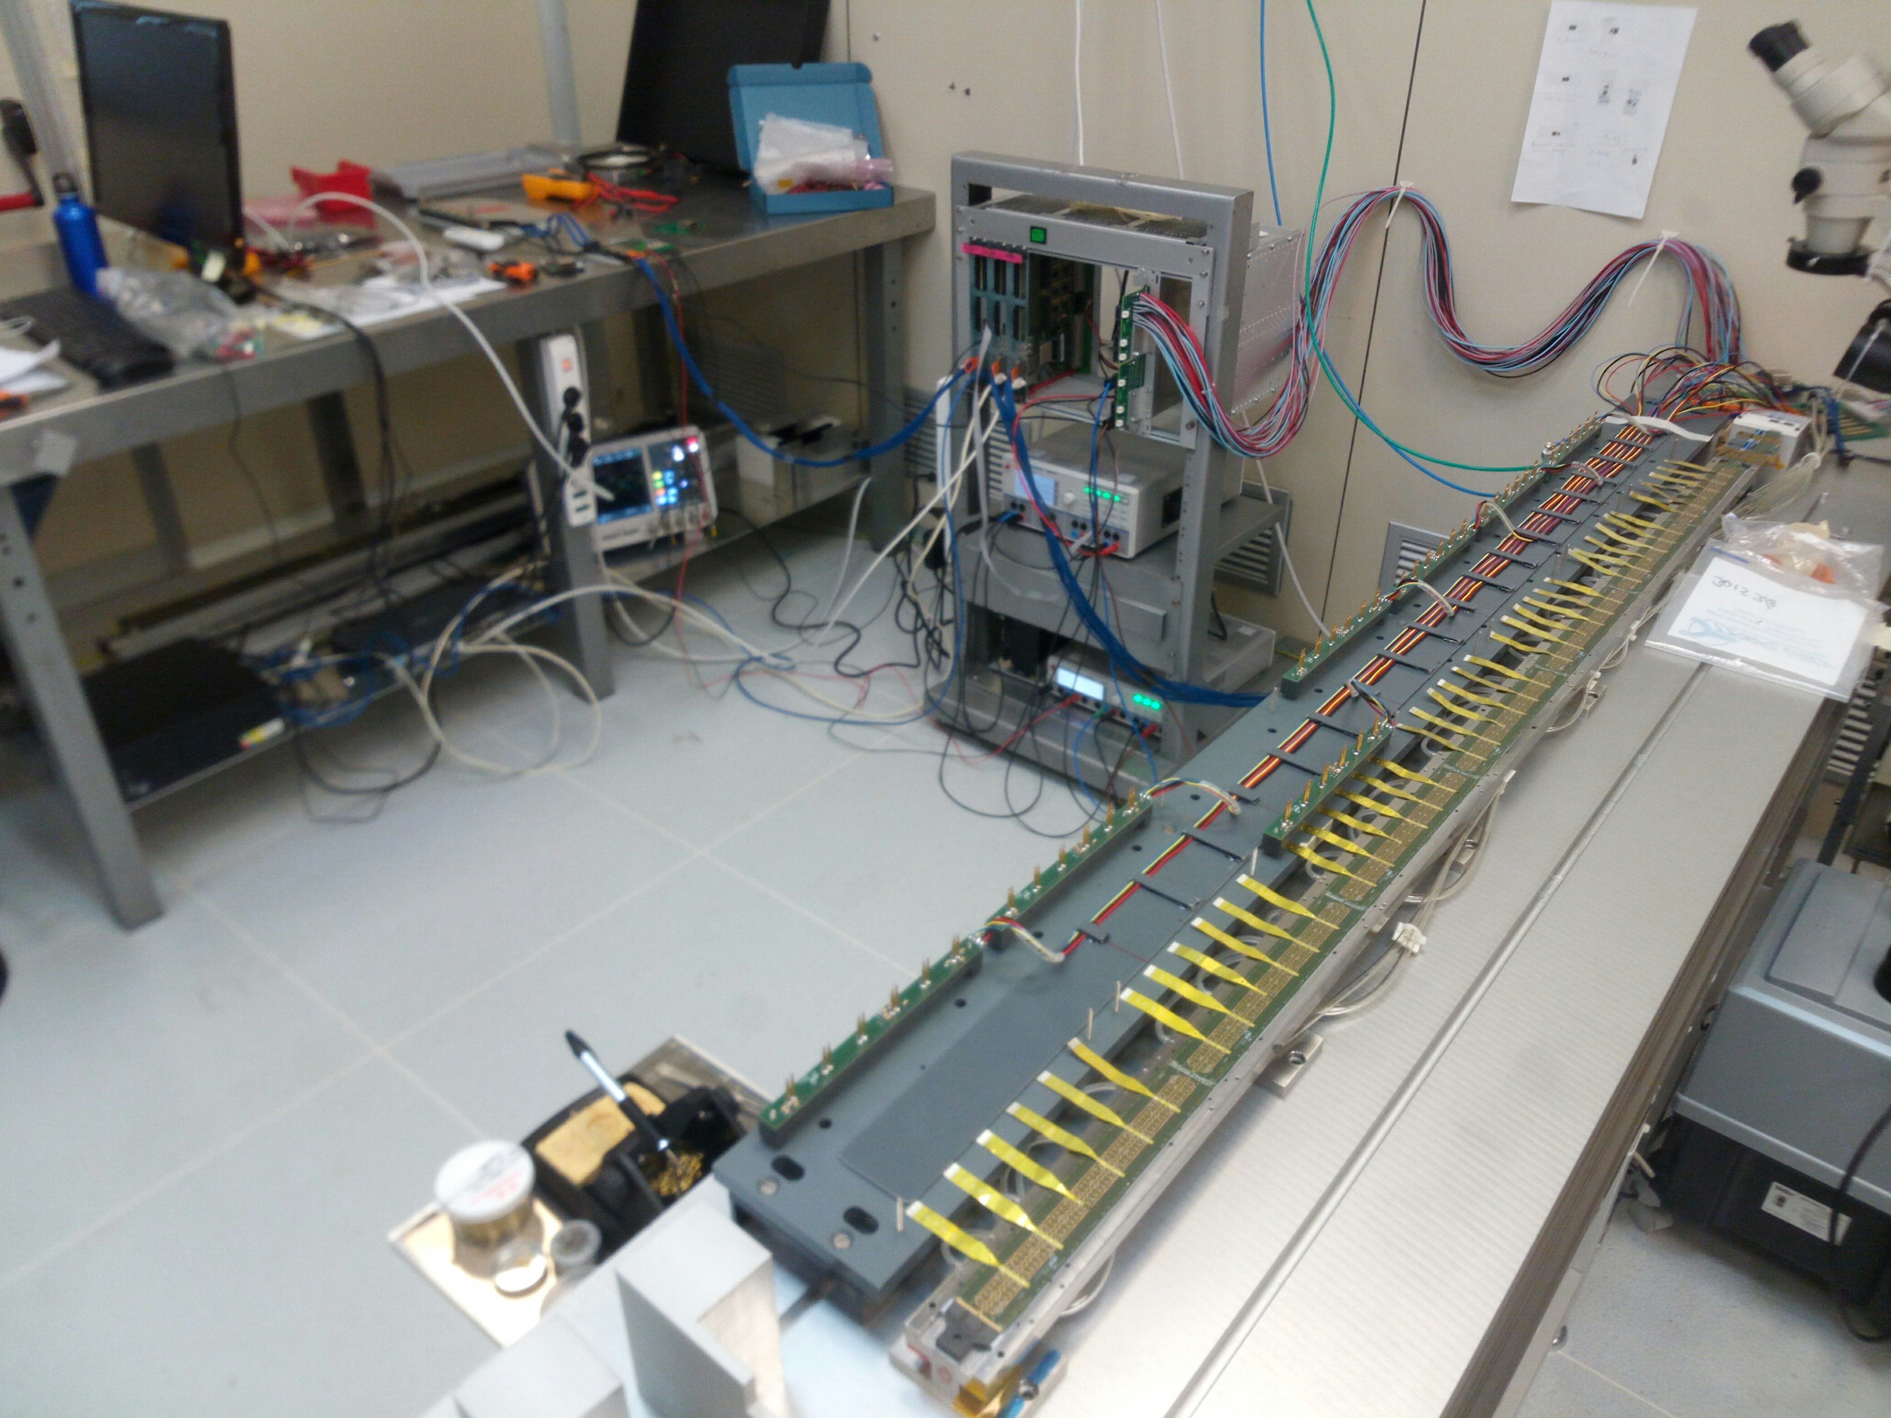
Stave Zero
Vacuum pumps stopped
Main pump oil refill
Secondary pumps installation
HS fixed with tape, cannot be moved
HS0-Right/Upper
Fully cabled
Basic scans: done
Th. Scan: done
need to check the data
Issue writing the DC
If scan OK then glue U-Arms
Light cover being finalized
Next: repeat scan with light cover and swap with HS0-Left/Lower

Slide 4
Stave Zero
Restart Pumps
HS0-Left/Lower
Perform R/O tests
Glue U-arms
Stave Zero Setup (Grey Area)
Prepare Power Busses
Condensers
Filter Boards
Bridges

Slide 5
Stave One
HIC delivered: 5 AL + 1 BL + 8 AR + 1 BL
- AL000255
- AL000299
- AL000300
- AL000379
- AL000449
- BL000057
Activity on incoming HICs
Reception tests
Tab Cuts
Fast Power tests
Mock Up
- AR000390
- AR000391
- AR000392
- AR000393
- AR000394
- AR000395
- AR000396
- AR000505
- BR000314

Slide 6
Material Inventory
Arrived / Purchased
PB capacitors
Filter Boards
Filter Boards bridges
New gluing masks
2011 glue (LNF)
Tweezers (LNF)
U-Arms
Cold plate and Space Frame
Need to empty all Cold Plate and Space Frame tubes and send them and the boxes back to CERN
Mock Up

Slide 7
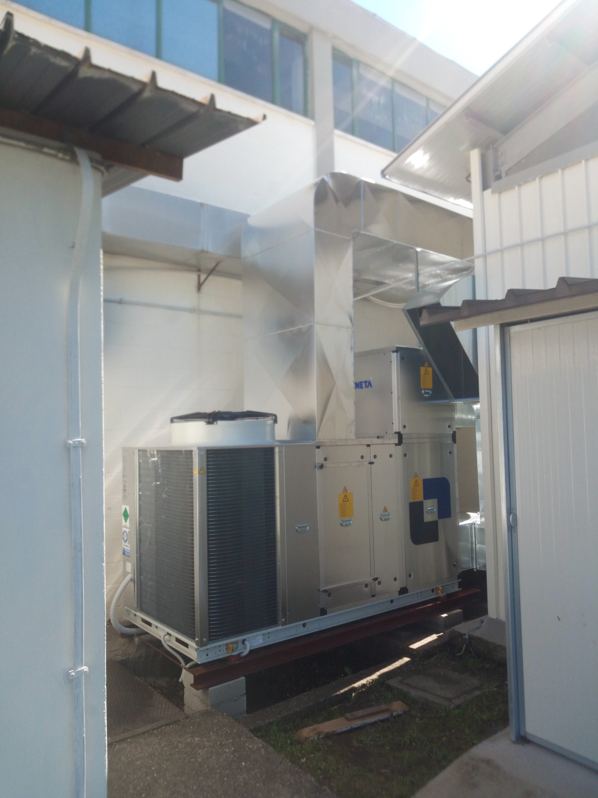
Infrastructure
Mock Up
Main ASTRA building heat pump being installed…

Slide 8
Planning
Hybrid Stave: finished, to be sent to CERN
Stave Zero
Finish HS0/R/U threshold scan, install U-Arms, repeat scan with cover
Restart pumps
Swap HS-0 Right and Left, perform scans on HS0-L, align HS-R
Prepare Power Bus
Stave One
Test and cut incoming HICs
23-24 OL Workshop in Daresbury
https://docs.google.com/spreadsheets/d/1eAJ7x8eKxwaejOACInSw65XRYKLIWqt51Y3jNUWw0vw/edit?pli=1#gid=1263503287

