Slide 1
Status and prospects of computing at IHEP
Xiaomei Zhang
IHEP Computing Center
April 4, 2018, CNAF

Slide 2
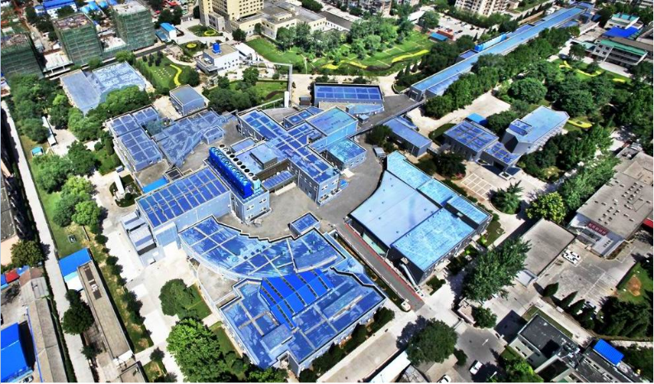
IHEP at a Glance
Institute of High Energy Physics, CAS, Beijing, China
The largest fundamental research center in China
Particle physics, AstroParticle physics, Accelerator and synchrotron radiation technology and applications
The major institute conducts the high energy physics experiments in China

Slide 3
. BES/CEPC/DYB/JUNO/LHAASO
Experiments and challenges

Slide 4
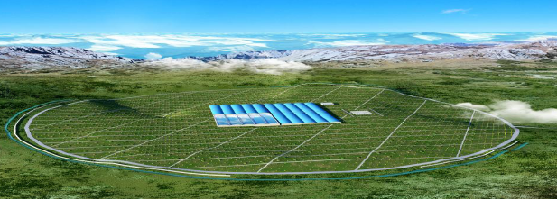
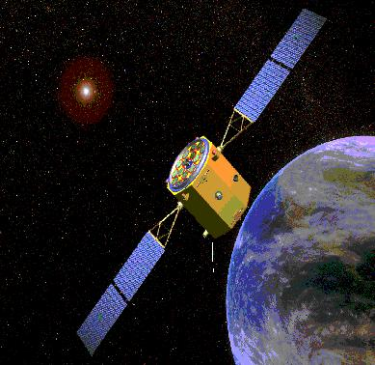
Experiments at IHEP
BESIII (Beijing Spectrometer III at BEPCII)
DYB (Daya Bay Reactor
Neutrino Experiment)
JUNO (Jiangmen Underground
Neutrino Observatory)
e+
IP1
e-
LTB
BTC
e+ e- Linac
(240m)
BTC
CEPC Collider Ring(50Km)
Booster(50Km)
IP2
YBJ (Tibet-ASgamma
ARGO-YBJ
Experiments)
LHAASO
HXMT
Large High Altitude Air Shower Observatory
Hard X-Ray Moderate Telescope

Slide 5
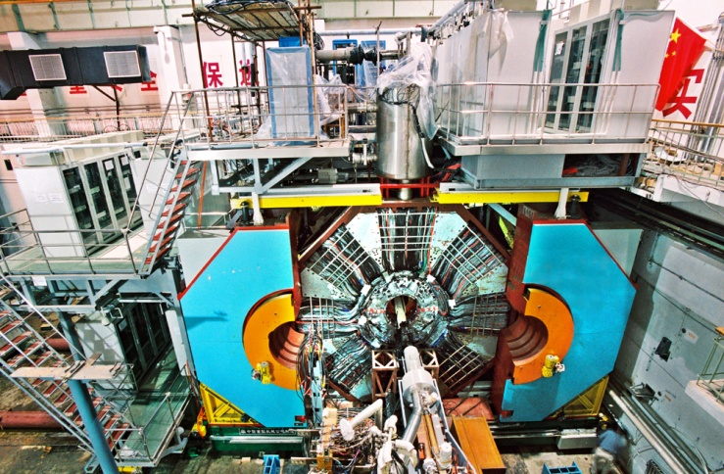
BEPCII/BESIII
BEPC: Beijing Electron-Positron Collider
BES: BEijing Spectrometer, general-purpose detector located on BEPC
upgrade: BEPCII/BESIII, operational in 2008
2.0 ~ 4.6 GeV/C
(3~10)×10³² cm⁻²s⁻¹
Produce 100TB/year, 5PB in total for 5 years
5000 Cores for data process and physics analysis

Slide 6
CEPC
Next Generation Accelerator in China after BEPCII which will complete its mission about 2021
Two phases
CEPC (Circular Electron Positron Collider, e+e- ~ Higgs/Z factory)
Precision measurement of the Higgs/Z boson, about 12 years
Beam energy ~120 GeV
Estimated to produce 200TB/year for Higgs factory and >100PB/year for Z factory
SPPC(Super Proton Proton Collider, pp ~ A discovery machine)
Discover new physics
Beam energy ~50TeV
Estimated to produce 100PB/year

Slide 7
CEPC
CEPC collider is planed to build with the 50/100KM ring at QingHuangDao close to Beijing
CEPC timetable
Pre-study, R&D and preparation work
pre-study: 2013-2015
R&D: 2016-2020
Engineering Design: 2015-2020
Construction: 2021-2027
Data taking: 2028-2035
e+
IP1
e-
LTB
BTC
e+ e- Linac
(240m)
BTC
Booster(50Km)
CEPC Collider Ring(50Km)
IP2

Slide 8
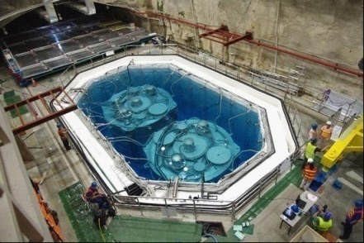
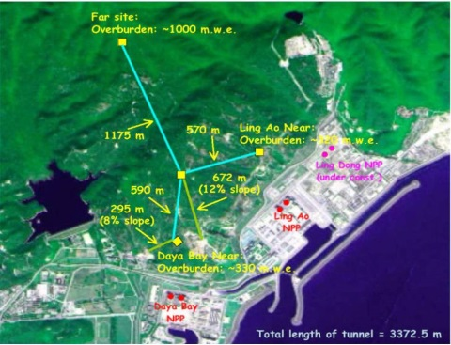
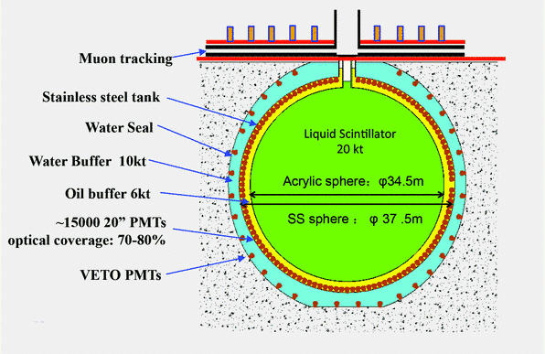
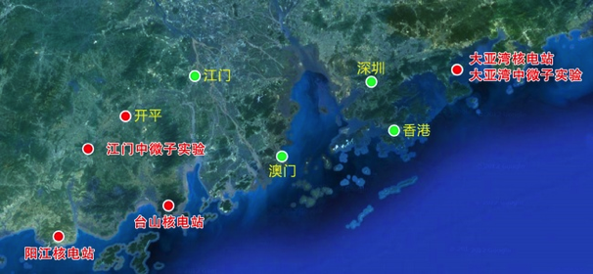
Neutrino Experiments
Daya Bay Reactor Neutrino Experiment
To measure the mixing angle θ₁₃
300 collaborators from 38 institutions
Produces ~200TB/Year (2011-2018)
JUNO - Jiangmen Underground Neutrino Observatory
Start to build in 2014, operational in 2020
20 kt LS detector
2-3% energy resolution
Rich physics opportunities
Estimated to produce 2PB data/year for 10 years

Slide 9
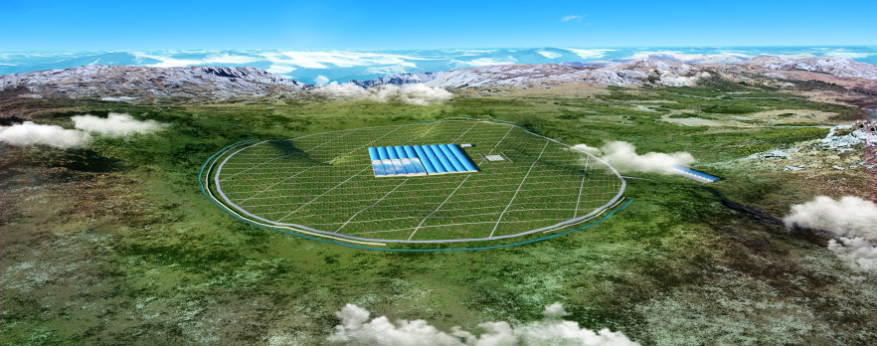
LHAASO
Large High Altitude Air Shower Observatory, located on the border of Sichuan and Yunnan Province
Multipurpose project with a complex detector array for high energy gamma ray and cosmic ray detection
Expected to be operational in 2019
~1.2PB data/year * 10 Years
On-site storage and computing resources. Data will be filtered and compressed before transferring back to IHEP

Slide 10
.Computing .Storage .Network
Computing environment at IHEP

Slide 11
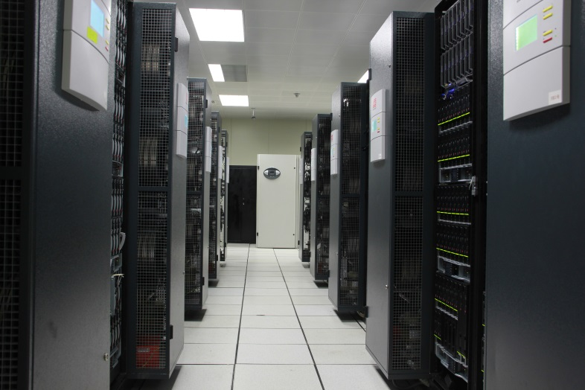
HTC Computing resources
Local clusters
16,000 CPU cores
Scheduler:
PBS/Maui (before)
HTCondor (now)
Grid site (WLCG)
1,200 CPU Cores, CreamCE
1PB for CMS and Atlas
Going to support LHCb this year
The DIRAC-based distributed computing system for BESIII, JUNO..
~ 3,500 CPU cores
IHEPCloud based on Openstack
~ 700 CPU cores

Slide 12
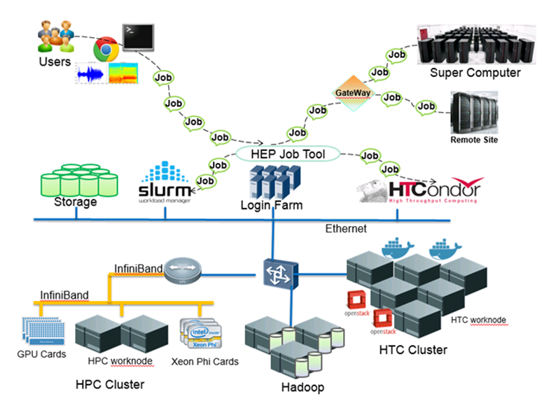
HPC farm
HPC farm is being built up last year in IHEP using SLURM, to support
BESIII partial wave analysis, Geant4 detector simulation (CPU time and memory consuming), Simulation and modelling for accelerator design, Lattice QCD calculation
Machine learning applications in IHEP experiments

Slide 13
Storage
Lustre as main disk storage
Capacity: 9 PB with 60 disk servers
Gluster system
350TB storage provided for cosmic-ray experiments
DPM & dCache
1PB, With SRM interface
HSM, with Modified CASTOR
2 tape libraries + 2 robots, 26 drives
Capacity: 5 PB

Slide 14
Storage
EOS
797TB, Beryl v0.3.195, 5 servers
For LHAASO
DPB
dCache
AFS
CVMFS
NFS
Gluster
CASTOR
0

Slide 15
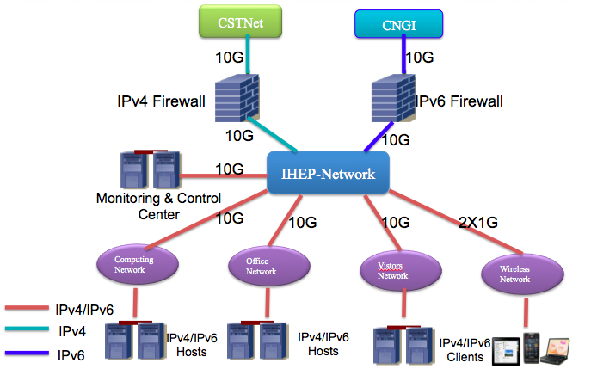
Local network
The largest campus network and bandwidth among all CAS institutes
10G backbone
IPv4/IPv6 dual-stack
Wireless covered
>3000 end users

Slide 16
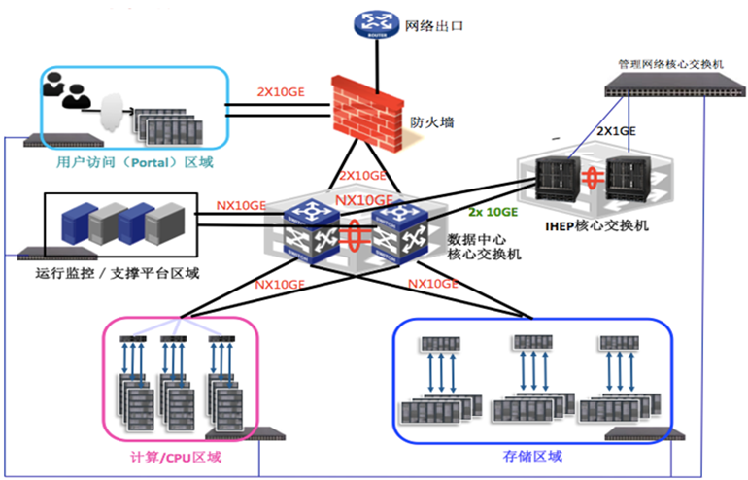
Data Center network
160 Gbps (4X40Gbps) for Layer2 Switches
2X10 Gbps for storage nodes

Slide 17
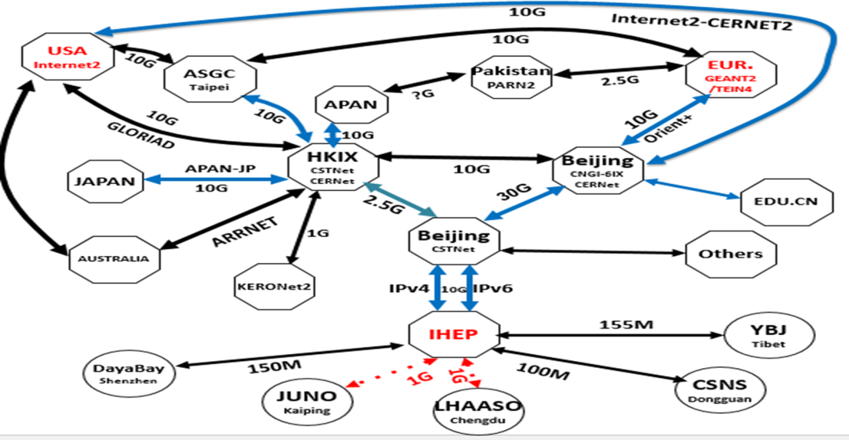
International and domestic links
Dedicated Links for three other IHEP sites
Shenzhen (Dayabay)
Dongguan (CSNS)
Tibet (YBJ/ARGO)
Kaiping (JUNO)
Chengdu (LHAASO)
Good Internet connections
IHEP-Europe: 10 Gbps
IHEP-USA: 10 Gbps
Join LHCOne this year
Dedicated 20Gb/s are added
Switching Tier2 to LHCOne
Non-LHC experiments applying to join
17

Slide 18
.Distributed computing .Virtualization and cloud .Volunteer Computing .Software Defined Network
Research activities

Slide 19
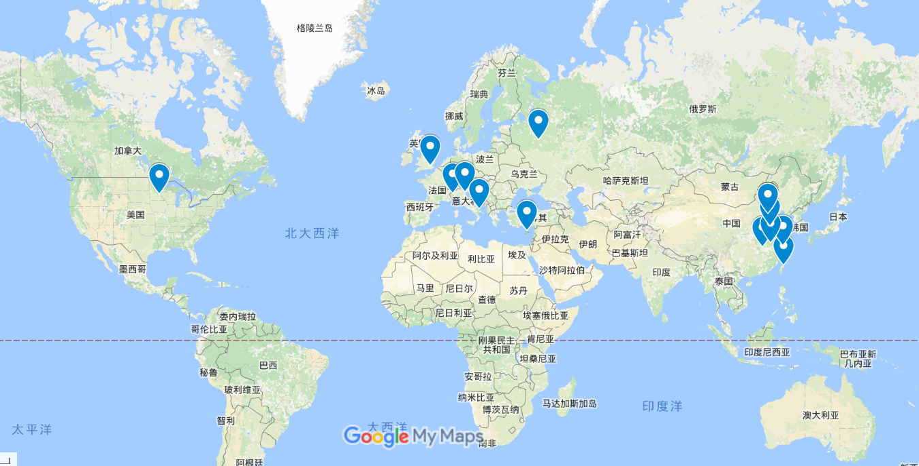
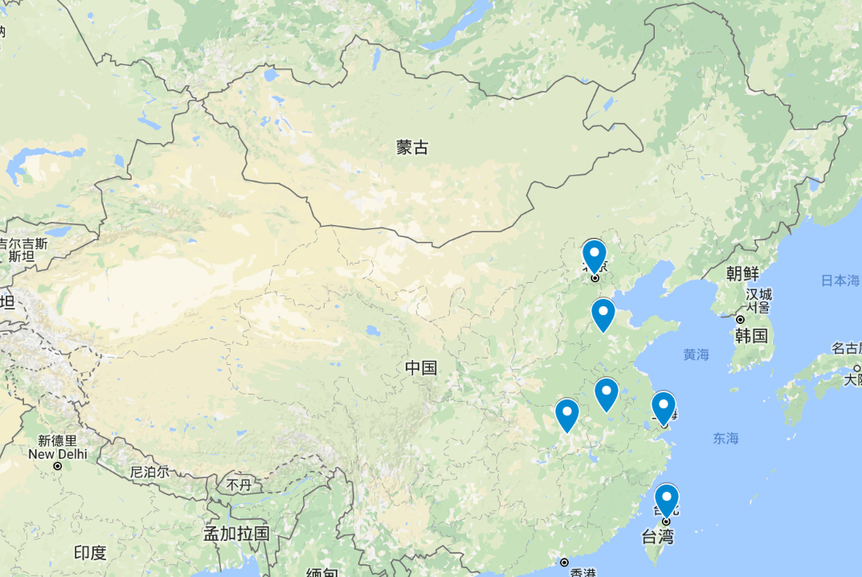
DIRAC-based Distributed Computing
Have developed the distributed computing system with DIRAC in collaboration with JINR.
Currently is being used by several experiments, including BESIII, JUNO, CEPC
15 Sites from USA, Italy, Russia, Turkey, Taiwan, Chinese Universities etc.
3500 cores, 500TB
10Gb/s
IHEP
10Gb/s
10Gb/s
19

Slide 20
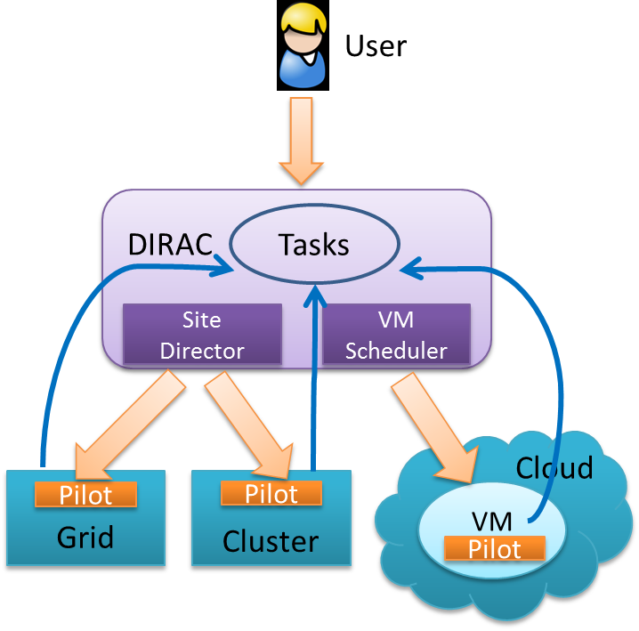
DIRAC-based Distributed Computing
4 resource type resources are supported
Grid, Cluster, Cloud and Volunteer computing
Distributed computing has successfully integrated cloud resources based on pilot schema, implementing elastic scheduling according to job requirements
Now there are 7 cloud resources joining

Slide 21
Multi-core supports in distributed computing
In order to support JUNO’s multi-core jobs, Multi-core(Mcore) scheduling is being studied
Single-core scheduling: One-core pilot pull one-core job (A)
multi-core scheduling: Two ways are considered
Mcore pilots added to pull Mcore jobs (B)
M-core pilots pull M-core jobs
Pilot “starving” when matching with mixture of n-core job (n=1, 2…)
Standard-size pilots with dynamic slots (C)
Standard-size: whole-node, 4-node, 8-node….
Pilots pull n-core jobs (n=1, 2…..) until all internal slots are used up
13

Slide 22
Virtualization and Cloud (1)
IHEPCloud has been built and launched in May 2014
Scale
Resources : 700 cores
Users: > 1000
Three current use cases
Self-Service virtual machine platform
Mainly for testing and development
Virtual Computing Cluster
automatically supplement when physical queue is busy
Distributed computing system
Work as a cloud site

Slide 23
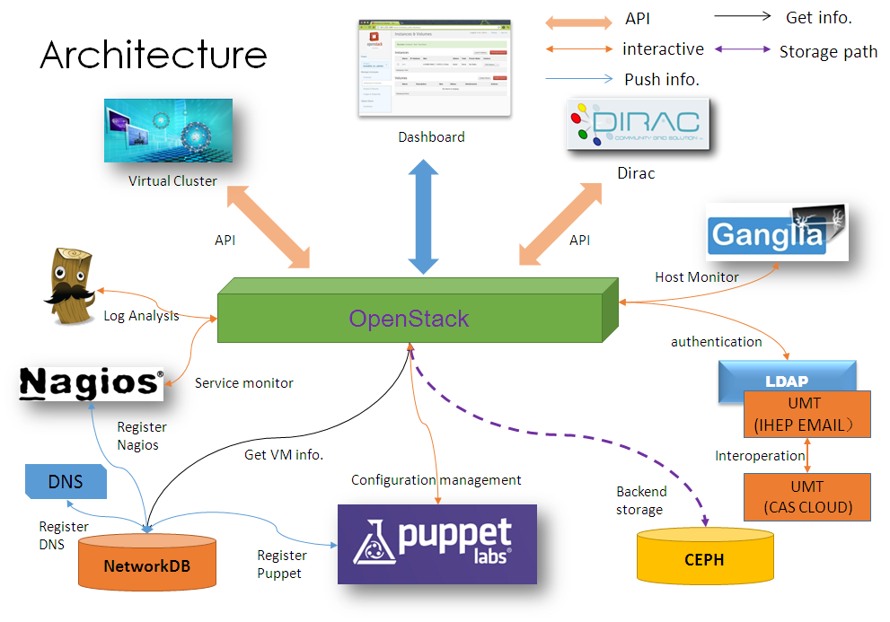
Virtualization and Cloud (2)
Core middleware: openstack
Configuration management tool: Puppet
Automatically VM images for different applications
Authentication
SSO with Email account
External storage
Using CEPH to support GLANCE, NOVA and Cinder

Slide 24
Volunteer Computing – CAS@HOME
CAS@HOME was Launched and hosted in June 2010
First volunteer computing project in China
Support scientific computing from Chinese Academy of Sciences and other Research Institutes
Host multiple applications from various research fields, including nanotechnology, bioinformation, physics
10K active users
1/3 are Chinese
23K active hosts
1.3 TFLOPS
(real time computing power)

Slide 25
Volunteer Computing – ATLAS@HOME
IHEP involved in the prototype of ATLAS@home and mainly contributed to solve three problems ( host virtualization, platform integration, security)
The first ATLAS@home was deployed and maintained at IHEP in 2013, and moved to CERN in 2014
IHEP contributes manpower in maintaining and upgrading ATLAS@home
Use virtualization to run ATLAS jobs on heterogeneous computers
Event display on BOINC GUI
Support of Multiple core jobs
Use ATLAS@home to exploit extra CPU from Grid sites and any clusters
BOINC scheduling optimization

Slide 26
SDN (1)
Motivation
Massive data sharing and exchanging among HEP experiments collaborating sites
Virtualization and scaling-up of computing and storage resources require more flexible and automatic network
Easier control over network facility and infrastructure
IPv4 performance differences among the collaborating sites
Goals
A Private Virtual Network across Chinese HEP Experiment collaborating sites Based on SDN architecture
An intelligent data transfer network route selection algorithm
Based on IPV6 among Chinese collaborating sites, but transparent to IPV4 applications

Slide 27
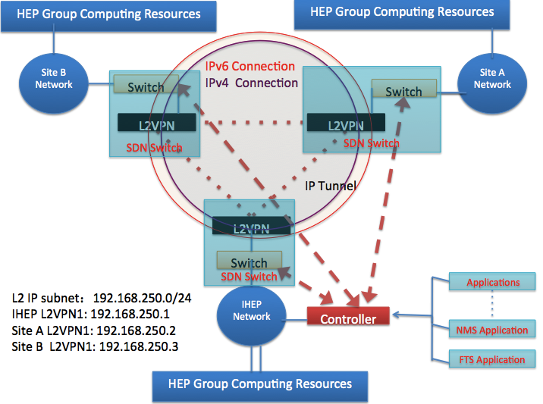
SDN (2)
Components
End user network
Backbone network（IPv6）
L2VPN gateway
Openflow switch
Control center
Participants
IHEP/SDU/SJTU/…
CSTNet / CERNet
Ruijie networks
Network path | IPv4 (Mbps) | IPv6 (Mbps) | SDN (Mbps)
SDU-IHEP | 3.15 | 12.60
SDU-SJTU | 3.51 | 66.40
SJTU-IHEP | 28.60 | 380.00
SDU-SJTU-IHEP |  |  | 38.60

