Slide 1
What is the wavefunction?
A realist approach in Bohm’s theory
Davide Romano

Slide 2
Interpreting quantum mechanics: Bohm’s theory
Bohm’s theory is usually regarded as an artificial theory, for it adds “unobservable entities” (particles) and “unobservable structures” (particle trajectories) to standard quantum mechanics.
But…is this true?
1. Particles exist also in quantum mechanics (after the collapse)
2. The uncertainty principle prevents to have trajectories in QM only if interpreted in ontological terms. If the uncertainty relations are epistemic (Ballentine, Bowman), trajectories are perfectly compatible with it.
OK, but how Bohm’s theory comes from QM?

Slide 3
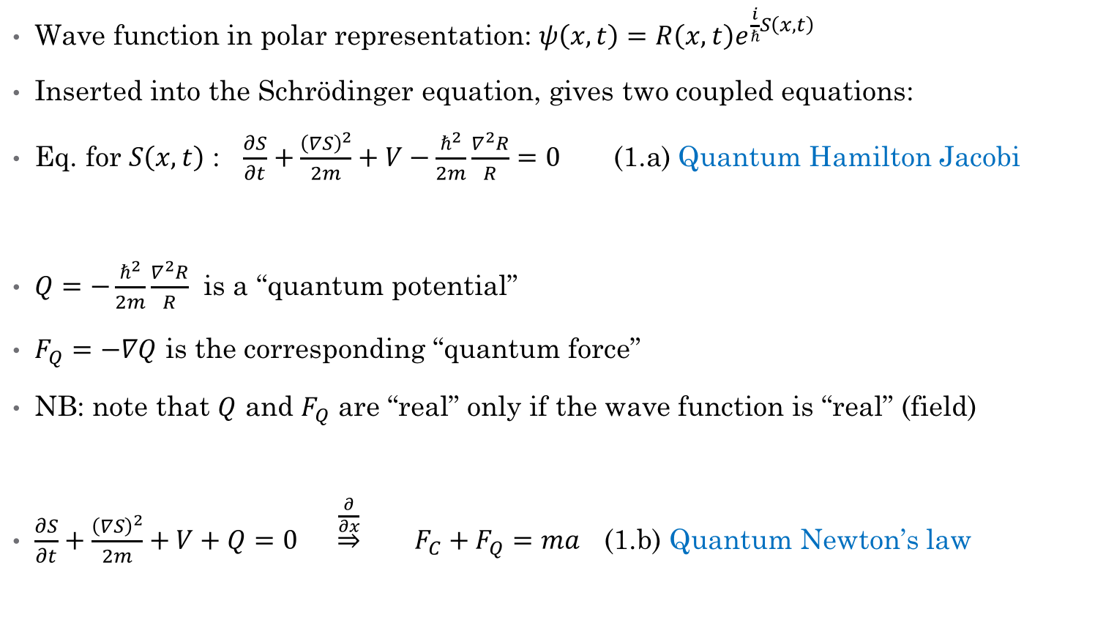
Bohm’s theory from quantum mechanics
Wave function in polar representation: $ψ\left(x,t\right)=R\left(x,t\right)e^{\frac{i}{ℏ}S\left(x,t\right)}$
Inserted into the Schrödinger equation, gives two coupled equations:
Eq. for $S\left(x,t\right)$ : $\frac{∂S}{∂t}+\frac{{\left(∇S\right)}^{2}}{2m}+V−\frac{ℏ^{2}}{2m}\frac{∇^{2}R}{R}=0$ (1.a) Quantum Hamilton Jacobi
$Q=−\frac{ℏ^{2}}{2m}\frac{∇^{2}R}{R}$ is a “quantum potential”
$F_{Q}=−∇Q$ is the corresponding “quantum force”
NB: note that $Q$ and $F_{Q}$ are “real” only if the wave function is “real” (field)
$\frac{∂S}{∂t}+\frac{{\left(∇S\right)}^{2}}{2m}+V+Q=0$ $\underset{⇒}{\frac{∂}{∂x}}$ $F_{C}+F_{Q}=ma$ (1.b) Quantum Newton’s law

Slide 4
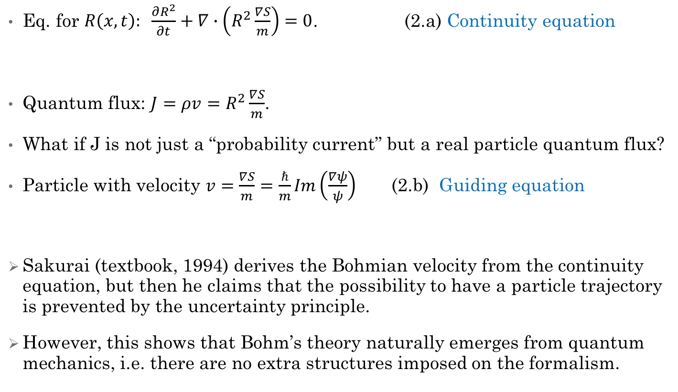
Bohm’s theory from quantum mechanics
Eq. for $R\left(x,t\right): \frac{∂R^{2}}{∂t}+∇∙\left(R^{2}\frac{∇S}{m}\right)=0$. (2.a) Continuity equation
Quantum flux: $J=ρv=R^{2}\frac{∇S}{m}$.
What if J is not just a “probability current” but a real particle quantum flux?
Particle with velocity $v=\frac{∇S}{m}=\frac{ℏ}{m}Im\left(\frac{∇ψ}{ψ}\right)$ (2.b) Guiding equation
Sakurai (textbook, 1994) derives the Bohmian velocity from the continuity equation, but then he claims that the possibility to have a particle trajectory is prevented by the uncertainty principle.
However, this shows that Bohm’s theory naturally emerges from quantum mechanics, i.e. there are no extra structures imposed on the formalism.

Slide 5
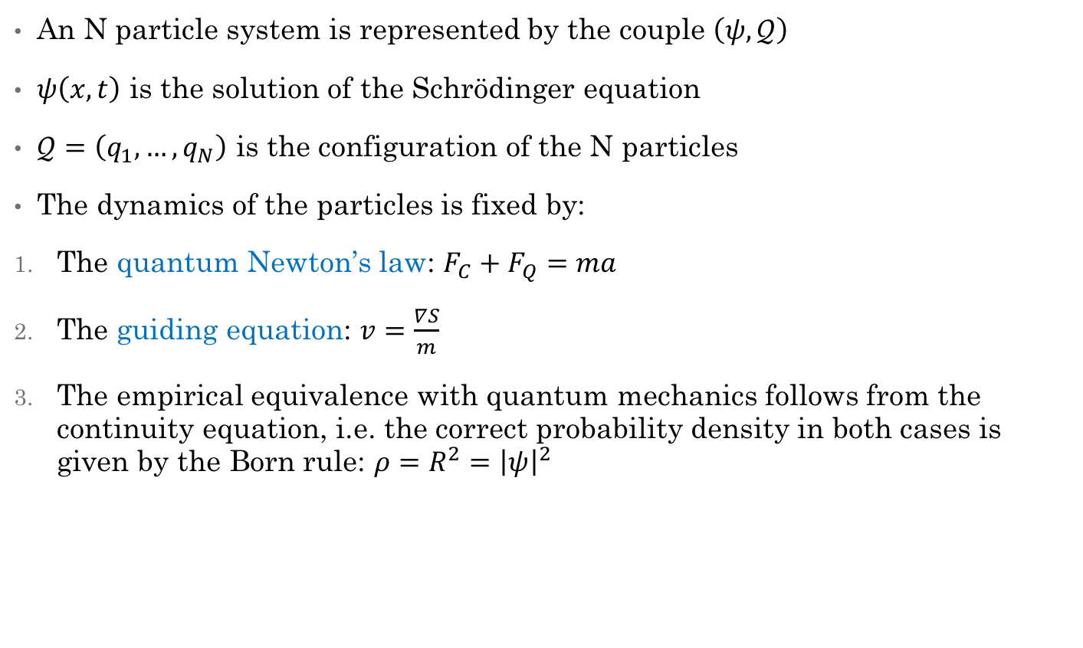
Bohm’s theory (1952)
An N particle system is represented by the couple $\left(ψ,𝒬\right)$
$ψ\left(x,t\right)$ is the solution of the Schrödinger equation
$𝒬=\left(q_{1}, …, q_{N}\right)$ is the configuration of the N particles
The dynamics of the particles is fixed by:
The quantum Newton’s law: $F_{C}+F_{Q}=ma$
The guiding equation: $v=\frac{∇S}{m}$
The empirical equivalence with quantum mechanics follows from the continuity equation, i.e. the correct probability density in both cases is given by the Born rule: $ρ={R^{2}=\left|ψ\right|}^{2}$

Slide 6
The wave function in Bohm’s theory
The physics of Bohm’s theory is clear (even if not always intuitive)
What about the metaphysics of the theory?
Particle configuration, OK!
Wave function?
Problem 1: it is a function defined in configuration space
Problem 2: it is a complex function (it takes on complex values)
Two options in the literature:
1. The wave function is a physical field in configuration space
  (Albert, Valentini, Holland)
2. The wave function is a nomological entity
  (Goldstein & Zanghì, Allori)

Slide 7
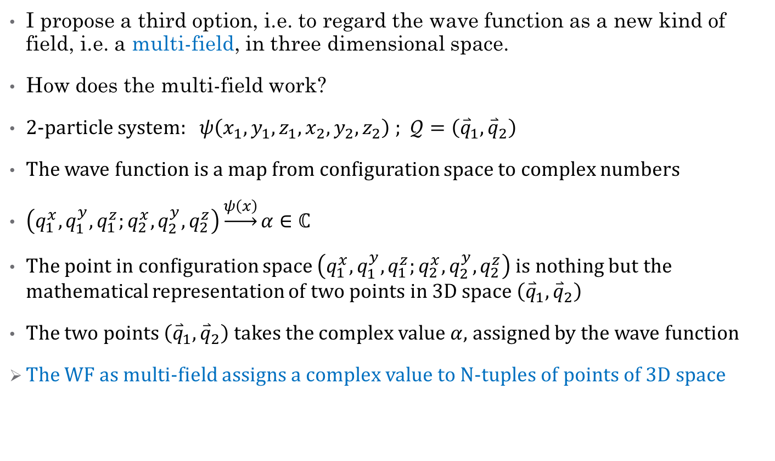
The wave function as multi-field
I propose a third option, i.e. to regard the wave function as a new kind of field, i.e. a multi-field, in three dimensional space.
How does the multi-field work?
2-particle system: $ψ\left(x_{1},y_{1},z_{1},x_{2},y_{2},z_{2}\right)$ ; $𝒬=\left({\overset{⃑}{q}}_{1},{\overset{⃑}{q}}_{2}\right)$
The wave function is a map from configuration space to complex numbers
$\left(q_{1}^{x},q_{1}^{y},q_{1}^{z};q_{2}^{x},q_{2}^{y},q_{2}^{z}\right)\underset{→}{ψ\left(x\right)}α∈ℂ$
The point in configuration space $\left(q_{1}^{x},q_{1}^{y},q_{1}^{z};q_{2}^{x},q_{2}^{y},q_{2}^{z}\right)$ is nothing but the mathematical representation of two points in 3D space $\left({\overset{⃑}{q}}_{1},{\overset{⃑}{q}}_{2}\right)$
The two points $\left({\overset{⃑}{q}}_{1},{\overset{⃑}{q}}_{2}\right)$ takes the complex value $α$, assigned by the wave function
The WF as multi-field assigns a complex value to N-tuples of points of 3D space

Slide 8
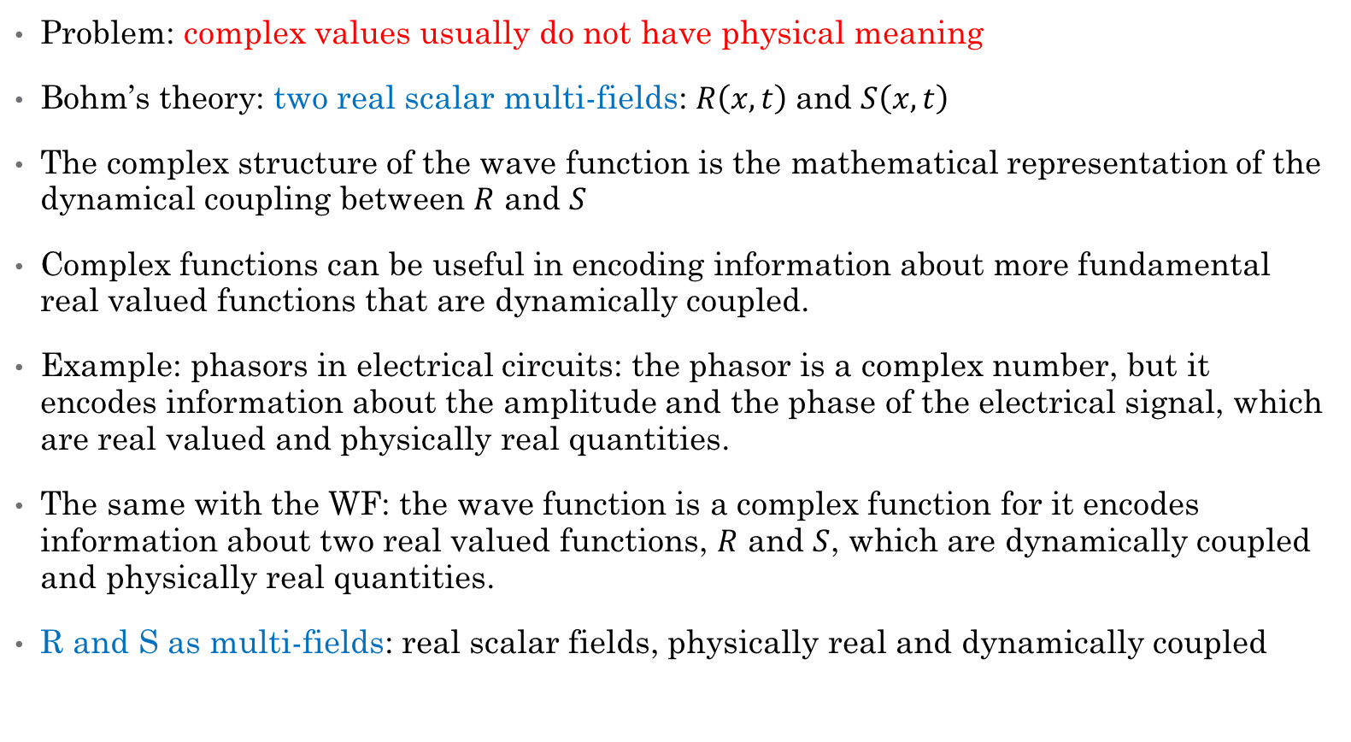
Multi-field as real scalar field
Problem: complex values usually do not have physical meaning
Bohm’s theory: two real scalar multi-fields: $R\left(x,t\right)$and $S\left(x,t\right)$
The complex structure of the wave function is the mathematical representation of the dynamical coupling between $R$ and $S$
Complex functions can be useful in encoding information about more fundamental real valued functions that are dynamically coupled.
Example: phasors in electrical circuits: the phasor is a complex number, but it encodes information about the amplitude and the phase of the electrical signal, which are real valued and physically real quantities.
The same with the WF: the wave function is a complex function for it encodes information about two real valued functions, $R$ and $S$, which are dynamically coupled and physically real quantities.
R and S as multi-fields: real scalar fields, physically real and dynamically coupled

Slide 9
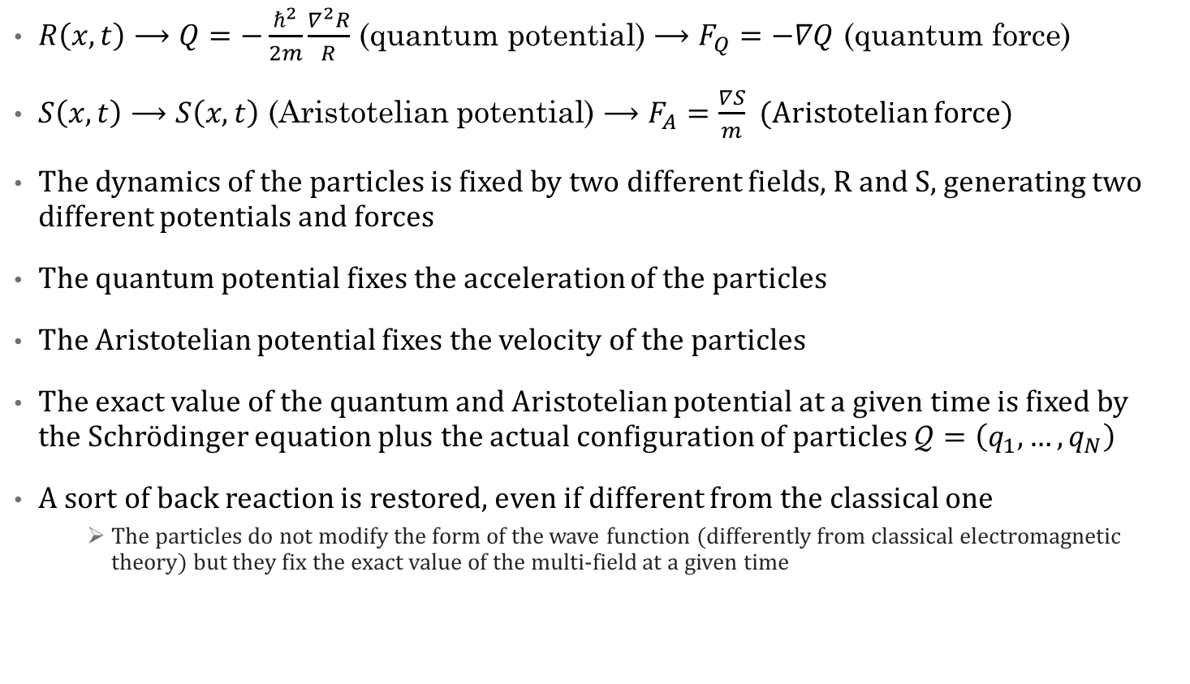
Multi-fields generate potentials and forces
$R\left(x,t\right)⟶Q=−\frac{ℏ^{2}}{2m}\frac{∇^{2}R}{R}$ (quantum potential) $⟶F_{Q}=−∇Q$ (quantum force)
$S\left(x,t\right)⟶S\left(x,t\right)$ (Aristotelian potential) $⟶F_{A}=\frac{∇S}{m}$ (Aristotelian force)
The dynamics of the particles is fixed by two different fields, R and S, generating two different potentials and forces
The quantum potential fixes the acceleration of the particles
The Aristotelian potential fixes the velocity of the particles
The exact value of the quantum and Aristotelian potential at a given time is fixed by the Schrödinger equation plus the actual configuration of particles $𝒬=\left(q_{1},…,q_{N}\right)$
A sort of back reaction is restored, even if different from the classical one
    The particles do not modify the form of the wave function (differently from classical electromagnetic theory) but they fix the exact value of the multi-field at a given time

Slide 10
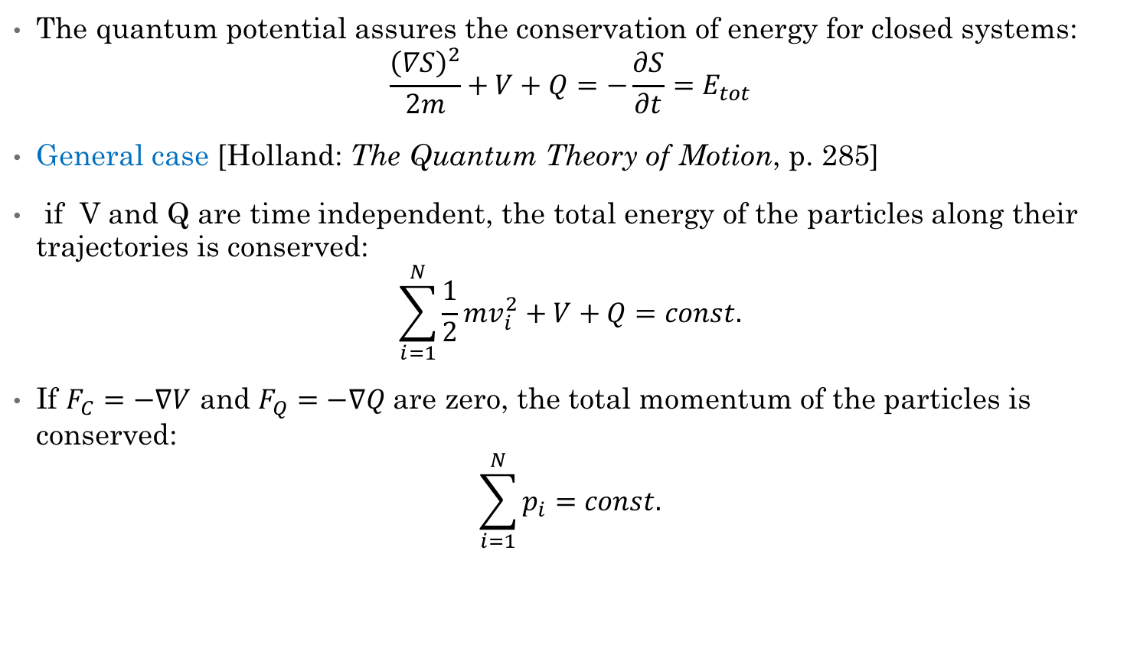
Conservation of energy
The quantum potential assures the conservation of energy for closed systems:
$$\frac{{\left(∇S\right)}^{2}}{2m}+V+Q=−\frac{∂S}{∂t}=E_{tot}$$
General case [Holland: The Quantum Theory of Motion, p. 285]
if V and Q are time independent, the total energy of the particles along their trajectories is conserved:
$$\sum_{i=1}^{N}{\frac{1}{2}mv_{i}^{2}+V+Q=const.}$$
If $F_{C}=−∇V$ and $F_{Q}=−∇Q$are zero, the total momentum of the particles is conserved:
$$\sum_{i=1}^{N}{p_{i}=const.}$$

Slide 11
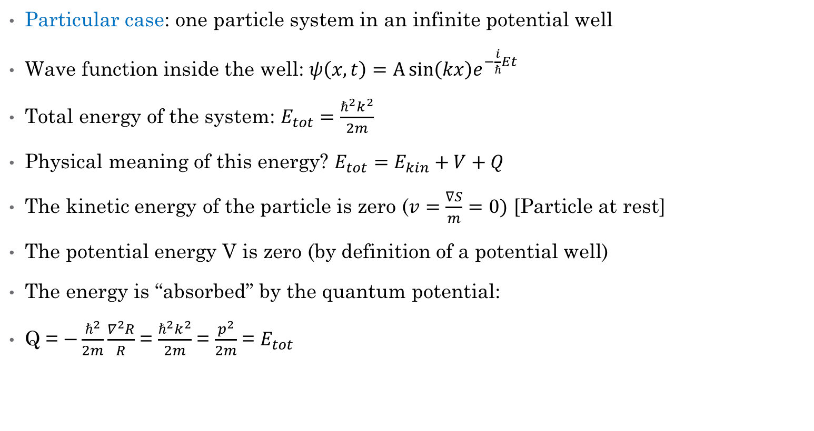
Conservation of energy
Particular case: one particle system in an infinite potential well
Wave function inside the well: $ψ\left(x,t\right)=A\sin\left(kx\right)e^{−\frac{i}{ℏ}Et}$
Total energy of the system: $E_{tot}=\frac{ℏ^{2}k^{2}}{2m}$
Physical meaning of this energy? $E_{tot}=E_{kin}+V+Q$
The kinetic energy of the particle is zero ($v=\frac{∇S}{m}=0)$ [Particle at rest]
The potential energy V is zero (by definition of a potential well)
The energy is “absorbed” by the quantum potential:
Q = $−\frac{ℏ^{2}}{2m}\frac{∇^{2}R}{R}$ = $\frac{ℏ^{2}k^{2}}{2m}$ = $\frac{p^{2}}{2m}$ = $E_{tot}$

Slide 12
Next steps and open issues
Multi-field and Relativity
Extension to quantum field theory

Slide 13
References
P. Holland (1993), The Quantum Theory of Motion. An Account of the de Broglie-Bohm Causal Interpretation of Quantum Mechanics, Cambridge University Press, Cambridge.
M. Hubert & D. Romano, The wave-function as a multi-field, European Journal for Philosophy of Science, 1-17, forthcoming.
D. Romano, Multi-field and Bohm’s theory, in preparation.

