Slide 1
Executive Summary
Hybrid Stave status
Stave Zero Status
Planning

Slide 2
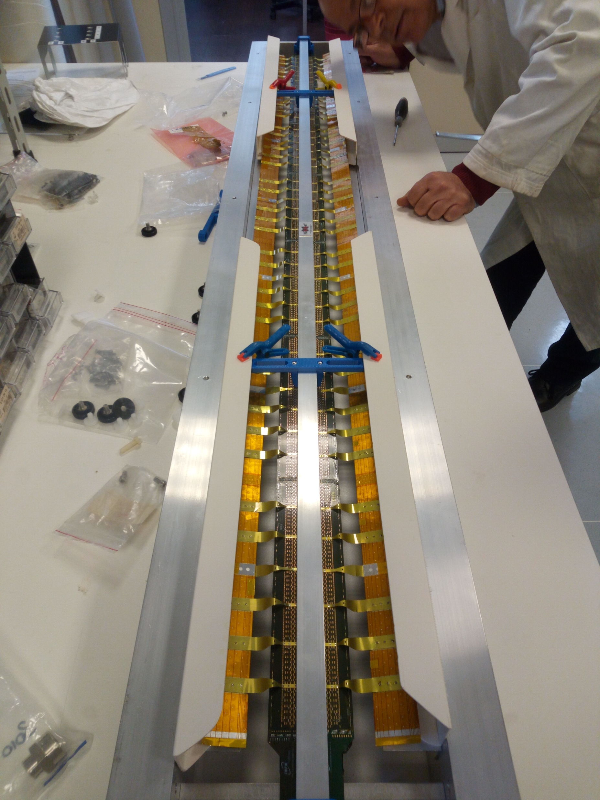
Pick Up Tool
Hybrid Stave
  Tested pick-up tool
  Pick up brackets produced and used
  Stave moved back and forth from old to new PB jig

Slide 3
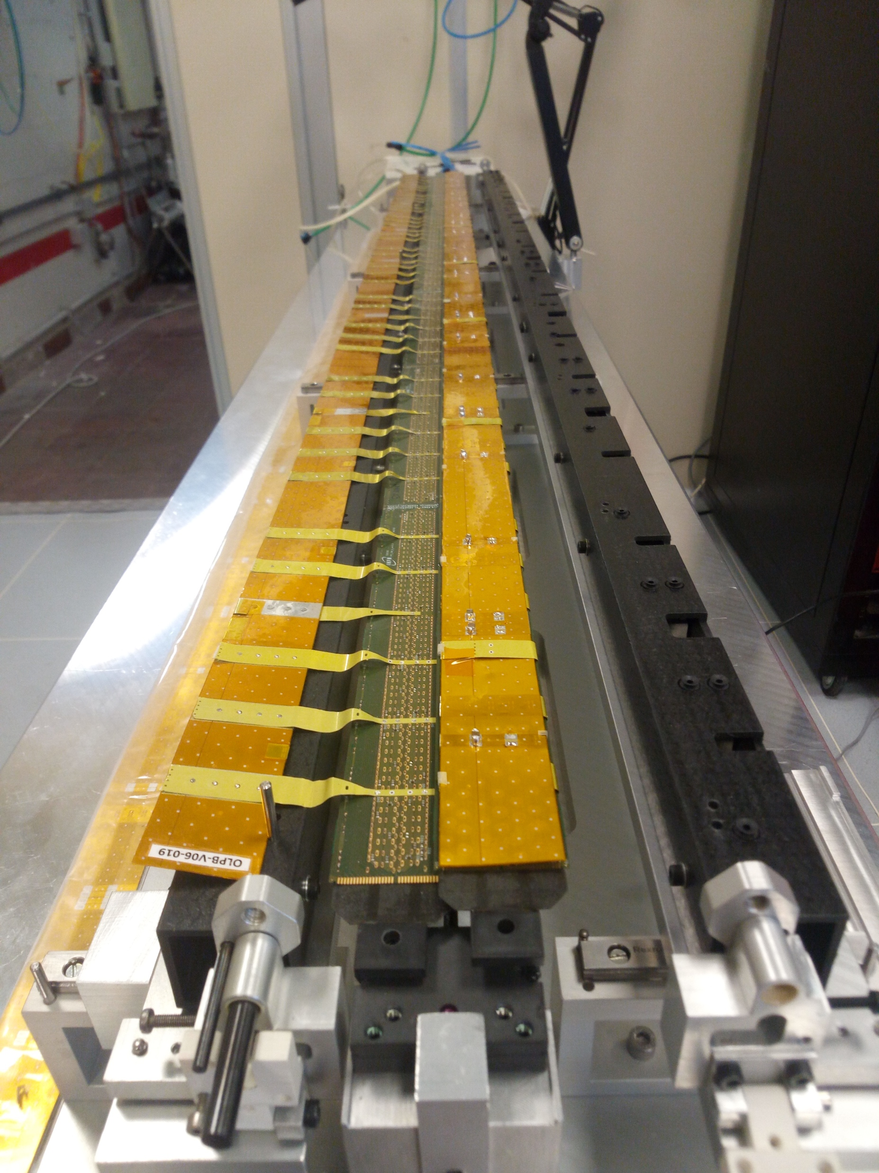
PB Jig
PB Jig
  PB folding rails and bars installed
  New supports for ruby pads installed
  Full review of the assembly with TO
  Services connected (vacuum, water)
  Jig READY
  U-arms installation tested on both HS
  PB folding tested on both HS
  NOTE: capacitors relocated

Slide 4
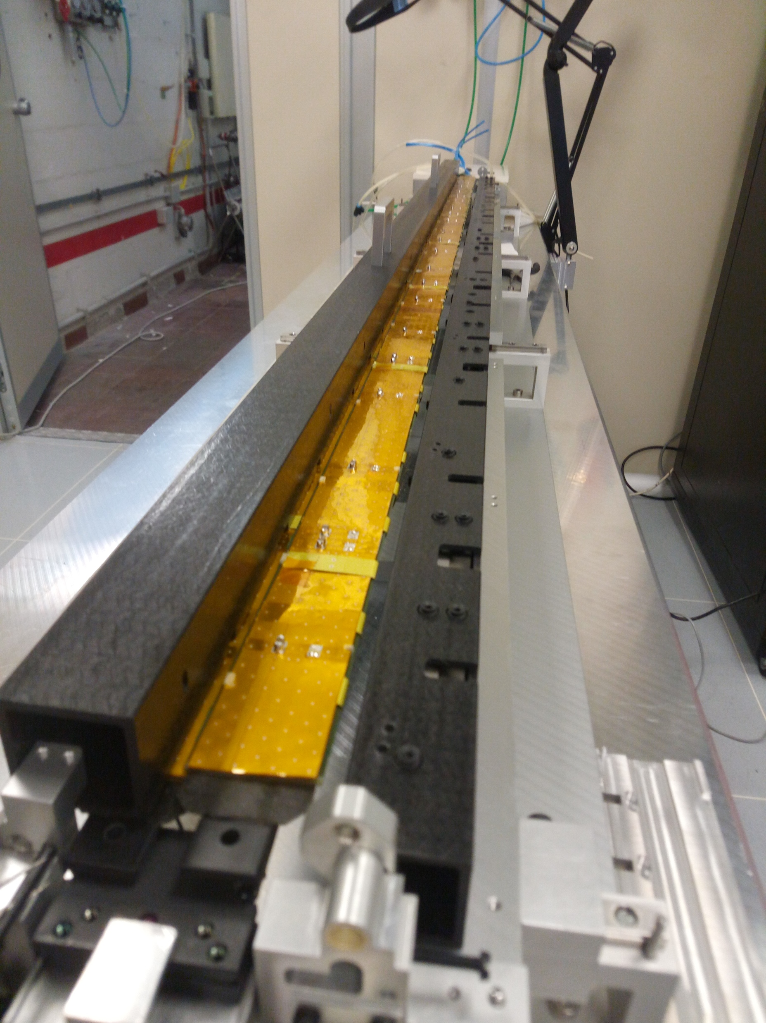
PB Jig
PB Jig
  PB folding rails and bars installed
  New supports for ruby pads installed
  Full review of the assembly with TO
  Services connected (vacuum, water)
  Jig READY
  U-arms installation tested on both HS
  PB folding tested on both HS
  NOTE: capacitors relocated

Slide 5
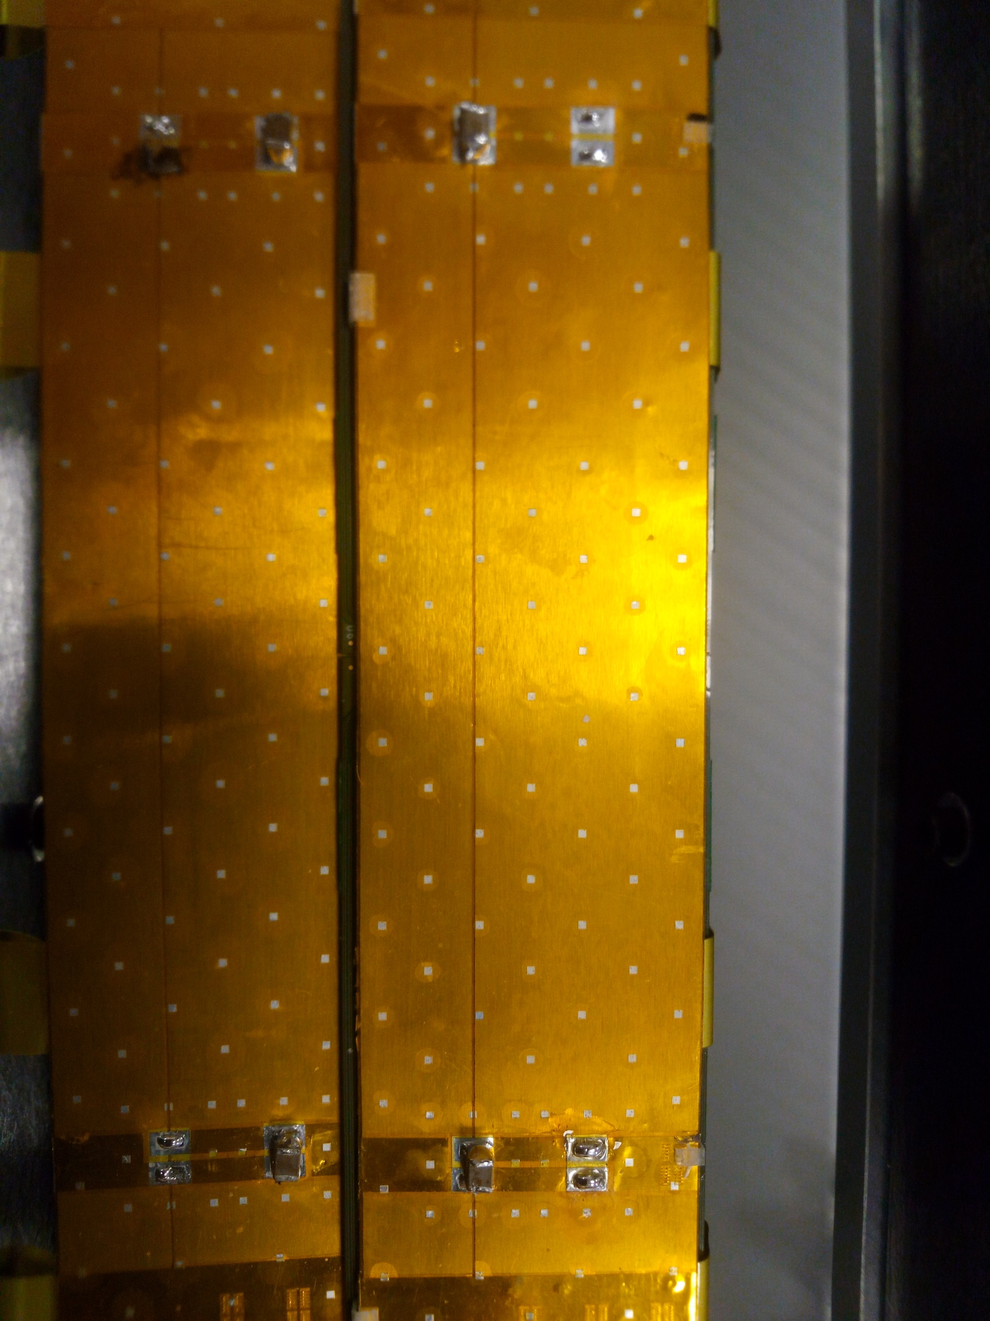
PB Jig
PB Jig
  PB folding rails and bars installed
  New supports for ruby pads installed
  Full review of the assembly with TO
  Services connected (vacuum, water)
  Jig READY
  U-arms installation tested on both HS
  PB folding tested on both HS
  NOTE: capacitors relocated

Slide 6
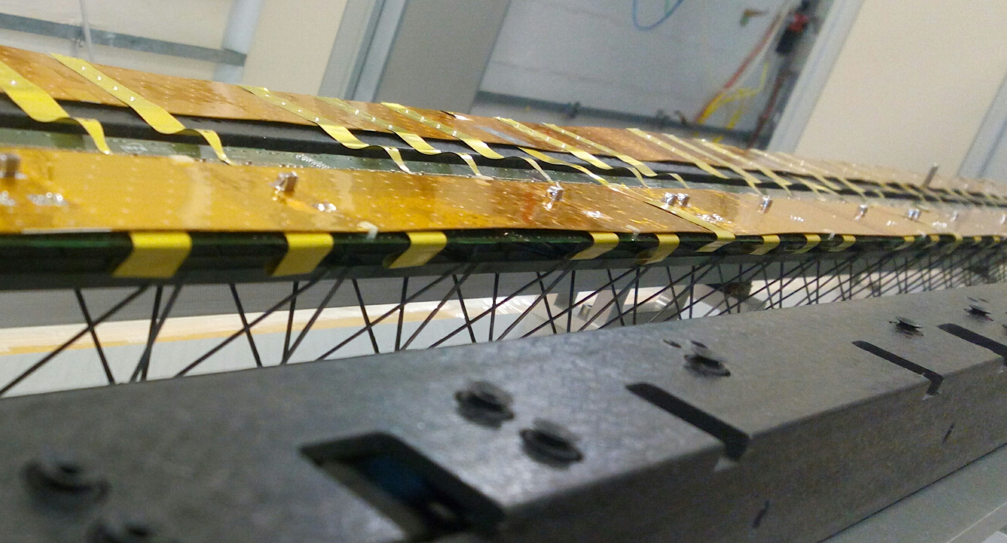
PB Jig
PB Jig
  PB folding rails and bars installed
  New supports for ruby pads installed
  Full review of the assembly with TO
  Services connected (vacuum, water)
  Jig READY
  U-arms installation tested on both HS
  PB folding tested on both HS
  NOTE: capacitors relocated

Slide 7
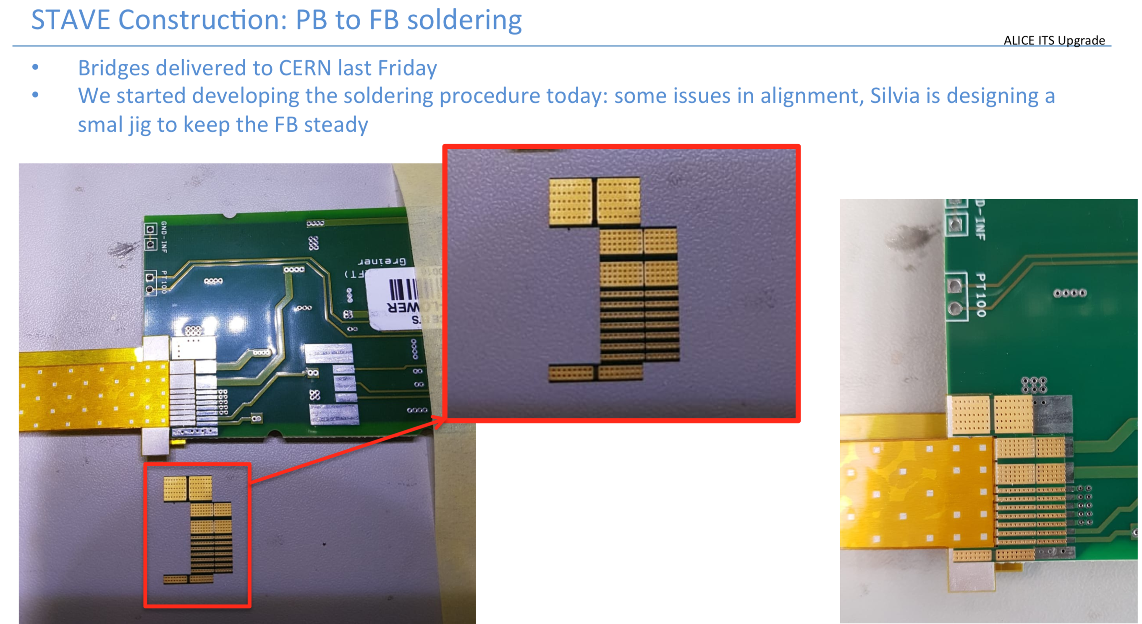
PB Jig

Slide 8
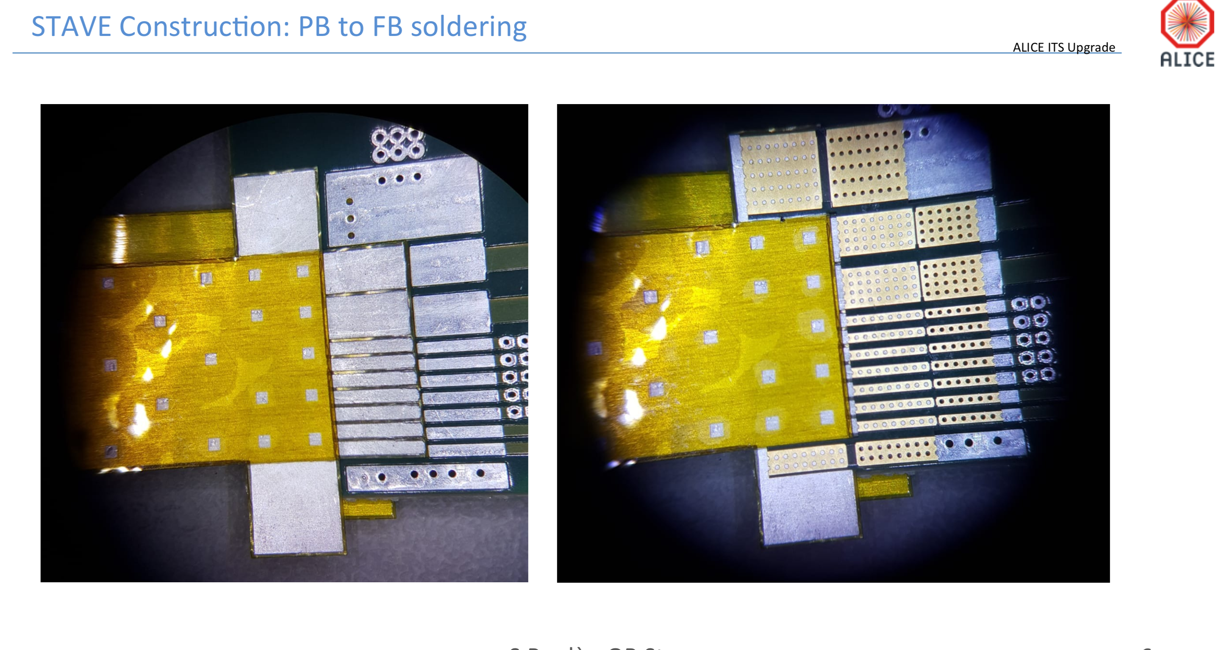
PB Jig

Slide 9
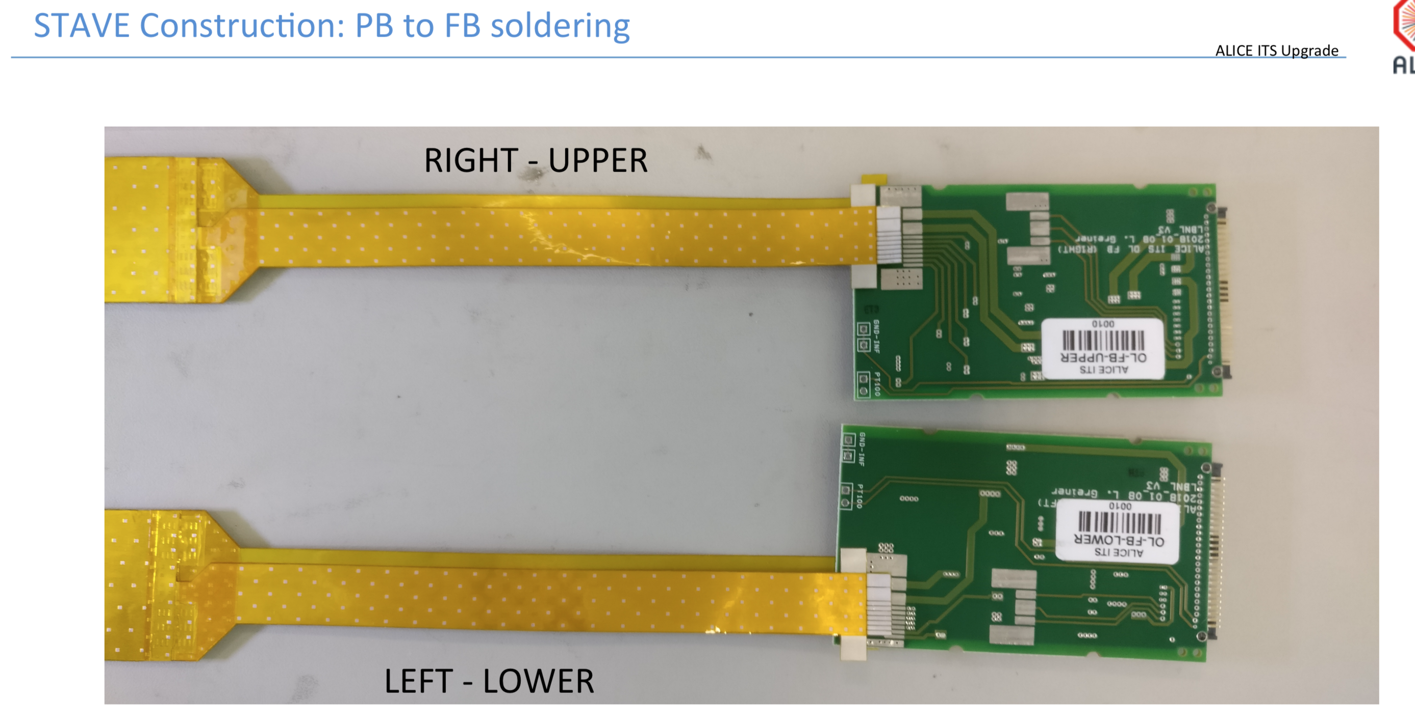
PB Jig

Slide 10
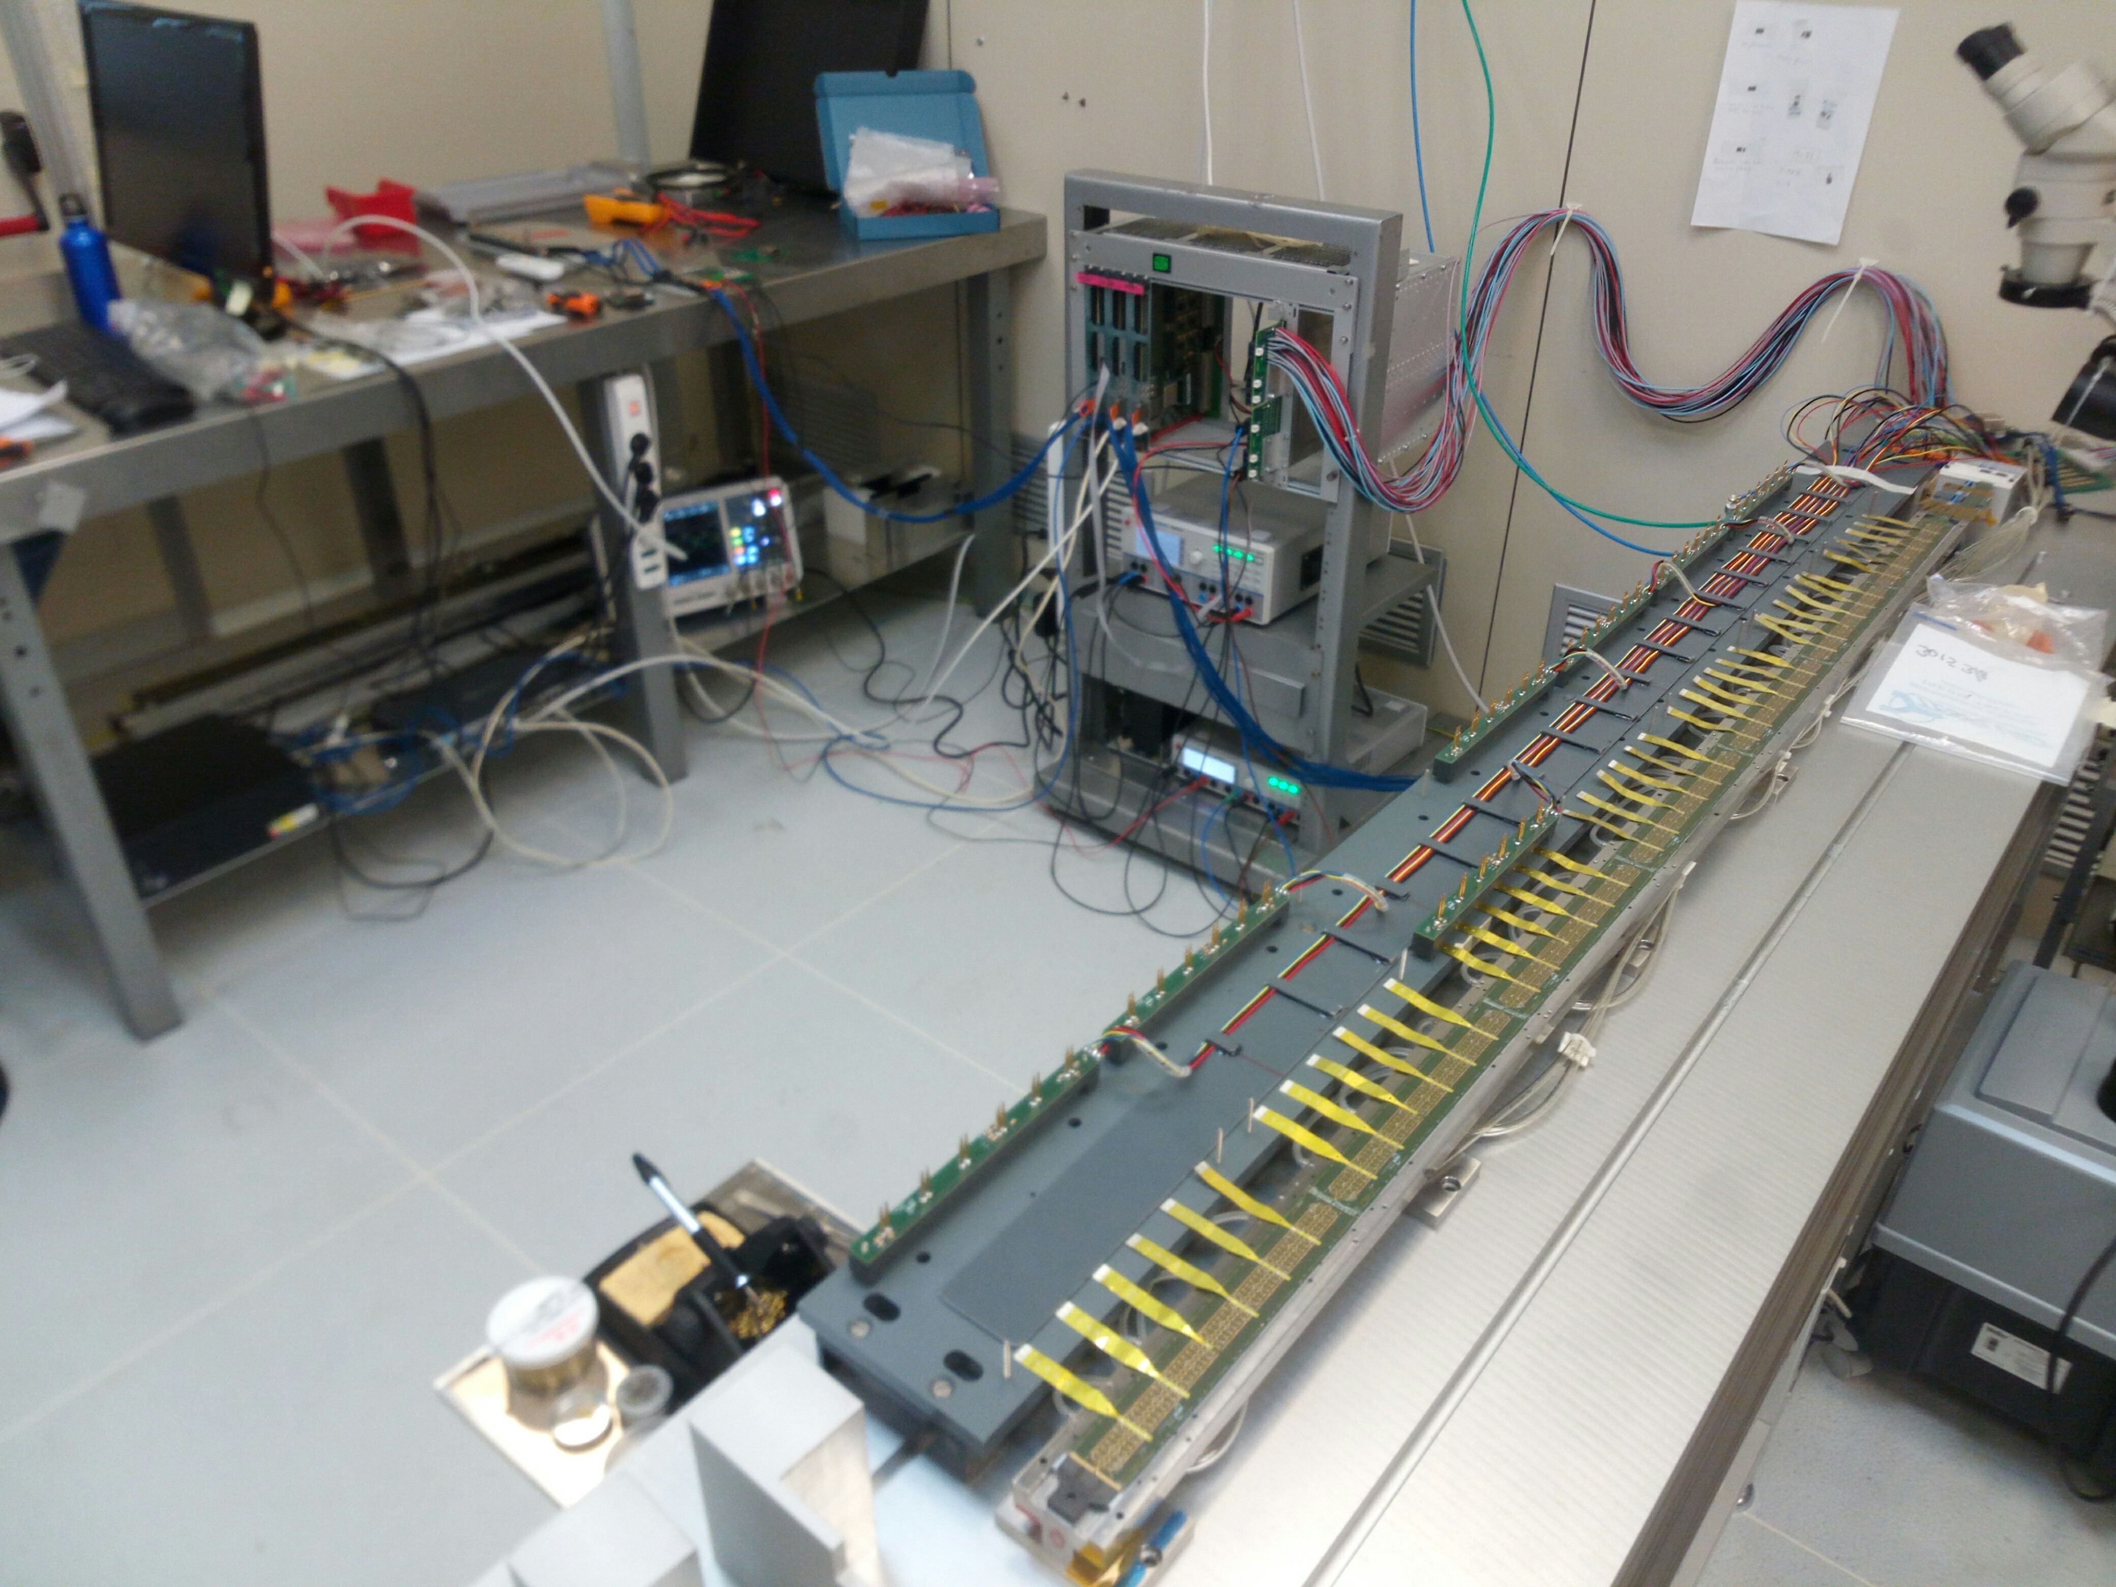
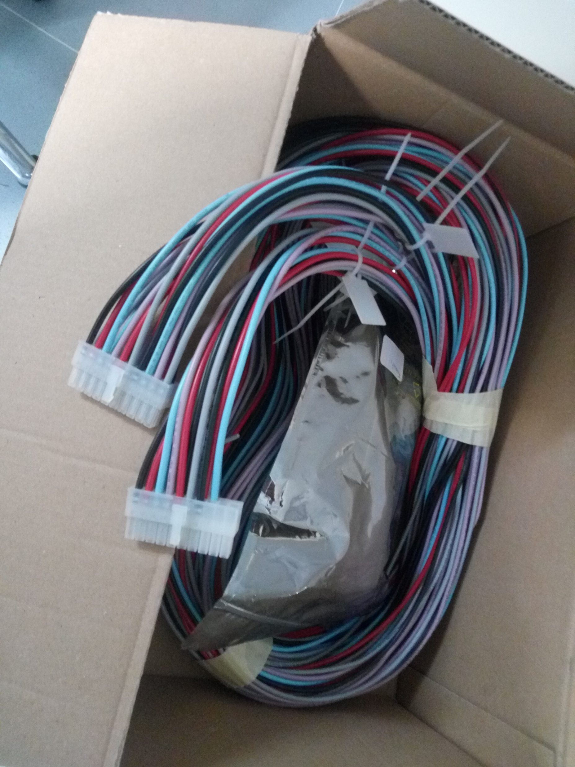
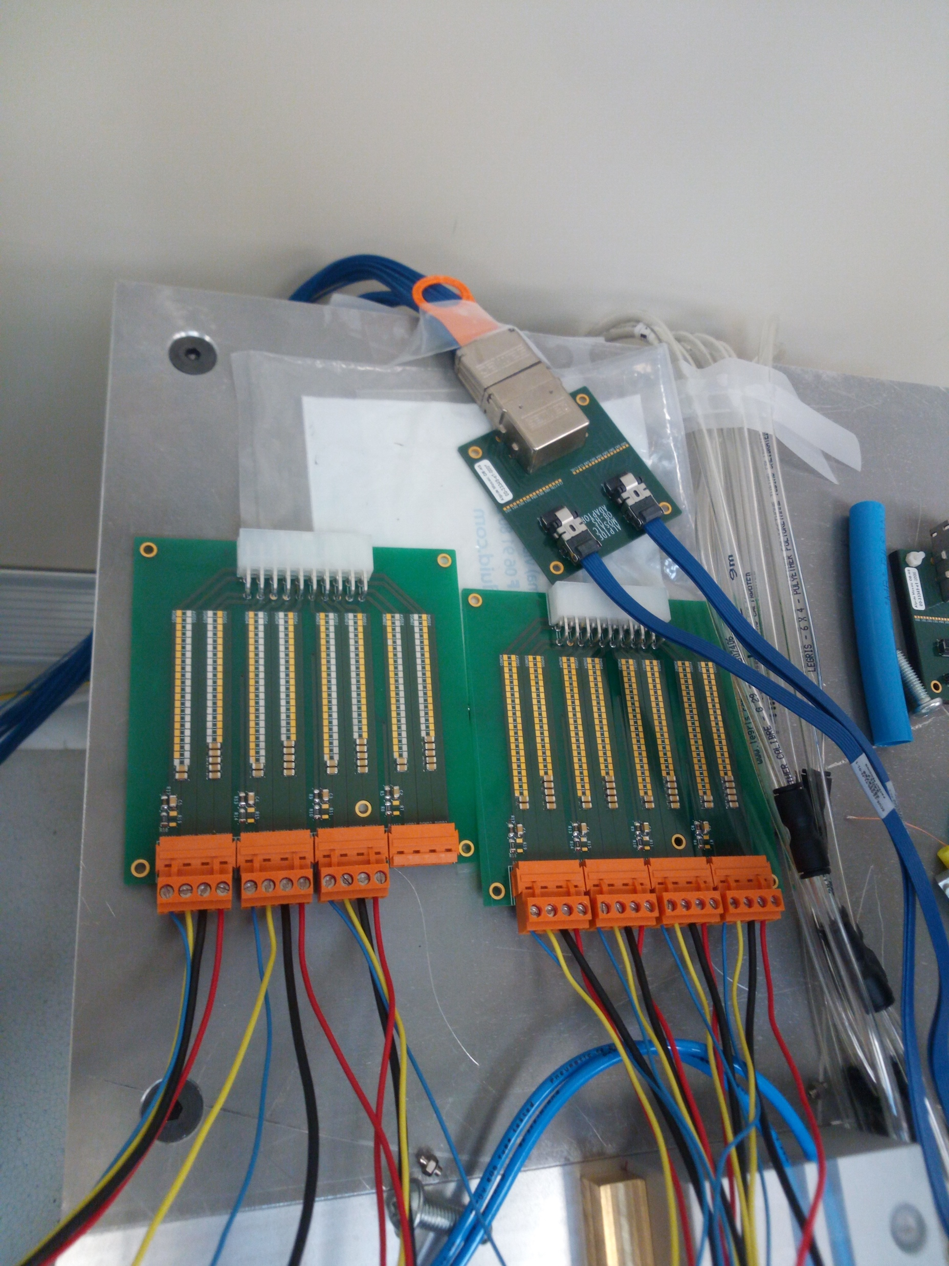
Stave Zero Status
HS0/Right/Upper
Service Power Bus installed
Filter Boards installed and
connected
HIC DCTRL test performed OK

Slide 11
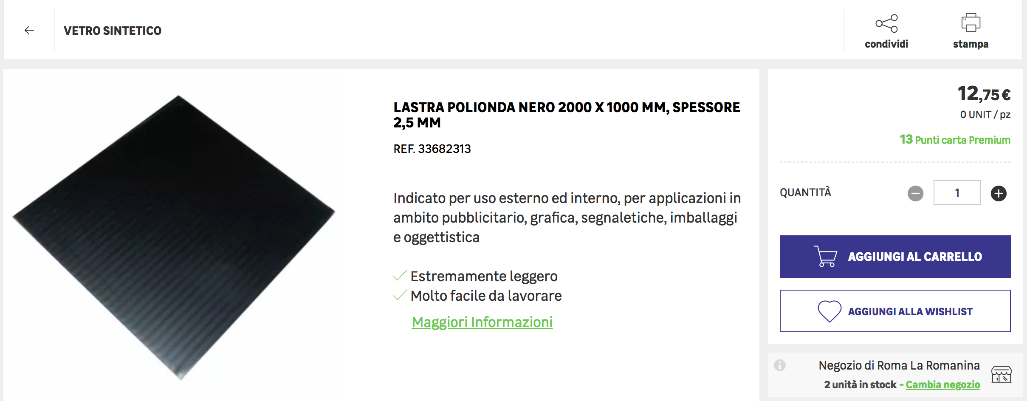
Stave Zero Status

Slide 12
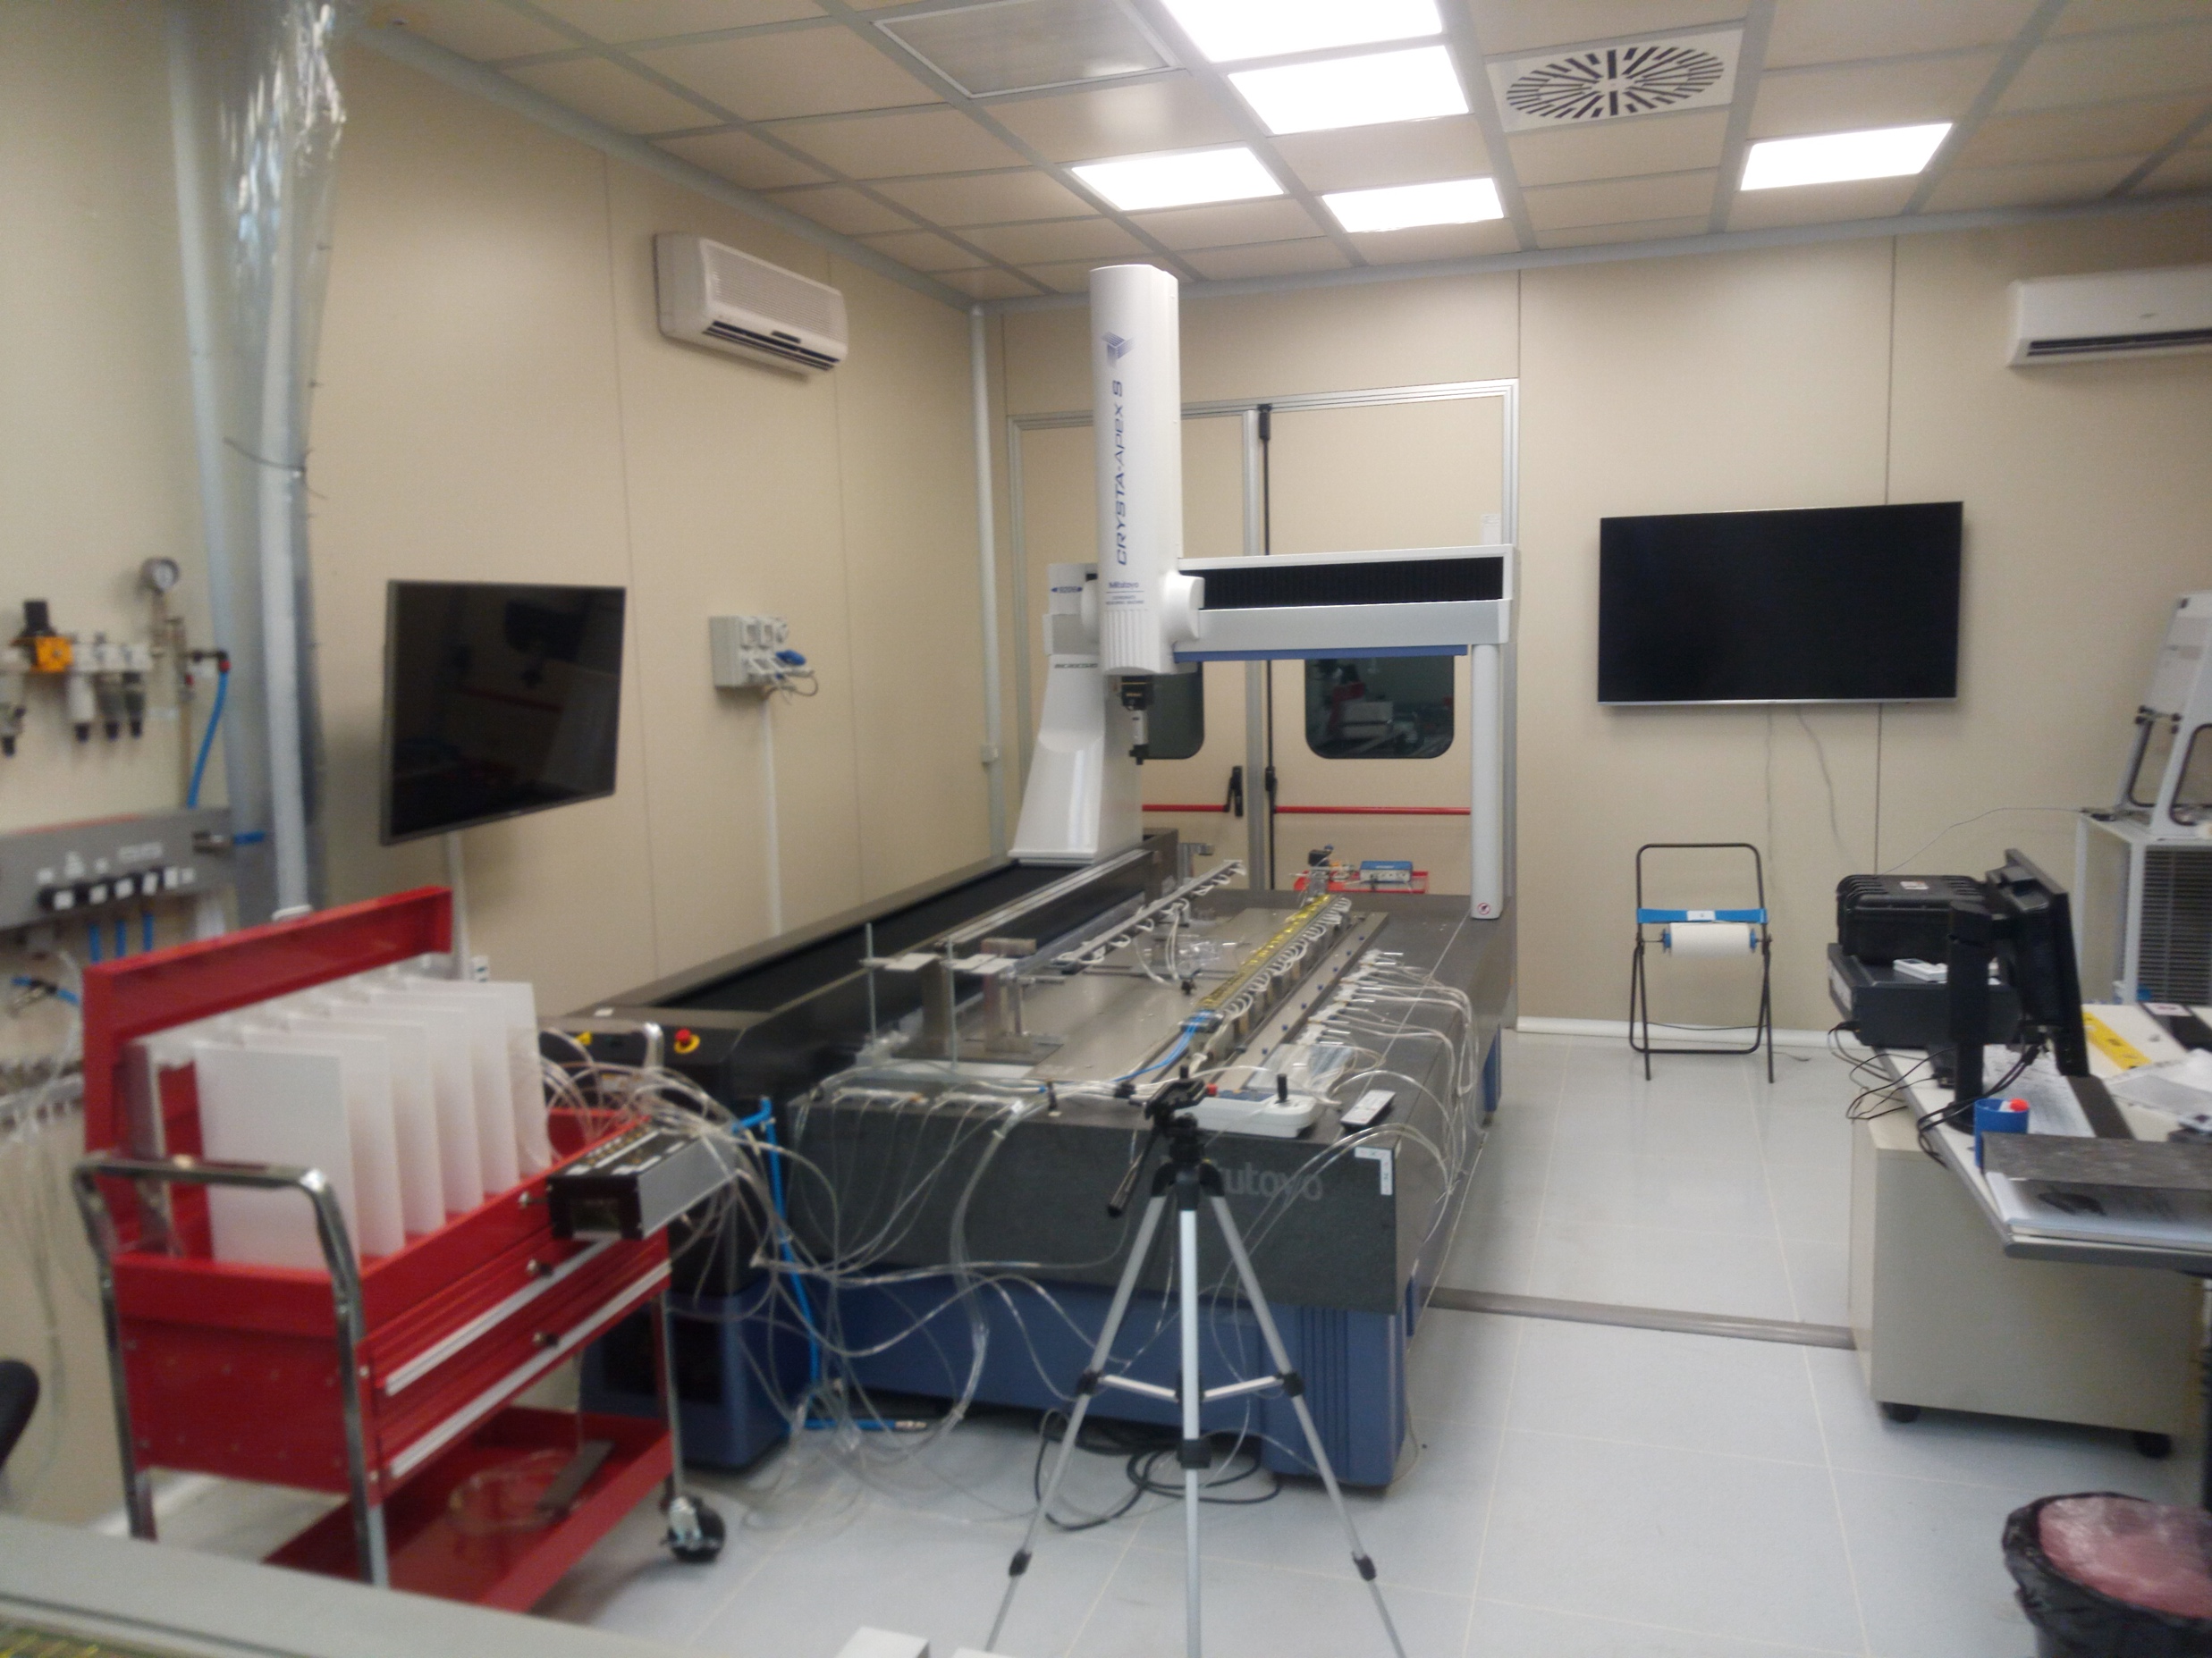
Stave Zero Status
HS0/Left/Lower on CMM
(glued, to be soldered once
HS0/R/U tested)
Mock Up

Slide 13
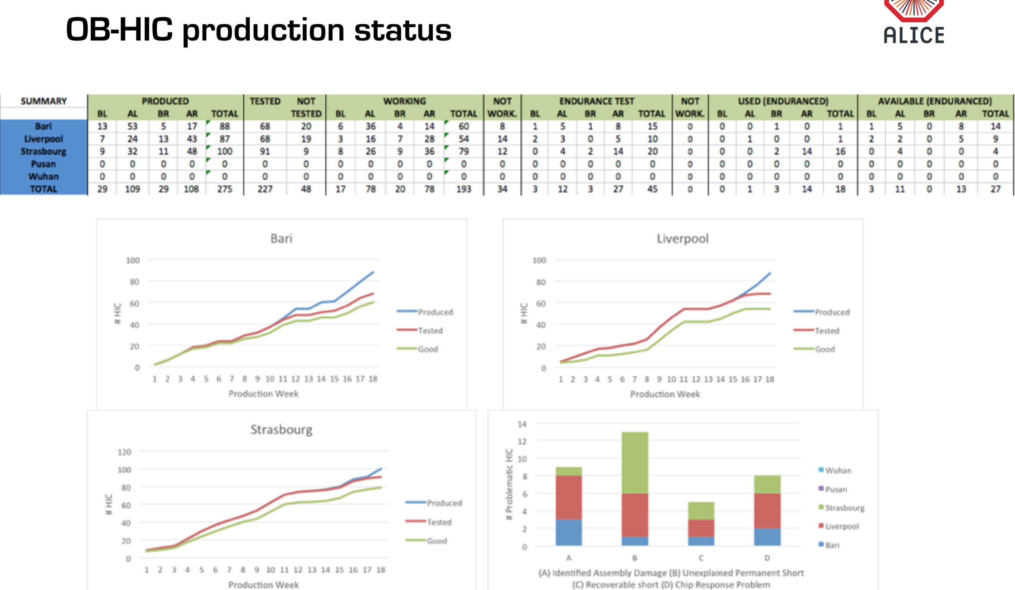
Stave Zero Status
Mock Up

Slide 14
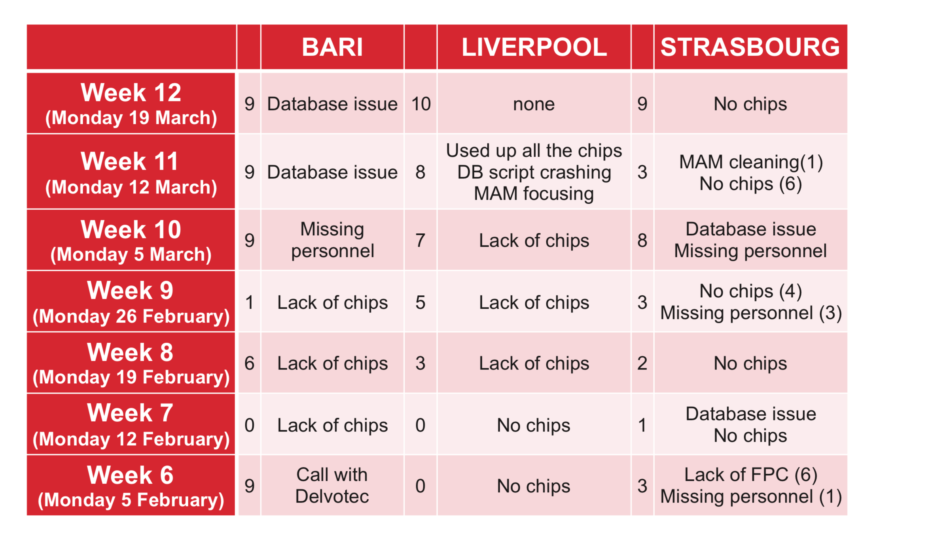
Stave Zero Status
Mock Up

Slide 15
Planning
MS:
Produced pick up tool brackets
Installed and finalized new PB jig
Moved Hybrid Stave back to PB jig
Install U arms by hand on Hybrid stave: ready to go to transport box
Stave Zero:
Finalized service PB on soldering table
Starting test of HS0/R/U
Install U arms, retest of HS0/R/U, align to SF
Install U arms, retest of HS0/L/L, align to SF
Install PB on Stave Zero
This
Week
End of march
After Easter

