Slide 1
Development of large-scale magnetic calorimeter arrays
Thomas R. Stevenson¹, Manuel A. Balvin¹, Simon R. Bandler¹, Archana M. Devasia^{1,2}, Peter C. Nagler¹, Kevin Ryu³, Stephen J. Smith^{1,2}, and Wonsik Yoon^{1,4}
¹NASA Goddard Space Flight Center, ²CRESST, University of Maryland, Baltimore County,
³Lincoln Laboratory, Massachusetts Institute of Technology, ⁴Science Systems and Applications Inc.

Slide 2
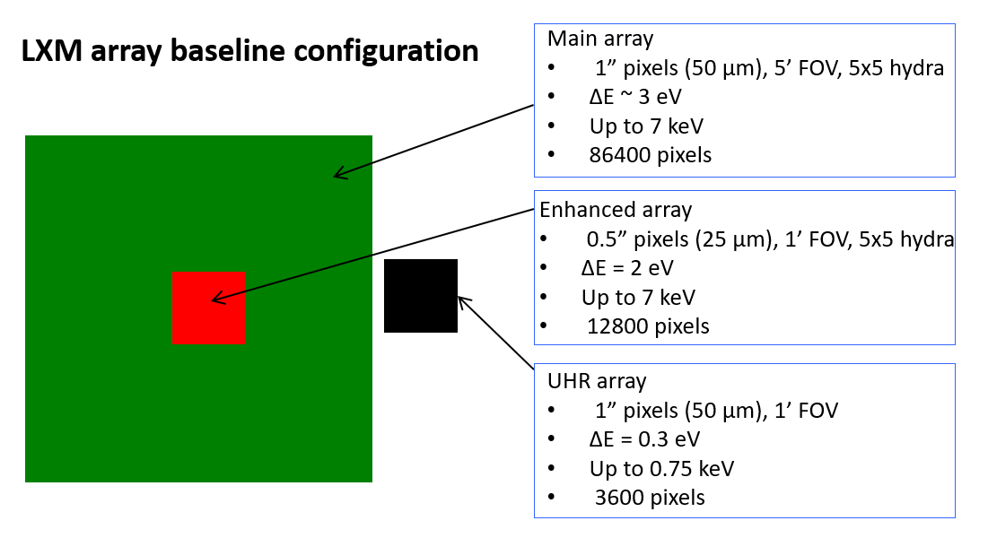
Introduction and Motivation
Metallic magnetic calorimeters (MMCs) use paramagnetic sensors such as Au:Er to detect temperature changes produced by absorption of X-rays
MMC is a potential sensor technology for the Lynx X-ray Microcalorimeter (LXM) on the Lynx mission concept
As array size increases
  Stray inductance of wiring increases
  - between pixels & fanout to amplifiers
  Routing of wiring between pixels and readout challenging due to requirements of low inductance, low crosstalk, high critical currents & high yield
MMCs can be scaled to large array sizes by,
  Maximizing the sensor inductance by decreasing sensor meander coil pitch
  Maximizing the magnetic coupling by scaling the sensor & insulator thicknesses with pitch
  Maintaining the Nb thickness with pitch in order to keep sufficient critical current
Buried layers can be used to achieve large scale, high density wiring
  Well suited for connecting thousands of pixels on large focal plane to readout chips with high yield
  Planarization allows use of top surface of wafer exclusively for pixels & heat sinking
  - allows new pixel geometries
  Alleviates crosstalk

Slide 3
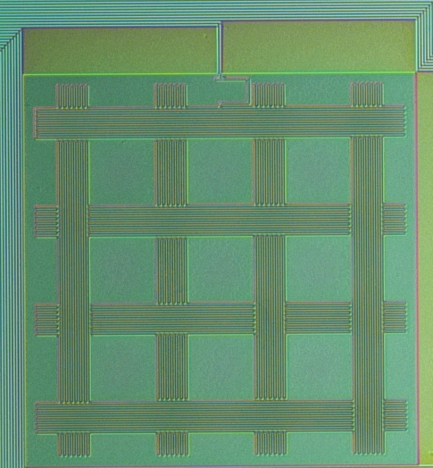
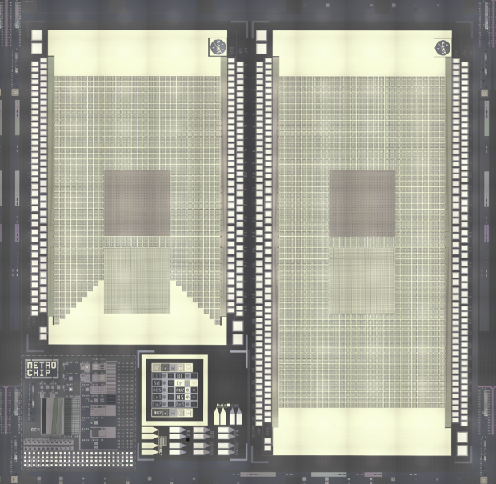
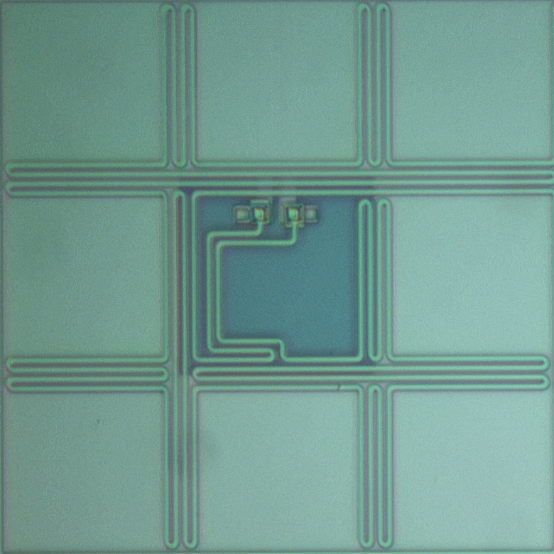
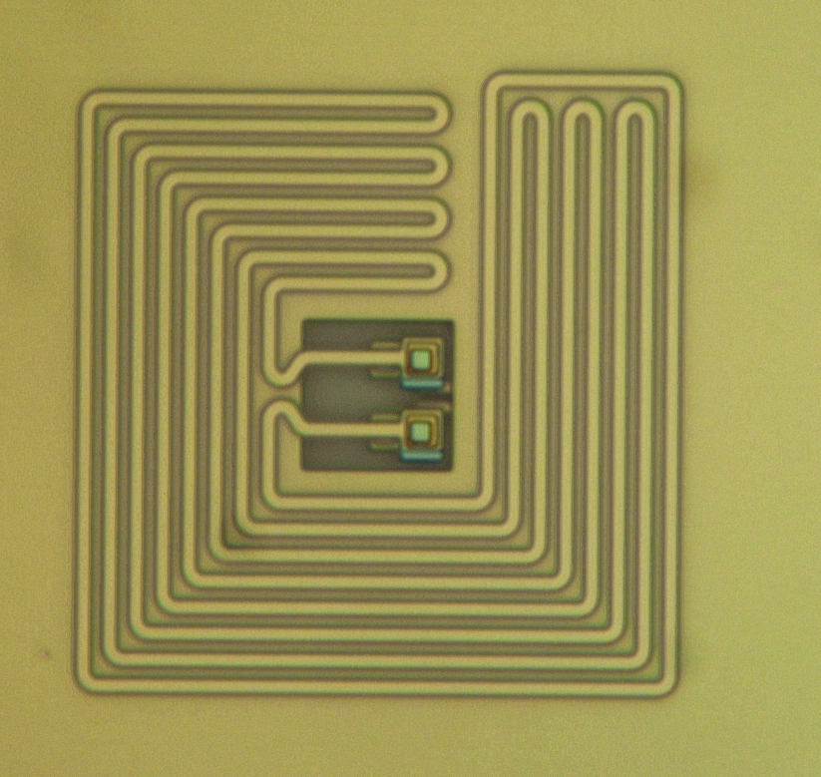
Fabrication of high sensor inductance
MMC arrays with buried wiring
Die layout of prototype MMC LXM array
  Buried wiring & sensor meander coil layers
  Nb deposition by dc magnetron sputtering
  Nb patterning by DUV (248 nm) and plasma etch
  SiO₂ ILD deposition by PECVD
  CMP of ILD to desired thickness
  ILD patterning by DUV lithography and plasma etch
  Au:Er deposition by sputtering & patterning by lift-off
  Thermalization Au deposition by e-beam evaporation
  Au heat sink deposition by e-beam evaporation
  Stems electroplated through photoresist mold on Au seed layer
  Absorbers electroplating and etch by ion milling
Main
Enhanced
UHR
22 mm x 22 mm reticle
consists of 2 chips, different sizes
Each chip comprises of Main array, Enhanced array and UHR array with 4 buried Nb layers
Larger chip consists of 55,800 pixels, 5688 sensors

Slide 4
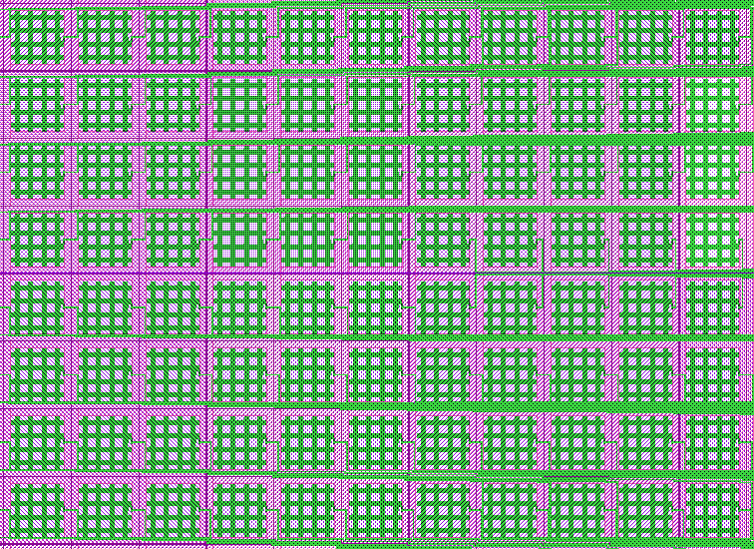
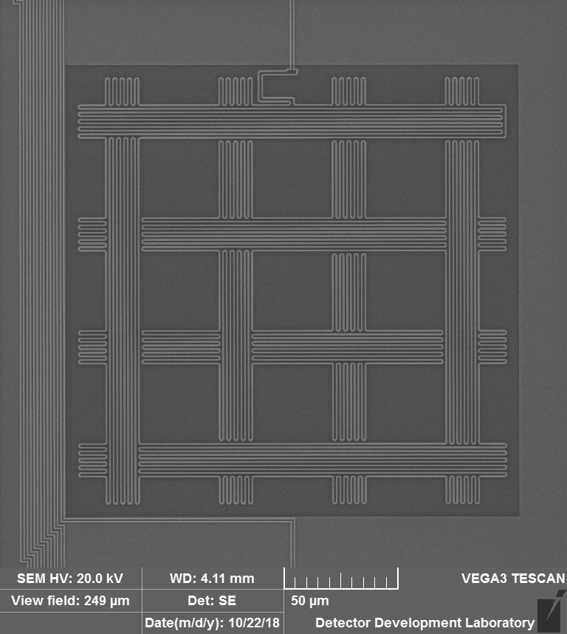
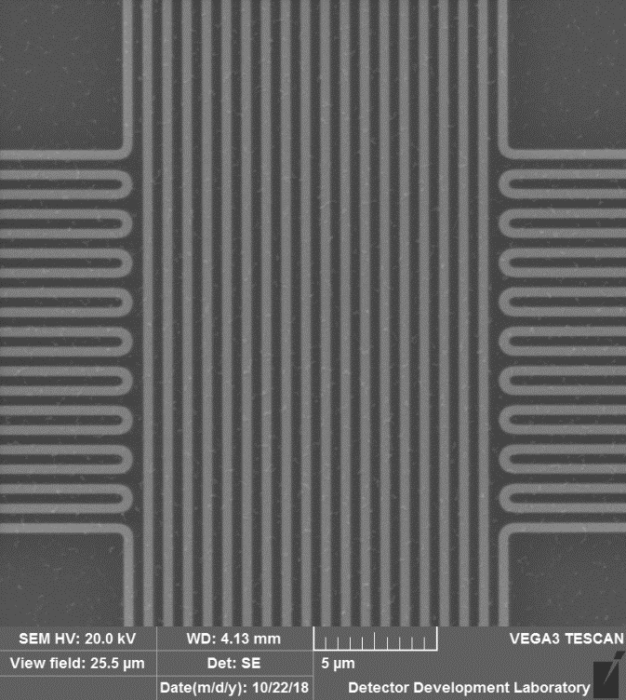
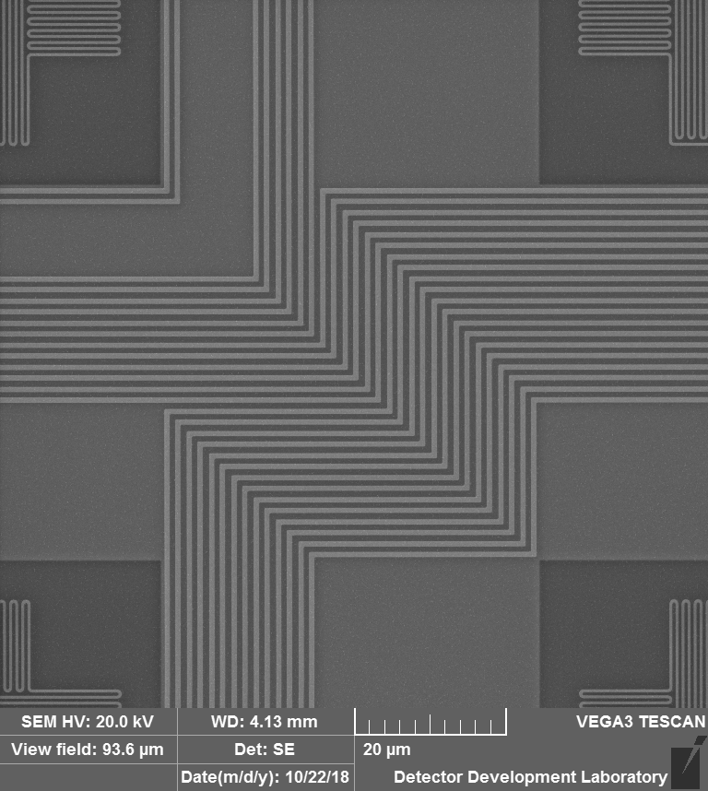
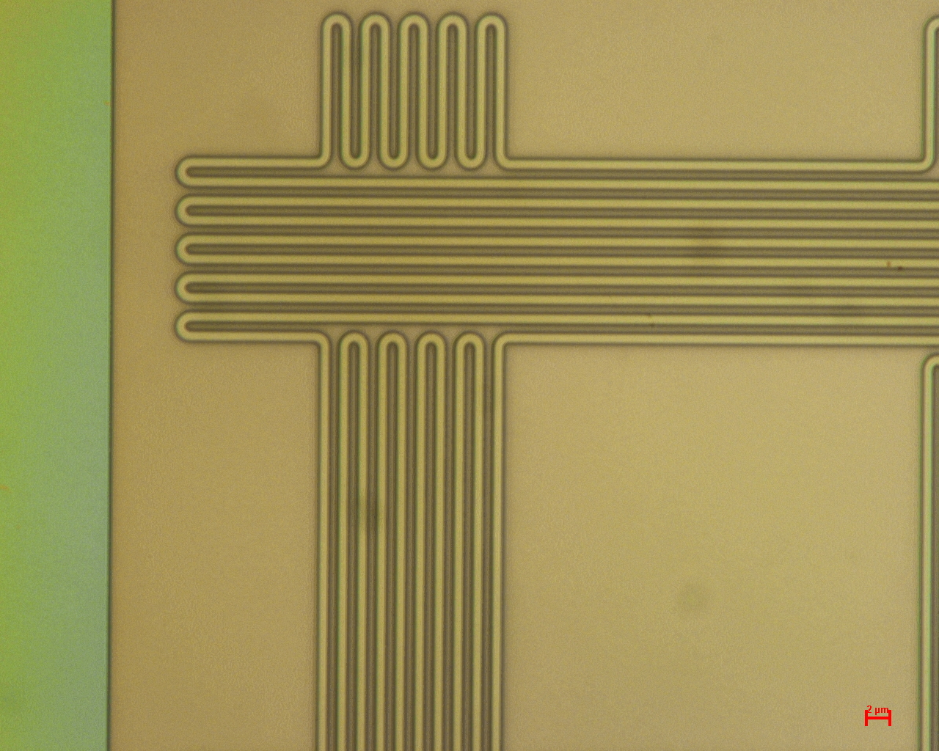
Components of Main Array
Main Array
60 x 30 sensor array with waffle shaped, multi absorber sensors (5 x 5 Hydra)
Sensor meander coils and twin microstrip wiring are both patterned on topmost Nb layer
Main array
Twin microstrip wiring
Buried Nb ground plane
Topmost Nb layer
Waffle shaped sensor meander coil and wiring on topmost Nb layer
0.8 µm pitch Nb meander coil
(1.2 and 1.6 µm pitch also used)
Main array twin microstrip wiring patterned on topmost Nb layer runs over a buried Nb ground plane layer

Slide 5
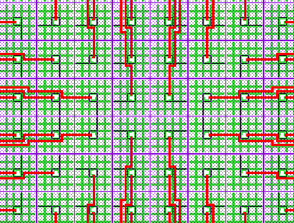
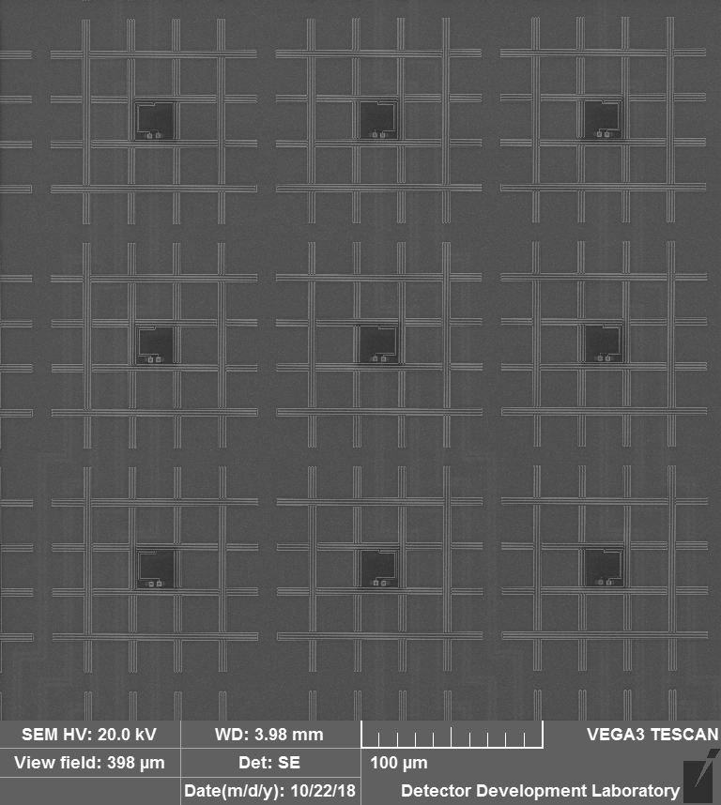
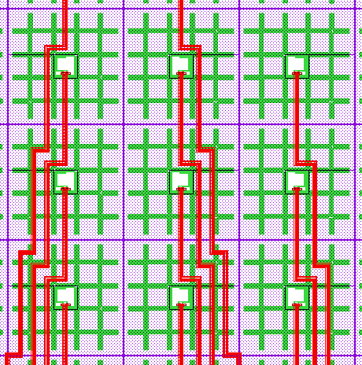
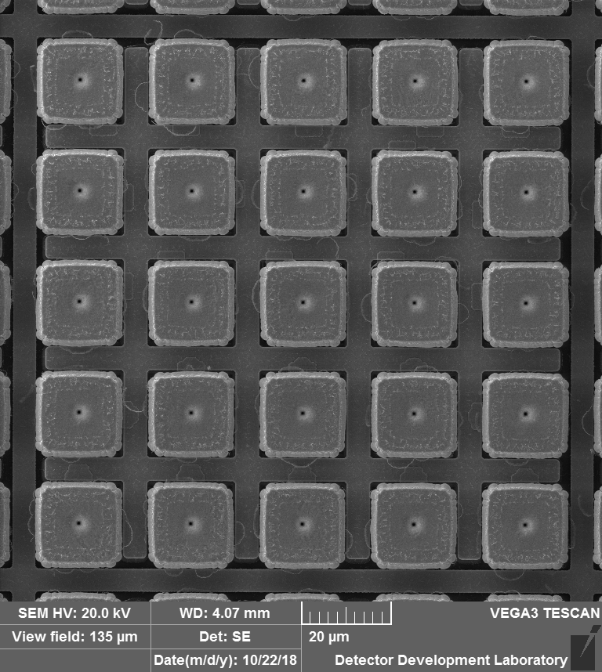
Components of Enhanced Array
Enhanced Array
24 x 24 sensor array with waffle shaped sensor in a 5 x 5 Hydra configuration
Sensor meander coils patterned on topmost Nb layer are connected through superconducting vias to twin microstrip wiring on bottom-most Nb layer
Using multiple layers of buried wiring, the twin microstrip wiring is laid out on bottom-most Nb layer on a relaxed pitch, without the need for aggressively packing it on the top most Nb layer. This reduces crosstalk between pixels.
Enhanced array
Sensor meander coils on top most Nb layer
Top Nb sensor meander layer (green) is connected through two intermediate metal layers to bottom wiring layer (red)
125 µm x 125 µm sized composite Hydra absorber partitioned into a 5 x 5 array

Slide 6
Thermalization of Au-Er “Waffle”
Thermal diffusion time across Au:Er main array waffle sensor as a function of thickness of Au capping layer
- added to speed thermalization.
Thermal diffusion time (curve) is sufficiently fast compared with fastest expected hydra pulse rise time and overall hydra decay time constant
600 nm added does not significant affect total heat capacity

Slide 7
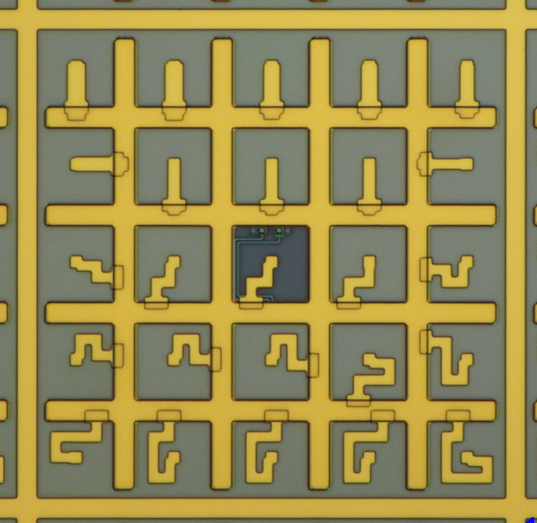
Thermal multiplexing with hydra links
Hydra design of Main and Enhanced Main Arrays allows 25 different pixels read out by single sensor
  Achieved by coupling 25 absorbers in 5 x 5 configuration to single sensor through Au thermal (hydra) links of varied thermal conductance
  Thermal conductance is varied by maintaining the same film thickness but varying the geometry (length) of the link
Arrangement of Main array hydra links.
Arrangement of Enhanced Main Array hydra links.
Schematic diagram of hydra device

Slide 8
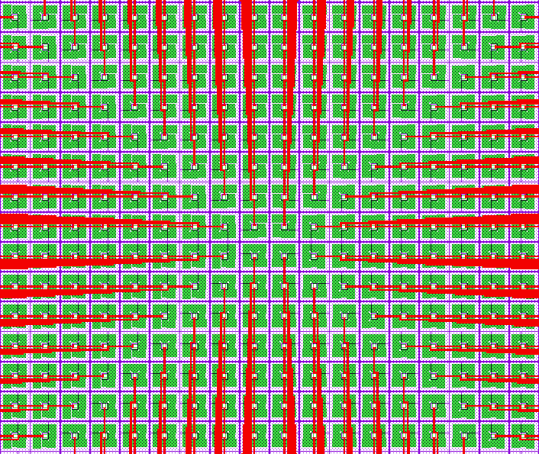
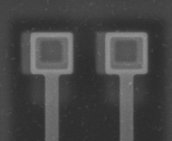
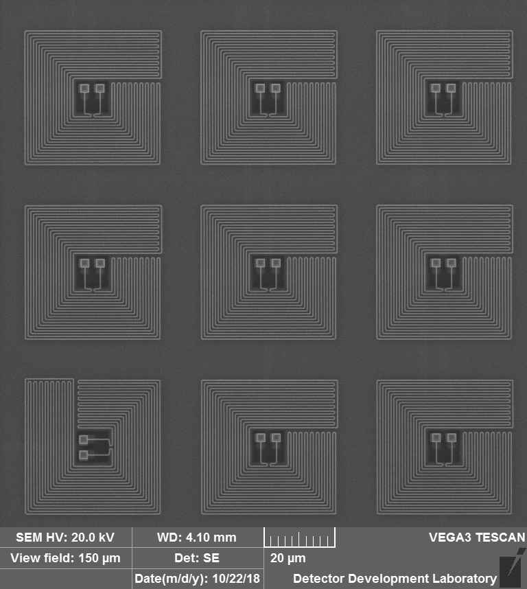
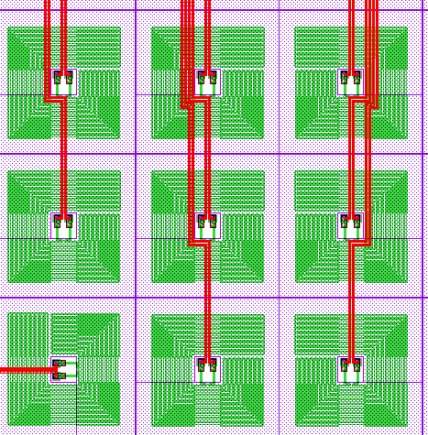
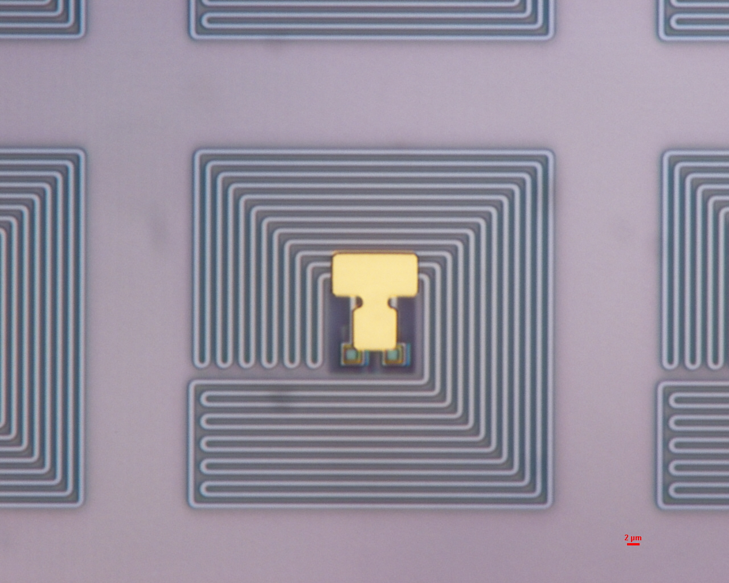
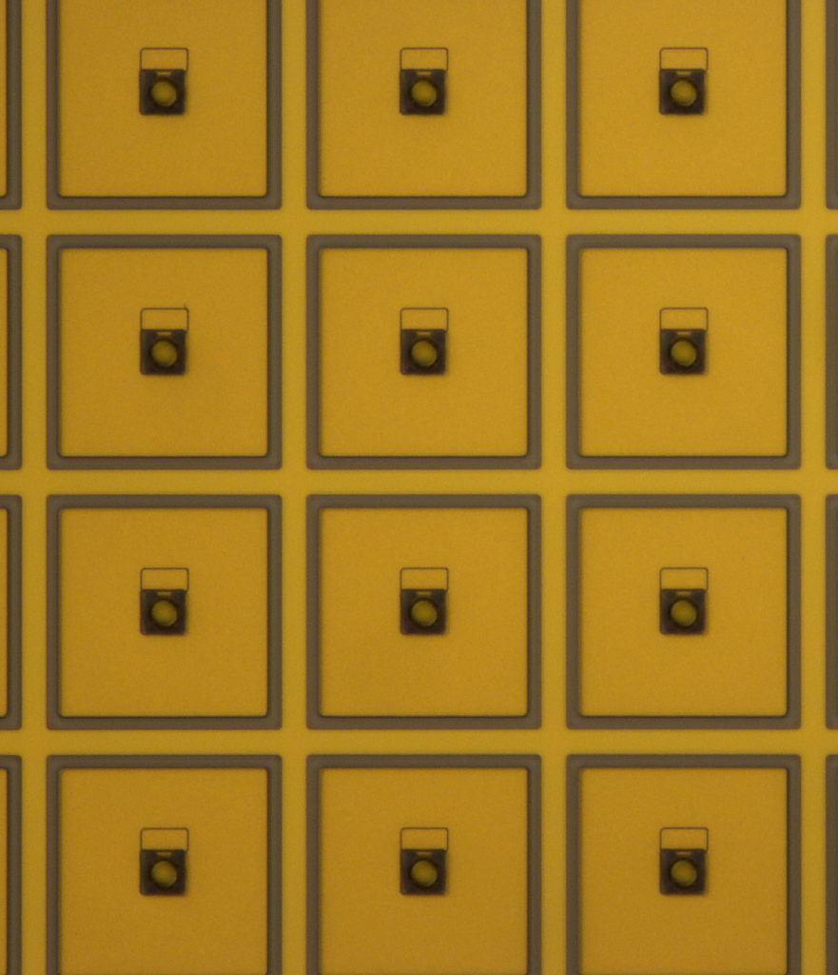
Components of UHR array
UHR array
60 x 60 sensor array with a square annulus shaped sensor
Au thermal link
Au:Er
Au stem
Au heat sinking grid
Array of sensor meander coils on topmost Nb layer. Superconducting vias located at center of meander coil connect coil to wiring
Top Nb sensor meander layer (green) is connected through two intermediate metal layers to bottom twin microstrip wiring layer (red)
To control size of slew rate at readout a Au thermal link connects sensor to absorber stem
Pixels with absorbers uncovered

Slide 9
MMC results (Main array)
T=50 mK
(a) measured and (b) modeled pulse-shape of Main array MMC Hydra with 25 absorbers at 50 mK
  25 different pulse shapes are clearly separated by means of rise-time and pulse height
  MMCs have high heat-capacity sensor, no need to add heat capacity to sensor for read-out optimization.
Expected energy resolution based on signal and noise measurements: 2.8 – 3.7 eV for 6 keV @ 50 mK
➔Simulation results: 3.2 – 3.8 eV FWHM

Slide 10
Modeling result (Main array)
T=40 mK
PHs@ 40 mK = PHs@ 50 mK × 2
Modeled FWHM energy resolution of Main array MMC Hydra with 0.8 μm pitch meander coil with optimized read-out
- dE is energy resolution without errors in position correlation
- dEx includes the effect of uncertainty in determining the pixel location that X-ray hit at 200 eV
For X-ray energy larger than 200 eV, the position error converges to zero, dEx approaches dE

Slide 11
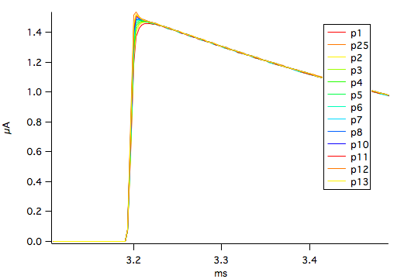
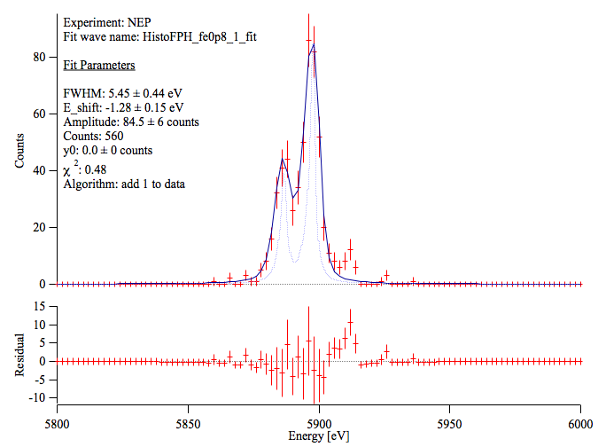
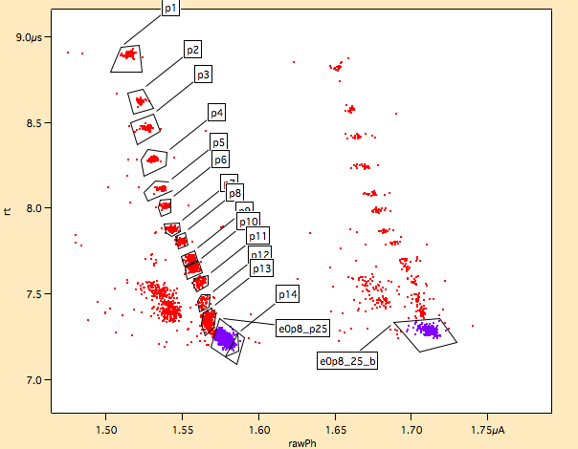
MMC results (Enhanced array)
T=50 mK
X-ray pulse data for Enhanced Array Hydra with 25 absorbers at 50 mK
  Only 13 of 25 different pulse shapes were clearly separated by means of rise-time and pulse height
  Hydra thermal links were fabricated with higher thermal conductance range than optimized design
  Thermal and electrical cross-talk effects were worsened by experimental details: need to float heatsinking grid, lack of x-ray mask over ballast inductor, and use of relatively high x-ray flux
Expected energy resolution based on signal and noise measurements: 2.0 eV for 6 keV @ 50 mK
Measured energy resolution from pulse histogram: 5.5 ± 0.4 eV @ 50 mK

Slide 12
Experimental performance of pixel types
Cooling system limited temperature of operation to 50 mK instead of 40 mK as designed
  Performance worse by about a factor of 1.2.
Each sensor not coupled to optimized SQUID (input inductance lower than optimum for design)
  Performance worse by about a factor of 1.6.
Main Array performance Integrated NEP @ 50 mK
  0.8 um pitch : 2.8 – 3.7 eV
  1.2 um pitch : 3.0 – 4.0 eV
  1.6 um pitch : 4.1 – 5.8 eV
  < 3 eV is achievable, even before incorporating sandwich design and improving noise.
Enhanced Main Array performance Integrated NEP @ 50 mK
  0.8 um pitch : 1.96 – 1.99 eV
  1.2 um pitch : not available
  1.6 um pitch : 6.3 – 6.4 eV
  < 2 eV is achievable, even before incorporating sandwich design and improving noise.
Ultra-Hi-Res performance Integrated NEP
  - 0.8 um pitch : 4.8 eV – even more highly unoptimized – needs “flux transformer”.

Slide 13
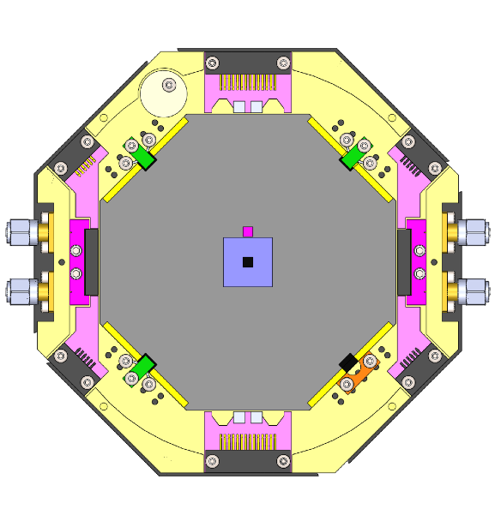
Summary and plans
Demonstrated large-scale, multilevel wiring to MMC sensors with high yield and high critical current.
Demonstrated fine-pitch MMC meander coils with high inductance suitable for large arrays.
Demonstrated the 25-pixel position-sensitive Hydra detector.
- 25-pulse shapes are clearly separated and pulse heights agree well with the modeling
Estimated energy resolution (NEP): 2.8-3.7 eV for 6 keV @ 50 mK.
Modeling result for the Main array assuming SQUIDs with optimal input inductance:
- 1.8 – 2.3 eV FWHM at 40 mK
Bump bonded μMUX chip
𝜇MUX x2
Next generation of MMC Arrays currently being designed
New MMC arrays:
  A full-size LXM MMC array with all pixels wired out on a full-size support wafer
    Requires “stitching” small-field (highest feature resolution) & large-field (for wiring out to read-out) mask-sets.
  New MMC “sandwich” geometries to improve coupling of sensor to pick-up coil – will improve energy resolution performance of all pixel types!
  Integration of “flux-transformers” to optimize performance of MMC UHR pixels.
  Allows testing of bump-bond connections to microwave read-out
    - as well as wire-bonds to current dc SQUIDs.
dc-SQUIDs x 2
2 cm
Package for testing full size arrays with dc and microwave readout SQUIDs

