Slide 1



Two-dimensional graphene superconducting and hot electron bolometer research
based-on metal atoms surface modification
张恒彬
2017年5月23日
Zhang Hengbin
7 / 26 / 2019
Qian Xuesen Laboratory of Space Technology

Slide 2
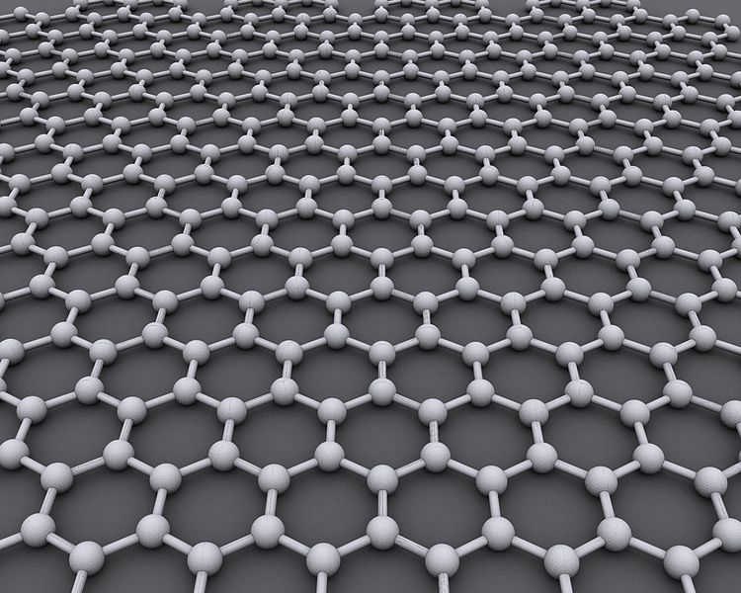
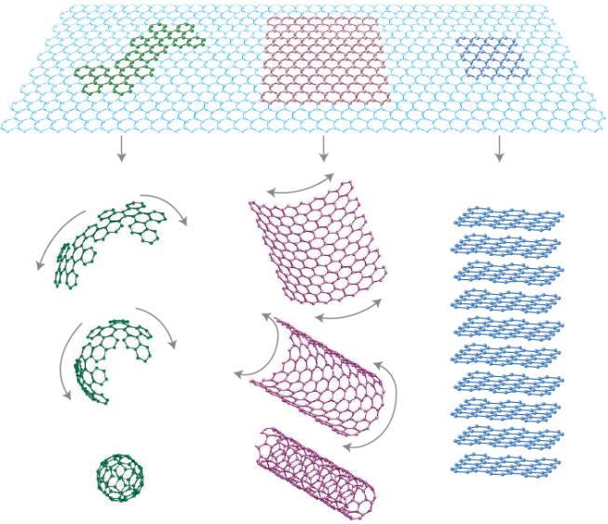
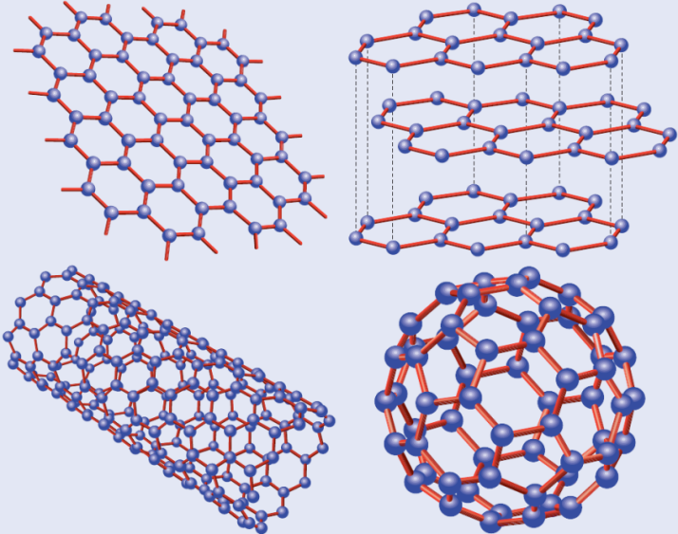
Graphene
Two-dimensional honeycomb lattice structure composed of single layer carbon atoms
Three σ bonds are formed by the interaction of sp2 hybrid orbitals between adjacent carbon atoms
The basis of the allotropes that make up zero-dimensional fullerenes, one-dimensional carbon nanotubes, and other carbons such as three-dimensional graphite
Wikipedia.org

Slide 3
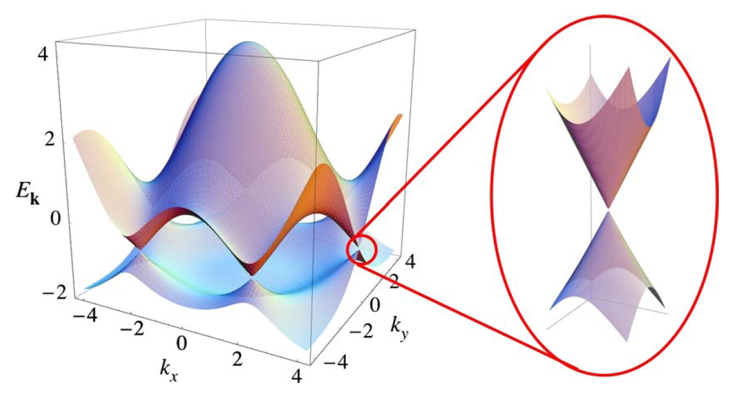
Graphene
Zero band gap structure, unique light absorption characteristics, high electron mobility(15000 cm²⋅V⁻¹⋅s⁻¹ ) and high thermal conductivity(5300 W⋅m⁻¹⋅K⁻¹).
Rev.mod.phys.2009,(81),109

Slide 4
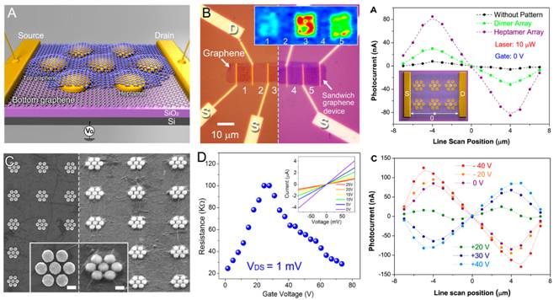
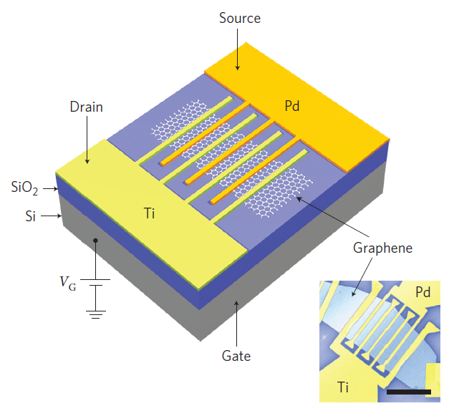
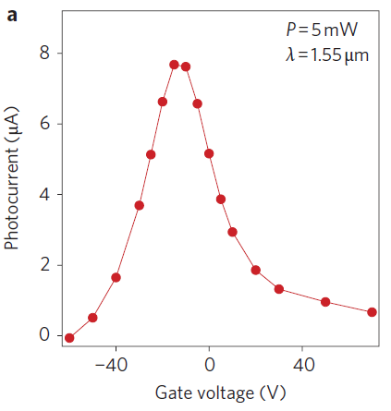
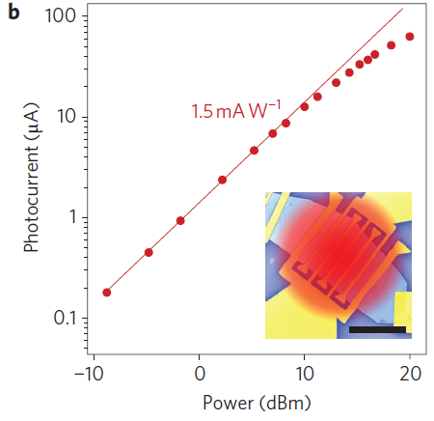
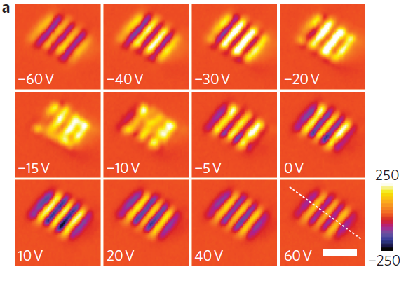
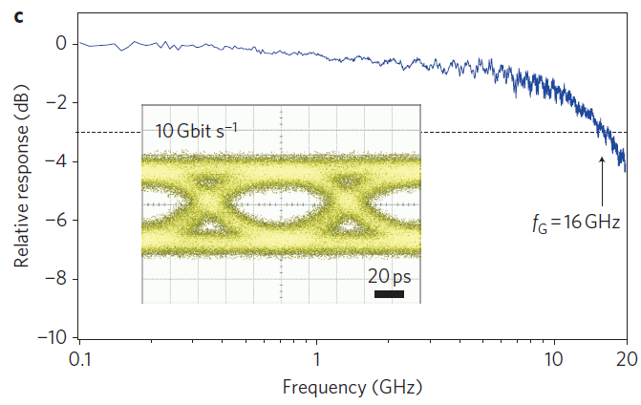
Graphene photodetector
Graphene-antenna sandwich
Metal–graphene–metal (MGM)
Zheyu Fang et al. NATURE NANOTECHNOLOGY. 2012, 19
Thomas Mueller et al. NATURE PHOTONICS. 2010, 40
Photocurrent enhancement: 800%
transfer of hot electrons generated in the antenna structure upon plasmon decay
direct plasmon-enhanced excitation of intrinsic graphene electrons due to the antenna
Asymmetric interdigital electrode
break the mirror symmetry of the internal electric-field
maximum photoresponsivity: 1.5mA⋅W⁻¹
optical communication speed: 10 Gbit s⁻¹

Slide 5
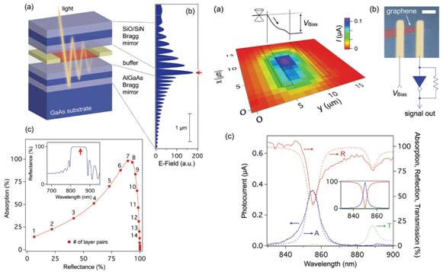
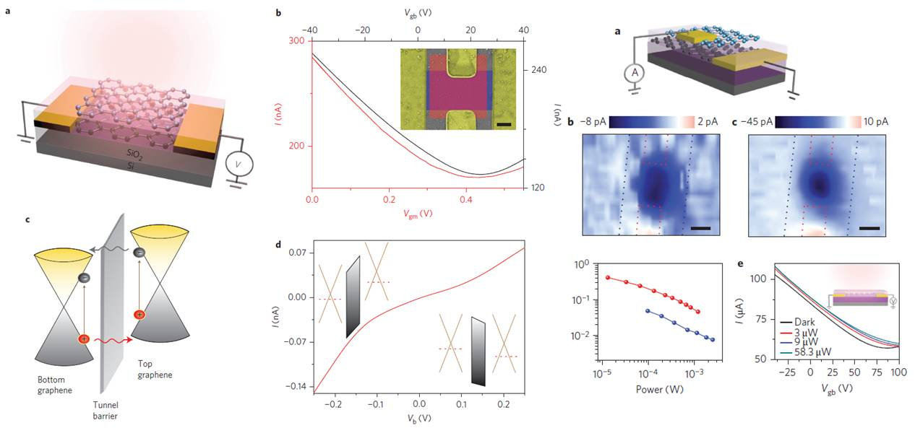
Graphene photodetector
Optical microcavity
Graphene double-layer heterostructure
Marco Furchi et al. PHYSICAL REVIEW B. 2011, 12
You-Chia Chang et al. NATURE NANOTECHNOLOGY. 2014, 31
Distributed Bragg reflectors (DBR)
quarter-wavelength-thick layers of alter­nating materials
light absorption: 60%
Responsivity: 21mA·W^{–1}
Stacked graphene+Tunnel barrier
photoexcited hot carriers tunnel from top layer into the bottom layer
visible to the midinfrared range
mid-infrared responsivity : 1A·W⁻¹

Slide 6
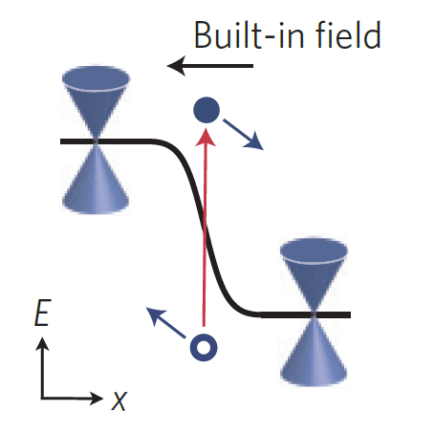
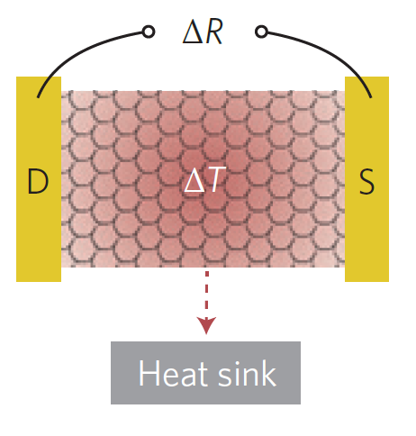
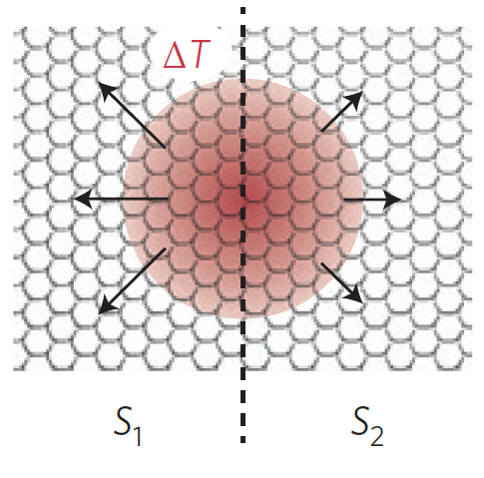
Graphene photodetector
Photovoltaic (PV)
Photo-thermoelectric(PTE)
Bolometric
Build-in electric field
local chemical doping
split gates
graphene-metal junction
Photocurrent direction
p-n to n-p
p-p⁺ to p⁺-p
Seebeck effect
V_{PTE} = (S1 – S2)Δt_{e}
Dominate in graphene p-n and suspended graphene
Mott formula
Mechanism: dP~dT
Semiconductor
Superconductor
Without p–n junction
Nat Nanotech. 2014,9,10

Slide 7
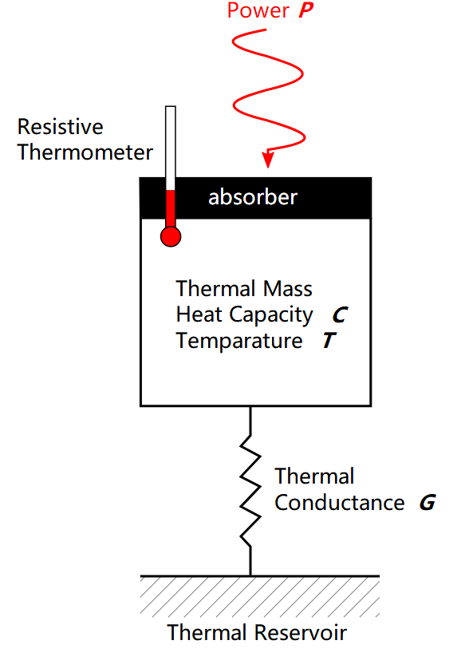
Graphene HEB
Bolometric(HEB)
Graphene HEB
Low heat capacity
(T<5K at Vg~10 V, for a 1 um² sample)
Response time:
Weak electron-phonon coupling
Sensitivity:
limitation:
Weak temperature-dependent resistance, no thermometer
Ideal HEB:

Slide 8
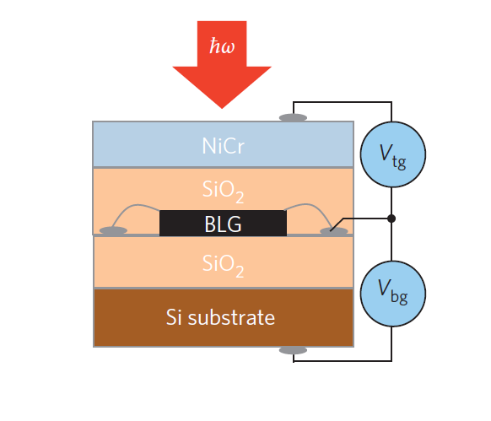
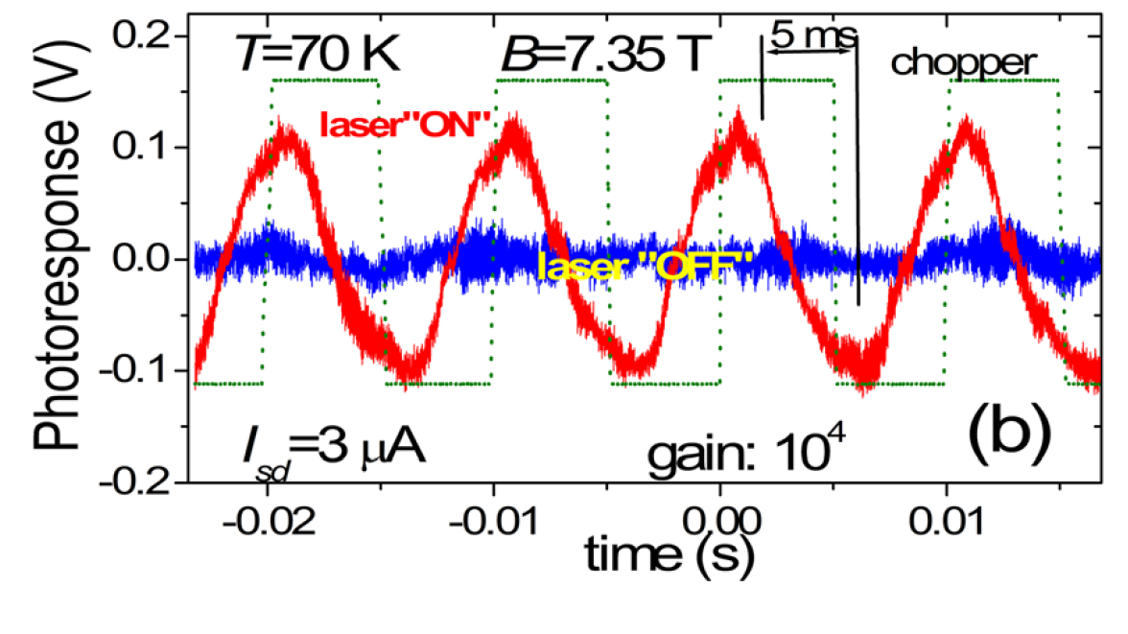
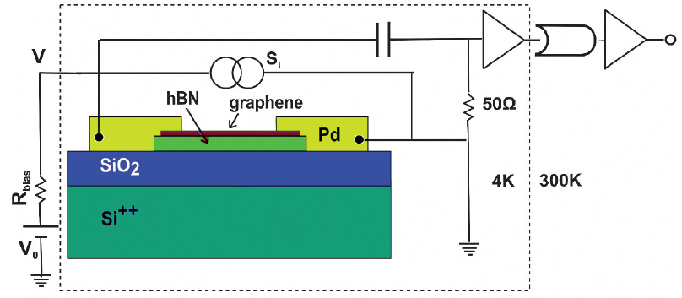
Graphene HEB
1. Strengthen the temperature dependence of the heat
resistance
Nat Nano 2012, 88,10
Appl. Phys. Lett. 2011, 99, 013504
2. Sense the temperature from noise thermometer
Advantage:
Fast response, low noise, far preceding HEB
Disadvantage:
Complicated fabrication process
Phys.Rev.Lett 2012, 109,1056805

Slide 9
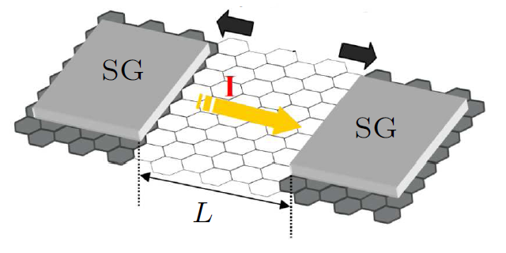
Graphene STJ HEB
Searching for
Strong temperature-dependent resistance
Simple device fabrication
High quality tunnel junctions
Research path :
Strong tunneling
resistance dependence
Strengthen R-T
Graphene STJ
The superconducting
proximity effect
Surface modification
Thermally isolation

Slide 10
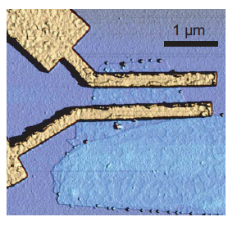
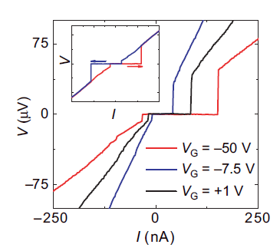
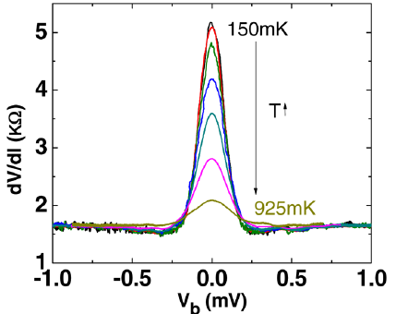
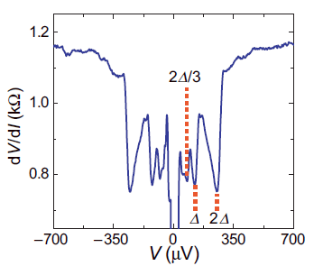
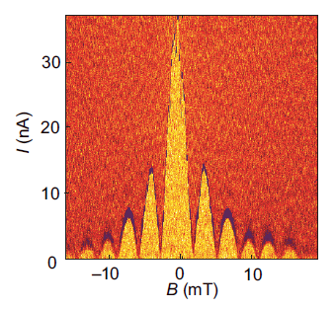
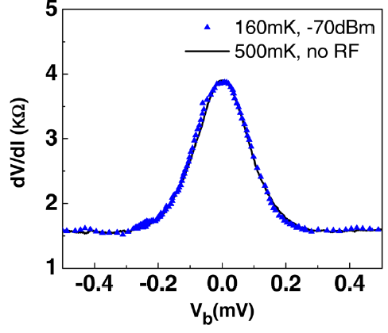
Graphene STJ HEB
Diffusive transport
Proximity effect
Appl. Phys. Lett., 2012,100,(15).
Nature., 2007. 446,7131.
Solutions:
Improve the quality of the tunnel junctions
Induce the intrinsic two-dimentional superconducting of graphene

Slide 11
Graphene STJ HEB
Hard mask fabrication
ZnO nanowire
Sprinkle a handful of zinc oxide nanowires to a free clean substrate
Pick up a suitable nanowire by two glass manipulator arms and put it on top of the graphene block
Cover the graphene all around with scotch tape, and the tape is just pressed on the both ends of the nanowire
Evaporated aluminum (70nm)/ palladium (7nm) membrane on the whole chip
Pull off the tape and remove the nanowire by the manipulator arms
Graphene
Al

Slide 12
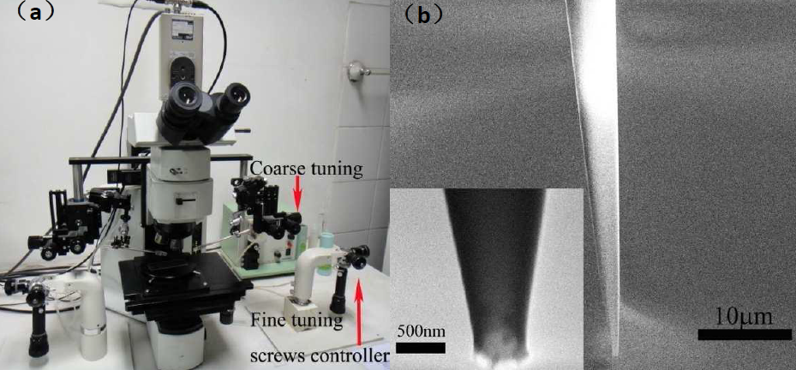
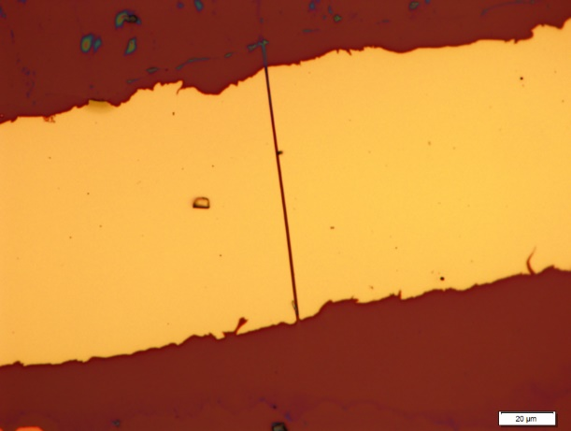
Graphene STJ HEB
Micromanipulation system
Final optical photograph before and after remove the ZnO nanowire

Slide 13
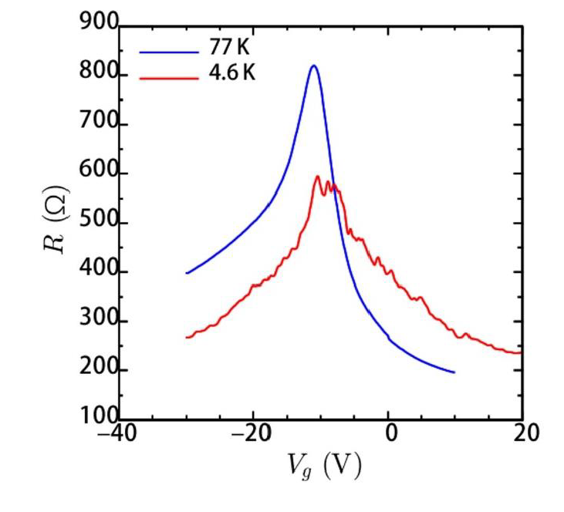
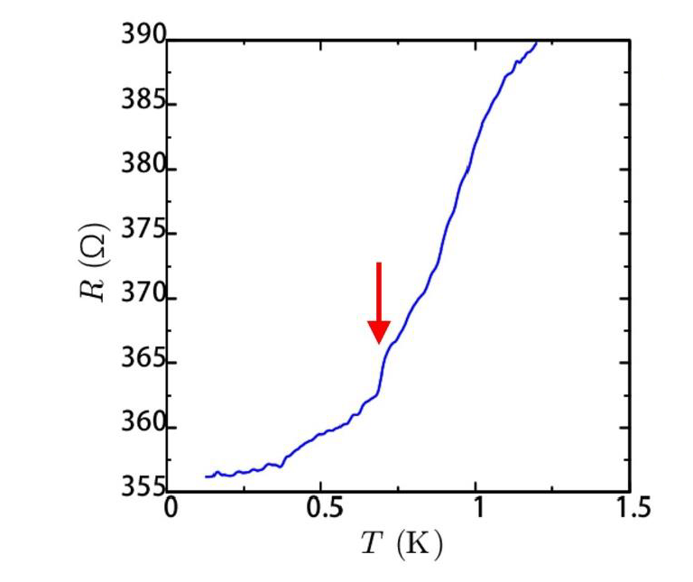
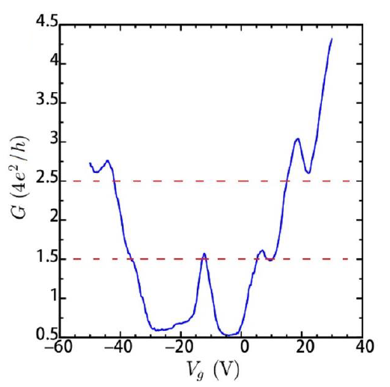
Graphene STJ HEB
Transport measurement
High quality:
Dirac point: V_{D} =-10V,
Mobility: 7.9×10³ cm² / V·s
Residual resistance: 90%R₀ (130mK)
Oxidation of electrode

Slide 14
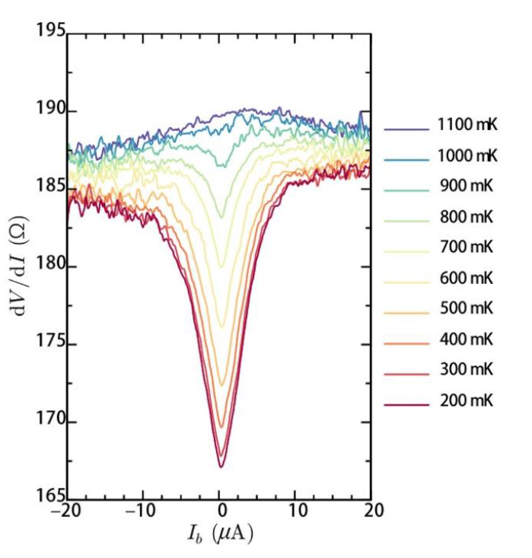
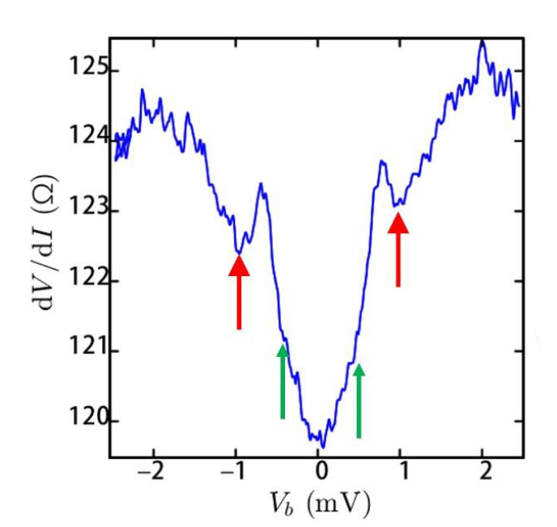
Graphene STJ HEB
Andreev reflection
Zero-bias anomaly (ZBA)
superconductor
y
e
h
x
Precursor of superconducting of graphene!

Slide 15
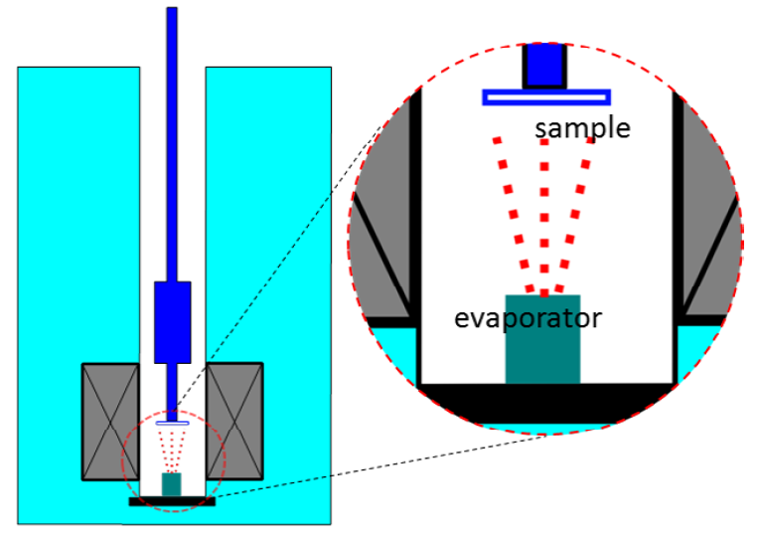
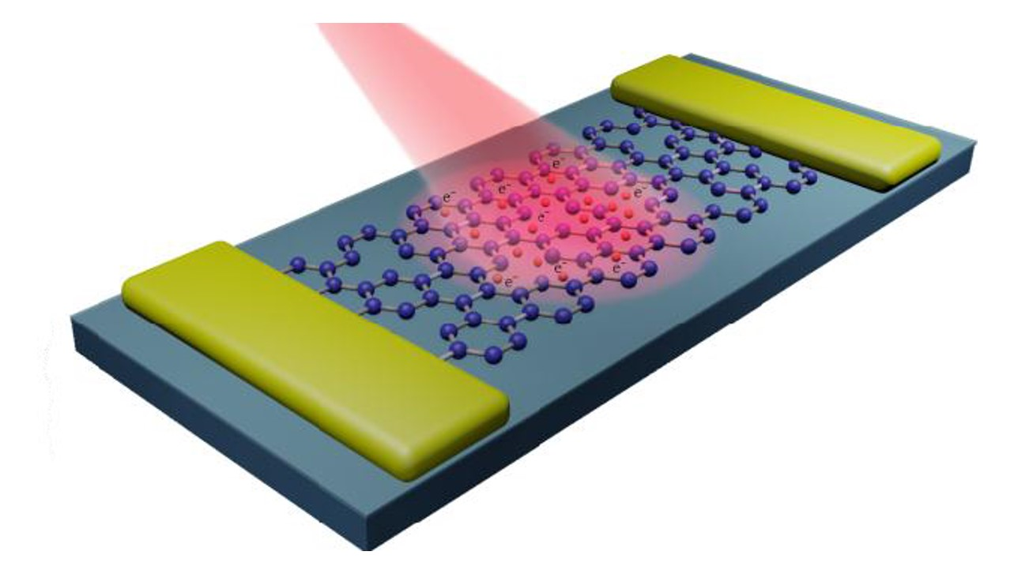
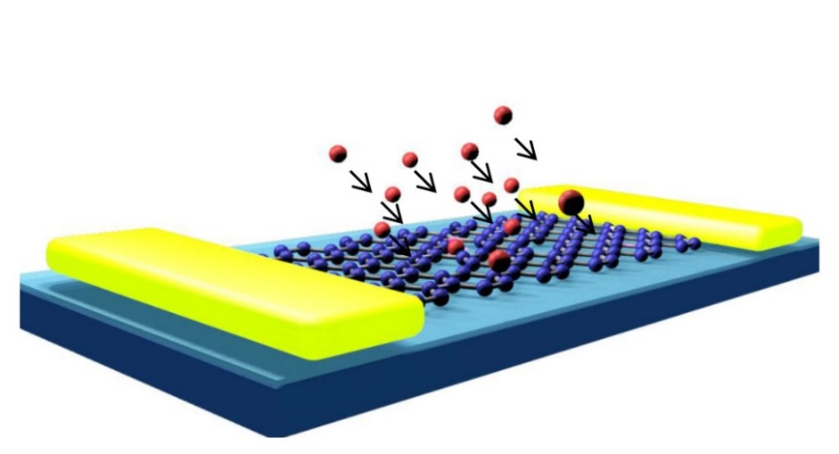
The next to do
Further improve the barrier quality to induce the two-dimentional graphene superconducting
Investigate the in situ doping with Ca atoms and the influence to the graphene intrinsic superconducting
Characterize the photon response of the GSTJ and improve its performance

Slide 16
Thanks for your attention！

