Slide 1
Advanced feedhorn coupled MKIDs
Michael Vissers
Jay Austermann, Max Malnou, Chris Mckenney, Brad Dober, Johannes Hubmayr Gene Hilton, Joel Ullom, and Jiansong Gao
Notes:
1 Thank the introducer
2) Thank the organizers/audience
3) Message:we can create MKIds photon noise limited below 100mHz
4) WHy I am excited: Can finally demonstrate closer to ideal mkids
5) why you: Enable new applicatoins

Slide 2
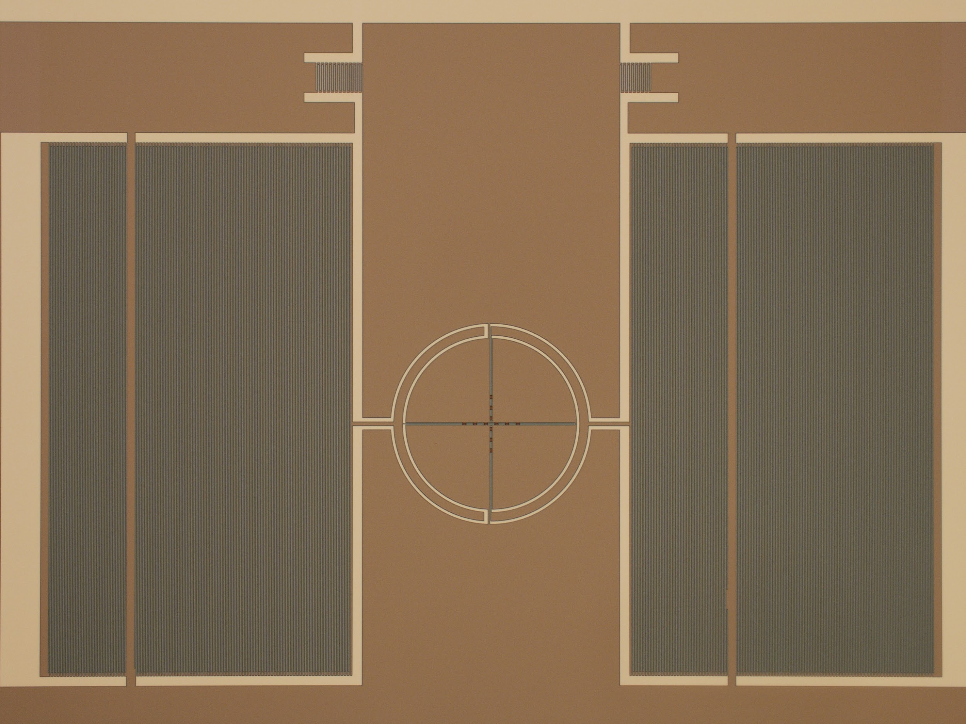
Microwave Kinetic Inductance Detectors (MKIDS)
C
C
Day (2003)
Incident optical power, breaks QP and induces frequency shift in microwave resonators. MKIDs inherently freq multiplexable as we make the detector out of the multiplexer
What do we want in an ideal MKID:
Photon noise limited
Arrays: Highly multiplexable and uniform
Stable: 1/f knee compatible with observing strategies
Compact: fabricate optimal footprint to match optics
L
Notes:
To talk about what we did…..how does it compare to the ideal case.
Idea: MKIDS multiplex easily, but in order to compete with the TES, can’t just rely on being easy to multiplex
Desiderata, often in tension

Slide 3
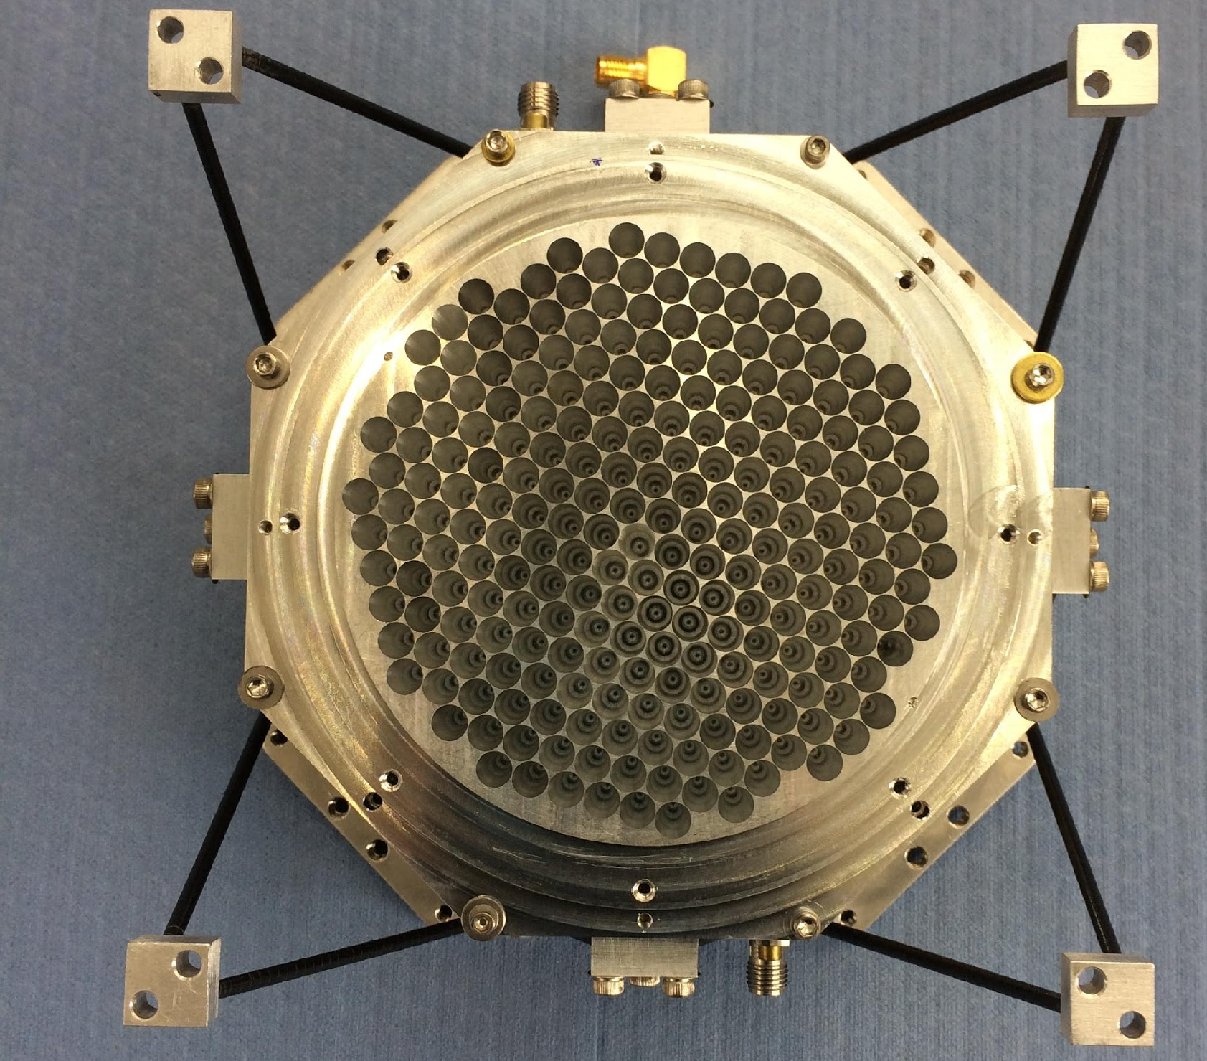
Direct absorbing NIST MKIDs
93 mm
1.2-1.6 K TiN/Ti/TiN uniform Multilayers for BLAST/Toltec
2 mm -> 250 microns, 5-19 pW loading, odd electrodynamics keep Qi high
Flexibly tile into arrays :Multiplexing of 544-938 resonators/feedline, 544-4012/wafer
Feedhorns couple to direct absorbing MKIDs
Need ~1000 Ohm in as little as 160 um or as much as 1.5 mm
Double duty as inductor and impedance matched absorber
Gao, Jiansong, et al. "APL 101 142602 (2012):
McKenney, CM., et al. RSI 90: 023908 (2019)
Notes:
What we have done on our first attempt: direct absorbing etc etc

Slide 4
Scaling MKID arrays to 150mm:
Toltec 1.1 mm Array:
4012 resonators, 1992 feedhorns
80 um / 470 um SOI wafer
135 mm Dodecagon
Notes:
Might have a wider uncropped version somewhere, possibly not. Looks ok
This is great why can;t we use TiN for everything?

Slide 5
Post-measurement lithographic corrections
X. Liu et al JAP 122, 3 (2017)
X. Liu et al. APL 111, 25 (2017)
Yield increases from 86% -> 98.5%.
Frequency spacing uniformity 3 to 4 parts per 10,000
Other groups have now implemented to improve their MKID array yield
Notes:
As wafer sizes and multiplexing yields go up, inevitable have more collisions: SAME AS DEAD RESONATORS, we shouldn’t accept yield hits
I noticed with pleasure that there are several talks in this workshop that show the utility of this and similar methods

Slide 6
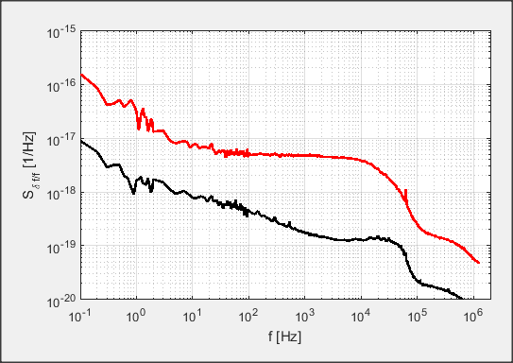
Noise Analysis of Single TiN Pixel
1/f qp noise under load
17pW
photon noise
inductor phase noise (Dark)
upper limit for TLS and other noise
250 μm single pixel resonator
Photon noise limited above a few Hz, well above dark noise sources
1/f limited at low frequencies, excess noise due to optical load
Excess noise mitigated in current projects through observing strategy, but can we solve?
Notes:
Actually kind of a bad pixel, easy to demonstrate the noise components,
TiN pixels work great for existing projects.

Slide 7
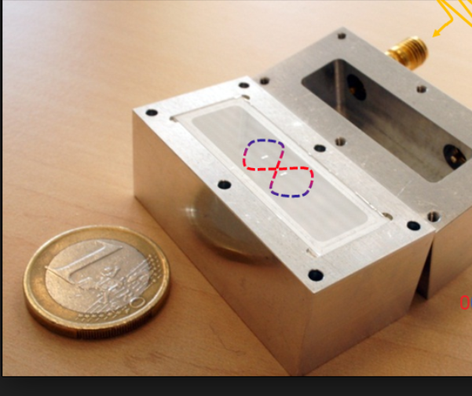
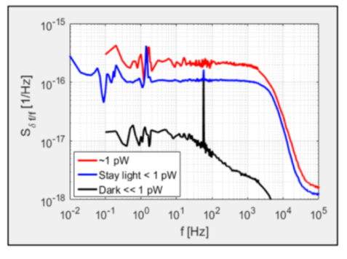
Why not just single layer Al?
Many great Al results, why didn’t we use for BLAST?
T_{bath} ~275 mK, induces thermal QP,
Direct absorbing: Difficult to match the normal state resistance of the inductor to the waveguide impedance ~1000 Ohms in 160 um at THz frequencies
High optical loading leads to low Qi, hurts final yield
Why not for longer optical wavelengths, and lower optical loading?
Interface for our Al and Si has too much TLS loss, but flat inductor noise
Diluting the interface participation by moving capacitors further apart can improve the noise, but at the expense of larger footprint and crosstalk
qutech.nl
Notes:
bad romeo and juliet jokes

Slide 8
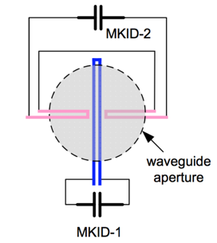
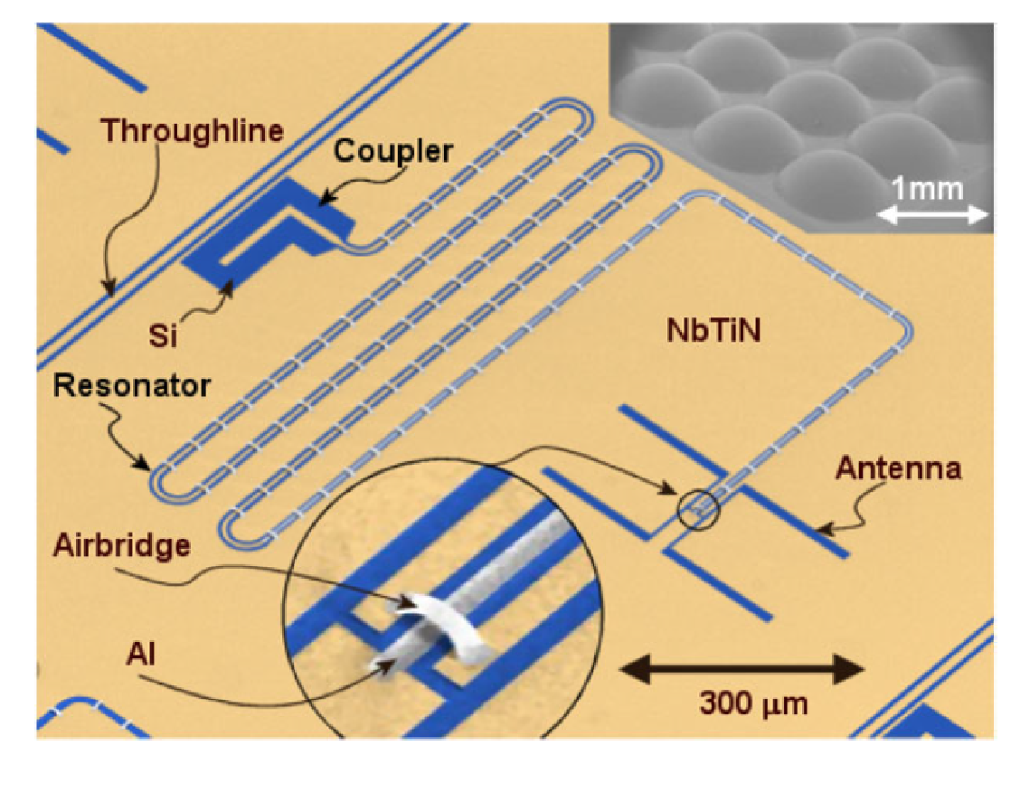
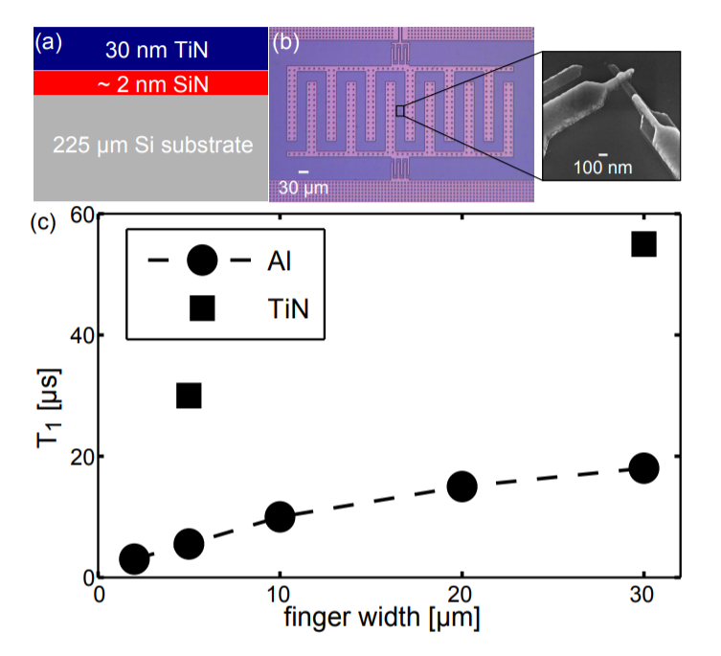
Hybrid device with best L and C?
Previously implemented in CPWs:
Single layer Al and TiN devices have shown they can be close to ideal components
Now, implement a device where the capacitor is TiN and the inductor is Al.
Can we fabricate the combined device without altering the ideal components?
TiN
Al
Bueno, J., et al. Applied Physics Letters 110, 233503 (2017)
Janssen, R. M. J., et al.SPIE 2014.
Janssen, R. M. J., et al. Applied Physics Letters 105 193504 (2014).
YJY Lankwarden, et al. J Low Temp Phy 167 367 (2012)
and qubits
Chang, J. B., APL, 103, 012602. (2013)
Notes:
Add cartoon of LE-KID back in, highlight the 2 different sections, say you can also do it in CPWs

Slide 9
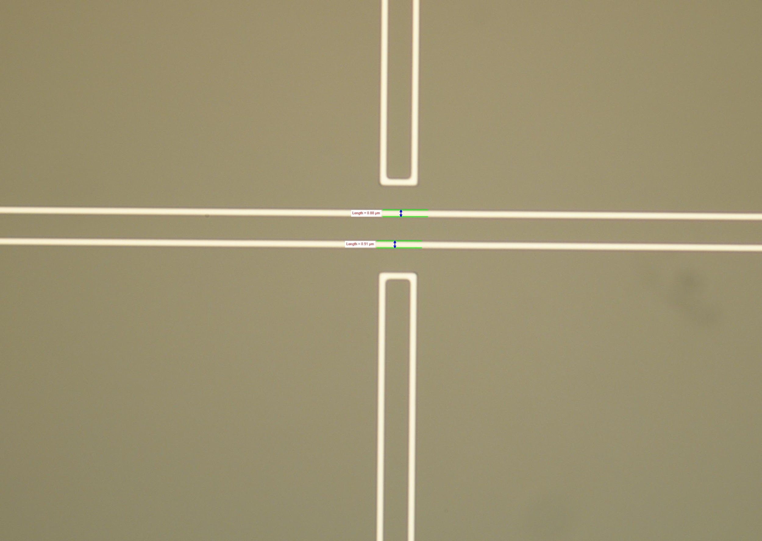
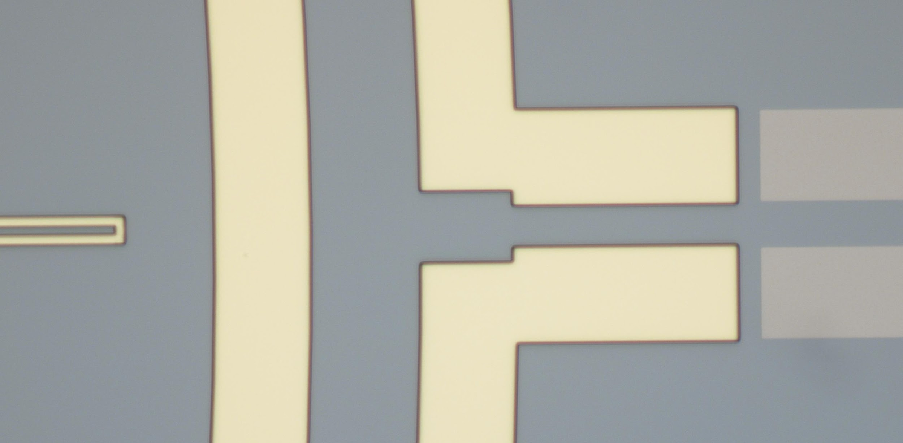
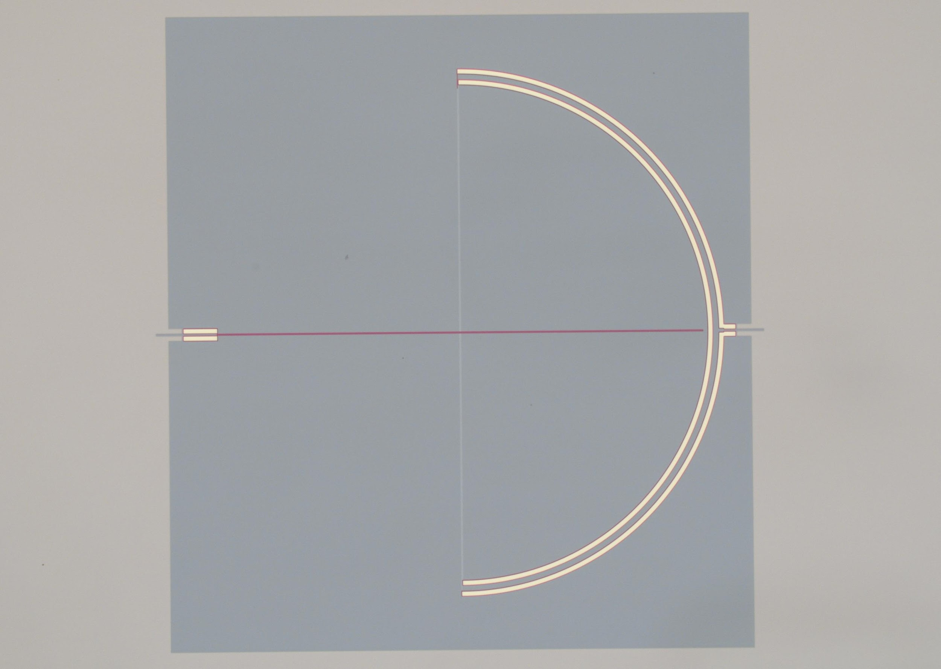
TiN-Al Process
30 nm Al
TiN
Si
TiN
0: Deposit Stoich. TiN
FZ i-Si device layer of 146 um SOI wafer
HF to remove oxide
1: Etch region for Al inductor
TiN sloped etch: want smooth surface for Al & minimal overetch into Si,
TLS contribution of inductor surface less important
2: Blanket sputter deposit 30 nm Al:
HF to remove native oxide, no ion clean
Wet etch for inductor, ~1 um widths
Wafer scale non-uniformity of etch, but have LED trimmer to fix
Wisbey, D. S., JAP 108, 093918 (2010)
Notes:
in our experience liftoff does not work….

Slide 10
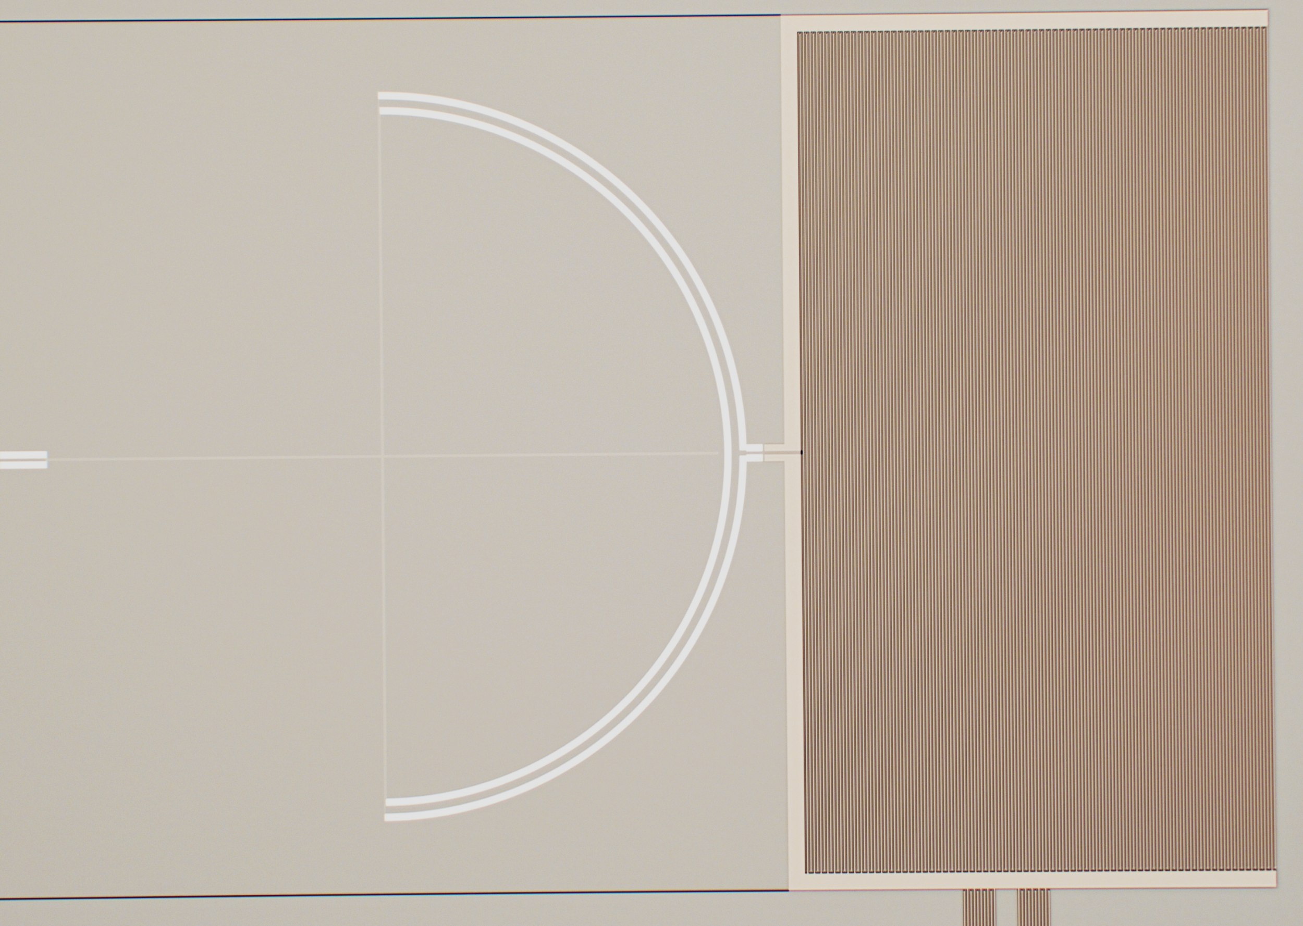
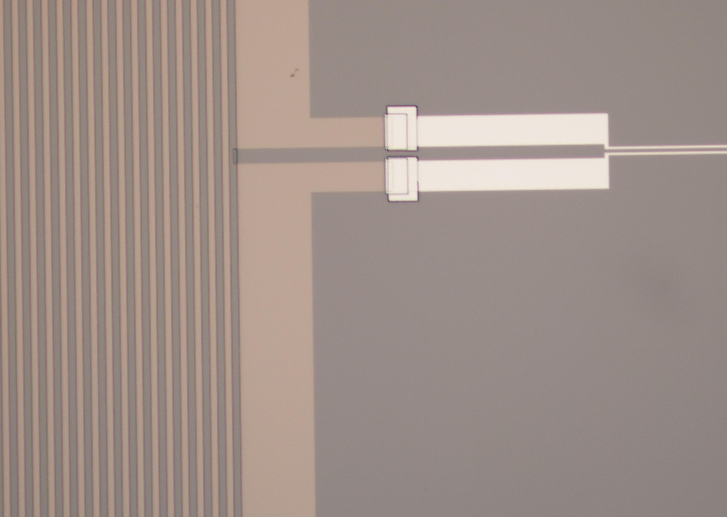
TiN-Al Process
3: Etch TiN IDC,
Straighter, lower loss etch,
Slight trench into Si, still need to connect L & C
4: 200 nm Al liftoff,
Ar ion clean to make good electrical connections to high quality TiN and Al,
Thick enough to cover steps
Notes:
AZ developer
Otherwise etch away 30nm Al

Slide 11
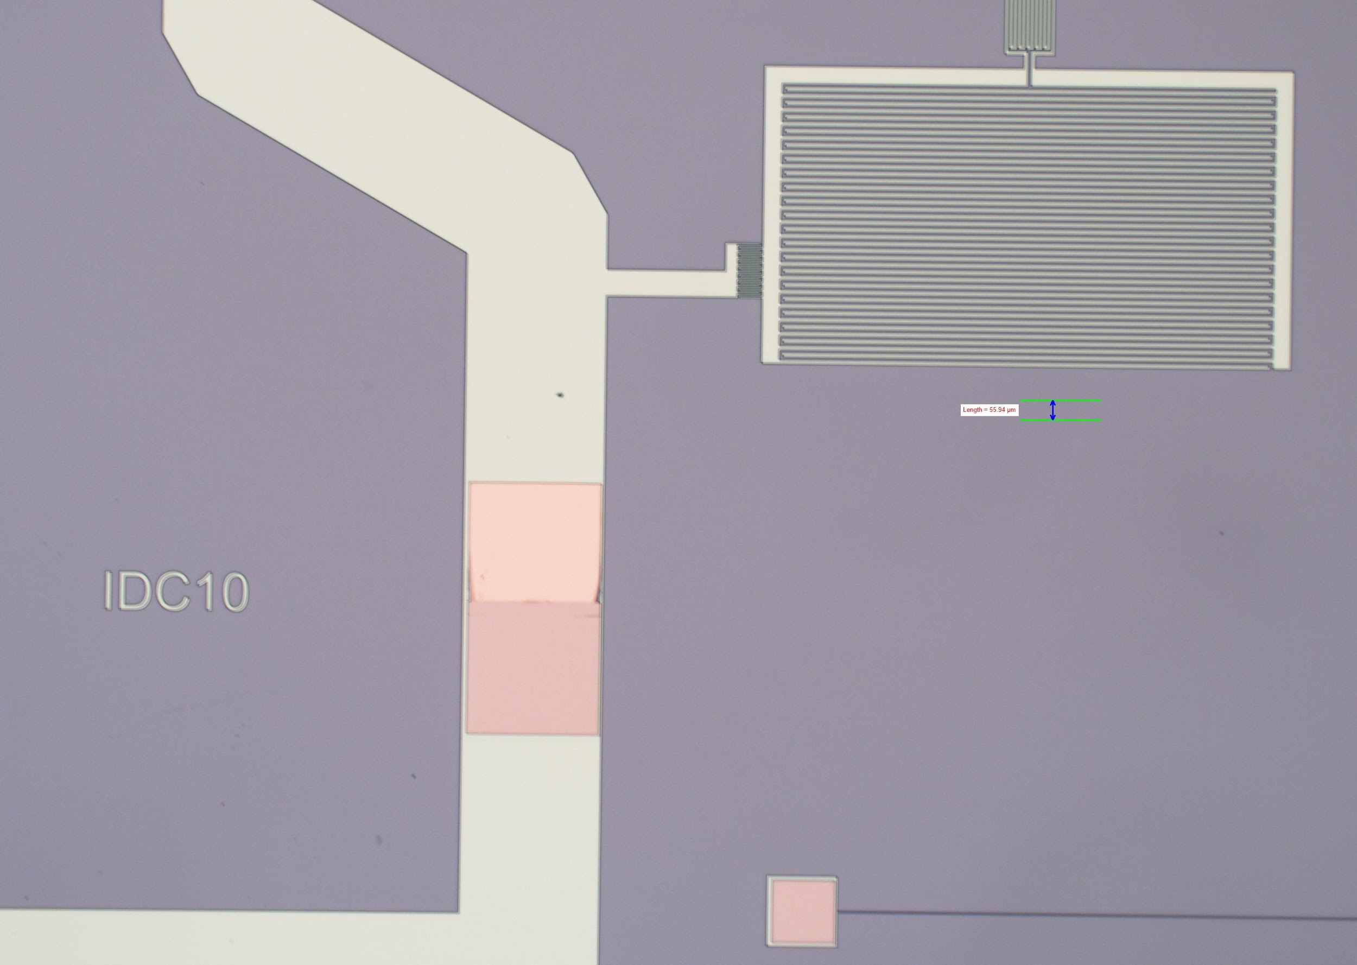
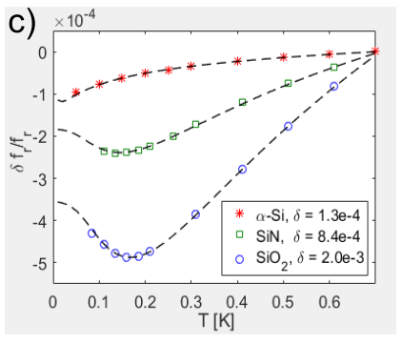
TiN-Al Process
5: 50 nm amorphous-Si for Al passivation,
etch openings for feedline bondpads
Thin dielectric to reduce TLS contribution on the capacitor
Etches for a-Si are not selective vs TiN or Si, but a-Si is lower loss than SiOx/SiN
As an estimate for 50 nm a-Si, 5um IDC : 1x10⁻⁴ loss tangent *2% participation = 2x10⁻⁶ loss contribution to circuit
Notes:
Add the a-Si loss plot from overleaf NASA proposal for evidence on low loss

Slide 12
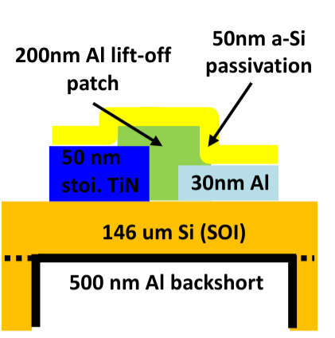
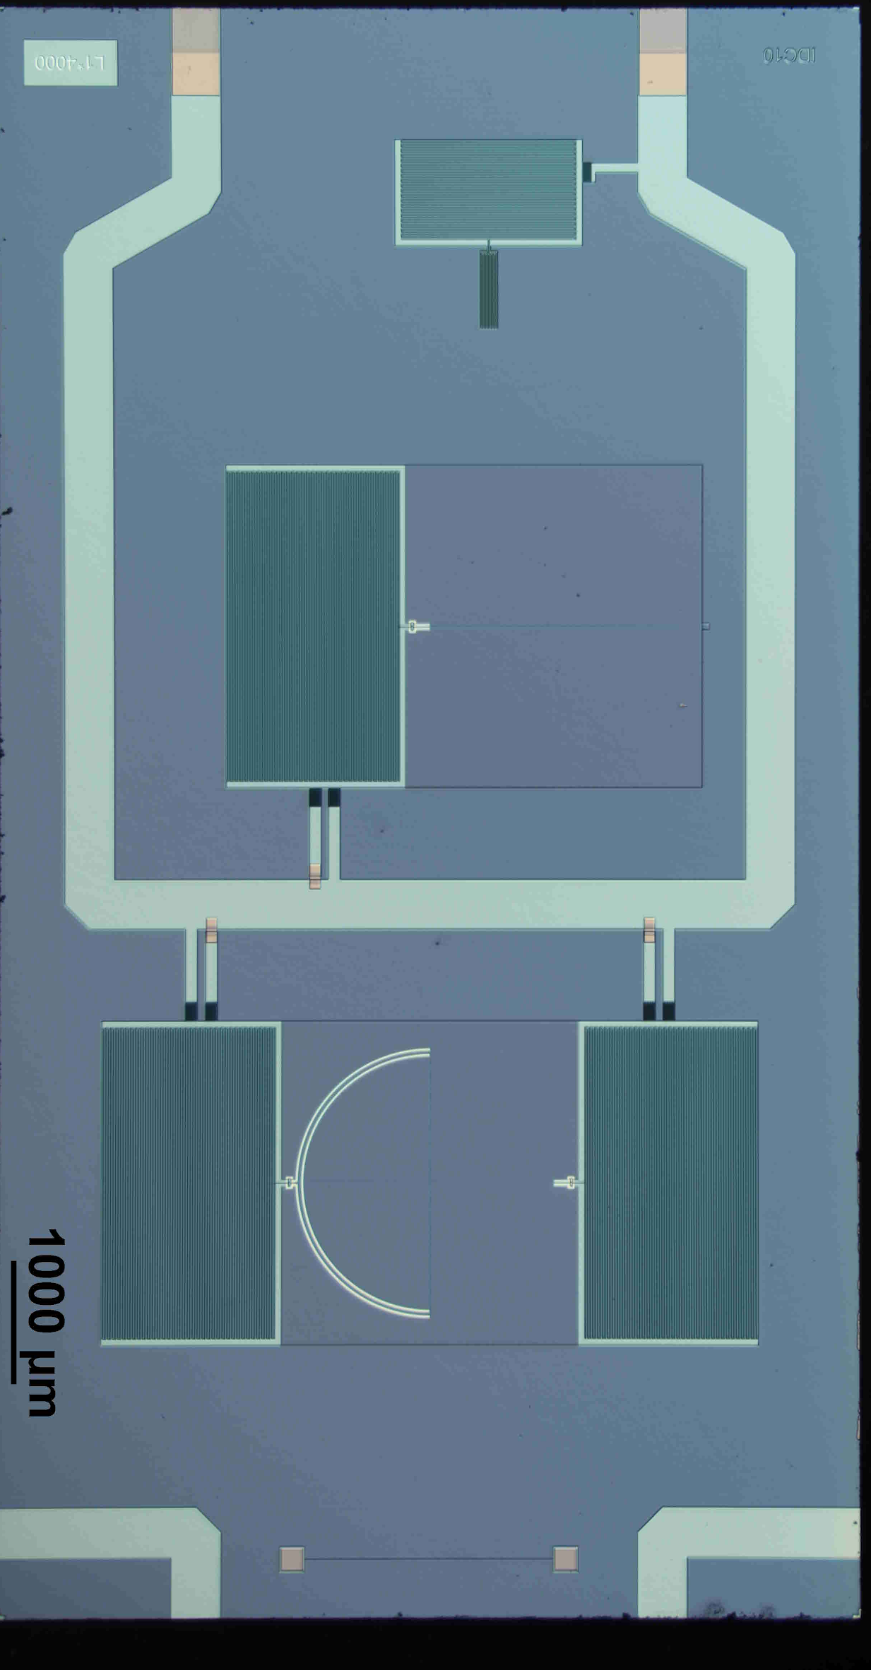
TiN-Al Process
6: Backside,
DRIE Si handle
RIE Buried SiOX beneath IDCs/Inductor
sputter thick Al for backshort
Dice and test
Optical, dark, and IDC test devices on the same chip

Slide 13
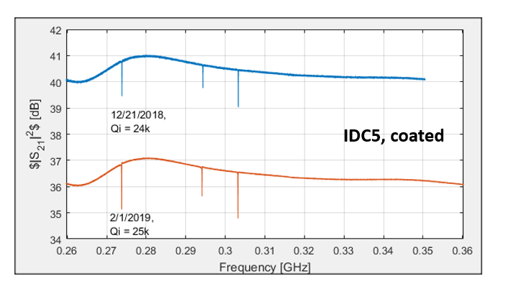
A-Si passivation: No aging of inductor with acceptable increased noise.
Lore exists that Al ages, sometimes. In our experience, our Al inductors change measurably on the timescale of days.
Thin Al covered with a-Si doesn’t age, and with an acceptable noise penalty: government shutdown provided natural experiment
Ideally, would only like to coat inductor and are working on ways to implement
Notes:
Need to check the overleaf for any more details on the setup, but maybe just talk about it in words
Natural experiment with the shutdown: Interesting things about working for the government is that you can suffer a lapse in appropriations, and the lab gets closed for 6 weeks.

Slide 14
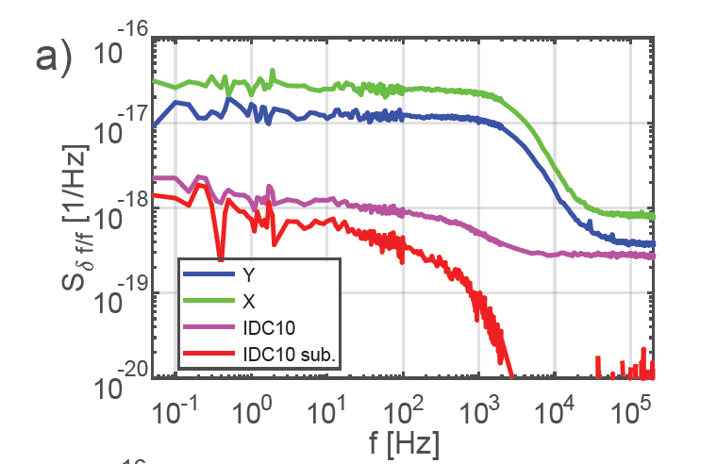
Results: Under 150 GHz optical load
Photon noise flat to below 50 mHz.
Limited by fridge stability?
Co-fabricated TLS noise limited resonators show order of magnitude less noise
See Jiansong Gao’s talk today for more detail
Notes:
IS this a coated device? I think so….. adds subdominant noise , exact details are ongoing

Slide 15
Conclusions
Al and TiN each have advantages, and we can synergize them to enable an optimal hybrid MKID
Single pixel results show photon limited noise performance down to 50 mHz.
Challenges to demonstrating arrays remain, but existing methods such as LED trimmer provide a path to ultrastable background limited MKID arrays.
Notes:
be on the lookout for a publication soon

