Slide 1
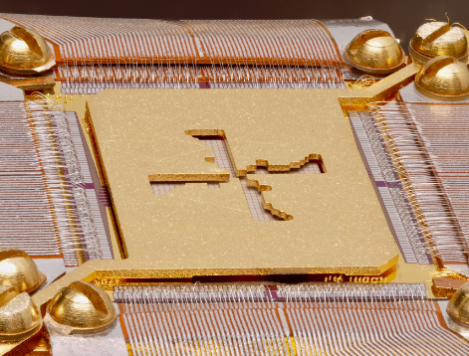
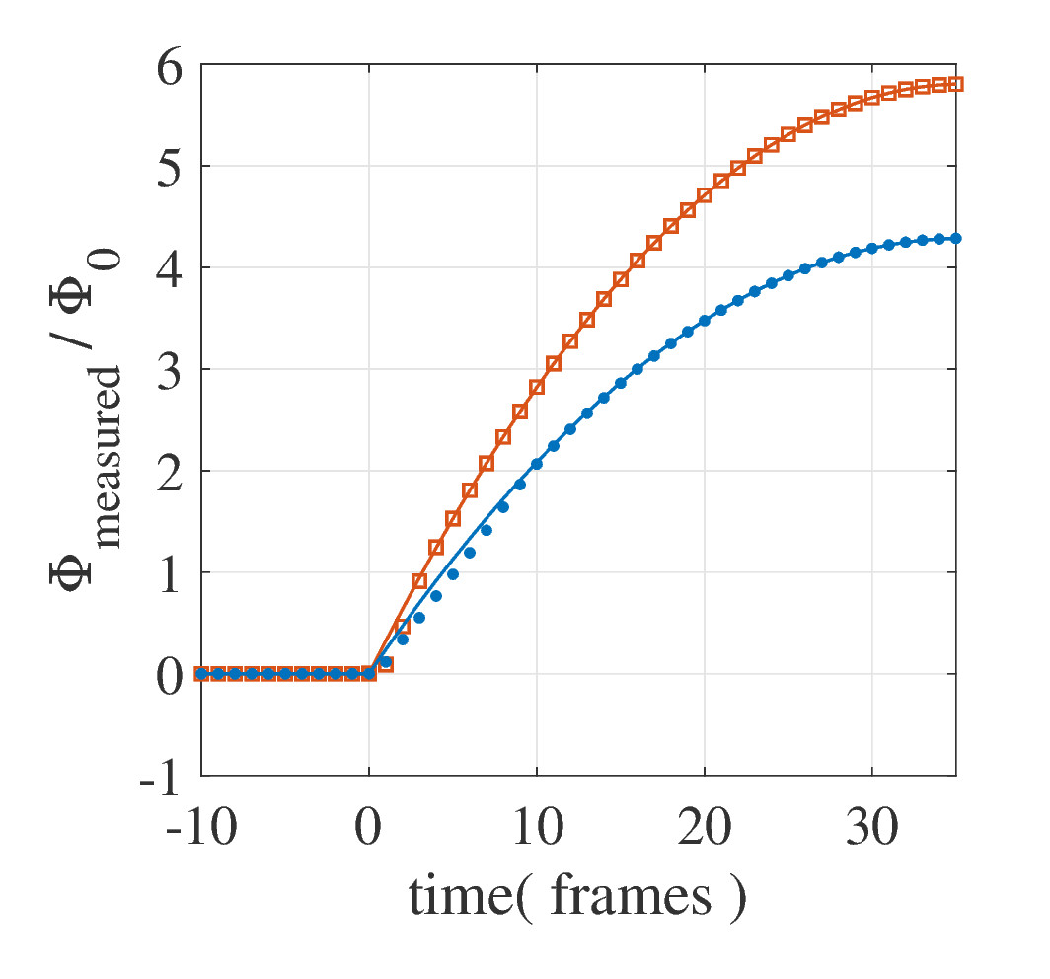
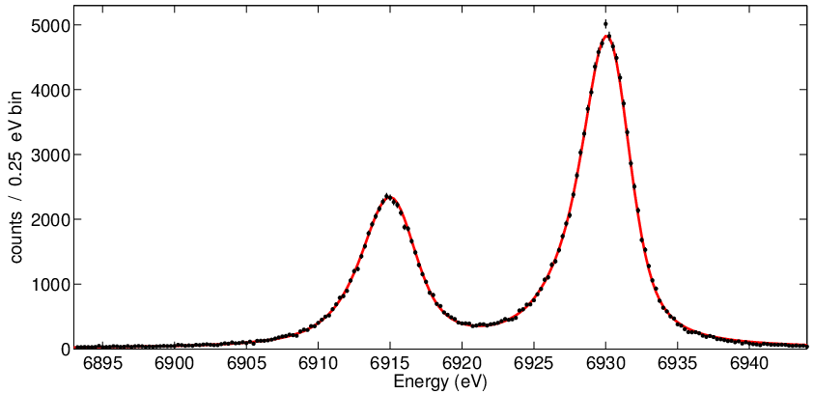
Advances in Time Division Multiplexing for X-ray TES arrays
Malcolm Durkin, on behalf of US Athena Collaboration.
NASA LPA 2.5a TES array
University of Colorado, Boulder: Malcolm.Durkin@NIST.gov
New flux locked loop Controller Algorithm Simulations
Highest energy pulse that the controller can handle.
48 row TDM for X-IFU?
New Algorithm
40 row TDM X-IFU demo (NASA LPA 2.5a TES array)
Old Algorithm
Co Kα (6.9 keV)
1 column X 40-row TDM
combined, ~190 k counts
ΔE_{FWHM} = 2.40 ± 0.02 eV

Slide 2
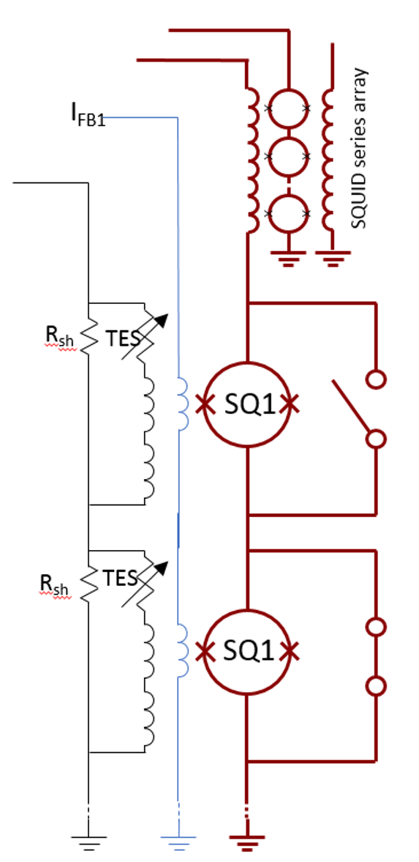
Time Division Multiplexing
TES bias
Row 0
(on)
DC Voltage Biased TESs
Row 1
(off)
Notes:
Fix 2 and 3 to be more similar in transition

Slide 3
Time Division Multiplexing
TES bias
Each TES read out by a first stage SQUID ammeter (SQ1).
Row 0
(on)
DC Voltage Biased TESs
Row 1
(off)
Notes:
Fix 2 and 3 to be more similar in transition

Slide 4
Time Division Multiplexing
TES bias
Each TES read out by a first stage SQUID ammeter (SQ1).
Row 0
(on)
DC Voltage Biased TESs
SQ1 is activated opening SC switch (TESs read out one at a time)
Row 1
(off)
Notes:
Fix 2 and 3 to be more similar in transition

Slide 5
Time Division Multiplexing
Signal further amplified by SQUID series array amplifier on 1K stage.
TES bias
Each TES read out by a first stage SQUID ammeter (SQ1).
Row 0
(on)
DC Voltage Biased TESs
SQ1 is activated opening SC switch (TESs read out one at a time)
Row 1
(off)
Notes:
Fix 2 and 3 to be more similar in transition

Slide 6
Time Division Multiplexing
We can read out many columns in parallel
Column 0
Column 1
TES bias
TES bias
Row 0
(on)
Row 1
(off)
8 column x 32 row systems routinely deployed.
(capable of reading out 250 pixel scale TES arrays)

Slide 7
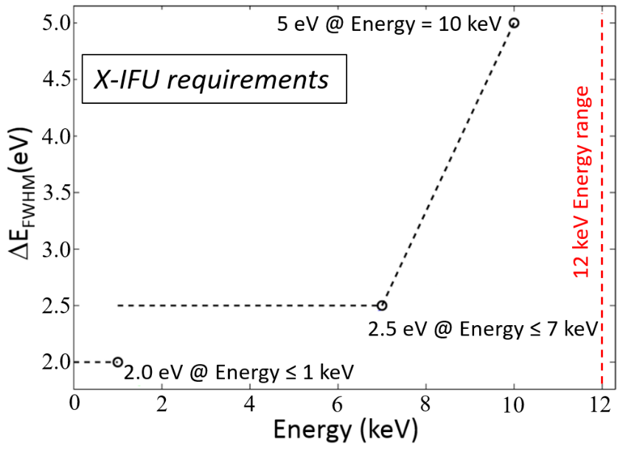
LPA 2.5a 40 row demo for Athena X-IFU
X-Ray Integral Field Unit
3,168 pixel TES array
FDM is primary readout option
TDM is backup readout option
~ 40 rows being considered for TDM
NASA LPA 2.5a TES array
“40 row” Demonstration of LPA2.5a with 8 x 32 system
160 ns row times allow readout of 12 keV pulses.
S. J. Smith et al. Poster Session
Notes:
Ref. Steve Smith

Slide 8
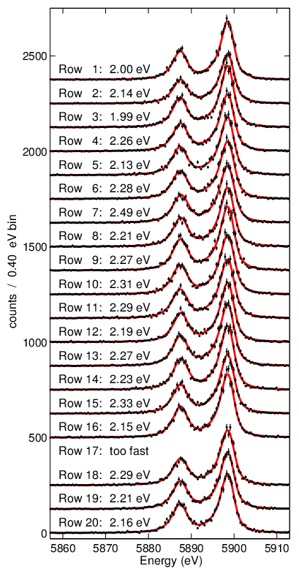
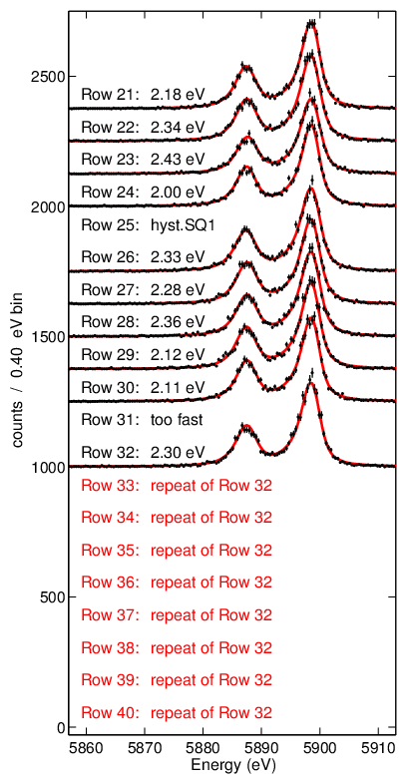
40 Row Demo for X-IFU
Individual Pixel Spectra
40 timing rows( 32 unique physical rows and 8 repeat rows)
Replicates noise and dynamic range of 40 row TDM

Slide 9
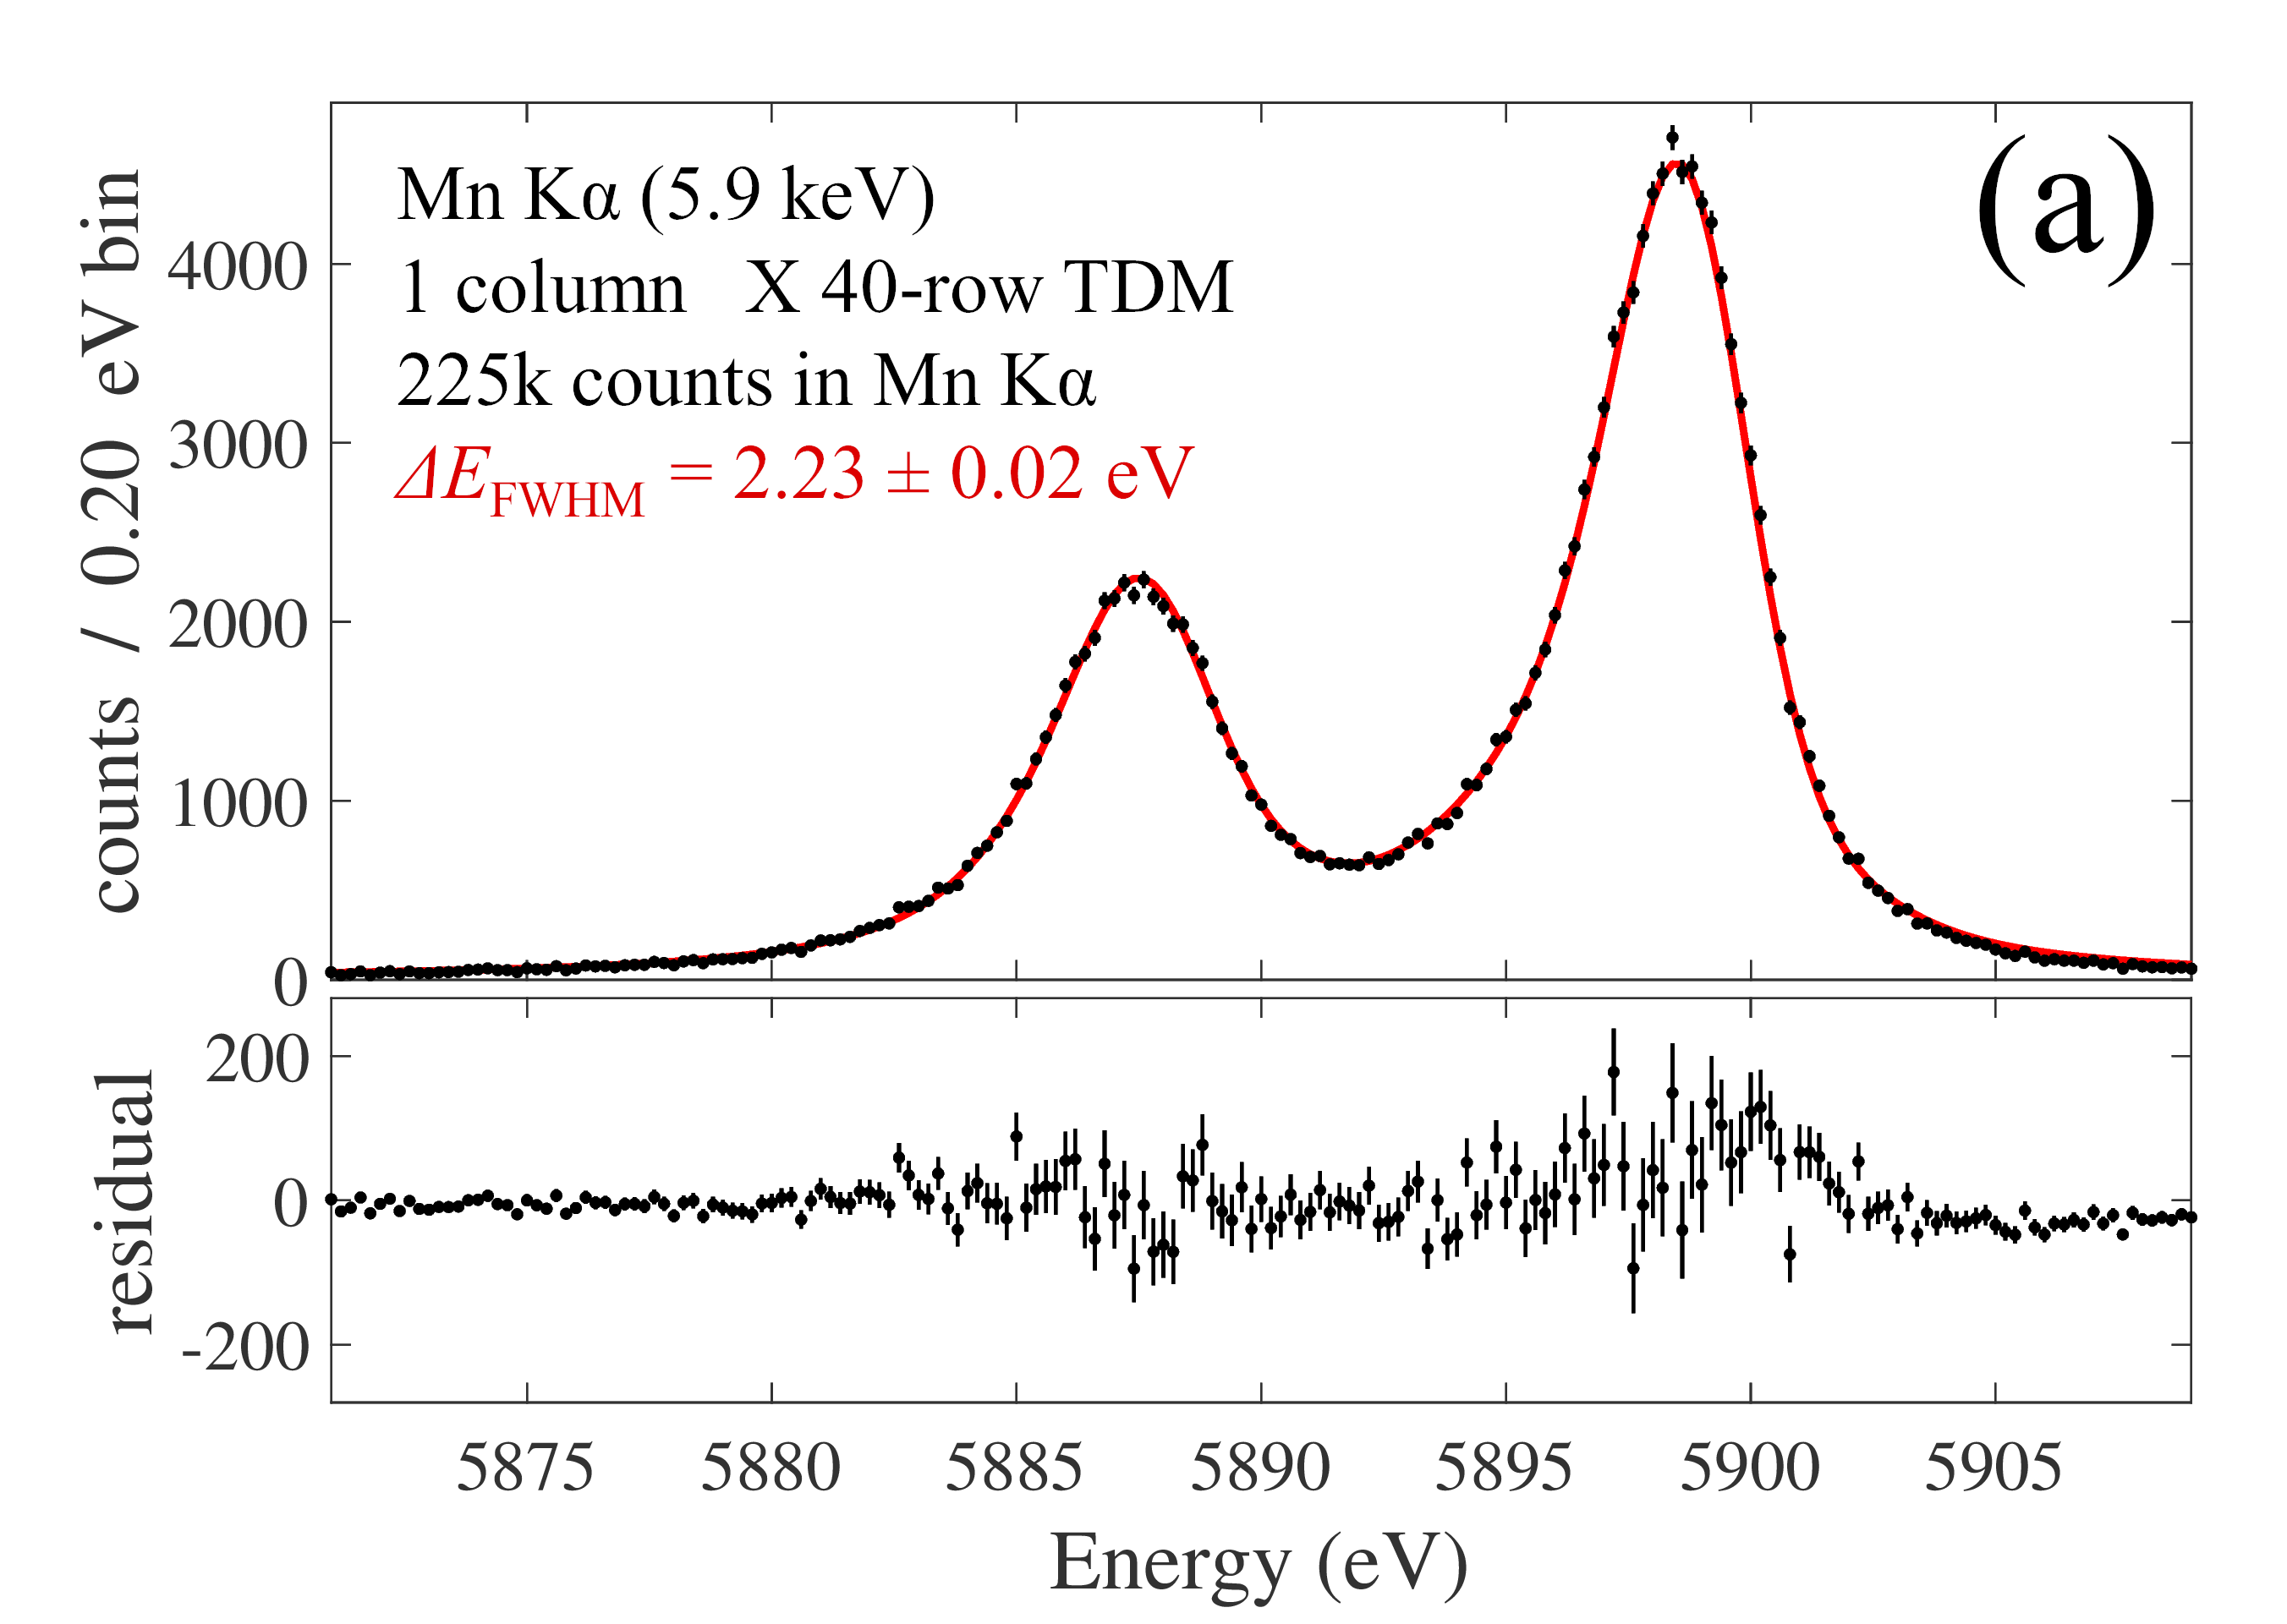
40 Row Demo for X-IFU
Individual Pixel Spectra
40 timing rows( 32 unique physical rows and 8 repeat rows)
Replicates noise and dynamic range of 40 row TDM
Coadded Spectrum

Slide 10
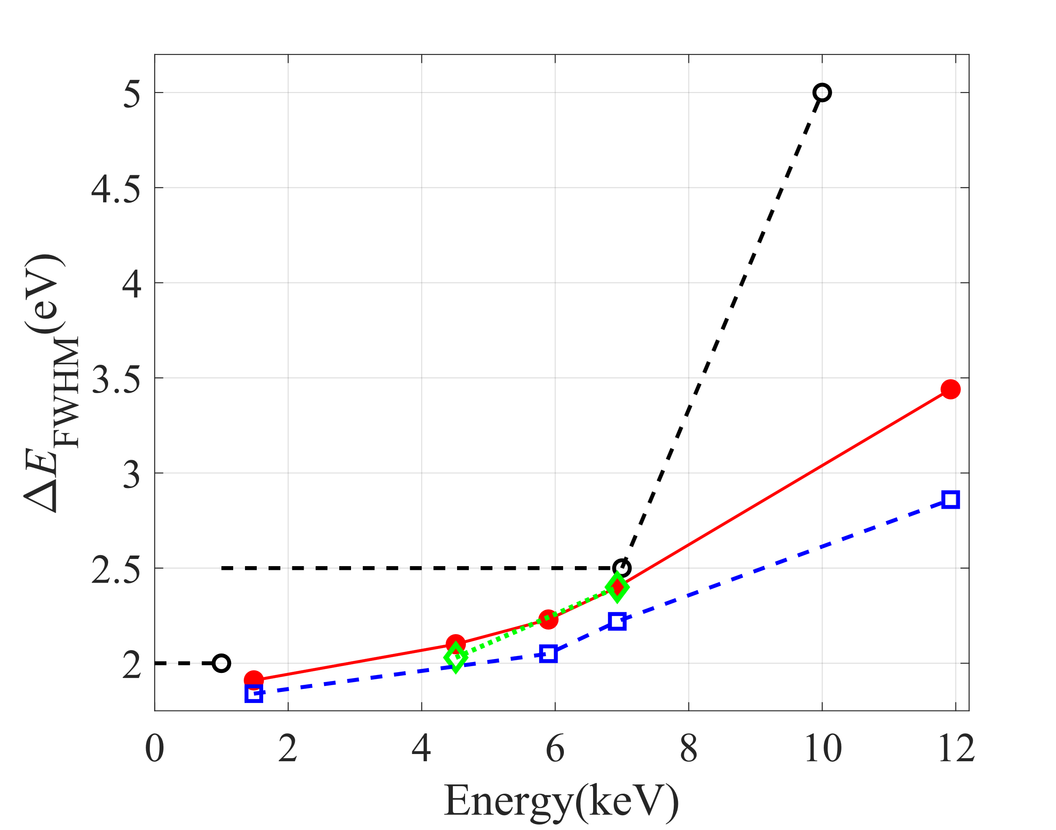
40 Row Demo for X-IFU
TDM 1x40: Achieved
X-IFU Requirements
TDM 3x40: Achieved
Non-multiplexed: estimated
M. Durkin et al. IEEE Trans. Appl. Supercond. 29, 25000305 (2019).
Future testing will occur on 960 pixel (40 row x 24 column ) TDM systems under construction.
See W. B. Doriese et al. Poster Session.

Slide 11
TDM Beyond 40 rows
TDM is a credible readout option for X-IFU and meets its specifications.
Further improvements are desirable to save spacecraft resources and/or offer expanded capabilities.
A new flux locked loop controller could allow significant increases in row count.

Slide 12
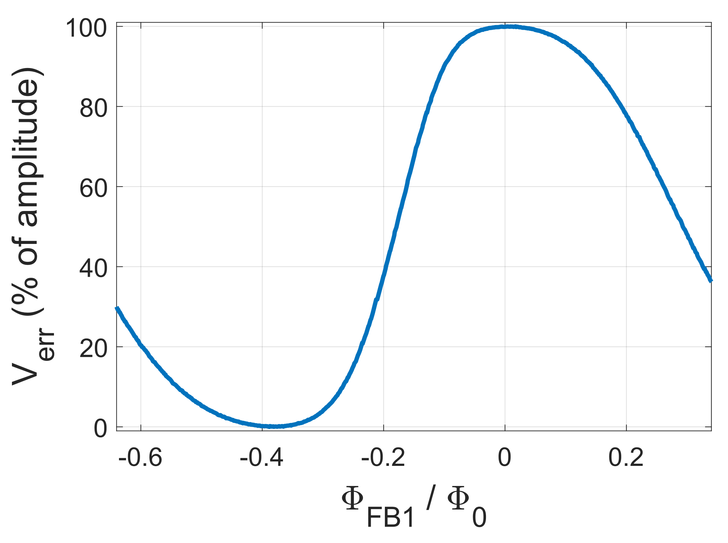
The Digital Flux Locked Loop
We linearize our SQUID amplifiers using a Flux locked loop.
A TDM column has one flux feedback line.
V_{err}
V_{SQ1B}
Lock Point
Row 0
(on)
The active SQ1 is locked.
Row 1
(off)

Slide 13
The Digital Flux Locked Loop
We linearize our SQUID amplifiers using a Flux locked loop.
A TDM column has one flux feedback line.
Each SQ1 FLL is updated once a frame
using an integral controller:
V_{err}
V_{SQ1B}
SSA readout used as error signal.
Feedback updated next frame
Lock Point
Row 0
(on)
The active SQ1 is locked.
Row 1
(off)

Slide 14
The Digital Flux Locked Loop
We linearize our SQUID amplifiers using a Flux locked loop.
A TDM column has one flux feedback line.
Each SQ1 FLL is updated once a frame
using an integral controller:
V_{err}
V_{SQ1B}
SSA readout used as error signal.
Feedback updated next frame
Lock Point
Controller is a frame behind
(Φ_{FB1, n+1} corrects for I_{TES, n}, not I_{TES, n+1})
Row 0
(on)
The active SQ1 is locked.
Row 1
(off)

Slide 15
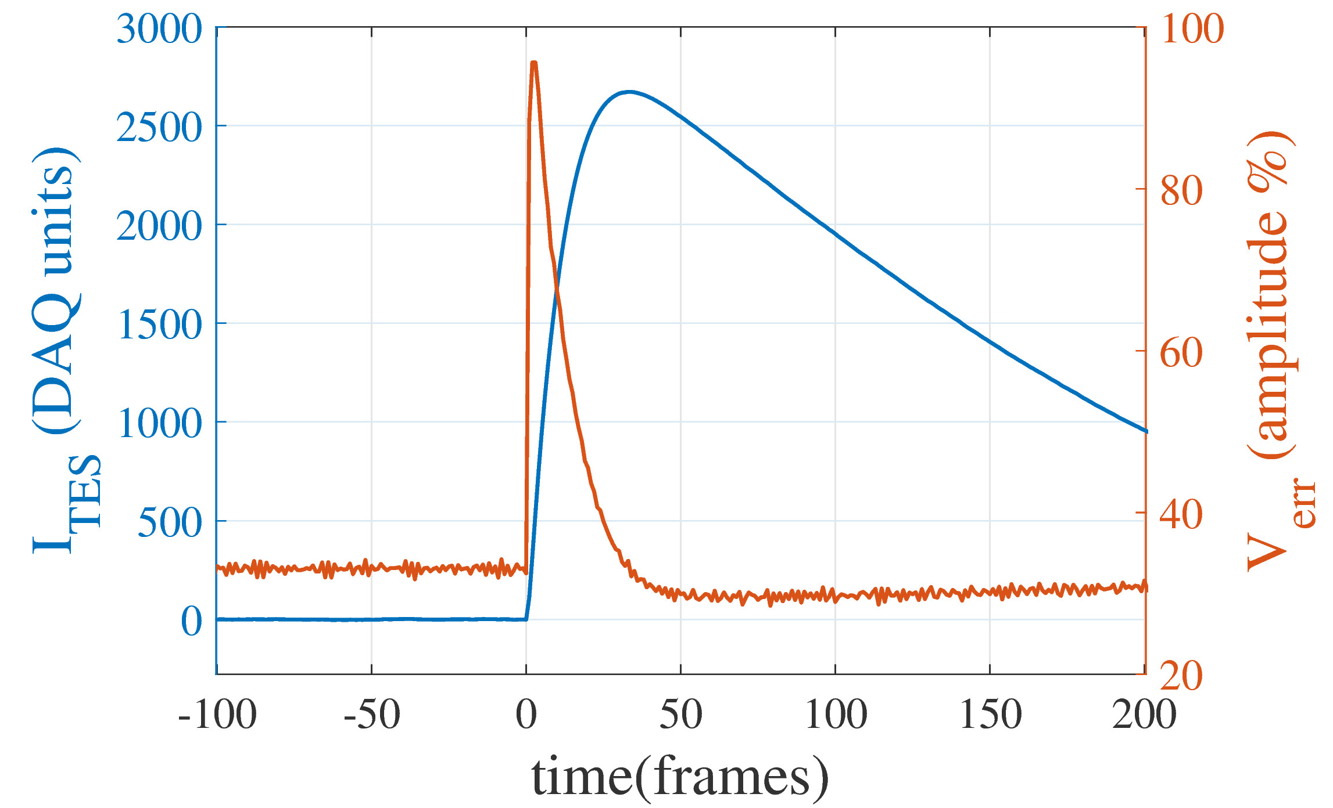
The Digital Flux Locked Loop
We linearize our SQUID amplifiers using a Flux locked loop.
Consequence: V_{err} is roughly proportional to dI_{TES}/dt.
(Higher energy X-rays→ greater V_{err})
Lock Point

Slide 16
The Digital Flux Locked Loop
We linearize our SQUID amplifiers using a Flux locked loop.
Consequence: V_{err} is roughly proportional to dI_{TES}/dt.
(Higher energy X-rays→ greater V_{err})
Lock Point
We do correct for this controller error,
However, this assumes linearity and fails at higher energies, setting limits on max energy.

Slide 17
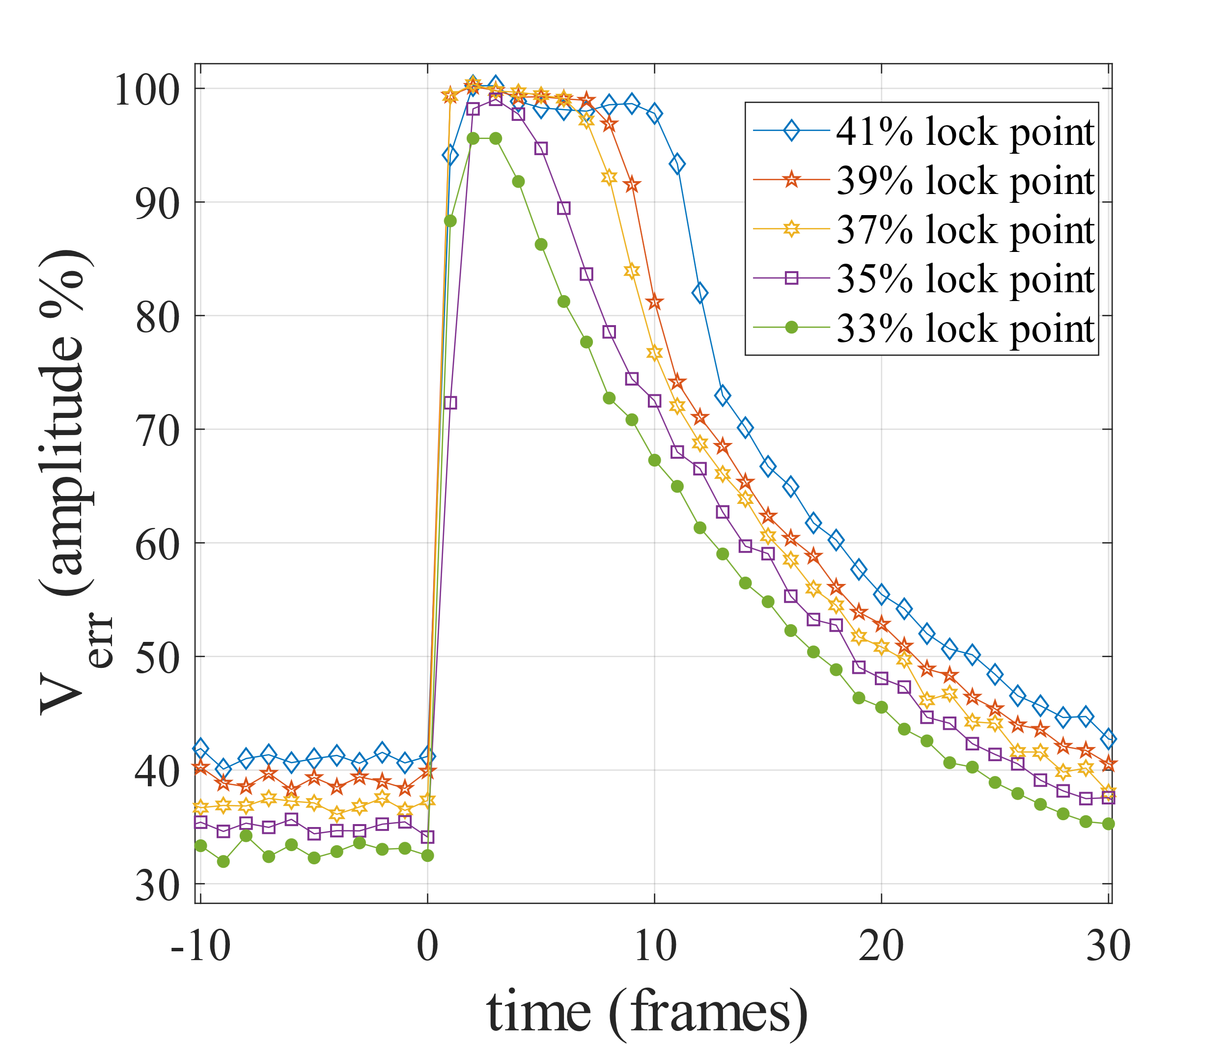
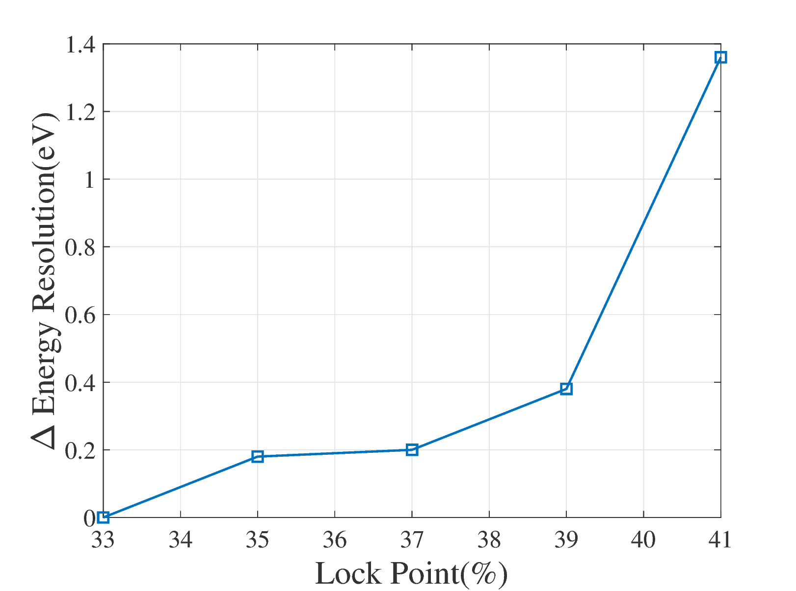
Identifying Controller Failure Modes
We test effects of nonlinearity by moving the lock point.
Failure Modes
Controller becomes trapped in nonlinear regime (41%), resolution degrades significantly
Controller becomes unlocked (43%), pulses no longer measurable
We propose a new controller to address these issues.

Slide 18
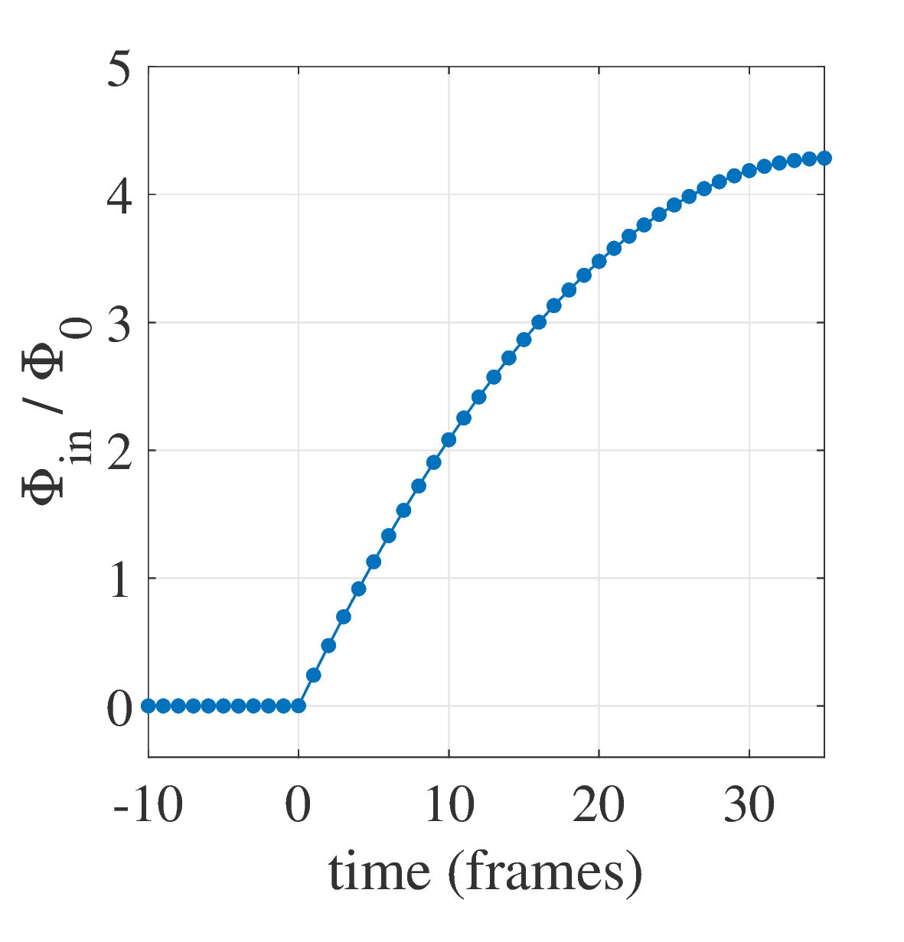
A New Controller Algorithm
Integral Term
Predictive term anticipates changes in Φ_{in}
Tracks slope of smooth part of pulse
Makes Rapid adjustment at start of pulse
(applied once during a pulse)

Slide 19
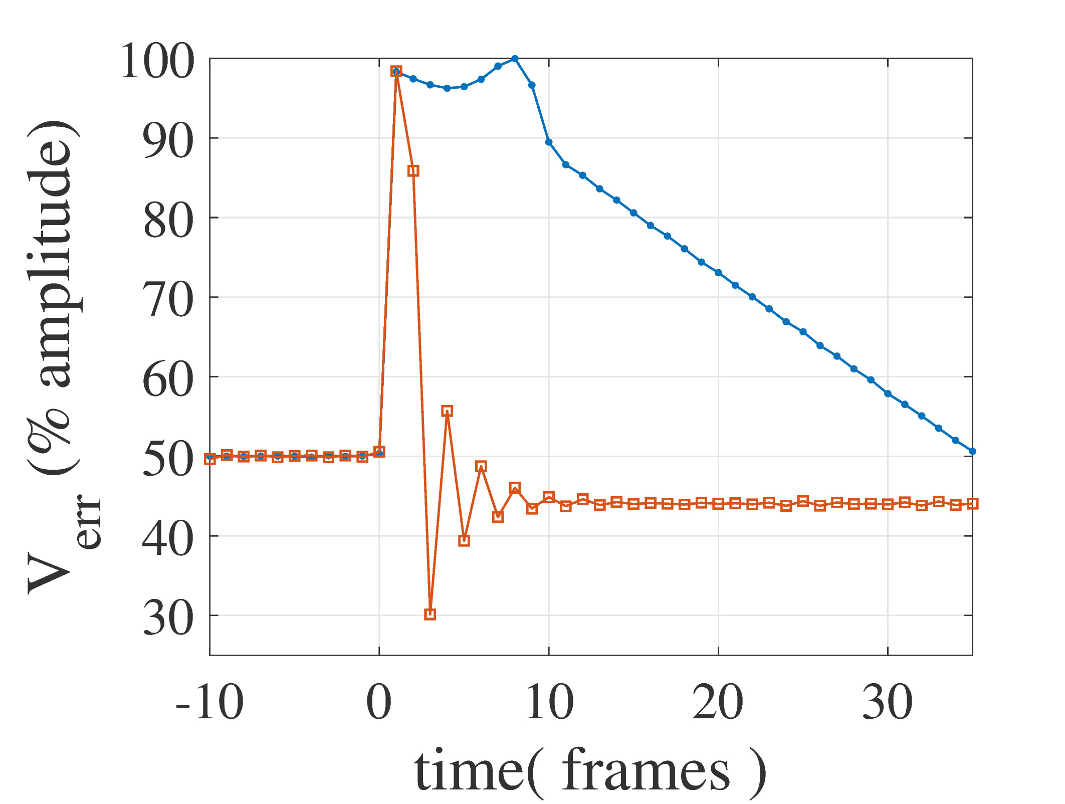
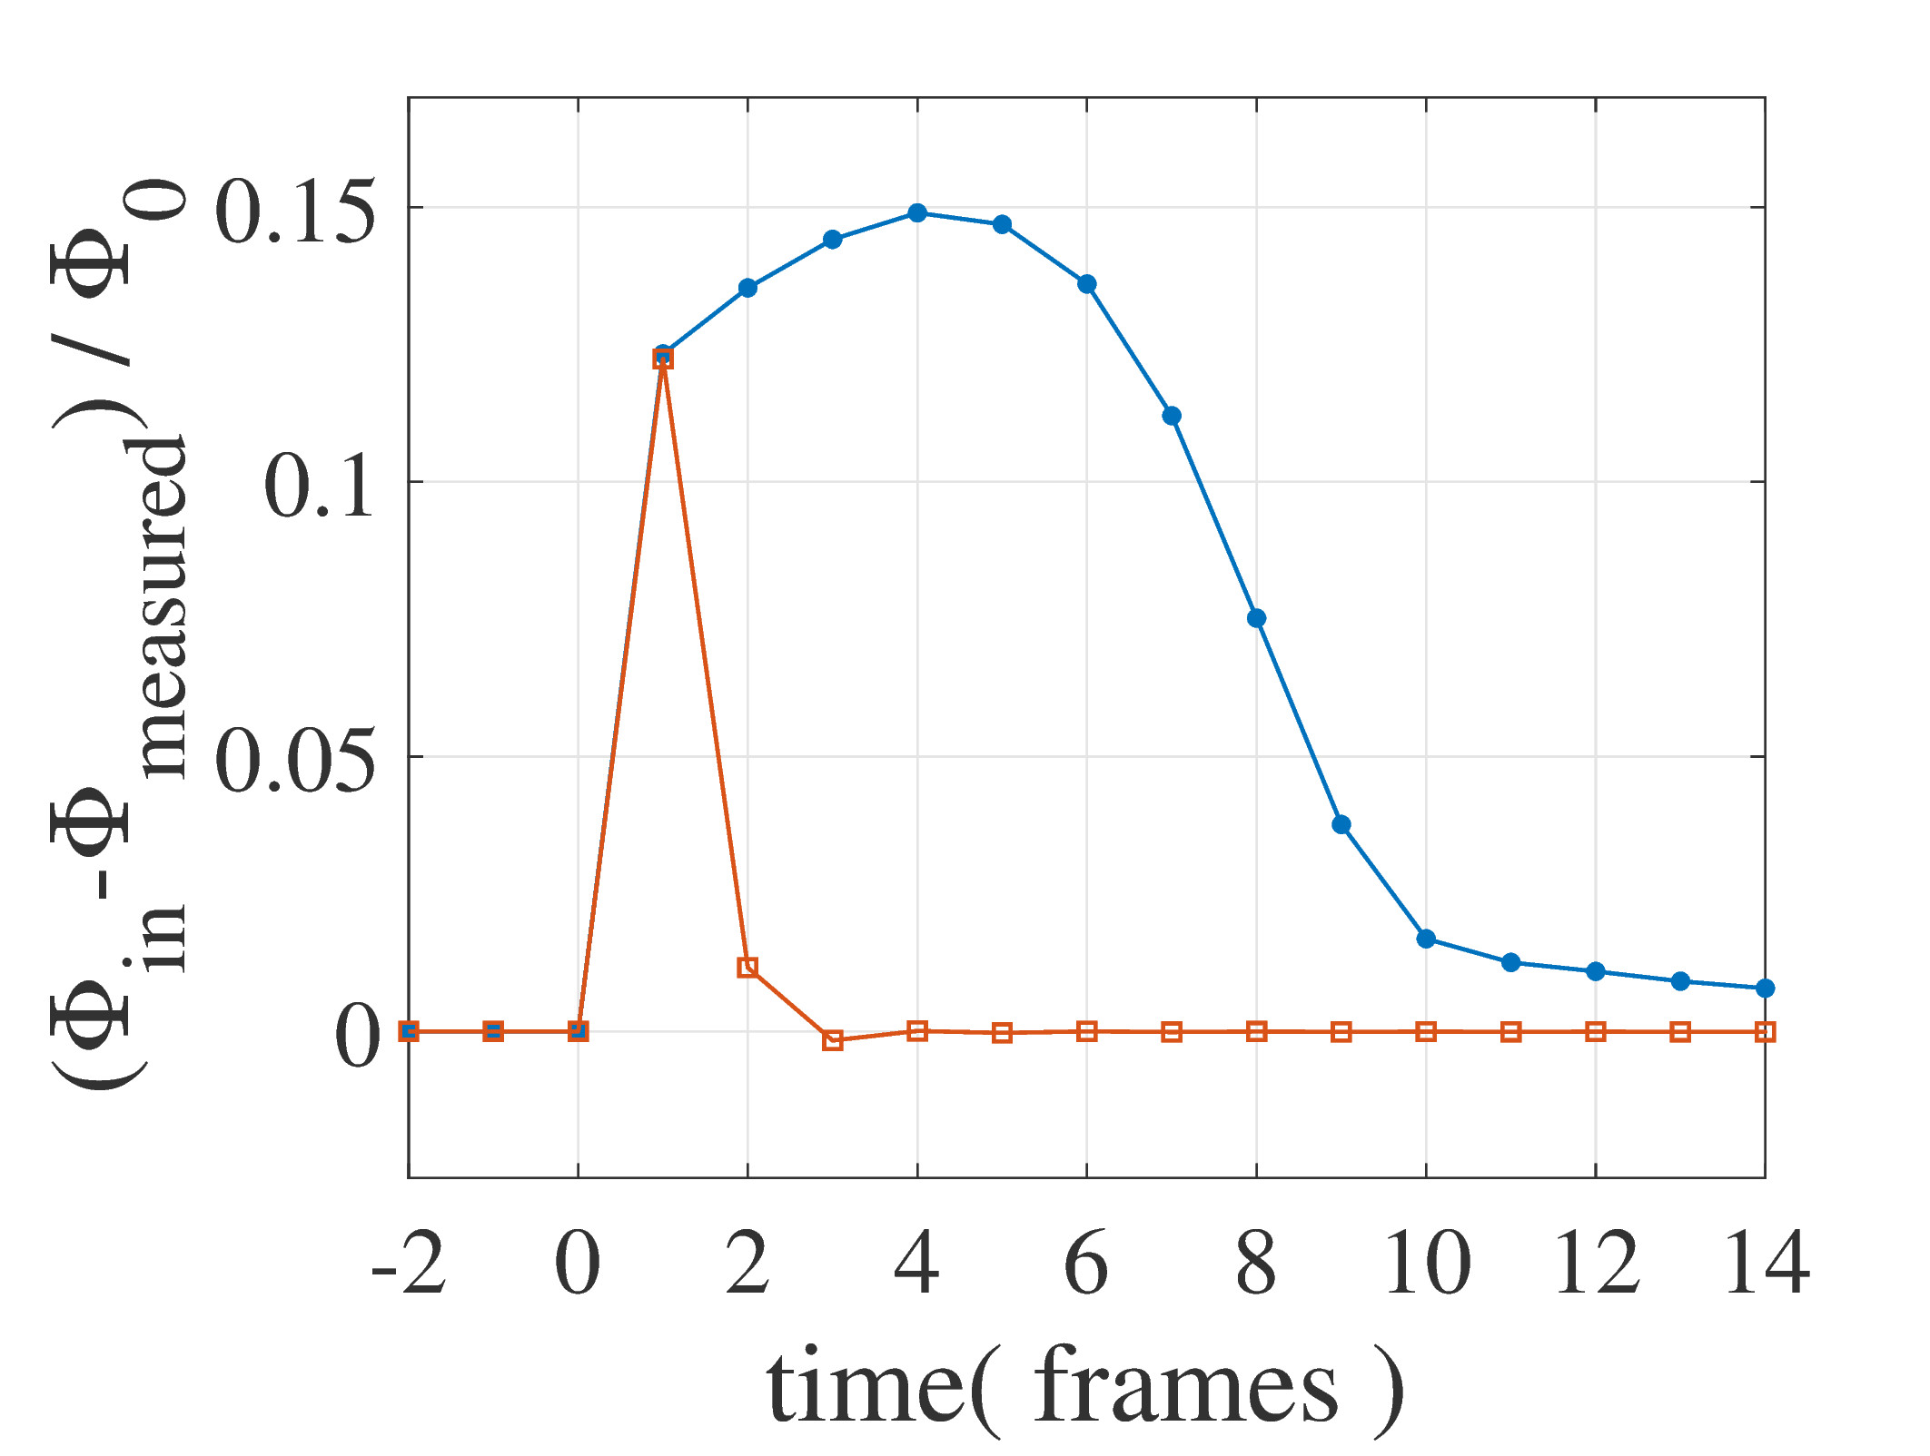
Simulation Results: Faster Convergence
Error Signal near old algorithm unlock point
Measurement Error
pulse max slew rate
0.24 Φ₀ / frame
pulse max slew rate
0.24 Φ₀ / frame
Old Controller
Old Controller
Typical TDM corrections
(i.e. applying mix terms)
New Controller
New Controller

Slide 20
Simulation Results
Simulated pulse tracking of highest energy pulse possible without readout failure.
New controller algorithm allows 1.35 x higher TES current slew rates without unlocking.
New Algorithm
Our 40 row demo’s max measurable energy would increase from 13 KeV to > 17.5 KeV.
Row count could be increased by a factor of (1.35)^{2/3} at constant SQUID noise.
Old Algorithm
48 row TDM possible (reduces multiplexer per TES by factor of 0.83).

Slide 21
Recent Reductions in TDM Crosstalk

Slide 22
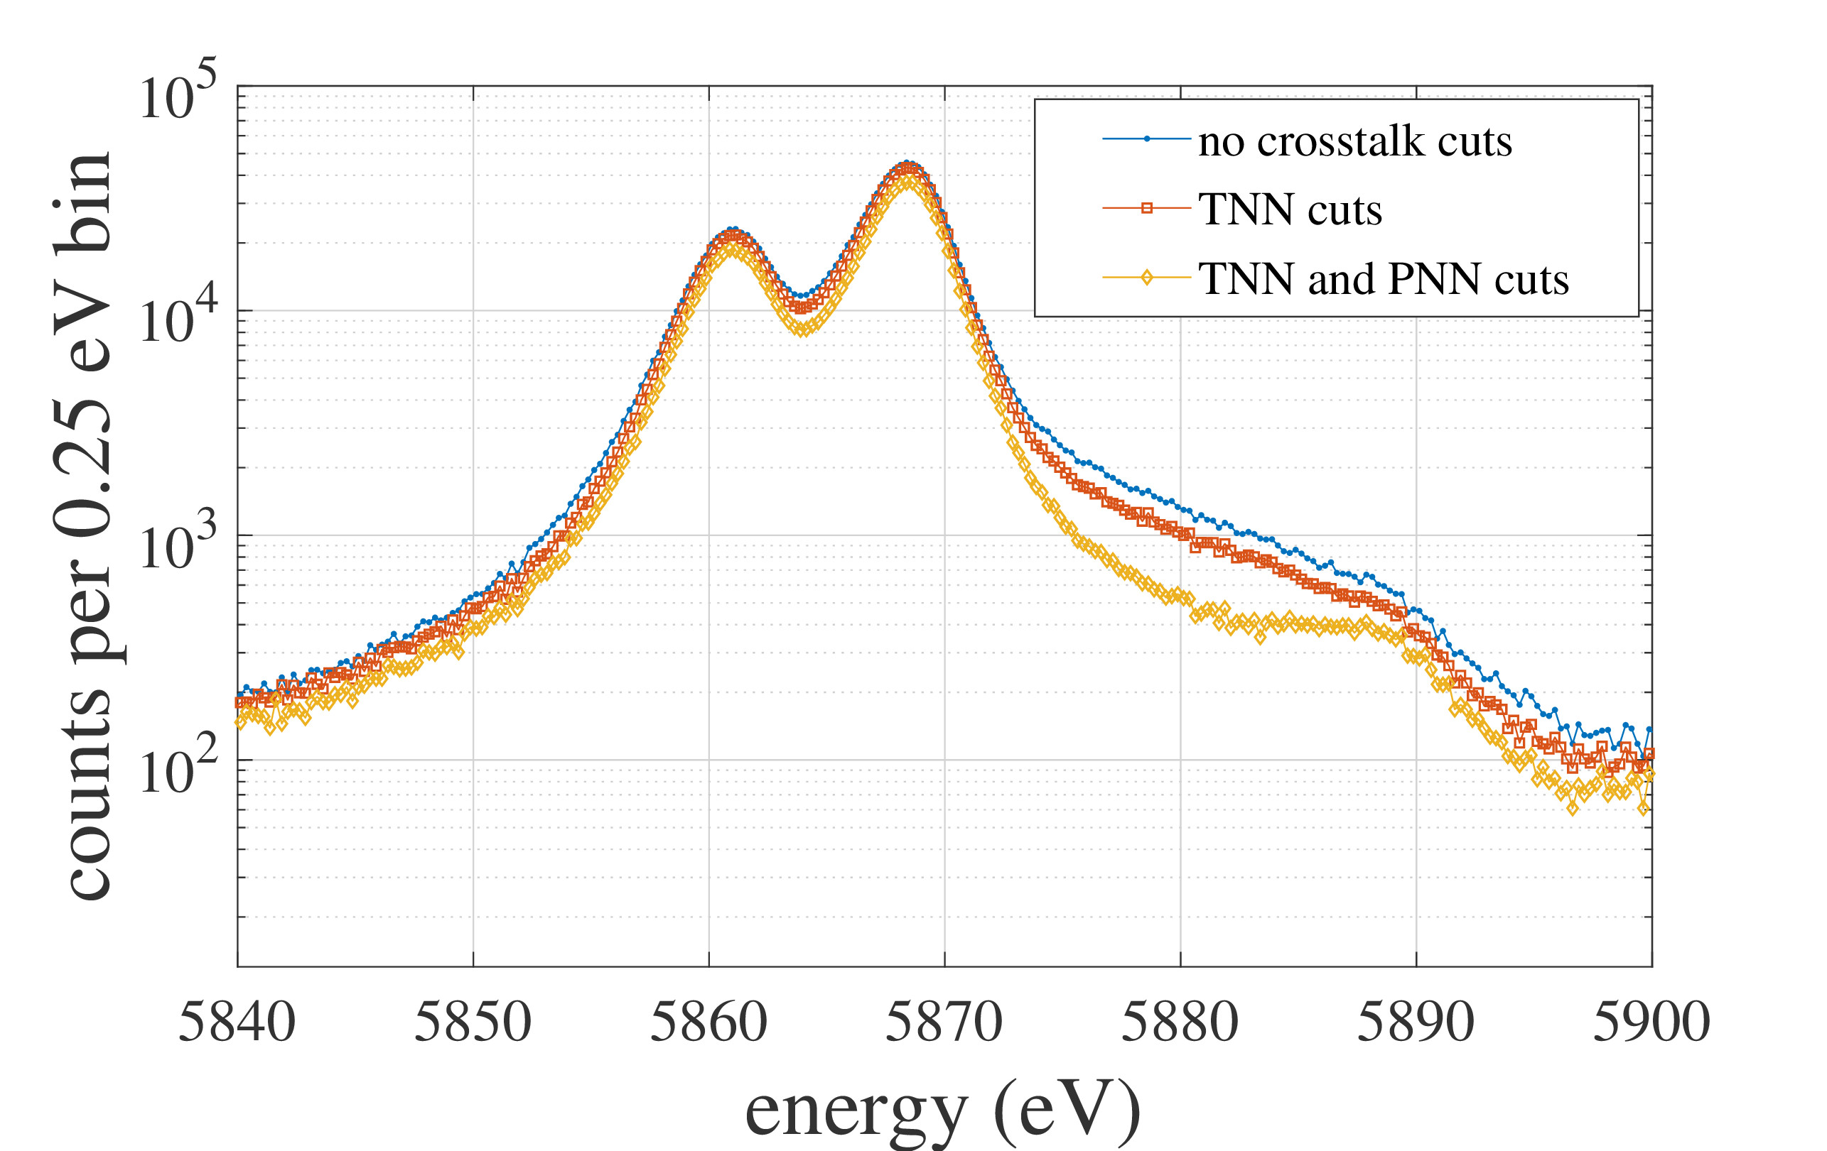
A High Energy Tail at High count rates
MUX 18B, LPA 2.5a @21.2 cps / pixel input count rate
Events affected by PNN and TNN crosstalk have large spread in energies (High Energy tail)
Event cuts find:
High Energy Tail
2/3 of Tail due to PNN crosstalk
1/3 of Tail due to TNN crosstalk
Excluding PNN and TNN events:
Maximum output count rate per pixel ¼ that of nonmultiplexed TES
We can do better than this.

Slide 23
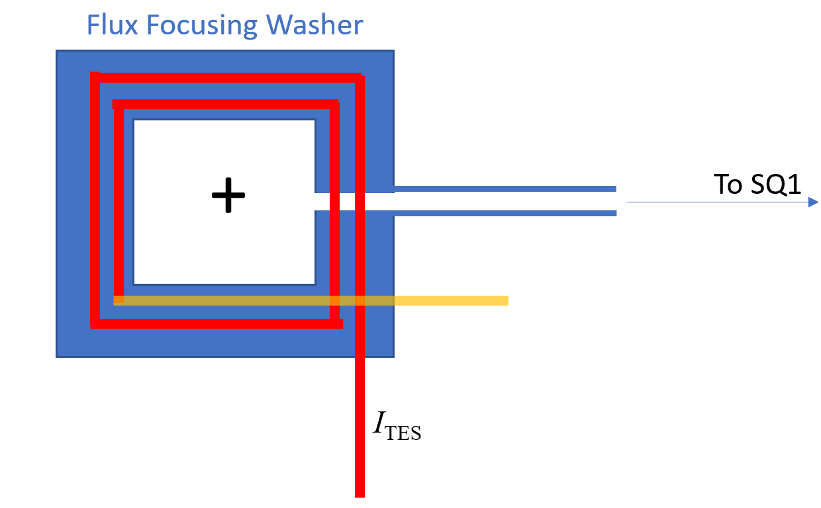
The Flux Focusing Washer/ TES readout coil
(simplified)
To SQ1
Coil Orientation
I_{TES}

Slide 24
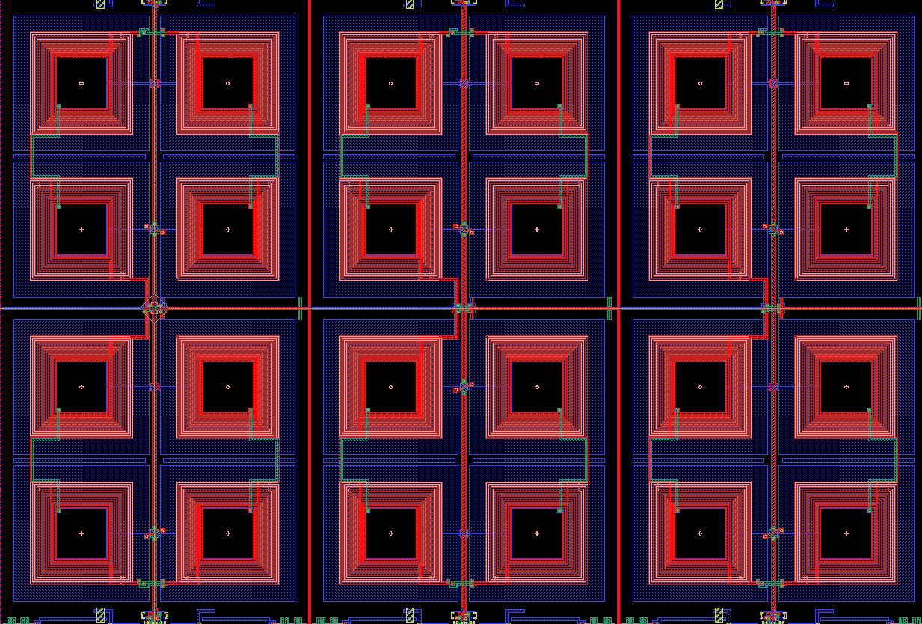
Implementation of Flux Focusing Washer and TES readout coil
Old Design:
Rows Packed together closely
New Design:
Coil windings encoded to reject signals from adjacent rows
Row 1
Row 2
Row 1 (pattern 1)
Row 2 (pattern 2)
-
-
-
-
+
+
+
+
-
-
-
+
-
+
+
+
-
-
-
-
+
+
+
+
-
-
-
-
+
+
+
+
Level of Nearest Neighbor Crosstalk = 3.4 ppt
Level of Nearest Neighbor Crosstalk < 0.1 ppt

Slide 25
Conclusions
Our 40 row performance satisfies the requirements of X-IFU.
We have a credible path towards higher multiplexing factors (~48 row TDM).
We continue to reduce crosstalk to improve high photon count rate performance.
Grant Acknowledgements
The authors gratefully acknowledge funding from the NASA SAT program “Providing Enabling & Enhancing Technologies for a Demonstration Model of the Athena X-IFU.”

