Slide 1
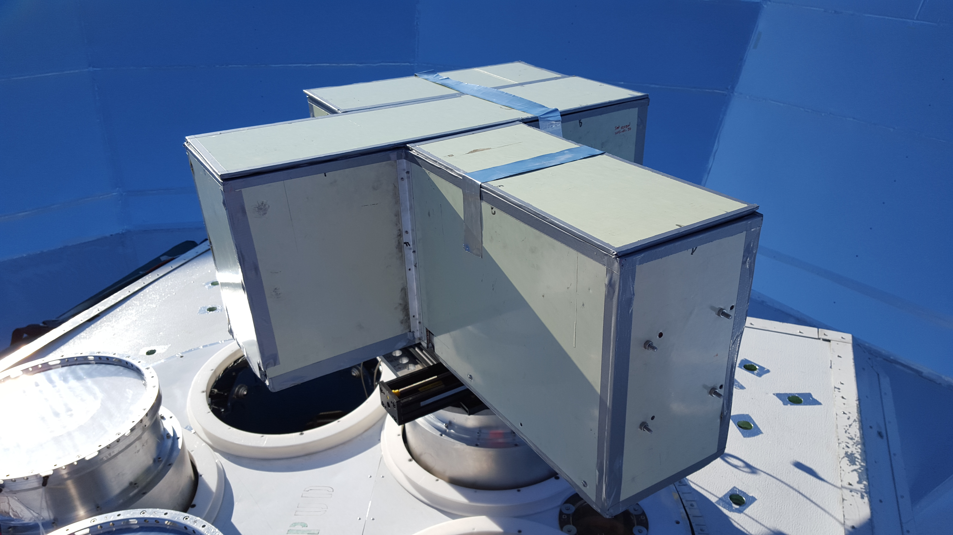
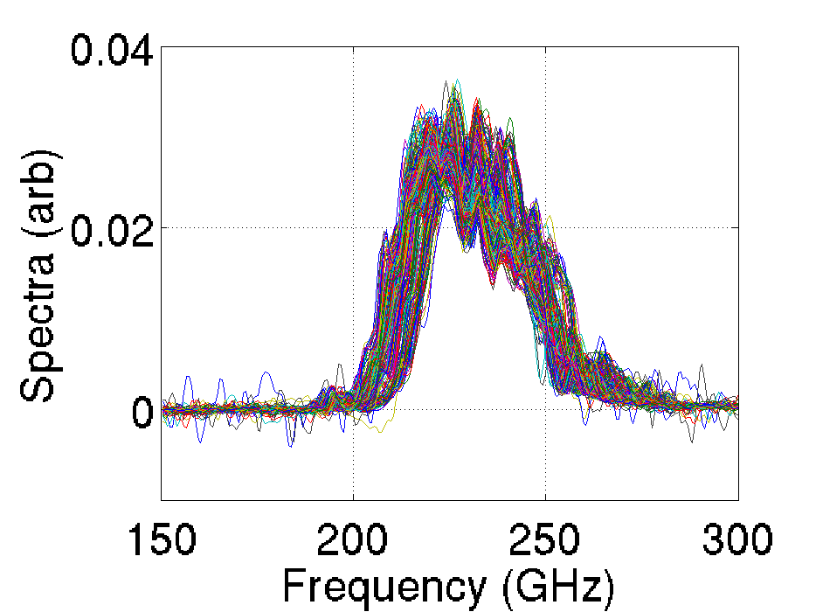
Optical Characterization of BICEP3 and the Keck Array CMB Polarimeters from 2016 to 2019
M. Tyler St Germaine for the BICEP/Keck Collaboration
(Harvard-Smithsonian Center for Astrophysics; stgermaine@g.harvard.edu)
~5000 antenna-coupled TES bolometers
Frequencies:
95 GHz
150 GHz
220 GHz
270 GHz
Multicomponent likelihood analysis
CMB temperature → polarization leakage
Feedback on optics and detector design
Poster ID: 7-92

Slide 2
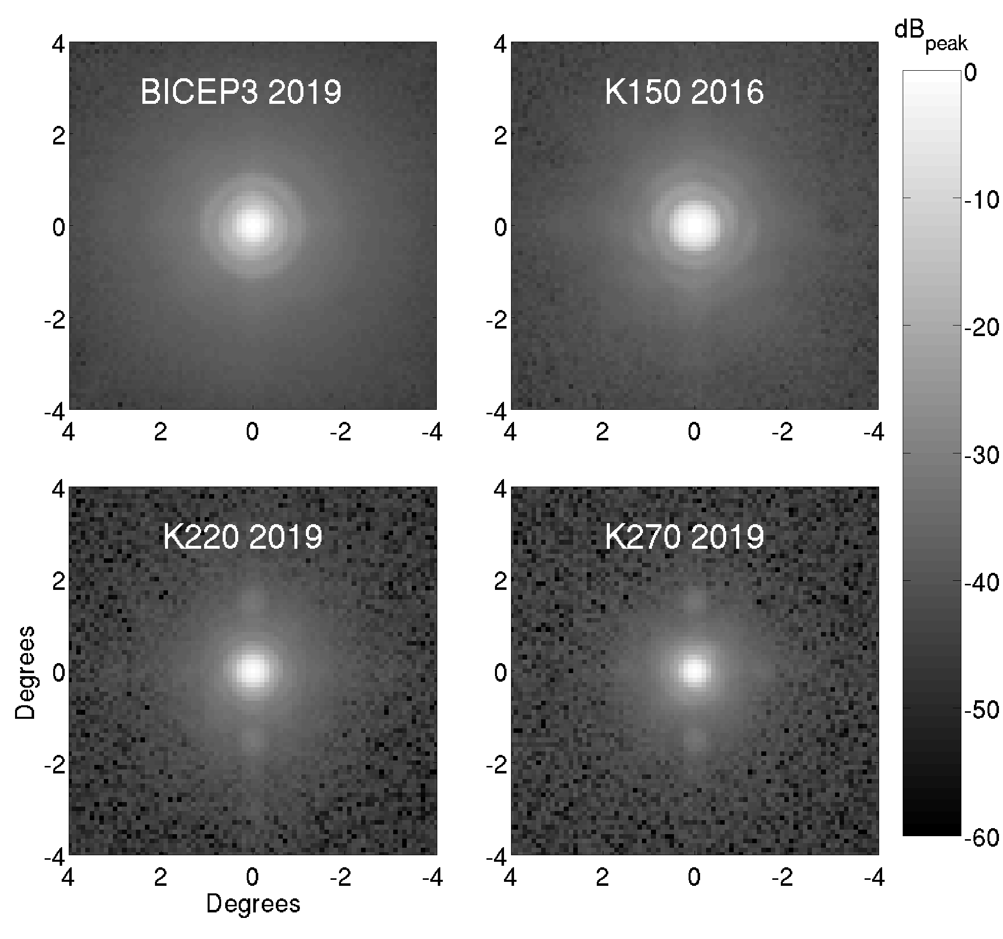
Optical Characterization of BICEP3 and the Keck Array CMB Polarimeters from 2016 to 2019
M. Tyler St Germaine for the BICEP/Keck Collaboration
(Harvard-Smithsonian Center for Astrophysics; stgermaine@g.harvard.edu)
~5000 antenna-coupled TES bolometers
Frequencies:
95 GHz
150 GHz
220 GHz
270 GHz
Improved analysis techniques + thermal source
Goal: quantify CMB T→P leakage from beam mismatch
Poster ID: 7-92

