Slide 1
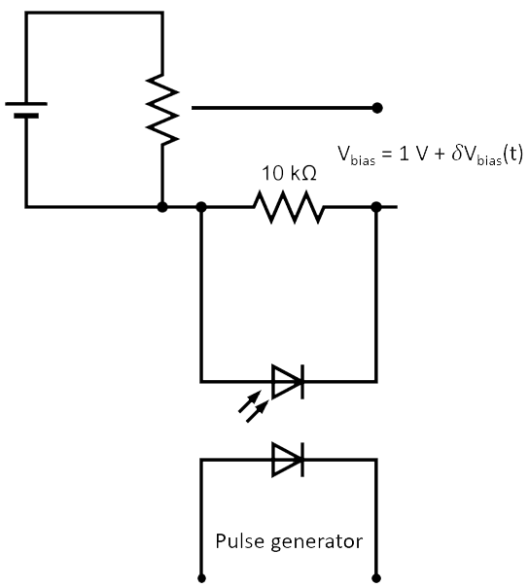
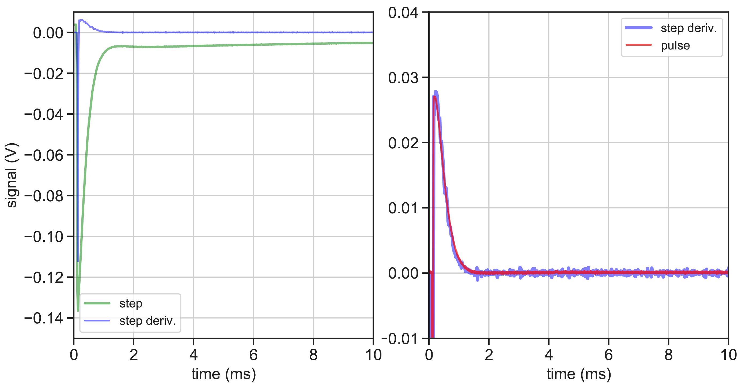
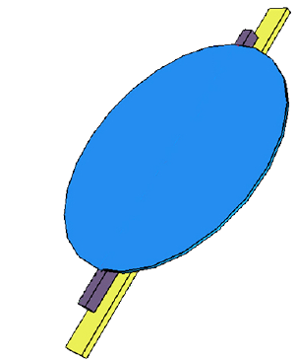
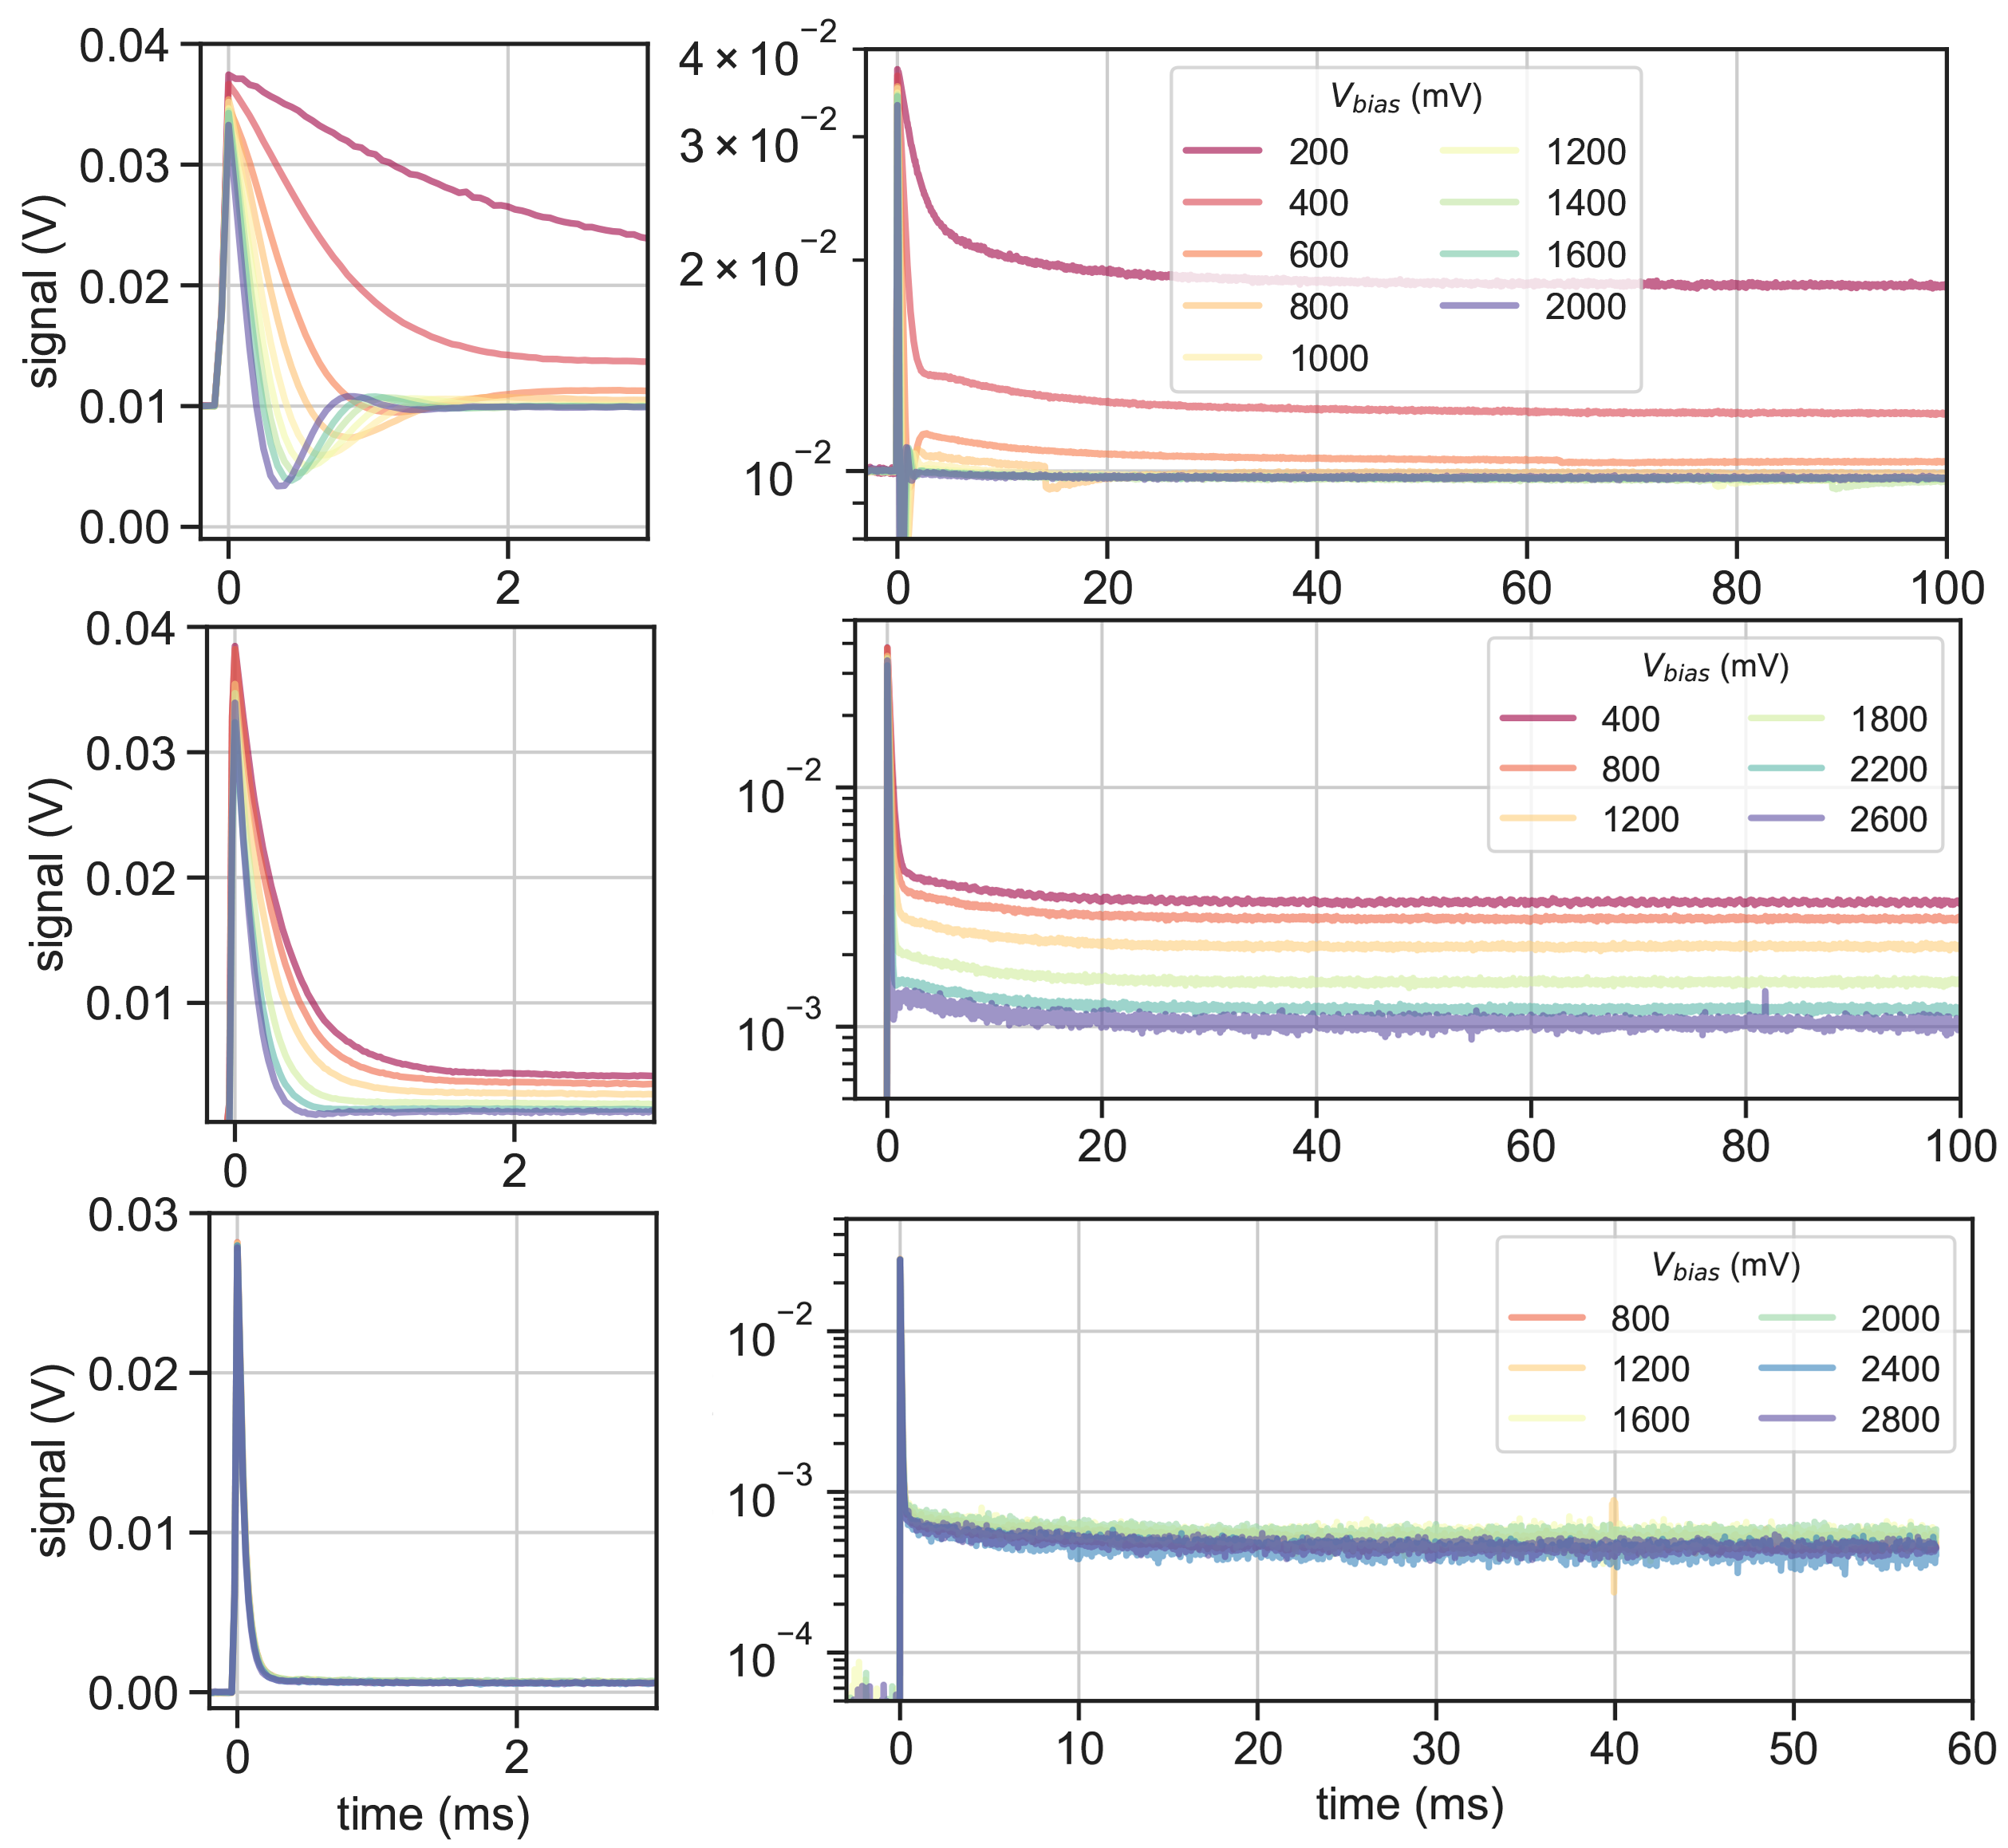
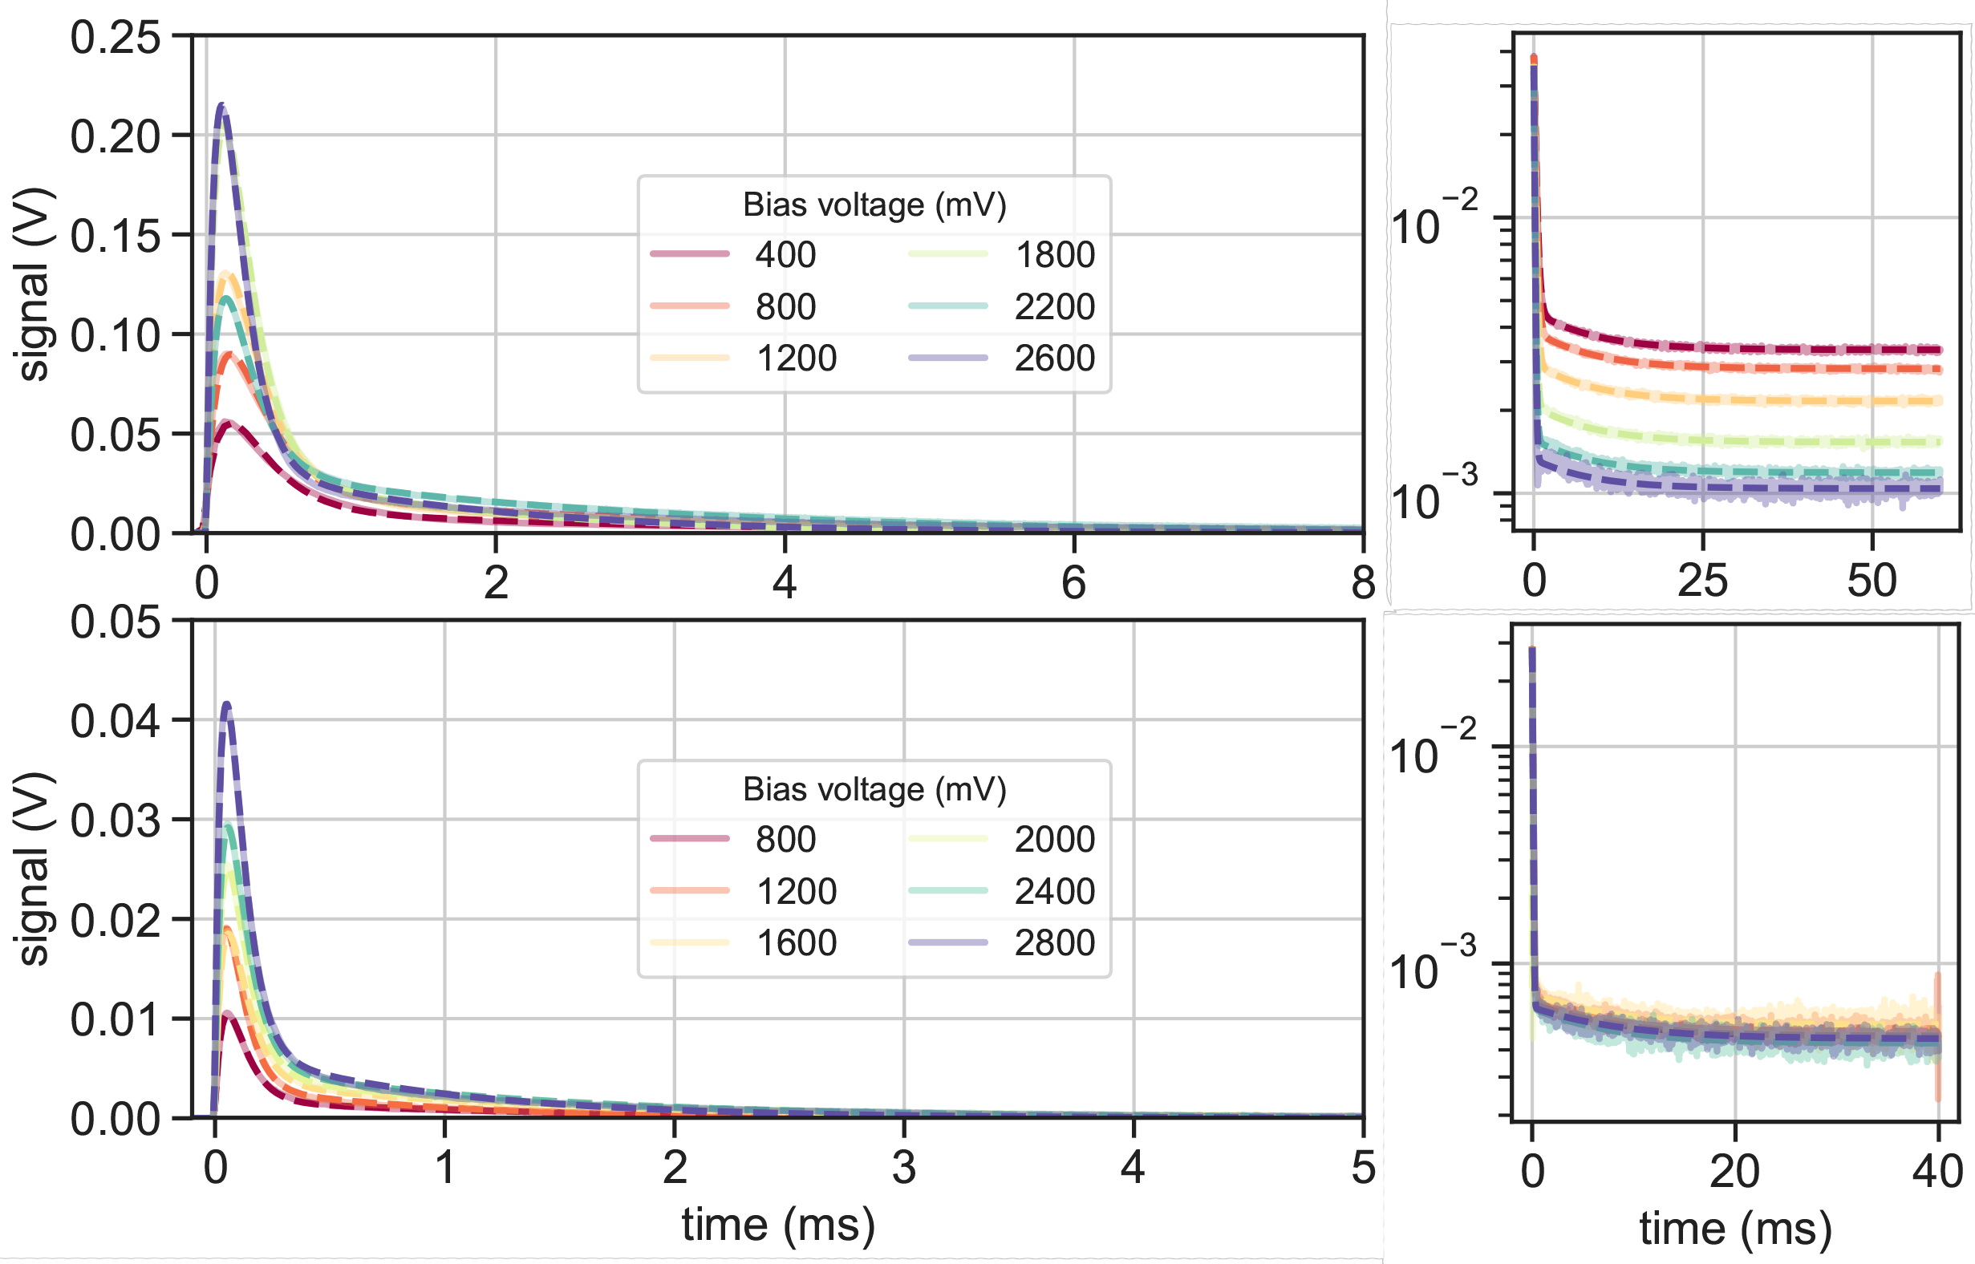
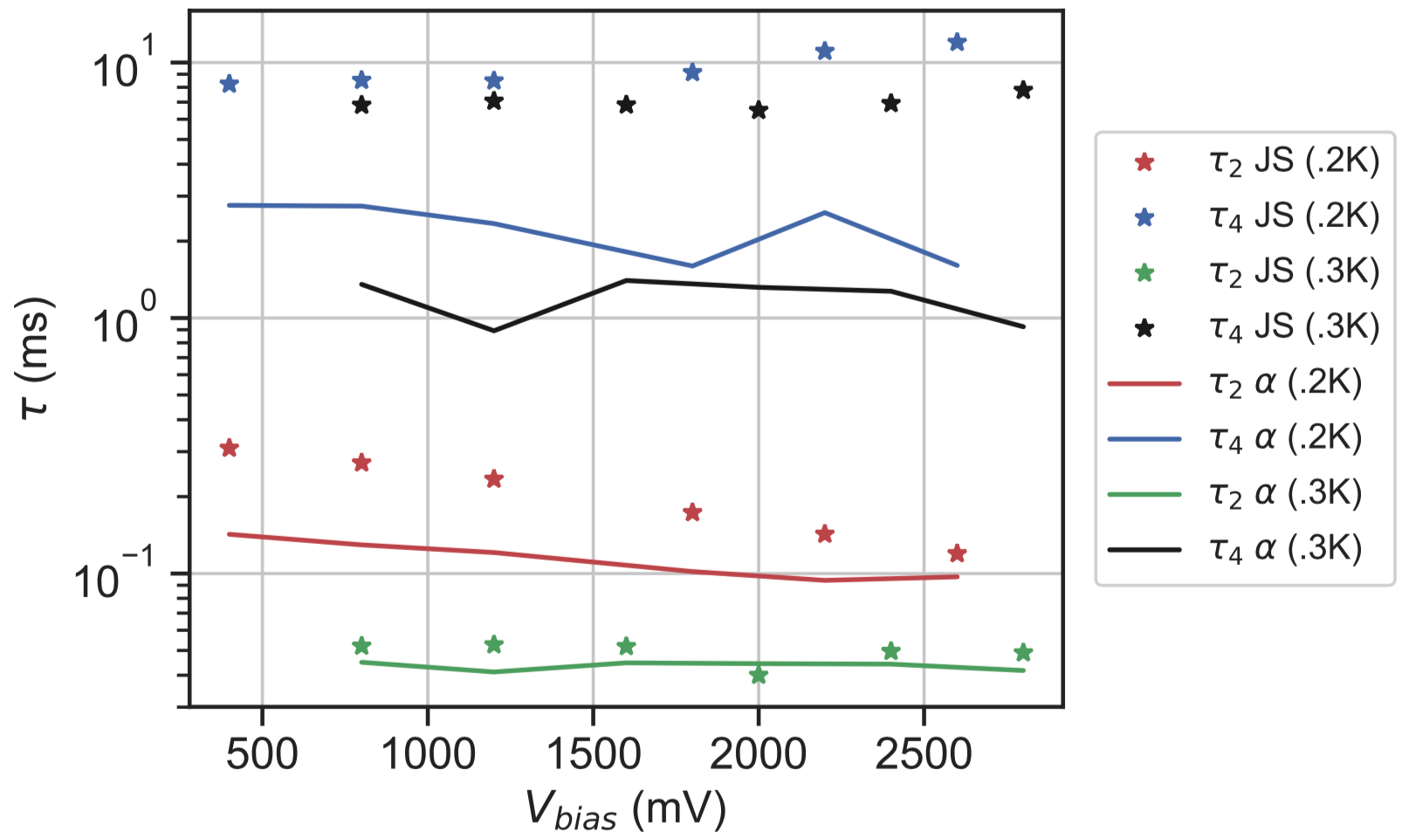
Benefits of bolometer Joule stepping and Joule pulsing
S. L. Stever, F. Couchot, V. Sauvage, N. Coron
Abstract: We introduce the `Joule stepping' technique, whereupon a constantly-biased bolometer has its bias voltage modified by a small additional step. We demonstrate this technique using a composite NTD semiconductor bolometer and a pulsing device which sends an extra step in voltage. We demonstrate the results of the technique over a range of bias voltages at 100, 200, and 300 mK. We find that Joule stepping allows us to directly measure long thermal tails with low amplitudes in the bolometer response, and could be a useful tool for quickly and easily understanding response functions of bolometric detectors. We also find that the derivative of the Joule step is equivalent to the bolometer response to a δpulse (or Joule pulse), which allows for greater understanding of fast transient behaviour.
Introduction
Joule stepping and Joule pulsing
Bolometer sensitivity usually measured using optical techniques
For sky-scanning space telescopes, detection of long thermal ‘tails’ in detection chain response functions is vitally important
CRs and planet measurements in Planck HFI showed long tails which were detected only in flight.
Must characterise bolometer time response down to 10⁻³ level in order to verify ‘cleanliness’ of response integral
→ Solution: Bolometer Joule stepping
We add a small ‘step’ in voltage on top of constant bias level
Initial response is instantaneous response of readout to change in V_{bias}
As the bolometer resistance changes, V_{bolo} changes according to bolometer response function.
Joule stepping sends a square wave at low f (~1 Hz) to see long-timescale thermal effects
Joule pulsing sends a fast pulse (to approximate a δ_{Dirac})
Experimental setup
Joule pulse vs. Joule step
We compare Joule step output with Joule pulse. We find…
…that the Joule pulse response is equivalent to derivative of Joule step
Joule Stepping:
Signal sent from pulse generator to LED
Optical cable carries signal to bias box via photodiode, generates extra δV with rise time of ~10μs
Small resistor in parallel with bolometer allows us to send pA-scale extra signal on top of ~10 nA-scale working point
We vary V_{bias} across many working points and T from 100-300 mK
Detector used is ‘Bolo 184’ (composite NTD Ge semiconducting bolometer)
Joule Pulsing:
Joule step output (and hidden τs)
Joule step vs. α particle glitch τs
Solid lines are data
Dashed lines are fits
α glitches
Joule step traces
τ₂
τ₂
100 mK
200 mK
τ₄
τ₄
α glitches
Joule step traces
τ₂
τ₂
200 mK
300 mK
τ₄
τ₄
Irradiate detector with 5.4 MeV Am²⁴¹ α particles
Average many glitches with highest ‘athermal’ (fast) component to avoid biasing results
‘Slow’ component thought to arise from thermal diffusion in absorber where all α land
Expect slight difference in long τ due to absence of absorber activity in Joule steps, but should be able to detect activity in same order of magnitude
300 mK
In linear scale, we only see decays in short (<10 ms) timescales
In log(y) scale, we see long time constants
Low-amplitude region accounts for ~2% of integral
Long time constant only able to be seen with Joule stepping, not Joule pulsing
∴ Joule stepping allows direct measurement of long time constants to 10⁻³ level and verification of the ’cleanliness’ of pulse integral
We detect fast (τ₂) and slow (τ₄) time constants at 200 and 300 mK within the same order of magnitude as those produced by
Conclusions: Sky-scanning space missions (e.g. Planck HFI) are threatened by long thermal ‘tails’ with low-level amplitudes. Must be detected on ground to at least 10⁻³ level before flight. Joule stepping a bolometer can allow the measurement of such time constants on ground and in flight, and 2 minutes of data taking allows measurement to the same accuracy as 1000s of cosmic ray glitches.
α particle glitches.
The Joule step long time constant (τ₄) in both cases is slower.

