Slide 1



Mark E. Bier*, Logan Plath*, Stephan Friedrich#, Mohammad Halim*,
Francisco Ponce#, Jack Harris⁺, Jonathan Shulgach*, Robin Cantor⁺⁺
*Department of Chemistry, Carnegie Mellon University, Pittsburgh, PA, USA
#Lawrence Livermore National Laboratory, Livermore, CA, USA
⁺XIA LLC, Hayward, CA, USA
⁺⁺ STAR Cryoelectronics Inc., Santa Fe, NM, USA
Mass-to-charge and Energy Distributions of Electrosprayed and Matrix-assisted Laser Desorbed Ions Measured by Nb- and Ta- Superconducting Tunnel Junction Cryodetection Mass Spectrometry

Slide 2
Outline
Introduction
  Historical account of cryodetector MS
  Advantages of using STJs in MS
Applications of STJ MS: Using MALDI TOF MS and ESI LIT MS
  Ultra-high m/z virus particles and gold nanoparticles
  Unique energy deposited measurements
    Energy measurements of metastable fragments, MS/MS
    Energy measurements for various ions and protein conformations.

Slide 3
History of Cryogenic Detection MS
1996 - Twerenbold et al. (Neuchâtel U.) - First to implement STJ MS.
1996 - Frank (LNLL) / Benner (LBL) et al., – Fast Nb-STJs, analysis up to 66kDa.
1998 - Hilton, et al. (NIST) / Twerenbold et al. (Neuchâtel U.), Impact energy MS measurements using microcalorimeters.
2003 - Comet AG, (Switzerland) Macromizer™ - First commercial STJ MS.
2005-2019
  Zenobi et al, ETHZ - data on a commercial MS, von-WF.
  Ohkubo et al, AIST - proteins, small molecules, metastable ions, higher temperature cryodetectors, large array STJs
  Cotter et al, JHU & Caprioli et al., VU – proteins
  Bier et al., CMU– polymers, capsid, whole virion, ferritin, nanoparticles, first ESI LIT STJ/CEM MS & with Friedrich et al., LLNL – incorporation of Ta-STJs (STAR Cryoelectronics, Cantor), new XIA electronics.

Slide 4
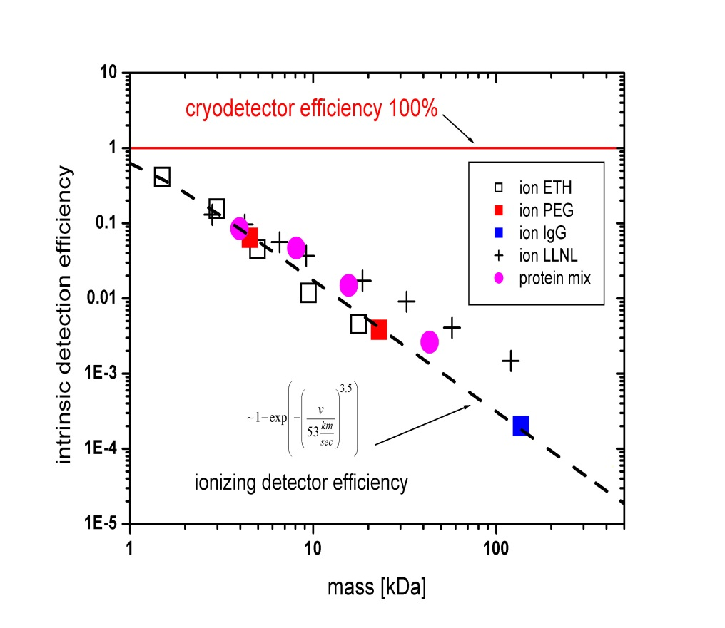
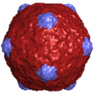
Cryodetector and MCP efficiency vs. Mass
Superconducting Tunnel Junction (STJ) Cryodetection
Principles of ion detection using a super-conducting tunnel junction
Cooper pairs break resulting in quasi-particles
0.35°K
S1
v
Tunnel current
+
KE
t (µs)
+
+
S2
T_{c} (tunnel current) is proportional to the number of quasi-particles formed which is proportional to the collision energy.
15 Ǻ oxide barrier
+ B field
The Cooper pairs break from thermal excitation or by the phonon energy available after particle collision.
∆ is the band gap parameter of the superconductor. (~meV)
The amount of energy required to break a Cooper pair is 2∆.
Twerenbold, D.; Gerber, D.; Gritti, D.; Gonin, Y.; Netuschill, A.; Rossel, F.; Schenker, D.; Vuilleumier, J-L. “Single Molecule Detector for Mass Spectrometry with Mass Independent Detection Efficiency”, Proteomics 2001, 1, p69.
KE_{ion} >> 2∆ !

Slide 5
Ta-STJ MS

Slide 6

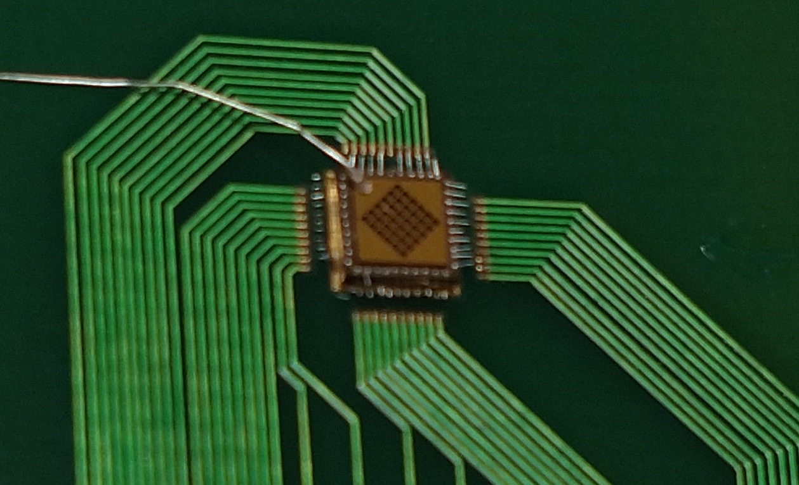
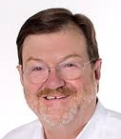
What is the noise level Ta-STJs at 350mK?
X-ray data for StarCryo Ta-STJs acquired at LLNL
Friedrich &
Ponce
400mK
Would the signals be fast enough?
What would be the maximum resolving power?
STAR Cryoelectronics 36 Ta-STJs

Slide 7

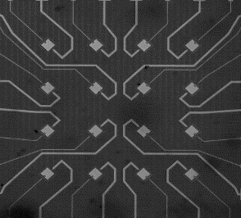
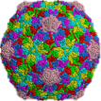
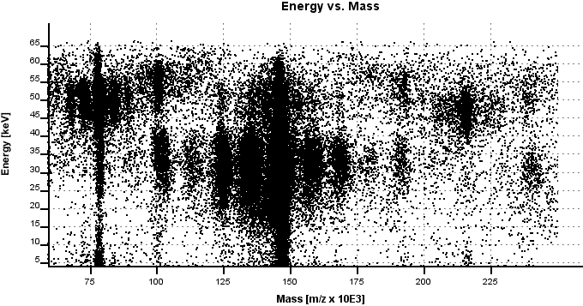
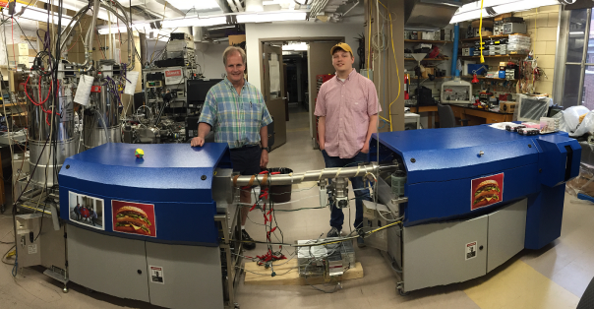
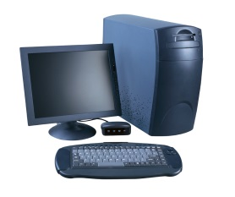
MALDI TOF Nb- or Ta-STJ MS
TOF length (linear mode): was 1.6m or 3.8m
Accelerating voltage up to 20,000 V
Delayed extraction linear resolution, R~ 500
16 element Nb-STJ cryodetector, dimension 2.2 x 2.2 mm, active surface 0.64 mm²
~ 4 to 16% of the ion beam!
32 Channel Nb or Ta-STJ detector intercepts ~30% ion beam
⁴He coldhead
COMET AG MacromizerTM
298K
30K
MALDI plate
hν
Nitrogen laser
337 nm, 3 ns pulse
4K
32 element Ta-STJ cryodetector
3 X 10⁻⁸ Torr
+50
32 channel
amplifier
XIA transient recorder
deflector
0.3K ³He
IR shields
Signal
20 kV
Einzel lens
cryostat
grid
Carnegie Mellon
Mass spectrum

Slide 8
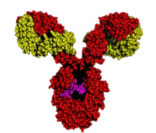

Ta-STJ Cryodetection MS of Large Protein Complexes
IgG1
IgM

Slide 9
Virus particles
Nb-STJ MS
Th=Thomson=m/z

Slide 10


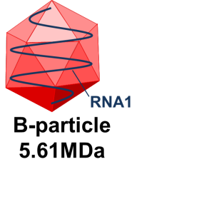
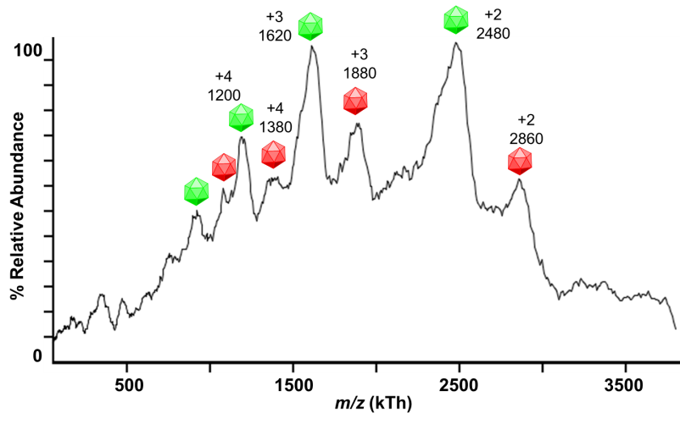
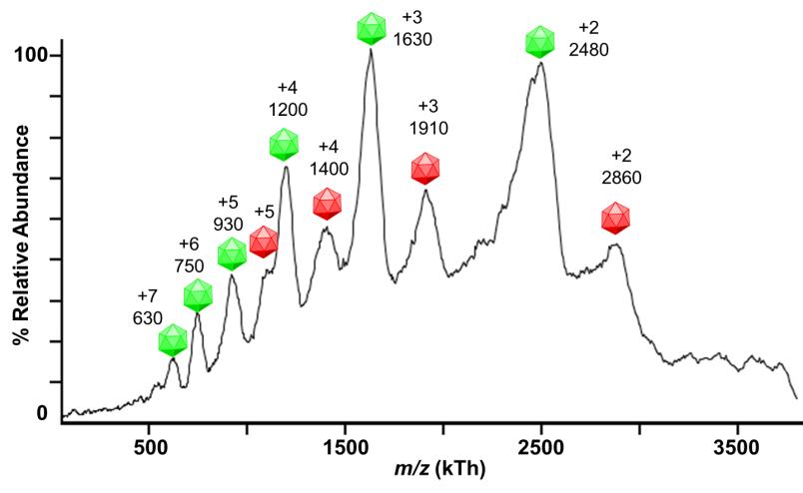
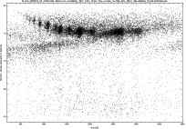

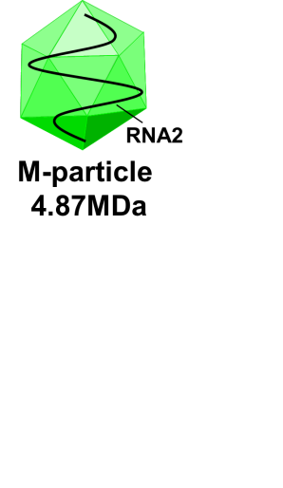


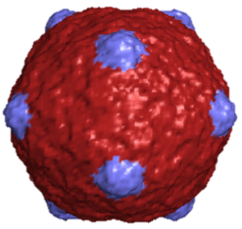

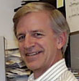
TOP: For the first time, two ~5MDa intact whole virion particles from CPMV have been separated in a mass spectrometer and the individual charge states resolved and detected by STJ MS.
Macromolecular MALDI Nb-STJ Cryodetection MS of Virus Particles
Logan Plath
Intact Separation of Two Whole Virions of Cowpea Mosaic Virus (CPMV) ~ 5MDa
Jonathan Feldman
Energy
kTh
Dr. David Sipe
Cross-linked
Anna Czapar (CWRU)
Capsid of Bacteriophage HK97 at 13MDa
+1
Head II
Prof. Nicole Steinmetz
(CWRU)
54 nm
Prof. Bob Duda (Pitt)
Prof. Roger Hendrix (Pitt)
Notes:
Nicole Steinmetz research is focused on modifying plant virus for other uses such as drug delivery. The Bier lab specializes is analyzing these heavy particles and we plan to characterizer her modified plant viruses now that we have shown that we can weigh them. The Bier Lab is seeking out biological discoveries in the study of virus now that we have proven that the analysis can be done. The bottom figure of HK97 show that we can analyze m/z 13 MDa after extending the mass range in software. The HK97 work is in collaboration with Prof Roger Hendrix Lab at the University of Pittsburgh.

Slide 11
Synthetic gold nanoparticles
Nb-STJ MS

Slide 12
STJ response vs particle type: 5 nm Au particles vs sinapinic acid
Sipe, D.M.; Plath, L.D.; Aksenov, A.A.; Feldman, J.S.; Bier, M.E. Characterization of Mega-Dalton-Sized Nanoparticles by Superconducting Tunnel Junction Cryodetection Mass Spectrometry. ACS Nano. 2018, 12, 2591-2602.

Slide 13
Energy deposition measurements
Nb-STJ

Slide 14
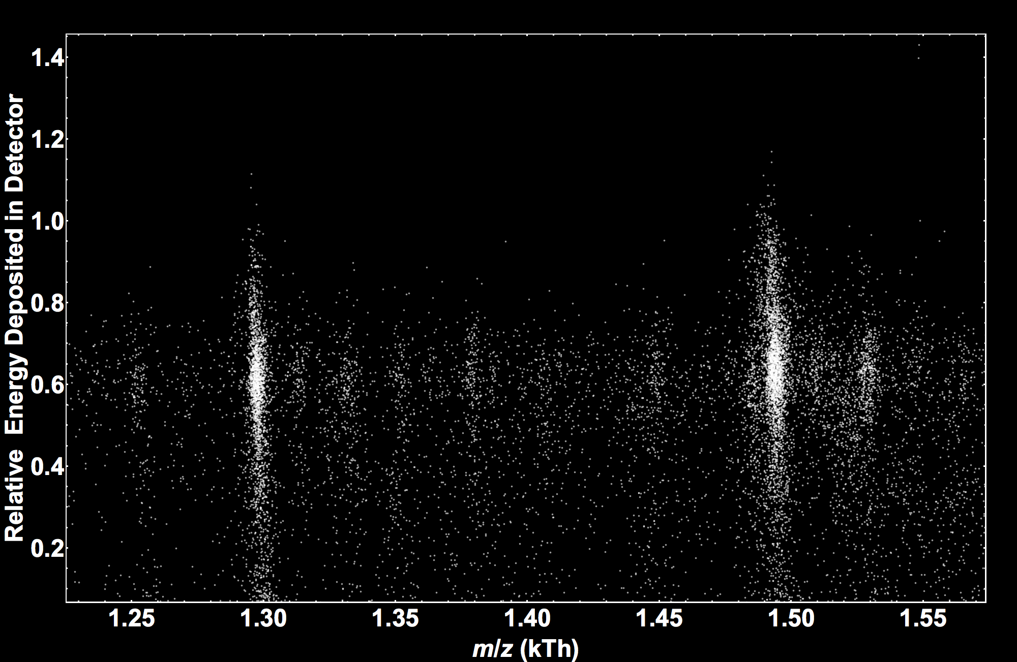
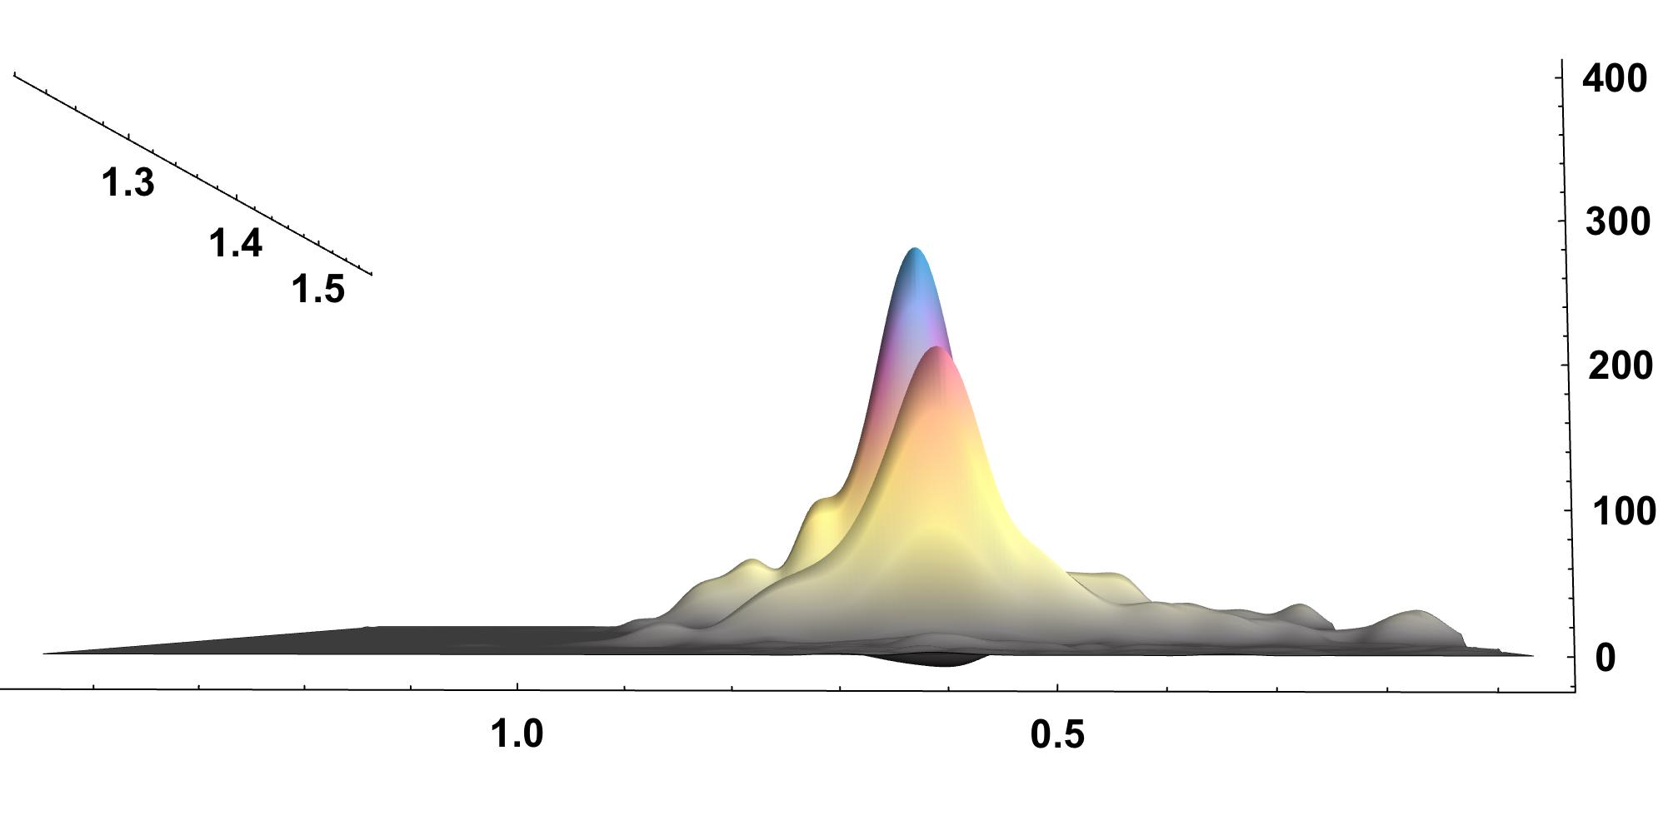
5% difference in energy deposited by adding one Au atom to angiotensin I
M = angiotensin
MW=1296.7 Da
Energy Scatterplot
[M-2H⁺+Au⁺³]⁺
0.620
[M+H]⁺
0.607
∆E
Intensity
Relative Energy Deposited in Detector

Slide 15
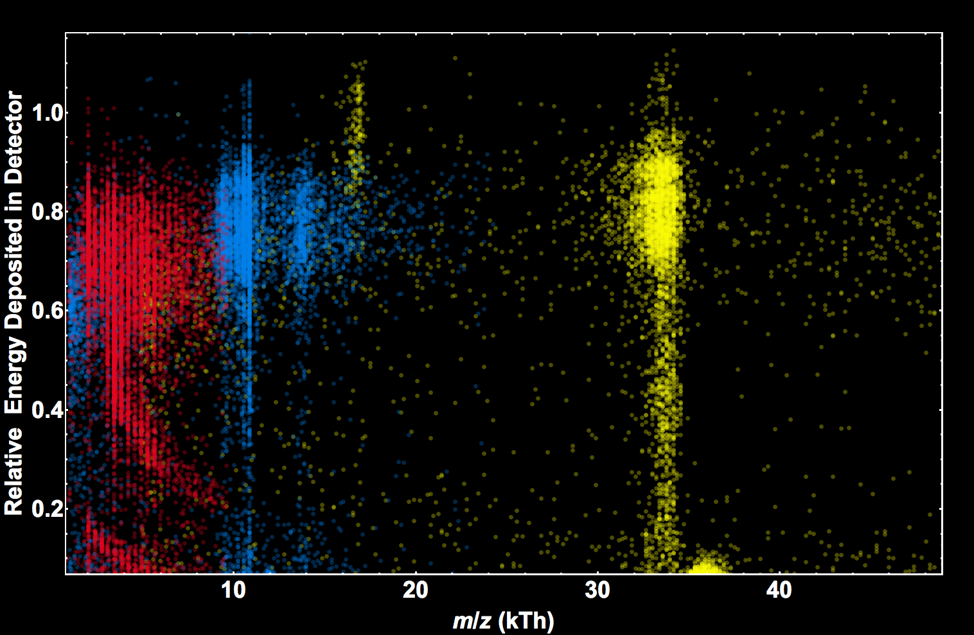
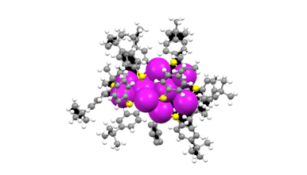
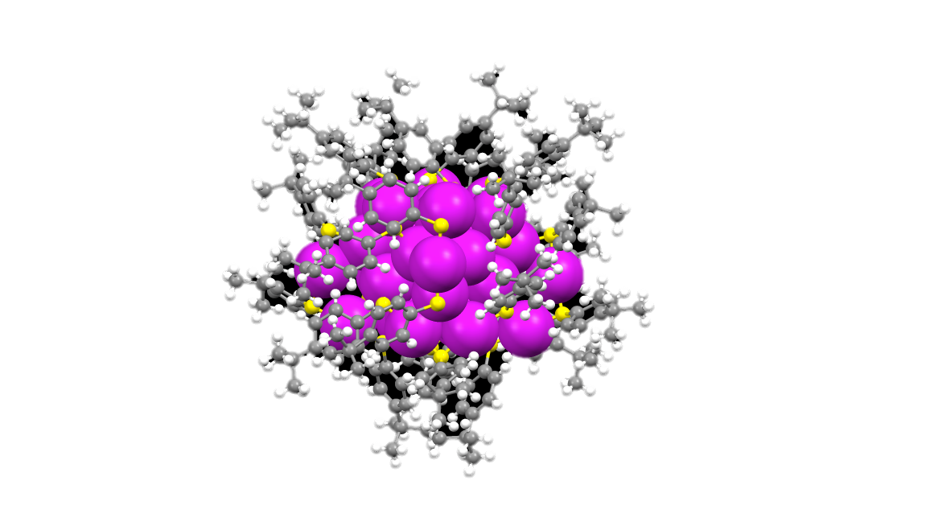
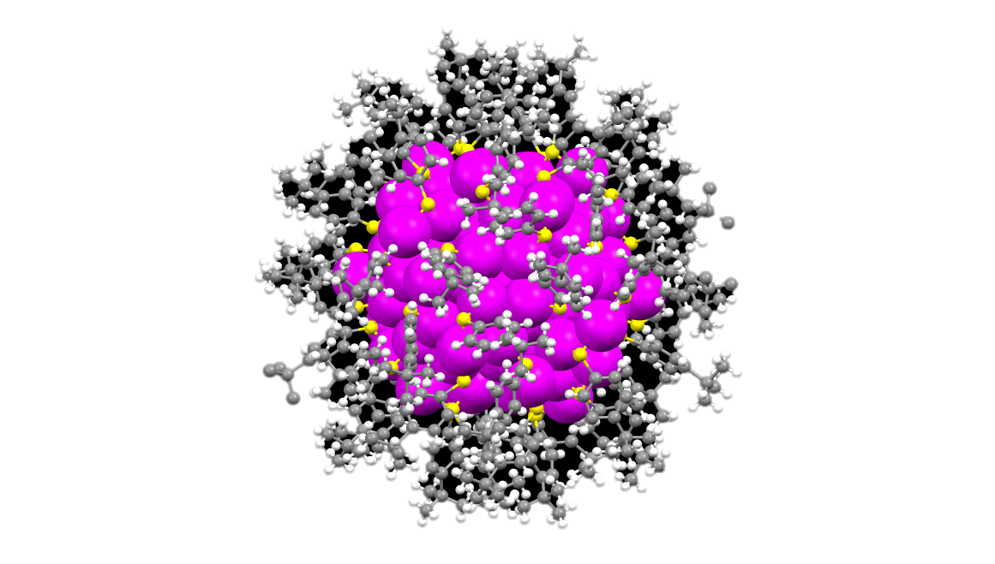

Au₁₀(S-C₆H₄-C₄H₉)₁₀
Au₃₆(S-C₆H₄-C₄H₉)₂₄
Au₁₃₃(S-C₆H₄-C₄H₉)₅₂
Increasing STJ Energy Response

Slide 16
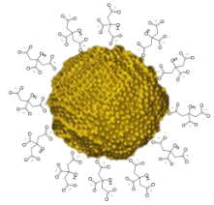
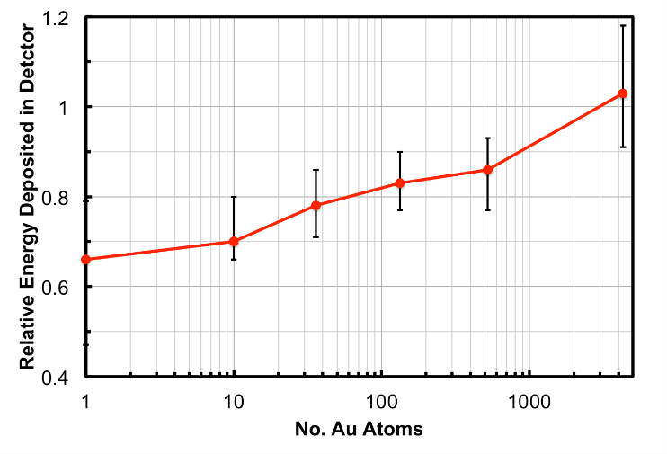

STJ energy response vs number of Au atoms
Angio-Au ⁺, Au_{n}(S-C₆H₄-C₄H₉)_{n}⁺ and 5nm Au⁺

Slide 17
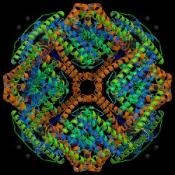
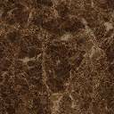
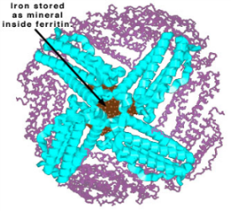
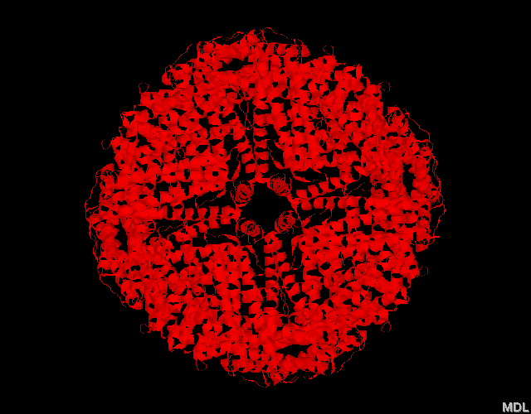

Which complex will deposit the most energy into the STJ detector?
IgM
apoferritin
holoferritin
Au
12 nm
?
12 nm
5 nm
KE
KE
KE
KE
STJ
STJ
STJ
STJ

Slide 18
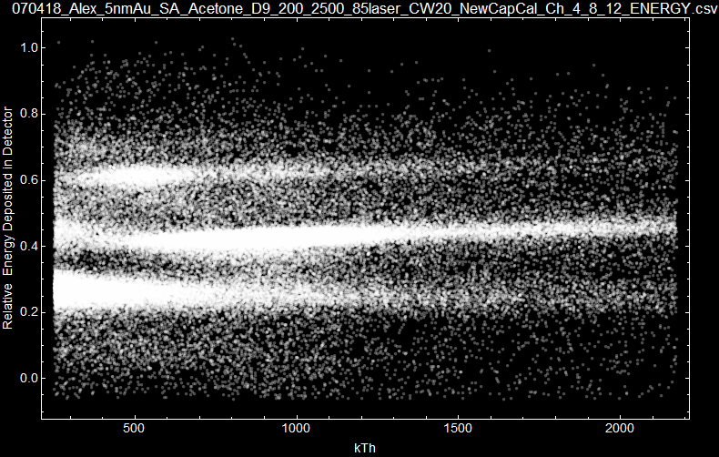
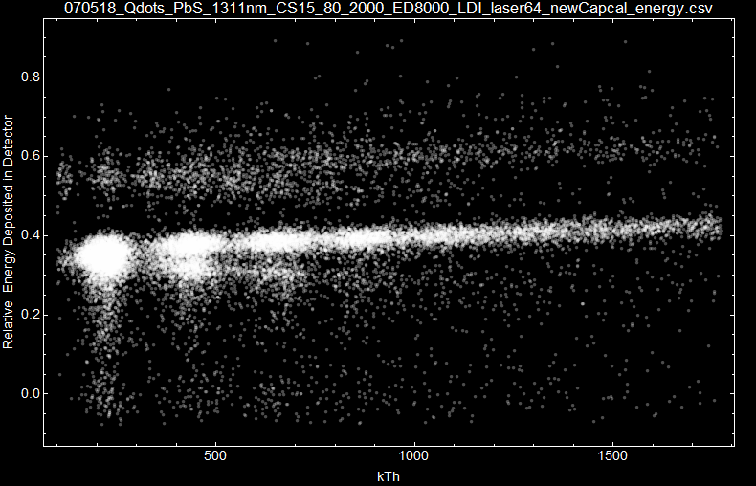
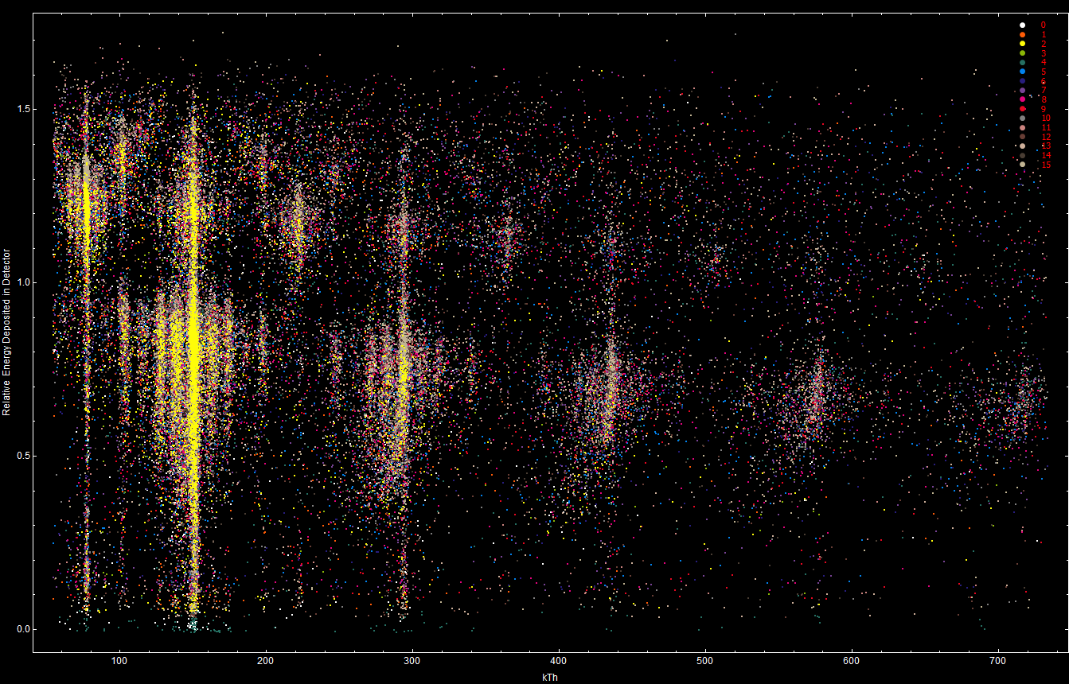
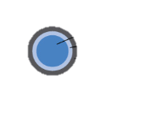
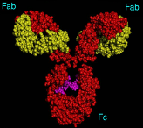
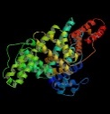
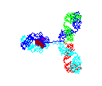
A new MS based analytical tool!
Protein
PbS quantum dot
5 nm Au
Energy deposited into STJ detector
kTh
kTh
kTh

Slide 19
STJ Energy Response of multiple samples (+1) vs MW
KE = 20keV
Westmacott, G.; Zhong, F.; Frank, M.; Friedrich, S.; Labov, S.; Benner, W. RCMS 2000, 14(7), 600.
Au/Ag
nanoparticle
Protein [M+H]⁺
Curve drawn for clarity
kTh

Slide 20
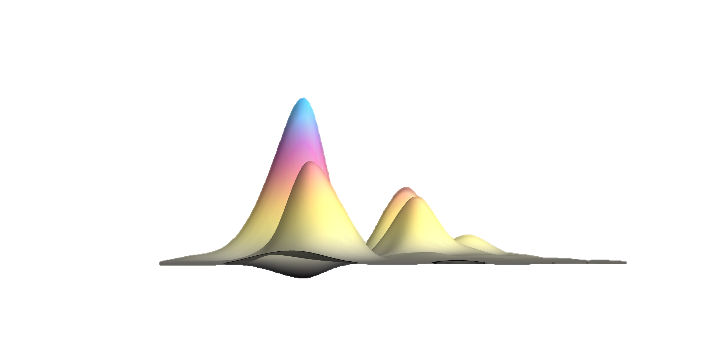



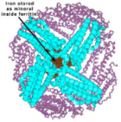

Although similar ion size, shape and collisional cross-section, Apo- and HoloFt differ in mass and density. We observe a higher energy response for the Fe-core containing Ferritin.
1
+1
[ApoFt]⁺
0.260
[HoloFt]⁺
0.266
Intensity
+2
0.2 0.4 0.6
Relative Energy Deposited in Detector

Slide 21
Metastable fragmentation
MS/ MS m_{product}= m*_{precursor} (E_{product}/E_{precursor})
Nb-STJ MS

Slide 22
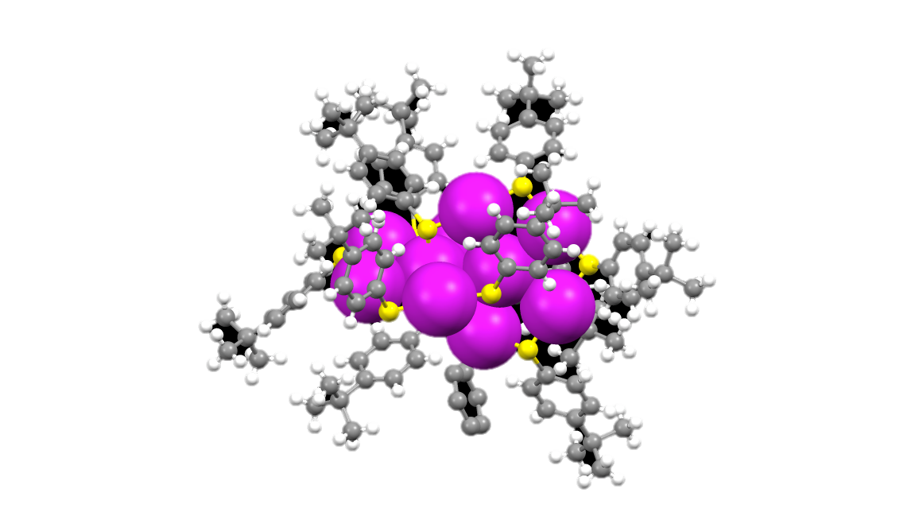
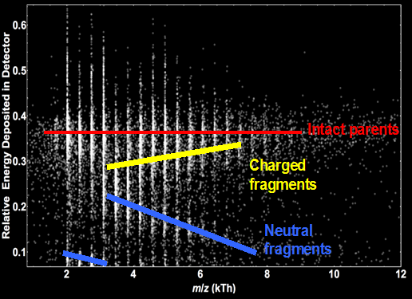
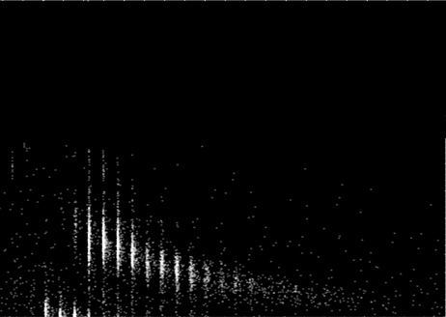
~13 Simultaneous MS/MS spectra based on metastable fragmentation
Au₁₀(S-C₆H₄-C₄H₉)₉⁺
Au_{n}(S-C₆H₄-C₄H₉)_{n-1}⁺ Fragments
Au_{n}(S-C₆H₄-C₄H₉)_{n-1}⁺ Adducts
All particles
Only neutral fragments
V_{DEFLECTOR} = 0V
V_{DEFLECTOR} = 1000V

Slide 23
One MS/MS product scan using metastable fragmentation
Precursor
Energy resolved metastable fragments of the Au₁₀(TBBT)₉⁺ precursor ion.

Slide 24
ESI Nb-STJ/CEM LIT MS
m/z and energy distributions for multimeric protein ions
energy deposition for different protein conformations

Slide 25
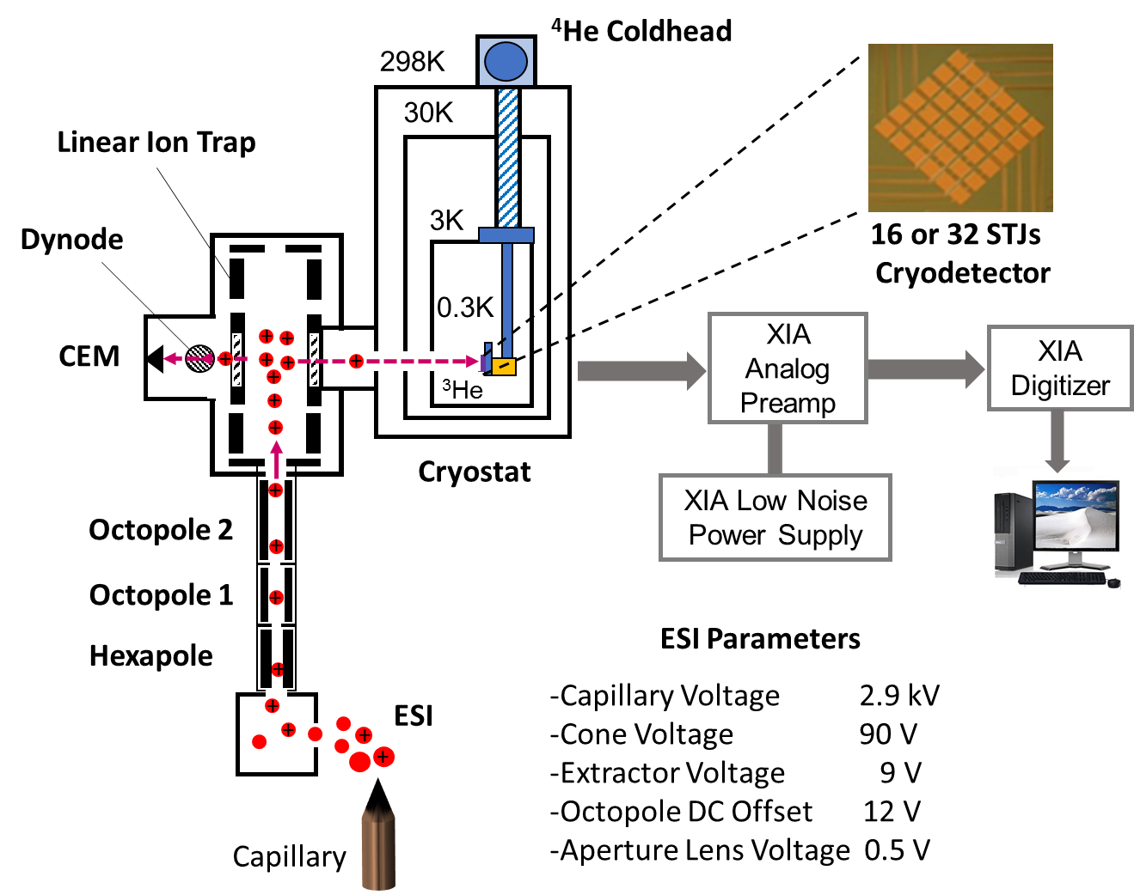
Electrospray ionization Linear Ion Trap STJ MS
Frequency scanning LIT from 100kHz-5kHz incorporating dual detectors

Slide 26
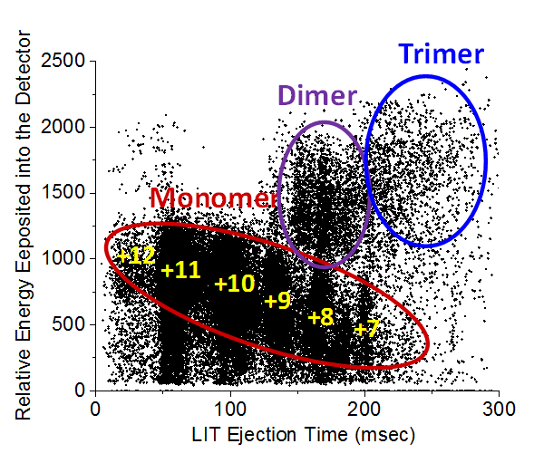
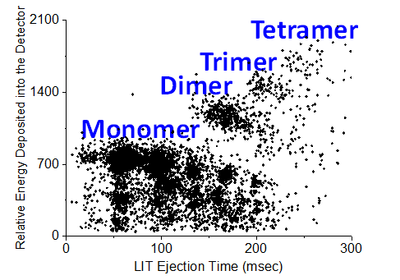
Native Protein carbonic anhydrase by ESI-LIT-STJ MS
MW=29kDa
16 Nb-STJ
1 Nb-STJ
16 Nb-STJ

Slide 27
Is there an energy deposition difference for a folded vs unfolded protein?
BSA
MW 67kDa
+18
+18
Native = folded
denatured = unfolded

Slide 28
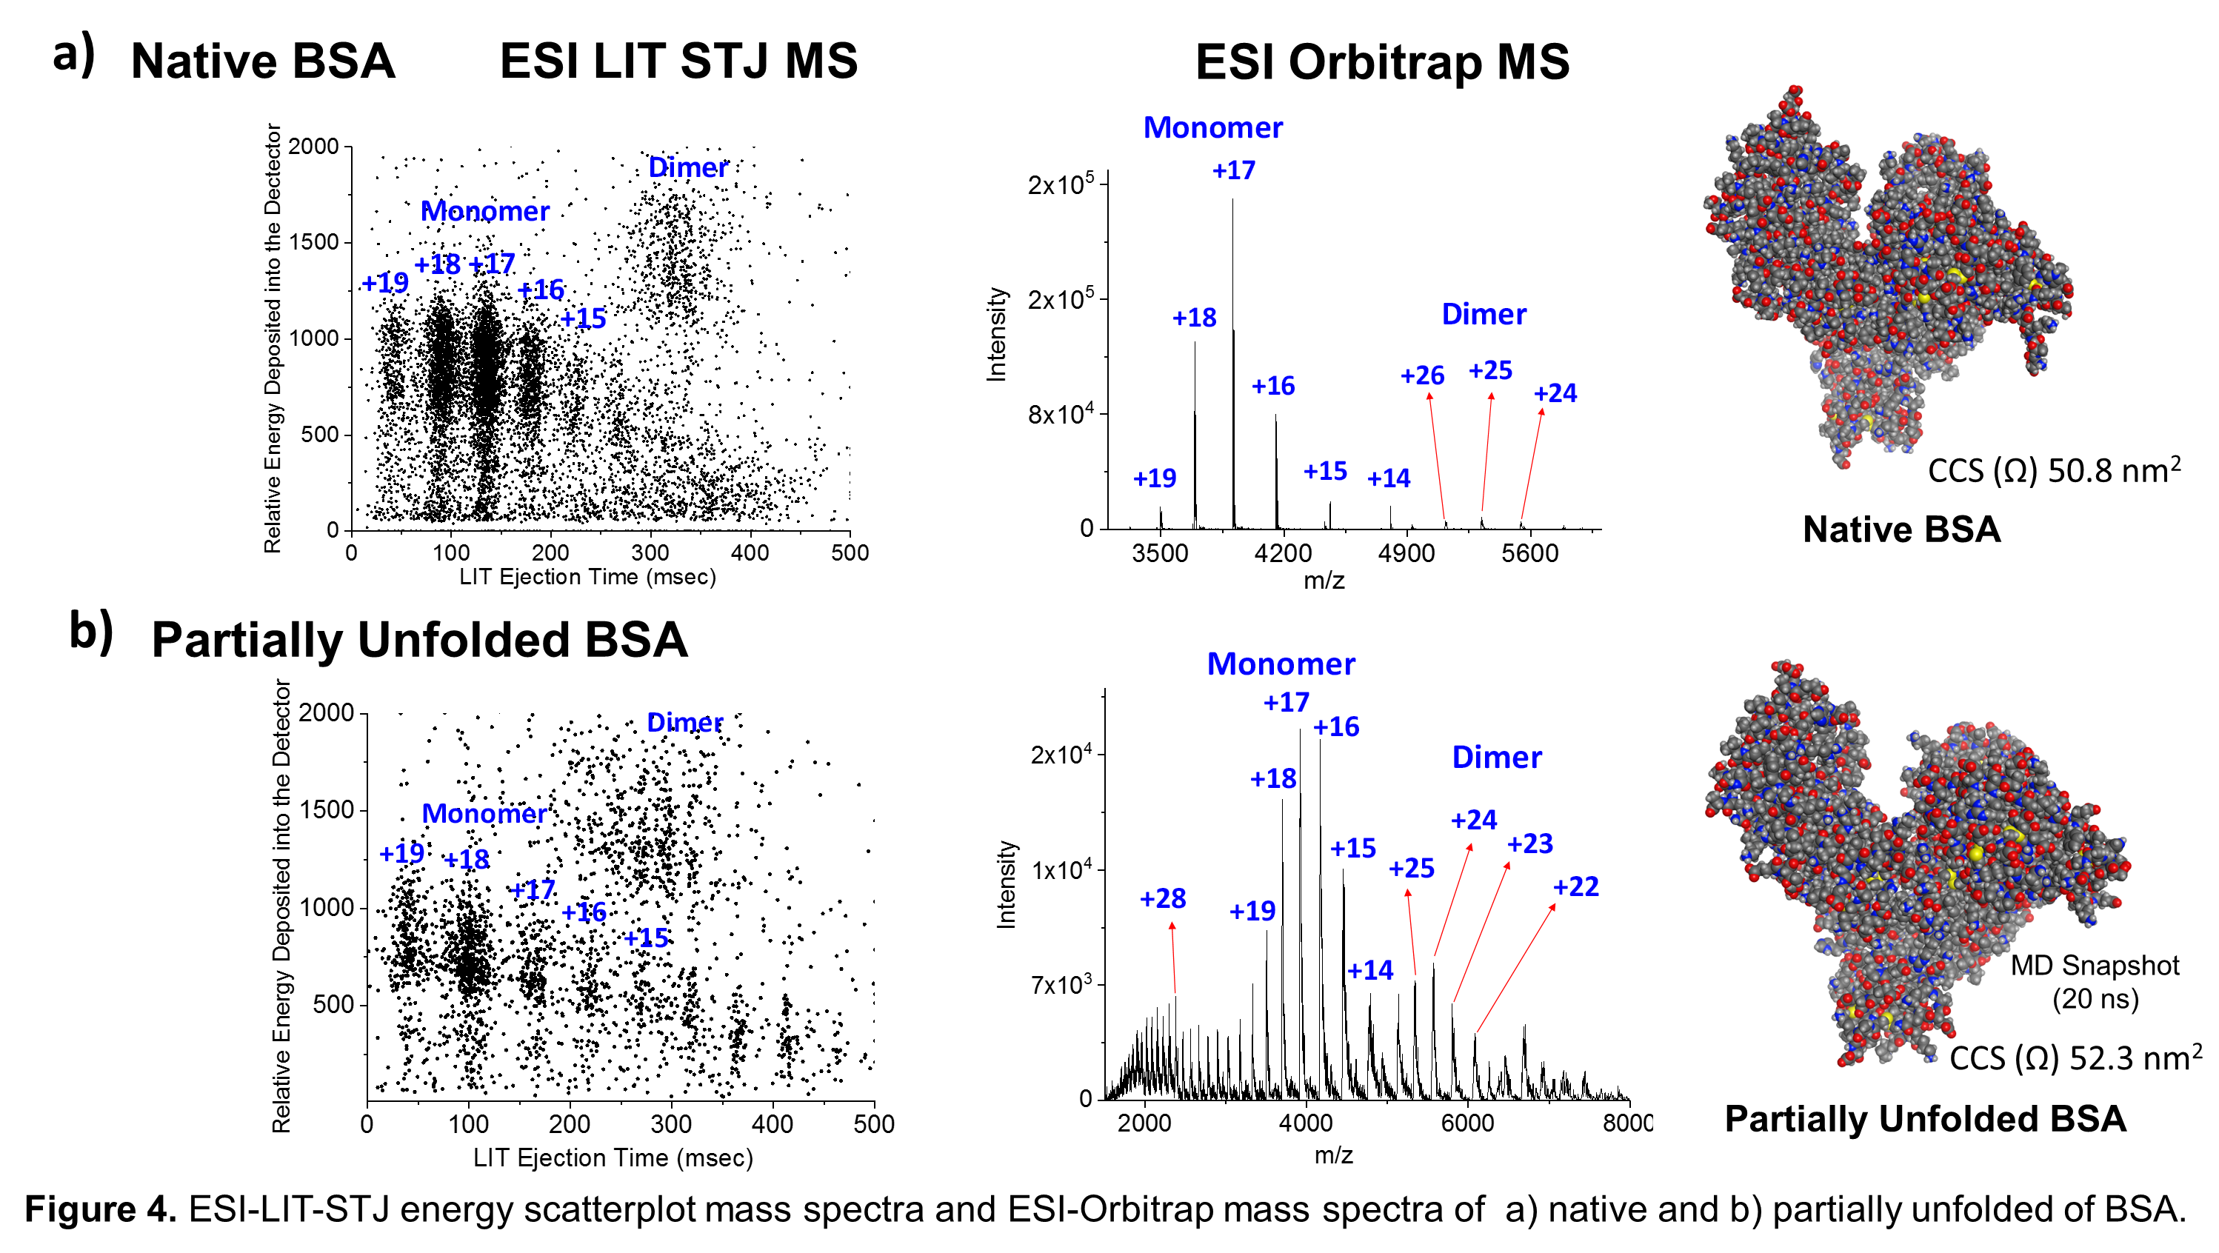
Native and Partially Unfolded Bovine Serum Albumin by ESI-LIT-STJ MS

Slide 29
Relative Energy Deposited into a STJ Detector for Folded vs Unfolded BSA
The preliminary results for the relative energy deposited into the STJ detector for the +18 charge state of native and partially unfolded BSA ion showed that the relative energy of native BSA was higher than the partially unfolded BSA ion. Ion mobility experiments are need to confirm this result.
Partially unfolded
Single pixel
s
Native (folded)

Slide 30
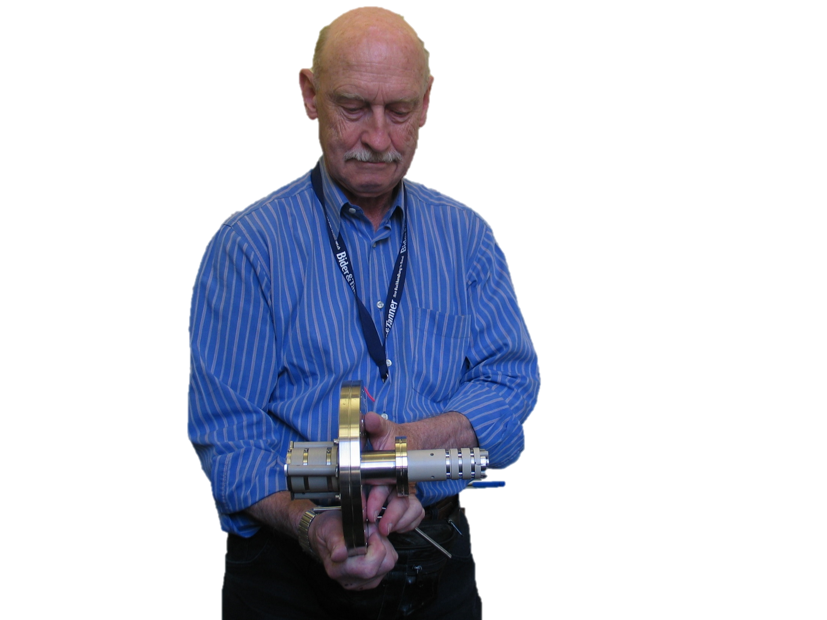
In memory of
Urs P. Schlunegger
September 27, 1934 - September 28, 2015

Slide 31
Conclusions
First implementation of Ta-STJs for MS.
First ESI LIT STJ/CEM MS.
ESI-LIT-STJ data showed higher order oligomers including dimer, trimer, and tetramer ions by m/z and energy.
ESI-LIT-STJ data showed low energy ions which suggests that there is more information in this region.
Energy deposited differences for various ion types suggests a new analytical tool for ion content or structure. Preliminary results show a potential application to protein conformational analysis.

Slide 32









Acknowledgments
Dr. Stephan Friedrich
LLNL
Mohammad Halim
Carnegie Mellon
Prof. Abdil Ozdemir
Sakarya University, Turkey
Prof. Roger Hendrix
Univ. of Pittsburgh
Prof. Bob Duda
Univ. of Pittsburgh
Robert Cantor
STAR Cryoelectronics
Logan Plath, GS
Carnegie Mellon
Stephen Tjader, BS
Carnegie Mellon
Jonathan Feldman, UG
Carnegie Mellon
Fan Wang, MS
Carnegie Mellon
Prof. Emeritus Urs Schlunegger
Univ. of Bern
Prof. Rongchao Jin
Carnegie Mellon
Dr. David Sipe
Carnegie Mellon
Dr. Alex Aksenov
UC Davis
Anna Czapar
Case Western Reserve U
Prof. Nicole Steinmetz
Case Western Reserve U.
NSF REU, HHMI, CMU SURG funding
Department of Chemistry & MCS
Carnegie Mellon University
VIPERdb2
USDA
NSF DBI 0454980 & NSF CHE-CMI-1611146

Slide 33

In memory of
Urs P. Schlunegger
September 27, 1934 - September 28, 2015

