Slide 1
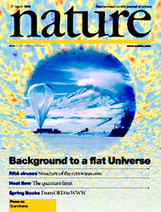
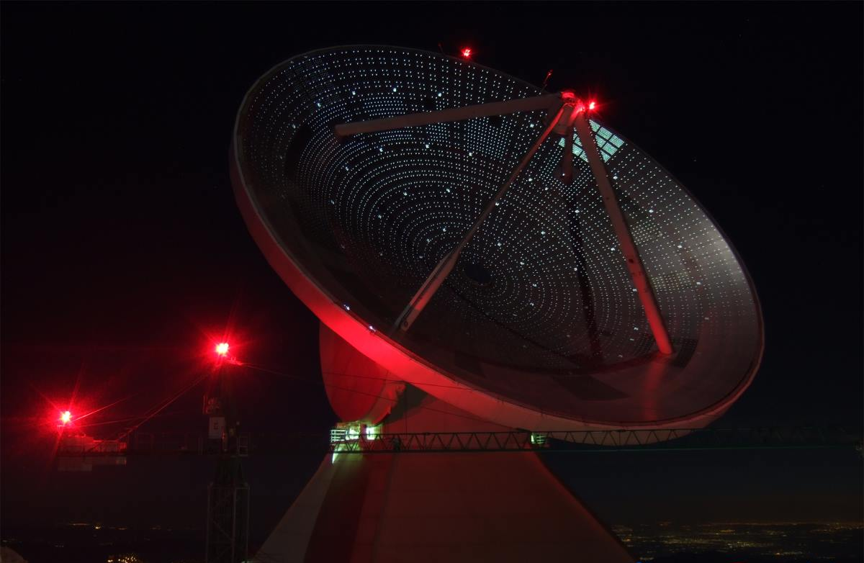
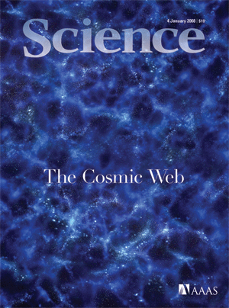
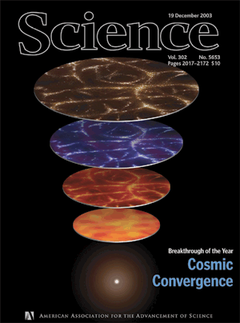

Readout systems for large arrays of superconducting resonators for astronomical imaging and spectroscopy
Phil Mauskopf, Arizona State University

Slide 2
Readout systems for large arrays of superconducting resonators for astronomical imaging and spectroscopy
Cosmology
  Science (Dark energy, Dark matter, Inflation, Neutrinos, etc.)
  Techniques (CMB, LSS, Lensing, Clusters, SNIa)
  CMB Instruments and measurements (COBE, WMAP, PLANCK, Balloons, Ground-based...)
FIR astronomy
  Science (Galaxy evolution and LSS, star formation, planetary system formation)
  Instruments and measurements (SCUBA/SCUBA2, Bolocam/AzTec/Toltec, BLAST, HERSCHEL, NIKA/NIKA2...)
Readout systems and technologies
  TES detector arrays (SPICA/SAFARI, SO, CMB-S4,...)
  Kinetic inductance detector arrays (BLAST-TNG, OLIMPO, Toltec, Superspec, MUSCAT, AMKID, DESHIMA…)
  Superconducting single photon counting detector arrays

Slide 3
Questions in cosmology:
What is the fate of the universe?
What is nature of dark matter and dark energy?
What is the topology of the universe?
What processes generated the initial conditions in the universe that led to our existence?
SN1A
CMB
LSS

Slide 4
Experimental Cosmology/Particle Astrophysics
Studying the evolution of the universe and probing fundamental physics (+ particle physics e.g. accelerators, tabletop):
1. Measure the baryons (small percentage of the matter)‏
- CMB (photon-baryon fluid) = mm-waves (BOOM, WMAP, PLANCK, etc.)
- Stars = optical/UV/IR light (e.g. EUCLID, WFIRST, SPHEREx, LSST, etc.)‏
- Dust = FIR (e.g. HERSCHEL, SCUBA2, ALMA, etc.)‏
- Gas (Hydrogen) = Radio/X-ray (e.g. SKA, SZ, IXO, etc.)‏
2. Measure the dark matter (larger percentage of matter)‏
- Direct detection (e.g. CDMS, EDELWEISS, XENON100, LZ, etc.)‏
- Indirect detection (e.g. γ-rays, CMB, LSS, lensing, etc.)‏
3. Measure weird/extreme phenomena or other particles
- Gamma ray bursts, fast radio bursts (still photons)
- Ultrahigh energy cosmic rays, neutrinos, gravitational waves, etc.

Slide 5
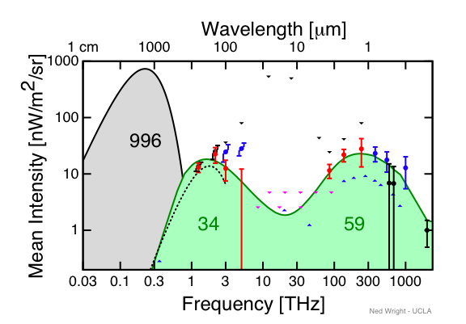
Extragalactic Radiation
99.6% of total EM energy
in Universe is the CMB:
2.73 K blackbody with
a peak at 150 GHz
Half of the EM radiation
in the universe emitted
since the BB is optical
light from stars
Half of the EM radiation
in the universe emitted
since the big bang is
THz radiation
Measuring this radiation
Is key to understanding the
evolution of the universe
VLA GBT PLANCK HERSCHEL HUBBLE
SKA CoRE ALMA SPICA JWST EUCLID E-ELT, etc.

Slide 6
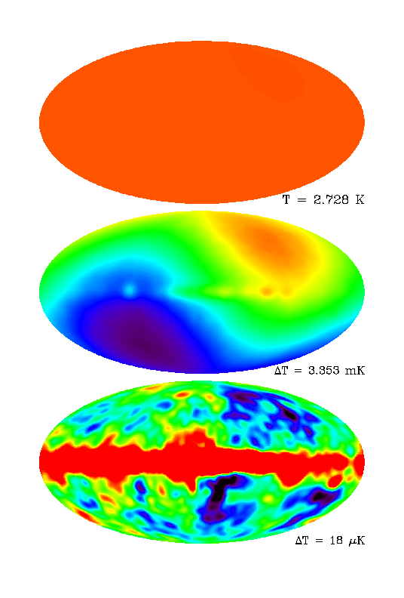
The CMB
COBE
Unlike other backgrounds,
the CMB is not resolvable
into individual objects
Uniform...
Tiny variations in CMB:
ΔT/T ~ 100 ppm maximum
Compare to earth’s surface:
ΔR/R ~ 1000 ppm
Ripples in the CMB tell
us about the physics of
the early universe
Measurements from ground, balloons and space
Dipole...
Galaxy + CMB !

Slide 7
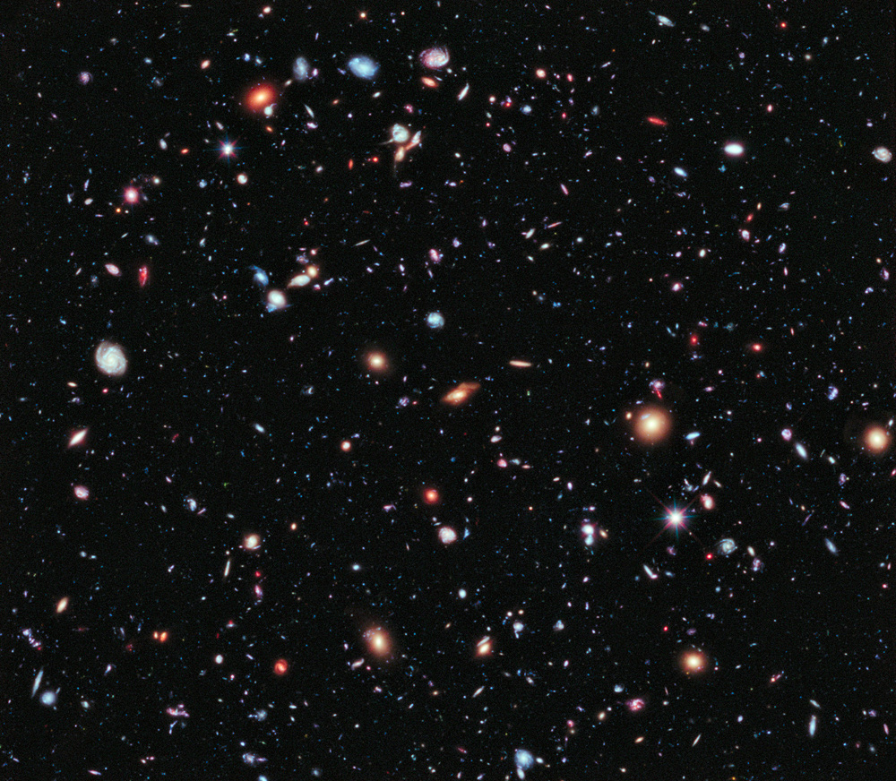
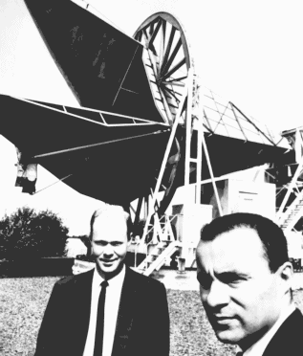
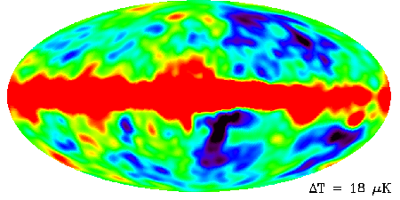
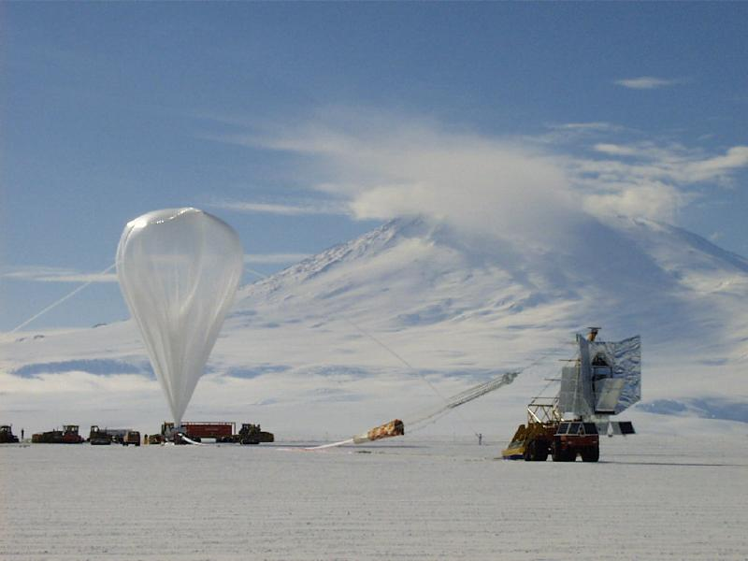
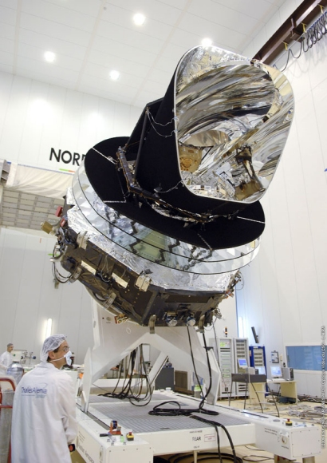
History of CMB Anisotropy Measurements
1965
Penzias & Wilson discover CMB
1970
CMB dipole discovered at +-3 mK
1975
The age of upper limits
1980
Nobel prize for CMB discovery
1985
1990
COBE-DMR makes first all sky CMB map
1995
First detailed images of CMB, B98
2000
Evidence for 'flat' universe B98, MAXIMA, ToCo
Polarisation anisotropy detected, DASI, B2K
2005
WMAP makes improved all-sky CMB maps
Nobel prize for COBE leaders
2009: Launch of PLANCK and HERSCHEL

Slide 8
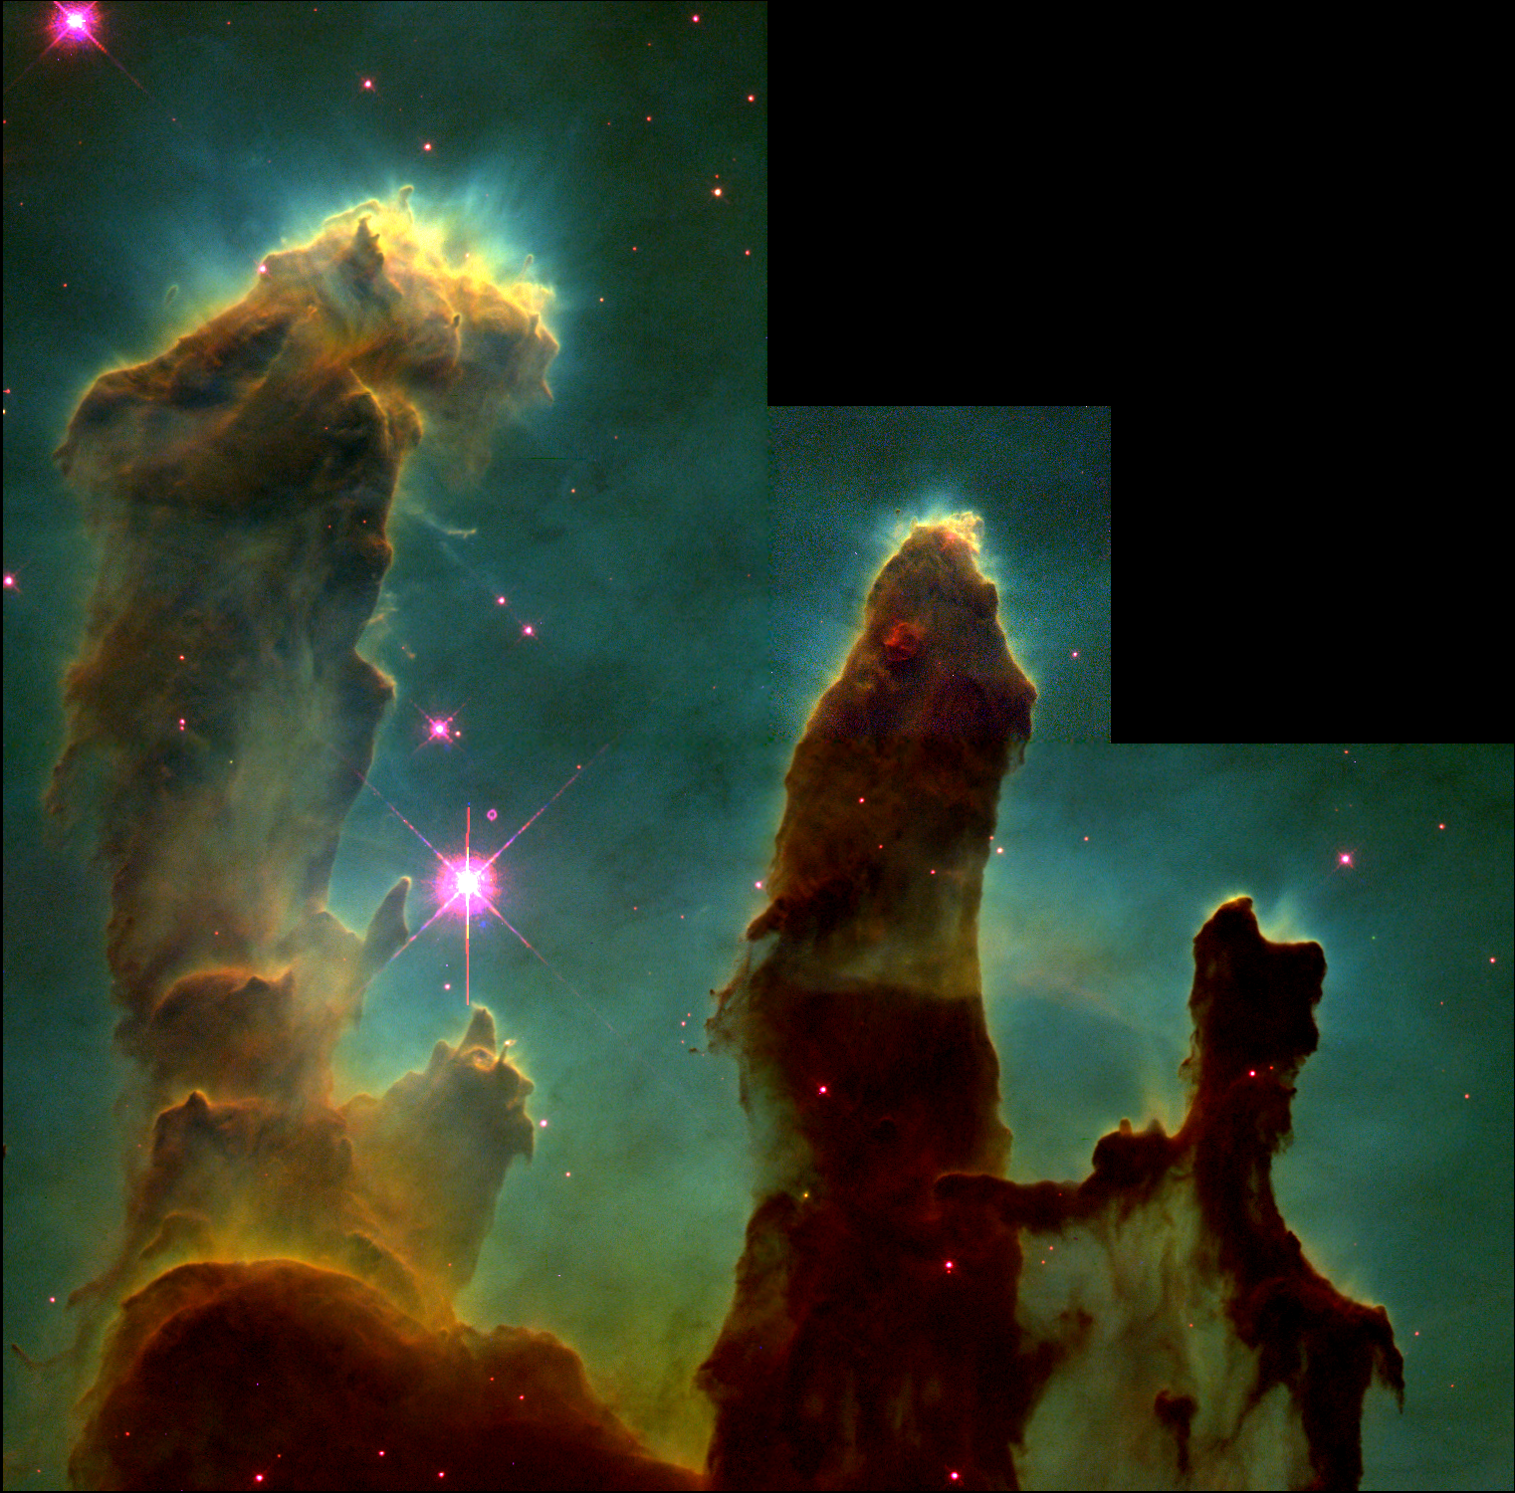
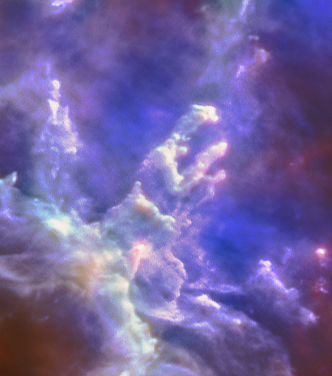
Why Submillimeter/Far-infrared Astronomy?
Image credit: ESA/Herschel
Dust absorbs optical, UV and near-infrared light
And radiates in the sub-mm/far-infrared
Image credit: Hester & Scowen

Slide 9
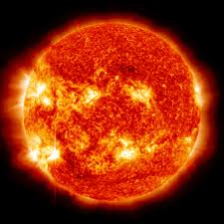
Because stars are like…

Slide 10
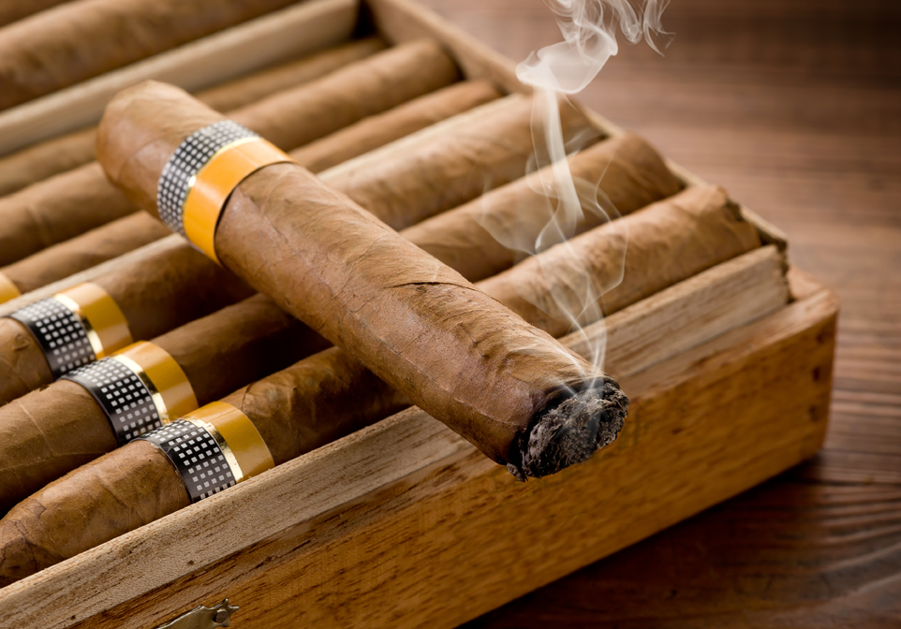
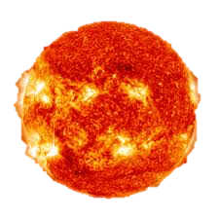
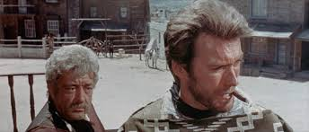
Cigars
Also many strong atomic and molecular emission lines from gas are in mm-FIR

Slide 11
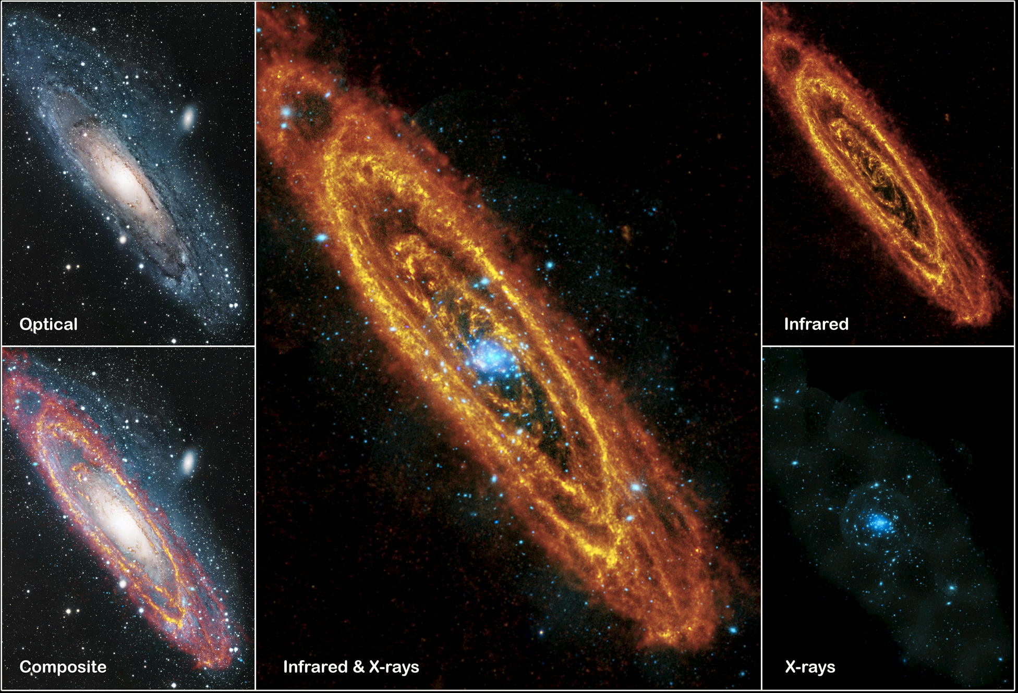
Andromeda with HERSCHEL (and optical/X-ray)
Stars
Smoke

Slide 14
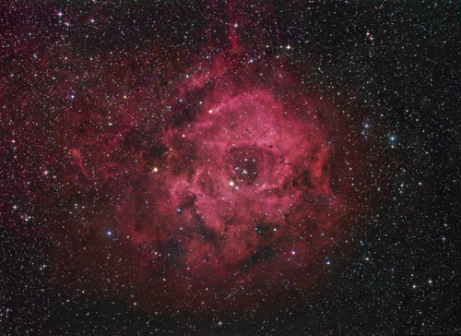
Pink is Hydrogen gas = fuel to produce more stars
Rosette Nebula, Optical Halpha

Slide 15
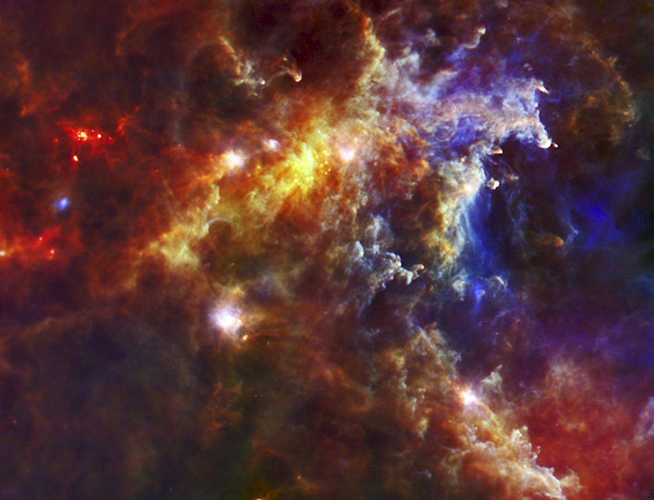
Rosette Nebula: HERSCHEL SPIRE
”Interstellar dust” from stars

Slide 16
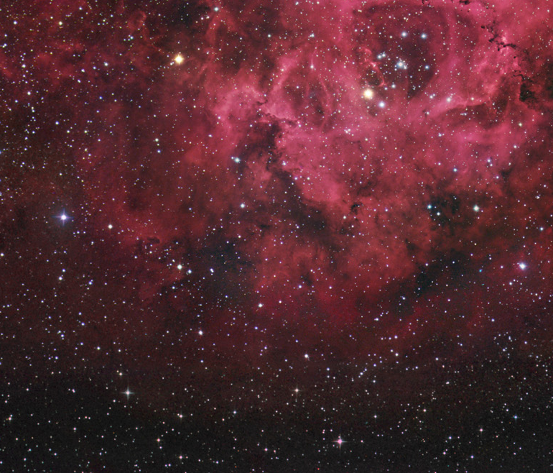
Rosette Nebula: HERSCHEL SPIRE

Slide 17
Technical challenges
Measurements at different wavelengths have different challenges:
Radio/mm-wave:
- Lots of photons (high occupation number)/Large background (CMB+Galaxies)
- Receiver sensitivity not a problem – need lots of receivers/detectors
- Need large baselines
- Need large collecting area (ground) – large throughput
- Need sites with low interference (atmosphere/communications)
FIR-MIR:
- Quite a lot of photons per source (~1000/s/m² in line emission per galaxy)
- Potentially large thermal background
- Need a cold telescope in space
- Need large (~few-10s m) apertures
- Need large arrays of sensitive cryogenic detectors
- Need cryogenic multiplexing readout electronics + simple integration
IR-optical:
- Few photons per source (<10/s/m² in line emission per galaxy)
- Low background interference
- Single photon detectors exist (semiconductor based) – need low background
- Large arrays exist – started with invention of CCD in 1969

Slide 18
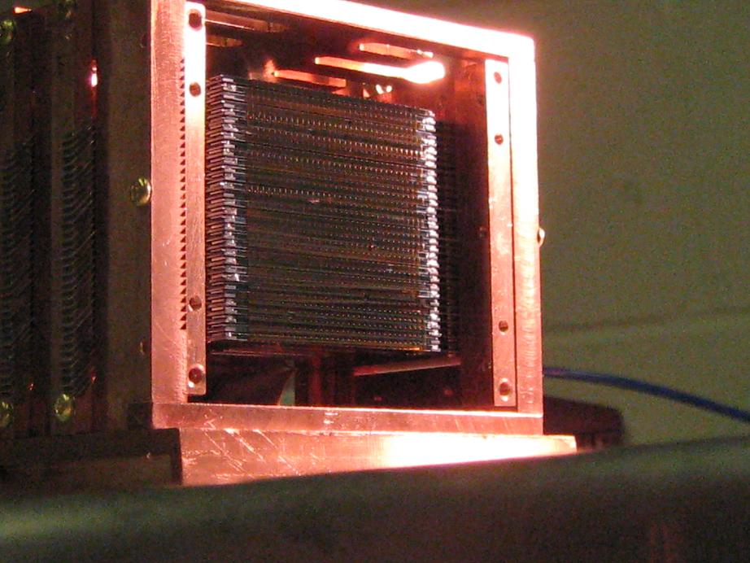
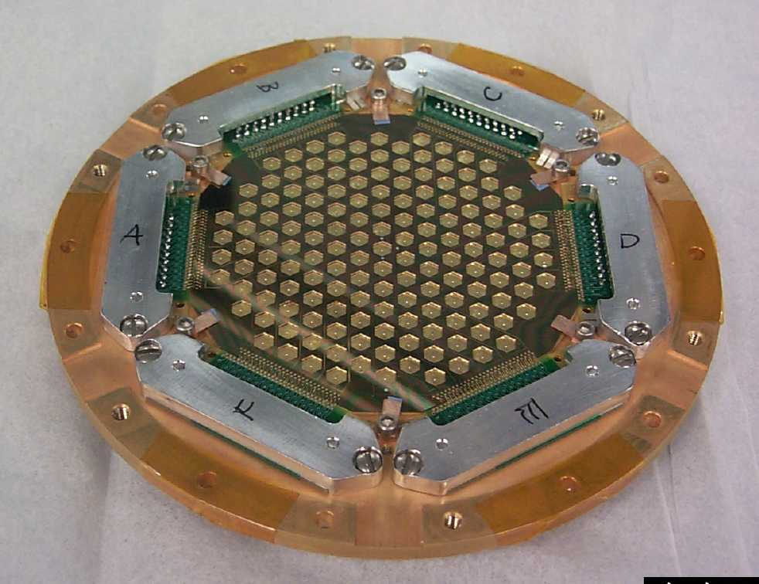
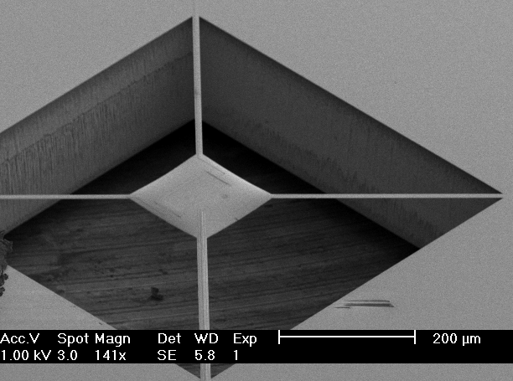
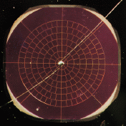
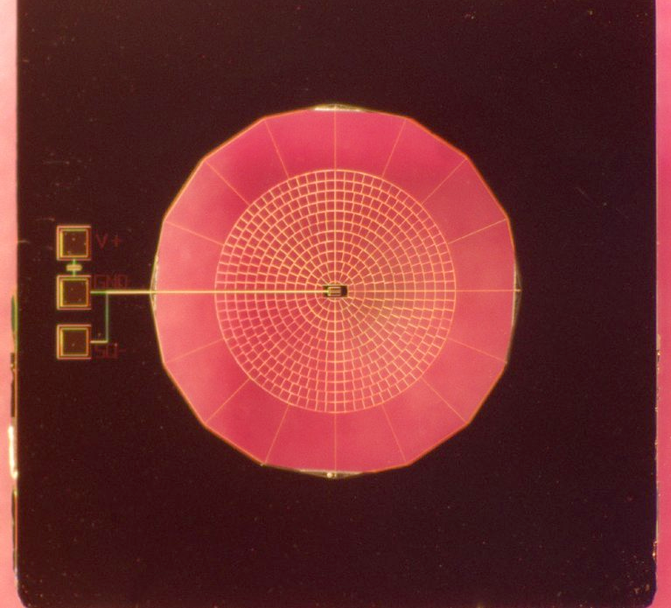
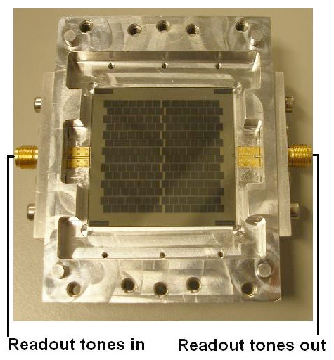
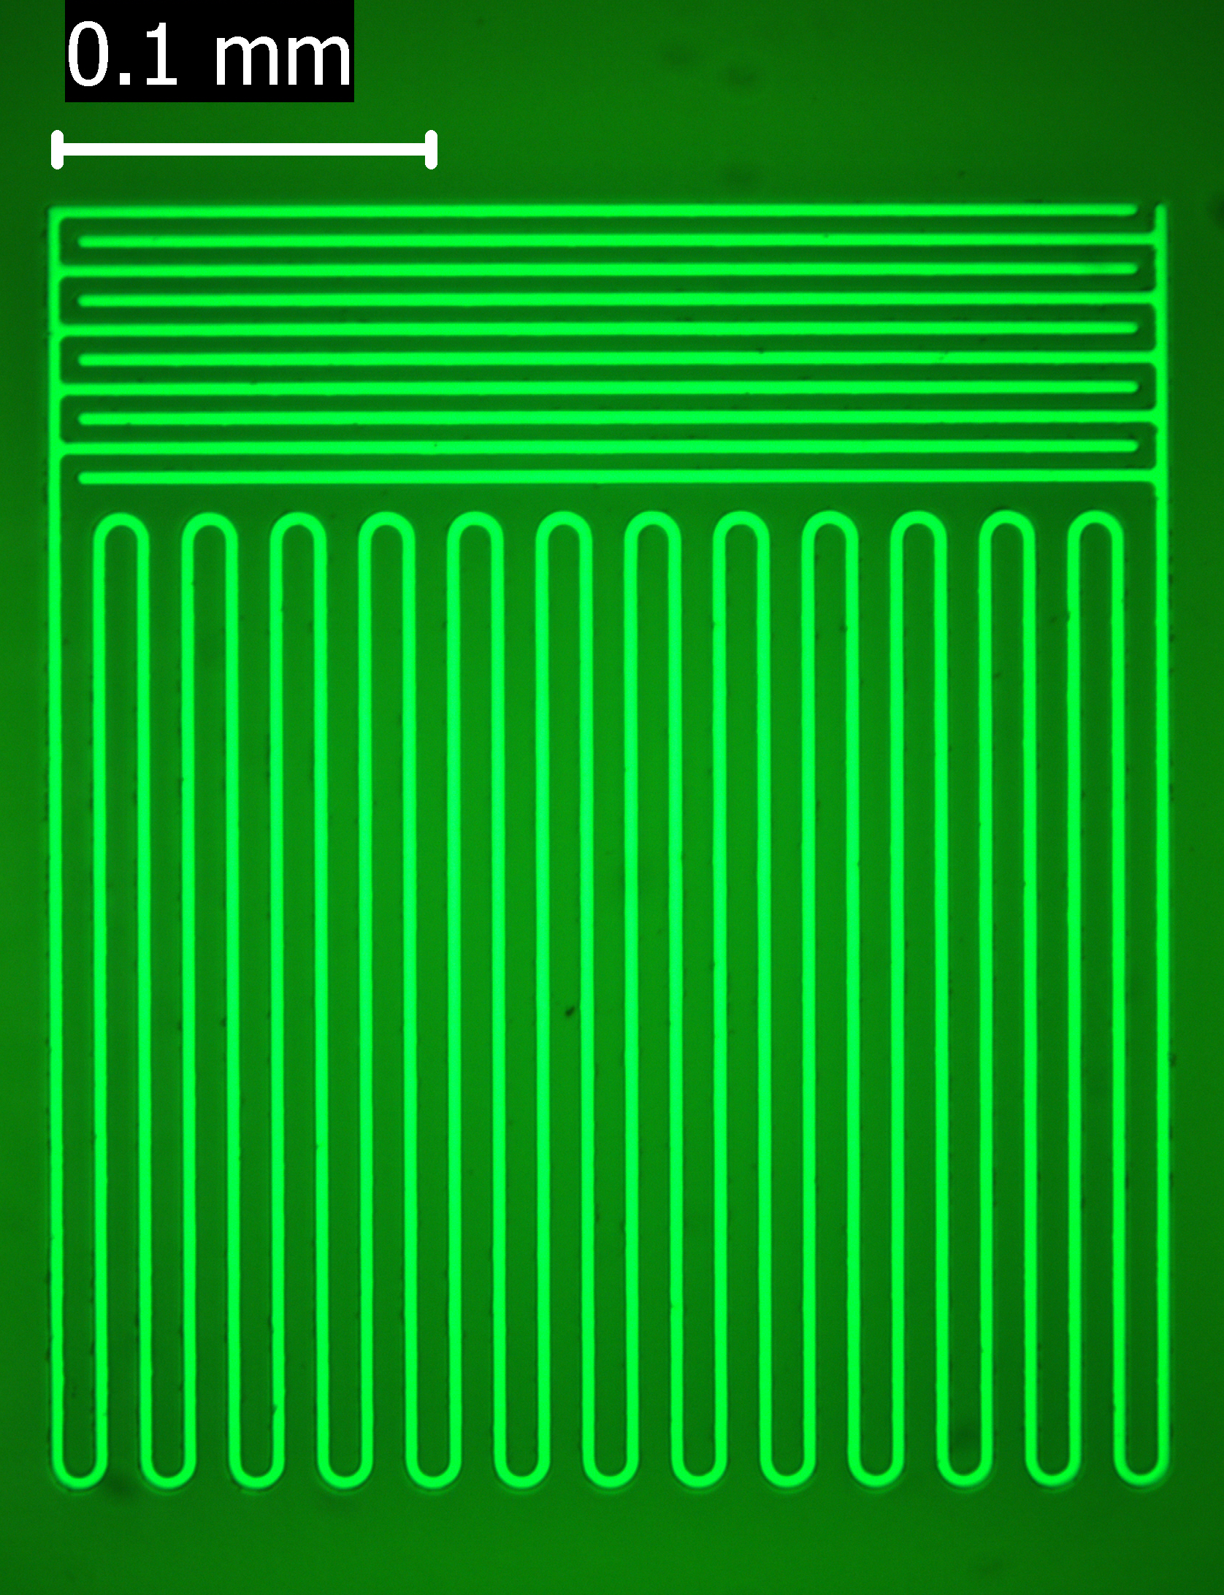
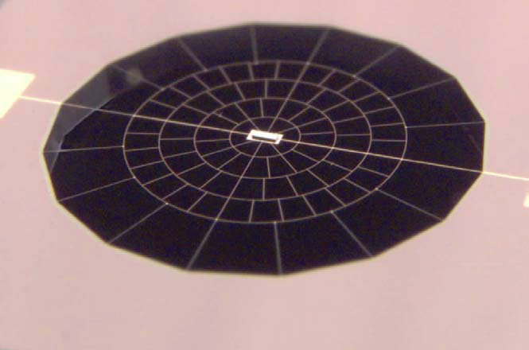
Detector gallery
Bolometers: Detectors used in current or past instruments
BOLOCAM/SuZIE – ground-based (Hawaii)
HERSCHEL/PLANCK – space-based (L2)
ACT, 2006-2011
BOLOCAM, 2000-2012
Superconducting detectors:
TES bolometers
Kinetic Inductance Detectors
For current and future instruments
More pixels
More sensitive
SPICA, 2019-2022
HERSCHEL, 2008-2012
SuZIE, 1997-2005
PLANCK, 2008-2012
NIKA, 2009-

Slide 19
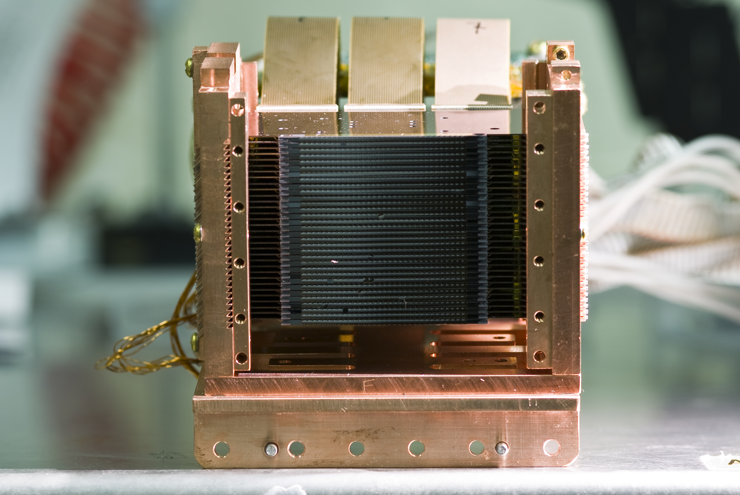
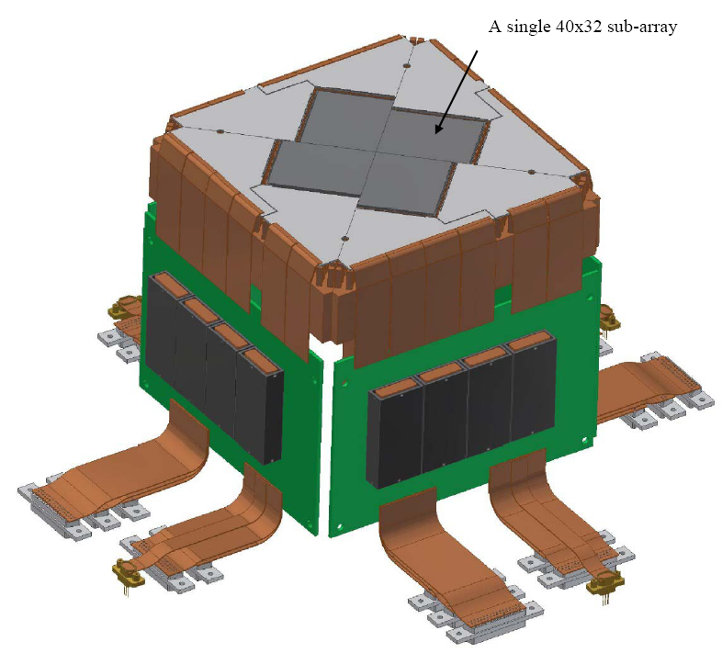
Timeline of Mm-wave/THz instruments in astronomy
1980s-90s - single pixel systems or multipixel assembled by hand (e.g. FIRAS, SCUBA - 37 pixels, BOOMERANG – 10 pixels)‏
1998 - First hybrid detector wafer: BOLOCAM - 144 pixels using Ge thermometers
2009 - Bolometers on ESA satellites (HERSCHEL, PLANCK) including 64x64 micromachined pixel array (PACS) with CMOS multiplexed readout
2000s - Development of transition edge superconducting (TES) bolometers - no hybrid, all photolithographic (10 steps for TES, 14 for SQUIDs)‏
2003 – Kinetic Inductance Detectors (KIDs) with GHz FDM (uMUX)
2007- ACT and SPT SZ survey experiments with >3000 TES pixels
2011- SCUBA2 TES camera - 10,000 pixels with SQUID TDM
2015 - ”Stage 2/Stage 3” CMB experiments with ~ 10,000 detectors (Adv-ACTPol, BICEP/Keck, SPIDER, etc.) with SQUID TDM
2017 – “Stage 2/Stage 3” CMB experiments with ~ few-10,000 detectors (SPT-3G, POLARBEAR, EBEX, etc.) with SQUID FDM (MHz)
2020 – ”Stage 3/Stage 4” CMB experiments with 50-500k detectors (e.g. Simons Observatory, CMB-S4) with FDM/uMUX (MHz - GHz)

Slide 20
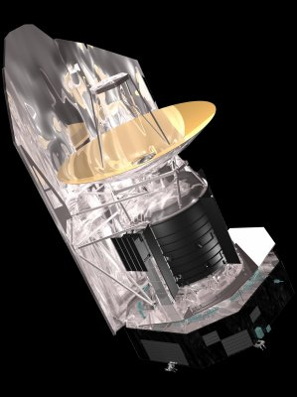
Challenges for Readout of Large Arrays
System integration complexity
Size, Weight, Power and Cost
Ease of operation and interface = software
10⁴
10³
100
10
1990
2000
2010
2020

Slide 21
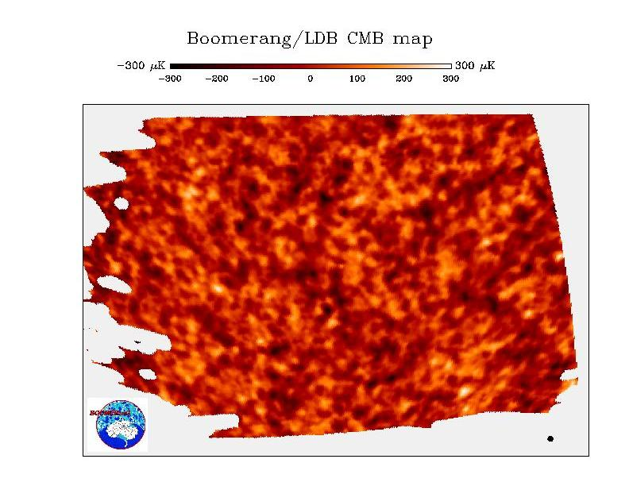
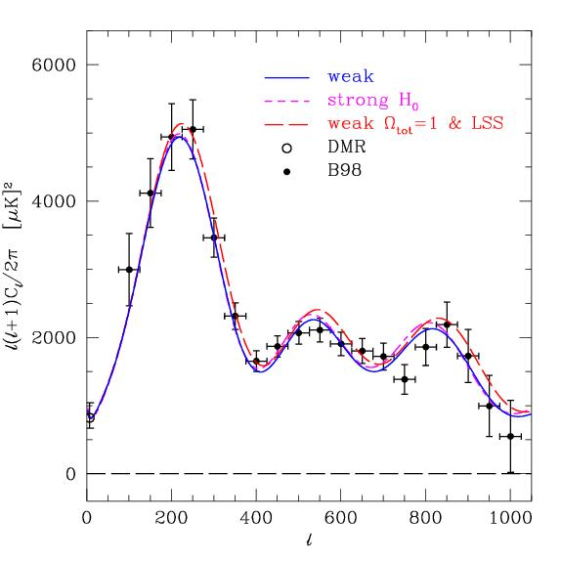
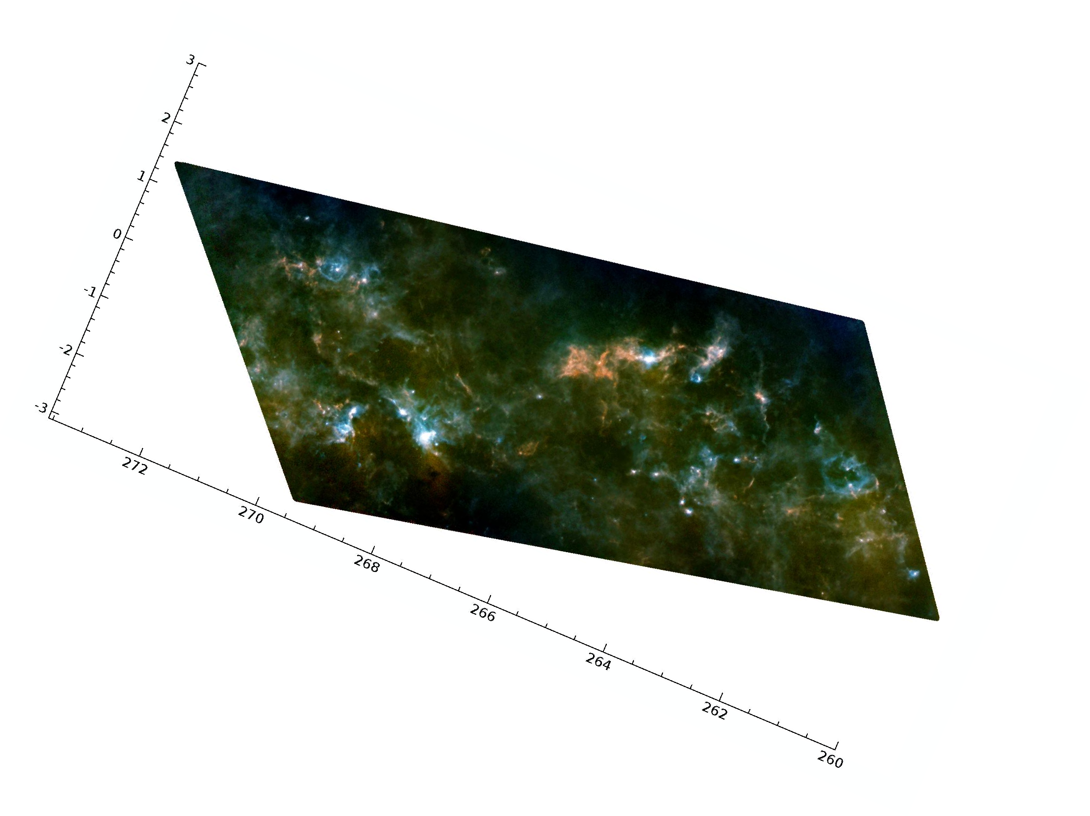
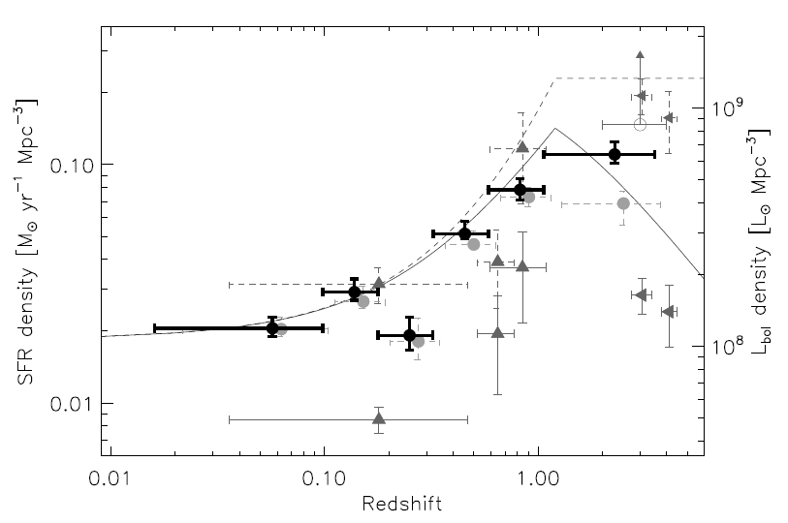
Low temperature detectors from balloons to satellites:
PLANCK and HERSCHEL, 2009
BOOMERANG: 1998/2001
BLAST: 2005/2006

Slide 22
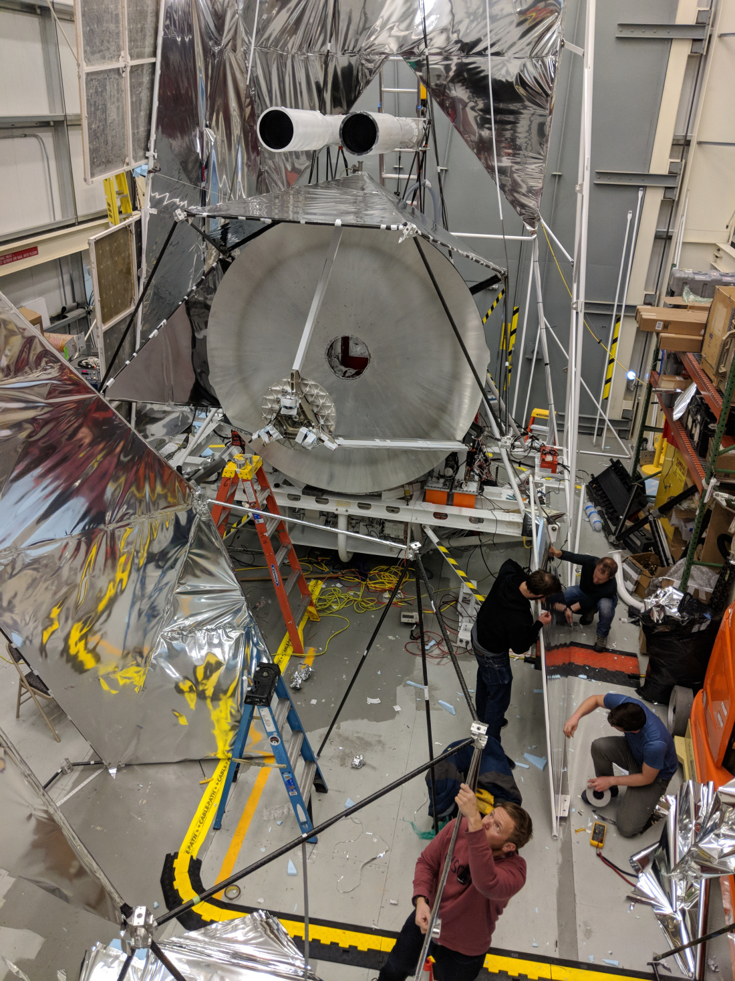
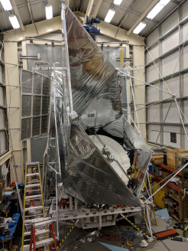
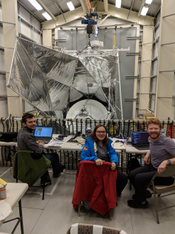
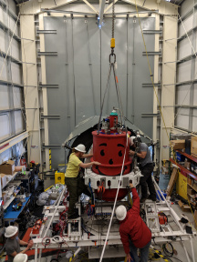
BLAST: 2019

Slide 23
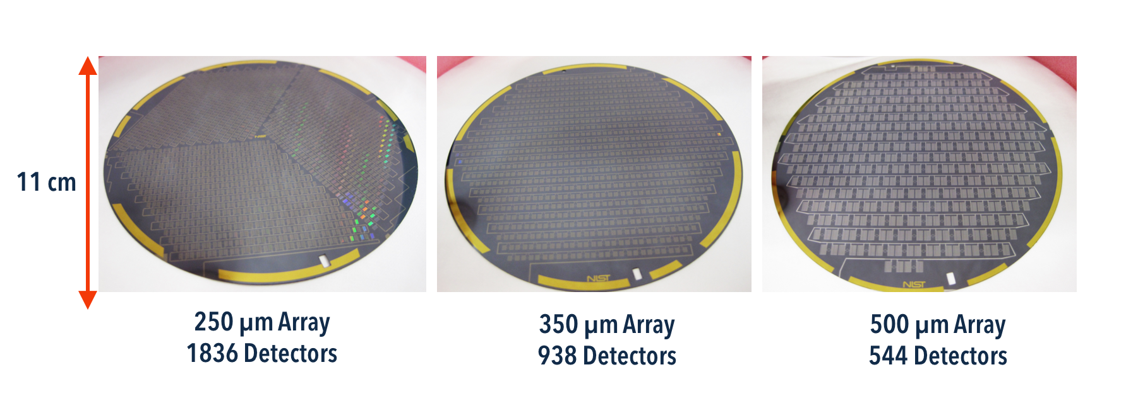
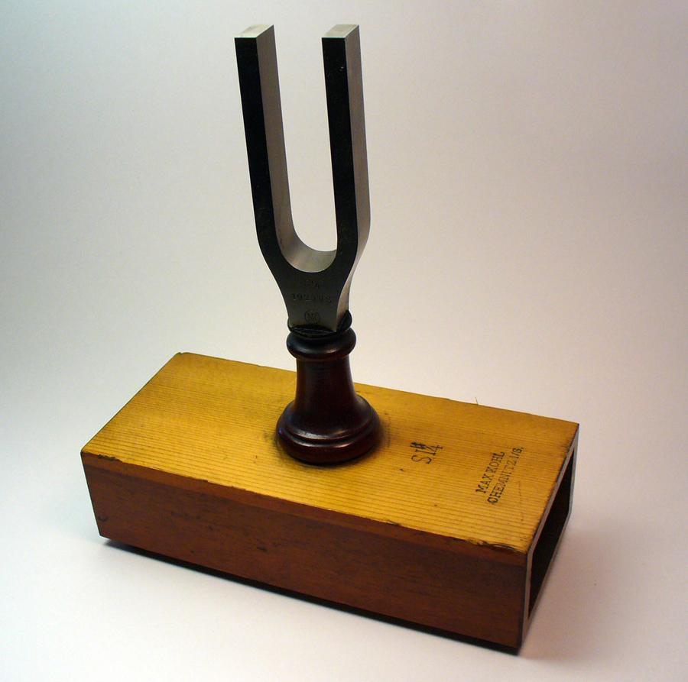
BLAST-TNG uses Lumped Element
Kinetic Inductance Detectors (KIDs)
10x more detectors than in BLAST-Pol
Each detector is a superconducting resonator with a unique frequency
More than 10x mapping speed
Readout uses high speed digital electronics

Slide 24
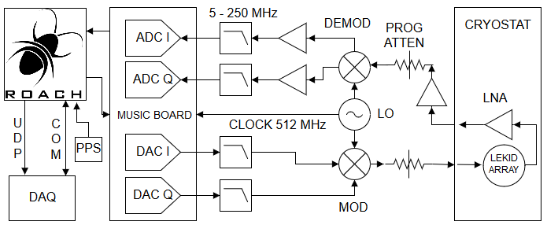
ROACH-2 FIR KID Array Readout System:
Developed for BLAST-TNG balloon-borne instrument
- Based on similar readout developed for Optical KIDs (Mazin, et al.) optimized for mm-wave/FIR arrays

Slide 25
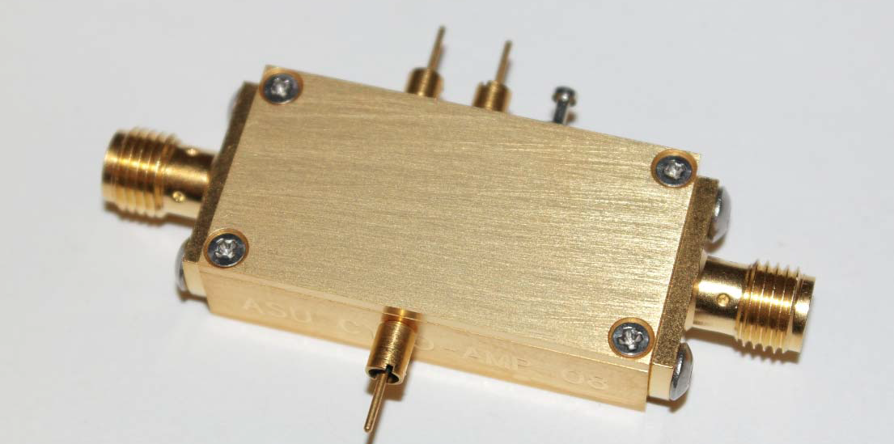
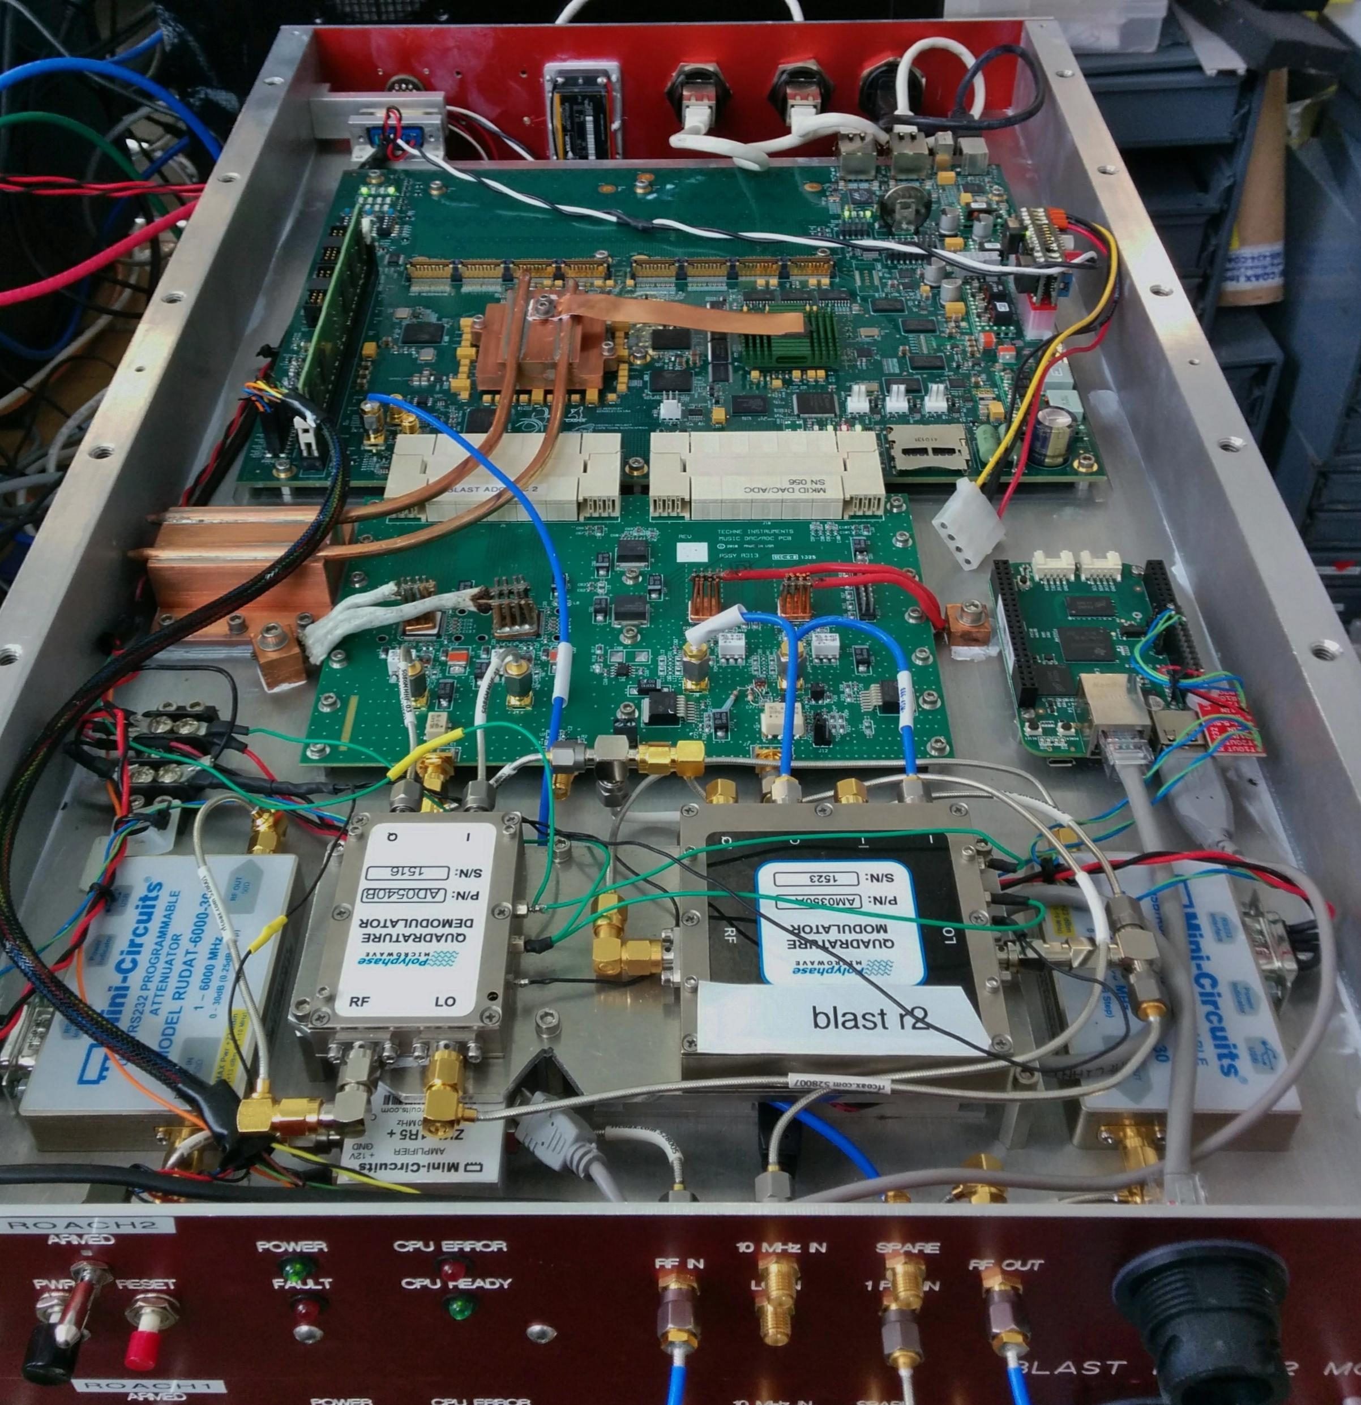
Microwave multiplexing KIDs
Kinetic inductance detector readout systems –
Components:
Cryogenic low noise amplifiers (LNA):
Commercially available or provided by ASU
Cost is about $3-5k per signal chain
Cryogenic cabling:
Superconducting/stainless steel/CuproNickel coax or stripline
Cost is about $3k per signal chain
Warm electronics:
IF components = IQ mixers, warm amplifiers, variable attenuators, nyquist filters
Currently using ROACH2 open source hardware/firmware/software
Bandwidth = 512 MHz per board, Power = 60-80 W per board
Cost is about $15k per signal chain without Xilinx FPGA donation ($8k)

Slide 26
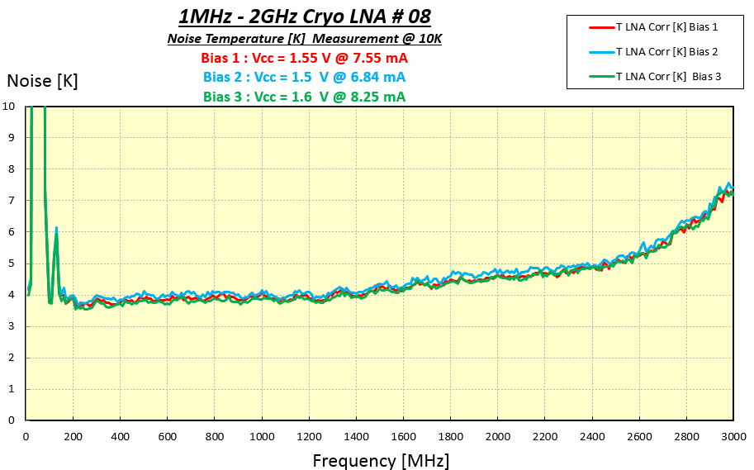
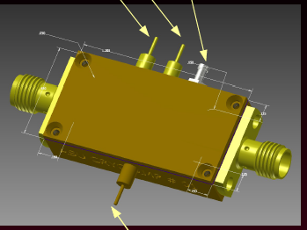
Readout: Cryogenic LNAs from 0.1-2 GHz
Custom built LNAs for low power dissipation
4 K noise temperature at <20 K operating temperature
>20 dB gain from < 1 MHz to 2 GHz

Slide 27
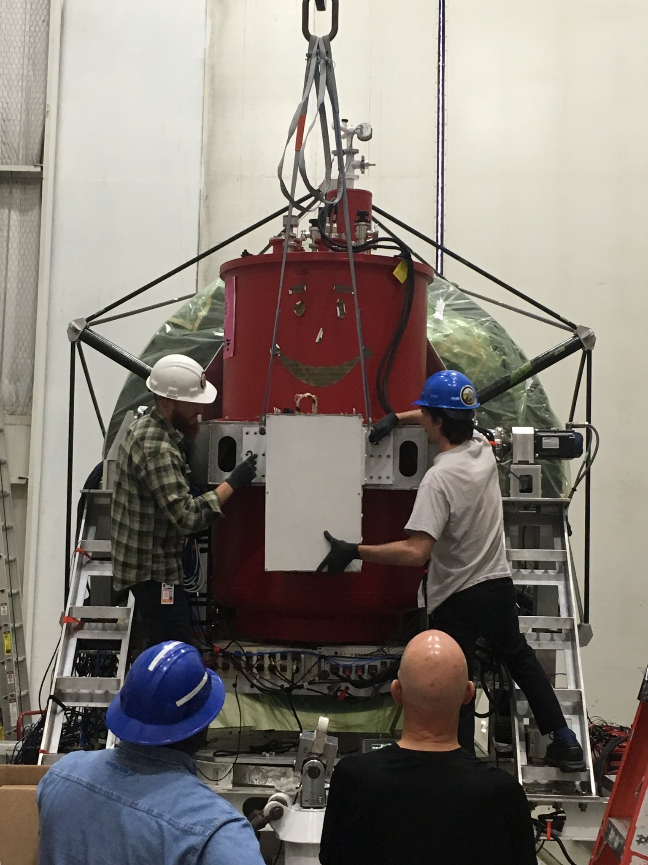
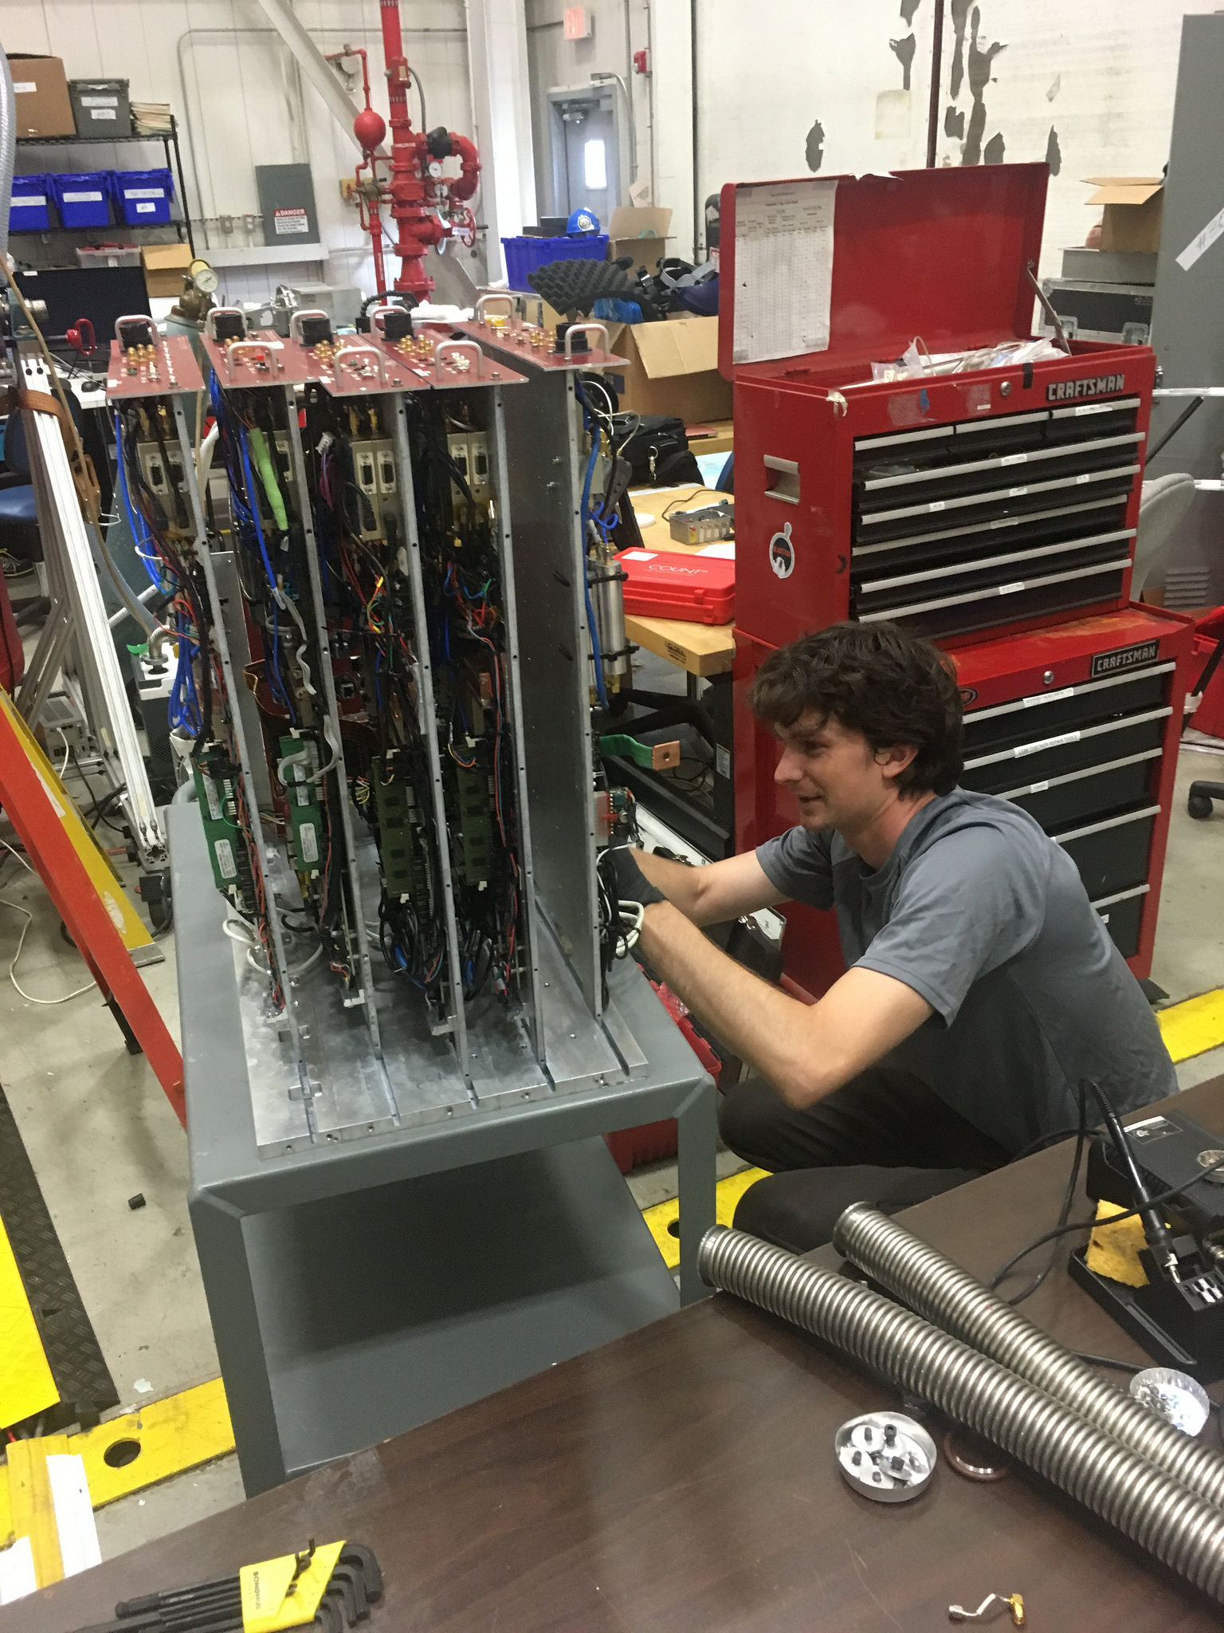
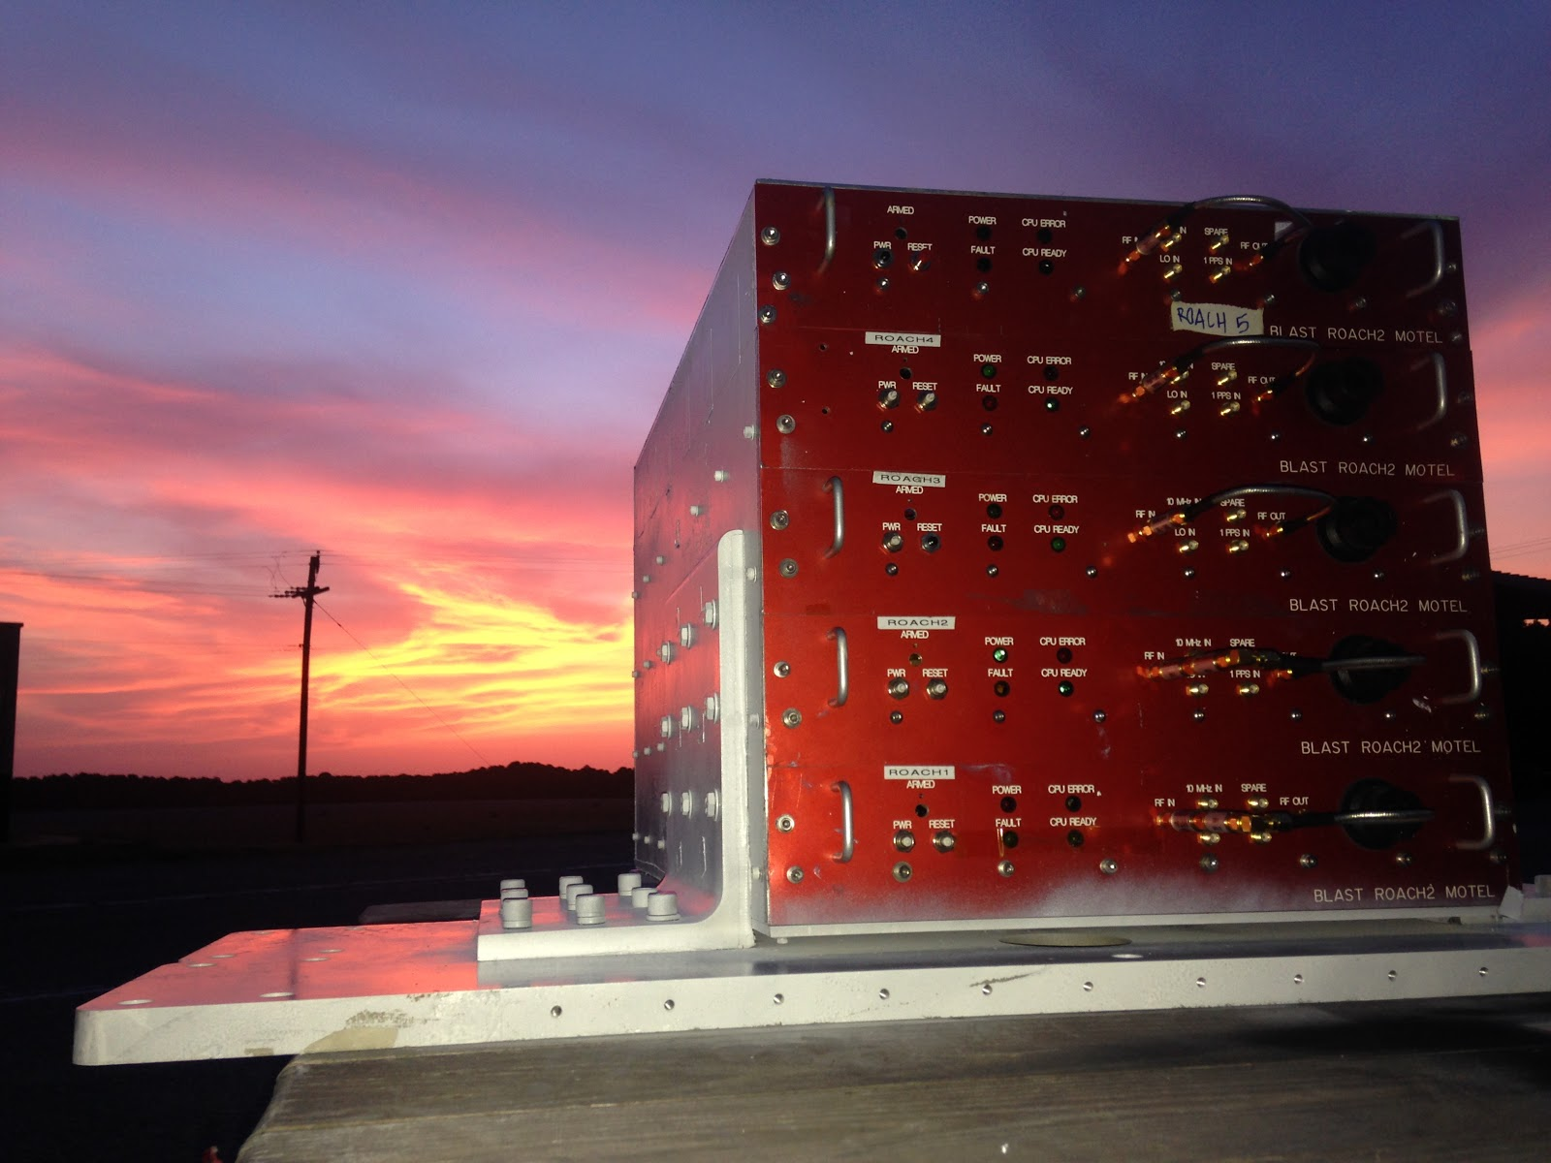
Sunset in Palestine, TX with the BLAST-TNG readout electronics
FPGA-based Software Defined Radio
(Can also be used for electronic warfare)
Mounting the electronics on the receiver

Slide 28
Anatomy of a BLAST-TNG readout module
CASPER
ROACH2 Board
Techne Instruments
MUSIC DAC/ADC Board
Front end RF electronics
Power consumption per module is ~60 W

Slide 29
Anatomy of a BLAST-TNG readout module
CASPER
ROACH2 Board
System allows multiplexing up to 1024 detectors
per readout
TolTEC will multiplex from 500-750 detectors per Tx lin.
Techne Instruments
MUSIC DAC/ADC Board
Front end RF electronics
Power consumption per module is ~60 W

Slide 30

ROACH2 BLAST-TNG 250μm Array Optical Test at NIST
NIST, December, 2016
T_{STAGE}
T_{BB}

Slide 31


ROACH2 BLAST-TNG 250μm Array Readout Power Optimization in Antarctica
NIST, December, 2016
See BLAST talk on Friday

Slide 32
Microwave multiplexing KIDs – ROACH2
Kinetic inductance detector readout systems in current and future instruments:
  OLIMPO (balloon borne 500 detectors), PI, Silvia Masi, Rome, Italy
    Successful flight in July, 2018 (see talk 112: Paiella, et al., Wednesday)
  BLAST-TNG (balloon borne 3500 detectors)
    Fully integrated, flight from Antarctica 2019/2020 season (see talk 320, Gordon, et al., Friday)
  Superspec (superconducting on chip spectrometer – 1500 detectors)
    Fall, 2019 integration (see poster/talk)
  MUSCAT (millimeter-wave imager with ~2000 pixels)
  Fall, 2019 integration on LMT telescope in Mexico (see poster(s))
  Toltec (3 band millimeter-wave imaging polarimeter.- 8000 detectors)
    Winter, 2019 integration on LMT telescope in Mexico (talk/poster)
  EXCLAIM (FIR balloon borne spectrometer)
    Project just started Spring, 2019 (talk/poster)
  TIM (Formerly STARFIRE FIR balloon borne spectrometer)
    Project just started Spring, 2019
  + others

Slide 33
Microwave multiplexing TESs
TES uMUX detector readout systems –
Components:
Cryogenic low noise amplifiers (LNA):
Commercially available or provided by ASU
Cost is about $3-5k per signal chain
Cryogenic cabling:
Superconducting/stainless steel/CuproNickel coax or stripline
Cost is about $3k per signal chain
Warm electronics:
IF components = IQ mixers, warm amplifiers, variable attenuators, nyquist filters
Wide band FPGA board (4 GHz) e.g. SMURF, RFSoC, etc.
Power consumption = 250 W per board (SMURF), 25 W (RFSoC)
Cost is about $9k per signal chain (ZCU111) or more (e.g. SMURF, Pentek, Abaco)

Slide 34
Xilinx Ultrascale+ FPGAs available now 16 GHz DAC and ADC at 25 W total
Makes all mux schemes possible from space (via ASIC or space qualification) and balloons
Detector count is not limited by readout power, size or weight (PSaW)

Slide 35
RFSoC Development

Slide 36
RFSoC Development

Slide 37
RFSoC Development
Naïve Algorithm scaling
SMURF: Uses one KU060 Ultrascale FPGA
  Has 2,760 DSP slices (Henderson, et al., 2018)
  Can process up to 4,000 channels
  Scaling to the 4,272 slices on the RFSoC yields
                6,191 detectors

Slide 38
Summary:
Microwave readout of detector arrays:
Used for several KID instruments – NIKA/NIKA2, AMKID, DESHIMA, OLIMPO
Current systems scale well to ~10k detectors
More KID instruments coming on line soon - Toltec, MUSCAT, Superspec, etc.
Microwave readout being developed for TES and TKIDs:
Demonstration on Keck Array, Simons Observatory, etc.
Also developing microwave readout for superconducting single photon counting detectors: see Glasby, et al., poster
Optical-NIR – NbN, TiN for HBT interferometry

