Slide 1
ASTROFLEX SPA
FLEXIBLE METAL HOSES AND BELLOWS
Key Points:
Laser welding
Hydroforming
Helium leak test < 1x10-9
Certification ISO 9001:2012
Cleanliness control system
We weld and form every type of Stainless steel and Inconel.
All the machines and equipments are designed and manufactured by ourself.
Up to internal diameter 100 mm
PED Directive compliance
Laser marking

Slide 2
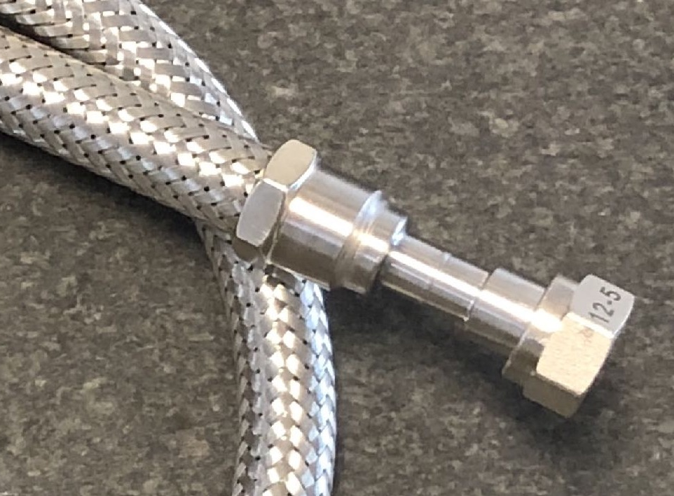
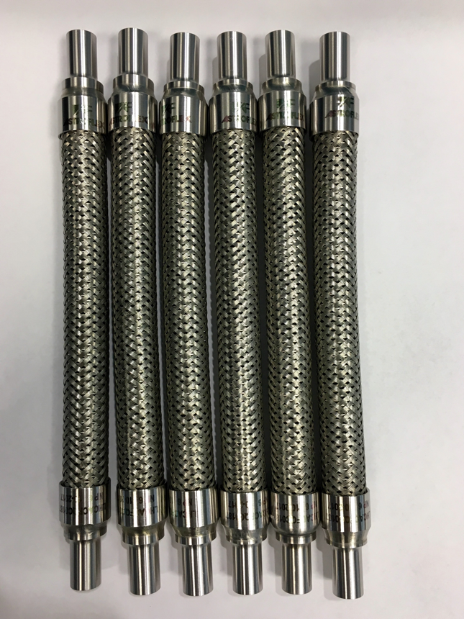
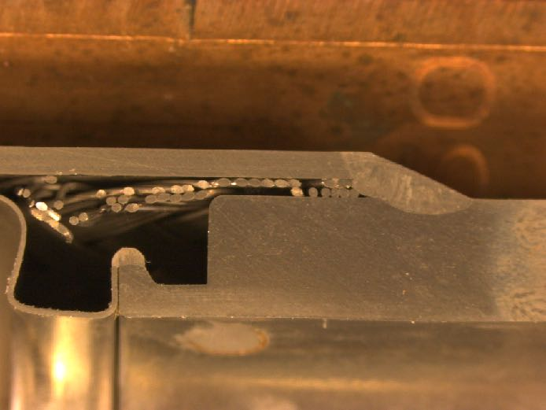
FLEXIBLE HOSES
Weldings sections

Slide 3
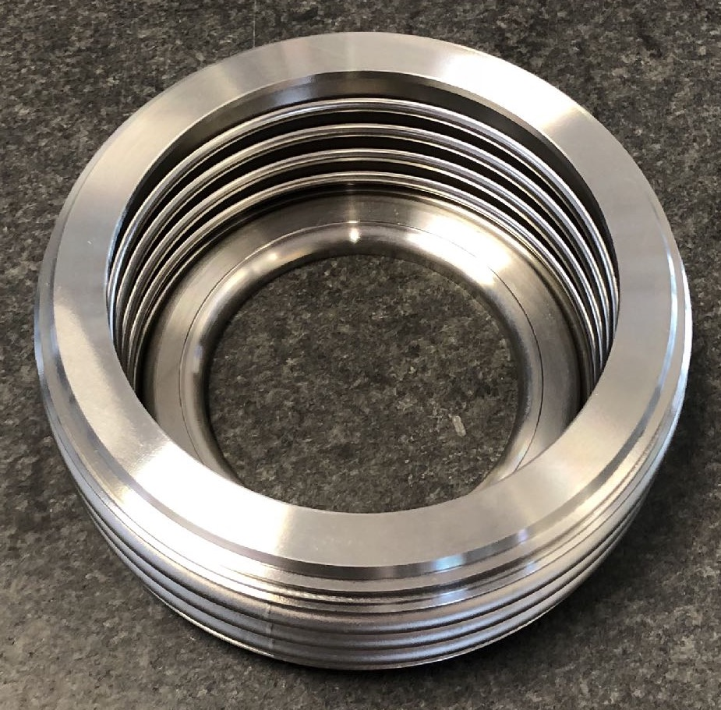
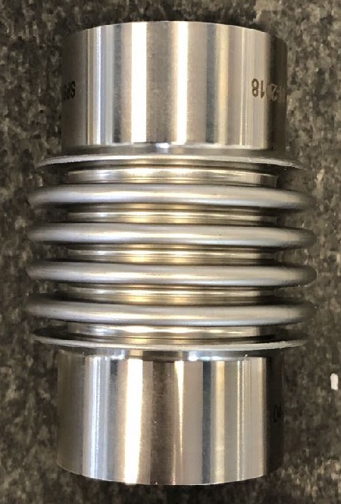
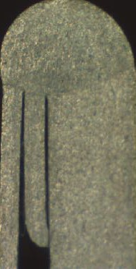
BELLOWS
Welding section

