Slide 1
Knowledge Transfer @ CERN
Giovanni.Anelli@cern.ch
Knowledge Transfer Group - IPT Department
19.09.2018

Slide 2
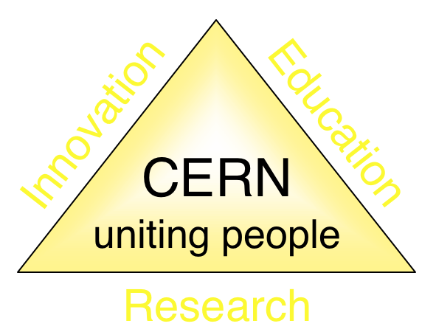
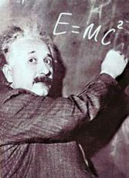
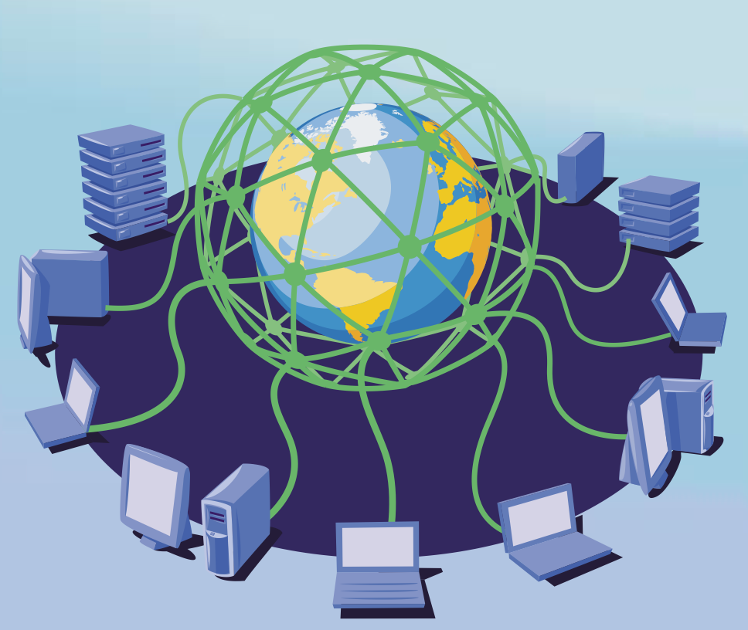
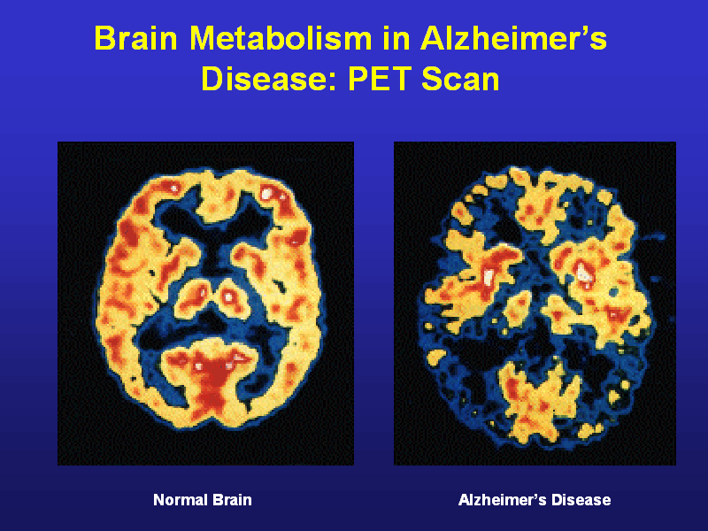
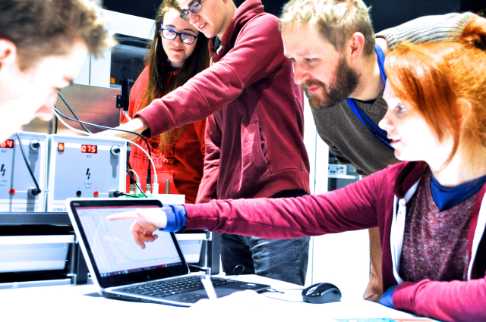
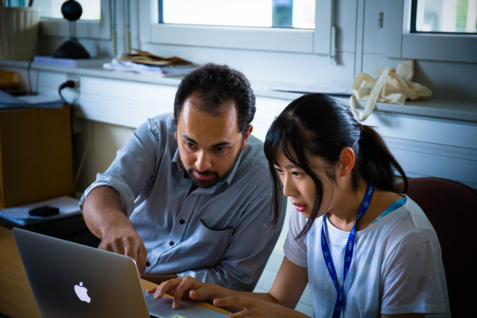
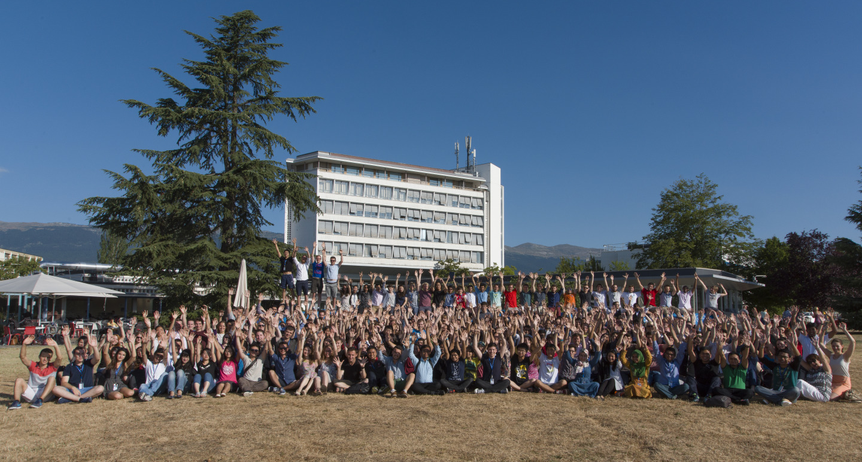
The Mission of CERN
Push back the frontiers of knowledge
E.g. the secrets of the Big Bang …what was the matter like within the first moments of the Universe’s existence?
Develop new technologies for accelerators and detectors
Information technology - the Web and the GRID
Medicine - diagnosis and therapy
Train scientists and engineers of tomorrow
Unite people from different countries and cultures
Notes:
2

Slide 3
KT Mission
Maximize the technological and knowledge return to society, in particular through Member States industry
Promote CERN’s image as a center of excellence for technology and innovation
Demonstrate the importance and impact of fundamental research investments
Key words are dissemination and impact

Slide 4
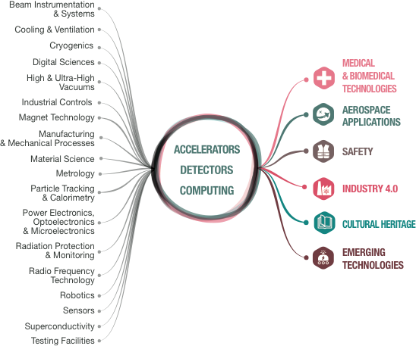
From CERN Technologies …
… to Society
Notes:
CERN’s mission extends beyond science: it also aims to advance the frontiers of technology, to train the next generation of scientists and to bring nations together. The transfer of CERN technologies and know-how to society – grouped under the concept of Knowledge Transfer – is an integral part of each of these activities.

Slide 5
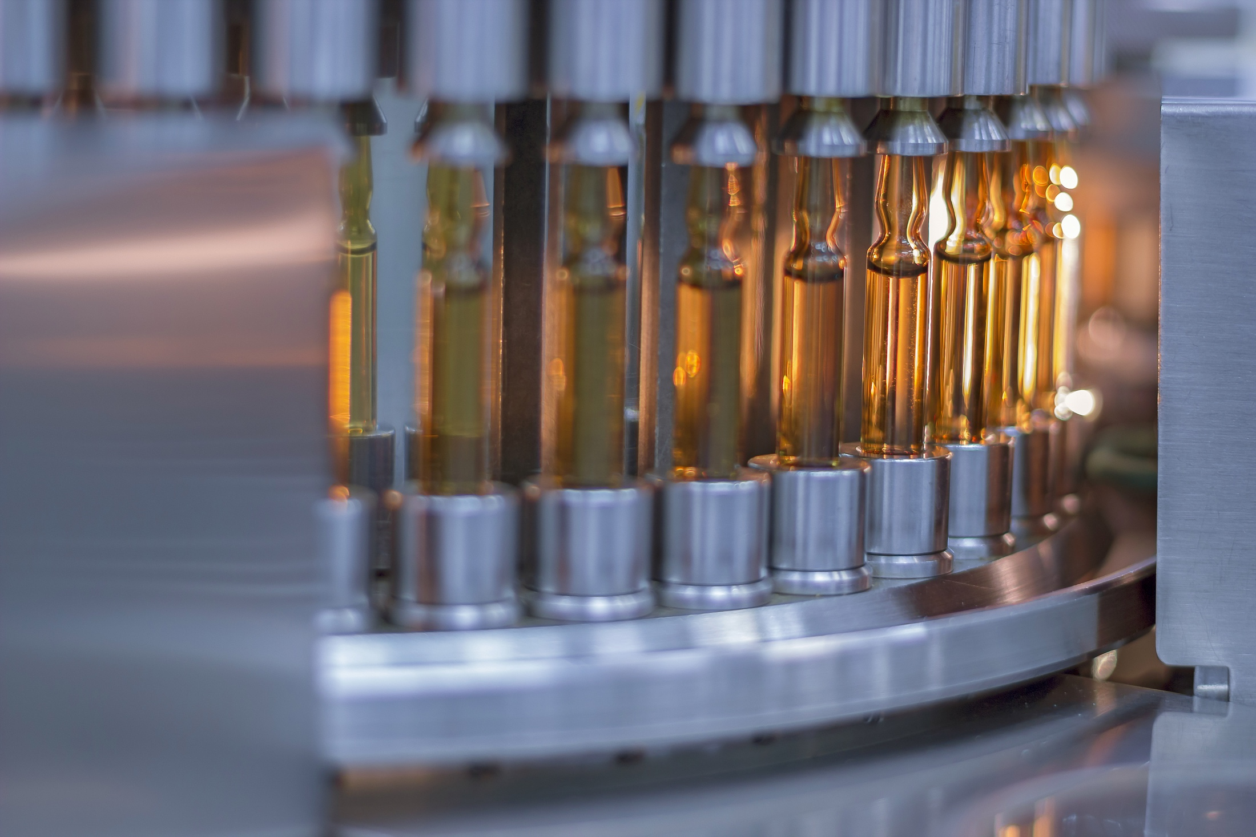
“How can machine learning improve vaccine production?”
CERN - Sanofi
Notes:
Example 1 - Medtech
CERN experts train Sanofi in machine learning - potential application in their vaccine production
Training was in 2017

Slide 6
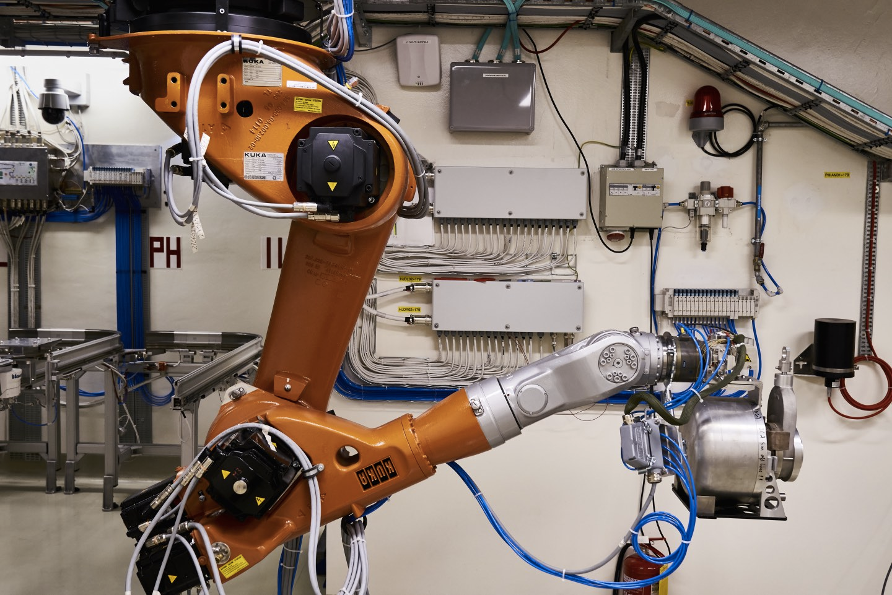
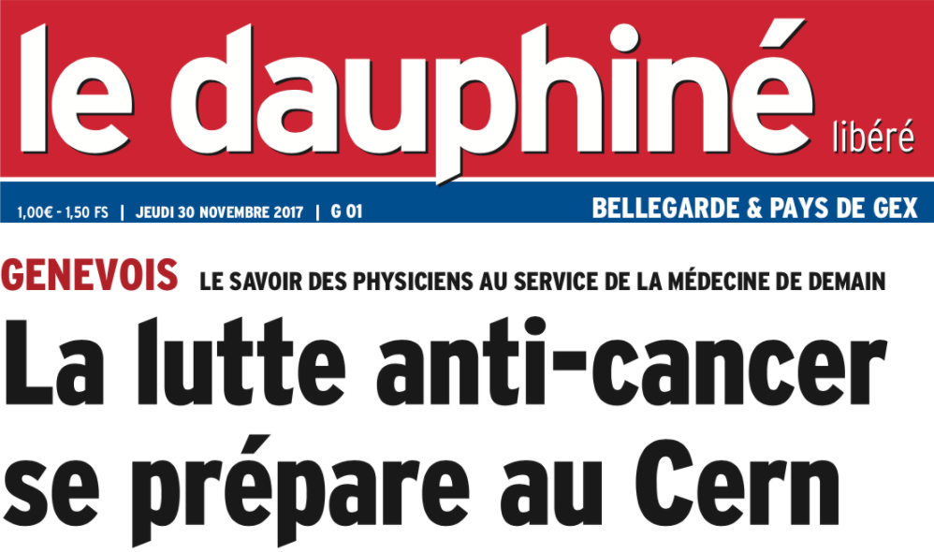
CERN-MEDICIS
First medical isotopes produced

Slide 7
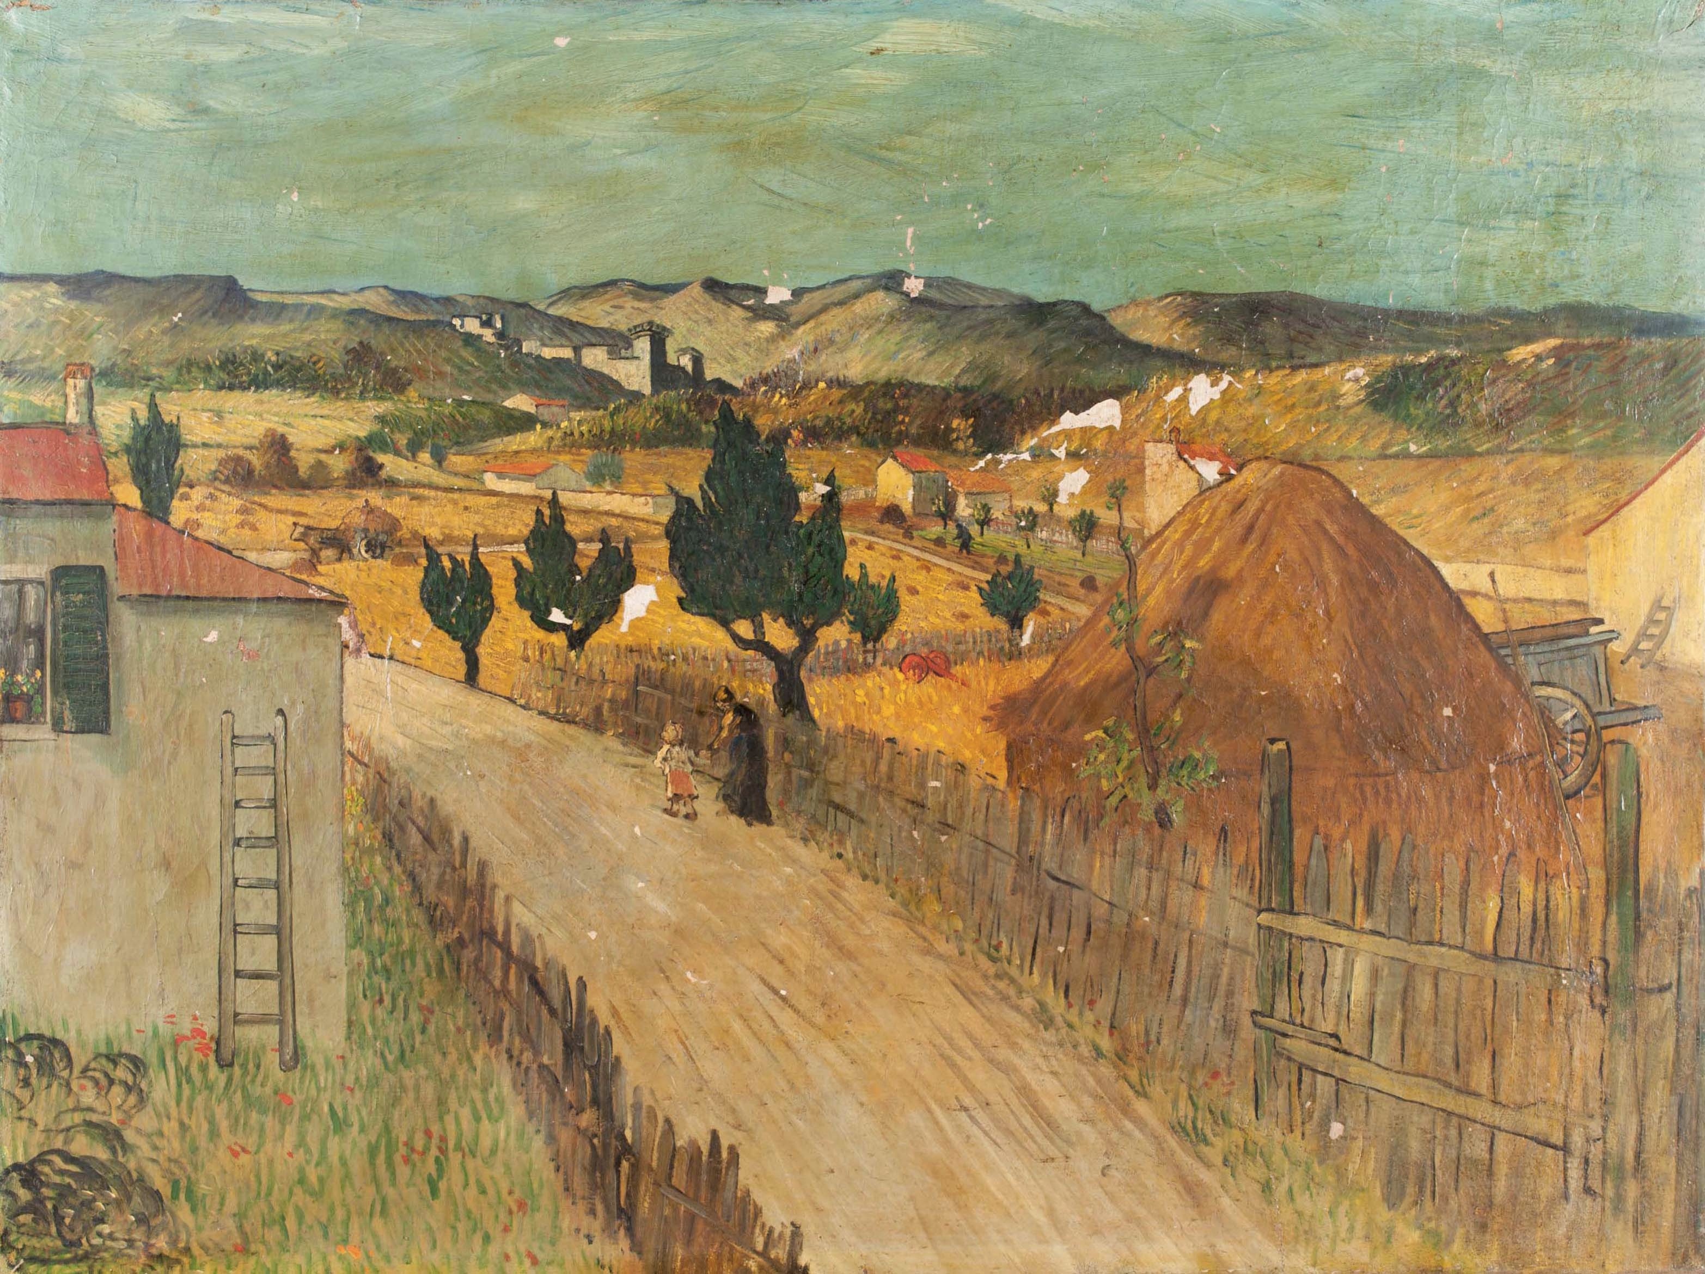
#EuropeForCulture
X-ray eyes for cultural heritage - Medipix chip
Notes:
#EuropeForCulture = because 2018 is the European Year for Cultural Heritage.
Note: Cultural Heritage is defined as: “Cultural heritage takes many forms: from the tangible legacy of monuments, artwork and books, to digital resources, either newly created or used to ensure cultural preservation. The concept also includes intangible (such as language and oral traditions) and natural elements (such as flora and fauna). This heritage may seem remotely connected to CERN's technological advances, yet the opposite is true: in 2018, several projects related to art restoration and digital preservation are using CERN technology.”

Slide 8
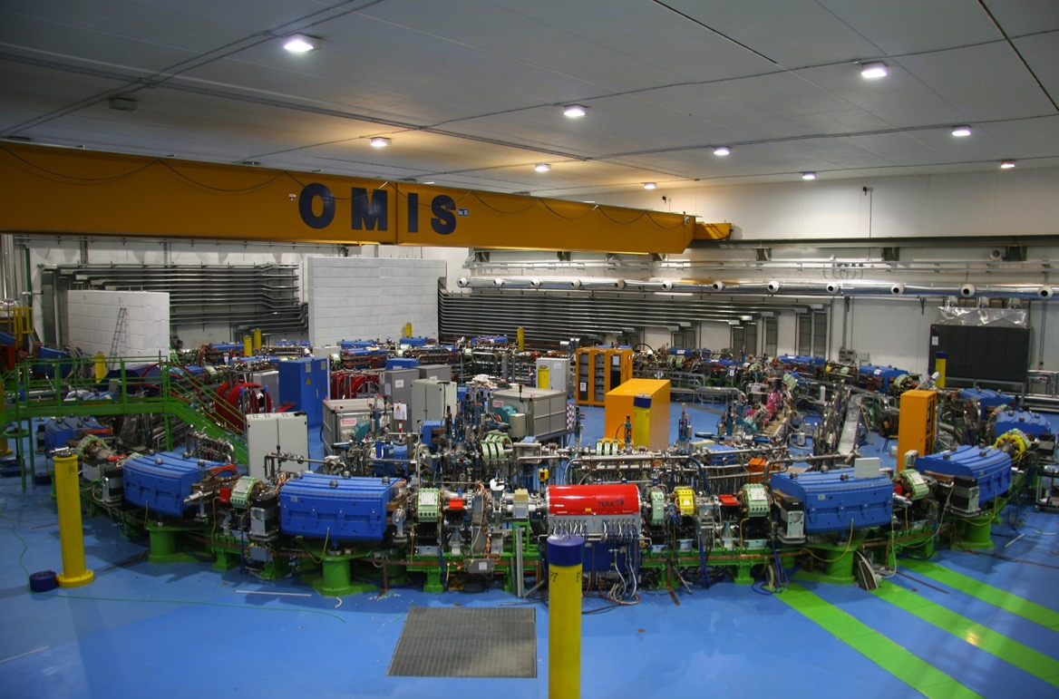
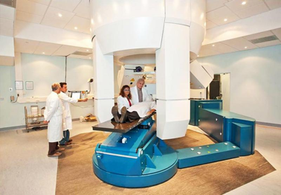

Slide 9
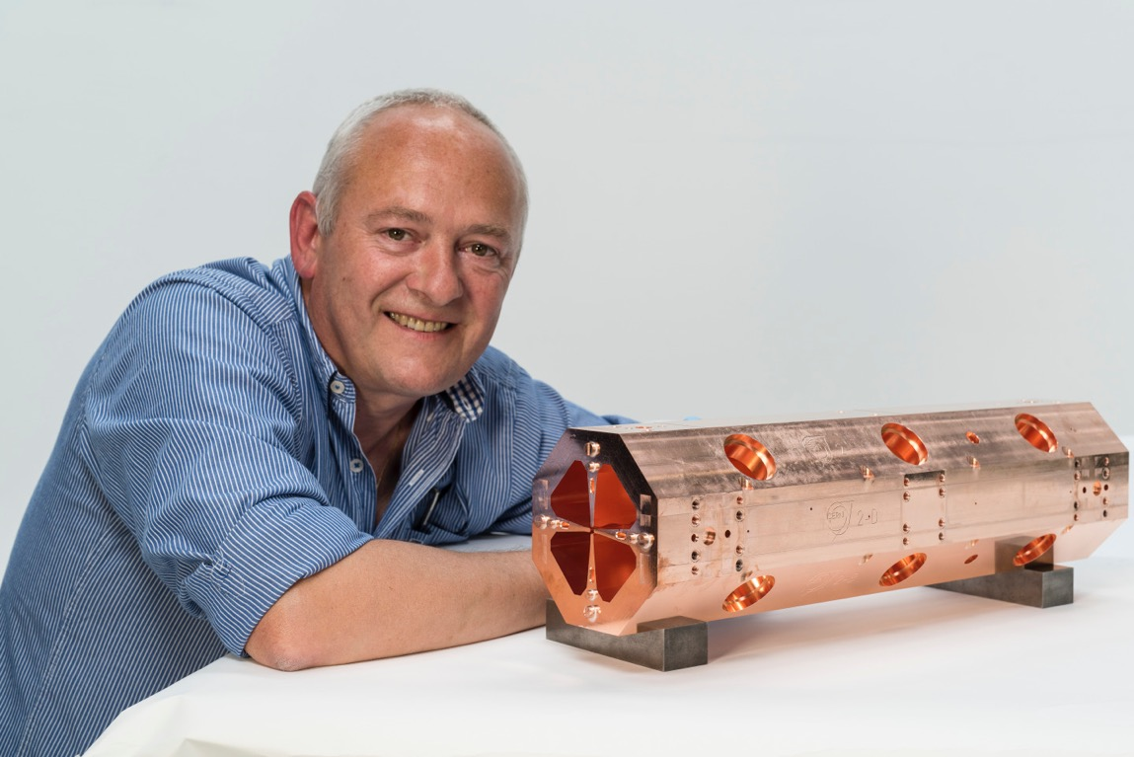

Slide 10
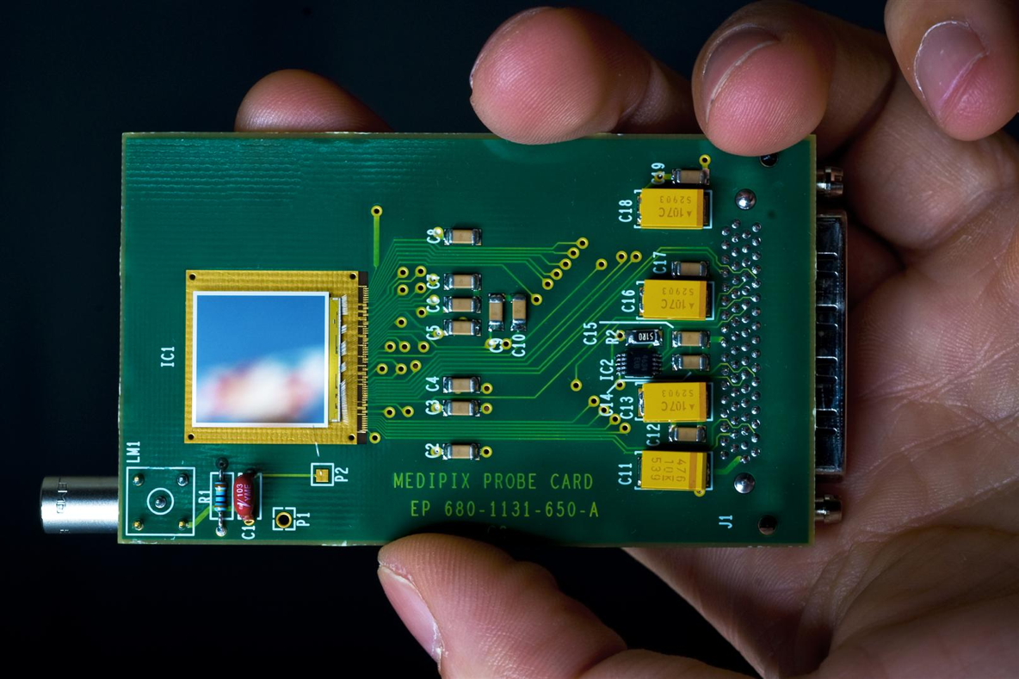

Slide 11
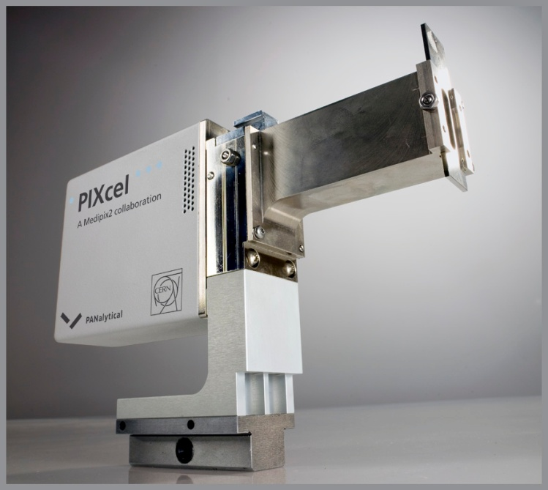

Slide 12
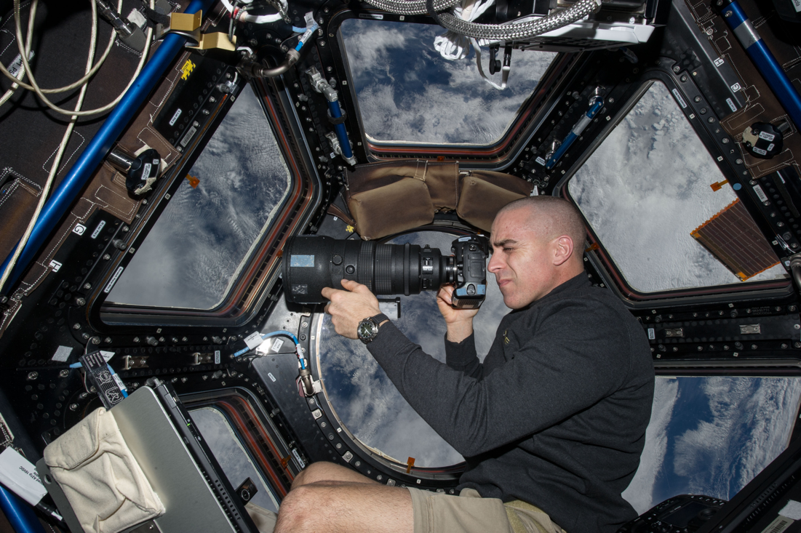

Slide 13
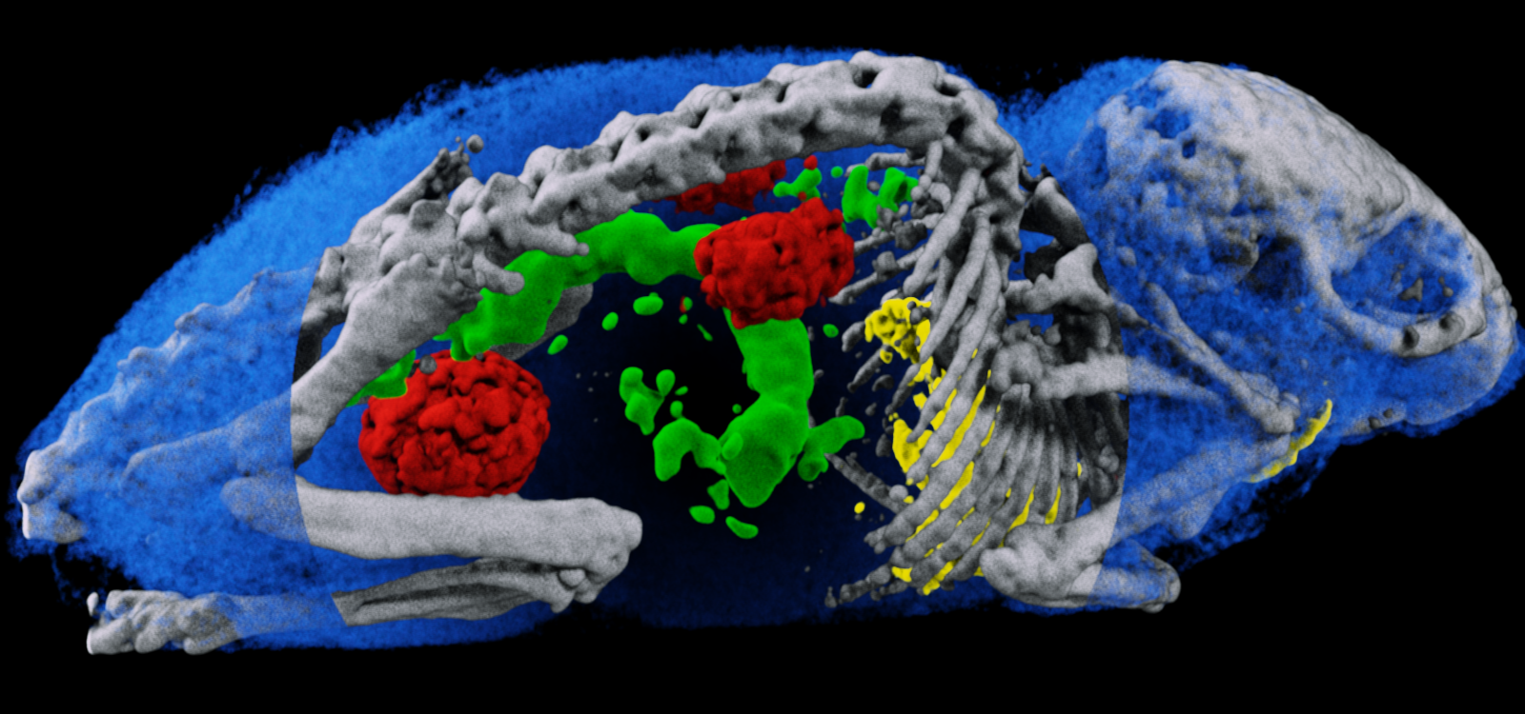
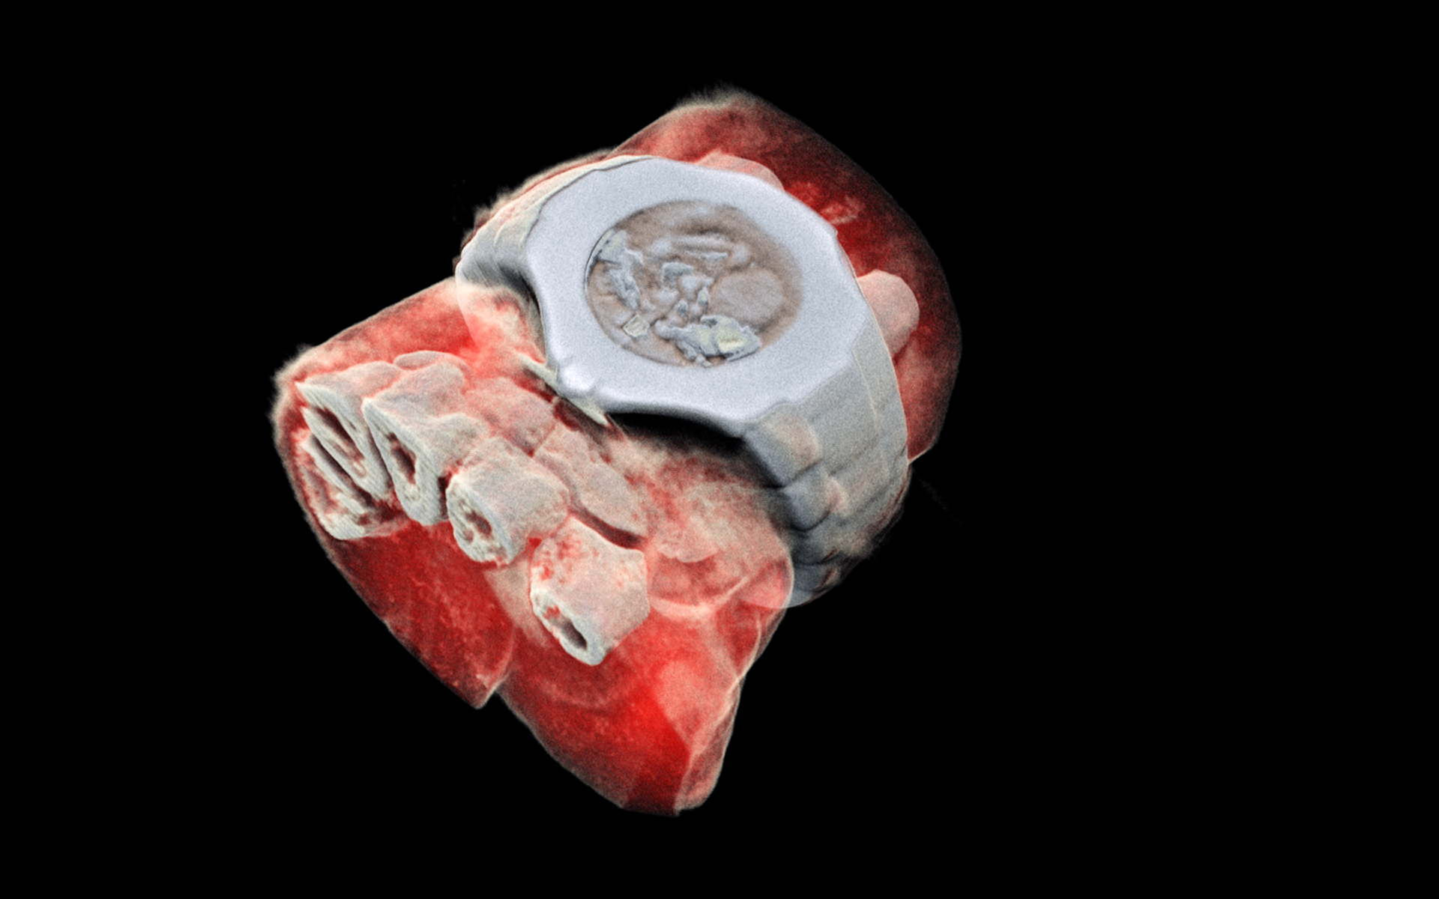
(courtesy of MARS Bioimaging Ltd)

Slide 14
Notes:
This slide needs to be updated

Slide 15
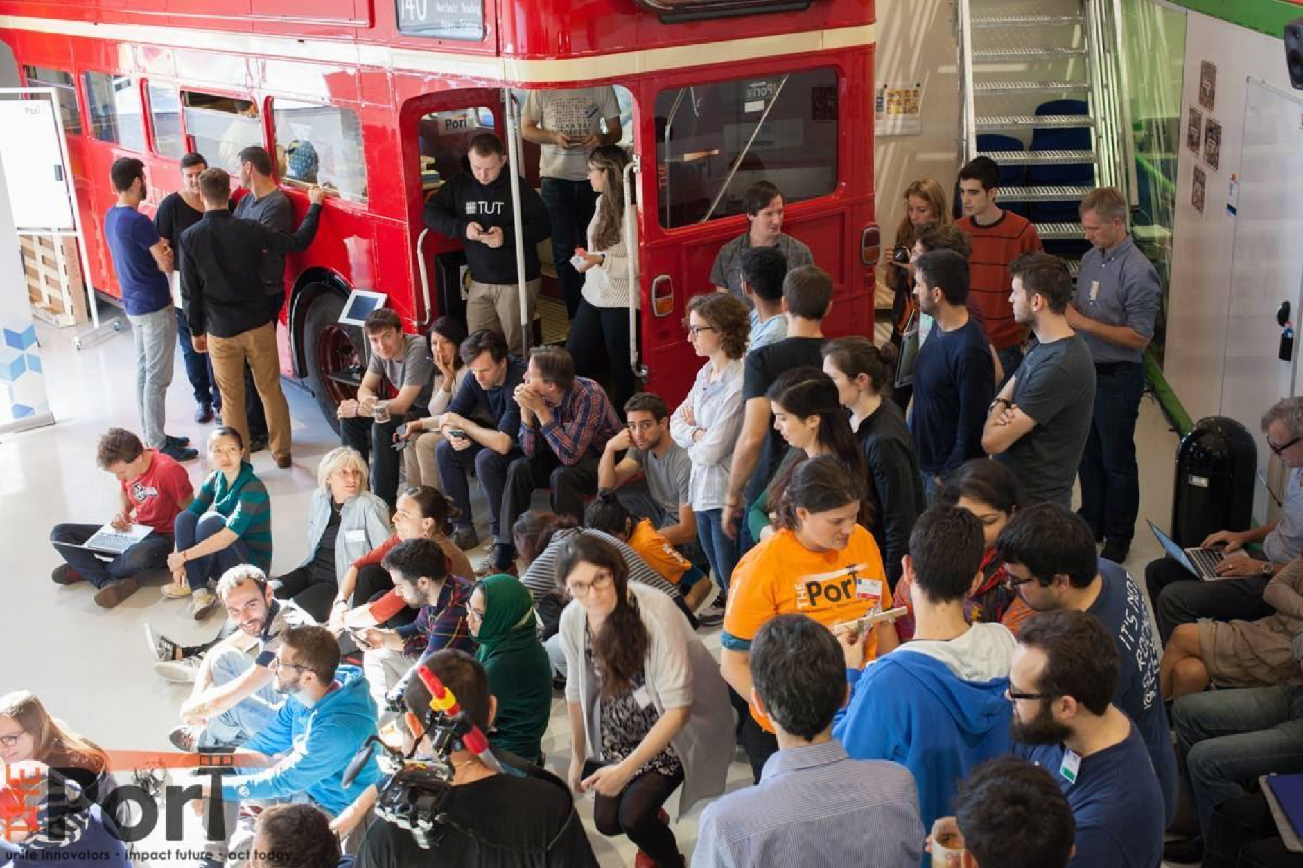
Entrepreneurship @CERN
Social
Entrepreneurship
THE PORT
Entrepreneur Mixer
Global Entrepreneurship
Week
Entrepreneurship
Meet-Ups
CERN-NTNU
Screening Week
Challenge
Based
Innovation
Start-Up
Corner

Slide 16
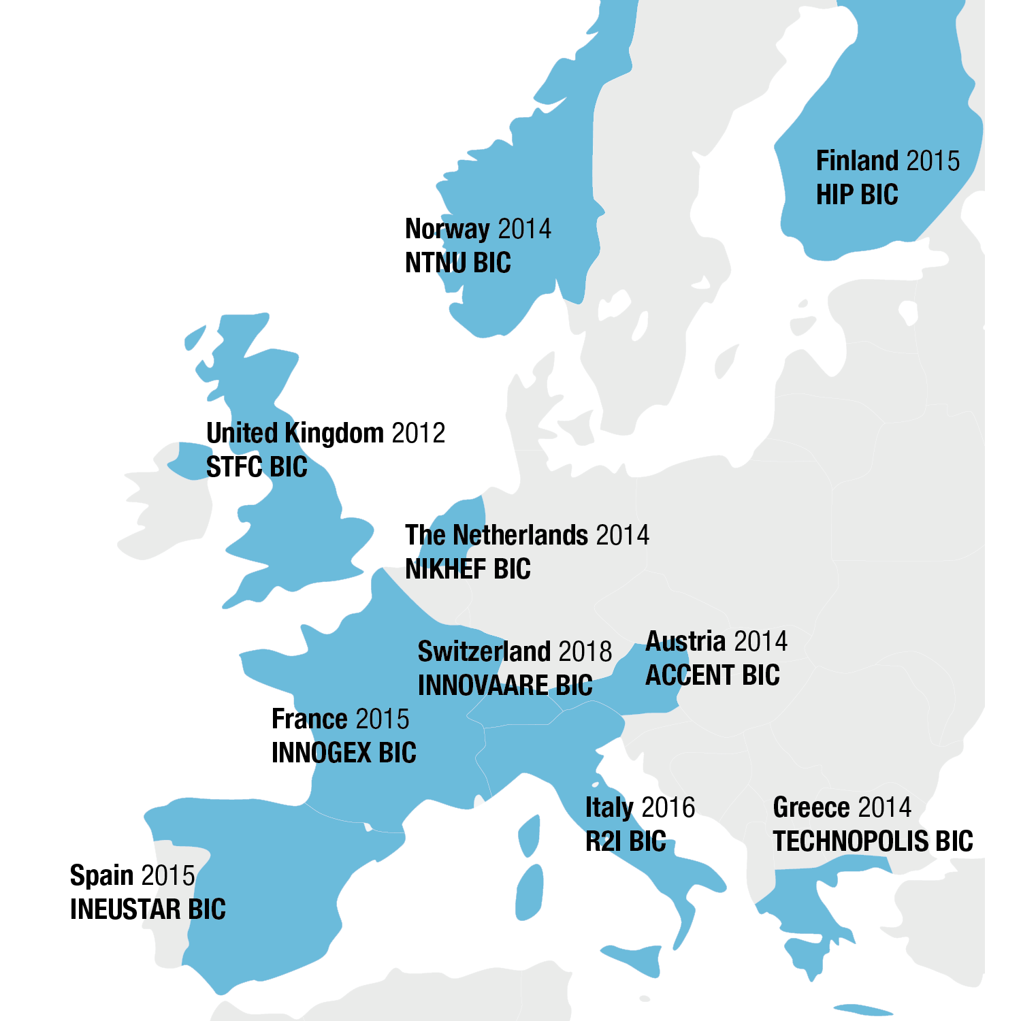
CERN BICs
CERN Network of 10 Member State Business Incubation Centres

Slide 17
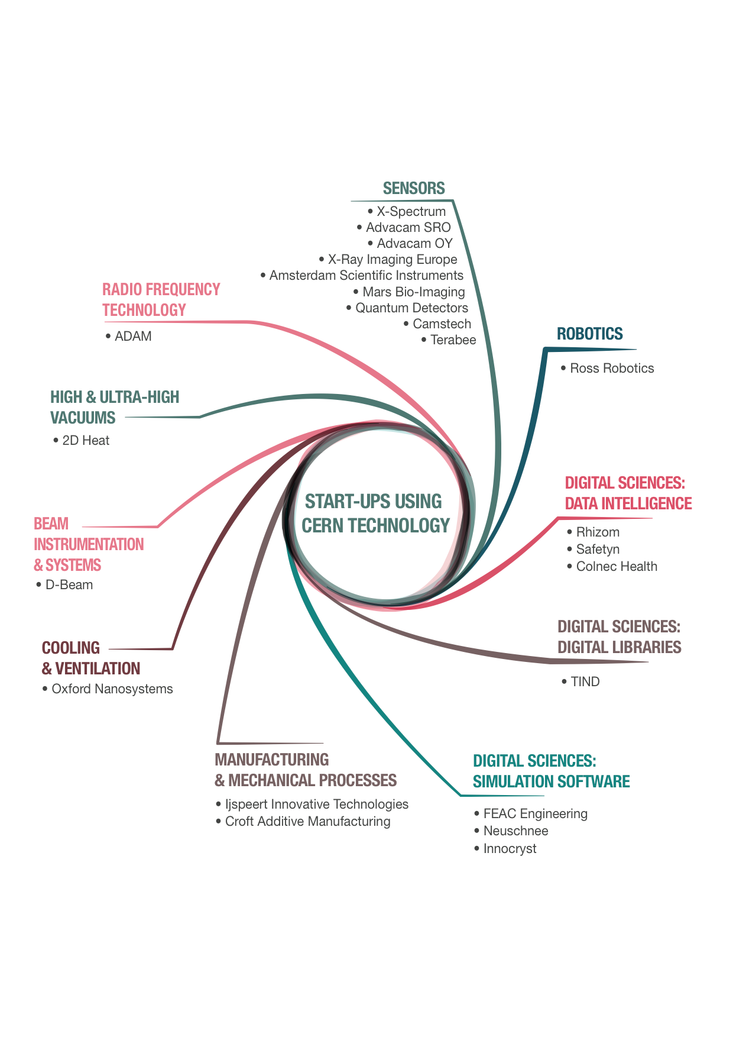
Notes:
Stats = currently 23 start-ups using CERN technology.
Fields from medtech to aersopace, and from industry 4.0 to cultural heritage.

Slide 18
Many thanks for your attention

