Slide 1
LS2 introduced to TE-PPR Group

Slide 2
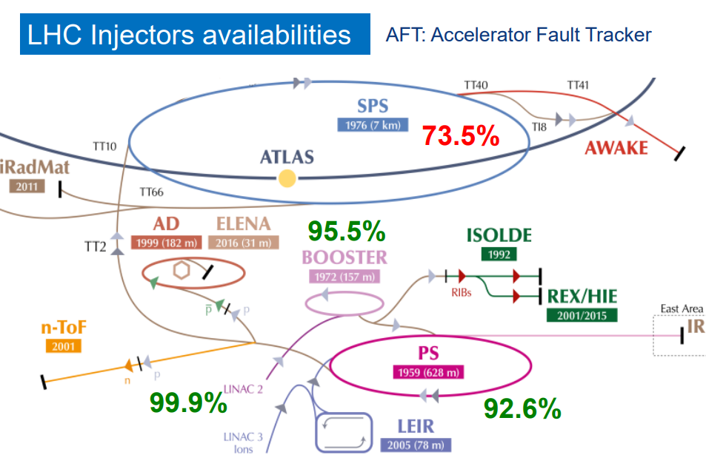

Slide 3
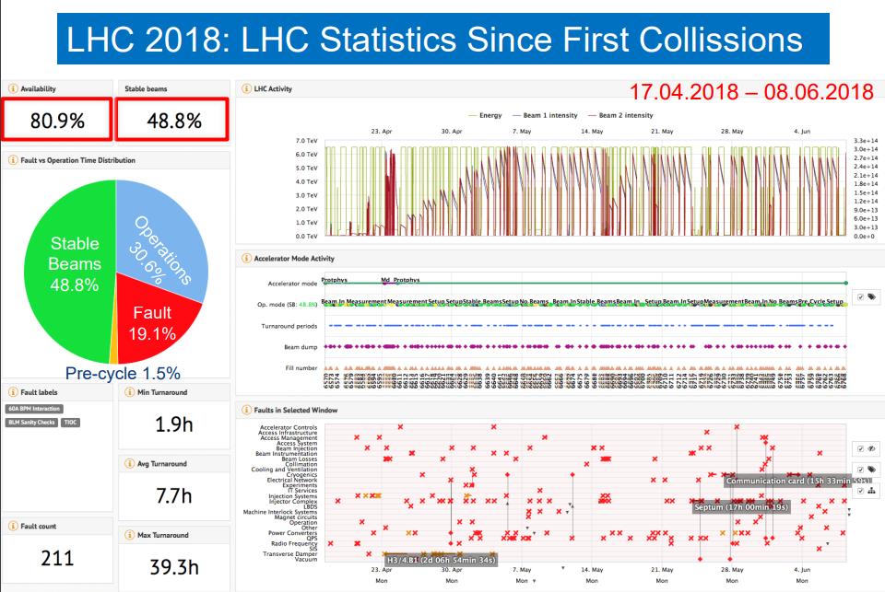

Slide 4
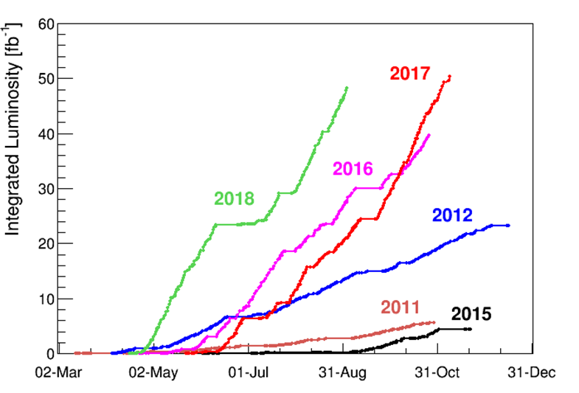
LHC multi-annual integrated performance

Slide 5

The LS2 Team
José Miguel JIMENEZ LS2 Coordinator
Jean-Philippe TOCK LS2 Office Manager
Katy FORAZ LS2 Planning Manager
Thomas OTTO Safety Support Officer for LHC
Ana Paula BERNARDES Safety Support Officer for Injectors
Jonathan MEIGNAN PLAN Quality Officer
Samy CHEMLI LS2 Committee Secretary
Anna LAMBERT Administrative Support Officer
Julie COUPARD Injectors & LIU Coordination
Marzia BERNARDINI LHC & HL-LHC Coordination
Beniamino Di GIROLAMO HL-LHC Link Person
Stefan ROESLER HSE Link Person

Slide 6
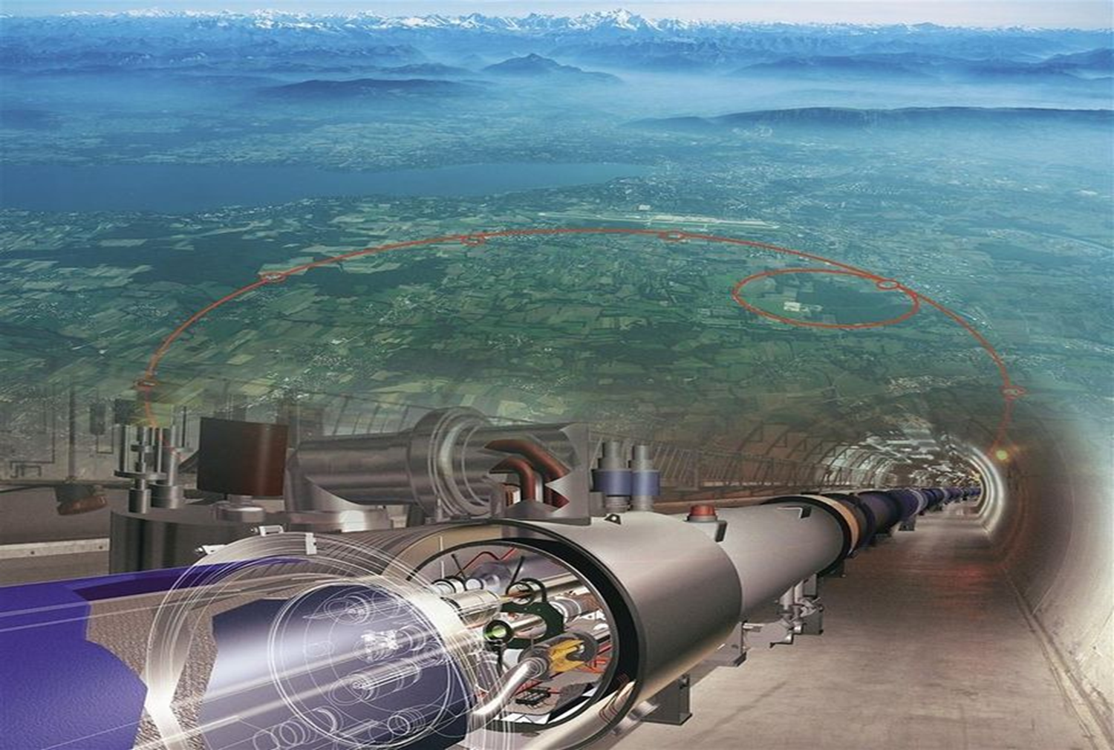
The Long Shutdown 2 (LS2)
Introduction
Perform major Maintenance and Consolidations
Increase intensity/brightness in the injectors to match HL-LHC requirements (LIU Project)
Increase injector reliability and lifetime to cover HL-LHC run (until ~2035) closely related to consolidation programs (in synergy with LIU Project)
Anticipate HL-LHC work
LS2

Slide 7
Long Shutdown 2 (LS2) Project
Project Scope & Mandate of LS2 coordinator (1/2)
Scope covers all activities carried out and resources needed in the context of LS2 over the whole CERN accelerator facilities.
The mandate of the LS2 Project Coordinator includes:
Prior to the start of the LS2, the definition of main works to be achieved over the LS2 and of potential options based on priorities given to activities. This study shall highlight in particular LS2 duration and resources needed for each option and be presented to the Directorate by mid-2017 for final decision;
The definition of a CERN-wide “resource-loaded planning”, ensuring the compatibility of resources and planning across the LHC Machine and LHC Experiments;

Slide 8
Long Shutdown 2 (LS2) Project
Project Scope & Mandate of LS2 coordinator (2/2)
The mandate of the LS2 Project Coordinator includes: (cont.)
The preparation, coordination and follow-up till completion of all LS2 activities in the frame of the Maintenance and Consolidations, LIU, HL-LHC Projects and other CERN approved projects. Work packages will define:
  The work absolutely essential to achieve the LS2 objectives, which execution will be closely followed up by the LS2 Coordinator;
  The work which can be postponed to the LS3, which impact on LS3 will be assessed by the LS2 Coordinator.
The flexibility to use the end-of-year technical stops before and after the LS2 to decrease the load of the LS2 is left at the discretion of the LS2 Coordinator and is also part of the scope of the project.

Slide 9
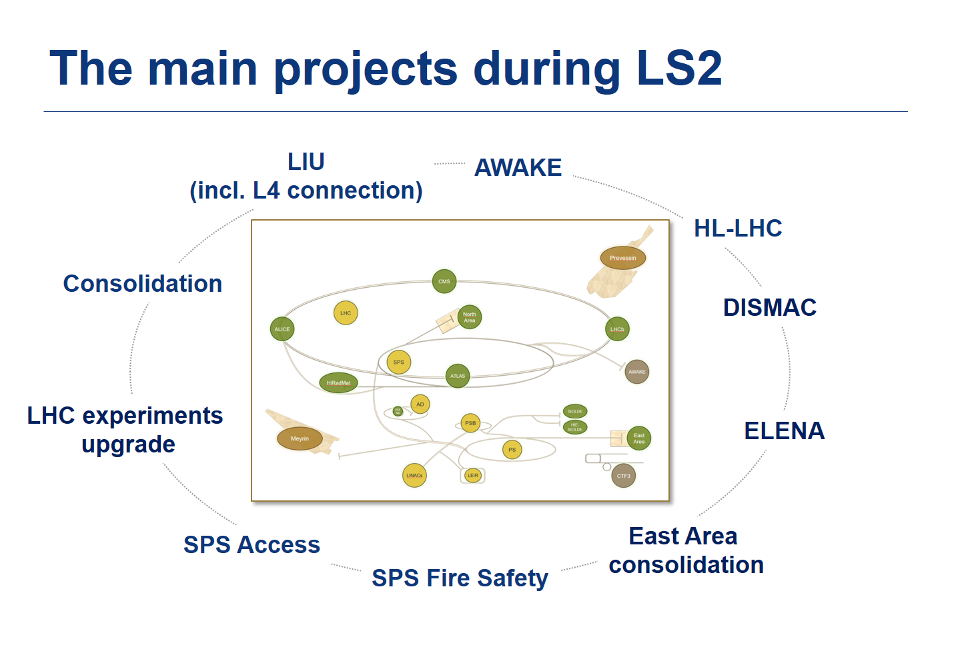

Slide 10
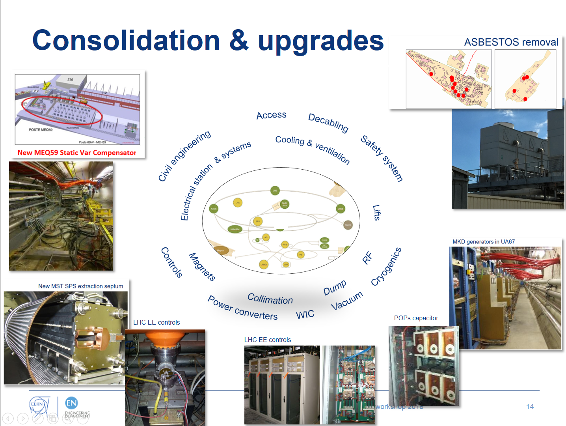

Slide 11
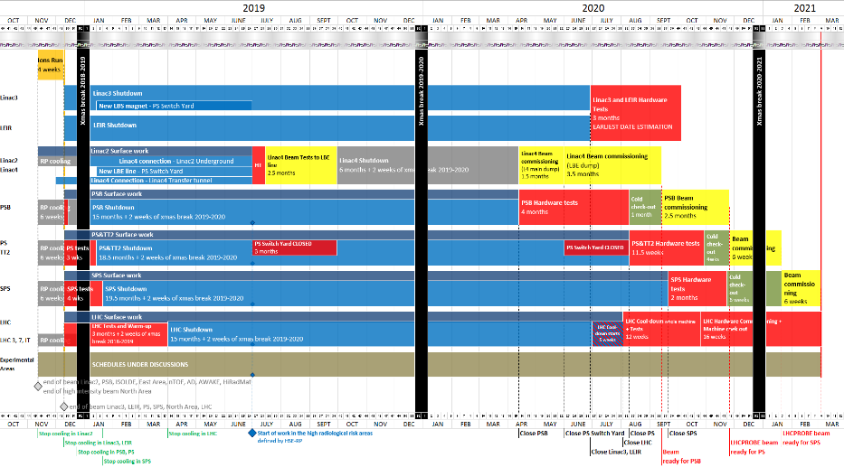
Injectors & LHC
6 months ahead !

Slide 12
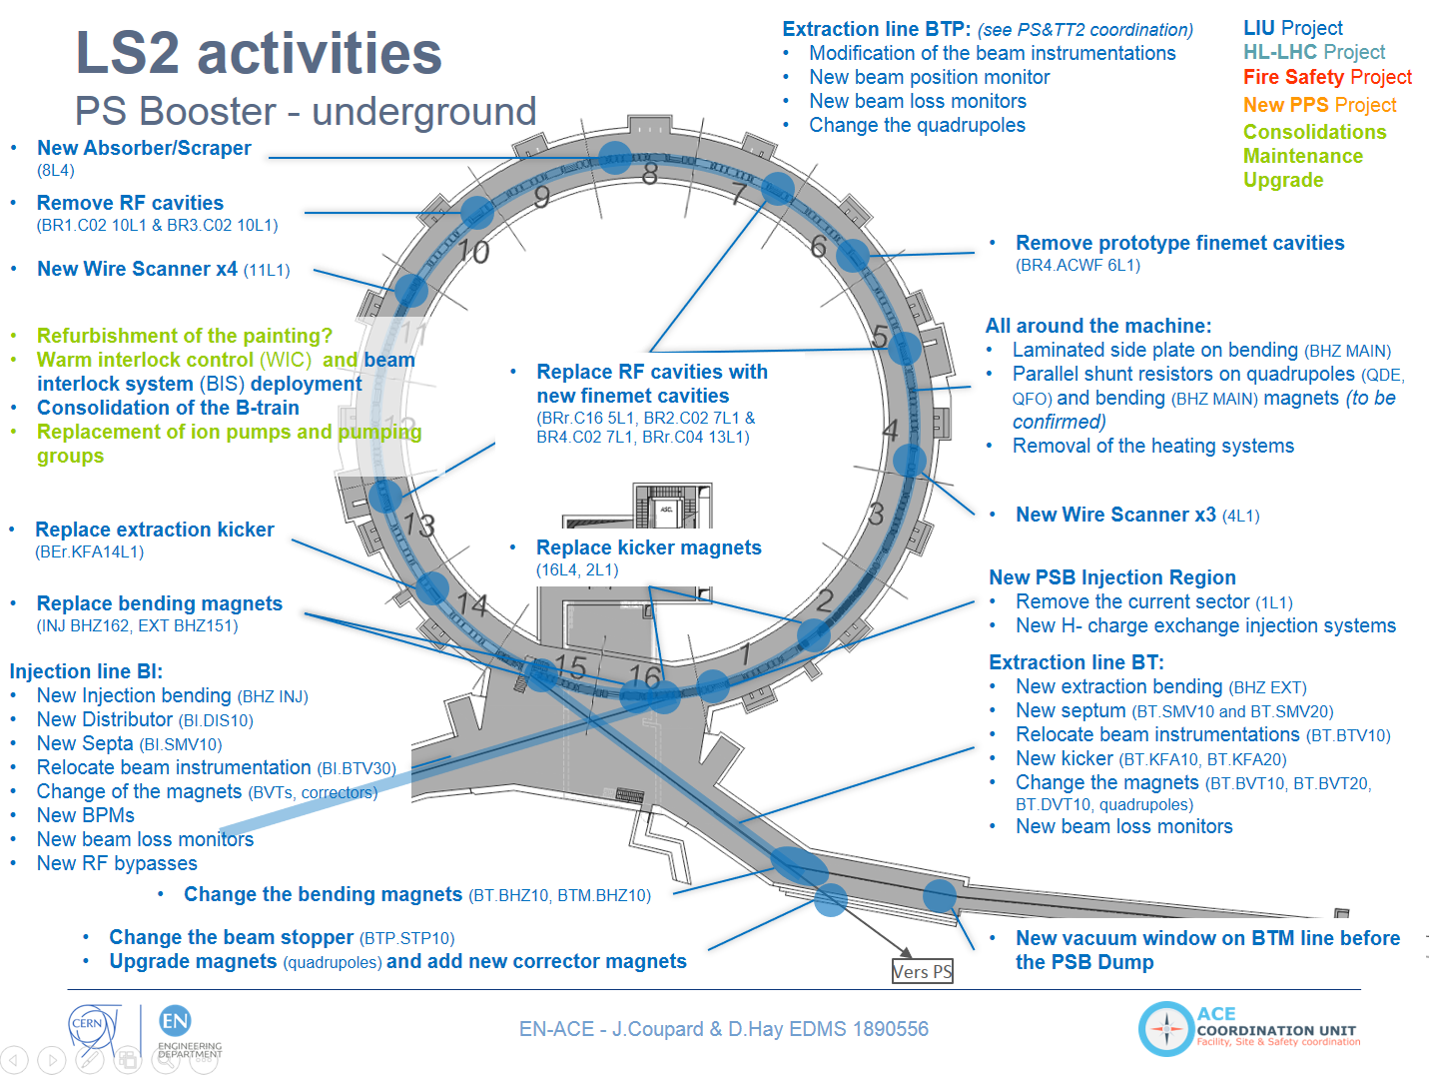

Slide 13
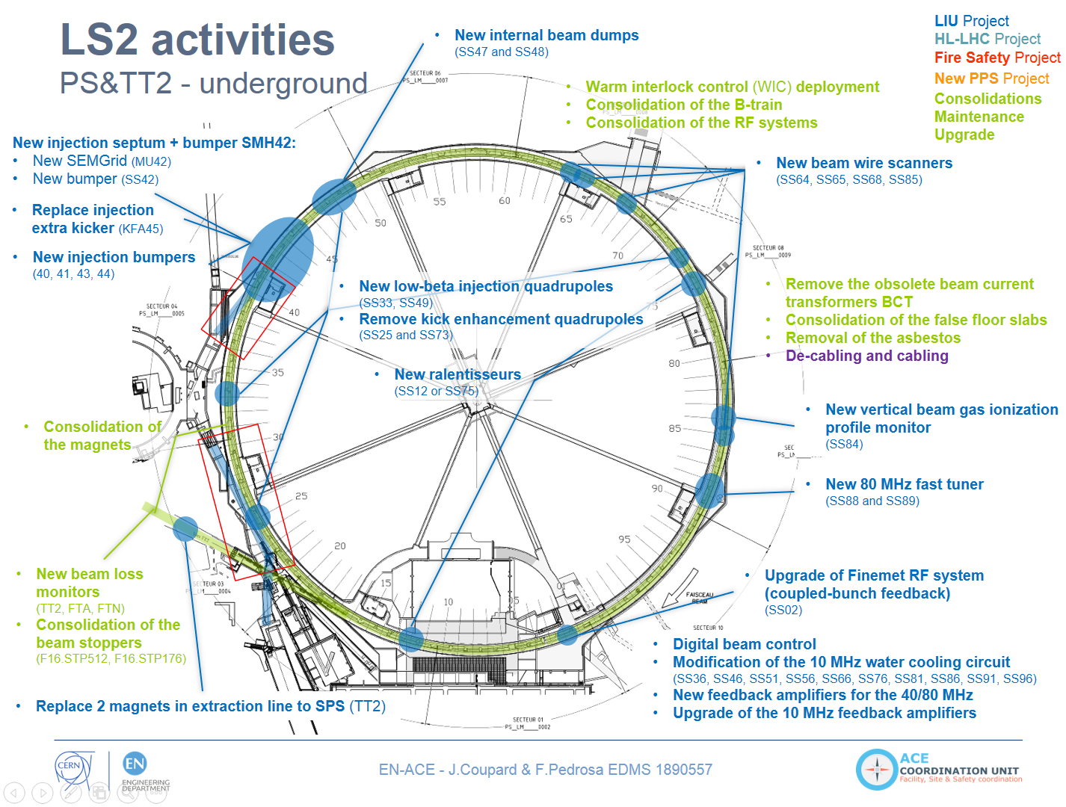

Slide 14
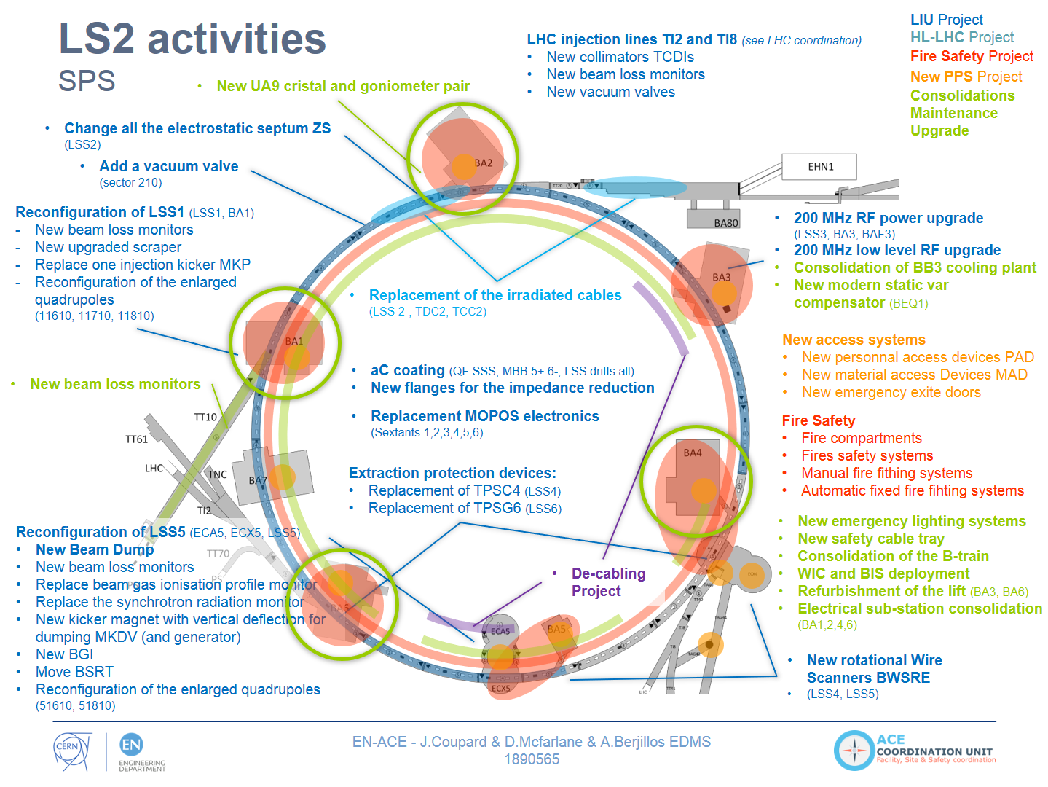

Slide 15
LS2 arbitrations in Injectors
Arbitrations decisions based on EL resources (I) Re-phased
SPS Fire Safety: delaying the installation of secondary and tertiary doors and of the dry risers in the arcs. Compensatory measures have been approved.
Irradiated cables: delaying the preventive replacement of irradiated cables SPS Point 2 and North Area. Compensatory measures have been approved for beam extraction in Point 2.
Declabing in Injectors: delay remaining decabling in Booster and PS.
Telecom radiating cable: delaying Priority 2 such as AD target, SPS Points 3&5, Awake and Priority 3 is SPS Points 4&6&7, TT60-61-70, TCC6. Compensatory measures will be taken after inspections for critical areas.
North Area: delaying all cabling except M&O activities.
SPS Electrical Network: delaying the consolidation of all the low-voltage network.

Slide 16
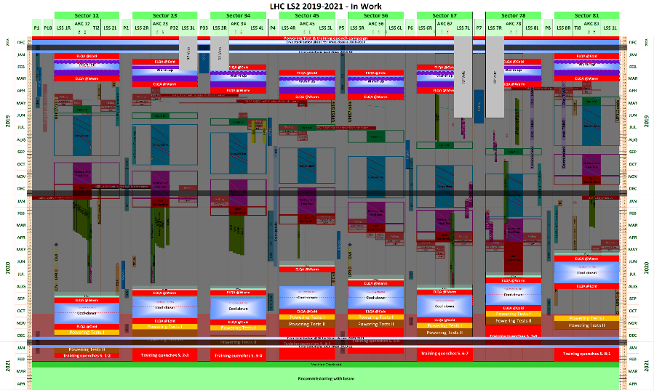
LHC & HL-LHC

Slide 17
LS2 arbitrations
Arbitrations decisions based on EL resources (II) Re-phased
LHC
  Telecom radiating cable: delaying the Priority 3 in LHC Points 3&7.
  Replacement of obsolete turbo pumps on Insulation Vacuum: delaying the replacement of the cabling on 7 Sectors.
  Compensatory measures have been found by recovering as spares the pumps from one Sector and as well with a successful extension of the maintenance contract by the pump supplier.
Surface buildings related to accelerators
  SM18 SC magnet test bench:
    Delaying the integration and cabling of the evolution of Clusters A, D, F.
    Compensatory measures will be studied for the preparation of the String 3 for
    HL-LHC.
    Delaying the electrical & cabling needed for the superconducting RF extension. Impact is being evaluated prior to formulate compensatory measures.
  SC Cable test bench (Blg 163 upgrade): delaying the integration and cabling of the upgrade of the infrastructure which includes the installation and commissioning of the FRESCA 2 test bench.
Impact on HL-LHC being evaluated

Slide 18
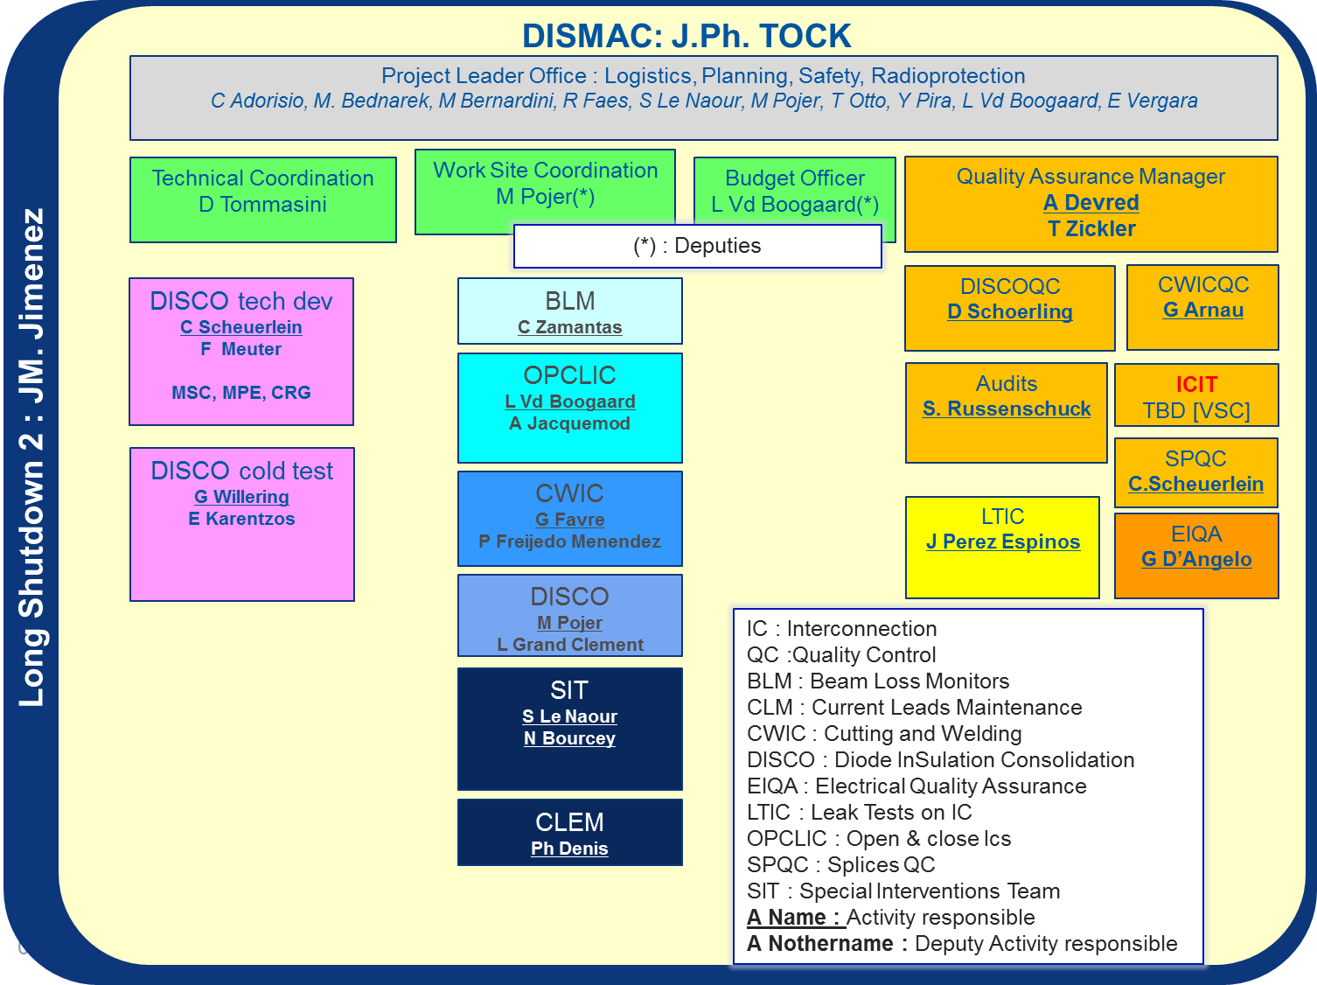
Impact on HL-LHC
Two activities added:
  Inner Triplet alignment: two-phase approach
    Restabilising the supporting configuration in IP1 & IP5 during LS2
    Study of a new supporting configuration, execution probably done post LS2
  DISMAC (Diode Insulation and Superconducting Magnets)
    Shortage of 11 FTE.y on HL-LHC activities
    2018(2.1), 2019 (5.5), 2020 (3.5)
    1.7 of Engineers / Physicists
    9.3 of Technician / Technical-Engineers
    Measures are being finalised by
    Management without financial impact on
    HL-LHC to limit the resource/competence
    impacts.

Slide 19
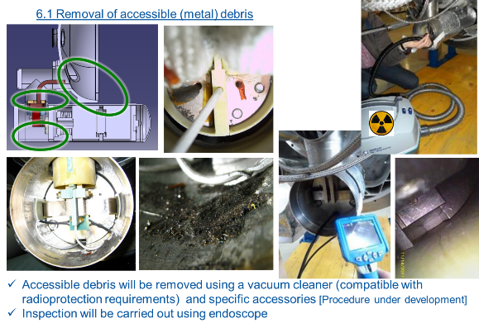
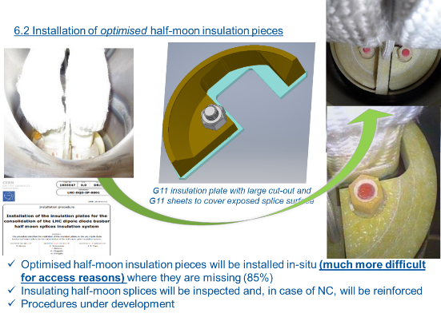
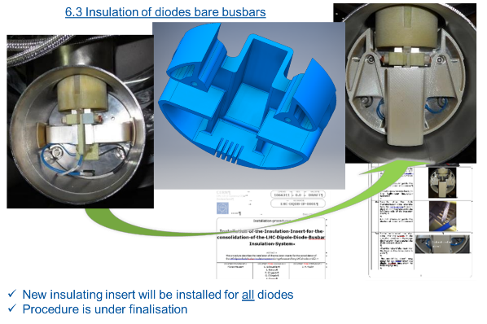
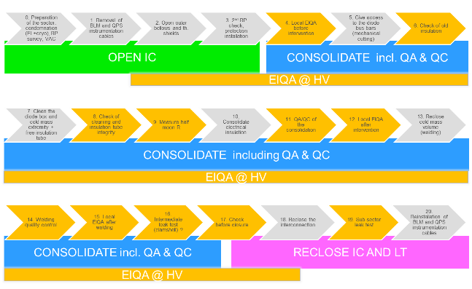
Challenges & Mitigations
Impact of DISMAC (TE-MSC) on HL-LHC

Slide 20

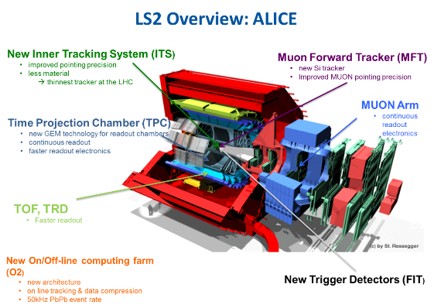
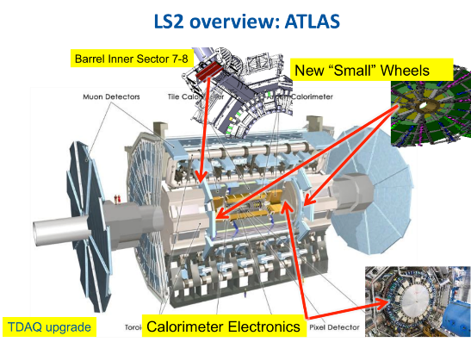
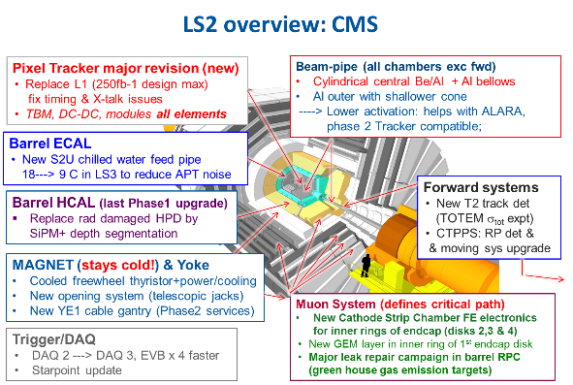
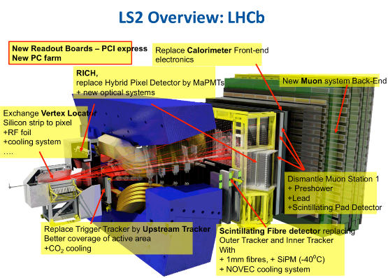
The LHC Experiments
Most of these activities need support from the A&T Sector

Slide 21
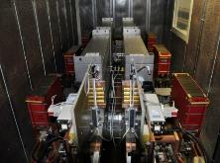
LHC-LS2: TE - Maintenance
TE-ABT: Kickers & LBDS general maintenance
TE-CRG: major revisions of all compressors (12 months needed)
TE-VSC
  Maintenance on all the vacuum pumps, valves and instrumentation
  Beam gas injection system in LSS4
  Remote reconditioning of NEG cartridge across the ring
  Exchange of ion pumps at MKBs
  Corrective maintenance on defective PIMs
  Leak tests after warm-up and before cool-down (after pressure tests): not maintenance but operational activity
TE-EPC: corrective and preventive maintenance on all power converters
TE-MPE: Maintenance of all systems – EE systems 13kA & 600A, QPS, MPE software,
current lead heating system
TE-MSC (including in DISMAC)
  Maintenance of all current leads and thermal switches of 600A, 6kA and 13kA
  Revision of heating systems of current leads
  Replacement of all fans 60-120A & cleaning of warm connectors 60-120A

Slide 22
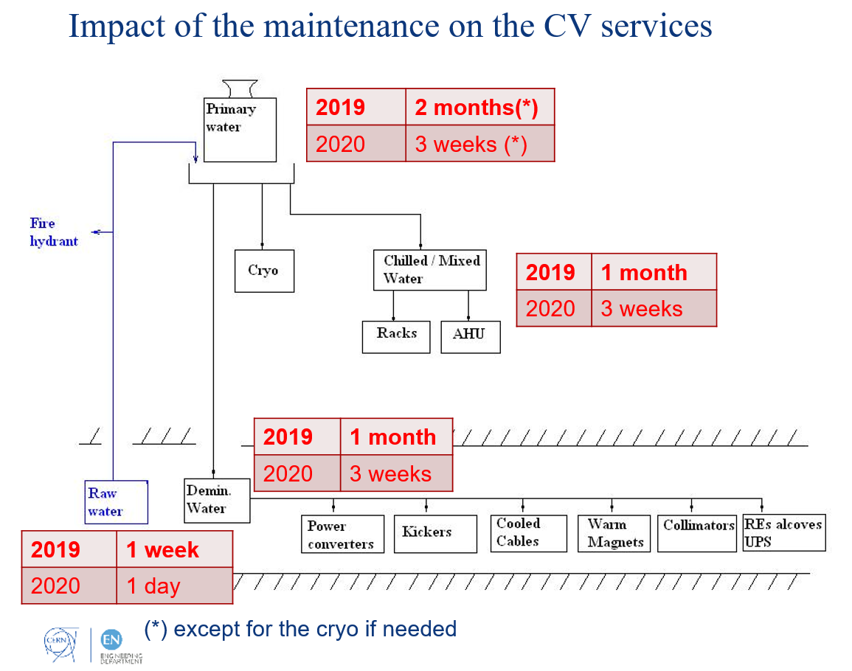
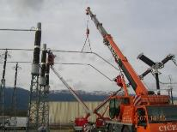
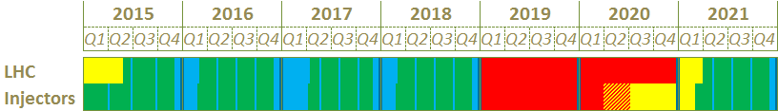
LHC-LS2: EN - Maintenance
2 major maintenance periods: during the LS2 and before the restart (as YETS)
EN-CV
  Mechanical and/or chemical cleaning of heat exchangers
  Safety requirements (vessels,..)
  Mechanical revision of valves, replacement of piping component
  (flexible sleeves)
  Maintenance of all rotating machine: engines of pumps, ventilators…
  Instrumentation calibrations
  Bug fixing and functional tests
EN-EL
  Power transformers 400 kV and 66 kV maintenance works
  Maintenance of the 400 kV and 66 kV circuit breakers
  Tests on RTE interface protections and various signals (AUG, auto-transfer, …)
  Request to HSE to perform maintenance and safety tests on 2 periods (vs 3) for EN-EL and BE-ICS
  Mid 2019 & end 2020

Slide 23
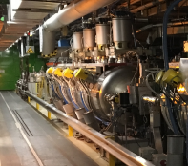
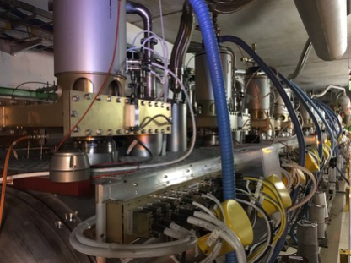
LHC-LS2: BE - Maintenance
BE-ICS
  Annual safety tests (fire detection, ODH, …)
  Maintenance of systems generating alarms level 3: gas, ODH, fire detection, red phones, sniffers
  Access control preventive maintenance
BE-BI
General Maintenance of all systems, in particular BSRT
Installation of consolidated interlock BPM electronics in P6
Installation of consolidated wire scanner control & acquisition electronics in P4
BGI reinstallation → under discussion
Installation of full vertical slice of new BLM acquisition electronics for validation in parallel to existing system
BE-RF
  ACS system
    Replacement of obsolete components (processors, PS, cards, etc.)
    Restructure of communication
    Radiation monitoring system update
    Klystron area reorganization
    Tuner system maintenance
    Maintenance of all FPC systems
  ADT system
    Maintenance of all amplifiers and kickers

Slide 24
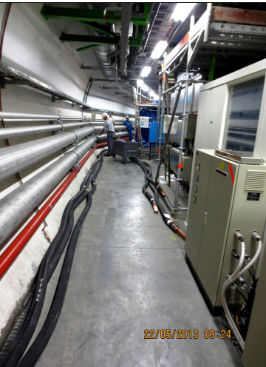
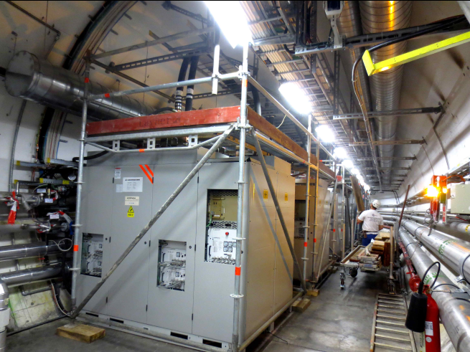
LHC-LS2: Infrastructures consolidation
Location | Replacement timeslot
PM15 | Dec. 2018 – Feb. 2019, 1st of LS2
PM25 | Feb. 2019 – Apr. 2019, 2nd of LS2
PM76 | Apr. 2019 – Jun. 2019, 3rd of LS2
PZ33 | Jun. 2019 – Aug. 2019, 4th of LS2
PZ45 | Aug. 2019 – Oct. 2019, 5th of LS2
PM56 | Oct. 2019 – Dec. 2019, 6th of LS2
PM65 | Aug. 2020 – Oct. 2020
PX15 (ATLAS) | Dec. 2020 – Jan. 2021, Last of LS2
EN-HE
  Lifts replacement→ 10 wks interruption per lift
  Experiments lifts will be used
  Monorail duct and guiding line consolidation for the MAFI handling machine
EN-CV
  Cooling: consolidation of chilled water production at SU4 and SU6
  Ventilation: installation of a new HVAC system for SR1
  (including power supply)
EN-EL
  Replacement of the water cooled cable hoses in P1, P2 and P5
  Consolidation of the fibre infrastructure in LHC
  48 V LHC, consolidation, refurbishment or replacement of the DC
  distribution systems ( rectifier, batteries, inverter, crates)
BE-ICS
  Modification of LHC PPS (Personnel Protection System) - LASS functionalities (unavailability of the access point during 2wks)
  Enlargement of MAD of PZ33, PZ45, PZ56, PZ76
  to be compliant with the new lifts dimensions
SMB
  Major support for MADs enlargement
  Cleaning and consolidation of LHC central drain in S. 3-4
  Renovation of underground sanitary systems

Slide 25
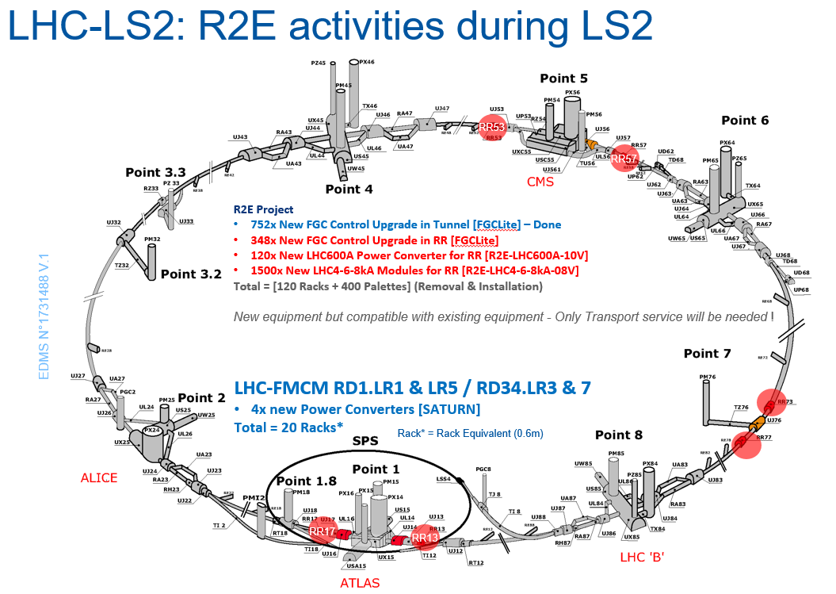
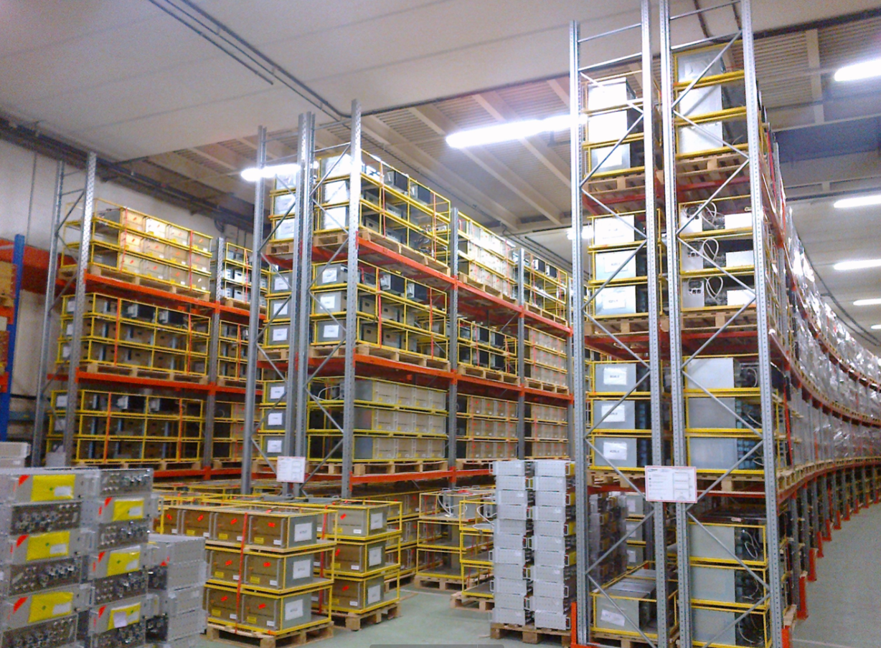
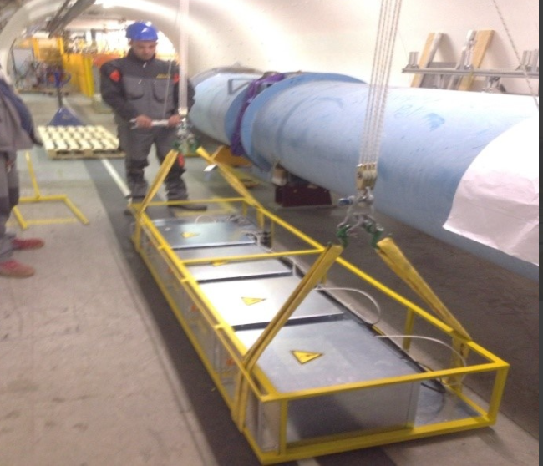
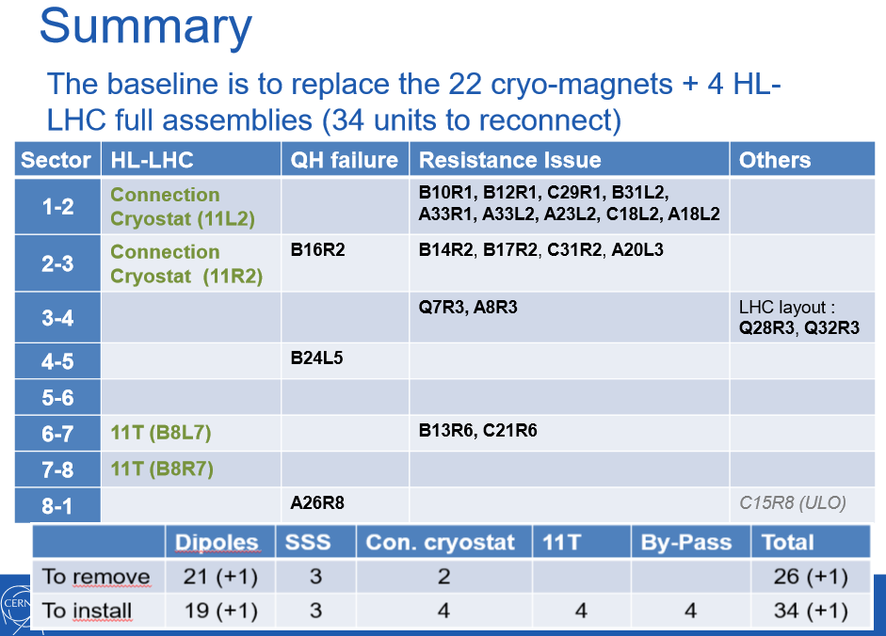
LHC-LS2: systems consolidation
TE-CRG: Consolidation of LHC cryogenics electrical and control system
TE-EPC (R2E): Radiation to Electronics
  Supply new LHC4-6-8 kA Power Modules for radiation areas
  Supply new LHC600 A-10 V power converters for radiation areas
  Supply new FGClite Control for LHC converters in RR areas
TE-MPE
  MPE - Upgrade of the DYPQ racks "Quadrupole Yellow Racks"
  All the DYPQ racks will be removed at the beginning of the LS2 and reinstalled in the tunnel at the end
  Upgrade of Quench protection components
  (DQLIM & DQLPR & DQLPU) hosted in the DYPQ racks
  EE - Consolidation of 13 kA & 600 A EE systems
  QPS - Upgrade for IPQ, IPD & IT protection, 600A
  QPS - Monitoring and protection of conical joints for 13kA warm leads
  MPE Software : AccTesting upgrades, to include the equipment changes
TE-MSC
  Exchange of 22 cryo-magnets, due to quench heater circuit failure,
  high internal splice resistance and layout recovery

Slide 26
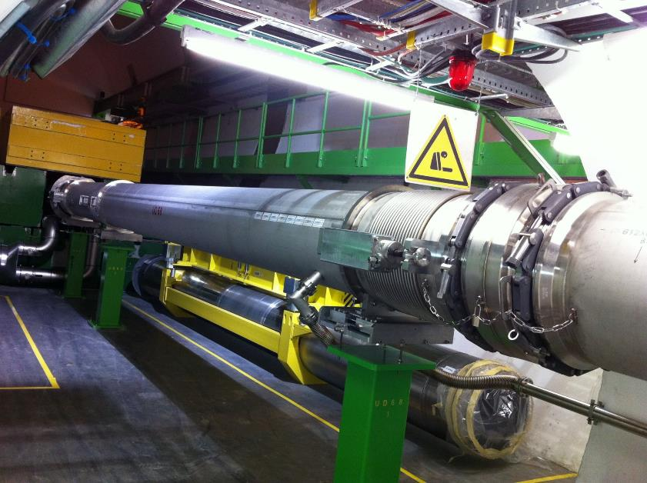
LHC-LS2: systems consolidation
TE-VSC
  Consolidation of all turbo pumps of the arcs and 30% of the LSS (LHC-Insulation vacuum)
  96 insulation vacuum turbo pumps in the LHC Arcs
  → Long cable pulling needed
  New sectorization of LSS1 and LSS5 around the D1 to be able to vent the D1 without venting the TAN
  Consolidation of warm modules and RF bridges
  Consolidation sector valves compressed air system
  MKB Vacuum Pumping Scheme Consolidation BTD62.DR
  Vacuum Pilot Sector (VPS) for the LHC LS2
  Installation of new turbo pumping groups on triplet cryostats of points 1, 2 & 8 (LHC-IV)
BE-BI
  Consolidation of BLM and CryoBLM, BSRT, wire scanners, BPM, …
EN-STI
  Installation of 4 new TCPPM in P7
  The action plan to consolidate the LHC main dumps will depend
  on the conclusion of the present YETS activities
  The control systems will be upgraded, maintained and consolidated

Slide 27
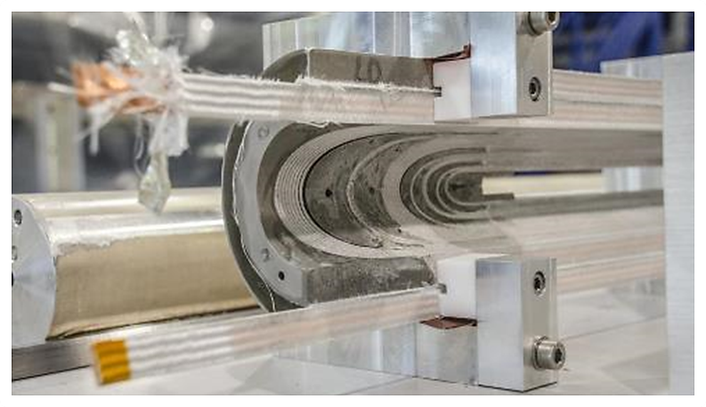
Thank you !

Slide 28
Risk Management
Engineering Change Requests to be issued by April 2018
Integration studies shall be completed by Summer 2018
Equipment readiness to be communicated for fine tuning of schedules by end of March 2018
Work package analysis to assess equipment and installation risks and feasibility by Q3-2018
ALARA committees to be scheduled already for Q2-2018
IMPACT tool to coordinate daily activities
Safety joint visits (VICs) and compensatory measures to be anticipated

Slide 29
“Running” the LS2…
Coordination and Logistics
  Individual system tests & overall Safety Coordination are being watched
  Space Management for Storage, “Base de Chantier” and Logistics: at prioritisation phase. March 2018
Milestones
  Arbitrations done, follow-up after QA checks with EN-EL
  LS2 consolidated Planning Baseline presented today
  (8 months ahead, final version in November)
    Priority given to ECR validation, Integration, Risk Mitigation and coactivity Risk Management

Slide 31
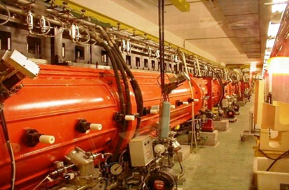
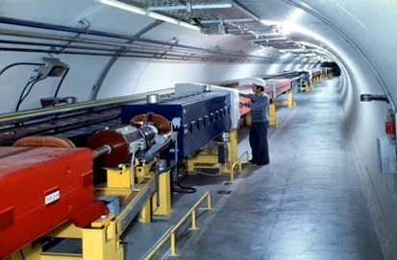
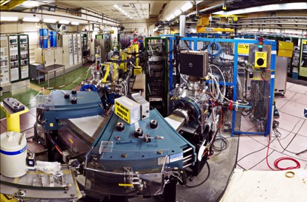
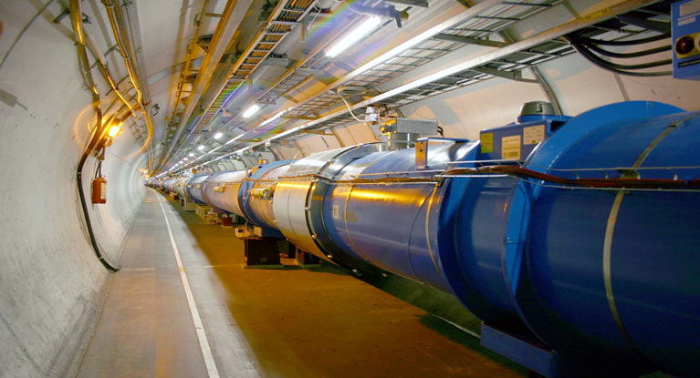
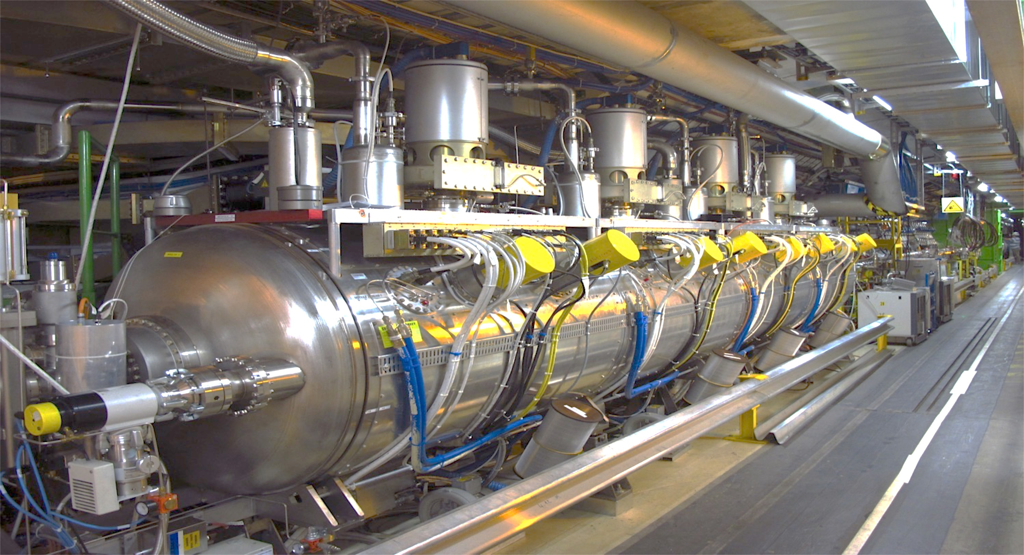
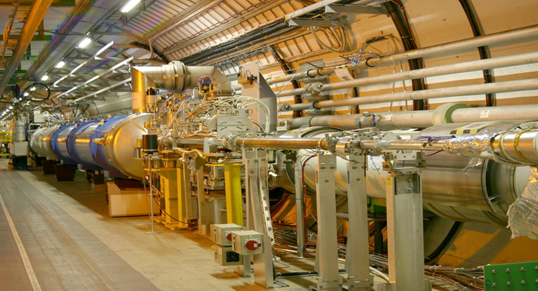
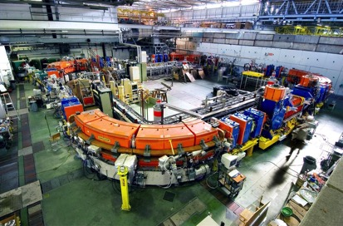
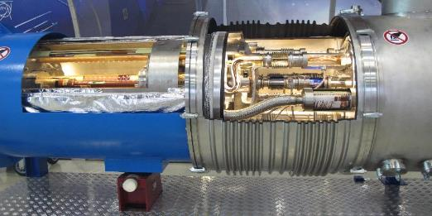
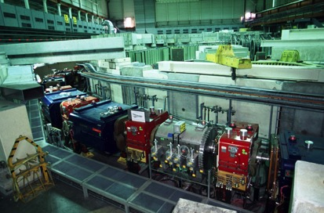
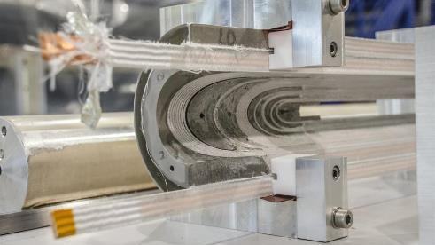
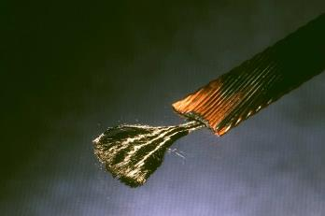
A unique Accelerator chain Worldwide…
LINAC2
Super Proton Synchrotron
LINAC3
Large Hadron Collider
PS Booster
LHC RF cavities
LHC straight section
LEIR
Proton Synchrotron
LHC interconnection
LHC Magnet Coil
Superconductor strand

Slide 32
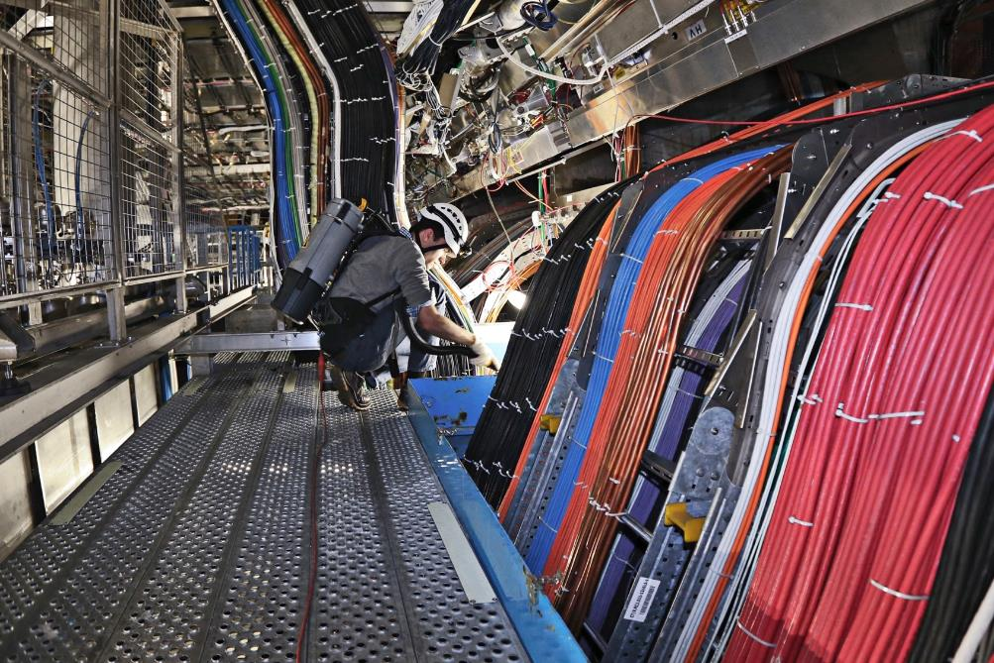
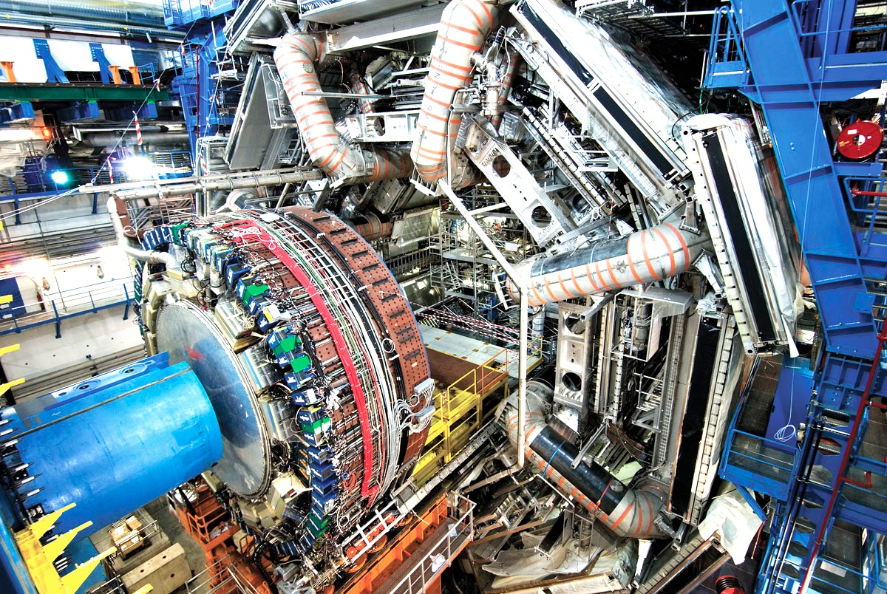
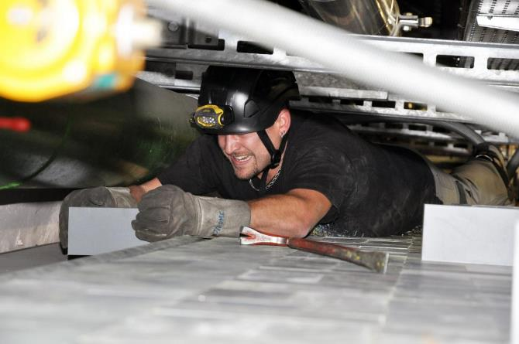
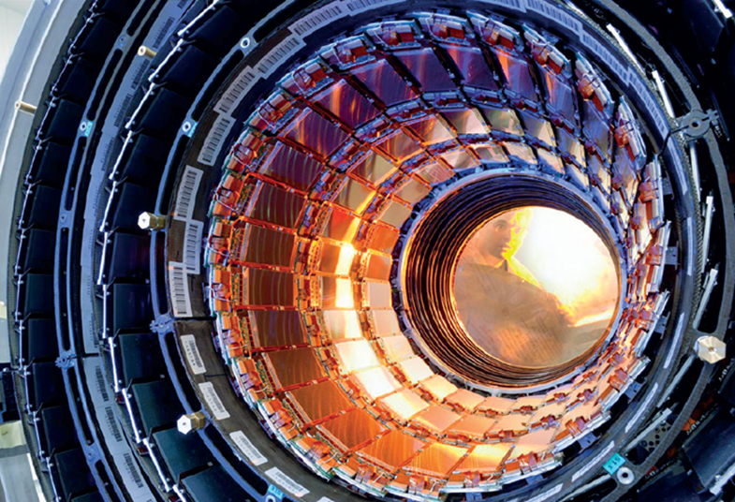
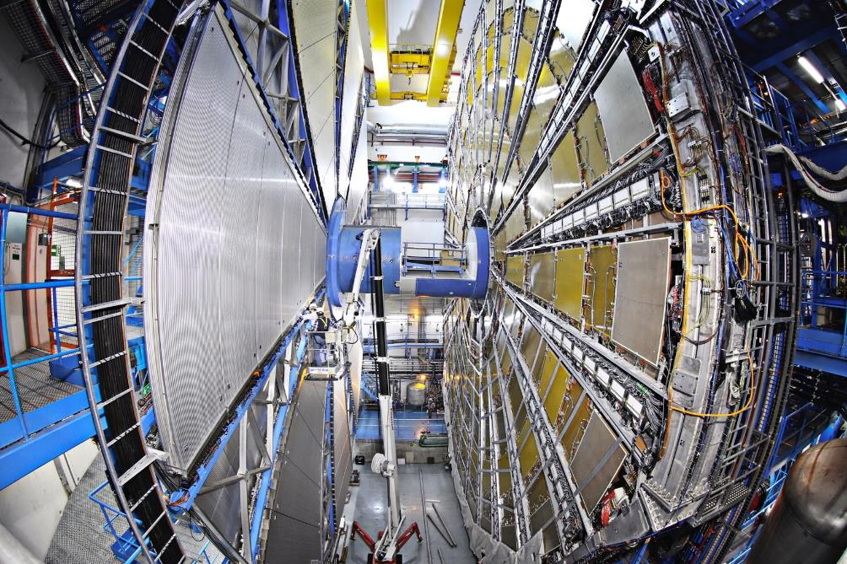

And amazing Detectors…
ATLAS

