Slide 1
Executive Summary
Hybrid Stave status
Stave Zero Status
Planning

Slide 2
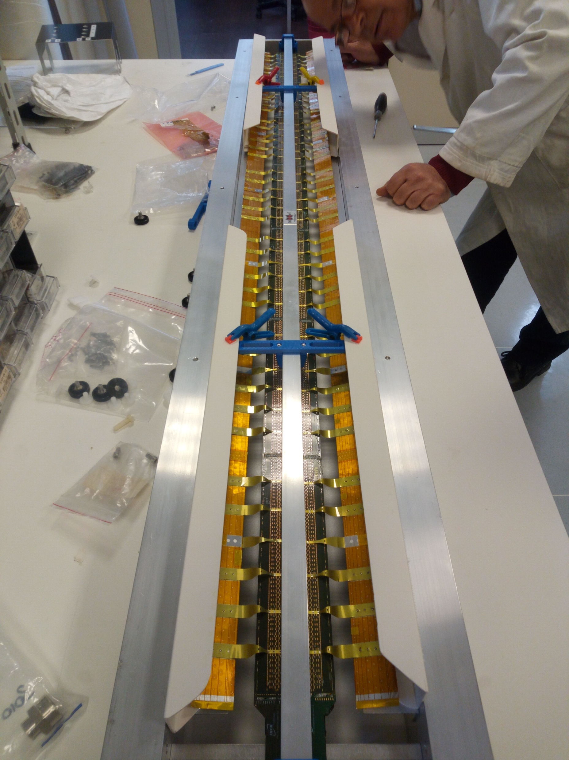
Hybrid Stave / PB Jig Status
Hybrid Stave
Tested pick-up tool
PB brackets produced (Aldo)
Test U-arms installation (place by hand)
PB Jig
PB folding rails and bars installed
New supports for ruby pads
Full review of the assembly

Slide 3
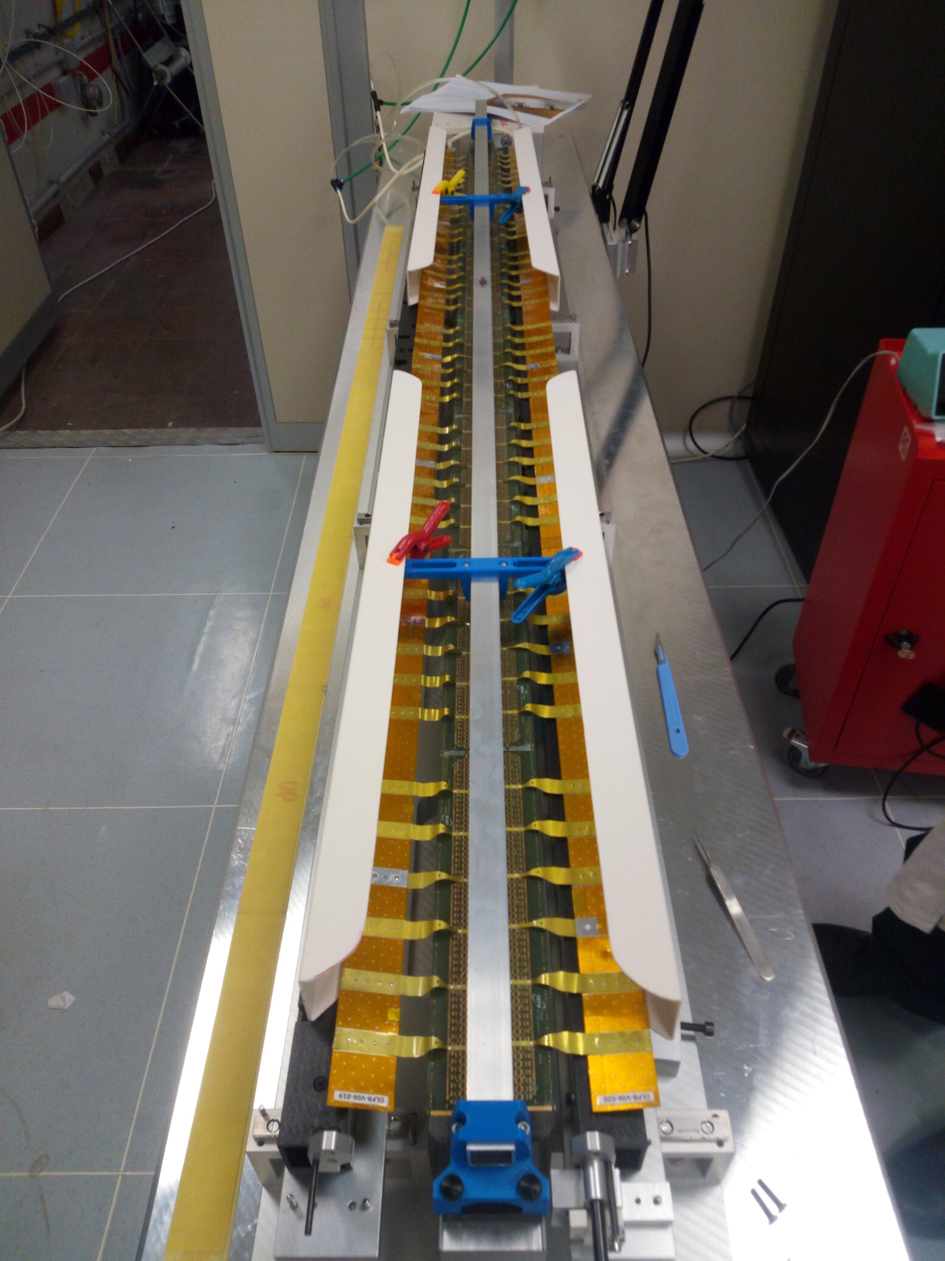
Hybrid Stave / PB Jig Status
Hybrid Stave
Tested pick-up tool
PB brackets produced (Aldo)
Test U-arms installation (place by hand)
PB Jig
PB folding rails and bars installed
New supports for ruby pads
Full review of the assembly

Slide 4
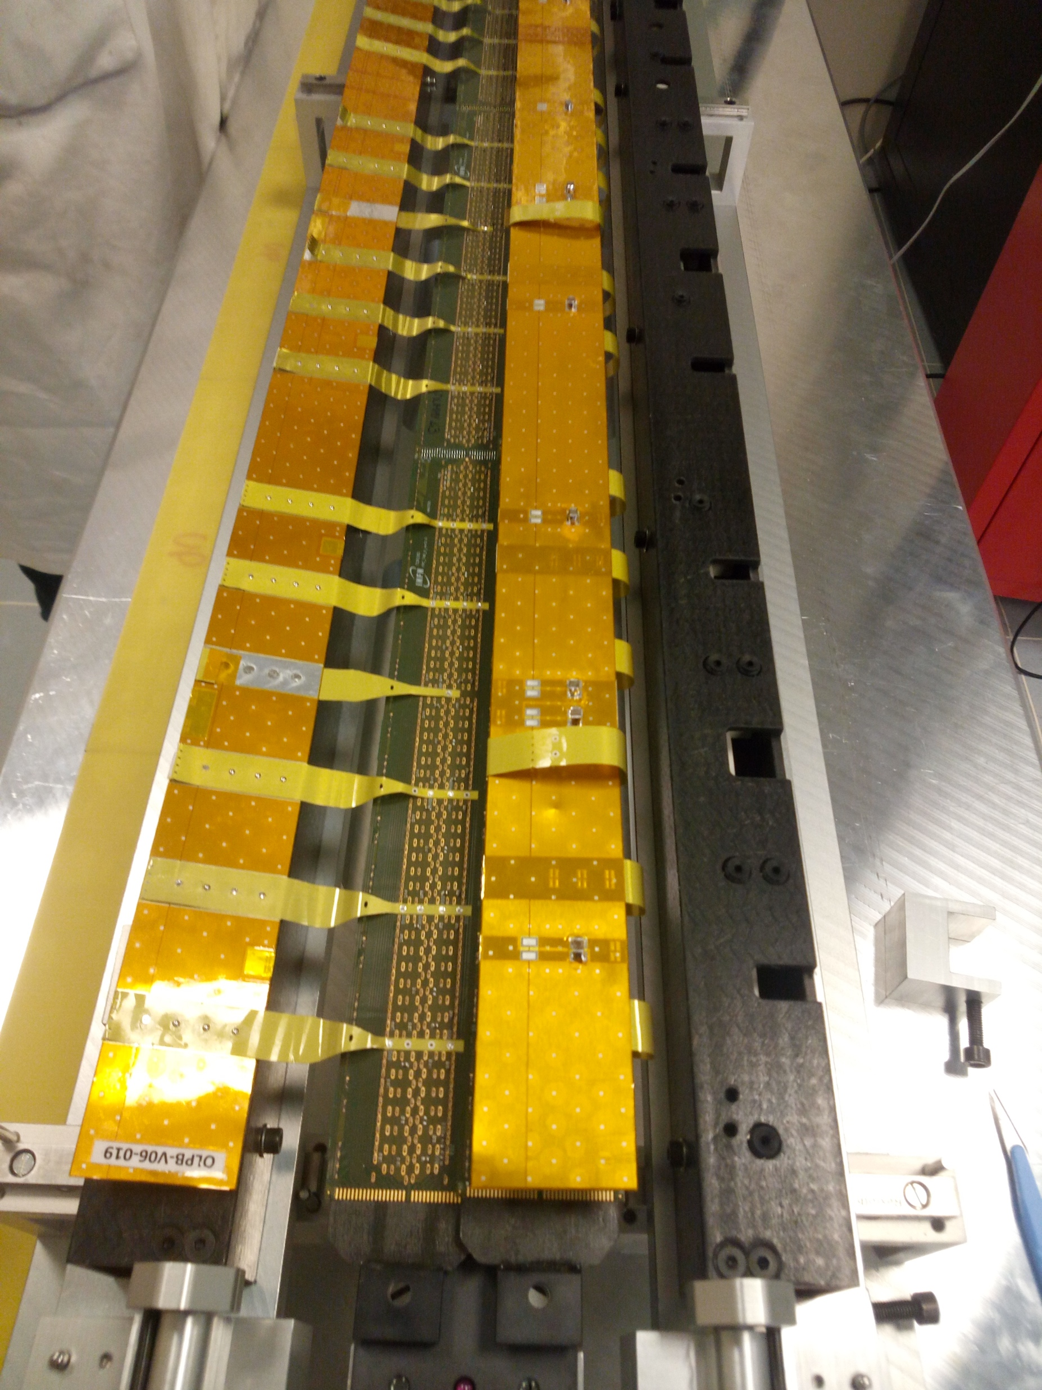
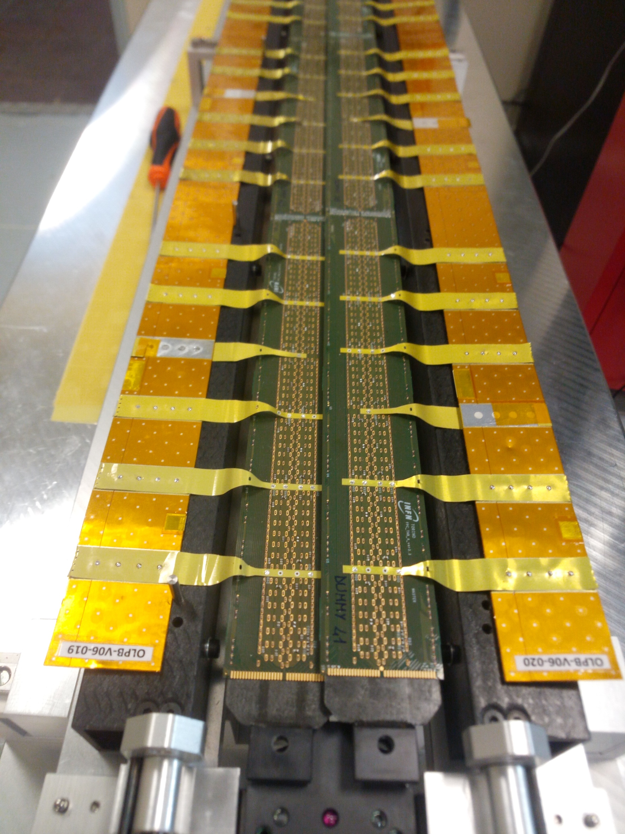
Hybrid Stave / PB Jig Status
Hybrid Stave
Tested pick-up tool
PB brackets produced (Aldo)
Test U-arms installation (place by hand)
PB Jig
PB folding rails and bars installed
New supports for ruby pads
Full review of the assembly

Slide 5
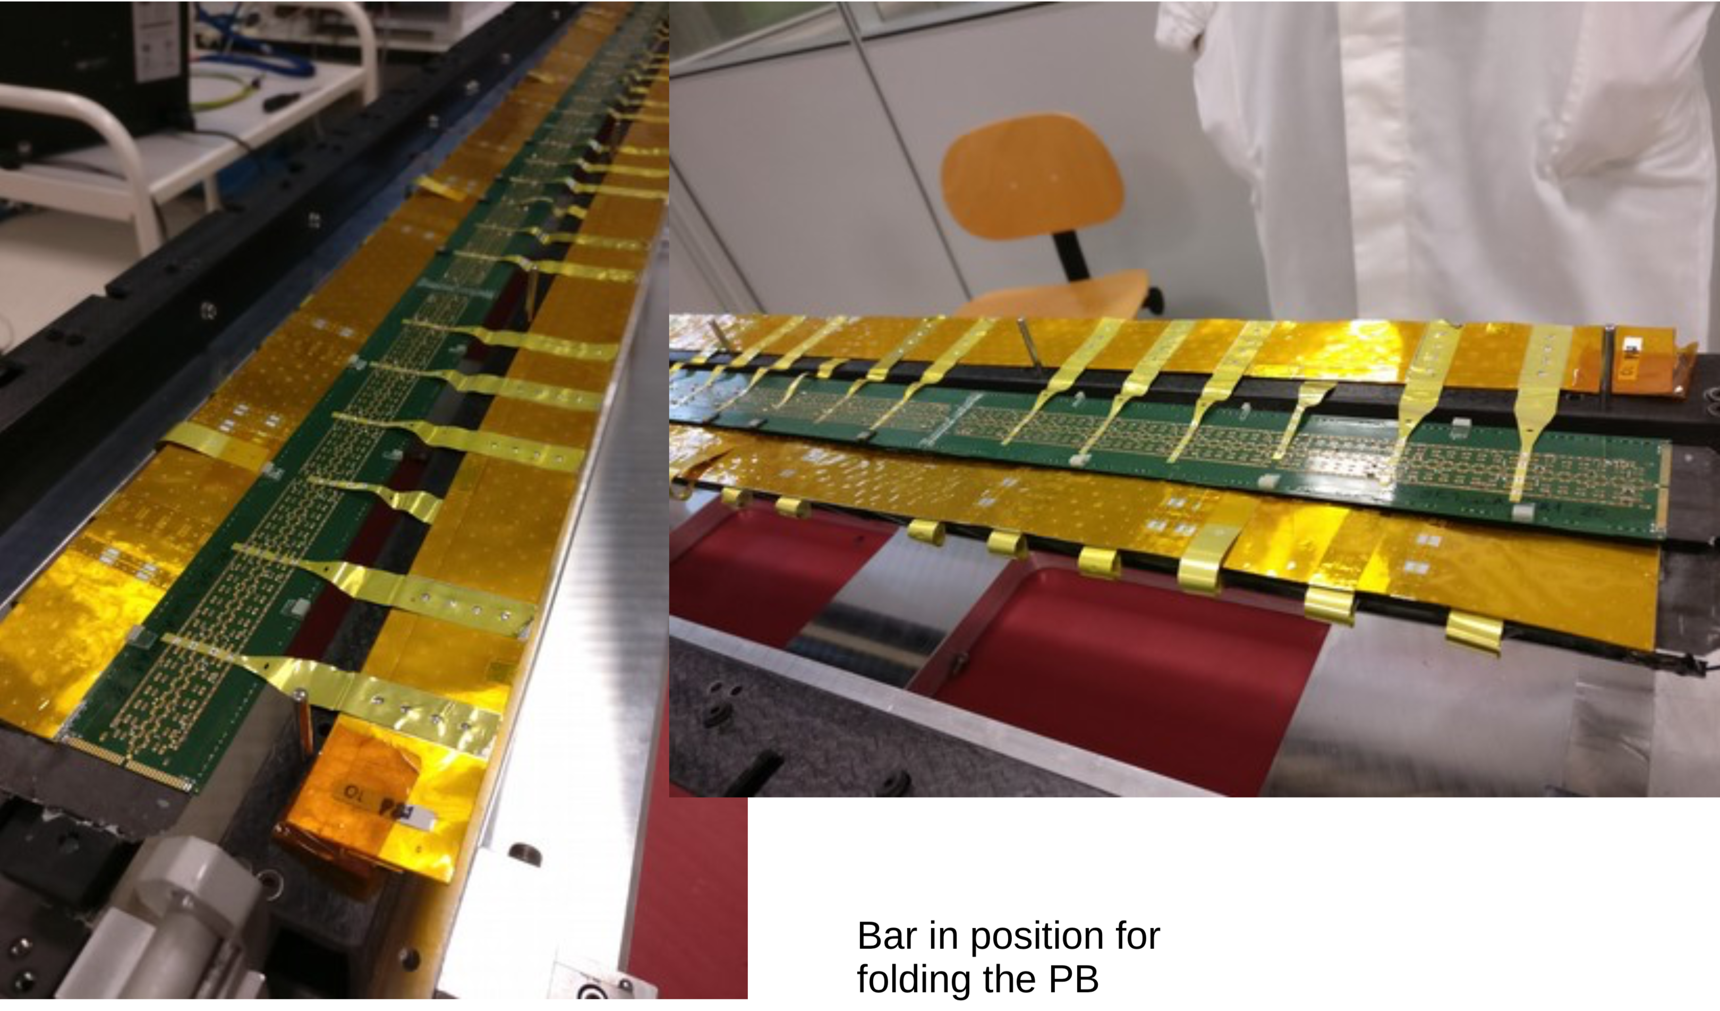
No u arm

Slide 6
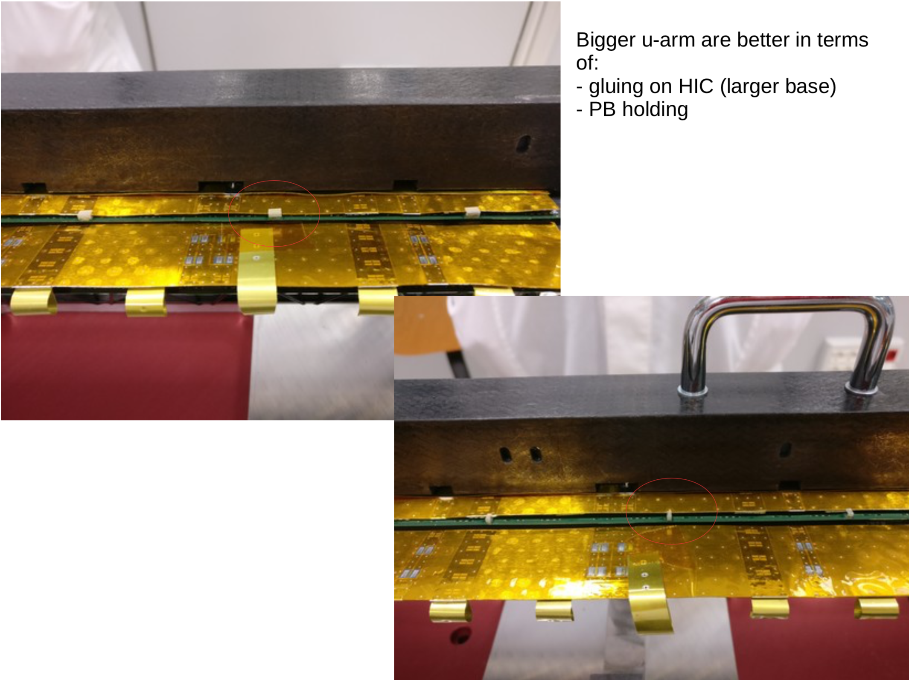

Slide 7
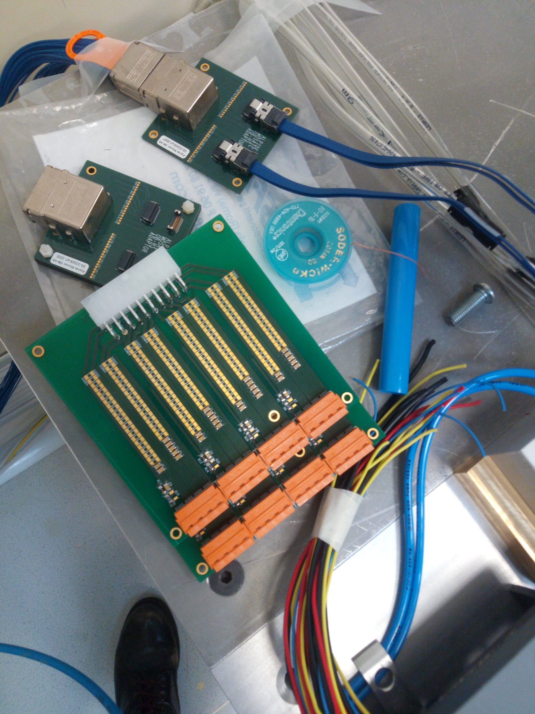
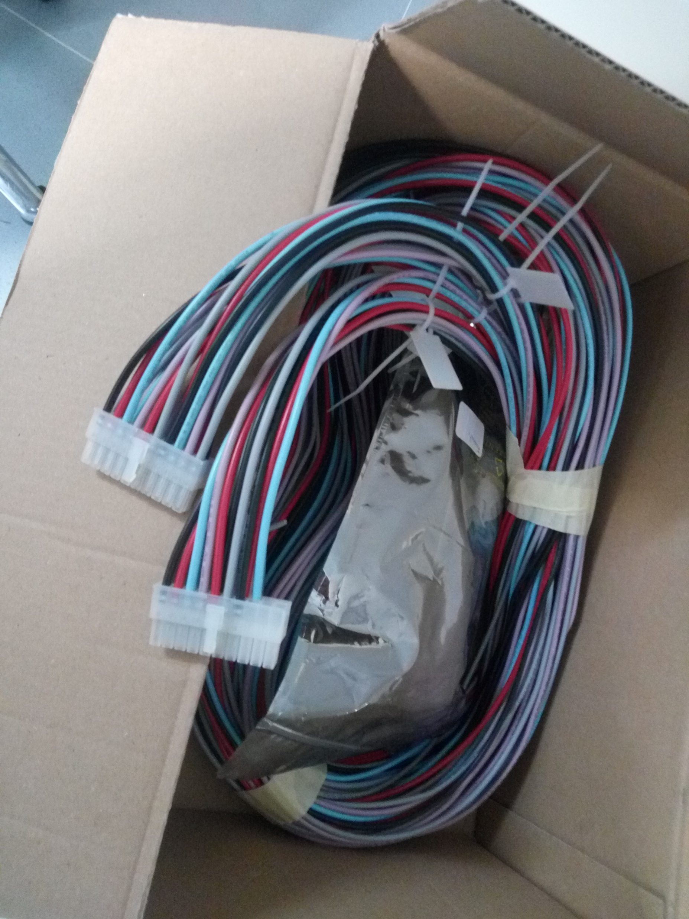
Stave Zero Status
Service Power Bus installed not yet wired up
Filter Boards to be installed
Connectors installed
HS/Right/Upper to be tested first
Mock Up

Slide 8
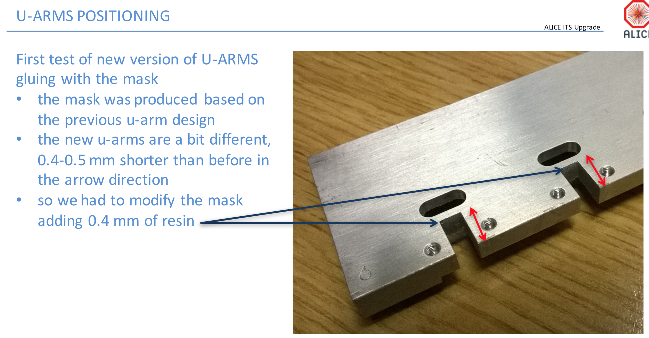

Slide 9
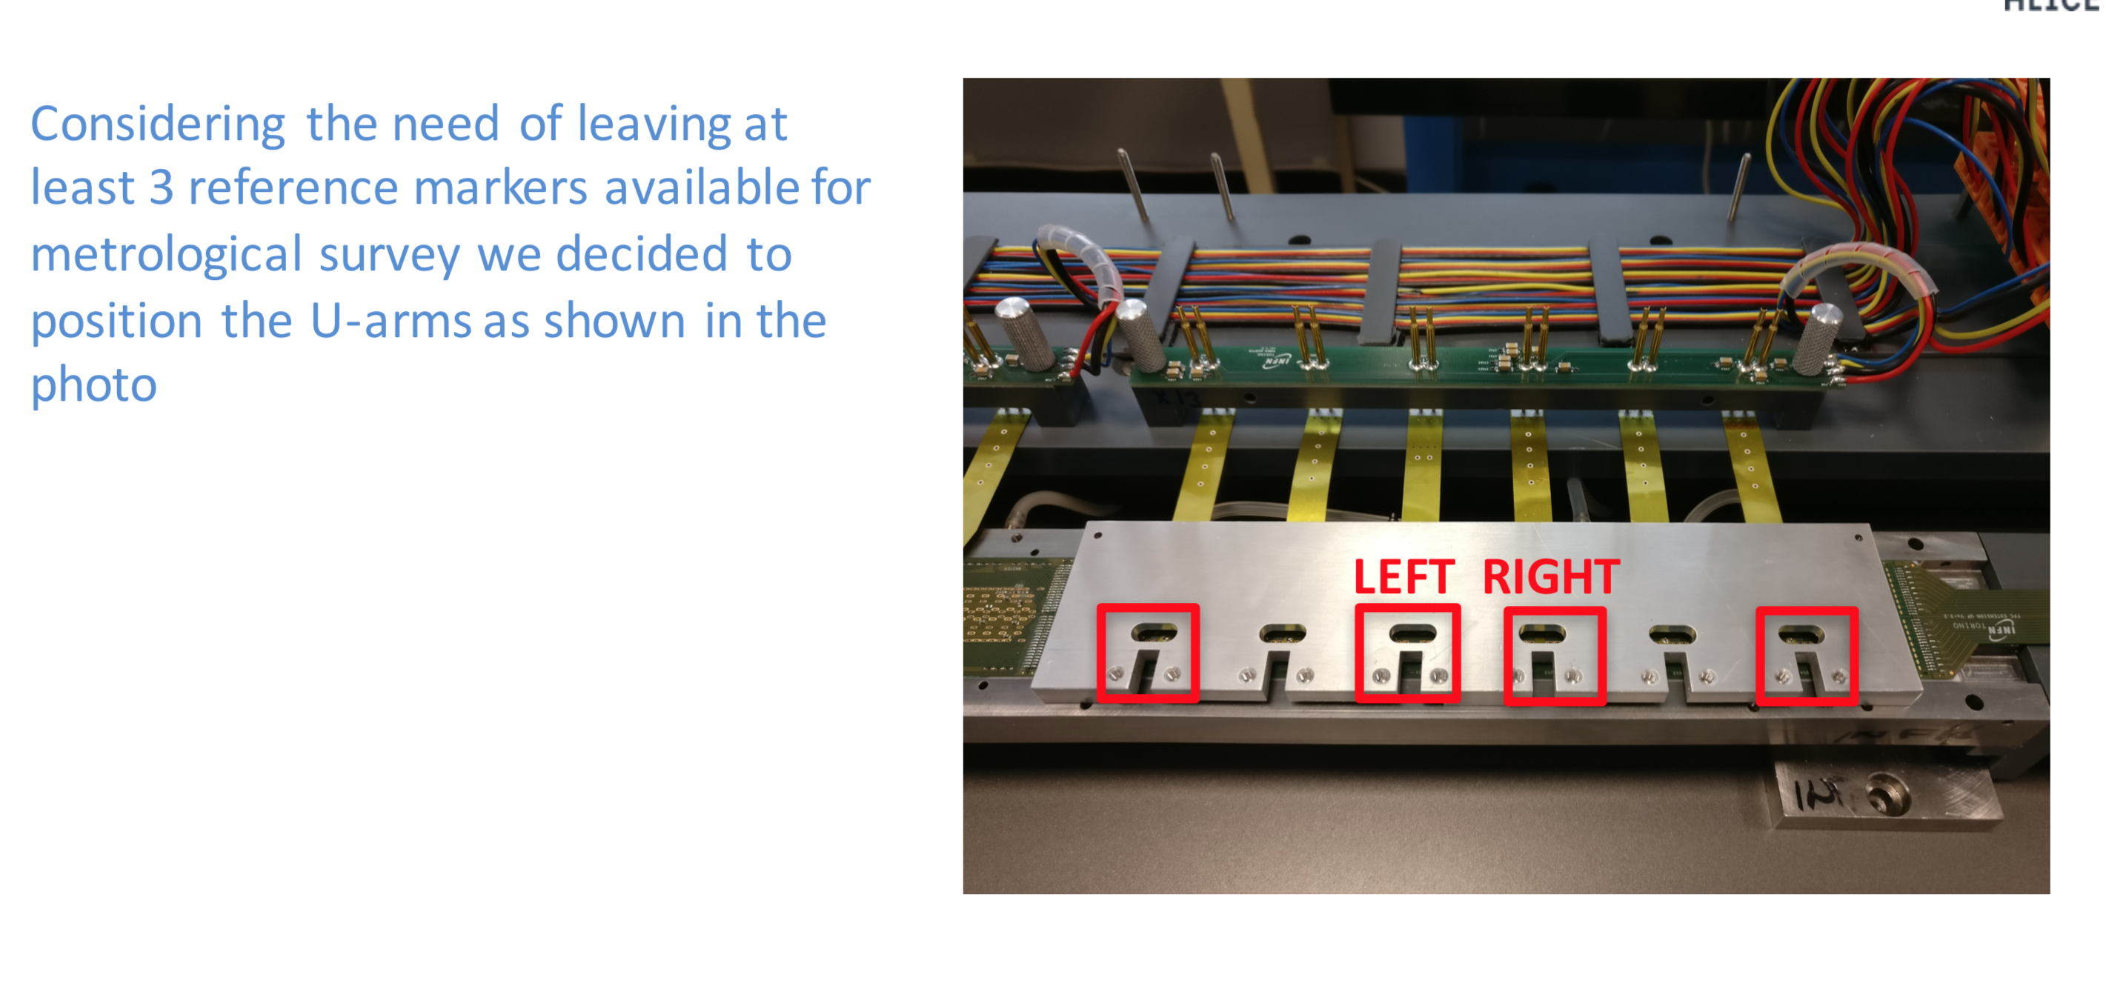

Slide 10
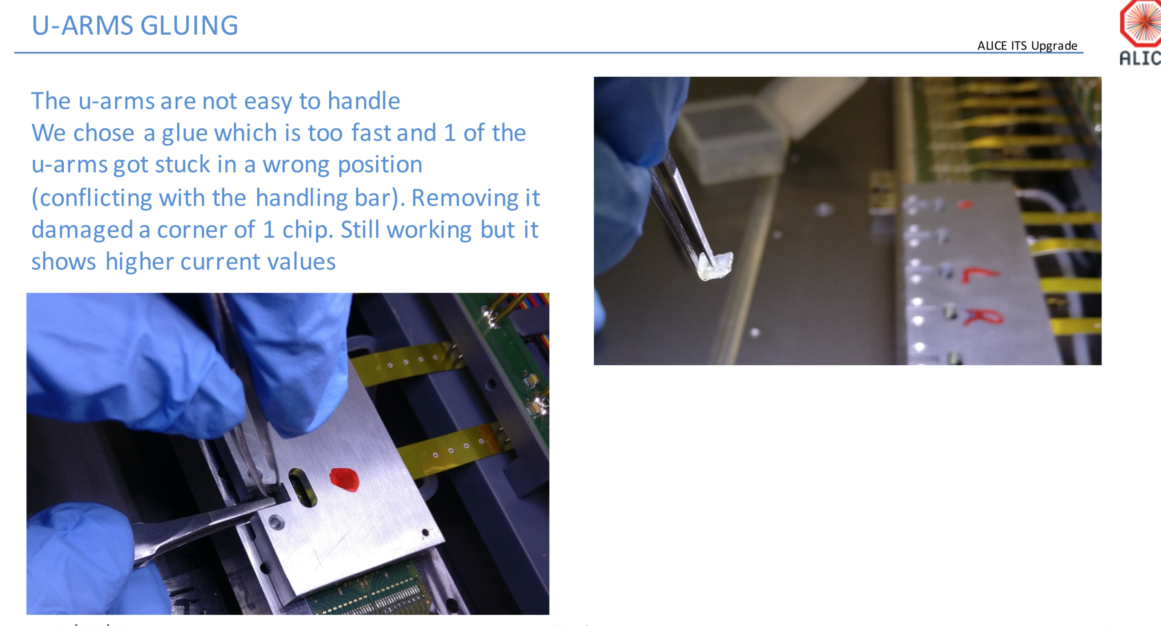

Slide 11
Planning
Produce pick up tool brackets
Install new PB jig
Move Hybrid Stave back to PB jig
Need to swap PBs (unsoldier the CC)
Install (glue) U arms by hand
Move hybrid stave back to transport box
Finalize service PB
Glue U arms on HS/Right-Upper using U arm tool
R/O test of the HS/R-U
Finish stave zero
→ ASTRA building heat pump installation started !
→ Daresbury meeting Apr 23 24
This Week
End of march

