Slide 1

Title
Design of the Diagnostic Stations for the ELI-NP Compton Gamma Source
Supervisor: L. Palumbo Co-Supervisor: A. Mostacci
M. Marongiu Accelerator Physics Doctorate

Slide 2
Outline
Optical Transition Radiation properties
GBS main parameters
OTR Screens
  Thermal issues
  Fatigue Stress
  Photons Evaluation
Beam Imaging
  Magnification
  Resolution
Energy Measurements
  Angular Distribution
  Data Analysis
  Simulation

Slide 3
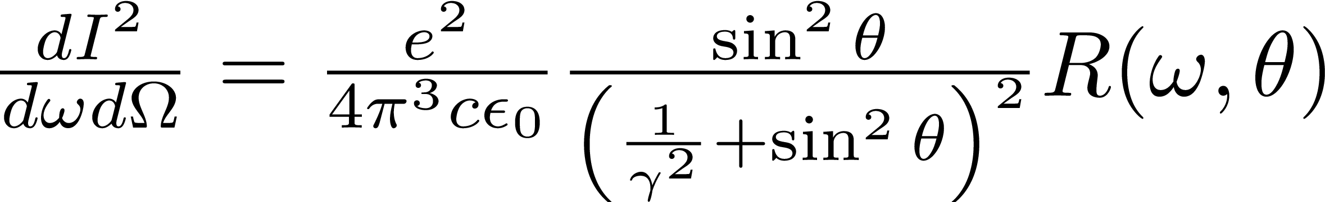
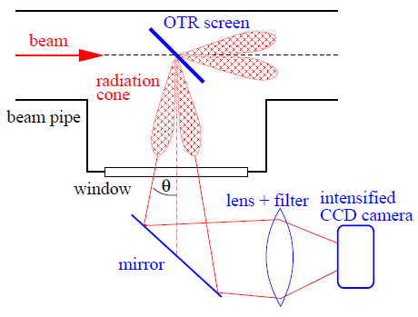
OTR Properties
Optical Transition Radiation (OTR) screens are widely used for profile measurements
The radiation is emitted when a charged particle beam crosses the boundary between two media with different optical properties
The visible part of the radiation is used and an observation geometry in backward direction is mainly chosen
Advantages
  Instantaneous emission process → Single shot measurements
  Good linearity
Disadvantages
  The process of radiation generation is invasive
  The radiation intensity is lower in comparison to scintillation screens

Slide 4
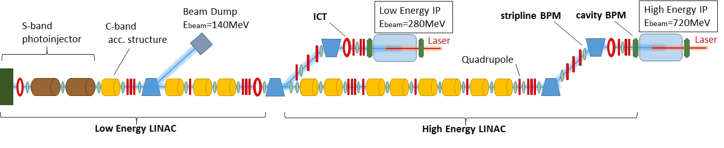
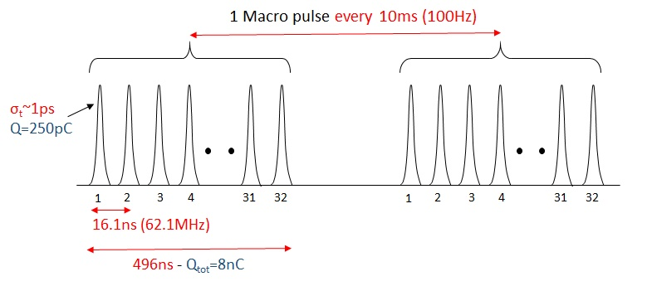
Electron Beam Parameters @ IP
Electron Beam Specifications
Max. Energy at IP [MeV] | 280 – 720
Macro Pulse rep. Rate [Hz] | 100
Number of bunches | up to 32
Bunch spacing [ns] | 16.1
Bunch length [ps] | 0.91
Bunch charge [pC] | 25-250
εn_x,y [mm·mrad] | 0.2-0.6
Bunch Energy Spread | < 0.1%

Slide 5
Linac diagnostics
Non-intercepting diagnostics:
Charge measurements:
4 Integrating Current Transformers
(bunch by bunch)
Position measurements:
29 stripline BPMs (Macro pulse)
4 cavity BPMs (bunch by bunch)
Beam Loss Monitor System
Intercepting diagnostics:
Phase-Space measurements:
23 Beam Screens (YAG and OTR)

Slide 6
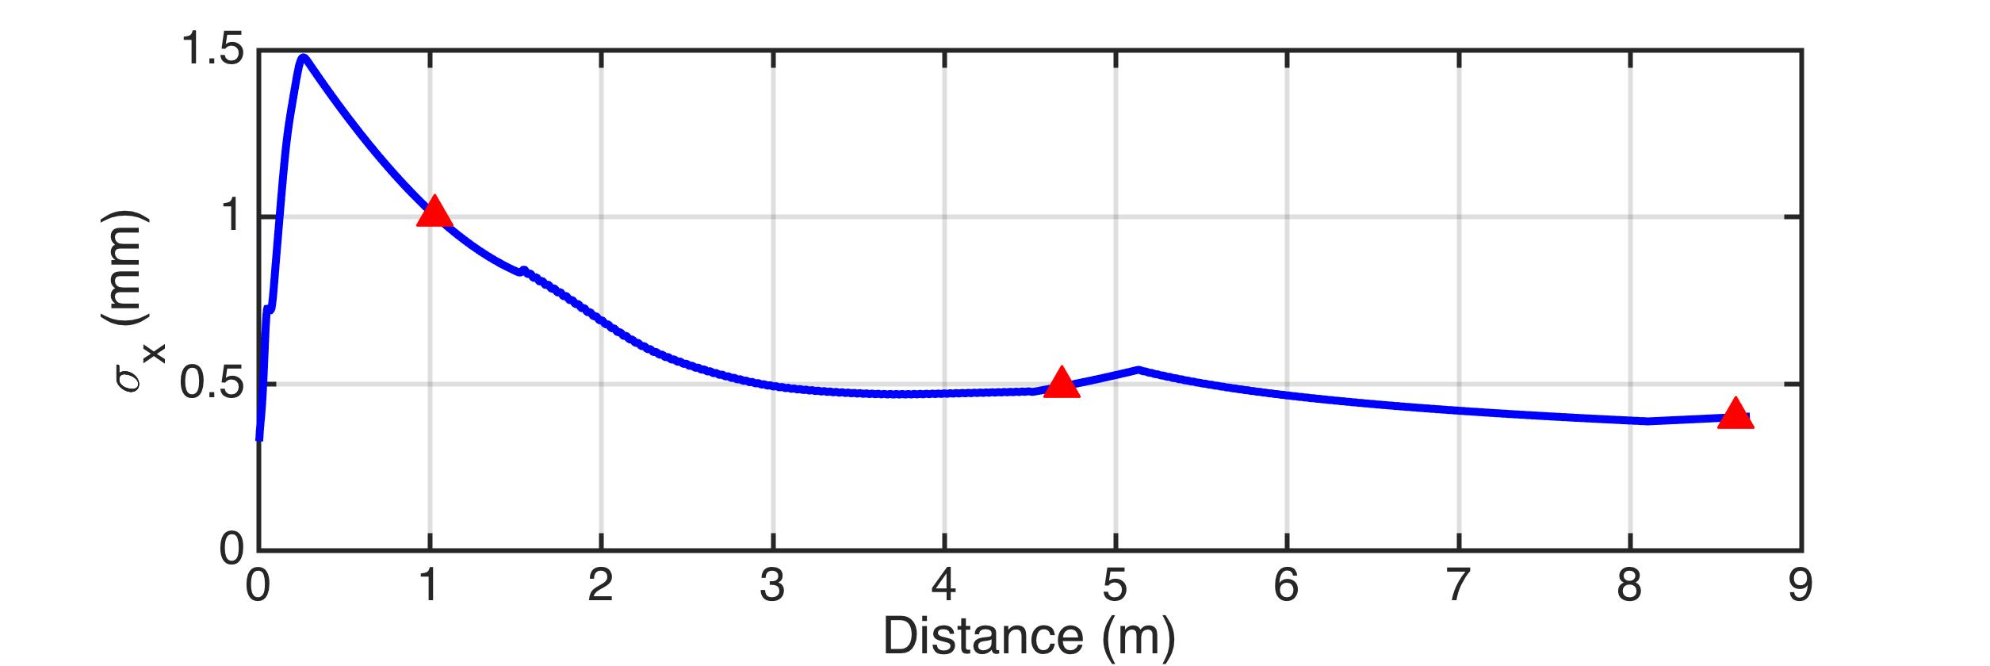
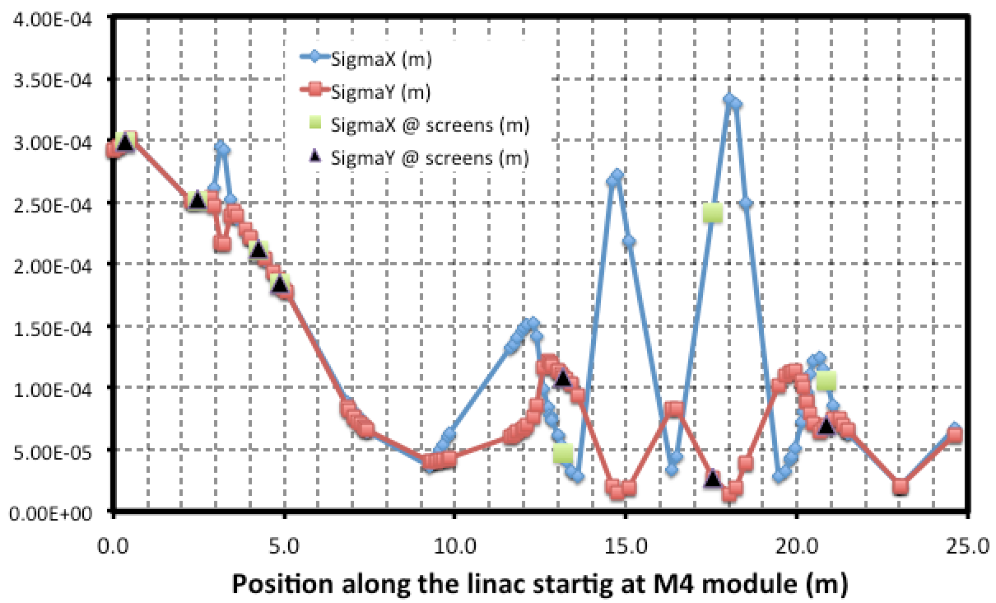
Beam envelope along the Linac
From Gun to S-Band (80MeV)
C-Band (280MeV)
A. Bacci, A. Giribono, C. Vaccarezza

Slide 7
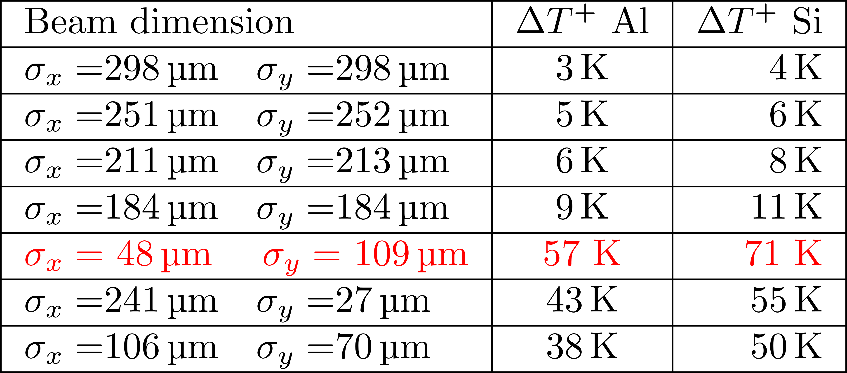
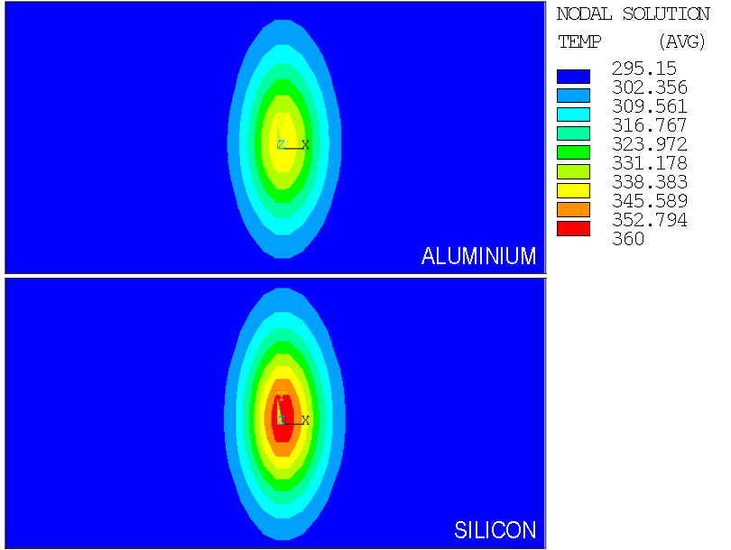
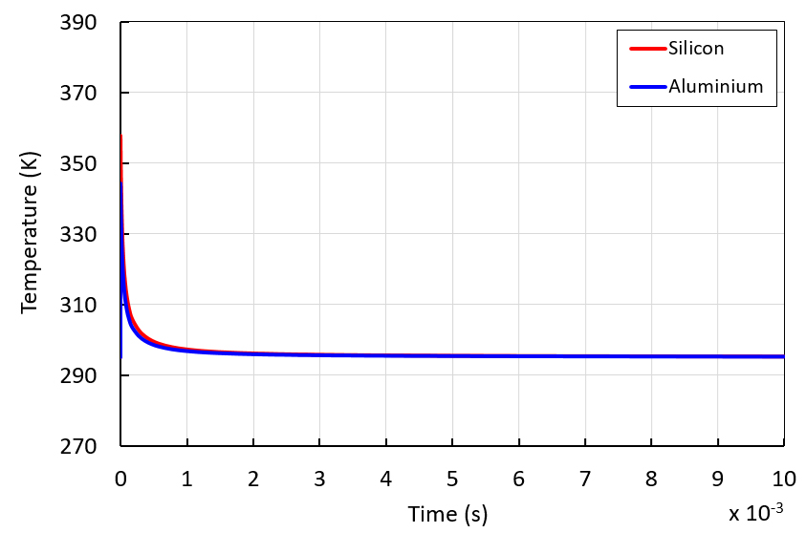
Thermal Analysis OTR
32 bunches, 250pC each
M. Marongiu, et al., https://doi.org/10.1016/j.nima.2016.07.040

Slide 8
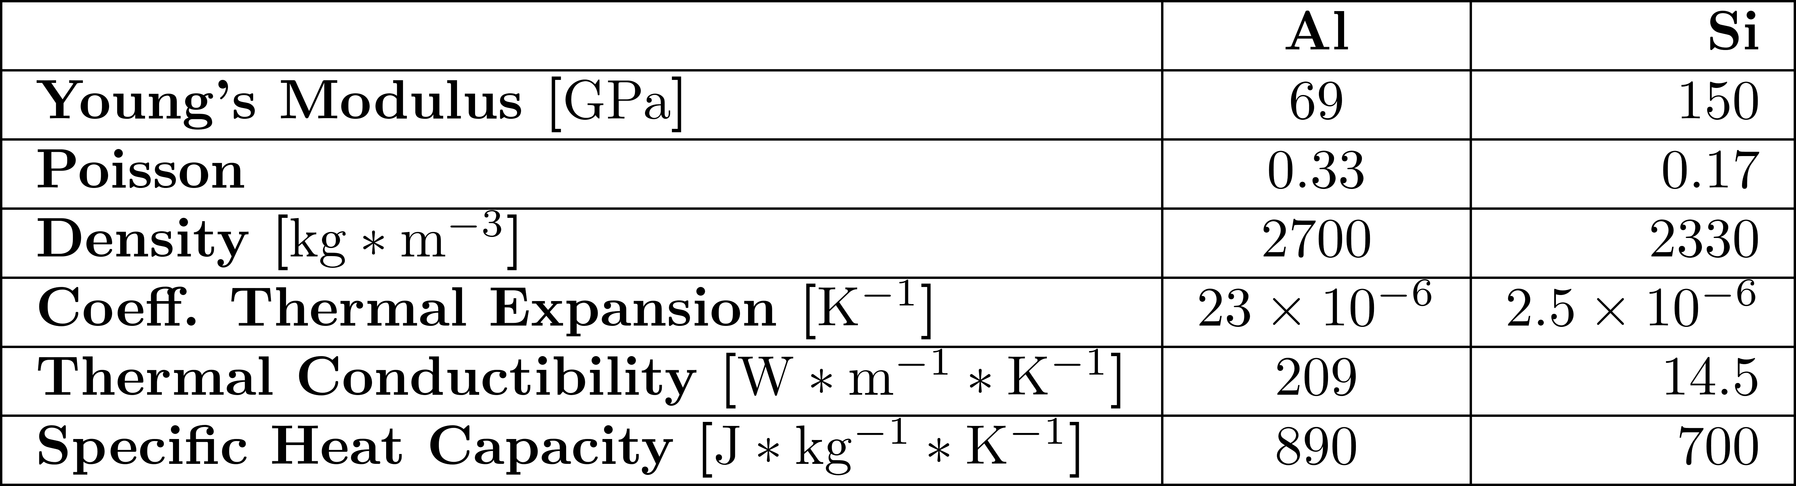
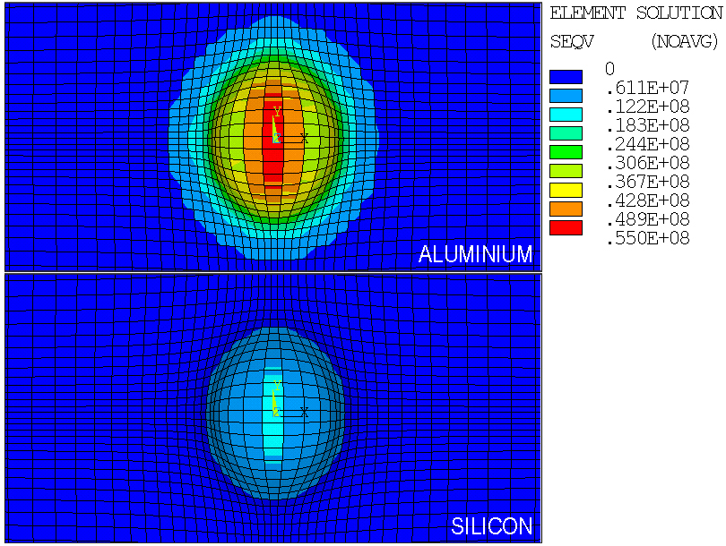
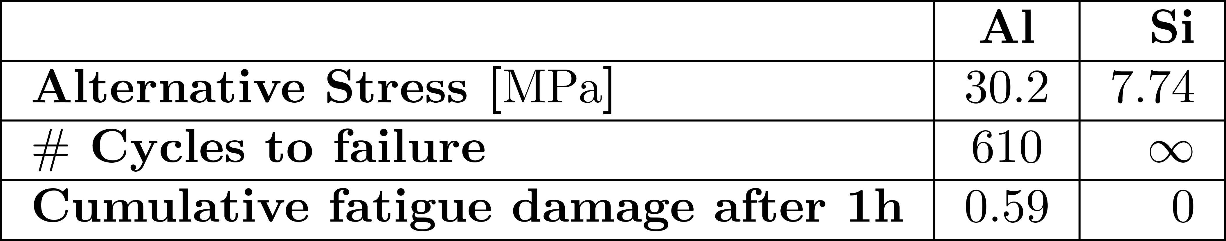
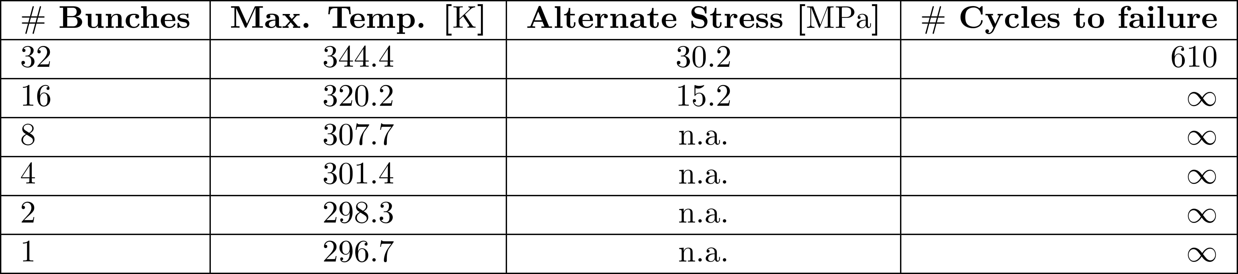
Fatigue Stress
6 seconds
Equivalent Von Mises Stress (Pa)
F. Cioeta, et al., ISBN 978-3-95450-182-3, pag. 246-249

Slide 9
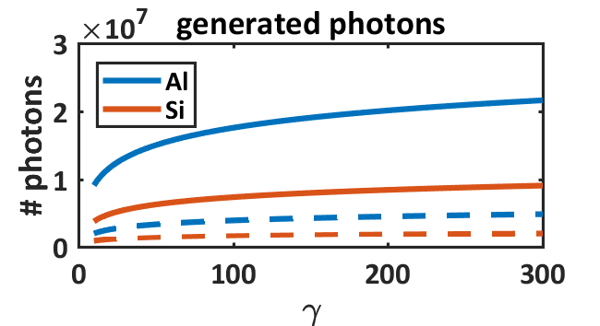
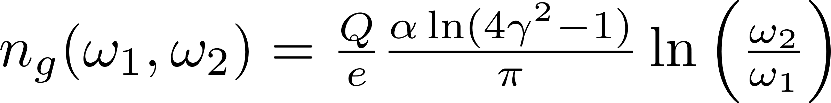
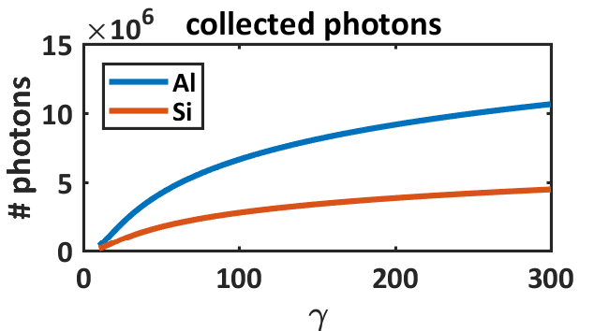
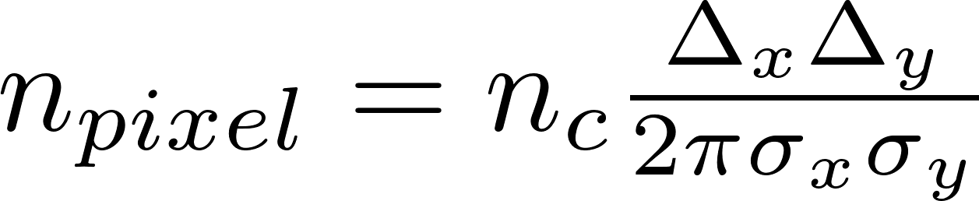
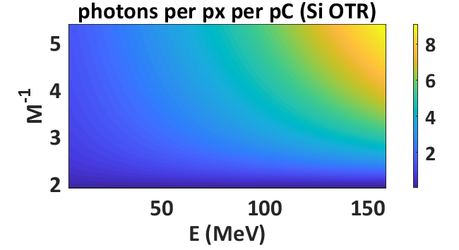
Photons Evaluation
(400-700 nm) continuous lines
(515-585 nm) dashed lines
x10⁴
M. Marongiu, et al., Proceedings of IBIC 2017

Slide 10
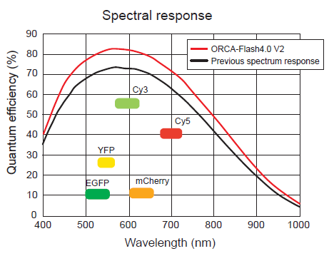
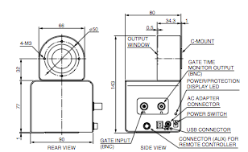
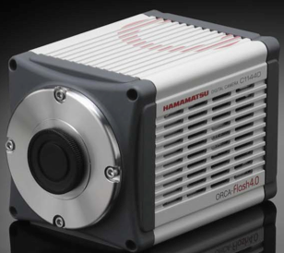
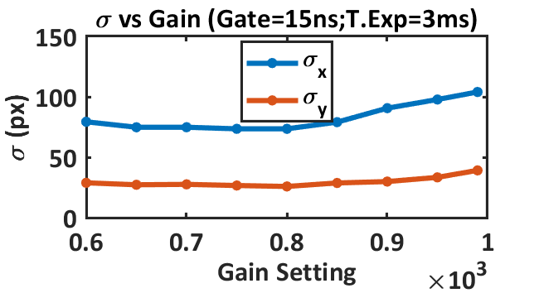
Gated intensified camera
82%@550nm
@ SPARC
46% for Basler scA640-70gm
A. Stella, G. Franzini
Measurements @ DAFNE

Slide 11
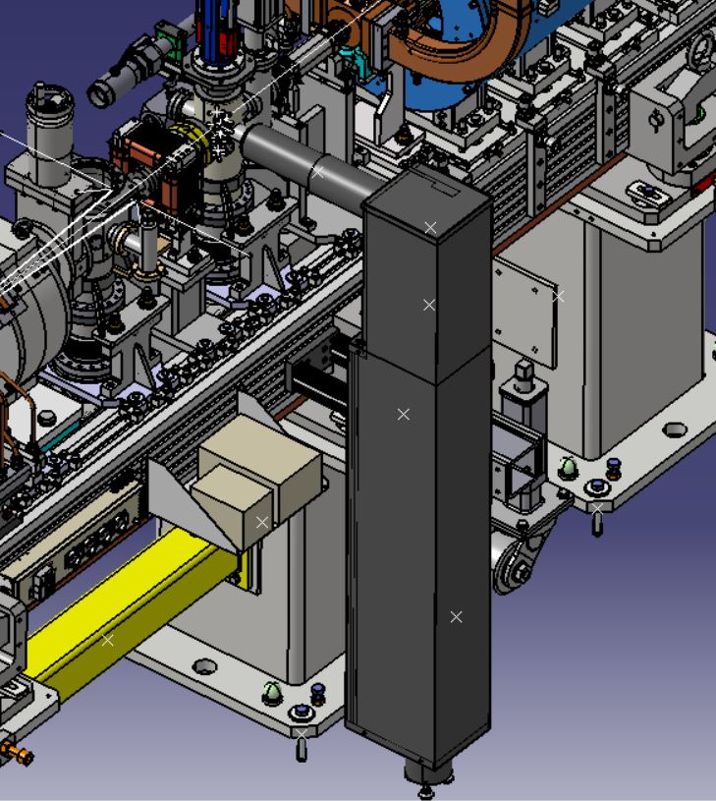
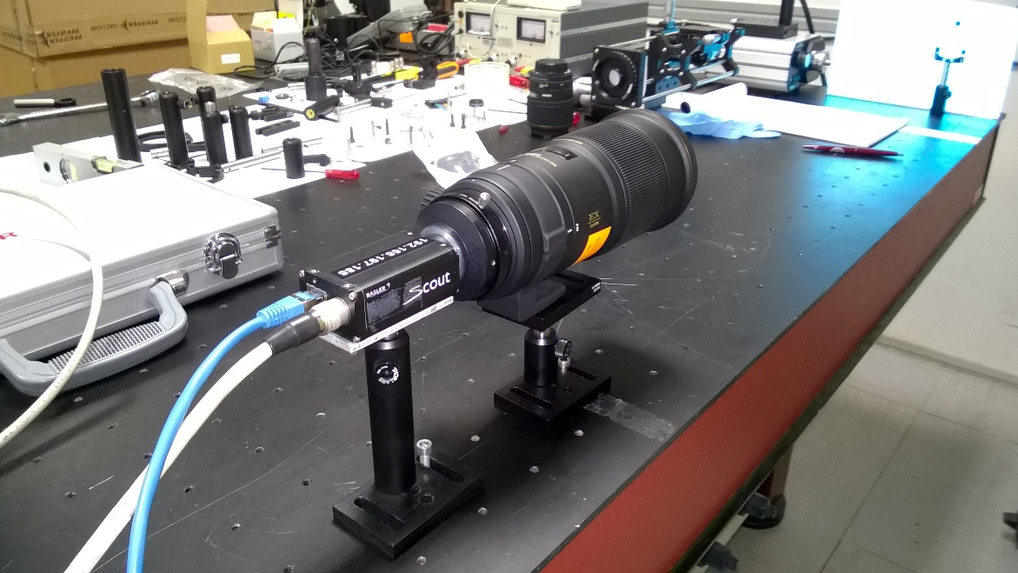
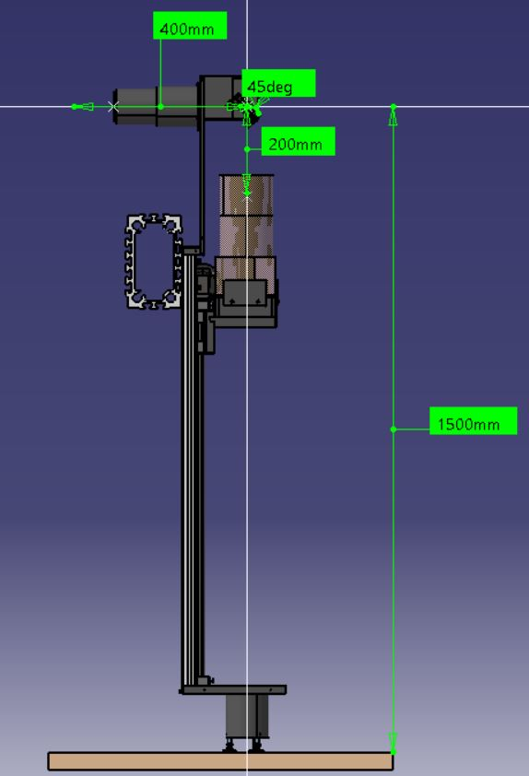
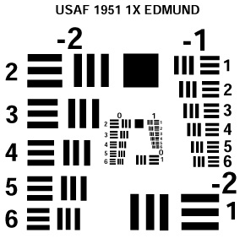
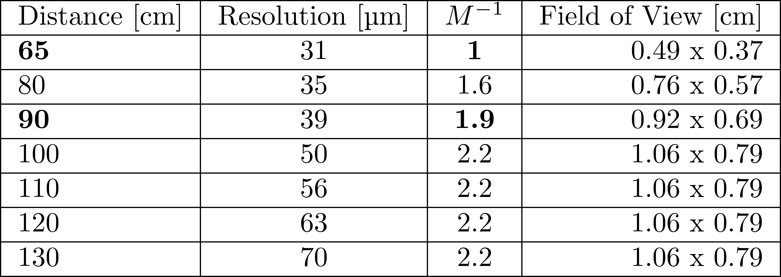
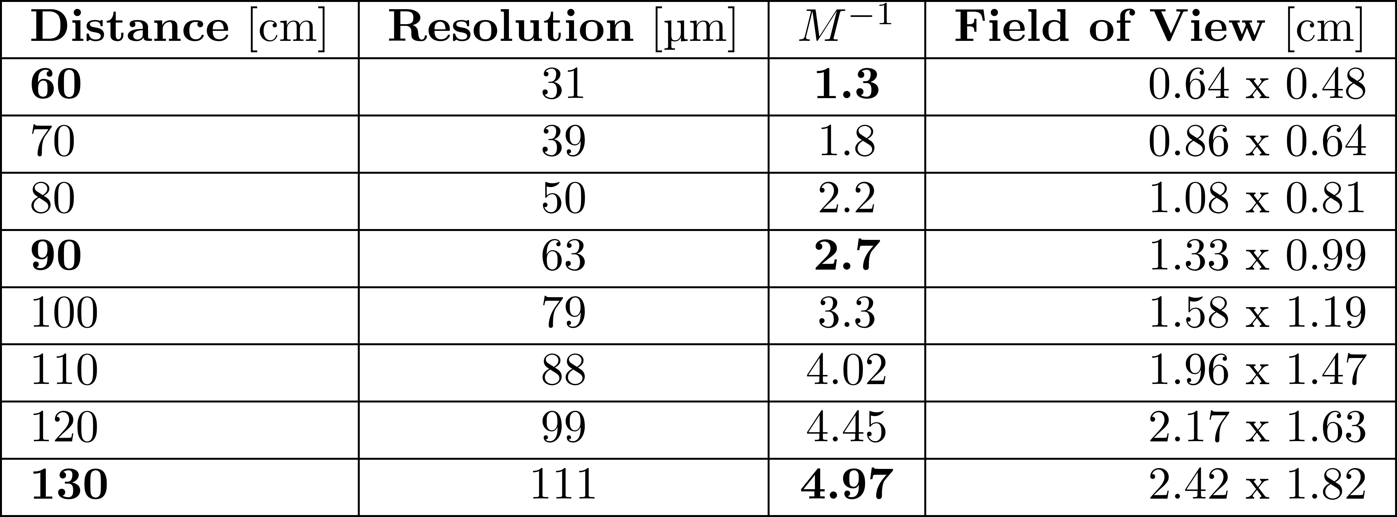
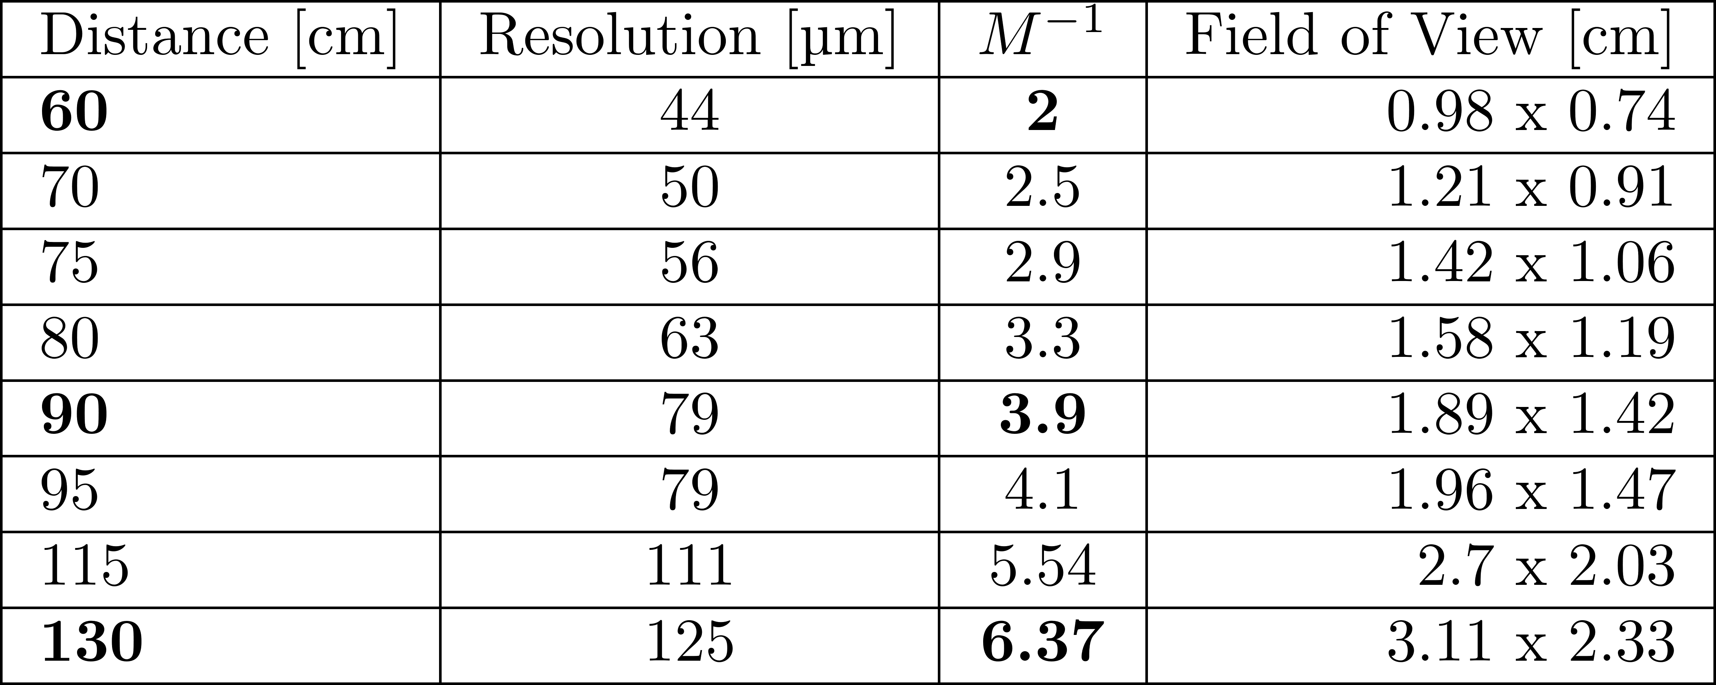
Camera lens layout
Camera Lens 180mm w/o teleconverter (2x)
Camera Lens 105mm w/o teleconverter (2x)
180mm lens with teleconverter (2x)
180mm lens with teleconverter (1.4x)
180mm lens
The resolution is 1/x (mm).
The sizes of each horizontal line are 2,5/x for the length and 1/(2x) for the width (mm) and vice versa for the vertical lines.
F. Cioeta, D. Cortis

Slide 12
Camera lens test-bench
Camera Lens 180mm w/o teleconverter (2x)
Camera Lens 105mm w/o teleconverter (2x)
180mm lens with teleconverter (2x)
180mm lens with teleconverter (1.4x)
180mm lens
The resolution is 1/x (mm).
The sizes of each horizontal line are 2,5/x for the length and 1/(2x) for the width (mm) and vice versa for the vertical lines.
M. Marongiu et al., ISBN 978-3-95450-182-3, pag. 238-241

Slide 13
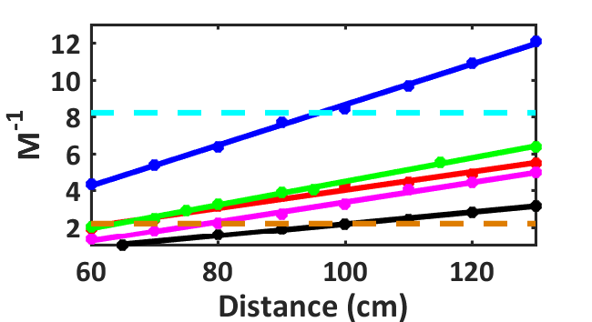
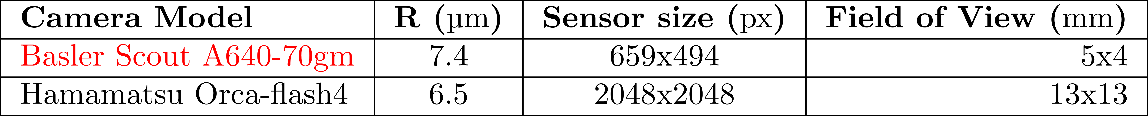
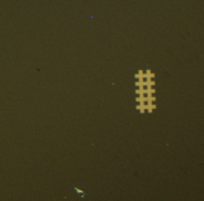
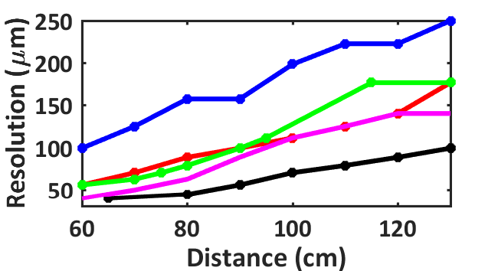
Camera lens Results
Camera Lens 180mm w/o teleconverter (2x)
Camera Lens 105mm w/o teleconverter (2x)
1:8
100µm
Screen (3 cm)
1:2
Beam (1 mm)
105mm
105mm with teleconverter (2x)
180mm
180mm with teleconverter (1.4x)
180mm with teleconverter (2x)
M. Marongiu et al., ISBN 978-3-95450-182-3, pag. 238-241

Slide 14
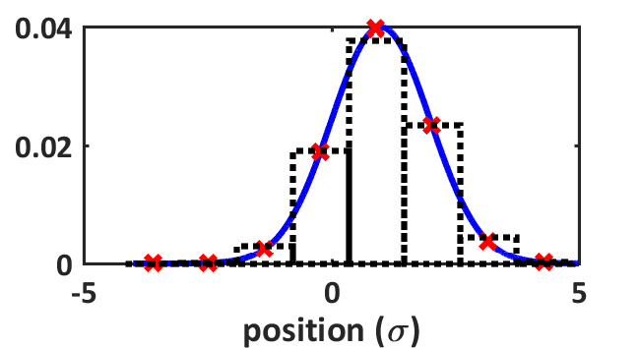
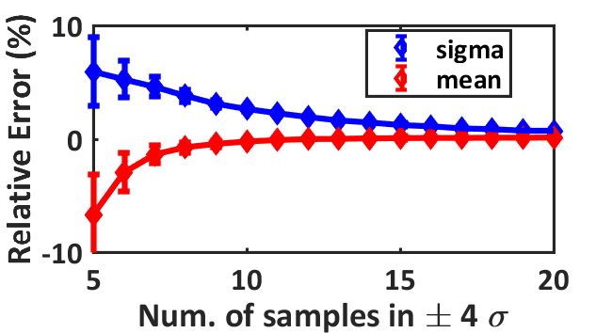
Gaussian Reconstruction
5 Samples
Error ~7%
If Resolution=30µm and σ>19µm
If σ=10µm and Resolution<16µm
20 Samples
Error <<0,01%
If Resolution=30µm and σ>75µm
If σ=10µm and Resolution<4µm
8 Samples
Error ~4%
If Resolution=30µm and σ>30µm
If σ=10µm and Resolution<10µm
M. Marongiu et al., ISBN 978-3-95450-182-3, pag. 238-241

Slide 15
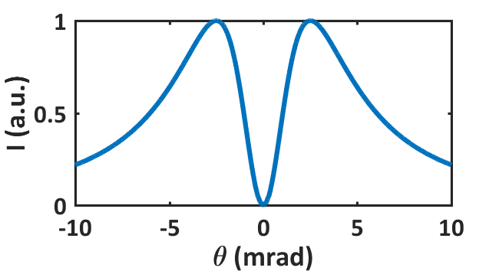
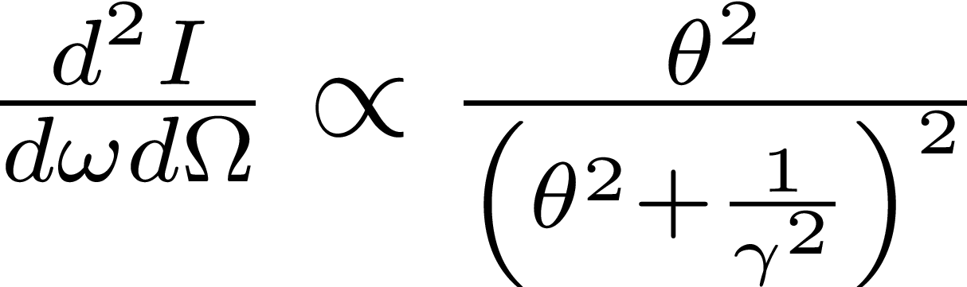
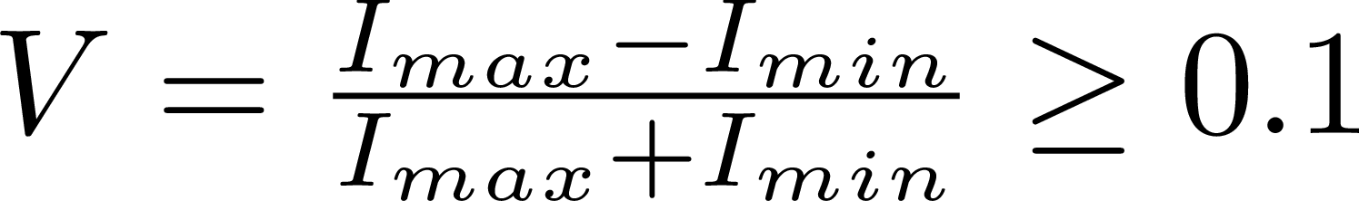

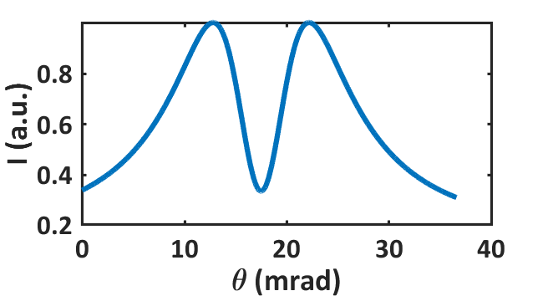


Energy Measurements
SPF
@ SPARC
~ 120 MeV
~ 120 pC

Slide 16
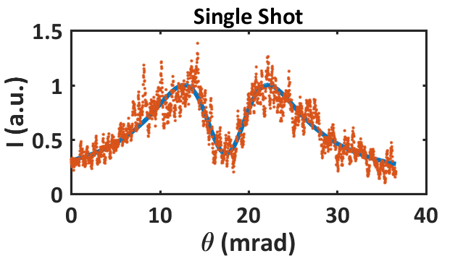
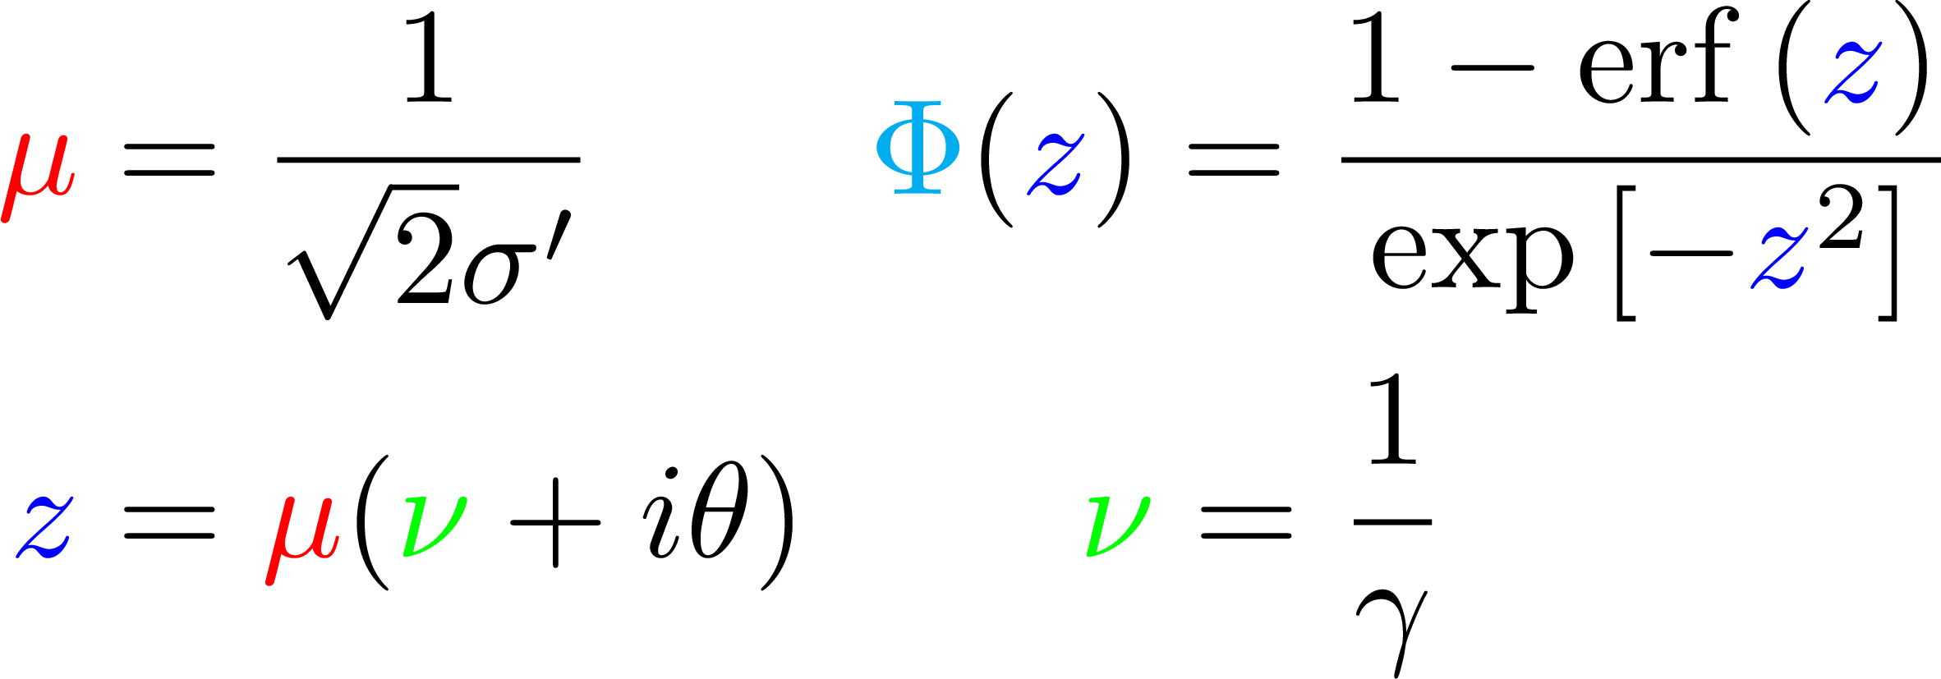
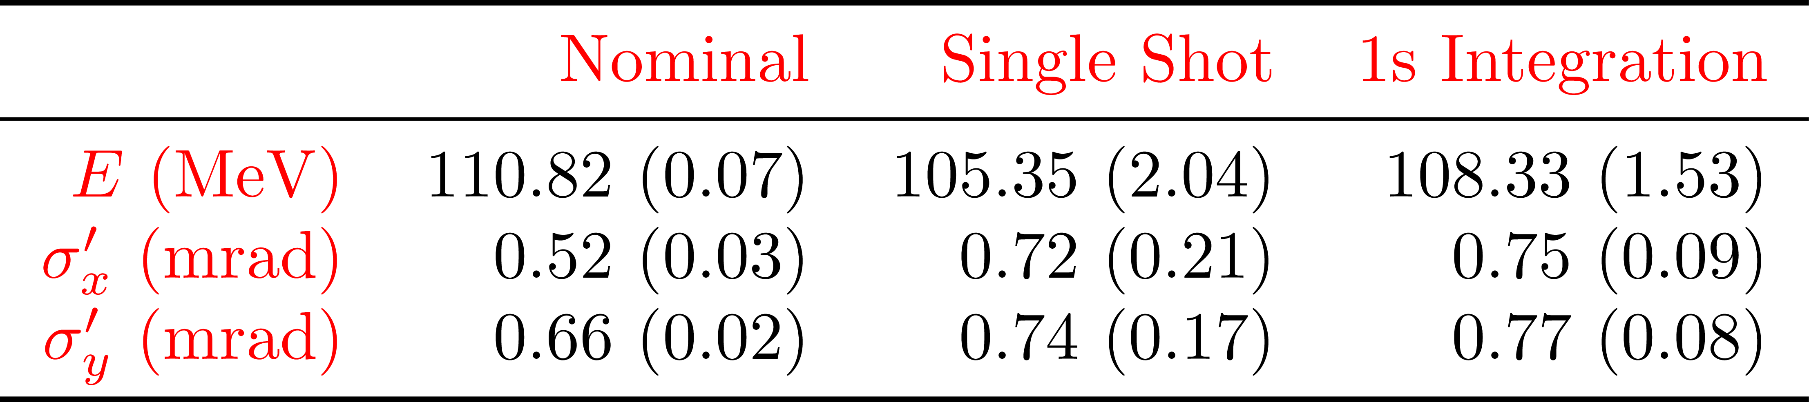
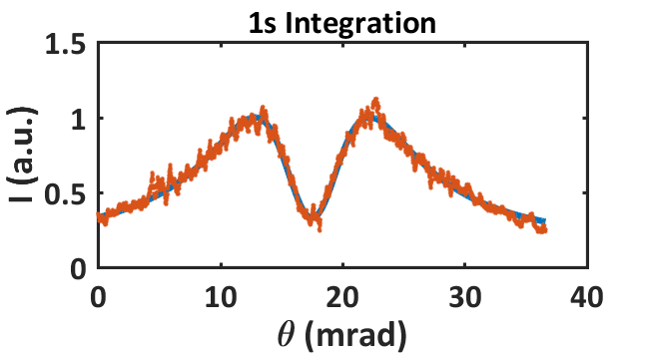
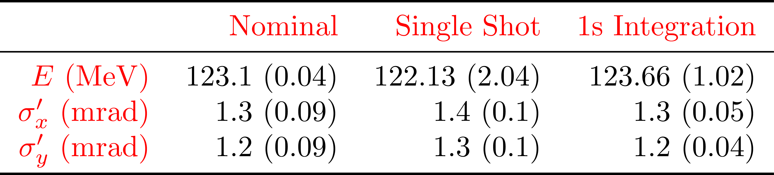
Data Analysis
Data Set 1
Data Set 2
M. Marongiu, et al., https://doi.org/10.1016/j.nima.2018.02.093
Notes:
Carica 100pC e 120pC e enrgy spread 0.1% nei 2 casi

Slide 17
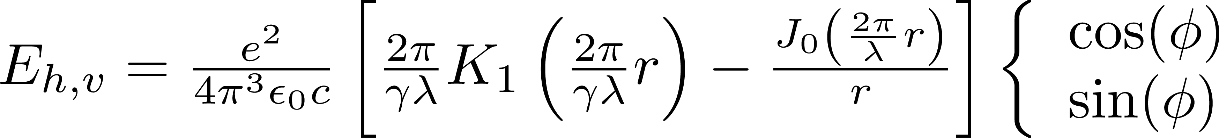
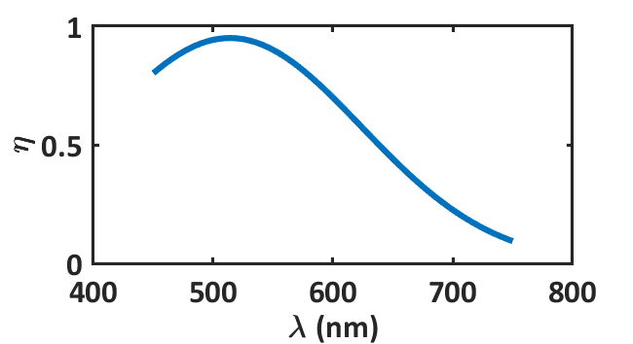
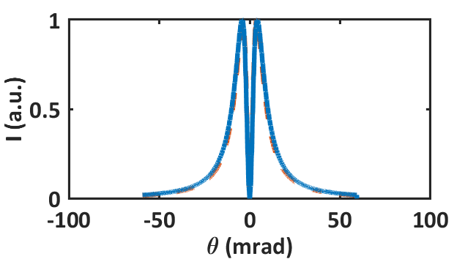
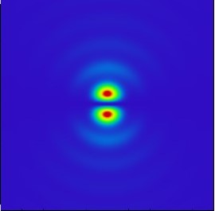
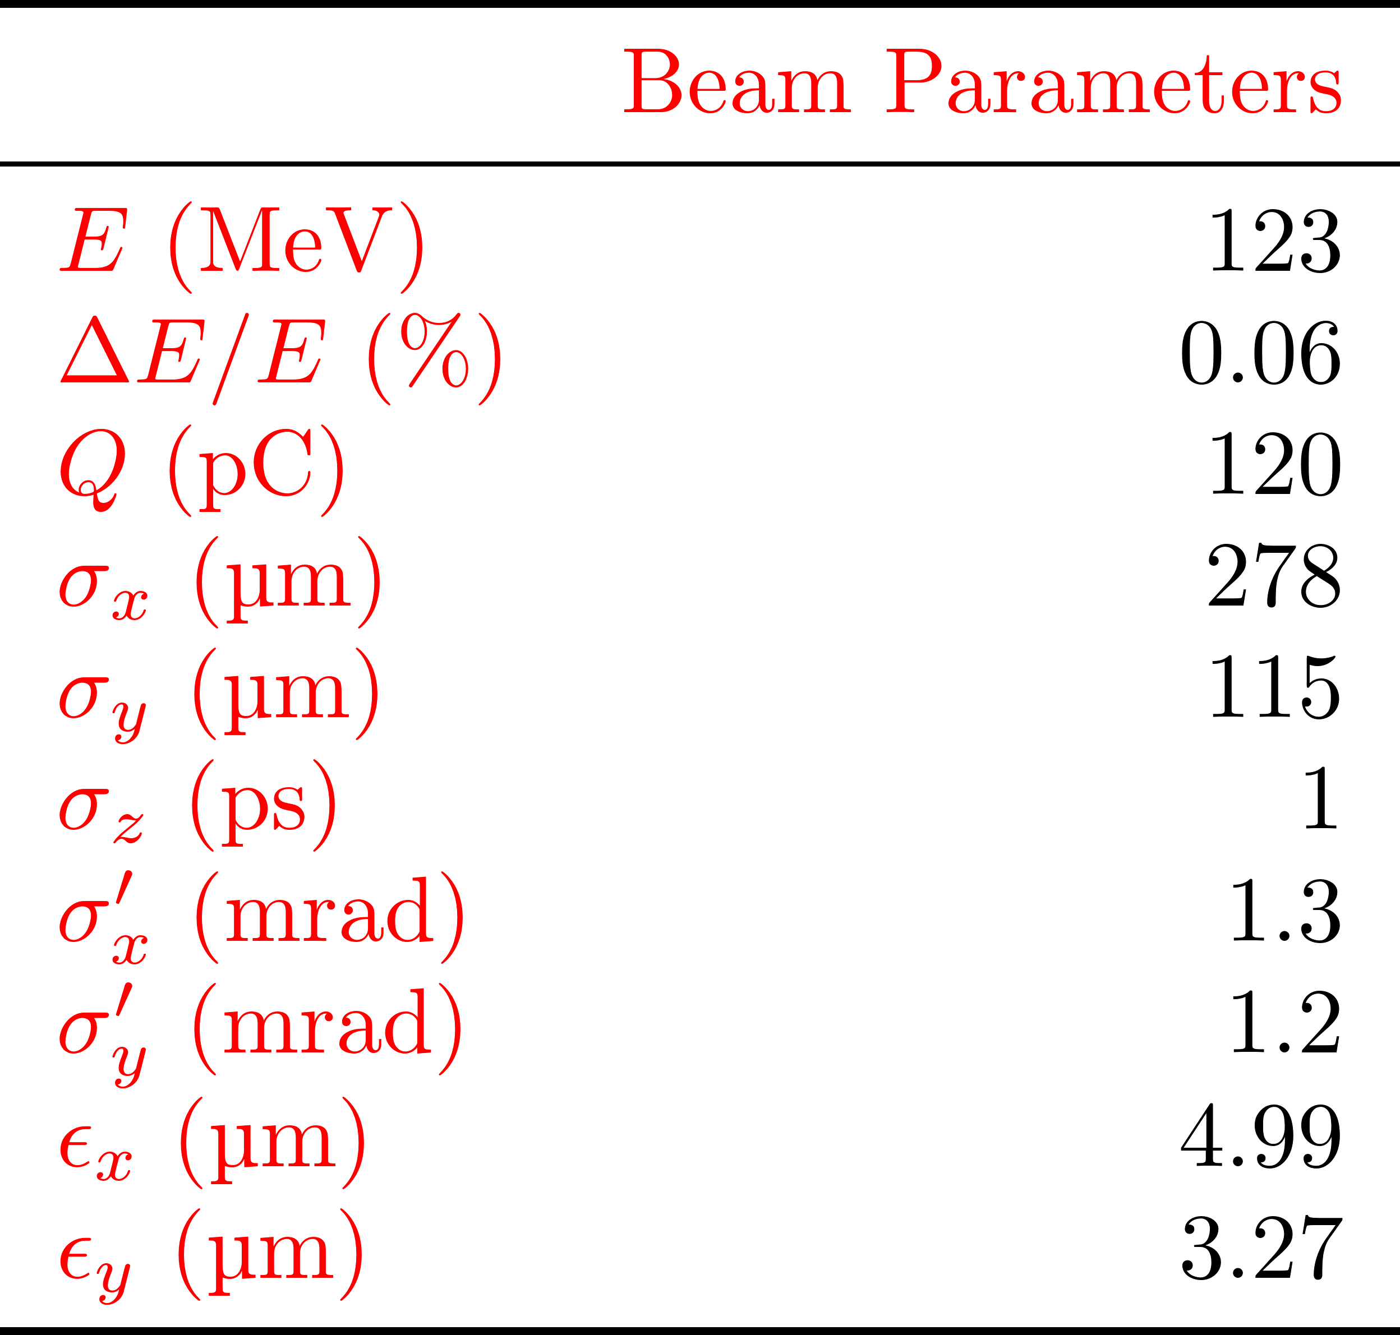
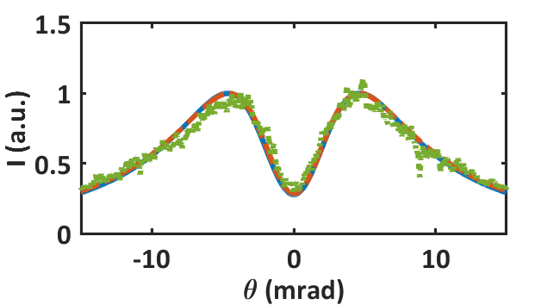
Zemax Simulation
Simulation
Theory
Data
F. Bisesto, A. Giribono, M. Croia
M. Marongiu, et al, WEPAL013, Proceedings of IPAC2018, Vancouver, BC, Canada

Slide 18
Further Development
Distributed energy measurement
  Define layouts
Bunch to bunch measurements
  Gating System Characterization
  Intensifier Characterization
Zemax Programming Language (ZPL) Macro
  Full Spectrum OTR Beam
  Longitudinal Information
IP Diagnostics
  Measurements @ LAL -> YAG limits

Slide 19
Thank you for your attention!

