Slide 1
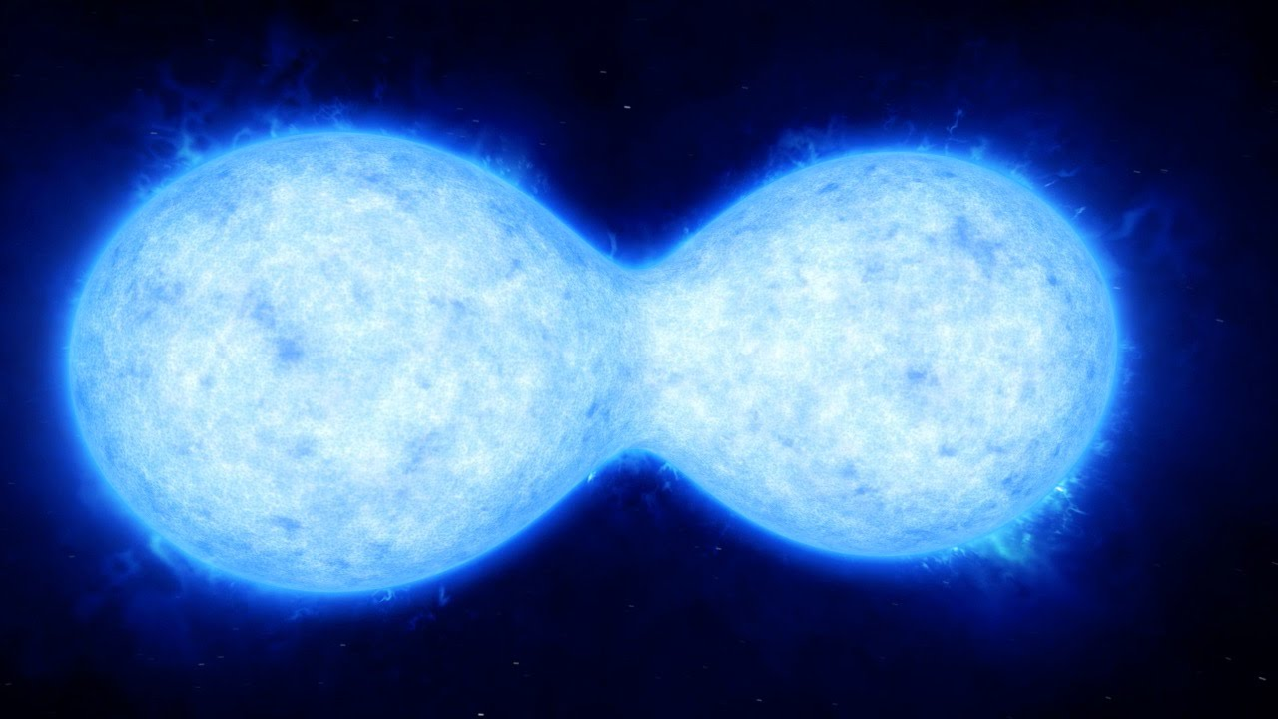

Slide 3
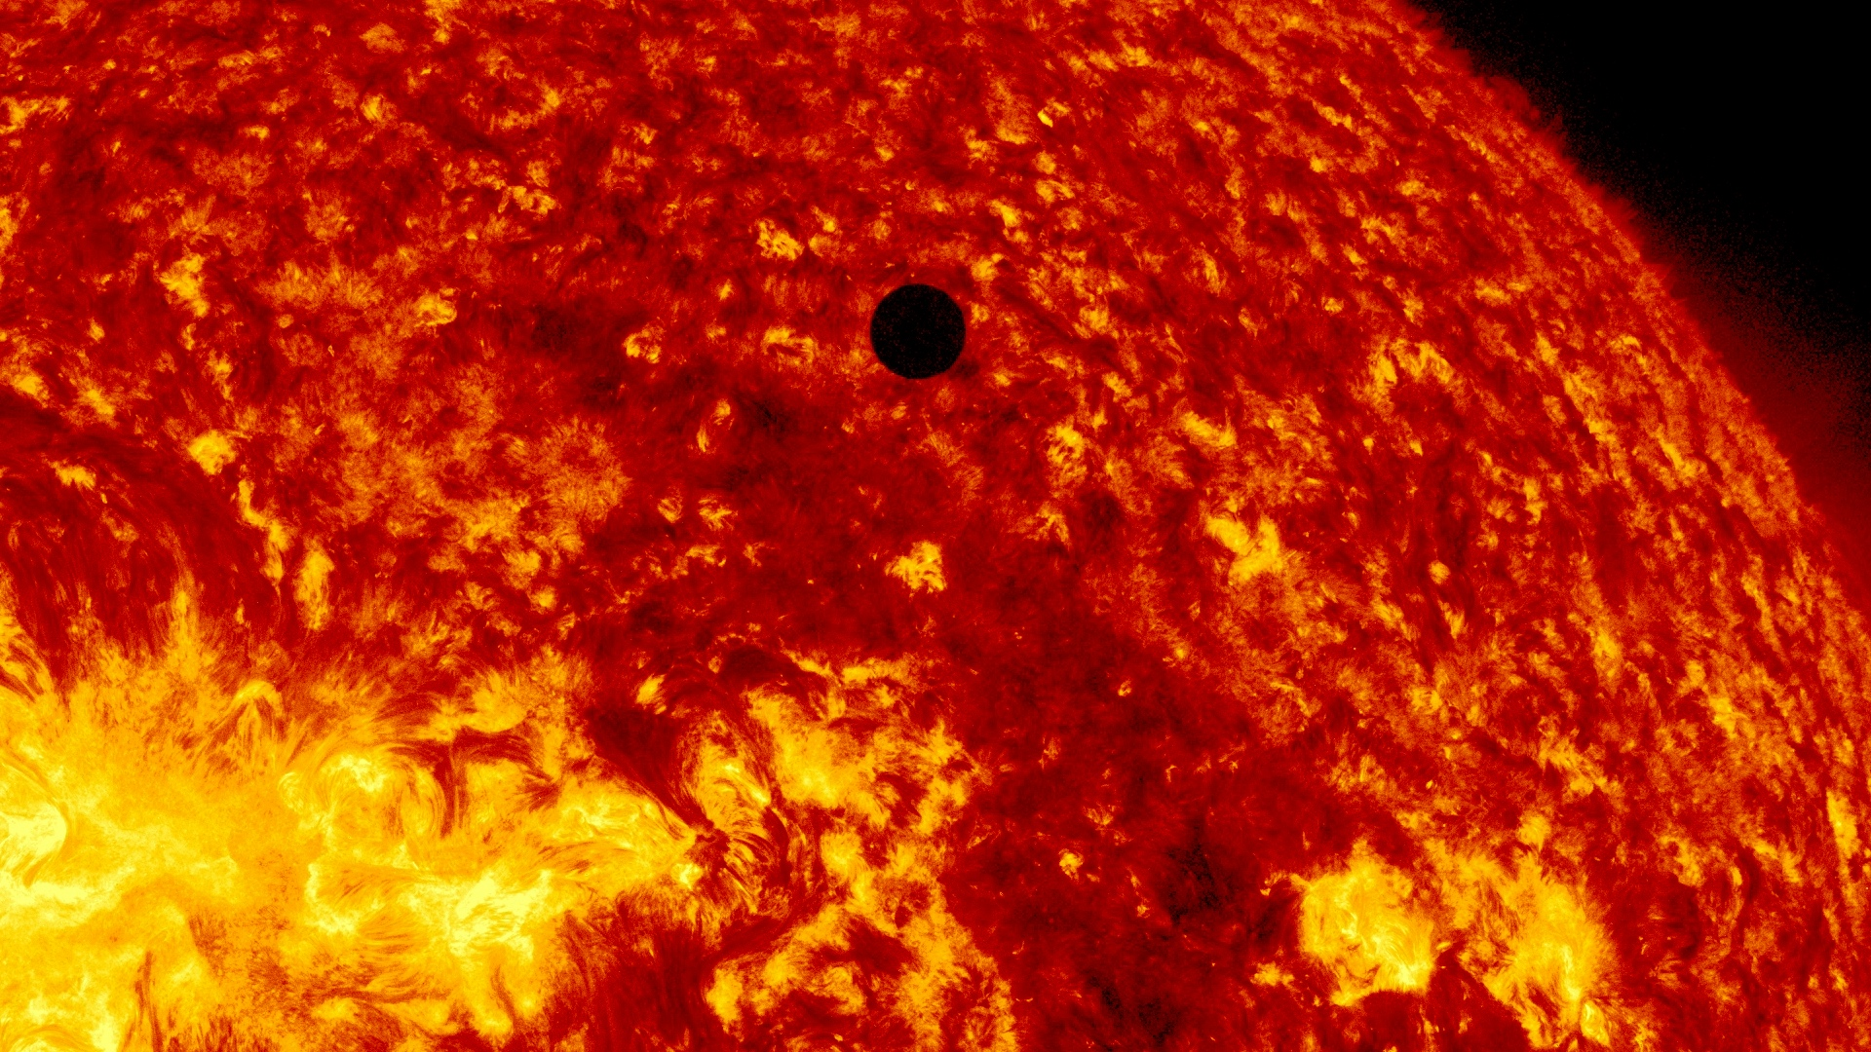

Slide 10
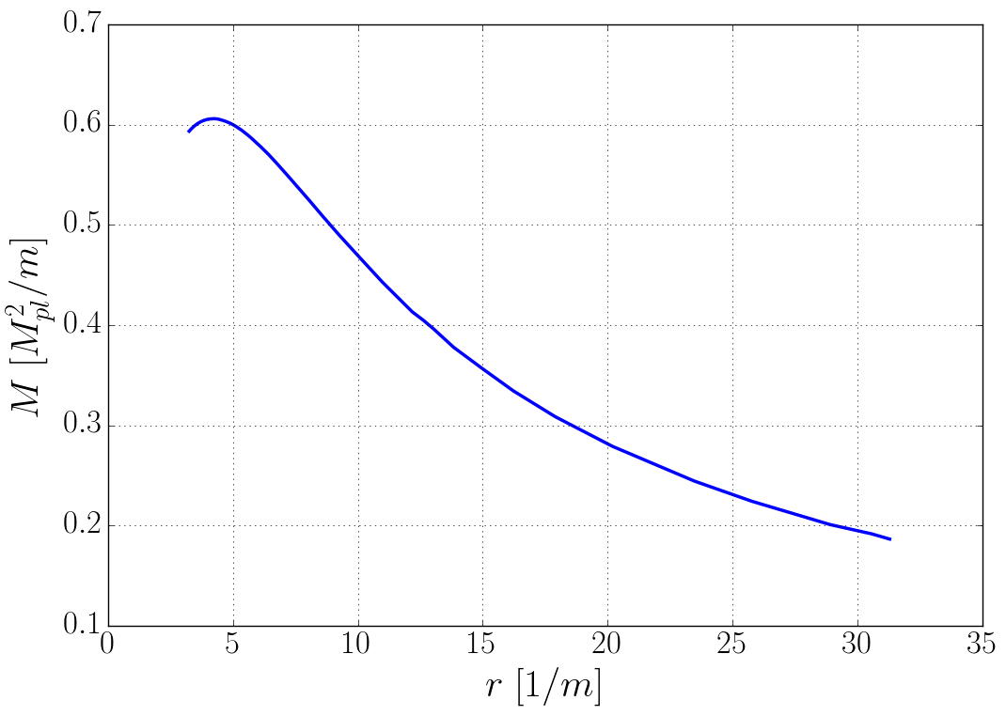

Slide 11
Head-on Collisions

Slide 12
Initial conditions

Slide 13
Initial conditions

Slide 14
Initial conditions

Slide 15
Initial conditions

Slide 16
Initial conditions

Slide 17
Initial conditions

Slide 18
Initial conditions

Slide 19
GRChombo
Numerical General Relativity code with Adaptive Mesh Refinement
MPI/OpenMP
Vectorised (AVX-512 compliant, ready for KNL)
BSSN/CCZ4+ScalarField
Available now on github.com/GRChombo

Slide 21
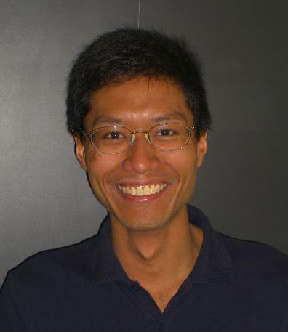
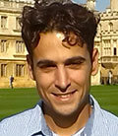
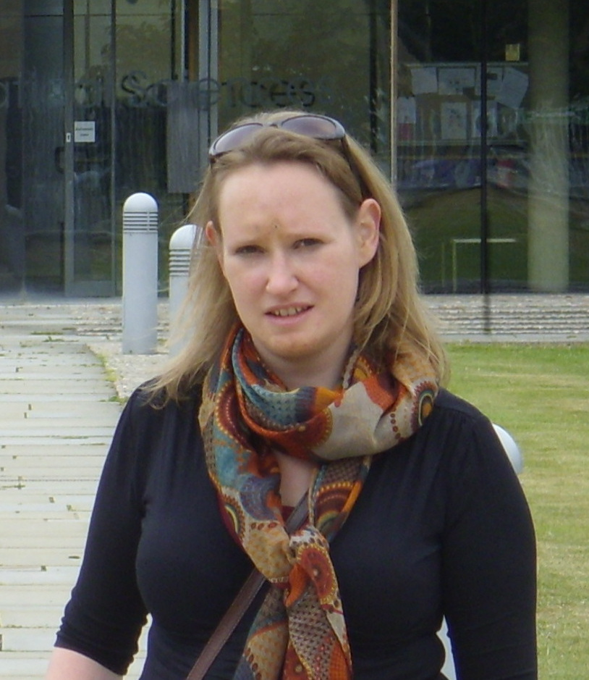
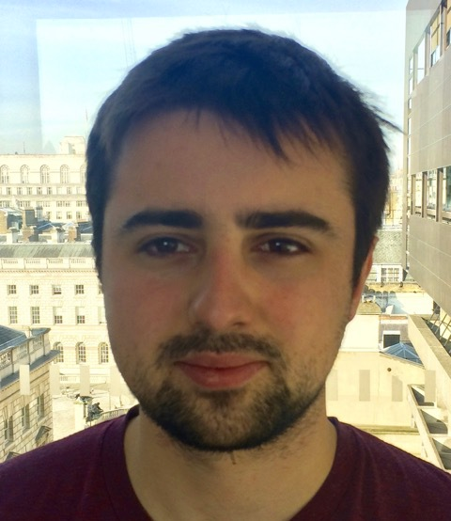
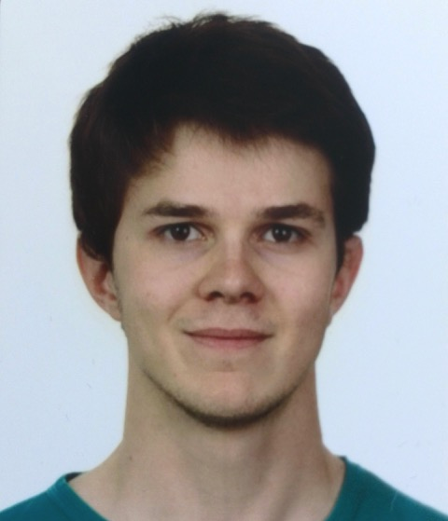
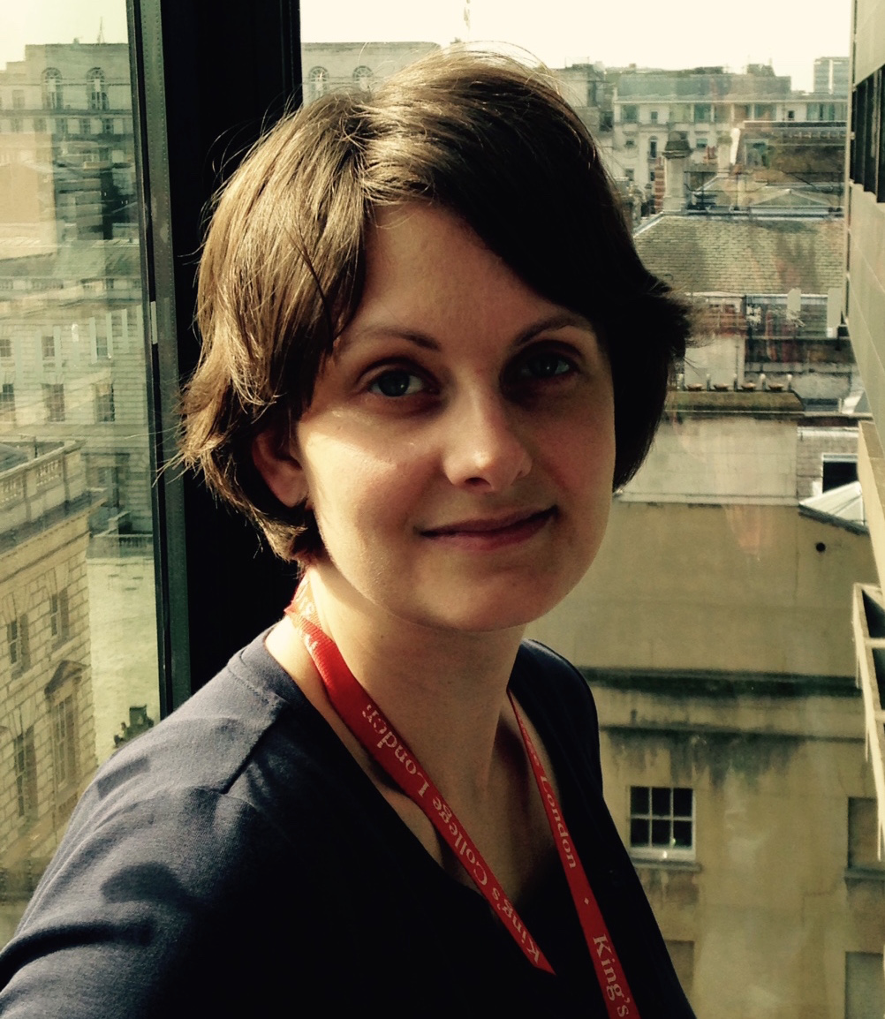
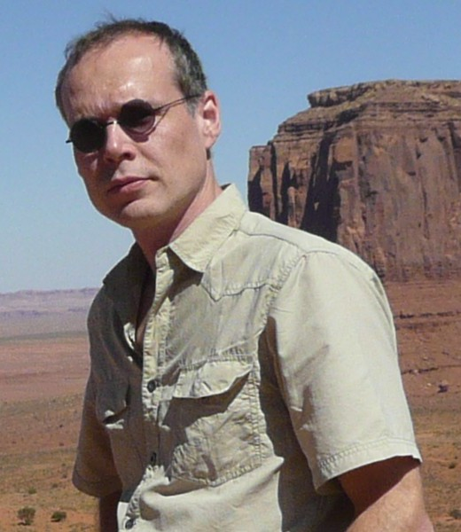
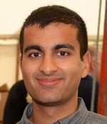
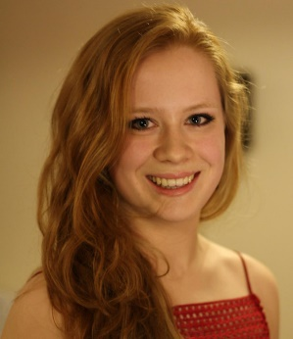

Slide 22
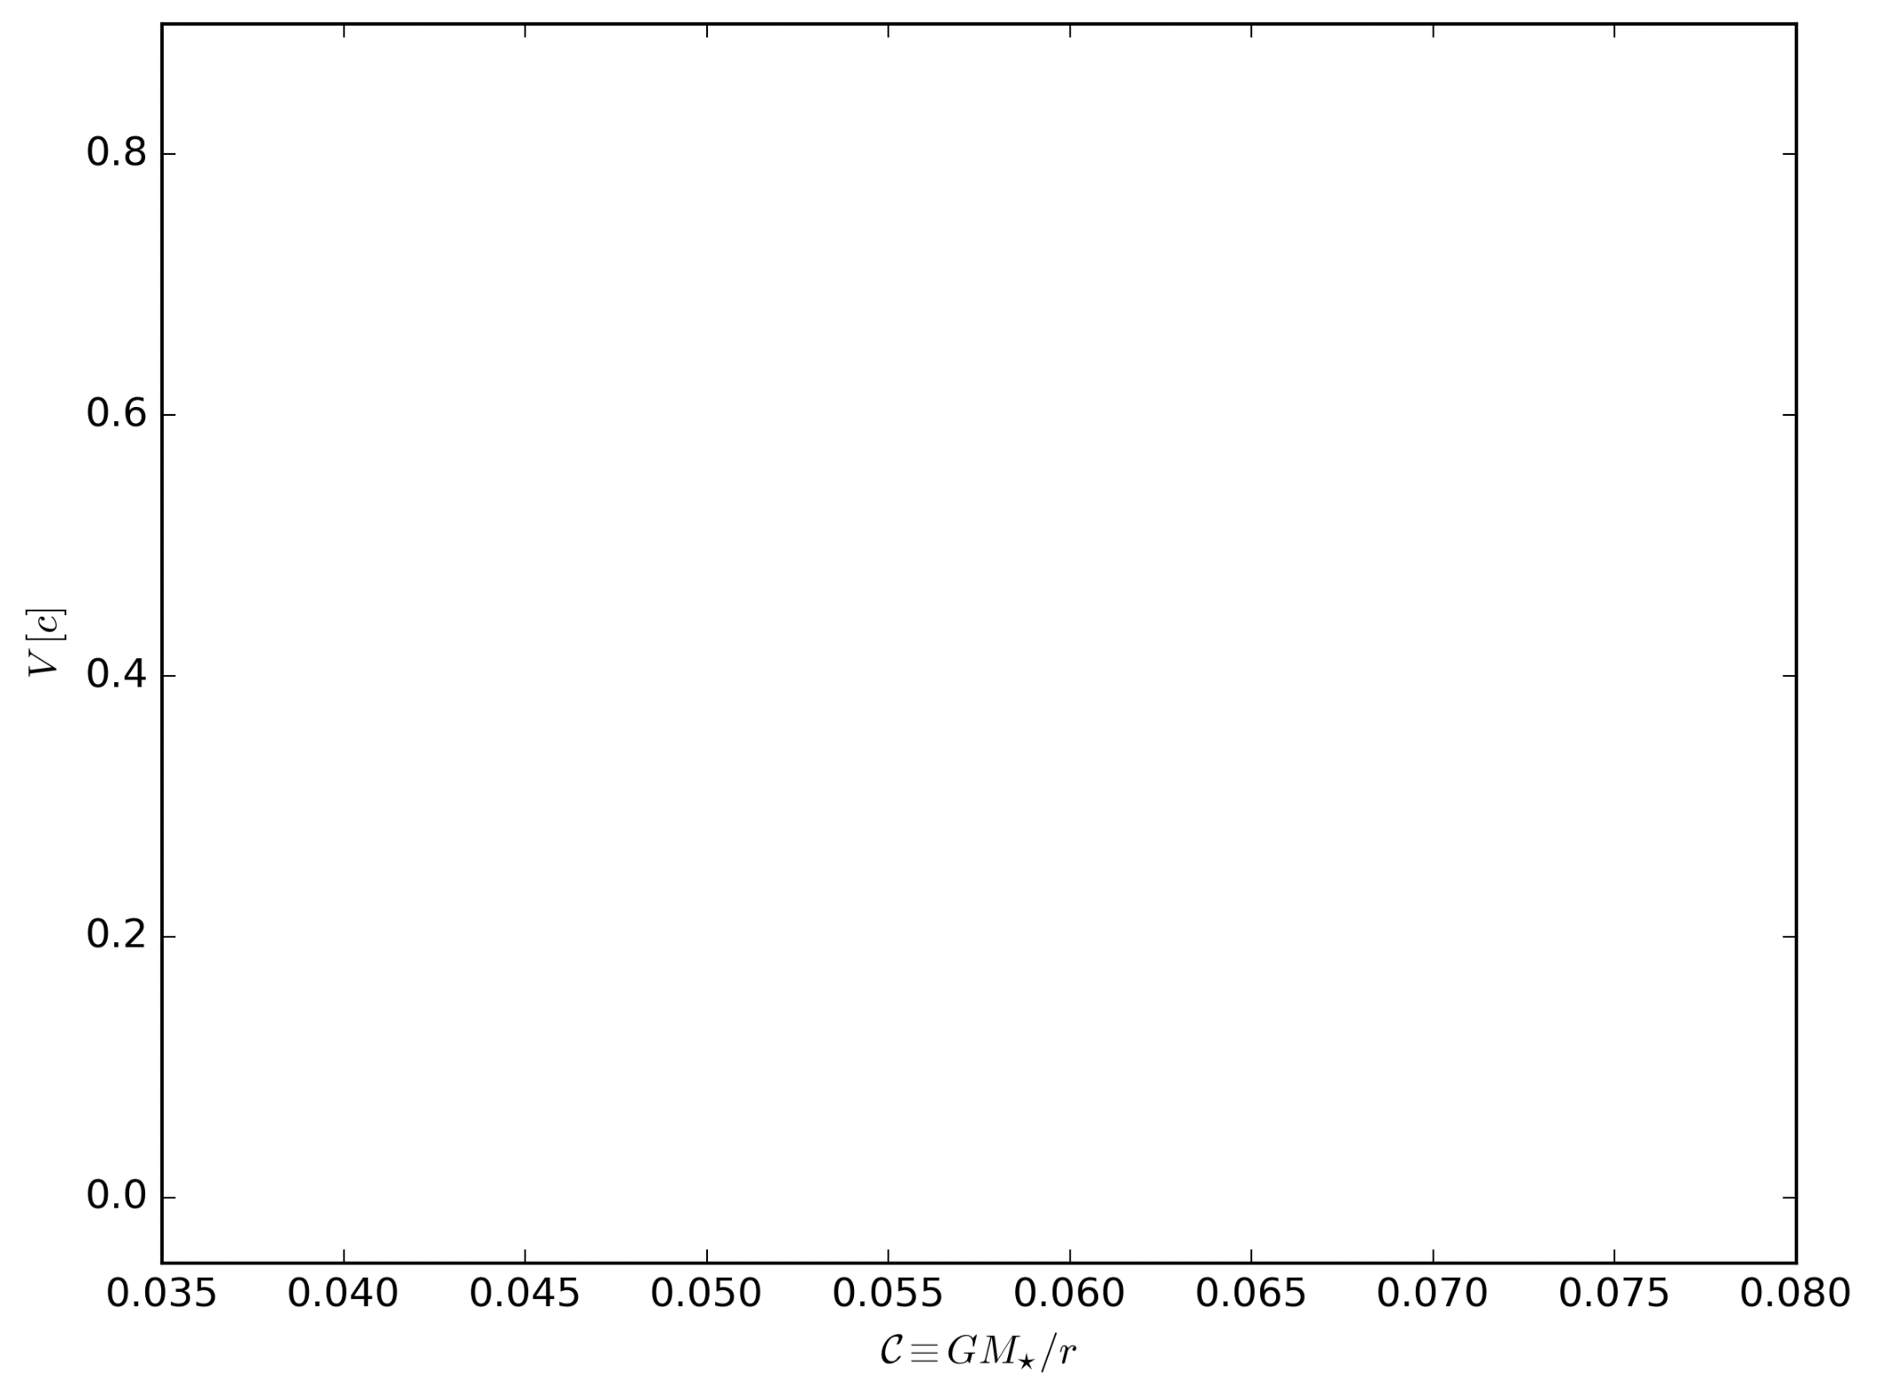
Results

Slide 23
Results

Slide 24
Results

Slide 25
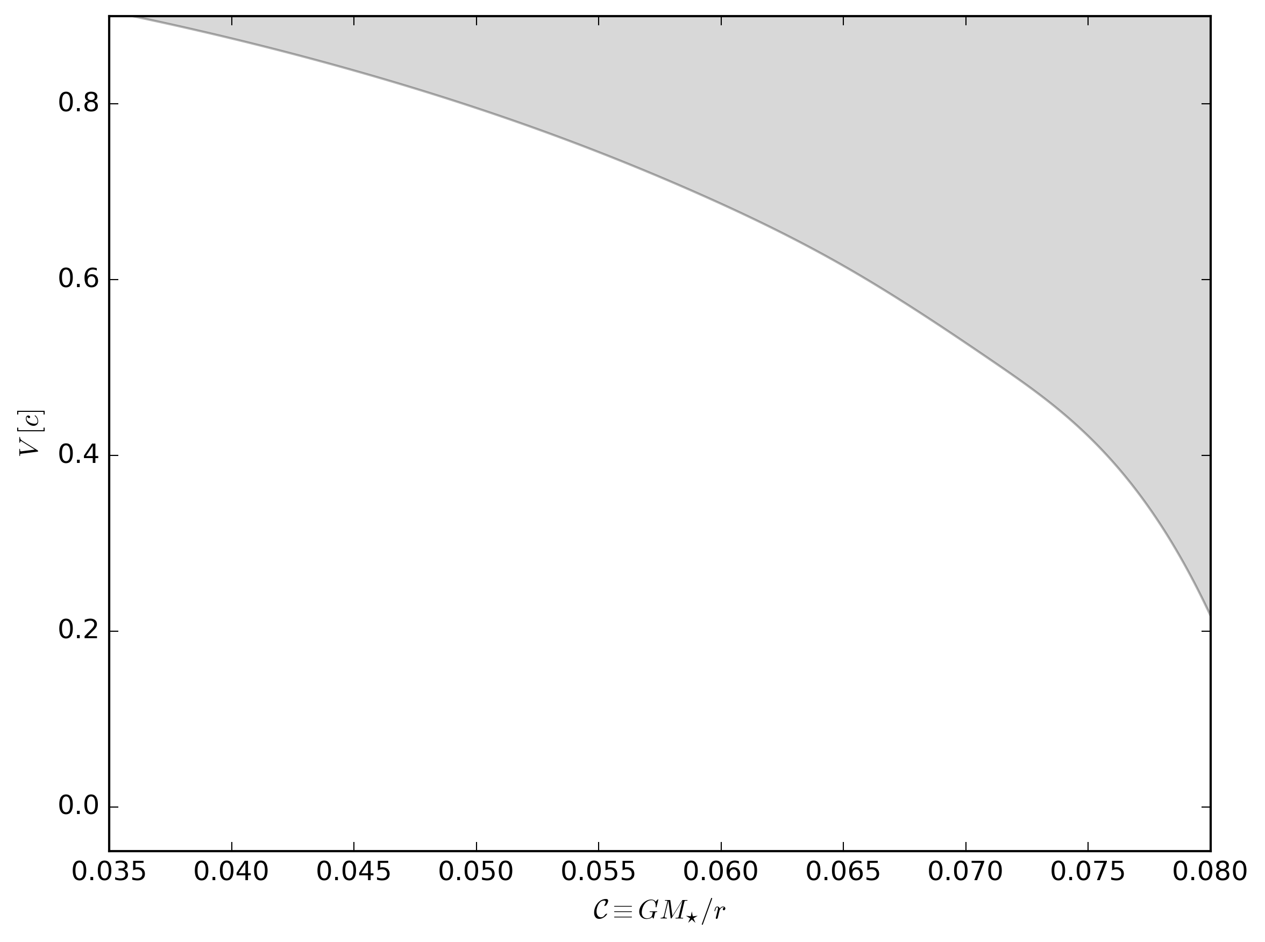
Results

Slide 26
Results

Slide 27
Results

Slide 28
Results

Slide 29
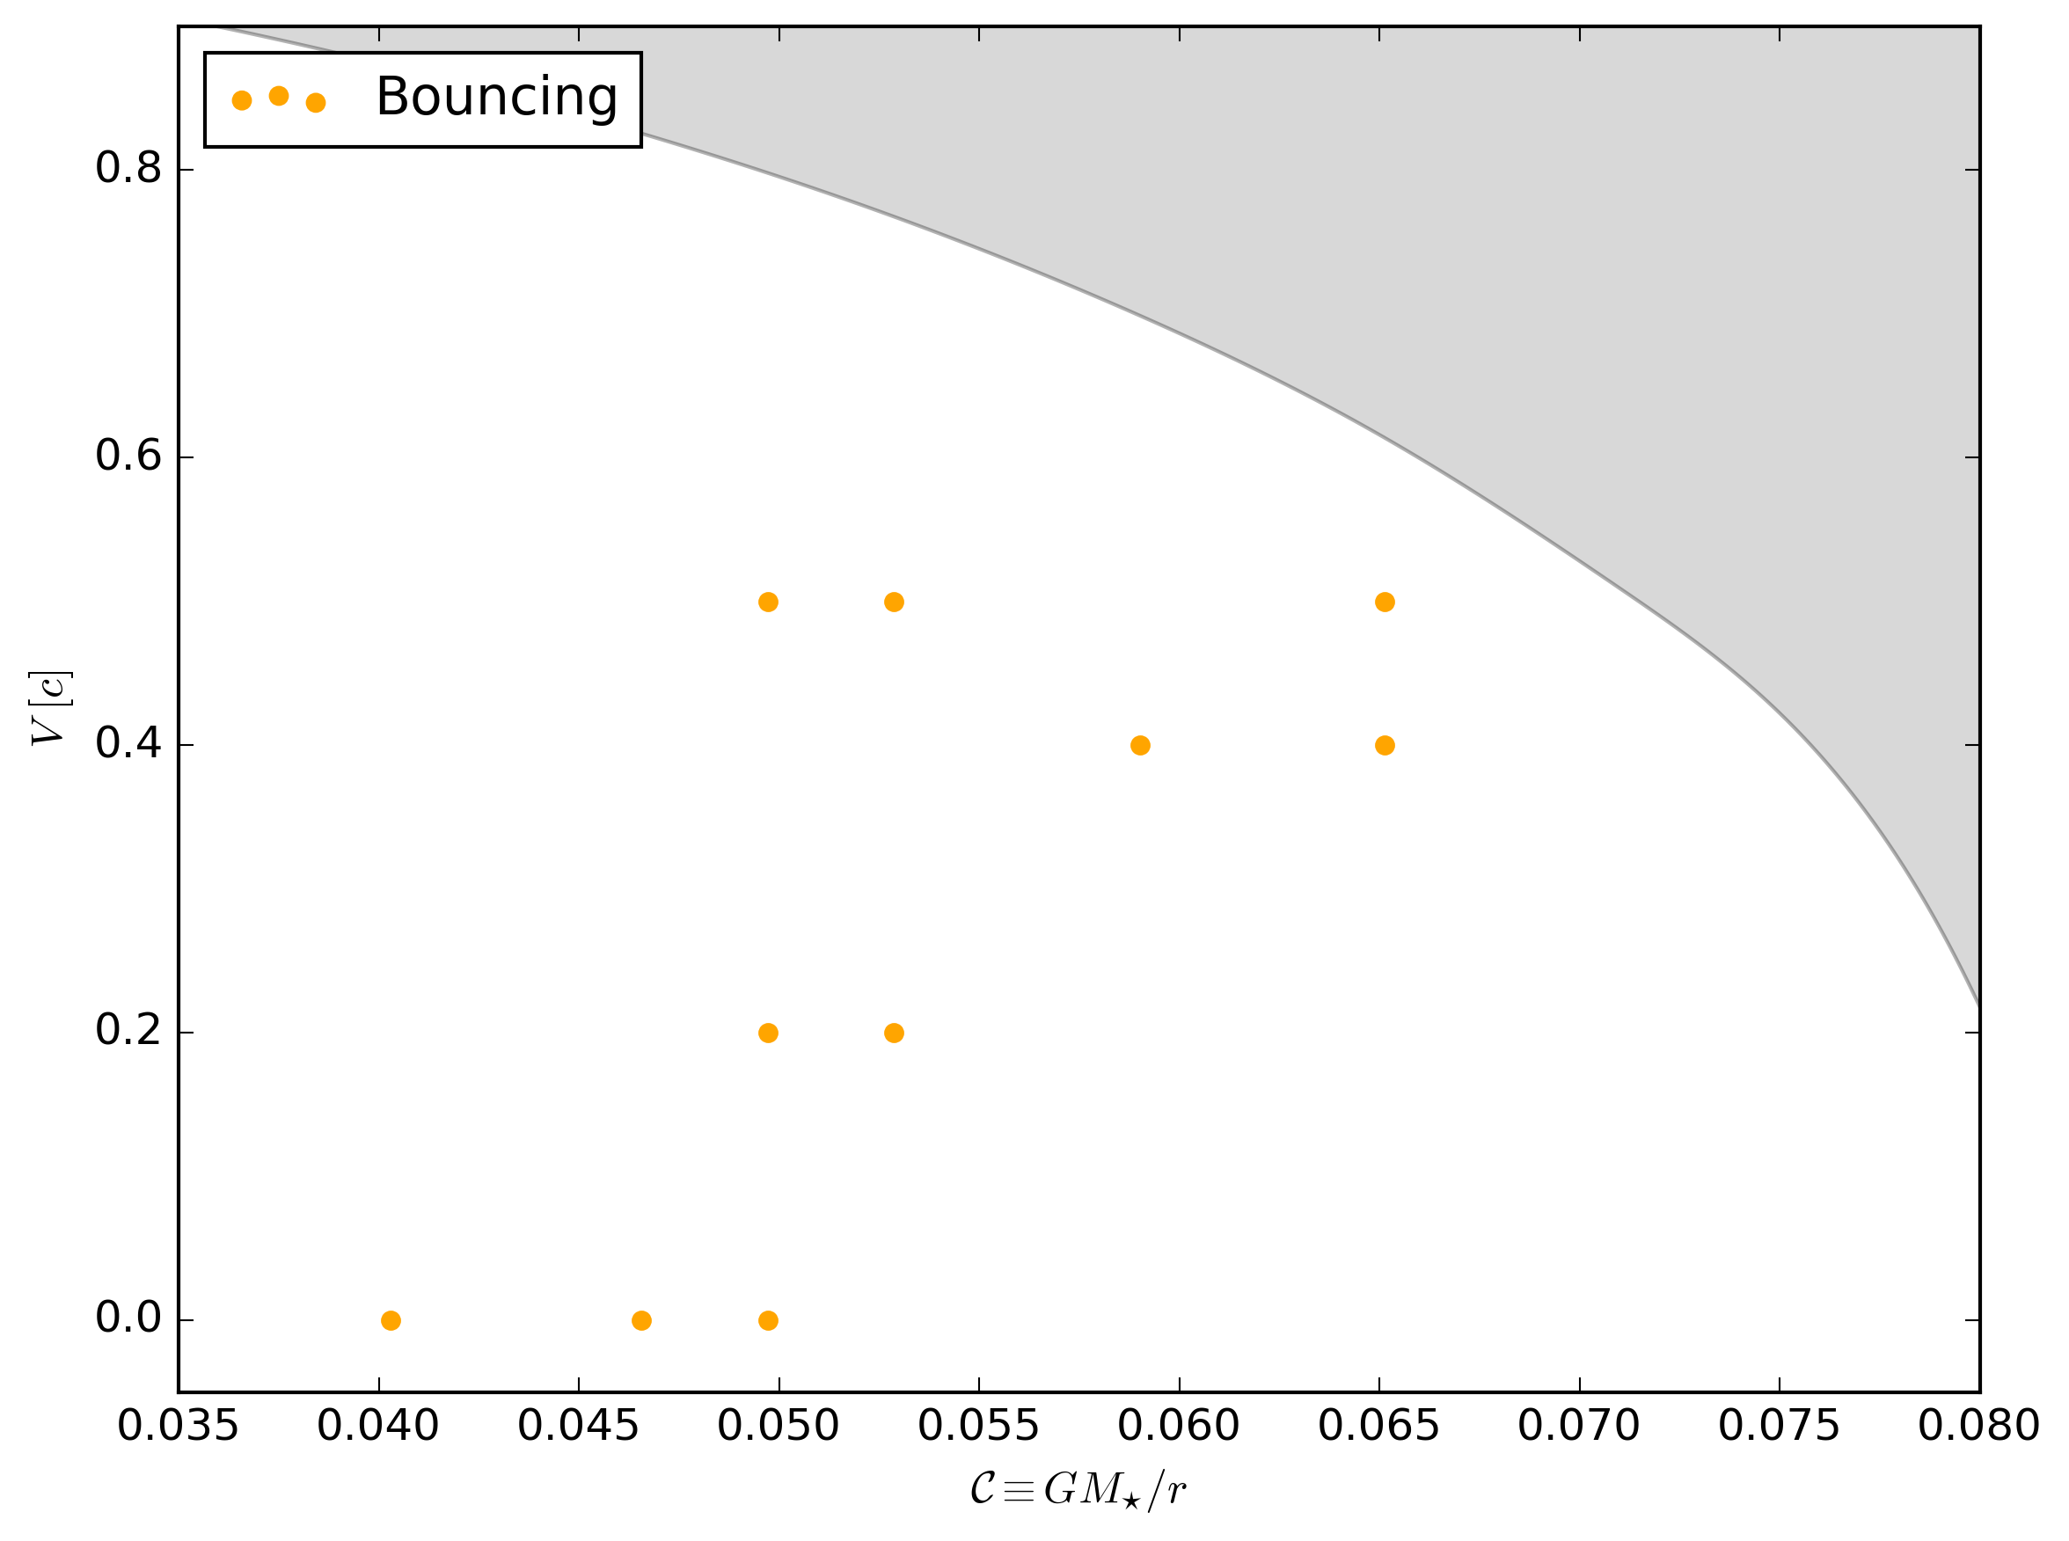
Results

Slide 30
Results

Slide 32
Results

Slide 33
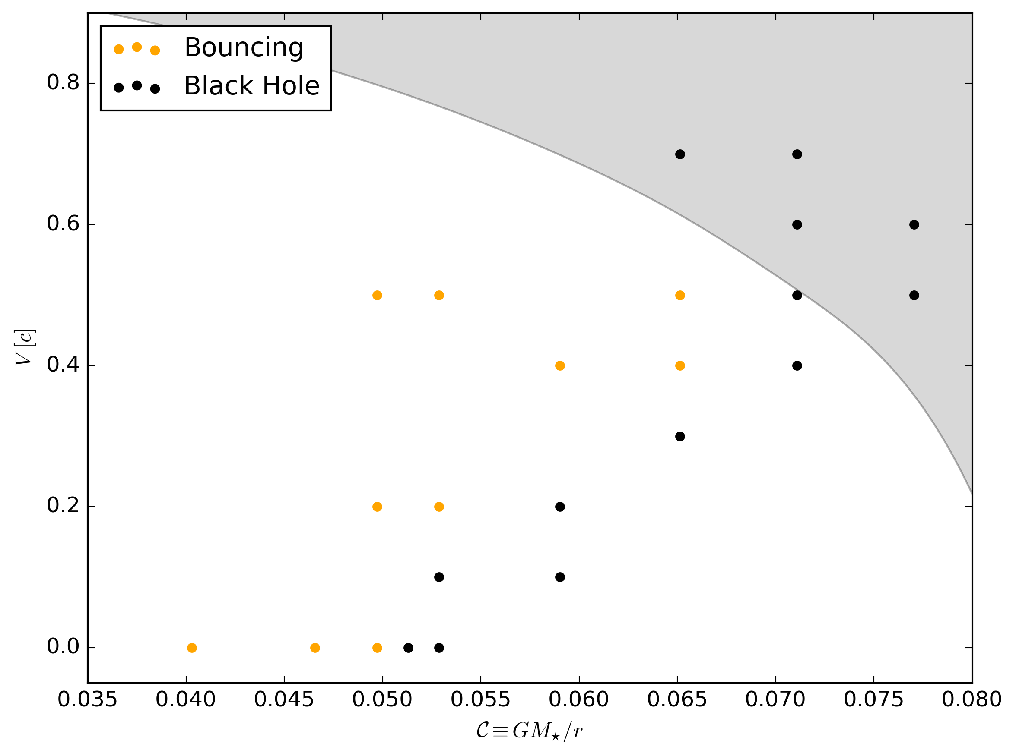
Results

Slide 34
Results

Slide 39
Results

Slide 40
Results

Slide 41
Effect on Binaries – Future work

Slide 42
Any Questions ?

Slide 43
Extra

Slide 44
Scattering

Slide 45
Dispersion

Slide 46
Cosmic Strings

Slide 47
Black Hole

