Slide 1
Summary of ADC Site Jamboree 2018 https://docs.google.com/document/d/1CqN2hOdLEtwIb_lsNZhwI9Un5RNdhdfCGyVnYNh4_q8/edit#

Slide 2
Appello ai siti/personale

Slide 3
Data Processing

Slide 4
Data management

Slide 5
2018 running plans

Slide 6
Tier-2 consolidation https://indico.cern.ch/event/692124/contributions/2901904/attachments/1611009/2558096/Jamboree_5March_T2_3.pdf

Slide 7
Tier-2 consolidation

Slide 8
Tier-2 consolidation

Slide 9
Tier-3 consolidation

Slide 10
Tier-3 consolidation

Slide 11
Tier-3 consolidation

Slide 12
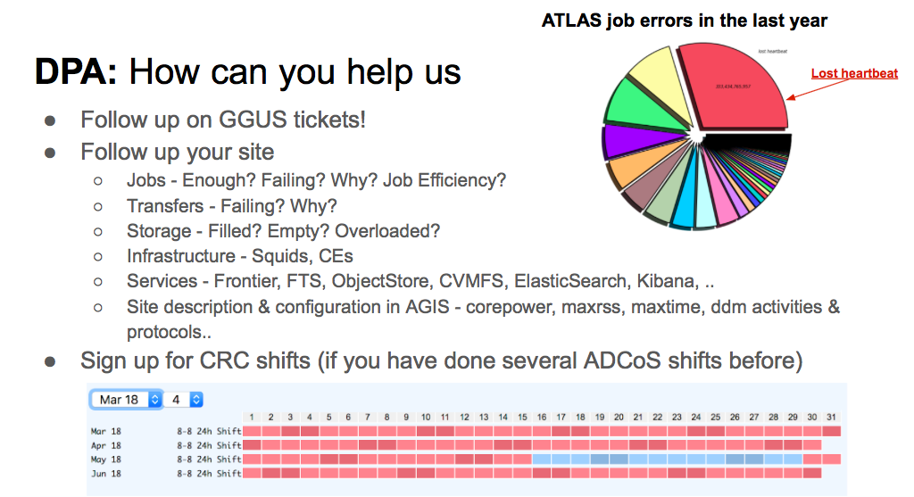
Distributed Production and Analysis team requests

Slide 13
ATLAS Site Requirements https://indico.cern.ch/event/692124/contributions/2898777/attachments/1611585/2559571/jamboree-2018-site_config.pdf

Slide 14
ATLAS Site Requirements https://indico.cern.ch/event/692124/contributions/2898777/attachments/1611585/2559571/jamboree-2018-site_config.pdf

Slide 15
ATLAS Site Requirements https://indico.cern.ch/event/692124/contributions/2898777/attachments/1611585/2559571/jamboree-2018-site_config.pdf
Keep sl6 and sl7 separated

Slide 16
ATLAS Site Requirements https://indico.cern.ch/event/692124/contributions/2898777/attachments/1611585/2559571/jamboree-2018-site_config.pdf

Slide 17
Unified Panda Queues https://indico.cern.ch/event/692124/contributions/2899912/attachments/1611637/2559722/UnifiedPandaQueue.pdf

Slide 18
HammerCloud Blacklisting https://indico.cern.ch/event/692124/contributions/2899914/attachments/1611506/2559099/BlacklistingOverview_ATLASSiteJamboree20180306_jschovan.pdf

Slide 19
Site Description https://indico.cern.ch/event/692124/contributions/2899911/attachments/1611612/2559328/Site_description_20180306.pdf

Slide 20
Event Service

Slide 21
FTS https://indico.cern.ch/event/692124/contributions/2899975/attachments/1611446/2559774/FTSAtlas_Jamboree.pdf

Slide 22
Cache recomandations

Slide 24
WLCG Evolution https://indico.cern.ch/event/692124/contributions/2903109/attachments/1612631/2561342/WLCG-ATLAS-290218.pdf

Slide 25
WLCG Evolution https://indico.cern.ch/event/692124/contributions/2903109/attachments/1612631/2561342/WLCG-ATLAS-290218.pdf

