Slide 1
General information (Part A)
Title:
Development of innovative high-performance calorimeters and photon veto detectors for the KLEVER project (2017E5FAMM)
ERC classification:
Main: PE
Subfield: PE2_2, Particle physics. Others?
Other general info for Part A:
Keywords
Short abstract (1300 chars)
Application should now be visible on-line

Slide 2
Personnel and research units
Original assumption for KLEVER PRIN: Only Principal Investigator (PI) and Associated Investigators (AIs) to be costed for co-funding
Not formally necessary to cost participants who are not PI or AI
But, for NA62 Run3 PRIN all participants are costed

Slide 3
Personnel and research units
PI has to register with REPRISE (done, but I need to update CV & Pubs)
All Associated Investigators (AIs) must confirm participation, which involves:
Curriculum vitae (10000 char)
Previous grants (2000 char)
Recognition (2000 char)
Publications (20 pubs)
h-index (World of Science, Scopus, other)
Common choice of source of h-index
Can we use INSPIRE (as “other” source of h-index”)
Submit merge requests to Scopus/WoS right away!
Status:
Only Ferruccio and Ezio have confirmed participation so far
Ezio has only 1 listed publication
Particpants must also confirm participation
Is above information requested for participants?
It does not appear in proposal

Slide 4
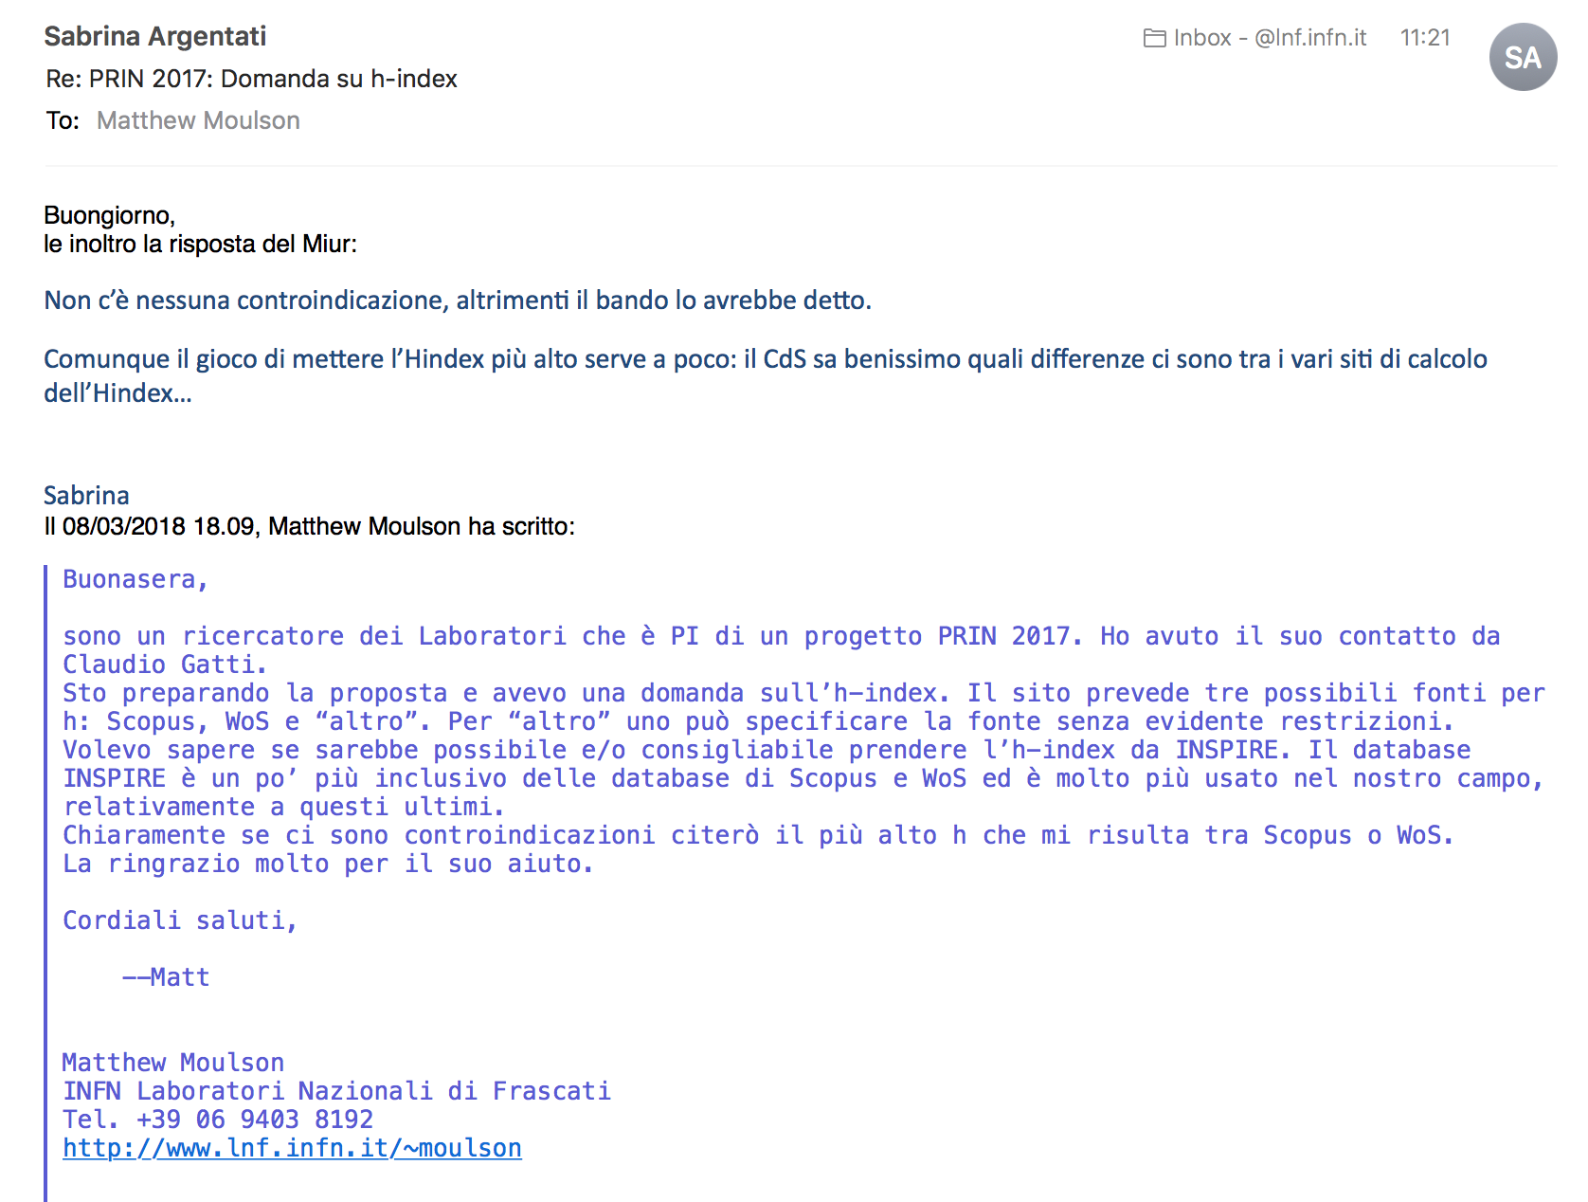

Slide 5
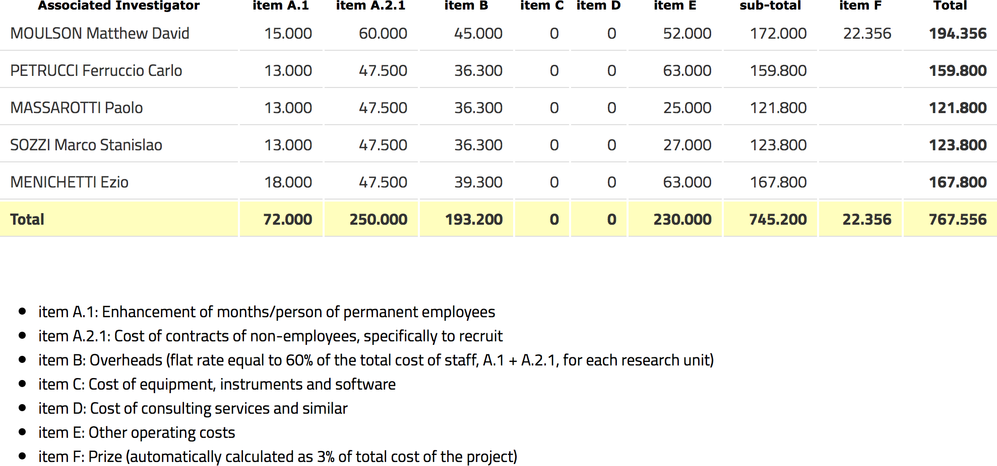
Budget
3 MU
2 MU
3 MU
2 MU
2 MU
Notes:
A.1: Need exact numbers for co-funded personnel costs?
A.2.1: 1 assegno 24 months per research unit
INFN assegno costed at €60k → bonus Roma

Slide 6
Participants
Location | INFN | University
Frascati | Moulson* | n/a
Ferrara | Gianoli | Petrucci*
Napoli | none | Massarotti*, Ambrosino
Pisa | Fantechi(?) | Sozzi, Costantini, Giudici(?)
Torino | Biino | Menichetti*, Migliore
Questions:
Need verbal confirmation from all participants to add to proposal
How many MU (if any) to list as dedicated to the project
How many MUs to cost
Complications from adding assegnisti outweigh possible advantages (T/F?)

Slide 7
Part B1: Project description
Abstract (5000 char ~ 1.5 pages in 12pt Word)
Mainly what was circulated to INFN (4300 chars)
Description (20000 char ~ 6.5 pages)
Goals expected to be achieved
Significance of goals in terms of advancement of knowledge
State of the art
Proposed methodology
Project development (10000 char ~ 3.5 pages)
Role of each unit with respect to achievement of goals
Integration, synergies, collaboration
Application potential (5000 char ~ 1.5 pages)
Scientific, technological, social, and economic impact

Slide 8
B1.2: Description
Project description section (B1.2):
Introduction:
Flavor problem in the SM, search for new physics
FCNC decays as probes, special role of K → πνν
NP sensitivity of K → πνν in specific models
State of current K → πνν measurements:
NA62 and KOTO
KLEVER, scope of previous PRIN project, continuity, PBC, status
General and innovative features of KLEVER, role of calorimetry
Role of specific systems in measurement of K_{L} → π⁰νν
Shashlyk calorimetry for Main Calorimeter and UV
LAVs
SAC
Readout systems

Slide 9
B1.2: Description → B1.3: Development
Project description section (B1.2), core part
For each system:
Significance to measurement of K_{L} → π⁰νν
State of the art, limitations of present technologies
Description of proposed solution
Specific project goals (prototypes, beam tests, etc.)
Project description section (B1.3), core part
Refer to specific goals and cost exercises detailed in following

Slide 10
Shashlyk calorimetry
Significance (Main calorimeter = “LKr”):
Event reconstruction: Efficiency, energy and position resolution
Event timing: Time resolution and matching
Particle identification: Rejection of μ, π, n interactions
Significance (Upstream veto)
State of the art:
Insufficiency of NA48 LKr vis-à-vis above requirements
Geometrical constraints and service life issues for LKr
Proposed solution:
Shashlyk calorimetry with longitudinal readout
KOPIO experience demonstrates sufficiency with respect to efficiency and enegy resolution
Protvino simulations indicate potential for particle identification capability
Specific goals:
Development of a cost-effective shashlyk design specific to KLEVER needs
Construction of prototype (2019)
Study of light readout (SiPM and front-end) (2019)
Beam tests at Frascati and/or Protvino (2019-2020), CERN (2021)

Slide 11
Shashlyk calorimetry
Materials and costs: Assume construction of 1 module
Scintillator tiles: 4kE
5 cm x 5 cm x 1.5 mm, Protvino: €2.50 ea?
4 x 400 tiles (~80 cm depth)
WLS fiber: 1 kE
144 x 0.8 m = 115 m, €3.4/m
Lead: negligible cost
SiPM+Front end: 2.9 kE
€400/channel, 4 channels + extra SiPMs to test (€300)
Assumes commercial front-end solution and digitizer HW on hand
Need to ask for more funds if developing own front-end
Mechanics for prototype, mounting & positioning: 10 kE (→ 3 kE?)
Mechanics for vacuum test (UV prototype): 2kE
Cylinder for test + 2 flanges ISO 200
Test beam transport: 1 kE
Total cost for Shashlyk: 20.9 kE
Primary responsibility: NA
Other considerations: Need model for collaboration with Protvino

Slide 12
Large-angle vetoes
Significance:
Photon veto: Coverage to 100 mrad with efficiency down to low energy (10⁻⁴ inefficiency at 100 MeV)
Cost-effective design: sensitive volume is very large
State of the art:
CKM VVS design, lead-scintillating tile
Studies of similar detectors for E949 and KOPIO suggest efficiency sufficient
Test of CKM VVS prototype at BTF, JLAB for CKM and NA62
Proposed solution:
Update and adapt CKM design for KLEVER
E.g. readout by SiPM in vacuum instead of PMT
Specific goals:
Small prototypes to test scintillating materials and SiPMs in laboratory (2019)
Source for high-quality, low cost scintillator and scintillating fiber essential to construction
Construction of prototype for beam testing (2020-2021)
Vacuum load measurements
Preliminary mechanical design, tests of assembly models and techniques

Slide 13
Large-angle vetoes
Materials and costs: Assume full-scale construction of 2 sectors
Scintillator tiles: 10 kE
1000 cm2 x 5 mm, Protvino: €50 ea (including machining)
200 tiles (2 sectors x 100 layers, 60 cm depth)
WLS fiber: 8.2 kE
200 tiles x 60 cm/tile x 3.4
144 x 0.8 m = 115 m, €3.4/m = 1 kE max
Lead: negligible cost
SiPM+Front end: 2.9 kE
€400/channel, 4 channels + extra SiPMs to test (€300)
Assumes commercial front-end solution and digitizer HW on hand
Need to ask for more funds if developing own front-end
Mechanics for prototype, mounting & positioning: 3 kE (→ 10 kE?)
Mechanics for vacuum test (UV prototype): 2kE
Cylinder for test + 2 flanges ISO 200
Test beam transport: 1 kE
Total cost for LAVs: 40.2 kE
Primary responsibility: INFN (i.e. Frascati)

Slide 14
Small-angle vetoes
Significance:
Photon veto: Good efficiency at high energy
Inefficiency < 1% at 5 GeV, < 10⁻⁴ at 30 GeV
Transparency to GHz neutron fluxes
Excellent time resolution to avoid blinding by random veto
γ/n discrimination (transverse and longitudinal segmentation)
Good radiation tolerance
State of the art:
No existing detector known to satisfy all criteria
Proposed solutions:
Si/W sampling calorimeter with crystal absorber
Heavy Cerenkov (e.g. PbF₂) calorimeter
Specific goals:
Construct small-scale prototypes for each solution
Laboratory and beam tests of each prototype by 2021
Verify essential sufficiency of one or both technologies with respect to performance requirements

Slide 15
Small-angle vetoes (Si/W)
Materials and costs: 1 tower, 3 x 3 cm
Tungsten tiles: 86 kE
10 x 10 x 1 mm³ (MatecK quote 2018, 3 pcs):
€900 material + €525 for surface finishing
Assume price for 30 x 30 x 1 mm² scales with size
10 layers
Provisional light readout for proof-of-principle test: 4kE
Scintillating tile or fiber
10 channels commercial SiPM readout, €400/channel
Possible Si detectors available in house or for ready purchase
Precision mechanics: 10 kE
Transport and material for test beam 0.5 kE
Total cost Si/W prototype: 100.5 kE
Primary responsibility: FE, TO
Other considerations: Avoid overlap with L. Bandiera PRIN project

Slide 16
Small-angle vetoes (Cerenkov)
Materials and costs: 2 layers, 4 x 4 cm2
PbF₂ blocks: 3.6kE
1 piece 20 x 20 x 50 mm (SICCAS quote, 2014): €400
PWO blocks: 3.6kE
1 piece 20 x 20 x 50 mm (SICCAS quote, 2014): €400
PMTs
1 PMT Hamamatsu R9880U-210: €500. 8 pz = 4 kE
Assume HV supply and readout with equipment on hand
Alternatively: SiPM readout: 3.7 kE (already purchased for Si/W?)
8 channels commercial SiPM readout, €400/channel = 0.5 kE for extra SiPMs to test
Enclosure and mechanics: 2 kE
Transport and material for test beam 0.5 kE
Total cost Cerenkov prototype: 17.4 kE
Primary responsibility: FE, TO

Slide 17
Readout
Readout is the work item that most requires feedback at the moment
Significance
Time resolution ~100 ps for pulses from “LKr”, SAC to avoid blinding by random veto
Total (γ) rates on SAC from hadronic interactions could be (100) 400 MHz
Cost-effective solution: O(10⁴) “LKr” channels, O(10³) UV, LAV channels
Radiation tolerance: Radiation at least 6x worse than NA62
Digital trigger to ensure collection of adequate numbers of calibration events
K_{L} → π⁰π⁰, K_{L} → π⁰π⁰π⁰, K_{L} →γγ
State of the art:
NA62 readout systems: TEL62/CREAM
LHC readout platforms?
Proposed solutions
Develop characteristics of common platform for fast digitization of signals from all calorimeters/vetoes
Avoid commitment to specific technological implementation for the moment

Slide 18
Readout
Specific goals:
Study signals from detector/front-end prototypes
Identify cost-effective solutions for common platform architecture that meet all of the requirements, anticipating future trends
Estimate data rates from experiment and develop a trigger strategy that can be implemented on the common platform
Additional items to include?
Triggerless readout (Dario)
Hybrid/streaming readout (Gianluca)
No costs budgeted for now
Originally had 20kE for off-the-shelf HW for signal studies
Can put back funding request of this magnitude if we have a specific idea
Primary responsibility: PI, TO

Slide 19
B1.4: Application potential and impact
Theoretical and scientific impact
Technological progress for calorimetry in high-energy physics
Dissemination of results within scientific community
Link to theoretical community to provide input to further define KLEVER goals and ensure theoretical support for kaon sector physics
Organization of conferences and workshops
Cultural impact on general public
Broader outreach activities?

