Slide 1
Measurements and tests IT
Emiliano Dané – ITk Meeting – LNF - 5 Apr 2018

Slide 2
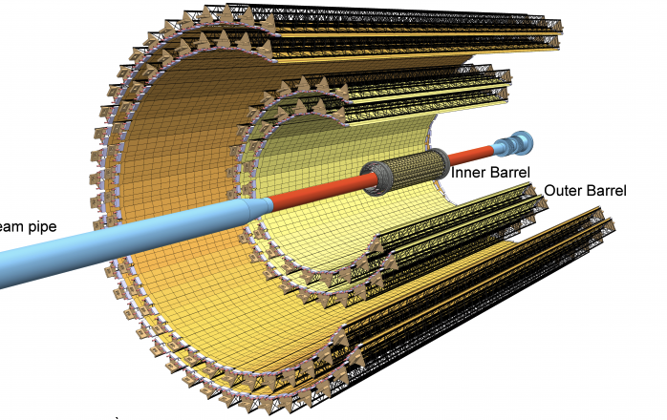
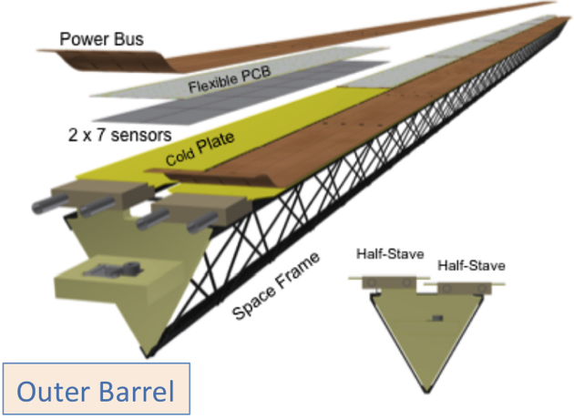
Alice ITS experience

Slide 3
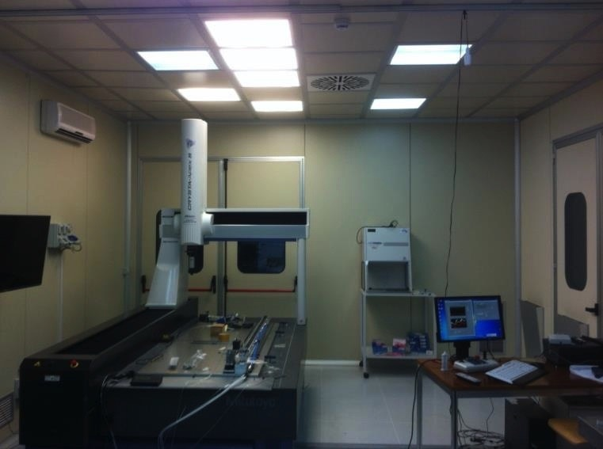
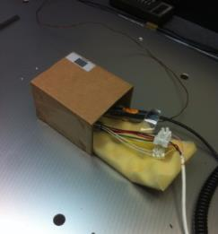
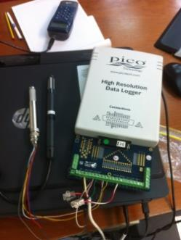
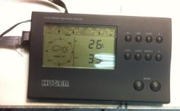
Clean Room Temperature Monitoring
We set up several enviroment temperature and humidity sensors in the clean room in order to acquire continuously and check the efficiency of our climatic system;
conditioning splitter
to be moved
Ch.2 Pico Temp&Humidity
Ch.2 Huger Temp&Humidity Sensor
Reference for calibration
2 channels pico technology
Ch.1 Pico Temp&Humidity Sensor
Ch.1 Huger Temp&Humidity Sensor

Slide 4
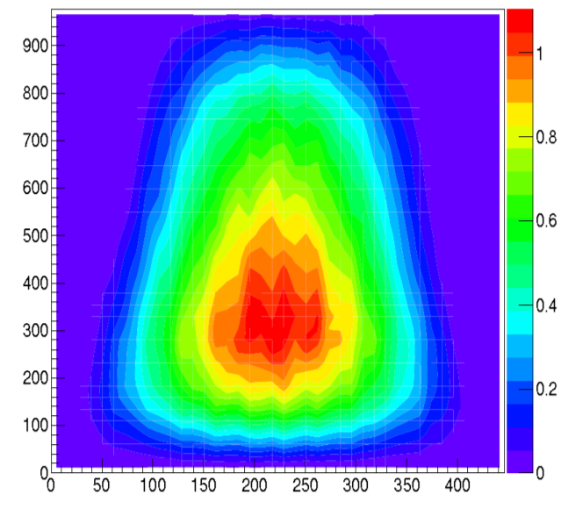
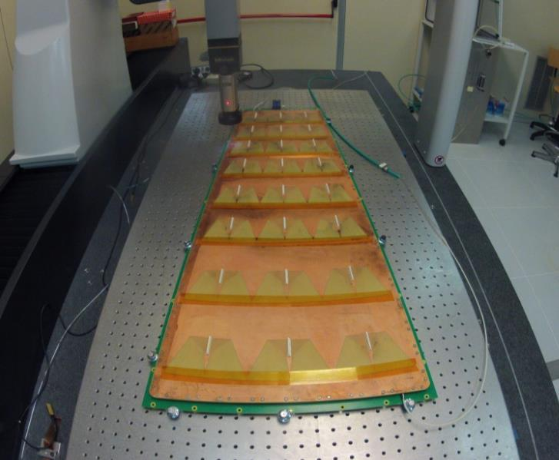
ALICE for CMS
Part 2 of Mitutoyo course (Nov 2015);
Measure of the GEM foil sagitta for CMS experiment;
This task useful for training on CMM and for developing new Utility Programs;
10x lens installed;

Slide 5
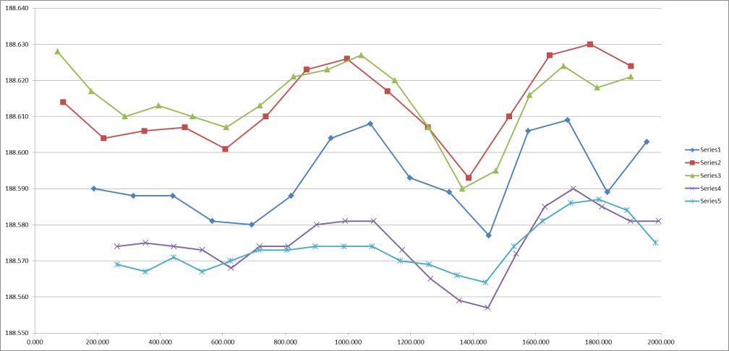
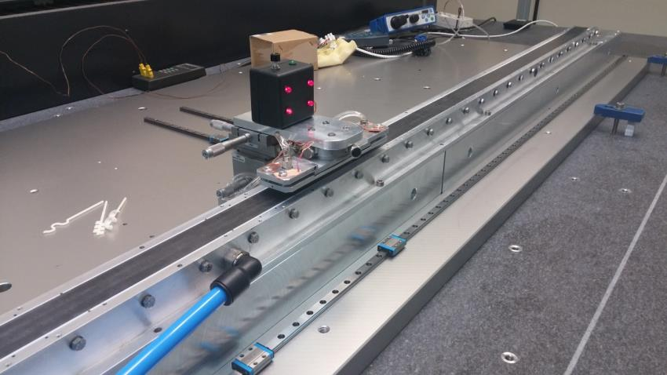
Qualification of planarity
Alcaplus Plate
Plan. <0.15 mm
LED system Torino-like
Al bars
Vacuum chamber
Alcaplus

Slide 6
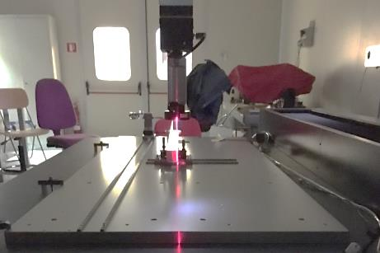
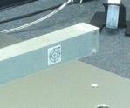

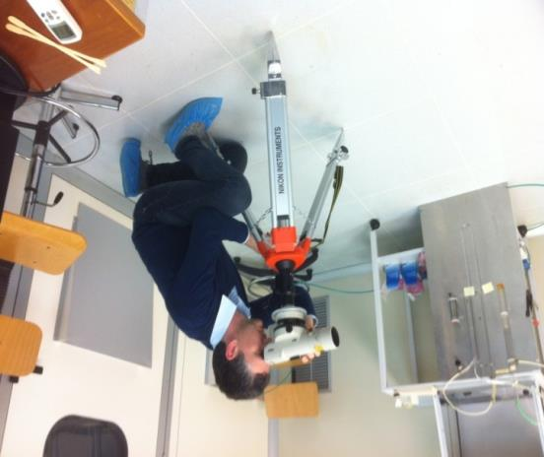
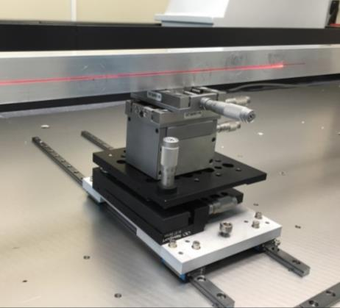
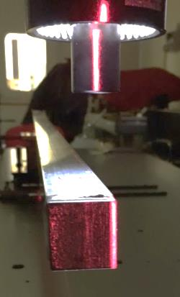
Simulation of HS Alignement on Space Frame
2 alignement systems: laser and optical;
Optical System
Laser Sytem

Slide 7
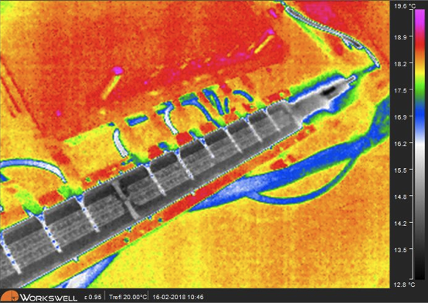
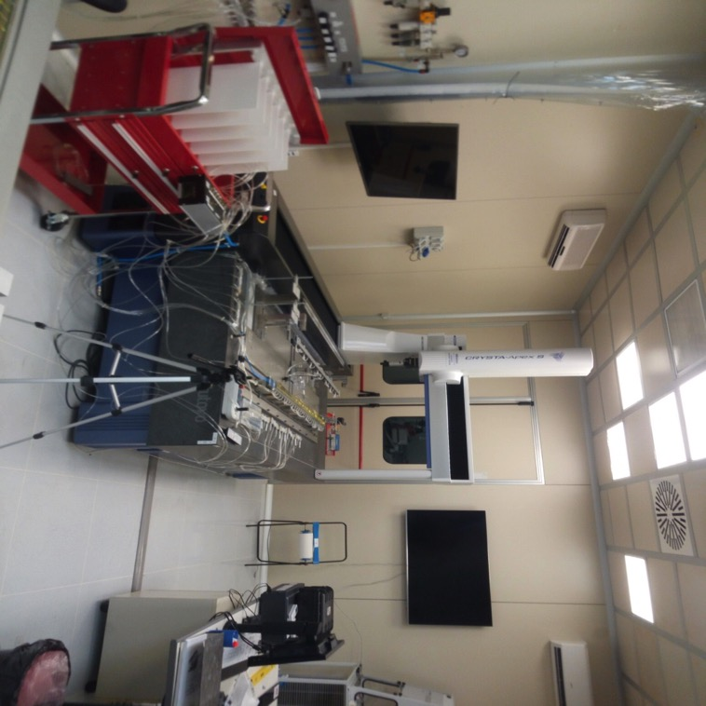
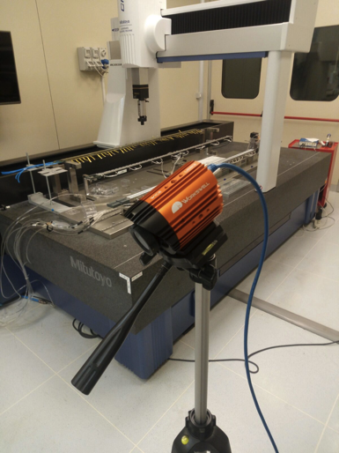
Stave Zero Status
HS0/Left/Lower on CMM
(glued, to be soldered once
HS0/R/U tested)
Mock Up

Slide 8

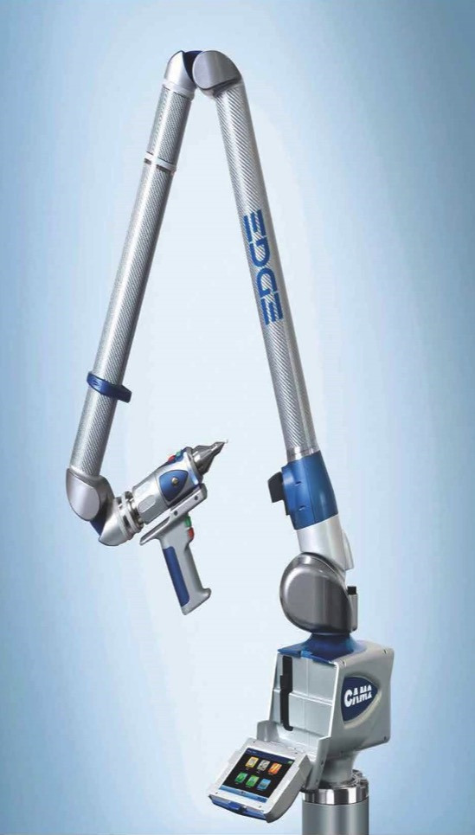
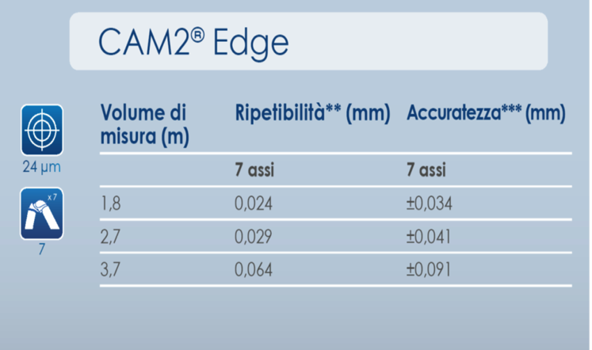
Luigi Pellegrino
Servizio Ingegneria Meccanica
CAM2 Edge Portable CMM:
(contact or laserscan measurement)
https://www.youtube.com/watch?v=0Hyp0SDY9sA

Slide 9

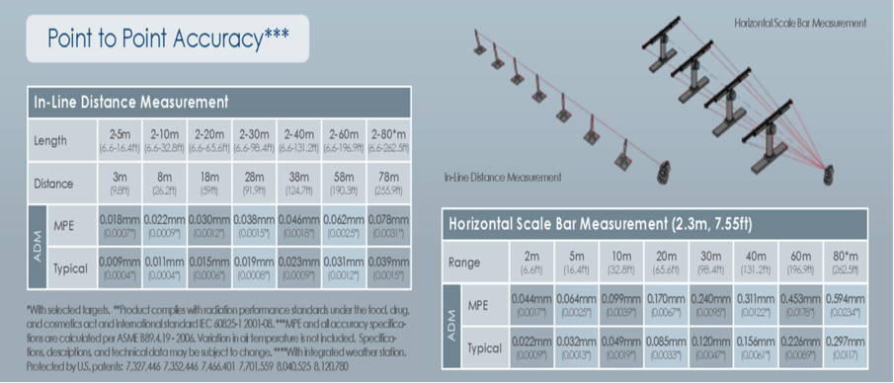
Luigi Pellegrino
Servizio Ingegneria Meccanica
FARO Laser Tracker Vantage: Measurement of the target position (contact measurement)
https://www.youtube.com/watch?v=Atb1lmfWvhQ

Slide 10


Slide 11
Tools
Laser arm
Laser tracker
Theodolite
CMM 2000x1000x600
CMM 1000x1000x500
Interferometer;
And more..
Traction machine
Microscopes

Slide 12
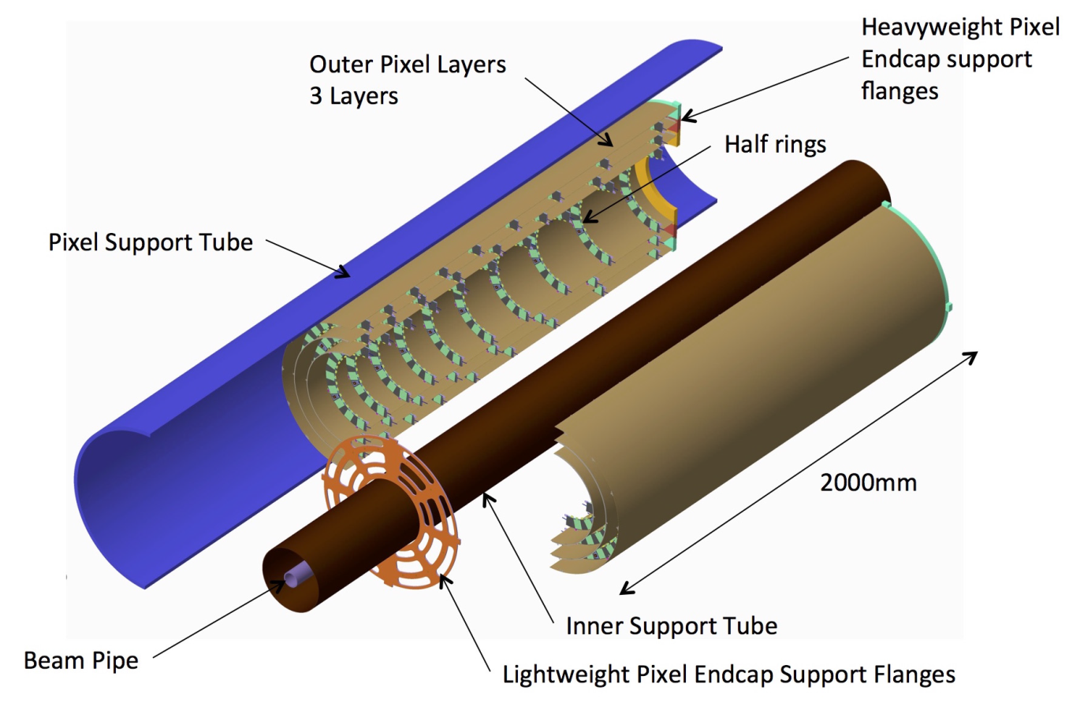
Step 0: fix tolerances and references.
Mechanical tolerance
  Quality of tools;
  Quality of components;
Positioning tolerance
  Tolerance of modules positioning;
  Tolerance of HR positioning;
  Tolerance of HC positioning;
  Tolerance of Cyl. positioning,;

Slide 13
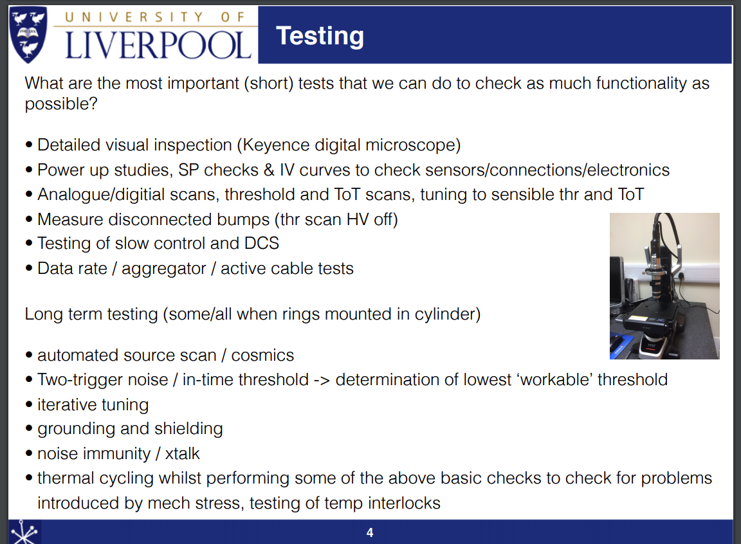
1. Reception test
TDR: “..reception testing leaving the half-ring attached to a handling jig. “
Reception tests of all components:
  Half Rings – mechanical
    visual inspection -> microscope;
    dimensional test -> CMM;
    pressure test -> already tested in HR assembly site;
  Half Rings - electrical (see presentation: Pixel System Test P. Dervan, J Taylor, I. Tsurin);
  Half Cylinders mechanical
    geometrical and dimensional test, brackets position;
Recovery in case of Half Rings test failure
Check of all the jigs before the assembly;
J.Taylor

Slide 14
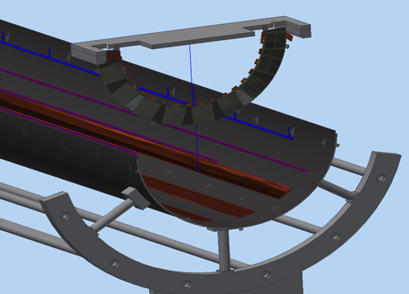
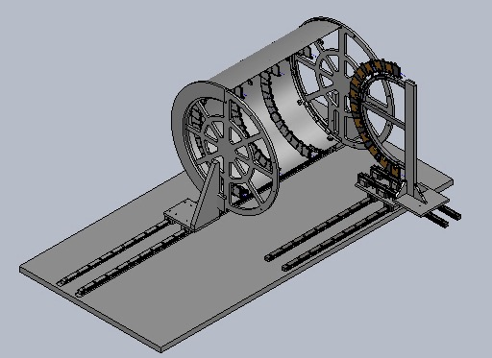
2. Half Ring Assembly Tests
TDR: “..using micro-adjusters the position of the half-ring relative to the half-cylinder is set and the half-ring is then translated side-ways into the half-cylinder.”
  All jigs involved have to be measured -> 0.1mm is totally different from 0.5 mm precision;
  Define some reference points on Cylinders and on HR;
TDR: “..the rigidity of the fixations is verified (how?) and the position of the half-ring surveyed (using points of reference)”

Slide 15
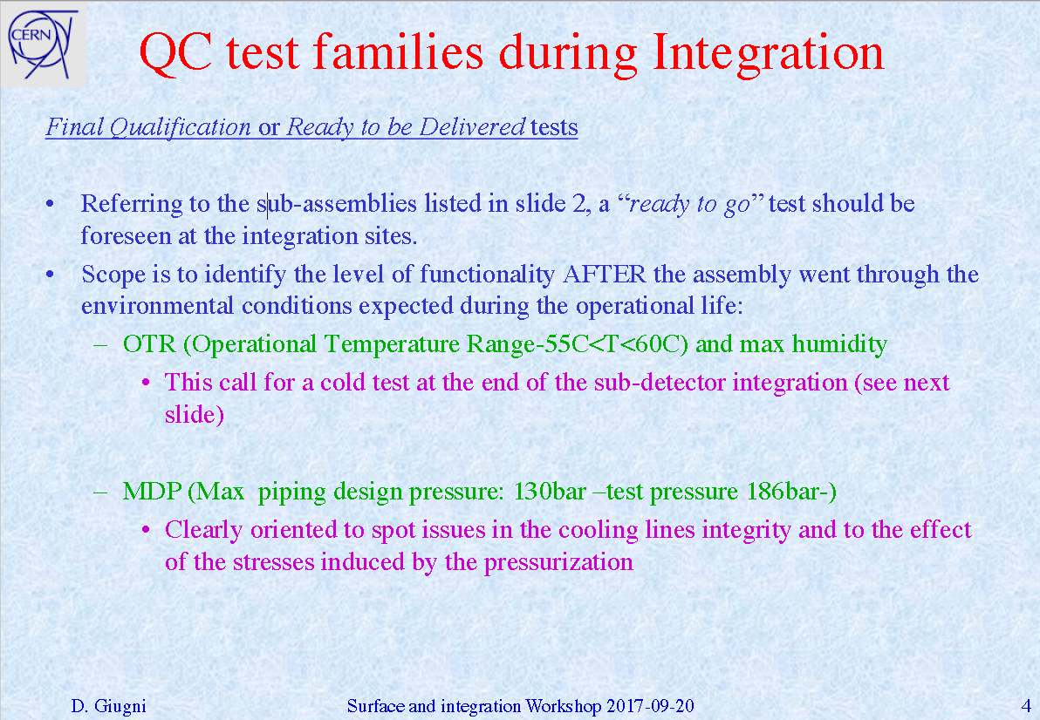
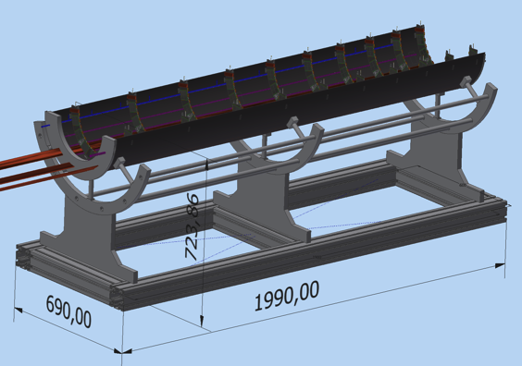
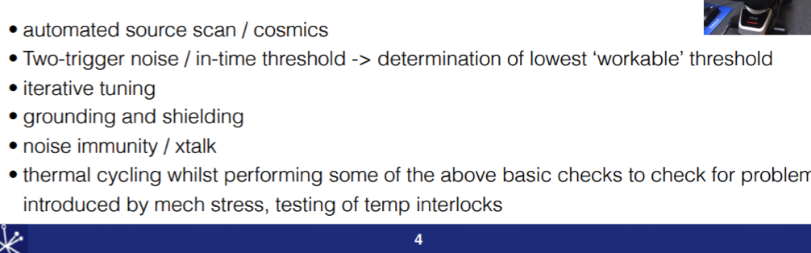
3. Half Cylinder Tests
in this step ther is the possibility to recover failures..
  Pressure test;
  Cooling and Power test;
  Mechanical survey after the thermal test;

Slide 16
4. Cylinder Tests
TDR: “..when pairs of half-cylinders are ready for integration they are mounted onto a pair of assembly jigs which allow the two sides to be brought together in a controlled manner.“
  Thermal cycling test;
  Warm e-test;
  Cooling and Power test;
  Mechanical survey after the thermal test;
can we reopen the cyilinder in case of failures?
Wich kind of failures we expect?

Slide 17
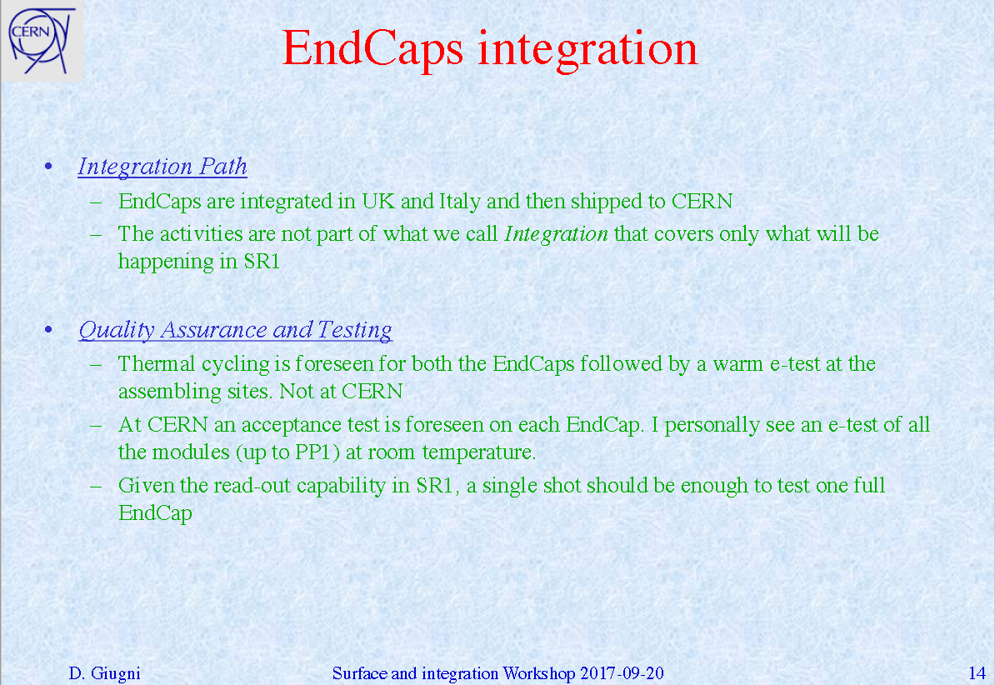
5. Cylinder final Test - EndCap
TDR: “After all three layers are assembled, the connectivity of all services will be validated. Sections of the end-cap corresponding to the availability of DAQ and power supply systems will be connected and all modules tested.”

