Slide 1
INTEGRATION PROCEDURES AND TOOLINGS FOR ATLAS ITK
D. Orecchini – M. Testa - S. Tomassini
INFN-LNF
Frascati, April 5th, 2018

Slide 2
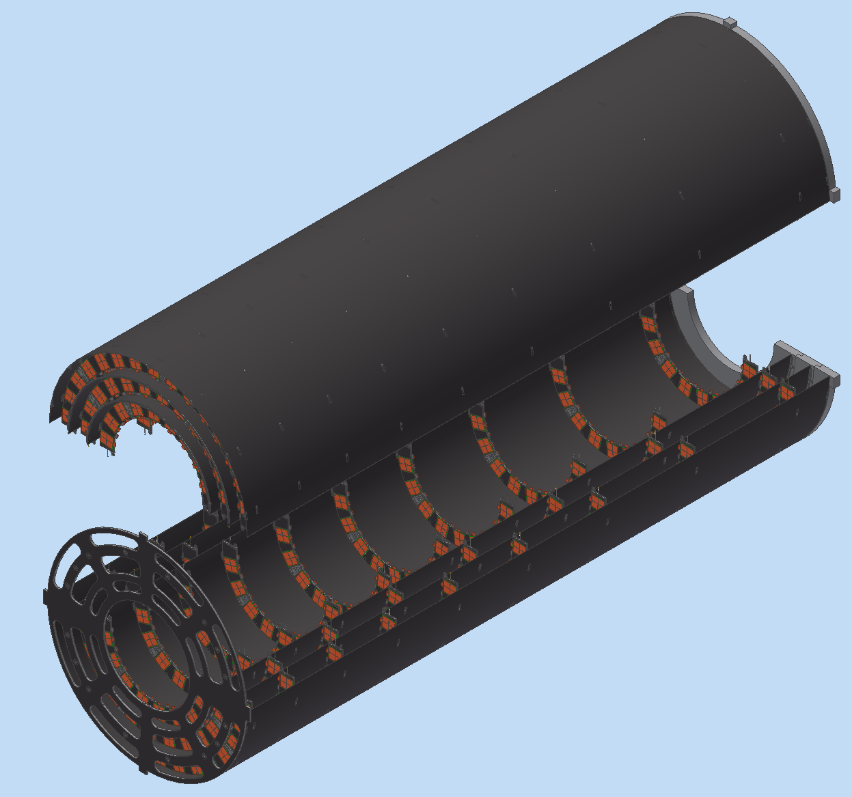
Pixel Endcap Integration @ LNF
Pixel Detector Area
Structure
Bulkhead
Strip Detector Area

Slide 3
Management
Management (Marianna & Tomassini)
Integration and transportation toolings (Sandro/Dario)
Type-1 Service Assemblies (Pietro/INFN Milan)
Half-ring Reception Testing (Marianna/Emiliano)
Endcap Assembly & QA (Sandro Dario, Emiliano/Giovanni)
System Tests (Marianna/Antonio)
Delivery of Endcap to CERN (Sandro/Dario)
From Tim Talk

Slide 4
PIXEL ENDCAP WBS @ LNF
Assembly area dressing up
Assembly tool design
Cooling system & Transfer lines procurement
Climate chamber Procurement
Design and production of the shipping skid
Reception and test of the shells
Reception and test of the half-rings
Integration of the services (Cooling & Cables)
Integration of half-rings in the half-shells
Qualification of half-shells
Assembly of full shells (for the three layers )
Debug of Pixel endcap
SHIP TO CERN

Slide 5
LNF Activity Plan
 | Q1 |  | Q2 | Q3 | Q4
2018 | Design patch panel 1 Tool Design Assembly procedure definition |  |  | PP1 Mockup Production & Leak Rate Test (LRT) Tool Design Assembly procedure definition Climate Chamber procurement Transfer Line Design
2019 | PP1 Mockup test (Cont’) Transfer Line Procurement Tool design Shipping Skid design |  |  | Tool Prototype Procurement Start refurbishment of Gransasso Hall Shipping Skid design Review
2020 | refurbishment of Gransasso Hall CO₂ plant installation Transfer line Installation Shipping Skid procurement |  |  | Tools installation and tests Half shell production Shipping Skid production
2021 | Half shell production Shipping Skid production |  |  | Half shell reception
 | Tests with dummy half-ring and dummy half shells
2022 | Reception of half-rings Assembly of Half rings in the Half shell Assembly of half shells in the End Cap
2023 | Pixel end cap debug | Transfer Pixel end cap to shipping skid |  | Pixel end cap debug | Ship to CERN

Slide 6
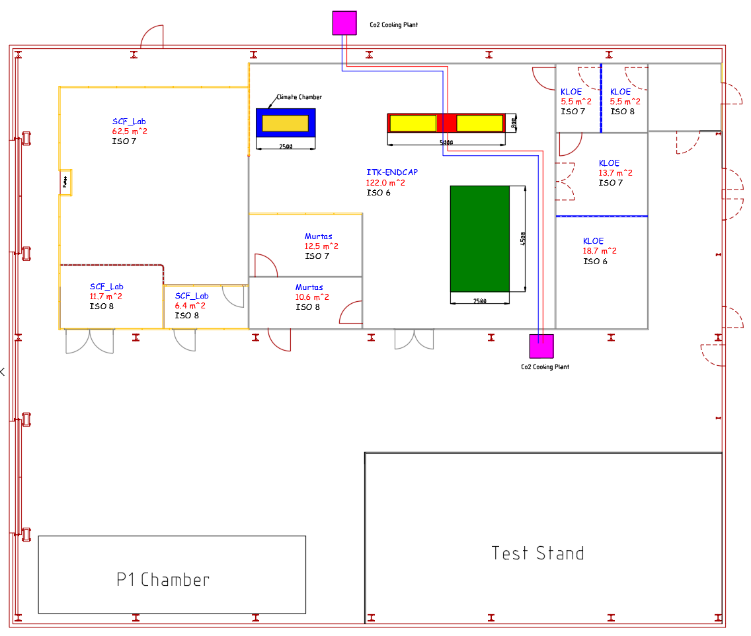
Assembly area at LNF
CO₂ cooling plant
Granite Table 1
5 x 0.8 m² (planarity to be qualified)
can be equipped for shell assembly
Granite Table 2
• 4.5 x 2.5 m²
large enough to load half- rings into half shells
To be equipped with supports for half-shell
CO₂ cooling plant
Infrastructures
CO₂ cooling system
Large climate chamber

Slide 7
Half shell reception from UK?
I Assume we receive the shells ALREADY dressed up.
IF NOT
Dress up can be done at LNF but tooling must be developed

Slide 8
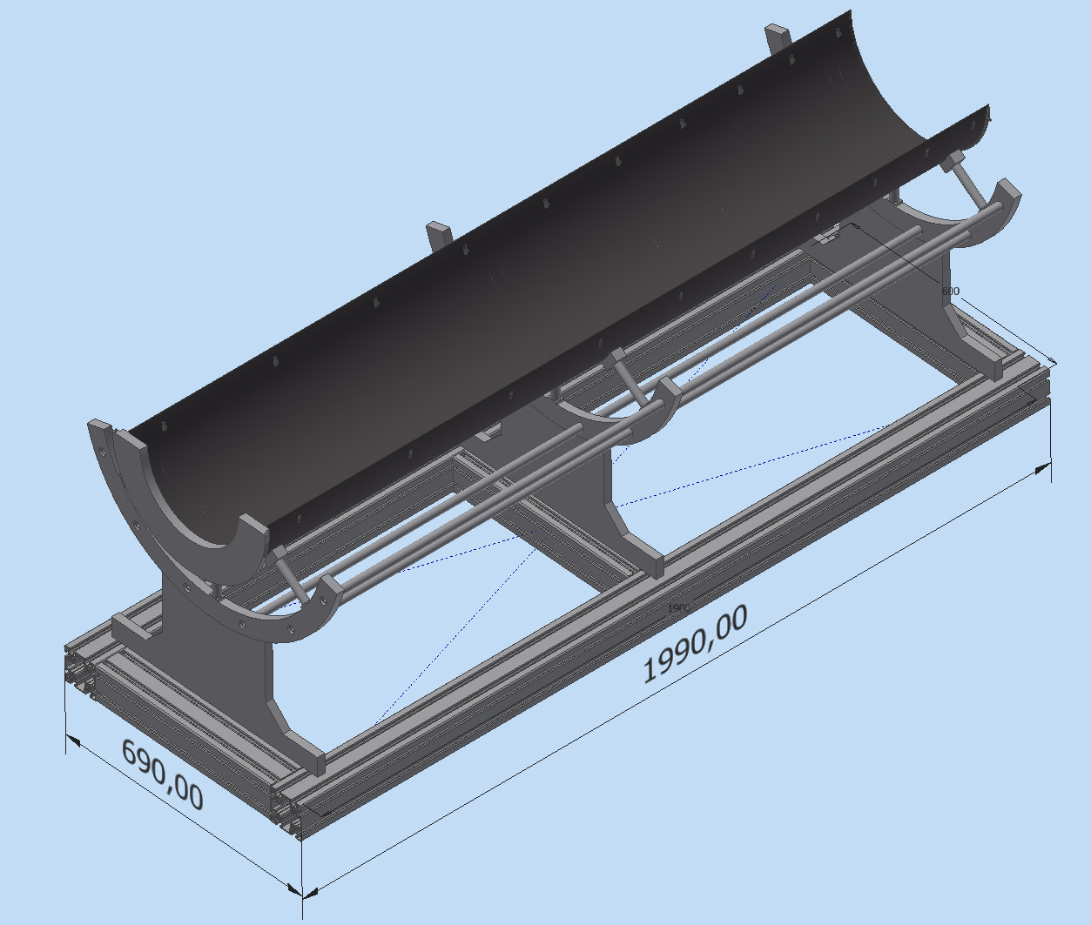
L1 Shell Getting Ready: Loading of the monolitic flange

Slide 9
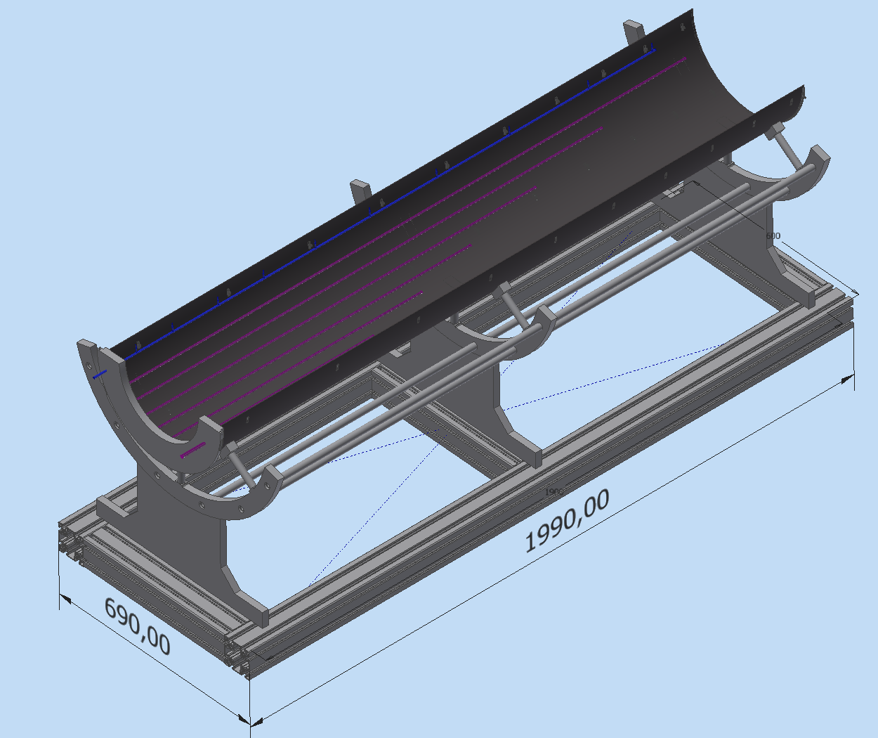
Type I Service Loading 1/2

Slide 10
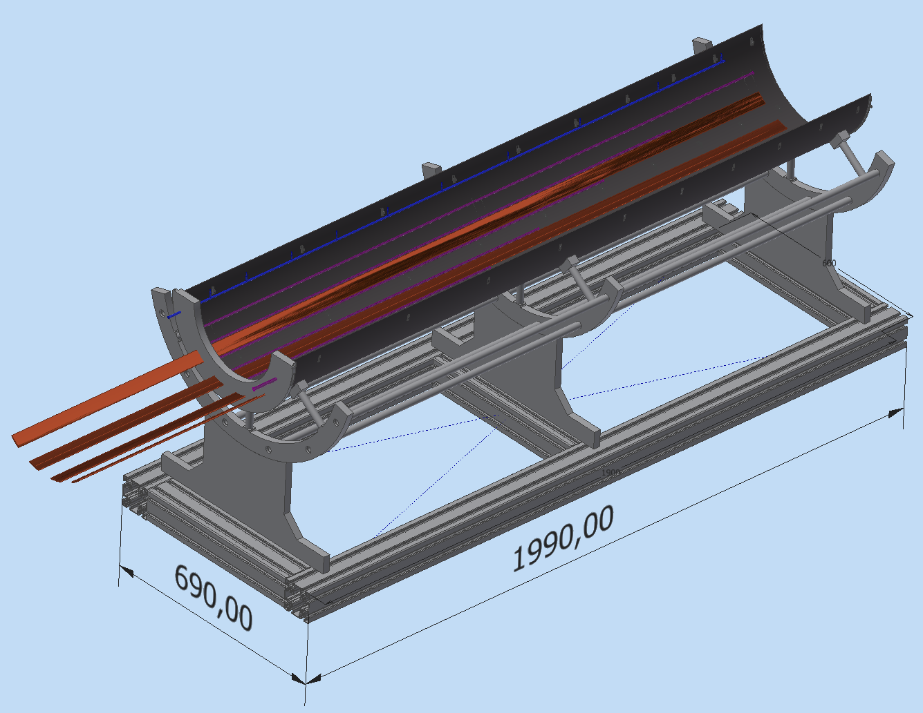
Type I Service Loading 2/2

Slide 11
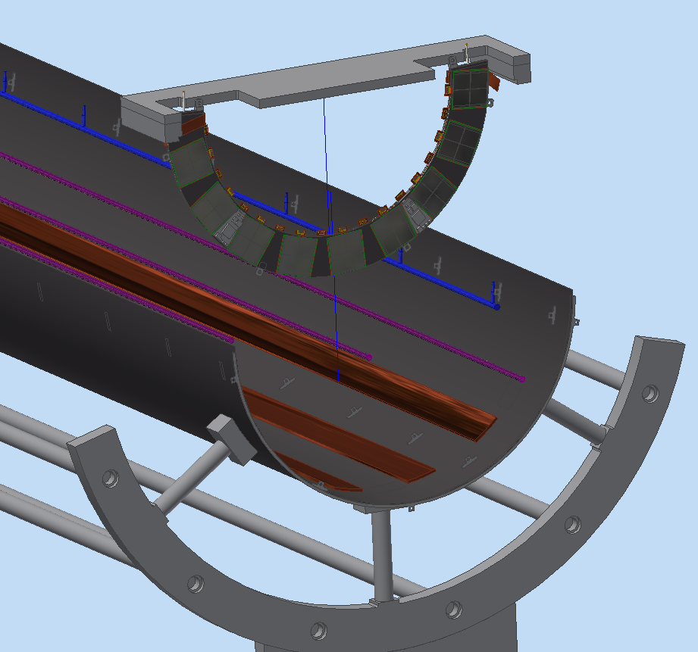
Half Ring Loading into Shell

Slide 12
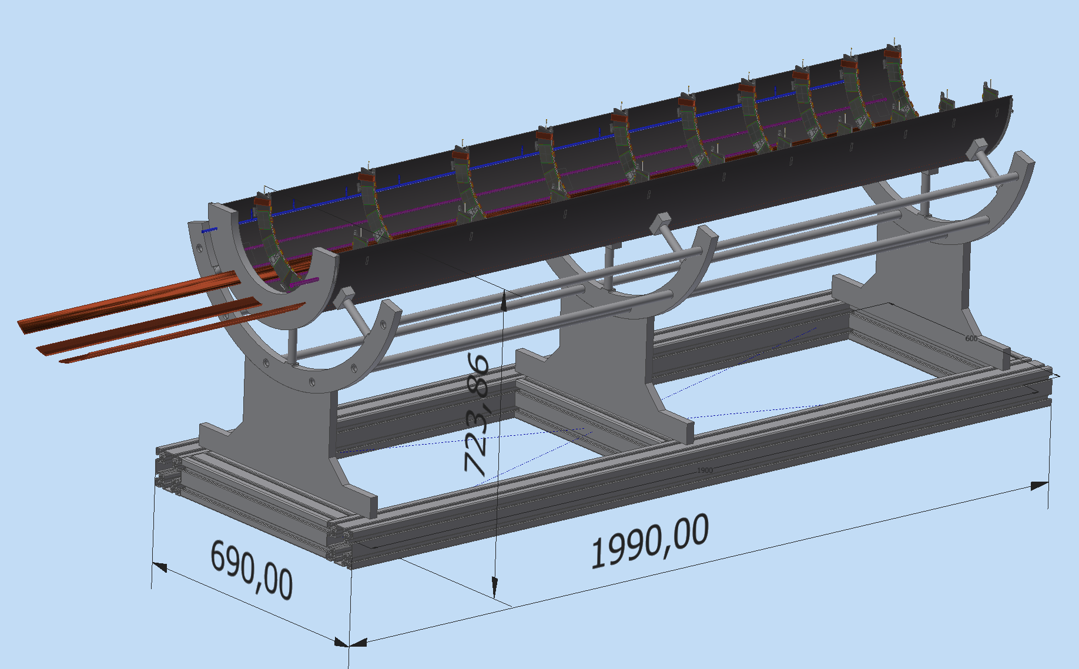
Test in the Climate Chamber @ - 55°C to 60 °C

Slide 13
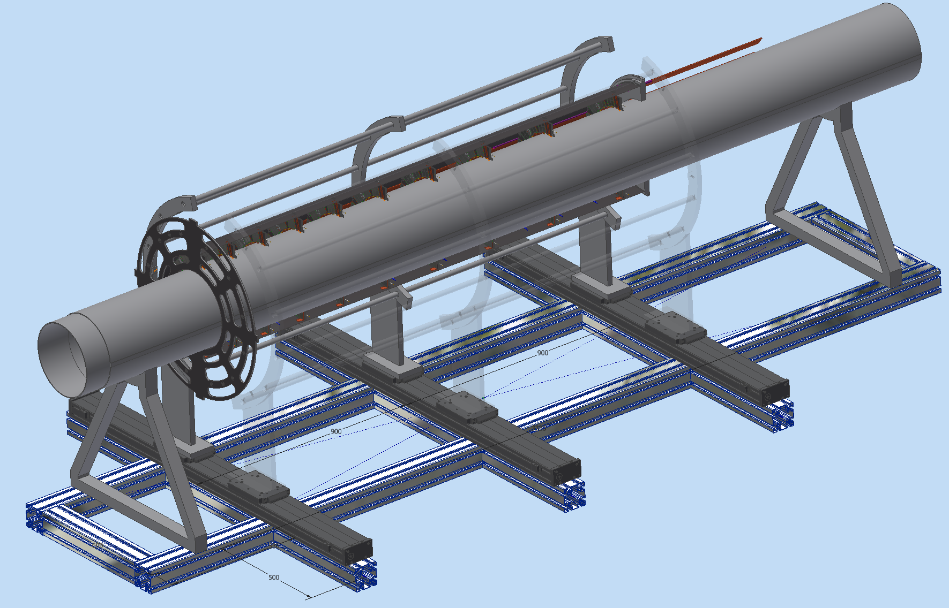
Half Cylinder Assembly @ LNF 1/3

Slide 14
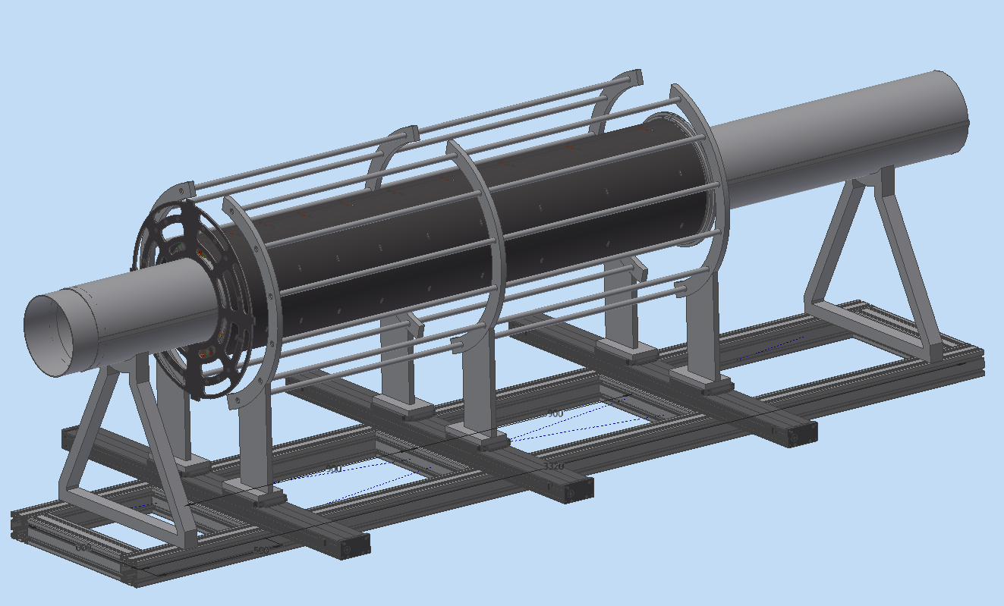
Half Cylinder Assembly @ LNF 2/3

Slide 15
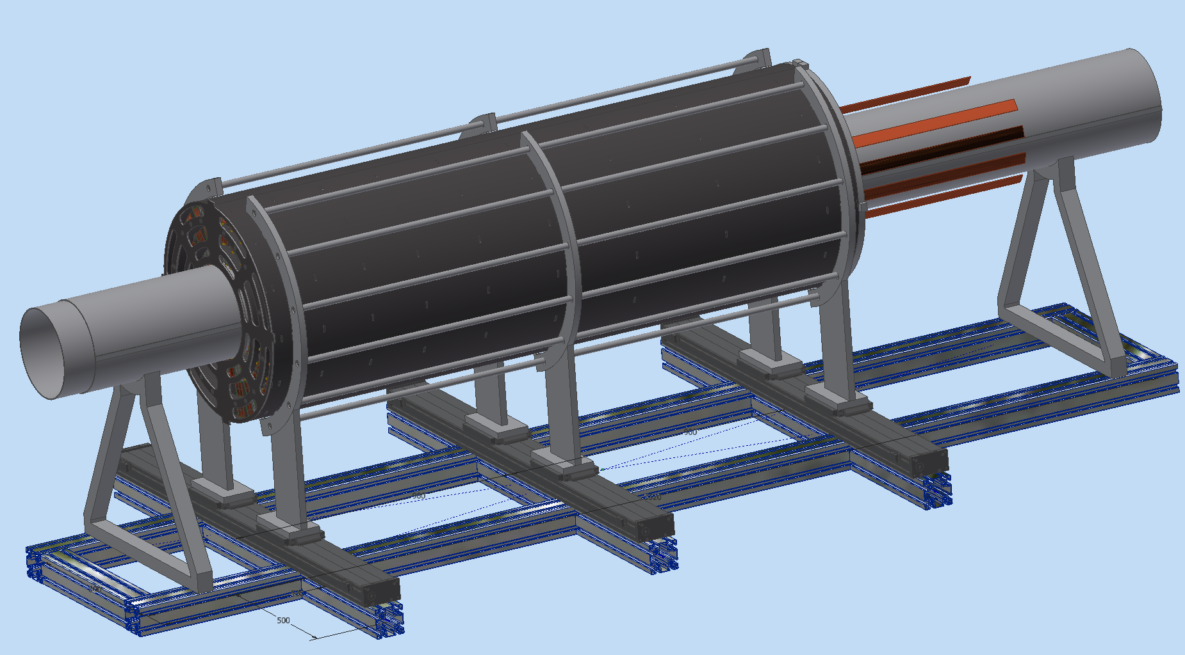
Half Cylinder Assembly @ LNF 3/3

Slide 16
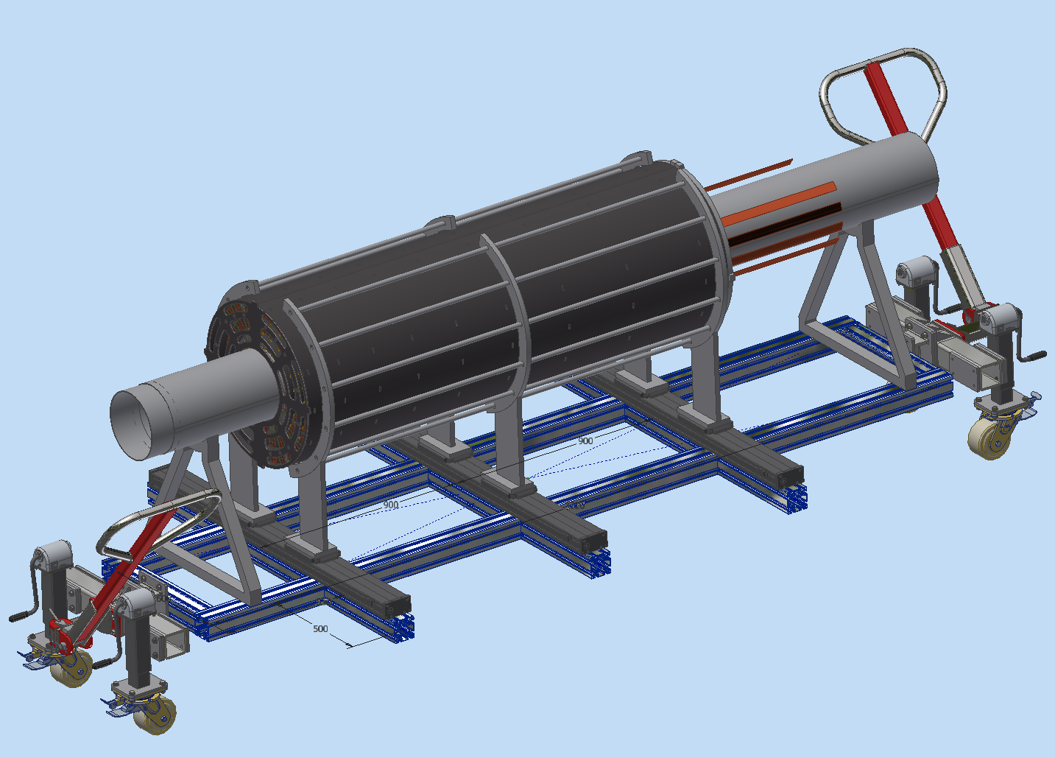
Handling in the clean room

Slide 17
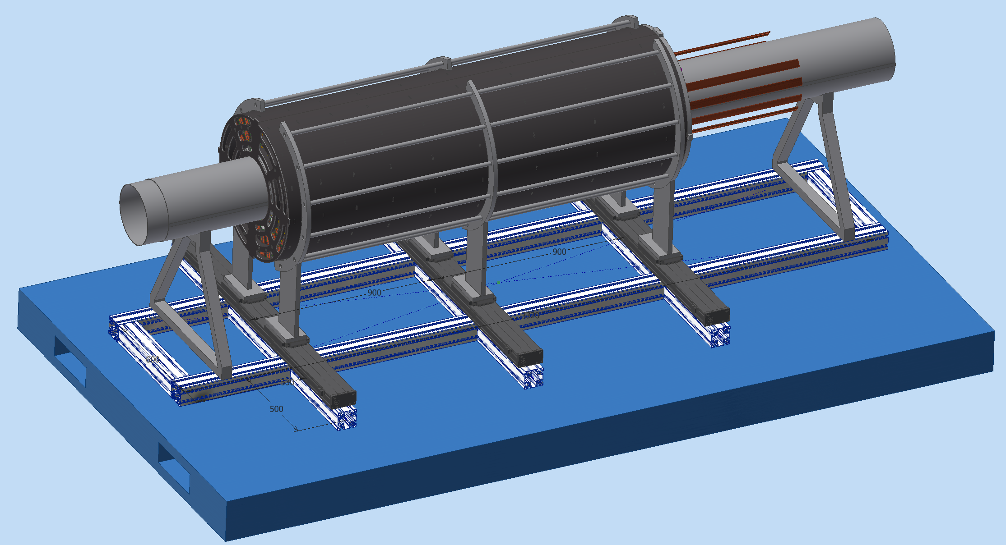
Transportation to CERN

Slide 18
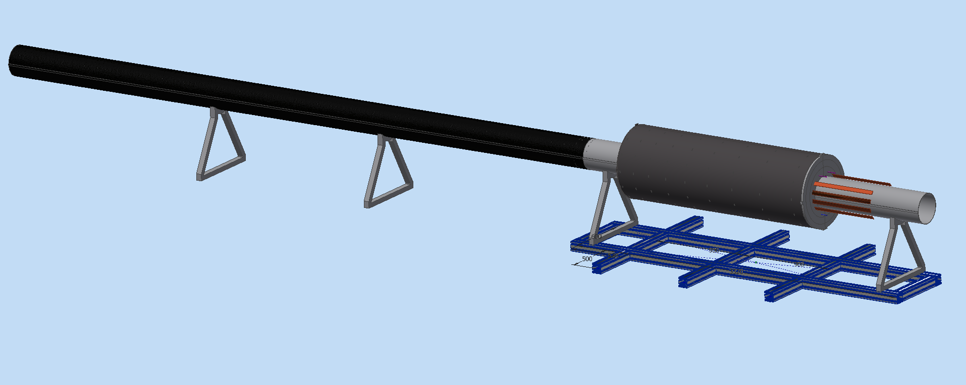
Integration @ CERN
Very preliminary

