Slide 1

UK-IT ITK INTEGRATION MEETING
LNF, 5 APRIL 2018
ATLAS ITK
PIXEL ENDCAP
COOLING SYSTEM
CONSTRUCTION
Simone Coelli
For the Milano Atlas Group
I.N.F.N. MILANO

Slide 2
SUMMARY
MAIN ISSUES TO BE ADRESSED FOR THE CO2 COOLING SYSTEM DESIGN AND PRODUCTION
HALF RING INTEGRATED COOLING PIPE
ENDCAP DISTRIBUTION SYSTEM
THIS IS NOT A PRESENTATION BUT MAINLY A COLLECTION OF MATERIAL TO HELP THE DISCUSSION

Slide 3
HALF-RING WITH INTEGRATED COOLING PIPE
TENTATIVE SUMMARY OF OPERATIONS AND QUESTION MARKS…
TITANIUM PIPE FROM HIGH-TECH UK COMPANY, ANNEALED
DESIGN PRESSURE 130 bar (DICTATED BY THE RUPTURE DISK PRESSURE)
PIPE DIAMETER AND THICKNESS UNDER INVESTIGATION, LENGTH
BRAZED CERAMIC DIELECTRIC ON BOTH SIDES
CO2 EVAPORATIVE SYSTEMS WITH PARALLEL EVAPORATORS NEED TO IMPLEMENT A LARGE (RELATIVE TO THE EVAPORATOR) INLET COOLING PRESSURE DROP
CAPILLARY/CALIBRATED ORIFICE OPTION
BENDING PIPES TO FINAL SHAPE
INTEGRATION OF PIPE IN THE HALF RING, GLUED IN CARBON FOAM GROOVE WITH THERMAL CONDUCTIVE COMPOUND (THERMAL SENSIBLE CONTACT LAYER)
JOINING HALFRING COOLING PIPE TO THE TO THE ENDCAP DISTRIBUTION SYSTEM
USING ORBITAL WELDING/CUSTOM CONNECTION?
DESIGN (WORKING DRAWINGS) FOR INNER/MIDDLE/OUTER HALF RINGS
VALID FOR THE TWO SIDES (LEFT/RIGTH AND FOR BOTH ENDCAPS?

Slide 4
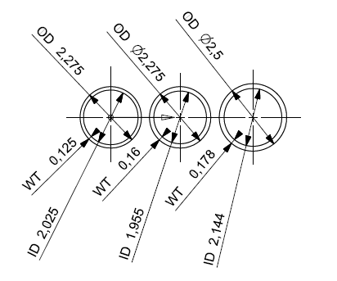
COOLING PIPE
2D PARAMETRIC FE MODEL
THERMAL FIGURE OF MERIT
CALCULATION
FOLLOWS

Slide 5
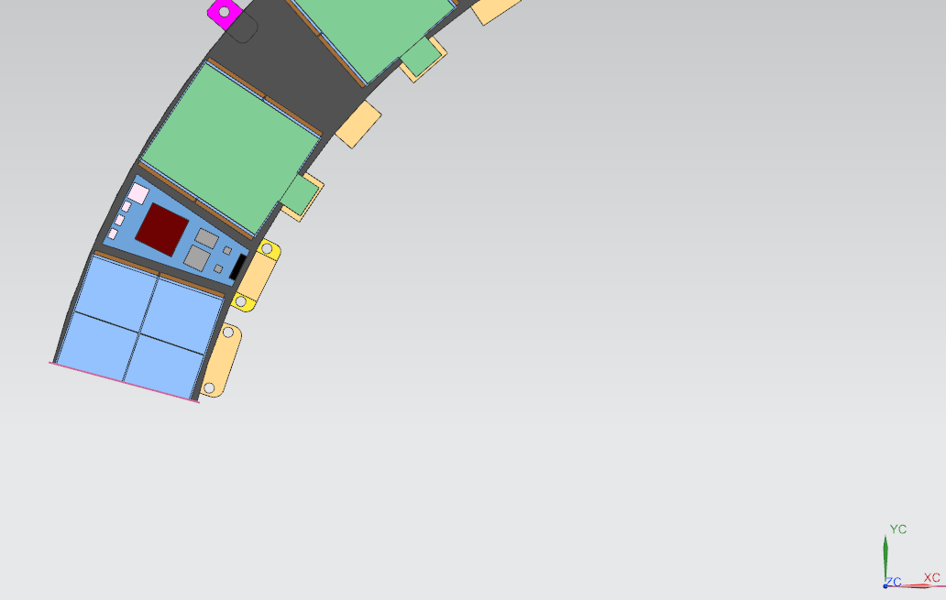
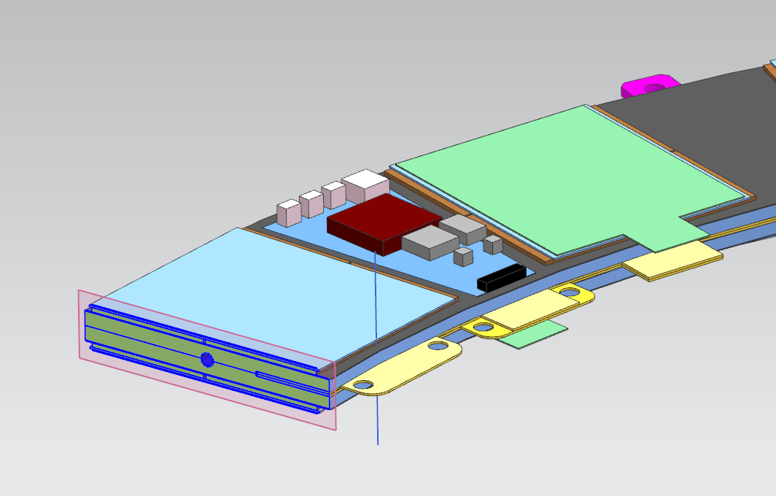
2D PARAMETRIC FE MODEL – TRANSVERSAL SECTION OF THE MIDDLE HALF RING
OVERLAPPING SENSORS REGION

Slide 6
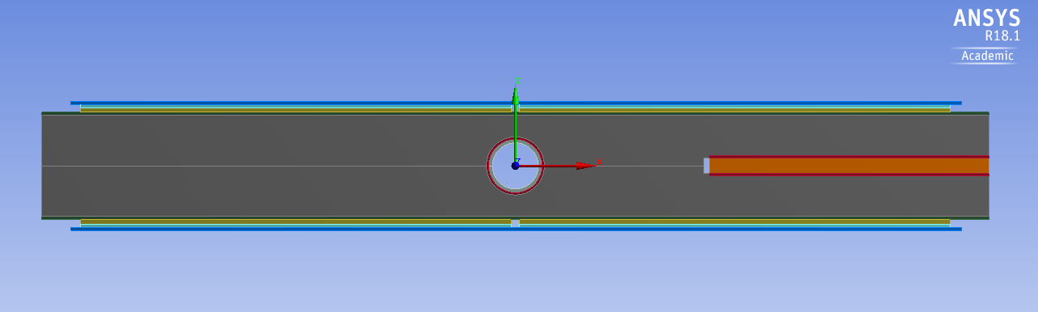
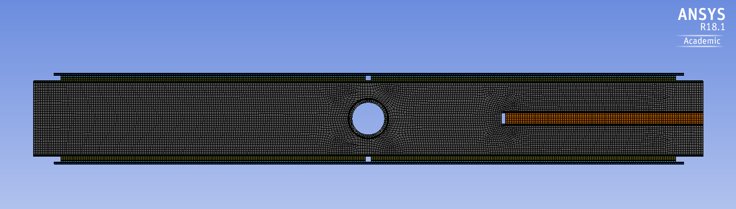
2D PARAMETRIC FE MODEL – TRANSVERSAL SECTION OF THE MIDDLE HALF RING

Slide 7
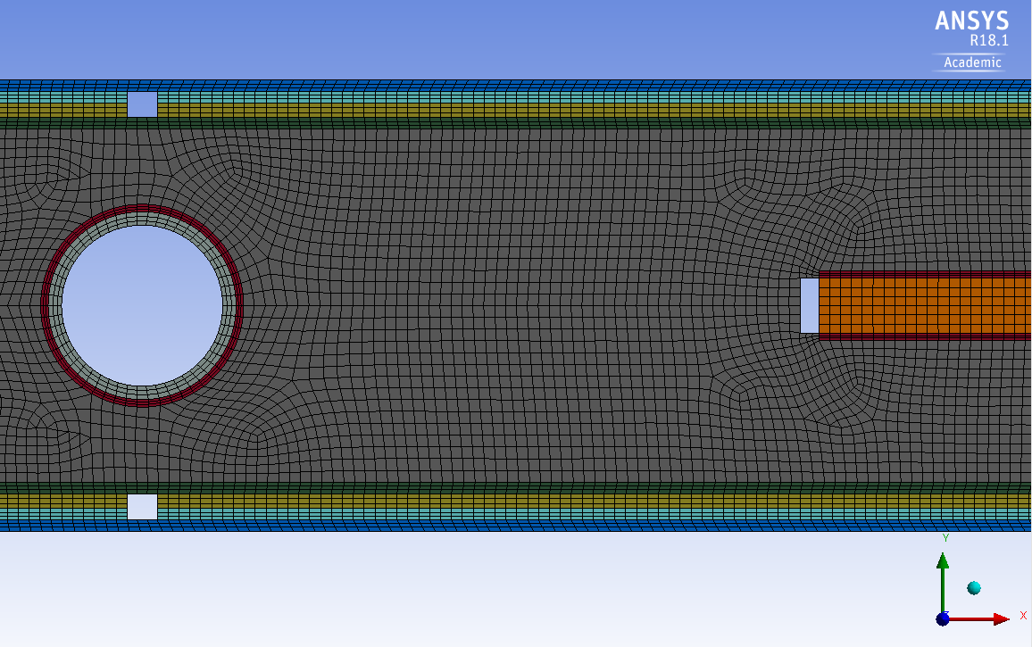
2D FE MODEL PARAMETERS:
PIPE ID
PIPE THICKNESS
MODULE GLUE THICKNESS
MODULE GLUE THICKNESS
PIPE ID
PIPE THICKNESS

Slide 8
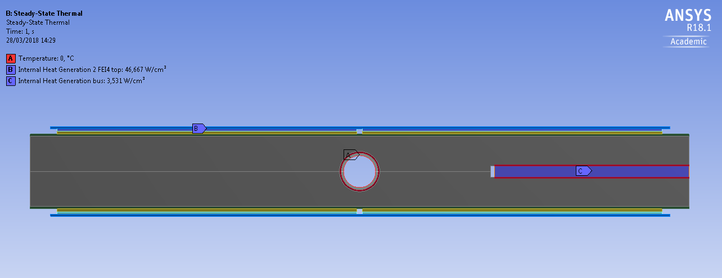

LOADS AND BOUNDARY CONDITIONS:
PIPE INNER WALL TEMPERATURE
FE INTERNAL HEAT GENERATION (ONLY FOR THE FE ON TOP)
BUS HEAT GENERATION (TURNED ON /OFF)

Slide 9
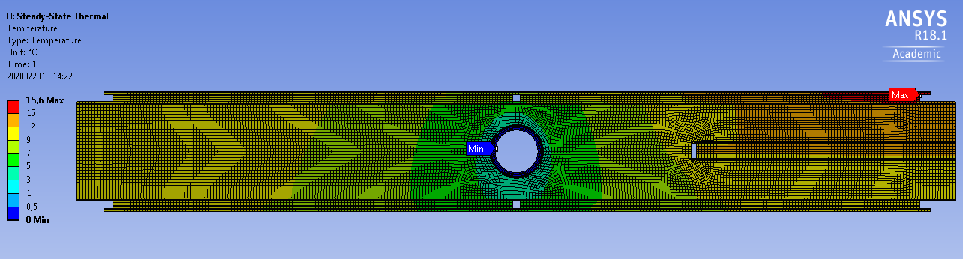
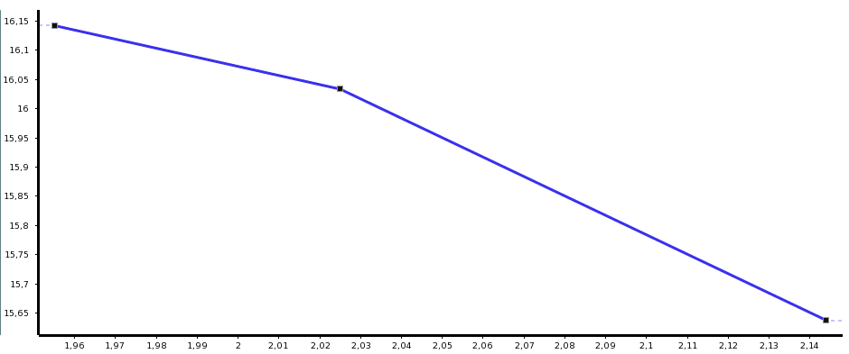
2D FE ANALYSIS
With POWER APPLIED TO THE FLEXBUS
ACTUAL
OD 2.275 mm
SENSOR MAX TEMPERATURE
DECREASE 0.4 °C
TFoM not defined (what thermalpower flux use?)
OD 2.50 mm
THICKER
PIPE INNER DIAMETER (AND RELATED THICKNESS)
OD 2.50 mm

Slide 10
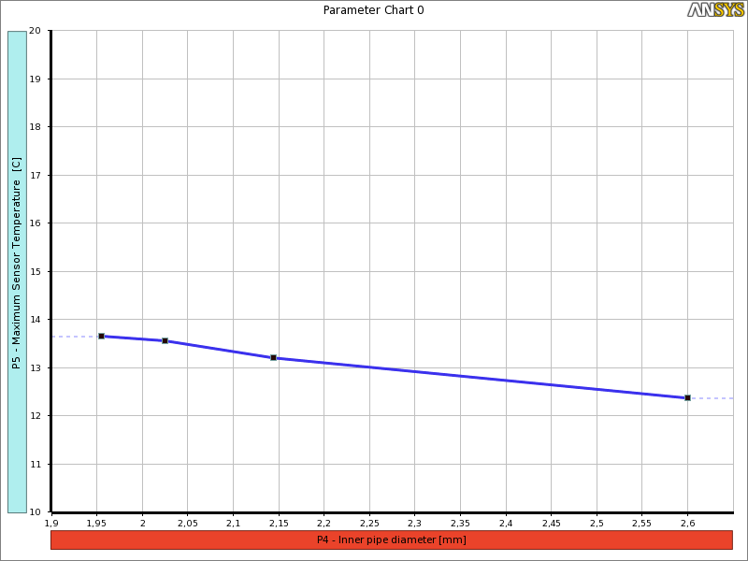
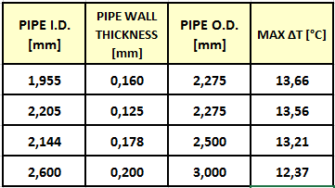
THERMAL CONDUCTIVE PERFOMANCE
OF THE MIDDLE HALF-RING vs COOLING PIPE SIZE
WITHOUT POWER APPLIED TO THE FLEXBUS
New
OD 2.275 mm
ID 1.955
OD 2.275
WT 0,16
ID 2.144
OD 2.50
WT 0,178
ID 2.60
OD 3.0
WT 0,20
SENSOR MAX TEMPERATURE
OD 2.5 mm
Hypothetical
OD 3 mm
FROM actual OD 2.275 mm
TO OD 2.5
MAX T DECREASES 0.35°C
CONDUCTIVE TFoM DECREASES 0.5 °C cm²/W
ID 2.025
OD 2.275
WT 0,125
ACTUAL
OD 2.275 mm
FROM New OD 2.275 mm
TO OD 2.5
MAX T DECREASES 0.45°C
CONDUCTIVE TFoM DECREASES 0.64 °C cm²/W
PIPE INNER DIAMETER (AND RELATED THICKNESS)

Slide 11
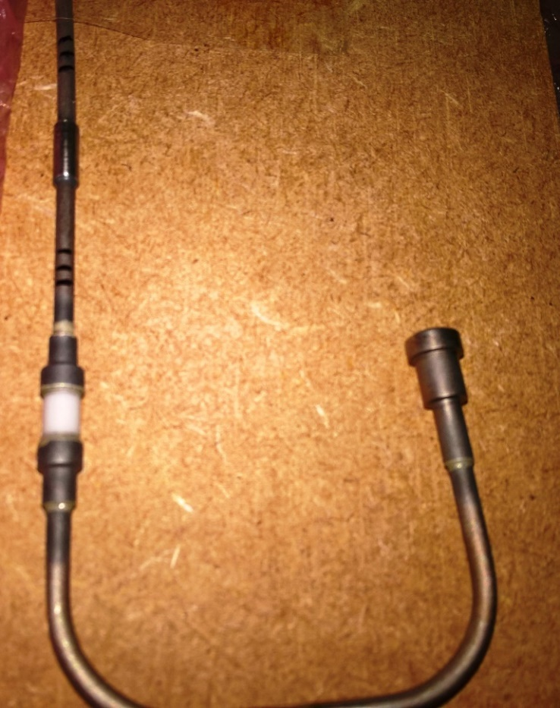
HIGH VACUUM BRAZING TECHNOLOGY

Slide 12
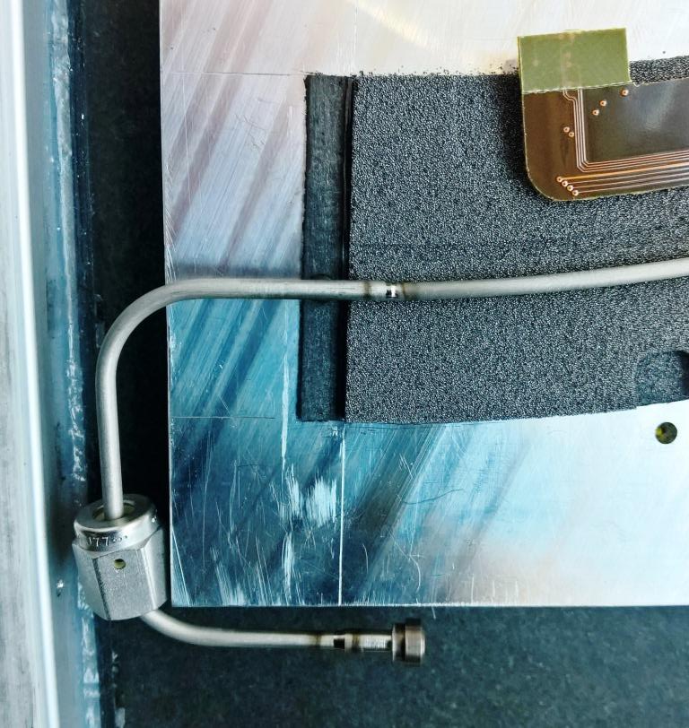
TITANIUM ORBITAL WELDING (MICRO-TIG) TECHNOLOGY
https://indico.cern.ch/event/701635/
Cooling Pipe Manufacture
Friday 9 Feb 2018, 09:00 → 12:30 GMT

Slide 13
ATLAS Pixel Endcap
Pixel endcap mechanics phone meeting - bus tape design
20 March 2018
THERMAL FEA STUDIES
FOR EXTERNAL FLEXBUS
OPTIONS
Simone Coelli, Mauro Monti I.N.F.N. MILANO

Slide 14
SUMMARY:
THERMAL FEA OF THE MIDDLE HALF-RING:
  «OPTION 0» BASELINE EMBEDDED FLEXBUS
  «OPTION 1» EXTERNAL FLYING FLEXBUS
  «OPTION 4» EXTERNAL FLEXBUS ON THE RING INNER SIDE
  «OPTION 2» EXTERNAL FLEXBUS WORK IN PROGRESS
THE GOAL OF THE SIMULATIONS IS TO COMPARE THE THERMAL PERFORMANCES OF THE DIFFERENT OPTIONS PROPOSED
ONLY CONDUCTION IS TAKEN IN ACCOUNT
THE CALCULATED TEMPERATURE FIELD IS RELATIVE TO THE INNER COOLING PIPE TEMPERATURE (THAT HAS BEEN SET TO 0 °C)
(NOT REAL/ABSOLUTE TEMPERATURES!)

Slide 15
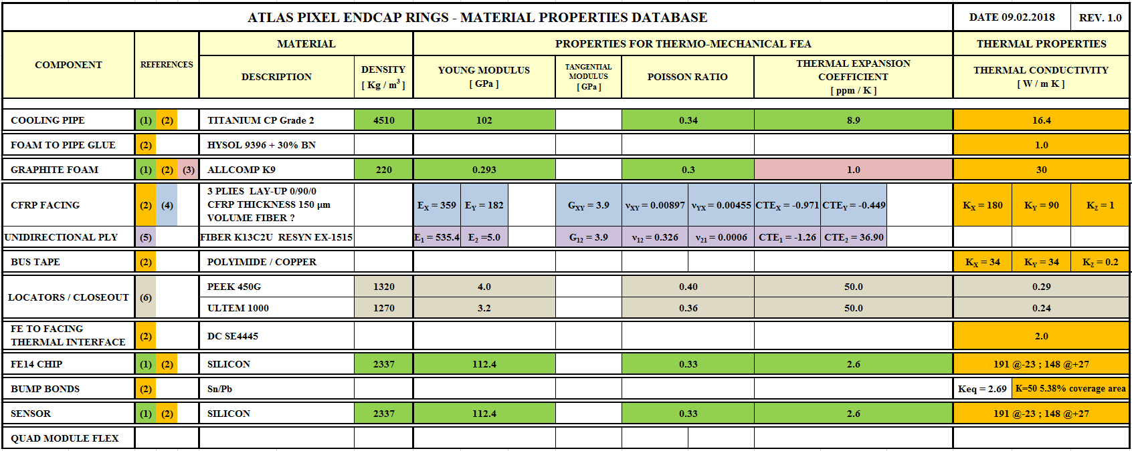
MATERIAL DATABASE FOR FEA
Excel file: ATLAS PIXEL ENDCAP MATERIAL DATABASE v.2.0.xls
@ Twiki https://twiki.cern.ch/twiki/bin/viewauth/Atlas/PixelOuterEndcaps
Flexbus thermal conductivity (source: QMUL THERMAL CONDUCTIVITY TABLE by Graham Beck)
In plane (X,Y): 34 W/m K
Through the thickness (Z): 0.2 W/m K.

Slide 16
  «OPTION 0»
  BASELINE
  EMBEDDED FLEXBUS

Slide 17
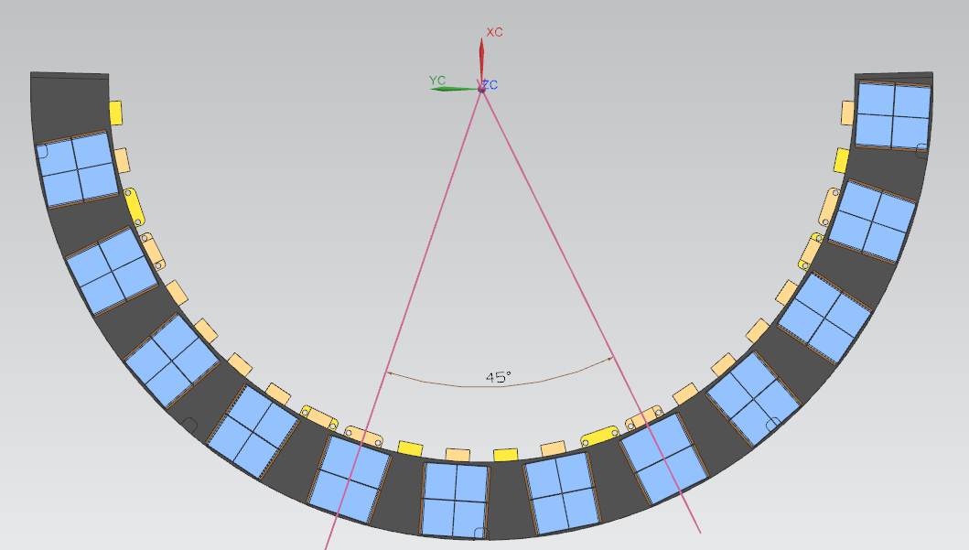
EMBEDDED FLEXBUS - MODEL
Step file: : endcap-assy.stp => NP49-04-18_ASM.stp (middle ring)
Endcap CAD files (P.Sutcliffe, 31-Oct-2017)
@ Twiki https://twiki.cern.ch/twiki/bin/viewauth/Atlas/PixelOuterEndcaps
Simulation: 45° sector
of the half ring

Slide 18
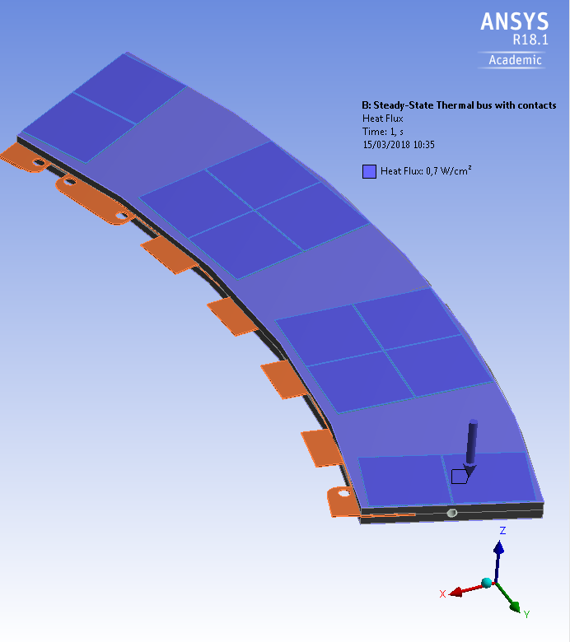
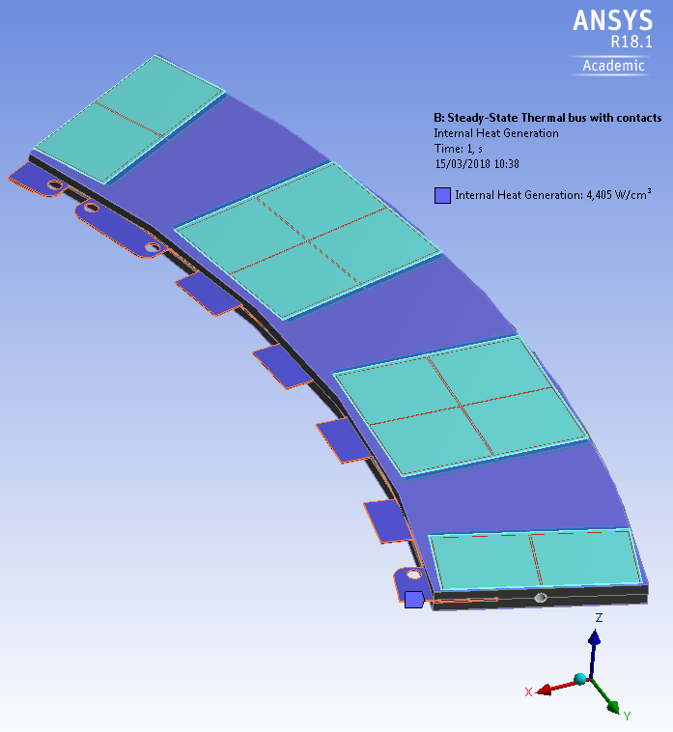
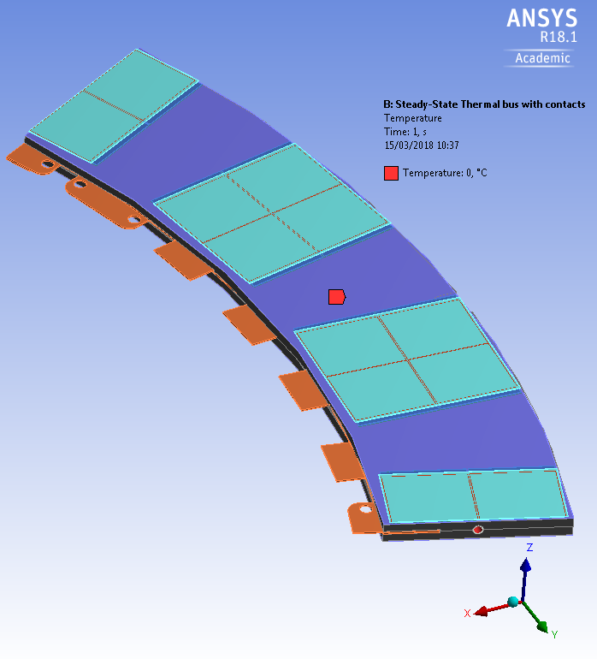
EMBEDDED FLEXBUS
THERMAL LOADS and BOUNDARY CONDITIONS
Heat Flux over FEI4:
0.7 W/cm²
Flexbus internal heat generation: 10% of the total power calculated for the 45° sector ⁽¹⁾
6.384 W
⁽¹⁾ See backup slide 1 for detail
Temperature
inner wall pipe: 0°C
Ring supposed to be adiabatic :
No convection
No radiation
ONLY THERMAL CONDUCTION

Slide 19

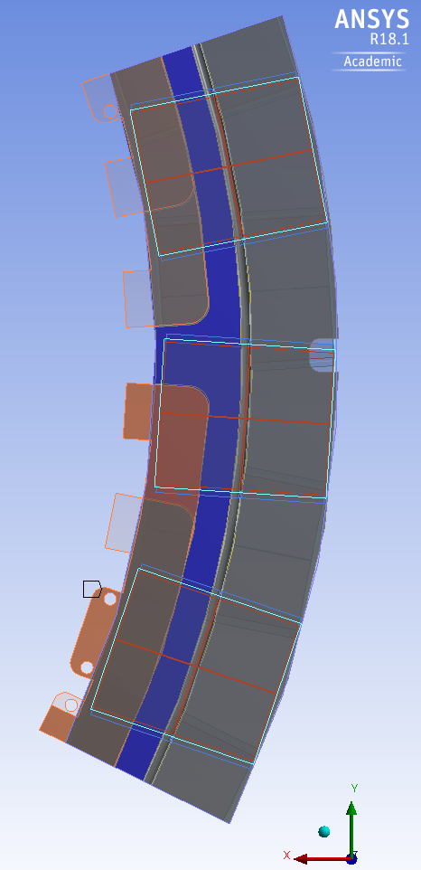
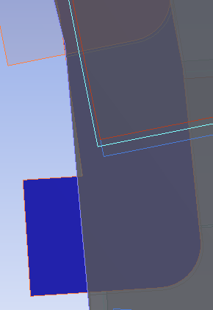
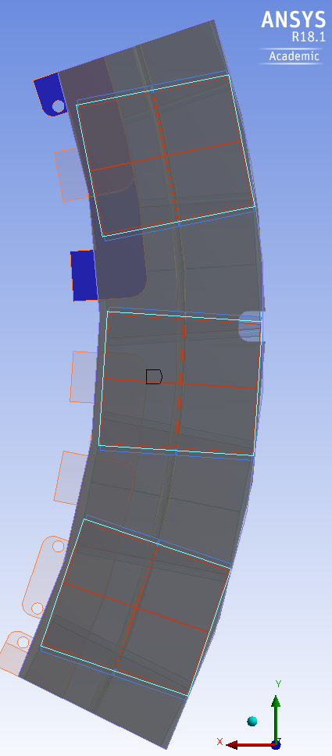
EMBEDDED FLEXBUS ORIGINAL 3D MODEL
HAS ONLY SMALL CONTACT REGIONS FLEXBUS/FOAM LOCATED ON THE ENDS
ELSEWHERE THERE IS A GAP (0,035 mm) BETWEEN THE FLEXBUS (FLOATING) AND THE FOAM
Floating bus
Contact area #1
Contact area #2
Floating bus

Slide 20
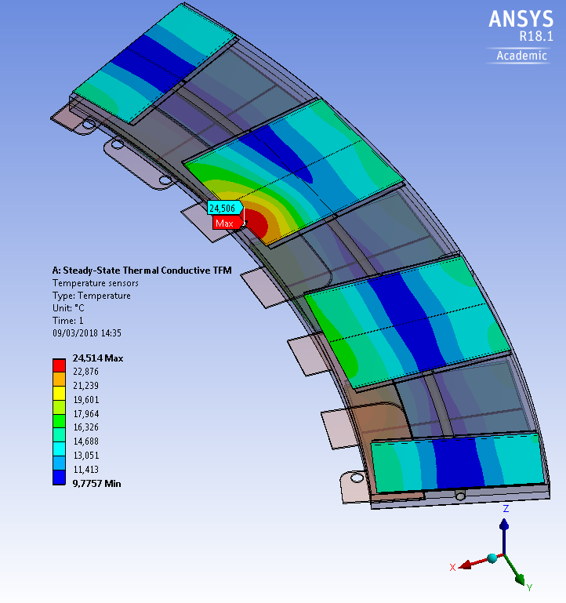
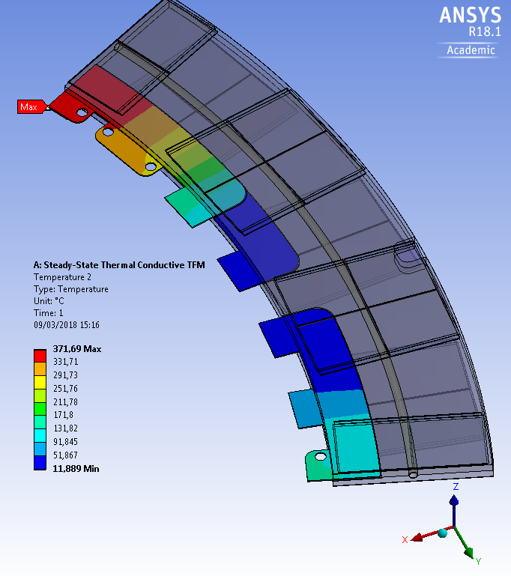
THE GAP (0,035 mm) BETWEEN THE FLEXBUS (FLOATING) AND THE FOAM
GIVES AN UNACCEPTABLE RESULT
Max delta T sensors - pipe: 24.5°C
flexbus temperature diverges!

Slide 21
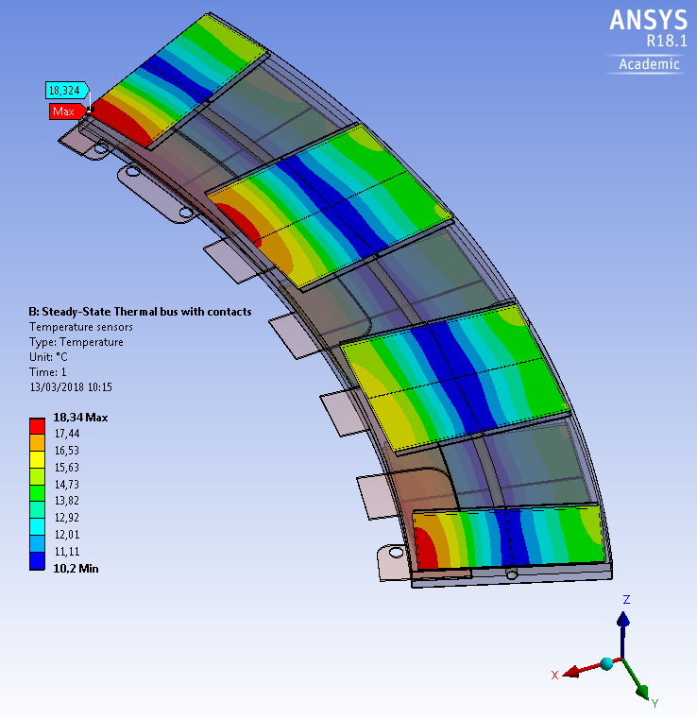
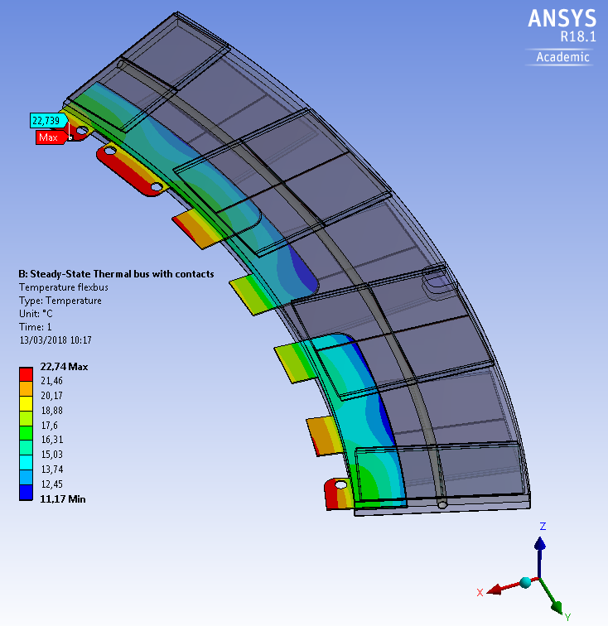
THE TWO SIDES OF THE FLEXBUS ARE PUT HERE IN «PERFECT THERMAL CONTACT» WITH THE CARBON FOAM
EXTENDING THE CONTACT REGION FLEXBUS /FOAM ALONG ALL THE FLEXBUS LENGTH
Max delta T sensors - pipe : 18.3°C
Max delta T bus-pipe : 22.7°C
=> IF THIS OTION 0 IS USED IT IS IMPORTANT TO HAVE A GOOD FLEXBUS /FOAM THERMAL CONTACT
FLEXBUS POWER INFLUENCE ON THE FEA CALCULATED SENSOR TEMPERATURE IS NOT NEGLIGIBLE
=> FROM ~15 °C TO 18,3 °C => + 3,3 °C

Slide 22
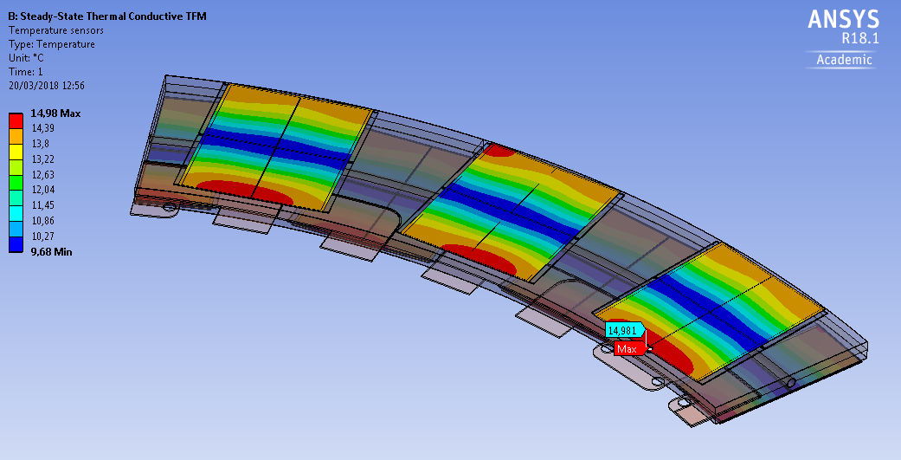
EMBEDDED FLEXBUS:
THERMAL FEA
WITHOUT POWER IN FLEXBUS
FOR CONDUCTIVE TFM CALCULATION
Max delta T sensors - pipe: 15°C

Slide 23
  «OPTION 1»
  EXTERNAL FLYING FLEXBUS

Slide 24
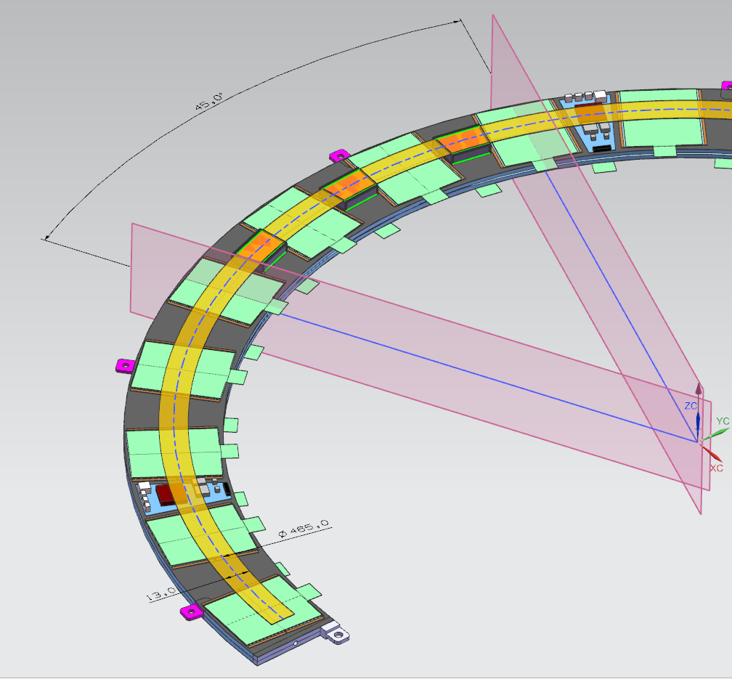
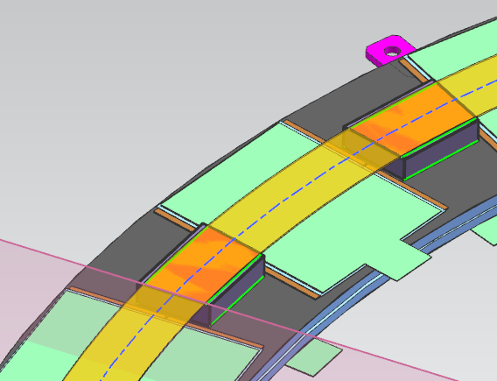
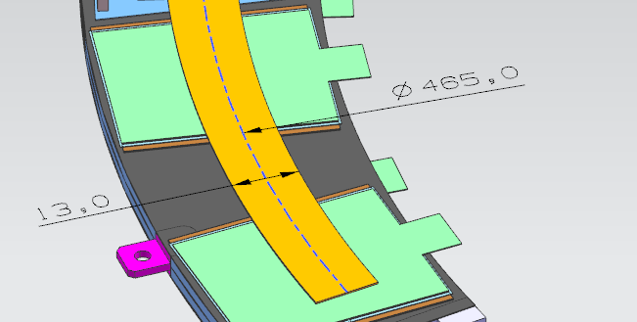
FLYING FLEXBUS OPTION 1 - MODEL
Flexbus passes over the DCS-card with a
minimum clearance 0.35 mm
Simulation of a 45° sector
of the half ring
Support pillars height: 5 mm
Material: Carbon foam: k = 30 W/ m K
Glue layers: 100 µm thick: k = 1 W/ m K
Radial width: 13 mm
thickness 0.36 mm
Middle radius 465 mm
(cooling pipe axis)

Slide 25
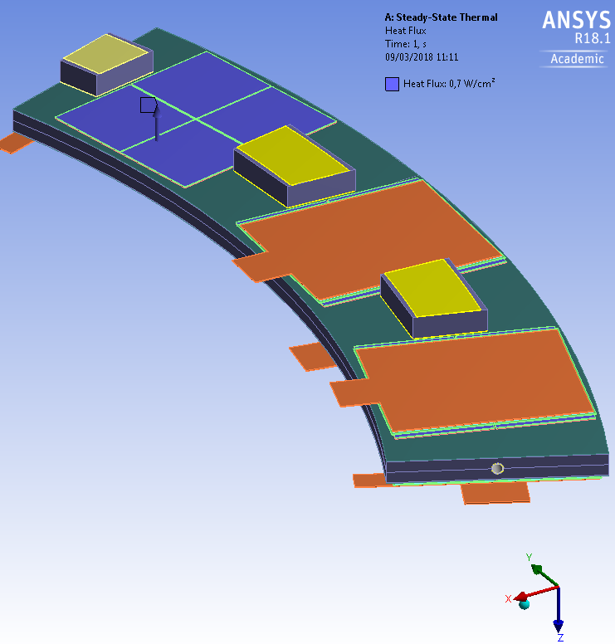
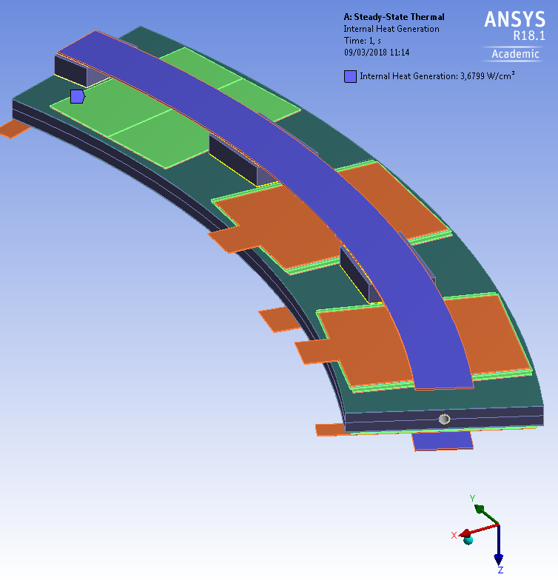
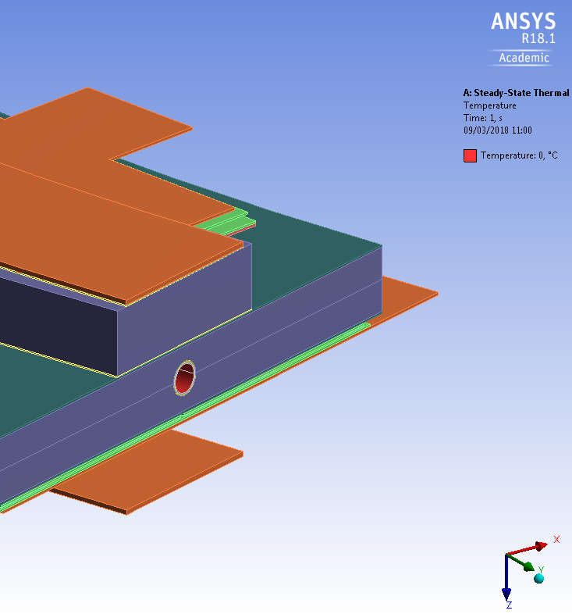
FLYING FLEXBUS OPTION 1
THERMAL LOADS and BOUNDARY CONDITIONS
Heat Flux over FEI4:
0.7 W/cm²
Flexbus internal heat generation: 10% of the total power calculated for the 45° sector ⁽²⁾
6.384 W
⁽²⁾ See backup slide 2 for detail
Temperature
inner wall pipe: 0°C
Ring supposed to be adiabatic :
No convection
No radiation
ONLY THERMAL CONDUCTION

Slide 26
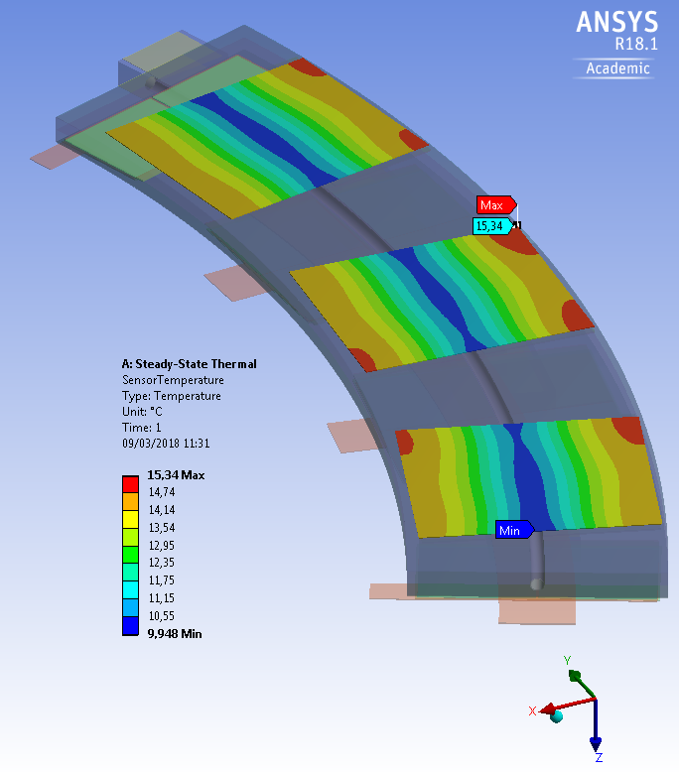
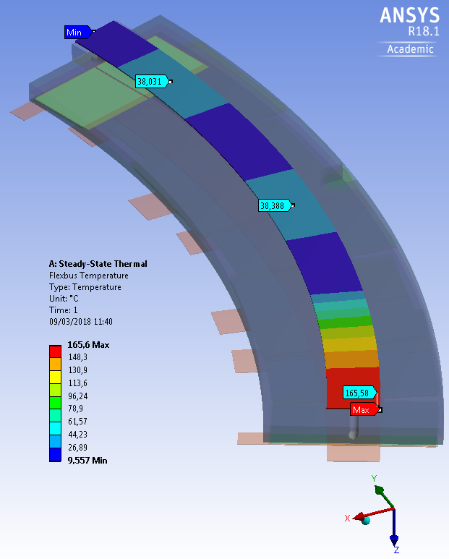
FLYING FLEXBUS OPTION 1
THERMAL FEA RESULTS
in the region between pillars:
Flexbus max delta T : 38°C
In the region passing over DCS:
max delta T: 165 °C See next slide
Max delta T sensors - pipe : 15.34°C

Slide 27
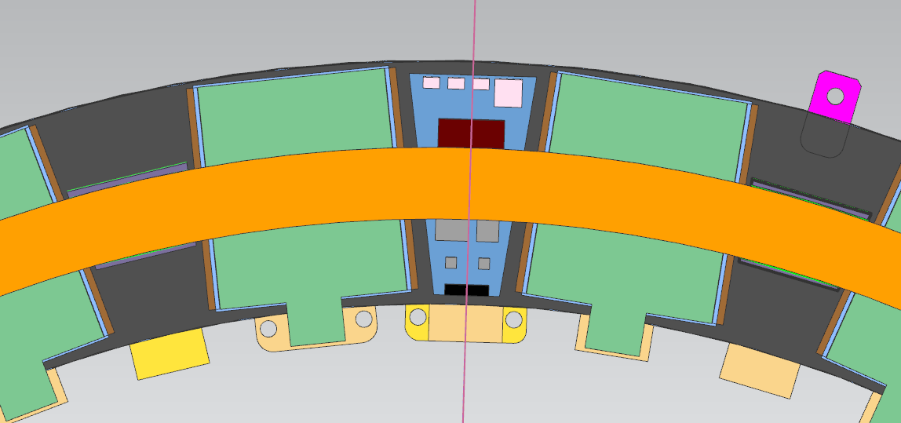
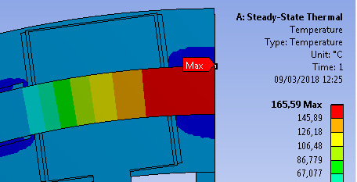
FLYING FLEXBUS OPTION 1
THERMAL FEA RESULTS
Flexbus max temperature: 165 °C
Distance along flexbus between two pillars, over DCS card region: ≈ 100 mm
Without any thermal contact the temperature rise in middle region.
THIS THERMAL ISSUE NEED TO BE ADRESSED IF THIS OPTION 1 IS USED
IMPROVING THE THERMAL CONTACTS..

Slide 28
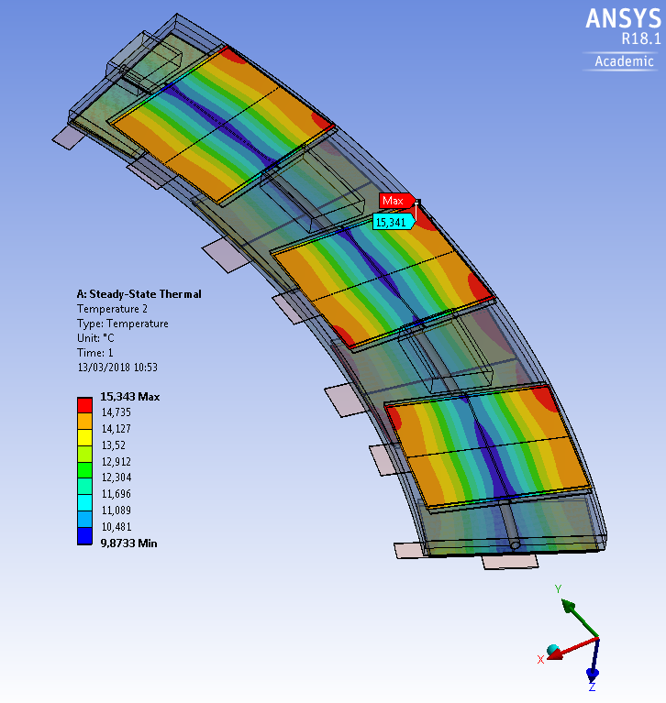
THERMAL COMPARISON BETWEEN AN
EMBEDDED TAPE AND AN EXTERNAL TAPE (OPTION1)
Embedded tape with 10% total power
Max delta T sensors - pipe : 18.3°C
Hot spot on the internal side of sensor
External flying tape with 10% total power
Max delta T sensors - pipe : 15.3°C
Hot spot on the external side of sensor
The max sensor temperature, using an external flexbus,
is 3 °C lower than using an embedded flexbus

Slide 29
  «OPTION 4»
  EXTERNAL FLEXBUS ON THE RING INNER SIDE

Slide 30
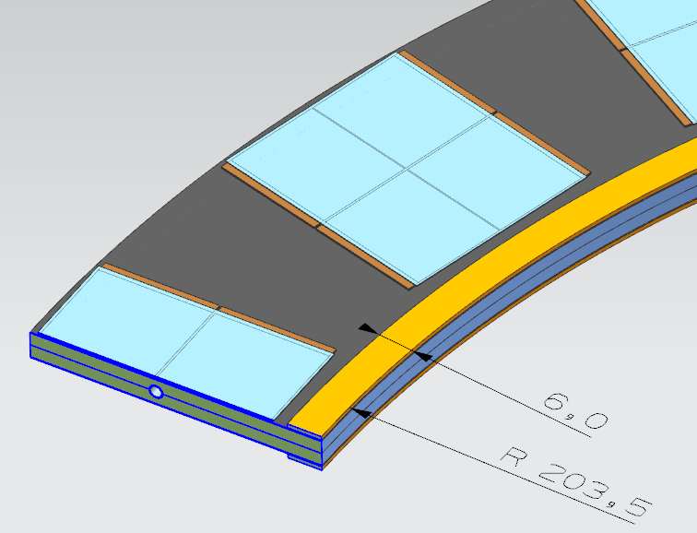
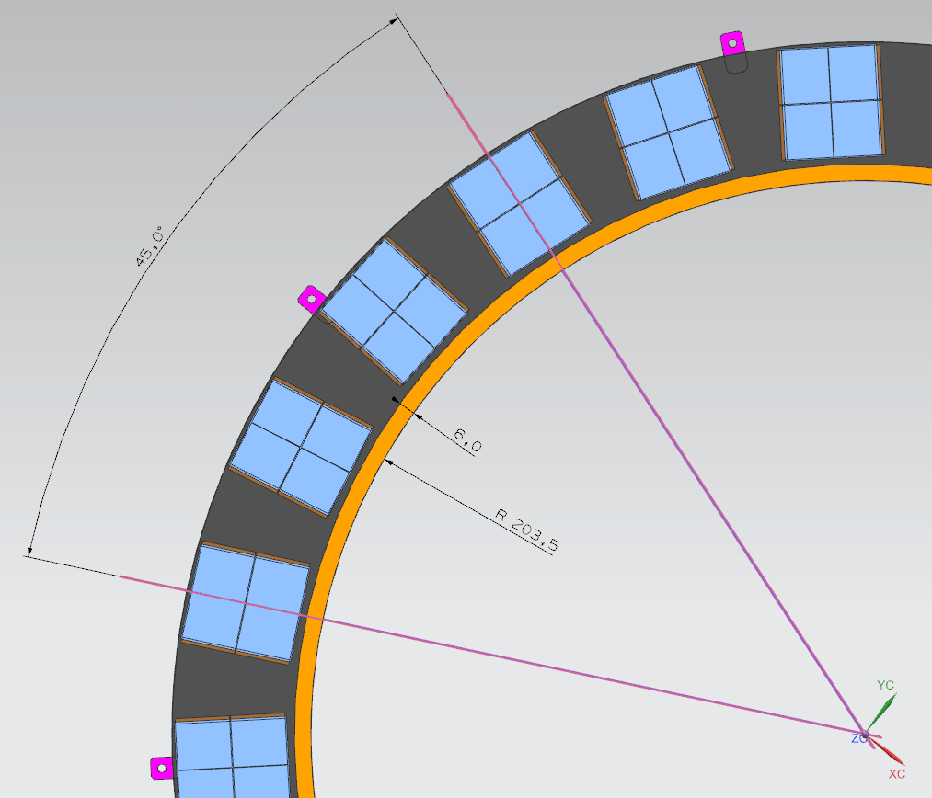
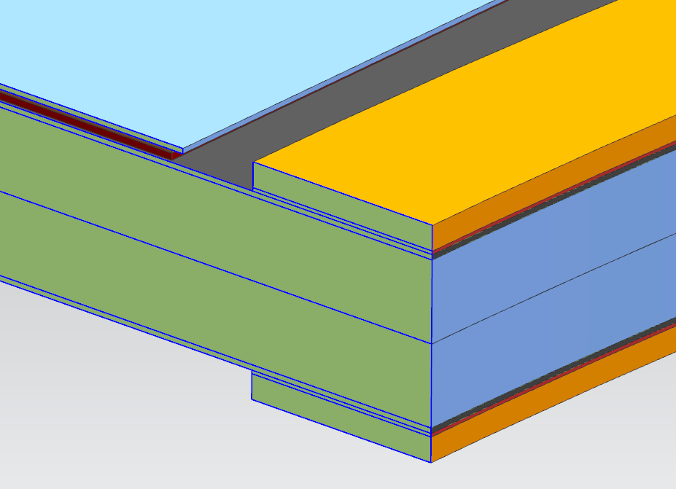
EXTERNAL FLEXBUS OPTION 4 - MODEL
Simulation of a 45° sector
of the half ring
Inner radius moved 7 mm, from 210.5 to 203.5 mm
Extension of the carbon foam and the CFRPs
Flexbus: 6 mm width x 0.72 thickness
Glue layer under flexbus 100 μm thick: k = 1 W/m K

Slide 31
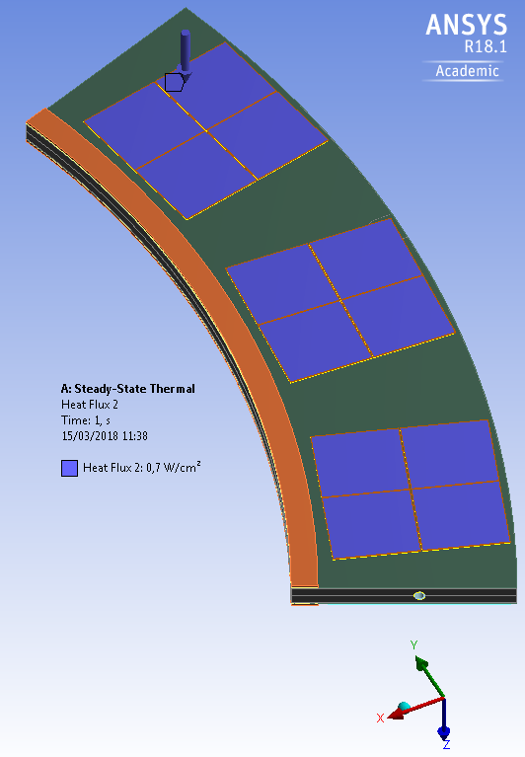
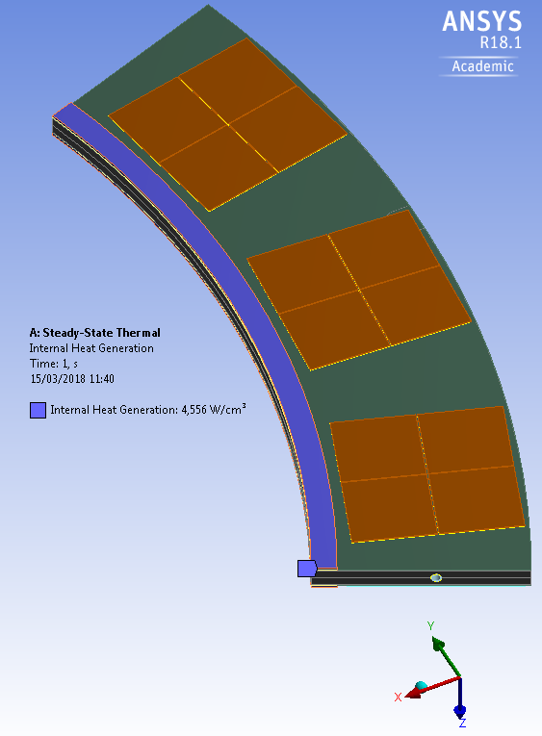
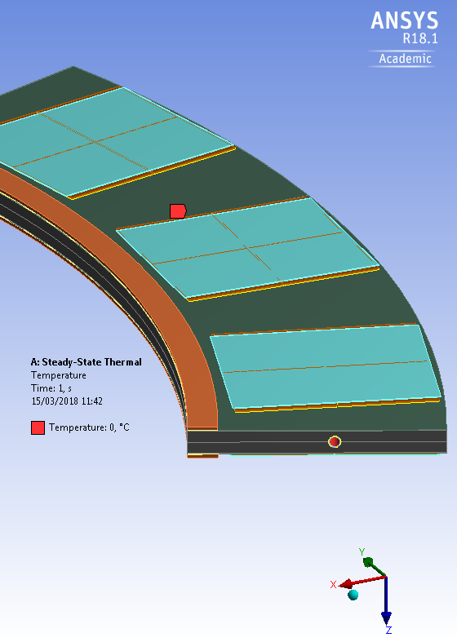
FLYING FLEXBUS OPTION 4
THERMAL LOADS and BOUNDARY CONDITIONS
Flexbus internal heat generation: 10% of the total power calculated for the 45° sector ⁽³⁾
6.384 W
⁽³⁾ See backup slide 3 for detail
Temperature
inner wall pipe: 0°C
Ring supposed to be adiabatic :
No convection
No radiation
ONLY THERMAL CONDUCTION
Heat Flux over FEI4:
0.7 W/cm²

Slide 32
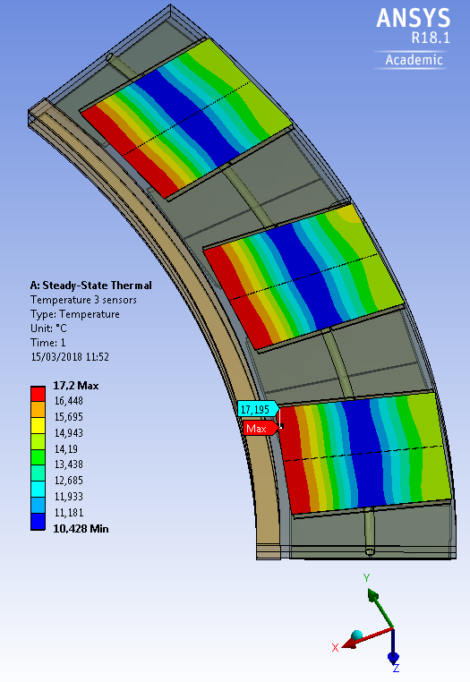
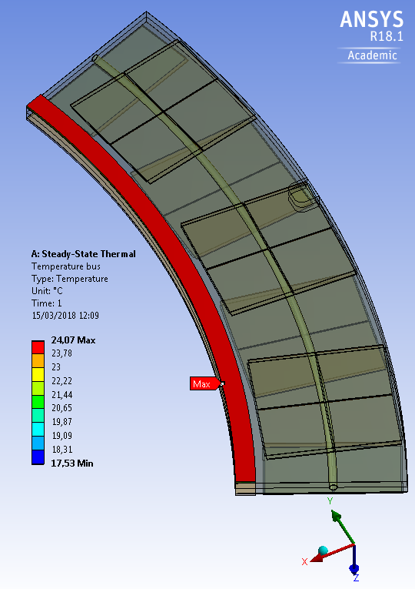
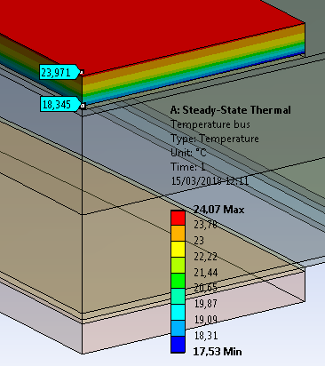
FLYING FLEXBUS OPTION 4
THERMAL FEA RESULTS
Detail of the temperature field into the flexbus.
Note: the variation in the thickness isdriven by the transversal low conductivity (0.2 W/mK)
Max delta T sensor - pipe : 17.2°C
Max delta T bus - pipe : 24°C

Slide 33
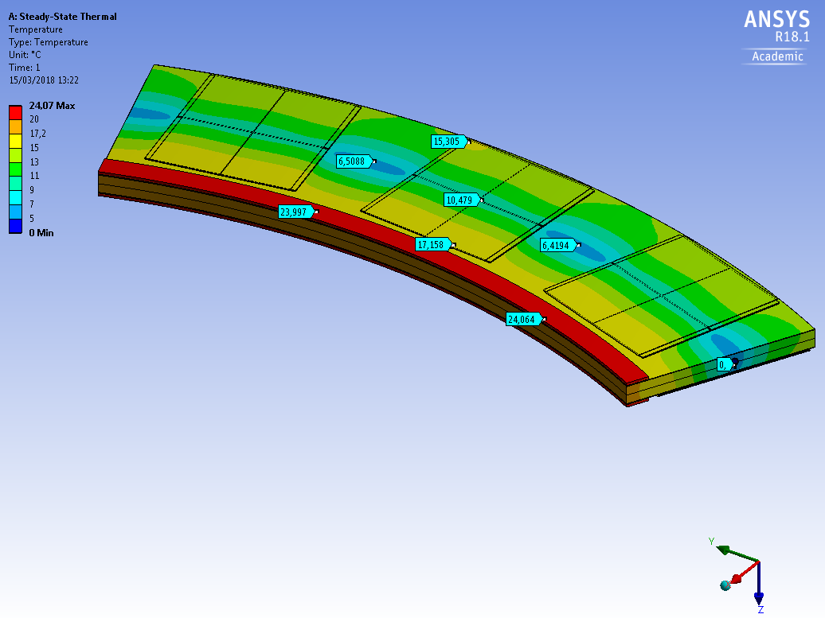
FLYING FLEXBUS OPTION 4
THERMAL FEA RESULTS
Overall Temperature field
middle ring
pipe temperature: 0°C

Slide 34
CO2 COOLING

Slide 35
ENDCAP COOLING DISTRIBUTION SYSTEM
TENTATIVE SUMMARY OF OPERATIONS AND QUESTION MARKS…
JOINING HALFRING COOLING PIPE TO THE TO THE ENDCAP DISTRIBUTION SYSTEM
USING ORBITAL WELDING/CUSTOM CONNECTION?
DESIGN (WORKING DRAWINGS) FOR INNER/MIDDLE/OUTER HALF RINGS
VALID FOR THE TWO SIDES (LEFT/RIGTH AND FOR BOTH ENDCAPS?
TRYING TO ALIGN TO THE VERY EXTENSIVE R&D WORK DONE IN UK
WITH MANY SPECIALIZED PEOPLE
AND IMPORTANT INFRASTRUCTURES
WE NEED TO UNDERSTAND THE BEST STRATEGY AND SYNERGIES
FOR THE CONSTRUCTION

Slide 36
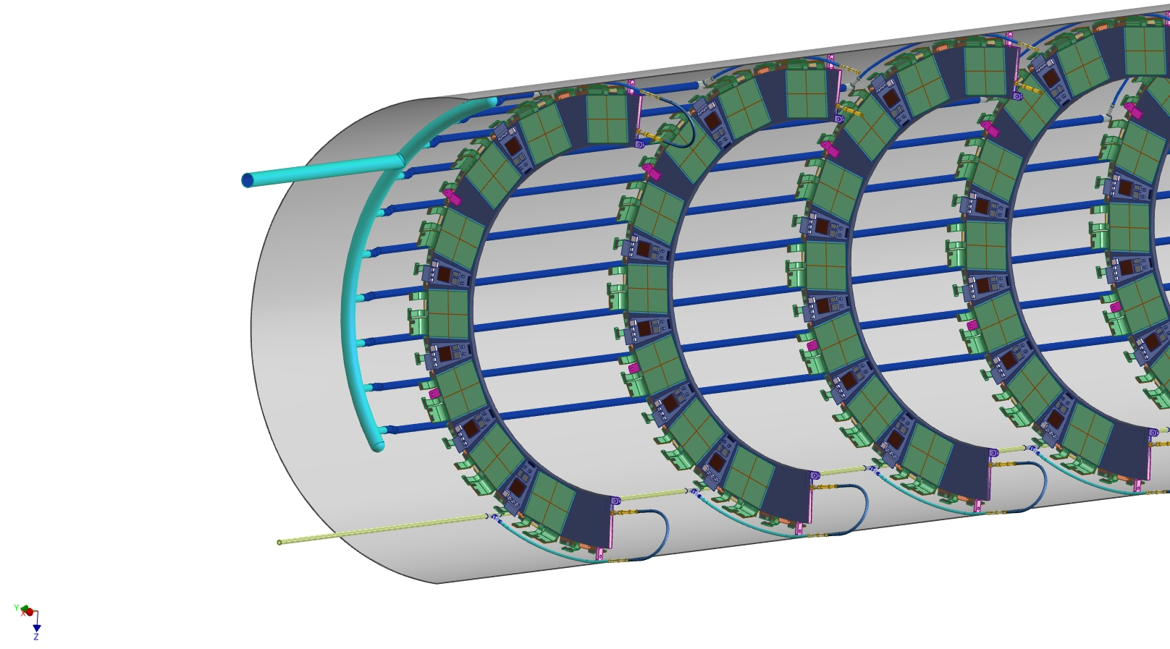
Inlet– Outlet tube Design / Location:
DESIGN FROM UK COLLABORATION
Manifold
Individual Exhaust Lines
Common Supply Line
Capillaries
Fred Gannaway (f.c.gannaway@qmul.ac.uk) / Peter Sutcliffe (peter@hep.ph.liv.ac.uk )

Slide 37
COOLING FLOW CALCULATION

Slide 38
COOLING FLOW CALCULATION

Slide 39
COOLING FLOW CALCULATION
From: Danilo Giugni
Sent: 26 March 2018 16:22
To: Simone Coelli; Alexander Bitadze
Cc: Danilo Giugni; Jo Pater
Subject: RE: endcap cooling mas flow rates
Hi Simone, Alex.
Let's try to fix this once for ever:
- There are 10, 8 and 9 HalfRings in one HalfShell , Inner, middle and Outer respectively
- Module power is 11.2W (0.7W/cm2 over 16cm2)
- There are 16, 22 and 26 quad modules in one HalfRing. Inner middle and Outer respectively
The power and flow rate should be as follow:
HalfRing |  | HalfShell
W | g/s | W | g/s
179.2 | 1.792 | 1792 | 17.92
246.4 | 2.464 | 1971.2 | 19.712
291.2 | 2.912 | 2620.8 | 26

Slide 40
DESIGN FROM UK COLLABORATION

Slide 41
x

Slide 42
CALIBRATED ORIFICES

Slide 43
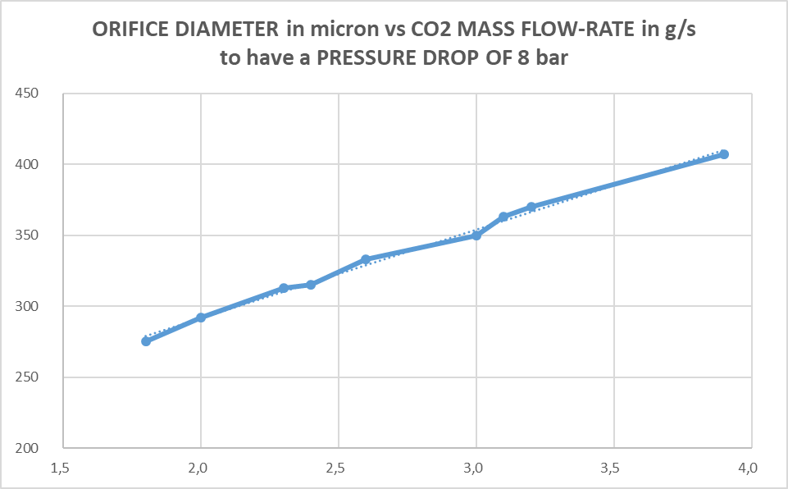
ESTIMATION OF ORIFICE DIAMETERS
TO BE UPDATED
SETTING AN INLET PRESSURE DROP OF 8 BAR
IF THIS PRESSURE DROP IS PRODUCED BY A CALIBRATED ORIFICE
=> ORIFICE PRELIMINARY DIMENSIONING:
PIXEL ENDCAP
INNER HALF-RING
CO₂ MASS FLOW-RATE = 2 ÷ 2.3 g/s
ORIFICE DIAMETER = 292 ÷ 313 micron
MIDDLE HALF-RING
CO₂ MASS FLOW-RATE = 2.6 ÷ 3.1 g/s
ORIFICE DIAMETER = 333 ÷ 363 micron
OUTER HALF-RING
CO₂ MASS FLOW-RATE = 3.2 ÷ 3.9 g/s
ORIFICE DIAMETER = 370 ÷ 407 micron
INNER
HALF-RING
MIDDLE
HALF-RING
OUTER
HALF-RING
CALIBRATED ORIFICES
FROM SWAGELOK CATALOGUE
FOR TEST

Slide 44
FROM SWAGELOK CATALOGUE
ORIFICES UNDER TEST

Slide 45
ESTIMATION OF ORIFICES FOR ATLAS ITK CO₂ FLOW DISTRIBUTION:
Thermodynamic constraints, REF.DANILOS SLIDES Pixel Mechanics 2017-11-07:
• Tevap @PP1 exhaust: -40 °C
• Max Tevap variation due to pressure drop from the orifice (excluded) to PP1: 5 °C (< 2 bar)
• Typical pressure drop from the orifice (included) to PP1 exhaust: 10 bar
• Power load: module (0.5W/cm2)+ sensor (0.1W/cm2) type0/1 (0.1W/cm2) = 0.7W/cm2
• Flow rate: 1g/s for 100W
CO₂ PROPERTIES AT-35 °C
ρ fluid density 1096 Kg/m^3
μ dinamic viscosity 0,000178 Pa*s

Slide 46
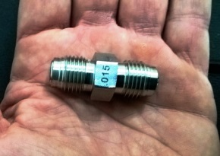


FLOW RESTRICTORS CO₂ COOLING TEST
SWAGELOK ¼ INCH FLOW RESTRICTOR
FROM CATALOGUE:
6LV-4-VCR-6-DM-010P, 6LV-4-VCR-6-DM-012P, 6LV-4-VCR-6-DM-015P, 6LV-4-VCR-6-DM-017P
1/8 INCH VCR GASKET Diam. 6 mm
LASER HOLE IN VCR GASKET
CUSTOM ORIFICES:
200, 225, 250, 275 μm
WE MEASURED THE OTHER GEOMETRICAL CHARACTERISTICS USABLE FOR THE PRESSURE DROP CALCULATION
Hole: 0,250 mm (= 250 μm)

Slide 47
CO₂ PROPERTIES:
Saturation Properties for Carbon dioxide
In the range of interest:
-35 °C … -40 °C for the Atlas detector
-20 °C … -30 °C for the TRACI measurements
CO₂ physical properties entering in the pressure drop calculation:
* Density
* Viscosity
Interesting for the outlet vapour fraction estimation:
* Henthalpy difference between liquid and vapour CO₂
Next slides show some plots captured from the web site of National Institute of Standards and Technology (NIST)

Slide 48

CO₂ Density:
1116 kg/m3
1032 kg/m3
- 35 °C

Slide 49

CO₂ Viscosity:
194 micro Pa s
140 micro Pa s
- 35 °C

Slide 50

CO₂ Enthalpy liquid to vapour:
THIS FIGURE IS USED TO CALCULATE THE NEEDED COOLING MASS FLOW-RATE
FOR A GIVER DIISIPATED POWER
AND FOR A GIVEN CO₂ EXHAUST (DETECTOR OUTLET) VAPOUR FRACTION, i.e. X_{OUT}= 50 %
Dissipated power Q (W)
Outlet vapour fraction X out (%)
Latent heat of vaporization H vap - h liq = H l-v (J/g)
=> calculated FLOW (g/s) = Q (W) / (0,50 * H l-v (J/g))
h l-v =313 J/g
h l-v =303 J/g
h l-v 283 J/g
- 35 °C

Slide 51


SPREADSHEET FOR ORIFICE PRESSURE DROP CALCULATION
FORMULAS FROM IDELCHIK HANDBOOK OF HYDRAULIC RESISTANCE
=> THICK-EDGED ORIFICE (OTHER MODELS DOESN’T WORK AS WELL)
IMAGES FROM "HANDBOOK OF HYDRAULIC RESISTANCE" I.E. IDELCHIK

Slide 52
SPREADSHEET FOR THE ORIFICE PRESSURE DROP CALCULATION
EXAMPLE OF PRESSURE DROP CALCULATION

Slide 53
EXPERIMENTAL MEASUREMENT OF ORIFICES PRESSURE DROP
ORIFICE TEMPERATURE DROP °C
ORIFICE PRESSURE DROP bar
MASS FLOW-RATE g/s
ORIFICE TEMPERATURE DROP °C
ORIFICE PRESSURE DROP bar
MASS FLOW-RATE g/s
ORIFICE TEMPERATURE DROP °C
ORIFICE PRESSURE DROP bar
PRESSURE AND TEMPERATURE DROP ACROSS ORIFICES IN DIFFERENT CONDITIONS
EACH FIGURE IS THE AVERAGE OF 20 EXPERIMENTAL POINTS: 1 MEASUREMENT/S FOR 20 SECONDS DATA-TAKING
MASS FLOW-RATE g/s

Slide 54
SPREADSHEET CROSS-CHECK WITH THE MEASUREMENTS
AGREEMENT WITH THE MEASUREMENTS
DEVIATION AT 1 g/s
200 micron laser orifice => calulated 9 bar, measured 6 bar => 33%
254 swagelok orifice => calulated 3,5 bar, measured 3,26 bar => 7%
250 micron laser orifice => calulated 3,7 bar, measured bar => 14 %
WORK IN PROGRESS TO CALCULATE MORE PRECISELY THE % ERROR USING ALL THE DATA
CO₂ PHYSICAL CONDITIONS IN THE VALIDATION TEST
μ dinamic viscosity 0,000165 Pa*s
ρ fluid density 1050 Kg/m^3
ORIFICE TEMPERATURE DROP °C
254 MICRON SWAGELOK ORIFICE:
calculated
O.5 g/s => 0.88 bar
O.8 g/s => 2.24 bar
1 g/s => 3.5 bar
ORIFICE PRESSURE DROP bar
MASS FLOW-RATE g/s

Slide 55



FLOW RESTRICTORS FLUID-DYNAMIC CHARACTERIZATION CO₂ TEST
DEDICATED COLD-BOX
DRY-AIR FLUXED
DEW POINT MEASUREMENT
ARMAFLEX INSULATION
CO₂ COOLING SUPPLY FROM TRACI COOLING UNIT
CO₂ MASS FLOW-RATE MEASUREMENT
CO₂ PRESSURE AND TEMPERATURE TRANSMITTERS BEFORE/AFTER THE COMPENT UNDER INVESTIGATION
1/4 INCH AND 1/8 INCH GASKETS CAN BE TESTED
3D MODEL
Danilo Trotta
PT
FLOW RESTRICTOR
PT
COLD-BOX AND LOOP FOR THE CO2 TEST
TT
TT
CO₂ FLOW
TEST CIRCUIT

Slide 56
SPREADSHEET CROSS-CHECK WITH THE MEASUREMENTS
CO₂ PHYSICAL CONDITIONS IN THE VALIDATION TETS
CO₂ PROPERTIES AT-30 °C
ρ fluid density 1050 Kg/m^3
μ dinamic viscosity 0,000165 Pa*s
254 MICRON SWAGELOK ORIFICE:
O.5 g/s => 0.88 bar
O.8 g/s => 2.24 bar
1 g/s => 3.5 bar
ORIFICE TEMPERATURE DROP °C
ORIFICE PRESSURE DROP bar
MASS FLOW-RATE g/s
DISCRETE AGREEMENT WITH THE MEASUREMENTS
WORK IN PROGRESS TO CALCULATE MORE PRECISELY THE % ERROR

Slide 57

200 MICRON LASER ORIFICE
ESTIMATED PRESSURE DROP
O.5 g/s => 2,3 bar
O.8 g/s => 5.8 bar
g/s => 9.1 bar

Slide 58

SUGGESTED SYSTEM CONTROLS USING A BOILING CHANNELS
A SENSOR TEMPERATURE TRANSMITTER ON THE LAST SENSOR FOR IMMEDIATE ELECTRIC POWER INTERLOCK
IN CASE THE CO2 FLOW DIMINISHES AND DRY-OUT SUDDENLY HAPPENS
SENSOR TEMPERATURE WILL RISE RAPIDLY
CO2 COOLING INLET
LIQUID NEAR SATURATION
CO2 HEXAUST
OUTLET
VAPOUR FRACTION
DESIRED AROUND 35%

Slide 59


SUGGESTED SYSTEM CONTROLS USING PARALLEL BOILING CHANNELS
AFTER DISCUSSION WIT BART VERLAAT (Cern cooling dpt.)
A CO2 FLUID TEMPERATURE TRANSMITTER SHOULD BE PLACED BETWEEN THE EACH LAST TWO BRANCHES
TO MONITOR THE MARGIN BETWEEN FLUID TEMPERATURE AND SATURATION TEMPERATURE
THE PROBLEM IS THAT A TRANSMITTER IS NEEDED THAT IS
RADIATION HARD
AND MAGNETIC FIELD RESISTANT
R&D IN PROGRESS TO FIND ONE..

Slide 60

HALF RINGS
THERMO-HYDRAULIC CHARACTERIZATION
HEAT DUMMY LOADS
GENERATING MODULE DISSIPATED POWER
CO2 COOLING
MEASURED FLOW-RATE
STABILIZED INLET TEMPERATURE i.e. -20 ..-35°C

Slide 61





HALF RINGS THERMAL PROTOTYPES
FOR COOLING TEST
3d model
DETAIL OF THE INLET ORIFICE
THE ORIFICES CAN BE EASILY CHANGED
THEY ARE MOUNTED WITH VCR FITTINGS
INLET / OUTLET
¼ INCH VCR FITTINGS
HEATING ELEMENTS ARE UNDER STUDY
He leack check of glued joints

Slide 62

FLOW RESTRICTORS FLUID-DYNAMIC CHARACTERIZATION CO₂ TEST
DEDICATED COLD-BOX
DRY-AIR FLUXED
DEW POINT MEASUREMENT
ARMAFLEX INSULATION
CO₂ COOLING SUPPLY FROM TRACI COOLING UNIT
CO₂ MASS FLOW-RATE MEASUREMENT
CO₂ PRESSURE AND TEMPERATURE TRANSMITTERS BEFORE/AFTER THE COMPENT UNDER INVESTIGATION
1/4 INCH AND 1/8 INCH GASKETS CAN BE TESTED
3D MODEL
Danilo Trotta
Danilo Trotta
PT
FLOW RESTRICTOR
PT
TT
TT
CO₂ FLOW
COLD-BOX PREPARED FOR THE TEST
TEST CIRCUIT

Slide 63

Cooling Pipe Manufacturing Meeting
Oxford
09 Feb 2018
ITk Pixel-EC Cooling System
Status of Pixel EC Manifolding
Jo Pater / Alex Bitadze
^{University of Manchester}
Representing the UK pixel-rings team
(Edinburgh, Glasgow, Lancaster, Liverpool, Manchester, Oxford, RAL, Sheffield, QMUL)

Slide 64

New “Layout TDR”:
3+2 Layer Design.
2x 9 Outer Half-Rings.
2x 8 Middle Half-Rings.
2x 10 Inner Half-Rings.
2x 11 Insertable Half-Rings.
2x 4 Insertable Half-Rings.
Peter Sutcliffe (peter@hep.ph.liv.ac.uk )

Slide 65
Inlet– Outlet tube Design / Location:
Manifold
Individual Exhaust Lines
Common Supply Line
Capillaries
Fred Gannaway (f.c.gannaway@qmul.ac.uk) / Peter Sutcliffe (peter@hep.ph.liv.ac.uk )

Slide 66

Pixel EC Cooling system structure / Manifolding:
PP1
PST
R3 out
USA
R4 in
9 R4
R2 in
8 R3
10 R2
R2 out
10 R2
8 R3
9 R4
US
R3 in
R4 out

Slide 67
Cooling System Parameters:
Tevap @PP1 exhaust -35C
Max Tevap variation due to pressure drop from the Capillary (excluded) to PP1 (included) : 5C (< 2 bar)
Typical pressure drop from the Capillary (included) to PP1 (included) : 10bar
Power load: module (0.5W/cm2)+ sensor (0.1W/cm2) type0/I (0.1W/cm2)= 0.7W/cm2
Flow rate: 1g/s for 100W

Slide 68
Cooling System Parameters:
Cooling Structure
Part | Description | Length (m) | OD (mm) | ID (mm) | DP (Bara)
Supply Line (Liquid CO2) | Common supply line from PP1 to each Capillary | 1.962 | 5 | 4 | 0.319
Capillary | From Supply line to each Stave | 0.176 | 0.8 | 0.5 | 8.040
Stave (evaporator) | Half-Ring | 0.926 | 2.27 | 2.02 | 0.980
Return Lines (Liquid/Vapour) | From Stave to Manifold | 1.962 ¹ | 6² | 4 | 0.667
Manifold | - | 0.827 | 12 | 10 | 0.036
PP1 Manifold | - | 1.000 | 12 | 10 | 0.159
 |  |  |  |  | 1.84
¹ Longest return line
² Outer/Middle/Inner Layers : 6mm/5mm/5mm
Calculations done for:
* Evaporation temp. -30C
* power in a quad module: 9.8W (0.7w/cm2x14cm2)
* Vapour quality = 0.5
* Total Flow = 33g/s
* Flow Per Layer: Outer 2.93g/s, Middle 2.35g/s, Inner 1.76 g/s.
* Length = 827mm (Perimeter of the middle half shell)
* Outer / inner shells ±20%
* Tube Wall thickness 1mm

Slide 69
27 March 2018
Starting
FULL POWER
COOLING TEST
on the
INNER HALF RING
Simone Coelli, Mauro Monti, Andrea Capsoni, Ennio Viscione, Carlo Gesmundo, Danilo Trotta, Davide Rosati
I.N.F.N. MILANO

Slide 70
COOLING TEST IN MILANO
Work in progress
THERMO-HYDRAULIC CHARACTERIZATION
for the INNER half ring
using TRACI in Milano
MEASUREMENT OF PRESSURE DROP
TEMPERATURE DROP
AT FULL POWER
INVESTIGATION ON THE FLUID CO2
TO PIPE TEMPERATURE
(CO2 BOILING HEAT TRANSFER COEFFICIENT)
first step toward design for the
OUTER HALF+RING FULL POWER COOLING TEST
to be mounted on the baby-demo plant at Cern

Slide 71


INNER HALF RING DUMMY
ALLUMINUM DUMMY
SUPPORT
TITANIUM PIPE
OD 2,275 mm
located in a semicircular groove
Surrounded by a layer ~0,1 mm thermal grease with k =5 W/mK

Slide 72


INNER HALF RING DUMMY
HEATING SYSTEM
FULL POWER 100 W + 100W ON THE TWO FACES
APPLIED WITH 5 + 5 KAPTON HEATERS LOCATED IN PLASTIC SUPPORTS SCREWED ON THE ALUMINUM PLATE, WITH A LAYER OF THERMAL GREASE k =5 W/mK
TO IMPROVE THERMAL CONTACT

Slide 73

INNER HALF RING DUMMY
MOUNTED ON TRACI
FLUID P,T
INLET
FLUID P,T
OUTLET
Test Closed in ARMAFLEX COLD BOX
3 layers * 25 mm, each side

Slide 74
NNER H.R. COOLING TEST MEASUREMENT POINTS
T10
PF5
T9
TF5
Ti2 pipe
T5 pipe
T8
T4 pipe
T3 pipe
T2 pipe
T1 pipe
Ti1 pipe
T7
TF4
PF4
T6

Slide 75
FIRST COOLING TEST
PRELIMINARY RESULTS
TO BE REPEATED AND CONTROLLED

Slide 76



0 W
Set evap T-30°C
CO2 mass flowrate
830rpm
pump bypass almost completely open
2 g/s
CO2 MASS FLOW-RATE
IN THE HALF RING COOLING PIPE

Slide 77



POWER ON
FROM 0 TO 200W
Mass flow rate drecrease to 1,92 g/s
(due to increase in pressure dop)
Heaters temperatures and pipe temperature increase
Evaporation pressure moves 3 bars
Due to Traci chilling and pump limits

Slide 78
CO2 FLOW = 2 g/s
Power from heaters 0 W (not easy to know ambient heat power)
SYSTEMATIC ERROR CORRECTED
Pressure drop
Temperature drop

Slide 79
CO2 FLOW = 3 g/s
Power from heaters 0 W (not easy to know ambient heat power)
SYSTEMATIC ERROR CORRECTED
Pressure drop
Temperature drop

Slide 80
CO2 FLOW = 1,92 g/s
Power from heaters 200 W
SYSTEMATIC ERROR CORRECTED
Pressure drop
242 mbar
Temperature drop
0,44 °C

Slide 81

8 °C
OUTSIDE PIPE T
7 «T» Thermocouples
Pressed against pipe with thermal grease contact
(Measured error < +/- 1,5 °C)
CO2 FLUID T
INLET
OUTLET
Observed Delta T fluid –pipe ~ 8-10 °C
Bigger than expected
To be better investigated

Slide 82


ALL PIPE T
FLUID T
Hottest spot
T15 ON HEATER H9
NOTE THAT
=> Delta t fluid –pipe ~ 8-10 °C

