Slide 1
Endcap Integration and Tooling
IT-UK Pixel Endcap Meeting
Peter Sutcliffe
5th April 2018
INFN - Laboratori Nazionali di Frascati

Slide 2
Integration and tooling overview
Clean room layout
Tooling x 3
Cylinder manufacturing, trim jigs, end flanges
Bare cylinder preparation and component gluing
Services preparation
Half ring insertion
Transport around the assembly room?
Systems testing-endcap frame
Half cylinder into full cylinder assembly
Dispatch to CERN-see Helens talk

Slide 3
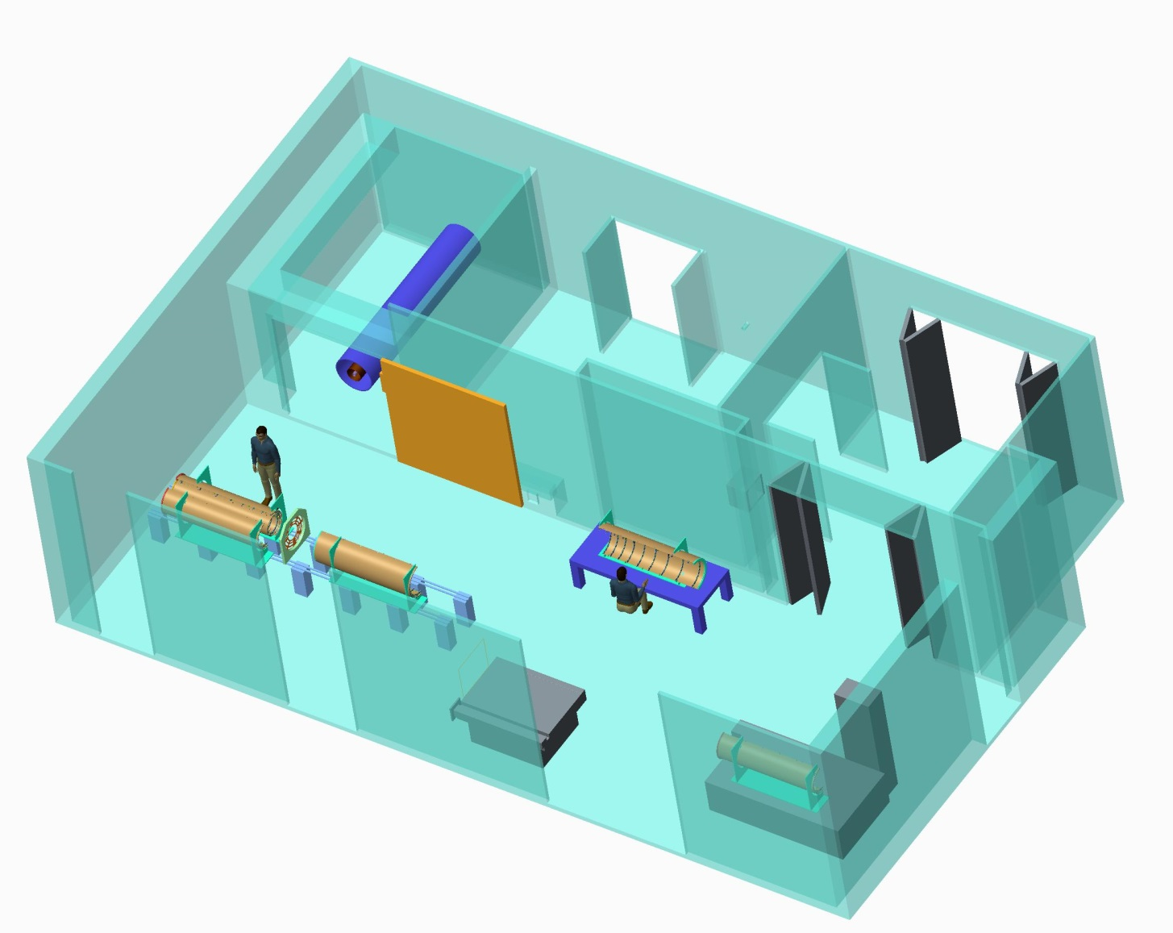
Clean room layout
First thing you notice is we still can’t afford chairs
Quite a minimalistic layout
Environmental Chamber
Services and welding bay
Endcap assembly
Half cylinder pre-production.
Half ring attachment
(on CMM)

Slide 4
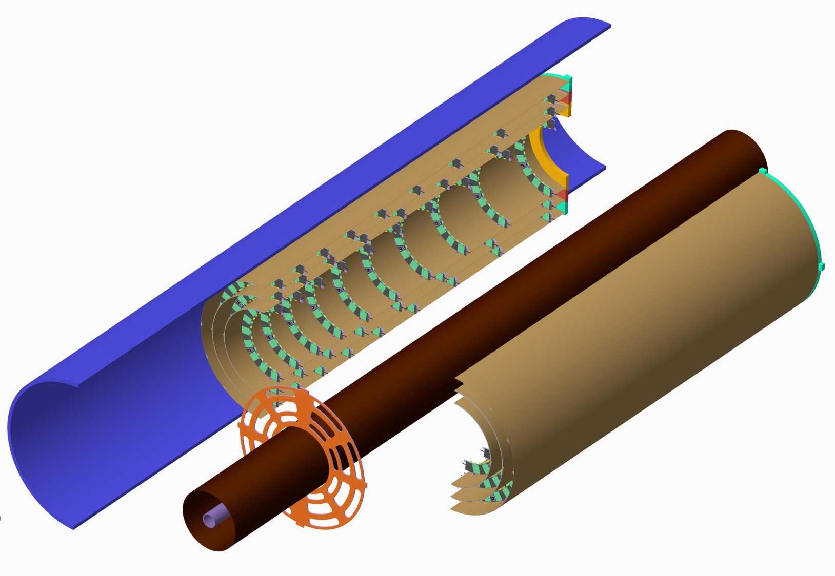
Endcap pixel layout TDR 9-8-10 Layout
Last half rings Z=3000
Heavyweight Pixel Endcap support flanges
9 outer half rings R275
8 middle half rings R212.5
10 inner half rings R150
Outer Pixel Layers
3 Layers
Half rings
Z=3120
Pixel Support Tube
1st half rings Z=1200
1975mm
Inner Support Tube
Beam Pipe
Lightweight Pixel Endcap Support Flanges

Slide 5
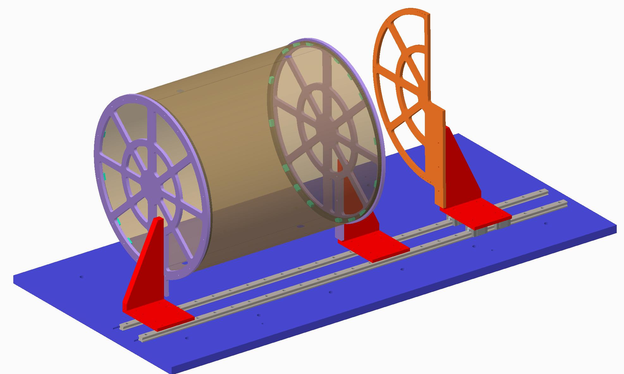
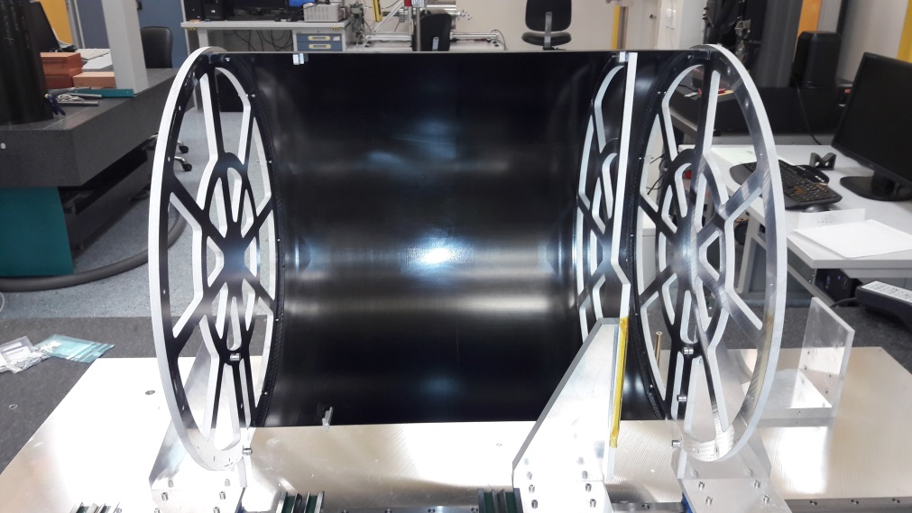
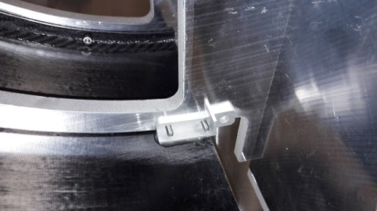
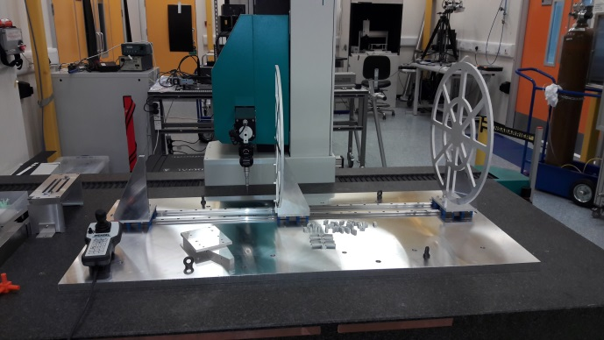
Bare cylinder preparation
Trim and dress half cylinders, add holes etc.
Mount CFRP end-flanges on jig and attach inserts (2x)
Spread adhesive on outer rims of end-flanges, mount two ½-cylinders and allow to cure
Cut end-flanges at top and bottom to split assembly into two parts
Add link pieces
Currently this is mounted on aluminium tooling plate on the CMM, but will be considering using a 2.2m long optical table instead
CMM 2.7m long

Slide 6
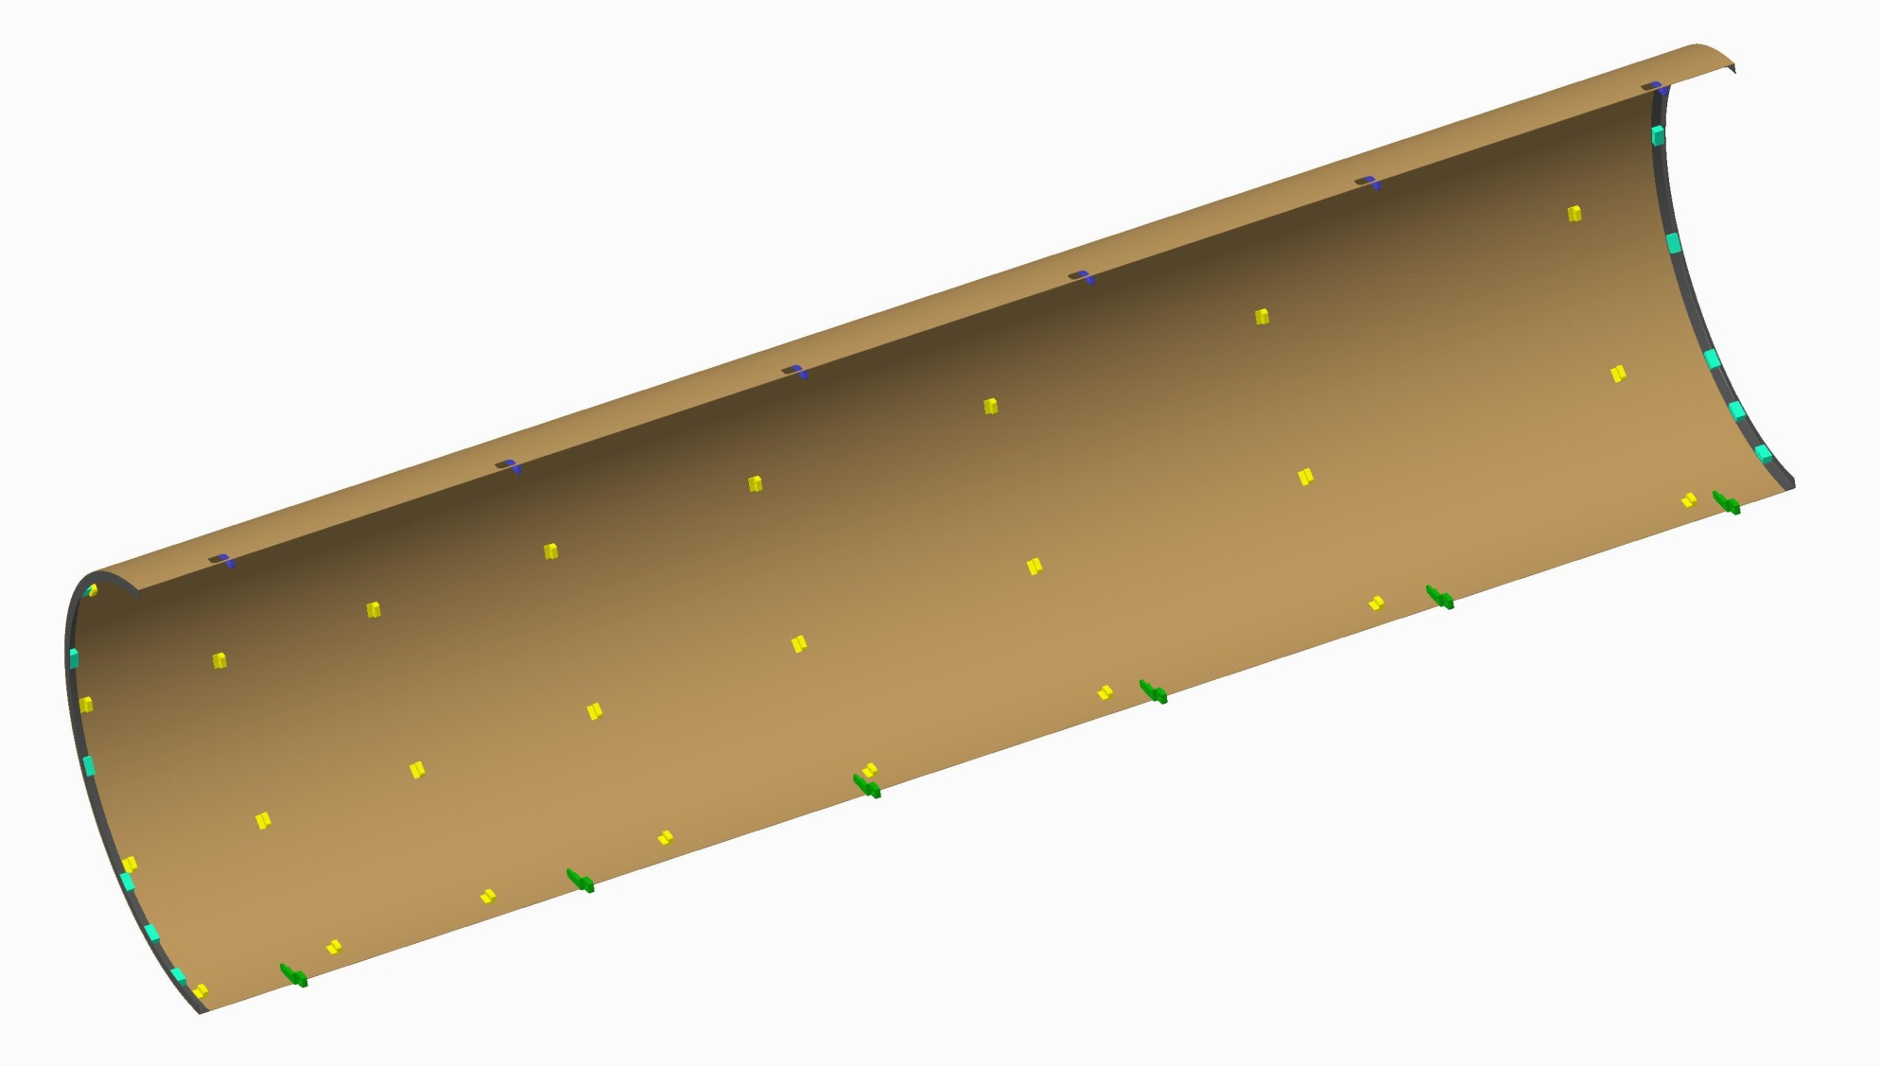
Completed middle half cylinder
Discrete components added, ready for services to be added….see Freds talk
At this stage tube and cable clips can also be added
Heavy Z=3000 will need to be added.

Slide 7
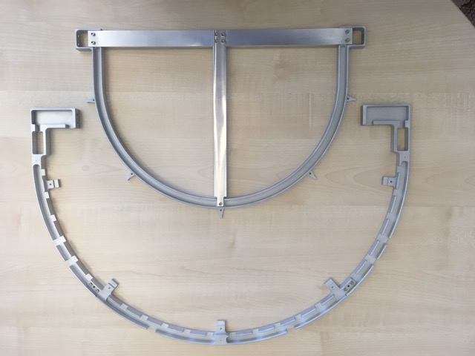
Half ring insertion Liam Cunningham
Fully populated ring in handling frame ready for insertion into the half cylinder
Attach T-piece to the handling frame
Remove the outer half of the handling frame, now ready to load into insertion jig

Slide 8
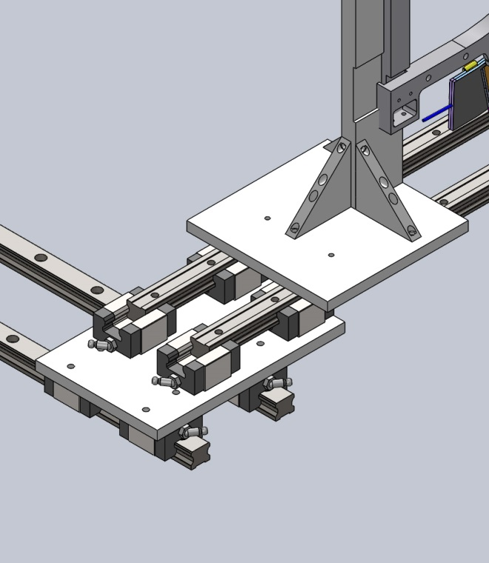
Half ring insertion… Liam
Unloaded jig, vertical edge mates with back of the T-piece
Ring in frame loaded into insertion jig ready for installing to half cylinder
Close up of linear slides for two axis movement

Slide 9
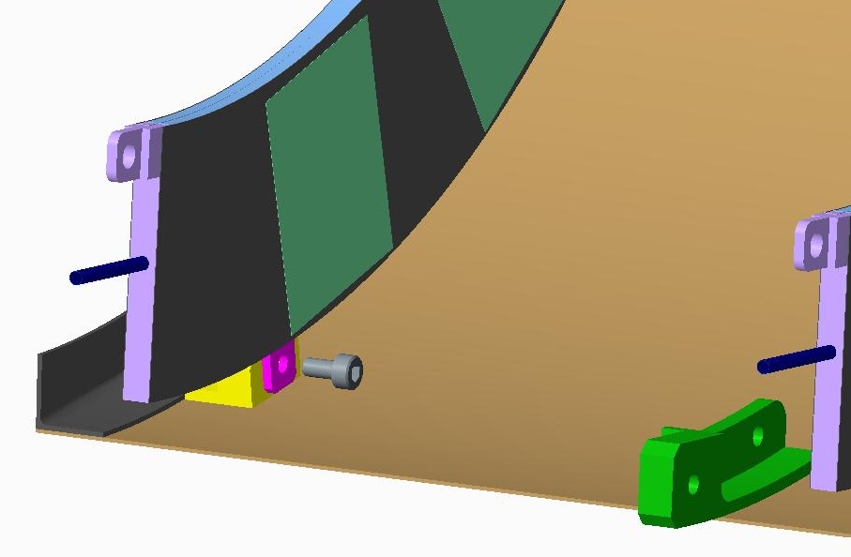
Half ring insertion…. Liam
Insertion tooling in retracted position with ring loaded ready for insertion
Insertion tooling in loaded position ring mounting tabs located at the correct position to be attached

Slide 10
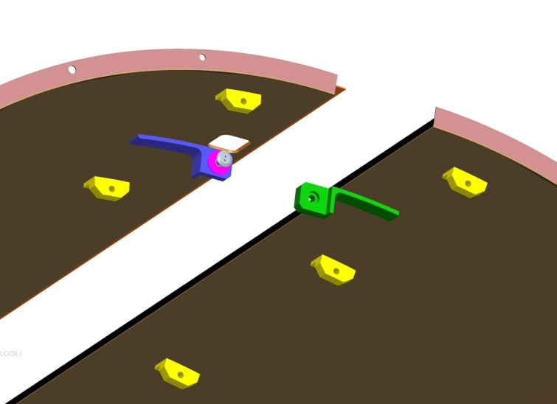
Assembly of half cylinders
Half cylinders will be assembled in the following order:
Fix the lightweight Z=1200 end flange in position
Inner left and right hand
Middle left and right hand assembled around the Inner layers
Outer left and right hand will be assembled around the Inner and Middle layers
Half cylinders connected with connection pieces and captive dowel screws

Slide 11
Endcap envelopes – 5th April 2018
1.9mm clearance
Envelope max R327
cylinder thickness 0.6mm
Outer cylinder I/R324.5
8mm outer services
R316.5
41.1
Nominal Module R295
50mm
R266.5
7mm tape
1.75mm clearance
cylinder thickness 0.6mm
Middle cylinder I/R264.15
8mm middle services
R256.15
41.1
Nominal Module R234.65
50mm
Preliminary
For
Discussion
R206.15
7mm tape
1.75mm clearance
cylinder thickness 0.6mm
Inner cylinder I/R203.8
8mm inner services
R195.8
41.1
Nominal Module R174.3
50mm
R145.8
7mm tape
Endcap I/R145.8
1.8mm clearance
IST O/R144

