Slide 1
Endcap Description
IT-UK Pixel Endcap Meeting
Peter Sutcliffe
5th April 2018
INFN - Laboratori Nazionali di Frascati

Slide 2
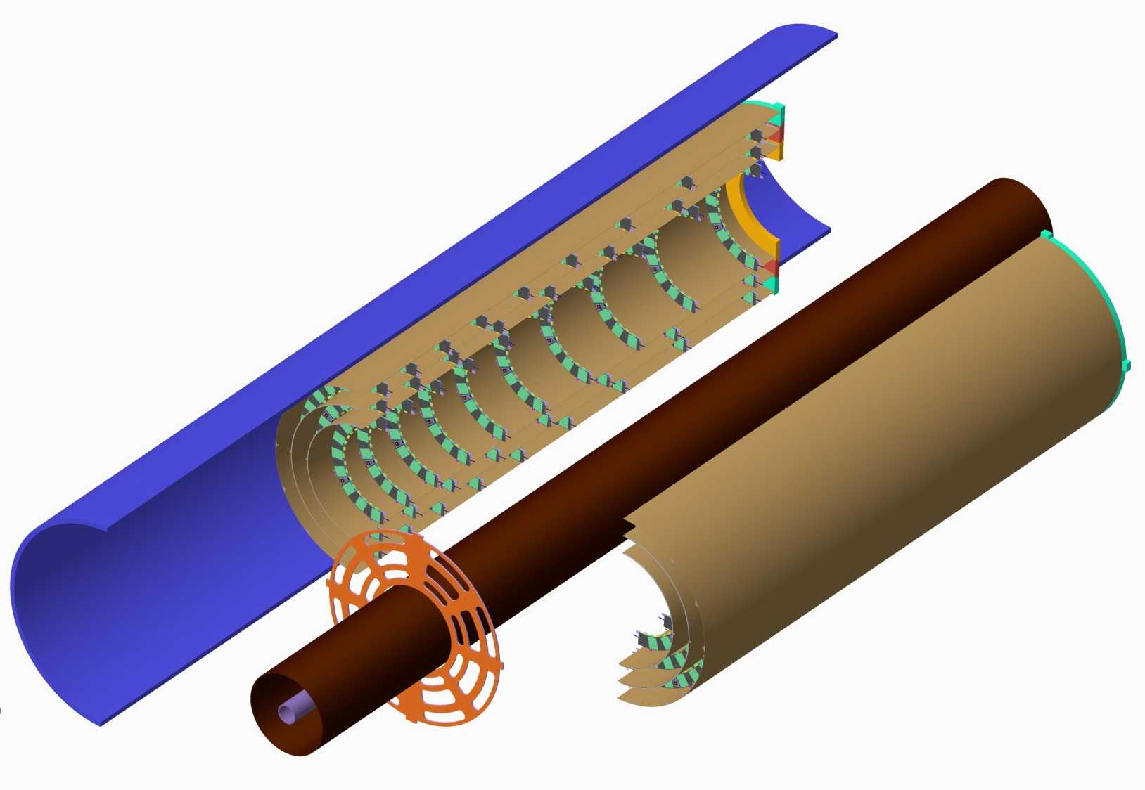
Endcap pixel layout TDR 9-8-10 Layout
Last half rings Z=3000
9 outer half rings R275
8 middle half rings R212.5
10 inner half rings R150
Incorrect radii
Heavyweight Pixel Endcap support flanges
Outer Pixel Layers
3 Layers
Half rings
Z=3120
Pixel Support Tube
1st half rings Z=1200
1975mm
Inner Support Tube
Beam Pipe
Lightweight Pixel Endcap Support Flanges

Slide 3
Pixel Endcap originally concepted as a modular structure.
Populated Half Rings
Bare Half Ring + Modules – Populated Half Ring
Populated Half Cylinder
Bare Half cylinder, with glued in attachments
Cooling and cabling services
Z=3000 End Bulkhead
Populated Half Rings
Fully Assembled Endcap
6 Half Cylinders
Z=1200 Support Structure
Services Support Structure

Slide 4
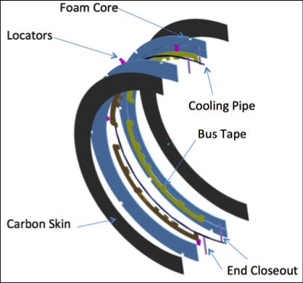
Middle Half ring Description
Nominal Radius 212.5
Section 44mm x 5mm

Slide 5
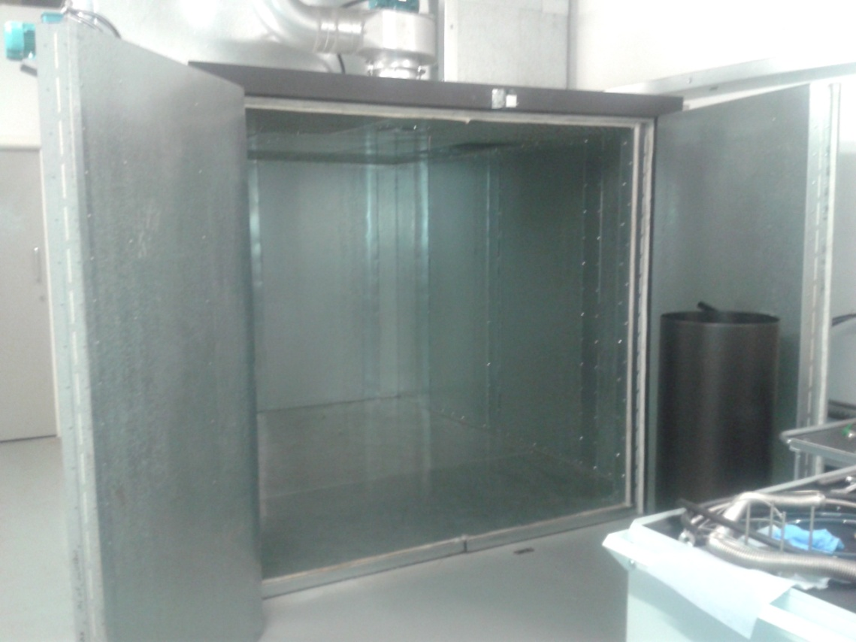
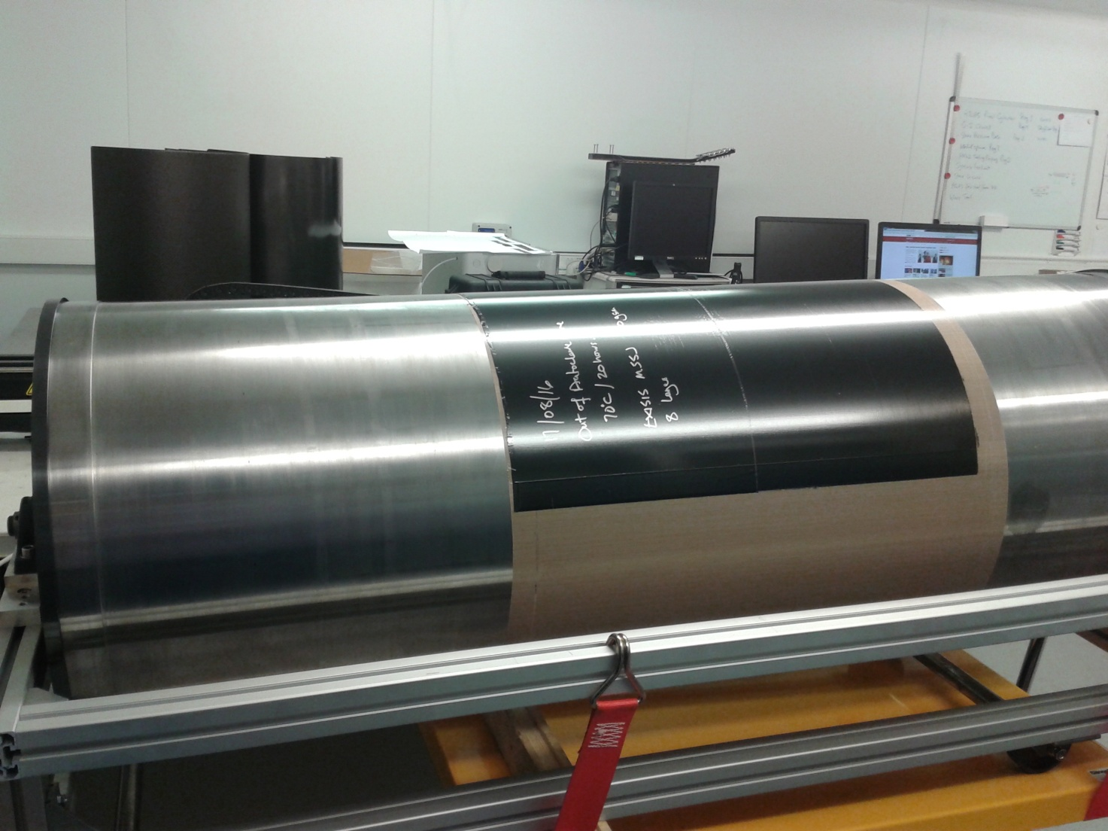
Half cylinder manufacture
Half cylinders layed up on carbon steel cylinders.
Oven cured (not autoclave due to size)

Slide 6
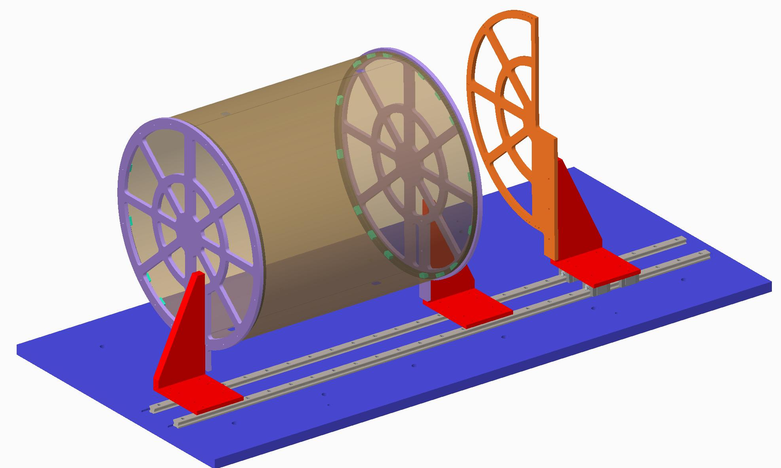
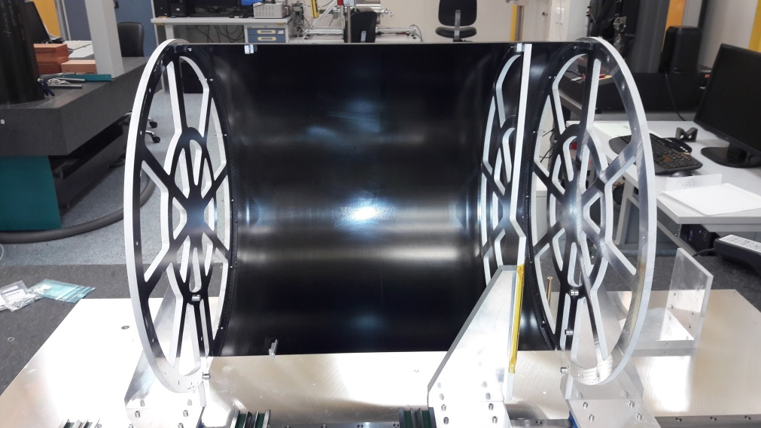
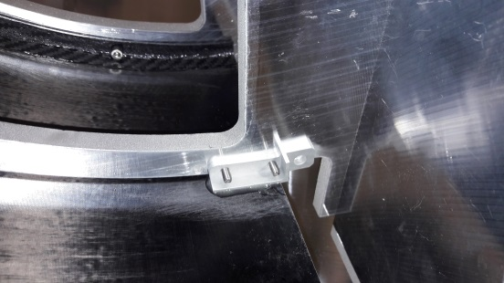
Bare cylinder preparation
Trim and dress half cylinders, add holes etc.
Mount CFRP end-flanges on jig and attach inserts (2x)
Spread adhesive on outer rims of end-flanges, mount two ½-cylinders and allow to cure
Cut end-flanges at top and bottom to split assembly into two parts
Add link pieces

Slide 7
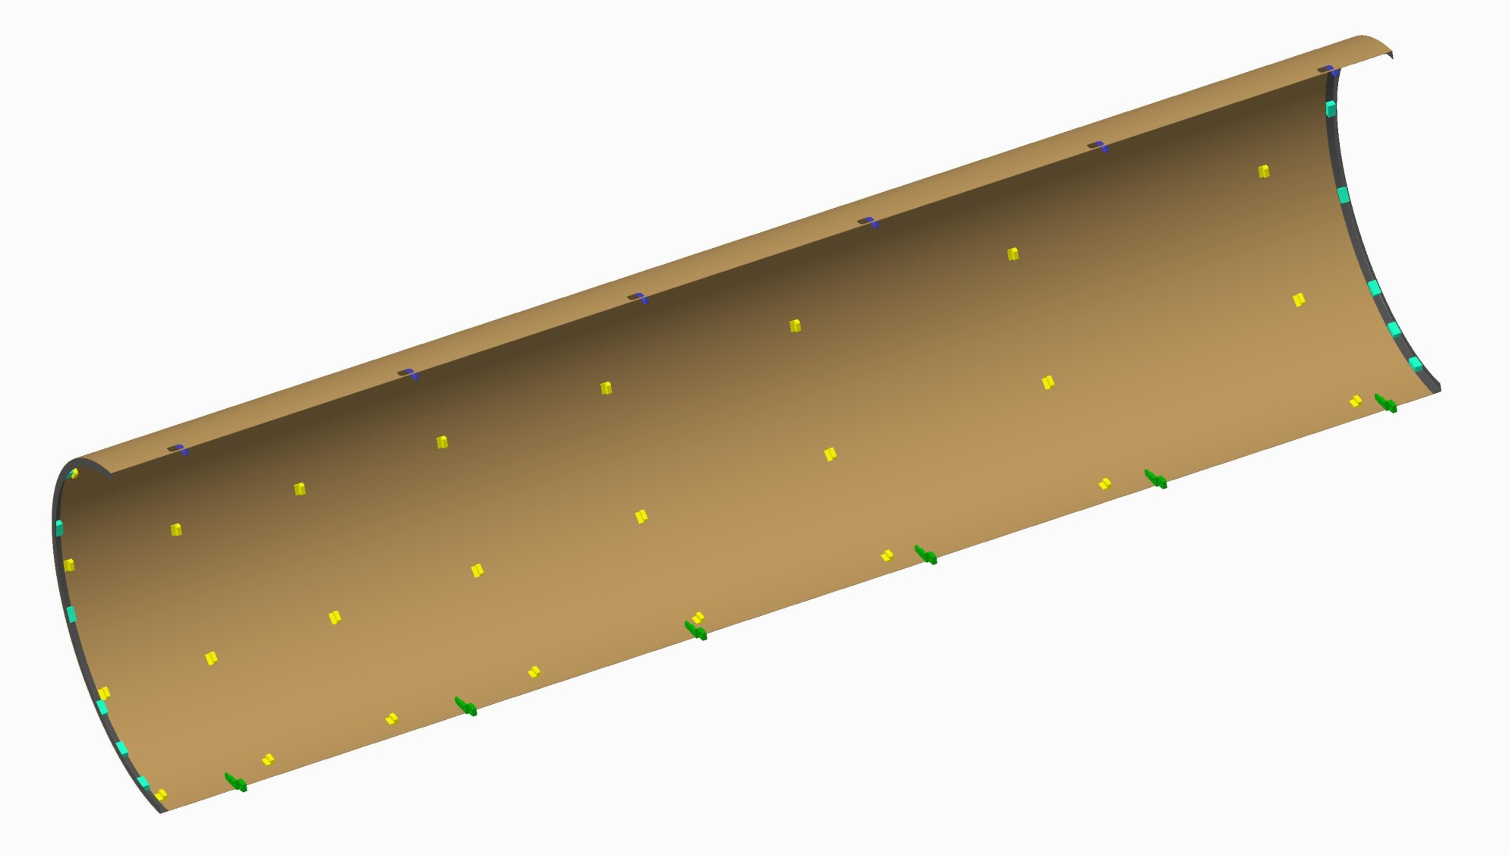
Completed middle half cylinder
Discrete components added, ready for services to be added….see Freds talk
At this stage tube and cable clips can also be added
Heavy Z=3000 will need to be added.

Slide 8
Half Cylinder and Services (Fred)

Slide 9
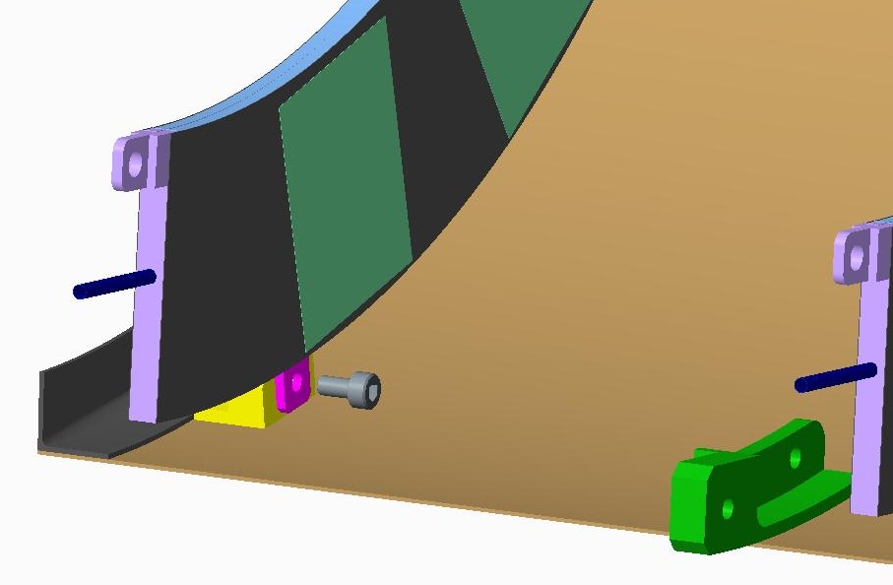
Half Cylinder with Half Rings Attached

Slide 10
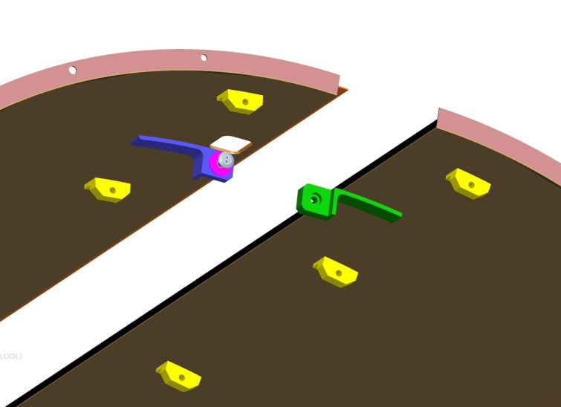
Assembly of half cylinders
Half cylinders will be assembled in the following order:
Fix the lightweight Z=1200 end flange in position
Inner left and right hand
Middle left and right hand assembled around the Inner layers
Outer left and right hand will be assembled around the Inner and Middle layers
Half cylinders connected with connection pieces and captive dowel screws

Slide 11
Cylinder Prototyping – what we intend to do
Dia. 527mm
Middle Layer
L1400mm
D527mm
Start with one ½-cylinder and learn …
How to position shell on end-flanges
How to position ½-ring mechanical interfaces
How to verify the placement accuracy
Very Important – to determine the accuracy a half cylinder can be made in order to stay within our envelope.
1400mm

Slide 12
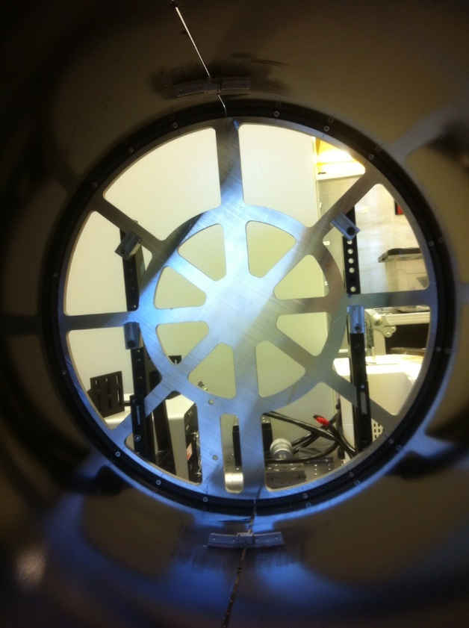
What we have done…
60 cm long half cylinders, with end flanges and connecting pieces.

Slide 13
Note on the Design
Currently trying to ‘fix’ the design
Well defined half ring, module and bus tape concept
Half ring radii fixed
Outer cylinder envelope
Overall endcap length

