Slide 1
Half-shell Design and Manufacture
LNF Endcap Integration Meeting
Peter Cooke, Tim Jones & Peter Sutcliffe
4th April 2018

Slide 2
Outline
Working assumptions
Conceptual Design
Prototyping
Material Costings
Tooling
Effort
Cost Summary

Slide 3
Working Assumptions
Half-cylinders
Three layers
Vertical split
6 half-cylinders / endcap
All ½ cylinders …
Have the same length
Have end-flanges at both ends which are of same cross-section
Are connected to their other half at the end-supports and at intermediate points along their length
½ ring interfaces
½ rings are mounted into half cylinders at N points around their outer perimeter
All ½-ring interfaces in a ½ cylinder are at the same phi angle

Slide 4
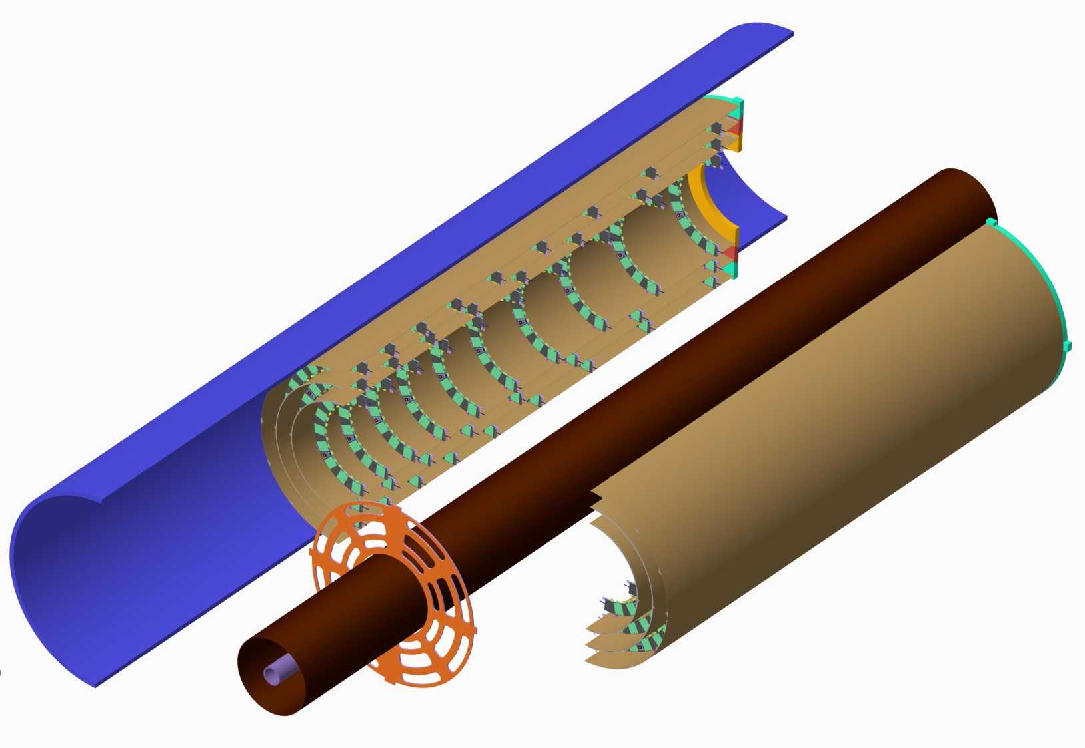
Endcap pixel layout TDR 9-8-10 Layout
Layer | ½-rings/side | Inner Radius
Inner | 10 | 150.0
Middle | 8 | 212.5
Outer | 9 | 275.0
Last half rings Z=3000
Half-shell (2 x 3)
Stiff support flanges
Half rings
Z=3120
Pixel Support Tube
1st half rings
Z=1200
1975mm
9 outer half rings R275
8 middle half rings R212.5
10 inner half rings R150
Inner Support Tube
Beam Pipe
Lightweight Pixel Endcap Support Flange

Slide 5
Example: Outer Half-cylinder
Pre-preg M55J/EX-1515 (80gsm, 40%RC)
Layup [90,-45,45,0]_{s}
Laminate thickness 0.62mm
R326mm
1975mm

Slide 6
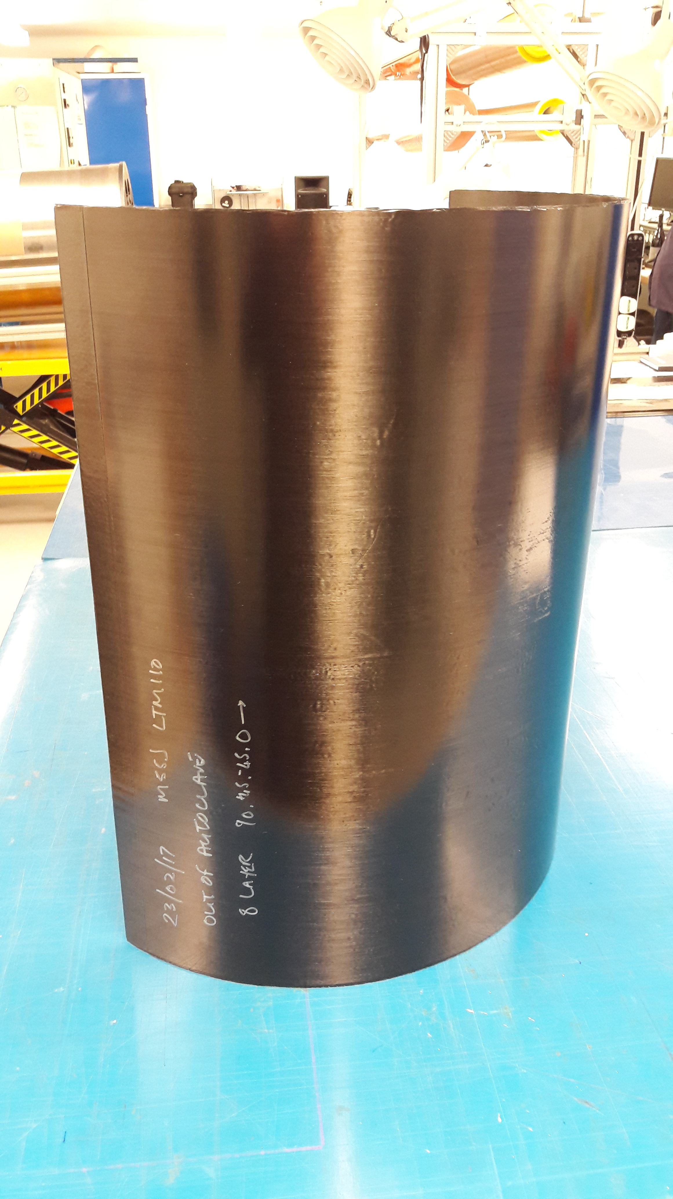
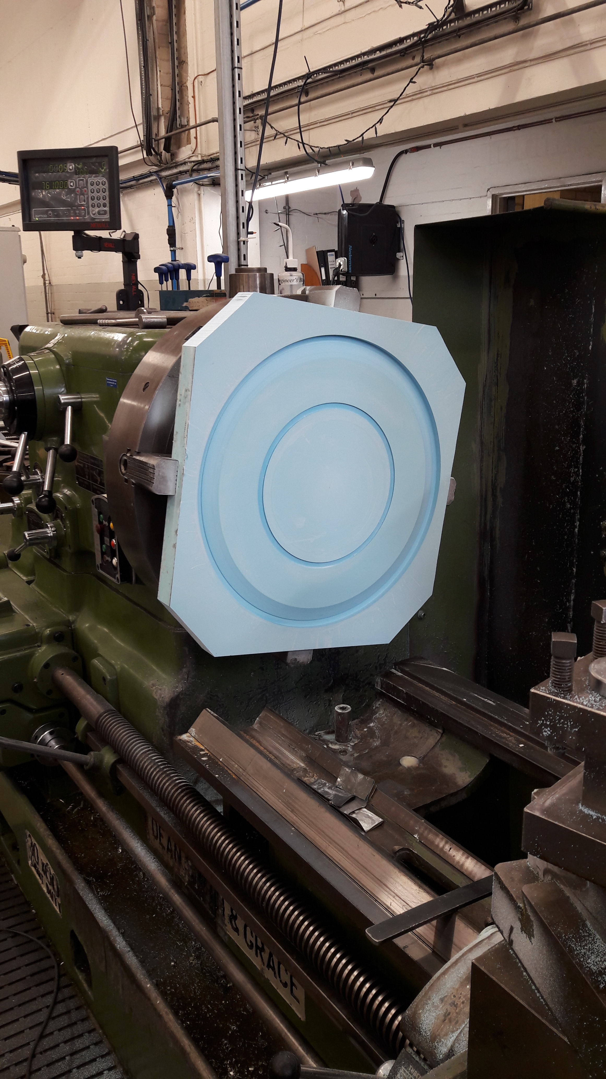
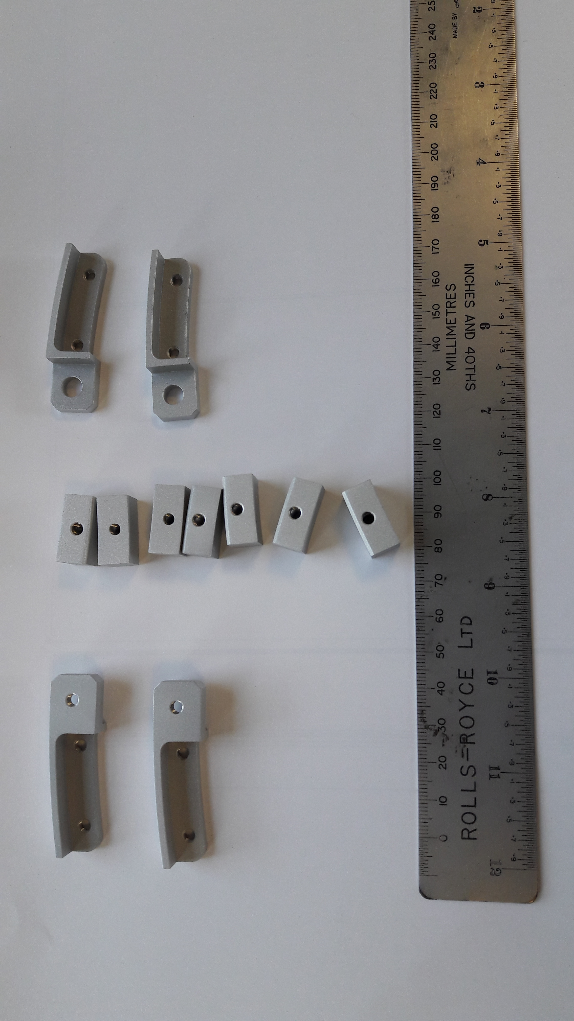
Half-cylinder Prototyping
Many half cylinders have been prototyped. 60cm cylinder manufactured from 8 layers M55J/LTM110 [90,45,-45,0]_{s} and oven cured in vacuum bag
End flange mould tooling manufactured
End flanges manufactured
Interlink parts made (Aluminium)

Slide 7
Single Simply-Supported ½ shell
One half-shell
Hung vertically on wires
Accelerometer at COG
Excited along mid-plane
1.76
Gradient $=\frac{1}{2πL^{2}}\sqrt{\frac{EI}{ρ_{L}}}$

Slide 8
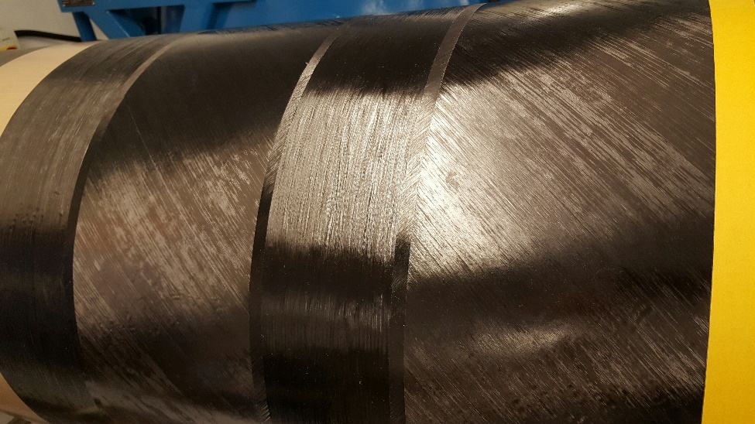
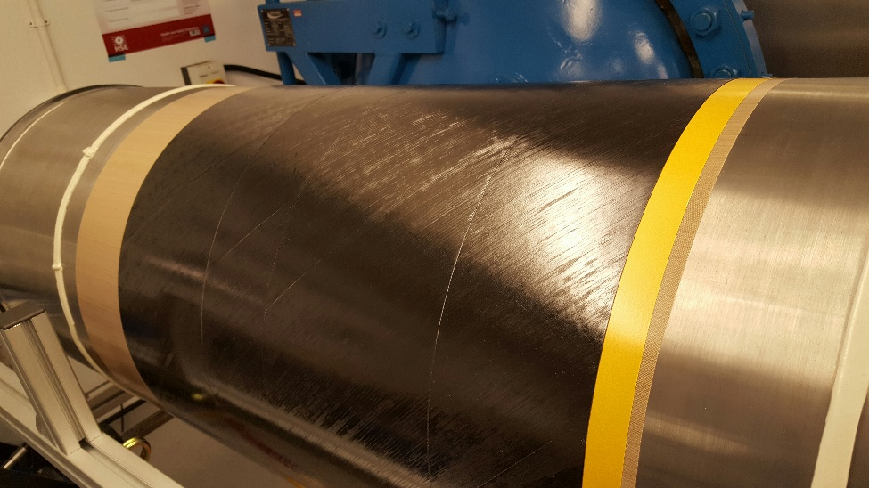
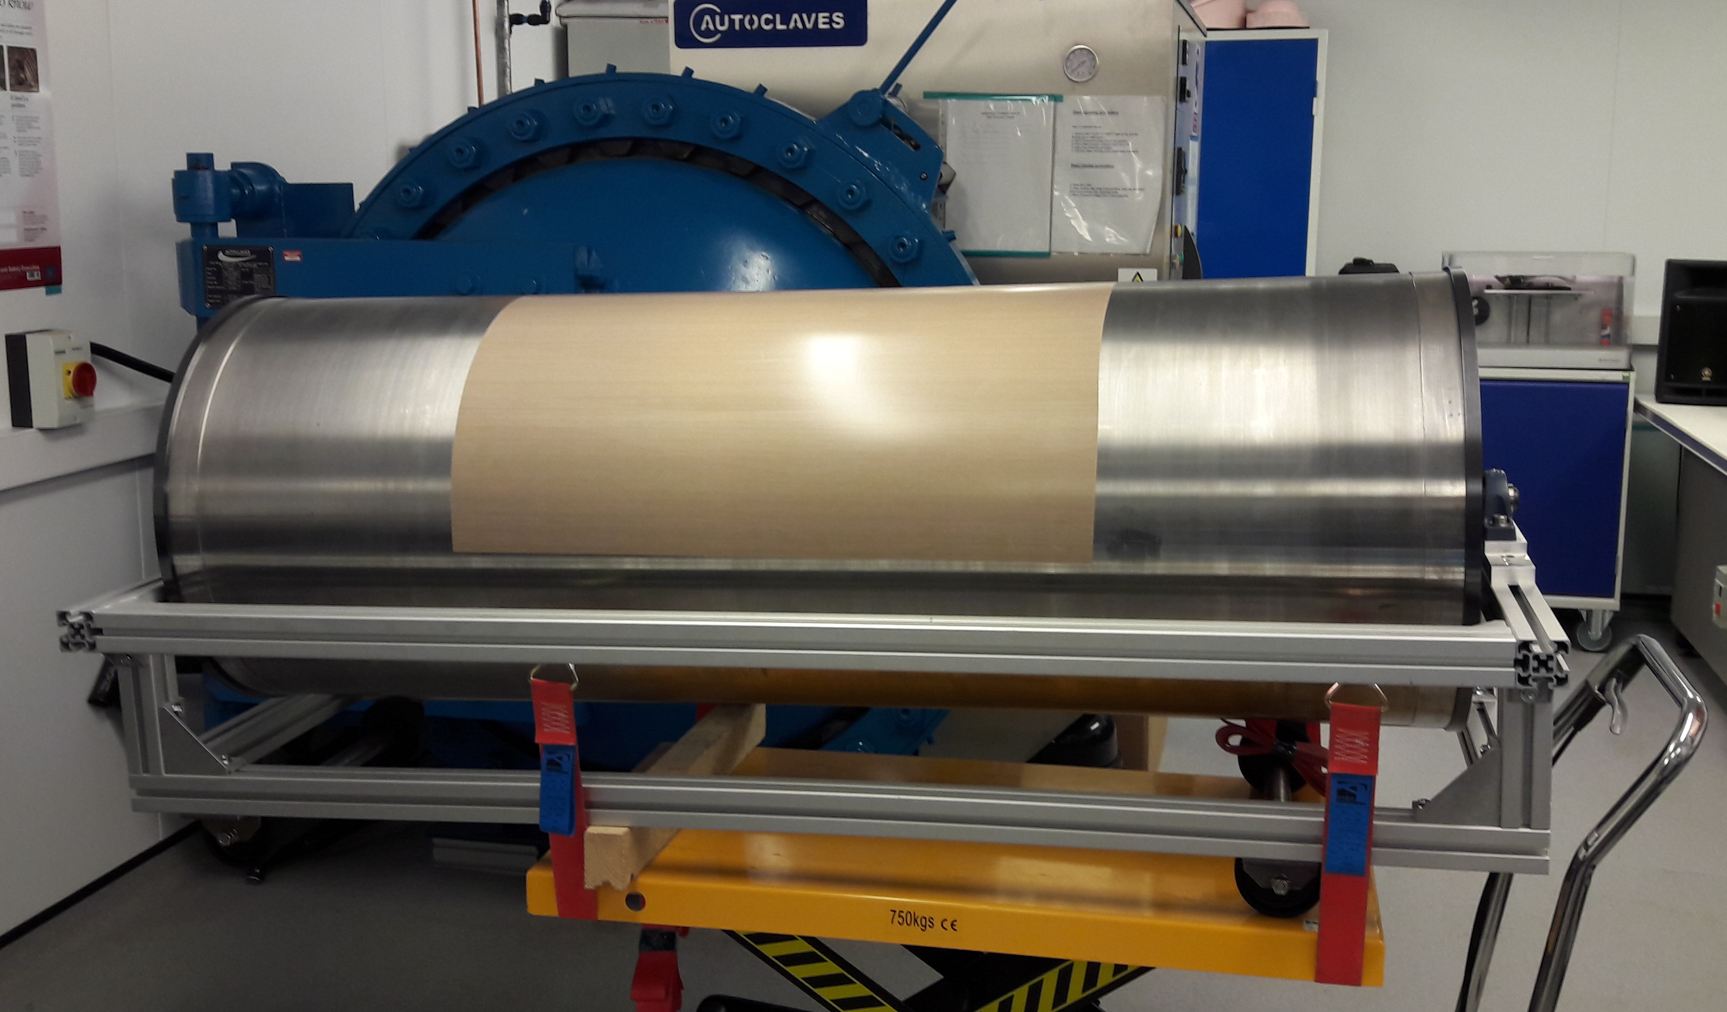
Half-cylinder Lay-up

Slide 9
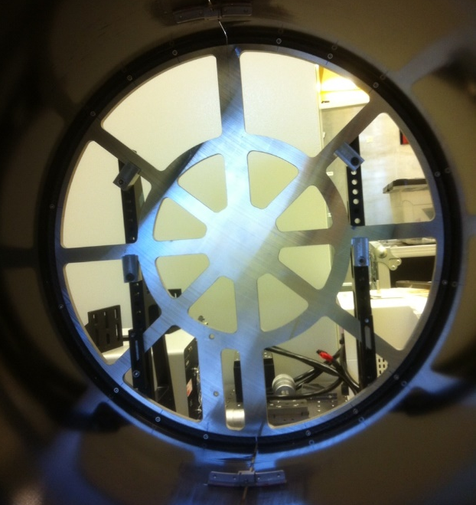
First tests with Full Cylinders
Two ½ cylinders
Two connections along both seams
One end attached to support plate – seams 12 & 6 O’clock
Mark out 16 points over circumference at free end
Accelerometer at 9, tap at 1-16

Slide 10
Half-cylinder Shell Costings
Shell | Radius (m) | Length (m) | Laminae | Sides | Area (m2) | Wastage | Requirement (m2)
Inner | 0.2015 | 1.975 | 8 | 2 | 20.00 | 15% | 23.00
Middle | 0.2636 | 1.975 | 8 | 2 | 26.16 | 15% | 30.09
Outer | 0.3267 | 1.975 | 8 | 2 | 32.43 | 15% | 37.29
Totals |  |  |  |  | 78.59 |  | 90.38
Qualification & test tokens |  |  |  |  |  |  | 9.62
Order Quantity (1 endcap) |  |  |  |  |  |  | 100.00
Core cost for pre-preg = $350/m² = 284 €/m²
Plus stiffening rings, inserts, ½ ring mounts, services supports to PP1, etc…
UK budget for material ≈ 66k€
UK budget for ½ cylinder tooling ≈ 30k€
Cost for two endcaps = 2 x 66 + 30 = 162k€

Slide 11
Half-cylinder End Supports
Low Z End Support
Optimised for low material
Has to take the vertical load of the pixel endcap (and 50% of half of the pixel OB services)
High Z End Support
Has to take the load of the pixel endcap (and 50% of half the pixel OB services) and provide the Z stiffness to control longitudinal vibrations
Both End Supports are assumed to be sandwich constructions with M55J/EX-1515 facings and a low density CF honeycomb
UK budget cost of material for one endcap is 20k€.
Tooling is about 2k€
Cost for two endcaps = 2 x 20 + 2 = 42k€

Slide 12
Half-cylinder Assembly Tooling
This is used to add features to the curved surface of the half-cylinders
Half-ring fixations
Services attachment points
Survey markers
Etc…
Assembly Concept
The half-cylinder is mounted in a jig
1 ½-ring worth of half-ring locators are mounted onto a precision machined jig which is offered up to the half-cylinder at the correct Z and locators are attached using adhesive
Prototype exists – need to evaluate
Tooling
Base is common to all layers
Needs end mounts & fixation carrier for each layer
Assume there are no throughput issues
Cost for one/two endcaps = 20k€

Slide 13
Half-cylinder Manufacture Effort
Column 1 in the table below is a summary from UK funding request for Pixel Endcap Structure Manufacture. Column 2 is my guess at the additional effort for the second endcap
 | 1st Endcap | 2nd Endcap | Two Endcaps
Management, Design & QA | 1.10 | 0.40 | 1.50
Tooling Manufacture | 0.35 | 0.00 | 0.35
CFRP Lay-up & Assembly | 1.80 | 1.80 | 3.60
Physicist/Engineer (TJ & PS) effort for QA for 2nd endcap will need ATLAS-UK & Liverpool approval.
You’d be welcome to come and help!
Composites manufacturing effort at Liverpool is a shared resource. UK endcap assembly takes 30% of available effort.
Request for additional effort to build second endcap should be available but we have to book it as soon as possible
Cost for manufacturing effort determined by Liverpool University not ATLAS-UK.
1.8FTE ≈ 200k€.

Slide 14
Half-cylinder Cost Summary
 | 1st Endcap | 2nd Endcap | Two Endcaps
Management, Design & QA (Ph & E) | 1.10 FTE | 0.40 FTE (QA) | 1.50 FTE
Tooling Manufacture Effort (T) | 40k€ | 0 | 40k€
Lay-up & Assembly Effort (T) | 200k€ | 200k€ | 400k€
Materials | 85k€ | 85k€ | 170k€
Tooling Cost | 50k€ | 0 | 50k€
Transport of Half-cylinders (guess) |  | 15k€ | 15k€
Total Cost (excl. Ph & E) | 375k€ | 300k€ | 675k€

