Slide 1
Outline
Ring design
Ring production procedures, tooling, quality control
Handling frame design and functionality
prototypes and testing

Slide 2
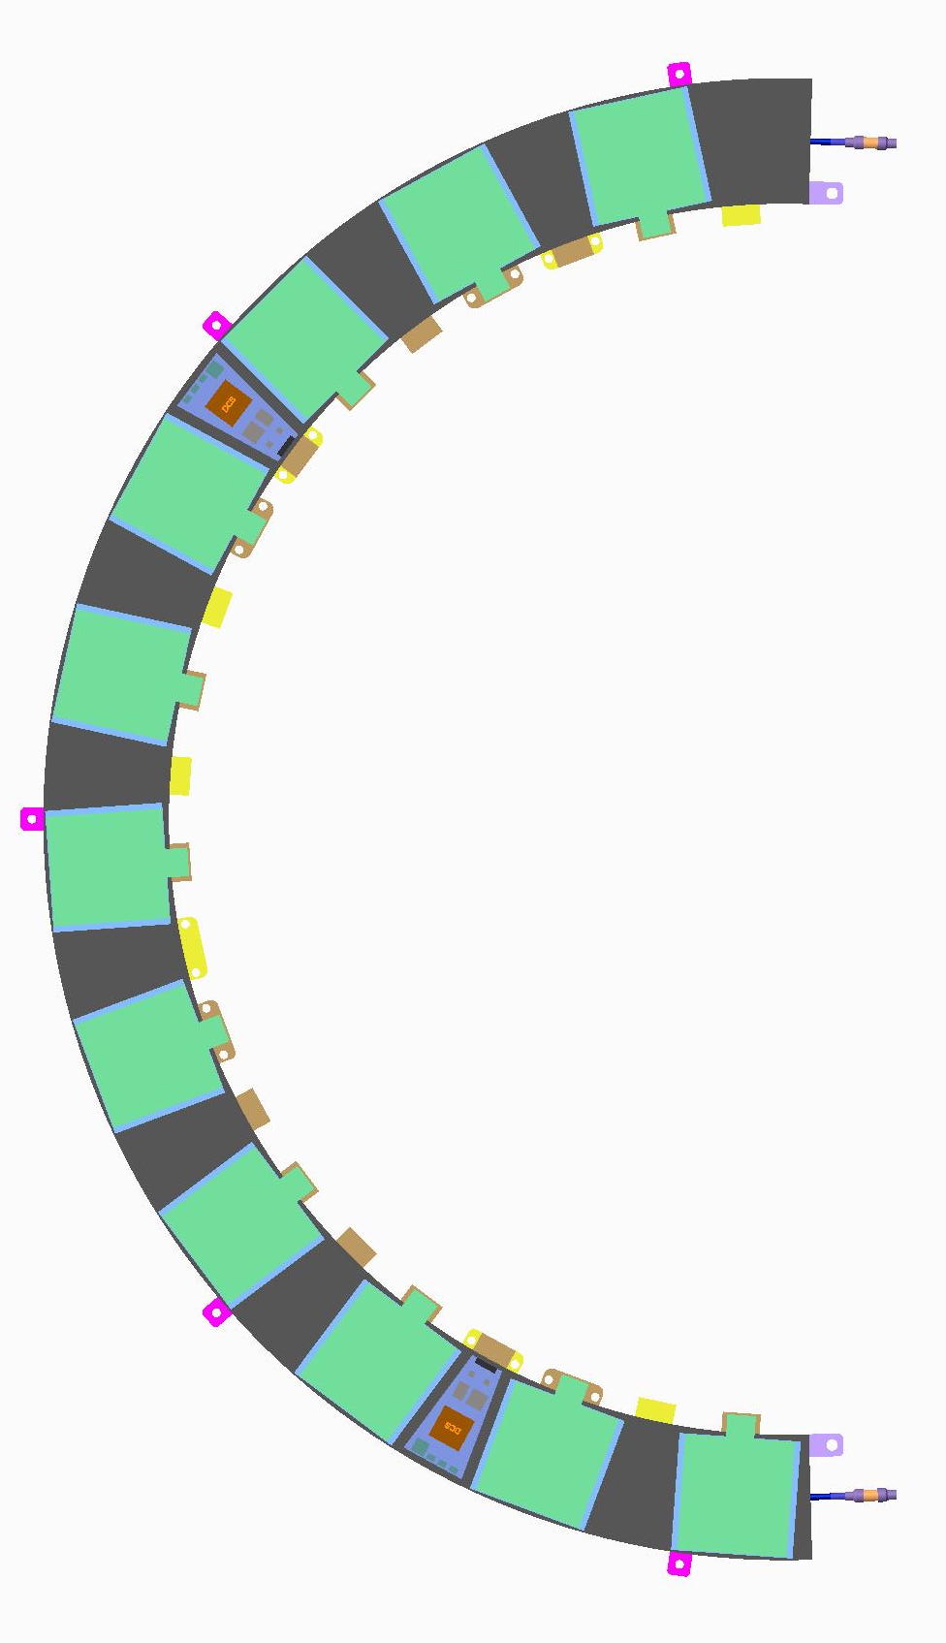
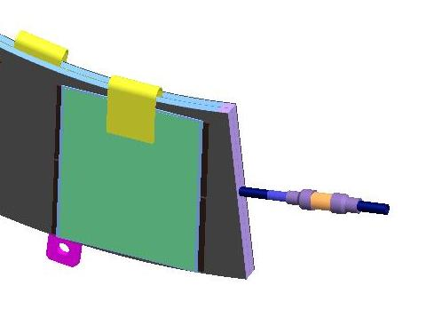
Half-Ring Design
The half-rings are Carbon-fibre/carbon-foam “sandwiches”
  One row of modules per ring
    Phi overlap achieved by alternating modules front/back
  Embedded bus tape as baseline
    alternate suface-mounted tape under consideration
  embedded cooling pipe; electrical isolators on ends
    Pipes are Titanium OD 2.275mm (possibly moving to OD 2.5mm)
  Electrical patch cards (“EoS cards”) on surface to transfer power, slow controls and clock/commands to modules via bus tape
    Shown conceptually at left in blue
    No data on bus tape, data cables will connect directly to modules
P.Sutcliffe

Slide 3
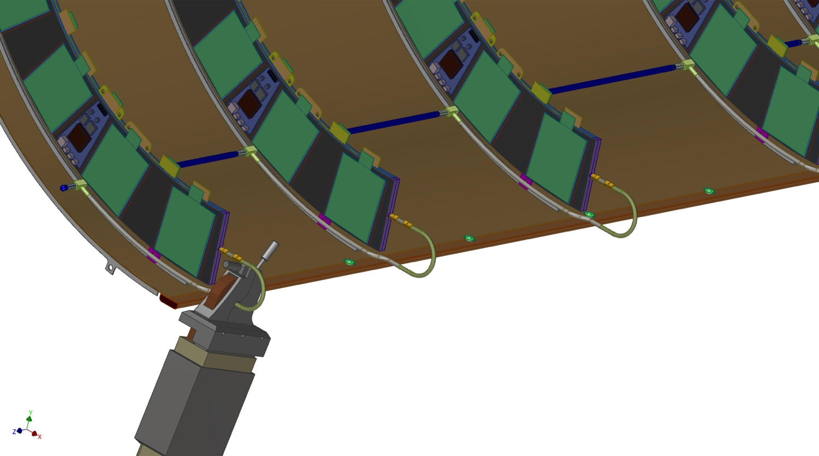
On-Ring Services
Cooling pipes:
  Once cut, bent and welded (including electrical breaks and fittings) the pipes will be pressure and leak tested:
    test pressure 186 bar
    helium leak test 10⁻⁶ mbar l/s
Bus tapes:
  produce in industry
  thoroughly test in ITk institute(s)
  automatic test kit under development (see photo)
    continuity
    shorts
    leakage
    mating cycles (QA)
    …
EoS cards
  produce in industry
  full functionaltiy tests in ITk institute(s)
  test kit in early stages of development
F.Gannaway
J.Stuart, B.Masic

Slide 4

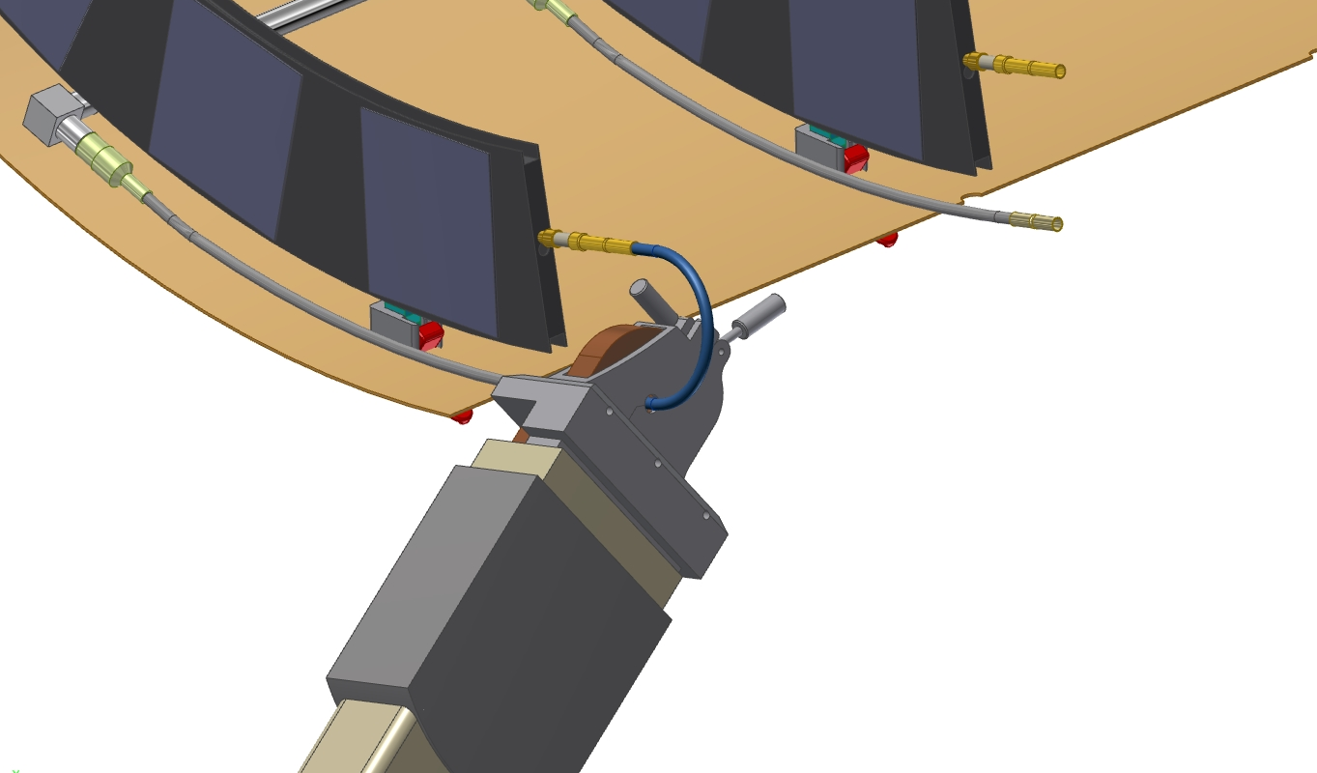
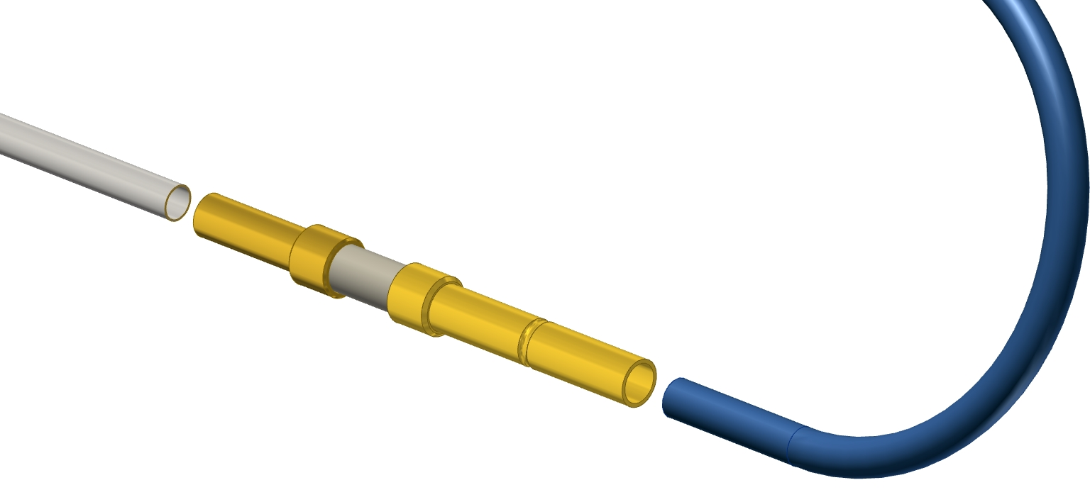
Return Loop Orbital Welding
(F.Gannaway, S.Edwards, R.French)
possible orifice locations:
- in electrical break
- at split-off from manifold
capillaries could
- spread out along inside of shell
- coil up between half-rings
orifices or capillaries?
endcap design can incorporate either (see right)
orifices are tidy/elegant but need to be proven
Milan to make a test loop with orifice for study at cern
Welding of Ring and Manifold – see backup slides

Slide 5
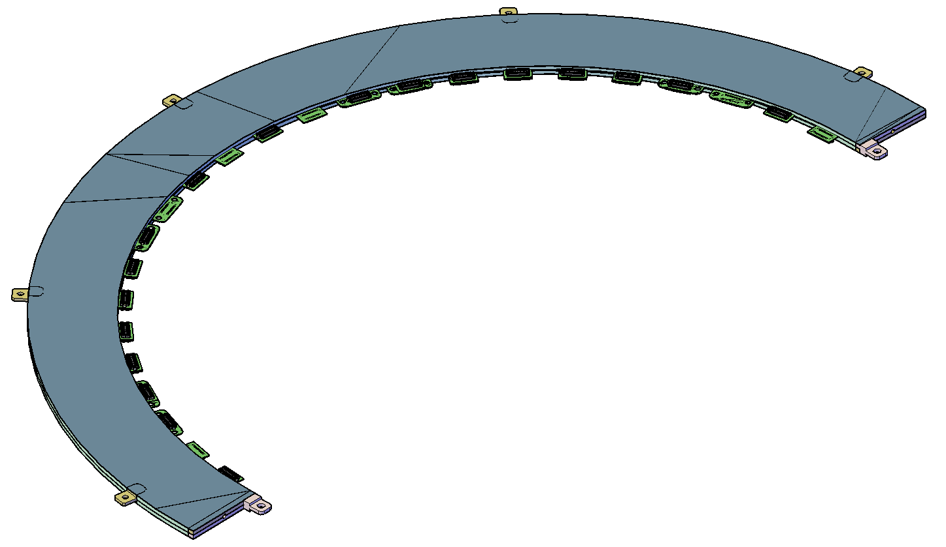
Middle Half-Ring Construction in UK
(Julian Freestone, Manchester)

Slide 6
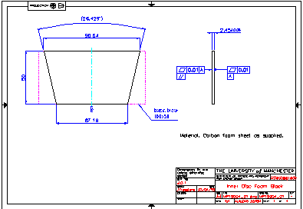
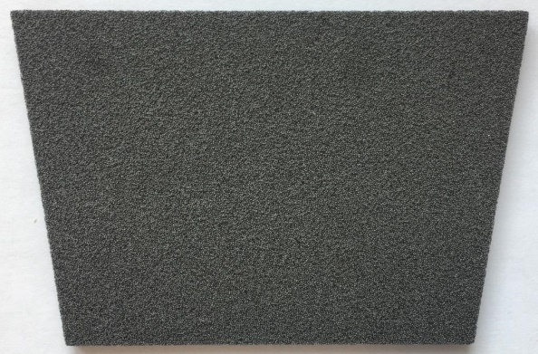
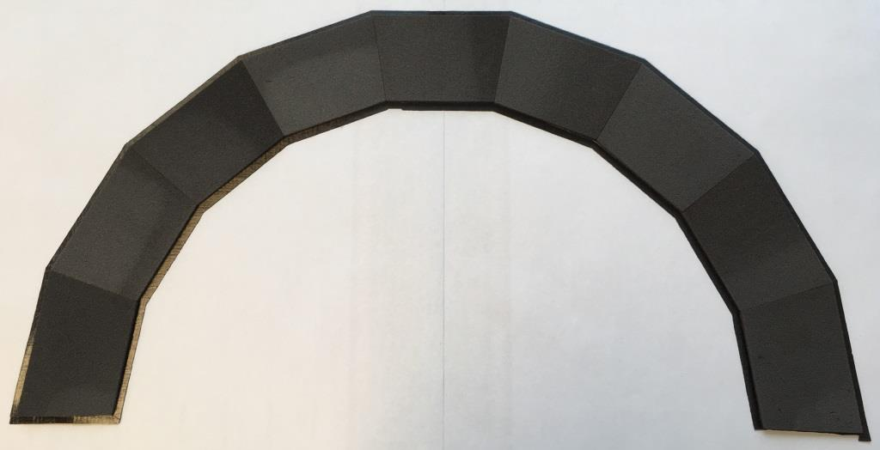
Parts:
Allcomp Foam
12” square x 1” slab. [0.19g/cm³] machined into 4.5mm thick wedges in Manchester University physics department workshop.
Need 18 trapezoid tiles per half-ring.
Tiles sent to Liverpool for pre-assembly onto face-sheets.
Face sheets: 3 layers of K13C2U/EX-1515 pre-preg.
45 g/m2
Layup: 0-90-0
resulting facesheet is
~0.15mm thick
9 foam tiles per arc are temporarily taped onto cut pre-preg sheet.
Co-cured on flat plate.
Assemblies returned to Manchester for machining.

Slide 7
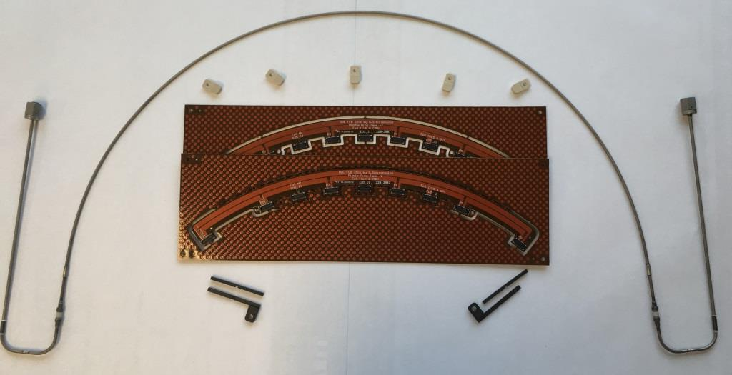
Cooling Tube (Lancaster, Sheffield)
2.275mm O/D fitted with connectors and electrical breaks (Lancaster, Sheffield).
(odd shape pictured is due to having recycled electrical breaks. To be replaced with correct shape.)
Power Tapes (Edinburgh)
Connectorised, in production plates. Need some trimming.
EoS cards: LV, HV, NTC (Manchester, Edinburgh)
Simple pass-through designs for connection to bench supplies and NTC readout
Closeouts and Mounting Tabs (Liverpool)
Batch production

Slide 8
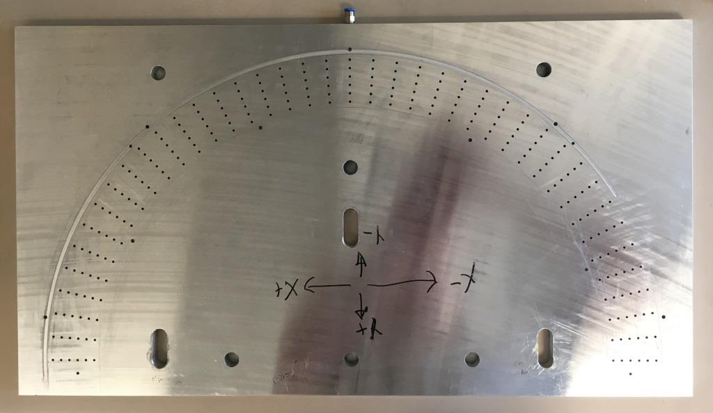
Tooling:
Vacuum Machining/Assembly Plate
Flat plate with vacuum channels for machining disk profiles.
For precision assembly has holes for dowels to locate mounting lugs and power tapes.
Vacuum ‘Bag’ Press
To press parts together whilst glue cures.

Slide 9
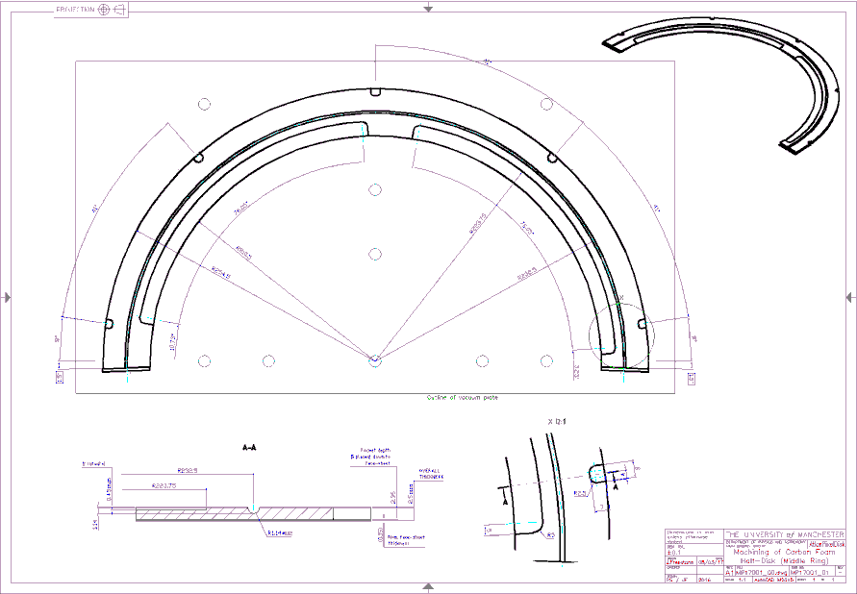
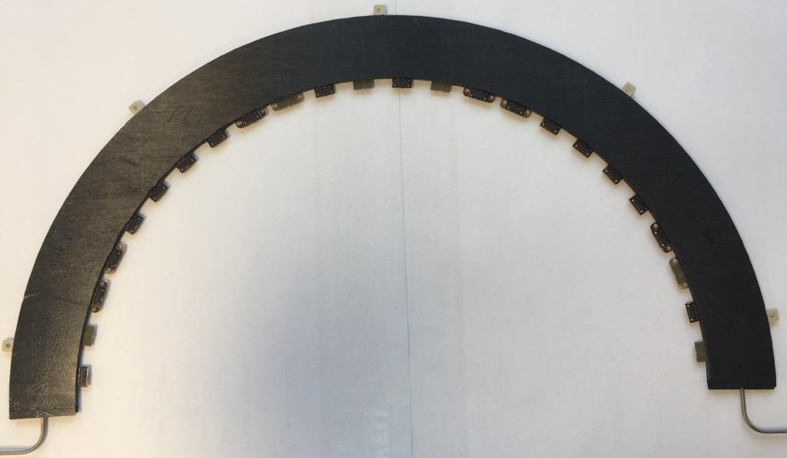
Construction:
Machine both half-ring faces flat and to uniform thickness. Machine recesses for tapes, pipes, mounting tabs, edge closeouts.
  2 days, Manchester workshop
Glue tapes into both faces, allow to cure
  1 day, Manchester engineer/technician
Final assembly: apply glue to foam side of both faces, locators, closeouts and pipe. Align and press together. Allow to cure.
  1 day, Manchester engineer/technician
Total Elapsed Time
About 1 week including preparation, cleaning, etc..

Slide 10
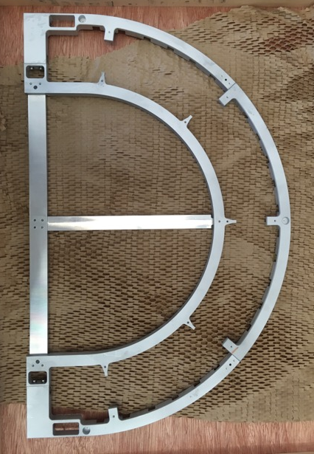
Half-Ring Handling and Transport half-ring assembly site → module loading site → endcap assembly site
Completed half-rings will travel in bespoke frame and box
  To include shock logger and indicator dessicant
Frame/box is multi-functional:
  will include electrical-test patch cards + cooling and gas-flush capability
    (pipe shape shown is not to baseline design)
  frame is part of endcap assembly tooling – see next slide

Slide 11
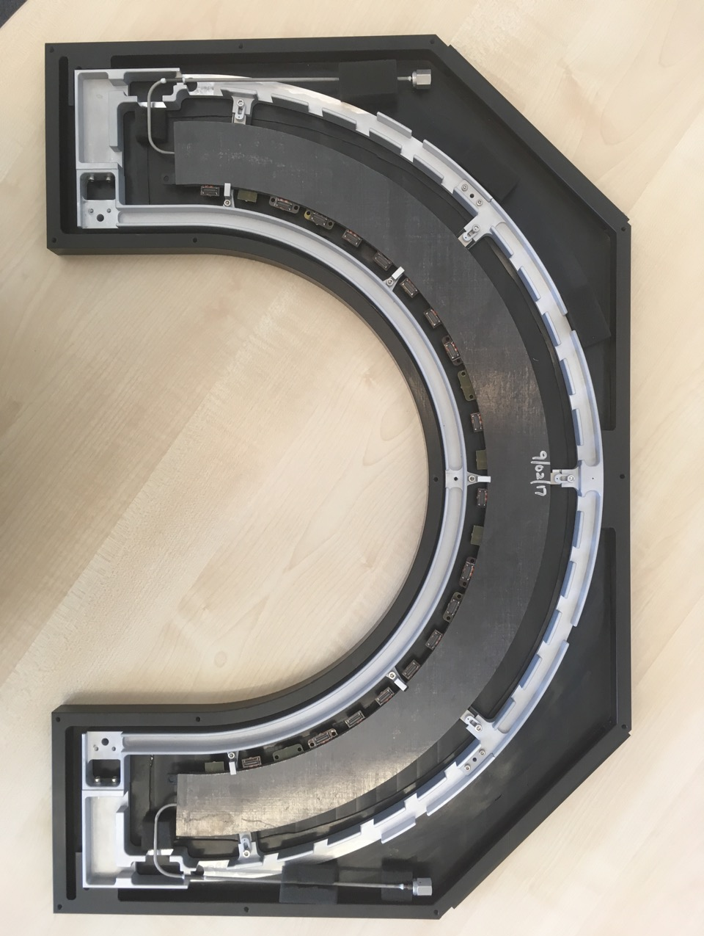
Half-Ring Handling and Transport half-ring assembly site → module loading site → endcap assembly site
Completed half-rings will travel in bespoke frame and box
  To include shock logger and indicator dessicant
Frame/box is multi-functional:
  will include electrical-test patch cards + cooling and gas-flush capability
    (pipe shape shown is not to baseline design)
  frame is part of endcap assembly tooling – see next slide

Slide 12
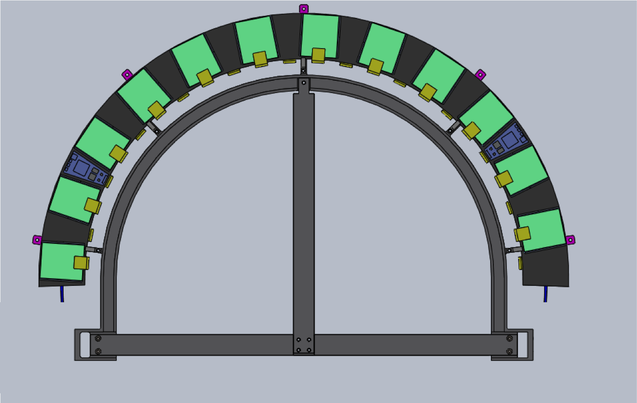
Half-Ring Handling and Transport
L.Cunningham
Outer ring removed and stiffening supports inserted. This has straight edge to be used as part of the insertion tooling.

Slide 13
Assembled Half-Ring QC
Thermal defect search with infrared video camera
  see following slides
Pressure cycle. Suggested:
  once to 186bar then many to 100bar
  motivation: expansion of pipe may degrade foam-pipe interface
    NB this should be better understood at prototyping/QA level
Repeat thermal defect search
Temperature cycle over specified operational temperature range (currently -55ºC→+60ºC)
Repeat thermal defect search
NB full-half-ring defect scan may be labour- and time-intensive making three repetitions impractical. May be scope here to streamline based on experience.

Slide 14
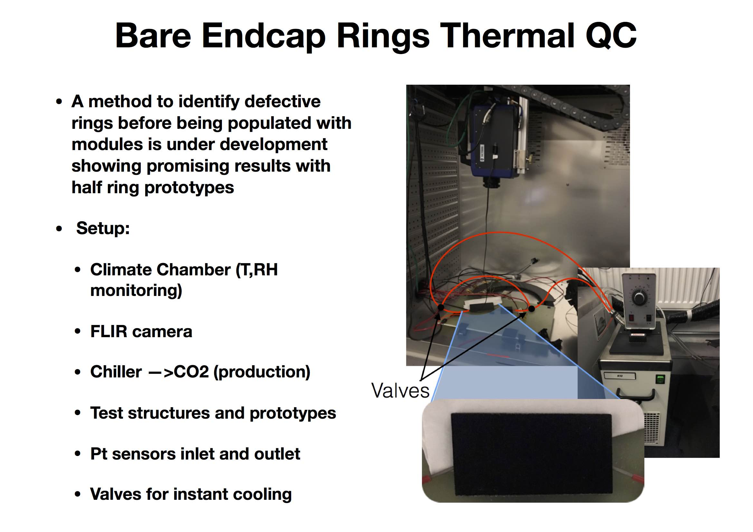
F. Munoz-Sanchez, N.Scharmberg
(fast video)

Slide 15
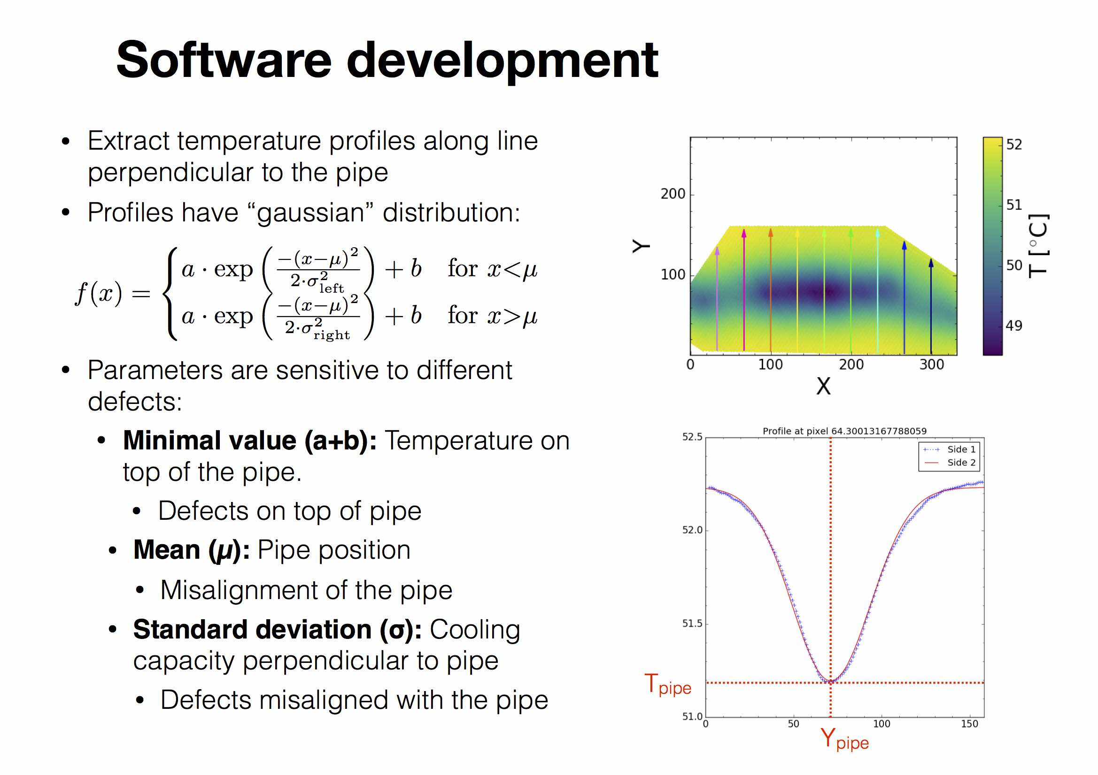

Slide 16
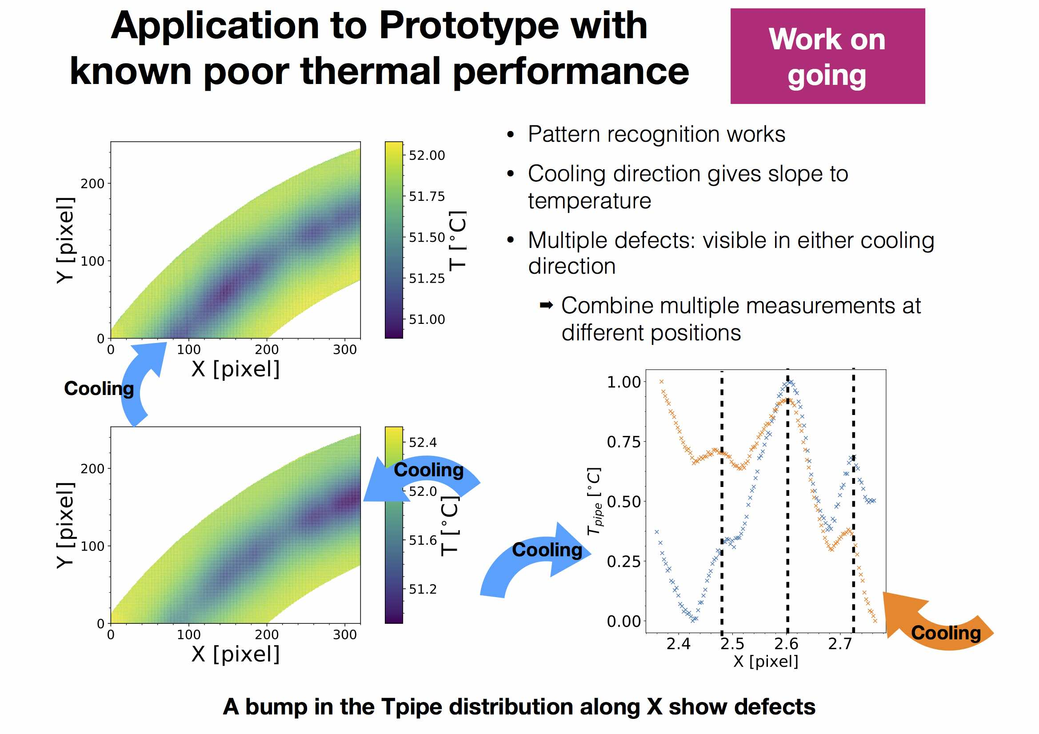

Slide 17
Prototypes - made
three inner (R2) rings
  two with bus tapes (old design)
  used for preliminary deformation measurements, TFM
  facesheets were cured separately and glued to foam → poor thermal performance
so far two middle (R3) rings
  first was used for TFM measurements (results were near spec), now going to Milan for thermal deformation work
  second was thermally cycled but glued pipe fell apart
  third is in production (see next slide), intended for electrical tests with modules

Slide 18
Prototypes - planned
“Ring-0” currently being produced (cf earlier slides this talk, from Julian Freestone)
  for electrical tests with up to 12 FEI4 quads
  middle layer (R3)
  2.275mmOD Ti pipes, electrical breaks, removable CO2 fittings
  embedded FEI4-style bus tapes (4 tapes each serving 6 modules), pass-through versions of EoS cards (to connect to bench power supplies)
near future:
  three more R3s planned for April-May-June
  3-4 inners (R2) planned from July
  all will be used for TFM measurement, QC development
  some to go to Liverpool for assembly tooling/procedures preparation

Slide 19
Key Dates
06/04/2018: Specifications Reviews
  Local Supports, Services
23/08/2018: Preliminary Design Review
  include results from preliminary prototypes
  start producing final prototypes. how many of what type is not clear, JP to discuss with DG. Should share the work Italy/UK.
30/05/2019: Final Design Review
  check performance of final prototypes
  start pre-production (6 rings i.e. 2 of each type?)
13/11/2019: Production readiness Review
  check pre-production rings
  start production: 20/16/18 R2/R3/R3
16/03/22: production complete

