Slide 1
Pixel System Test
P. Dervan, H Hayward, J Taylor, I. Tsurin
AWP20 Kick Off 22.03.18

Slide 2
Contents
Where we are now:
13 module straight stave
Where we are going:
Ring0 test -> quad modules mounted on half ring prototype
Ring1 test -> RD53? half ring prototype
=>full system tests with real rings inside cylinders (building up the DAQ, services, modules etc..)

Slide 3
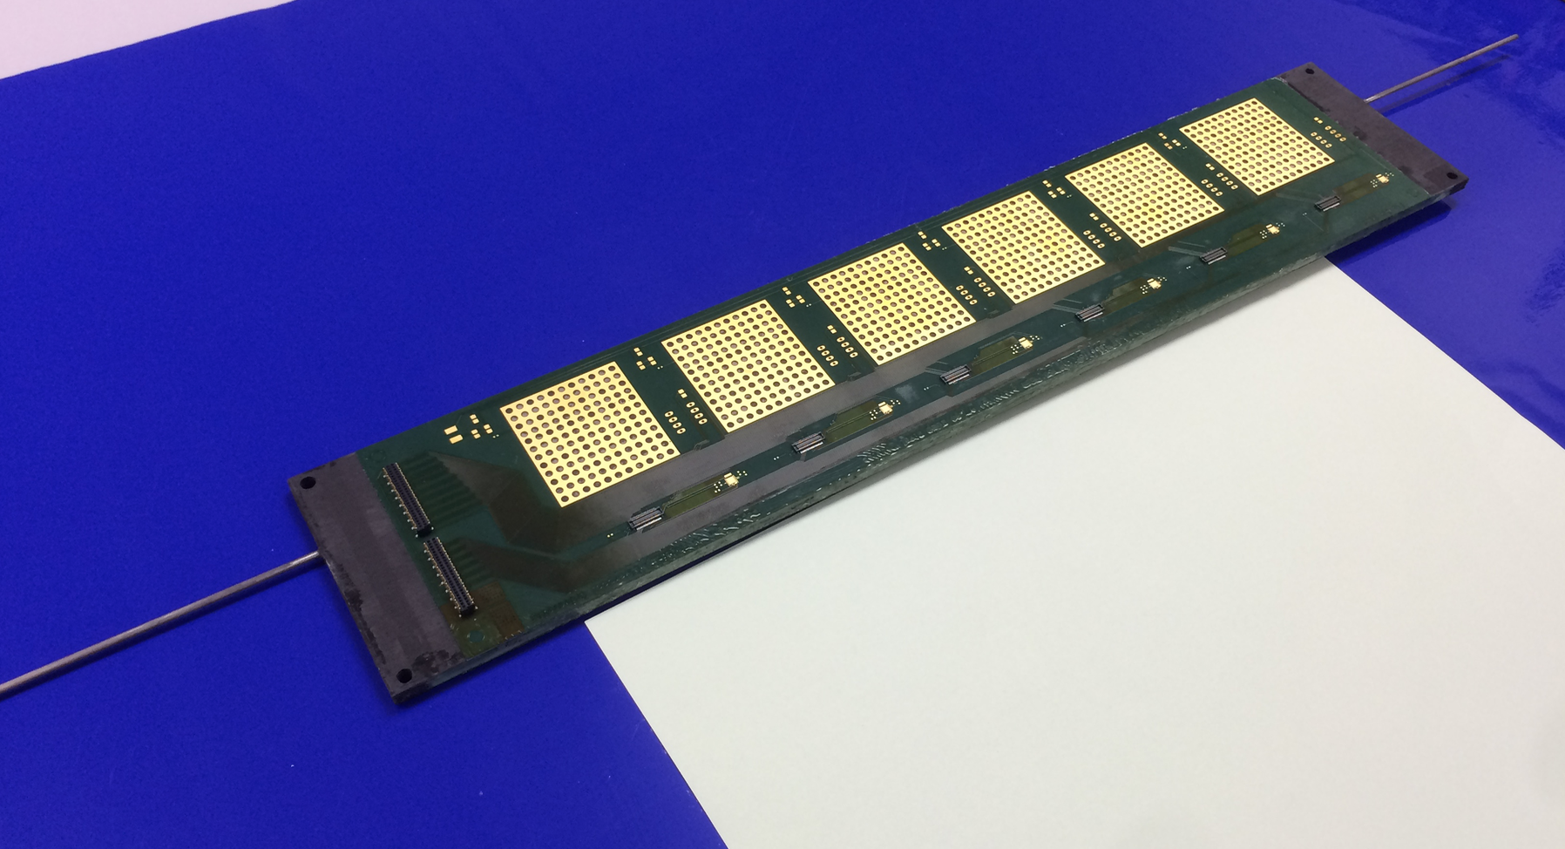
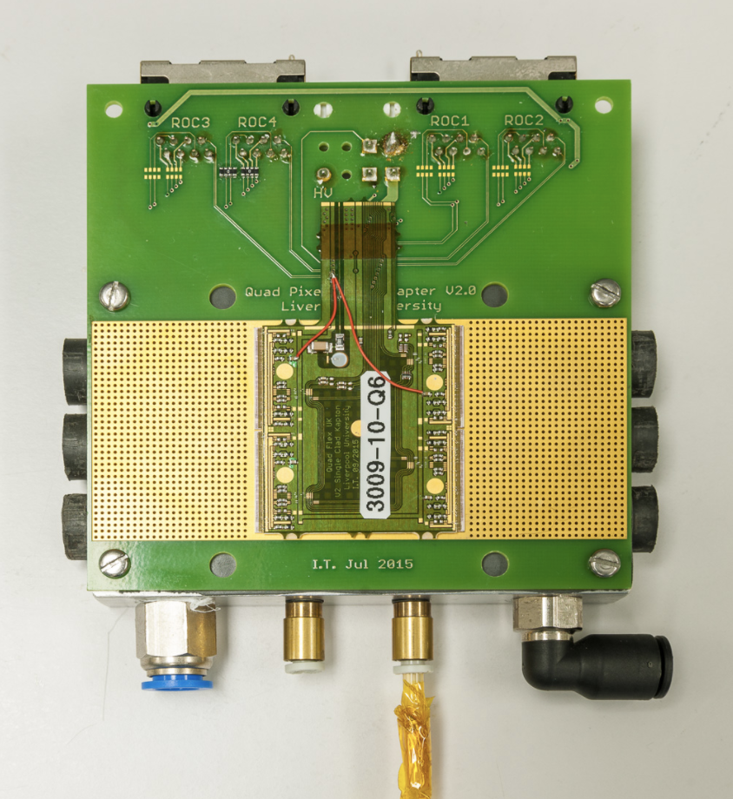
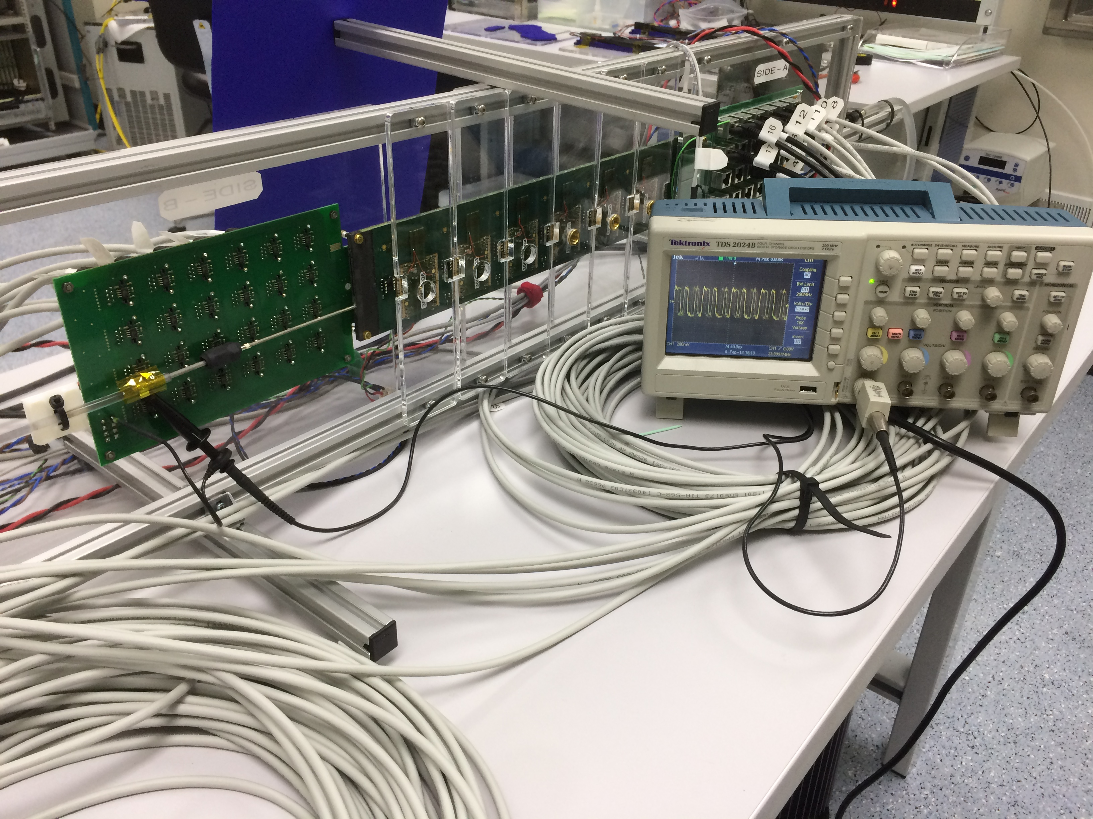
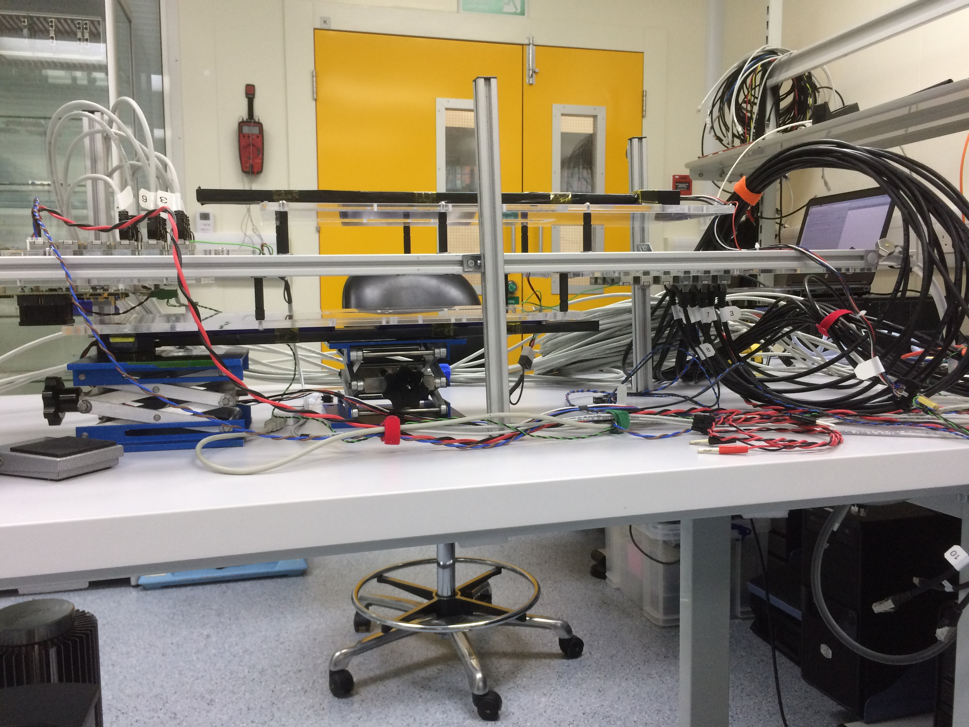
CF stave
Double sided stave allowing 6 quads (24 FEs/side)
Although each side has separate LV and HV for these tests we have joined the LV of both sides to allow build up of a serial powering chain of 12 quads.
Add a 13th quad to chain
using test chuck

Slide 4
Serial powering tests (13 modules)
(1) Can we power and configure all FE’s in the chain so that they draw current?
(2) Can we stimulate quads with random and non-random triggers and read out data from at least 1 FE / quad?
Further tests:
noise immunity,
lengthening of power cables,
joining of LV and HV return,
two-trigger noise etc
No PSPP chip present ……yet
qualify modules off stave before by completing steps (1) and (2) on test chuck before adding them to the serial powering chain on the stave and repeating the steps again - no failures so far…
4￼

Slide 5
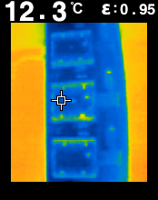
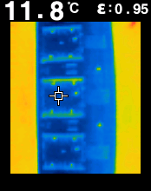
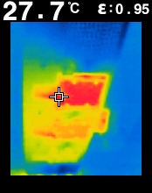
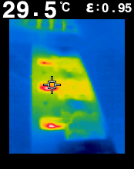
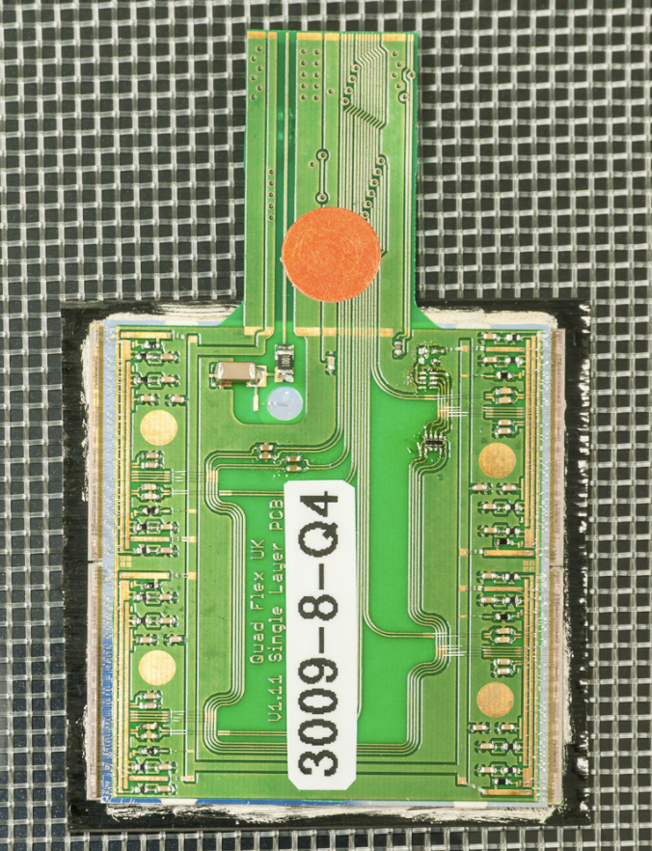
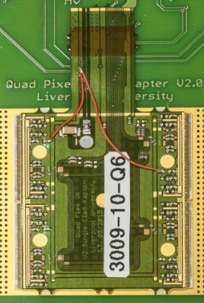
Cooling
FR4
Kapton
Before powering
After powering, configuring and tuning
Hotspot on FR4 side comes from
single module mounted on carbon fibre
Hotspot on all Kapton modules due to
patch on power rail
Water cooling used, 7deg at 1.5bar,
cooling pipe in stave: 2.3mm inner ⌀

Slide 6
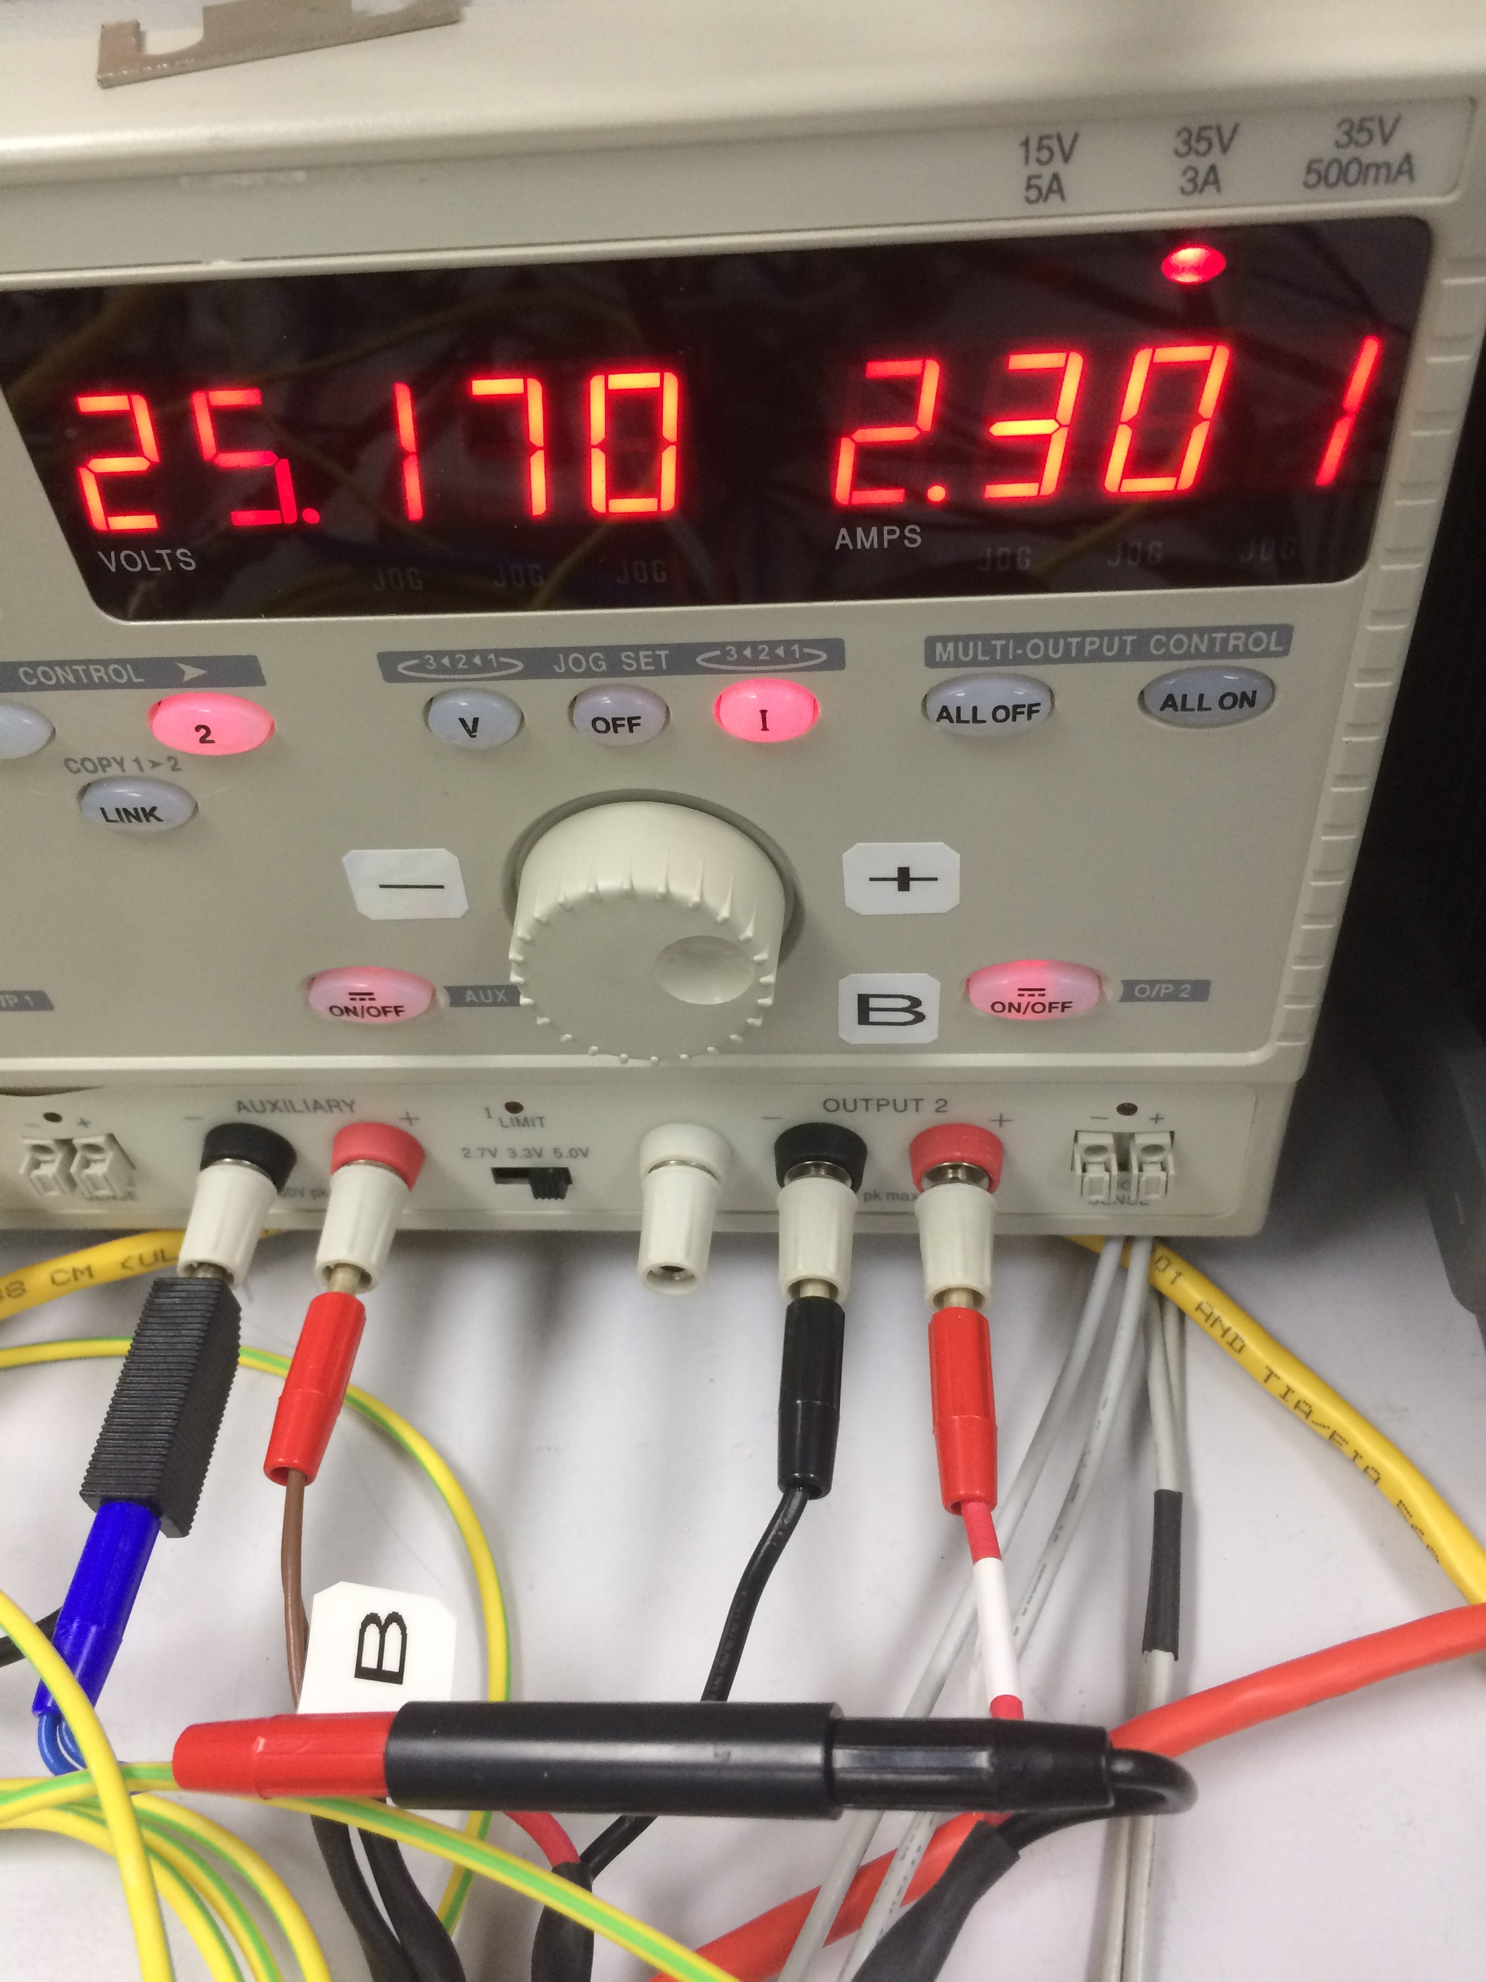
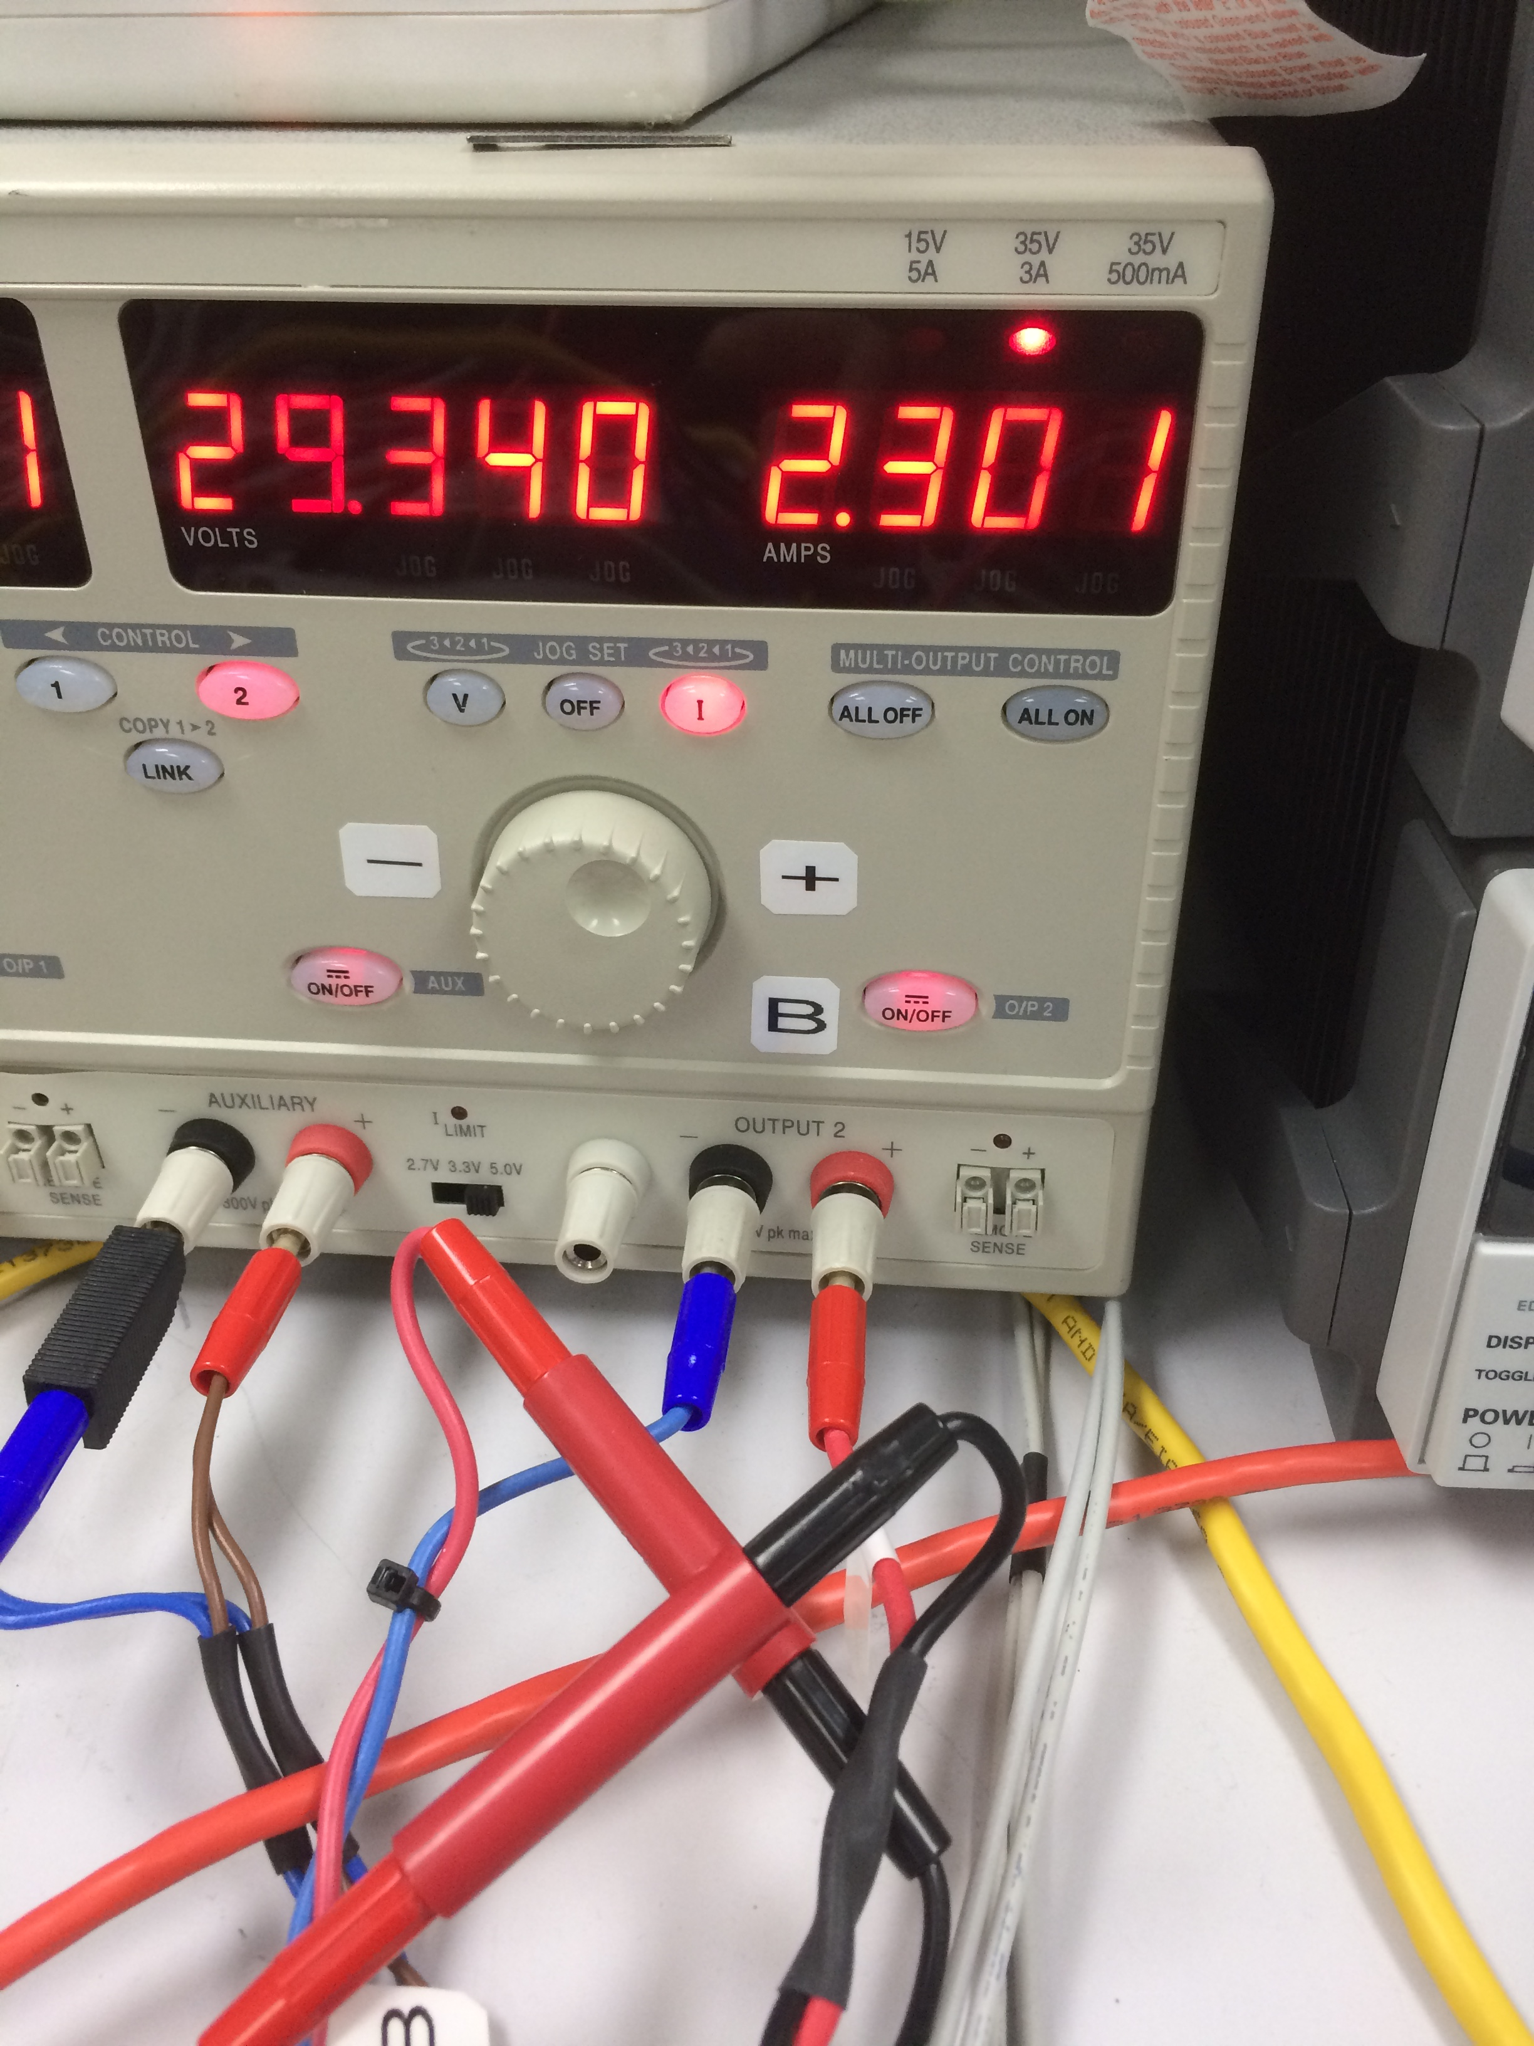
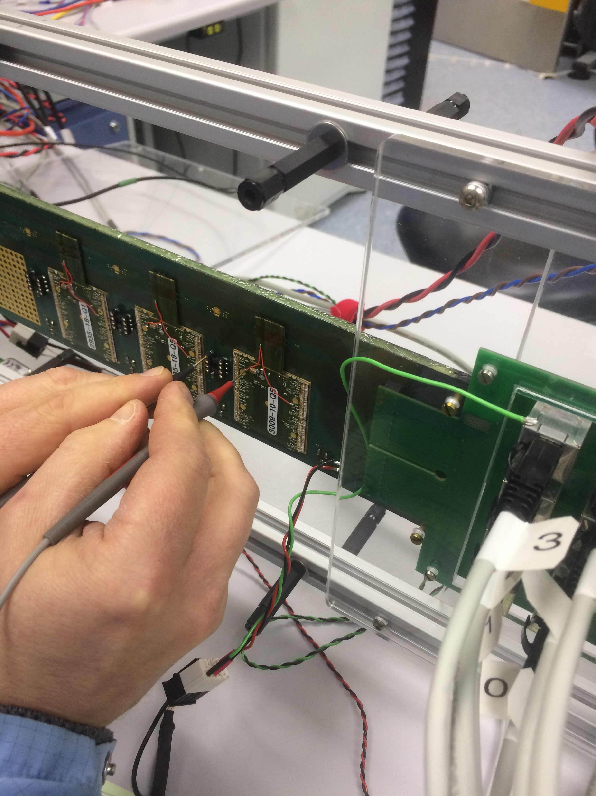
Powering the SP chain
CC 2.3A supplied for powering the chain - close to max output available from TTi power supply (35V, 3A)
HV supplied to each side separately but joined for all modules on a side
LV supplied to both sides together : cable is ~2m long
FE’s configured one at a time allowing voltage drop across the chain to be monitored
Notes:
The power to each quad can be monitored or shunted using a DIL8 connector mounted next to each quad (upgrade with PSPP chip, Manchester.)
Power to individual FE’s can also be monitored on the hybrid but is a bit more risky due to proximity of wire bonds and neighbouring quads

Slide 7
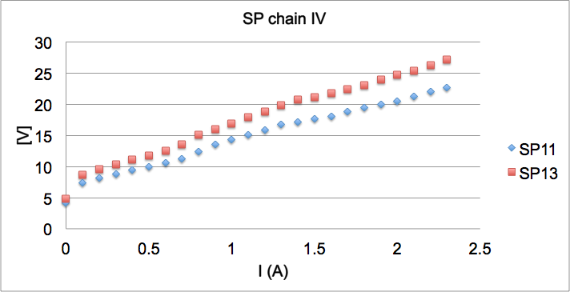
Powering the SP chain
13 modules are now glued to the stave: 6 Kapton flexes, 6 FR4 flexes, 1 FR4 test chuck
These 12 modules + 1 module on test chuck (52FE’s) have been powered and configured
48/52 FE’s are available for readout and there are 4/52 FE’s that don’t deliver data, however, they still have working regulators -> still part of SP chain
IV of serial powering chain

Slide 8
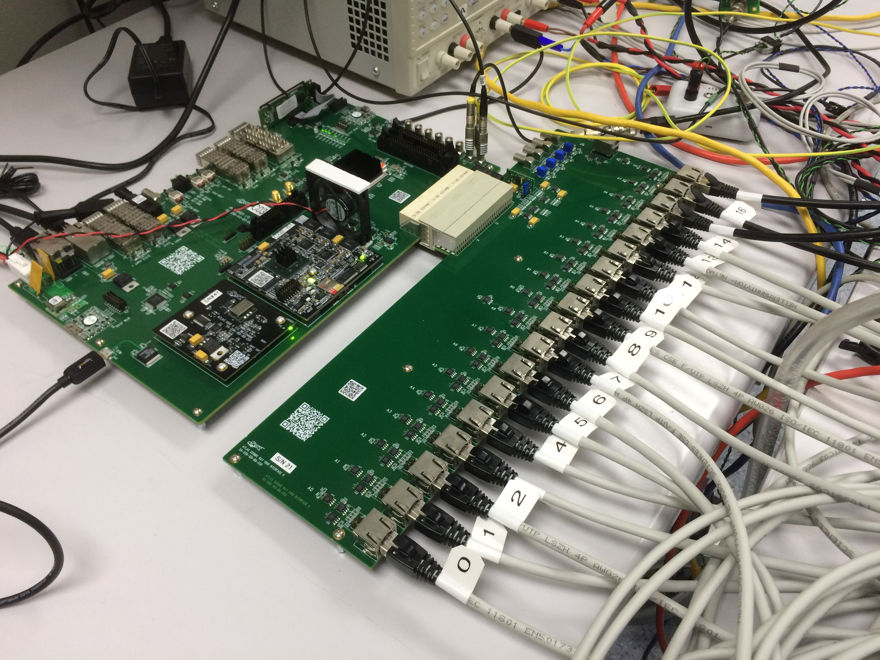
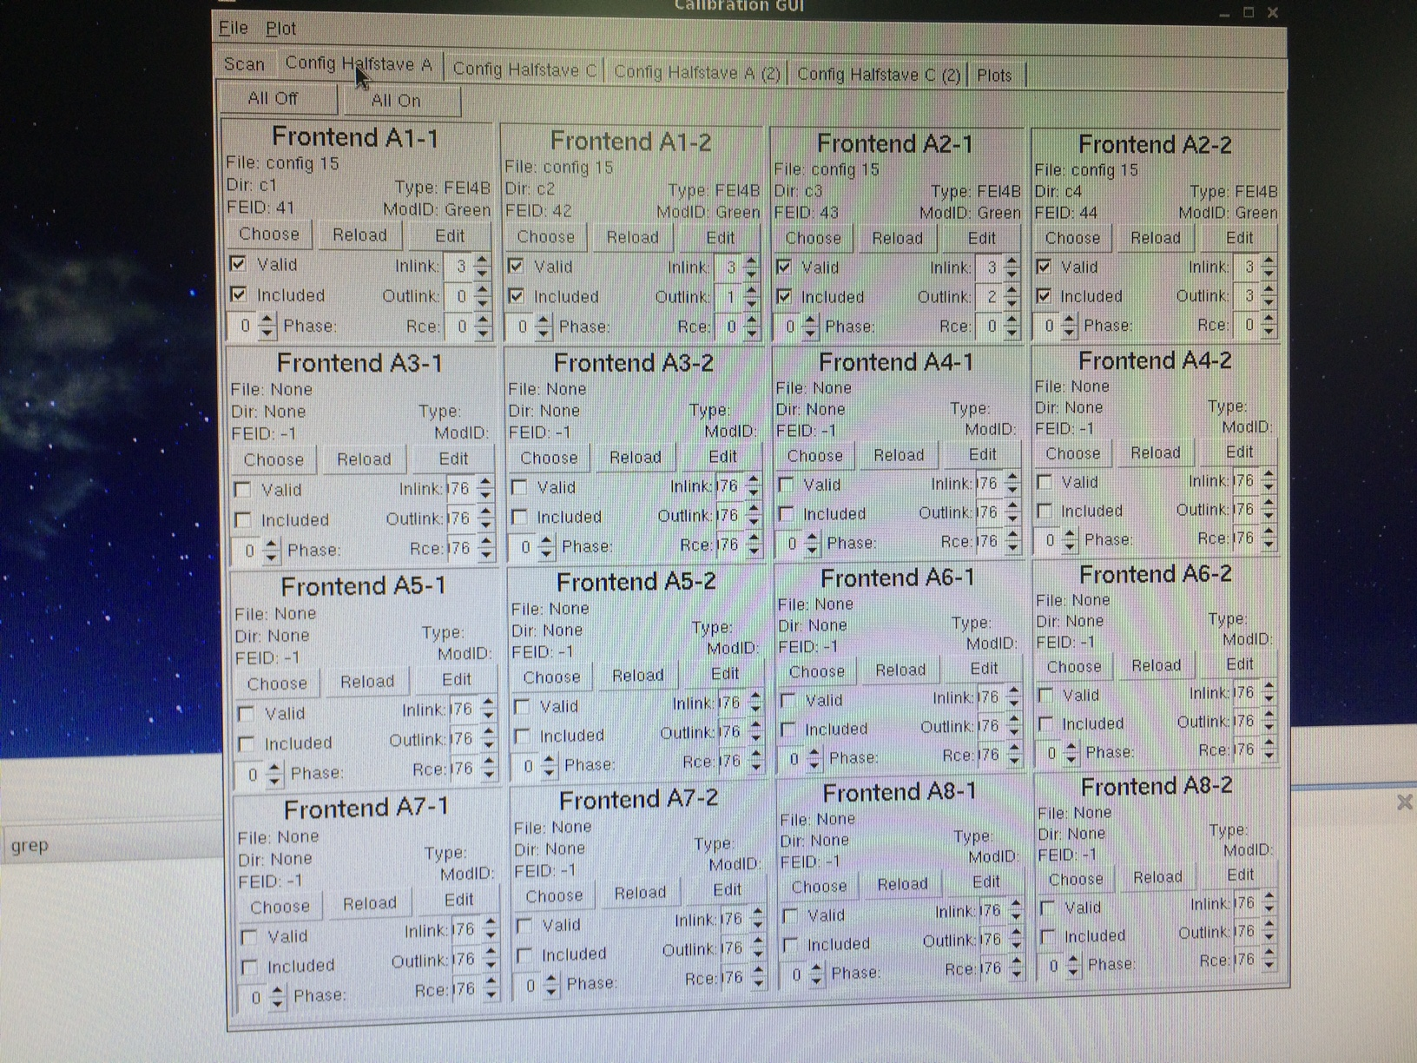
Configuring and readout of SP chain
Each of the 52 FE’s in the SP chain can be enabled and configured one by one using the calibGui panel
DAQ only supports 18 FE’s (4.5 quads) for tuning and scans. We get around this by connecting ROC4 on each quad since it supplies clk/cmd to the rest of the quad this enables all FE’s on a quad to draw current and join the serial powering chain even though we cannot read data back
We can see this data / clk / cmd on the scope even though the DAQ cannot (because there is no cable to carry it)
Correct ‘inlink’ for clk/cmd but Dummy ‘outlinks’ are supplied to all FE’s not read out.. requires a little bit of hacking of DAQ software but works..

Slide 9
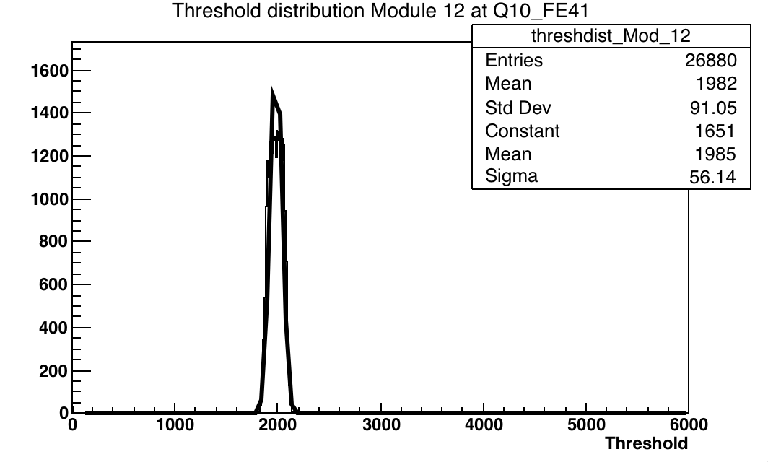
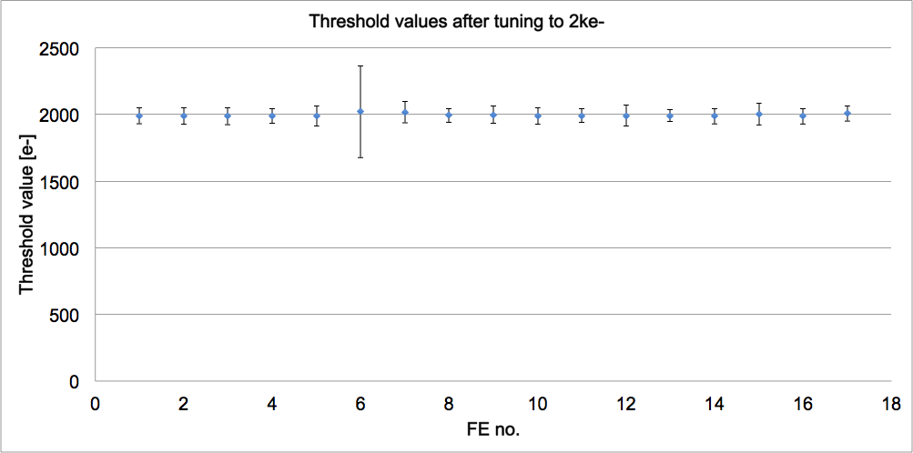
Thresholds after tuning to 2000e-
13th quad on chuck
All FE’s tuned to 2ke- with 8 ToT @ 20ke-

Slide 10
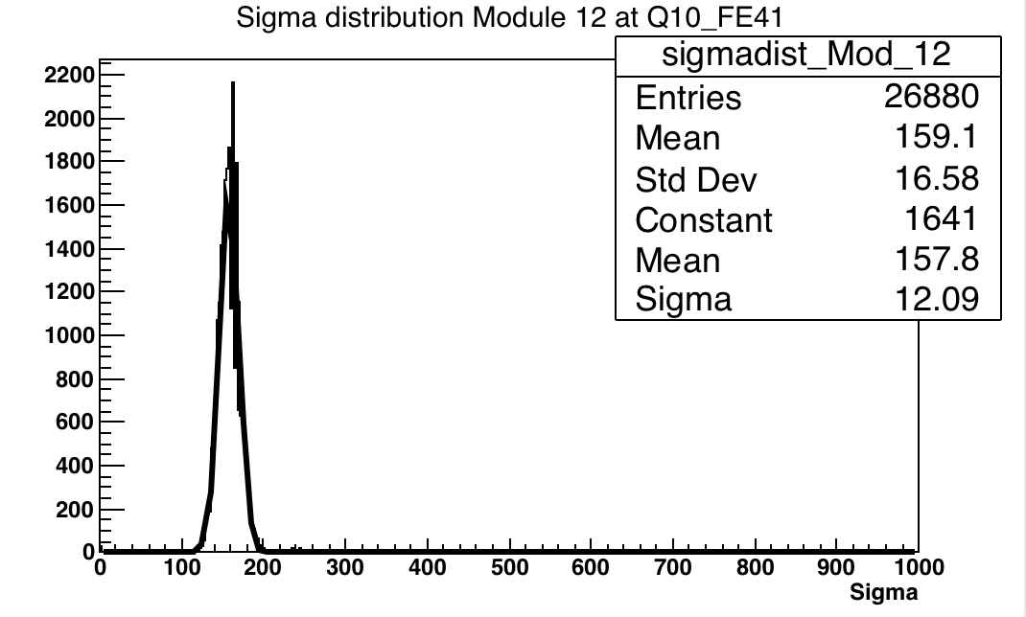
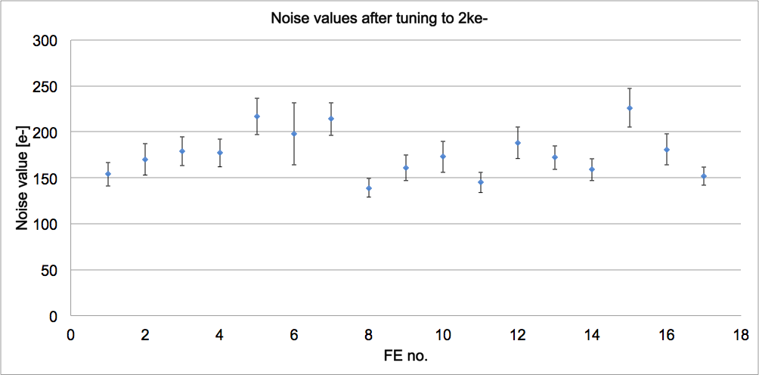
Noise values after tuning to 2000e-
13th quad on chuck
All FE’s tuned to 2ke- with 8 ToT @ 20ke-

Slide 11
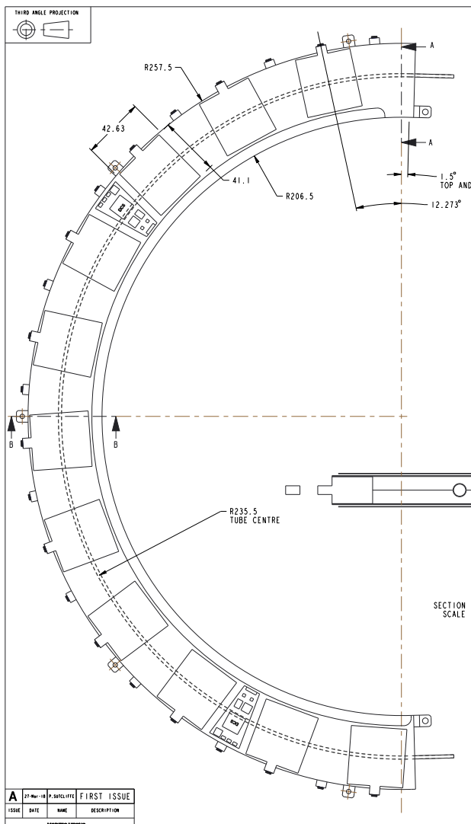
Next steps
Working with the CERN barrel demonstrator people. - trying to come up with a common list of tests.
The chain has been successfully powered, all quad modules (52 FE’s) configured, and data read back from at least 1 FE / quad
Tuning down to 1.3ke was done and good results seen
Running of up to four quads with cosmics was carried out over the holidays as test of long term stability and response of the setup to random triggers
Next tests..
Setup of COB + VLDB allowing more FE’s to be read out
-> prepare for readout of Ring-0/Ring-1 and RD53 modules
(development time 6-9 months)
Joining of HV and LV return
New PCB now ready for mounting of PSPP v3 on tape
Vary threshold down from the 2ke- threshold that is currently used
Using longer cables with realistic cross sections
Two-trigger noise and cross talk scans
Noise injection on power rail and cooling pipe
Noise injection via FE (Vthin alt fine)
Electrical break
Test beams
Full list here: https://twiki.cern.ch/twiki/bin/viewauth/Atlas/ITkPixelSR1SystemSetupCommissioning

Slide 12
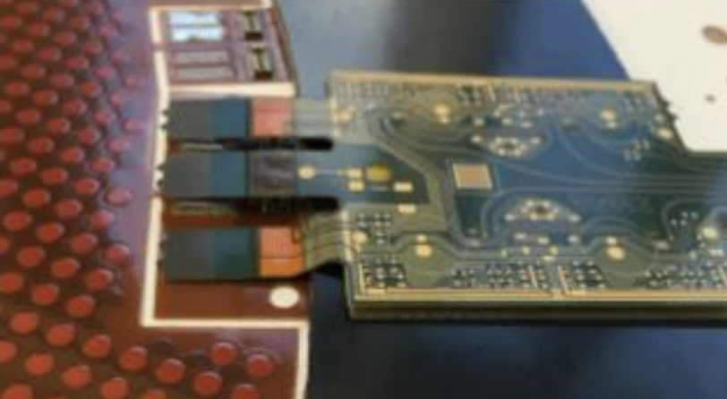
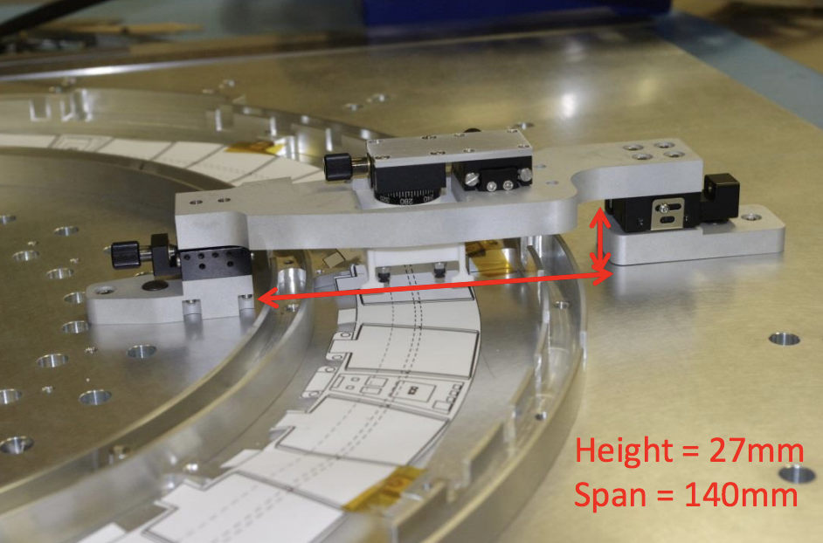
Looking further ahead
Lukasz available in Q2 2020 allowing testing of demonstrators
First loaded HR due at Liverpool Q2 2021, brief electrical testing before and after loading modules (accuracy < 100um)
A total of 54 half rings will need to be tested to complete UK endcap, reception testing expected to these expected to take ~2 years to complete assuming the following…
40 working weeks / year
~18 modules/week in total from all UK sites
Rings arriving at a rate of 2-3/month (depending on size of ring)
Things will be slower at the start…
https://indico.cern.ch/event/703112/contributions/2938512/attachments/1620216/2577376/JM_notes_v3.pdf

Slide 13
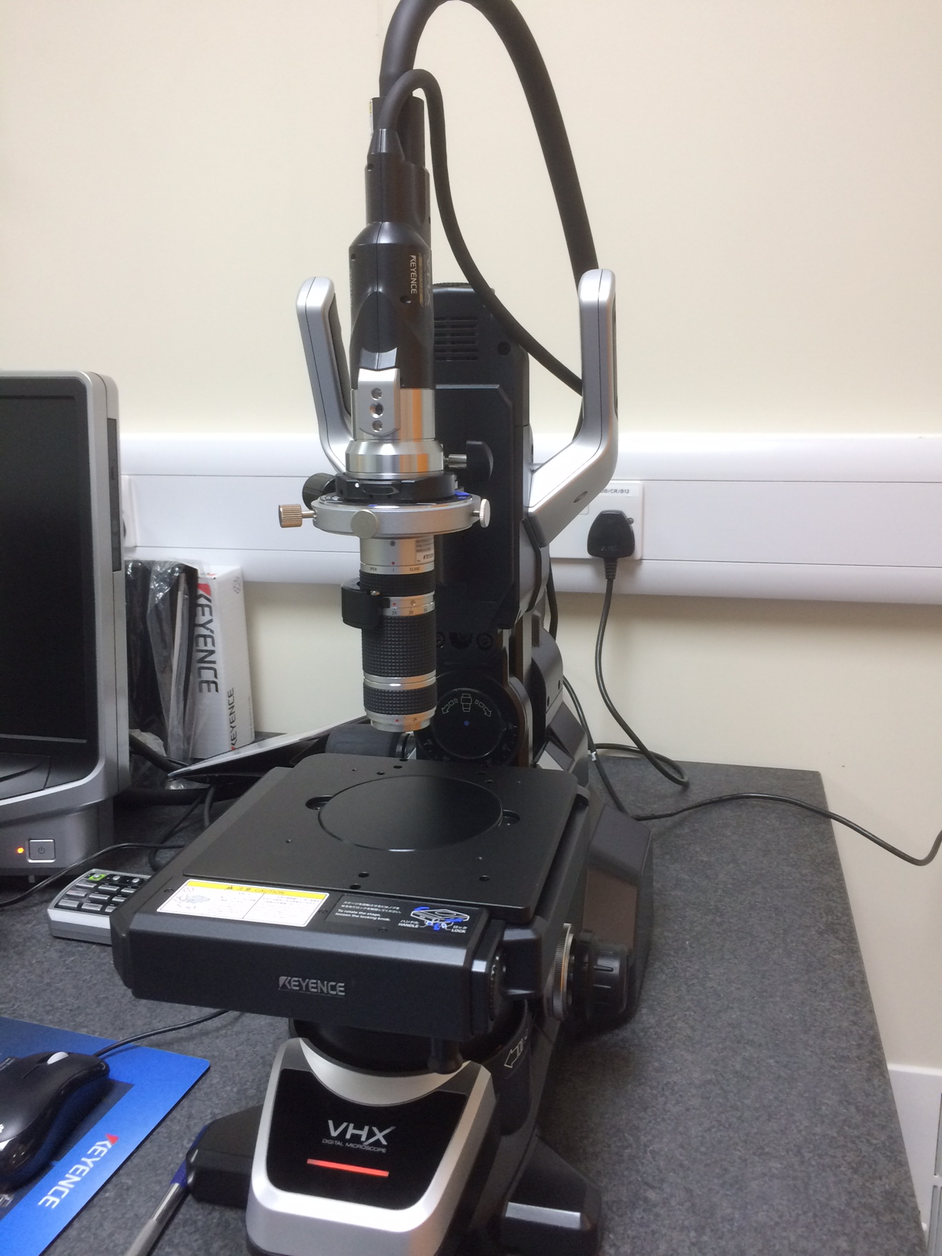
Testing
What are the most important (short) tests that we can do to check as much functionality as possible?
Detailed visual inspection (Keyence digital microscope)
Power up studies, SP checks & IV curves to check sensors/connections/electronics
Analogue/digitial scans, threshold and ToT scans, tuning to sensible thr and ToT
Measure disconnected bumps (thr scan HV off)
Testing of slow control and DCS
Data rate / aggregator / active cable tests
Long term testing (some/all when rings mounted in cylinder)
automated source scan / cosmics
Two-trigger noise / in-time threshold -> determination of lowest ‘workable’ threshold
iterative tuning
grounding and shielding
noise immunity / xtalk
thermal cycling whilst performing some of the above basic checks to check for problems introduced by mech stress, testing of temp interlocks

Slide 14
Summary
Program of system tests under development

Slide 15
Backup

Slide 16
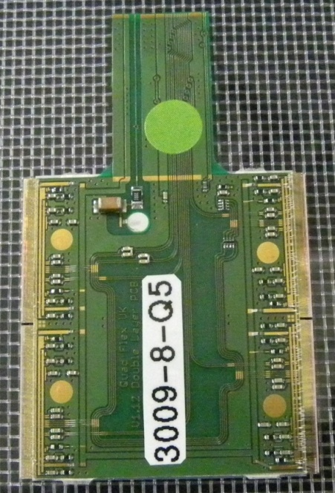
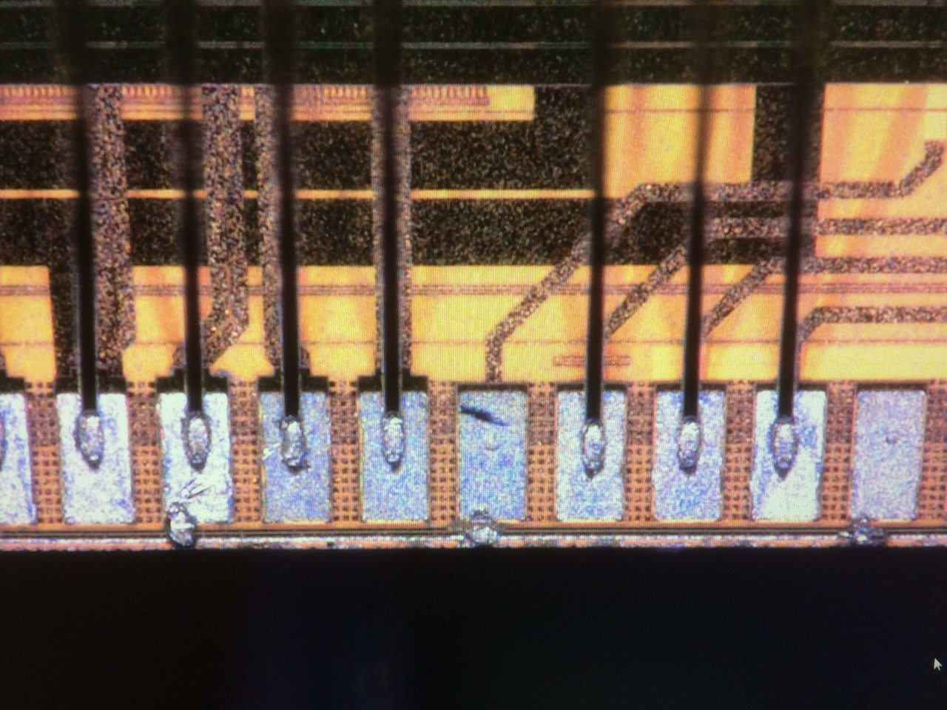
Quad modules
FR4
Kapton
Patches for FR4: removal of shorts / wire bonding fixes
6 on stave (side B)
1 on test chuck
Patches for Kapton:
All need power rail patch (red wires) and some need wire bonding fixes
6 on stave (side A)
Flexible PCB with single layer Kapton / FR4, 100 / 50um base material, 18 / 9 um copper clad
Clock, command and data LVDS lines are AC-coupled
Resistors on PCB control Shunt-LDO regulators allowing generation of 1.8V voltage drop across each module with ~2A total supply current
shorts on FEI4

Slide 17
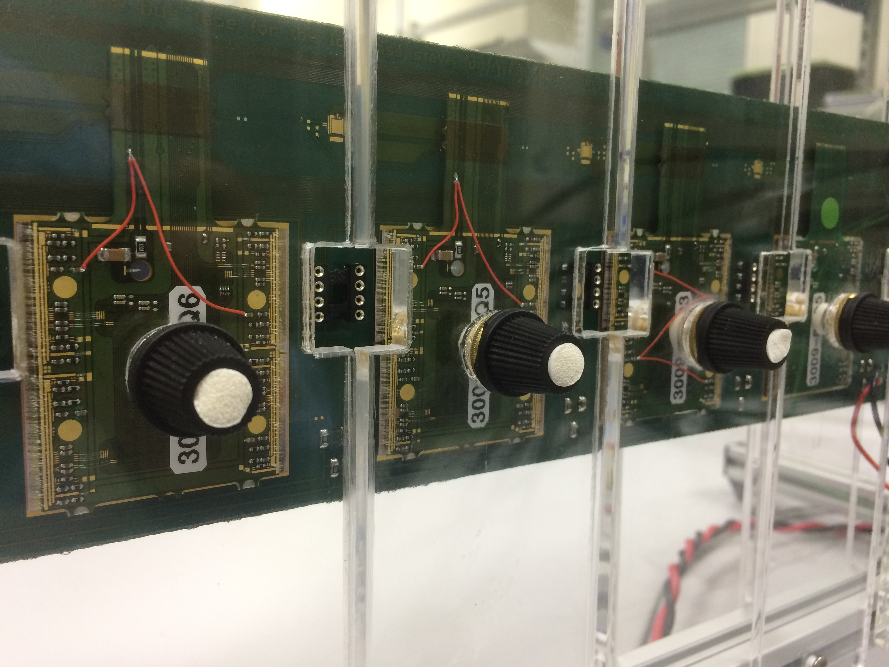
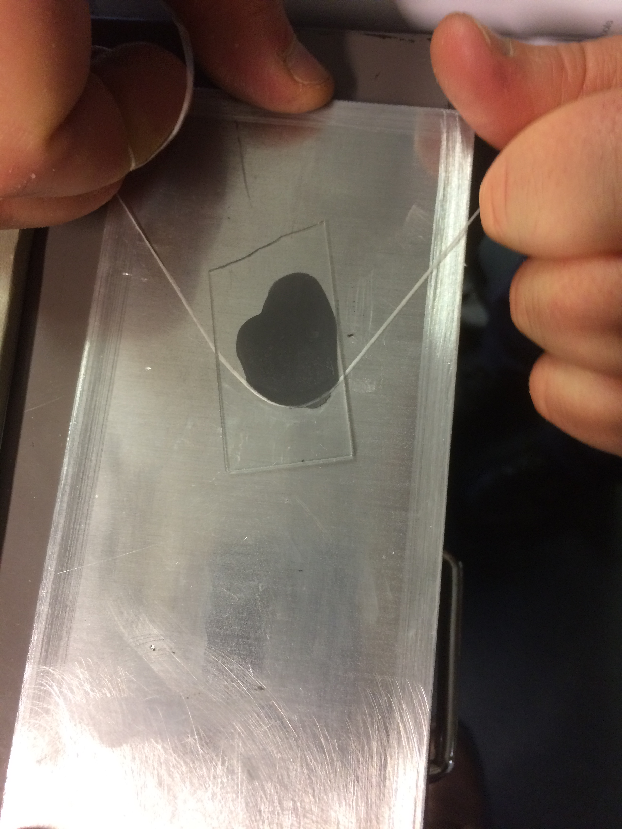
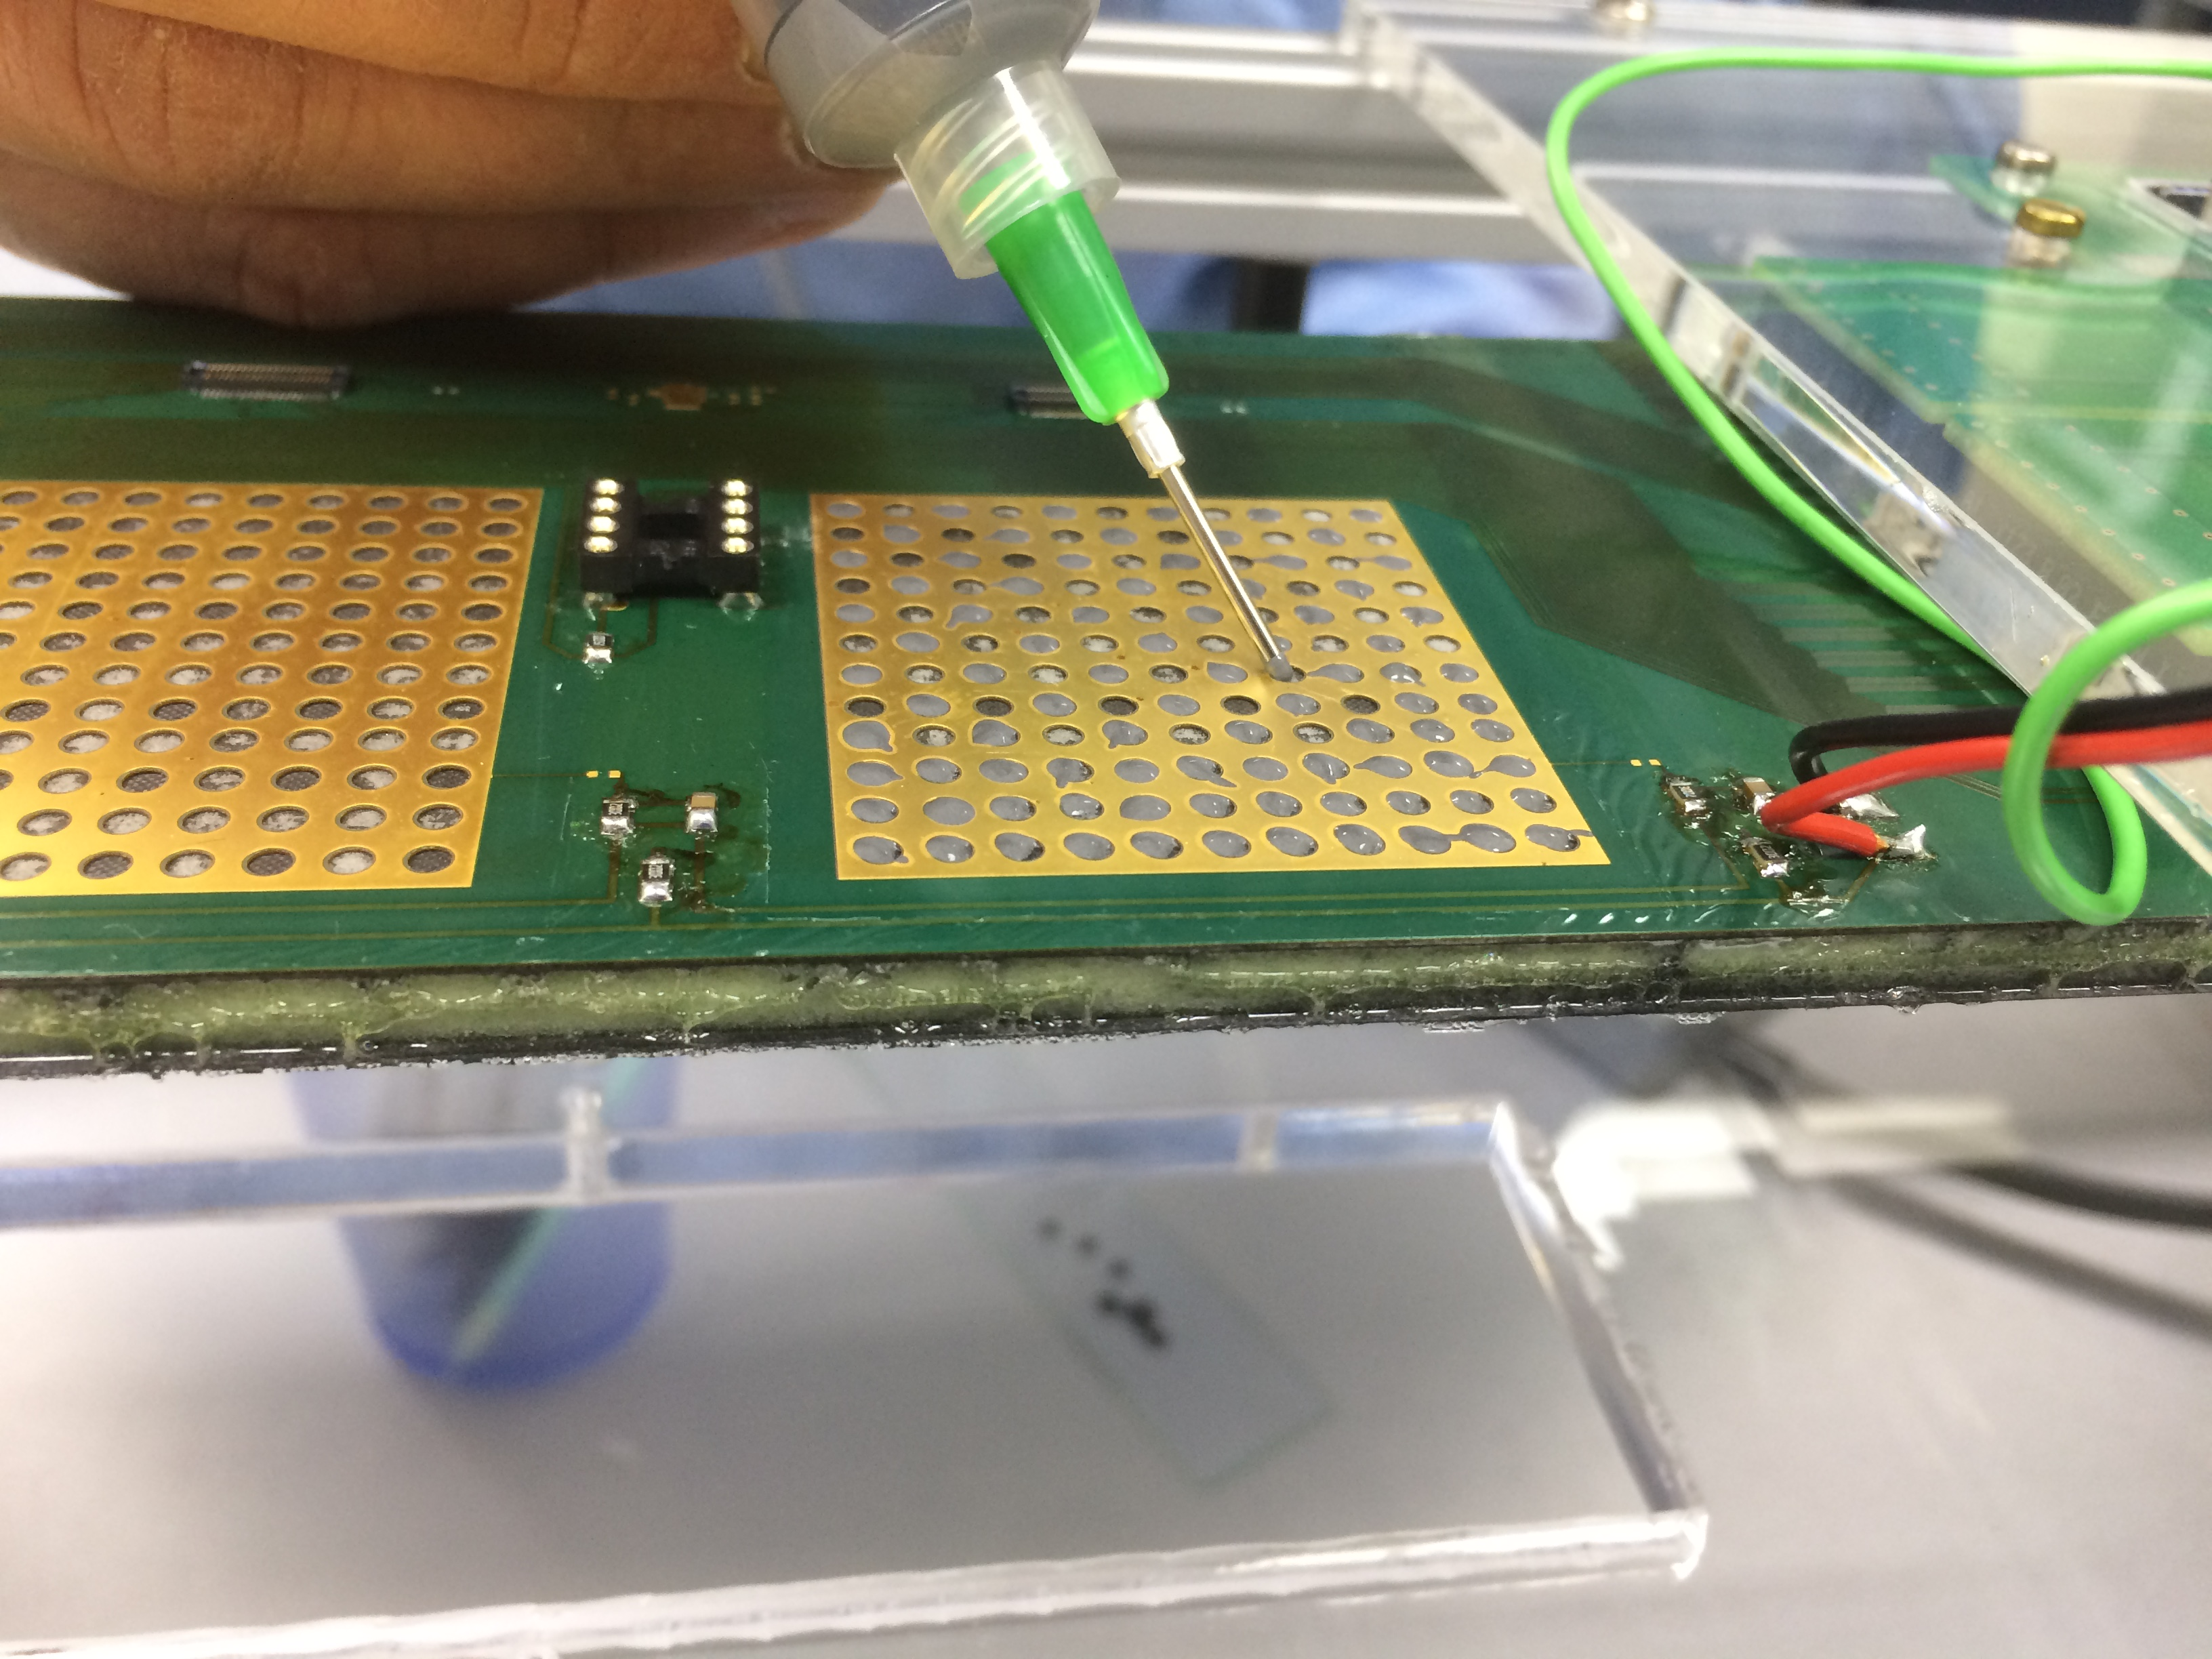
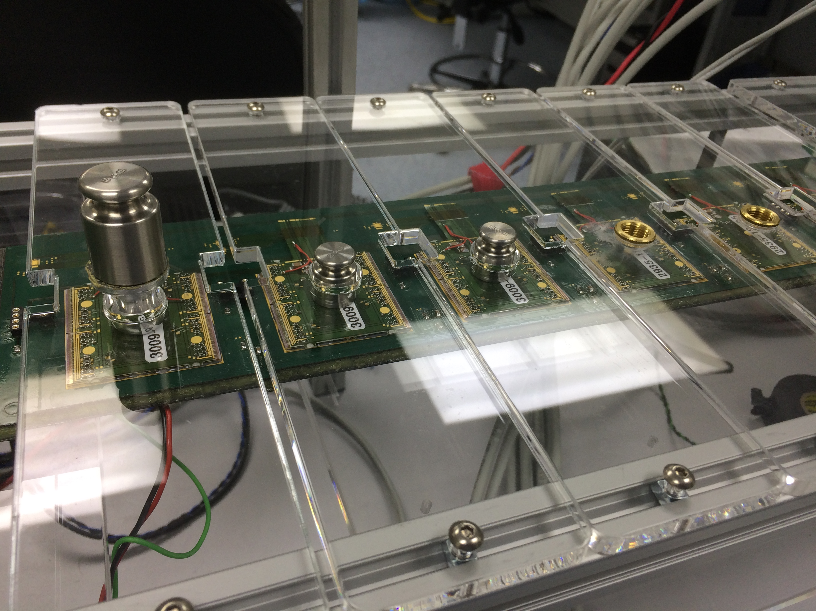
Module mounting
Previous mounting
Best modules have been taken on and off stave many times for lab tests and 2 test beams. Hybrid connector only has ~30 mating cycles
Gluing down modules to prevent overuse / damage to connectors or modules
SE4445 glue used for attachment of modules, removal with fishing wire / dental floss is possible
Kapton modules on stave side A, FR4 on side B. All quads have >= 2 FE’s that deliver data and all FE’s drawing current
All modules now glued down to stave

Slide 18
Powering the SP chain
CC 2.3A supplied for powering the chain - close to max output available from TTi power supply (35V, 3A)
The power to each quad can be monitored or shunted using a DIL8 connector mounted next to each quad (upgrade with PSPP chip, Manchester.)
Power to individual FE’s can also be monitored on the hybrid but is a bit more risky due to proximity of wire bonds and neighbouring quads
HV supplied to each side separately but joined for all modules on a side
LV supplied to both sides together : cable is ~2m long
FE’s configured one at a time allowing voltage drop across the chain to be monitored

Slide 19
Configuring and readout of SP chain
Quad no. | Quad name | ROCs read out | RCE ports | Stave connections | Voltage (before configuring) | Voltage (after configuring)
0 | 3009-10-Q2 | 4,3 | 0,14 | Side B: 1.4, 1.3 | 1.84 | 2.10
1 | 3009-10-Q3 | 4 | 1 | Side B: 2.4 | 1.81 | 2.18
2 | 3009-8-Q4 | 4 | 2 | Side B: 3.4 | 2.06 | 2.16
3 | 3009-8-Q5 | 4 | 3 | Side B: 4.4 | 2.21 | 2.16
4 | Yellow (no ID) | 4 | 4 | Side B: 5.4 | 2.20 | 2.16
5 | 3164-2-Q4 (200um) | 4,3 | 5,15 | Side B: 6.4, 6.3 | 1.99 | 2.13
6 | 3009-10-Q6 | 4,3 | 6,16 | Side A: 1.4 1.3 | 1.65 | 2.21
7 | 3009-8-Q3 | 4 | 7 | Side A: 2.4 | 2.44 | 2.41
8 | 3009-10-Q4 | 4 | 8 | Side A: 3.4 | 2.2 | 2.24
9 | 2935-18-Q1 | (4 dead), 3 | 9,10 | Side A: 4.4, 4.3 | 1.84 | 2.27
10 | 2935-18-Q5 | 4 | 11 | Side A: 5.4 | 2.08 | 2.27
11 | 3009-10-Q5 | 4,3 | 12,17 | Side A: 6.4, 6.3 | 1.87 | 2.17
12 | 3164-2-Q3 (200um) | 4 | 13 | Chuck: ROC4** | 2.2 | 2.16
Configure sequence begins with the modules that have the highest voltage drop
After configuring power distribution is much more uniform
1-2 FE’s per quad are have data read out (see next slide)

Slide 20
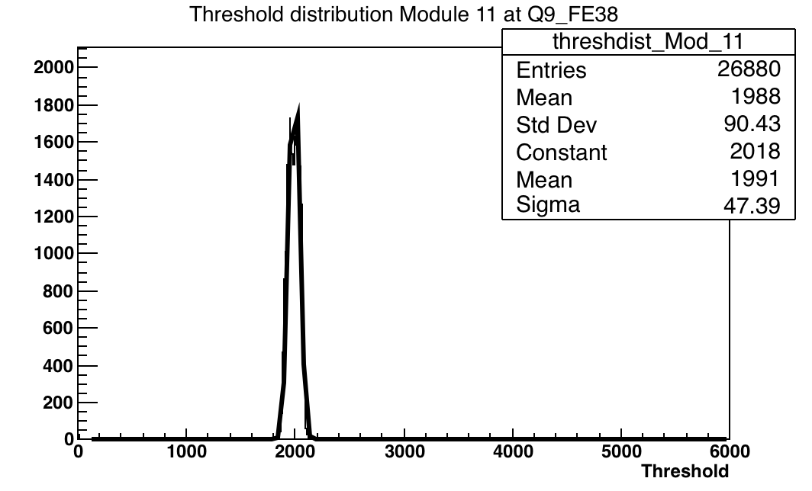
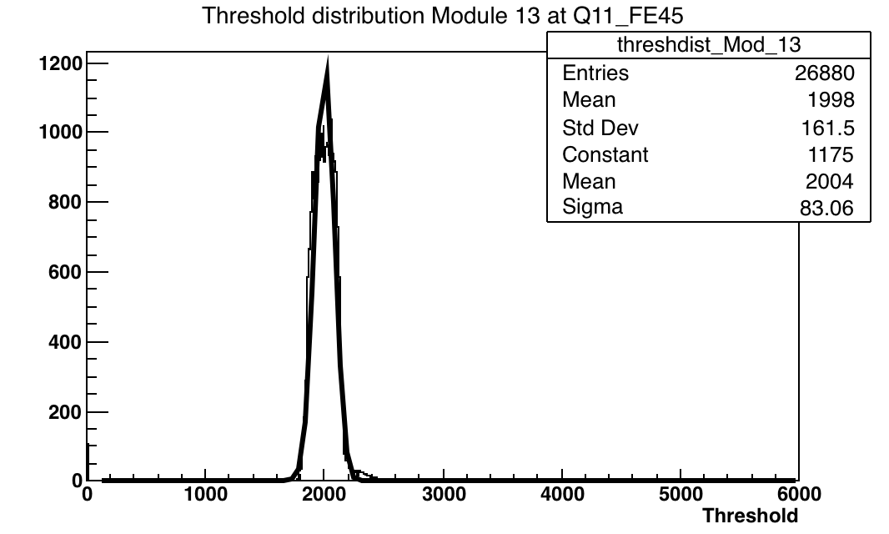
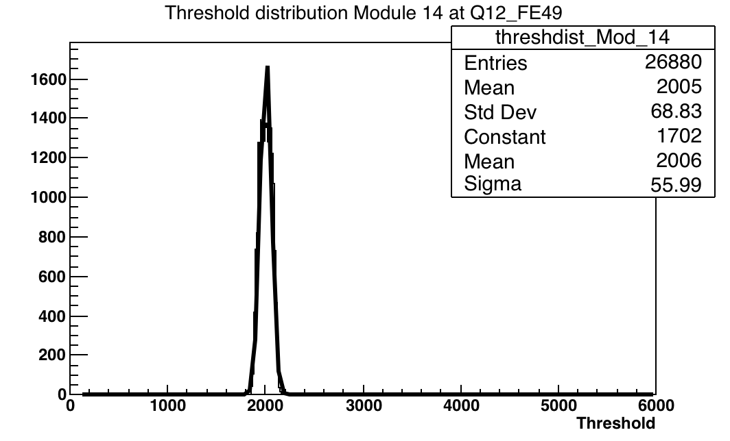
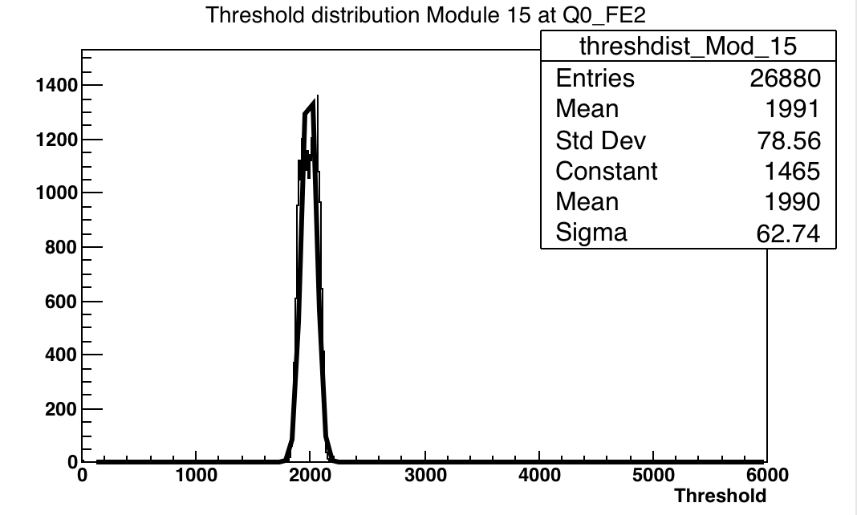
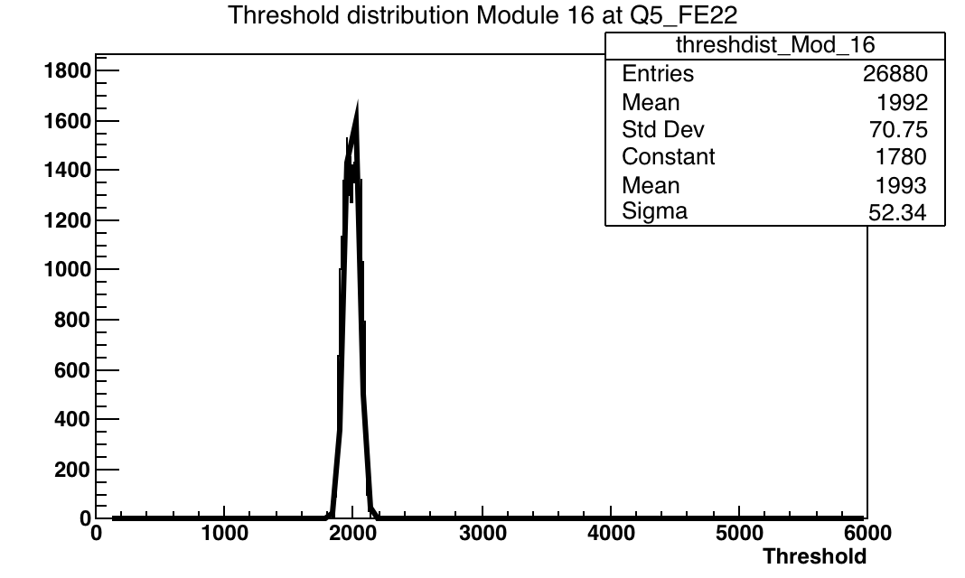
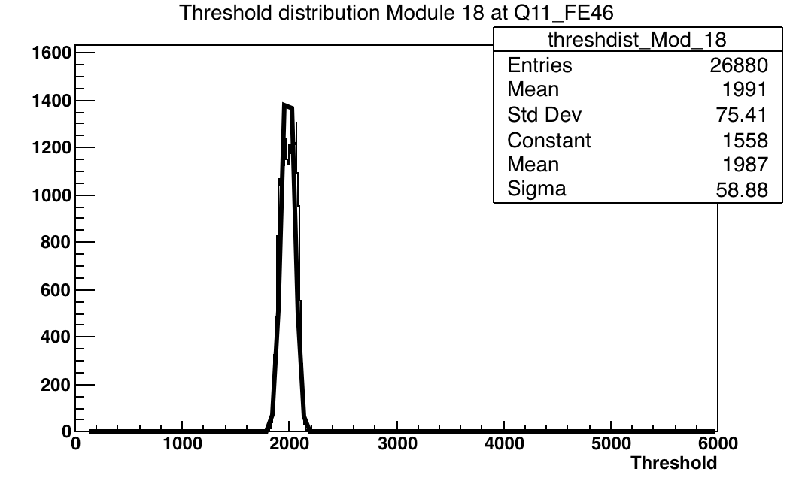
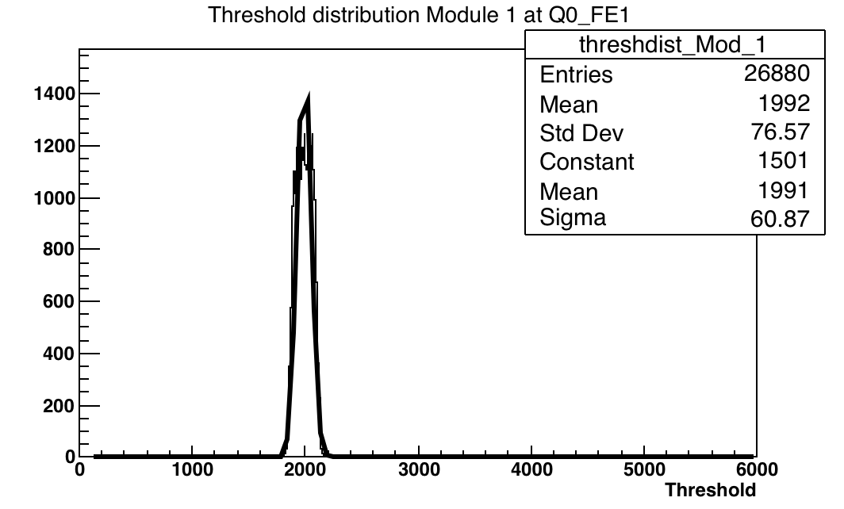
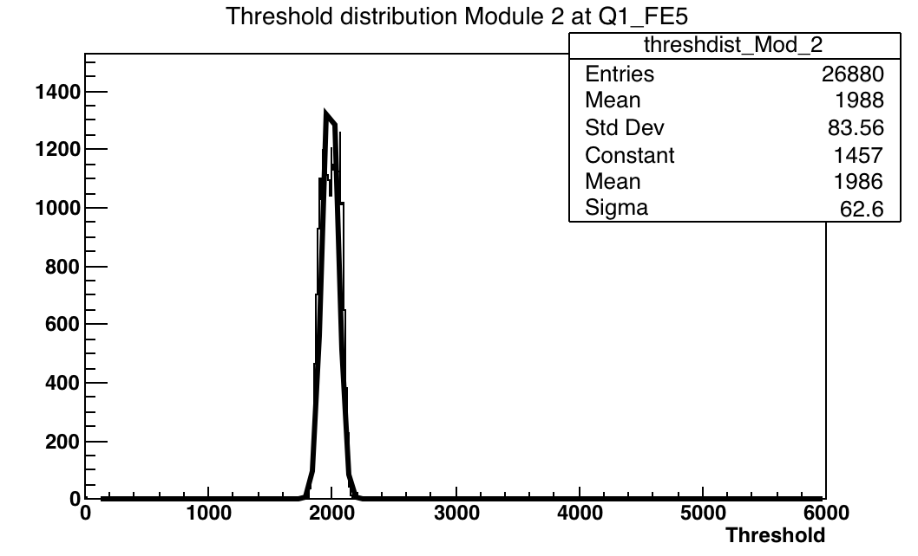
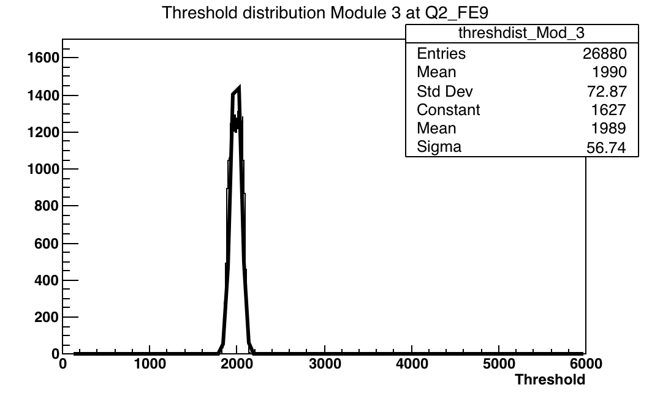
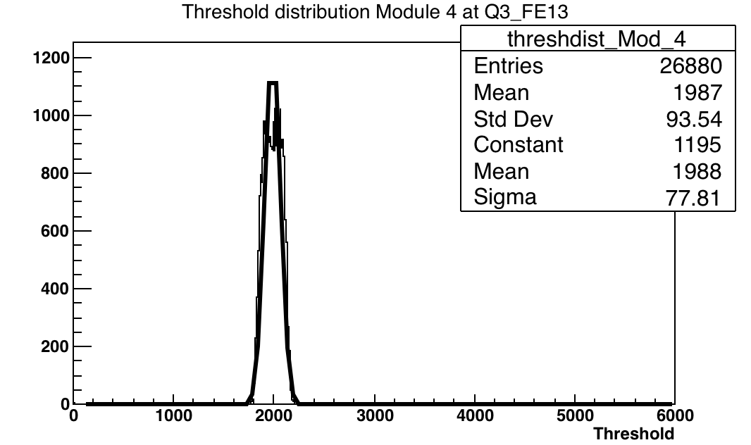
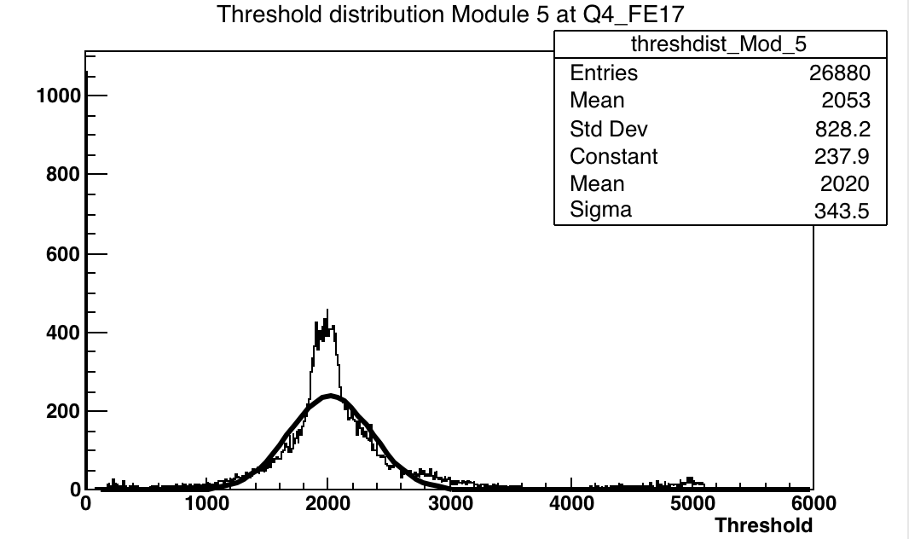
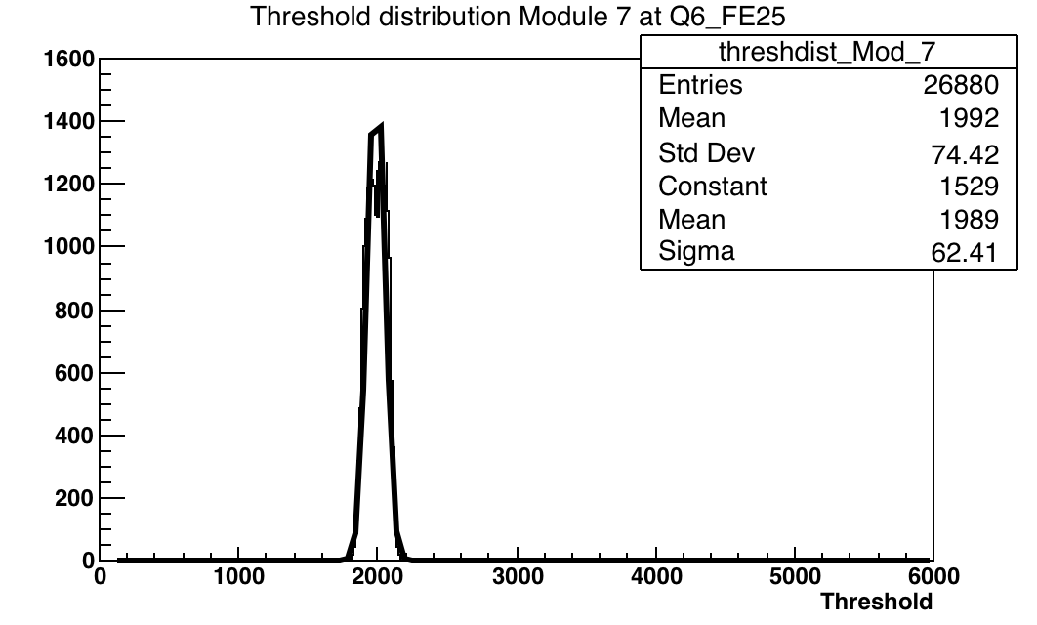
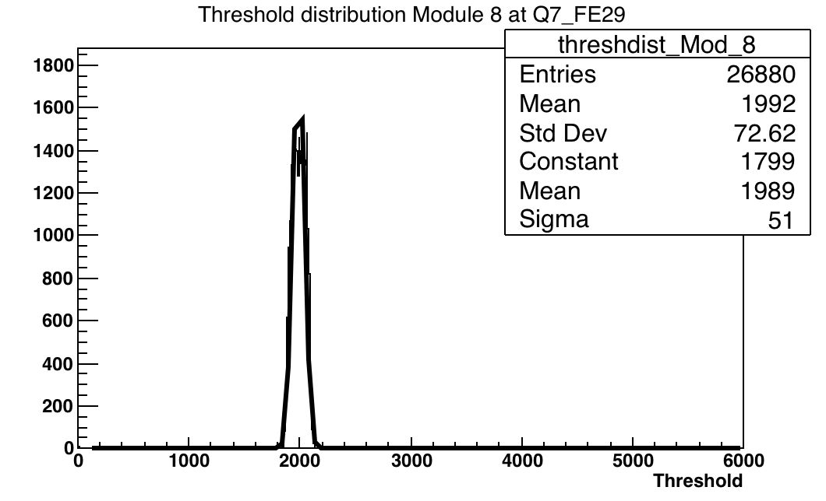
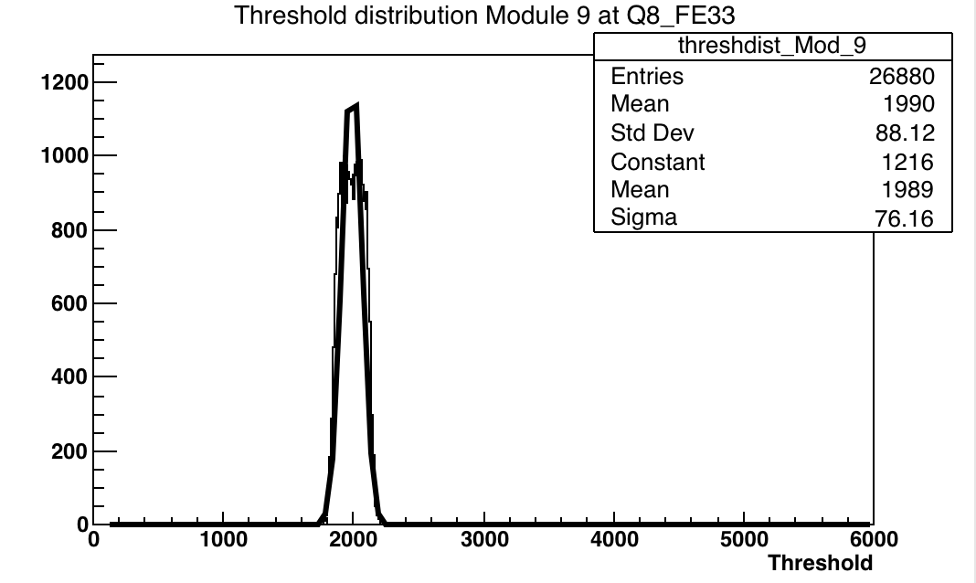
Tuning results for 16 FE’s on stave (thresholds)

Slide 21
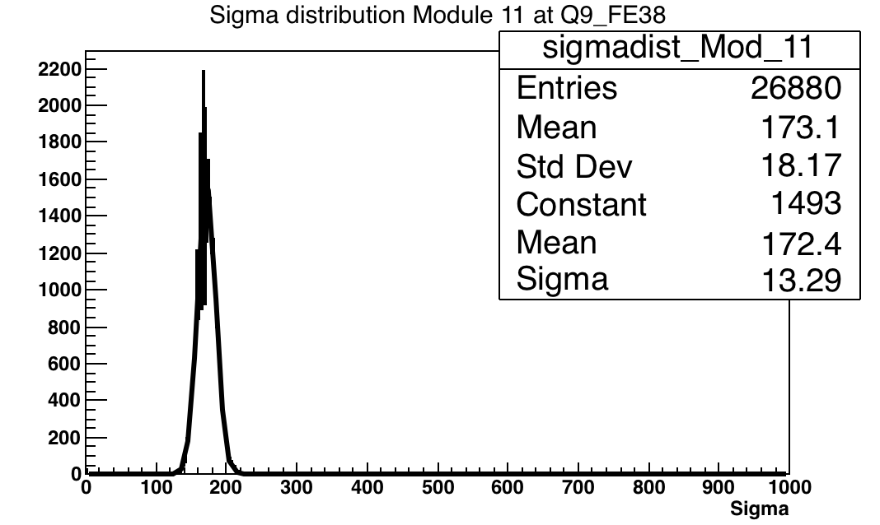
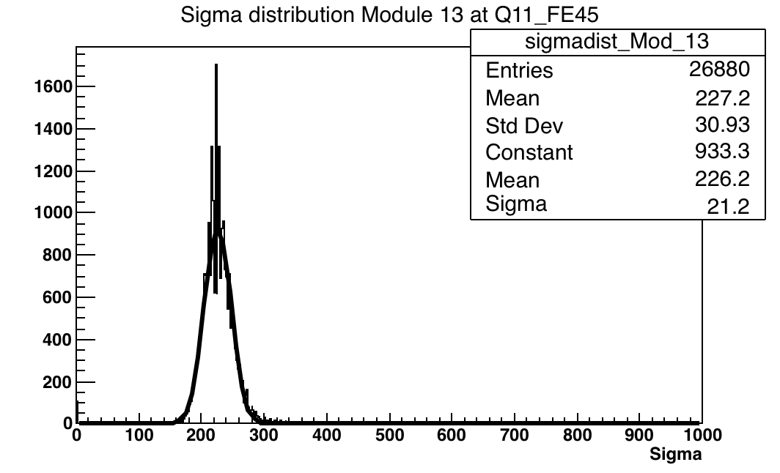
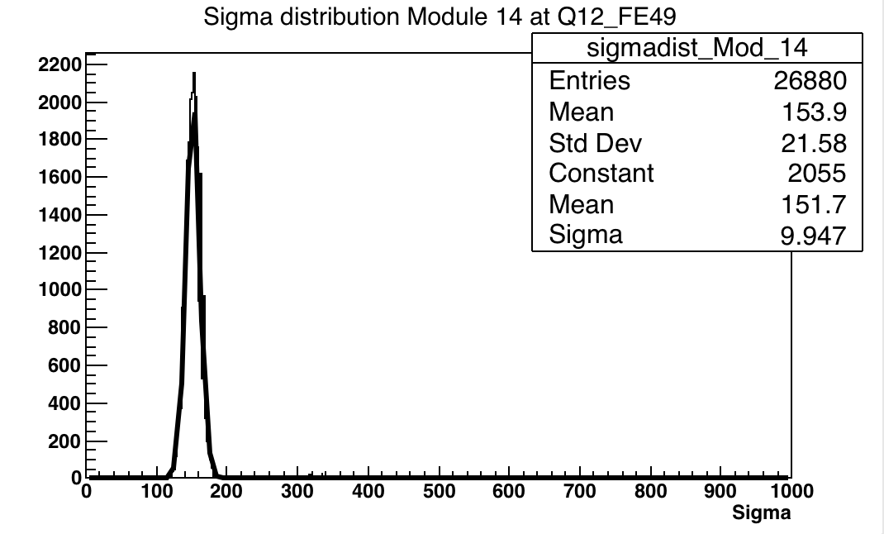
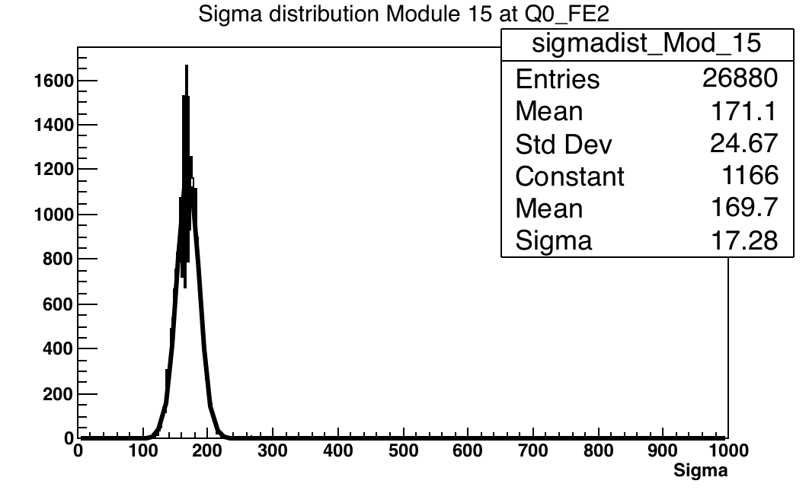
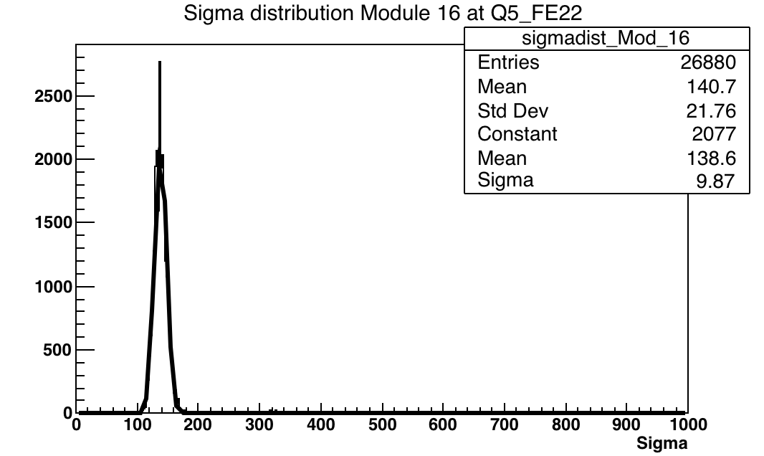
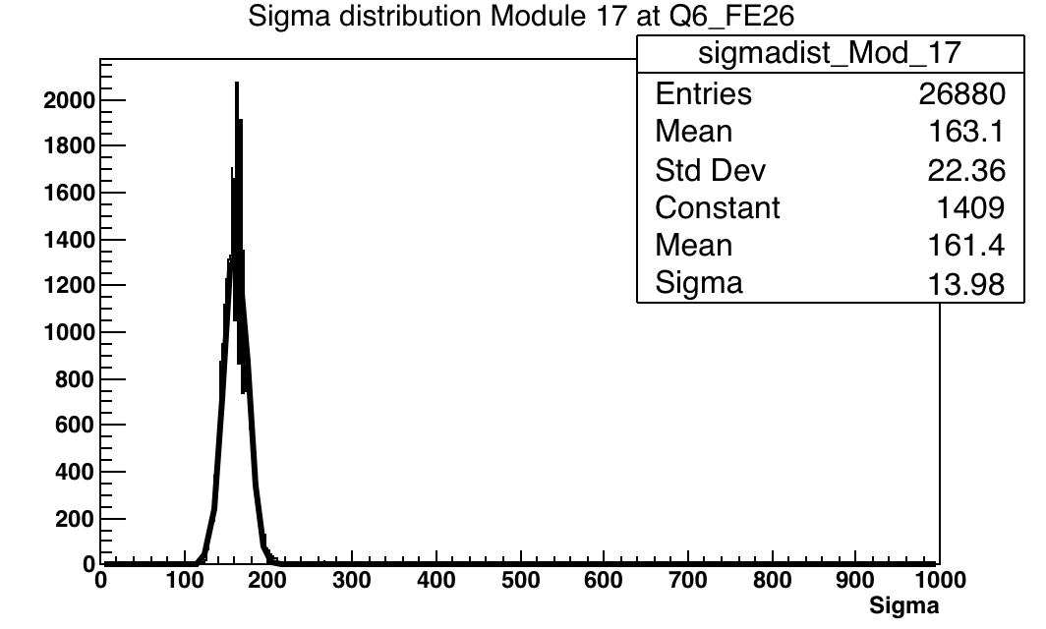
Tuning results for 16 FE’s on stave (noise)

Slide 22
Random triggers from cosmics
Plastic scintillaor (EJ-200) supplied by Scionix, and tuned with Sr90 source in the lab
Expected rate of ~3Hz seen on scintillaor trigger as an OR, ~0.5Hz when using AND due to distance between them

Slide 23
Random triggers from cosmics
System test..
Stimulate system with random triggers
Test of long term stability of serial powering chain/DAQ -> towards system tests of larger structures e.g half rings etc
Simple tracking possible through pairs of quads mounted back to back
Solved timing problems seen at test beam

Slide 24
Summary / next steps
HV test w/o
solder resist
Moving onto the new hybrid (ring 1)
HV test
Transm.
line test
Transm.
line test
Thermode
pads: Jim’s design
Thermode
pads with
plated vias
Wire bond
pads: etched RA copper
High current test:
electroplated and
etched RA copper

Slide 25
To illustrate that last point…
A Abdesselam et al 2008 JINST 3 P05002

Slide 26
Questions for discussion
Are their other tests / equipment / important points to include?
Can we save time, if needed by running less tests?
Testing limited no. of FE’s may be risky but how about a fraction of all channels?
Can we run HR at lower speed (reduced data rate) ?
How do we manage the risk of missing something important with reduced testing?
How much time should be spent with rings that don’t pass inspection and where should they go for debug/fixing?
What are most likely delays that will prevent the reception testing and integration from proceeding at the planned rate?
Sensor & ASIC production, bump bonding, module assembly, wire-bonding, probably not limited by module mounting time
Given the problems that have been seen with current hardware at low doses (CMS DC-DC converter problem, ATLAS TID bump) is it worth irradiating half-ring demonstrators (ring-0, ring-1 etc)
Irradiation and subsequent system tests at a range of doses from low to high
Irradiation whilst powering the demonstrators to emulate real use

Slide 27
Inventory
DAQ system (COB + RD53/ITKpix adaptor, Felix, YARR?)
Need a DAQ capable of reading out up 52 FE’s simultaneously, more when testing multiple HRs inside cylinders
DCS and slow control systems
EoS card, PSPP, DCS, Aggregator, HV,LV, Temp, humidity ….
Computing resources
working database + scripts for extracting data from DAQ output to database
PCs and disk space currently use ~10 Mb / thr scan for just 18 FEI4s -> reduce/compress data saved to database
Cooling plant
CO2 system shared with LHCb (Q2 2020)
Other systems water cooling, LN2 etc for demonstrators
LV & HV power supplies (Bench supply and custom made)
Realistic cables and connectors (correct length and gauge: Type 2 + Type 3 ~ 72m)
High resolution microscope -> Keyence
Working environmental chamber (final tests with cylinders and completed endcap)

