Slide 1
Shipping and Transportation
Helen Hayward

Slide 2
What are we transporting?
Use expertise gained in the transport of SCT Endcap C
Need to transport endcap and associated service jigs
General concept is a cradle within a cradle within a box
Design should minimise work needed at CERN for integration
  Need input from CERN Integration team soon
  This will drive the design of the transportation tooling and the assembly tooling at the integration sites
Need full inspection before departure

Slide 3
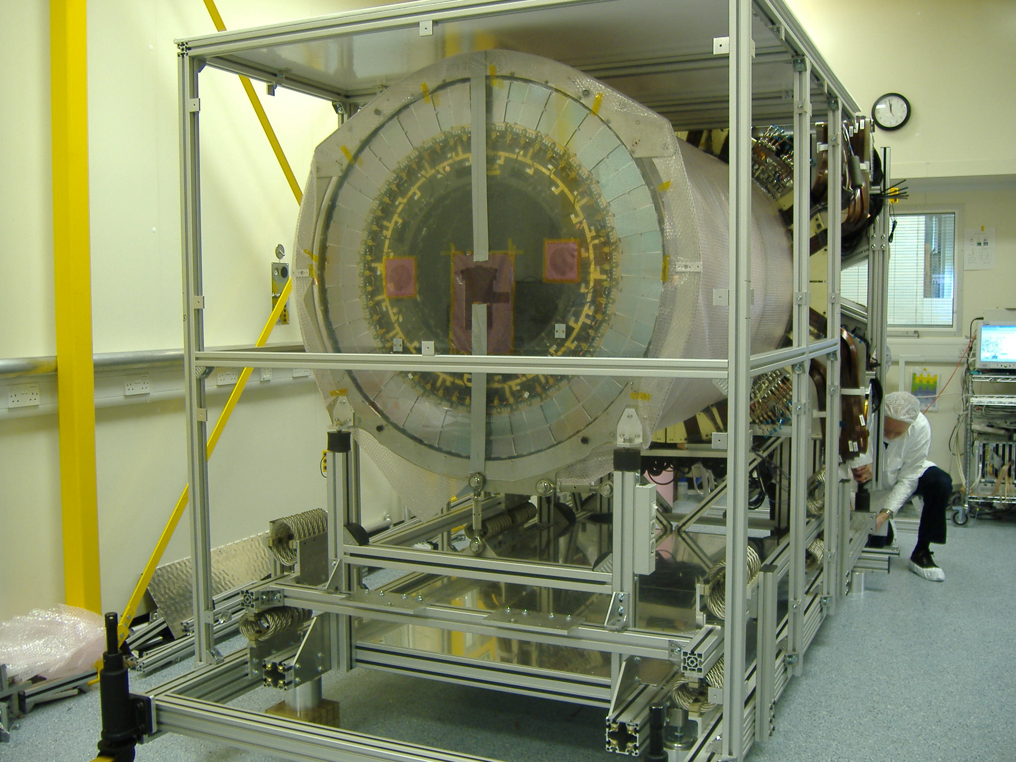
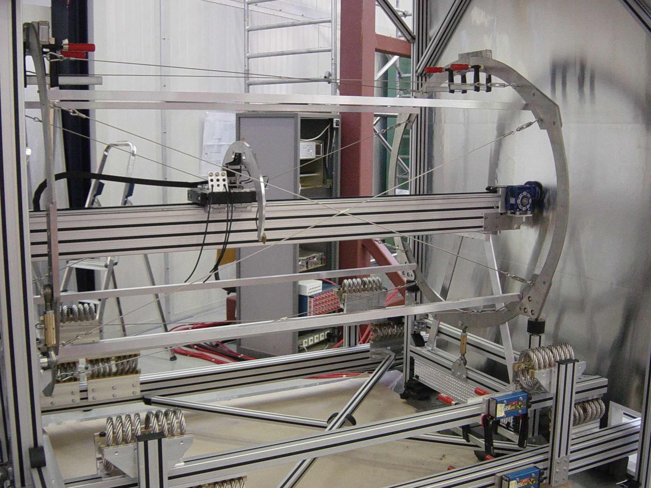
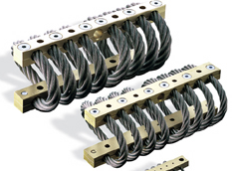
SCT Archaeology …Feb 2006
Services
Integration frame
outer frame
services

Slide 4
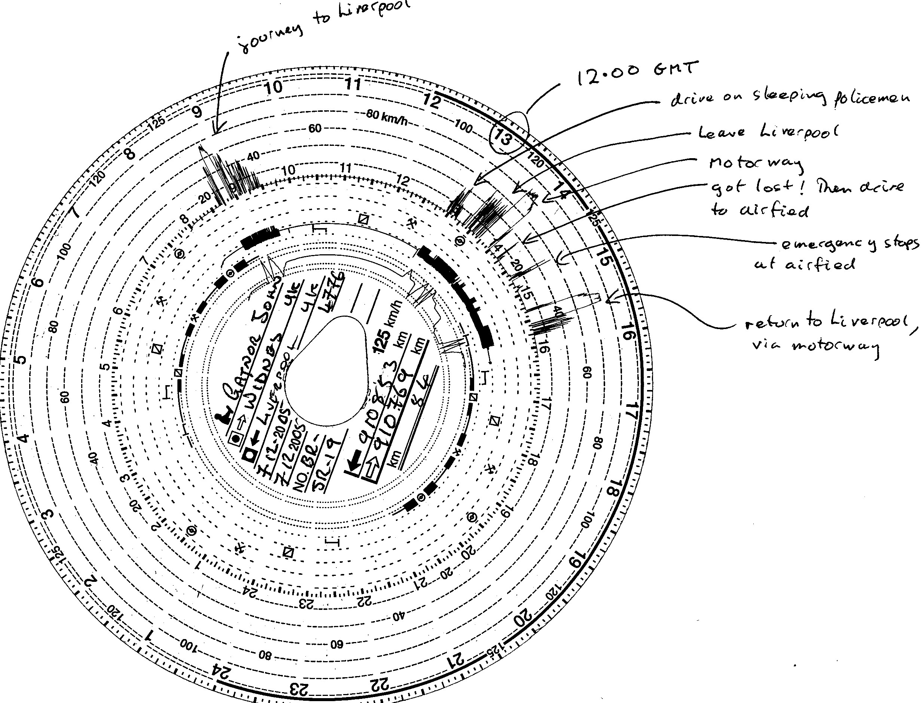
Preliminary Test drive Findings
SCT Archaeology …Dec 2005
Shock logs
  Loading / Unloading < 0.2g typical, 0.7g max
  City Traffic < 1.0g typical, 1.5g max.
  Motorway ~ 0.5g typical
  Emergency Stops ~ 0.75g longitudinal
Position Sensors
  Top of inner frame moves
  forward by ~ 10mm during
  breaking, springs
  back 6mm when stopped
  before coming back to ‘neutral’
  position
  75mm allowed in box
Modules
  No mechanical damage
  All connectors still in
  Modules not yet electrically tested

Slide 5
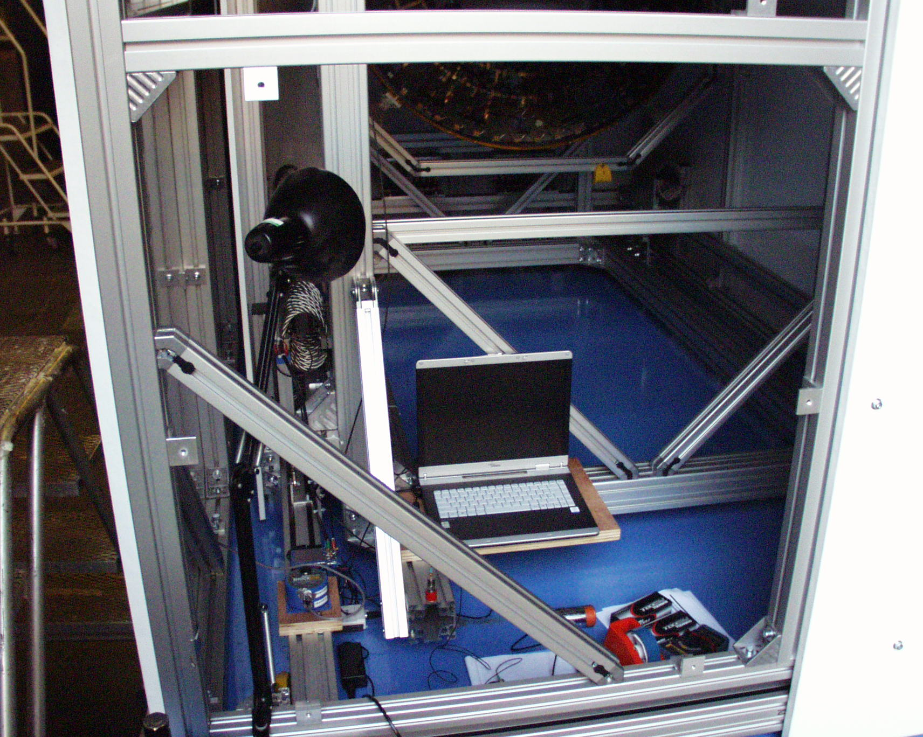
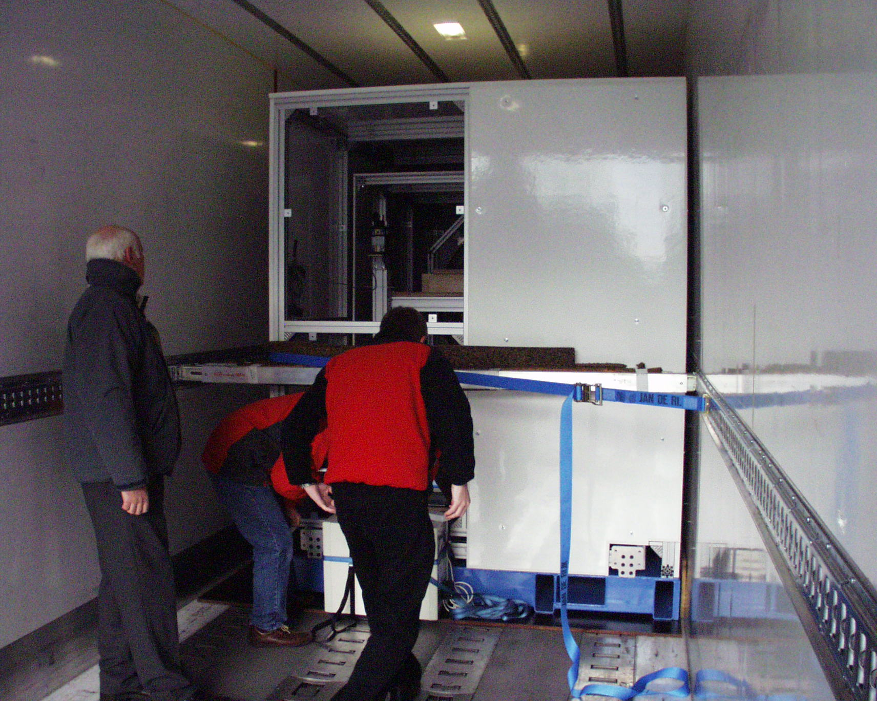
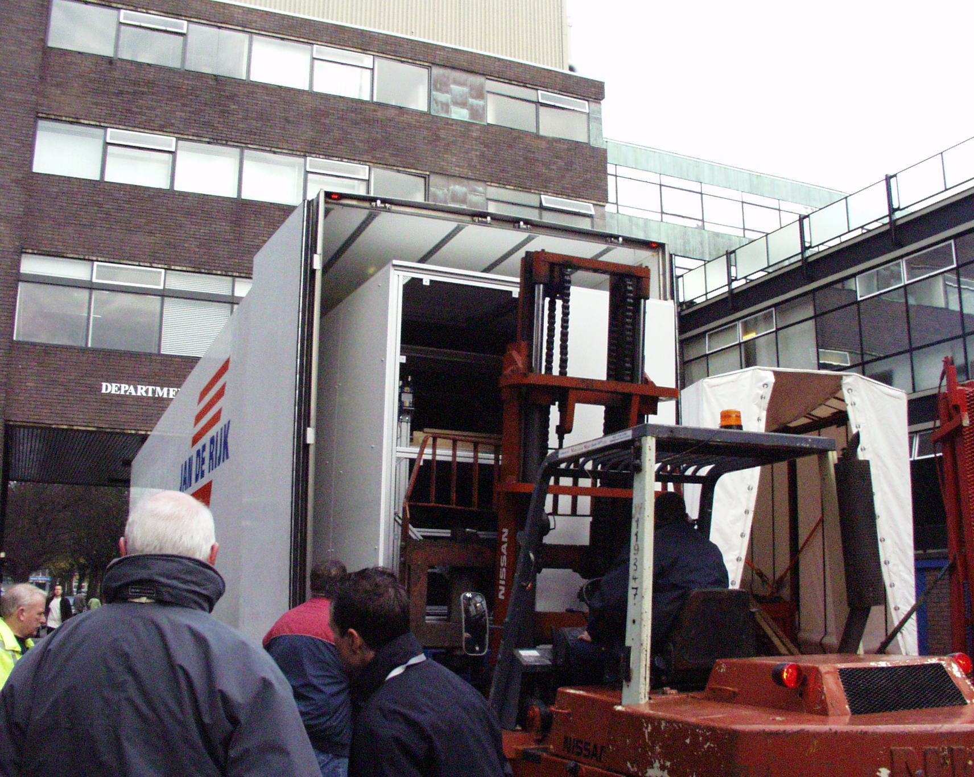
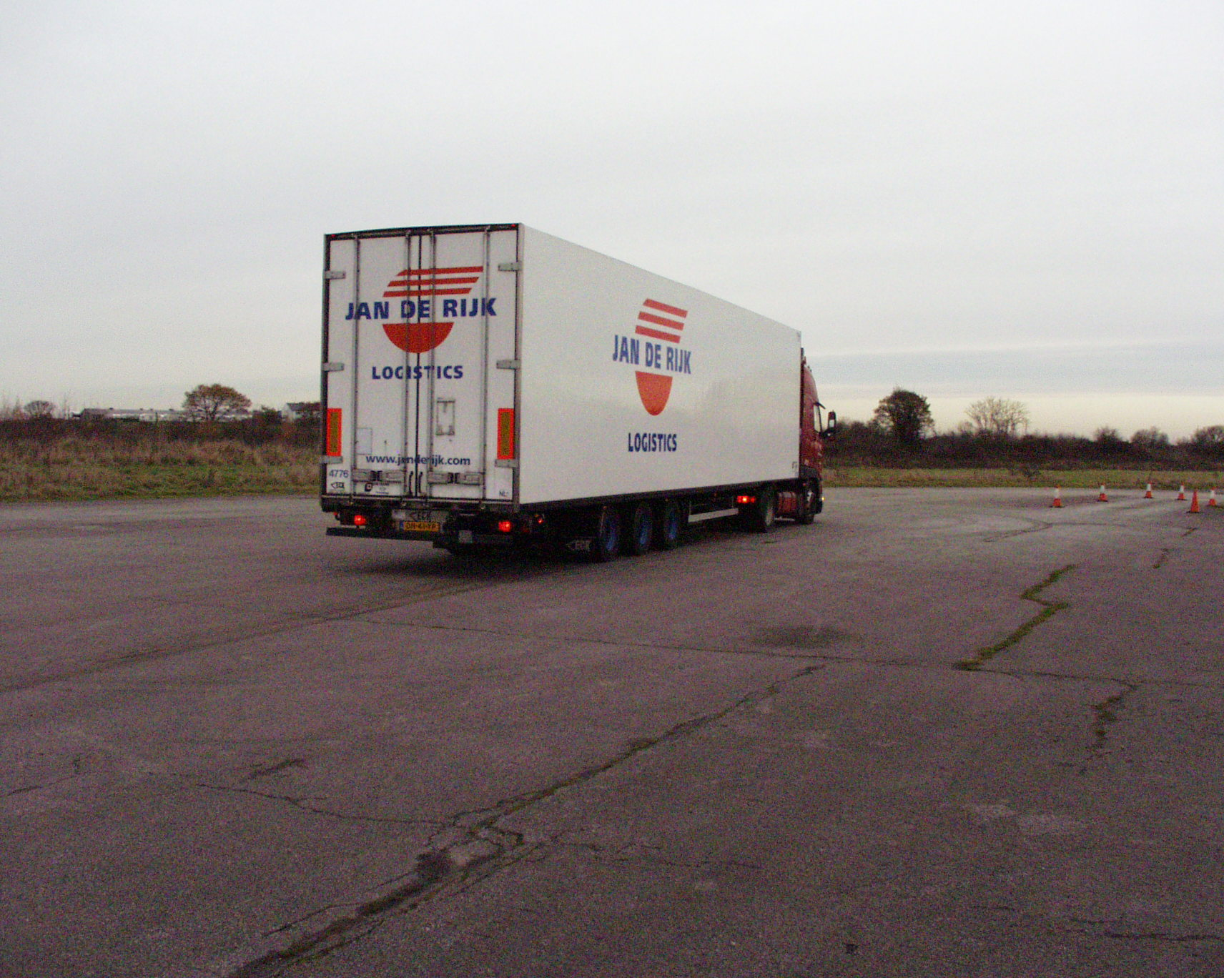
SCT Archaeology …Dec 2005
Box in Truck
DAQ
Loading
Emergency Stop

Slide 6
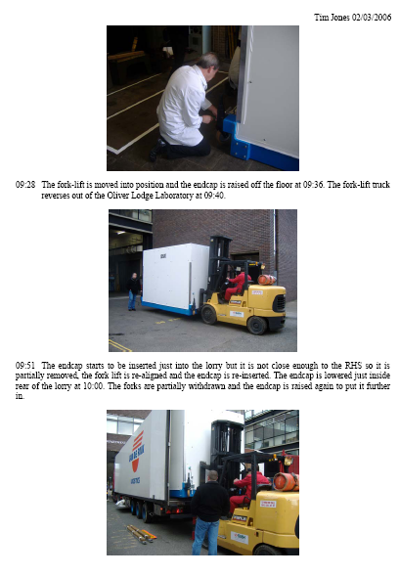
SCT Archaeology …March 2006

Slide 7
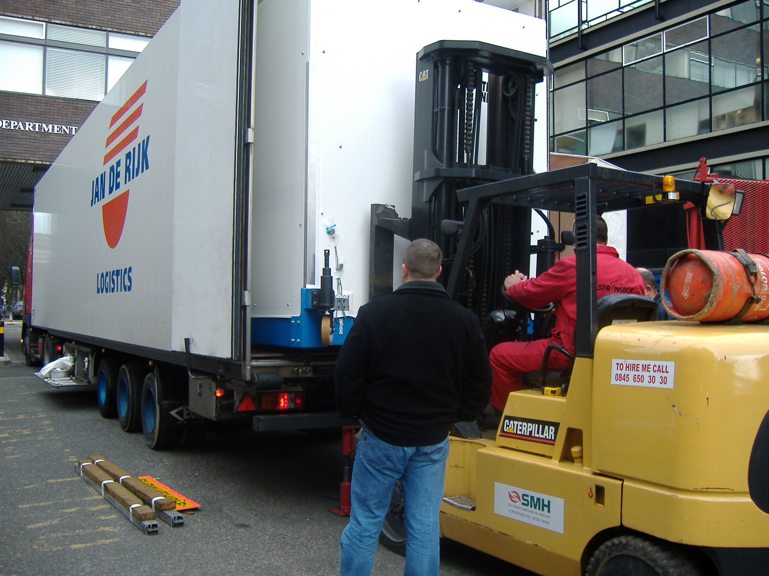
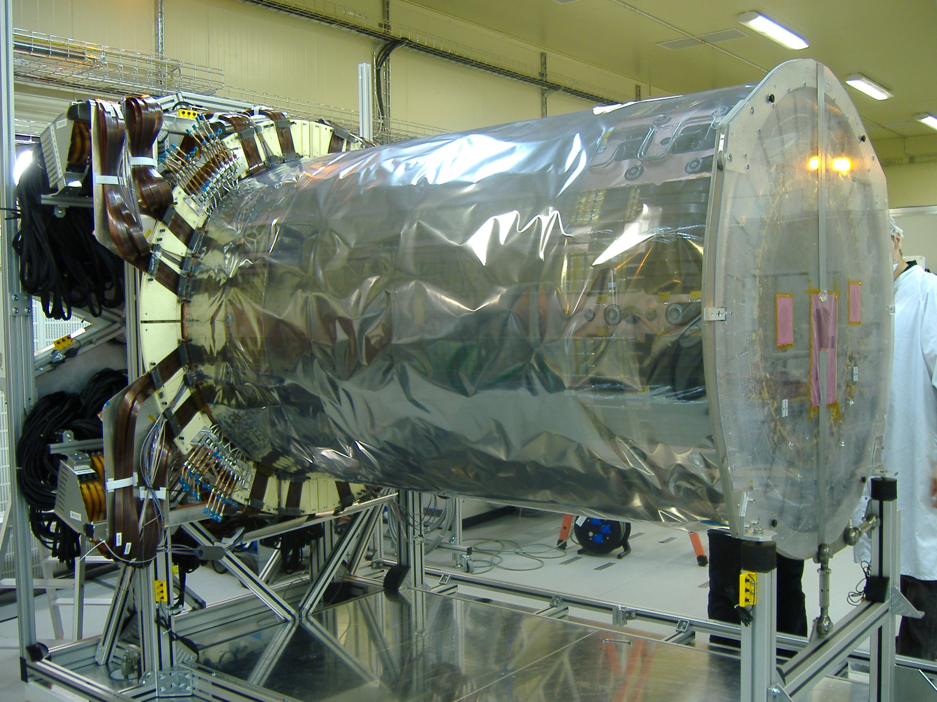
Transport of Endcap C
SCT Archaeology …March 2006
Diary
  20th Feb am – pick-up from Liverpool.
  22nd Feb pm – arrival at Prevessin.
  23rd Feb am – Unload at SR1.

Slide 8
How are we shipping?
  Getting it out of the clean room and Oliver Lodge
    => wheels/ fork lift
  Loading it onto lorry
    Assume Fork lift => constraints on dimensions
  What lorry (any constraints on design? Dimension?)
    Assume climate controlled, =>constraints on dimensions
  Unloading
  Getting it into SR1
  Sensors
    Shock-logs, Position sensors
    Environment – temperature/humidity
    Events – photos, video, notes, tachographs

Slide 9
Arrival at CERN
Removal from outer packaging
  General inspection (any obvious lose debris?)
Installed into SR1
Connections made to dummy PP1s
Verification of no damage has been sustained in transit
  Full visual inspection (repeat of inspection done before departure – any new defects?)
  Ring survey – Any movement in x-y-z?
  Cooling circuits leak check
  Electrical connectivity
  Check fibre harness connections

Slide 10
What do we need to know soon?
Installation height
Constraints on dimensions due to Lorry
Constraints on dimensions due to fork lift
Constraints due to environment chamber
  Integration frame should fit inside.
How is endcap supported inside the frame?
How are services supported?
Room needed for services?

