Slide 1






ISOLPHARM_AG - Task1
Nuclide production simulation with FLUKA and GEANT4
status report: March 2018
TASK 1: Michele Ballan

Slide 2
Overview
⚛ FLUKA vs GEANT4: similarities and differences
⚛ Standard input definition
  Primary beam (FLUKA & GEANT4)
  Target geometry (FLUKA & GEANT4)
  Target material (FLUKA & GEANT4)
  Scorers and detectors (only FLUKA)
⚛ FLUKA from terminal:
  Simulation run
  Data merging
  Data evaluation
TASK 1: Michele Ballan

Slide 3
FLUKA vs GEANT4 (I)
☢ A general purpose tool for calculations of particle transport and interactions with matter- Not a toolkit!!!
☢ Very little possibility to modify the core code (adding custom physics, nuclear cross sections, etc…)
☢ Fortran based
☢ Provided with its own official GUI for both input editing and data post-processing (flair, but it’s optional)
☢ Parallelization: number of cycles
☢ A toolkit for the simulation of the passage of particles through matter
☢ Very wide possibility to modify the core code (adding custom physics, nuclear cross sections, etc…)
☢ C++ based
☢ Input editing and data post-processing can be performed with any text-editor or data-analysis software (i.e. Vim, Gedit, Pluma, Root, etc…)
☢ Parallelization: fully possible
TASK 1: Michele Ballan

Slide 4
FLUKA vs GEANT4 (II)
Input editing
Source files editing
Custom GEANT4 application build
Standard FLUKA application run
Simulation run through macros/commands
Data post-processing
Data post-processing
Do you want more/other results?
Do you want more/other results?
TASK 1: Michele Ballan

Slide 5
Web portal: overview
ISOLPHARM_AG web portal
The ISOLPHARM_AG web portal is will perform the automatic definition of the FLUKA and Geant4 input files and the automatic post-processing of the produced results. In addition it will provide a platform for the consulting of the produced results
Guests:
Consult the results
Regular users:
Consult the results
Launch standard simulations
Advanced users:
Consult the results
Launch standard simulations
Add new target configurations/ materials
TASK 1: Michele Ballan

Slide 6
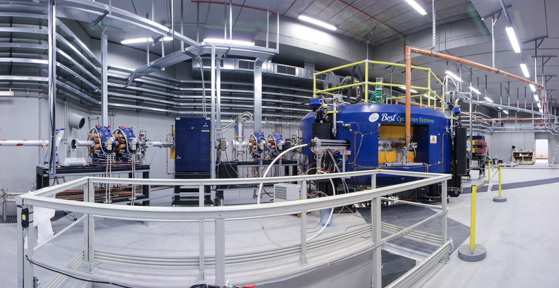
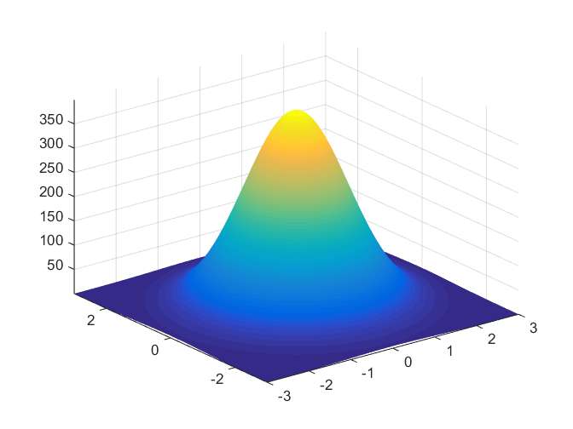
Web portal: primary beam
>> Primary beam
>> Target geometry
>> Target material
>> Simulation setup
Beam particle
Proton
˅
Beam energy [MeV]
40
Beam intensity [µA]
200
Gaussian energy spread
σ_{x} [cm]
0,7
σ_{y} [cm]
0,7
Wobbling radius [cm]
1,1
Primary beam
Target geometry
Target material
Simulation setup
>
>
>
Next >>
TASK 1: Michele Ballan

Slide 7
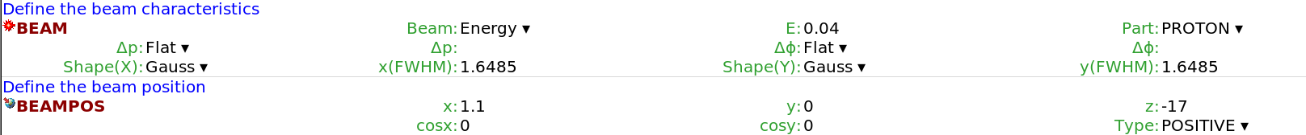
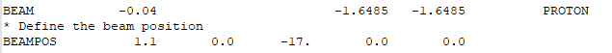
Standard input: primary beam
In flair
In the input file
In the “beam.mac” file
/gps/particle proton
/gps/ene/mono 40 MeV
/gps/pos/center 1,1 0 -17 cm
/gps/pos/sigma_x 0,7 cm
/gps/pos/sigma_y 0,7 cm
TASK 1: Michele Ballan

Slide 8
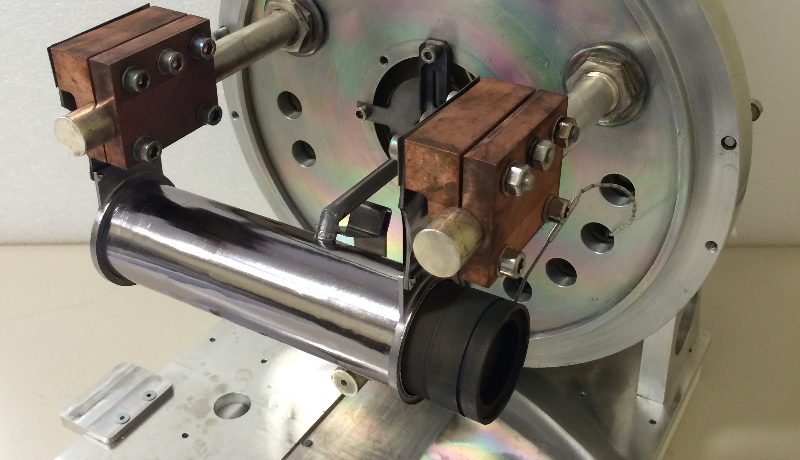
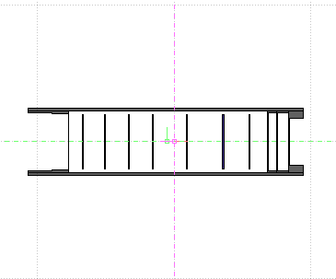
Web portal: target geometry
>> Primary beam
>> Target geometry
>> Target material
>> Simulation starting
Number of disks
7
˅
Disks diameter [mm]
40
˅
Geometrical set
Standard
˅
Primary beam
Target geometry
Target material
Simulation setup
<< Back
>
>
>
Next >>
TASK 1: Michele Ballan

Slide 9
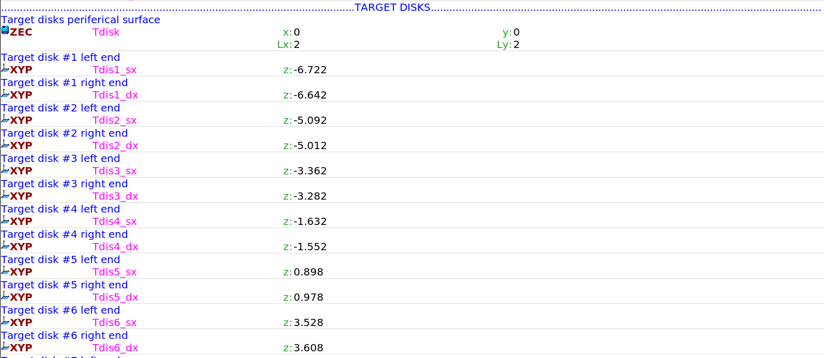
Standard input: target geometry (I)
In flair
TASK 1: Michele Ballan

Slide 10
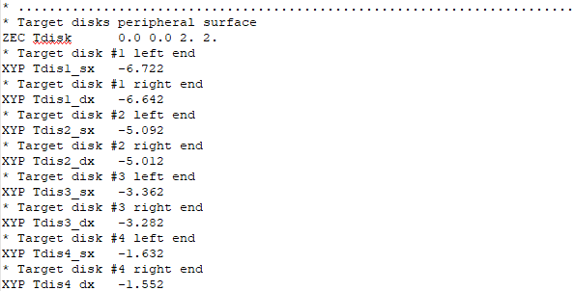
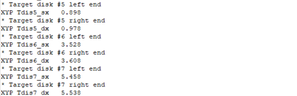
Standard input: target geometry (II)
In the input file
TASK 1: Michele Ballan

Slide 11
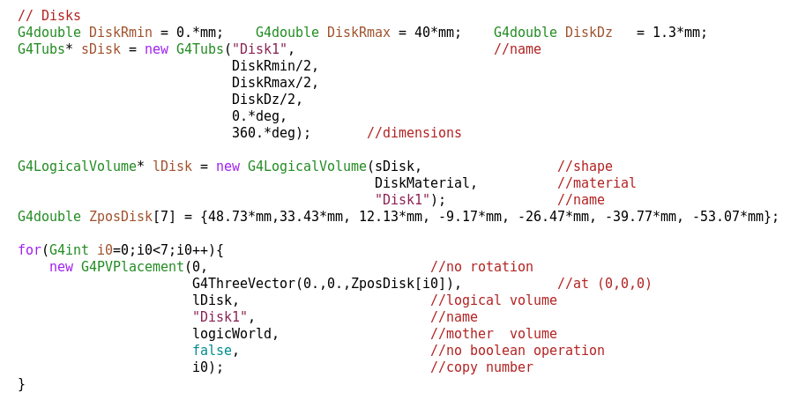
Standard input: target geometry (III)
In the “DetectorConstruction.cc” file
TASK 1: Michele Ballan

Slide 12
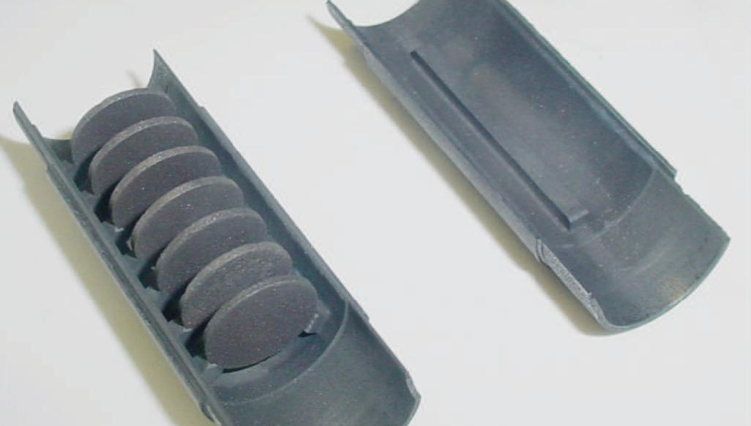
Web portal: target material
>> Primary beam
>> Target geometry
>> Target material
>> Simulation starting
Target material
UC_{X}
˅
Material density [g/cm³]
4,00
˅
Primary beam
Target geometry
Target material
Simulation setup
<< Back
>
>
>
Next >>
TASK 1: Michele Ballan

Slide 13
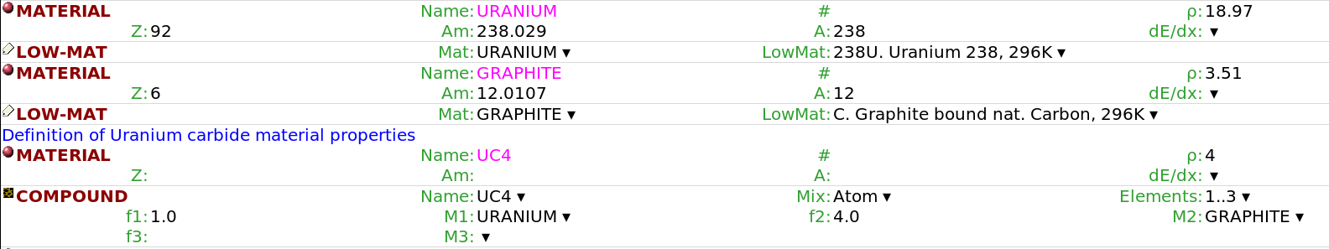
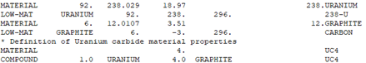
Standard input: target material (I)
In flair
In the input file
TASK 1: Michele Ballan

Slide 14
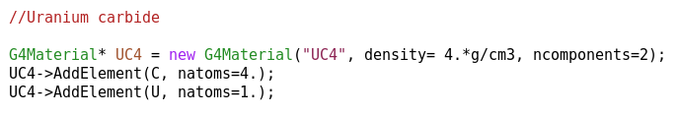
Standard input: target material (II)
In the “DetectorConstruction.cc” file
TASK 1: Michele Ballan

Slide 15
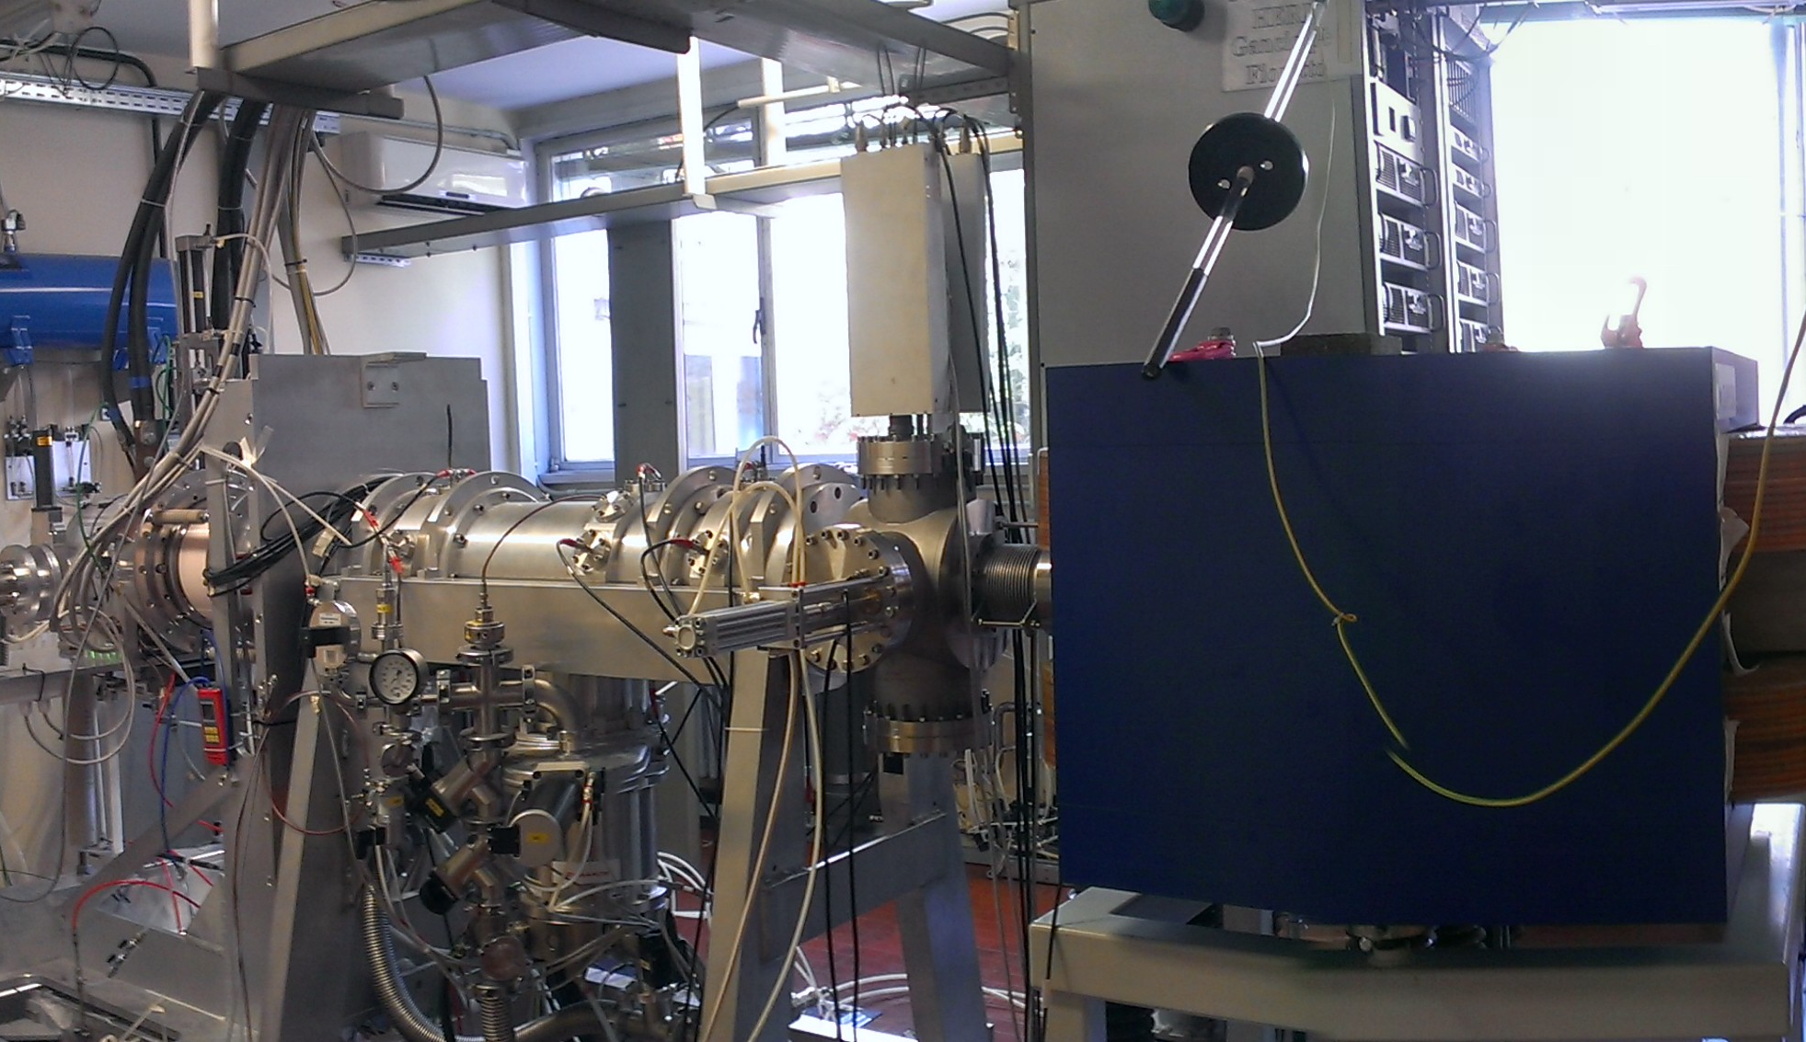
Web portal: scorers & detectors
>> Primary beam
>> Target geometry
>> Target material
>> Simulation starting
Nuclide production
On
˅
Fission count
On
˅
Power deposition
Off
˅
Off
Primary particles flux
˅
1
Accuracy level
˅
Primary beam
Target geometry
Target material
Simulation setup
<< Back
>
>
>
START
TASK 1: Michele Ballan

Slide 16
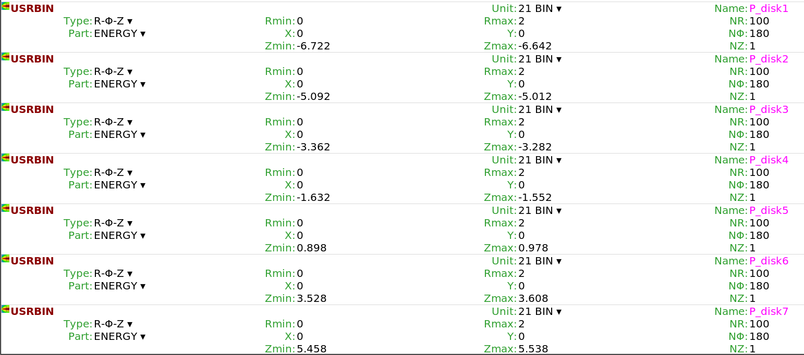
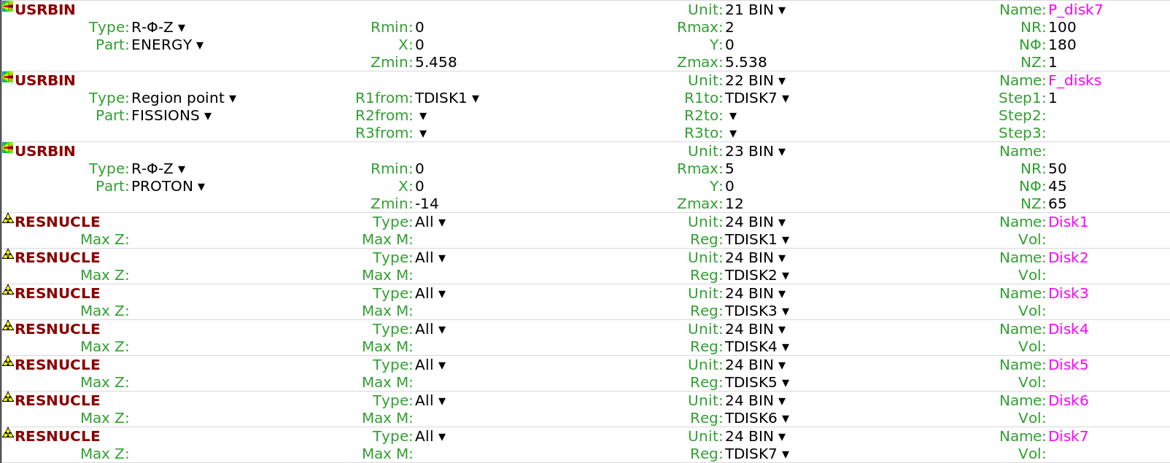
Standard input: scorers & detectors (I)
In flair
TASK 1: Michele Ballan

Slide 17
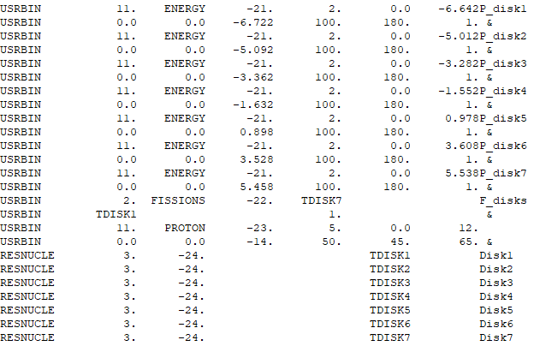
Standard input: scorers & detectors (II)
In the input file
TASK 1: Michele Ballan

Slide 18
FLUKA from terminal: simulation run
$FLUPRO/flutil/rfluka -N0 -M5 InputFile &
FLUKA executable rfluka
Initial cycle number
Final cycle number
Input file name (without .inp file extension)
Allows to run the simulation in background without “freezing” the terminal window
TASK 1: Michele Ballan

Slide 19
FLUKA from terminal: data merging
USRBIN scorers:
energy deposition, number of fissions, proton fluence
First:
$FLUPRO/flutil/usbsuw.f
(statistical merging of the results in an unformatted file)
Than:
$FLUPRO/flutil/usbrea.f
(provides an array with the scored results and related statistical error)
RESNUCLEi scorers:
nuclide production
$FLUPRO/flutil/usrsuw.f
(statistical merging of the results in a table)
TASK 1: Michele Ballan

Slide 20
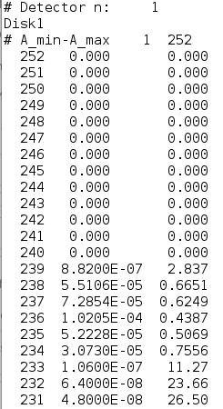
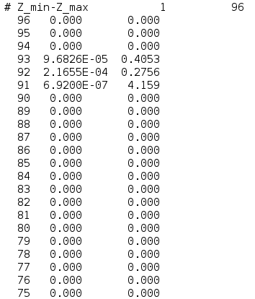
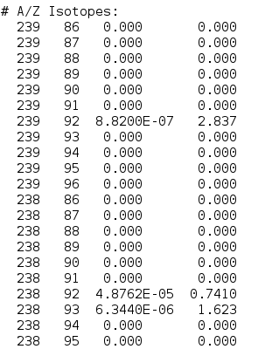
FLUKA from terminal: data evaluation
Example:
RESNUCLEi scorers
(nuclide production)
Mass number A
Element number Z
Nuclide production [nuclide/proton]
Statistical error [%]
Disk number
TASK 1: Michele Ballan

