Slide 1


Gravitational tests using atom interferometers
Gabriele Rosi
CDS seminar
07/03/2018

Slide 2
Outline
Introduction to atom interferometry
MAGIA experiment
MAGIA ADV: 2017 results and 2018 on going activities
Long term prospects
G. Rosi CDS 2018

Slide 3
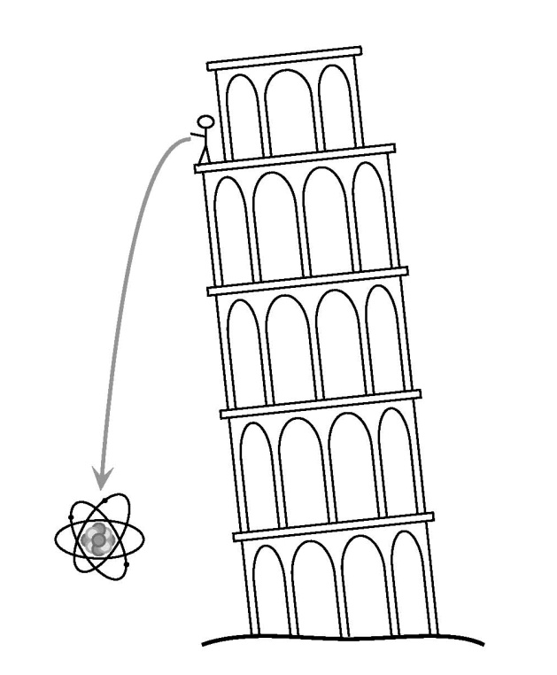
Atom Interferometry for gravity measurement
Atom Interferometry can measure accelerations
We use Cold Atoms as free falling microscopic masses
Quantum features of matter allow to improve the sensitivity
(not just a time-of-flight measurement in the “classical way”)
Ingredients:
A source of Cold Atoms (~ μ K or less)
(the sample must be slowly expanding and weakly interacting )
A laser system to cool the sample and to manipulate
the wavepacket
G. Rosi CDS 2018

Slide 4
Atom / light Interferometry: the analogy
Optical interferometer
π /2 pulse works like a beamsplitter
momentum transfer
π pulse works like mirror;
momentum transfer
Mirror
interference
fringe
state |1>
beamsplitter
state |2>
Atom interferometer
Once you have an atomic two level system you can make the analogy with light looking at the Rabi’s population oscillations scheme
P₁₋₂
|2 ›
|1 ›
Interaction time τ [1/Ω]
π/2
π
SPLIT
REFLECT
RECOMBINE
G. Rosi CDS 2018

Slide 5
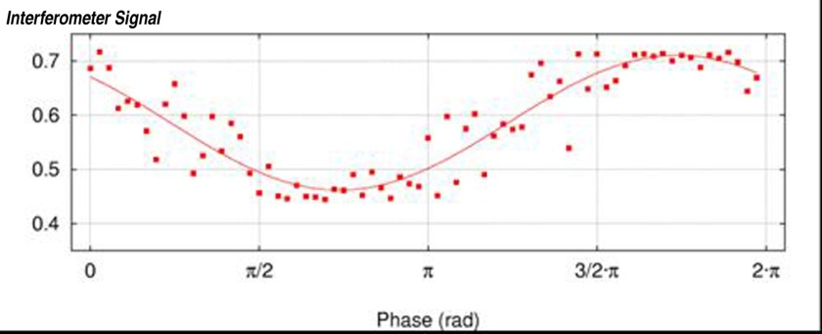
Atom Interferometry: theory
Wave function PHASE evolution
GRAVITY BREAKS
THE SIMMETRY
totally symmetric
evolution
If
Population on final State depends
On the interferometer phase
z
|2>
fringes
|1>
varying RAMAN laser’s phase
t
G. Rosi CDS 2018

Slide 6

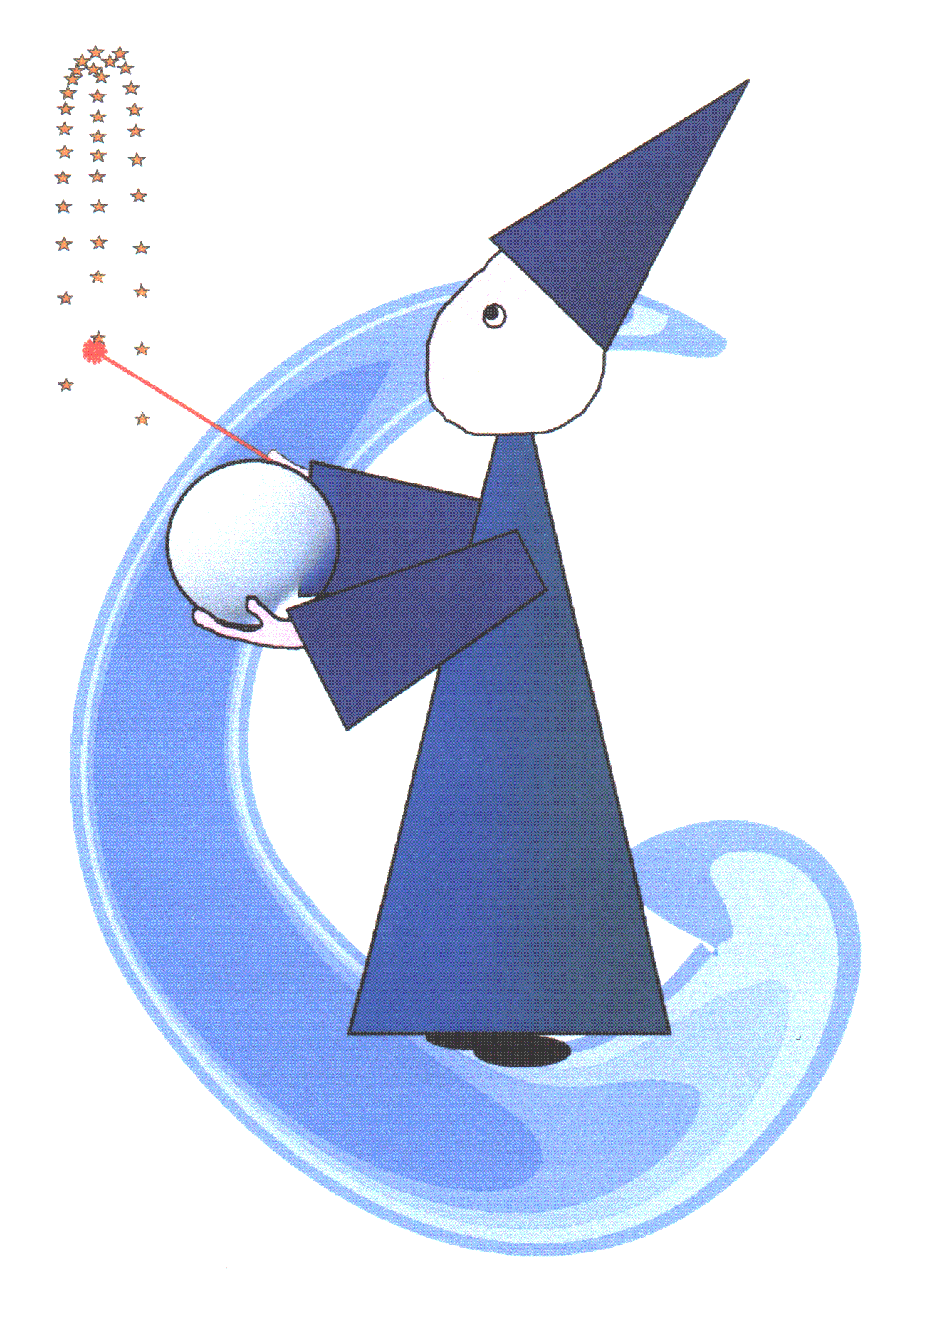
MAGIA
Misura Accurata di G mediante Interferometria Atomica

Slide 7
MAGIA - the procedure
SOURCE MASSES
Well-characterized tungsten cylinders
PROBE MASSES
Cold, freely falling ⁸⁷Rb atoms
MEASUREMENT METHOD
Raman atom interferometry (local acc.)
Spatial & temporal differential scheme
CALCULATION of gravitational attraction
G
G. Rosi CDS 2018

Slide 8
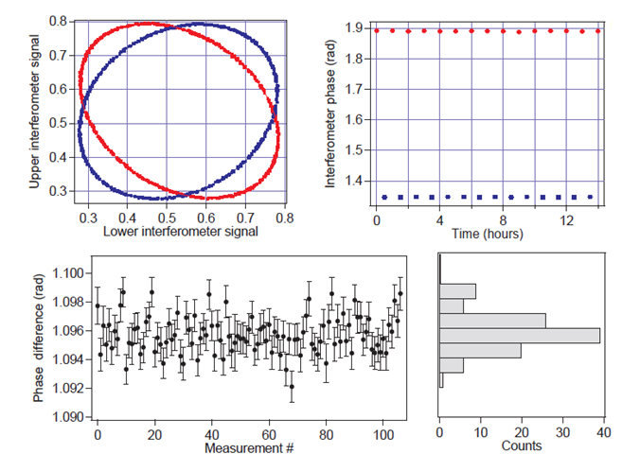
The G measurement
Features:
Source masses modulation time: 30 mins
Integration time:
more than 100 hours over 2 weeks (July 2013)
Sensitivity: 3x10⁻⁹ g/Hz^{1/2}
Final sensitivity: ~ 10⁻¹¹ g
G = 6.67191(77)_{stat}(62)_{sys}× 10⁻¹¹ m³ Kg⁻¹ s⁻²
G. Rosi CDS 2018

Slide 9
MAGIA ADV: 2017 Results

Slide 10
Quantum formulation of the EEP
The Einstein Equivalence Principle plays a crucial role in our understanding of gravity.
It can be organized into three conditions:
Equivalence between the system’s inertia and weight (WEP)
Independence of local non-gravitational experiments from the velocity of the free falling reference frame (LLI)
Independence of local non-gravitational experiments of their location (LPI)
How to implement EEP in a non-relativistic quantum theory?*
Non-relativistic Hamiltonian with classical potential
Developing to the first order:
Gravitational time dilation term
Relativistic time dilation term
*Zych et al. “Quantum formulation of the Einstein Equivalence Principle”, arXiv:1502.00971 (2015)
G. Rosi CDS 2018

Slide 11
Quantum formulation of the WEP
The acceleration operator in the Heisenberg picture is:
where
and
If internal and external degrees of freedom can be entangled!
*Zych et al. “Quantum formulation of the Einstein Equivalence Principle”, arXiv:1502.00971 (2015)
G. Rosi CDS 2018

Slide 12
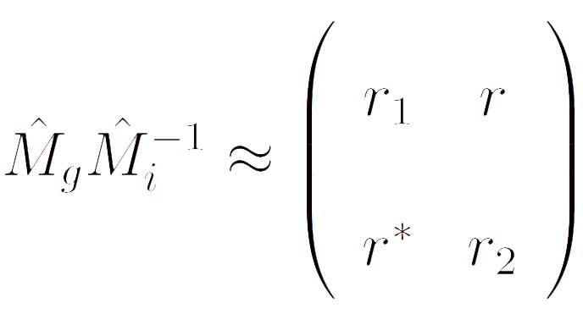

A quantum WEP test
Quantum formulation of WEP requires
In QM a state of internal energy can involve superpositions of states → for
the validity of the quantum WEP we need equivalence between the off-diagonal elements of the operators.
$$\hat{M_{g}}=\hat{M_{i}}$$
Let us consider a two level systems (in our case F=1 and F=2 hyperfine ground state of ⁸⁷Rb:
r₁ and r₂ are real numbers
r is a complex number r=|r|e^{iφ}
Classical WEP is valid if r₁ = r₂ =1
Quantum WEP holds if r = 0
G. Rosi CDS 2018

Slide 13


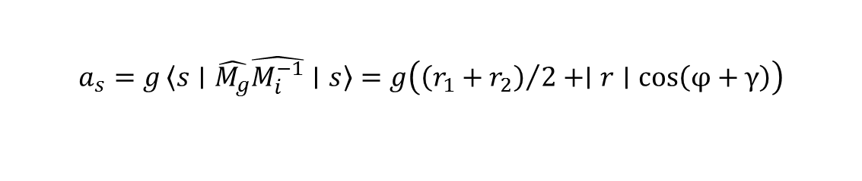
A quantum WEP test
Instrument is sensitive to*:
$$a_{1}=g〈1∣\hat{M_{g}}\hat{M_{i}^{−1}}∣1〉=gr_{1}$$
$$a_{2}=g〈2∣\hat{M_{g}}\hat{M_{i}^{−1}}∣2〉=gr_{2}$$
$$a_{s}=g〈s∣\hat{M_{g}}\hat{M_{i}^{−1}}∣s〉=g\left({\left(r_{1}+r_{2}\right)}/2+∣r∣cos\left(φ+γ\right)\right)$$
(|s> = (|1> + e^{iγ} |2>)/√2)
A classical WEP violation (introduced by diagonal elements r_{1,2}) emerges as a differential acceleration proportional to r₁ – r₂.
A quantum WEP violation would produce an excess phase noise on the acceleration measurements due to γ (random phase >> 2π).
*G. Rosi et al. Nature Communications 8, 15529 (2017)
G. Rosi CDS 2018

Slide 14
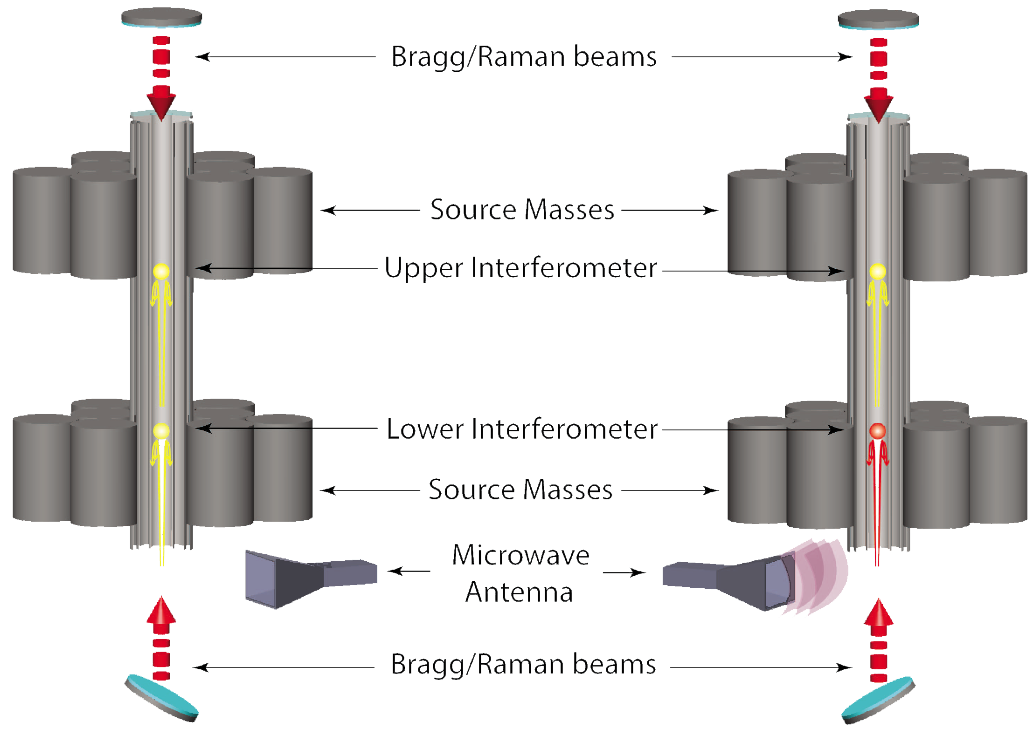
A quantum WEP test
With the Bragg gradiometer we compare the free fall accelerations for atoms prepared in pure hyperfine states (F = 1, F = 2) and atoms prepared in a coherent superposition of two different hyperfine states.
Superposition state is prepared with RF pulse
s = (|1> + |2> e^{iγ})/√2
γ: random phase introduced with RF pulse
*G. Rosi et al. Nature Communications 8, 15529 (2017)
G. Rosi CDS 2018

Slide 15
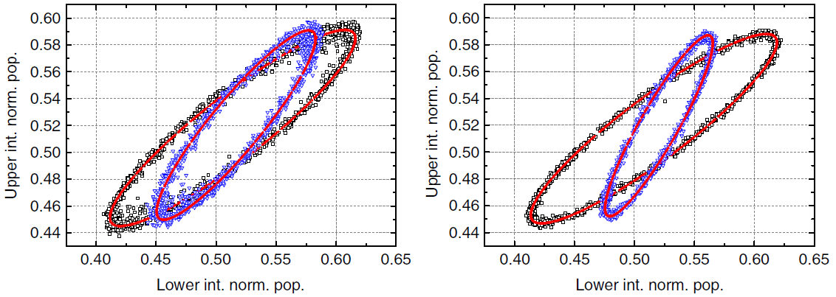
A quantum WEP test
We realize three possible gradiometric configurations → Φ₁₋₁, Φ₁₋₂, Φ_{1-s}
Classical WEP test → δg₁₋₂ ~ (Φ₁₋₁ - Φ₁₋₂) → η₁₋₂ = (1,4 ± 2,8) x 10⁻⁹
Quantum WEP test → Attributing all observed phase noise on 1-s ellipse to a WEP violation we estimate an upper limit for |r| → r ≤ 5 ∙ 10⁻⁸.
Black ellipse: 1 – 1 gradiometer
Black ellipse: 1 – 1 gradiometer
Blue ellipse: 1 – s gradiometer
Blue ellipse: 1 – 2 gradiometer
G. Rosi CDS 2018

Slide 16
A quantum WEP test: prospects
Energy difference between hyperfine state very tiny! (28 μeV)
Likely, the commutator is proportional to the typical magnitude of H and therefore large ΔE yields to larger effects!
Next step: Sr interferometer on clock transition!* ΔE= 1.8 eV!
Next next step: entangled states between different isotopes**?
*L.Hu et al., PRL (2017)
**Geiger et al. PRL (2018)
G. Rosi CDS 2018

Slide 17
Cancelling gravity gradients
The tidal forces on the atoms in a uniform gravity field and gradient modify the wavepacket trajectories. The gravimetric phase shift is
φ = k_{eff}gT² + k_{eff}Γ_{zz}(z₀ + v₀T)T²
z₀, v₀ initial atomic position and velocity.
The error on z₀ and v₀ is one of the major sources of noise and systematics:
For WEP tests at 10⁻¹⁵ level is required a control on z₀ and v₀ of 1 nm and 0,3 nm/s.
In the AI determination of G^{[1]} one of the major sources of systematic error arises from the limited control on the thermal cloud degrees of freedom.
[1] G. Rosi, F. Sorrentino, L. Cacciapuoti, M. Prevedelli & G. M. Tino, “Precision measurement of the Newtonian gravitational constant using cold atoms”, Nature 510, 518-521 (2014).
G. Rosi CDS 2018

Slide 18
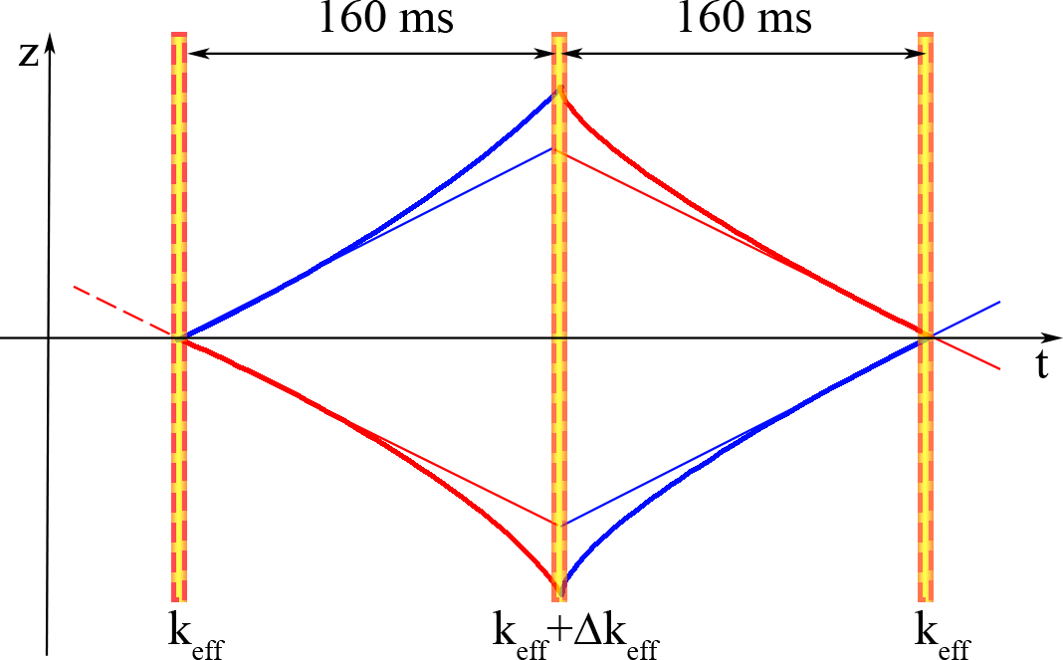
Cancelling gravity gradients
Readapting the effective wave vector k_{eff} of the π pulse it is possible to compensate the effect of Γ_{zz}^{[1]}
Δk_{eff} = (Γ_{zz}T²/2)k_{eff}
φ no longer depends on z₀ and v₀.
This procedure simulates the effect of a gravity gradient on the atomic trajectories. We implement it to measure gravity gradients, gravity curvature
[1] A. Roura, Phys. Rev. Lett. 118, 160401 (2017).
G. Rosi CDS 2018

Slide 19
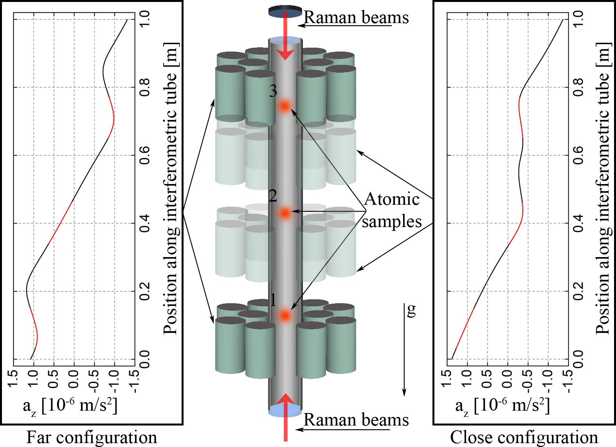
Cancelling gravity gradients
We simultaneously interrogate three clouds with the Raman interferometer for two source masses configurations. During the π pulse the frequency of the Raman lasers is changed by Δν*.
For the three gravity gradiometers (1-2, 2-3, 1-3) we measure the linear dependence Φ(Δν) vs Δν (Φ gradiometric phase)
Gravity gradient is traslated into a frequency!*
G. Rosi CDS 2018

Slide 20
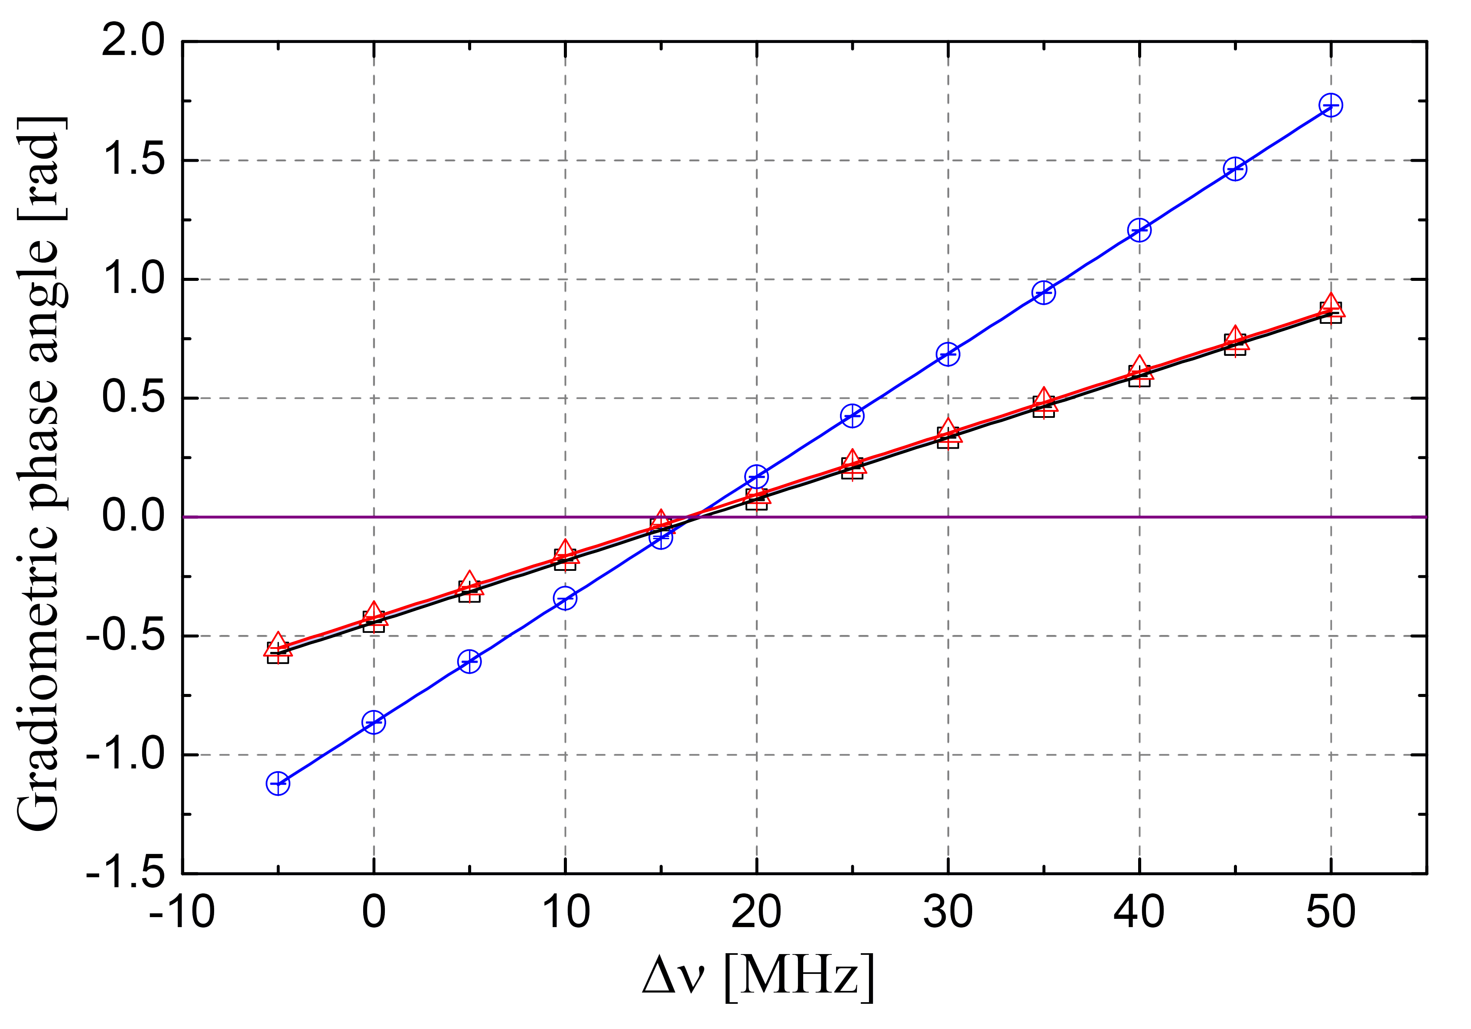
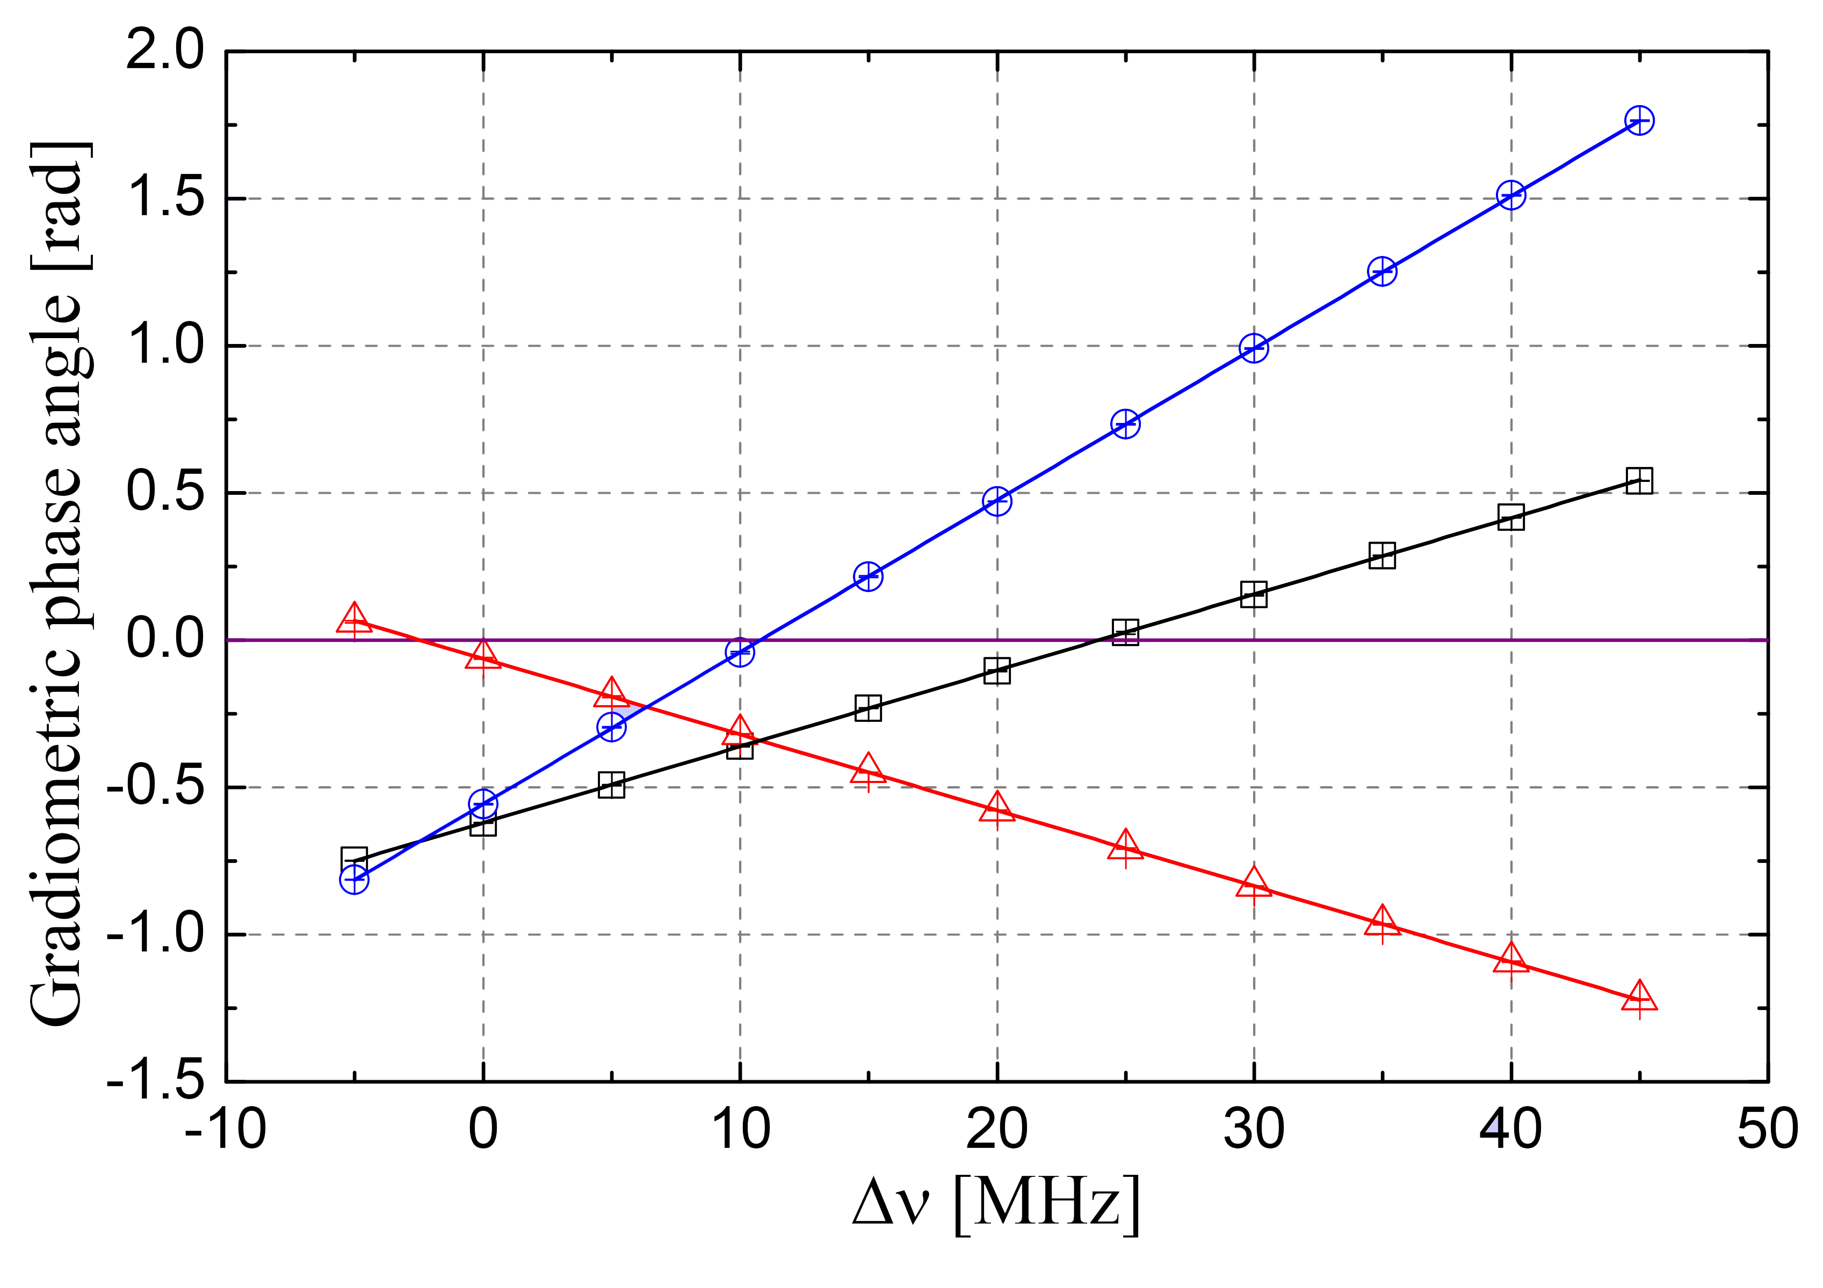
Cancelling gravity gradients
Final results*:
Far configuration
Close configuration
 | Γ₂₃ [10⁻⁶ s⁻²] | Γ₁₂ [10⁻⁶ s⁻²] | Γ₁₃ [10⁻⁶ s⁻²]
Far | -3,32 ± 0,02 | -3,48 ± 0,01 | -3,40 ± 0,01
Close | 0,497 ± 0,006 | -4,87 ± 0,01 | -2,193 ± 0,006
Measurements also provide gravity gradient sign.
As expected Γ₁₃ = (Γ₁₂ + Γ₂₃)/2.
Measured cloud distances and gravity curvature in close configuration:
d₂₃ = (307,2 ± 0,3)mm d₁₂ = (308,6 ± 0,4)mm
ξ_{close} = (Γ₂₃ - Γ₁₂)/d = (1,743 ± 0,004) x 10⁻⁵ m⁻¹s⁻²
*D’amico et al. PRL(2017)
G. Rosi CDS 2018

Slide 21
Prospects
In presence of a linear gravity gradient the zero crossing frequency is independent by clouds positions and velocities
The main systematic effect in G determination with cold atoms arises from the required knowledge of atomic distribution
Can we fabricate a source mass in order to produce an almost linear acceleration profile? Yes
Determination of G at 10 ppm possible with thermal clouds!*
Recipe: double differential zero-crossing frequency determination
*G. Rosi, Metrologia (2018)
G. Rosi CDS 2018

Slide 22
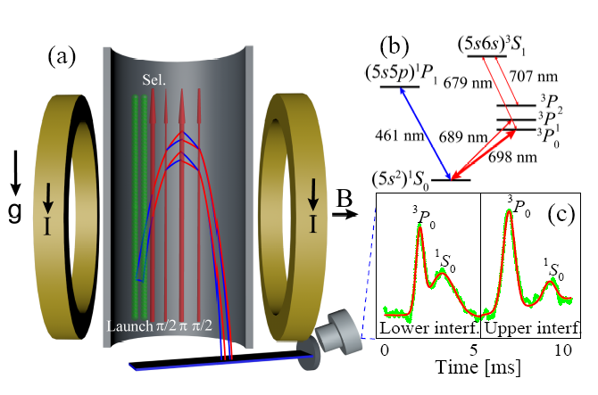
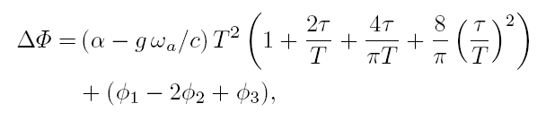
Activities 2017 (Sr)
Clock Interferometer 698 nm*
Isotopo ⁸⁸Sr
Campo statico B=300 G -> Δν=20 μHz
Frequenza di Rabi Ω~1kHz
*Hu et al PRL (2017)
Phase shift gradiometro
G. Rosi CDS 2018

Slide 23
Activities 2017 (Sr)
Sr squeezing on momentum states
Salvi et al PRL (2017)
G. Rosi CDS 2018

Slide 24
Activities 2018
  Rb
  Implementazione e test di fasci non gaussiani sul campione atomico;
  Studio e implementazione di sistemi di raffreddamento con dark mot;
  Test di schemi interferometrici a più impulsi;
  Studio di sistemi di raffreddamento evaporativo;
  Sr
  Update sistema Sr (fontana da 1 m)
  Completamento sistema laser a 461 nm con sistema laser di raffreddamento 2D;
  Costruzione sistema laser di ripompa a 497 nm;
  Completamento sistema laser a 689 nm con tapered amplifier;!
  Caratterizzazione e test della cavità ottica in aria;
  Costruzione apparato da vuoto con produzione di campione di atomi freddi;
  Integrazione dell’apparato con la cavità ottica.
G. Rosi CDS 2018

Slide 25
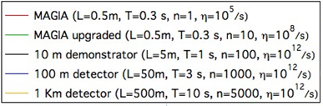
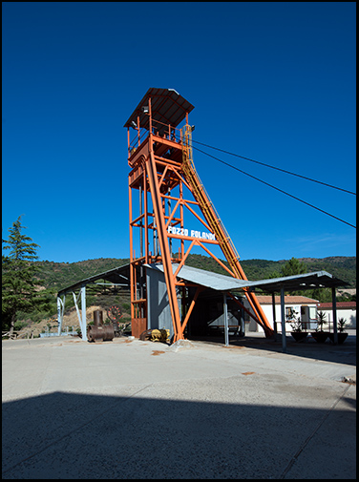
Long term developments
Miniera di SOS ENATTOS
EP Tests, Dark matter detection
G. Rosi CDS 2018

