Slide 1
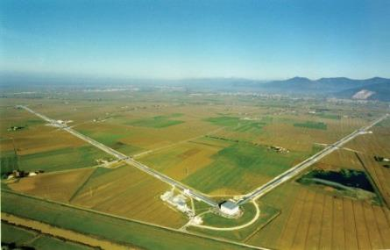
ET and the Advanced Detectors
The Advanced Detectors (Virgo&LIGO) has reached the great success of GW discovery
The ADV+ will reach in the next few years new better sensitivity but will approach the limits
New infrastructure are needed for the next decades
LONGER ARMS & UNDERGROUND
Virgo in 1997

Slide 2

ET history
2000
ESF exploratory workshop on 3G GW detectors
2005
ILIAS (FP6)
Networking activity
of future GW
2010
ELiTES (FP7) Project
(KAGRA-ET synergies)
ET conceptual
design study (FP7)
2015
ET R&D
funded by ASPERA-2
2020

Slide 3
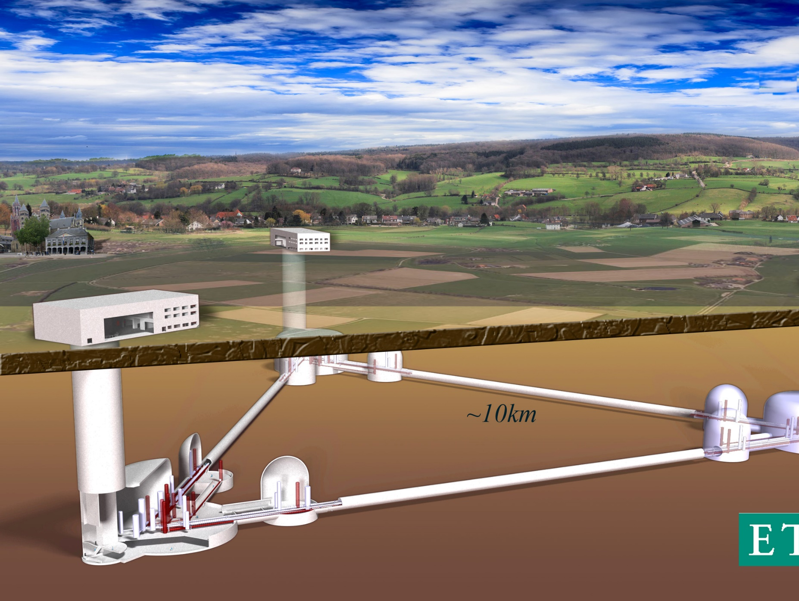

Towards the candidature of SOS-Enattos as 3G GW observatory:
The Einstein Telescope

Slide 4
ET design study
Involving 5 EU countries and a wider science team
Delivered a conceptual design report describing:
  New concept of a 3G observatory
      Research Infrastructure vs detector
      Wide band
      Polarisations
      Pointing capabilities
  Science case for a single 3G observatory
  Enabling technologies for a 3G GW detector
  Rough cost estimation for the infrastructure
  List of sites in Europe compatible with 3G requirements
Formed an ET scientific community meeting every year (ET symposia) since 2008

Slide 5
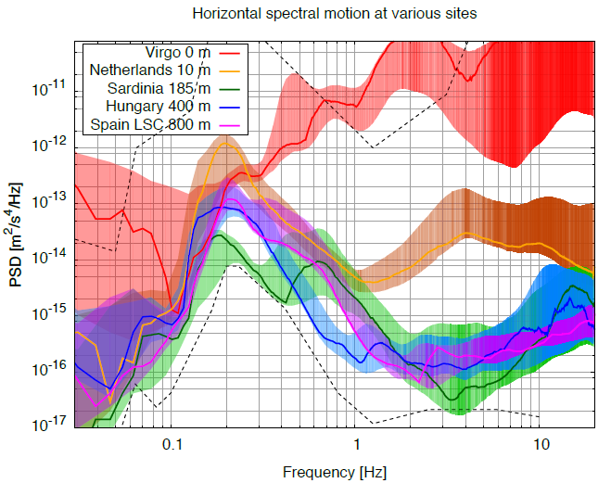
Underground Seismic noise Measurement
Underground sites are the candidates for a very quiet site
Credits: J.v.d. Brand

Slide 6
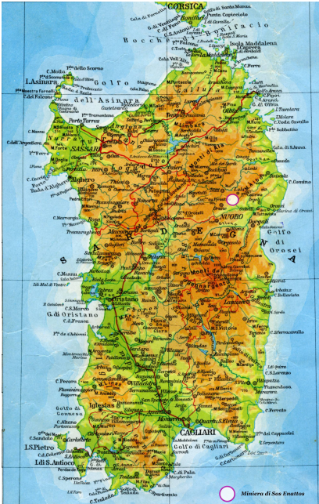
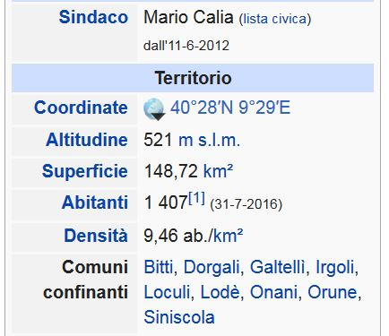
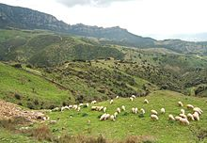
Site Location

Slide 7

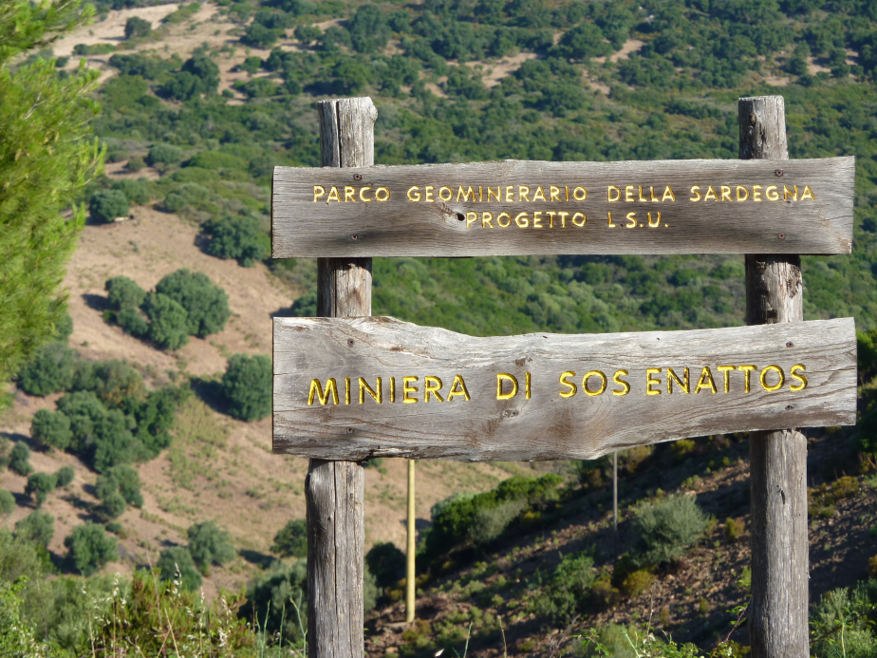
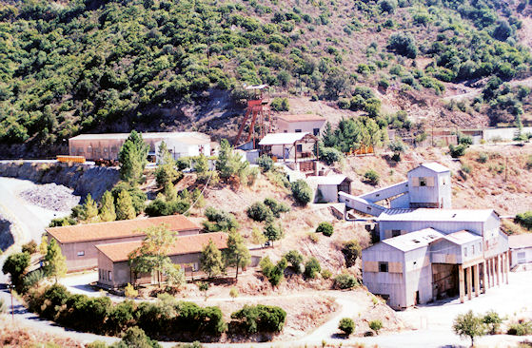
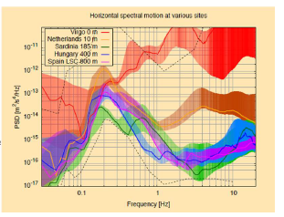
Low Seimic and anthropic noise
Disused mine SOS - ENATTOS presso Lula (Nu)
Seismic
Measurements
By Virgo and
ET collaborations
SOS ENATTOS green

Slide 8
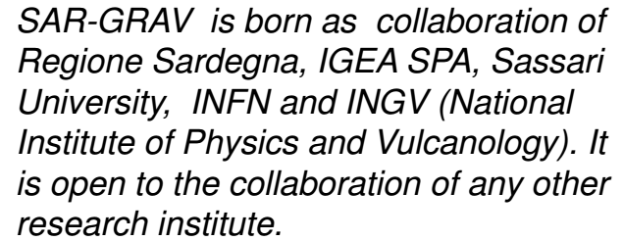
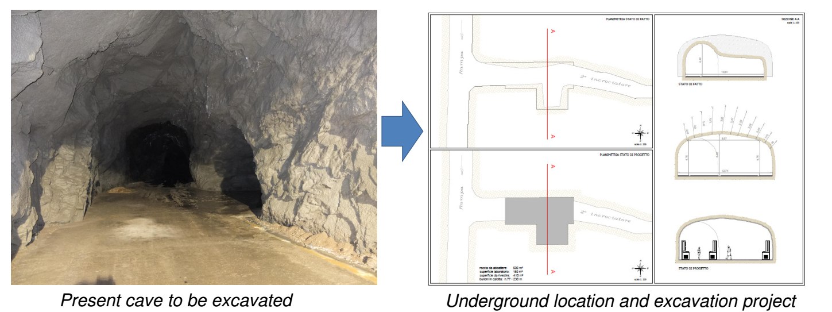
The SAR-GRAV pilot laboratory
The construction of an underground laboratory has been funded by Regione Sardegna
It is expected to be completed within this year
It is devoted to gravitational experiments that need a very quiet environment
It will host Archimedes as first experiment
It will be the base for a complete characyerization of the site

Slide 9
Characterization of the site Geological studies
Extremely big caverns
Are they really needed?
Is the rock sufficiently
resistent?
Can ET be optimally rotated?

Slide 10
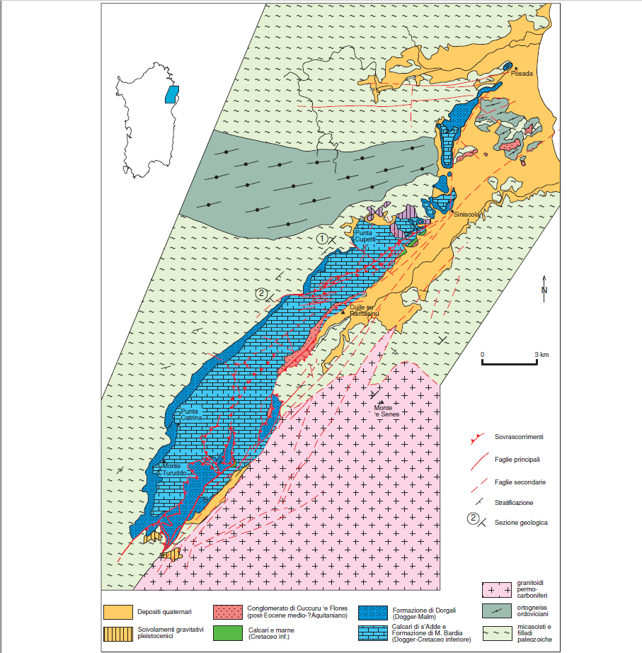
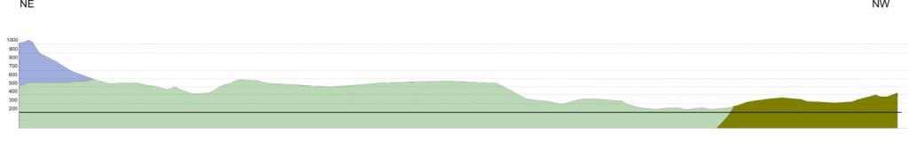
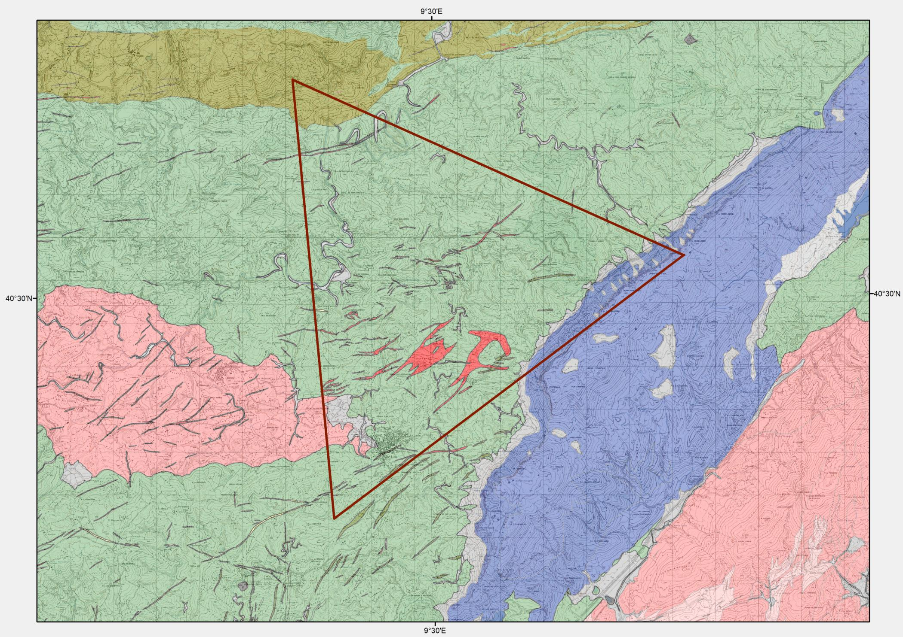
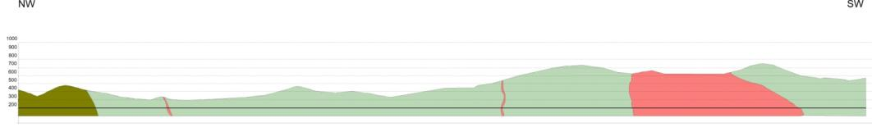
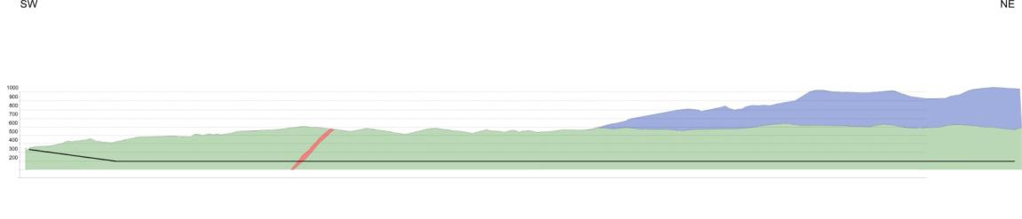
Very different rocks are present in the region
The region is ondulated
Possibile to individuate entrances at low depths

Slide 11
Seismic characterization and newtonian noise projection of SOS-Enattos site
Seimic accelerometers (trillium 240) array km size all over the region and at different depths
Measurement in the whole bandwidth
Tiltmeter in low frequency in SAR-GRAV lab
Environmental measurements

Slide 12
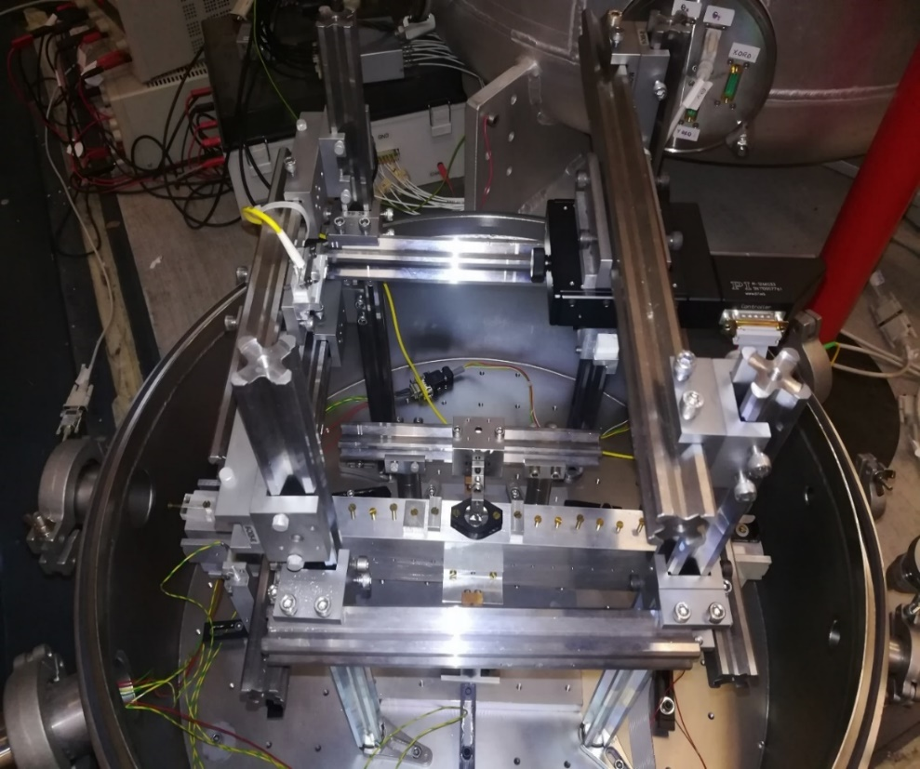
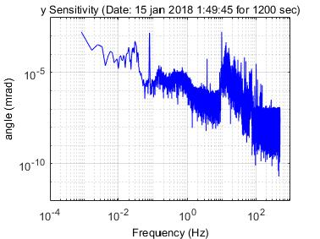
Tiltmeter
10⁻⁹ rad/sqrt(Hz)

Slide 13
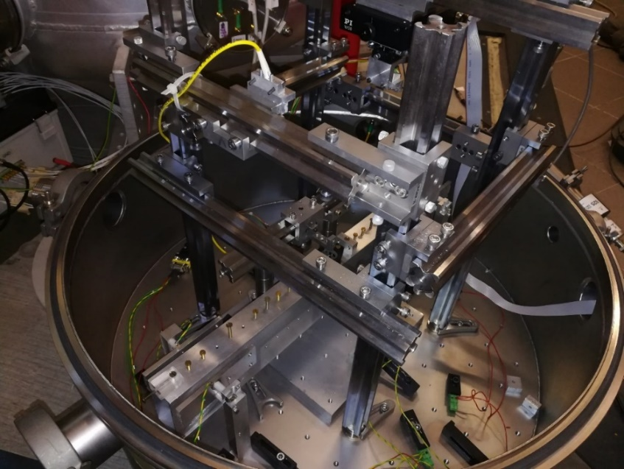
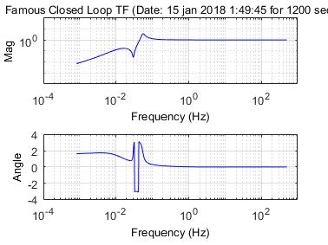
Characteristic of the present balance
Read-out: Optical lever and quadrant photodiode – 3 reflections
Balance works on closed loop
Elettrostatic Acutators
Photodiode follows the beam (repositioning every 1.5 hour)
Small force power/supply/Actuator to maintain low actuator noise
Balance lying on a Plinto of about 6 m³ of concrete.

Slide 14
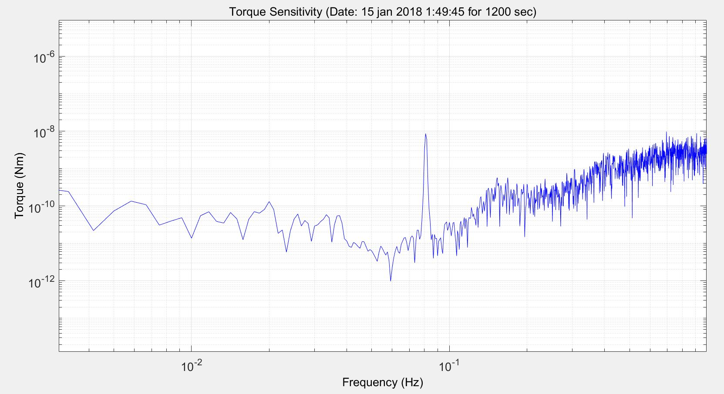
Present Torque Sensitivity
Calibration
peak
Lower than 10⁻¹¹ in the region of interest.
We are continuing in trying to improve → thermally threated joints, lower coupling with seism, suitable feed-back for lower resonance frequency

Slide 15
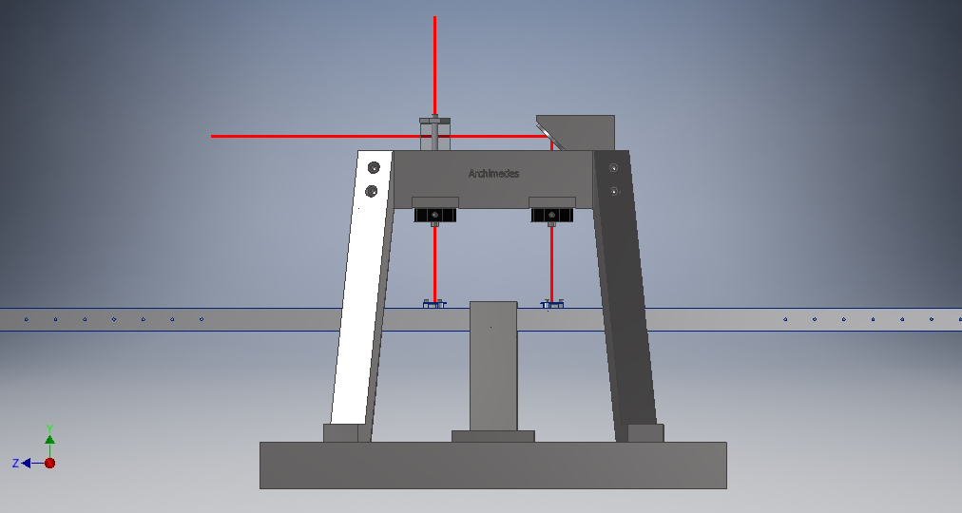
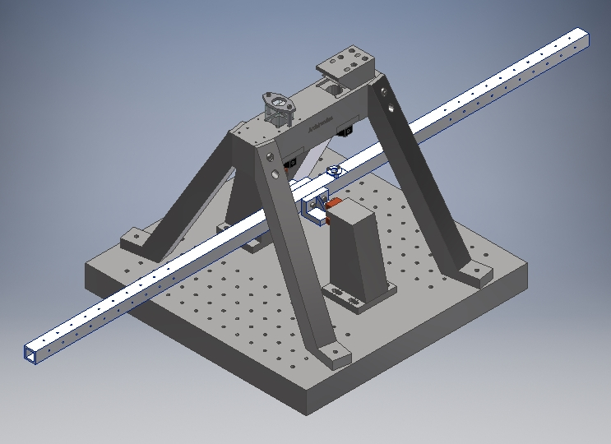
New Balance and Michelson mechanical design
The interferometer is embedded in a monolithic steel structure
Total arm length:
        1m
Base dimensions:
        40 cm x 40 cm
Total height :
        ~35 cm (~15 cm only the balance)

Slide 16
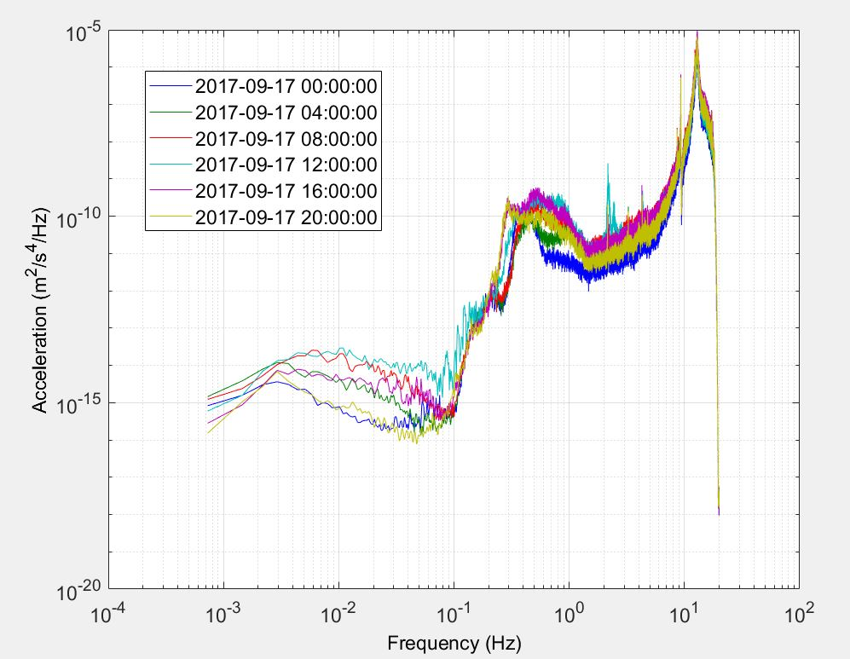
Km size km Array of accelerometers
Minimum of 8 Accelerometers placed also at different depth to recover 3D mass displacemente
Coherence study
Newtonian projection on the ET test masses and study for Newtonian noise reduction
Estimation of Newtonian Noise and projection on ET Sensitivity Curve
Trillium 240 measurement in an NOT quiet lab

Slide 17
CONCLUSION
New phase for ET
ET is now a prioritary project in the APPEC european consortium that will push ET in the ESFRI roadmap
SOS-Enattos will be one the most studied candidates, the decision is expected most probably in 2021

