Slide 1
The DataLake model for the scientific computing of the next decade
As discussed at the DOMA kickoff meeting at CERN with the XDC perspective
Daniele Cesini – INFN-CNAF
Patrick Fuhrmann - DESY

Slide 2
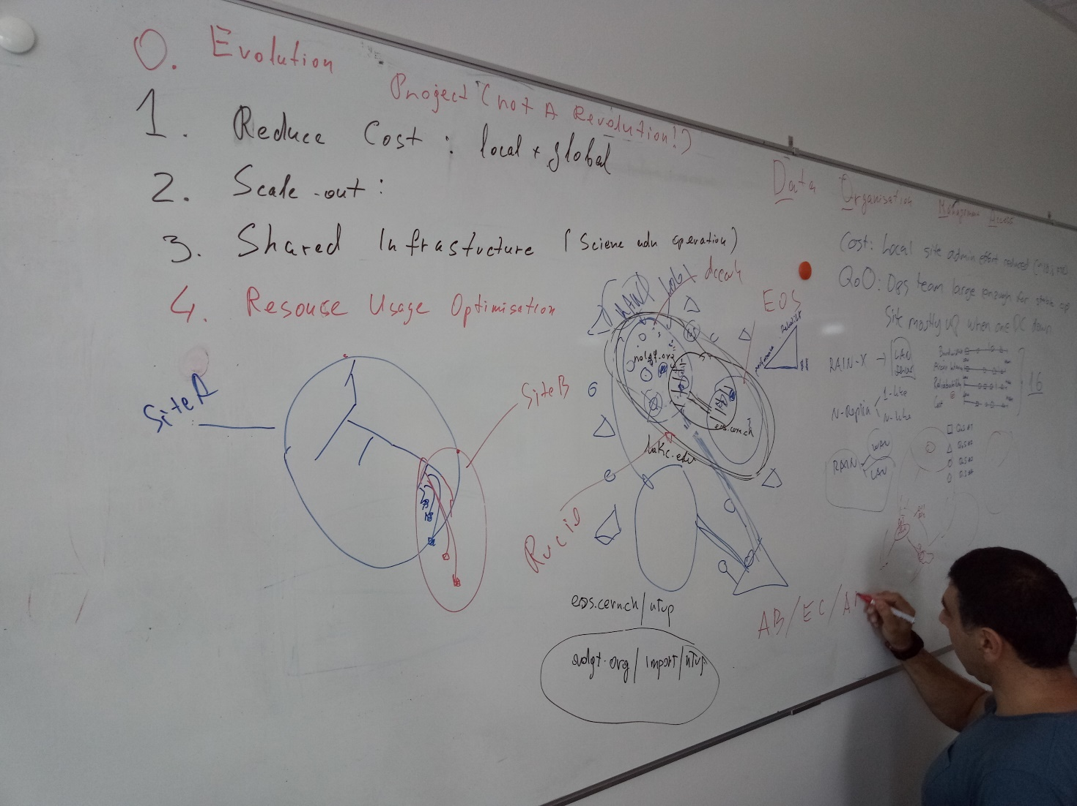
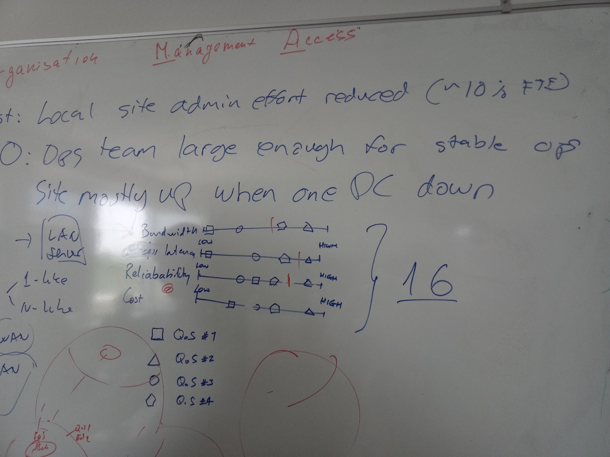
Mainly a report form the Data Organization Management Access KickOff
WLCG DOMA kick-off: https://indico.cern.ch/event/729930/

Slide 3
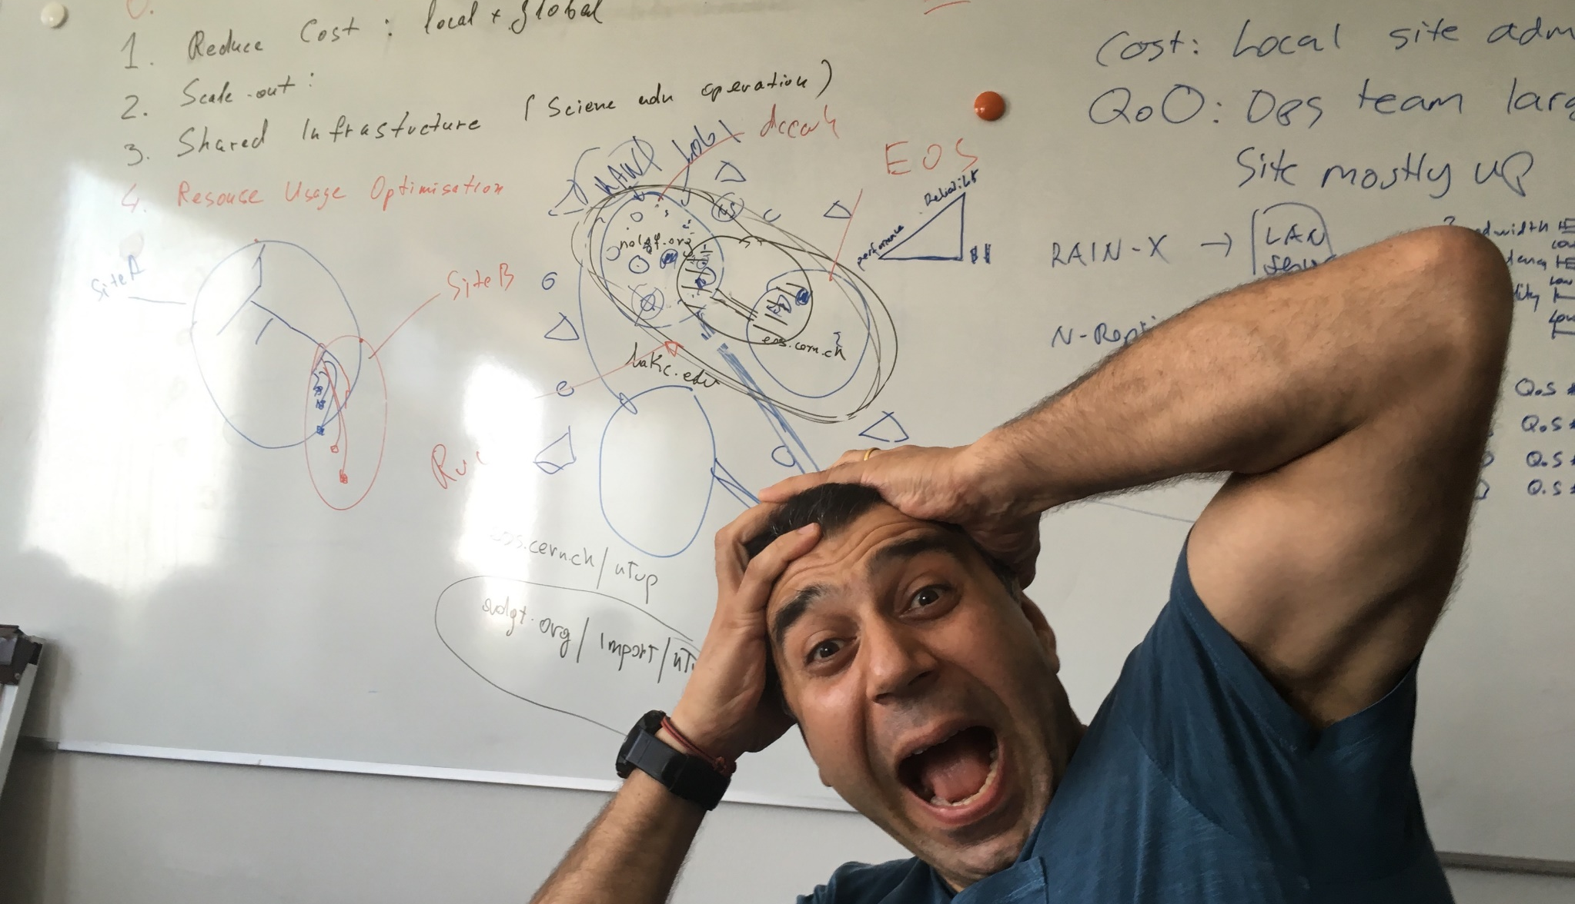
DOMA
WLCG DOMA kick-off
Photo: Courtesy Xavier

Slide 4
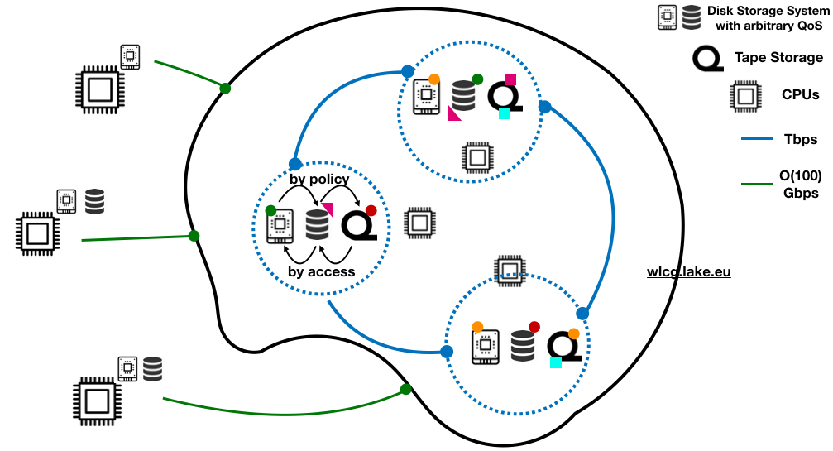
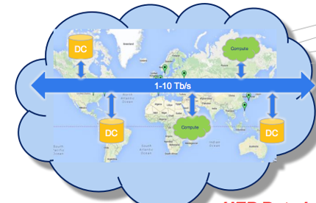
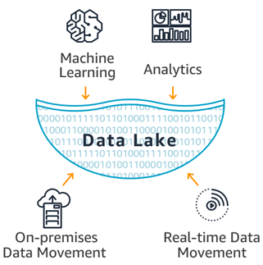
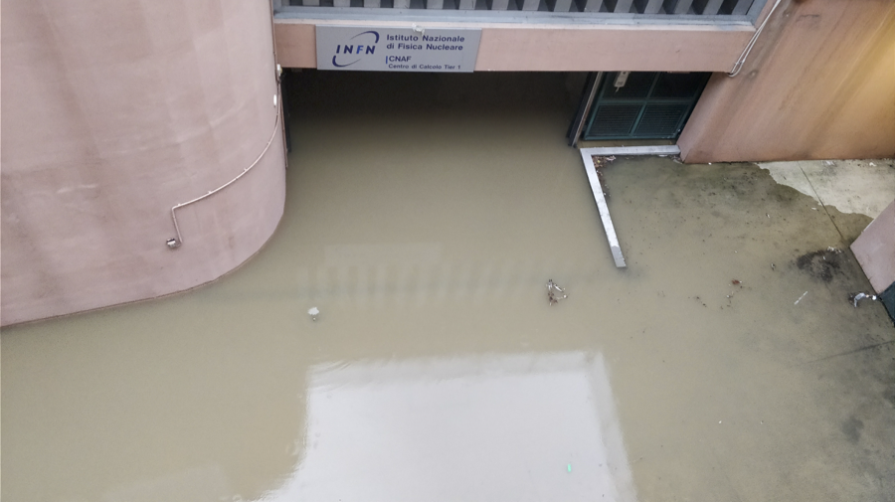
The DataLake

Slide 5
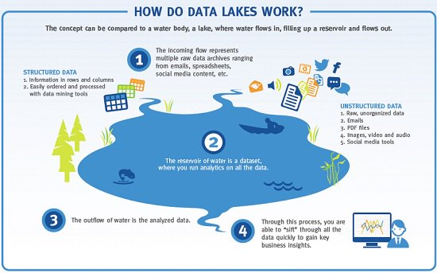
Data Lakes in Wikipedia
A data lake is a method of storing data within a system or repository
in its natural format
facilitates the collocation of data in various structural forms
usually object blobs or files.
The idea of data lake is to have a single store of all data
raw data
transformed data for Reporting, Visualization, Analytics and machine learning
The data lake includes
structured data, i.e DB
semi-structured data, i.e. CSV, logs, XML, JSON)
unstructured data, i.e. emails, documents, PDFs
binary data, i.e. images, audio, video

Slide 6
Data Lakes in Wikipedia
A data lake is a method of storing data within a system or repository
in its natural format
facilitates the collocation of data in various structural forms
usually object blobs or files.
The idea of data lake is to have a single store of all data
raw data
transformed data for Reporting, Visualization, Analytics and machine learning
The data lake includes
structured data, i.e DB
semi-structured data, i.e. CSV, logs, XML, JSON)
unstructured data, i.e. emails, documents, PDFs
binary data, i.e. images, audio, video

Slide 7
Data Lakes in WLCG
Storage Consolidation
Storage services are the most complicated to operate in WLCG
Investigating the possibility to reducing the number of storage endpoints
Consolidate, especially at the national level, different endpoints into a single distributed instance
Data lakes are an extension of storage consolidation
Geographically distributed storage centers, potentially deploying different storage technologies, are operated and accessed as a single entity
Storage centers in a lake should be connected through high bandwidth links (> 10Gb/s in 2017) and relatively low latency (< 50 ms), consequently it is expected that a single data lake would not span more than one continent.

Slide 8
On the definition of the Data Lake
Very diverse understanding of the expression data lake.
Attempts to define it by ‘name space’ or ‘region’ or ’country’ all failed.
Good suggestion by Maria Girone: We should avoid using the expression
Looks like one thing, but is composed of many
Stolen from Vincent (NDGF)

Slide 9
Or…
Looks like one thing and is composed by one thing…
Caching
Network Performance

Slide 10
Data Lakes in WLCG
Experiments already handle very complex data distribution workflows and rely on a certain level of non co-location between data and processing units
They all implemented techniques and workflows for remote reading of data
The point here is to move this “intelligence” and “orchestration” of geographically distributed data at the infrastructure level

Slide 11
QoS: What is that ?
Ongoing work started with INDIGO. Great progress based on work from KIT and CNAF.
Instead of caring about disk and tape on the experiment framework level, it would be less complex and more future proof define the quality of local storage, concerning persistency, access latency and price
These ‘storage classes’ need to be well and commonly defined
Example:
Storage centers define two (or more) classes with names and properties:
‘archive’: Probability of data loss < ( 1 in 1.000.000) and max access latency 2 hours
‘archive-online’ same data loss probability but max access latency 1 ms.
QoS classes need to be discoverable

Slide 12
QoS Advantages
We don’t care how storage provides fulfill their QoS SLA: e.g. Tape, CEPH with 20 copies or engraved in stone.
We are prepared for storage technology changes, w/o changing our data persistency model.
Eg. Tape could be replaced by disk arrays or cloud storage
HPC might need new storage qualities, like super low latency (BeeGFS)
We could directly map to cloud providers
Amazon: Glacier (cheap, safe, high latency), S3 (low latency, expensive)
QoS will become discoverable and orchestration middleware (Rucio) can use matching or AI algorithms to select the right combinations of ‘classes’ at the storage provider endpoints.
This kind of model is attractive to new (younger) communities. They essentially don’t know anyway what a tape is.

Slide 13
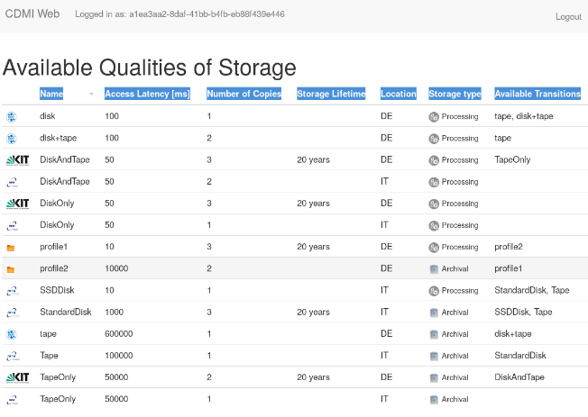
INDIGO-DataCloud/XDC CDMI QoS
Quality of Service in storage – broker page
DESY
KIT
PSNC
INFN
Access Latency [ms]
Number of Copies
Storage Lifetime
Location
Available Transitions

Slide 14
QoS in the Lake
We are looking for a solution in which the lake behaves as hierarchical system and optimizes the data organization based on policy (first) and usage (after) exploiting different QoS
Moreover, the solution should foresee the possibility to attach a volatile storage to the lake
It should be used as tactical storage, hosting a redundant set of data, to optimize data access and the system should auto-recover in case the volatile storage disappears

Slide 15
A QoS–based workflow in the Lake
One can imagine a data workflow where files that need several levels of processing start with a fast disk (hot) requirements and eventually transition to a nearline disk (warm) to finally end up archived on tape (cold) with a low likelihood they get recalled shortly after.
The three tiers mentioned before strongly relates to performance, reliability and resiliency which are metrics dominated by cost.
The transition between the storage tiers (or hierarchy change) can be either:
passive (ie. estimations on processing/access/replication time for a particular data/set)
active by implementing triggers at metadata level once the needs for the data/set change.
This approach opens the possibility to steer data workflows in real-time through extended attributes “flags” on the namespace.

Slide 16
The Data Lake

Slide 17
What are we told would justify changes ?
Reduce cost for storage
Global (WLCG level) and local (Site level)
Hardware
Operations
Number of replicas is already below 2 on avg (Atlas reported 1.3)
Scale out
Does the current model really have a scale-out problem ?
Which architecture would solve that ?
Or simply : Evolution forced by ’external’ technologies or methodologies. (Best example is the ‘cloud’)

Slide 18
On Cost
Saving costs by reducing operational complexity. Or better: getting more storage for the same money
Focus on larger sites, assuming small sites are ineffective
There are no numbers available, how much that would save us
There are ideas to run smaller sites ‘operator-less’ regarding storage
Probably it’s better to avoid drying-out universities
Operational cost savings are not automatically transferred to more storage space. That funding could simply disappear
Saving cost by providing fewer copies or smarter caching of data
Improved high level orchestration. (data placement)
Well defined storage retention (QoS, see later)
Balancing network against storage (depends on network costs)
With or w/o smarter caching.

Slide 19
Some scenarios (Taken from XDC)

Slide 20
Data Lake, simple cache site
In production for years e.g. NDGF, Michigan
Center
Data Management Controller
Data Pool
Satellite Site
Remote Data Pool

Slide 21
Complex multi provider scenario 1
KIT
Advantages
DESY
no additional software stack needed at sites.
Still disadvantage
Local data not accessible in case data link is down or central service not available

Slide 22
Complex multi provider scenario 2(a)
Sync Namespace
Request
CERN
DESY
Advantages
Same software stack as we currently have at the sites.
After the data has been transferred to the local storage system, a name space entry has been created locally and the data is available at the local site independently of the remote network link and the availability of the central service.

Slide 23
Requirement for the complex cases
We would need to see a benefit
We would need to agree on
A namespace synchronization protocol
On client request
On client request plus subsequent lazy background fill (like Dynafed)
Message queues for selected namespace events (producer – consumer)
ACL synchronization
Identity Mapping
XDC minimum viable product”:
- read-only operation
- fetch data on miss with service credentials
-- data can be chunked or full-file
- manage cache residency, evicting data when necessary
- HTTP frontend with group-level authorization

Slide 24
XDC “Data Lake” concepts
lake.infn.it
cache.desy.de
dCache
Data Centre 4
lake.cern.ch
Federated access
Cached access
Custodial
cloud.tsys.de
EOS
Data centre 1
EOS
Data Centre 2
dCache
Data Centre 3
Standalone xrootd/pure-HTTP/WebDAV cache
Cloud Centre 5
Cached access
Managed Buffer
s3.amazon.com

Slide 25
Caching infrastructure with XROOTD
https://indico.cern.ch/event/729930/contributions/3021531/attachments/1661988/2663057/WLCG_DOMA.pdf

Slide 26
Caching infrastructure with XROOTD

Slide 27
Discussion on caching @DOMA
Caching will cost hardware
caching will have to be used wisely
making sure that one caches most of the reuse data.
We do not have today clear numbers that caching is really effective
facilities w/o storage (HPCs, CPU only sites)
facilities with storage, but dealing with non local data
We even do not have a forum to discuss this
Caches need to offer the capability to be pre-filled (pre-placement) or be passive caches (cache based on access)

Slide 28
Where is the data lake in those scenarios ?
The complex scenarios above could either
be inside a data lake
connecting data lakes.
Optionally data lakes are connected by DM solutions (Rucio). See Vincent’s presentations for the NorduGrid Meeting.
Stolen from Vincent (NDGF)
Two “RUCIOs”
Internal to the DataLake
Externel, orchestrating among DataLakes

Slide 29
Summary
Data Lake
Expose unique storage entry point – looks like one but it’s (or can be) made of many
Support different QoS for the internal components
Hierarchical storage
Caching at (every?) storage and CPU location
Pre-placement vs access-based
Intelligent management of data movement
RUCIO?
Unique namespace? (maybe)
To be deployed in parallel to the current infrastructure
Cost improvement to be understood

