Slide 1

LABORATOTY TOPIC:
THGEMs
Silvia DALLA TORRE
Stefano LEVORATO
Giorgio MENON
Fulvio TESSAROTTO
INFN - Trieste

Slide 2
PLEASE, RECALL THAT …
THGEM R&D is work in progress
in particular, our goal, namely
THGEM-based photon detectors
are not yet there

Slide 3
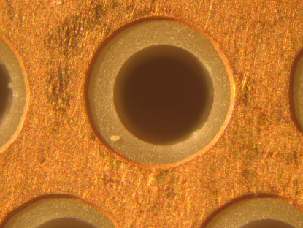
ABOUT THGEMs
THGEMs (Thick GEM)
are elctron multipliers derived
from GEM concept changing the
production technology
GEM
THGEM
Max 10³ gain in
single GEM
Max 10⁵ gain in
single-THGEM
1mm
1mm
manufactured through standard PCB techniques
drilling holes in G-10 and applying Cu etching
Cu
rim
FROM LITERATURE:
Gain 10⁴-10⁵ (single electrons)
Rise time < 10ns
Rate capability: 10MHz/mm²
Insensitive to magnetic fields
Invented by:
Weizmann group
(A. Breskin et al.)
V. Peskov
I Seminario Nazionale Rivelatori Innovativi, LNF 30/11-4/12/2009 THGEMs

Slide 4
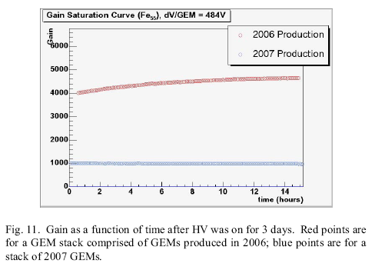
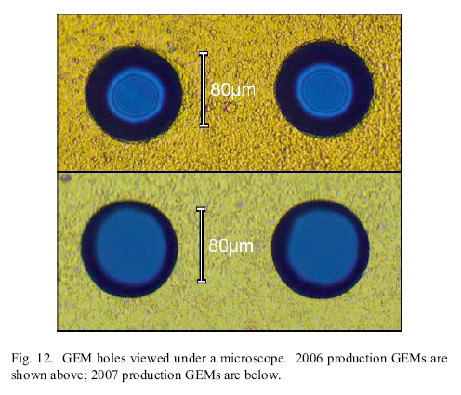
… there is a “rim” also in GEM’s …

Slide 5
THGEM, APPLICATION FIELDS
Some features
  Space resolution ~ 1mm
  Time resolution ~ 10 ns
  Non negligible material budget (a THGEM is a PCB, thickness 0.4-0.6 mm)
What is appealing
  Industrial production
  Moderate cost
  large size
  Insensitivity to magnetic field
Applications:
  Sampling calorimetry
  Muon tracking
  Photon detection (in Cherenkov imaging counters)

Slide 6
Our path towards THGEM-based PDs
Characterization
  Gain stability completed, OK
  THGEM production techniques completed, OK
  Effective QE in THGEM-based PDs in progress, ~OK
  Photon detection and gain request in progress, promising
  Time properties started, promissing
  Ion feed-back started
Engineering
  THGEM capacitance and discharges started
  High voltage operation ≥ 8 kV in progress
  Large surface THGEM boards in progress
  Large surface THGEM-based detectors in progress

Slide 7
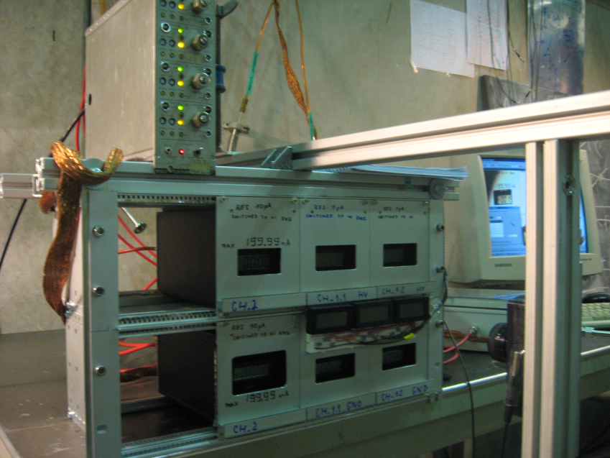
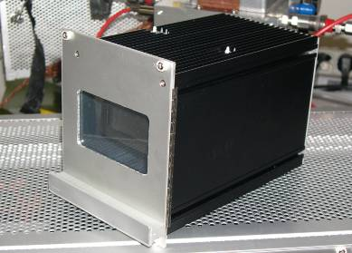
About lab equipment
Picoamperometri floating (battery powered)
resolution 1 pA
optical read-out via webcam
~100 € /ch
Our design and constuction
PLS 265-10 (pulsed LED)
and controller
by PicoQuant GmbH, Berlin, Germany
600 ps long pulses
up to 40 MHz
spectrophotometer measurement
UV LED-255
peak @ 258
PLS 265-10
peak @ 269
220 240 260 280 300 nm

Slide 8
CHARACTERIZATION

Slide 9
GAIN STABIOLITY 1/3
Different ΔV applied to the THGEMs, maximizing the gain for stable working conditions
•A factor >>2 in gain variation between the initial drop and the stabilization;
•Different behaviour for THGEMs with and without (or small) rim.
Continuously irradiated with collimated X-Ray source
zooming
Name | Diam (mm) | Pitch (mm) | Rim (μm) | Thick (mm)
Std_no_rim | 0.3 | 0.7 | 0 | 0.4
Std_10_μm | 0.3 | 0.7 | 10 | 0.4
Std_100_μm | 0.3 | 0.7 | 100 | 0.4
Small rim

Slide 10
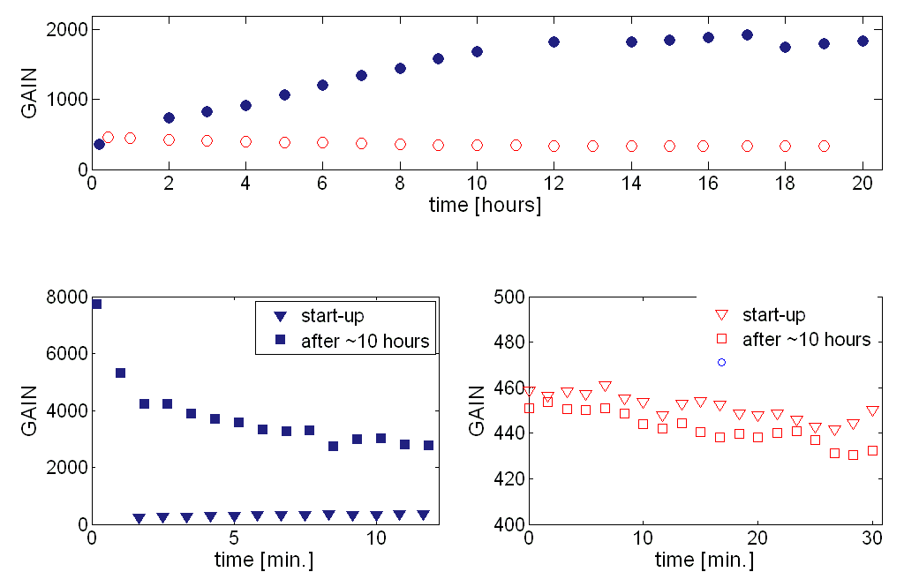
GAIN STABIOLITY 2/3
Name | Diam (mm) | Pitch (mm) | Rim (μm) | Thick (mm)
M1 | 0.4 | 0.8 | 0 | 0.4
C4 | 0.4 | 0.8 | 100 | 0.4
⁵⁵Fe source; uniform irradiation
Long time gain variation
100 μm rim
no rim
START IRRADIATING after ~10 hours at nominal voltage
Irradiation at HV switch on, after ~1 day with no voltage
Short time gain variation
100 μm rim
no rim

Slide 11
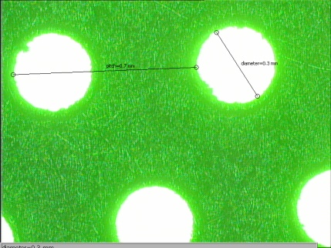
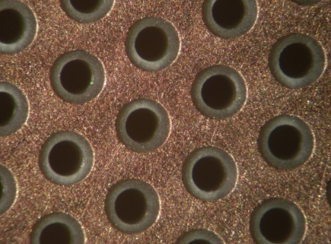
GAIN STABIOLITY 3/3
PARAMETERS:
Diameter = 0.3 mm
Pitch= 0.7 mm
Thickness = 0.4 mm
Rim = 0 mm
Gas: Ar/CO₂ – 70/30
RATE CAPABILY
PARAMETERS:
Diameter = 0.3 mm
Pitch= 0.7 mm
Thickness = 0.4 mm
Rim = 0.1 mm
Gas: Ar/CO₂ – 70/30
20%
120 kHz / mm²
120 kHz / mm²
RECALL:
120 kHz/ mm², 300 e- → single photoelectron rates of ~35 MHz/ mm²

Slide 12
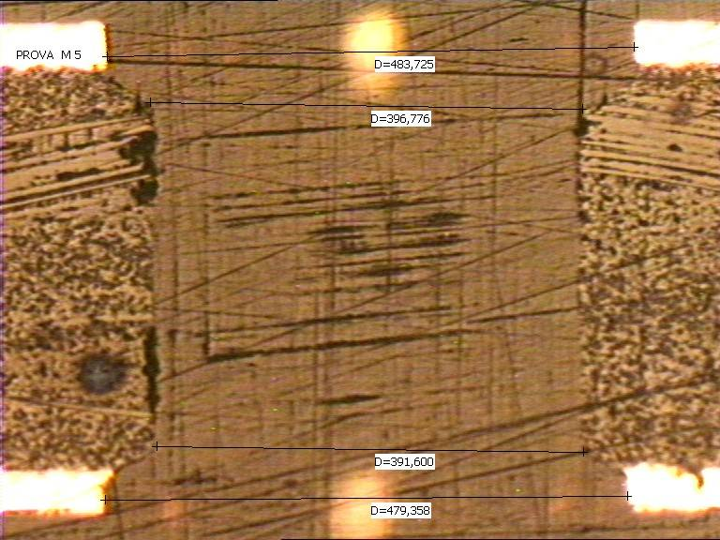
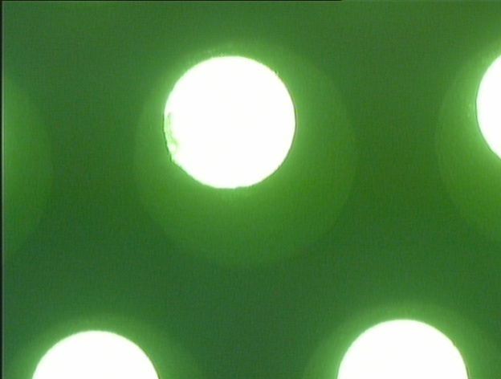
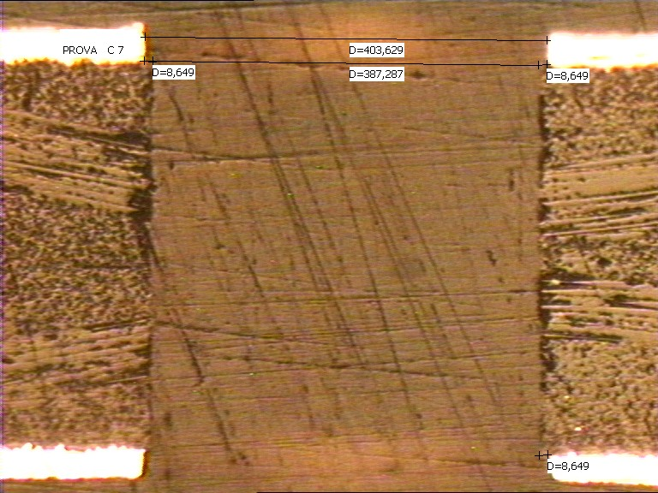
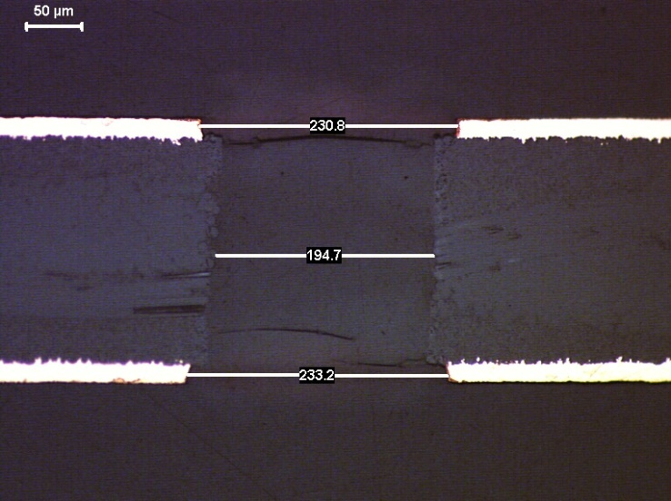
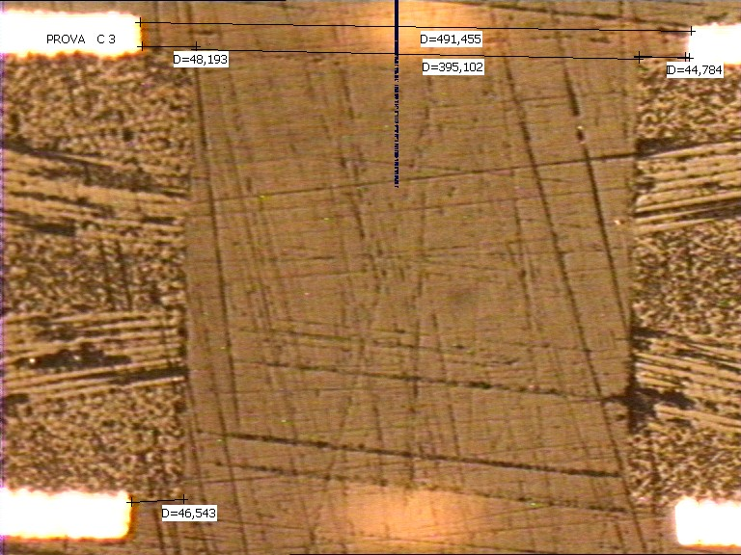
PRODUCTION STUDIES 1/2
RIM production techniques – 5 approaches tested
Double
drilling
Weizmann technique
Global etching:
No photoresistive
layer
(proposed by ELTOS)
etching from
hole edges w
image transfer
CERN : etching from hole edges w/o image transfer

Slide 13
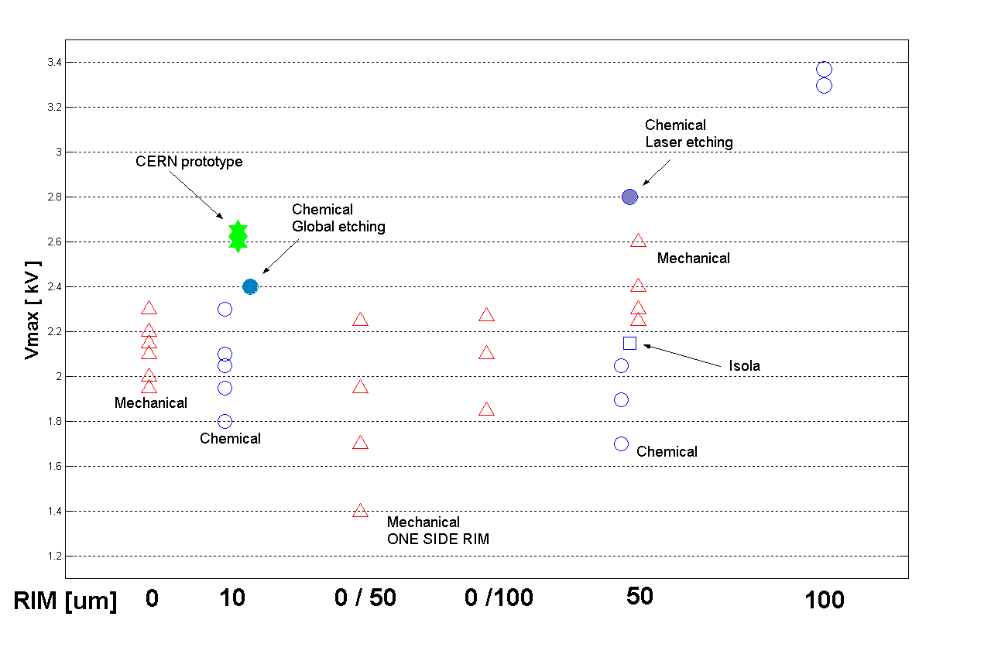
PRODUCTION STUDIES 2/2
Vmax = discharge limit in pure N₂
different production techniques ➔ different behaviors

Slide 14
PHOTOELECTRON EXTRACTION 1/6
Photocurrent measurements in various gas atmospheres
2009
UV
light
source
fused silica window
-
─ CH₄
─ Ar/CH₄, 66/34
─ Ne/CH₄, 62/38
─ Ar/CO₂, 70/30
pA
CsI
photocurrent (pA)
e⁻
atmospheric pressure,
reproducibility @ 1% level
10 mm
Keithley
picoAmp
E(V / cm)

Slide 15
PHOTOELECTRON EXTRACTION 2/6
Photoelectron extraction
vs ΔV and E,
simulations and measurements
UV
light
source
2009
E_field,
sign convention
<0 >0
fused silica window
WIRES (V1)
d
E
THGEM 1 ( top: V2, bottom: V3)
CsI
anode (with pads)
E = (V2-V1) / d
ΔV = V3 – V2

Slide 16
PHOTOELECTRON EXTRACTION 3/6
y
photoelectron trajectories from
a THGEM photocathode, simulation,
multiplication switched off
thickness 0.6 mm, diam. 0.4 mm, pitch: 0.8 mm, ΔV = 1500 V
x
external field above the THGEM : 0
x cross-section
y cross-section
2009

Slide 17
PHOTOELECTRON EXTRACTION 4/6
y
y
photoelectron trajectories from
a THGEM photocathode, simulation ,
multiplication switched off
thickness 0.6 mm, diam. 0.4 mm, pitch: 0.8 mm, ΔV = 1500 V
x
x
external field above the THGEM : - 500 V /cm:
photoelectron lost (not entering the holes)
E
x cross-section
y cross-section
2009

Slide 18
PHOTOELECTRON EXTRACTION 5/6
y
y
photoelectron trajectories from
a THGEM photocathode, simulation ,
multiplication switched off
thickness 0.6 mm, diam. 0.4 mm, pitch: 0.8 mm, ΔV = 1500 V
x
x
external field above the THGEM : + 500 V /cm:
photoelectron lost (too low field to extract them)
E
x cross-section
y cross-section
2009

Slide 19
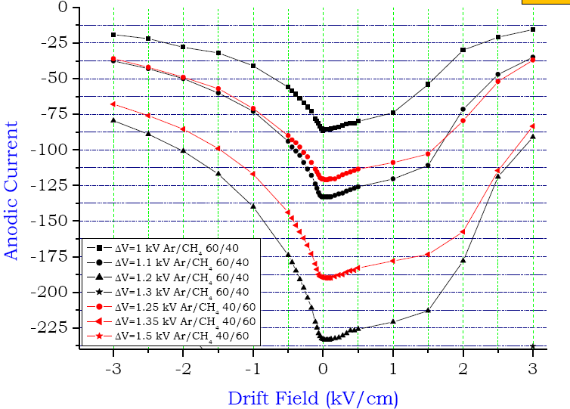
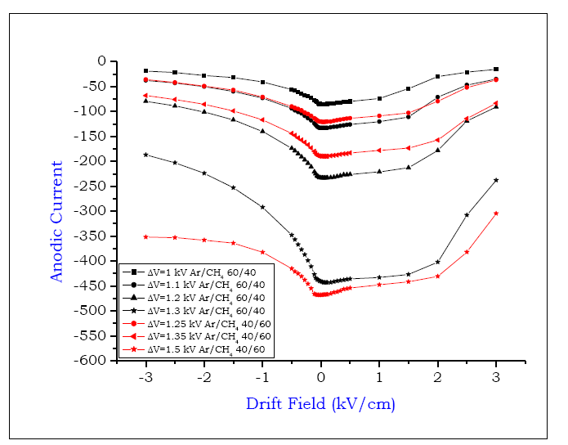
PHOTOELECTRON EXTRACTION 6/6
Anodic current in a THGEM detector versus
the external electric field applied ,
a measurement
2009
ZOOM
Ar/CH₄: 40/60; 60/40
ΔV =
1kV
1.1, 1.2
1.25, 1.3
1.35
1.5
The behaviour predicted by the
simulation is confirmed!
A clear suggestion to optimise
the detector design
PROSSIMO PASSO:
VERIFICA DI QUESTA INDICAZIONE CON IL PHOTON COUNTING

Slide 20
OPTIMISATION RECIPES
Values of E_{z} on the CsI surface for various pitches and diameters for ΔV = 1000 V (no rim)
active area
E_{z} ~ 1/ (pitch)⁴
E_{z} ~ exp(diam.)
(V/cm)
(V/cm)

Slide 21
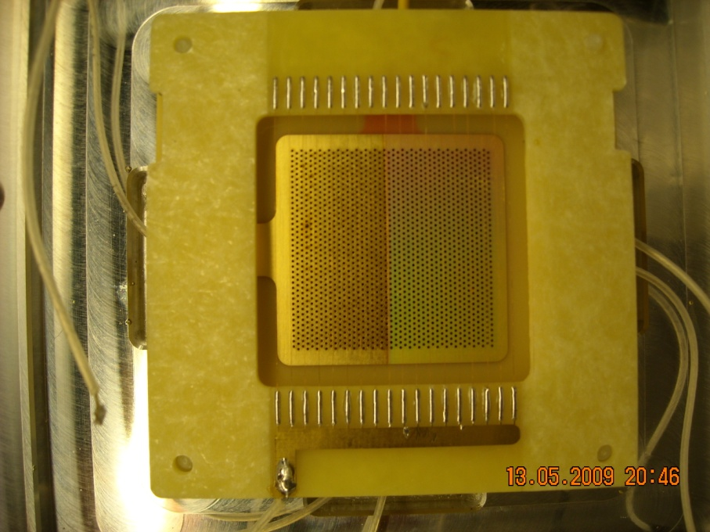
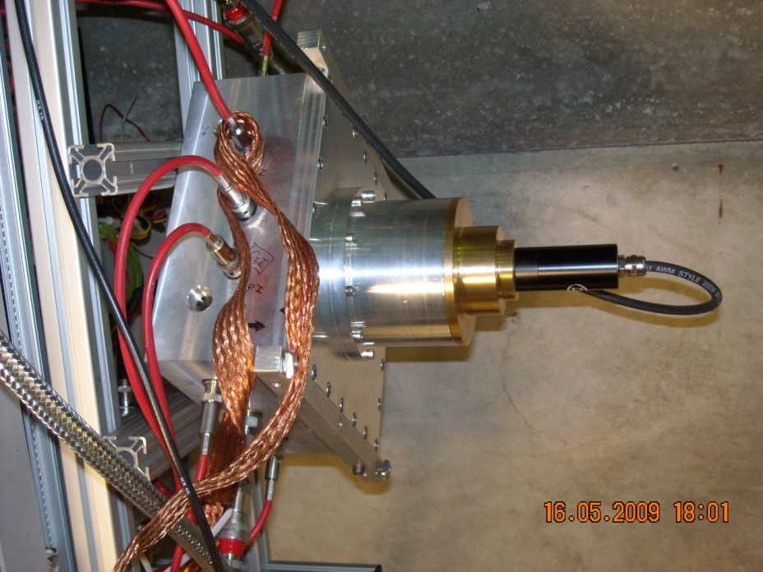
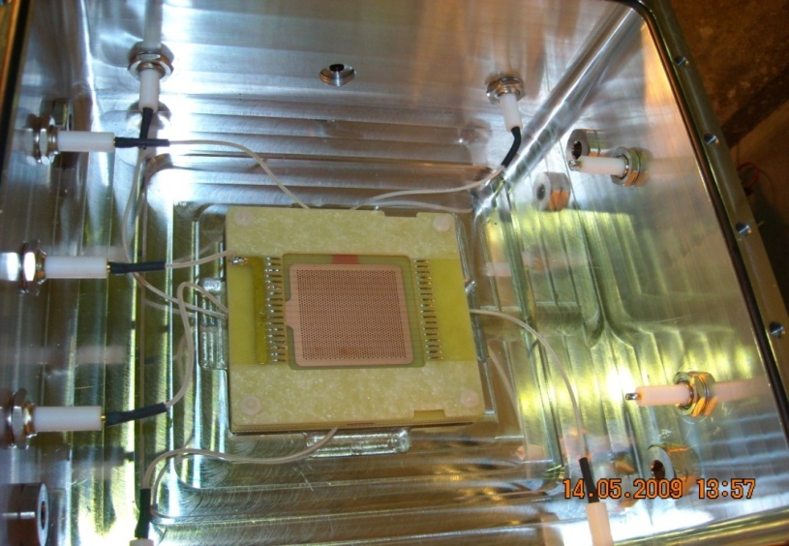
OUR FIRST THGEM-BASED PDs
Pulsed Diode Laser
Triple THGEM (CsI) Ar/CH₄
CsI coating
Diam=0.4 mm, pitch =0.8,
Thick=0.4, rim ≤10 μm
21
Incontro coi referees COMPASS in CSN1, Roma, 31/08/2008
Fulvio TESSAROTTO

Slide 22
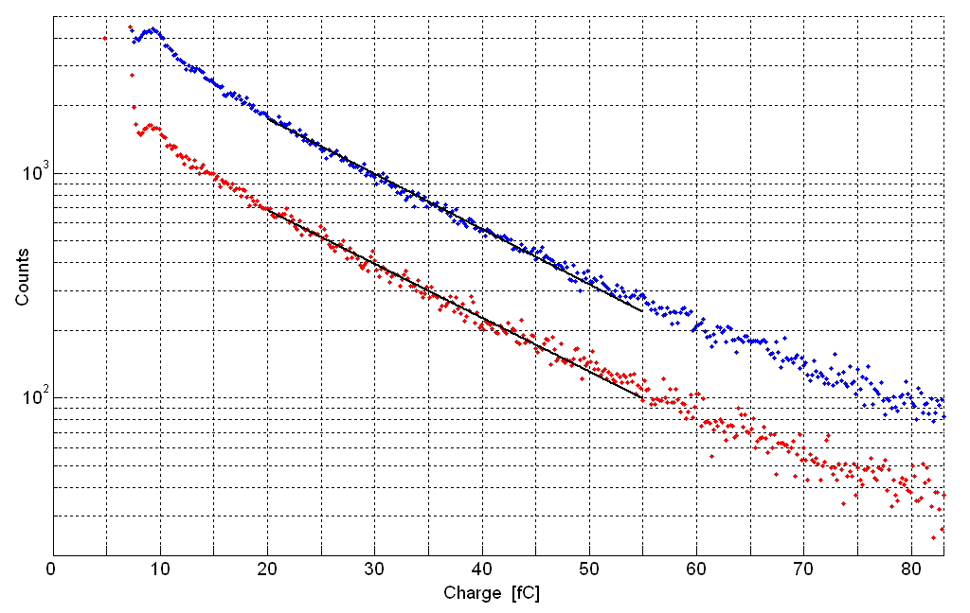
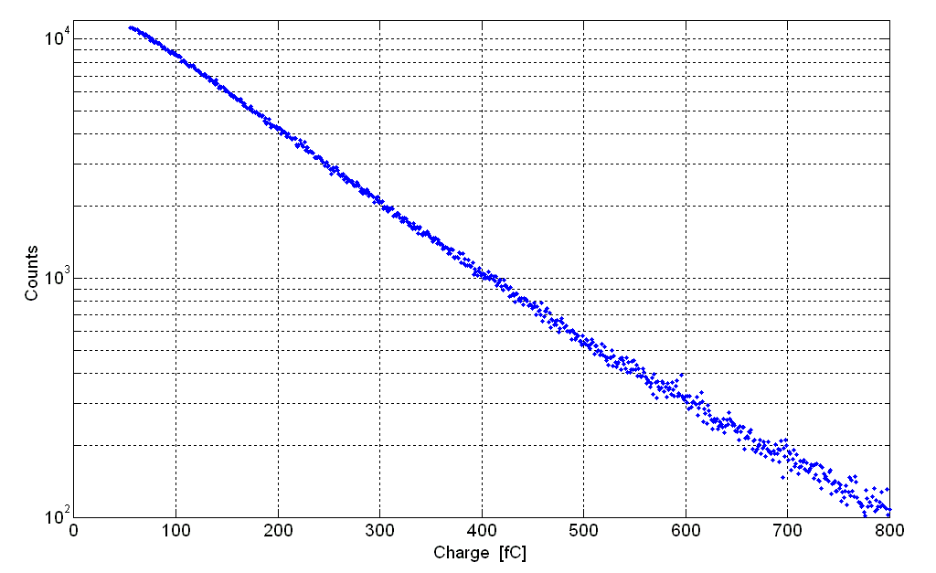
SINGLE PHOTON DETECTION AND LARGE GAIN
2009
MARCH 2009 JUNE 2009
-
Stable up to gain ~ 10⁶
PMT- like gains !
-
stable detector bevariour
at gains up to ~130 000
Ar/CH₄: 40/60
Effective gain:
0.91 · 10⁶
-
─ gain: 110 000
-
─ gain: 113 000
Ar/CH₄: 50/50

Slide 23
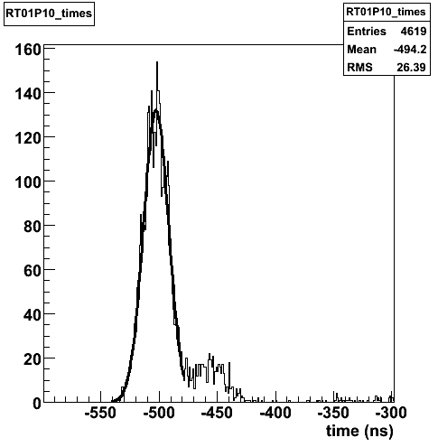
TIME RESOLUTION
σ = 10.8 ns
Recall:
TDC bin size: 108 ps
pulse width: 600 ps
No detector optimisation
for time response performed so far
Fulvio TESSAROTTO

Slide 24
ION FEED-BACK
presently typical charge sharing
drift
0%
Drift
26%
THGEM 1
1%
Gain ~ 10⁶ →
on photocathode
~500000 ions/detected photon :
It has to be decrease:
~ 5 – 10 less
5%
THGEM 2
4%
68%
THGEM 3
49%
Induction
47%
anode

Slide 25
ENGINEERING

Slide 26
CAPACITANCE AND DISCHARGES
Electrical permittivity of the fiberglass used: 5
  FE protection
  THGEM segmentation
  For 2. a systematic study is on-going
square | thickness | C (pF) | C (pF)
side |  | calul. | meas.
(mm) | (mm)
32 | 0.4 | 113 | 130
100 | 0.4 | 1106 | 1200
600 | 0.6 | 26550 | 22000

Slide 27
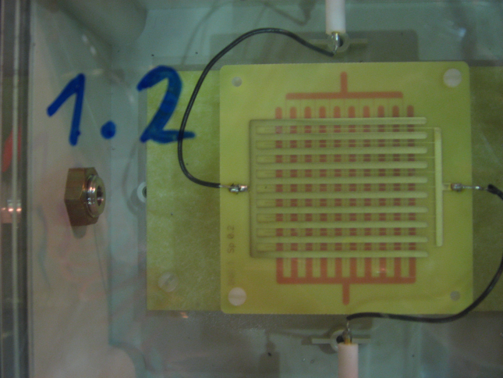
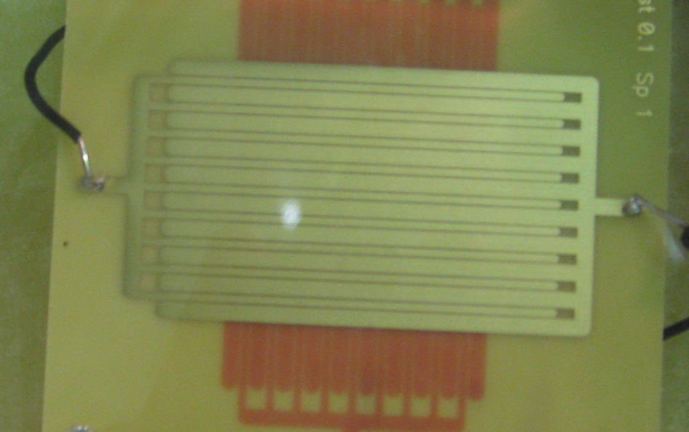
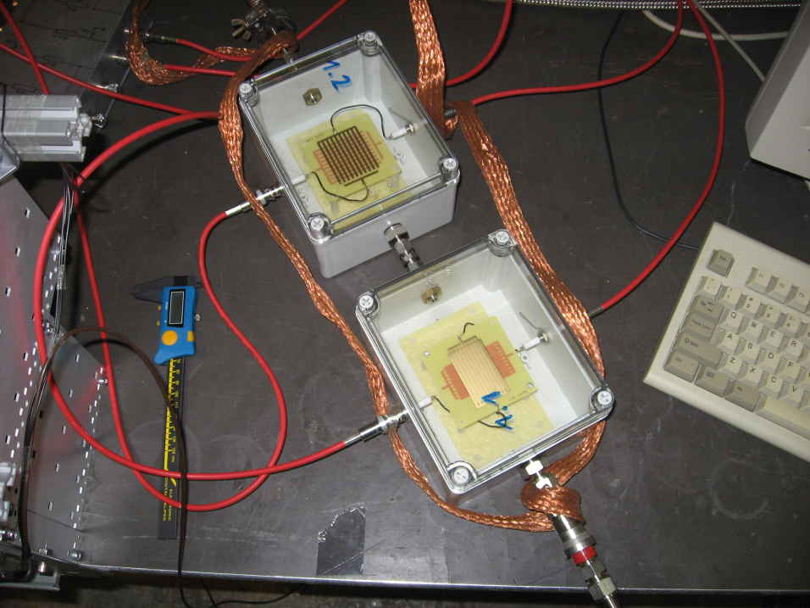
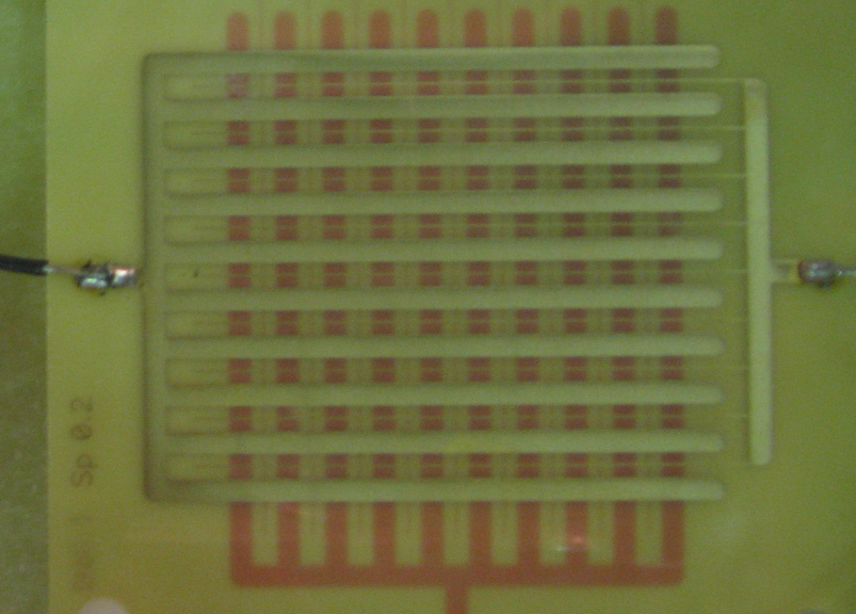
PIST DISTANCE AND DISCHARGES
Samples of 20 different types
Determine the breakdown voltage
Use this information to properly design the THGEM segmentation

Slide 28
HV OPERATION (V ≥ 8 Kv)
requirements:
Must stand HV up to 10 KV
Very low leakage current (<<1 pA)
negligible charging up effect (not detectable)
Must fit our space availability
Gas tightness
To be applied in 3 interconnected sectors
connectors
cables
powersupply
Electrical
requirements
Mechanical
requirements

Slide 29
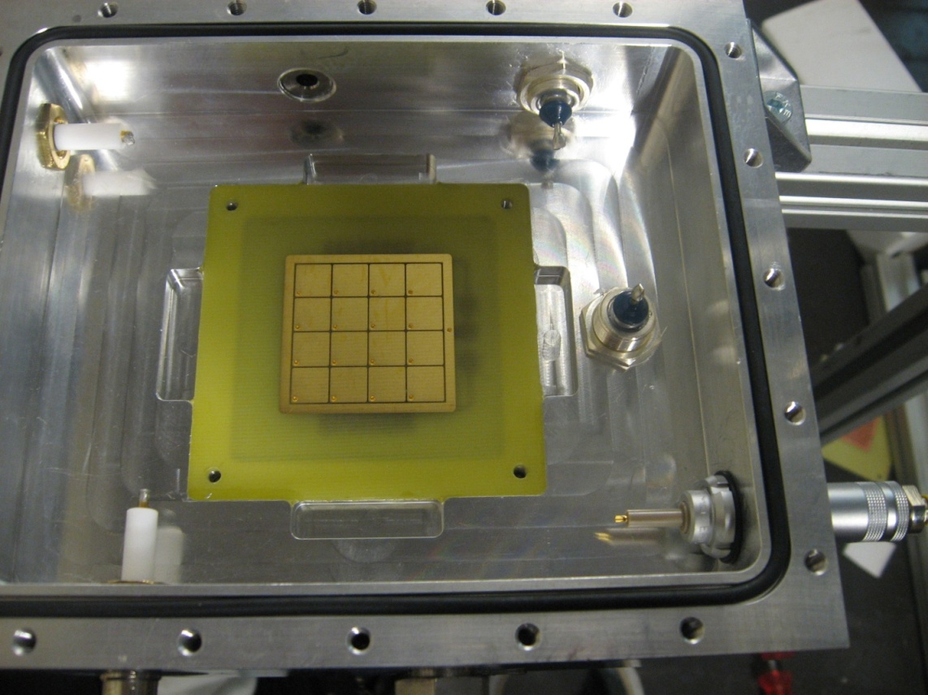
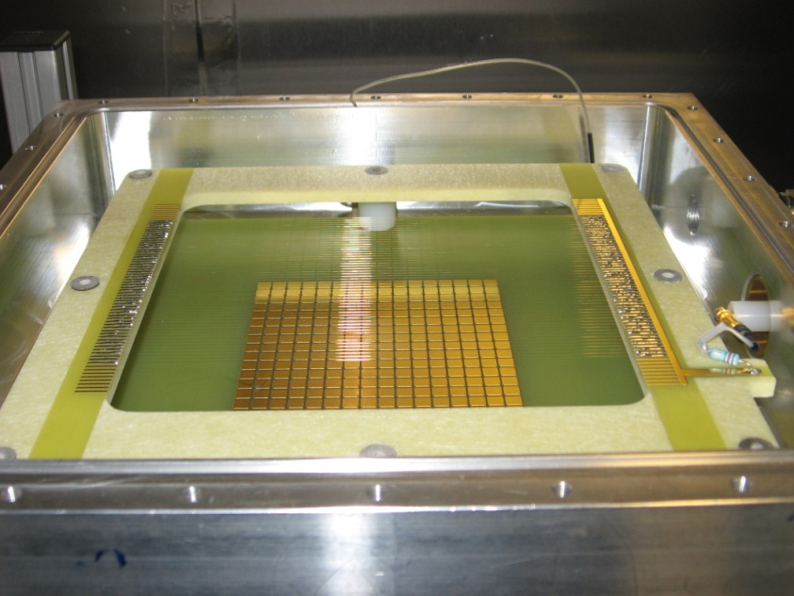
CONNETTORS
connectors in real conditions
Hubersuhner
SHV – Type / Pattern 22
Hermetic sealed connector
5 kV d.c. operating voltage
SHV connector type
LEMO ERA 3S type
Hermetic sealed connector
15 kV d.c. operating voltage
SHV connector
U rated max. : 10 kV d.c. 1 mn
U TEST : 12,0 kV d.c. 1 mn
INSULATING MATERIAL : POLIETYLENE
LEMO connector
U rated max. : 10 kV d.c. or peak a.c.
U TEST : 10,6 kV r.m.s - 50 Hz R
INSULATING MATERIAL : PEEK
SEALING : - Helium test: 10**-4 Torr l/s

Slide 30
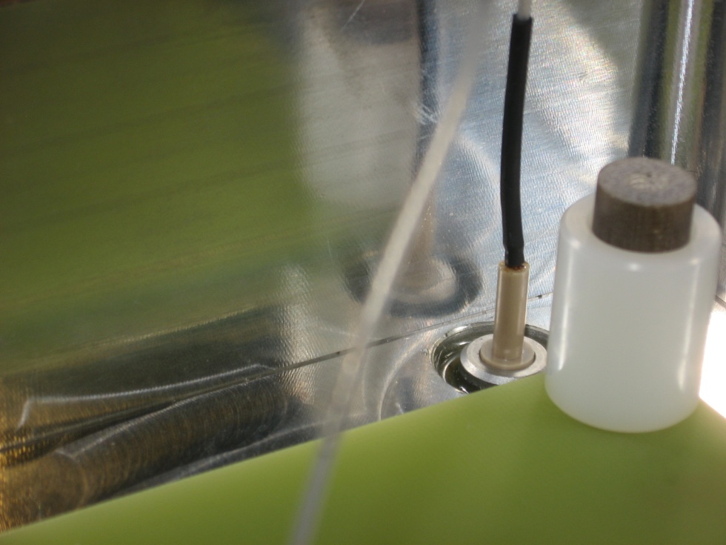
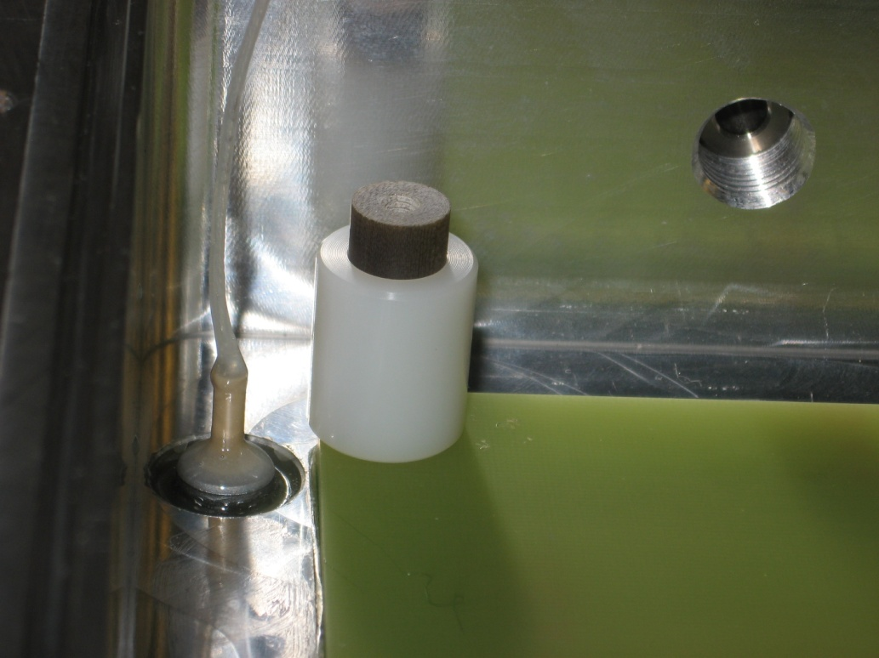
AND BEYOND CONNECTORS:
Extra insulator
(Heat Shrinkable polyolefine)
Extra insulator: araldite to
improve dielectric strenght

Slide 31
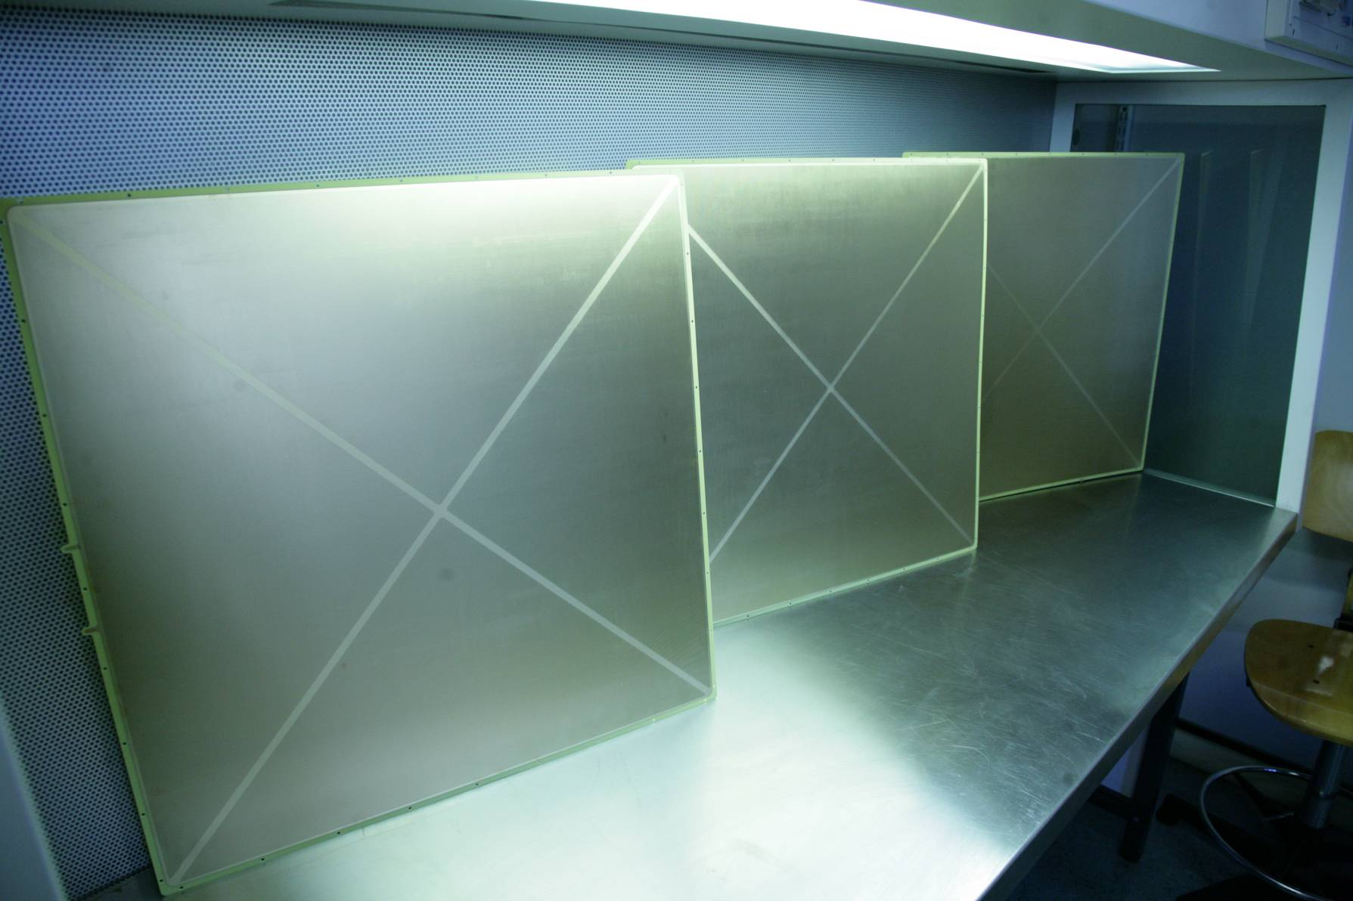
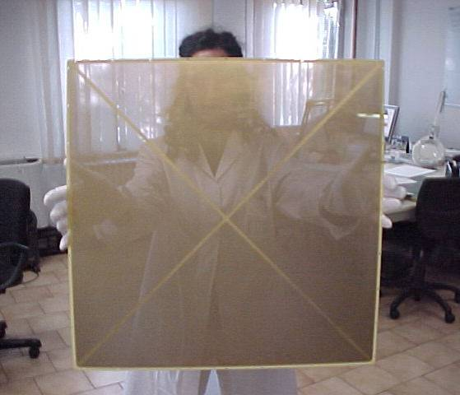

LARGE SIZE THGEMs
600 x 600 mm²
~600,000 holes/piece, 0.001 € / foro
Ø: 0.4, pitch: 0.8, thickness: 0.6 mm
rim: 5 μm (micro-etching)
Ni-Au coating

Slide 32
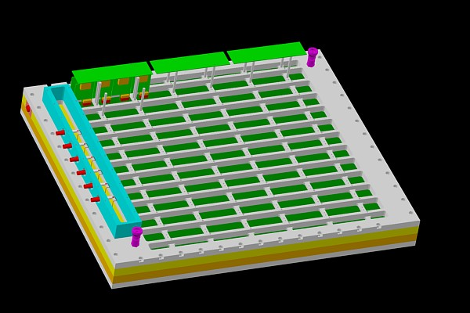
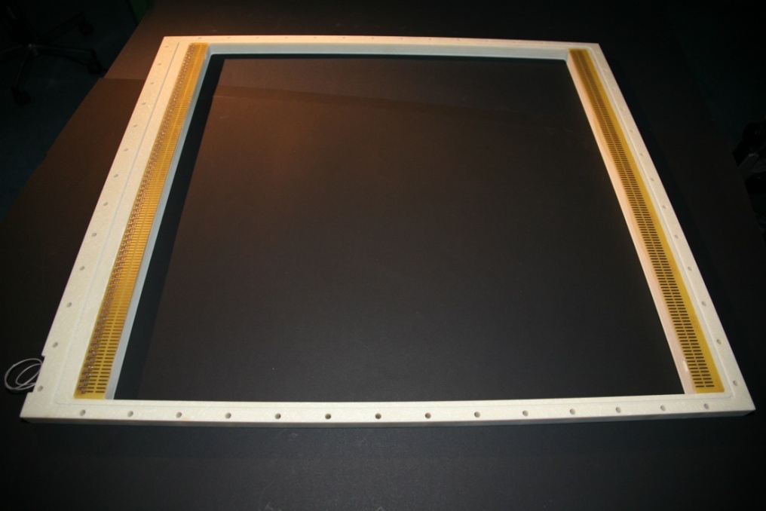
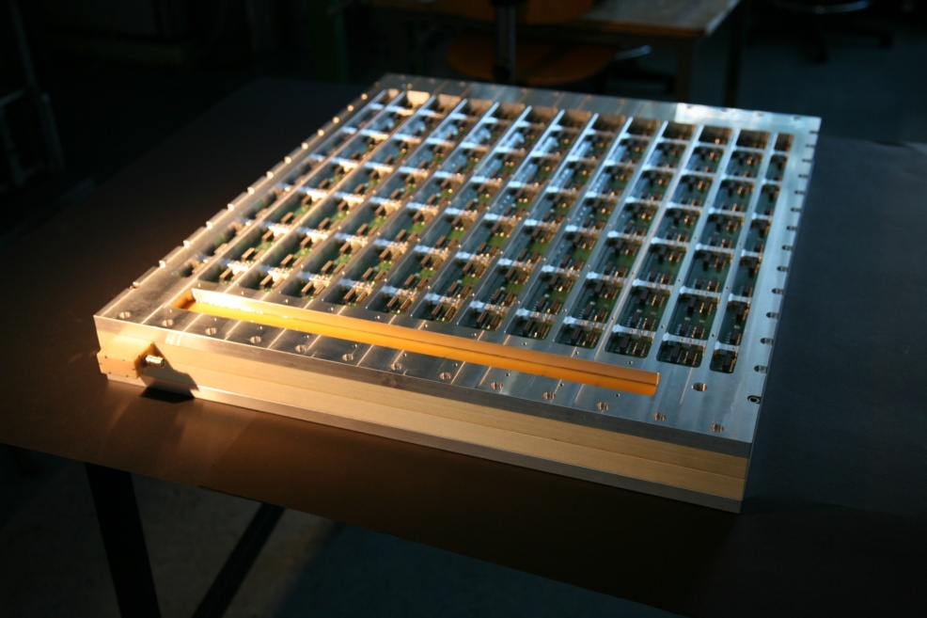
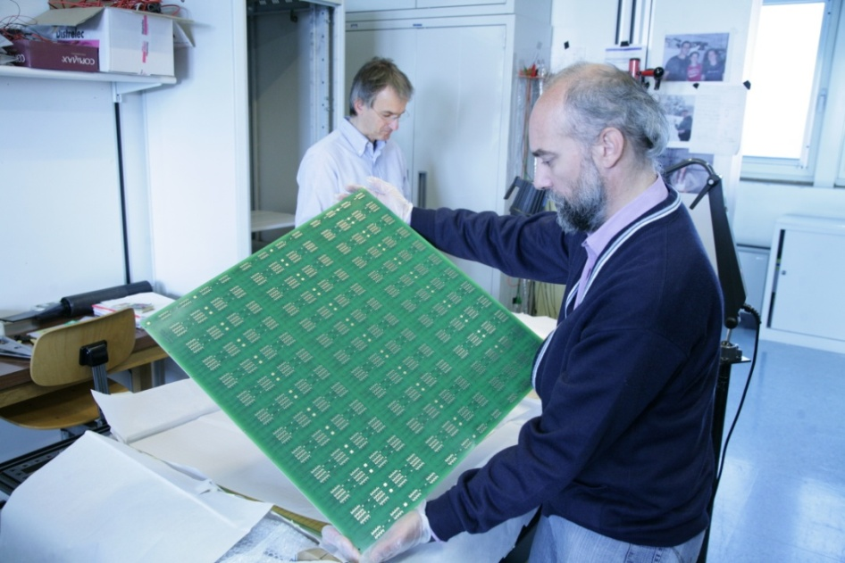
LARGE SIZE DETECTORS

Slide 33
The introduction stops here.
Please, now enjoy the lab session !

