Slide 1
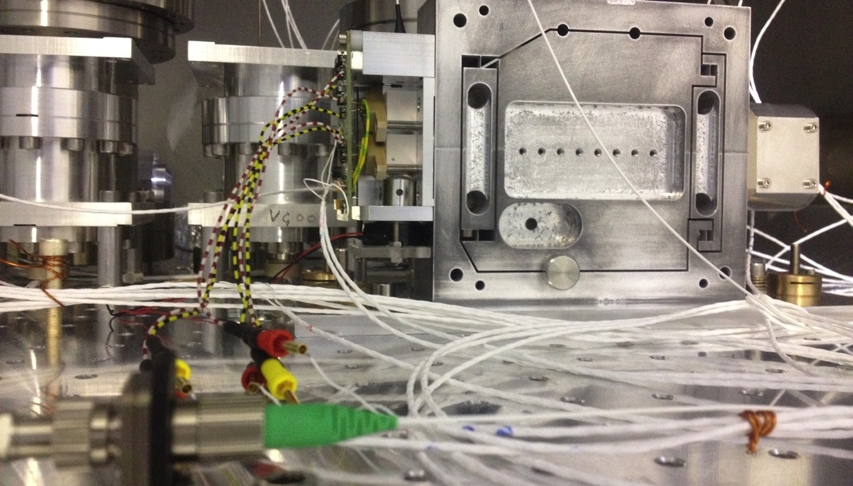
Towards a ‘fm per √Hz’ resolution
A novel interferometrically read out inertial sensor for future gravitational wave detectors
Seminar @ La Sapienza | March 6 2018

Slide 2
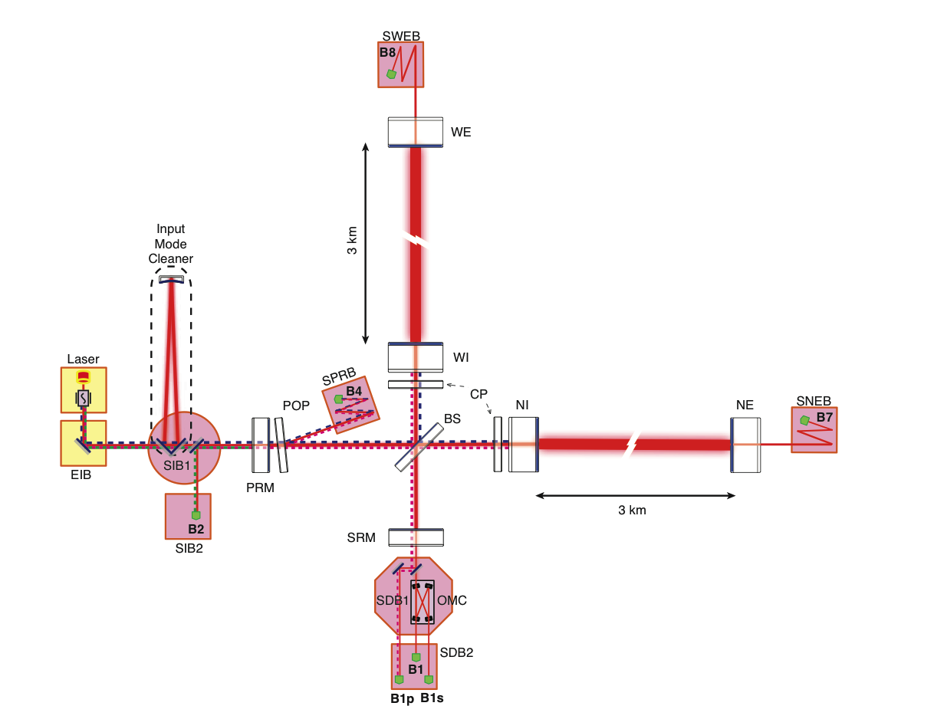
Adding suspended benches to AdVirgo
Optical systems for controlling the interfero-
meter are installed on benches in vacuum
For Advanced Virgo, seismic isolation of these
optical benches is necessary
5 suspended benches are shown here with
a circle, and all systems have been installed
Results (slide 6)

Slide 3
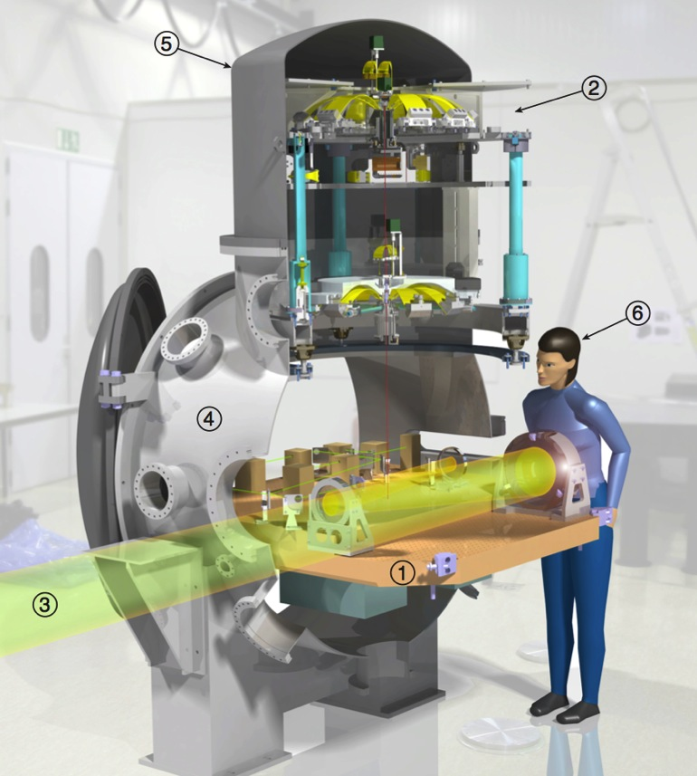



MultiSAS isolates these benches
Suspended bench
MultiSAS
Transmitted light
MiniTower
Cupola
Observant physicist

Slide 4
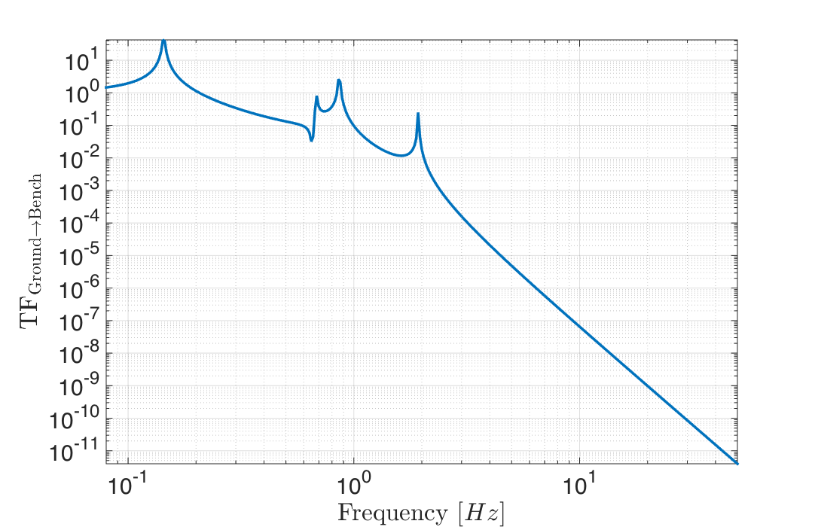
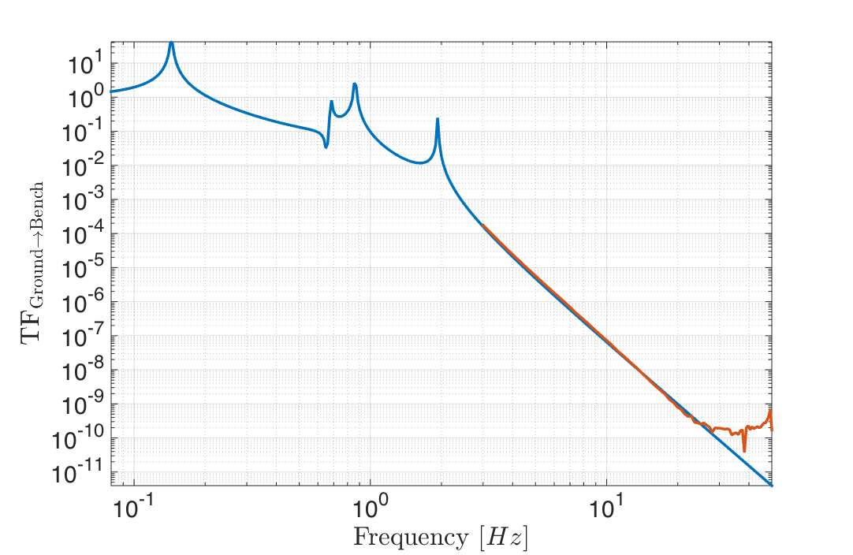
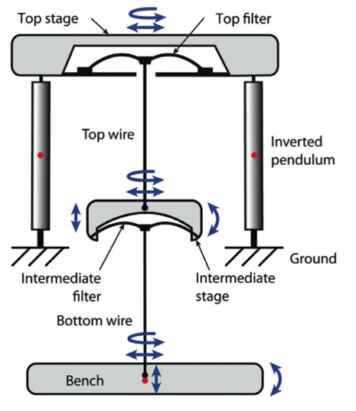
Passive attenuation for f_{input} > f_{modes}
Horizontal modes in the chain
@10 Hz: 10⁻⁷ attenuation of
< 10⁻⁸ m/√Hz ground motion
Takanori Sekiguchi and Kazuhiro Agatsuma

Slide 5
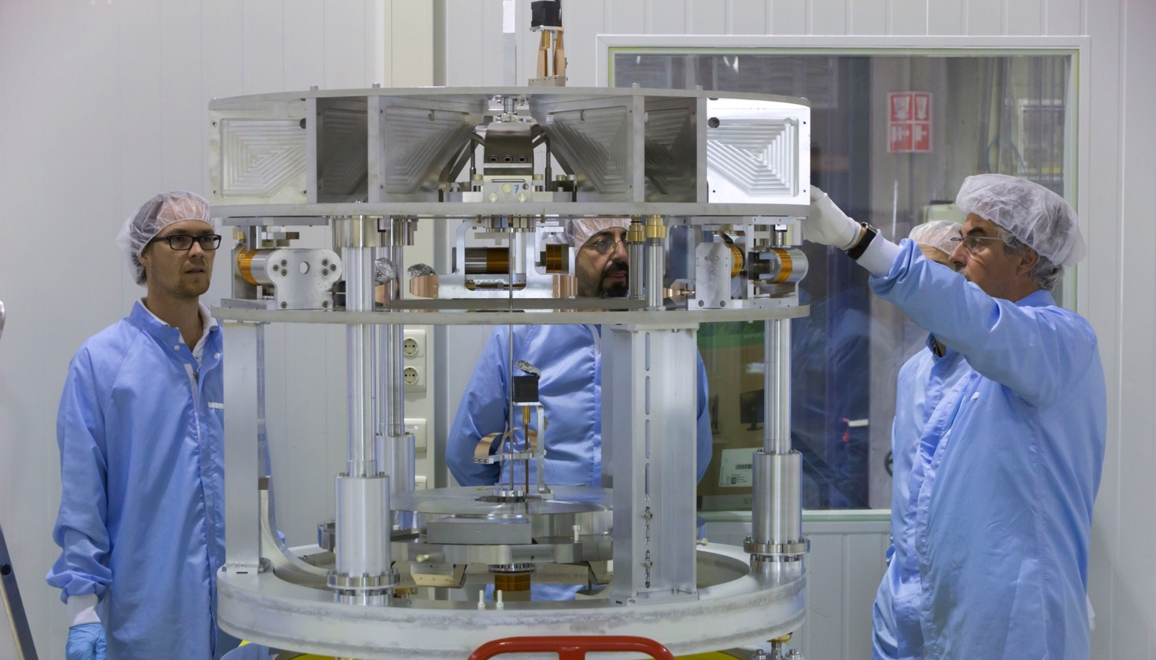

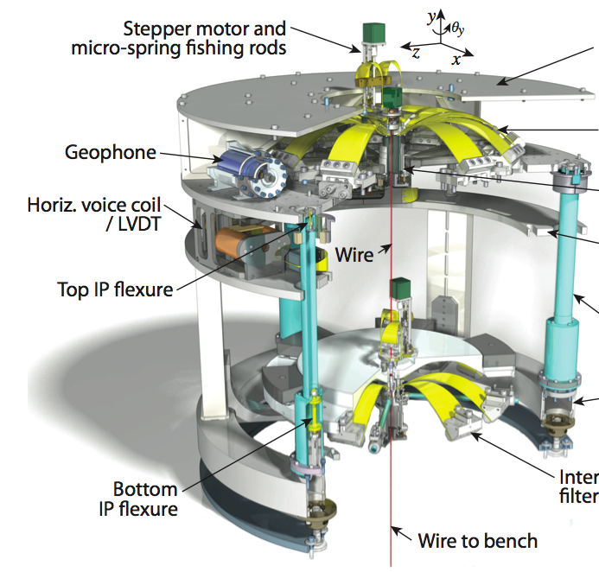


Sensors and actuators in the chain
28 sensors:
Top stage control:
3 ground absolute sensors (geophone)
3 top stage absolute sensors
3 top stage differential position
sensors (LVDT)
1 vertical diff. position sensor
Bench control:
4 horizontal diff. position sensors
4 vertical diff position sensors
Diagnostics:
6 (3 horizontal/ 3 vertical) absolute sensors on the bench
2 Optical levers
1 Monolithic accelerometer with
an interferometric readout

Slide 6
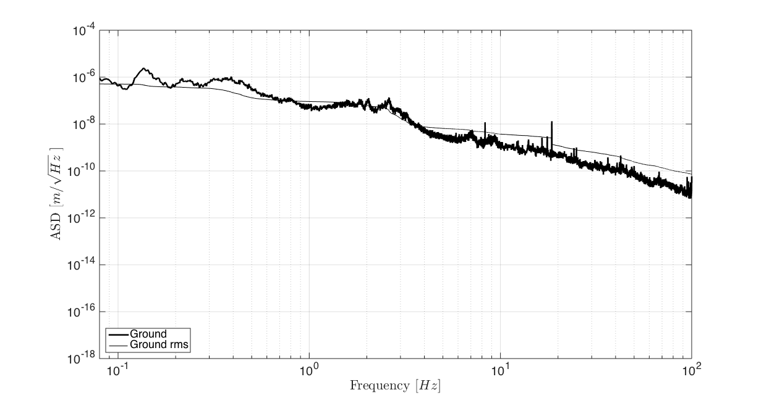
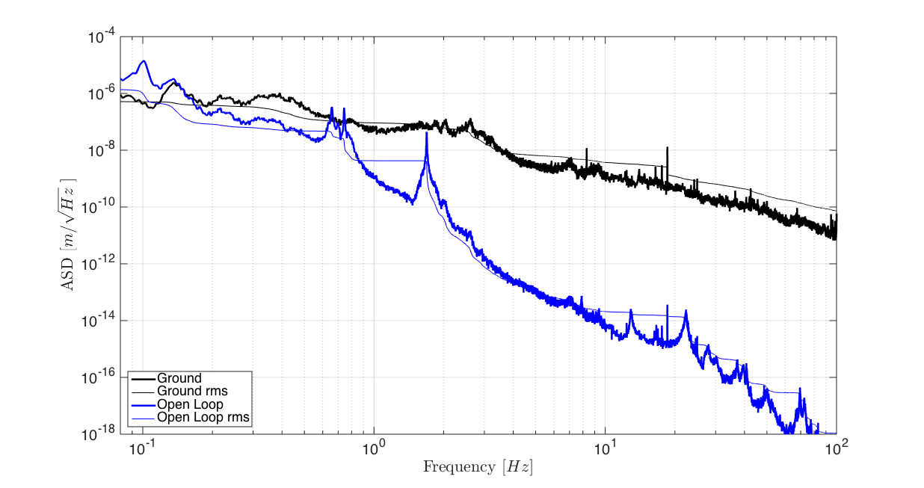
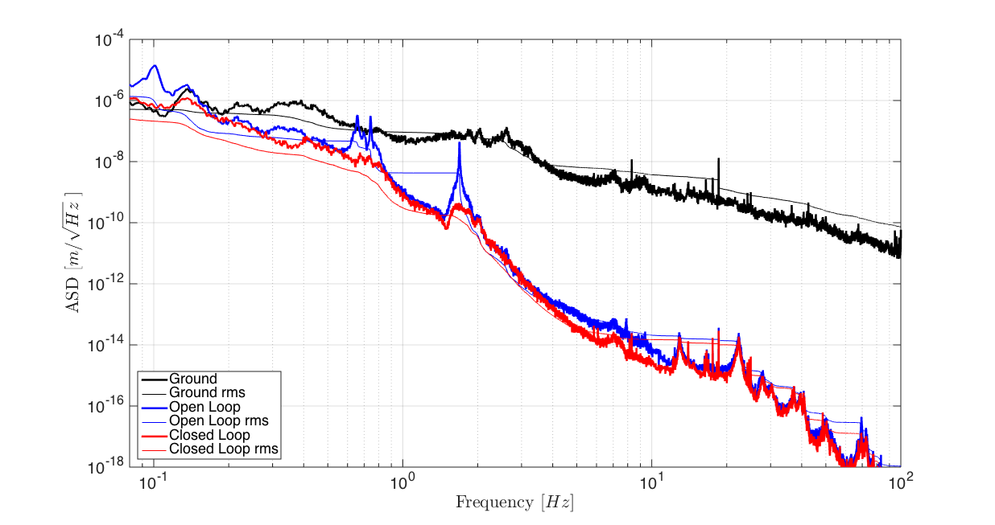


Results of SDB2 (dummy) measurements
Measurement × Projection
Req.
Requirement

Slide 7
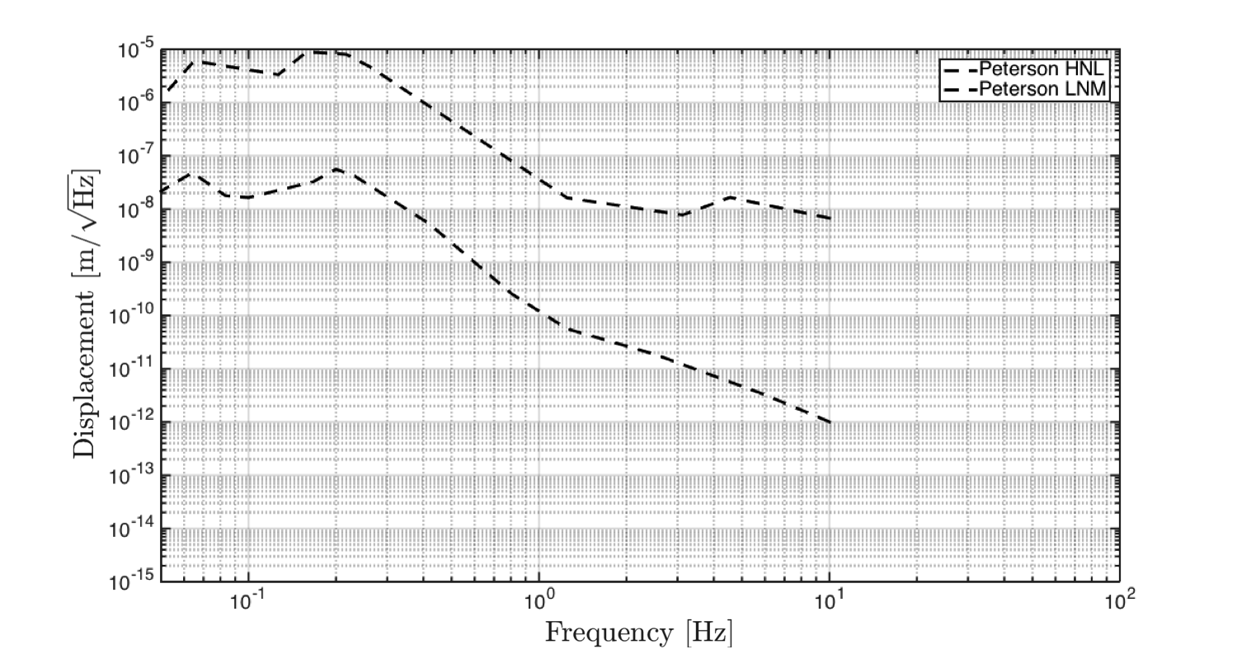
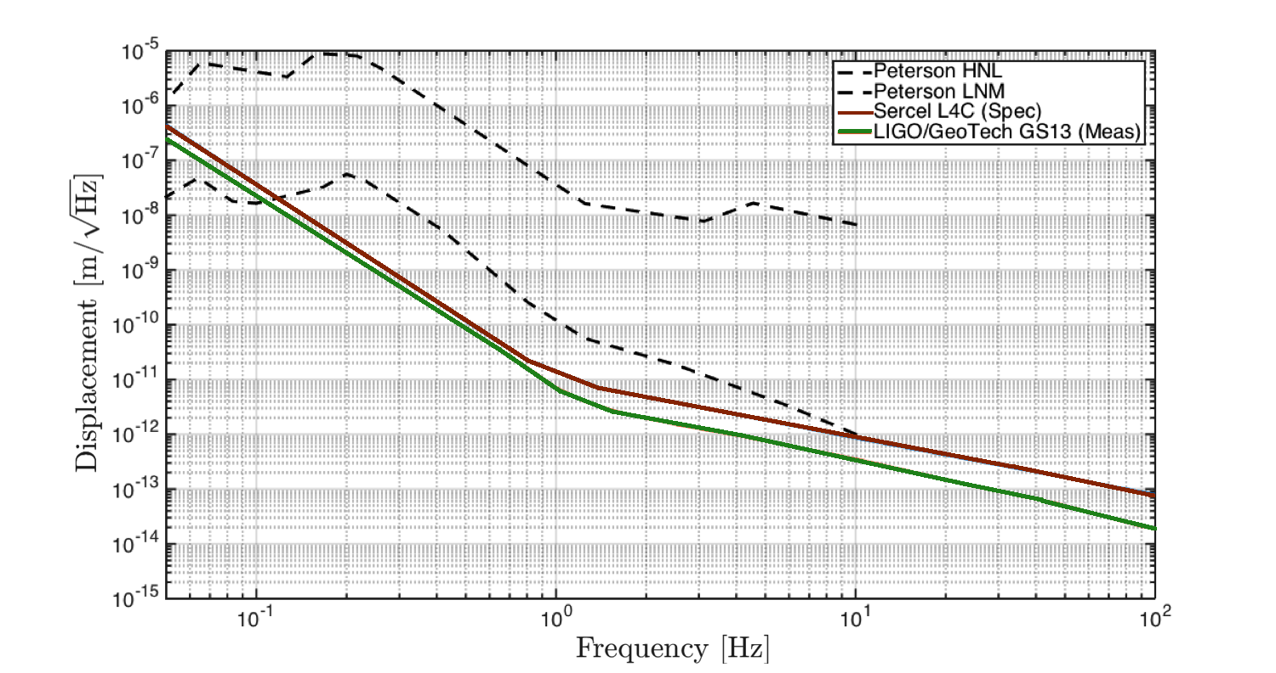
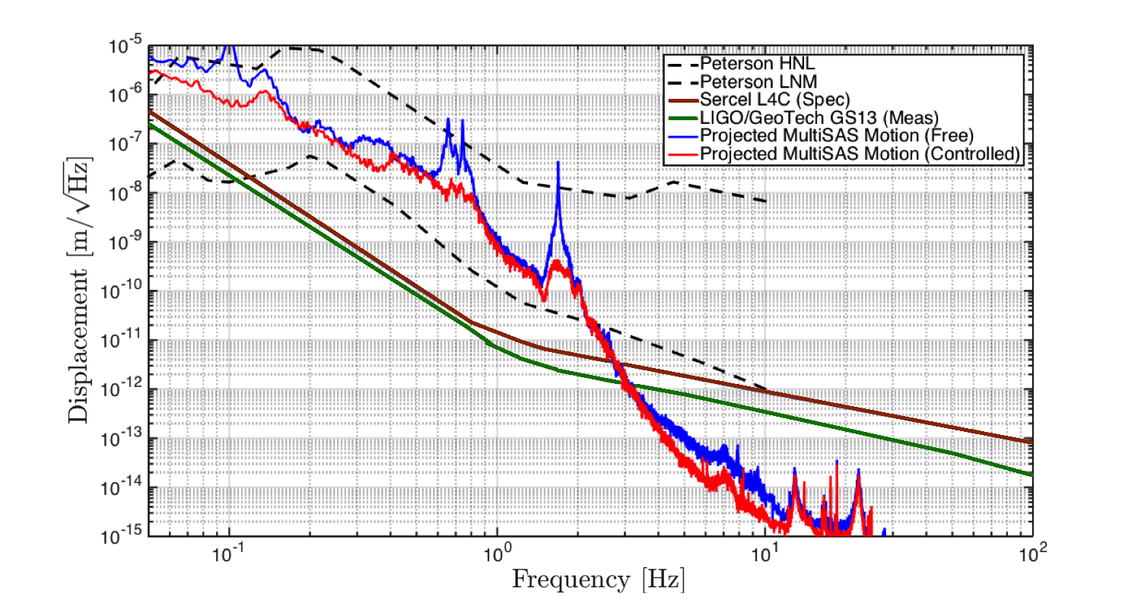
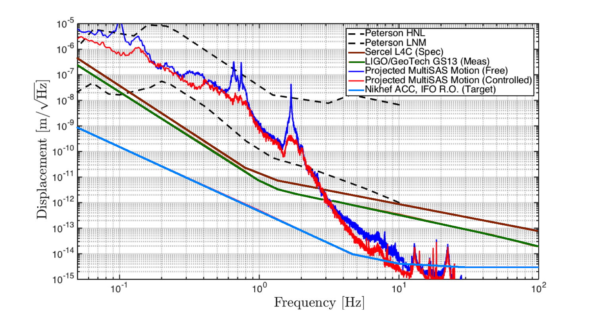
Measuring the suspended bench residual

Slide 8
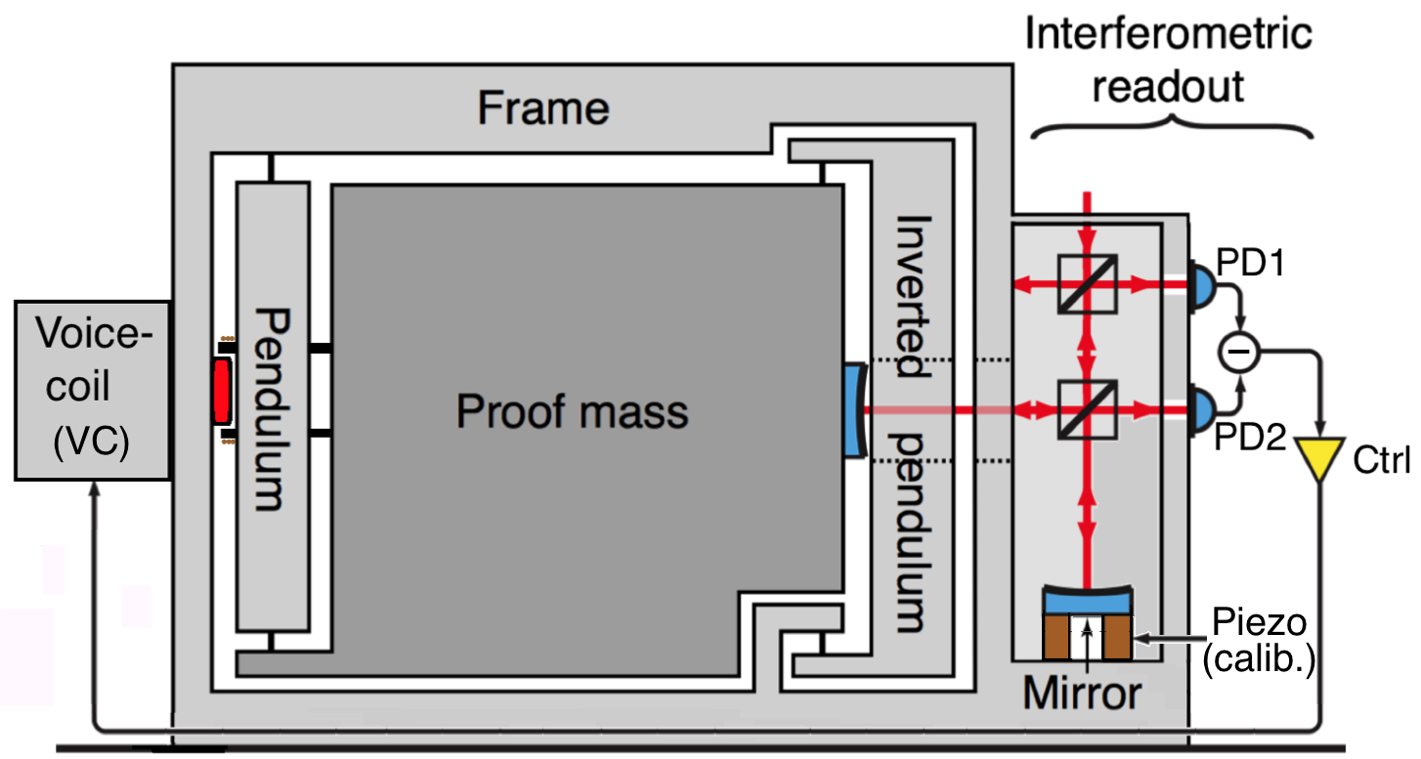
Use of a table-top sized interferometer
1550 nm, 700 Hz LW
A. Bertolini et al., NIM A, 556, pp 616-623 (2006)
M.B. Gray et al., Opt.Quant.Electron., 31, pp 571-582 (1999)

Slide 9
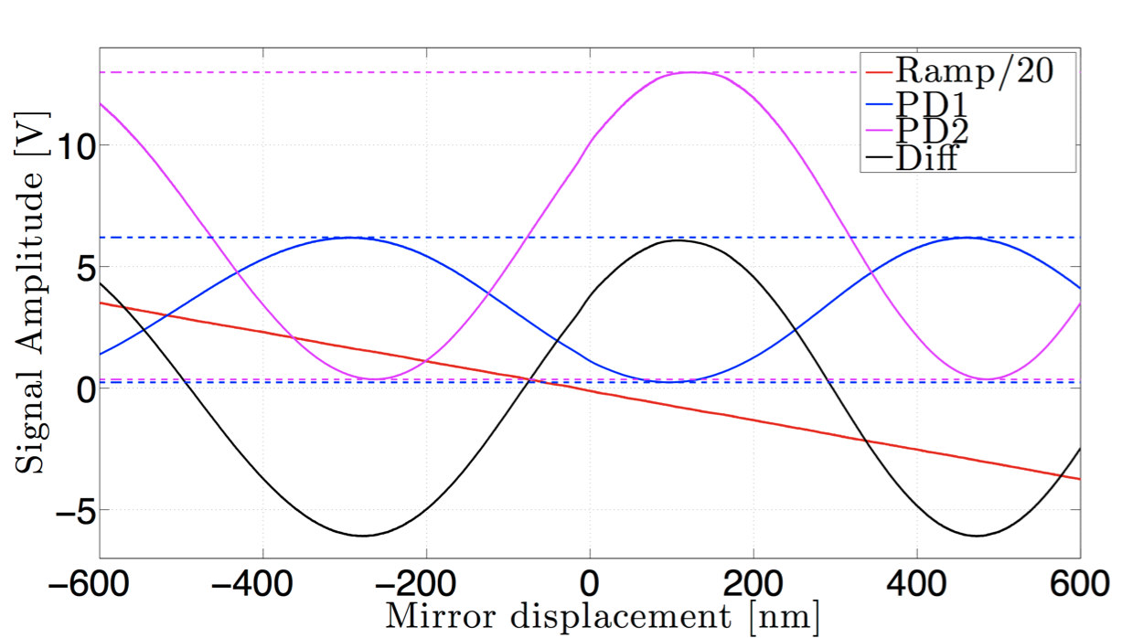
Conversion of sensor output to meters
(actual data!)
Operation point

Slide 10
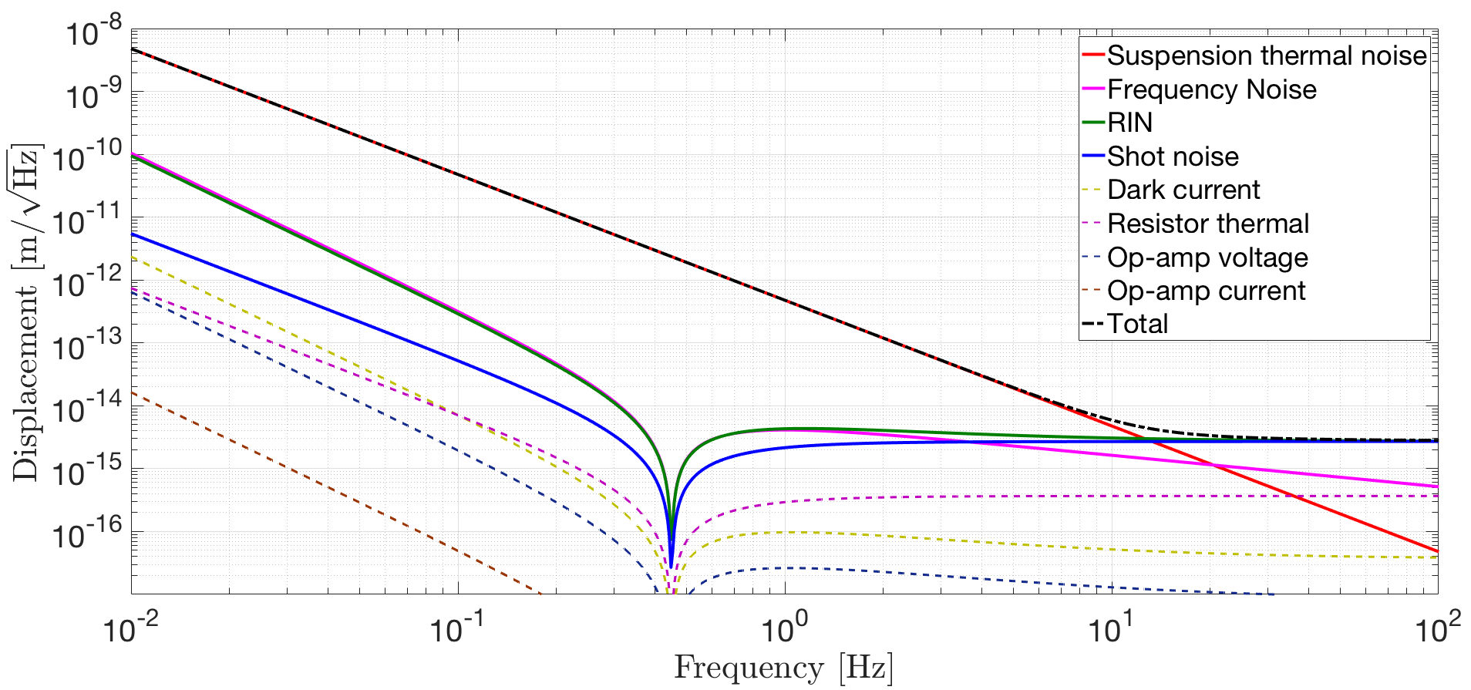
Noise budget of the sensor

Slide 11
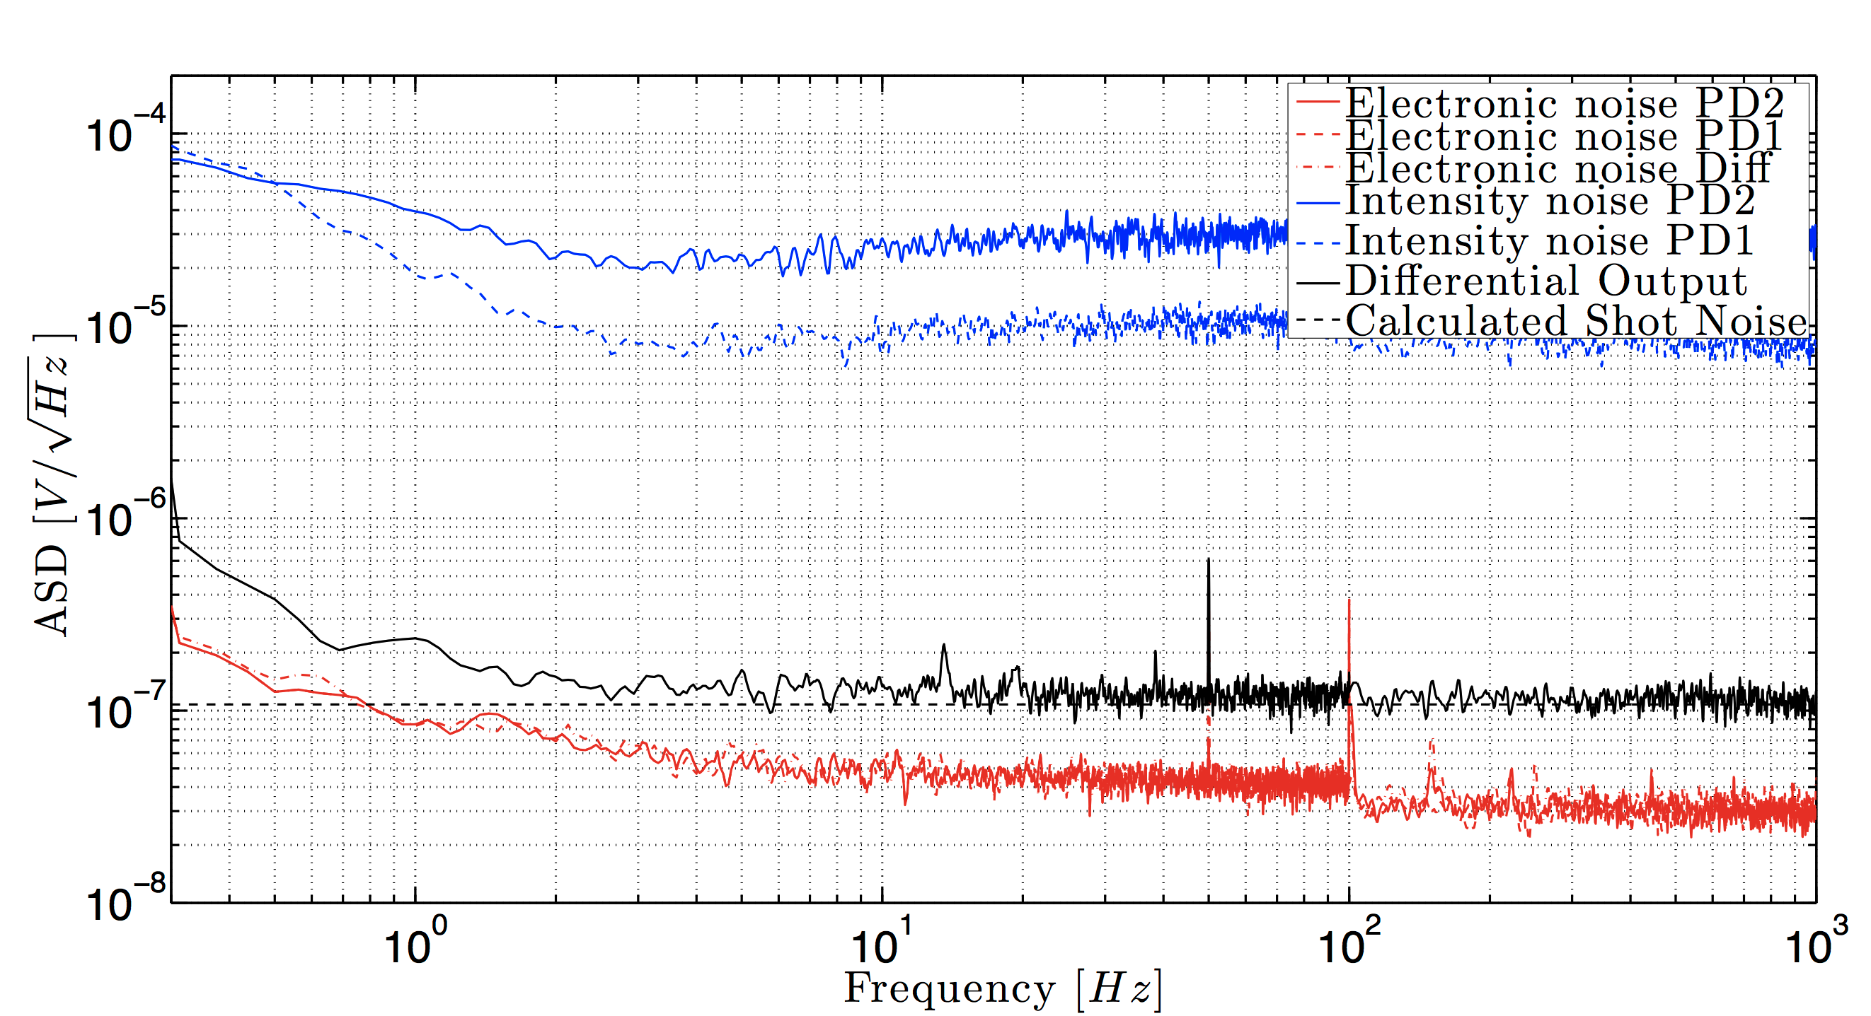
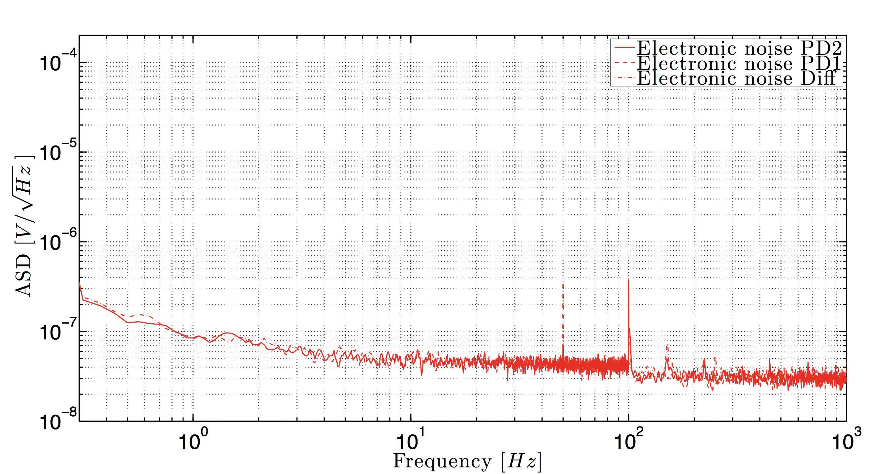
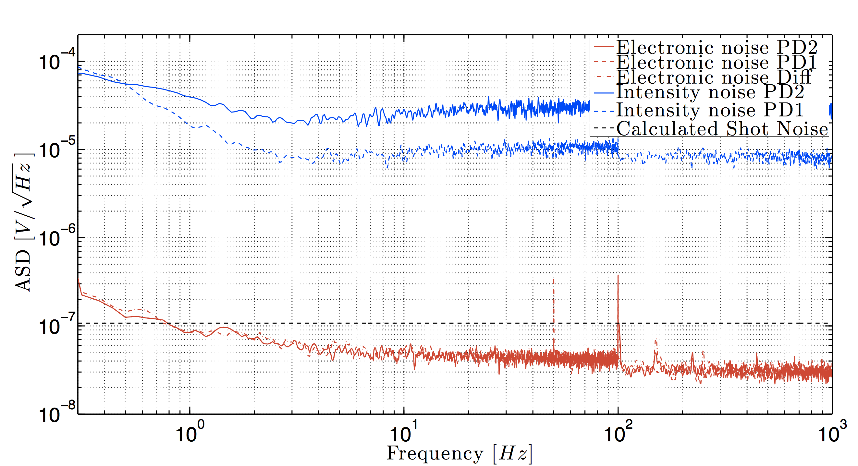
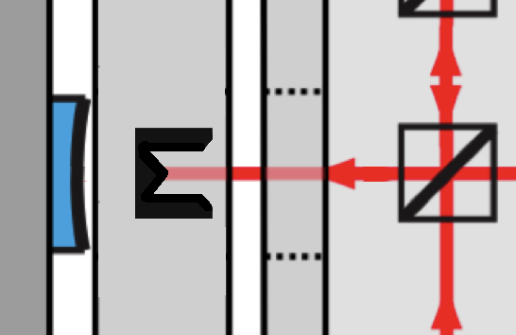
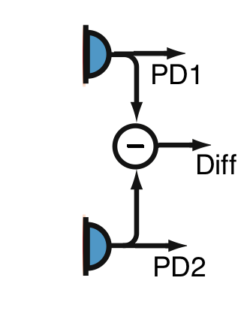
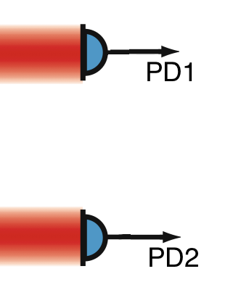
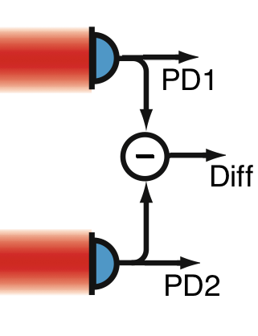


Shot noise limited from 10 Hz onwards?
Measurement done without interference, one interferometer arm blocked

Slide 12
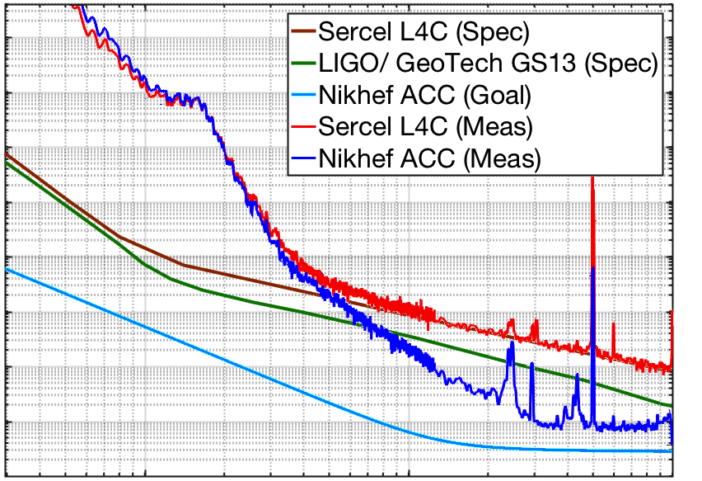
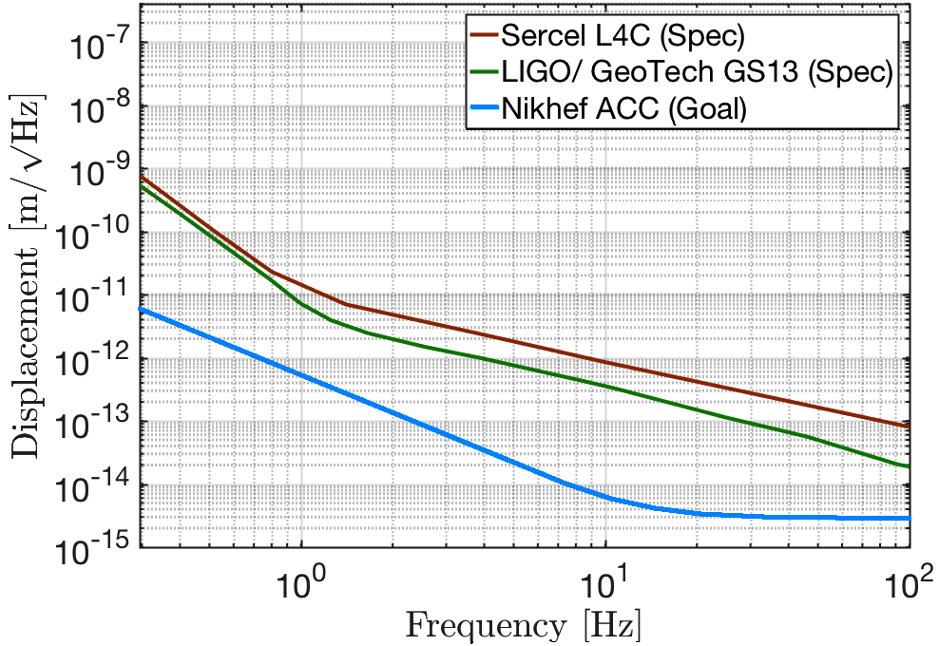
Results on a controlled bench: 8 fm/√Hz

Slide 13
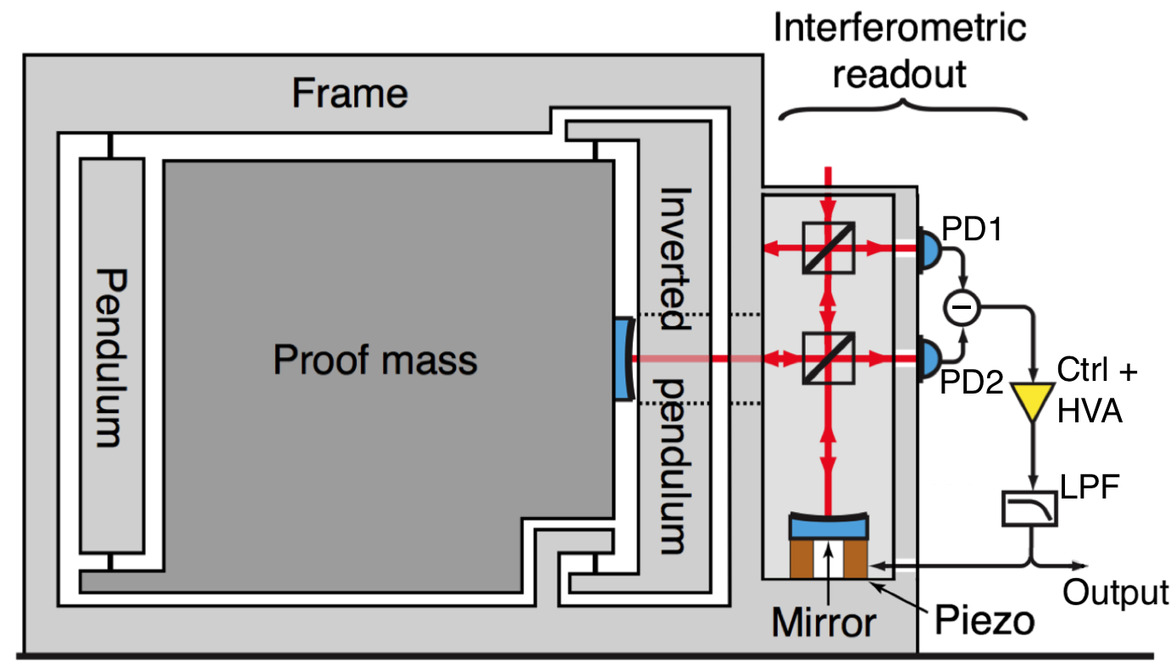
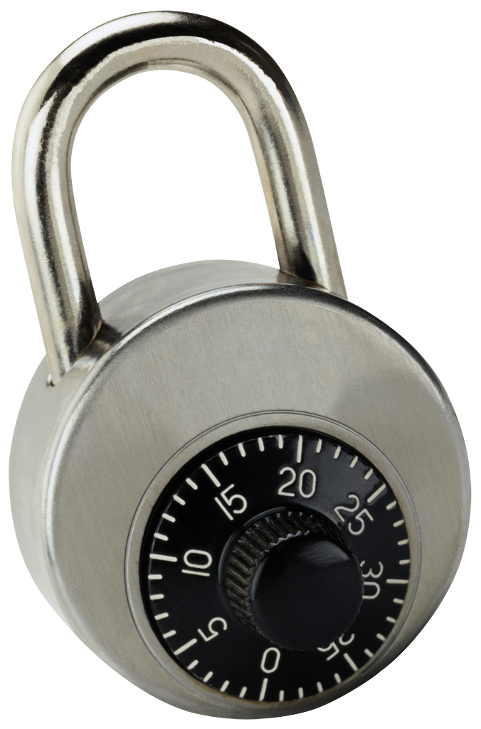
Lock the mass to test the readout

Slide 14
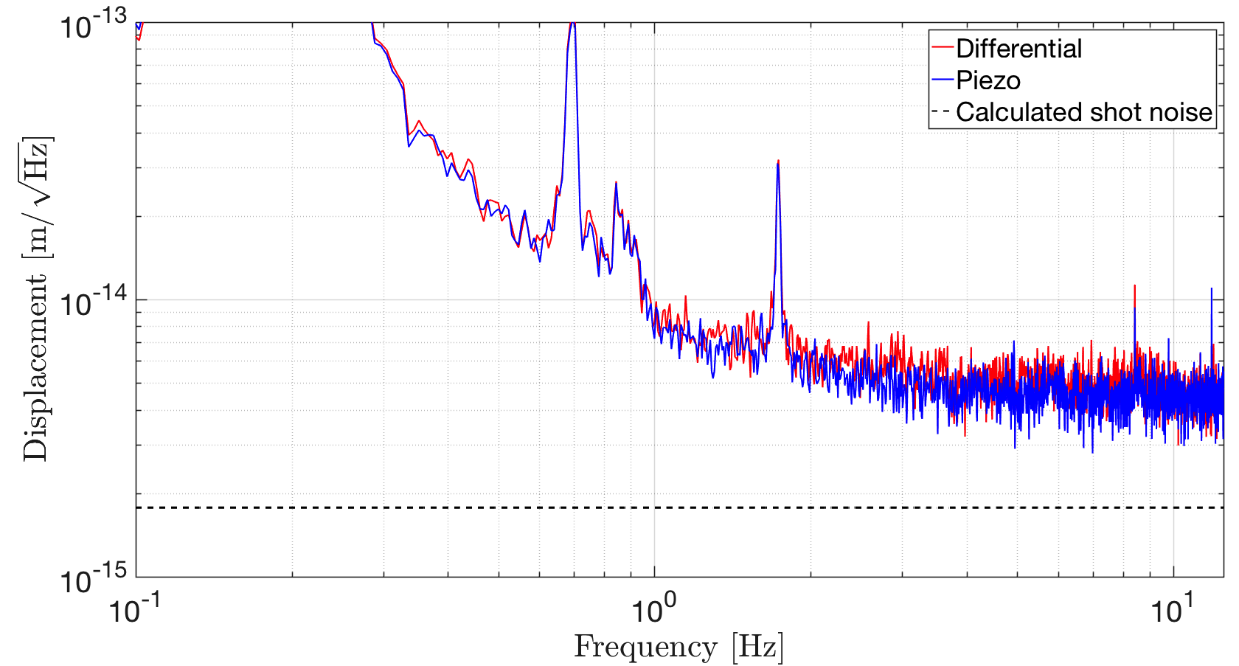
The piezo readout reaches 4 fm/√Hz

Slide 15

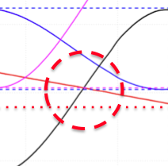
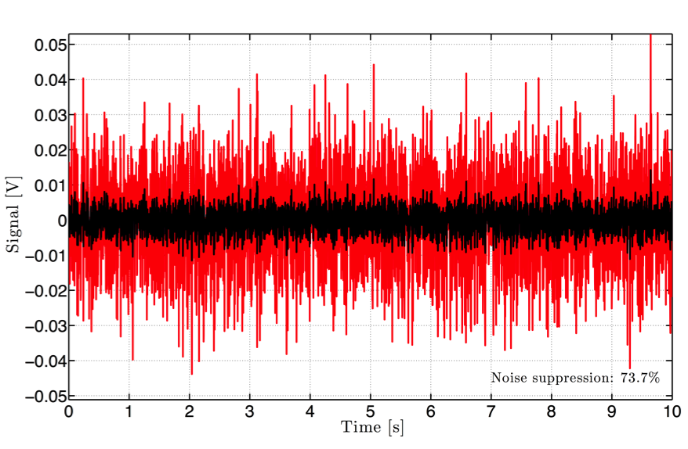
Flat fm/√Hz level in both cases too high
MultiSAS bench still has some residual motion
This makes the subtracted ‘diff’ signal deviate
from zero and thus the
laser intensity noise is
not subtracted optimally
These simulations show
a 50 nm shift of the mass

Slide 16
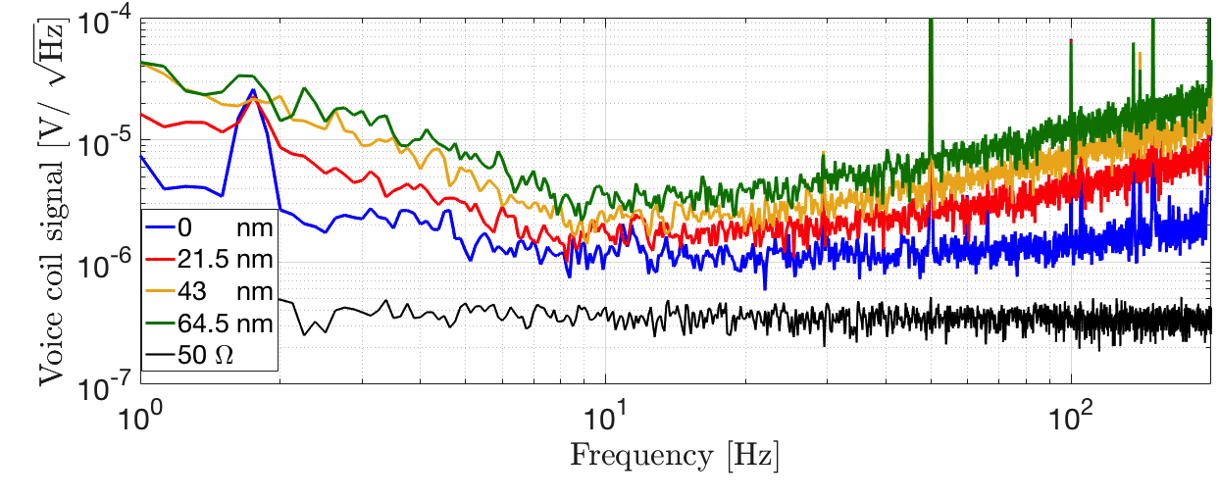
Changing lock point in VC loop
Let the loop lock on 0, 1, 2 or 3 Volt

Slide 17
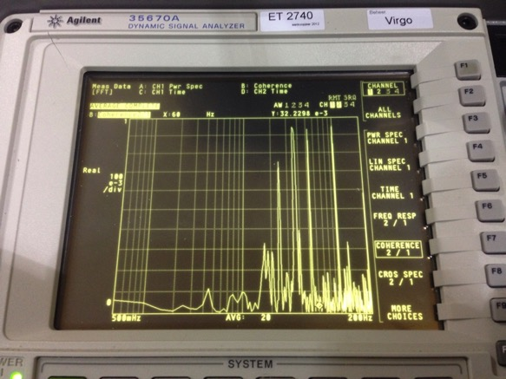
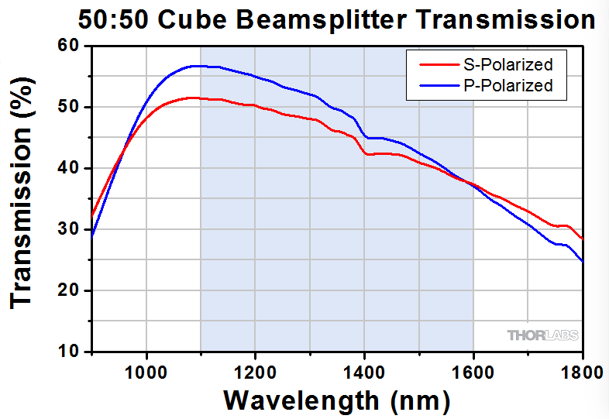
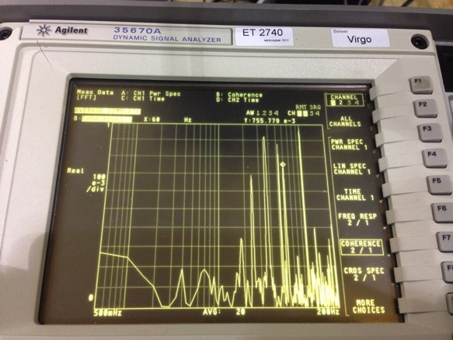
Another suspect: polarization issues
Laser outside MiniTower
Vibration could couple into polarization
noise via the fiber
By injecting a 60 Hz line with a piezo
outside, we’re able to see those lines
which are not expected mechanically

Slide 18
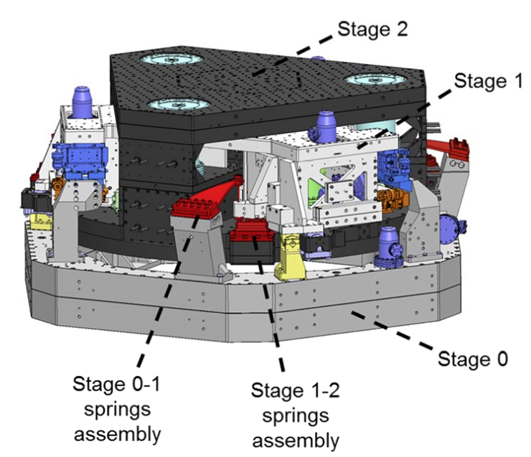
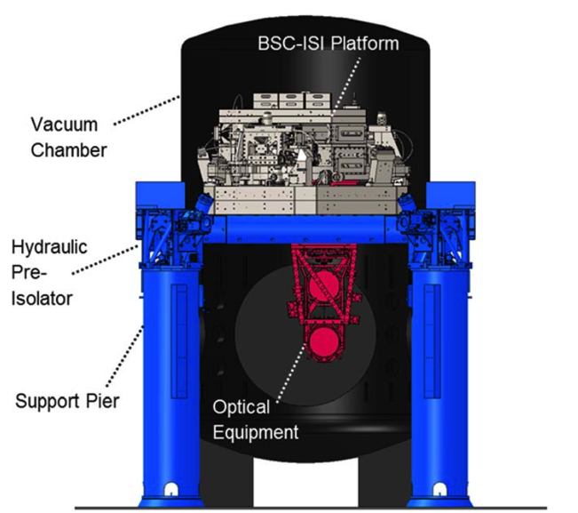
LIGO stage 2 residual = GS13 performance
Future gravitational wave detectors could use more sensitive sensors to create more quiet platforms
Platform is moving
< 10⁻¹¹ m/√Hz @ 1 Hz

Slide 19
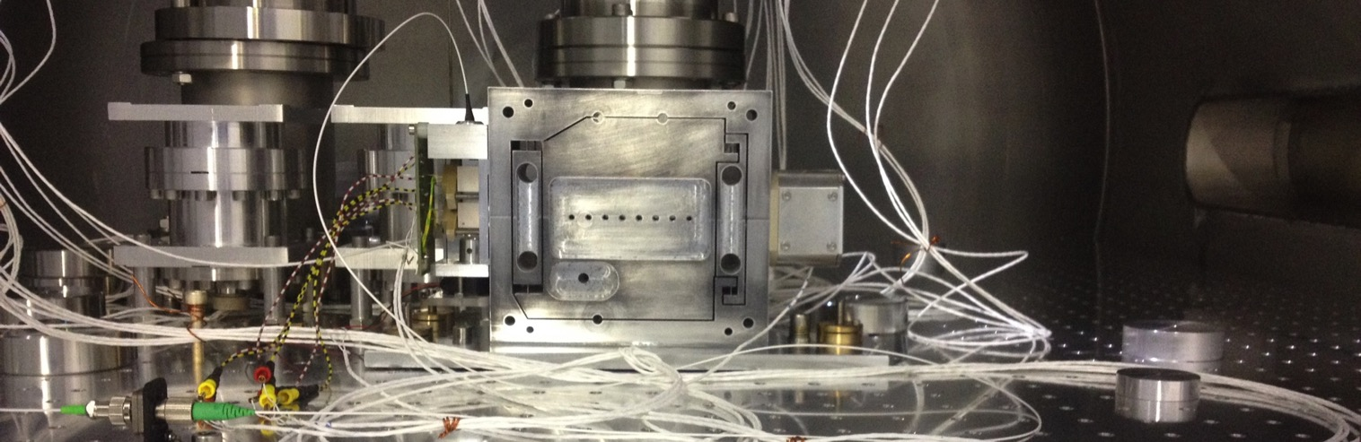
Similar sensor in collider environments?
Vacuum compatible
Very compact and low mass
Low resonant frequency
Electronics not radiation hard
Voice coil is not useable in
(varying) high magnetic field

Slide 20
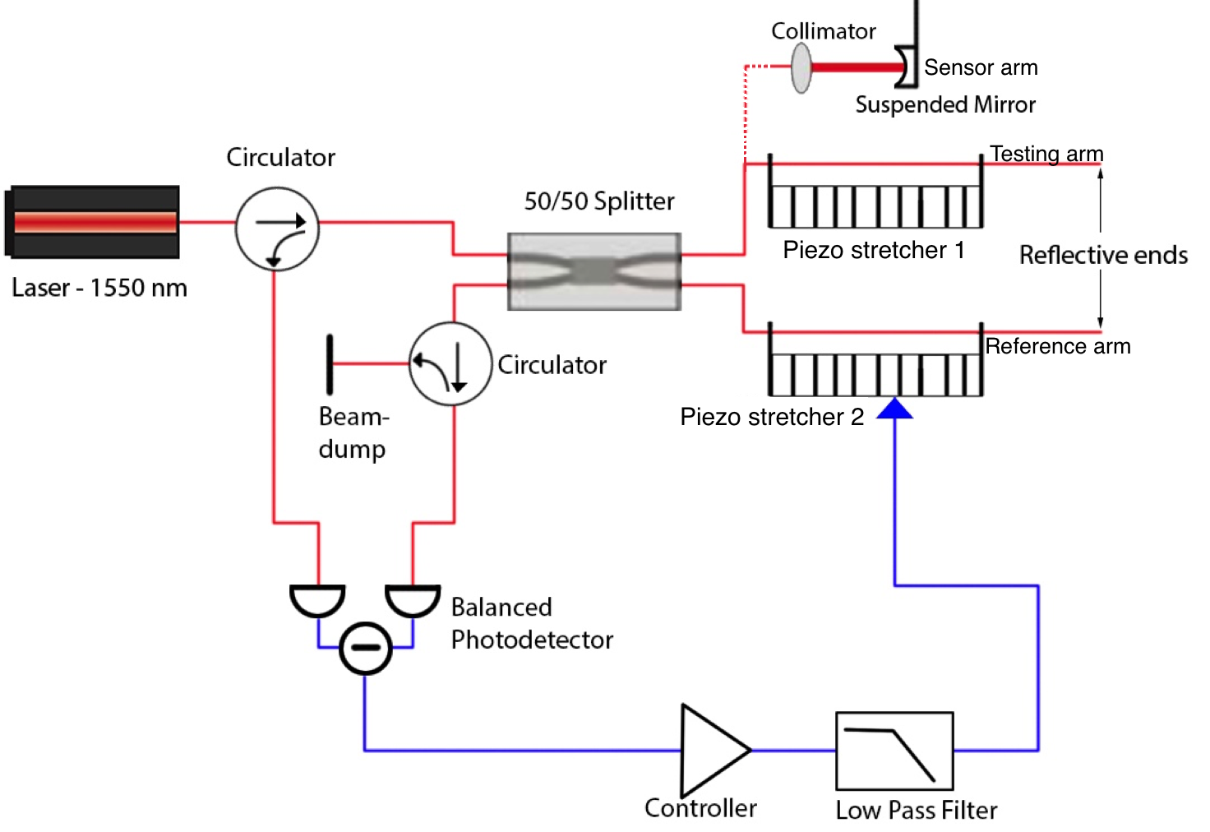
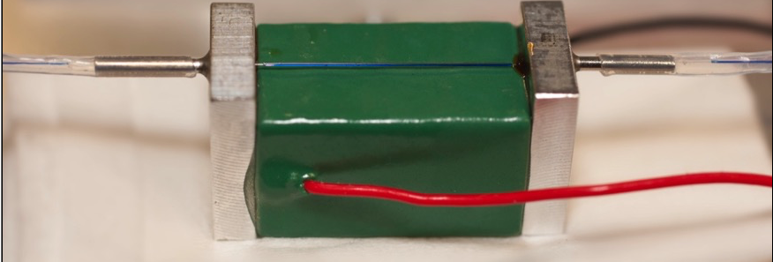
Parallel project: same sensor in fiber

Slide 21
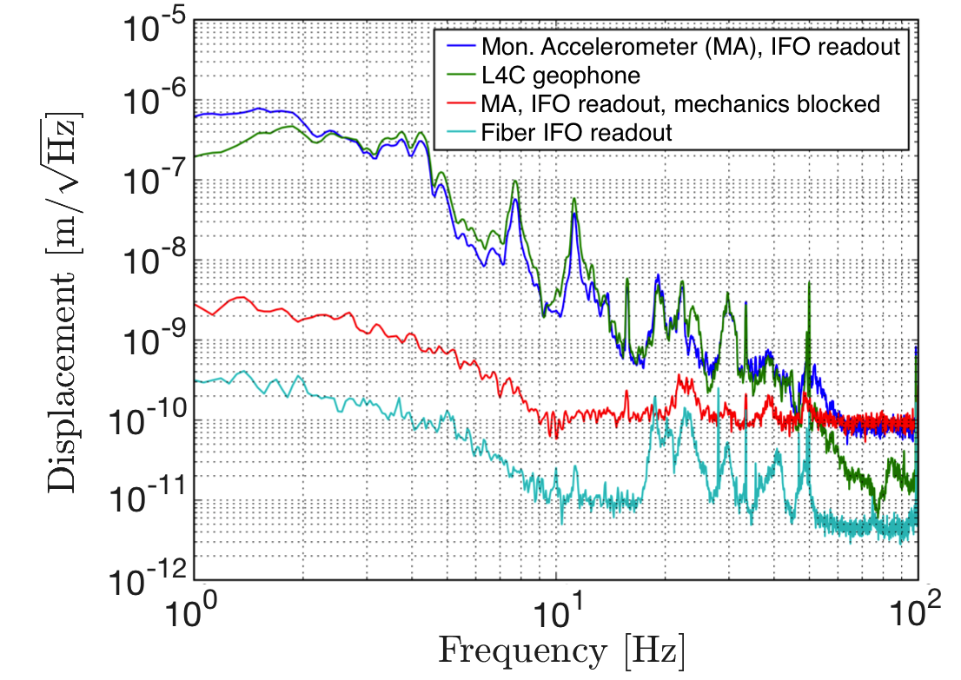
Reaching a few pm per √Hz for readout

Slide 22
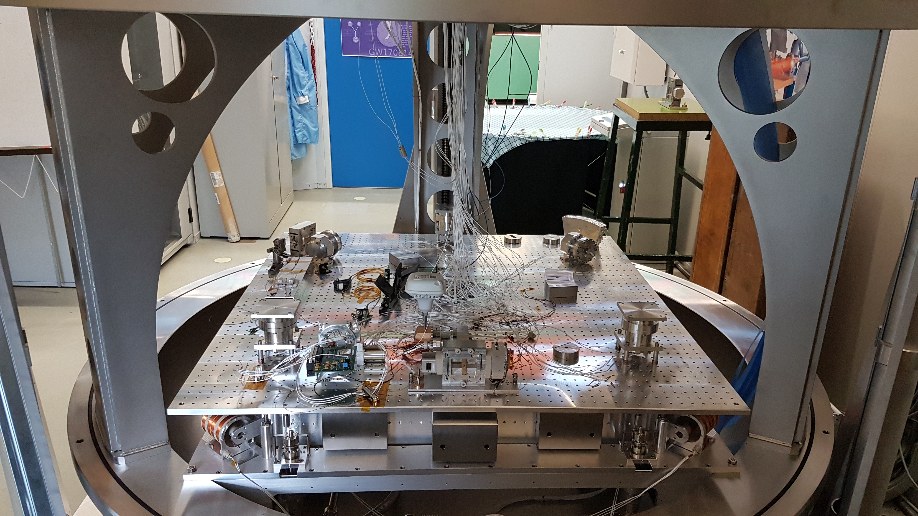
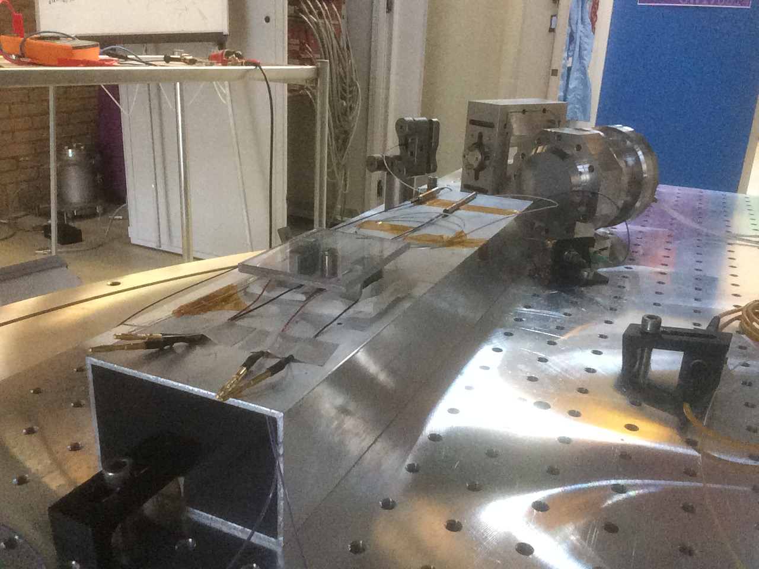
Now ready for low-noise measurement

Slide 23
Noise hunting continues…..
Projected results show MultiSAS meets its rms requirements and its spectral
density requirements. At Advanced Virgo, all systems are functioning well
A novel sensor has been built at Nikhef and is now reaching unprecedented
sensitivities around 8 fm/ √Hz from 30 Hz onwards
A similar sensor is being built completely in fiber in order to be applicable in high
magnetic field/ high radiation environments and is reaching a few pm/ √Hz
Such fiber interferometer readout can also be used stand-alone, to measure e.g.
the suspended objects (test mass mirrors) themselves

Slide 24
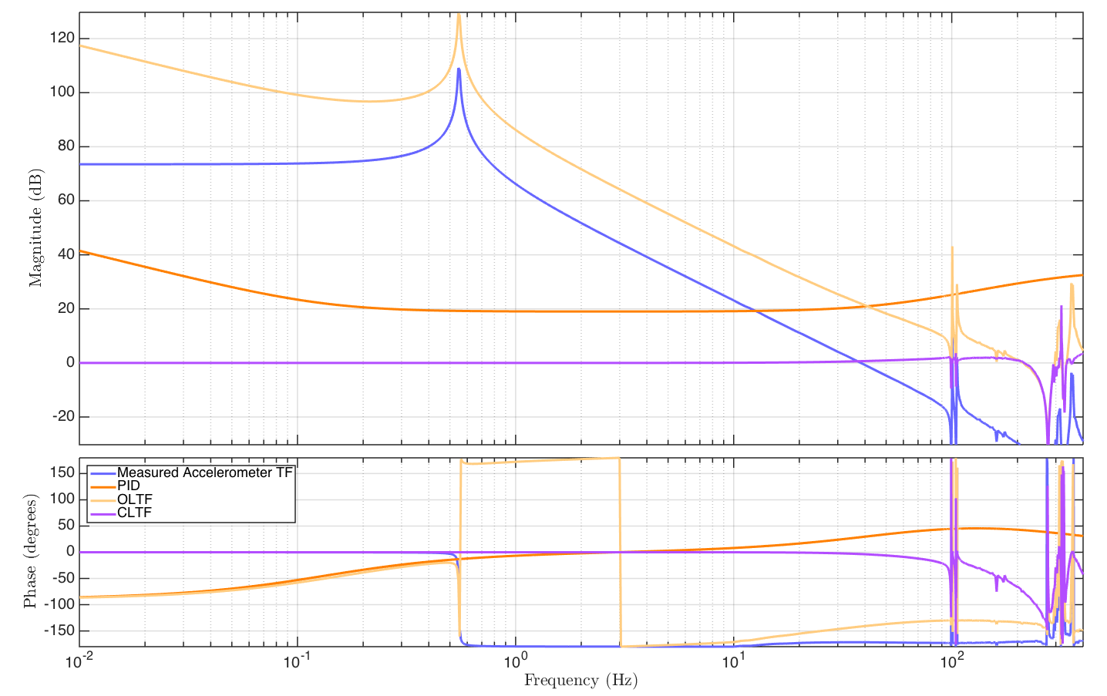
Sensor loop design

Slide 25
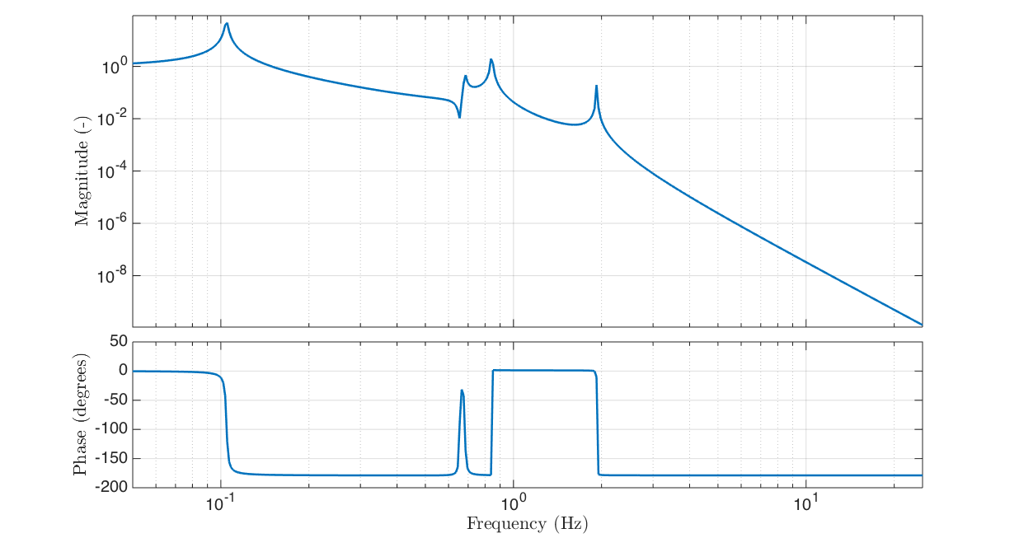
What are the modes?
Horizontal modes
in the chain:

Slide 26
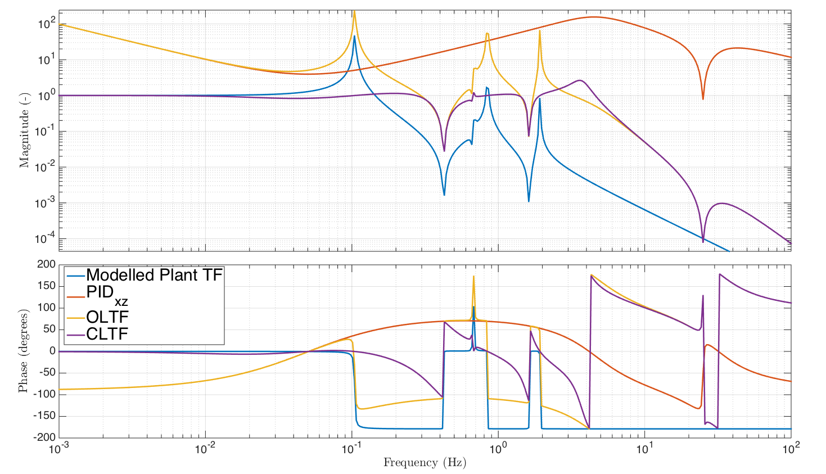
Loop design MultiSAS Control

Slide 27
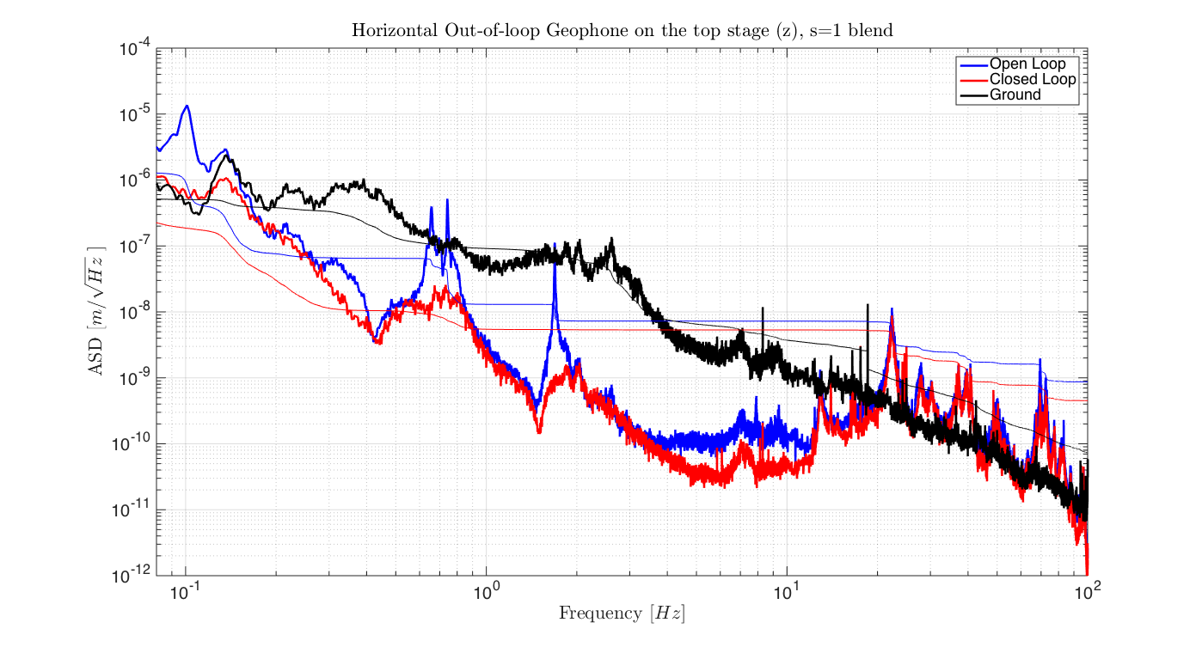
Topstage measurement

Slide 28
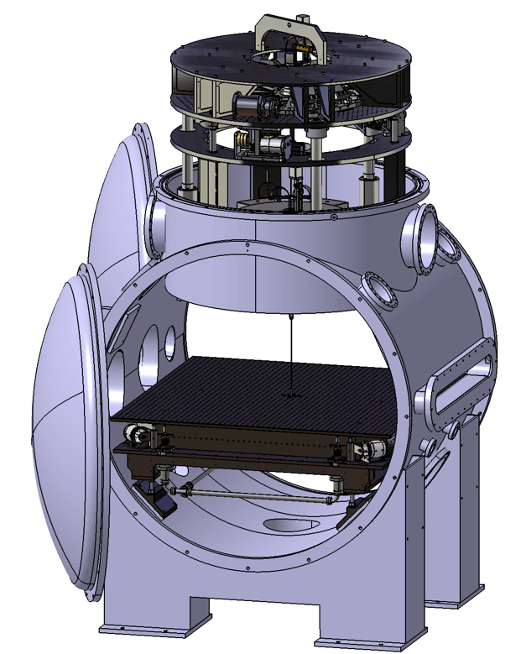
Sensors and actuators at the bench
4 horizontal and 4 vertical co-located
LVDT/ coil-magnet actuator pairs
Very low frequency viscous control
loop to damp roll, tilt (200 mHz) and
yaw (15 mHz) modes of the bench

Slide 29
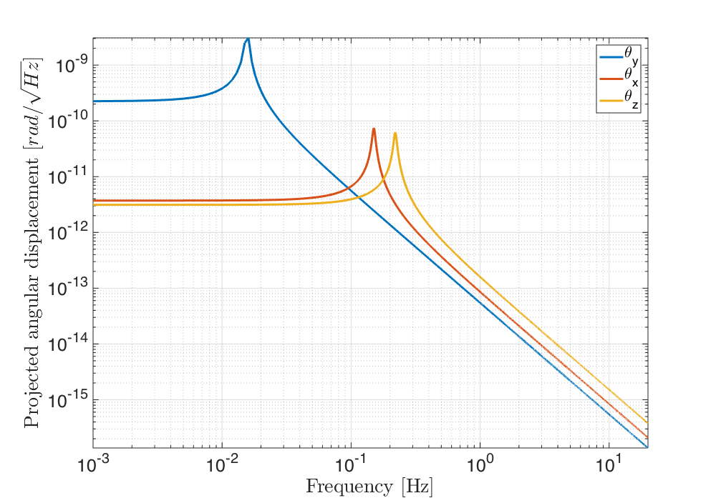

Local bench control design
DAC injection assuming
1 μV/√Hz white noise
LVDT noise below
10 nm/√Hz
So, assuming 0.5m
lever arm, closed loop
response should be at
least 5 × 10⁻⁹ at 10Hz to
avoid LVDT noise spoil-
ing angular performance

Slide 30

New vacuum tank for future/ used equip.
Beam splitters: Thorlabs BS006 Cubes
Photo diodes : Thorlabs FGA21 InGaAs
Piezo: HPCh 150/12-6/2
Laser: NPPhotonics ‘The Rock’ 1550nm
PID controller: VU (Free University) Lockbox
Power supply: HP E3630A
Monolithic Acc. material: 7075-T6 Al alloy
Piezo stack: PSt 150/10x10/20
High Voltage Amplifier: Falco Systems WMA-280
GRIN Fiber Collimator: Thorlabs 50-1550A-APC
Scope : Agilent DSO-X 3024A
Spectral analyser: Agilent 35670A

Slide 31

Fiber piezo tracking test

