Slide 1



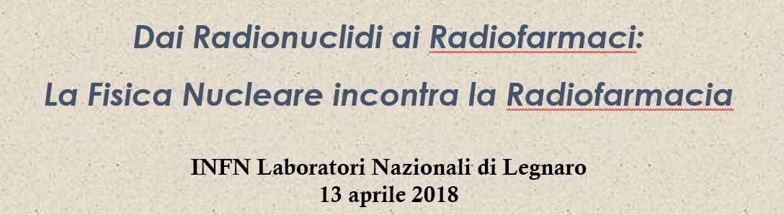
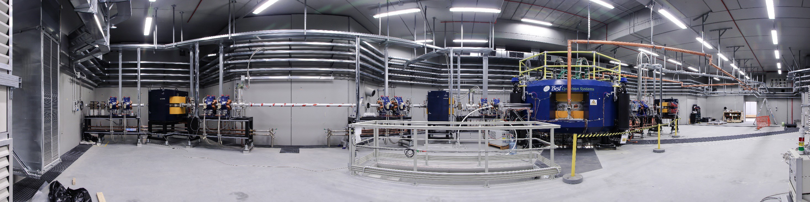
Laboratori Nazionali di Legnaro (LNL)
The LARAMED project at LNL: a new facility for the Production of Radionuclides for Medicine
J. ESPOSITO, ON BEHALF OF LARAMED COLLABORATION gropu
juan.esposito@lnl.infn.it

Slide 2


The LARAMED project mission: 4 basic items….
To establish a LAboratory of RAdionuclides for MEDicine granted as “competitive project” at national level:
To setup a new nuclear science & technology research center at LNL;
(dedicated to both nuclear medicine and applied nuclear physics R&D activities)
To stimulate technology transfer of relevant scientific results;
( Novel/unprecedented radionuclides to the healthcare system, thus favoring the development of useful radiopharmaceutical products)
To provide additional funding routes for INFN (and LNL);
(External funds from radioisotopes research/production are a must to guarantee the future running of LARAMED facility)
To grow up a research community interested in radioisotopes (both for Medicne&Physics);
(Proposal of research project to INFN National Scientific Committees to be funded )
The big Challenge: INFN ready for partnership with private enterprises in the field?
Waiting for the new research infrastructure (now under construction), LARAMED may currently be seen as a research environment for some running experimental projects

Slide 3
How LARAMED infrastructure is setup
LAboratory of RAdionuclides for MEDicine, includes:
A research laboratory (RILAB)
Jointly owned by INFN and CNR for:
High-precision determination of nuclear excitation functions
Low-activity-production of Radio-isotopes/Radio-pharmeceutical for research purposes
A proving ground for new/advanced technologies developed to test high power targets
A production facility (RIFAC)
operated by INFN and a private partner:
Production of ⁸²Sr/⁸²Rb and ⁶⁸Ga/⁶⁸Ge radionuclides for generator systems to meet market demands

Slide 4
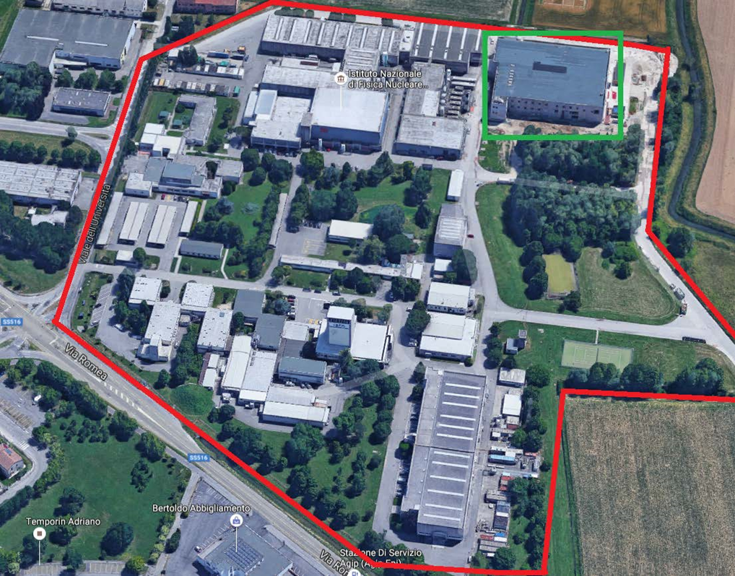
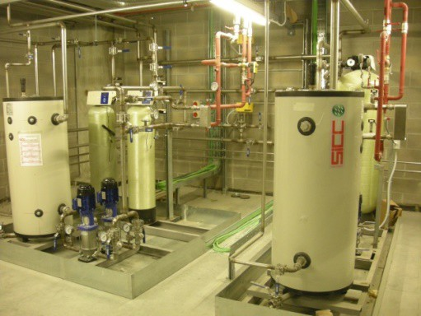
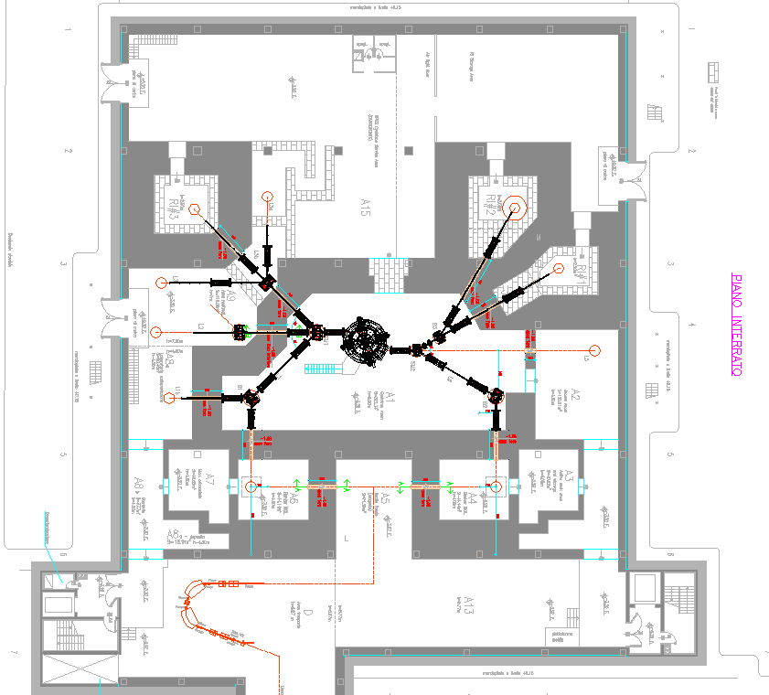
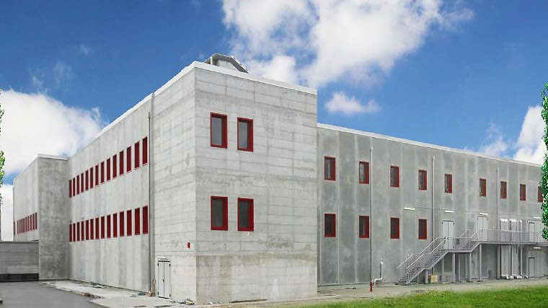
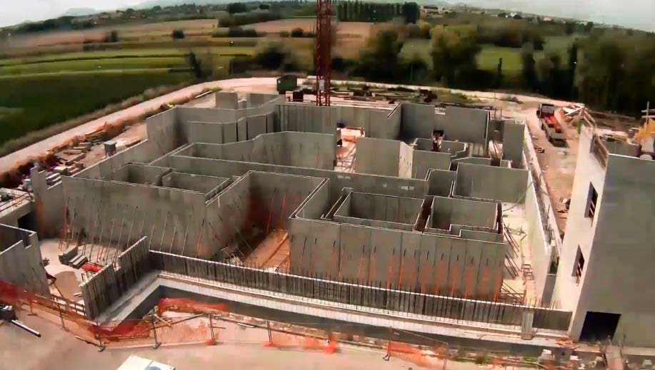
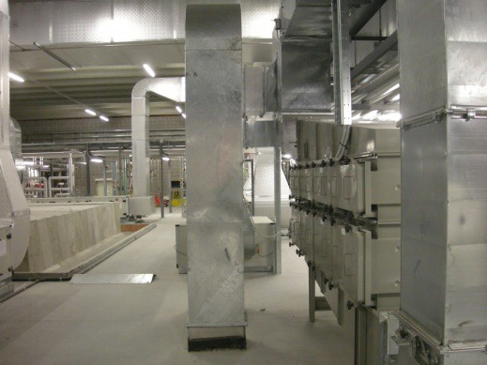
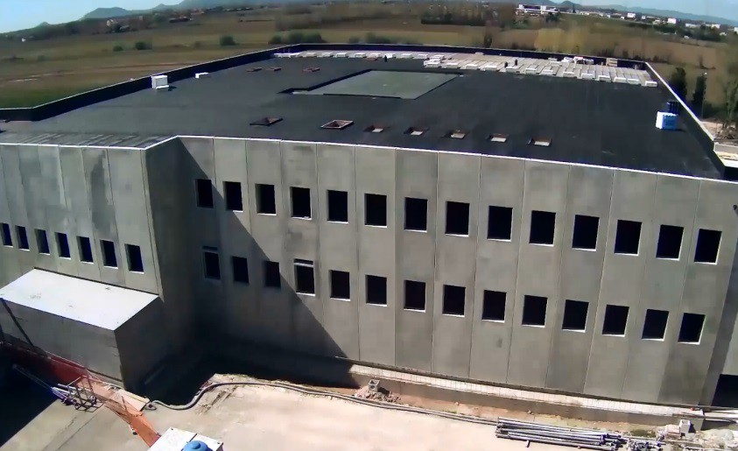
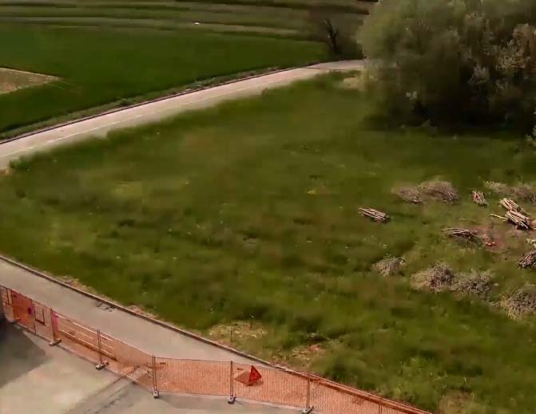
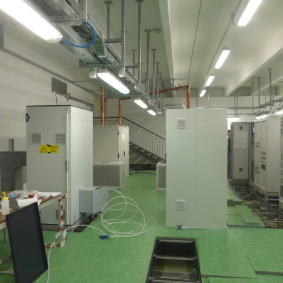
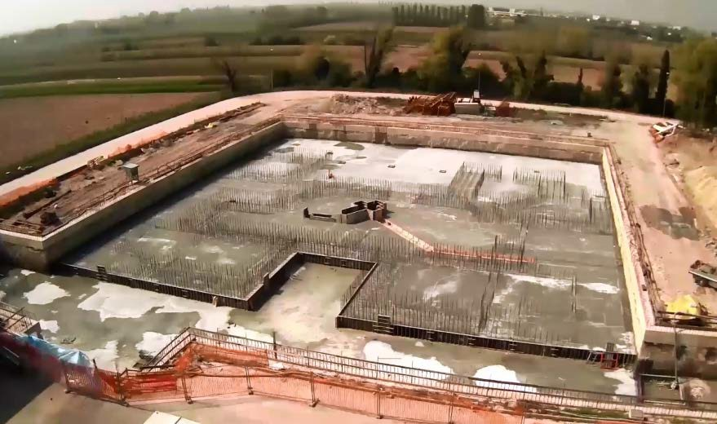
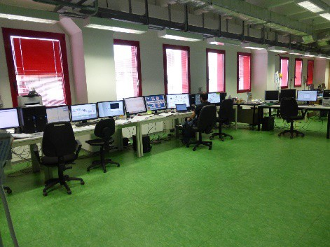
The New SPES/LARAMED Building/infrastructure
2015 2014
2012 2013
Plants
Plants
Power Supply room
50 x 60 m²
-7 to +11 m height
24.000 m³ of concrete
1.150 tons iron
3-4 m thick shielding walls
Control room
4 years to complete the work
No additional costs respect to the initial budget
It was a success of public tender management
12

Slide 5
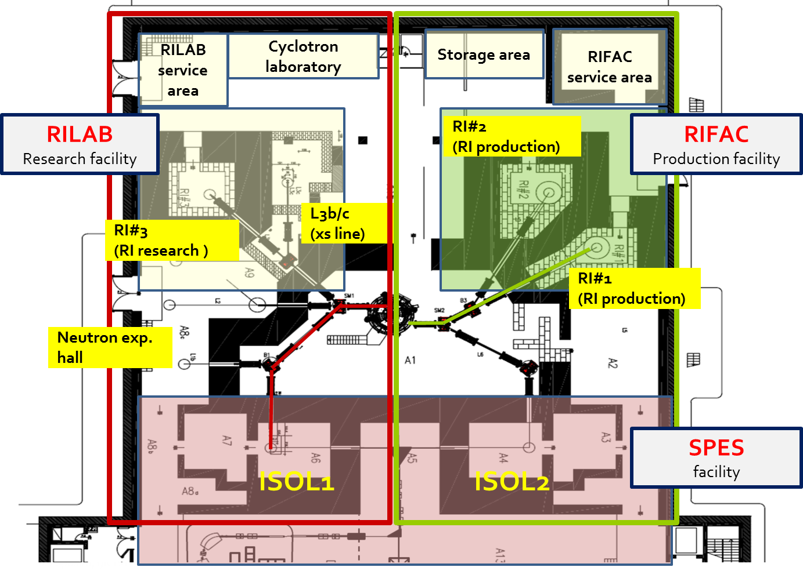
Final Configuration of Cyclotron and Beamlines (-1 floor)
Up to 9 irradiation target points
2 ISOL target stations (A6, A4)
3 Shielded bunkers (RI
#1,#2,#3) for High Intensity irradiation
4 medium and low intensity target areas (A8, A9, A15)
SPES/LARAMED building -1 level
8

Slide 6
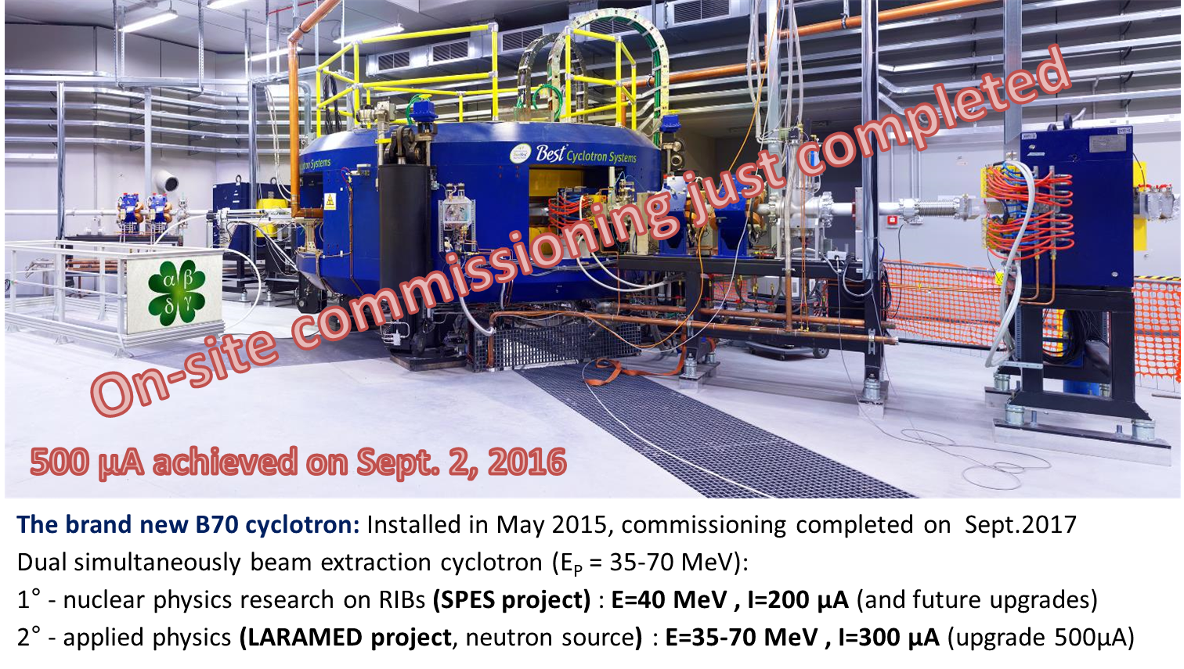

The new 70 MeV, 750µA proton driver
Main Parameters
Accelerator type | Cyclotron AVF with 4 sectors, Resistive Magnet
Particle | Protons (H⁻ accelerated)
Energy range | 35-70 MeV
Max Current Intensity | 700 µA (variable within the range 1µA-700µA)
Extraction | Dual stripping extraction
Max Magnetic Field | 1.6 T (Bo = 1 T)
RF System | nr. 2 delta cavities; harmonic mode=4; f _{RF} =56 MHz; 70 kV peak voltage; 50 kW RF power (2 RF amplifiers)
Ion Source | Multi-cusp volume H⁻ source; I_{ext} =8mA; V_{ext}=40 kV; axial injection
Dimensions | Φ=4.5 m, h=2 m, W=190 tons

Slide 7
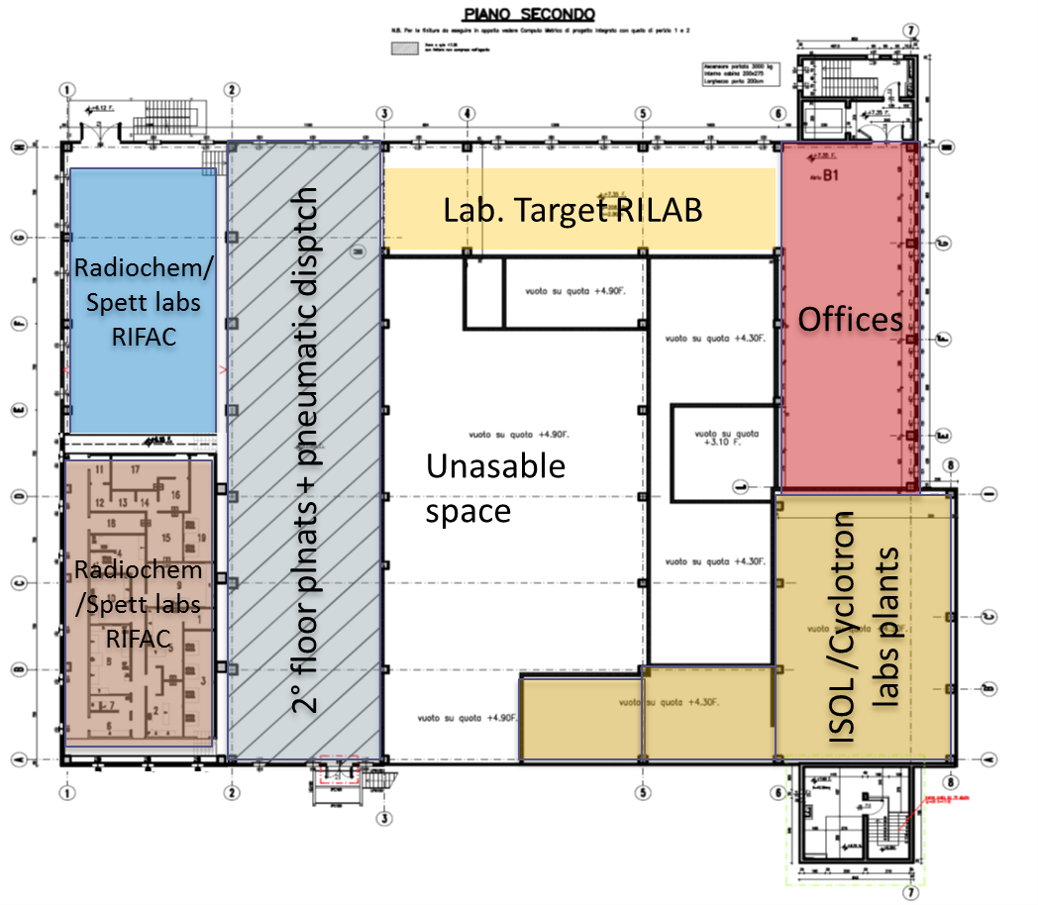
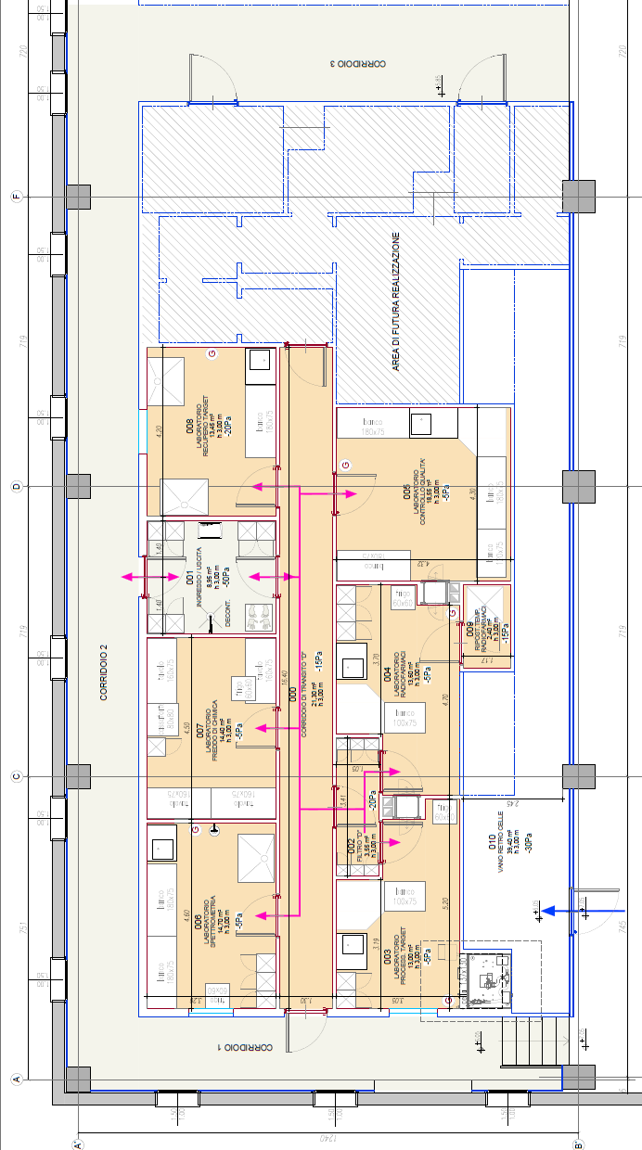
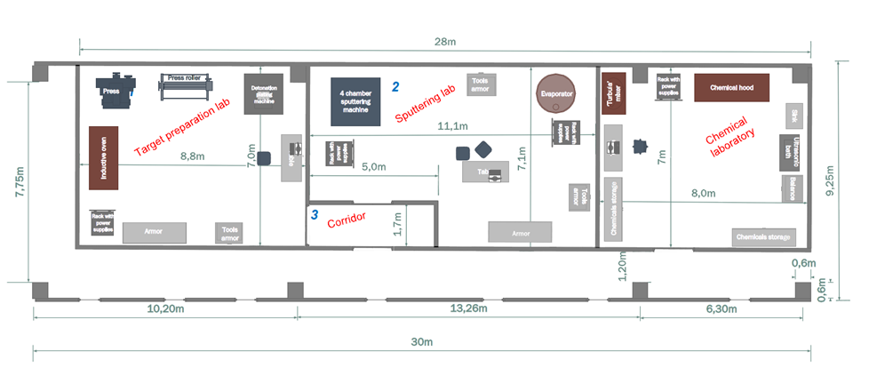
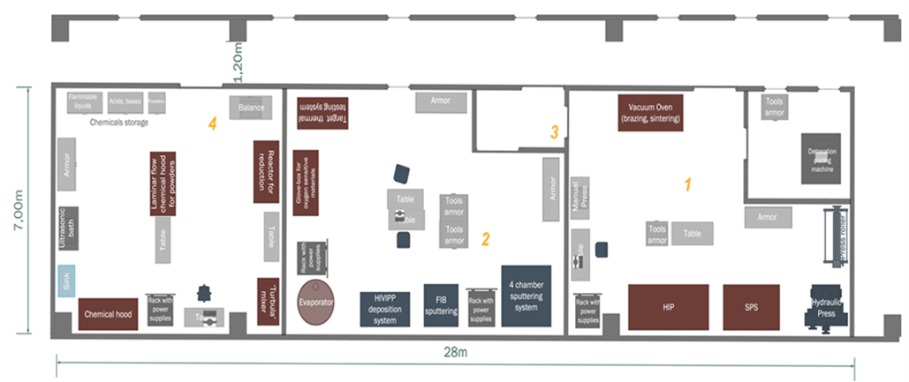
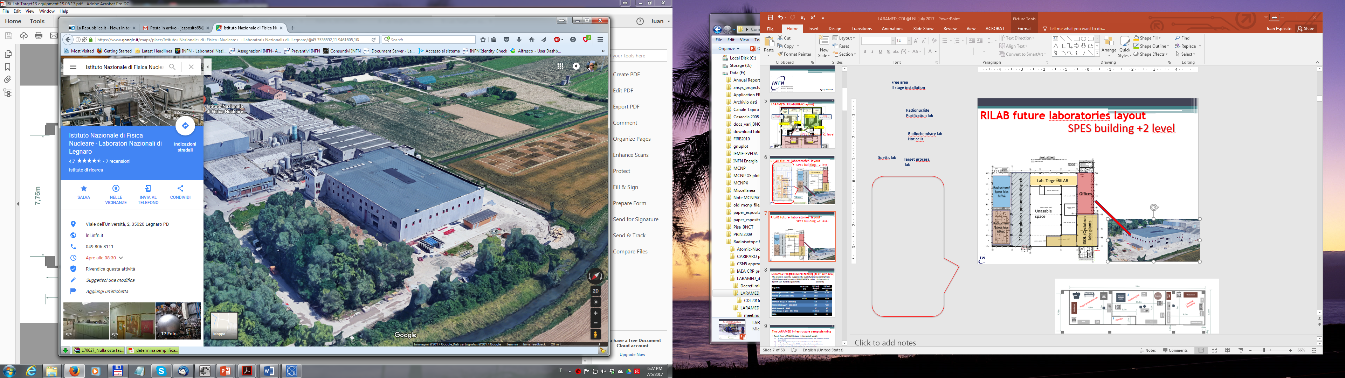
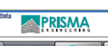
LARAMED Infrastractures (+ 2 floor)
Target processing/
radiochemistry lab
Start of installation schedule: 2017/2018
Target production
cold chemistry lab
Future GMP-compliant
production
Radionuclide
Purification lab
Hot cells
Spectrometry
lab
Target process.
lab

Slide 8
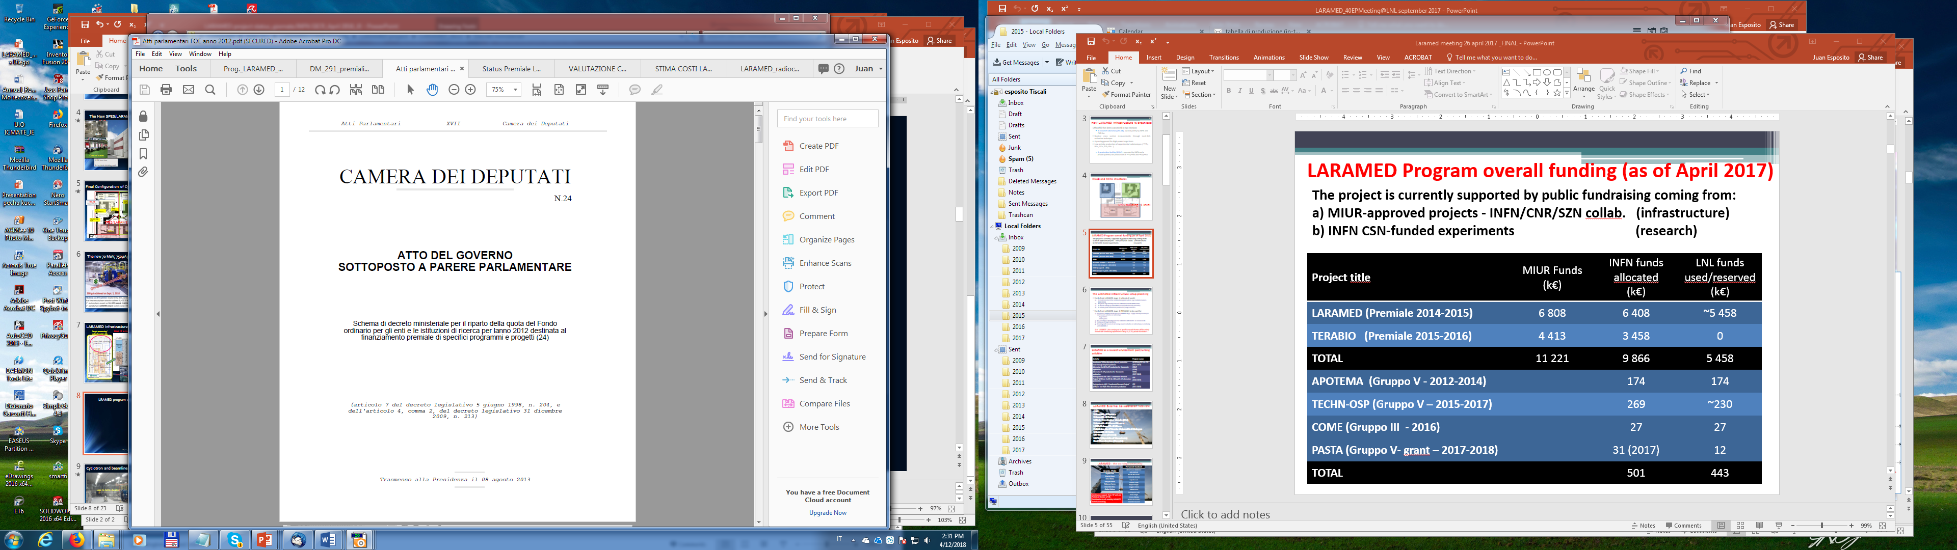

LARAMED program overall funding (as of April 2018)
The project is currently supported by public fundraising coming from:
a) MIUR-approved projects - INFN/CNR/SZN collab. (infrastructure)
b) INFN CSN-funded experiments (research)
Full LARAMED facility cost - instrum. Included - (2015 estimation): ~ 13 M€
Project title | MIUR Funds (k€) | INFN funds allocated (k€) | LNL funds used/reserved (k€)
LARAMED (Premiale 2012) | 6 808 | 6 408 | ~5 250
TERABIO (Premiale 2014) | 4 413 | 3 458 | ~1 400
TOTAL | 11 221 | 9 866 | ~6 650
APOTEMA (CSN 5 - 2012-2014) |  | 172 | 172
TECHN-OSP (CSN 5 – 2015-2017) |  | 271 | 271
COME (CSN 3 - 2016) |  | 27 | 27
PASTA (CSN 5- grant – 2017-2018) |  | 66.5 | 56
E-PLATE (CSN 5- grant – 2018-2019) |  | 32 (2018) | 10.5
METRICS (CSN 5 - 2018-2020) |  | 55 (2018) | 2.5
TOTAL |  | 623.5 | 539
Atti parlamentari FOE anno 2012
Atti parlamentari FOE anno 2014

Slide 9
past/running R&D activities within LARAMED framework
Il progetto LARAMED ha come scopo l’R&D per la produzione da ciclotrone di radioisotopi metallici convenzionali, come il Tc-99m (progetto TECHN-OSP), ed emergenti, come il Cu-67 (progetto COME), per uso medicale
INFN already funded/running projects | Project name
Accelerator-Tc-99m alternative (direct) production route through hospital cyclotrons | APOTEMA (2012-2014) TECHNOSP (2015-2017)
“Coordinated Research Project ' (CRP) on“Alternative, non HEU-based, Tc-99m /Mo99 supply” | IAEA CRP (2011-2015)
Alternative Cu-64/Cu-67 production for theranostic application | COME (2016)
Alternative Sc-47 production for theranostic application | PASTA (2017-2018)
CRP on “Radiopharmaceuticals Labelled with New Emerging Radionuclides” Cu-67, Re-186, Sc-47” | IAEA CRP (2016-2019)
High Power Target concepts R&D (^{64/67}Cu) | TERABIO comp. project (2016-2019)
High intensity vibrational powder plating | E_PLATE (2018-2019)
Multimodal pET/mRi Imaging with Cyclotron-produced Mn-52/51 and stable paramagnetic Mn iSotopes | METRICS (2018-2020)
LARAMED first radionuclides list of interest
Radioisotope | Half-life
Tc99m | 6.01 h
Cu-64 | 12.7 h
Cu-67 | 2.58 d
Sc47 | 3.35 d
Mn-52 | 5.59 d

Slide 10
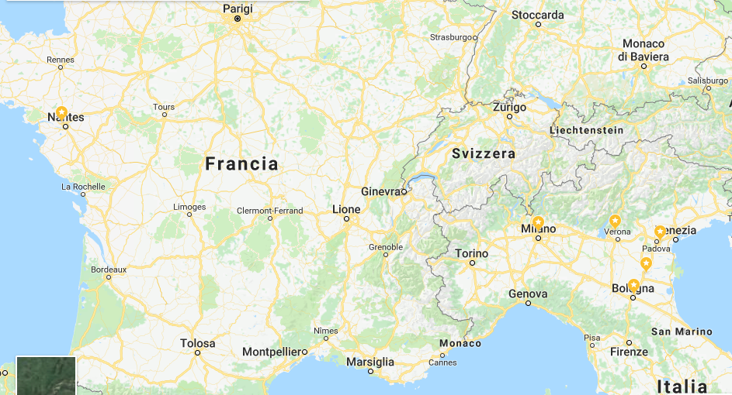
LARAMED External Collaboration Network
Waiting for dedicated beam-lines and available laboratories, we are collaborating with:
ARRONAX facility (Nantes, France), 70 MeV multi-particle cyclotron
St. Orsola Hospital (Bologna, Italy). 16 MeV cyclotron
Sacro Cuore Don Calabria Hospital (Negrar, VR, Italy). 19 MeV cyclotron
Ferrara University (Italy), YAP-(S)PET-CT small-animal imaging system
National Research Council (CNR) in Milan (Italy), Facility for cellular and pre-clinical studies
LNL-INFN
S.C. Don Calabria Hospital
(Negrar)
St. Orsola Hospital
(Bologna)
CNR
Milan
ARRONAX
(Nantes)
University of Ferrara

Slide 11
Laboratori Nazionali di Legnaro (LNL)
APOTEMA - CSN5 - 2012/2014
TECHN_OSP - CSN5 - 2015/2017

Slide 12
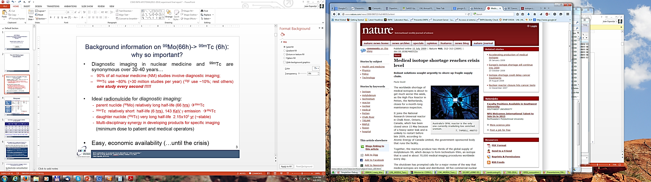
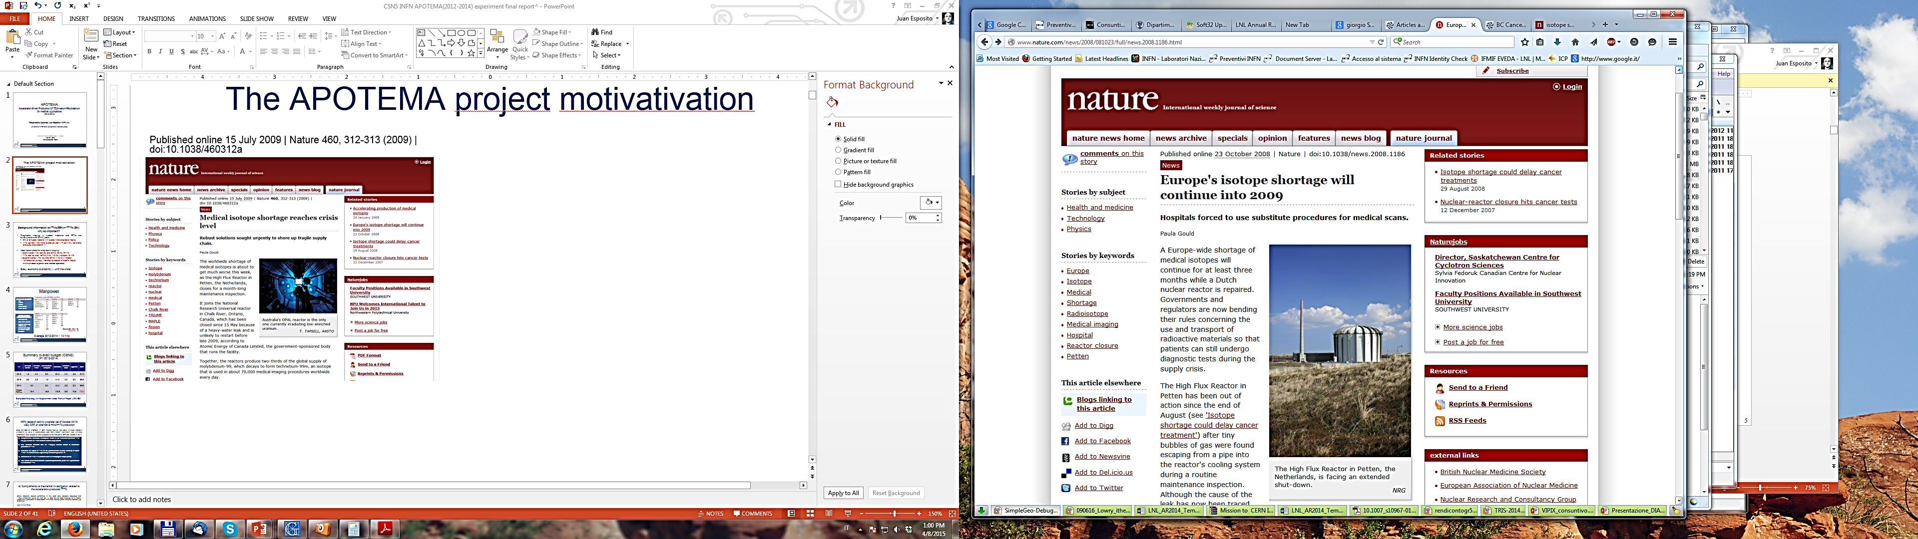
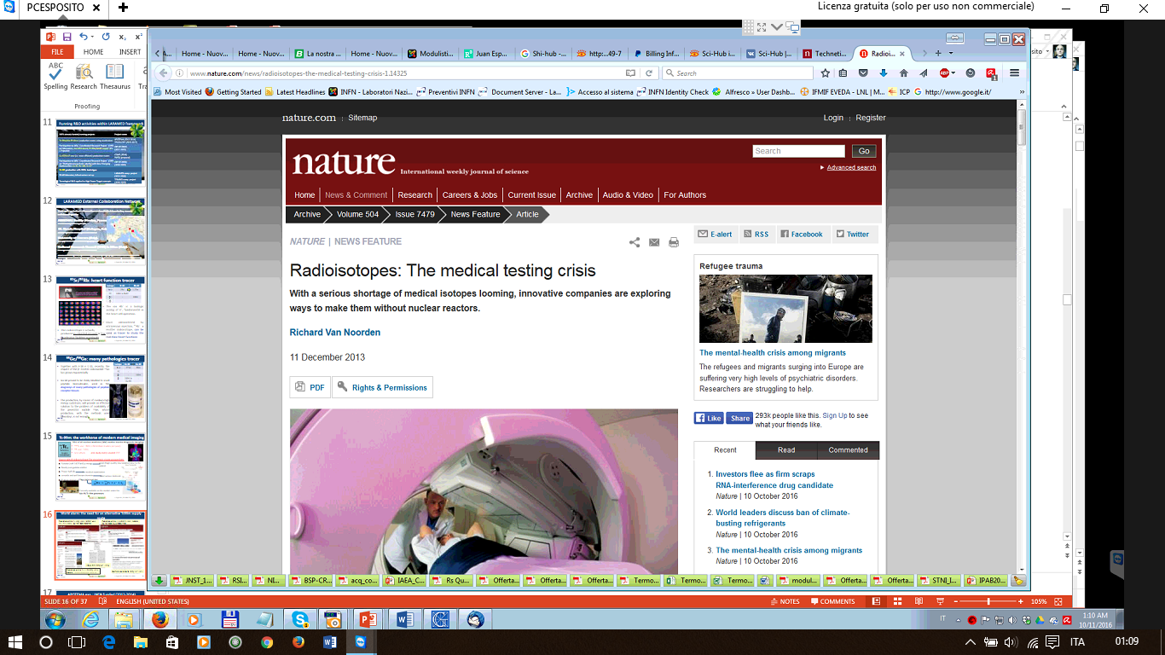
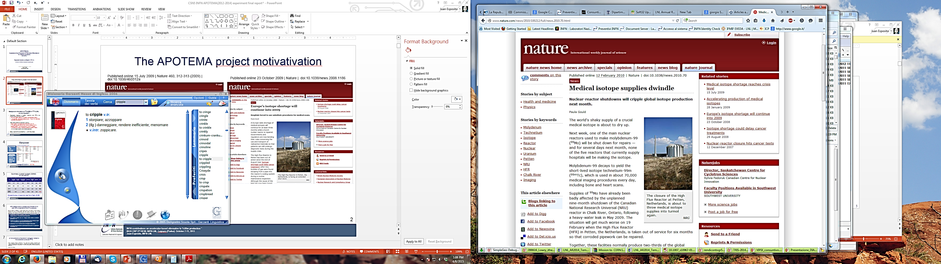
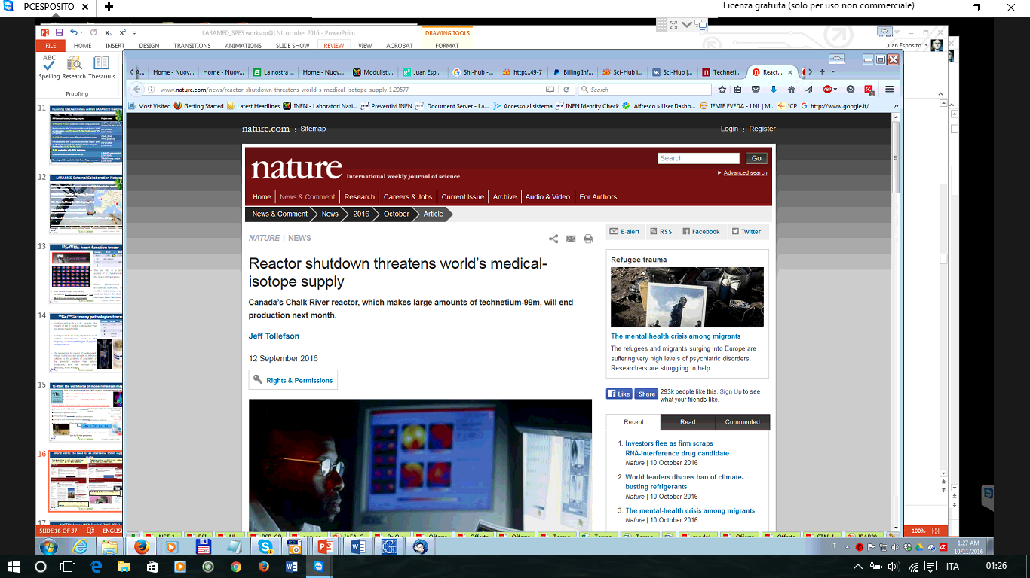
Tc99m supply World crisis: seeking for alternative routes
Published online 15 July 2009 | Nature 460, 312-313 (2009) | doi:10.1038/460312a
Published online 23 October 2008 | Nature | doi:10.1038/news.2008.1186
Published online 12 December 2013 | Nature doi:10.1038/504202a
Published online 12 February 2010 | Nature | doi:10.1038/news.2010.70
Published online 12 September 2016 | Nature ! doi:10.1038/nature.2016.20577

Slide 13
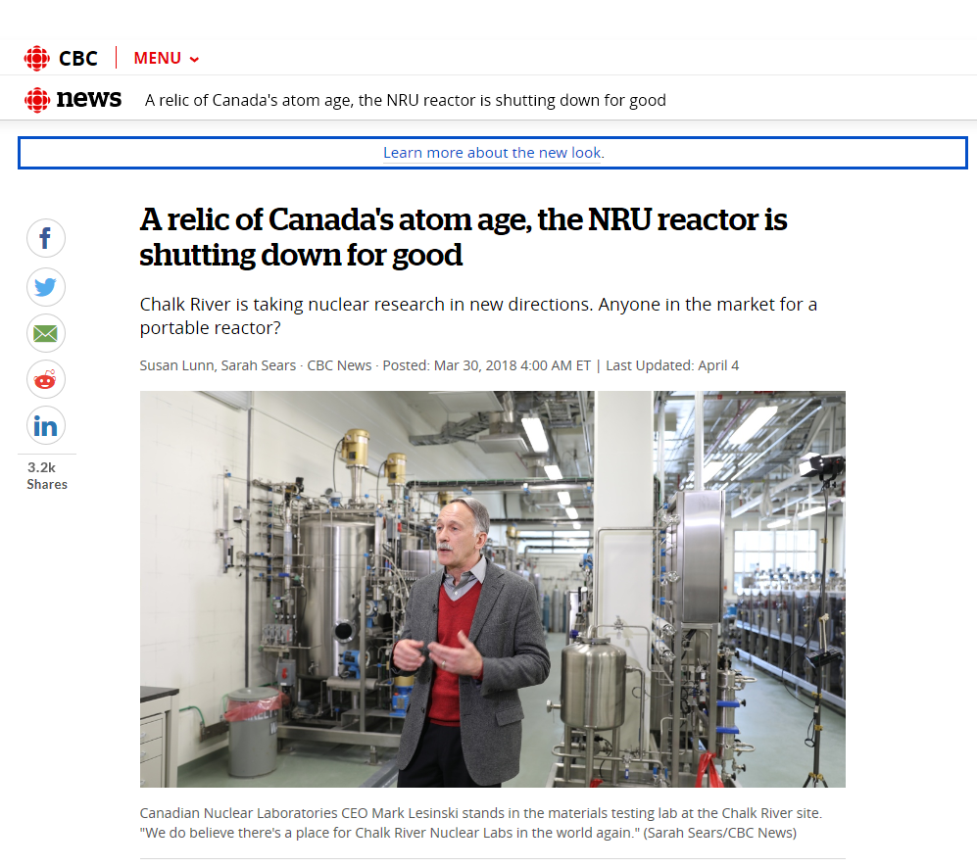
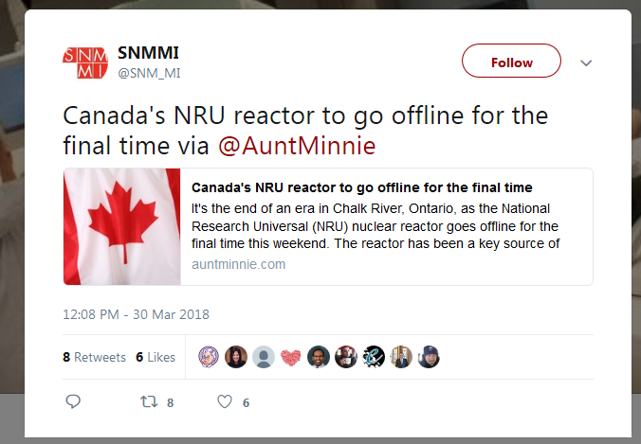
The Canada's NRU reactor: the largest HEU-based ⁹⁹Mo world-supplier (2/3 demand)
March 31, 2018: the world's oldest operating nuclear reactor in the world (first criticality, Nov. 1957) has been permanently shut down
As of July 2017, almost all Mo-99 for medical use was being produced by irradiating solid uranium targets in the six research reactors listed below (available production capacity of the reactors is shown in parentheses)
BR-2, Belgium (7,800 six-day Ci/week)
HFR, Netherlands (6,200 six-day Ci/week)
LVR-15, Czech Republic (3,000 six-day Ci/week)
Maria, Poland (2,700 six-day Ci/week)
OPAL, Australia (2,150 six-day Ci/week)
SAFARI-I, South Africa (3,000 six-day Ci/week)
End of operation
2026
2024
2028
2030
2057
2030
What will happen in the mid term: another shortage ?

Slide 14
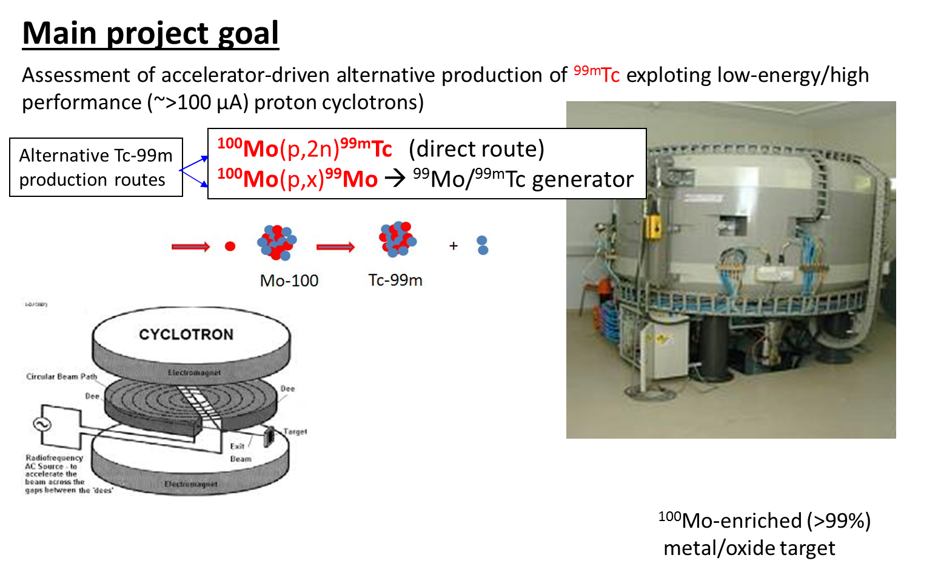
The most promising alternative route for ^{99m}Tc supply
INFN studies started in 2010. Two CSN5- funded research projects approved in last 6 years:
APOTEMA (2010-2014)
Feasibility studies aimed at investigating, possible alternative Tc99m production routes, from the nuclear physics (both theoretical and experimental) point of view.
TECHNOSP (2015-2017)
R&D of a technology aimed at having an, as easy as possible, and cheap accelerator-Tc99m in-house production.
Basically make available, to an already existing 16-20 MeV class medical cyclotrons network in a country (e.g. Italian situation) the possibility of a routine accelerator-Tc99m local supply.
Main conclusion:
Direct production of ^{99m}Tc is by far the best route

Slide 15
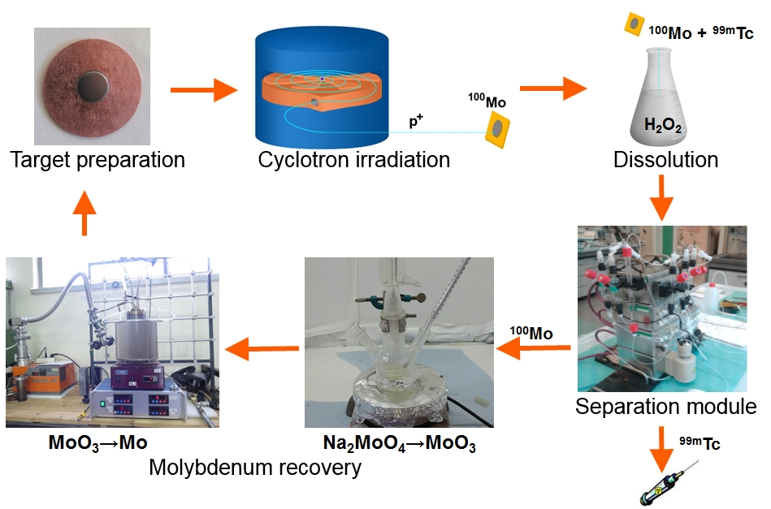
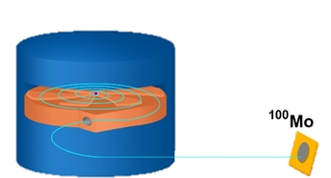
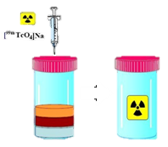
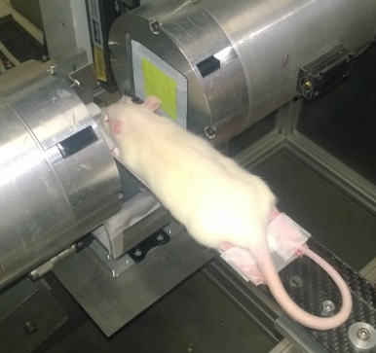
Direct ^{99m}Tc Cyclotron Production
Closed-loop technology developed at LNL: recovery of costly target material
Target
production
Cyclotron
irradiation
Extraction separation purification
Radio-pharmaceuticals,
QC, imaging
¹⁰⁰Mo recovery techniques
¹⁰⁰Mo(p,2n)^{99m}Tc

Slide 16
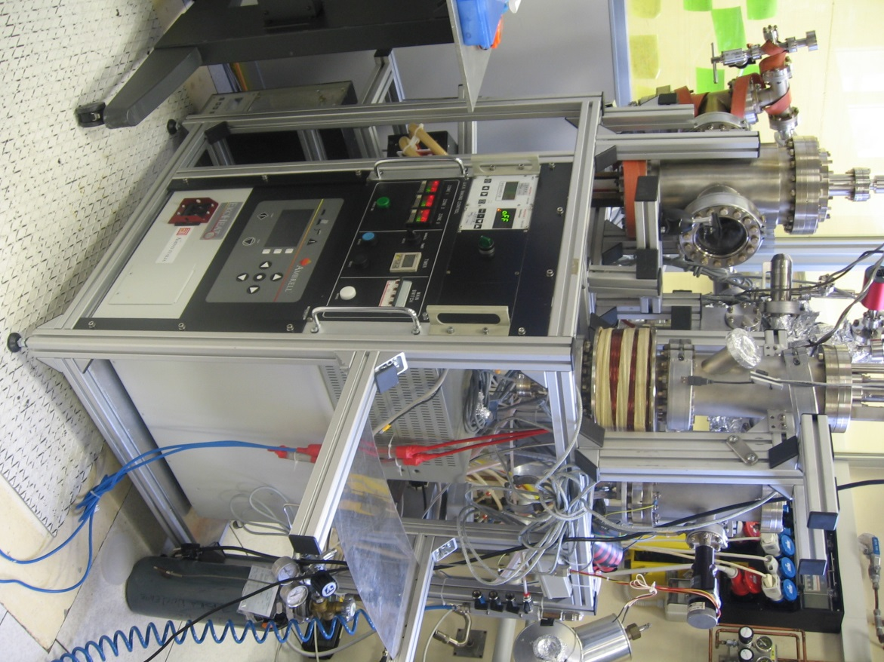
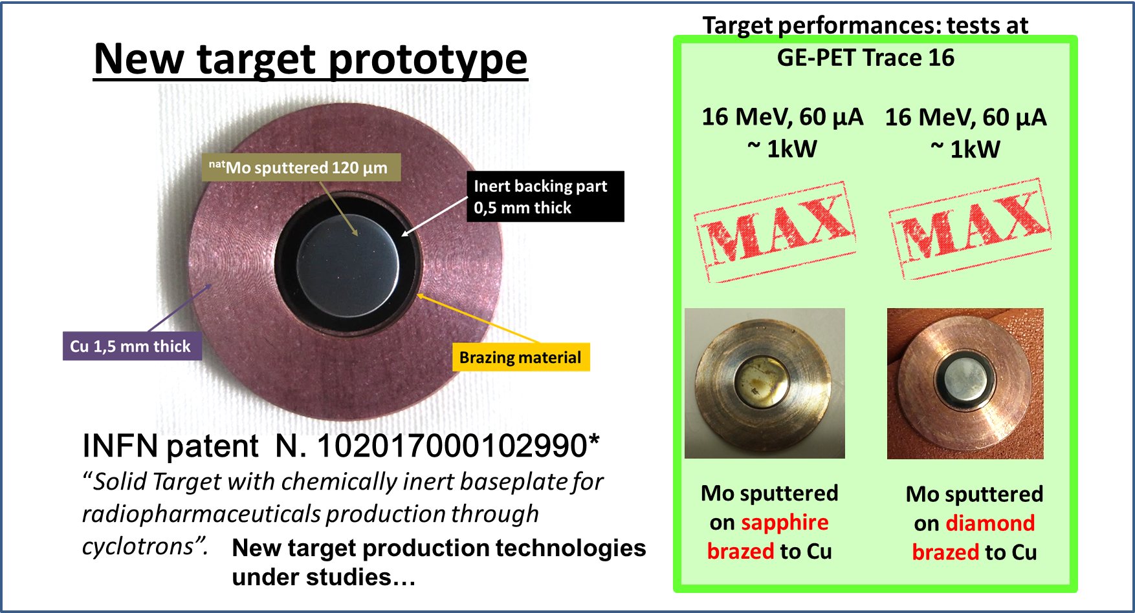
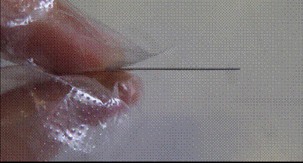
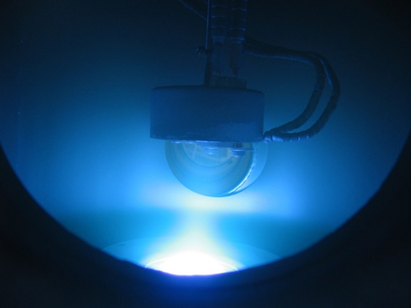
Direct ^{99m}Tc Cyclotron Production
New solid target technology R&D
Isotopic composition (%)
Mo-100 | Mo-98 | Mo-97 | Mo-96 | Mo-95 | Mo-94 | Mo-92
99,05 | 0,54 | 0,07 | 0,11 | 0,10 | 0,05 | 0,08
First successful test to deposit multiple layers (0.5 μm each) up to ∼300 μm on a copper backing using the Physical Vapor Deposition (PVD) technique under UHV at LNL. No stress at micro-structure level has been observed.

Slide 17
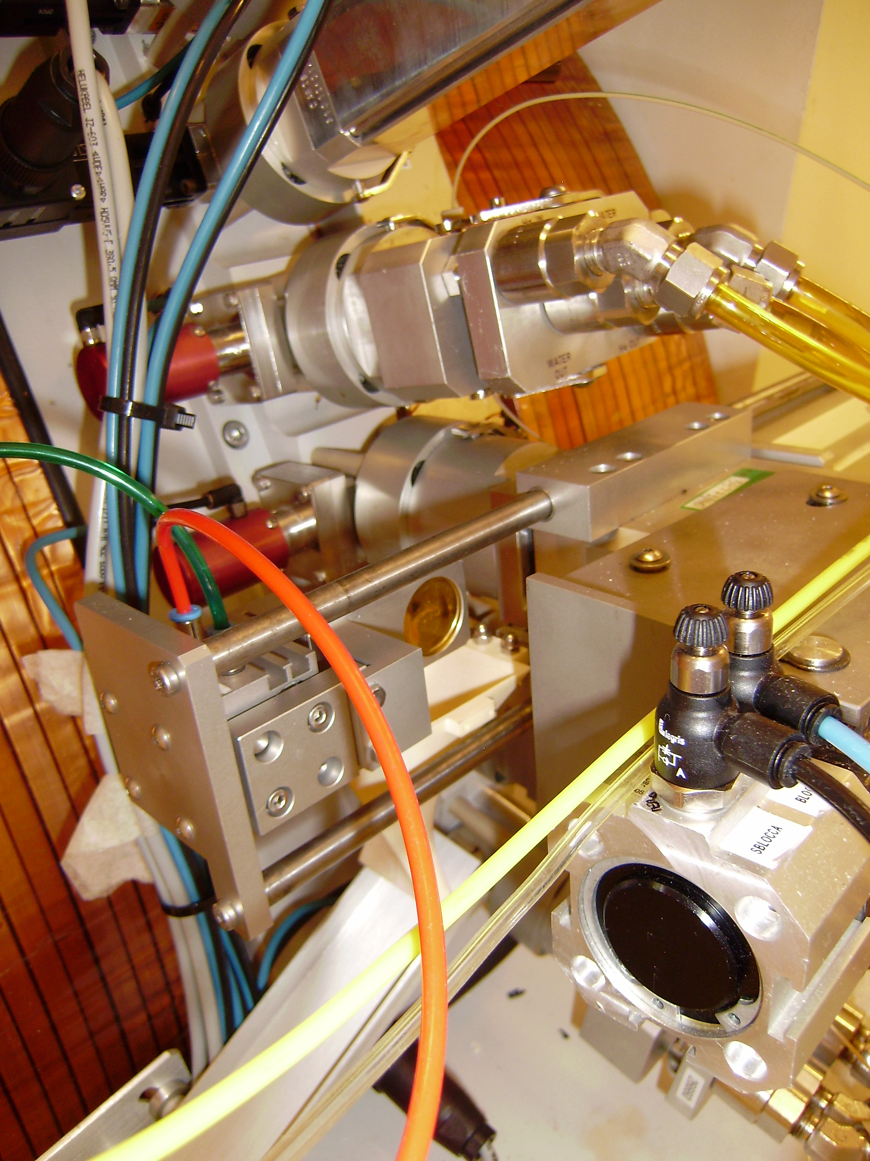
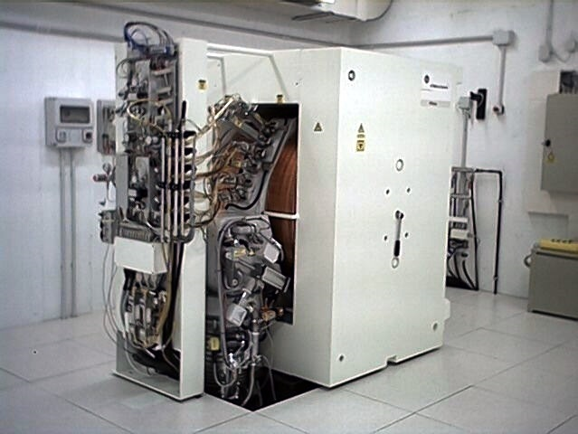
Target Irradiation tests at S. Orsola Hospital (Bologna)
110 μm Mo-nat directly sputtered onto Cu backing (first time ever)
70µA, 15.6 MeV (1hr irradiation) -> ~1.1 kW/cm² achieved!!
Contact between sputtered Mo film, and Cu-backing remains excellent
6hrs irr/day -> ~2.0 Ci daily needs S. Orsola Hospital could be fulfilled
Before
Additional ~1.5 kW/cm², no-direct cooling
target concept under study
GE PetTRACE -16
Protons: 16 MeV, up to 75 μA (1.2 kW)
Deuterons:8.4 MeV, 50 μA deuterons
MaX available
PetTRACE
beam current
After

Slide 18
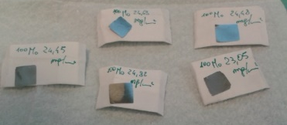
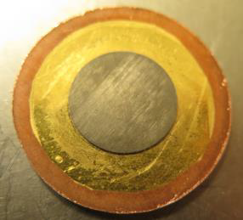
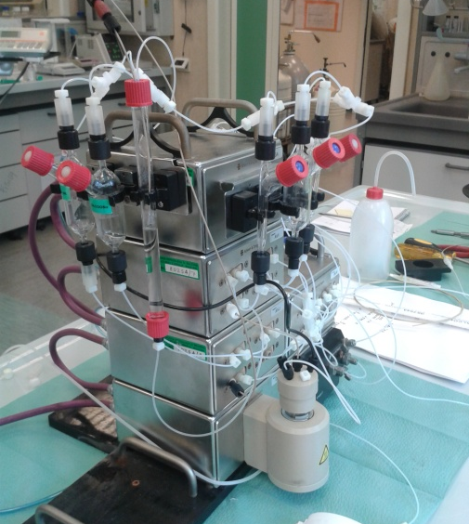
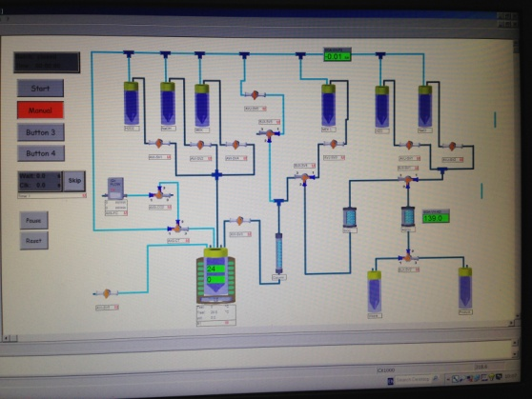
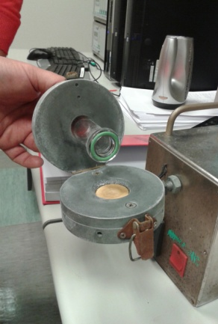
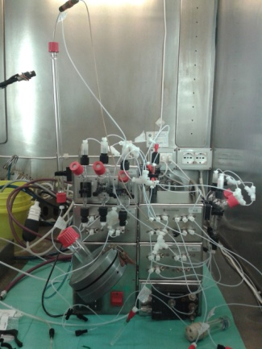
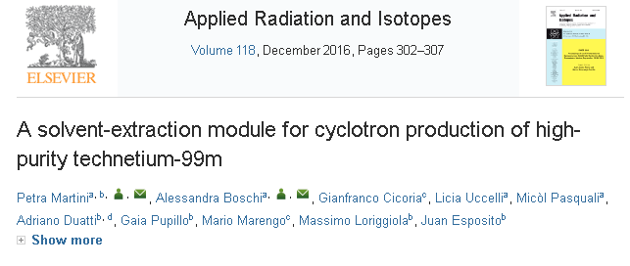
Direct ^{99m}Tc Cyclotron Production
Extraction Separation Purification
First automatic Prototype
(Unife/S. Orsola OspBO)
Second automatic Prototype
(Unife/S. Orsola OspBO)
Recovery Yield | >93%
Time | 60 min
Target mass | Up to 500 mg

Slide 19
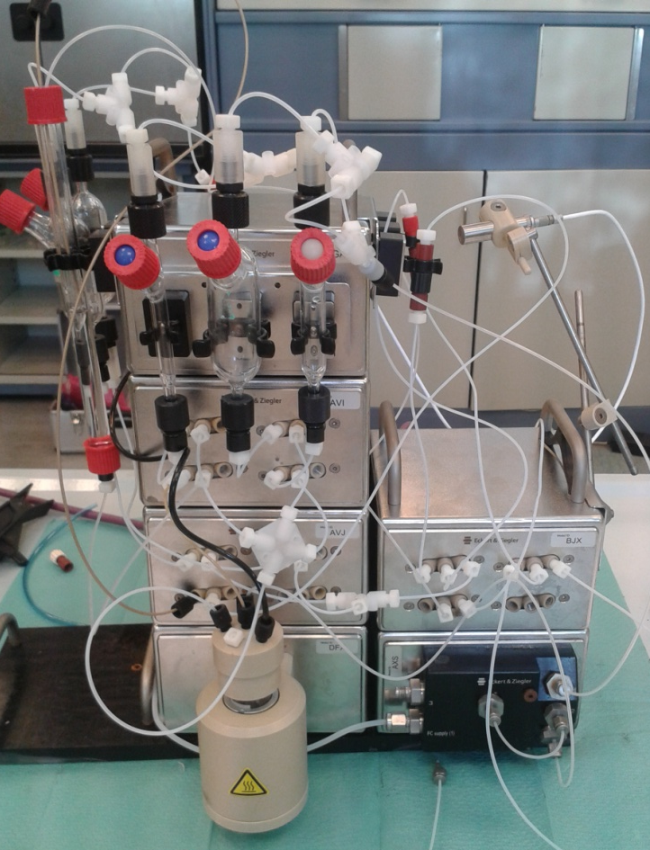
Target dissolution/Purification of ^{99m}Tc
The fully-automated, PLC-operated, remote-controlled chemical separation module prototype Developed: Ferrara Univ. and S. Orsola Hospital (Bologna) working groups.
MEK-based (Methyl-Ethyl-Ketone) Solvent Extraction method:
Process time: 60-70 min
^{99m}Tc Recovery Yield (efficiency) : > 93%
Radiochemical Purity: > 99% ^{99m}TcO₄ (ref. Eu-Pharm >95%)
Trace analysis: < 5 ppm Al3+ (ref. Eu-Pharm <5 ppm)
non-Tc impurities < MDA
P. Martini, et al. ARI, 118, (2016) 302-307
M. Gumiela,
Separation methods of
cyclotron-produced 99mTc, Nuclear Medicine and Biology (2017), doi:
10.1016/j.nucmedbio.2017.11.001
“…It is worth to emphasize that this solvent-extraction fully automated module results among the discussed methods in the highest recovery yield of ^{99m}Tc…”.

Slide 20
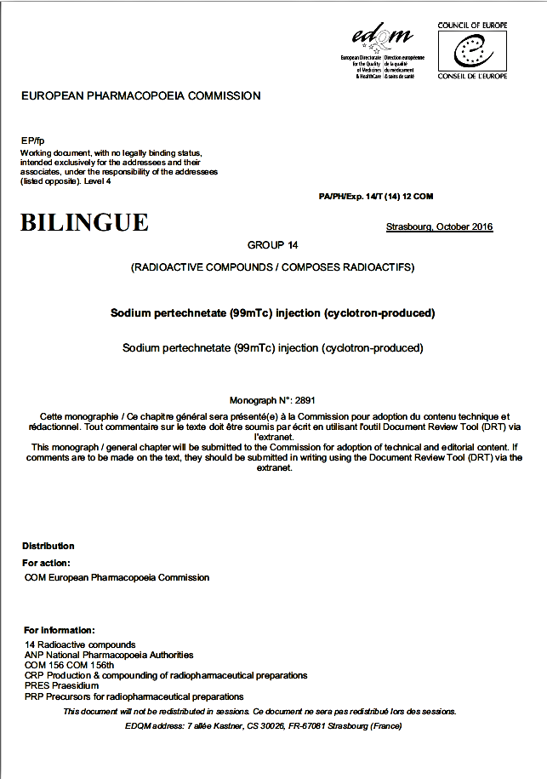

Direct ^{99m}Tc Cyclotron Production
Radio-pharmaceuticals, QC, imaging
SEPARATION YIELD | % | ^{9x}Tc | ⁹⁹Mo | ^{9x}Nb
 | Final solution | 93 ± 3 | ND | ND
 | Aqu. phase | 5 ± 1 | 96 ± 2 | 97 ± 2
 | Waste | 0.03 ± 0.02 | ND | ND
 | Washing | 0.5 ± 0. 1 | 3 ± 1 | 2 ± 1
 | Silica column | 0.2 ± 0.1 | ND | ND
 | Alumina col. | 0.2 ± 0.1 | ND | ND
 | Generator-^{99m}Tc | Cyclotron-^{99m}Tc
^{99m}Tc-Myoview SPECT-CT Immages
Tomographic images of the Jaszczak phantom
Planar image of the grid phantom
RN/ ISOTOPIC PURITY | Radionuclide | T_{1/2} | % Activity
 | Tc-93g | 2.8 h | 0.012%
 | Tc-94g | 4.9 h | 0.094%
 | Tc-95g | 20 h | 0.110%
 | Tc-95m | 61 d | 0.001%
 | Tc-96g | 4.3 d | 0.031%
 | Tc-99m | 6.01 h | 99.758%
CHEMICAL PURITY | pH | 4.5-5
 | Mo | <5ppm
 | Al3+ | <5ppm
 | MEK | <0.0004% (v/v)
Eu-Parmacopoeia approved Oct 2016
(ref. Eu-Pharm
<5 ppm)
RADIOCHEM. PURITY | ^{99m}Tc-NaTcO₄ | >99%
 | ^{99m}Tc-HMPAO | 83%
 | ^{99m}Tc-Myoview | >99%
(ref. Eu-Pharm >95%)

Slide 21



Direct ^{99m}Tc Cyclotron Production
¹⁰⁰Mo Recovery Techniques
Stage 1 : Na2MoO4(H2O)x → MoOx
Stage 2 : MoOx → Mo
¹⁰⁰Mo/^{99m}Tc separation module “waste”:
Na₂MoO₄ (H₂O)_{x} + NaOH
MoO₃(s) +H₂(g) = MoO₂(s)+H₂O(g)
MoO₂(s) +2H₂(g) = Mo(s)+2H₂O(g)
450°C-750°C
Na₂MoO₄ → MoO₃
750°C-950°C
Yield >90% MoO₃
Yield >95% Mo
Notes:
Na₂MoO₄ + HNO_{3(excess)} (80⁰ C, reflux)= NaNO₃ + H₂MoO₄
ΔT → MoO₃↓ + H₂O↑
Washing with EtOH+H₂O solutions, centrifugation, drying
Riduzione in 780 minuti

Slide 22

The daily need of ^{99m}Tc in Italy: Some facts and starting numbers....
Based on meetings had with the medical physics head of the St. Orsola Hospital (Bologna)-Nuclear Medicine Dept., and with people involved in Ferarra hospital we have been aware that:
^{99m}Tc needs for S. Orsola Hospital only for routine diagnostic procedures : 1÷2 Ci/day
^{99m}Tc daily need for the whole country be about S. Orsola Hospital x 150 ≅ 150-300 Ci
Is this range likely?
-------------------------------------------------------------------
Former information we had for Veneto region in past years: ~7 Ci/day
Rough extrapolation: 7x 20 Italian regions =140 Ci
Former information we had for Ferrara Hospital in past years: ~1 Ci/day
Emilia Romagna region estimated ~ 10 times Ferrara needs = 10 Ci/day x 20 = 200 Ci/day
Average ^{99m}Tc daily need may thus be supposed ~150-200 Ci in the whole country

Slide 23
Direct ^{99m}Tc Cyclotron Production
How much ^{99m}Tc may we produce?
By using high-performance cyclotrons (i.e. 300-500 µA current intensity and energies up to 20 MeV) the daily needs of the entire Veneto region (273 GBq/day = ~ 7 Ci/day) may be supplied.
By using medical cyclotron commonly installed in Nuclear Medicine Dep. (16-19MeV), ¹⁰⁰Mo-enriched targets up to 99.86% (thickness 260 and mass 450 mg) irradiated at 80 µA, 15.0 MeV, over a period of 120 min. Under these conditions, the expected yield of Tc-99m is approximately 30-36 GBq ~ 0.7-1 Ci/day.
Injected dose: 20 mCi; (preparation dose is 40 mCi)
Tc99m cyclotron production (15 MeV, 100 μA )
2 hrs irr | 6 hrs irr
~80 €/dose (2.02€/mCi) | ~60 €/dose (1.51€/mCi)
Generator 99mTc cost ~25 €/dose (0.63€/mCi)
0.63€/mCi
0.36€/mCi
Source: GE-Healthcare
The generator-produced Tc-99m price is expected to further increase with NRU reactor permanent shutdown in 2018.

Slide 24
Laboratori Nazionali di Legnaro (LNL)
COME - COpper Measurements
2016

Slide 25


⁶⁷Cu and ⁶⁴Cu: new emerging radionuclides couples
Cu-67 very attractive because of physical-chemical properties (T_{1/2} 2.58 d). Suitable for Theranostic (Therapy + Diagnostic ) applications, as single isotope, or in pair with
⁶⁴Cu (β-emitter, half-life 12.7 h).
⁶⁴Cu is ALREADY used in nuclear medicine for PET (diagnostic proc.)
⁶⁴Cu seems to provide excellent results also in THERAPY (under simple ⁶⁴CuCl₂)
Before
After
Malignant melanoma images (left leg) before and after 100 mCi ⁶⁴CuCl₂ injection
SPECT
⁶⁷Cu
Mean β energy: 141 keV
What will it happen by using ⁶⁷Cu ?
Mean Auger e energy: 28 keV
  ⁶⁷Cu is a promising nuclide in RAdio Immuno Therapy (RAIT)
  ⁶⁷Cu‘s limiting factor: LOW availability
  Worldwide Production per month : only (100 mCi ≈ 3.7 GBq); 1 patient dose
  → ⁶⁷Cu production: Goal for both LARAMED and ARRONAX !
Mean β energy: 190 keV
⁶⁴Cu
Mean Auger e energy: 2 keV
PET
*Peng F et al., J Nucl Med (2006)47:1649-1652 ; **H Cai et al. , J Nucl Med (2014) 55:622-628.
Notes:
Intro sui rami :
2 - spiegazione TERANOSTICA sia come isotopi singoli sia come miscela dei due

Slide 26




⁶⁷Cu current production route
⁶⁸Zn(p,2p) reaction, already used but…not efficient
COME (COpper xs MEasurement) exp.: INFN funded (2016)
New reaction route under exam.: ⁷⁰Zn(p,α)⁶⁷Cu
IAEA Technical Report Series No. 473 (2011)
IAEA Technical Report Series No. 473 (2011)
No experimental data available for E_{P} > 35 MeV
⁶⁷Cu monthly production: 100 mCi (@ BNL)
Only ONE
therapeutic dose !
CoMe project:
⁷⁰Zn(p,x)^{67,64}Cu
xs measurements
In order to have a pure ⁶⁷Cu (RNP>99%) it is necessary to wait that ⁶⁴Cu decays
→ lose ≈ 80% of ⁶⁷Cu activity
In order to have a pure ⁶⁷Cu (RNP>99%) it is necessary to wait that ⁶⁴Cu decays → lose ≈ 80% of ⁶⁷Cu activity

Slide 27
Laboratori Nazionali di Legnaro (LNL)
Ongoing and just started projects

Slide 28

Laboratori Nazionali di Legnaro (LNL)
PASTA –Production with Accelerator of Sc-47 for Theranostic Applications
2017/2018
CONCORSO PER GIOVANI RICERCATORI
PI: Gaia Pupillo

Slide 29



PASTA project : ⁴⁷Sc cyclotron production@LNL
PASTA: Production with Accelerator of Sc-47 for Theranostic Applications
Overall proton-induced reactions for ⁴⁷Sc production (NNDC, 2016)
Scientific Motivation: Why ⁴⁷Sc?
⁴⁷Sc (3.35 d, γ SPECT, β- terapy) is a promising radionuclide in Radio Immuno Therapy (RIT).
Suitable half-life to follow the slow bio distribution of monoclonal antibodies (mAbs)
Low energy β-emitter suitable to treat small-sized tumors
⁴⁷Sc current production methods through neutron induced nuclear reactions at reactor sites: ⁴⁷TiO₂(n,p)⁴⁷Sc or ⁴⁶Ca(n,γ)⁴⁷Ca ->⁴⁷Sc
Contaminants co-production: ^{44m}Sc (58.61 h, β+),
⁴⁴Sc (3.97 h, β+), ⁴⁶Sc (83.79 d, β- )
Main goal: find-out 47Sc alternative cyclotron-driven production routes, with as low as possible contaminant nuclides
The trend of these nuclear cross sections has to be confirmed..
J. Esposito, 9ICI 2017, Doha (Qatar), 12-16 Nov. 2017

Slide 30
Laboratori Nazionali di Legnaro (LNL)
E-PLATE
Electrostatic Powder pLating for Accelerator TargEts
CONCORSO PER GIOVANI RICERCATORI
PI: Hanna Skliarova

Slide 31


E-PLATE
High intensity vibrational powder plating - HiViPP
This deposition technique exploits the phenomenon of vibrational motion of metallic particles in a static electric field [1].
Experimental set up
Ti per Pasta
Cr per METRICS
Mo per E-PLATE
Te per I production
Gd per ARRONAX
Sn su Carbon foil NUMEN
Advantages:
Two targets are deposited simultaneously
High Efficiency: 95-98%!
High uniformity
1 – backing (upper electrode, anode)
2 – backing (lower electrode, cathode)
3 – quartz or glass cylinder
4 – pressing plate
5 – spring
6 – insulator holder
^{nat}Ti metal on Al foil
for PASTA project
Process is realized in vacuum
[1] An application of a new type deposition method to nuclear target preparation, Isao Sugai
Notes:
Technique is very interesting, but has a lot of not clear aspects

Slide 32
Laboratori Nazionali di Legnaro (LNL)
METRICS
Multimodal pET/mRi Imaging with Cyclotron-produced ^{52/51}Mn and stable paramagnetic Mn iSotopes

Slide 33

METRICS- Mn-52
Diagnostic imaging mismatch because of the chemical diversity between the contrast and radioactive agents.
To achieve a genuine fusion between PET and MRI, the contrast and radioactive agents should be chemically identical
Multi Modality Imaging MMI
PET/SPECT | CT/MR
functional imaging | anatomical imaging
radiolabeled tracer | contrast agent
e.g. ¹⁸F-FDG for PET | e.g. Ba and I for CT
or ^{99m}Tc-HMPAO for SPECT | or Gd-OMNISCAN for MRI
Mn is the only element having both:
isotopes with positron-emitting nuclear properties (i.e. ⁵²Mn average E_{β+} ~ 250 keV; ⁵¹Mn average E_{β+} ~ 960 keV) that could be conveniently employed as PET tracer
and useful paramagnetic properties to be used as MRI contrast agents (Mn²⁺)
Aiming at new dual-modality PET/MRI investigations using the same injected radionuclide/contrast agent
Project Goals:
Develop/optimize the proper separation and purification method to minimize chemical reagents
Establish stable Mn(II)-complexes

Slide 34


Slide 35

More Copper-64/67 @ LNL
The research on COPPER does not end with CoMe project
This is just the beginning
On the basis of CoMe results we have big project in mind for Cu-64/67

Slide 36























LARAMED
Family
Collaborators
THANK YOU
M. Marengo e G. Cicoria (BO)
G. Fiorentini (INFN/UNIFE)
A. Duatti (UNIFE)
S. Todde (MI)
A. Duatti
S. Cisternino
G. Pupillo
C. Rossi Alvarez (INFN-LNL)
J. Esposito
(INFN-LNL)
G. Keppel
(INFN-LNL)
F. Haddad
(Director)
G. Gorgoni e
E. Cazzola (VR)
L. Mou
H. Skliarova
L. Uccelli
M. Pasquali
P. Martini
A. Boschi
L. Uccelli
G. Sciacca (LNL)
G. Di Domenico

