Slide 1


New MPGD applications beyond HEP
G. Croci^{1,2,3}, E. Perelli Cippo^{1,3}, A. Muraro¹, M.Rebai^{1,3}, G.Grosso¹, F. Murtas⁵, D. Pacella⁶, G. Claps⁵, F. Cordella⁶, R. Pasqualotto⁴, M.Tardocchi^{1,3} and G. Gorini^{2,1}
¹IFP-CNR, Milano - ²Università di Milano-Bicocca - ³INFN–Milano-Bicocca - ⁴Consorzio RFX Euratom-ENEA Association, Padova - ⁵LNF-INFN, Frascati – ⁶ENEA, Frascati
Gabriele Croci

Slide 2
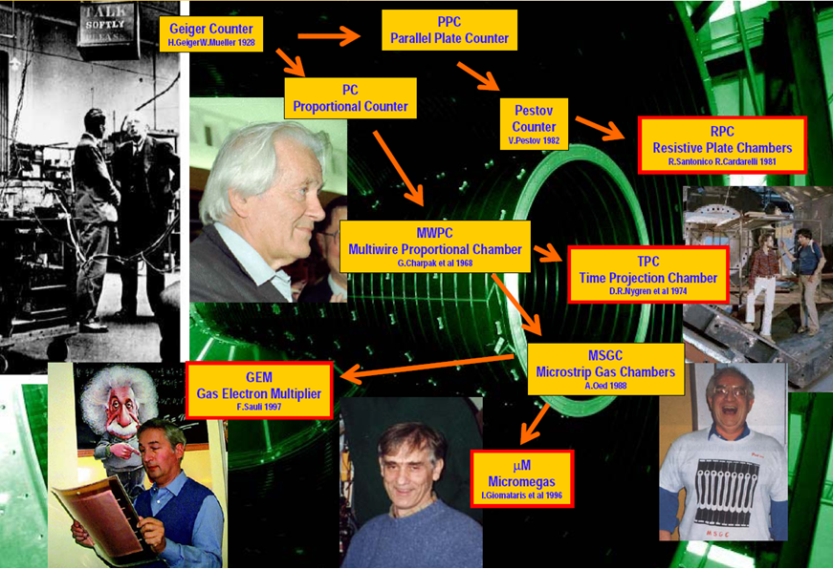
What are MPGDs ?
Micropatten Gasueous Detectors

Slide 3
HEP MPGDs applications
Born in late ‘90s
Two main lines:
  GEM (Gas Electron Multiplier and derivatives (e.g µWell)
  Micromegas and derivatives
Large area and high rates
Largerly used in past and future high energy physics experiment
All major LHC experiment will use them during the next high luminosity phase (HL-LHC)
Development co-ordinated by an international collaboration (RD51)
LHCB
TOTEM
COMPASS
BES-III
ATLAS
CMS
3

Slide 4
New non-HEP applications
Fast Neutrons
Fusion Nuclear Energy Plant (NBI)
Tokamak Diagnostics
Chip Irradiation
Thermal Neutron
3He alternatives
Small angle neutron scattering
Neutron diffraction
Pixelated GEM
Microdosimetry
Tissue Equivalent chamber
Direct measurements with real tissue
Radon Monitor
High Intensity Beam Monitors
Hadrotherapy
Ions Beam Monitor
Xray Low energy
Tokamak diagnostics
Radioactive waste

Slide 5

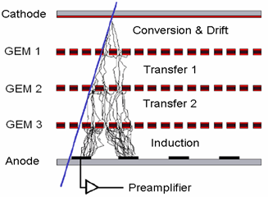
A triple GEM Chamber
A Gas Electron Multiplier (F.Sauli, NIM A386 531) is made by 50 μm thick kapton foil, copper clad on each side and perforated by an high surface-density of bi-conical channels;
Several triple GEM chambers have been built since 2001
…LHCb, Dafne Upgrade, KLOE2, UA9, IMAGEM, GEMINI, AIDA/BTF, CMS, ATLAS, ALICE …
70 µm
140 µm
GEM foil
Working with different levels of gain it is possible to obtain
high level of particle discrimination

Slide 6
GEMs for fast neutron detection

Slide 7
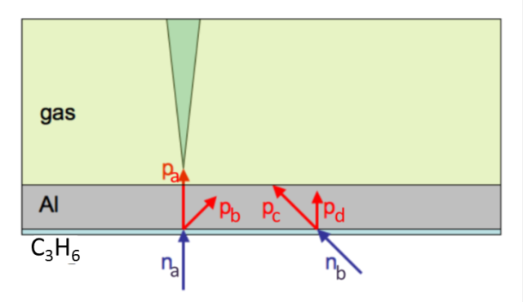
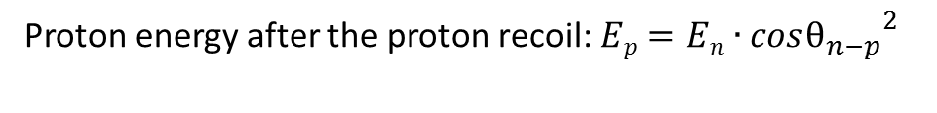
Fast neutron detection principle
GEM is intrinsically a charged particle detector
QUESTION: How to use GEM in order to detect neutrons???
ANSWER: by detecting recoiling protons produced by neutrons in plastic
Proton energy after the proton recoil: $Ep=En∙{cosθ_{n−p}}^{2}$
Not in scale.....
With this cathode only a proton recoiled by a neutron incident with an energy and an incidence angle above than a certain threshold can be detected by the nGEM
This introduces a directionality selection effect to the detector, that is thus able to provide the neutron emission map with a spatial resolution approaching the size of the footprint of the SPIDER beamlets.

Slide 8
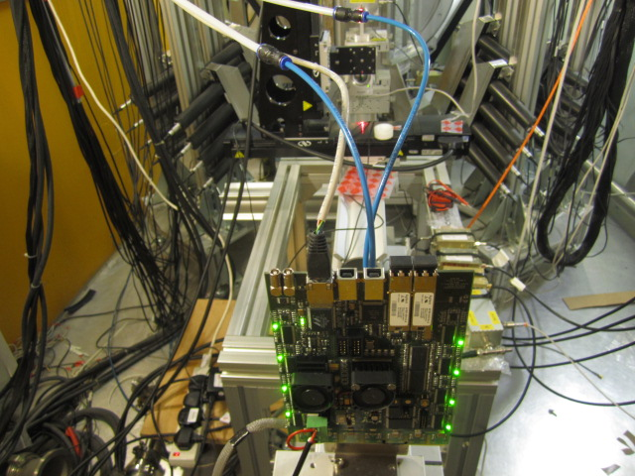
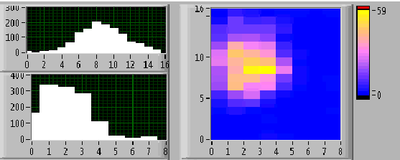
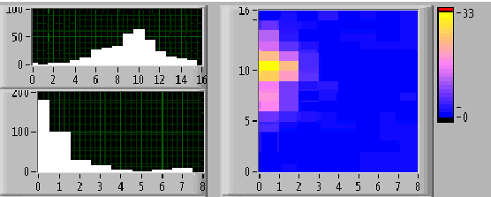
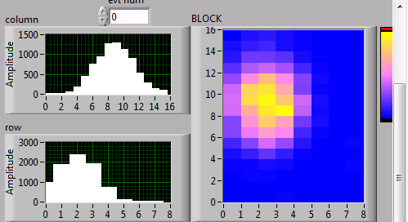
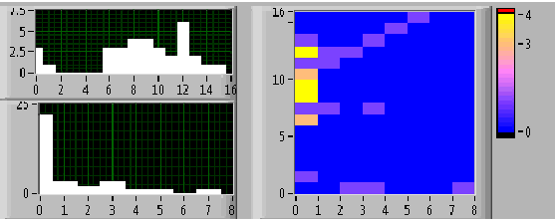
Fast Neutron Beam Monitor @ISIS
Monitor for a fast neutron beam with energies ranging from a few meV to 800 MeV
Tested at neutron beam of the Vesuvio facility at RAL-ISIS.
Beam profiles and intensity
in real time
Neutron beam monitorig during the shutter opening

Slide 9
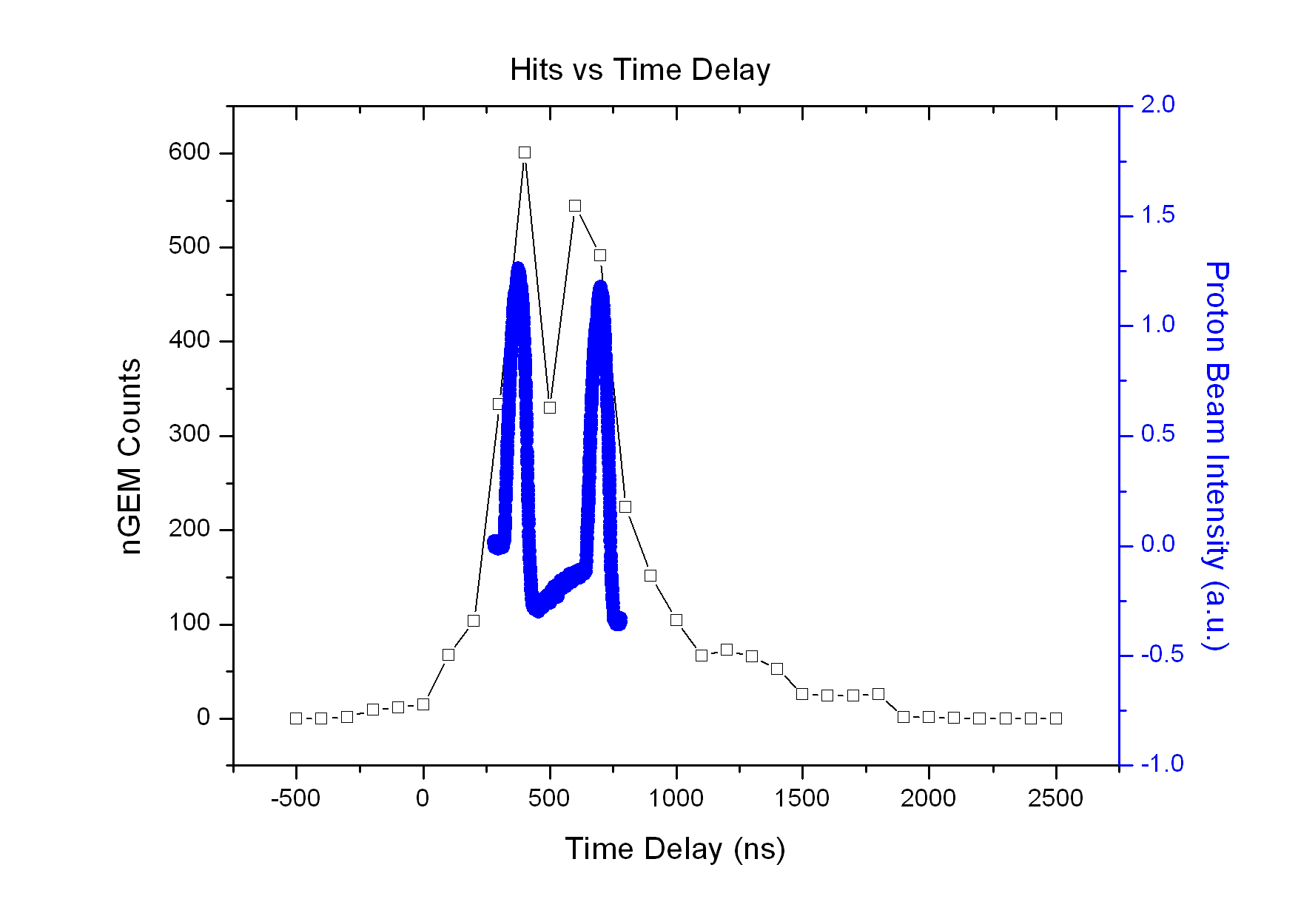
Fast Neutron arrival spectrum
E_{n}>2MeV
E_{n}<2MeV
Rate measurement scan on time delay from beam T₀ using GEM detector with 100 ns gate.
Comparison with proton beam profile intensity
Notes:
Mettere referenza articolo Croci

Slide 10
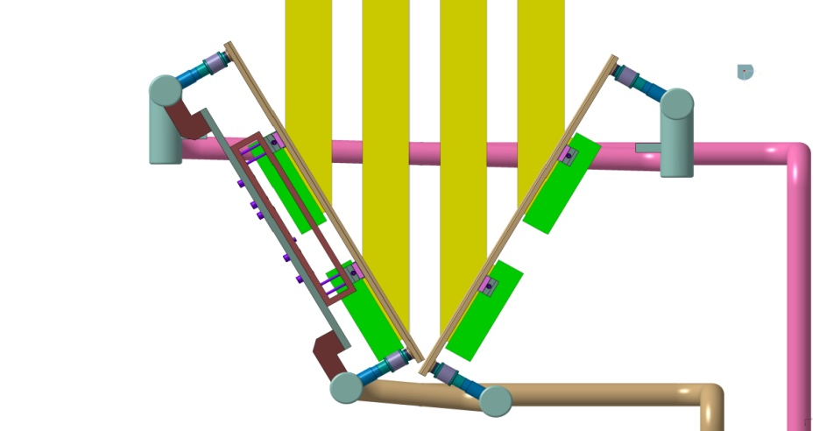
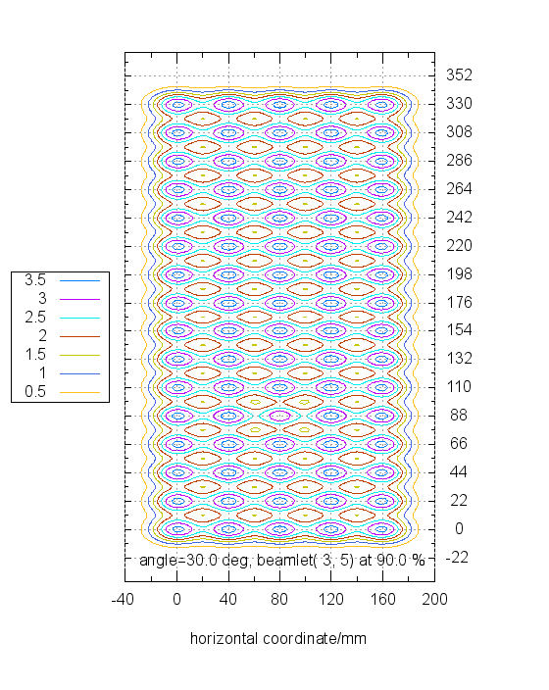
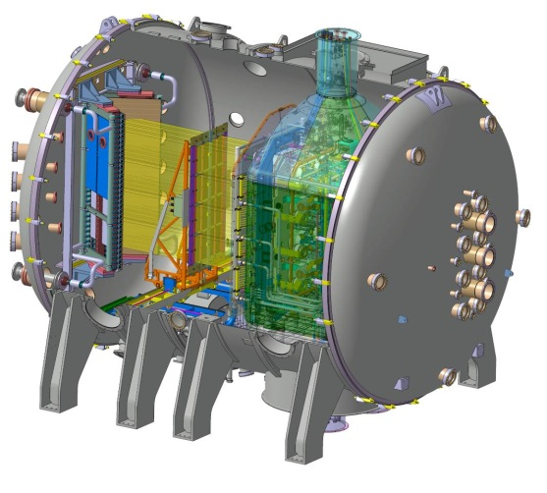

CNESM diagnostic @ SPIDER
Neutrons are emitted via the reaction:
The proposed detection system is called Close-contact Neutron Emission Surface Mapping (CNESM).
Deuterium beam
E_{d}=100keV
nGEM
Neutron Detector
Power density map (W/m²)
Beam Dump
100 kV
beam
dump
SPIDER
STRIKE
RF
source

Slide 11
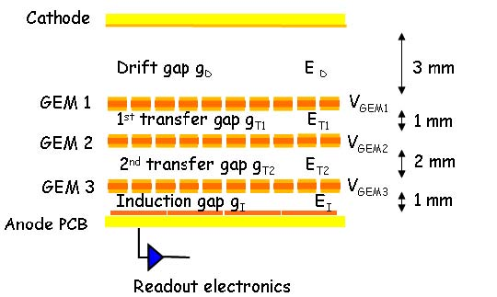
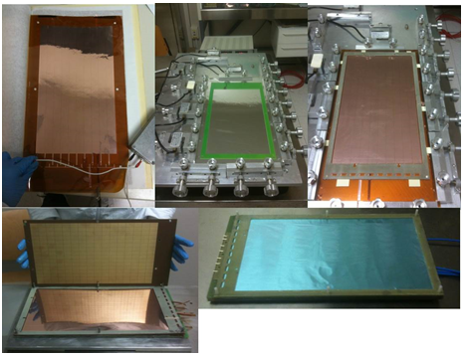
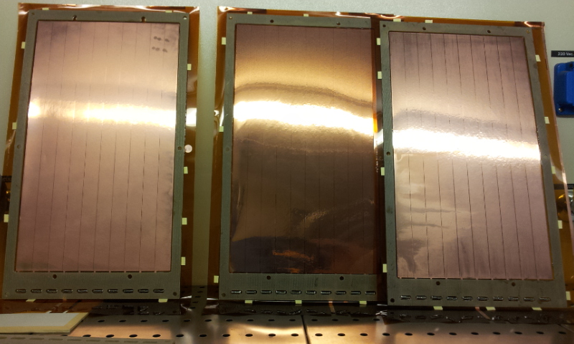
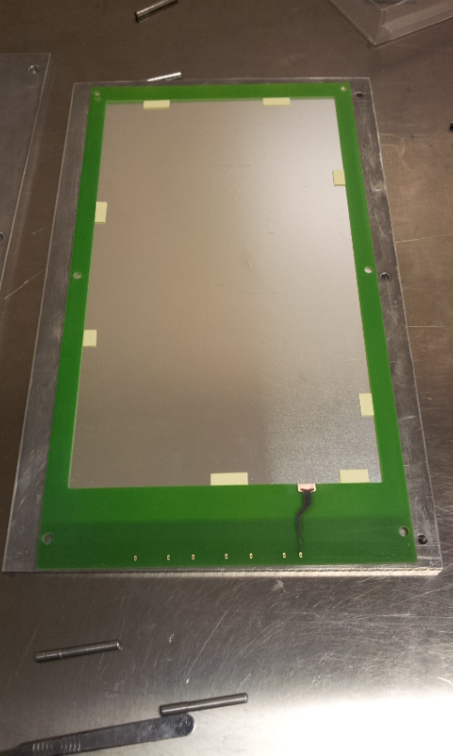
nGEM constructon
Cross section schematics of the triple-GEM detector.
2mm polypropylene(C₃H₆)
50 um Al
Active area: 25x35 cm²

Slide 12
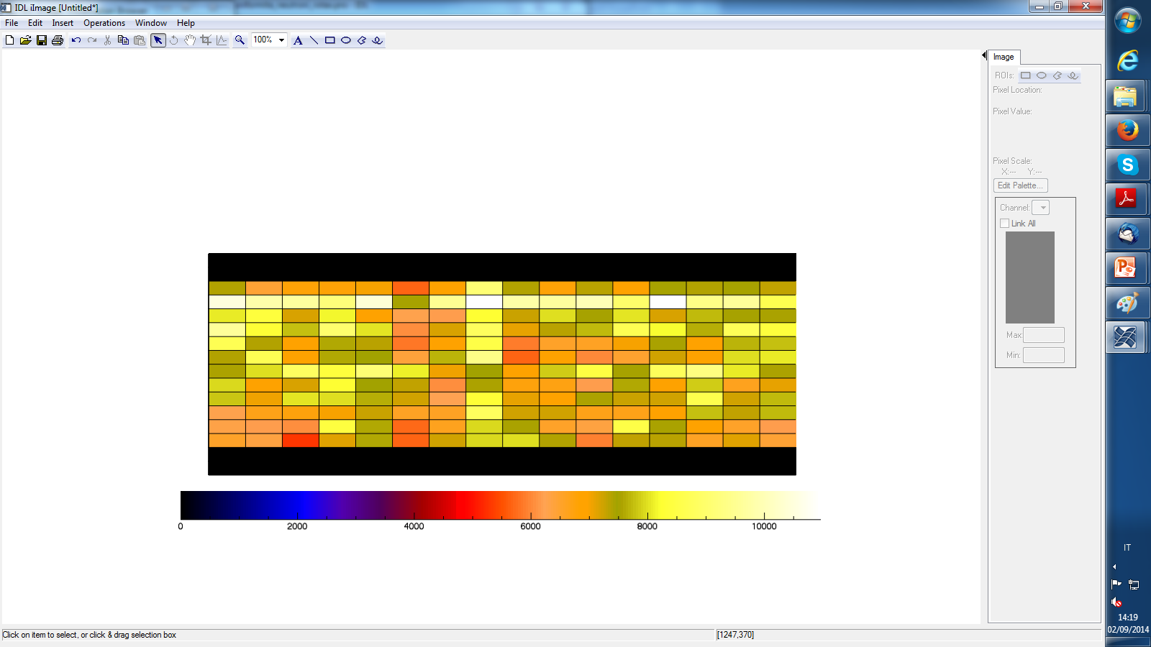
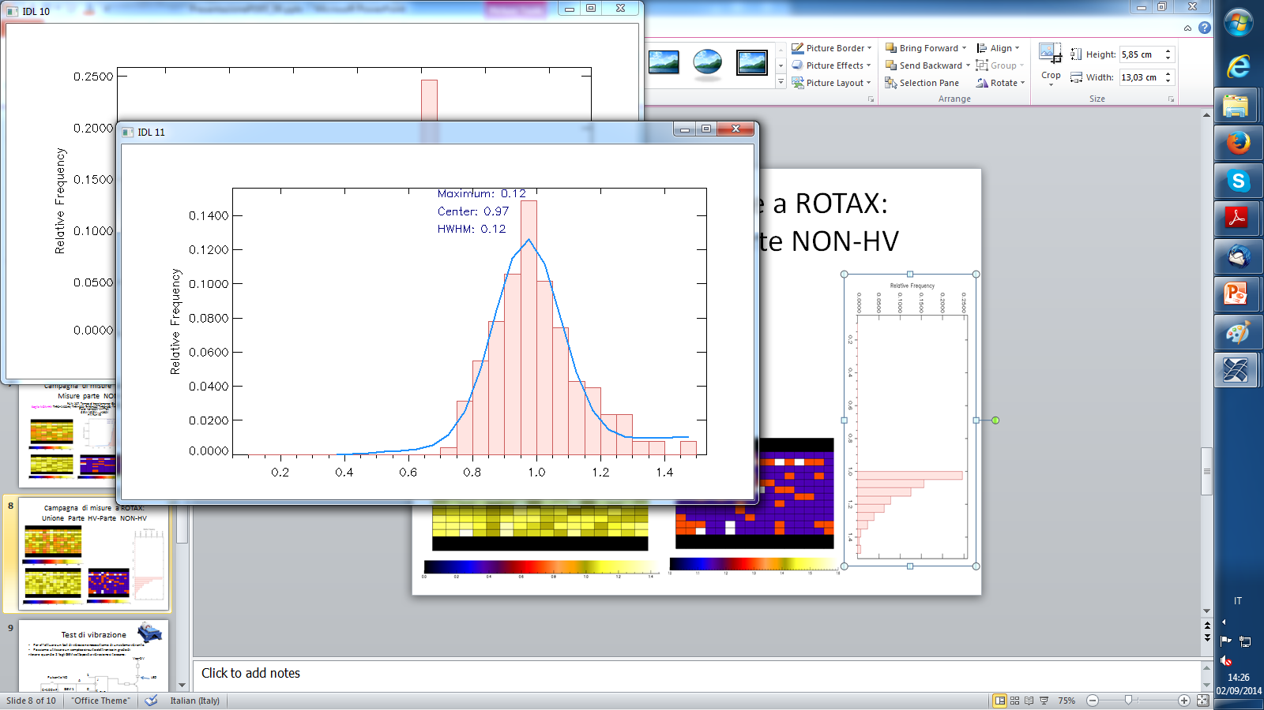
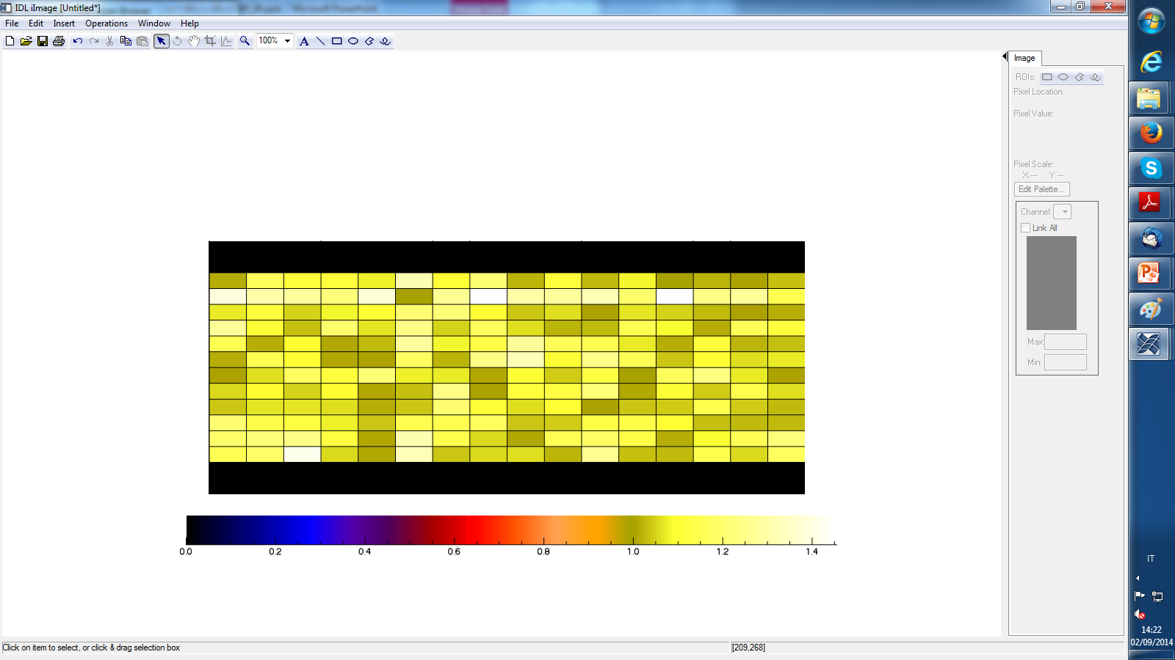
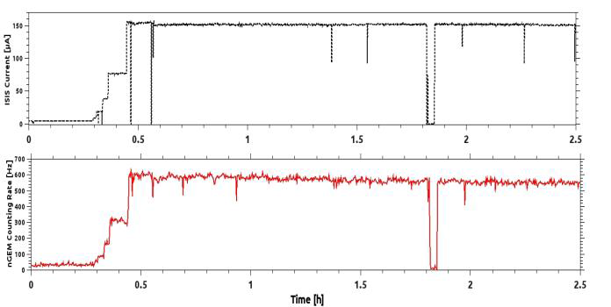
Results on efficiency uniformity
HWHM=0.12
Integrated Counting rate map (absolute)
Uniformity distribution
(relative integrated counts distribution)
Uniformity Map
(Integrated counting rate map – relative)
nGEM counting rate (bottom) compared to ISIS proton current: the detector is able to follow current variation

Slide 13
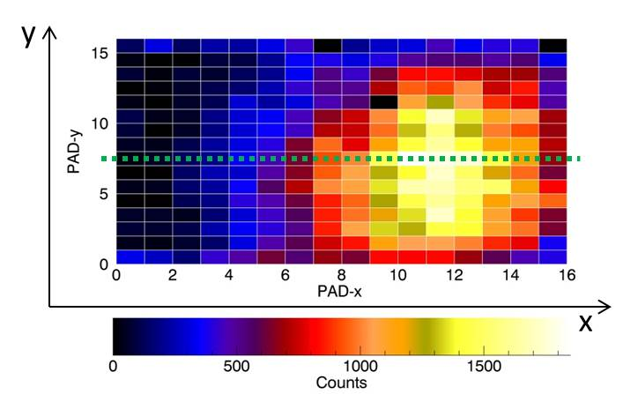
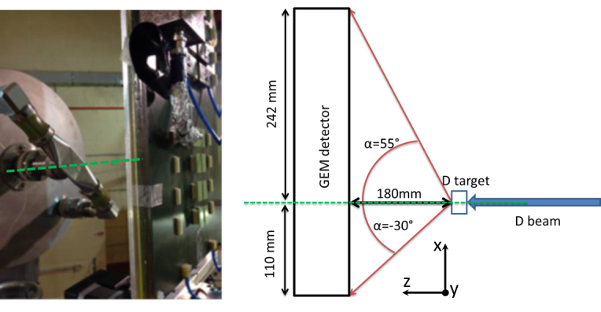
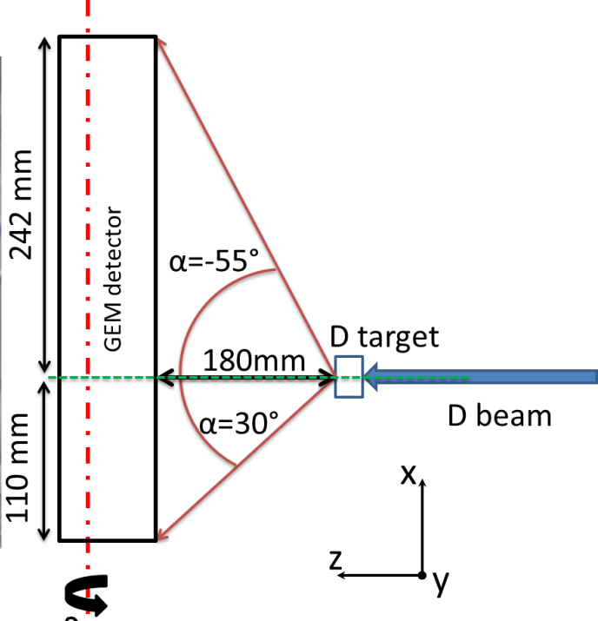
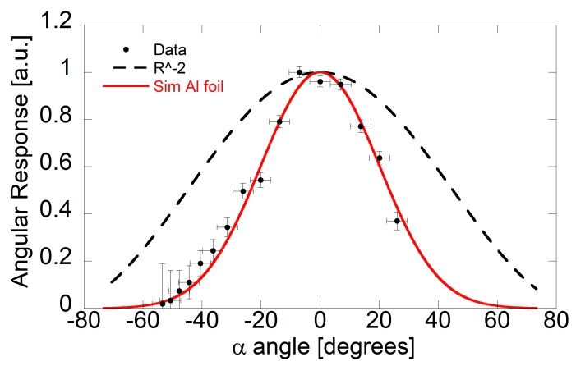
Test results on directionality selection @ FNG
Digital 2D measurments

Slide 14
GEMs for thermal neutron detection

Slide 15
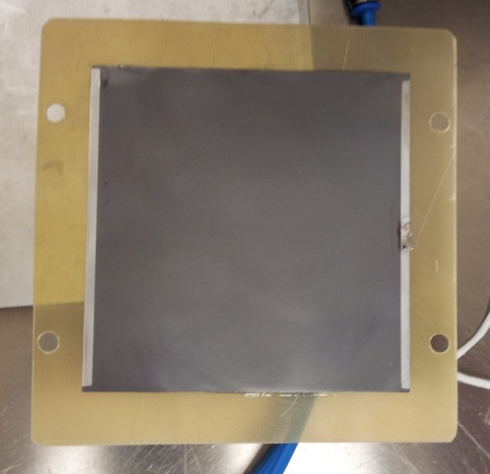
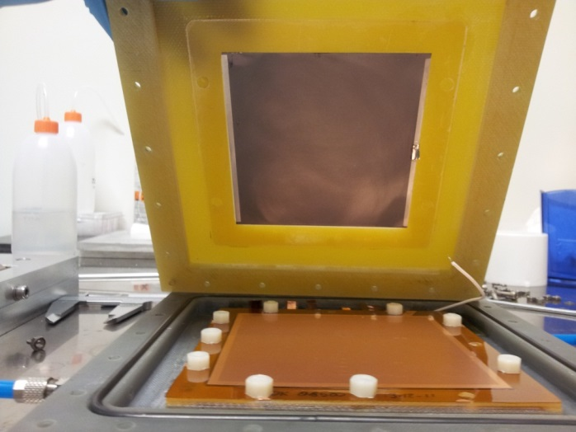
GEM thermal neutron detector
Triple GEM detector equipped with an aluminum converter coated with 1μm of B₄C: first bGEM prototype
Exploit the ¹⁰B(n,α)⁷Li reaction in order to detect thermal neutrons
n
α
Detector Schematics
B₄C coated aluminium cathode assembled inside the bGEM chamber layout
B₄C coated aluminium cathode mounted on its support
Single Stage is a Low efficiency detector (few % maximum)

Slide 16
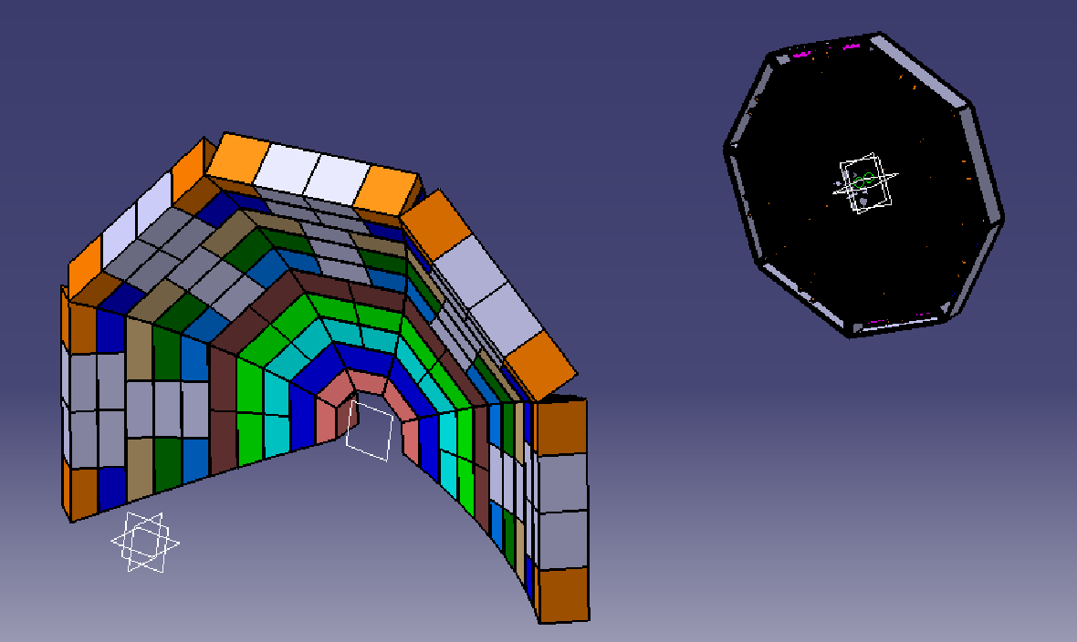
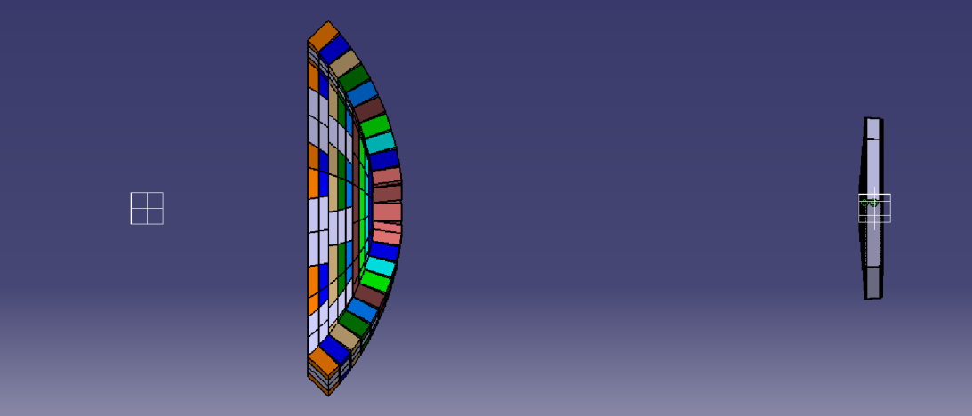
The BAND-GEM detector system for SANS
Boron Array neutron detector coupled to a triple GEM
Requirements for SANS detectors
Rate Capability | > 200 kHz/cm²
Time Res | < 1 ms
Spatial Res | About 6 mm
Efficiency | > 35% @ 4 Å
Middle bank. Composed of 8 BAND-GEM full module
5 m
n beam
Sample position
3 m
Front detector bank. Composed of BAND-GEM sectors

Slide 17
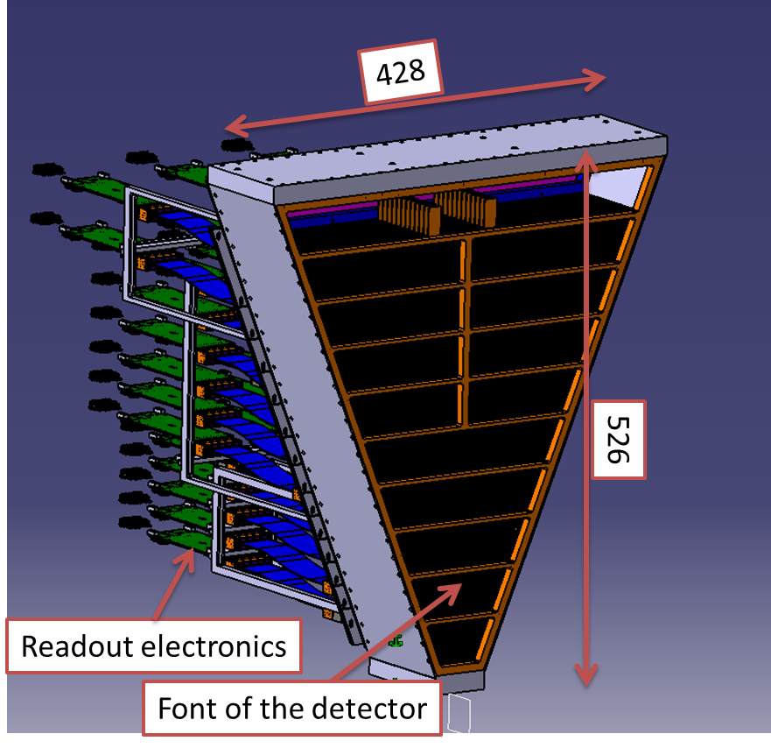
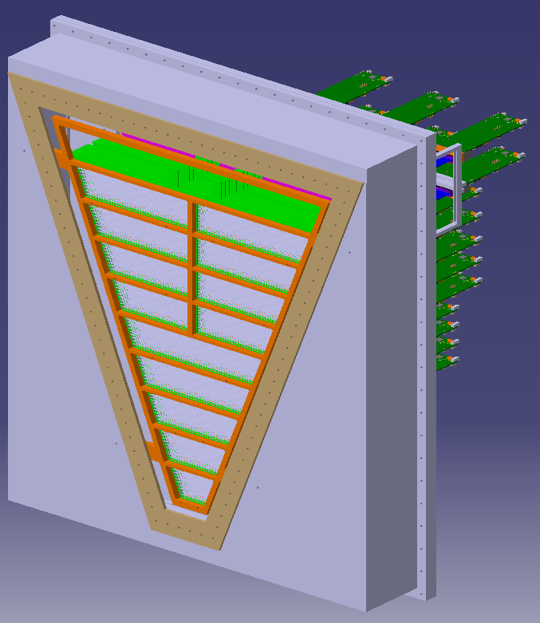
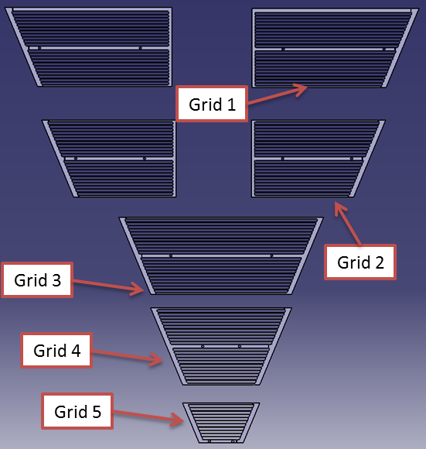
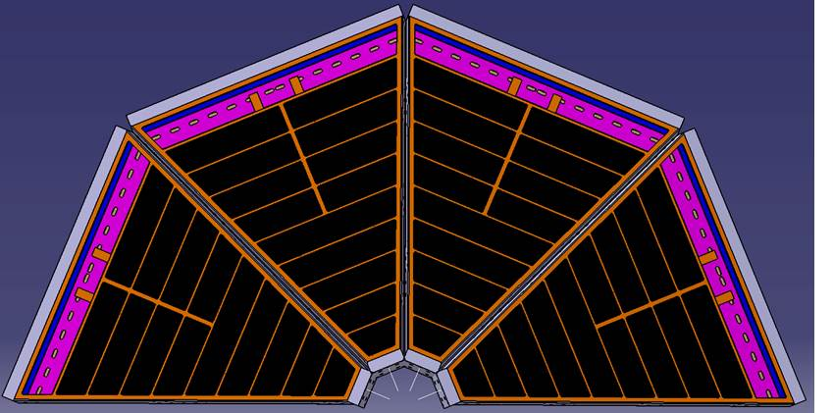
Large area module for SANS
Front of the detector
Detector BOX
1472 anodic pads (channels)
GEMINI Chips Used (see later)

Slide 18
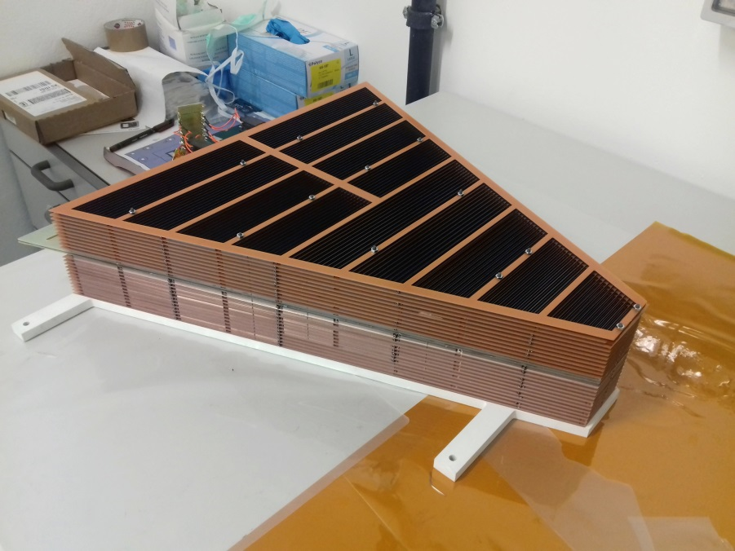
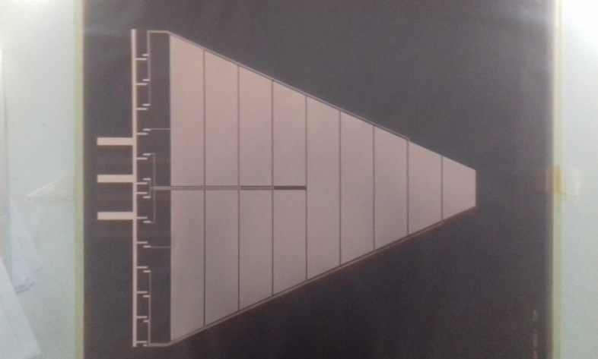
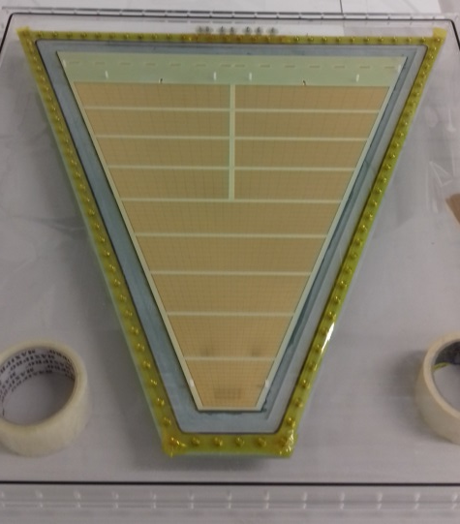
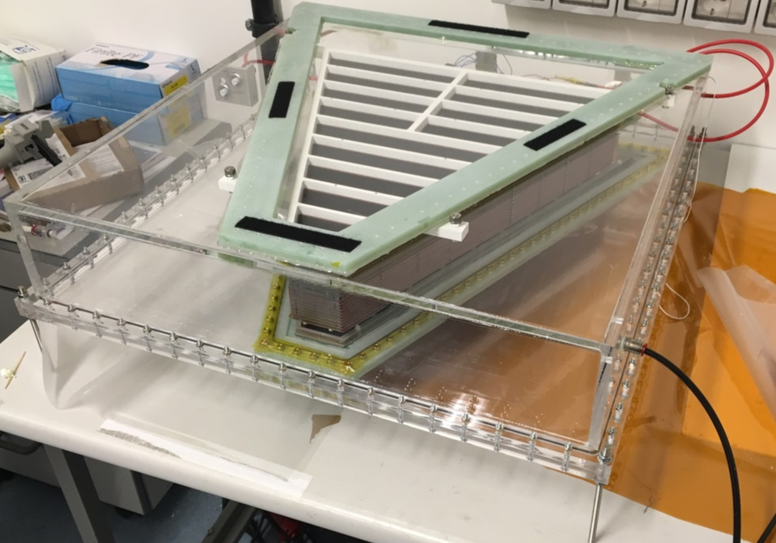
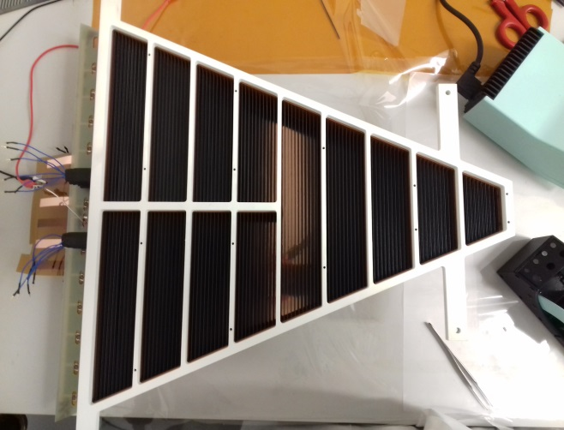
Large area module construction
The GEM foil
The 3D-C assembled
The padded anode

Slide 19
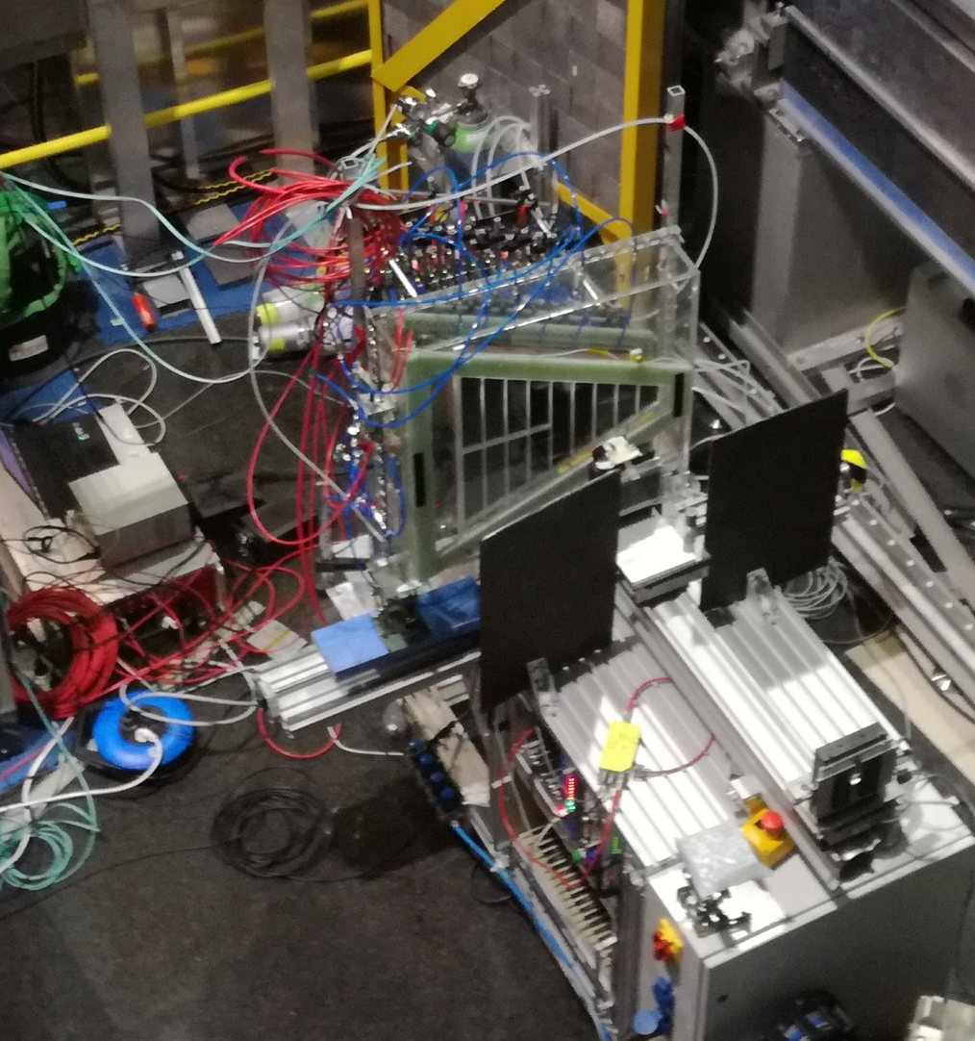
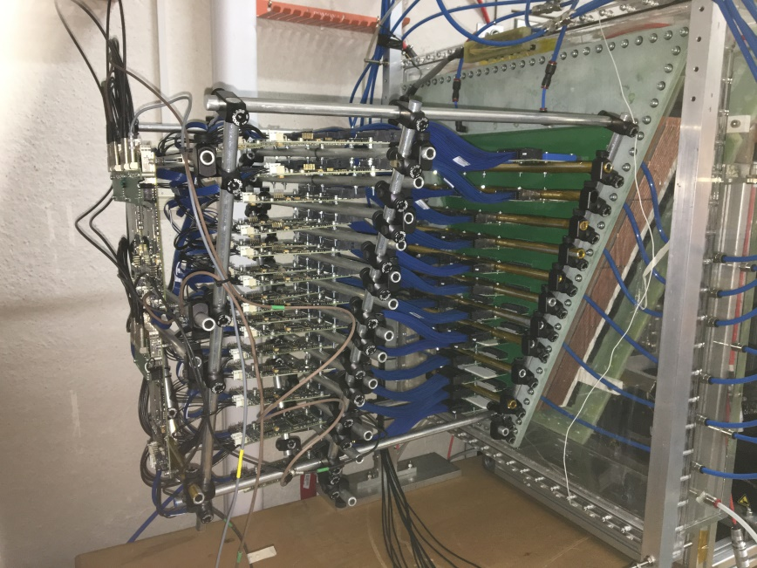
Test of the module @ TREFF (DE)
BAND-GEM
BAND-GEM with GEMINI electronics
Monochromatic neutrons with wavelenght λ=4.78 Å
Neutron beam

Slide 20
High rate performance
Performed @ LLB-Saclay
Linearity scan of BAND-GEM demonstrator relative to Fission Chamber, performed at reactor power 10.1 MW.
The BAND-GEM is linear (relative to the reference FC detector) up to about 1 MHz/cm².
V_{cathode}-V_{TopGrid} = -10 kV
ΣV_{GEM} = 870 V
Tilt angle = 5°
Full beam
1.8 mm attenuator
3.6 mm attenuator
Black dots: BANDGEM count rates per cm²; red line: fit of the data with saturation law; purple line: linear component of the saturation law.

Slide 21
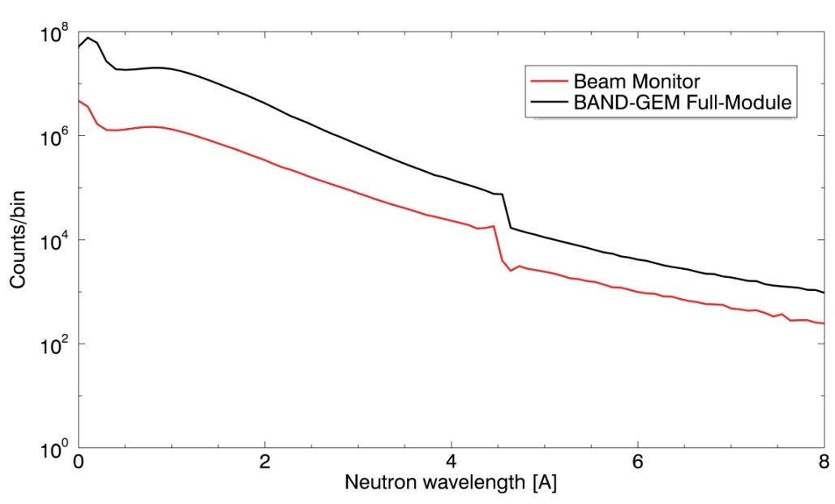
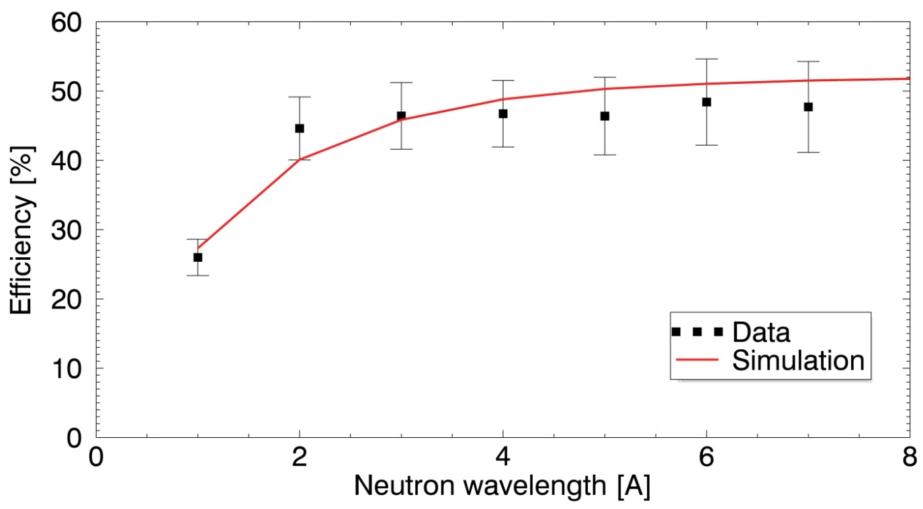
Efficiency vs neutron wavelength @EMMA
ToT neutron Spectrum
Tilting angle Ѳ = 8°

Slide 22
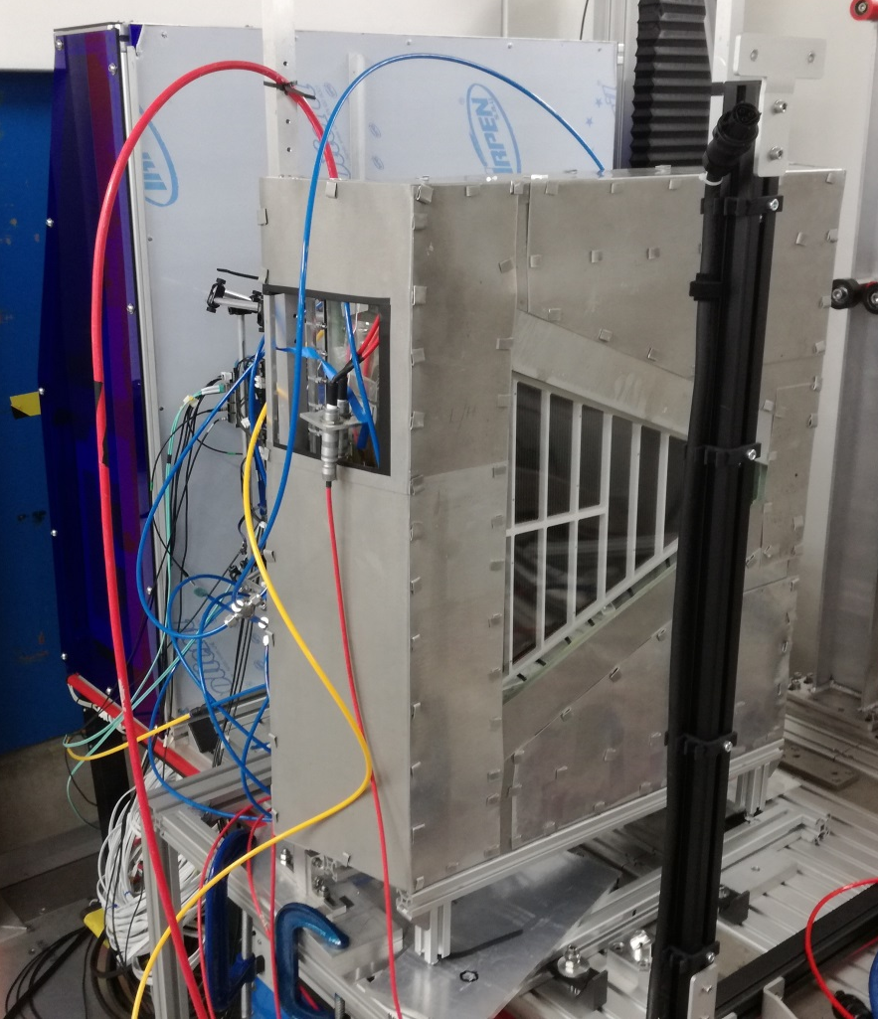
Test of the module @ LARMOR beam line
(SANS instrument).
SANS measurement performd with a concentrated ludox silica dispersion sample.
With this sample, the expected 2d map on the detector position is a circular ring moving to larger radius at longer wavelengths.
BAND-GEM
1,5 m
Sample
BAND-GEM full module with Cd mask
Neutron beam

Slide 23
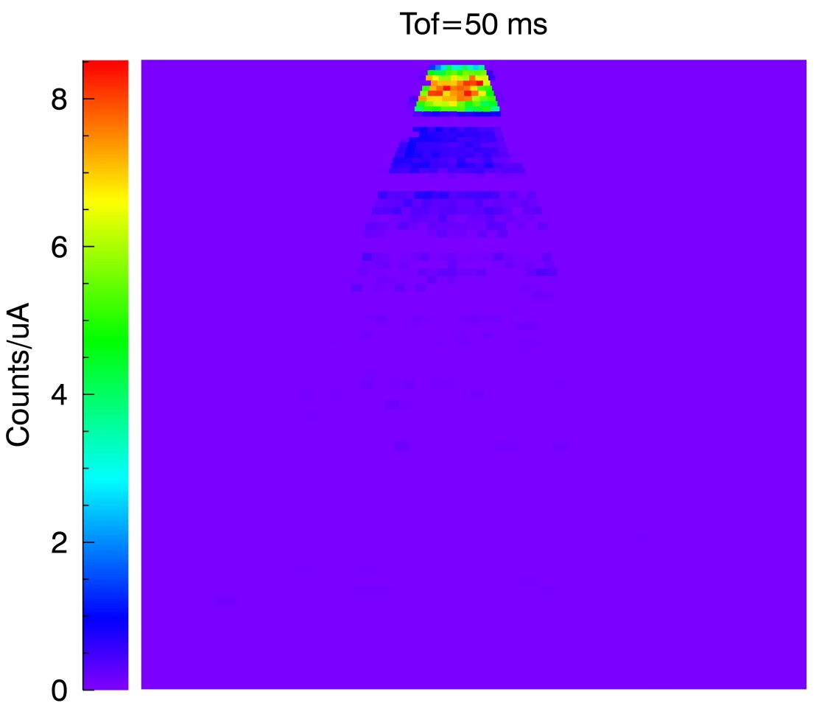
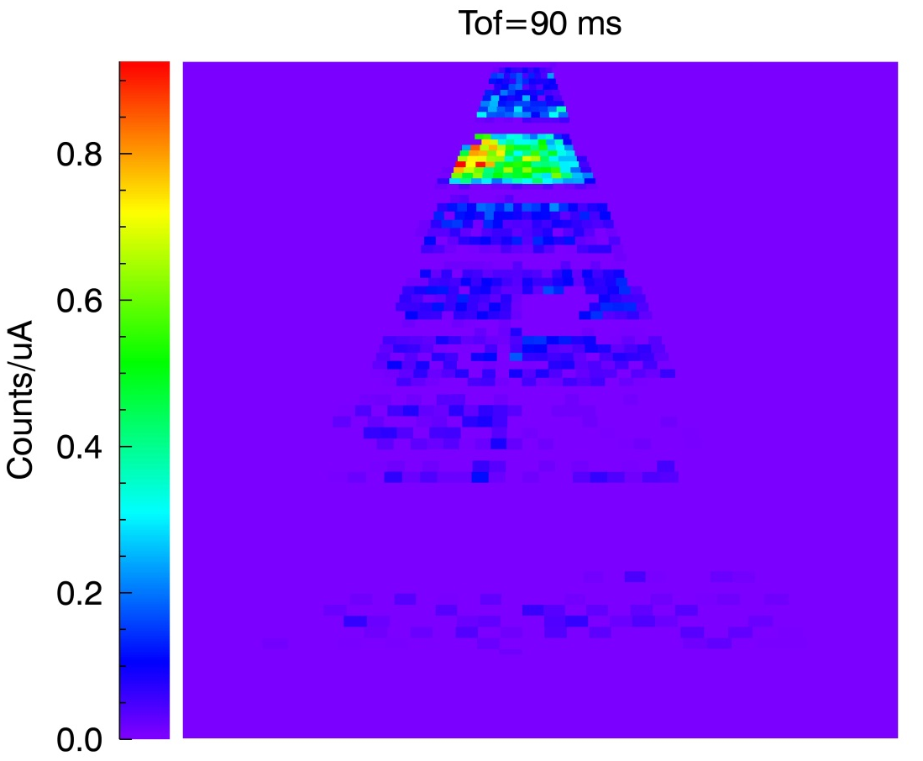
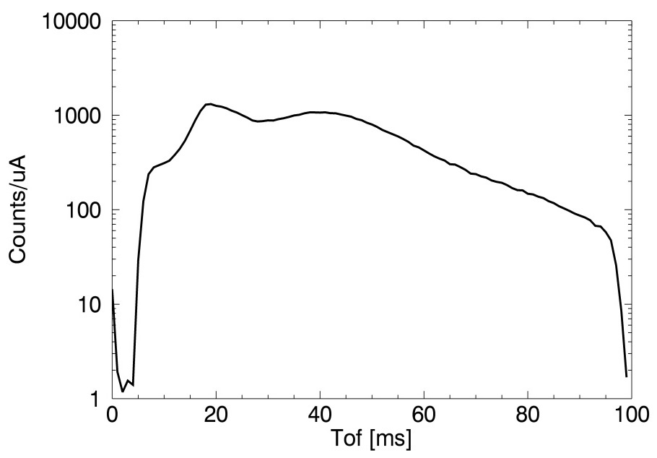

Preliminary SANS results
Circular ring

Slide 24

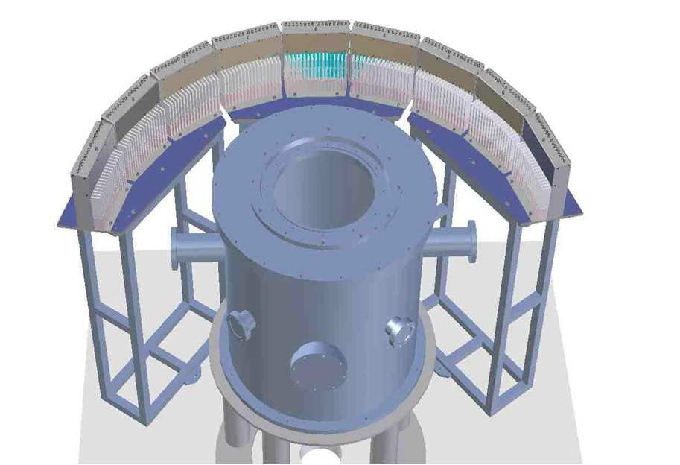
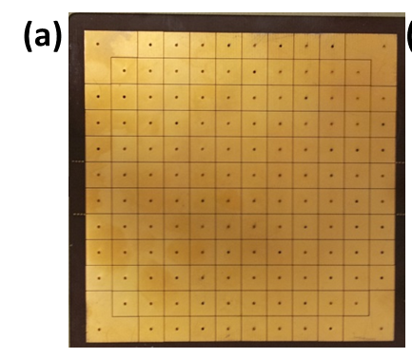
Neutron diffraction
INES sample position
bGEM – borated cathode
³He tubes
Transmitted neutron beam
Incident neutron beam
λ = [ 0.17 , 3.2 ] Å
128 8x8 mm² pads
GEM position
Interface with ISIS-DAE: Time of Flight measurement perfomed using standard ISIS TOF DAE → First Time a GEM is inside standard ISIS DAQ System

Slide 25
Neutron diffraction: comparison with ³He
1
2
GEM
S/B for selected peaks
3
 | GEM | ³He
Peak 1 | 1.6 ±0.2 | 2.3±0.1
Peak 2 | 2.3 ± 0.4 | 2.8±0.1
Peak 3 | 4.9±1.5 | 5.3±0.4
1
³He
2
3

Slide 26
GEMs for x-rays detection

Slide 27
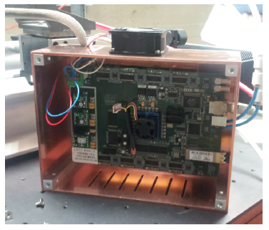
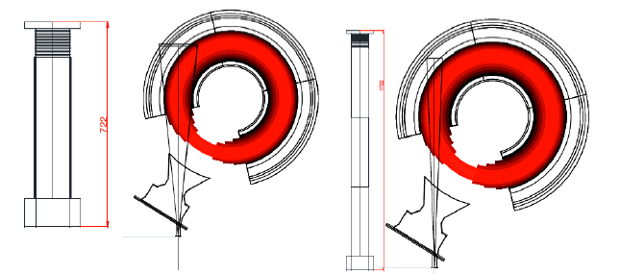

Tokamak diagnostics at KSTAR (KOREA) and EAST (CHINA)
FPGA Board
KSTAR Toroid
⁵⁵Fe Source
Done with CARIOCA chips
The system firmware is able to produce a movie of 65000 frames of 1 ms.
The 2018 KSTAR data taking will start in few weeks.
D. Pacella et al. :
GEM-based Energy Resolved X-ray Tangential Imaging System at KSTAR

Slide 28

Low energy X-Ray Images
These images was realized in real time
moving a triple gem with an array
of 128 pads 0.5x0.5 mm
crossing the beam

Slide 29



Preliminary results using GEMINI
Possibility to reconstruct imaging and charge spectrum (using ToT) simulateneously for each pad
Crucial for impurities reconstruction in a tokamak plasma

Slide 30
Summary
All results achieved by a collaboration between UNIMIB, INFN, CNR and ENEA started in 2011
The triple GEM tecnology is very relayable and usefull for
different applications in different science and technology fields
Recently very good results have been obtained for a real time fast
and thermal neutron detectors with spatial and time high resolution
High dinamic range in rate measurements with very low background
for few KeV X ray
New GEMINI electronics gives simultaneously images and PH spetrum
measurments
Working in progress towards improment of TRL

